Slide 2
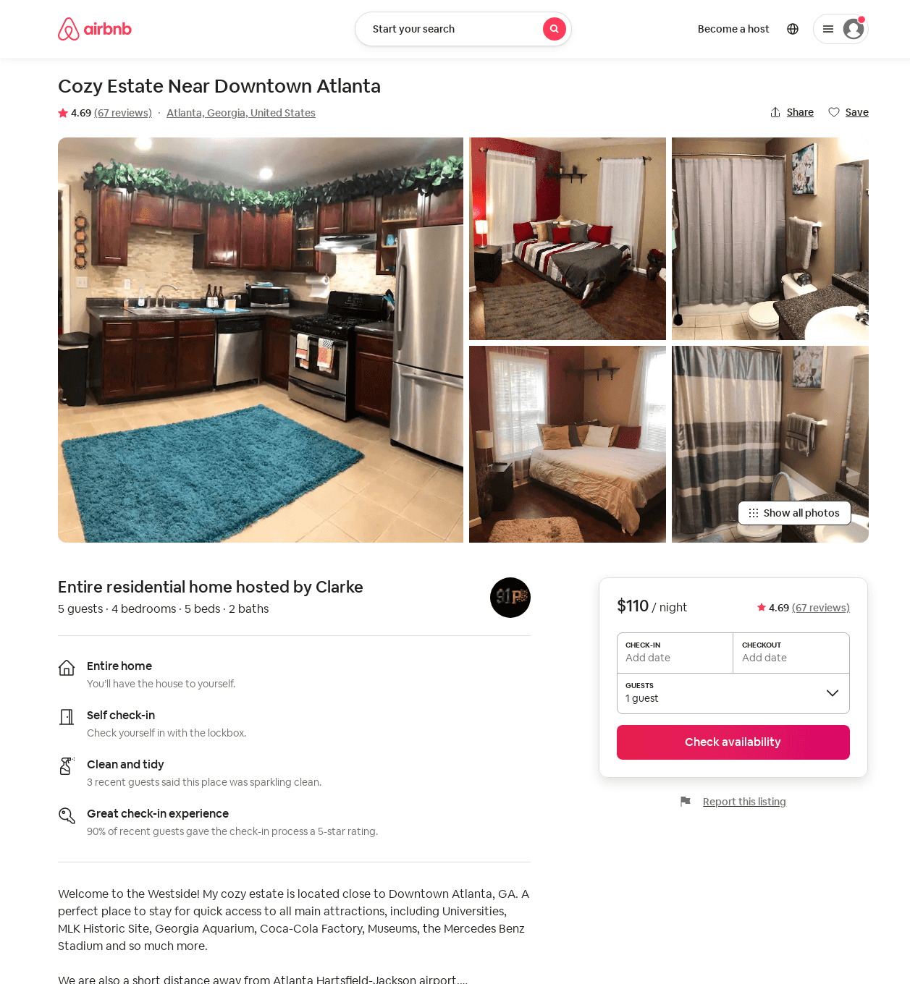
Listing 38719179
4
5
$109 - $141
4.64
2
Clarke
92884438
1
https://www.airbnb.com/rooms/38719179
Jun 2022

Slide 3
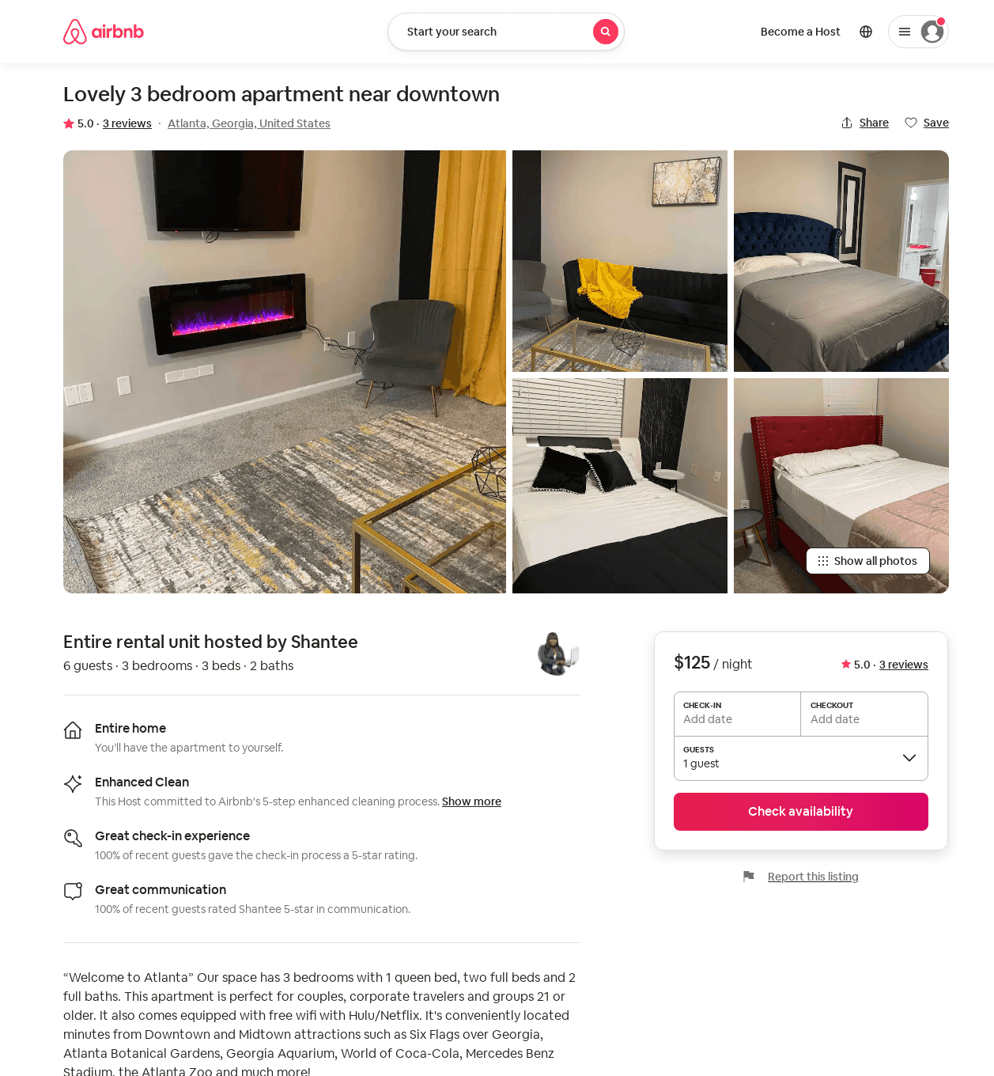
Listing 53462693
3
6
$95 - $125
4.33
2
Shantee
432918206
1
https://www.airbnb.com/rooms/53462693
Aug 2022

