Slide 2
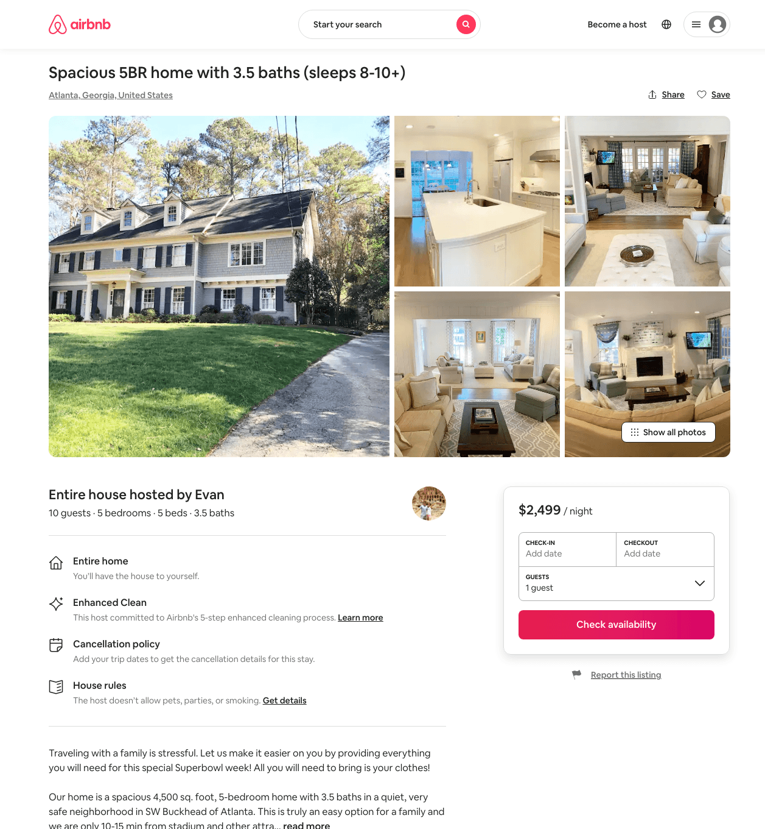
Listing 31720257
5
10
$2499
3
Evan
9998421
1
https://www.airbnb.com/rooms/31720257
Aug 2022

Slide 3
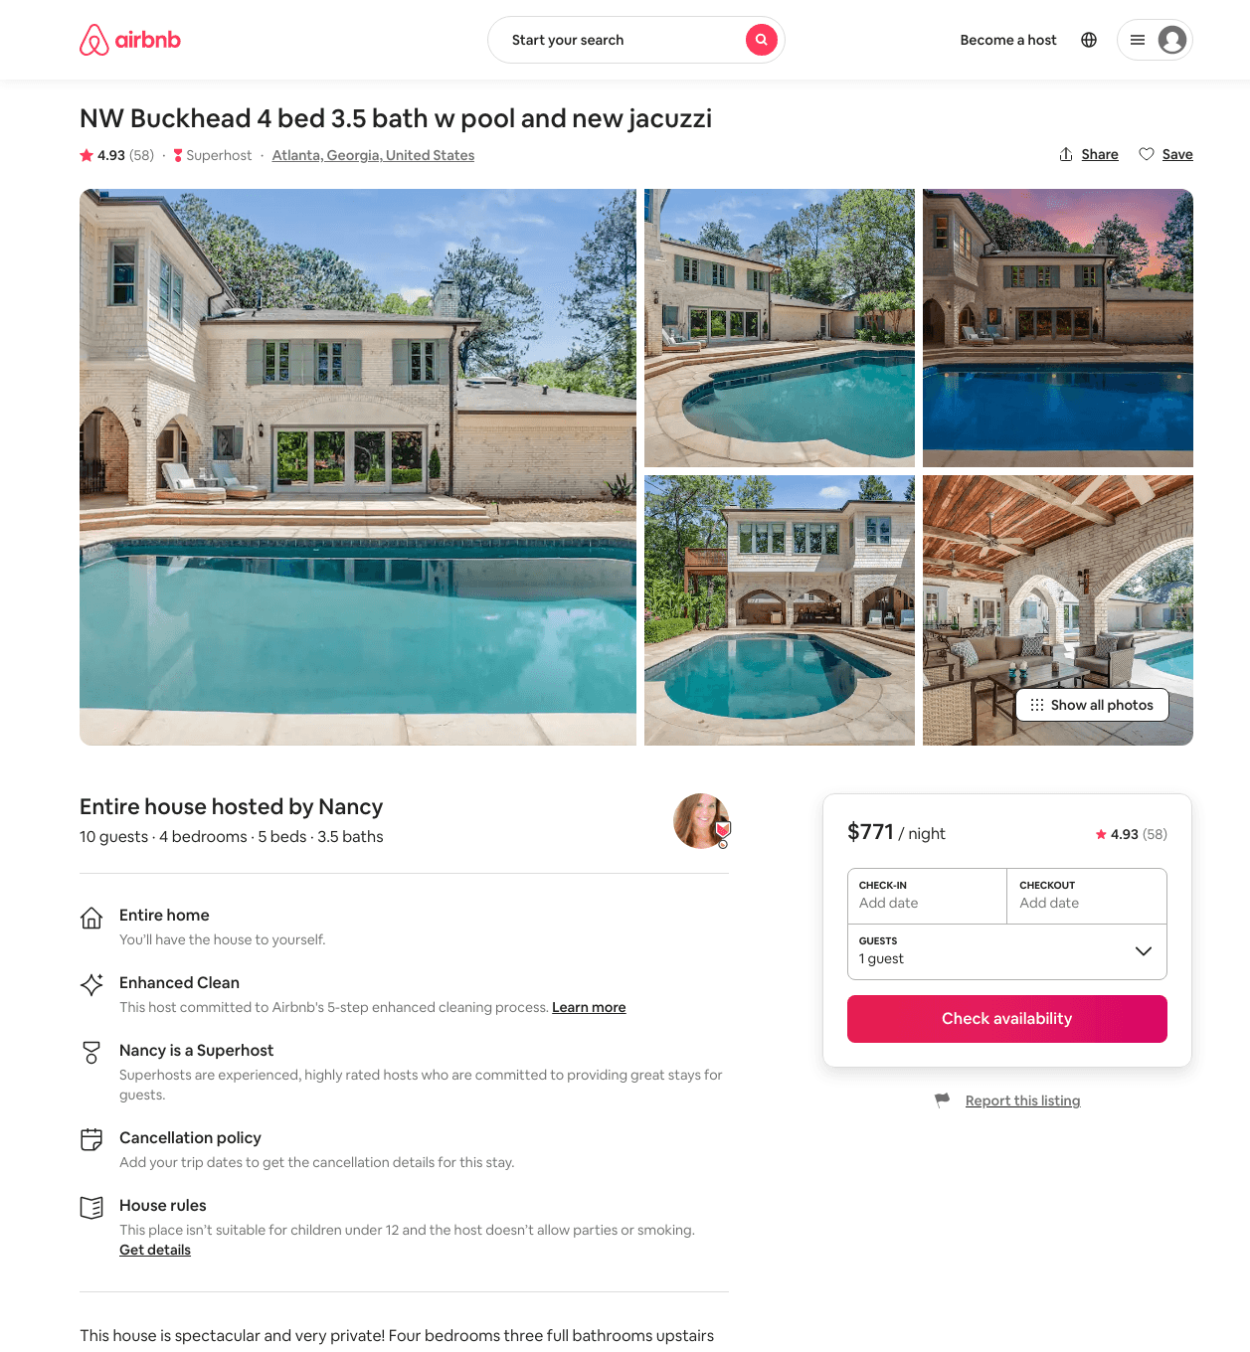
Listing 34462321
4
10
$750 - $1043
4.92
30
Nancy
2773373
9
https://www.airbnb.com/rooms/34462321
Aug 2022

