Slide 2
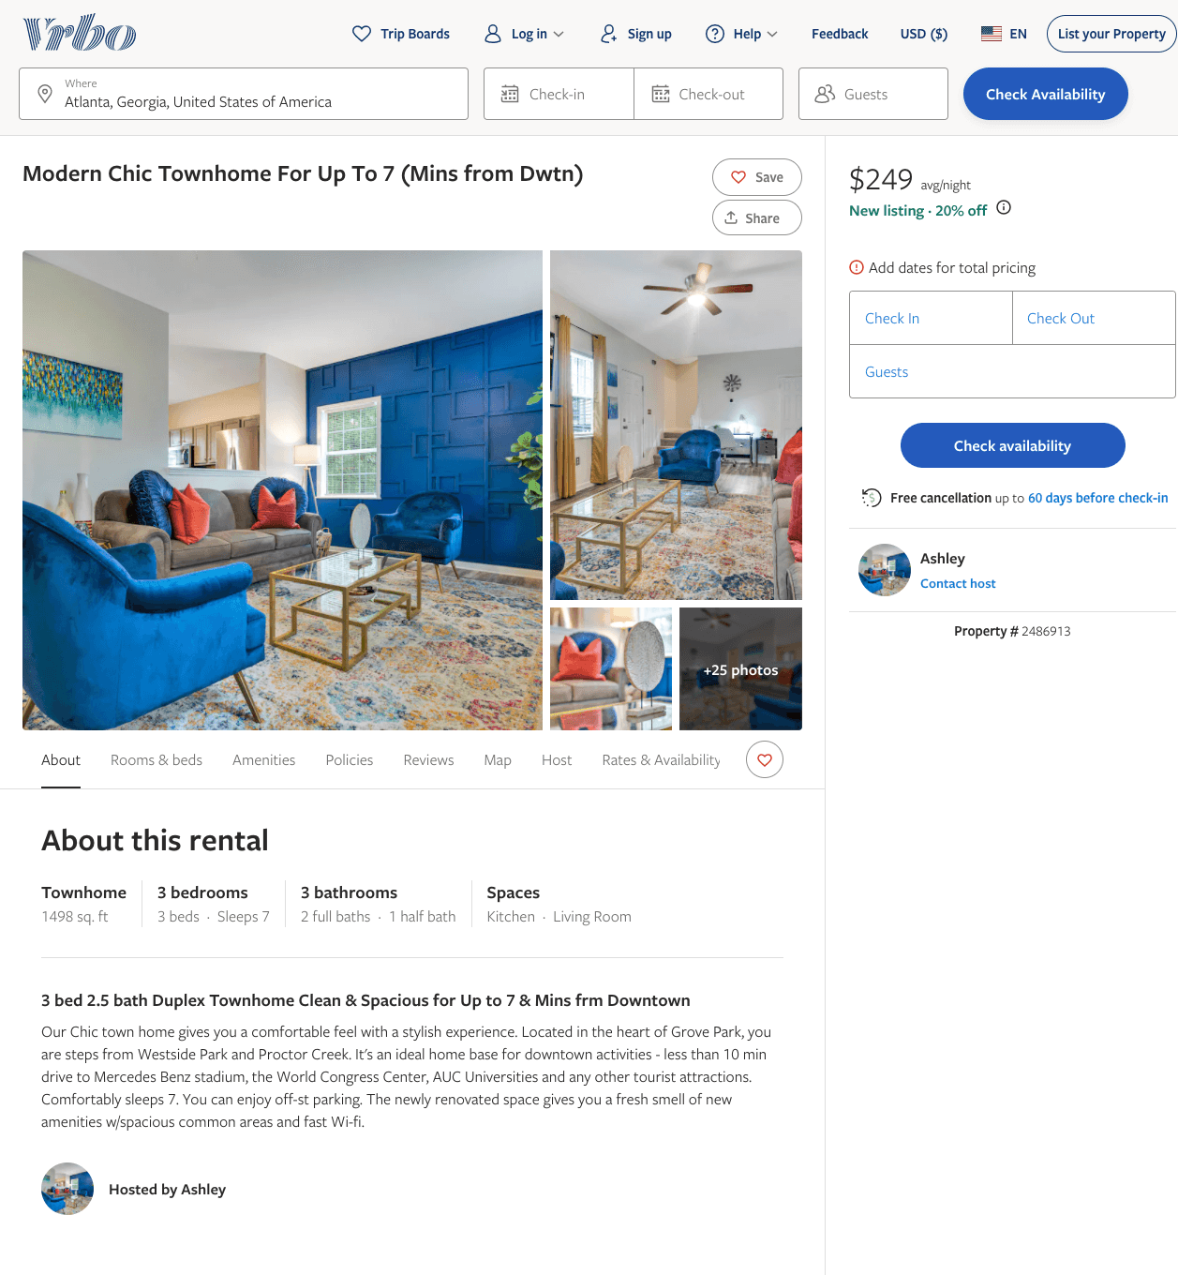
Listing 2486913
3
7
$156 - $249
4.25
2
Ashley
https://www.vrbo.com/2486913
Aug 2022

Slide 3
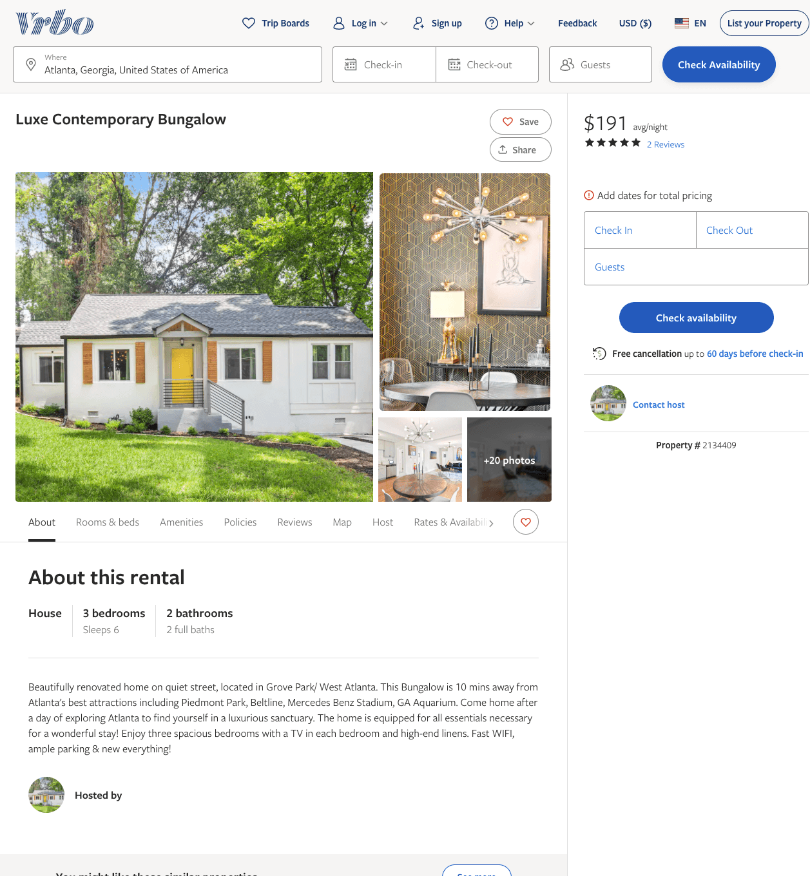
Listing 2134409
3
6
$165 - $191
4.6
1
https://www.vrbo.com/2134409
Aug 2022

Slide 4
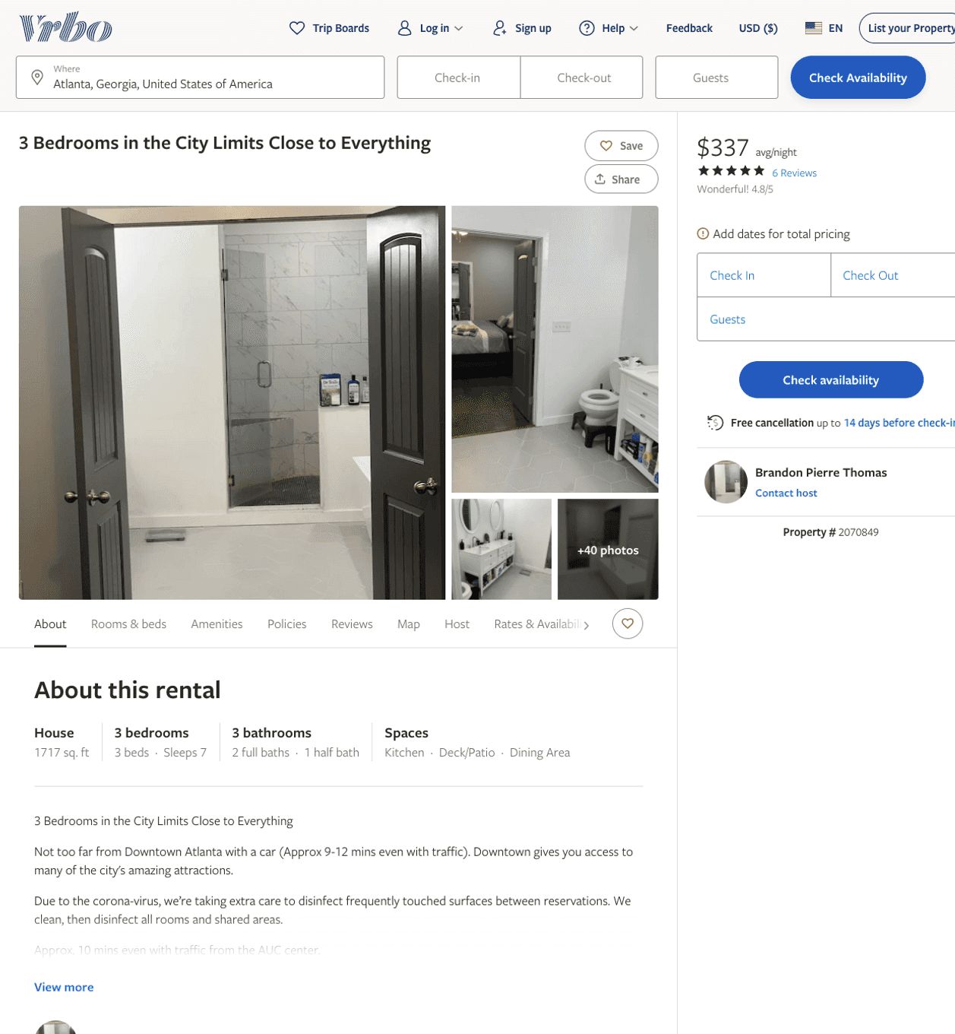
Listing 2070849
3
7
$329 - $385
4.8
2
Brandon Pierre Thomas
https://www.vrbo.com/2070849
Aug 2022

Slide 5
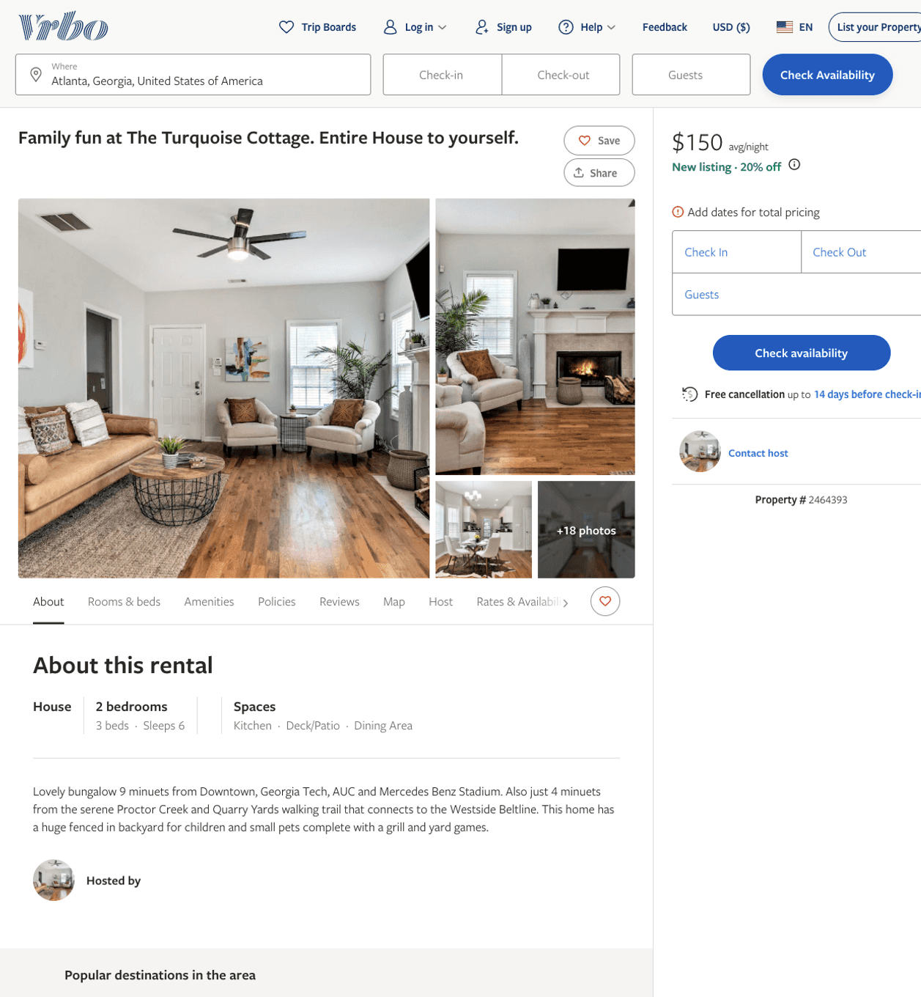
Listing 2464393
3
6
$130 - $228
4.7777777
2
Darcy Aldridge
https://www.vrbo.com/2464393
Aug 2022

Slide 6
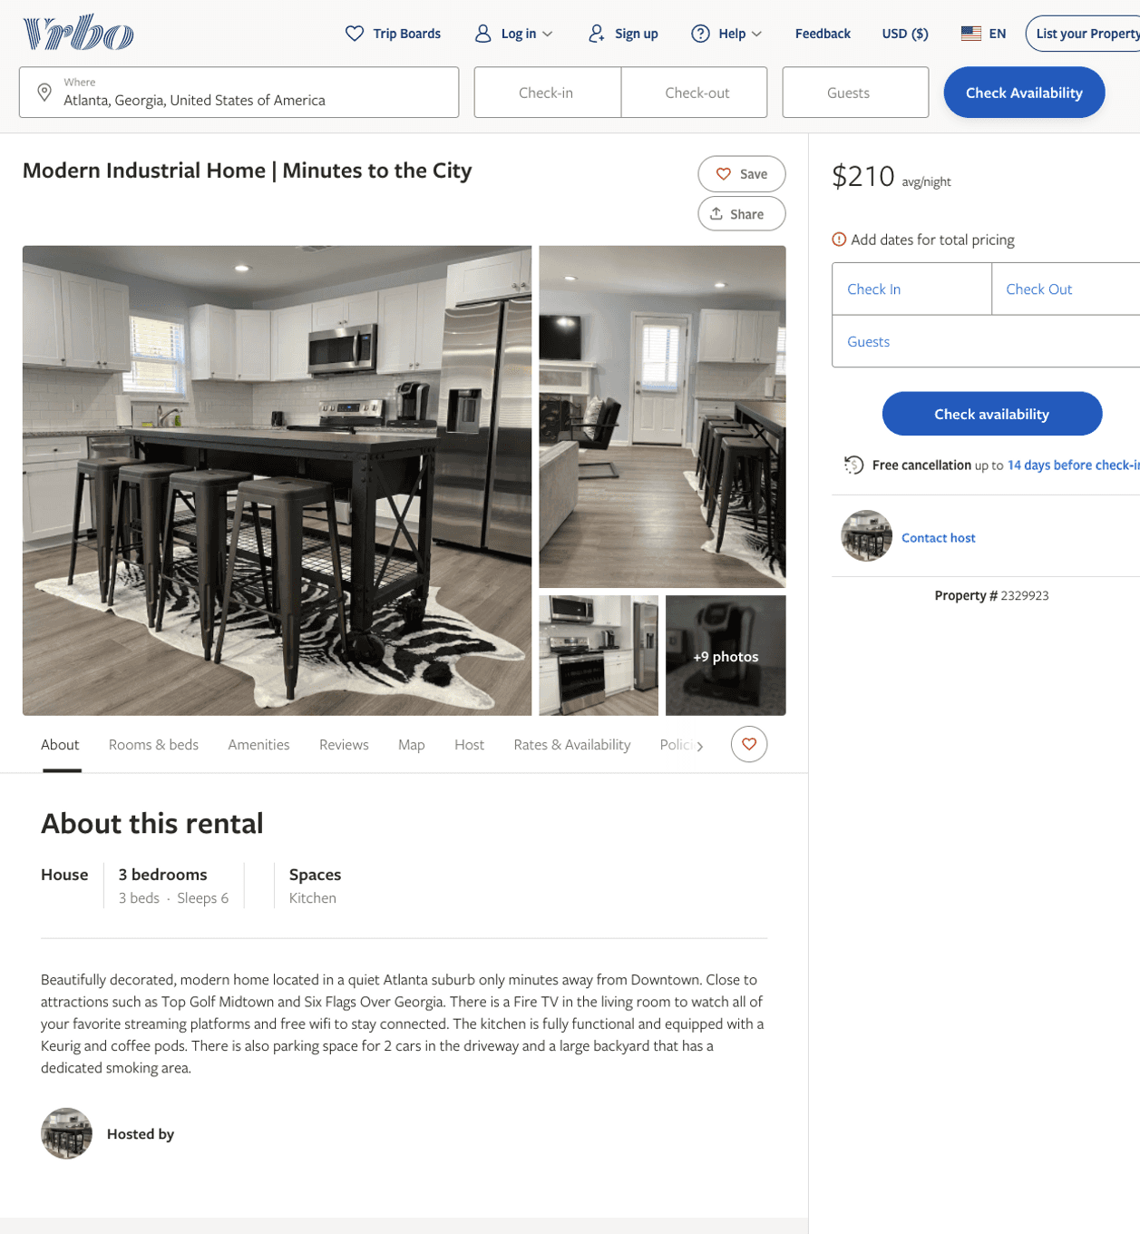
Listing 2329923
3
6
$200 - $274
1
https://www.vrbo.com/2329923
Aug 2022

Slide 7
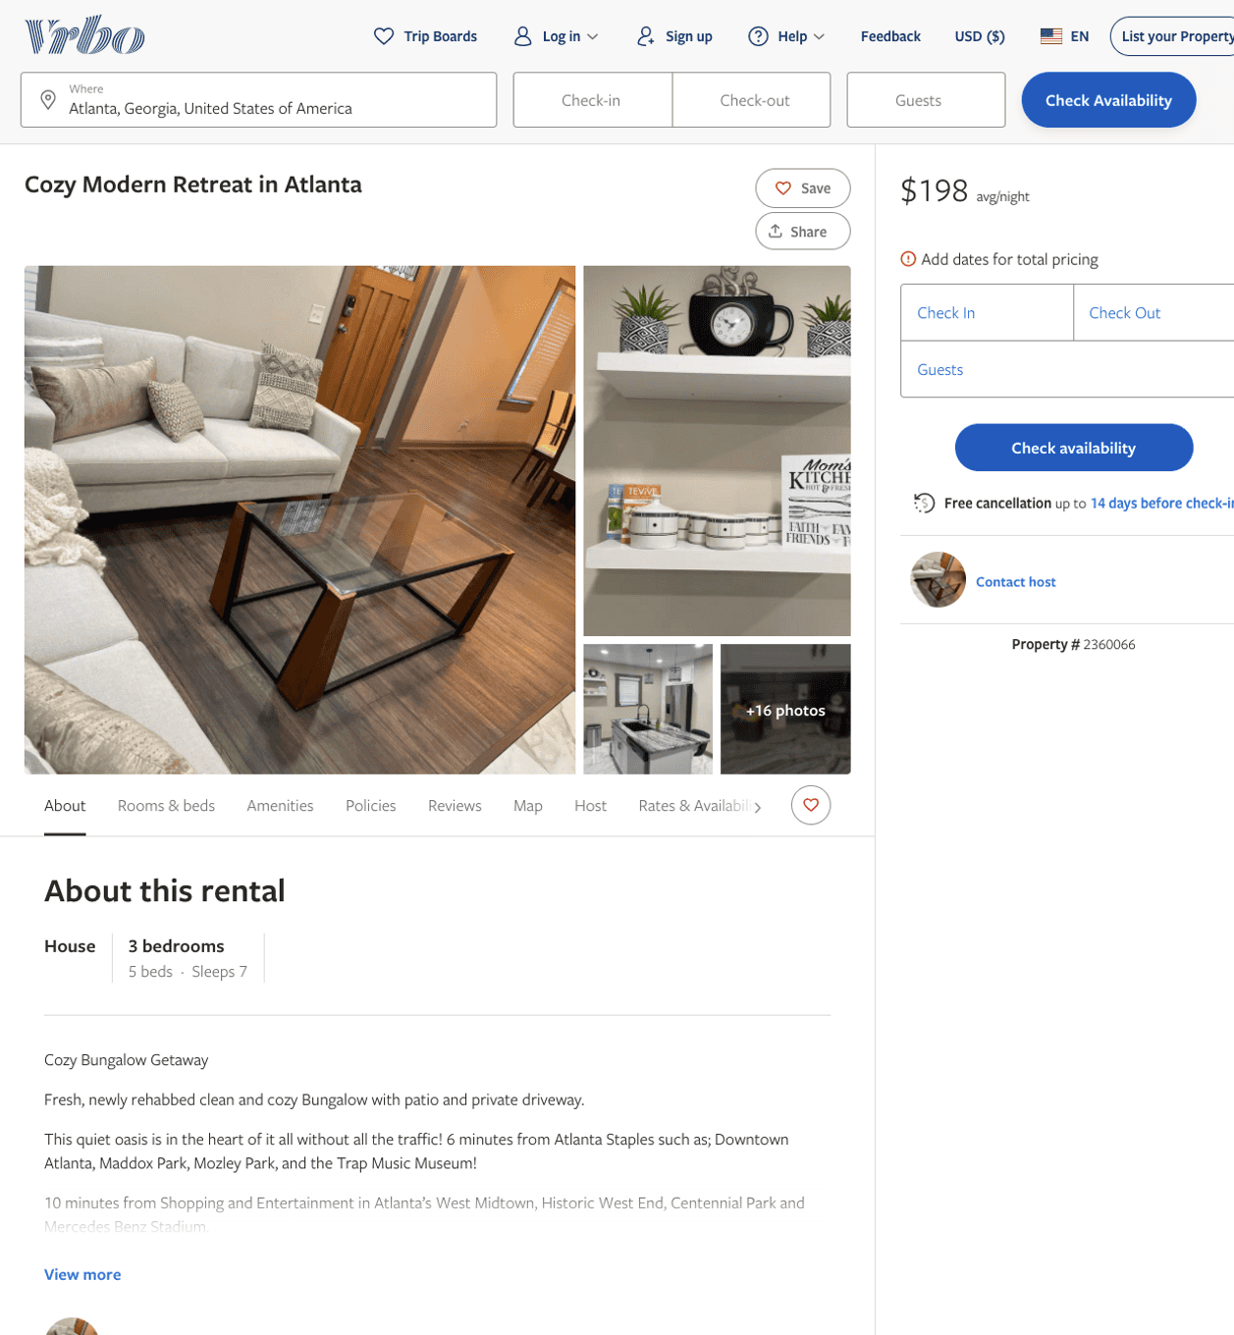
Listing 2360066
3
7
$153 - $198
4.5
3
Retreats Atlanta
https://www.vrbo.com/2360066
Aug 2022

Slide 8
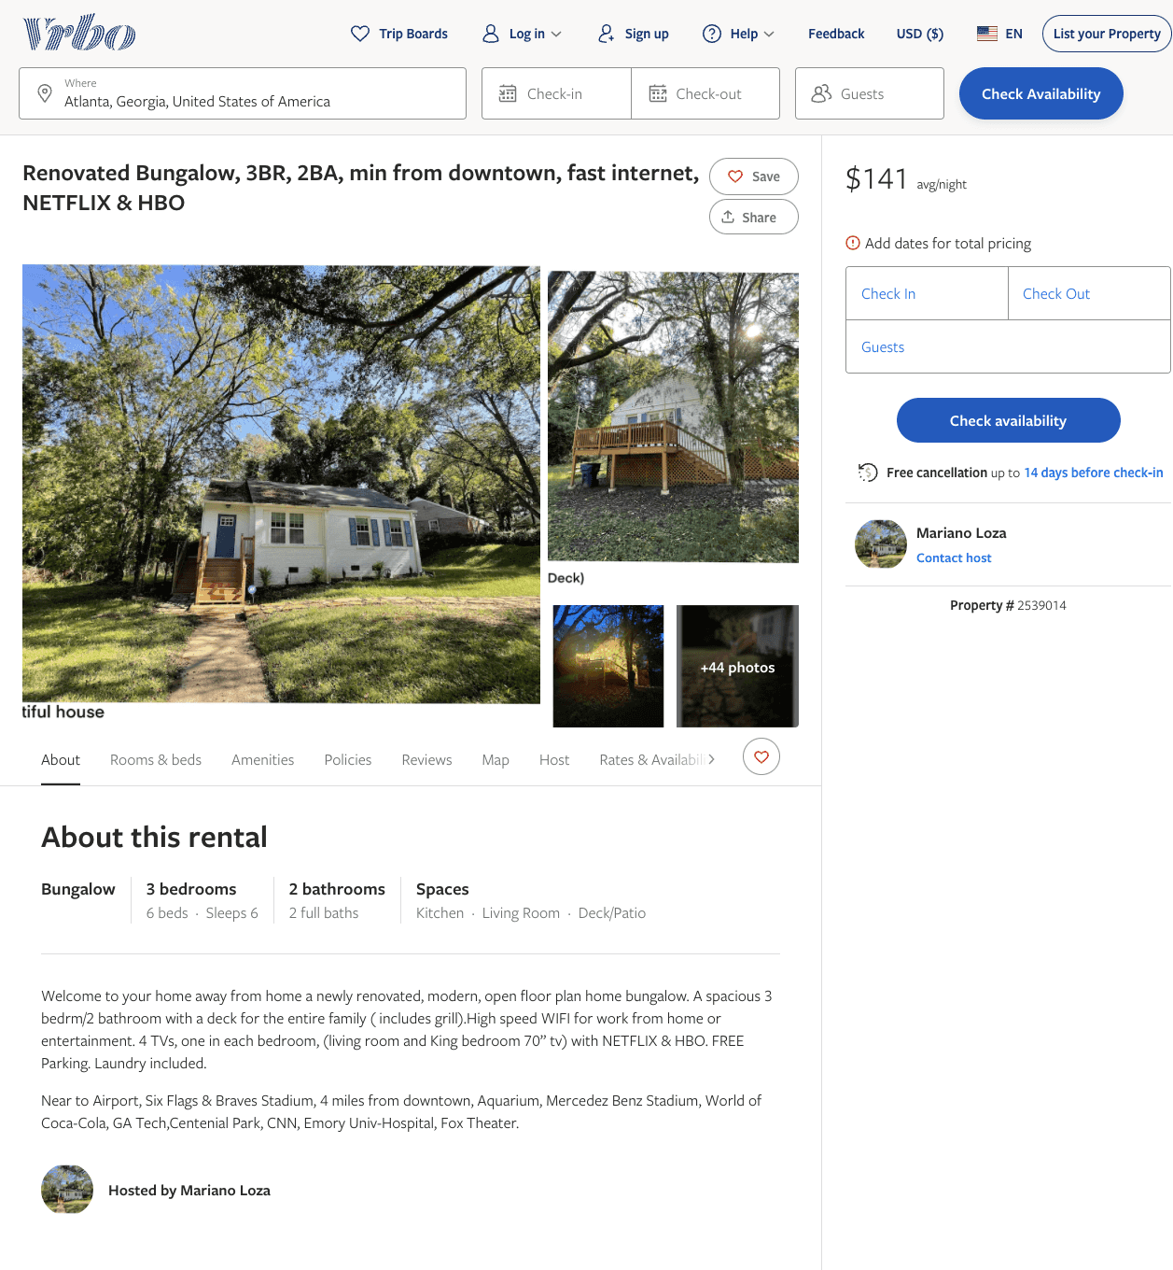
Listing 2539014
3
6
$117 - $176
4.8125
1
Mariano Loza
https://www.vrbo.com/2539014
Aug 2022

Slide 9
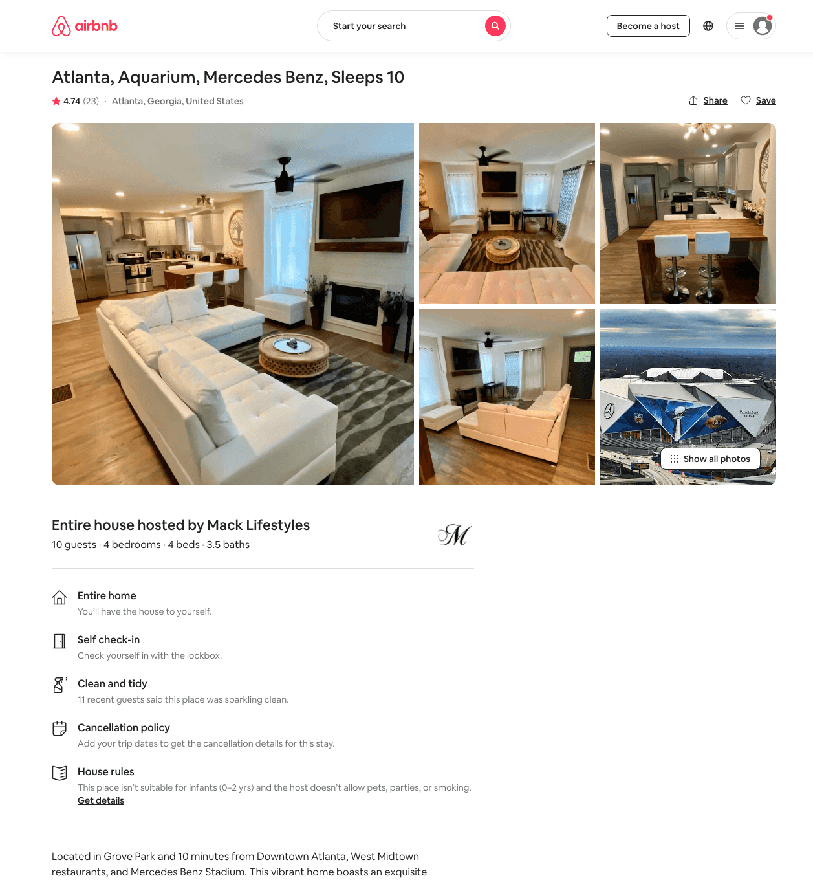
Listing 39750731
4
10
$180 - $400
4.79
4
Mack Lifestyles
226899481
1
https://www.airbnb.com/rooms/39750731
Aug 2022

Slide 10
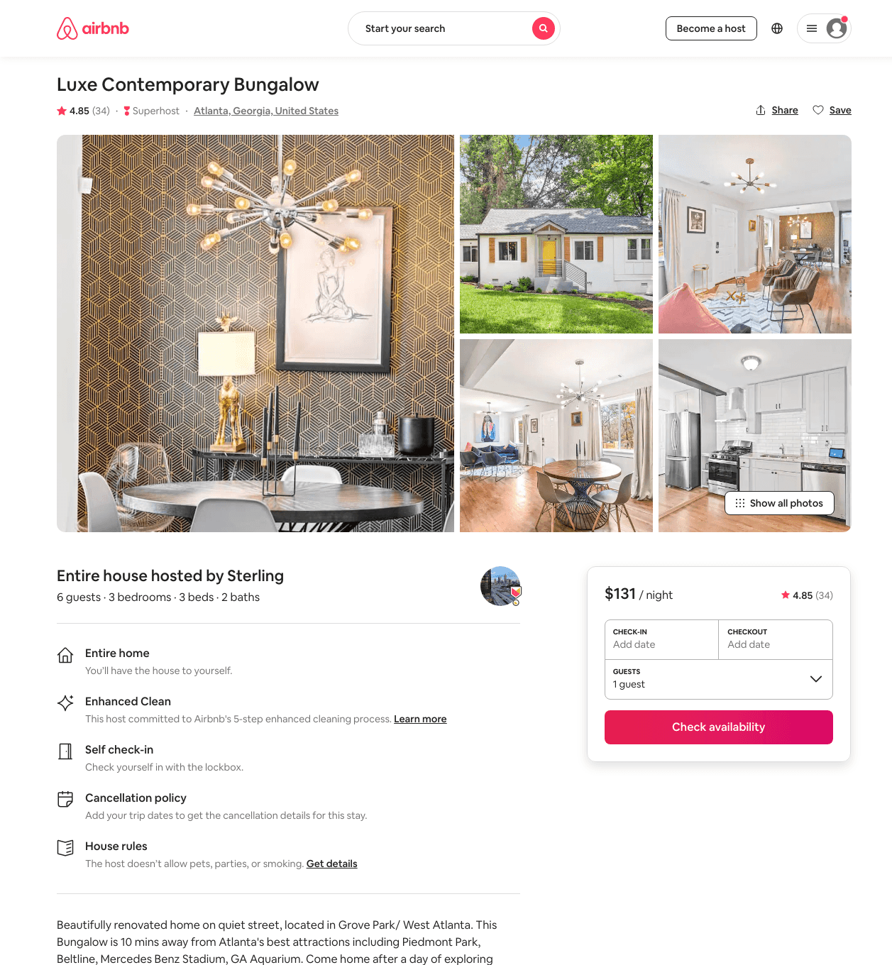
Listing 45028297
3
6
$122 - $198
4.87
2
Sterling
29622744
2
https://www.airbnb.com/rooms/45028297
Aug 2022

Slide 11
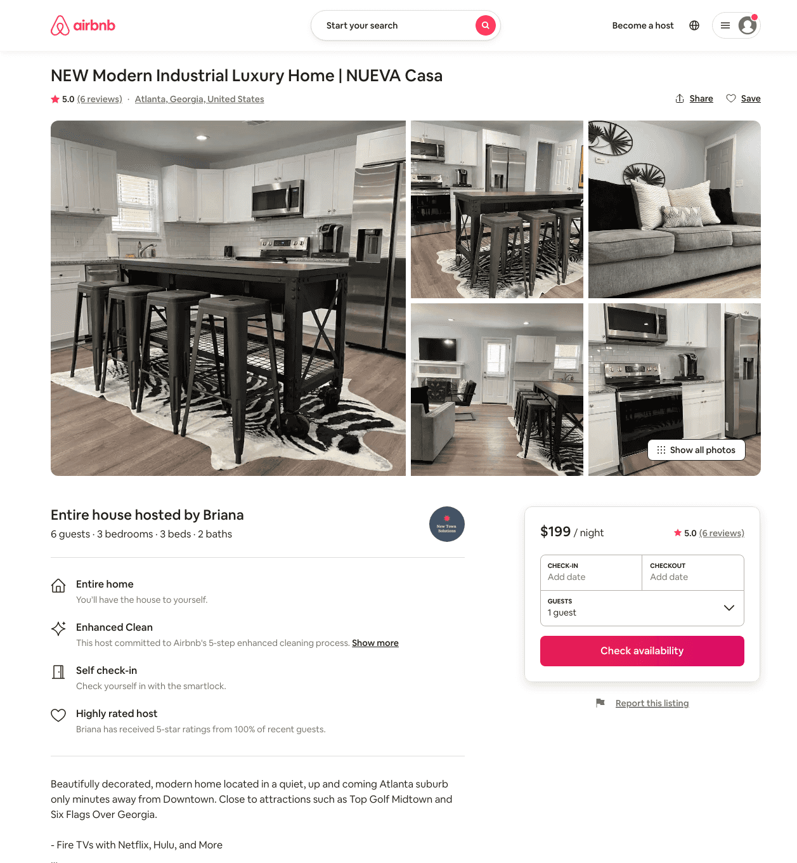
Listing 50027060
3
6
$88 - $215
4.53
2
Briana
403071786
1
https://www.airbnb.com/rooms/50027060
Jun 2022

Slide 12
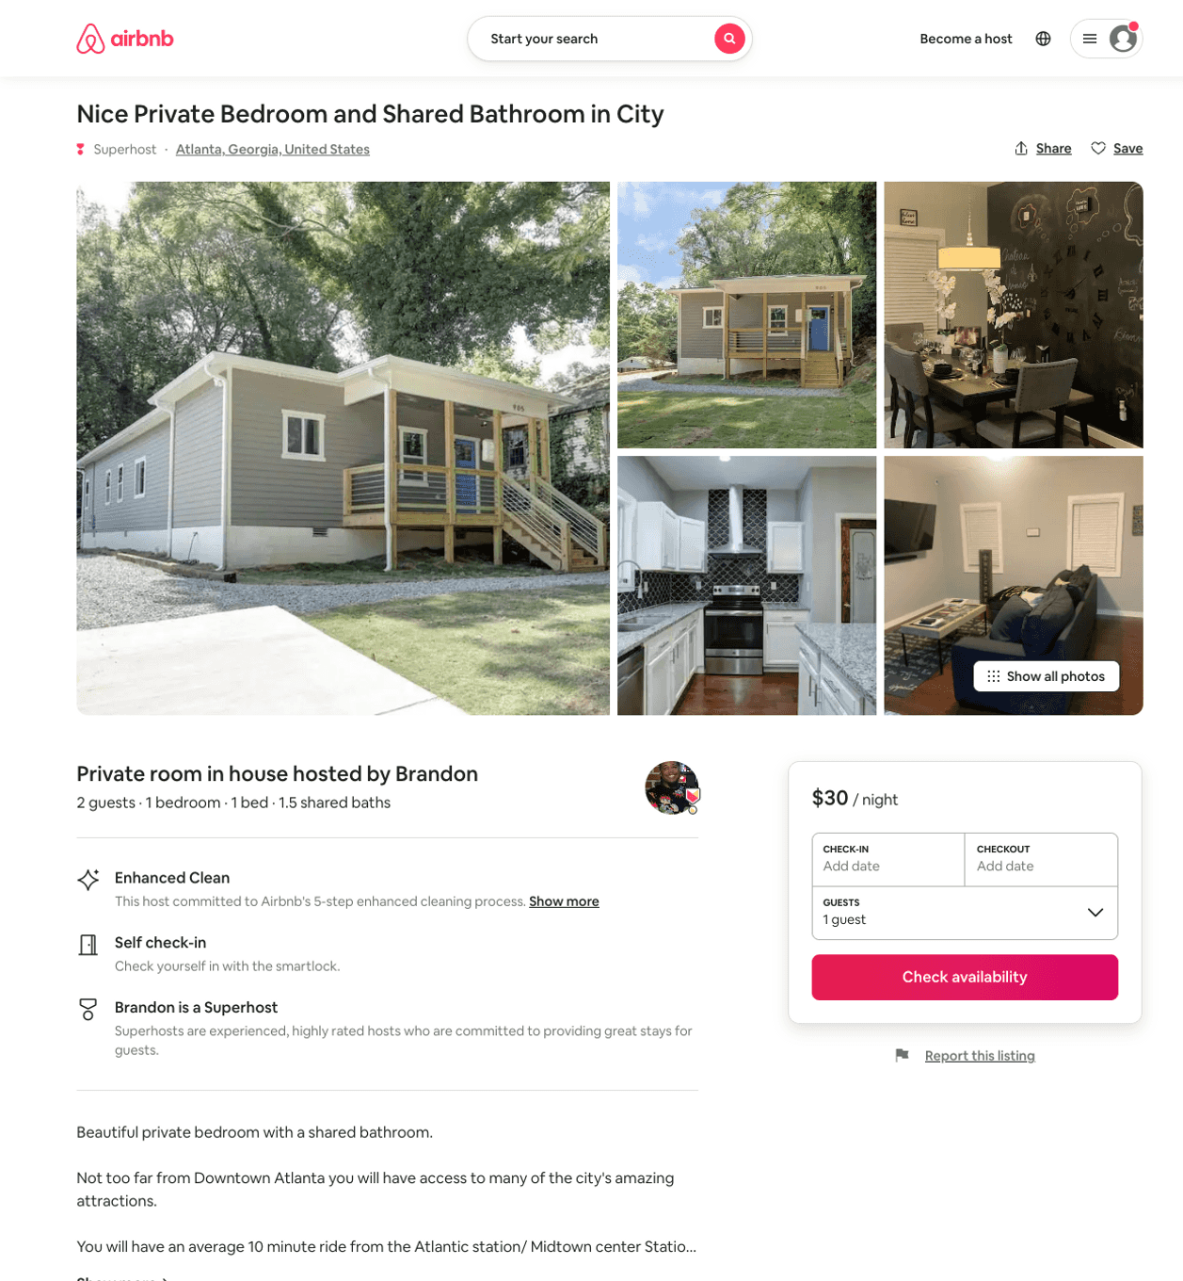
Listing 44649363
1
2
$25 - $45
4.87
1
Brandon
31879338
4
https://www.airbnb.com/rooms/44649363
Aug 2022

Slide 13
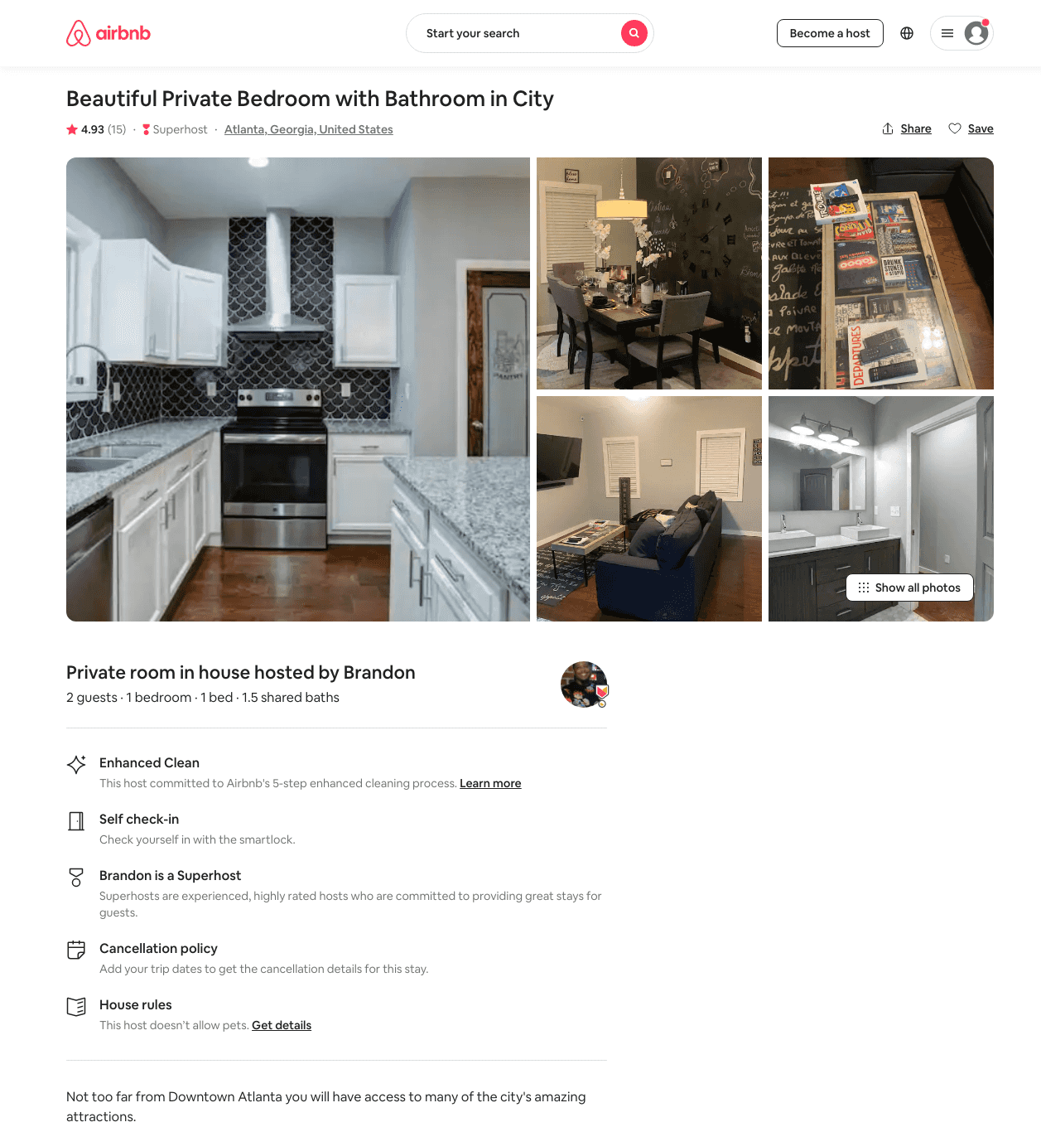
Listing 41207340
1
2
$42 - $160
4.89
1
Brandon
31879338
4
https://www.airbnb.com/rooms/41207340
Aug 2022

Slide 14
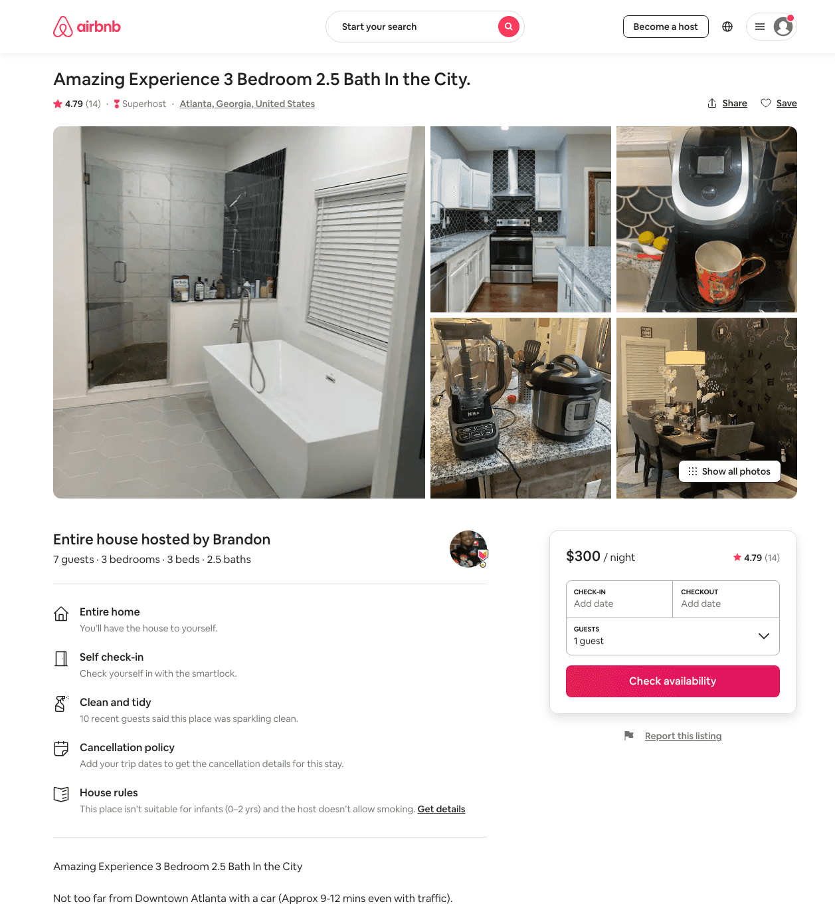
Listing 45402031
3
7
$232 - $312
4.87
2
Brandon
31879338
4
https://www.airbnb.com/rooms/45402031
Aug 2022

Slide 15
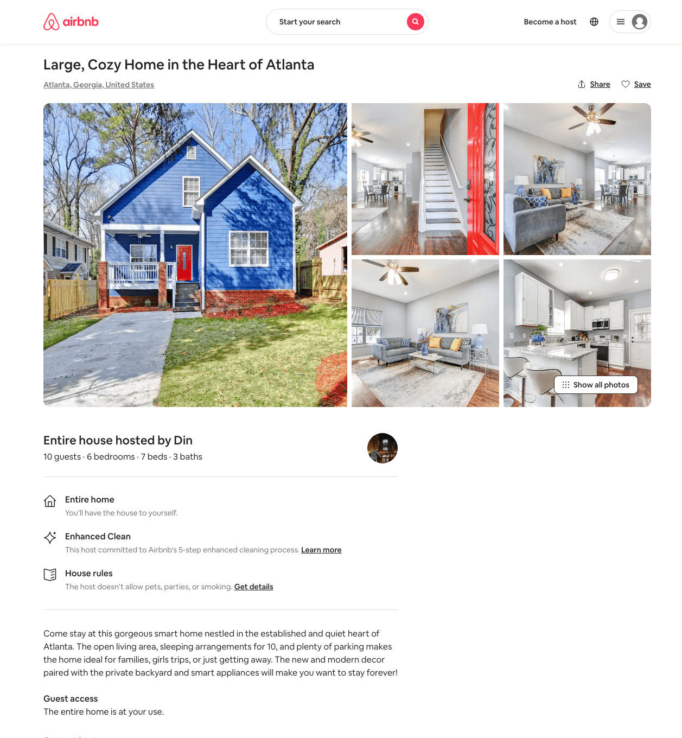
Listing 48632022
6
10
$141 - $406
4.71
3
Din
303900723
1
https://www.airbnb.com/rooms/48632022
Aug 2022

Slide 16
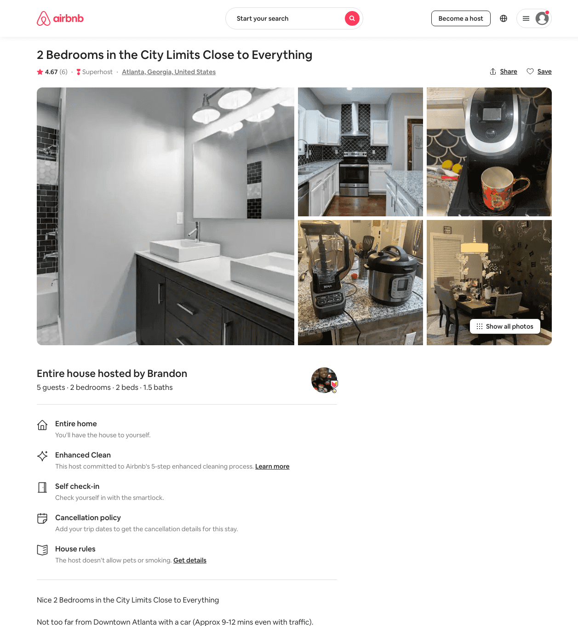
Listing 44702996
2
5
$143 - $250
4.73
2
Brandon
31879338
4
https://www.airbnb.com/rooms/44702996
Aug 2022

Slide 17
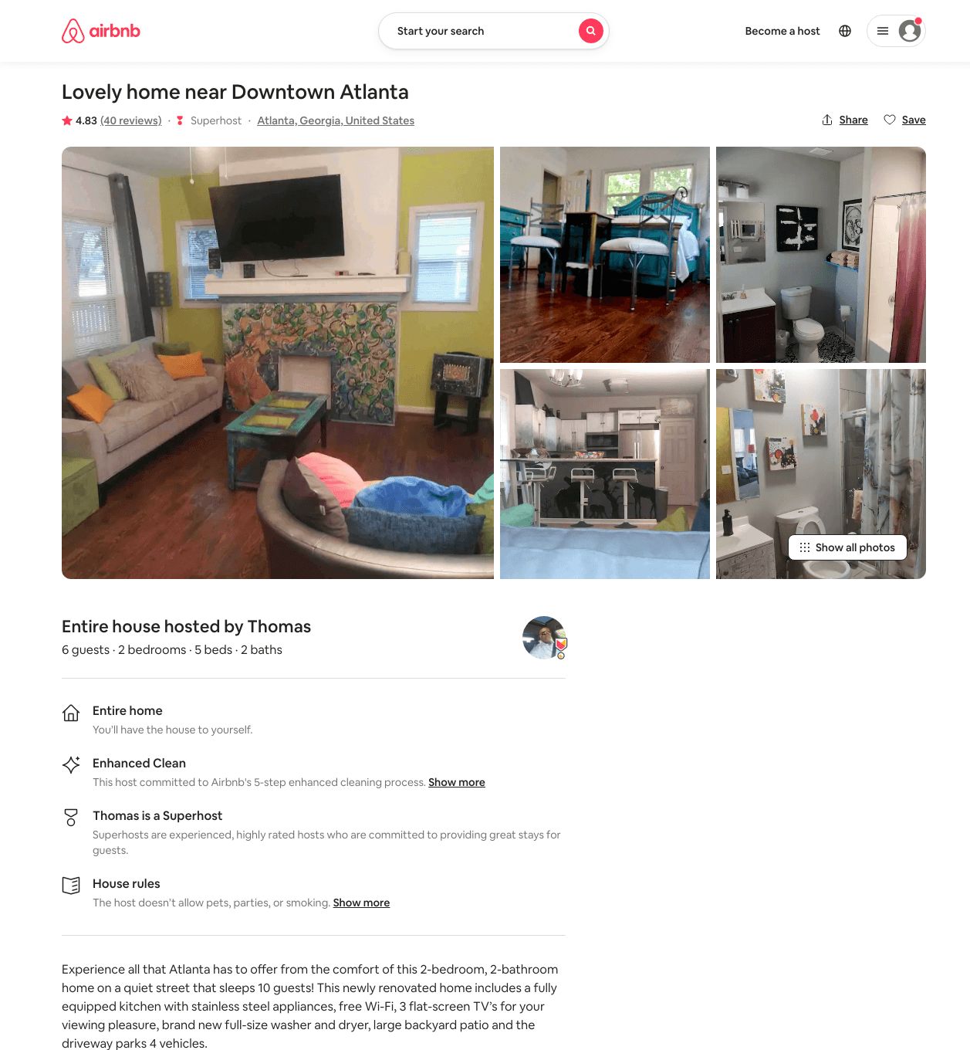
Listing 31837630
2
6
$185 - $250
4.87
2
Thomas
202003151
1
https://www.airbnb.com/rooms/31837630
Jun 2022

Slide 18
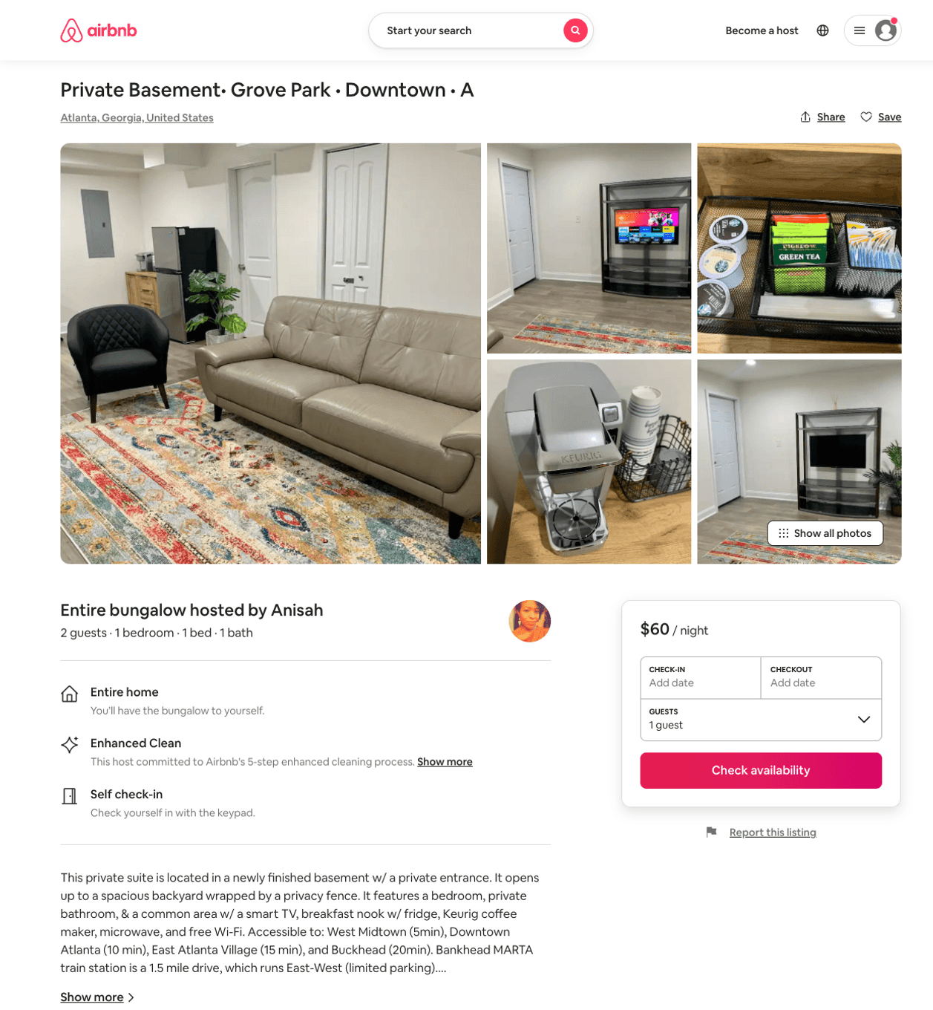
Listing 47407401
1
3
$49 - $88
4.93
2
Anisah
46593612
1
https://www.airbnb.com/rooms/47407401
Aug 2022

Slide 19
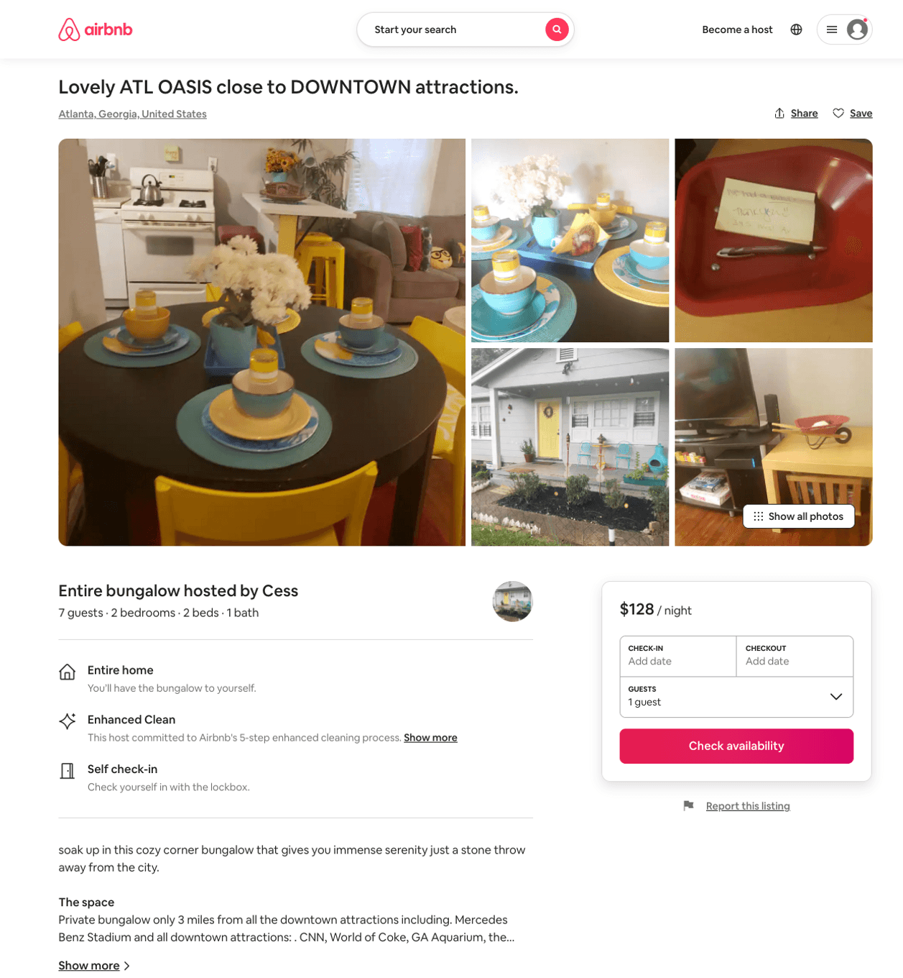
Listing 50879763
2
6
$103 - $163
3.60
2
Cess
403476497
2
https://www.airbnb.com/rooms/50879763
Jun 2022

Slide 20
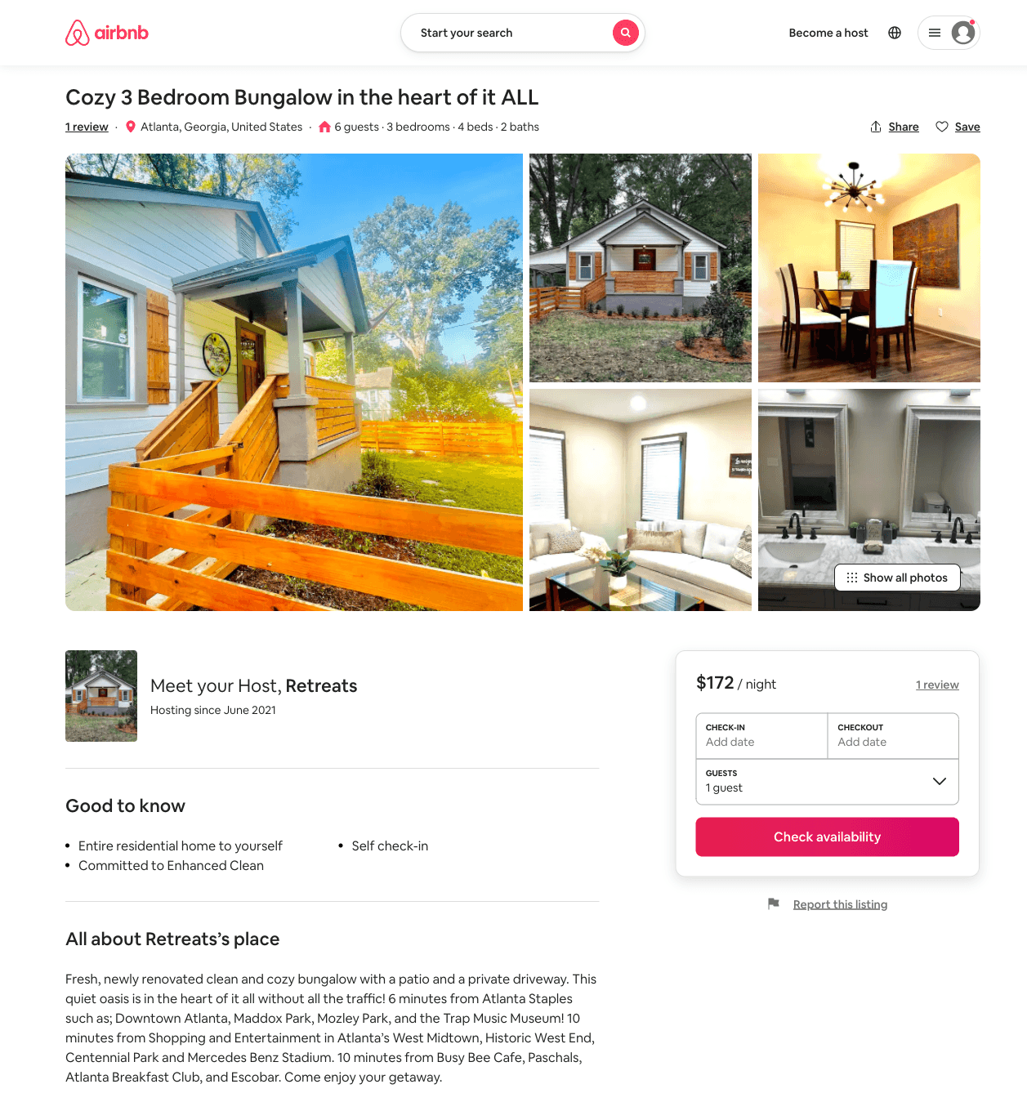
Listing 50372621
3
6
$118 - $190
4.74
3
Jennie
406879168
2
https://www.airbnb.com/rooms/50372621
Aug 2022

Slide 21
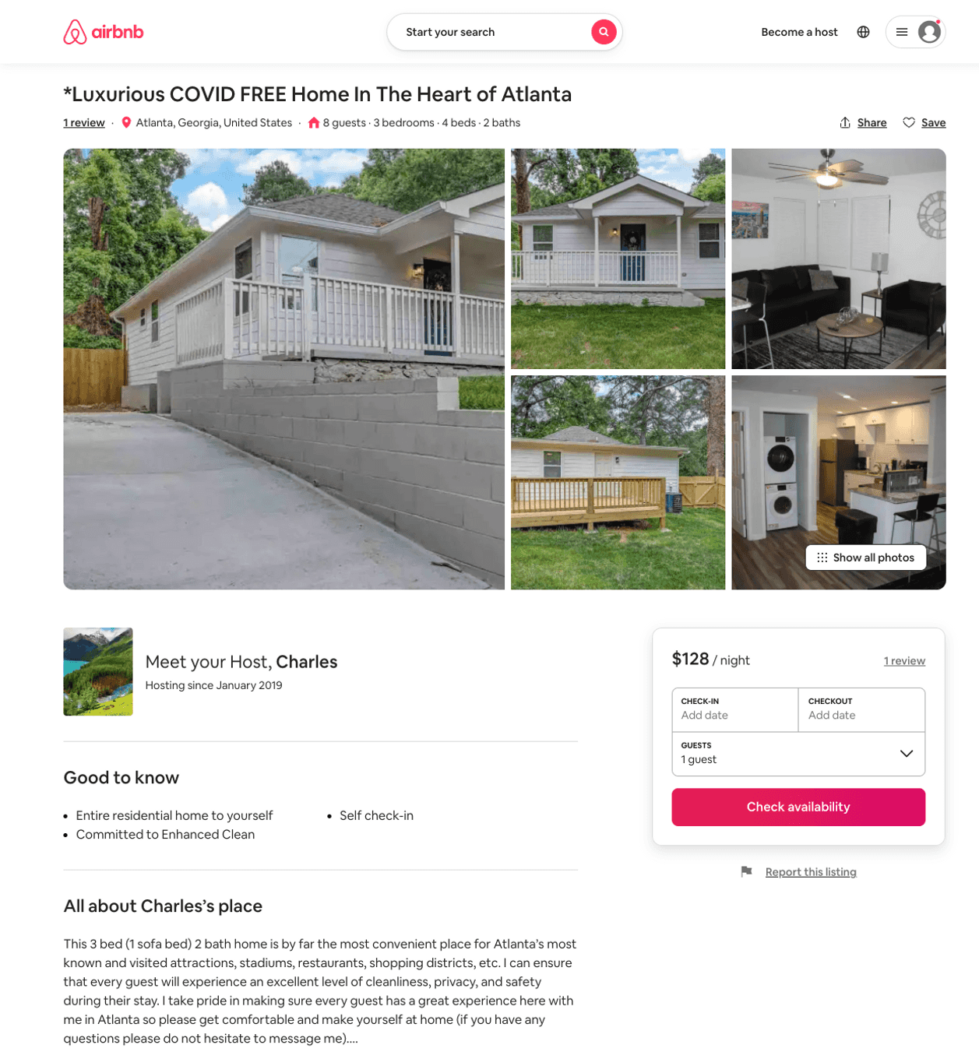
Listing 51510079
3
11
$55 - $128
4.86
1
Charles
239947647
1
https://www.airbnb.com/rooms/51510079
Aug 2022

Slide 22
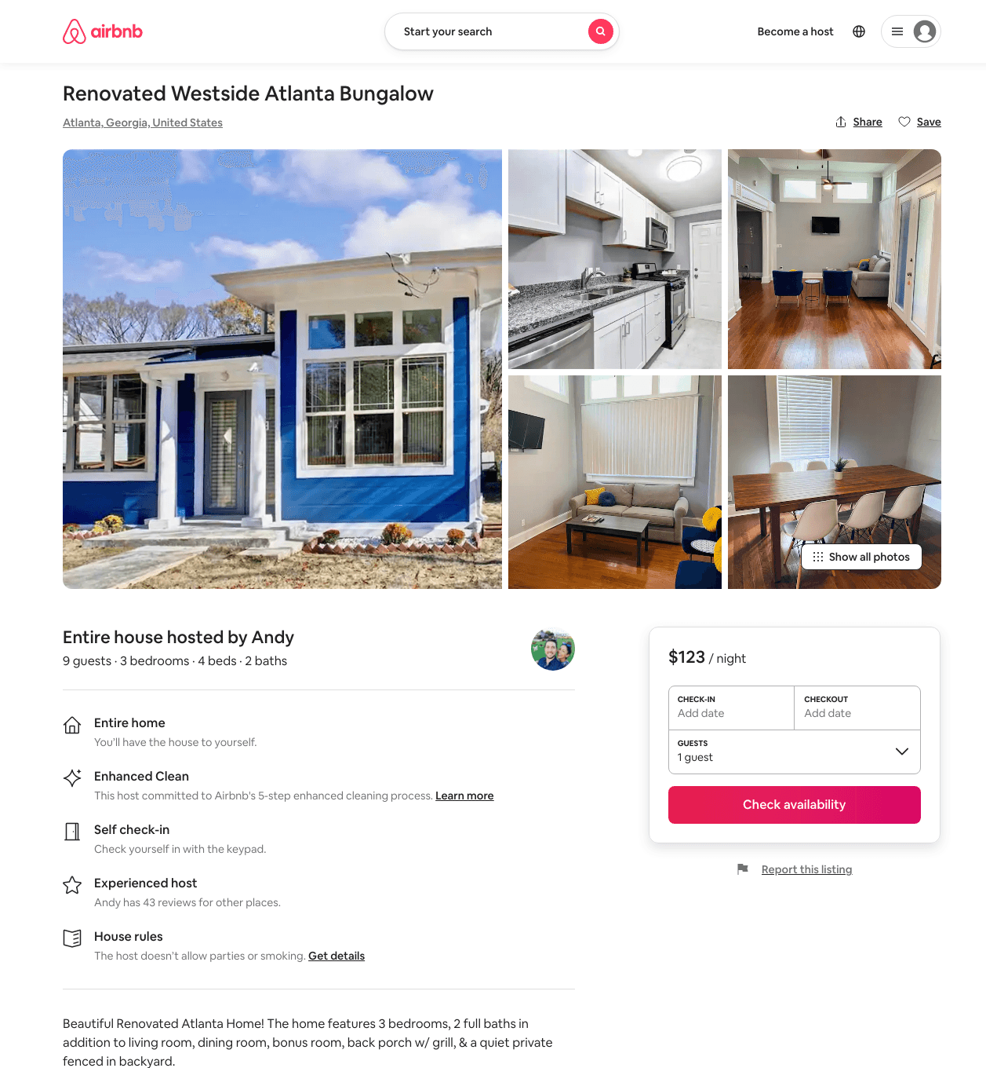
Listing 47354093
3
9
$123 - $254
4.74
1
Andy
271060041
3
https://www.airbnb.com/rooms/47354093
Aug 2022

Slide 23
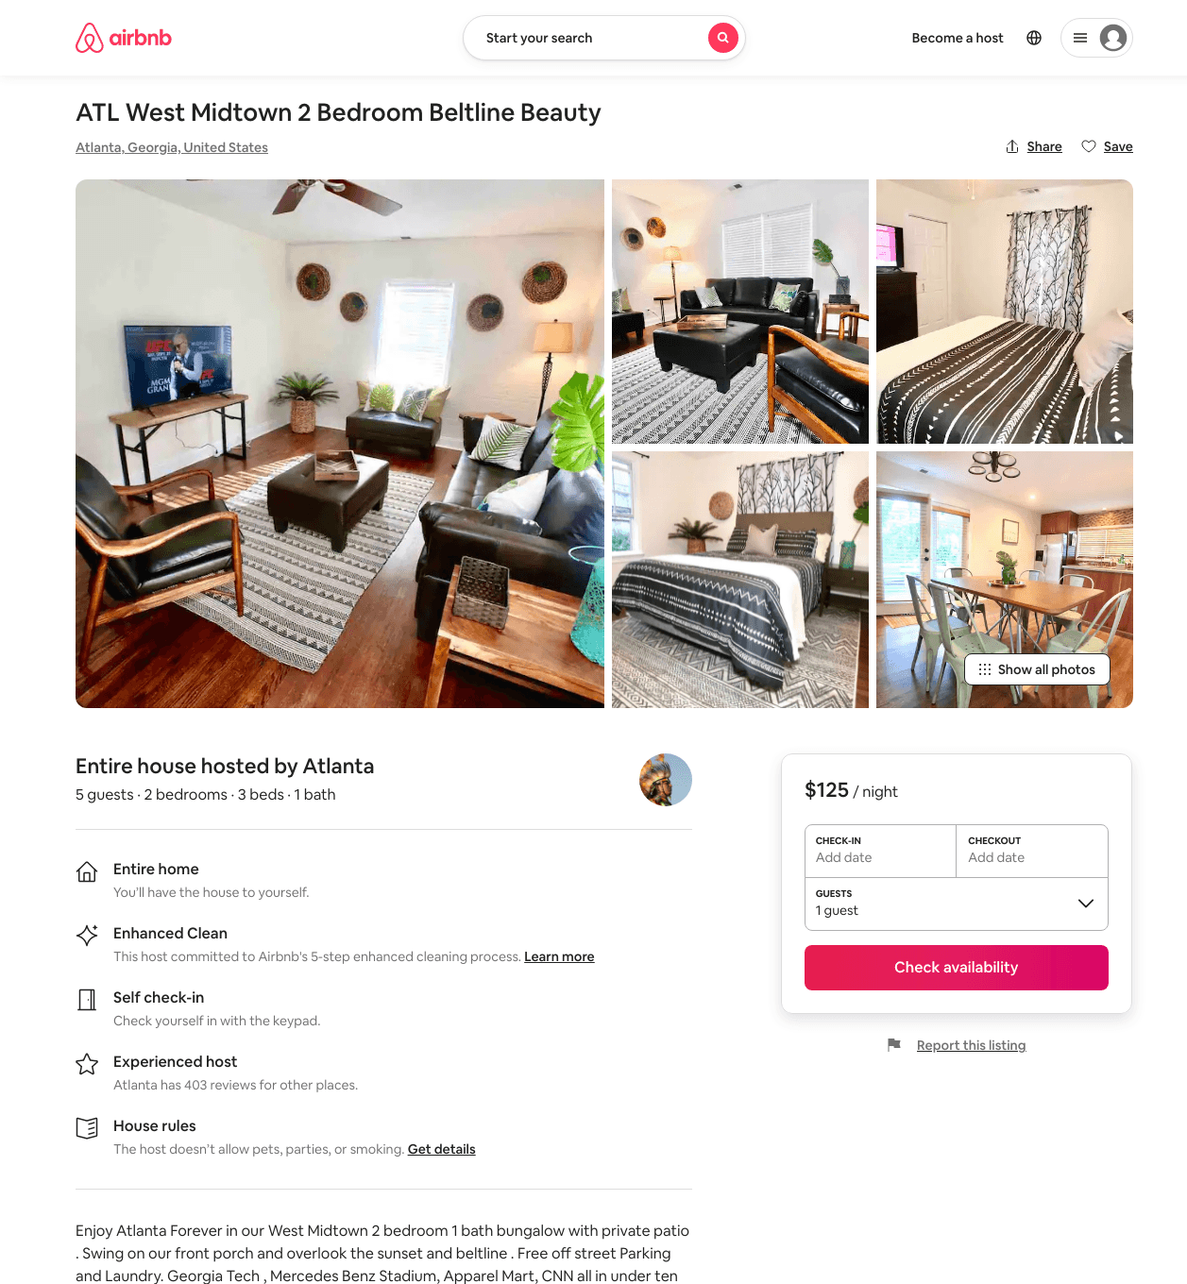
Listing 48681591
2
5
$109 - $145
4.44
3
Atlanta
61366
7
https://www.airbnb.com/rooms/48681591
Jul 2022

Slide 24
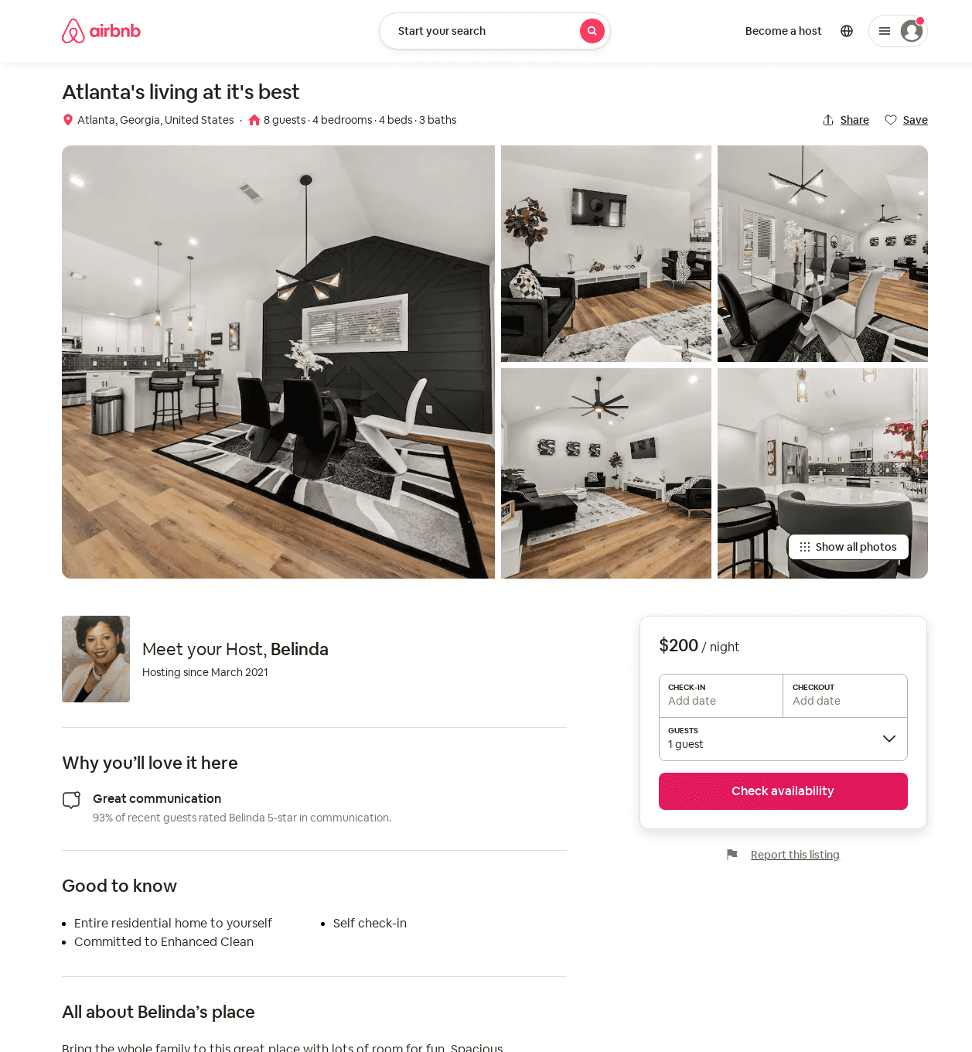
Listing 52187697
4
8
$200 - $336
4.87
2
Belinda
393511526
3
https://www.airbnb.com/rooms/52187697
Aug 2022

Slide 25
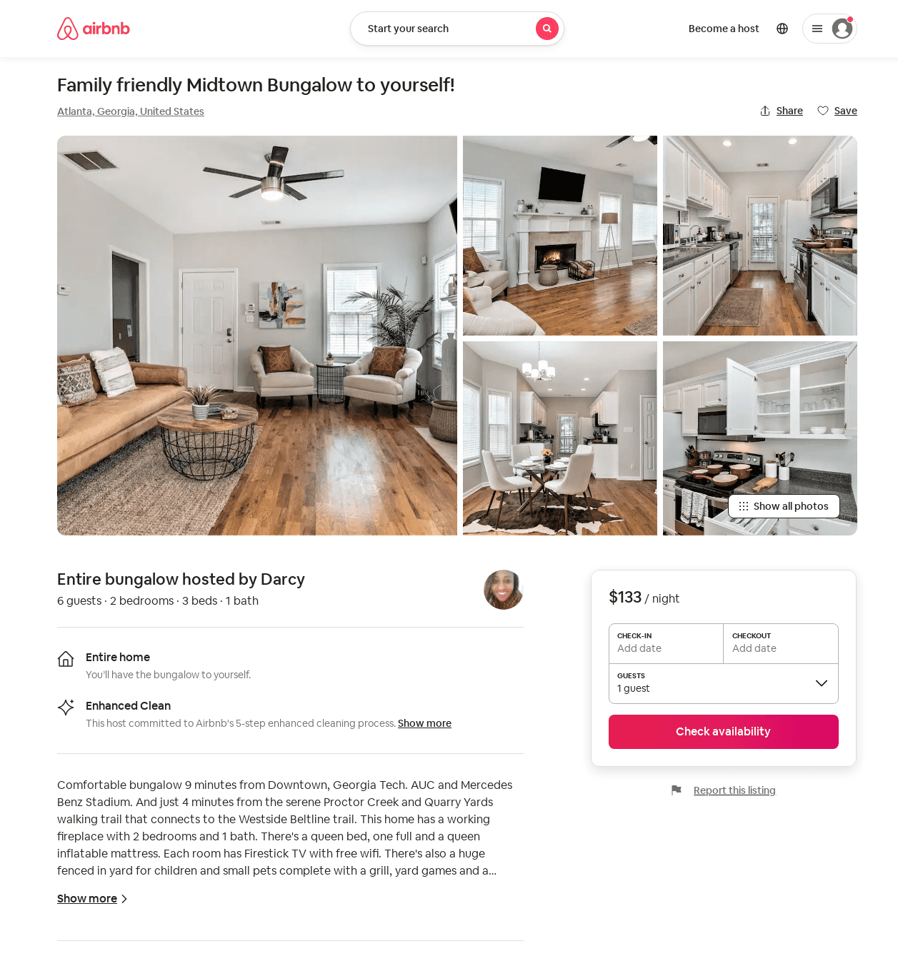
Listing 52285662
3
6
$126 - $159
4.67
2
Darcy
256122574
1
https://www.airbnb.com/rooms/52285662
Aug 2022

Slide 26
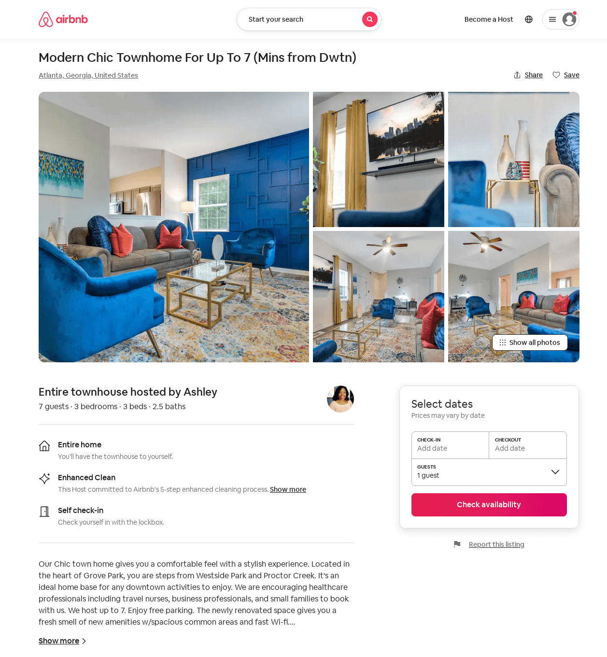
Listing 52556981
3
7
$118 - $228
4.73
2
Ashley
138405605
1
https://www.airbnb.com/rooms/52556981
Aug 2022

Slide 27
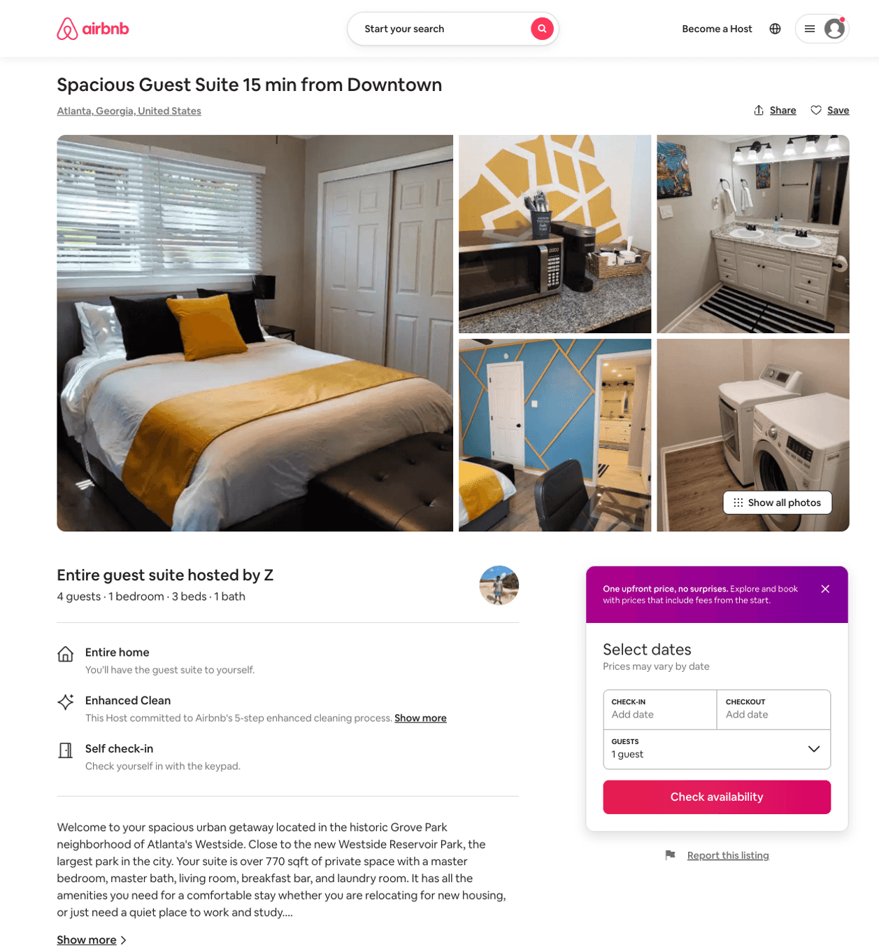
Listing 48601379
1
4
$59 - $100
4.88
2
Z
181641140
1
https://www.airbnb.com/rooms/48601379
Aug 2022

Slide 28
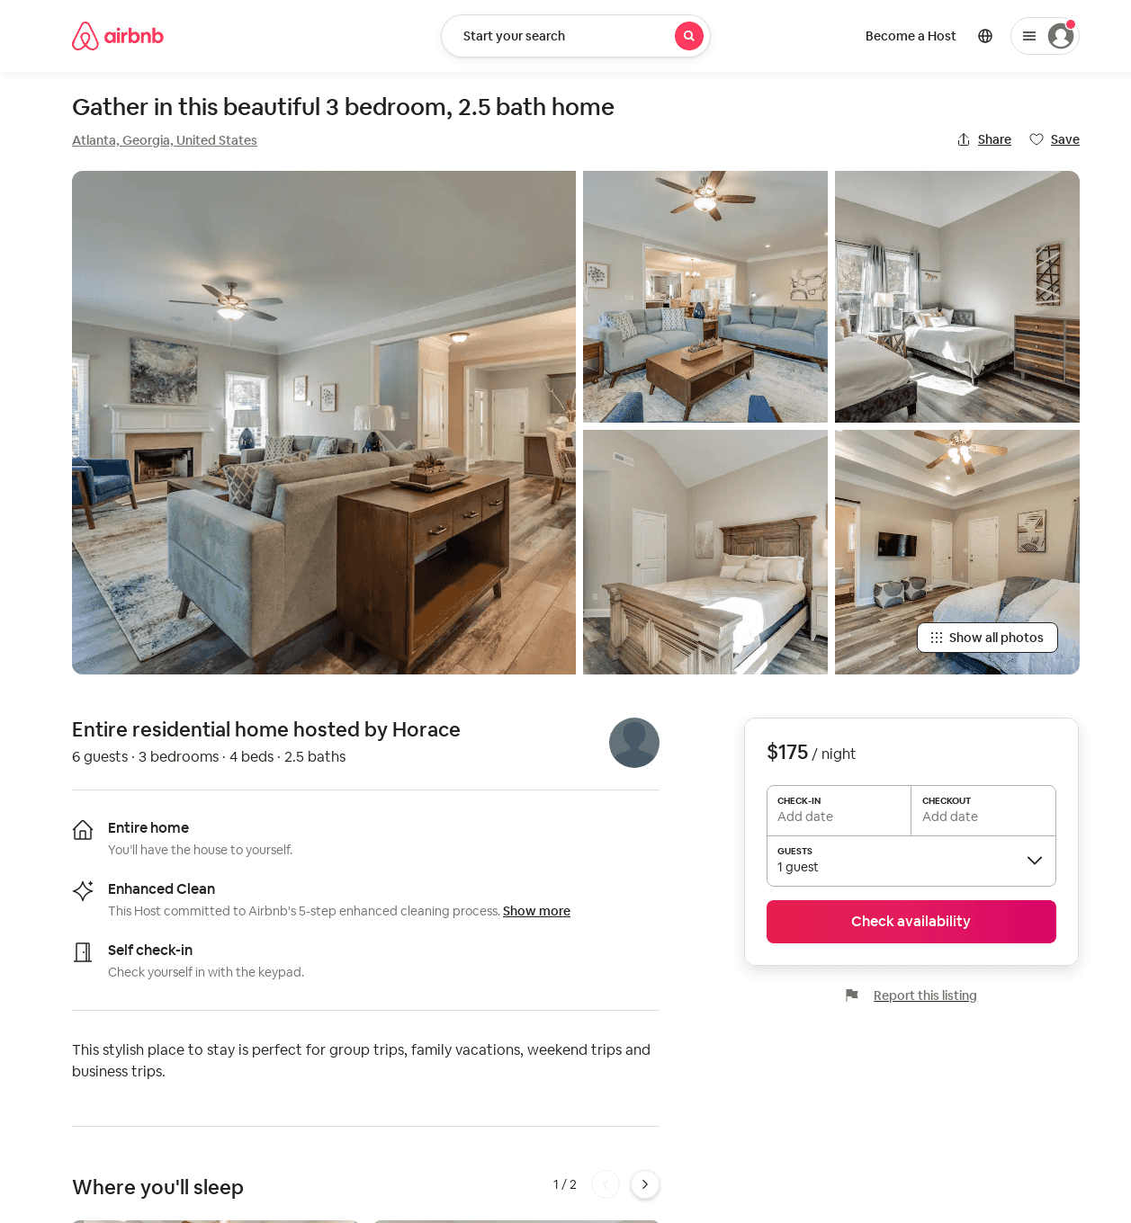
Listing 53341787
3
6
$175 - $209
4.85
2
Horace
431886606
1
https://www.airbnb.com/rooms/53341787
Aug 2022

Slide 29
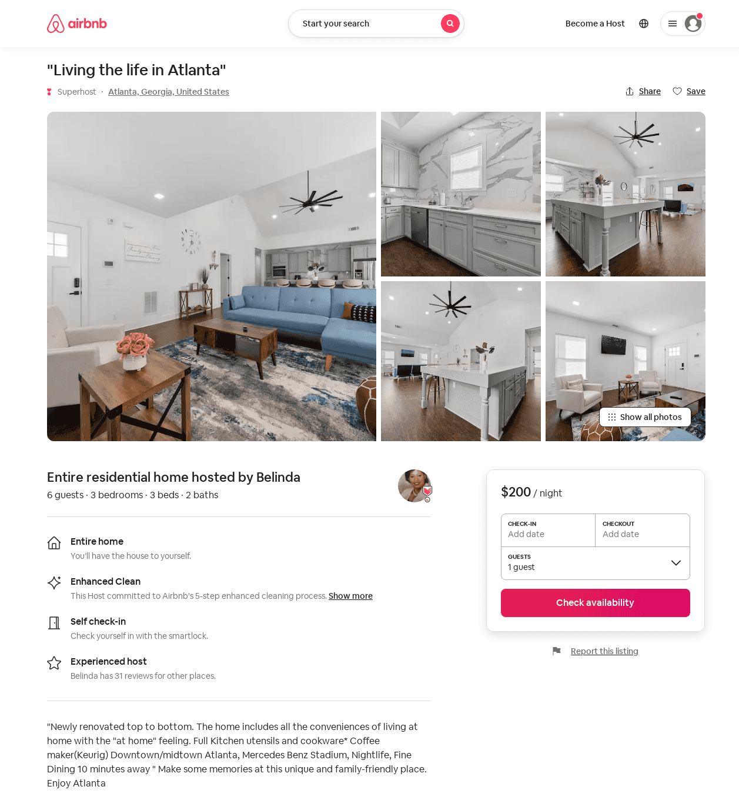
Listing 53674310
3
6
$200 - $286
2
Belinda
393511526
3
https://www.airbnb.com/rooms/53674310
Aug 2022

Slide 30
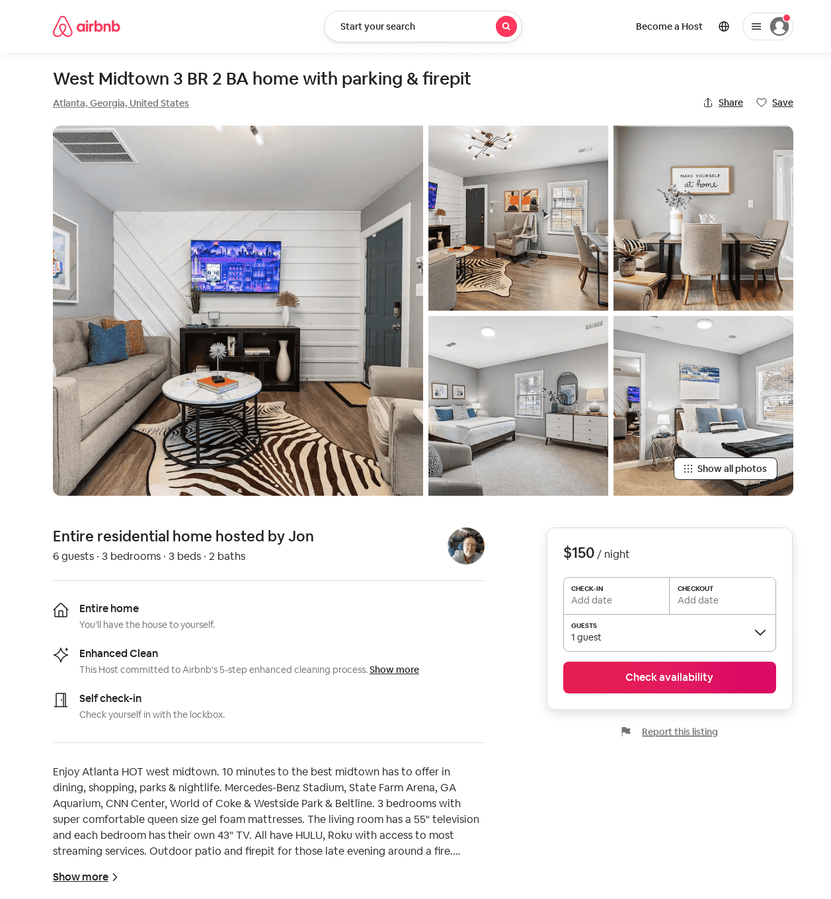
Listing 53769469
3
6
$150 - $216
4.76
3
Jon
191716285
1
https://www.airbnb.com/rooms/53769469
Aug 2022

Slide 31
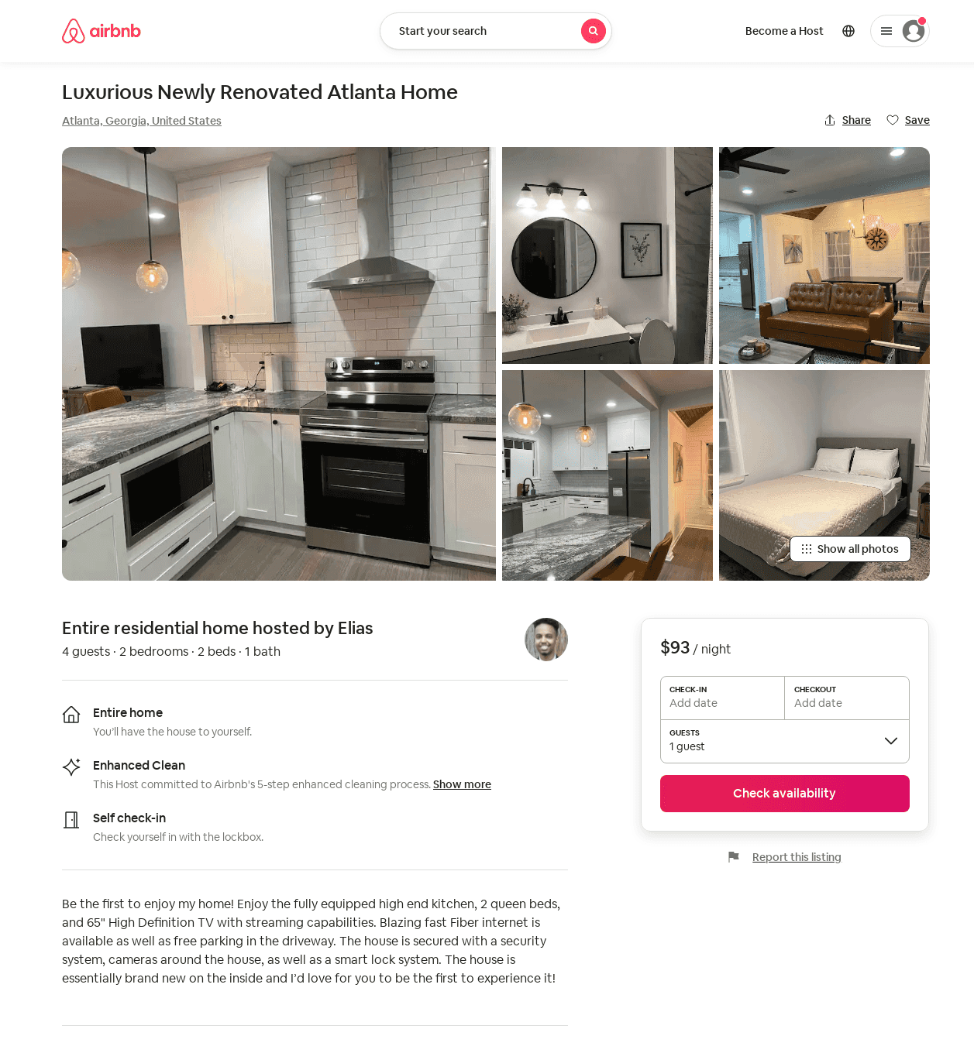
Listing 53852296
2
4
$89 - $115
5.0
2
Elias
70494678
1
https://www.airbnb.com/rooms/53852296
Aug 2022

Slide 32
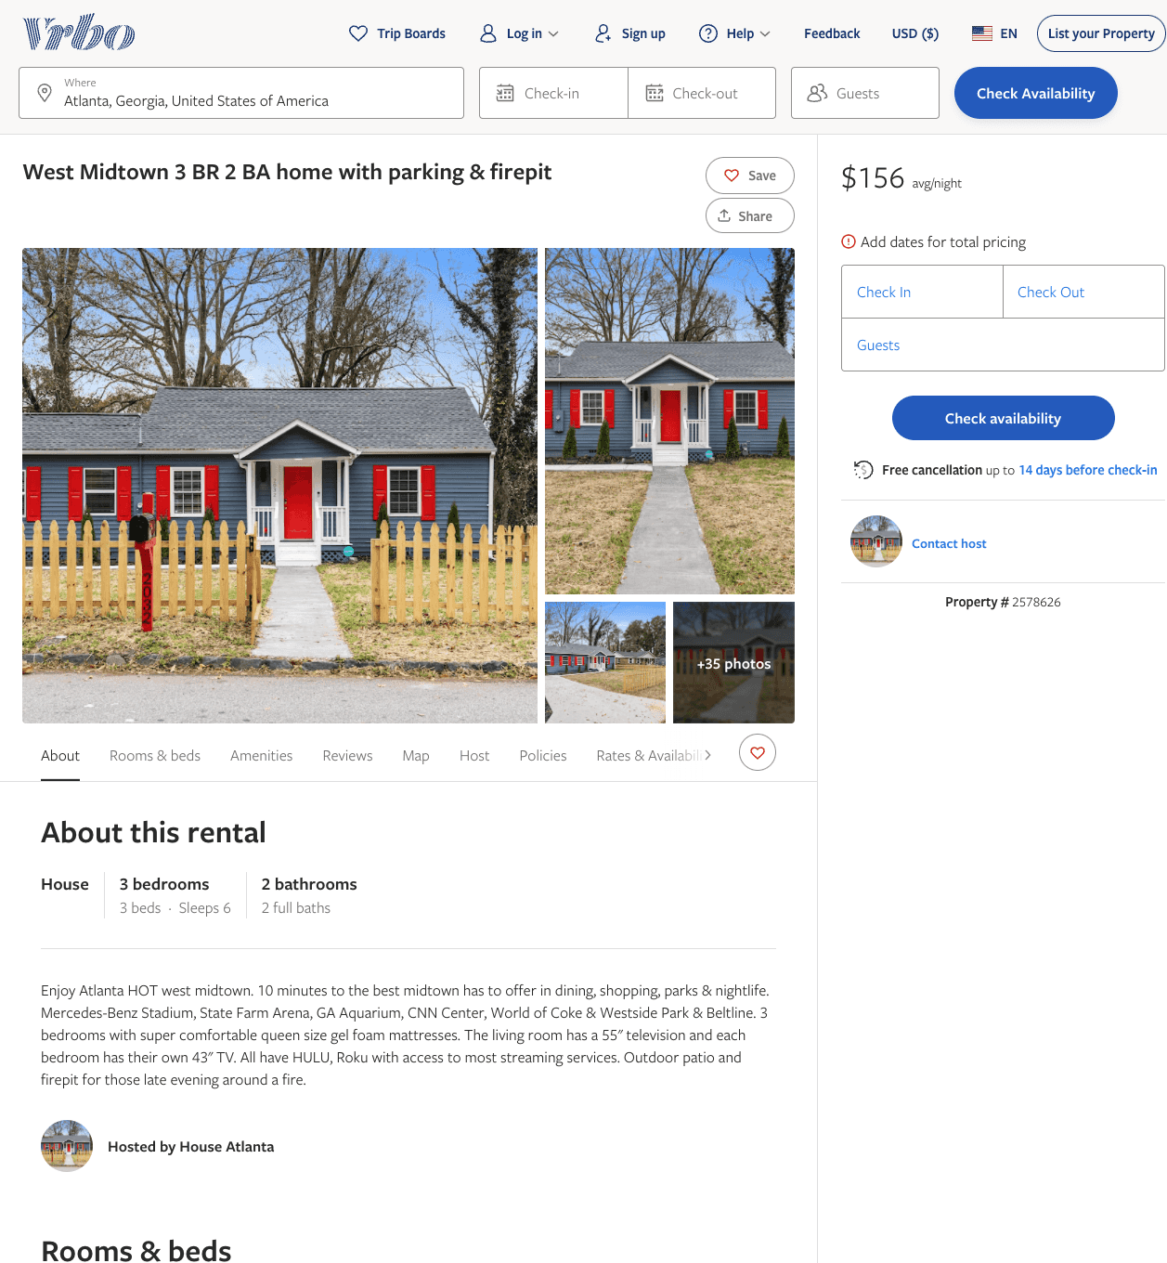
Listing 2578626
3
6
$156 - $223
4.5
3
https://www.vrbo.com/2578626
Aug 2022

Slide 33
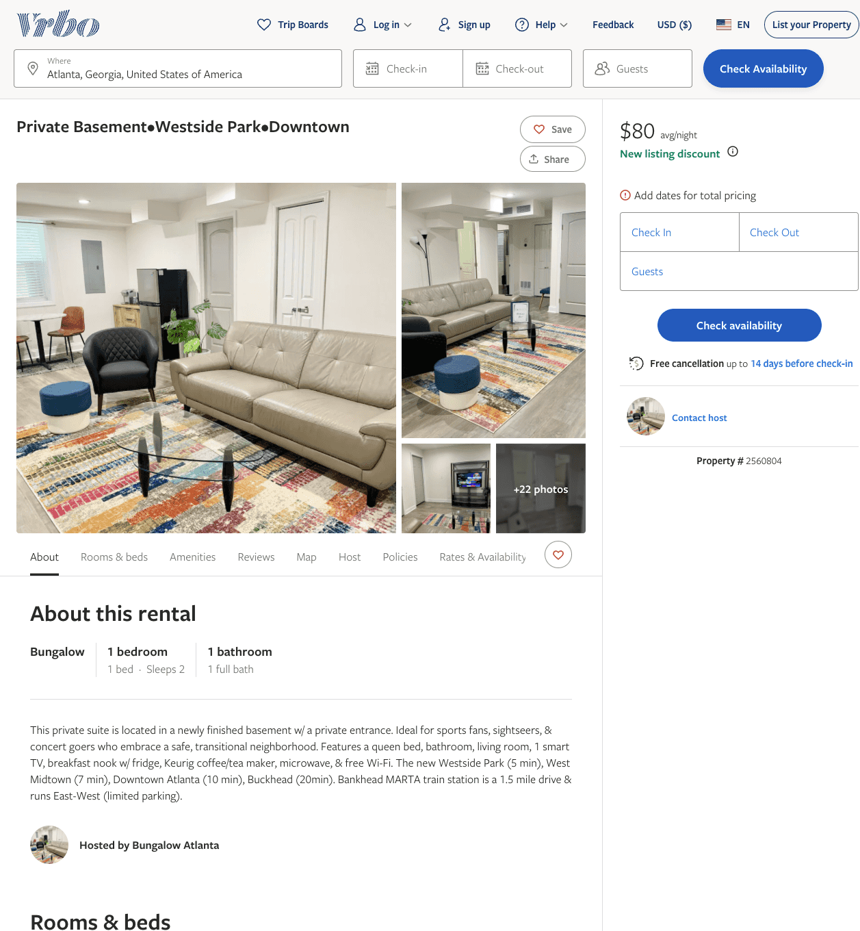
Listing 2560804
1
2
$78 - $90
2
Anisah
https://www.vrbo.com/2560804
Aug 2022

Slide 34
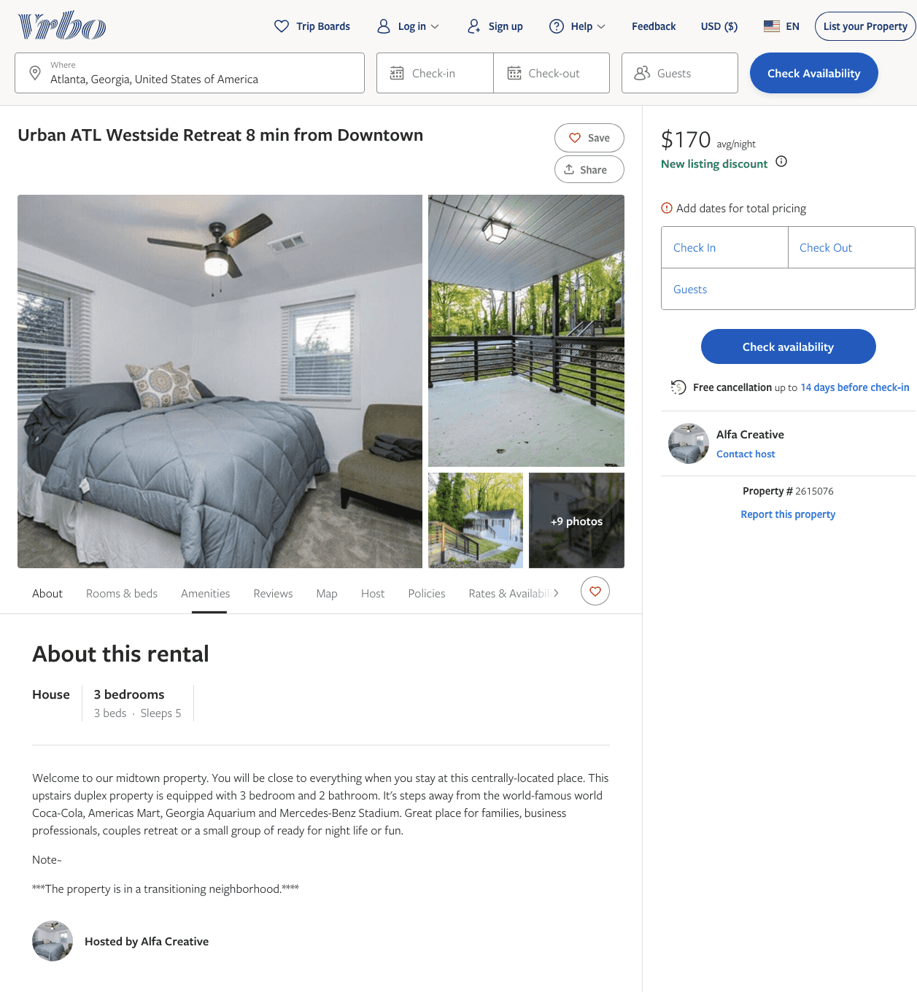
Listing 2615076
3
5
$170
4
2
Alfa Creative
https://www.vrbo.com/2615076
Aug 2022

Slide 35
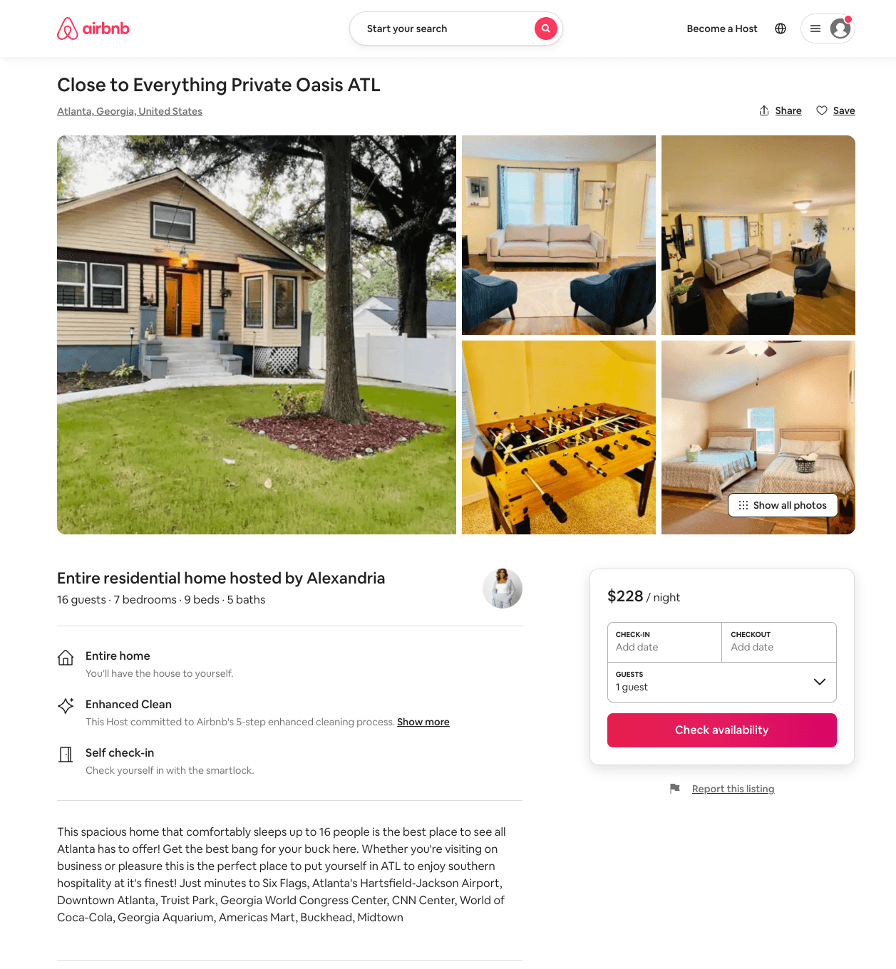
Listing 54120219
7
16
$202 - $359
4.43
2
Alexandria
313647630
2
https://www.airbnb.com/rooms/54120219
Aug 2022

Slide 36
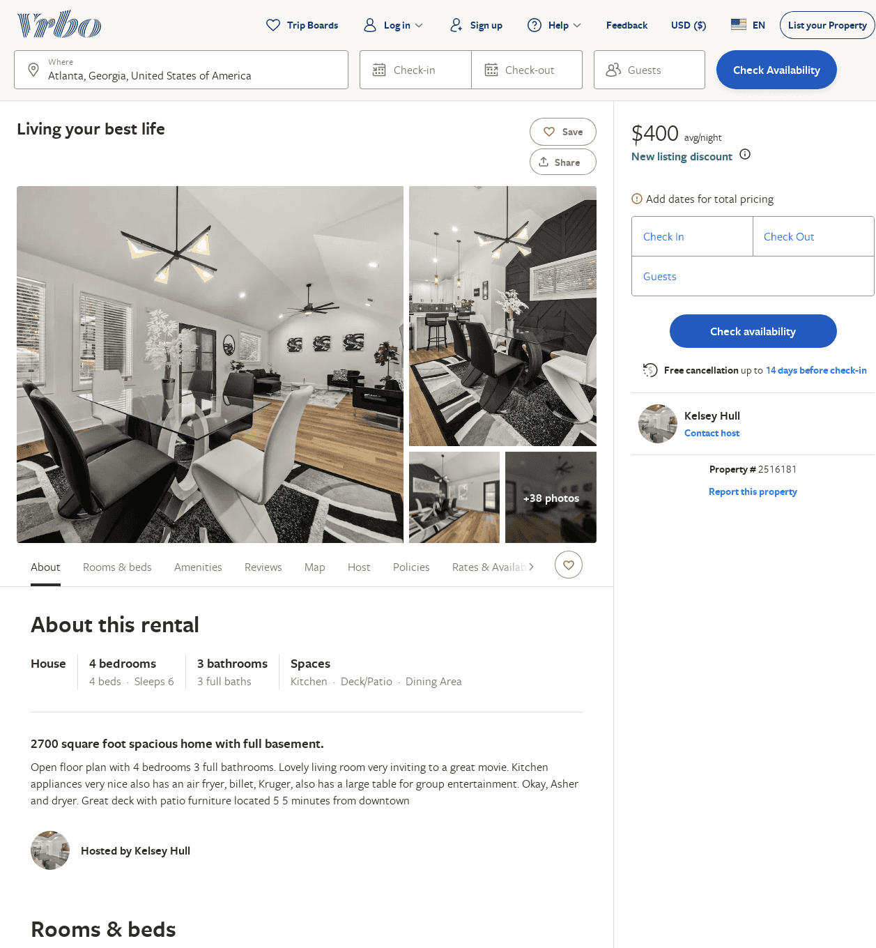
Listing 2516181
4
6
$338
5
2
Kelsey Hull
https://www.vrbo.com/2516181
Aug 2022

Slide 37
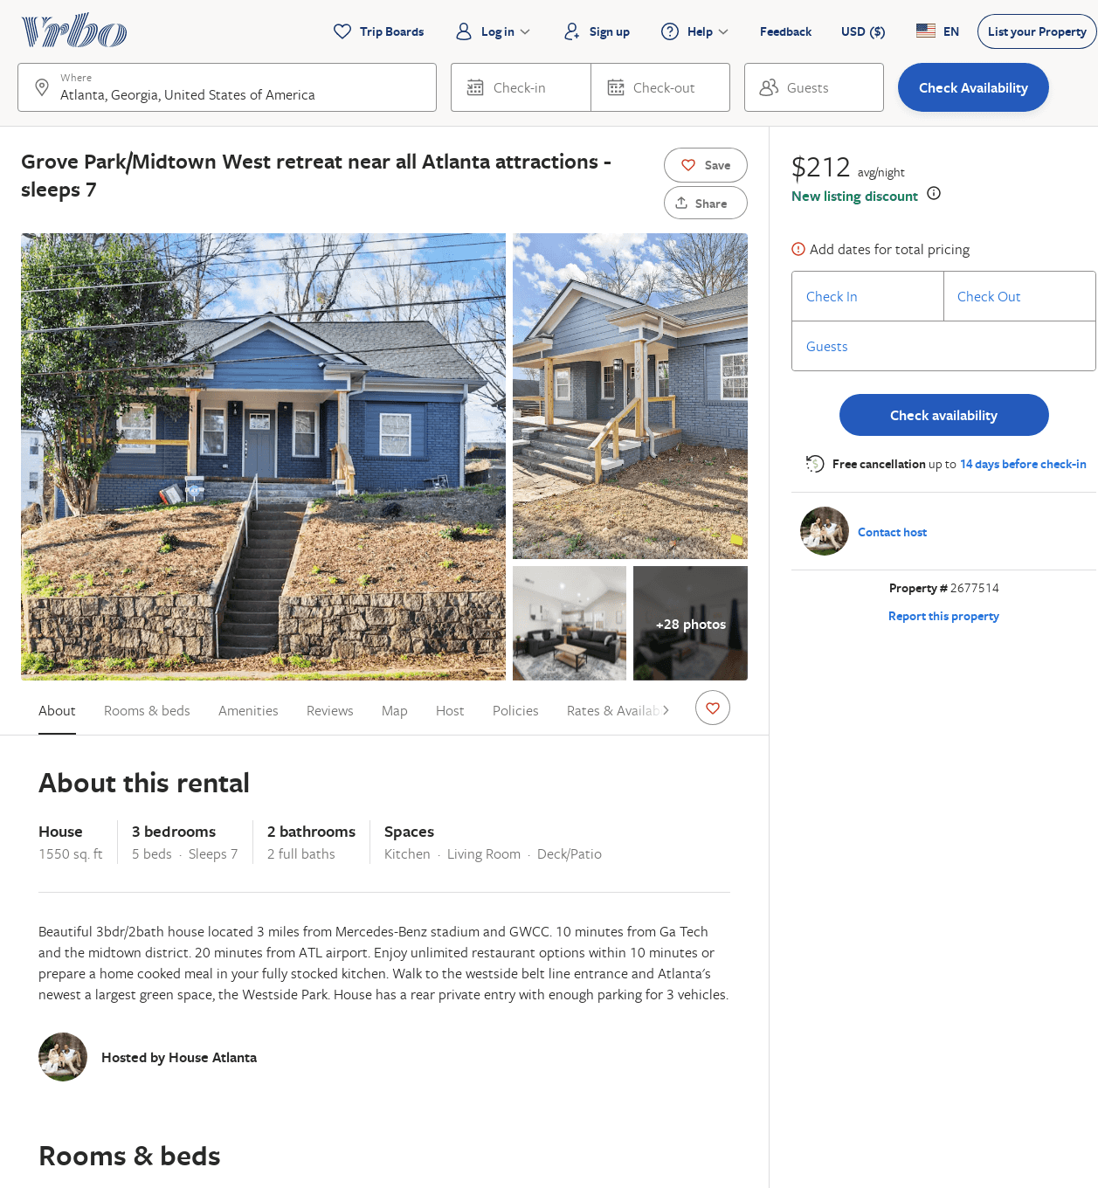
Listing 2677514
3
7
$265
3
Candice Ramirez
https://www.vrbo.com/2677514
Aug 2022

Slide 38
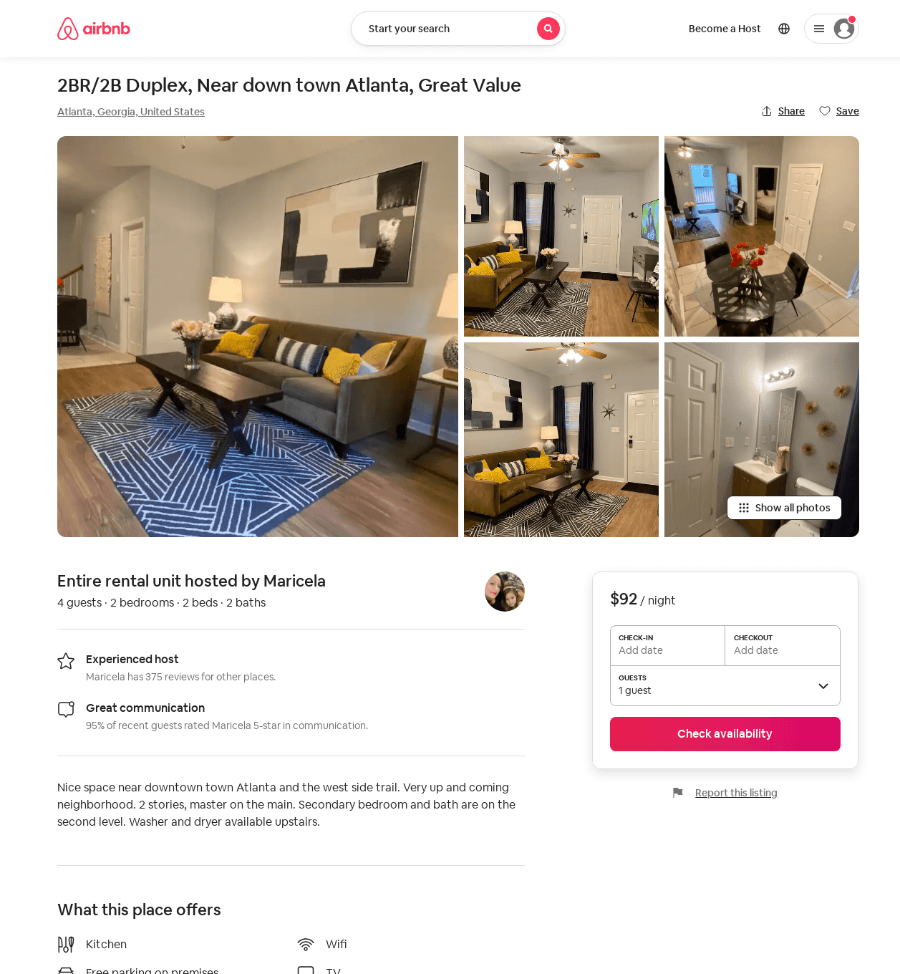
Listing 47979823
2
4
$87 - $98
4.13
2
Maricela
224571647
2
https://www.airbnb.com/rooms/47979823
Jul 2022

Slide 39
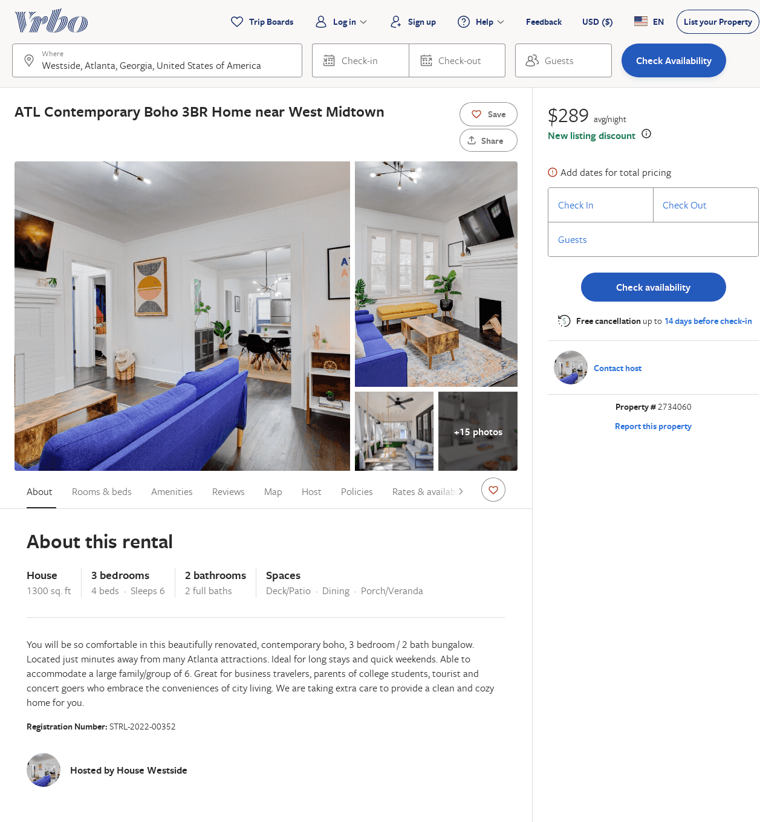
Listing 2734060
3
6
$186
5
1
https://www.vrbo.com/2734060
Aug 2022

Slide 40
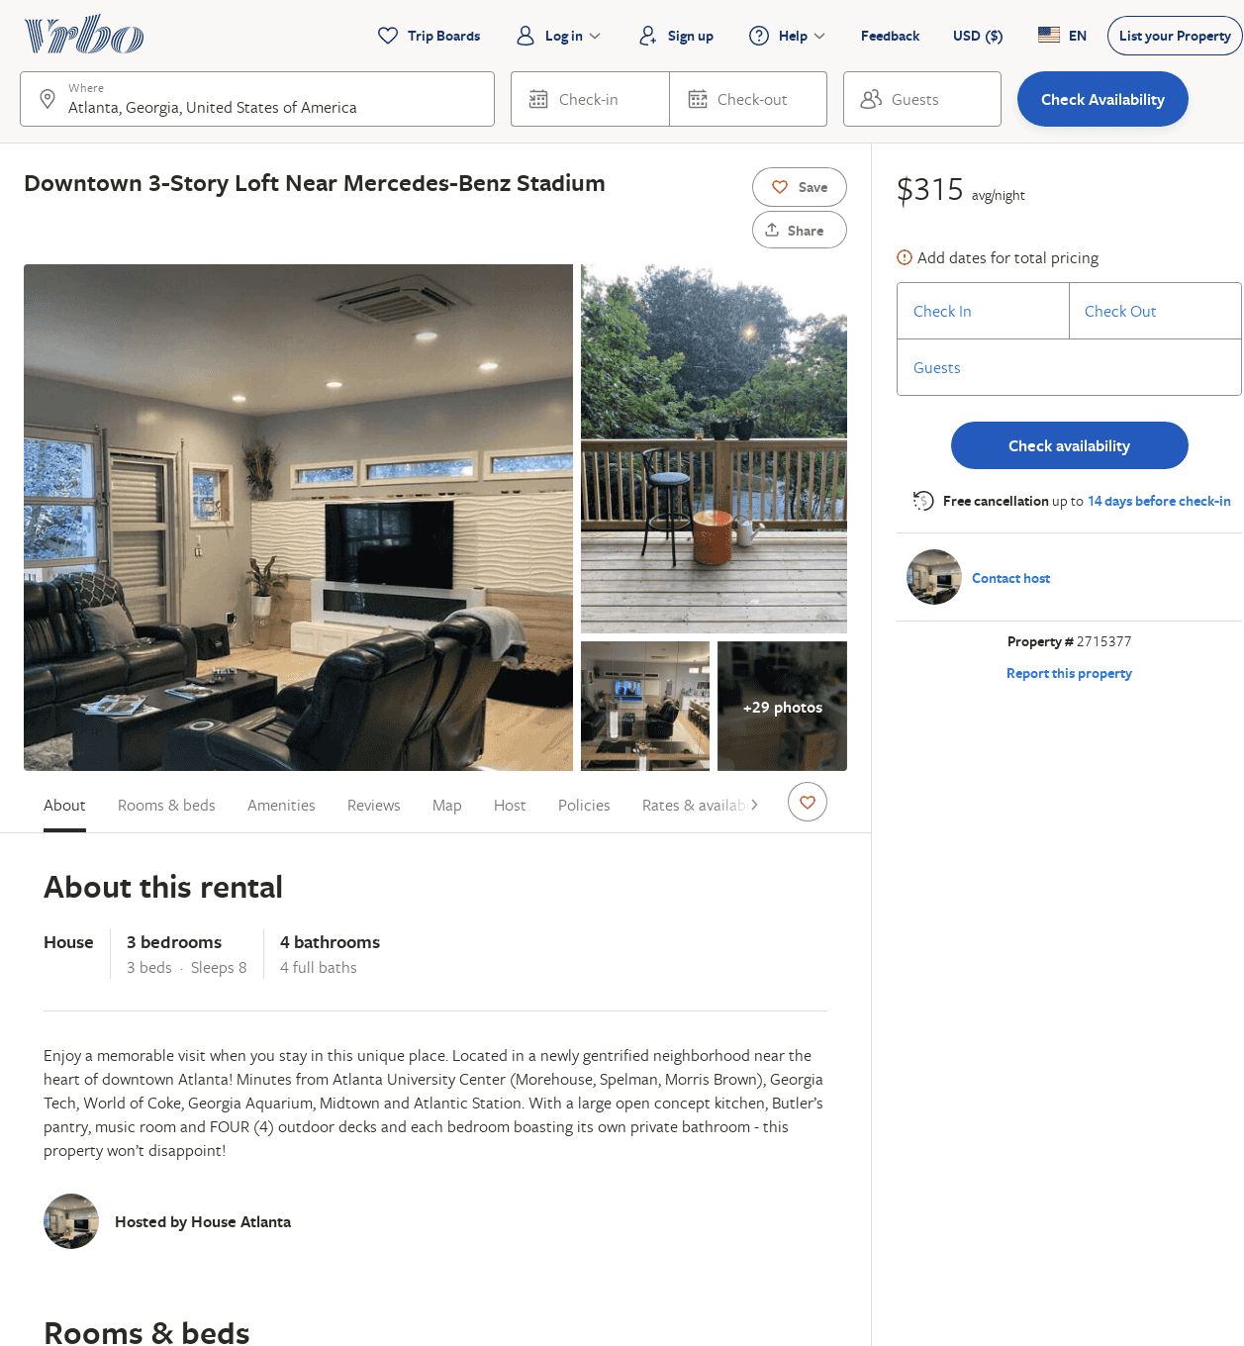
Listing 2715377
3
8
$315
3
https://www.vrbo.com/2715377
Aug 2022

Slide 41
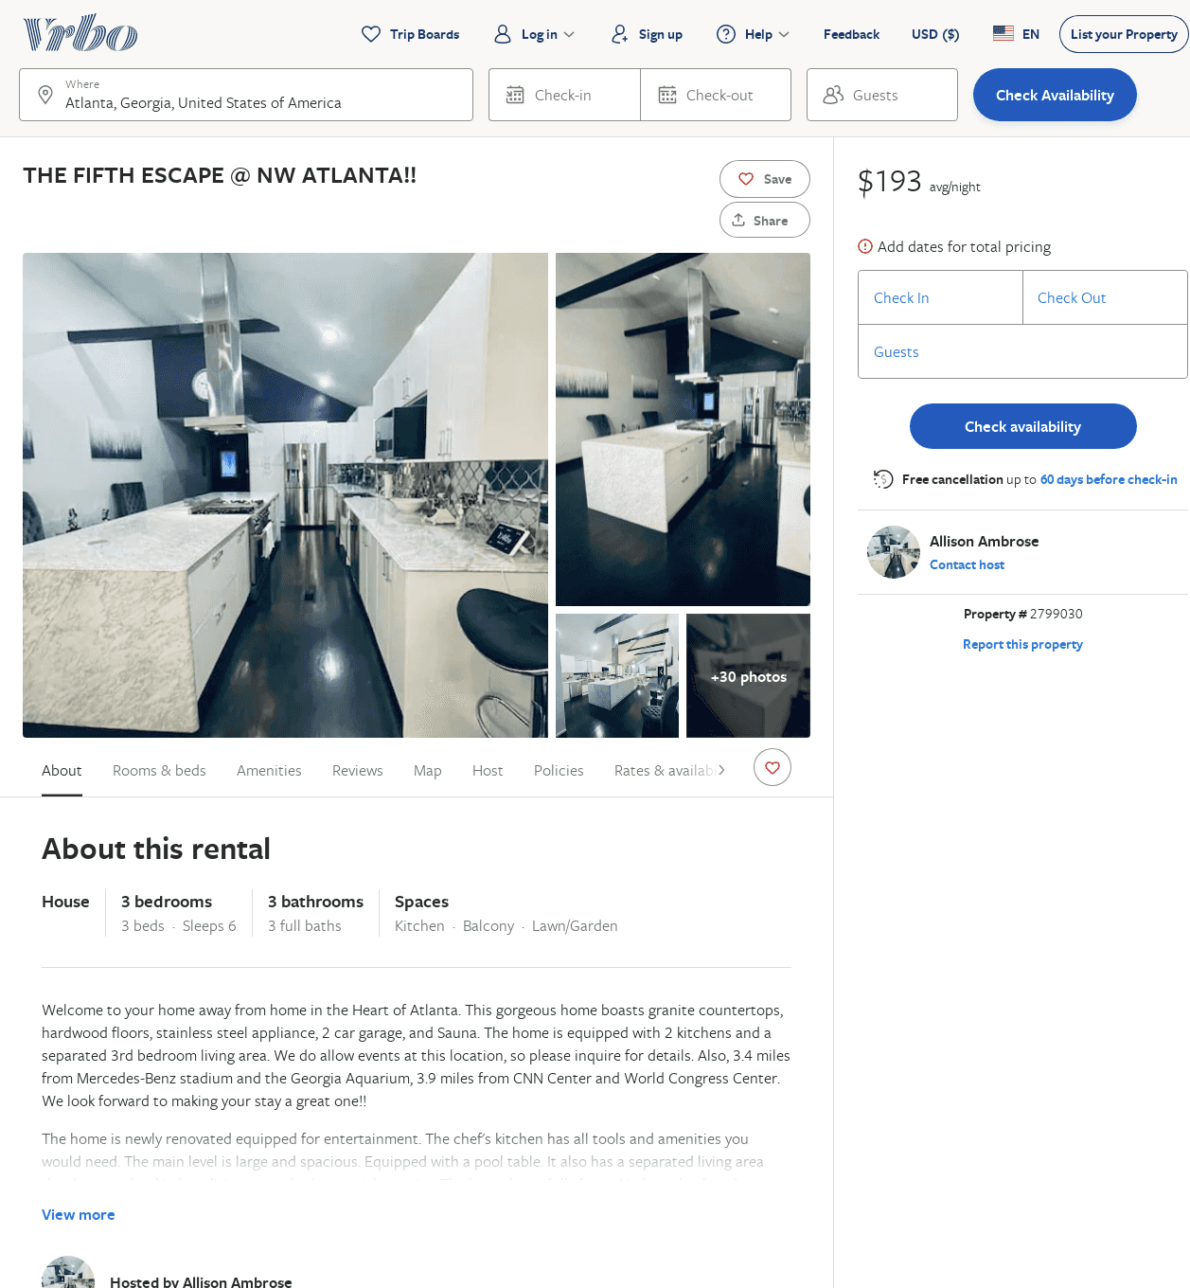
Listing 2799030
3
6
$161
3
Allison Ambrose
https://www.vrbo.com/2799030
Aug 2022

Slide 42
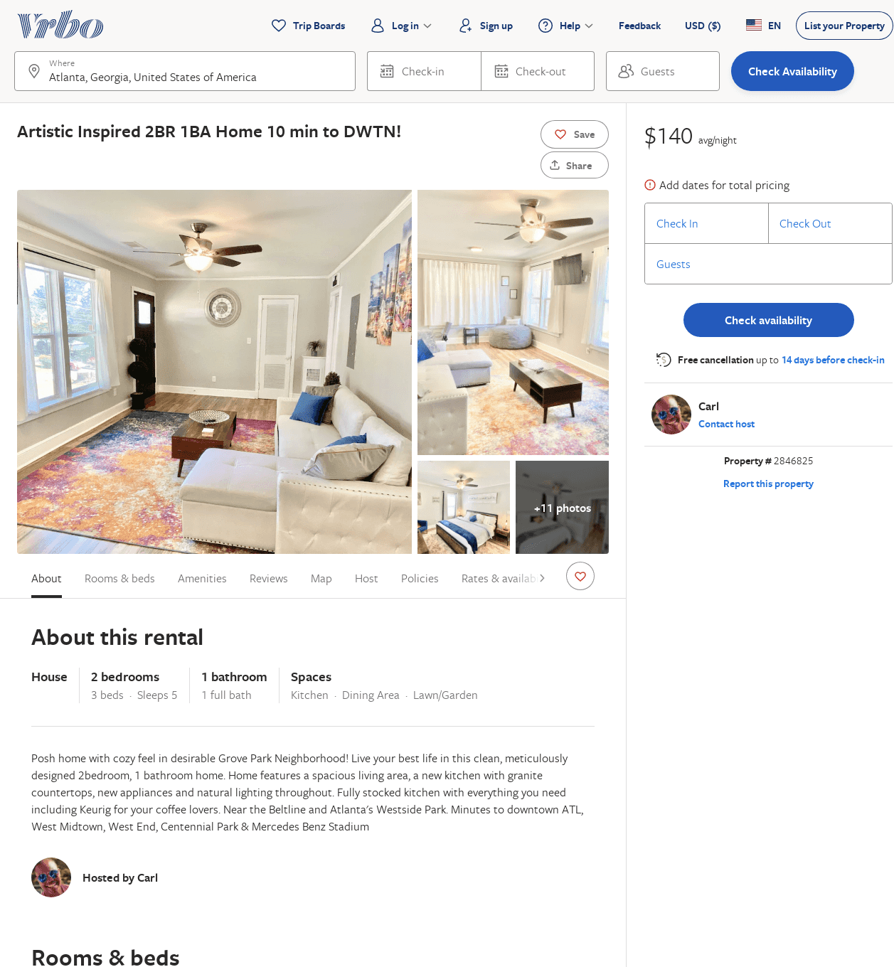
Listing 2846825
2
5
$140
3
Carl
https://www.vrbo.com/2846825
Aug 2022

Slide 43
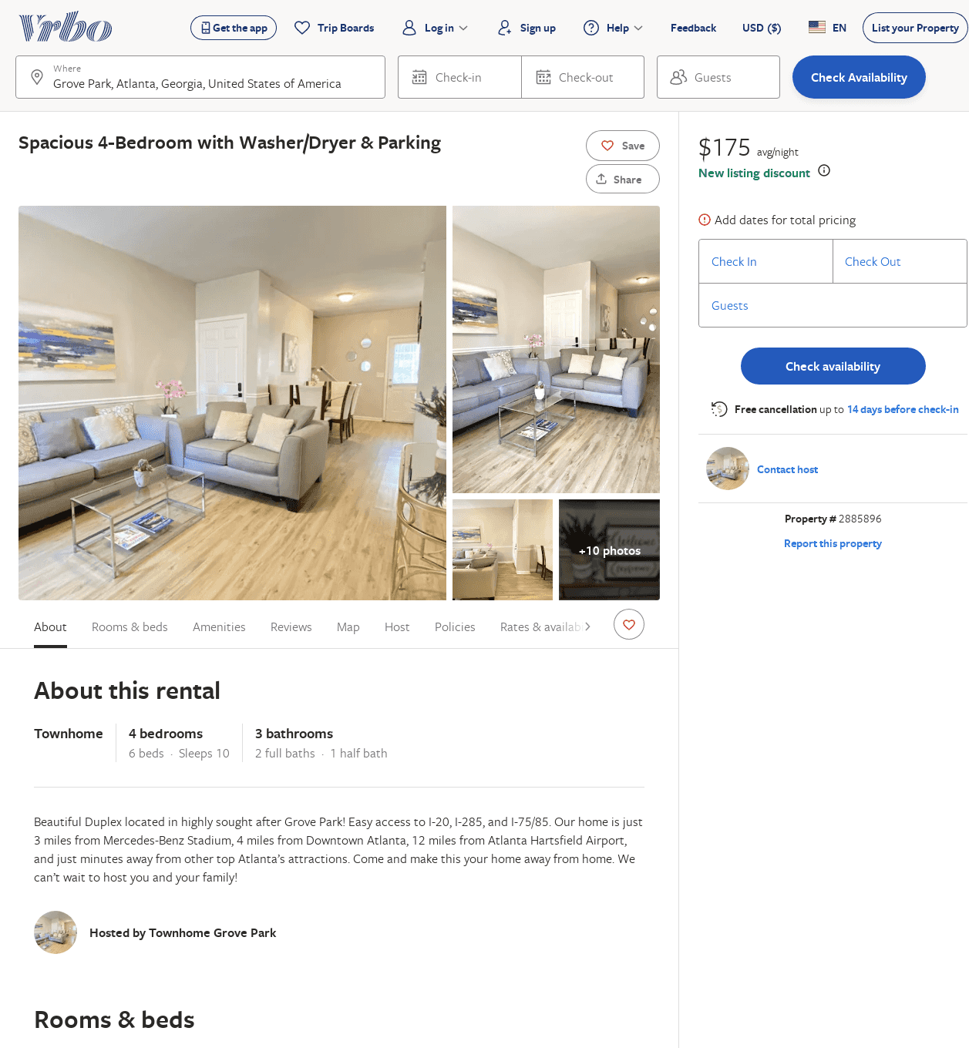
Listing 2885896
4
10
$176
2
https://www.vrbo.com/2885896
Aug 2022

Slide 44
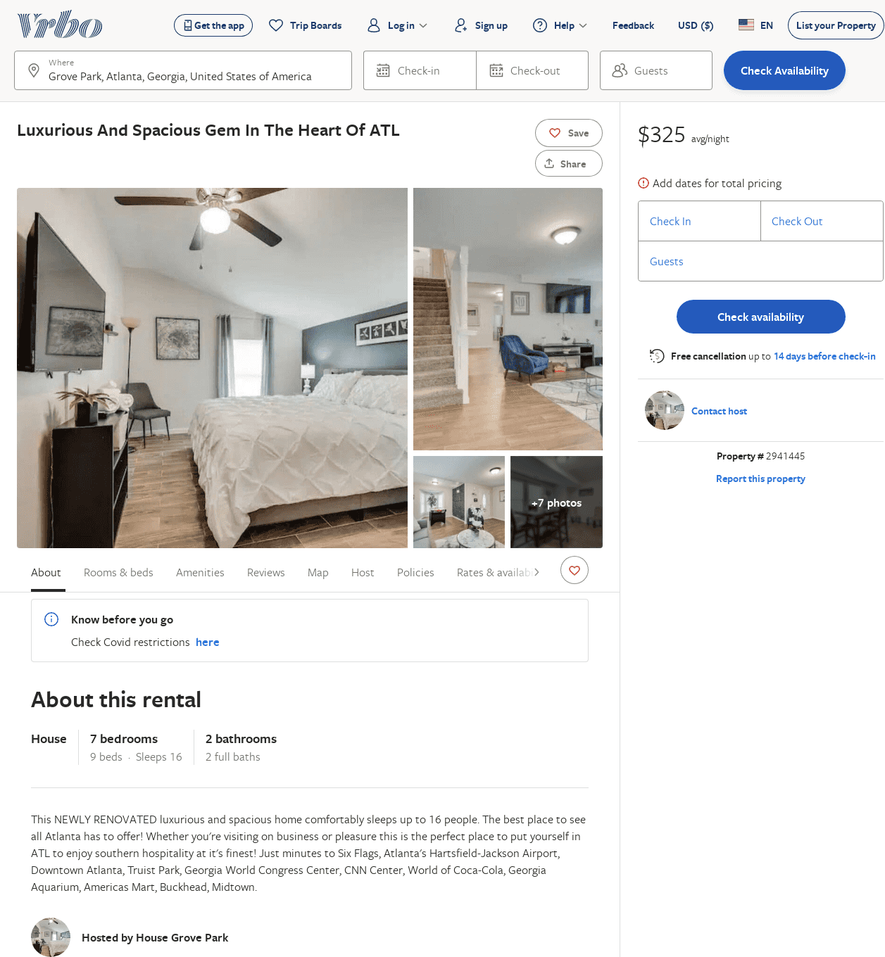
Listing 2941445
7
16
$325
2
https://www.vrbo.com/2941445
Aug 2022

Slide 45
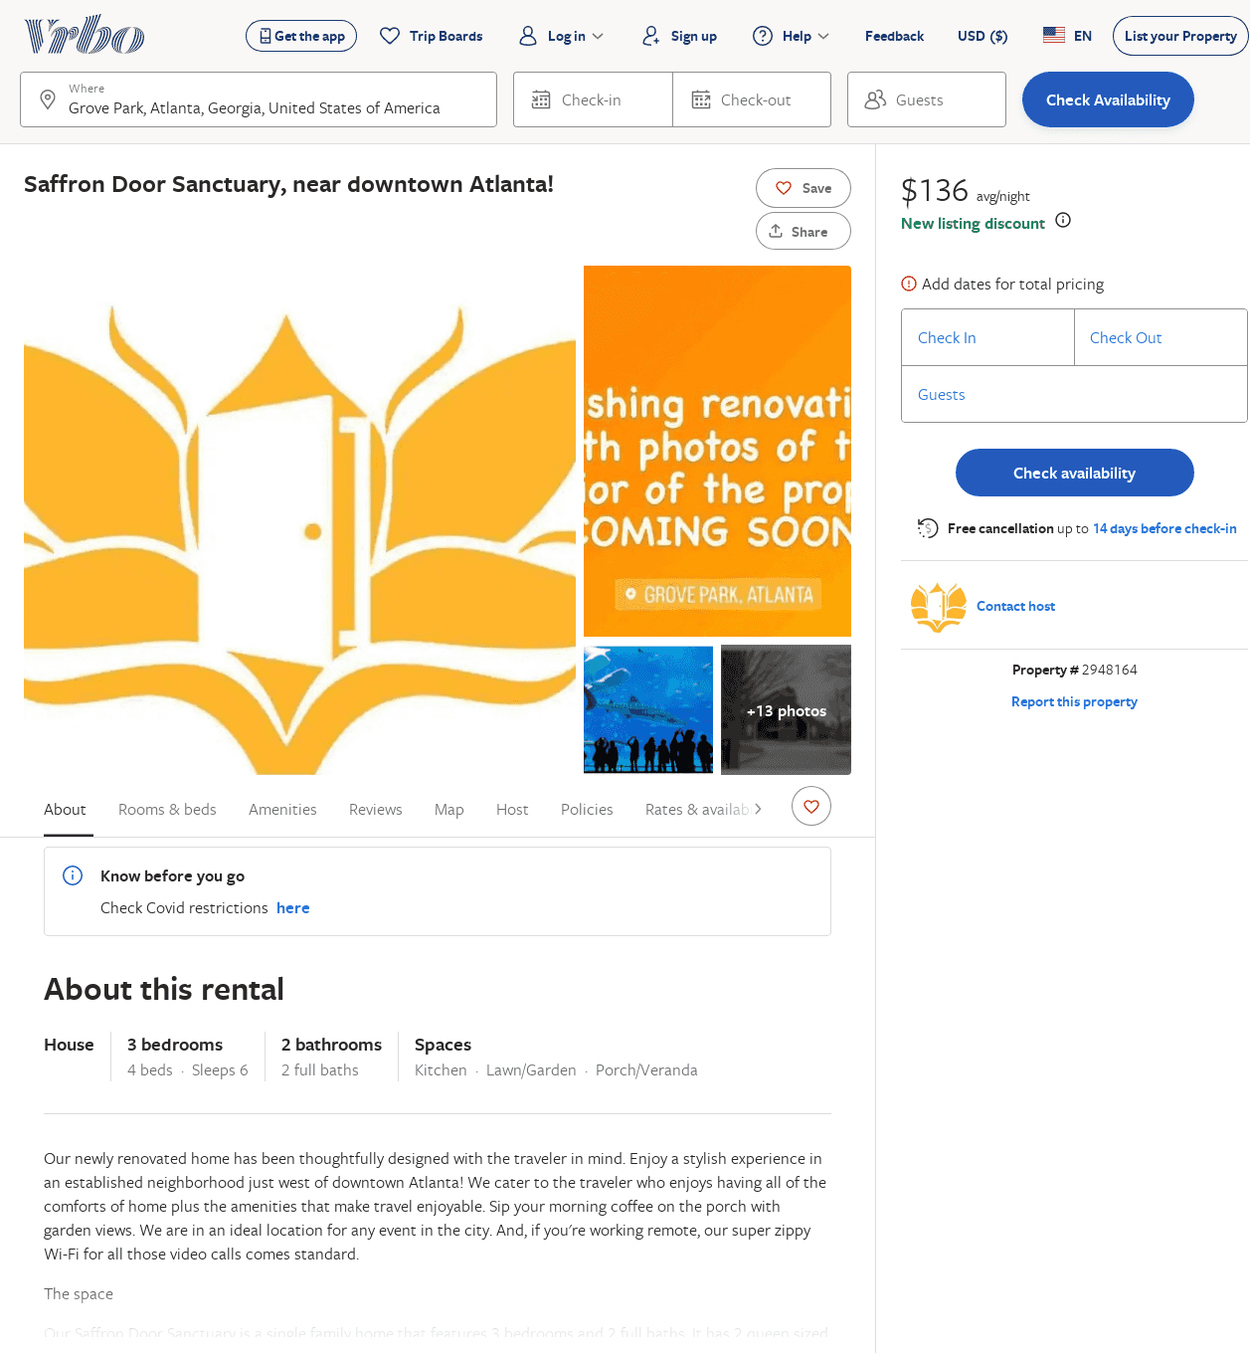
Listing 2948164
3
6
$136
2
https://www.vrbo.com/2948164
Aug 2022

