Slide 2
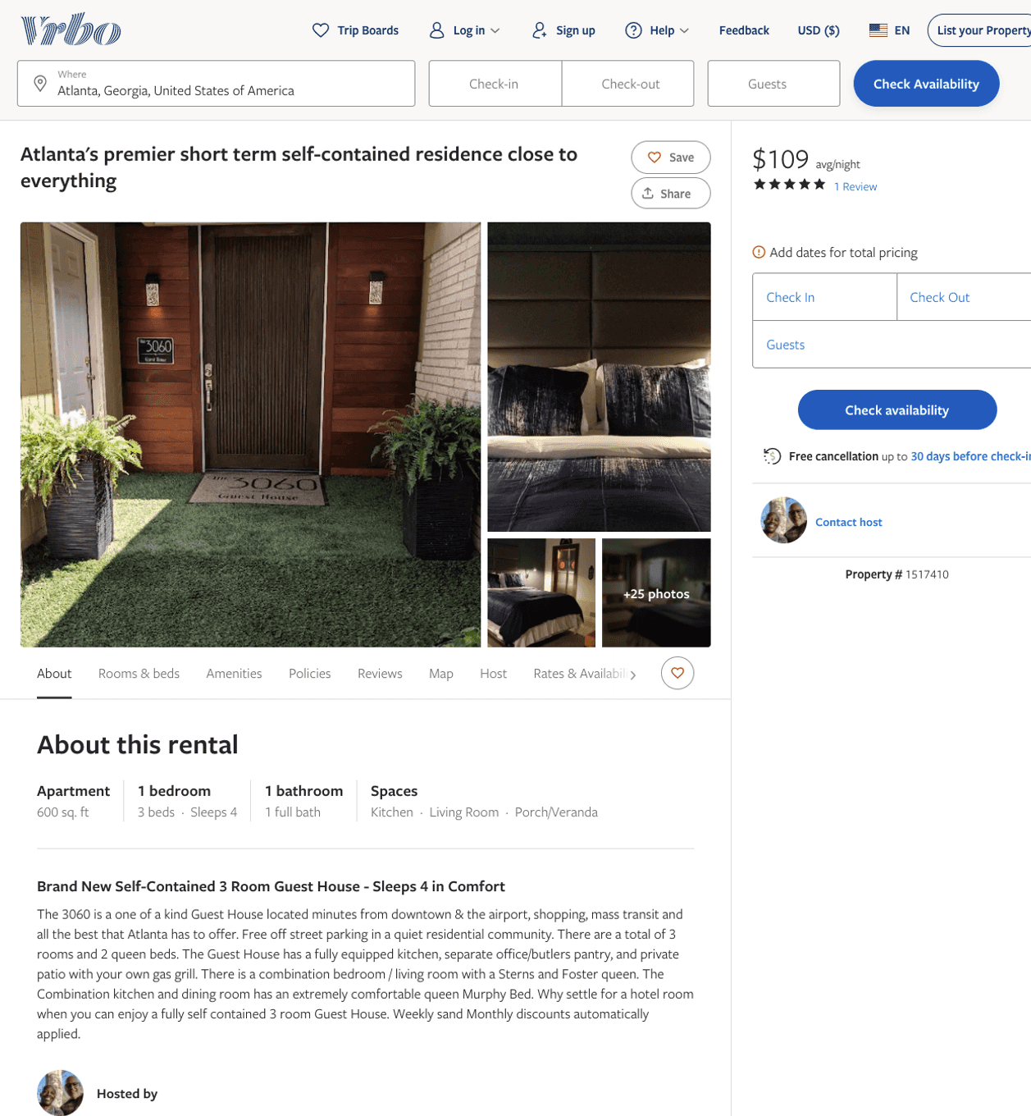
Listing 1517410
1
4
$109 - $92
5
2
https://www.vrbo.com/1517410
Aug 2022

Slide 3
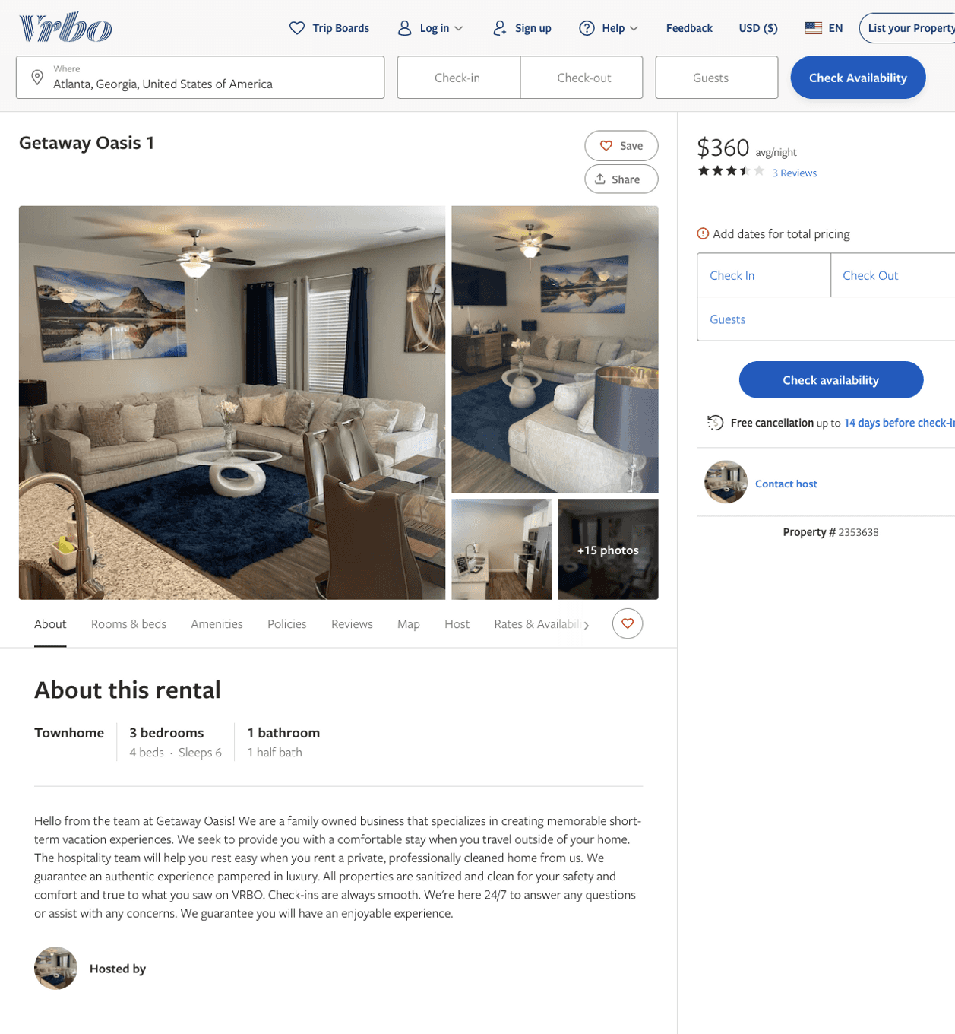
Listing 2353638
3
6
$225 - $360
3.6666667
2
Rudean Weir
https://www.vrbo.com/2353638
Aug 2022

Slide 4
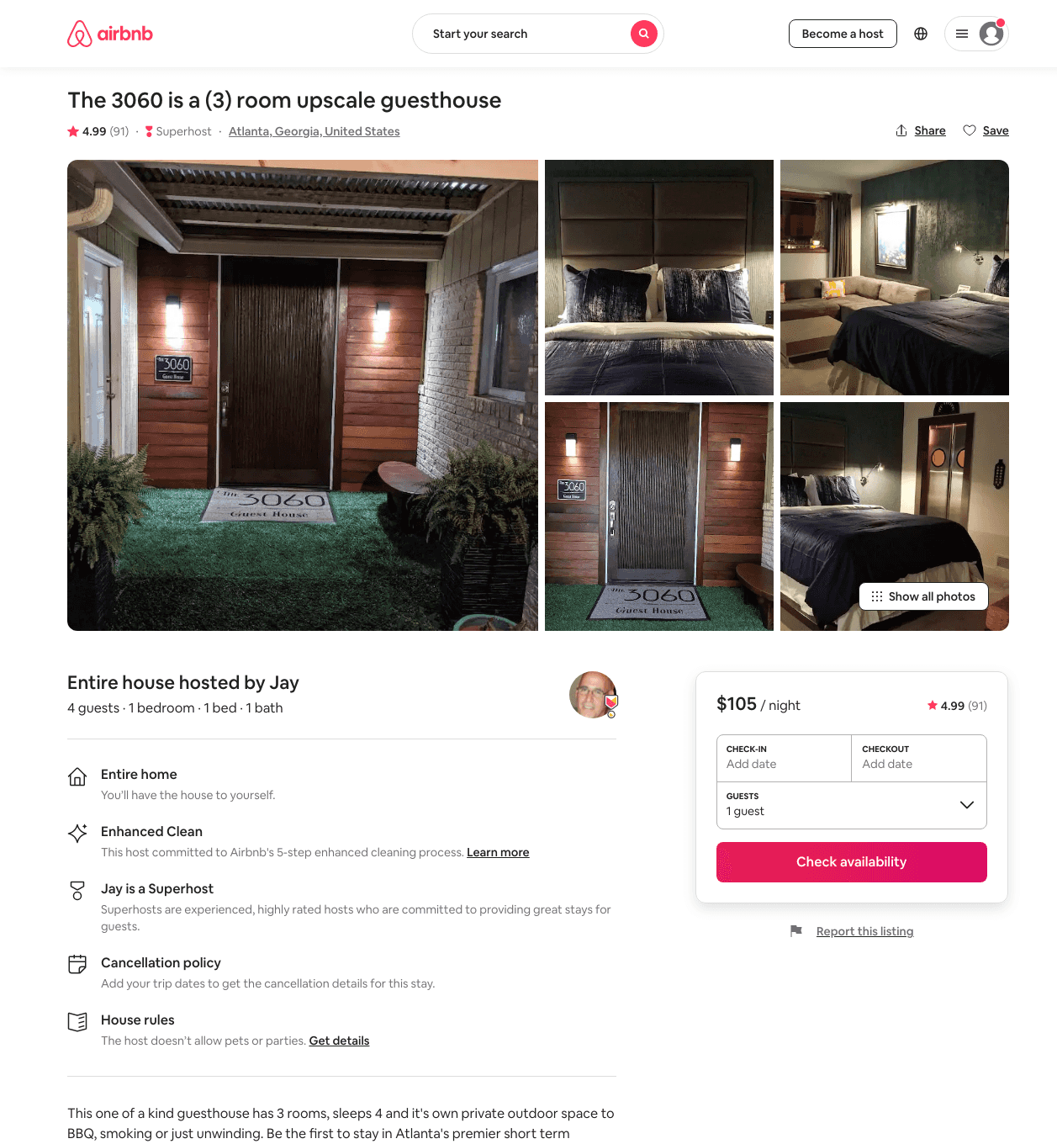
Listing 31848051
1
4
$97 - $146
4.99
1
Jay
26812241
1
https://www.airbnb.com/rooms/31848051
Aug 2022

Slide 5
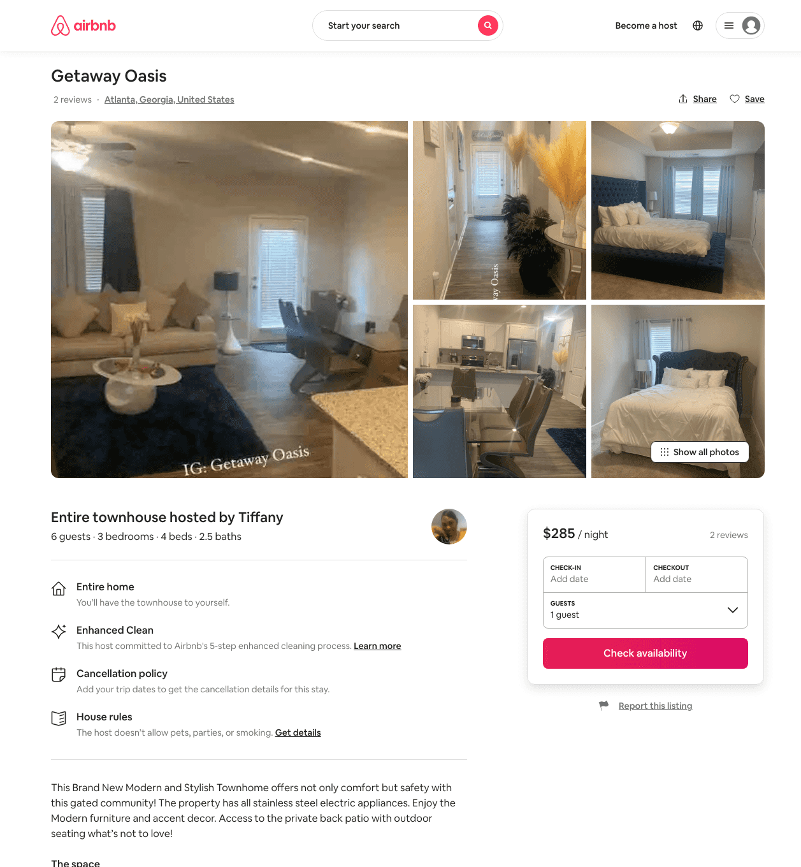
Listing 48622545
3
6
$201 - $305
5.0
2
Tiffany
392236267
1
https://www.airbnb.com/rooms/48622545
Aug 2022

Slide 6
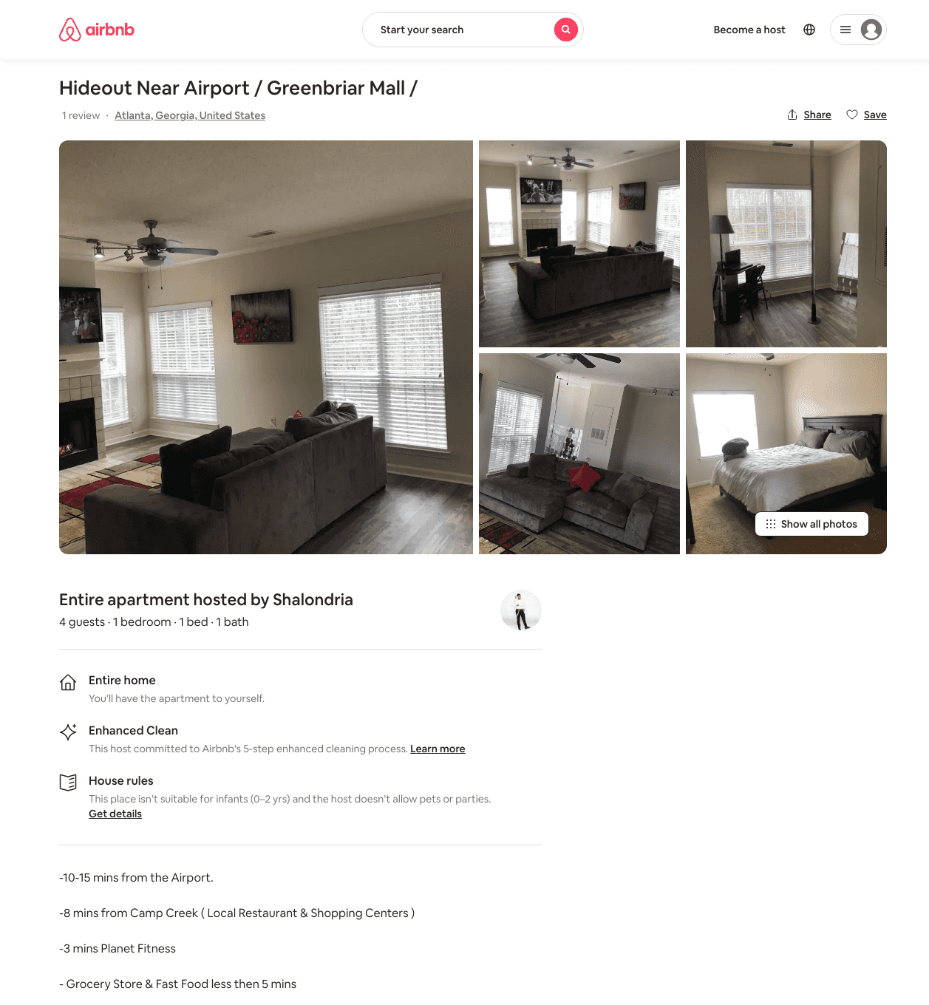
Listing 31803899
1
2
$500
1
Shalondria
80765080
1
https://www.airbnb.com/rooms/31803899
Aug 2022

Slide 7
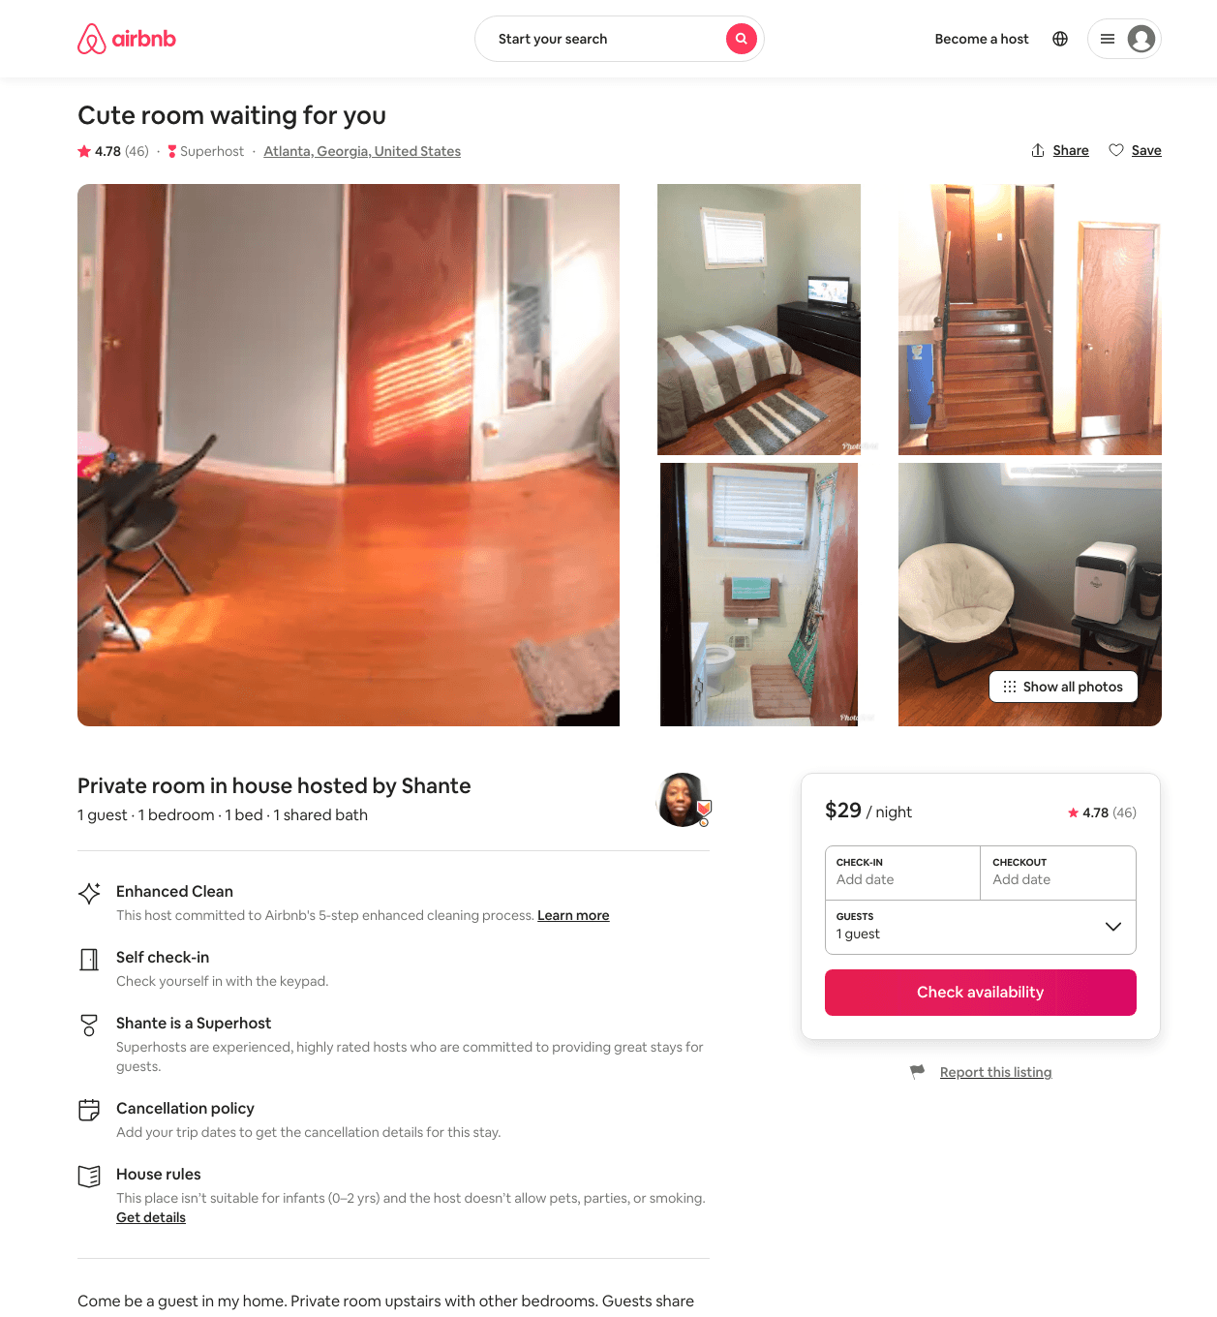
Listing 29881181
1
1
$29 - $37
4.83
2
Shante
75702615
4
https://www.airbnb.com/rooms/29881181
Aug 2022

Slide 8
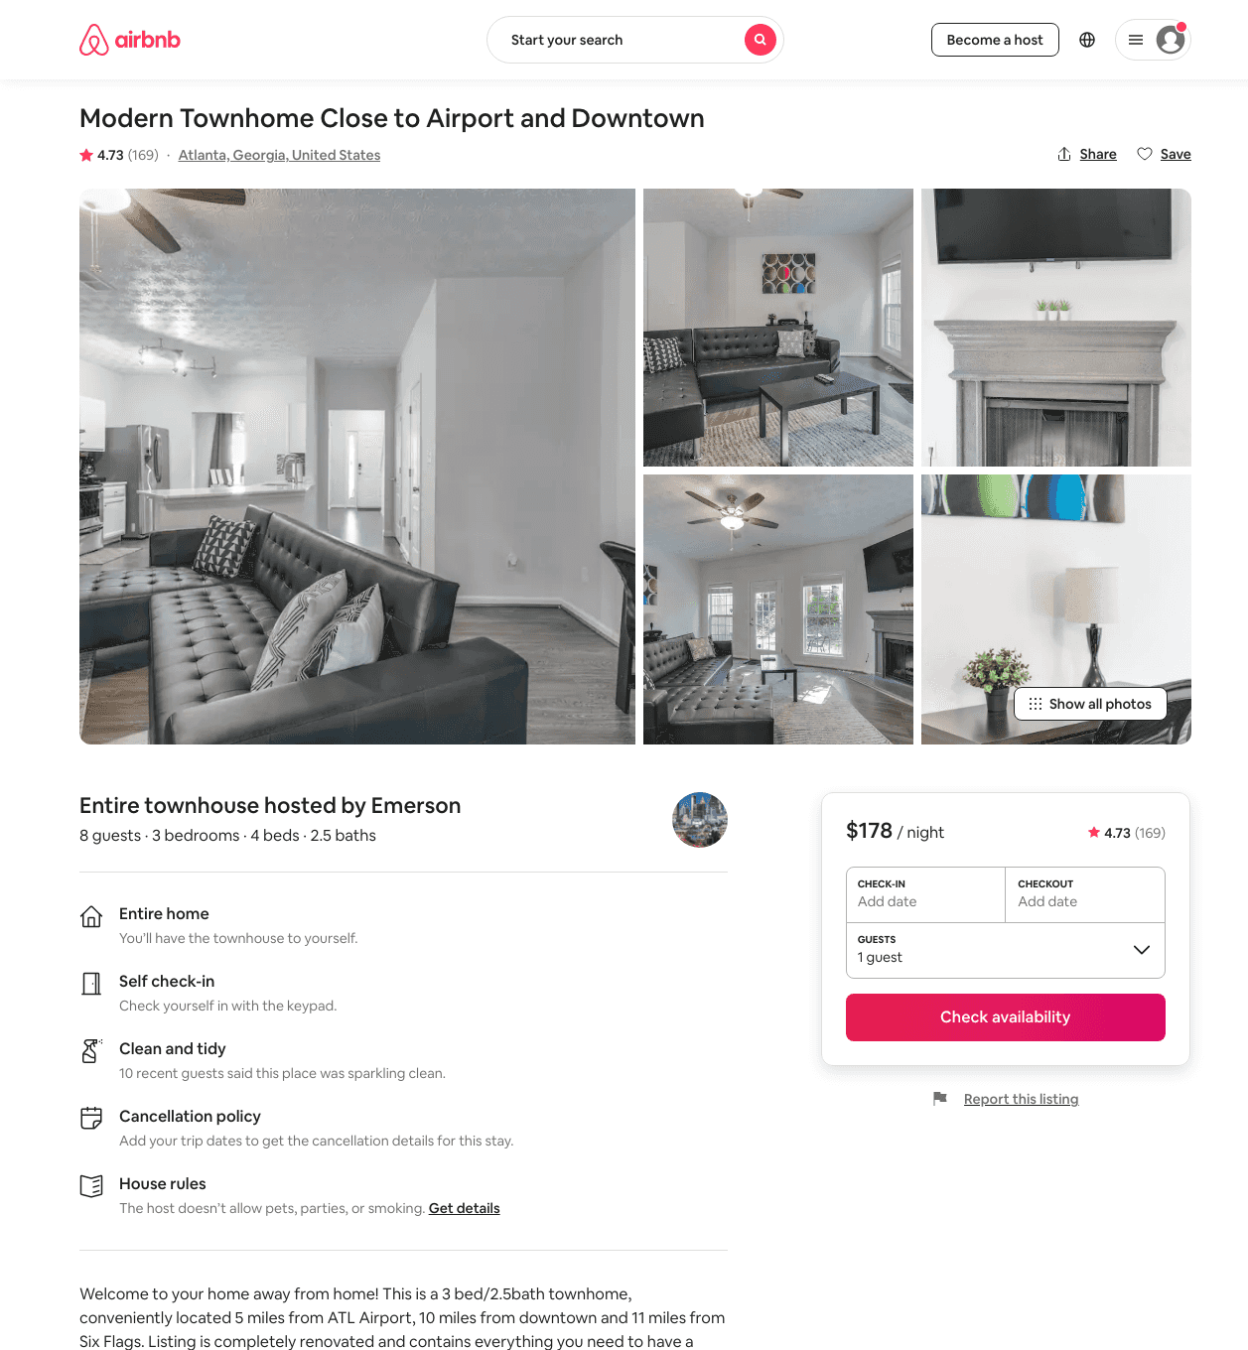
Listing 24288780
3
6
$116 - $266
4.63
2
Emerson
23706814
1
https://www.airbnb.com/rooms/24288780
Jun 2022

Slide 9
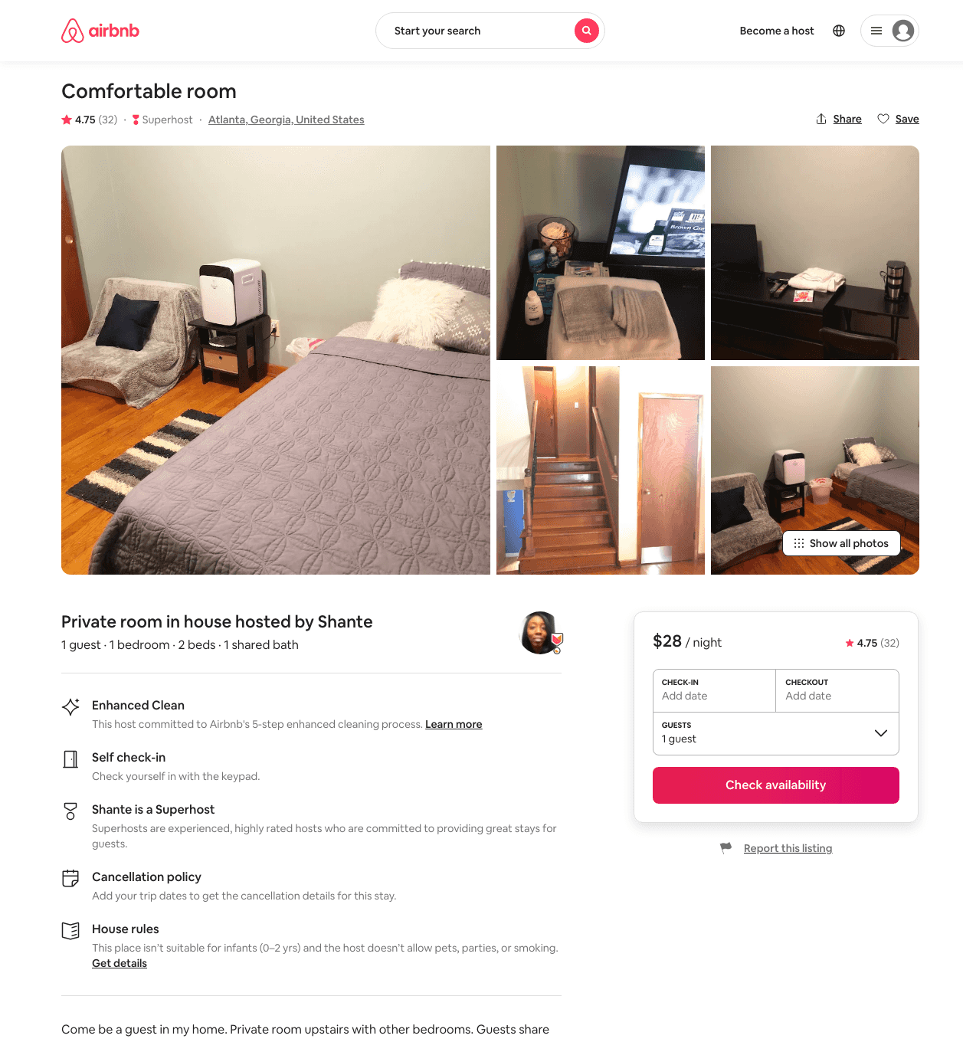
Listing 30761679
1
1
$28 - $41
4.75
3
Shante
75702615
4
https://www.airbnb.com/rooms/30761679
Aug 2022

Slide 10
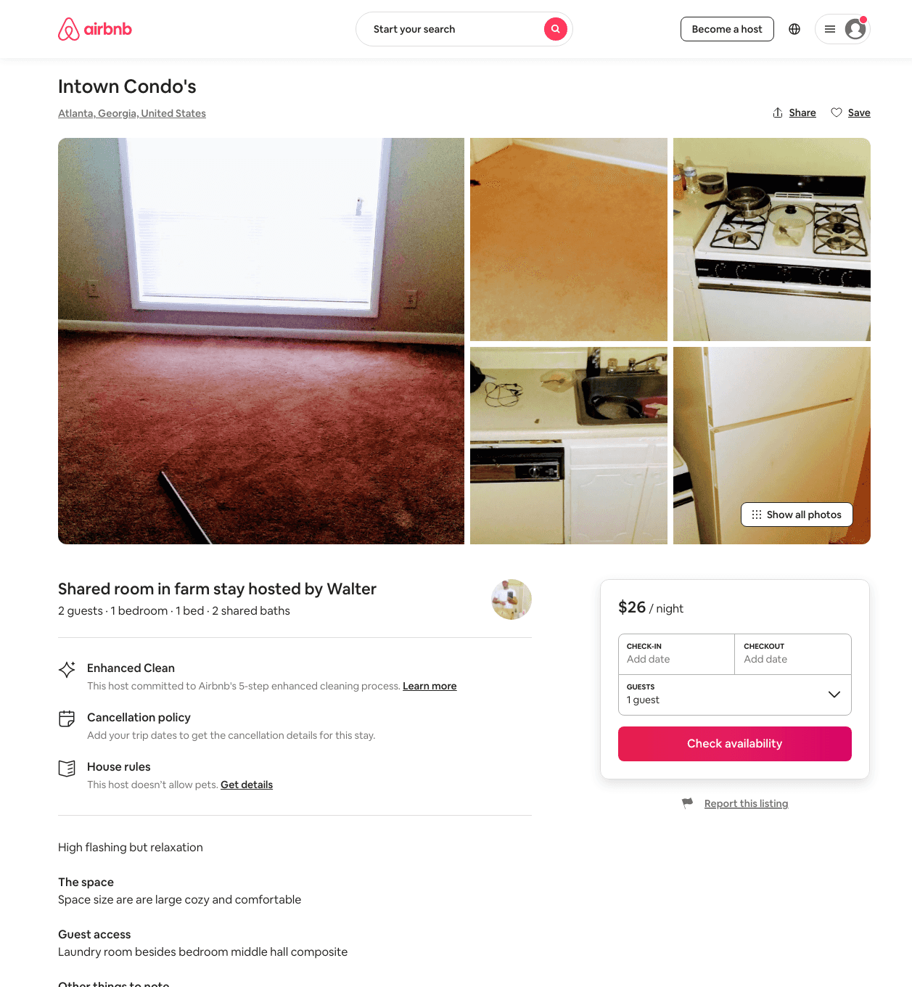
Listing 33019353
1
2
$26
7
Walter
173485427
1
https://www.airbnb.com/rooms/33019353
Aug 2022

Slide 11
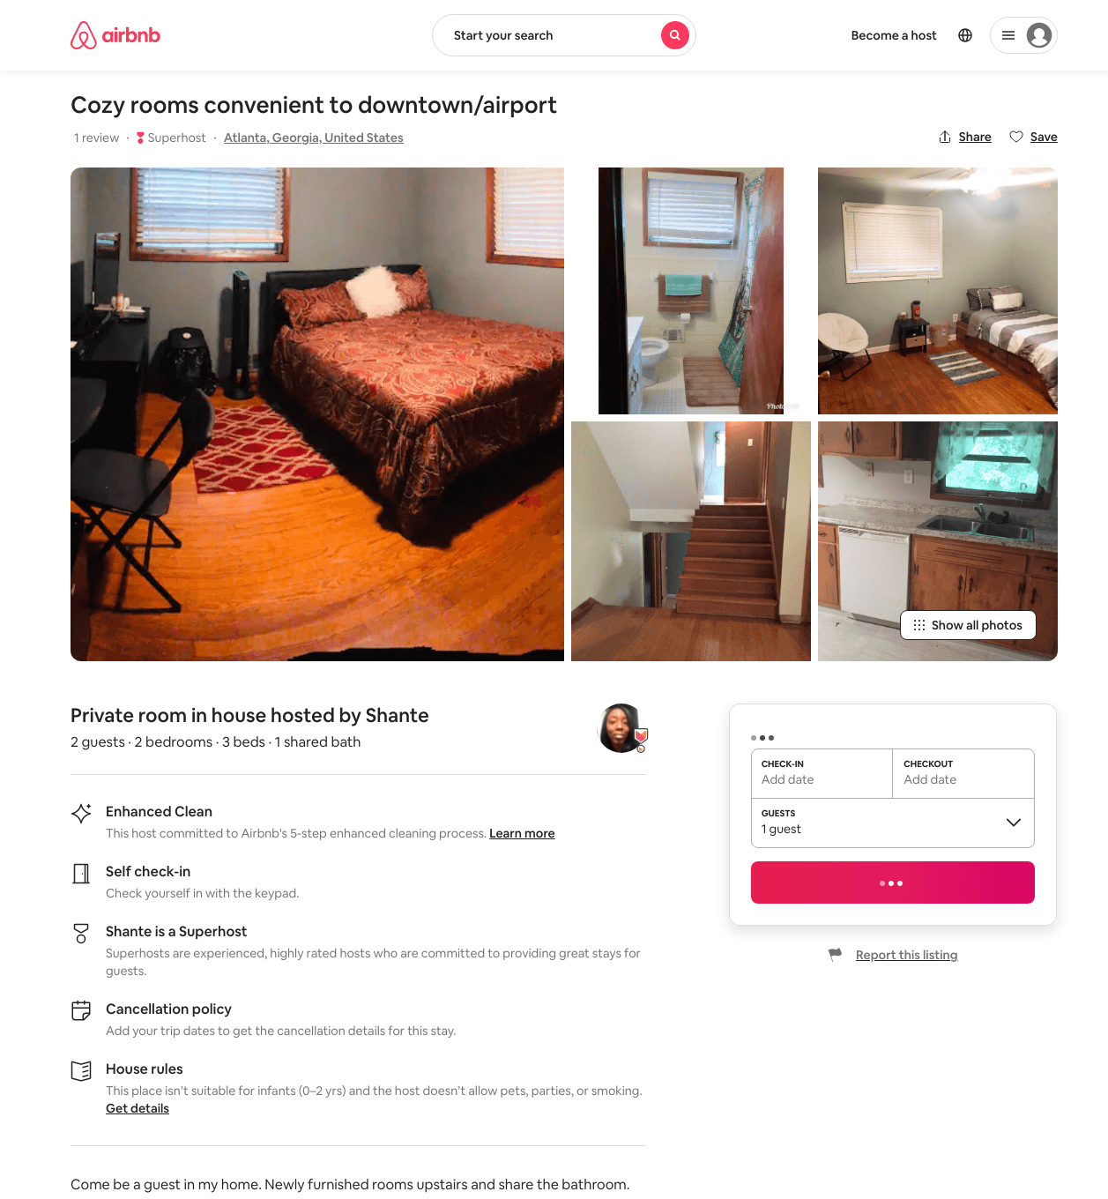
Listing 29583935
2
2
$50 - $79
3
Shante
75702615
4
https://www.airbnb.com/rooms/29583935
Aug 2022

Slide 12
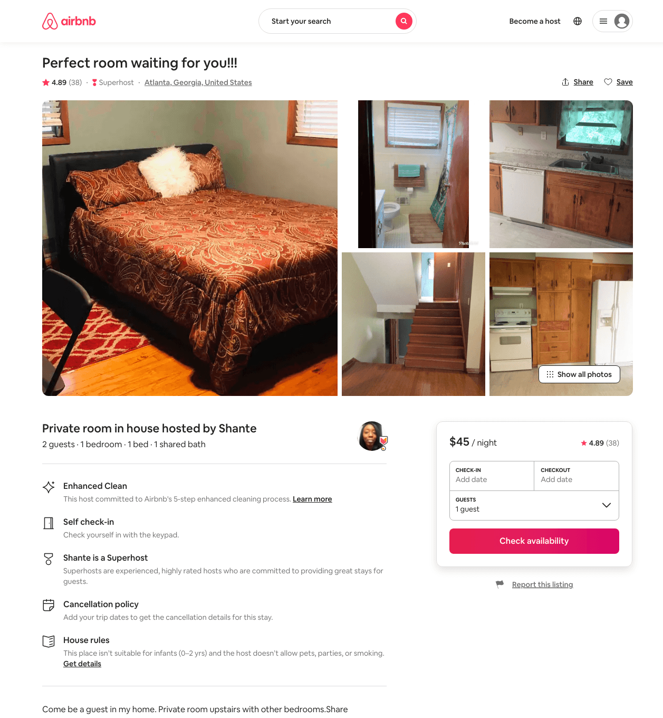
Listing 29889479
1
2
$32 - $45
4.91
2
Shante
75702615
4
https://www.airbnb.com/rooms/29889479
Aug 2022

Slide 13
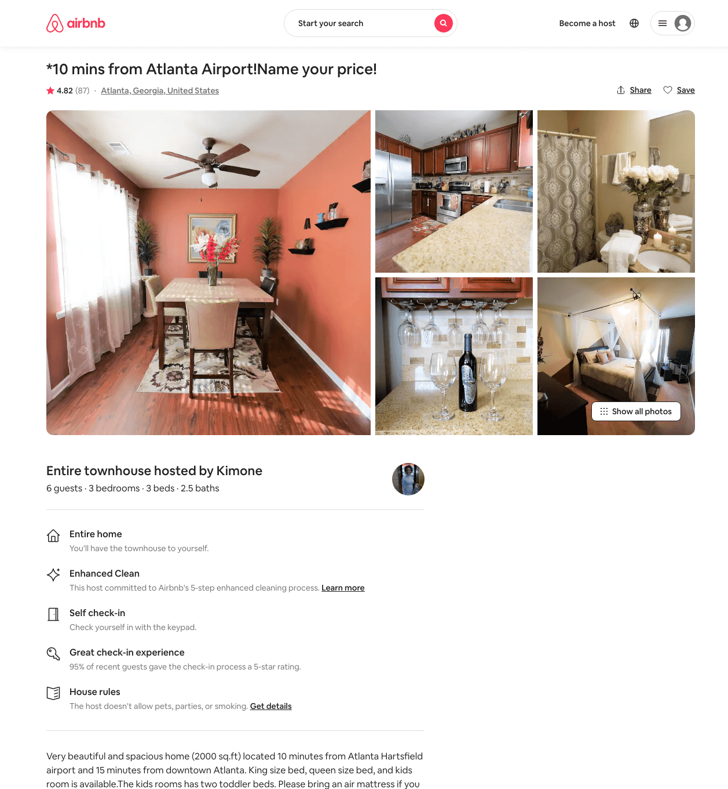
Listing 30091969
3
11
$138 - $310
4.83
1
Kimone
226109197
2
https://www.airbnb.com/rooms/30091969
Aug 2022

Slide 14
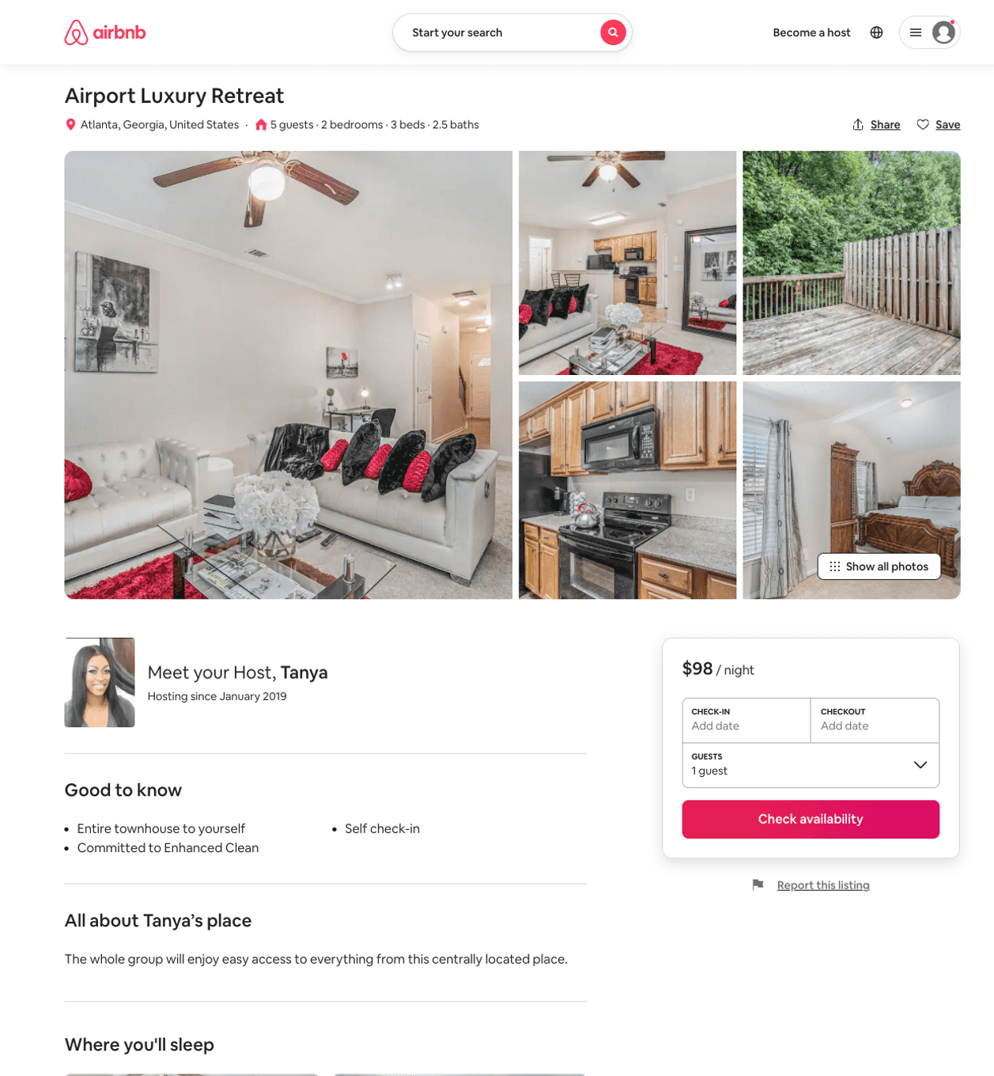
Listing 51752572
2
4
$98 - $140
4.47
2
Tanya
238481124
1
https://www.airbnb.com/rooms/51752572
Aug 2022

Slide 15
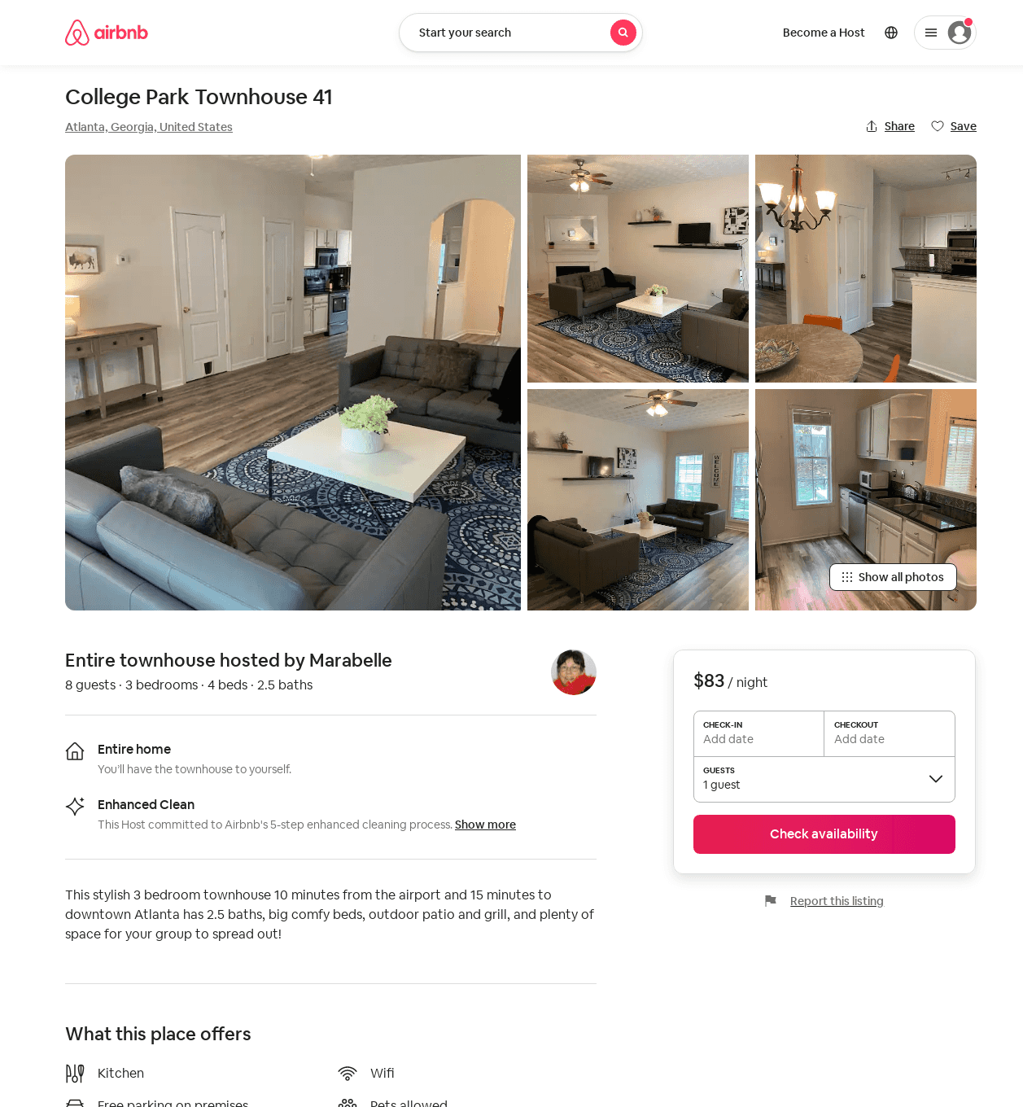
Listing 53122966
3
8
$83 - $135
4.30
1
Marabelle
82392155
6
https://www.airbnb.com/rooms/53122966
Aug 2022

Slide 16
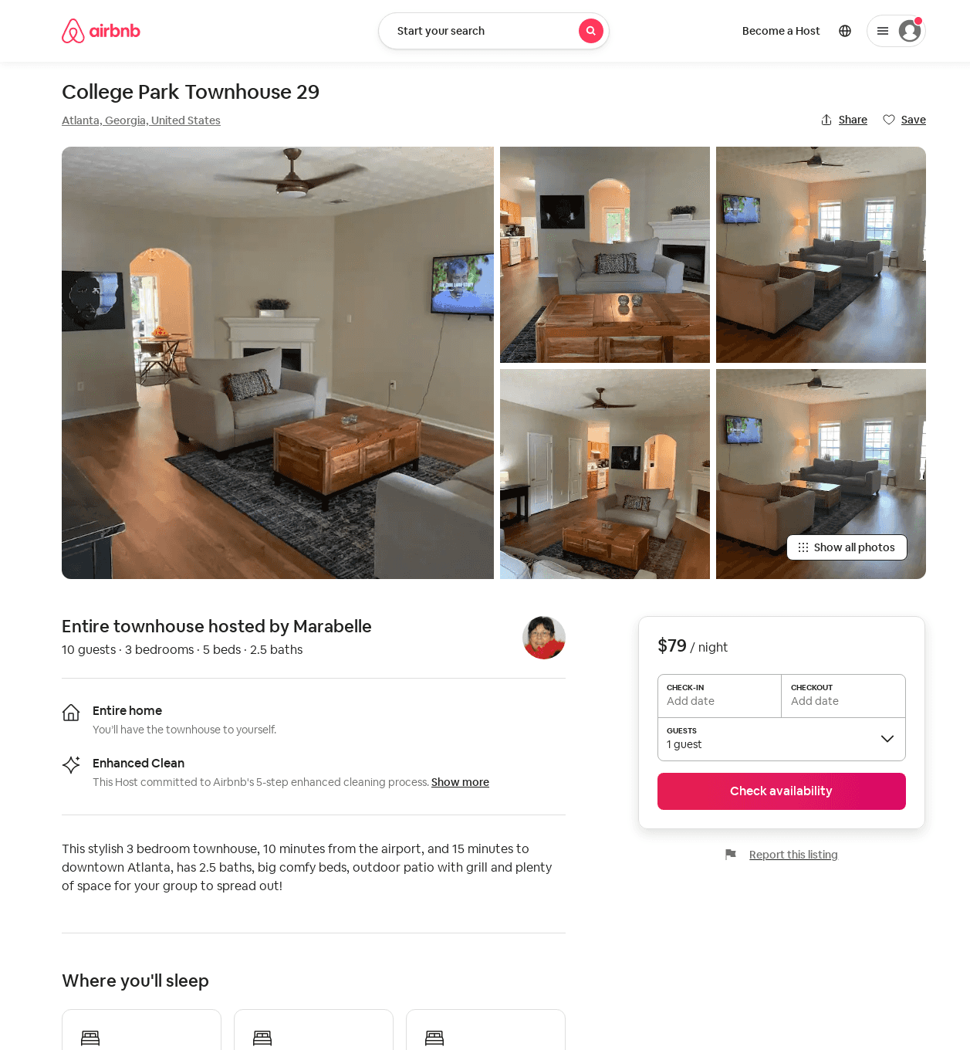
Listing 53120743
3
8
$79 - $133
4.07
1
Marabelle
82392155
6
https://www.airbnb.com/rooms/53120743
Jun 2022

Slide 17
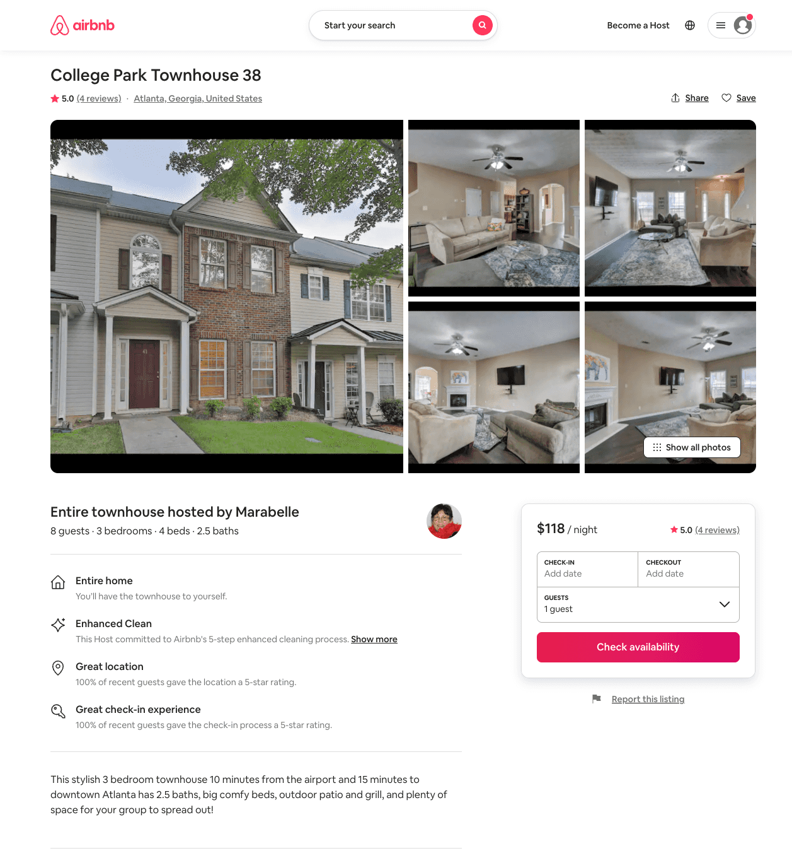
Listing 53145746
3
8
$86 - $152
4.57
1
Marabelle
82392155
6
https://www.airbnb.com/rooms/53145746
Aug 2022

Slide 18
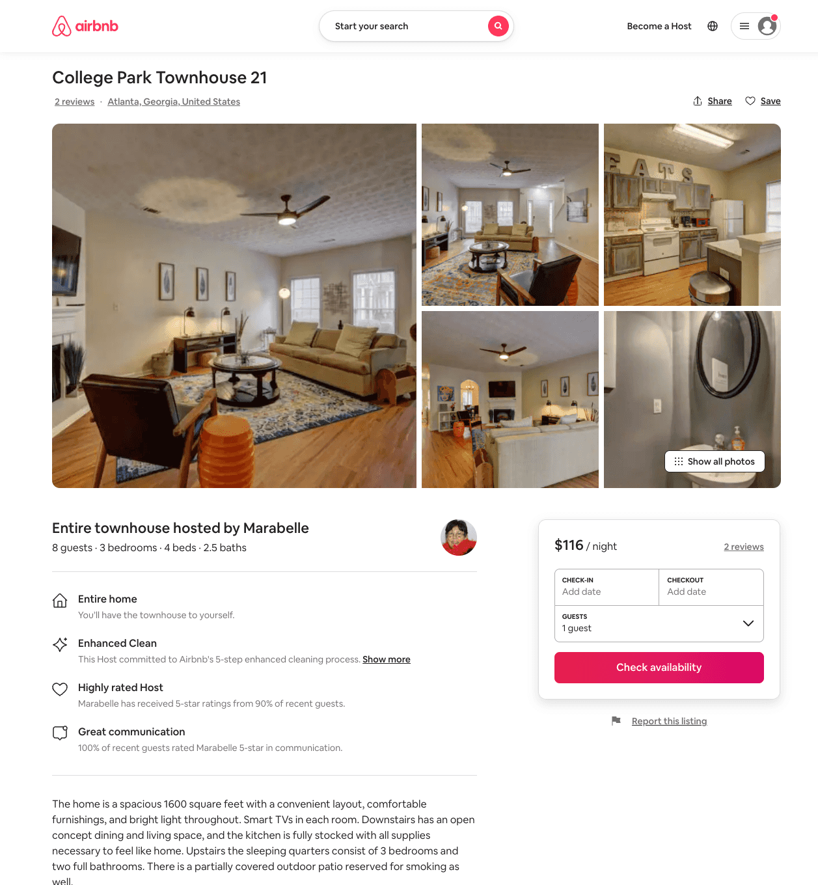
Listing 53214349
3
8
$75 - $137
4.53
1
Marabelle
82392155
6
https://www.airbnb.com/rooms/53214349
Aug 2022

Slide 19
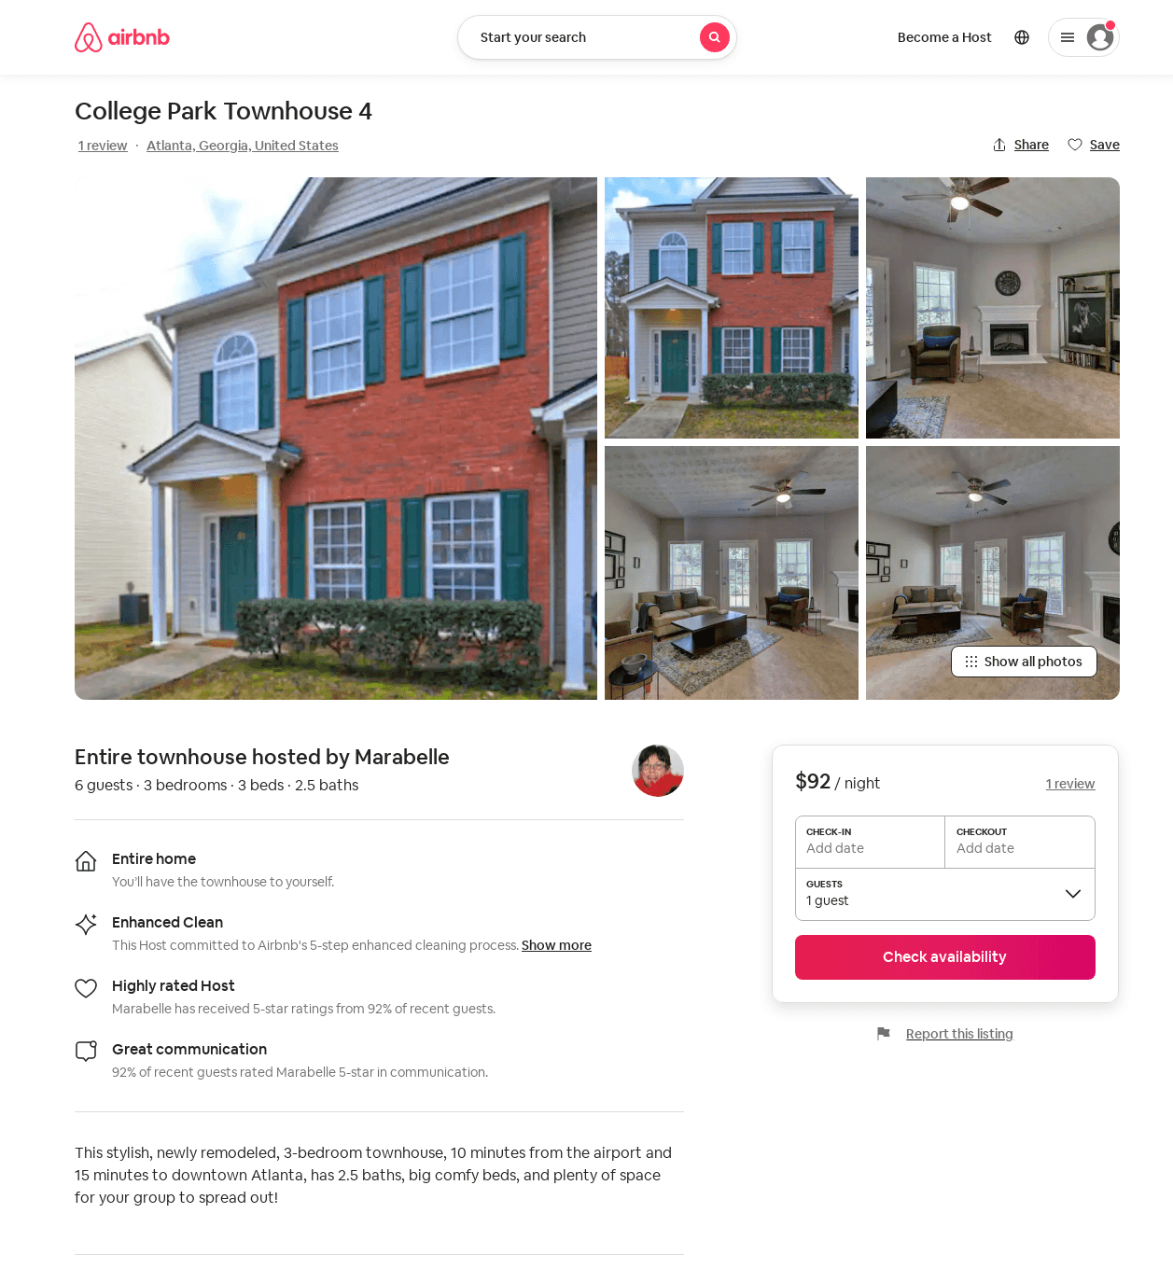
Listing 53187911
3
6
$85 - $140
4.31
1
Marabelle
82392155
6
https://www.airbnb.com/rooms/53187911
Aug 2022

Slide 20
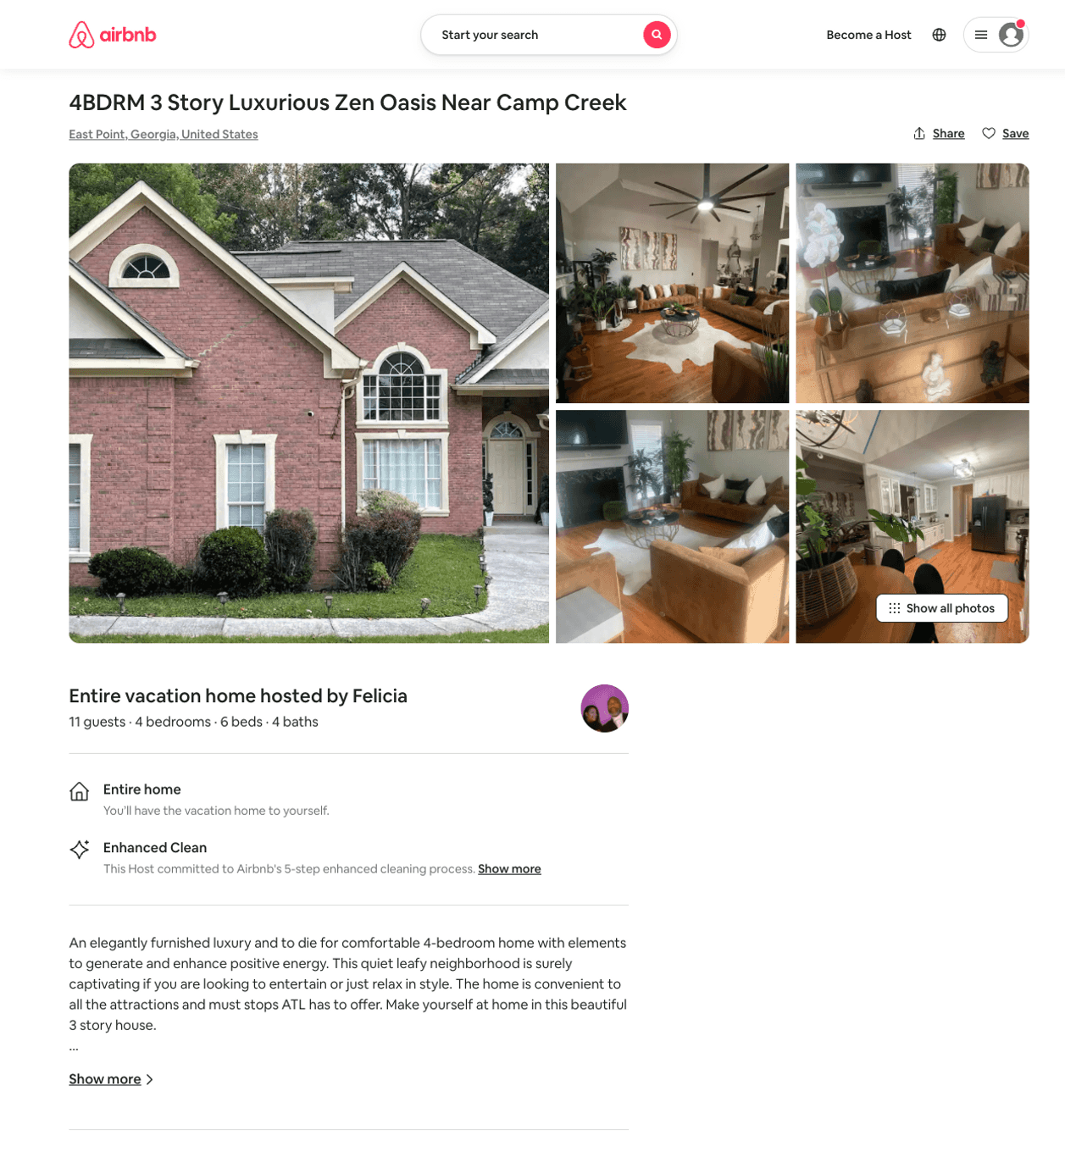
Listing 24262765
4
11
$400 - $571
2
Felicia
182955301
1
https://www.airbnb.com/rooms/24262765
Aug 2022

Slide 21
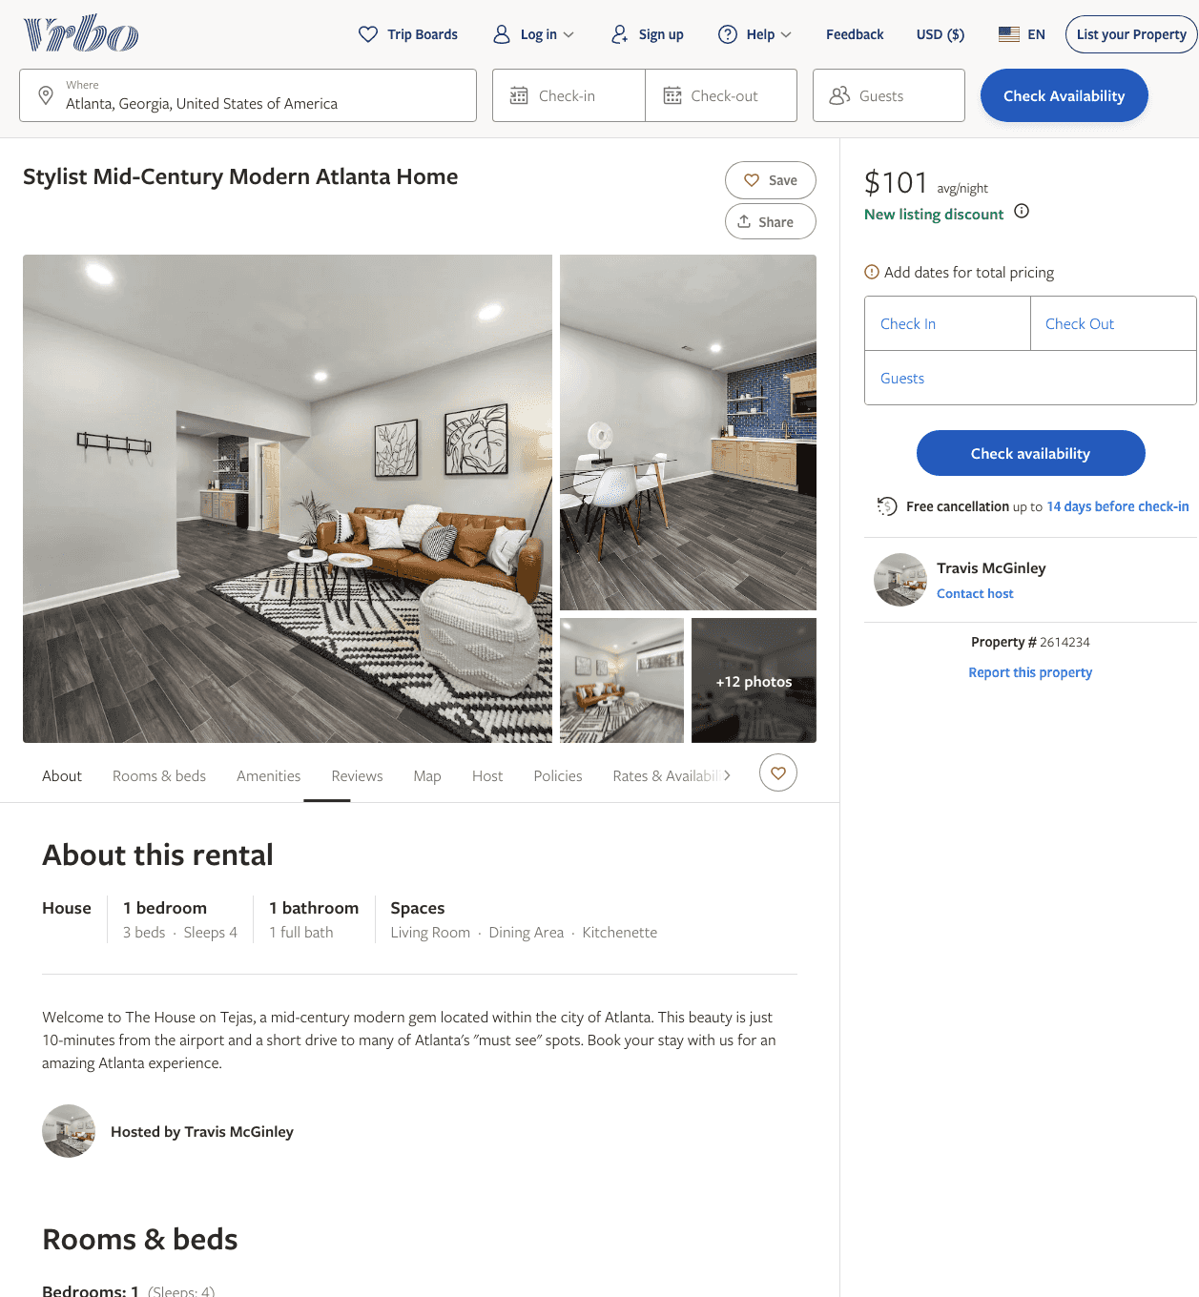
Listing 2614234
1
4
$101 - $102
5
3
Travis McGinley
https://www.vrbo.com/2614234
Aug 2022

Slide 22
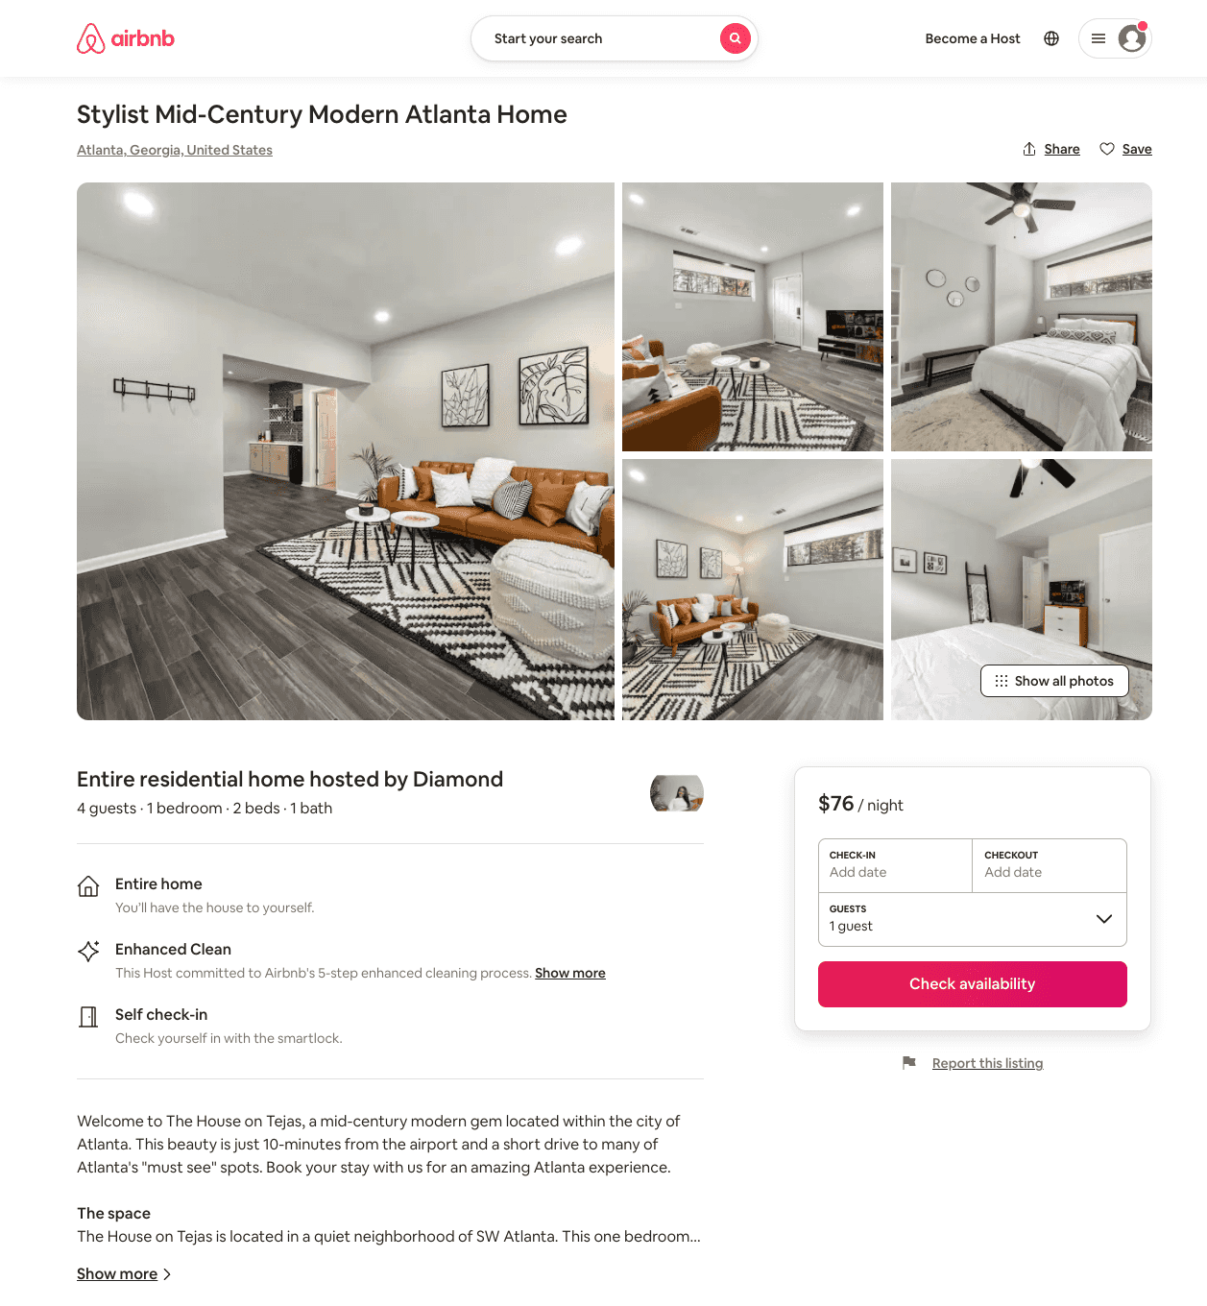
Listing 54198179
1
4
$75 - $98
4.55
2
Diamond
195508061
1
https://www.airbnb.com/rooms/54198179
Jun 2022

Slide 23
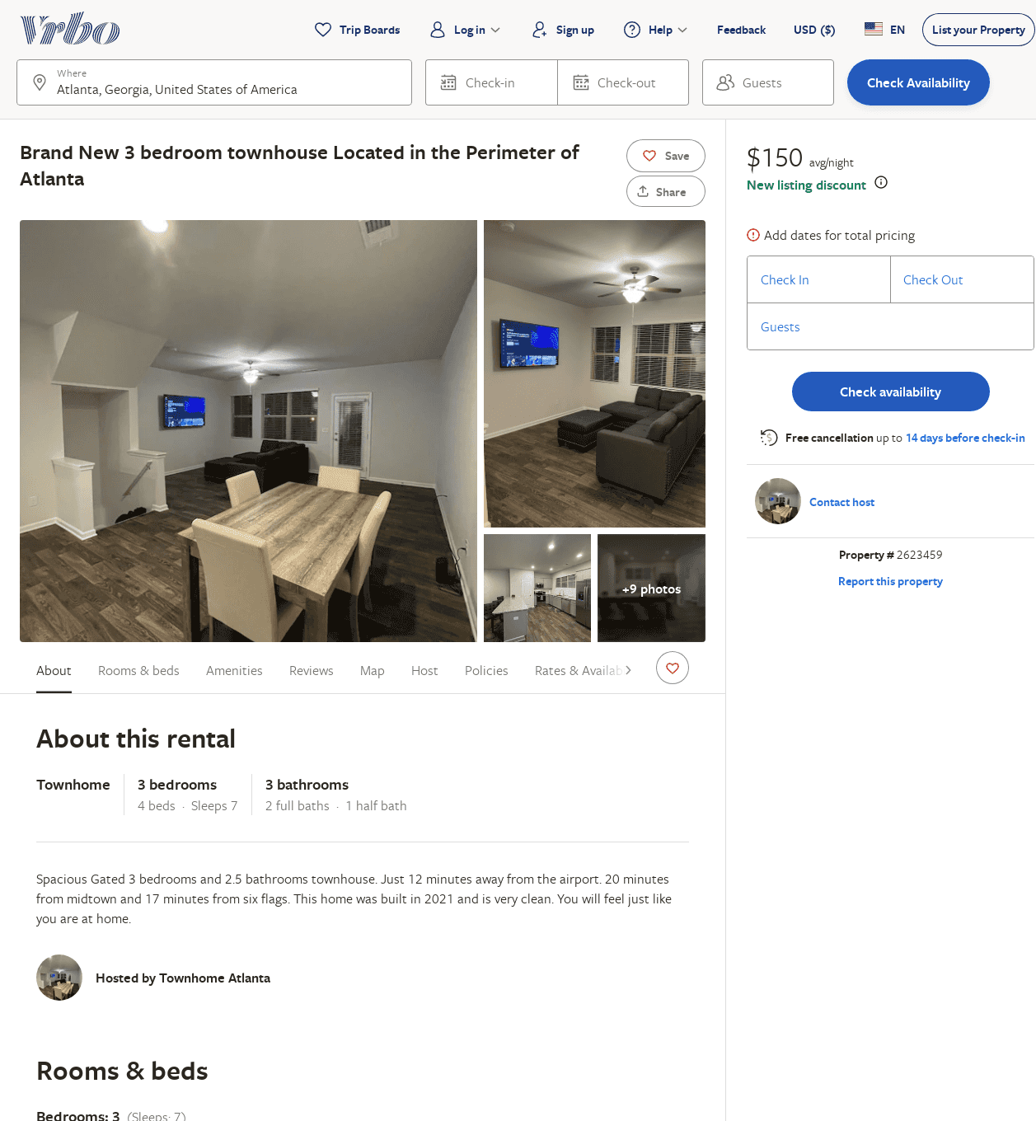
Listing 2623459
3
7
$200
5
3
https://www.vrbo.com/2623459
Aug 2022

Slide 24
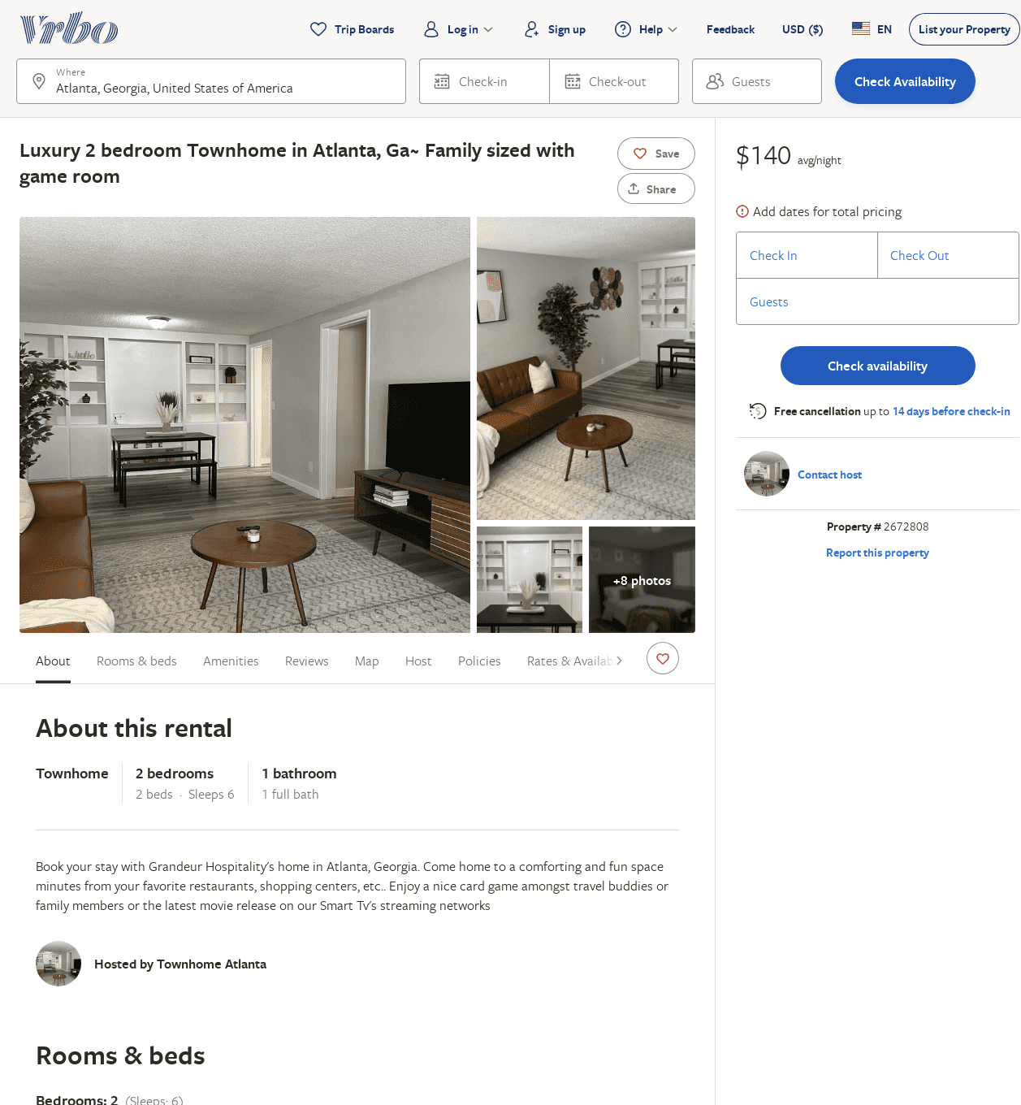
Listing 2672808
2
6
$140
2
https://www.vrbo.com/2672808
Aug 2022

Slide 25
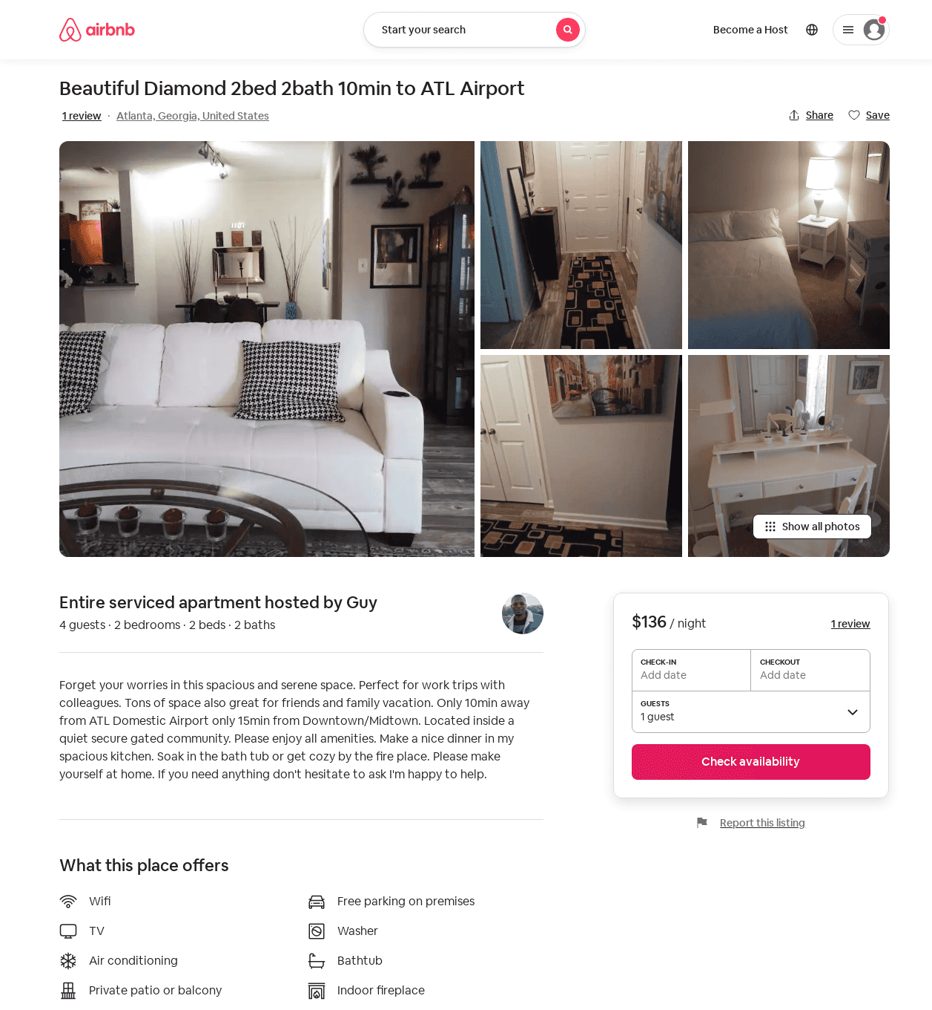
Listing 50574778
2
4
$136
1
Guy
385869897
1
https://www.airbnb.com/rooms/50574778
Aug 2022

Slide 26
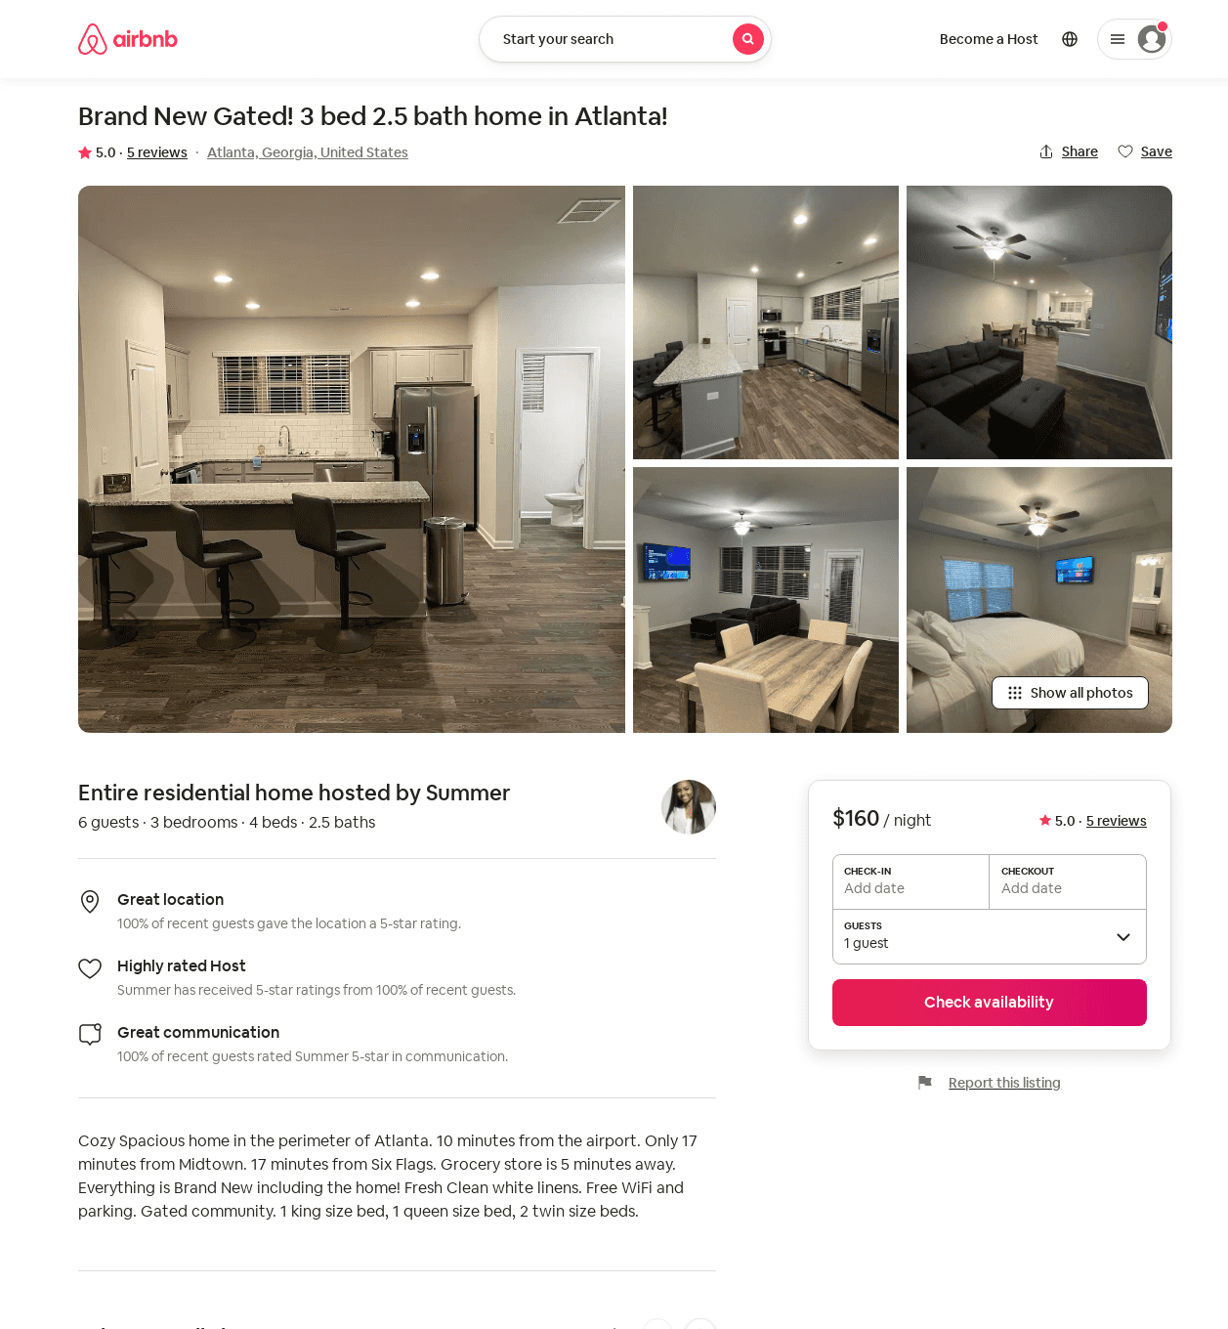
Listing 53978721
3
6
$160 - $200
5.0
3
Summer
357884163
1
https://www.airbnb.com/rooms/53978721
Aug 2022

Slide 27
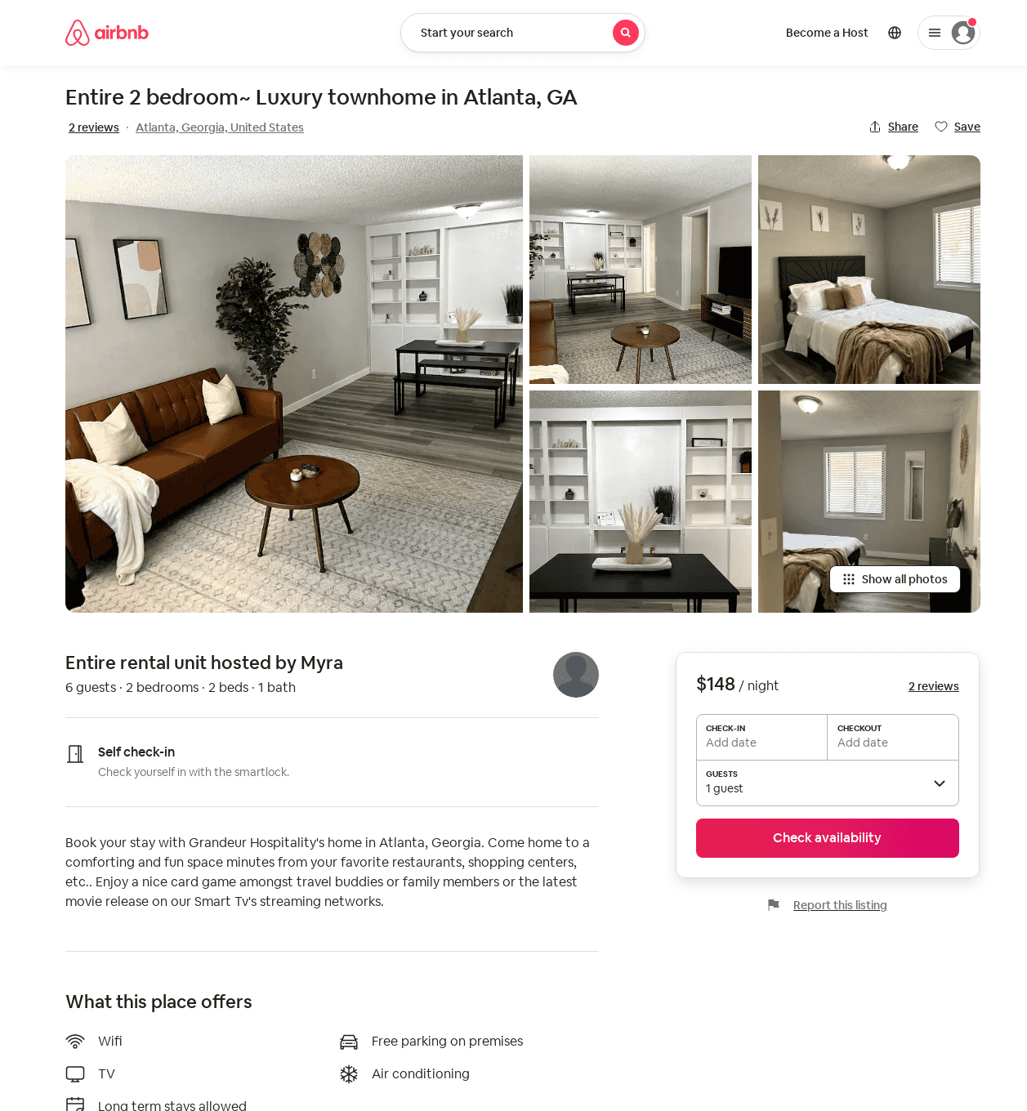
Listing 54240818
2
6
$148
2
Myra
439399738
1
https://www.airbnb.com/rooms/54240818
Jun 2022

Slide 28
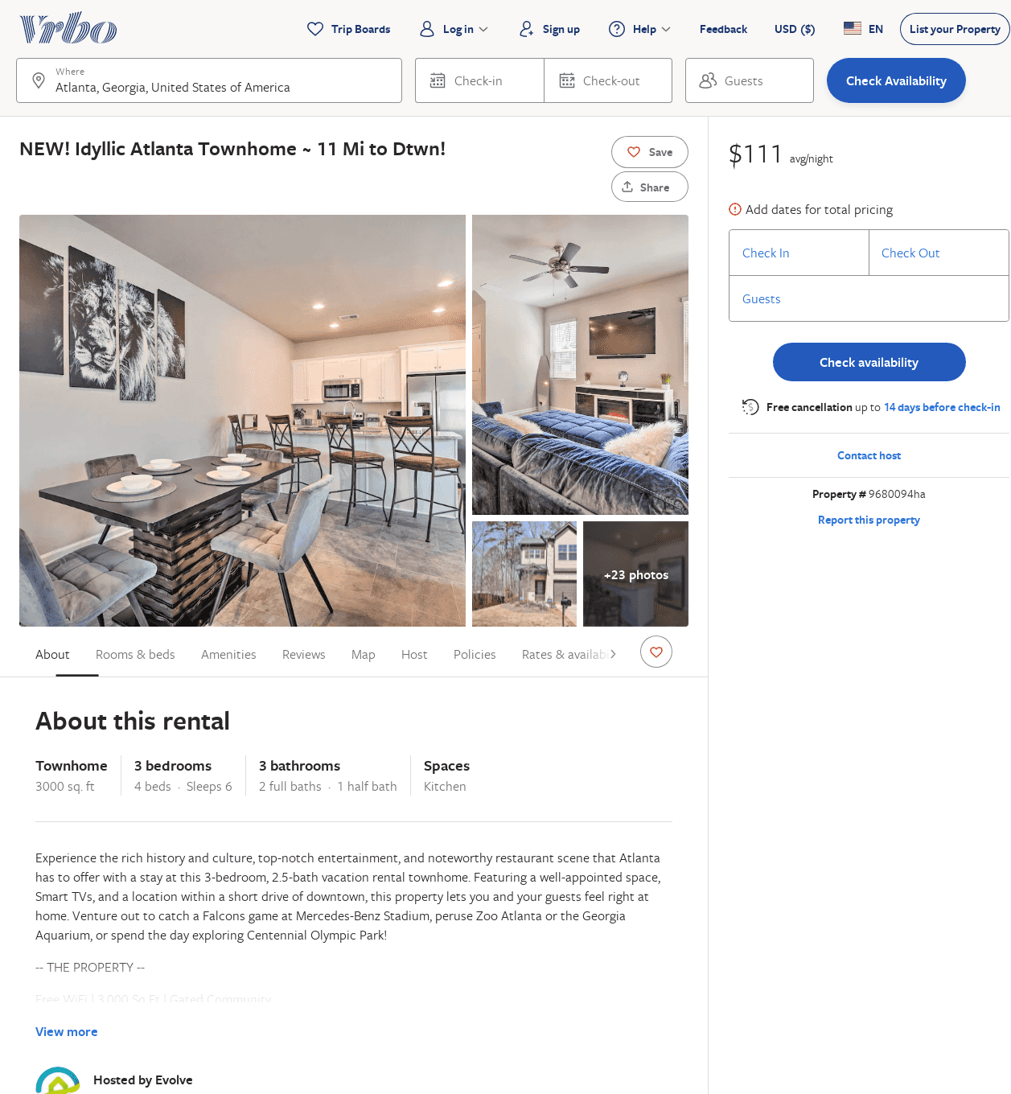
Listing 9680094
3
6
$133
3
Evolve
https://www.vrbo.com/9680094ha
Aug 2022

Slide 29
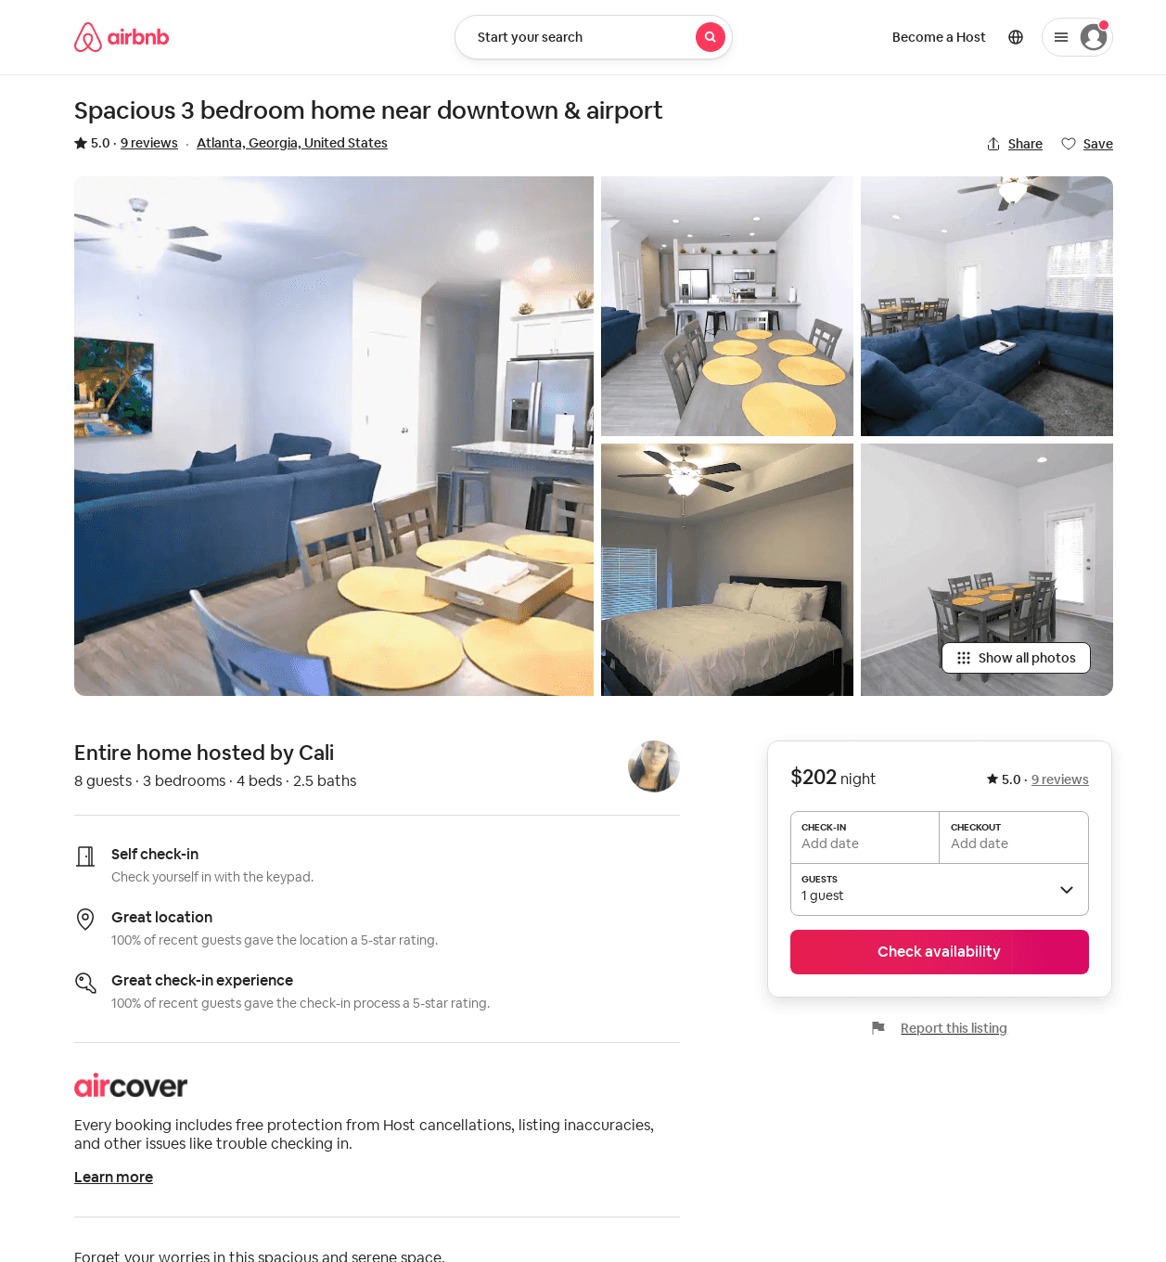
Listing 39221392
3
8
$202
5.0
2
Cali
138841176
1
https://www.airbnb.com/rooms/39221392
Aug 2022

Slide 30
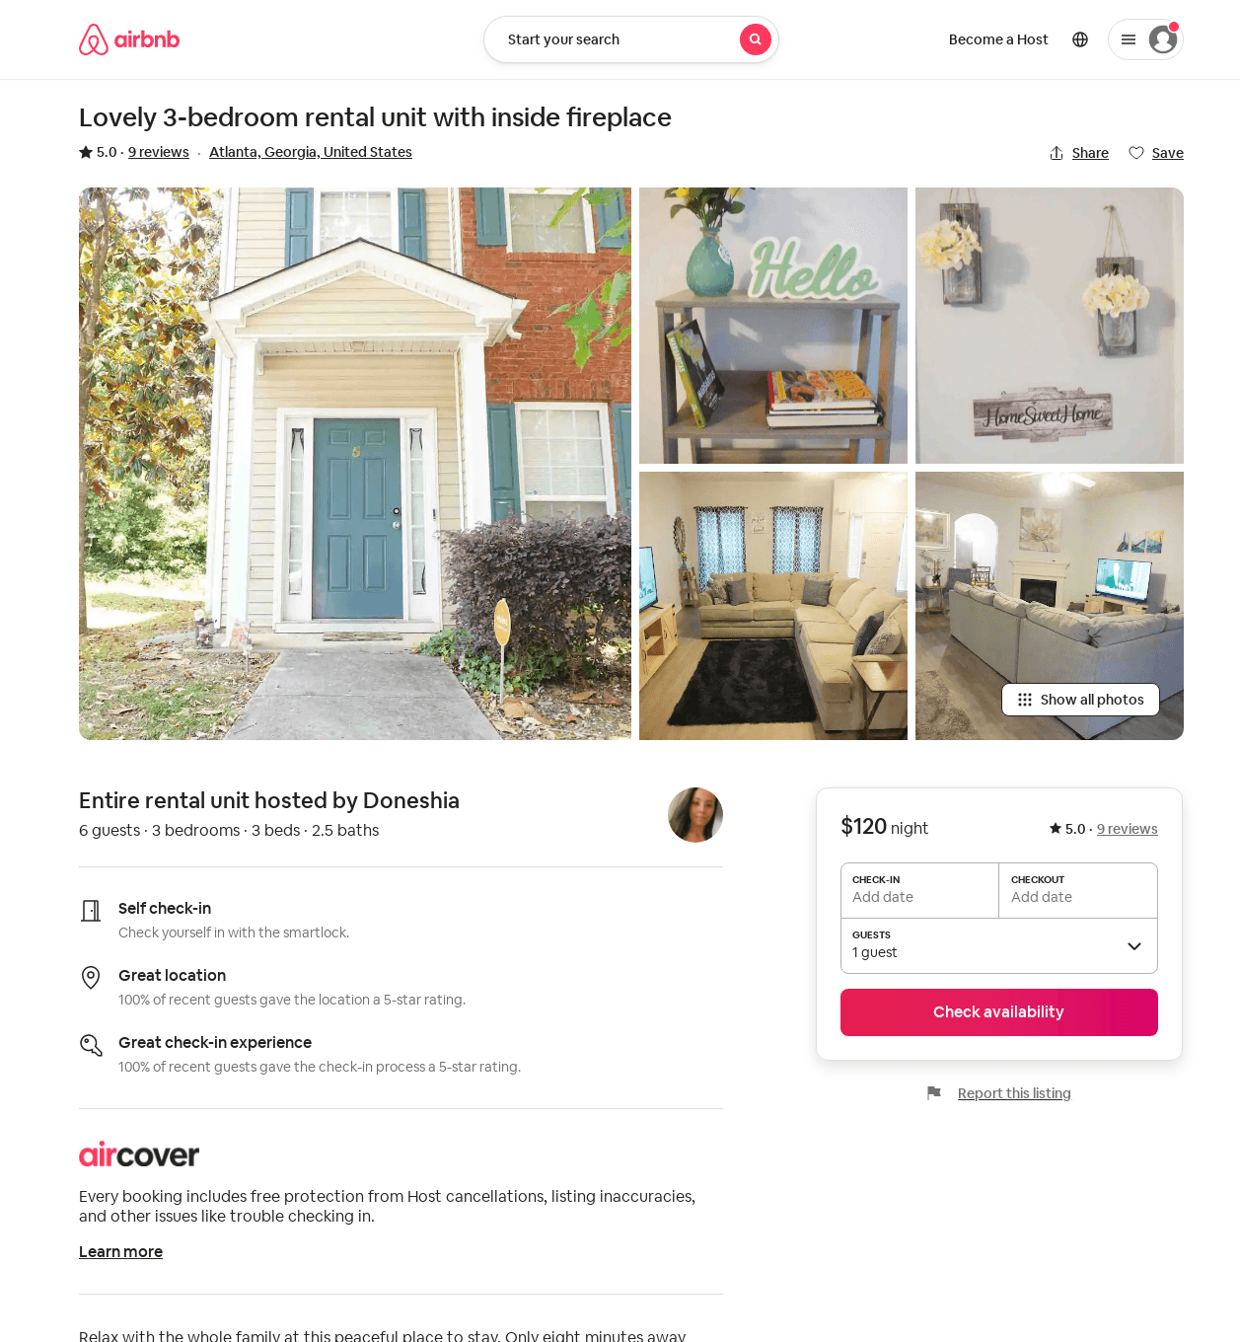
Listing 51267421
3
6
5.0
2
Doneshia
350753028
1
https://www.airbnb.com/rooms/51267421
Aug 2022

