Slide 2
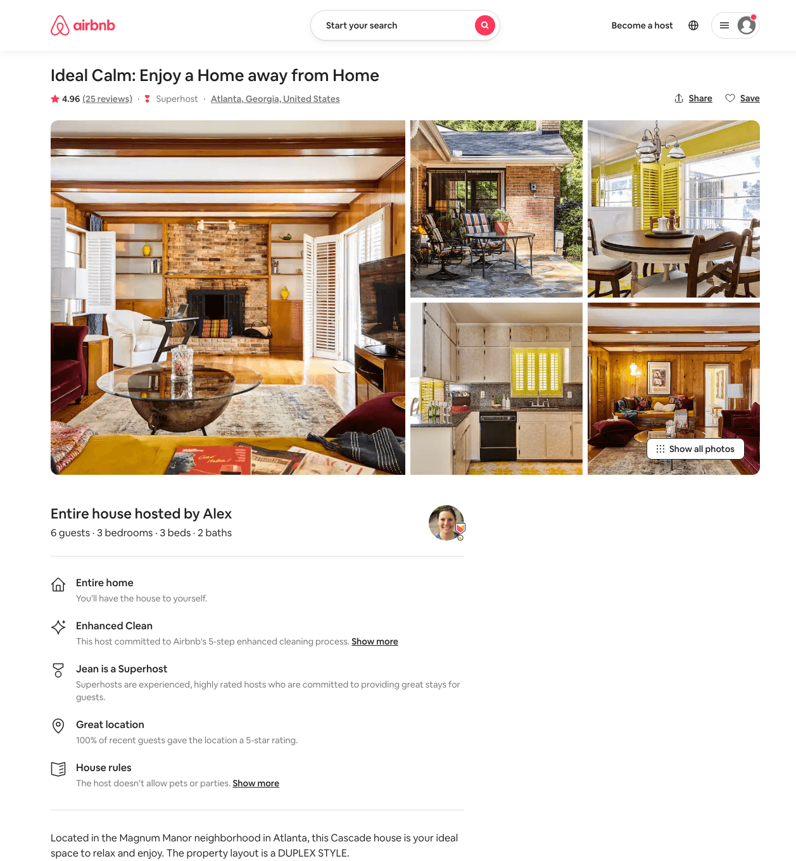
Listing 15027013
3
6
$120 - $231
4.84
28
Alex And Christina
20605441
40
https://www.airbnb.com/rooms/15027013
Jun 2022

