Slide 2
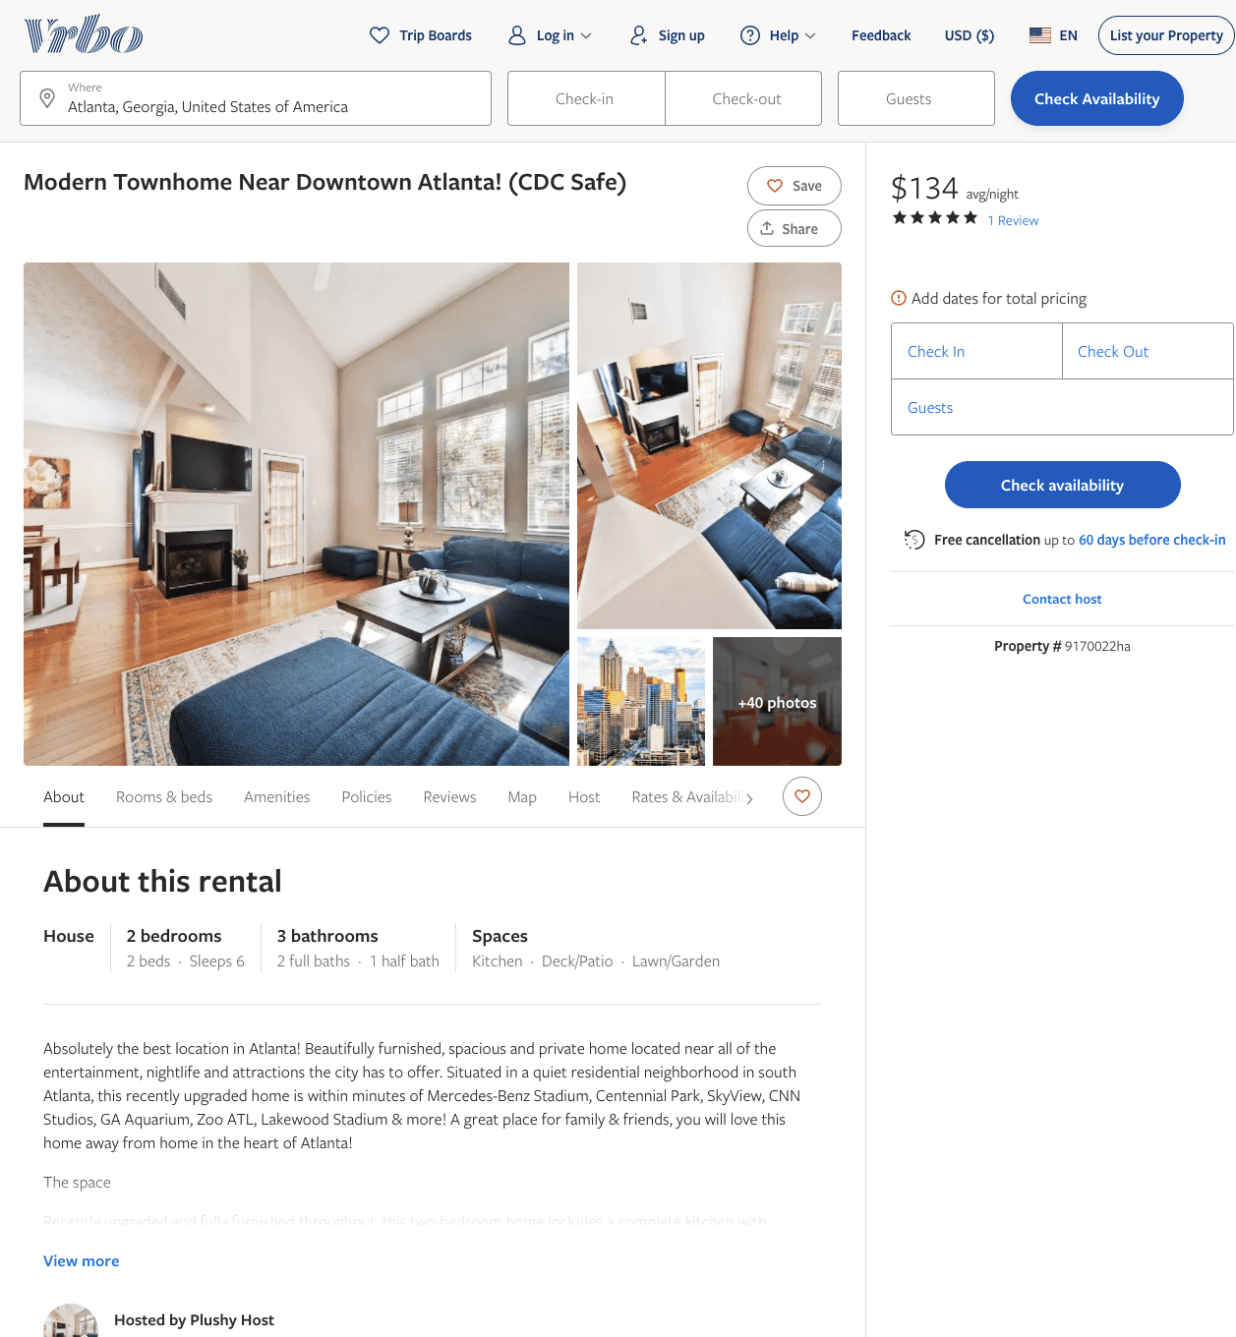
Listing 9170022
2
6
$121 - $206
5
2
Plushy Host
https://www.vrbo.com/9170022ha
Aug 2022

Slide 3
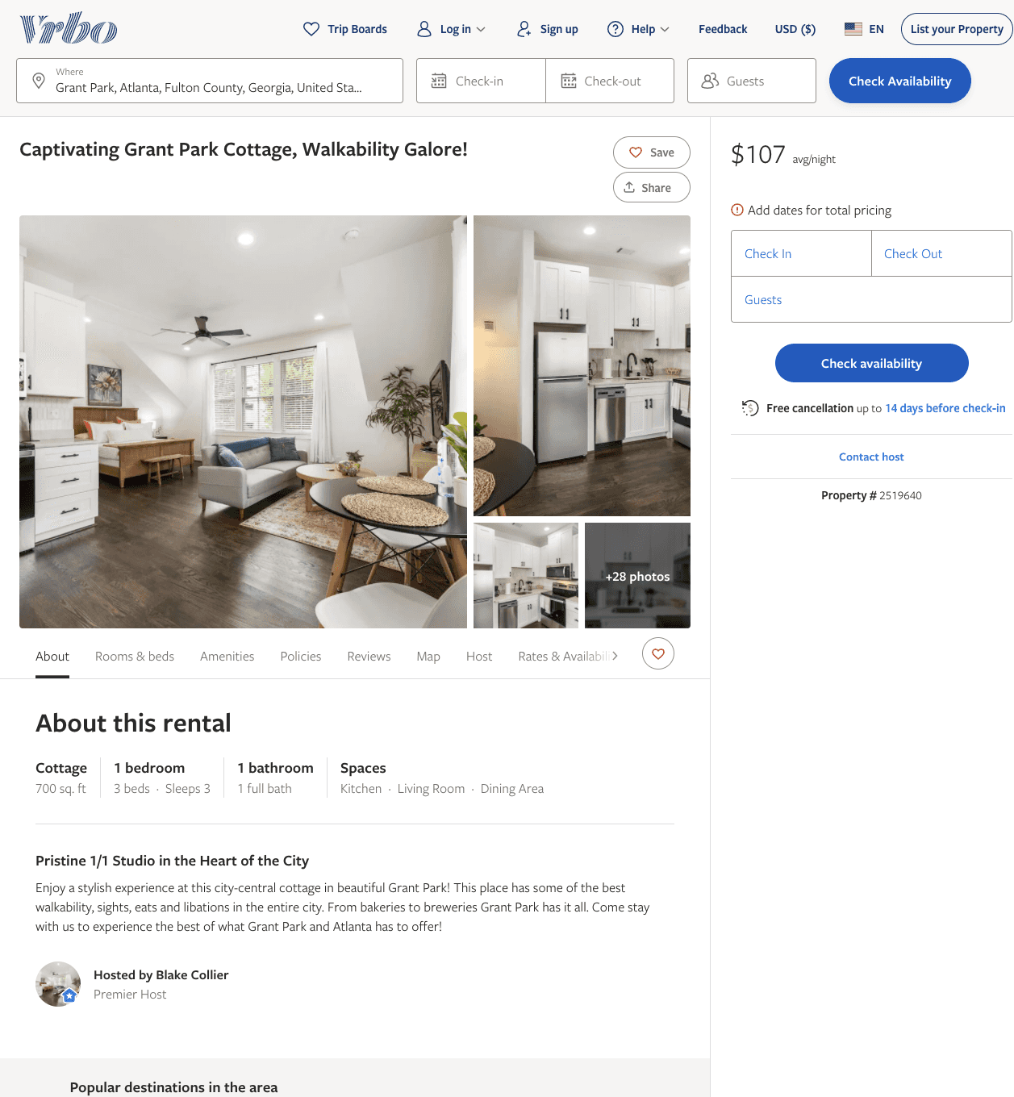
Listing 2519640
1
3
$105 - $111
5
2
Blake Collier
https://www.vrbo.com/2519640
Aug 2022

Slide 4
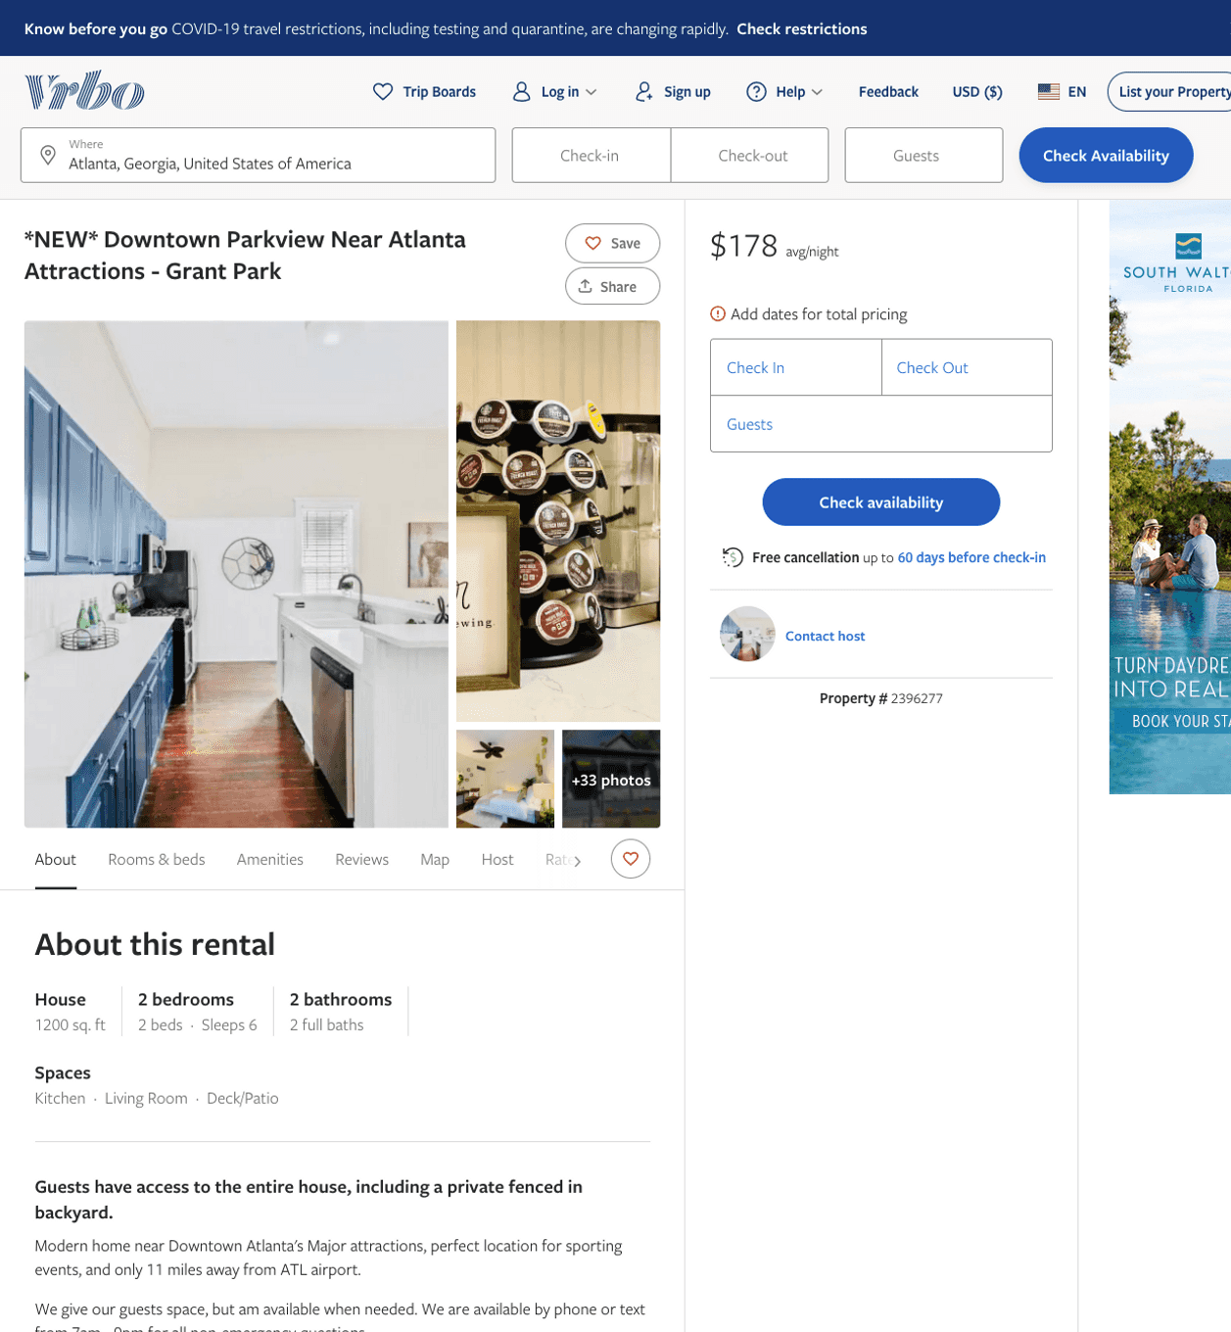
Listing 2396277
2
4
$104 - $242
4.8333335
1
4047911776
https://www.vrbo.com/2396277
Aug 2022

Slide 5
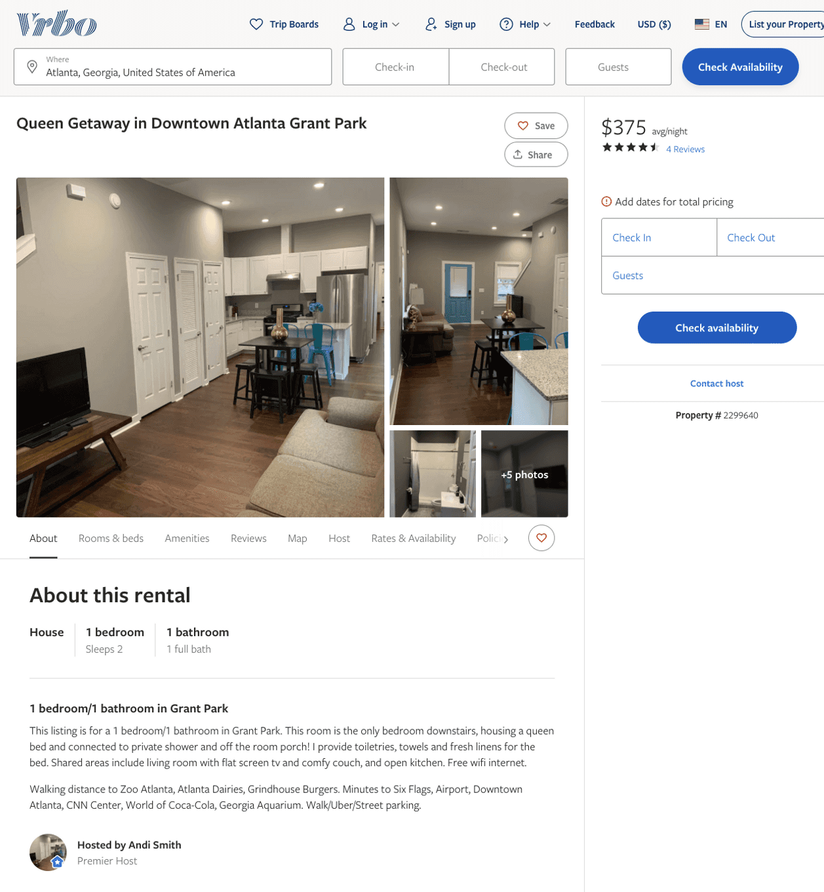
Listing 2299640
1
2
$375 - $80
4.8235292
1
Andi Smith
https://www.vrbo.com/2299640
Aug 2022

Slide 6
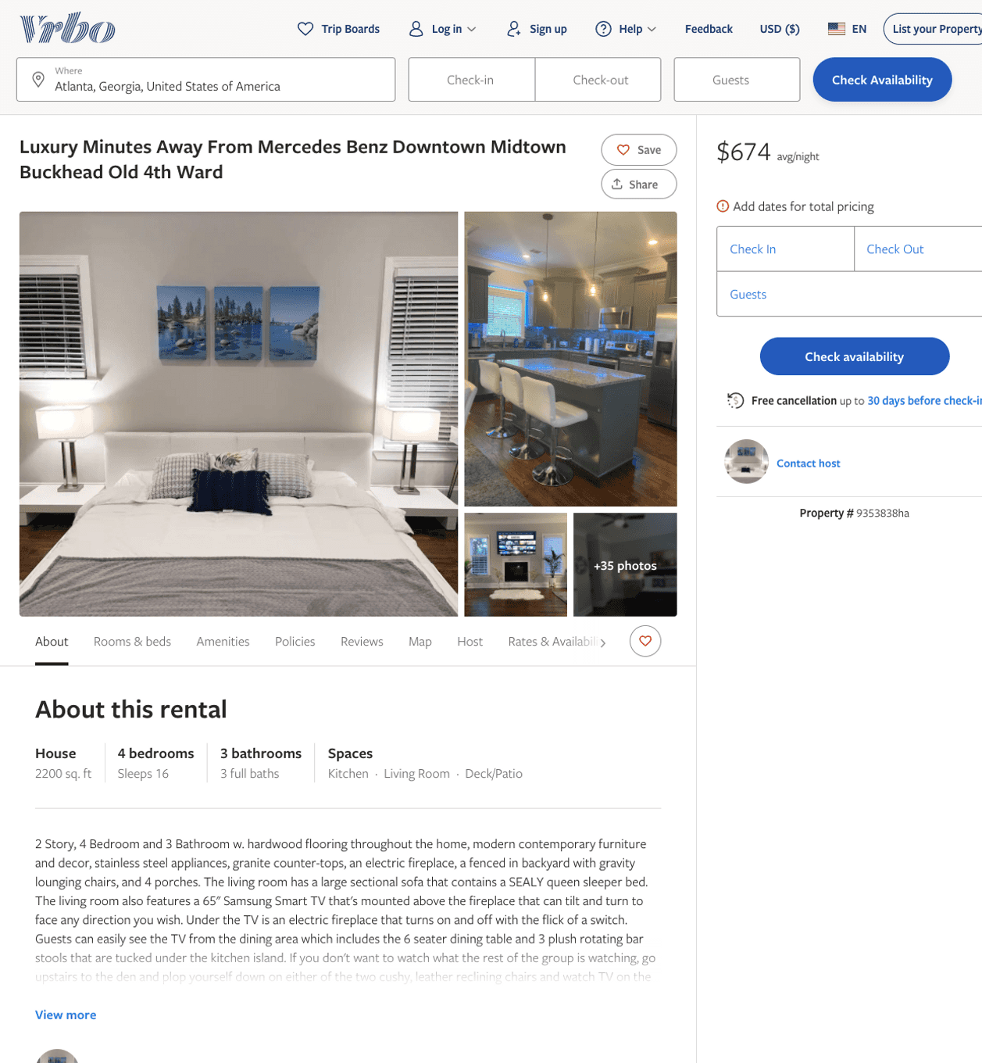
Listing 9353838
4
16
$599 - $757
3
https://www.vrbo.com/9353838ha
Aug 2022

Slide 7
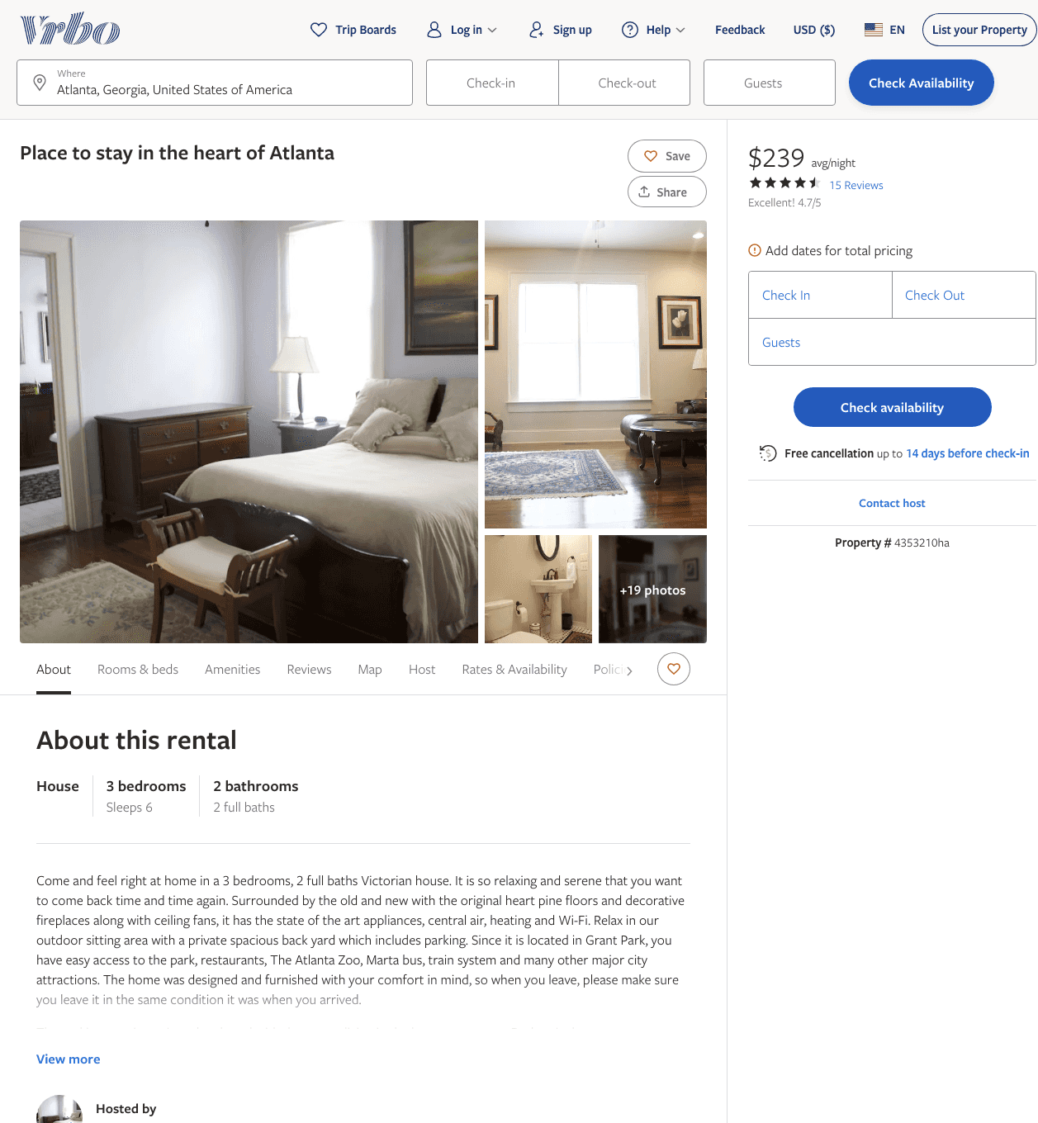
Listing 4353210
3
6
$204 - $239
4.8
1
https://www.vrbo.com/4353210ha
Aug 2022

Slide 8
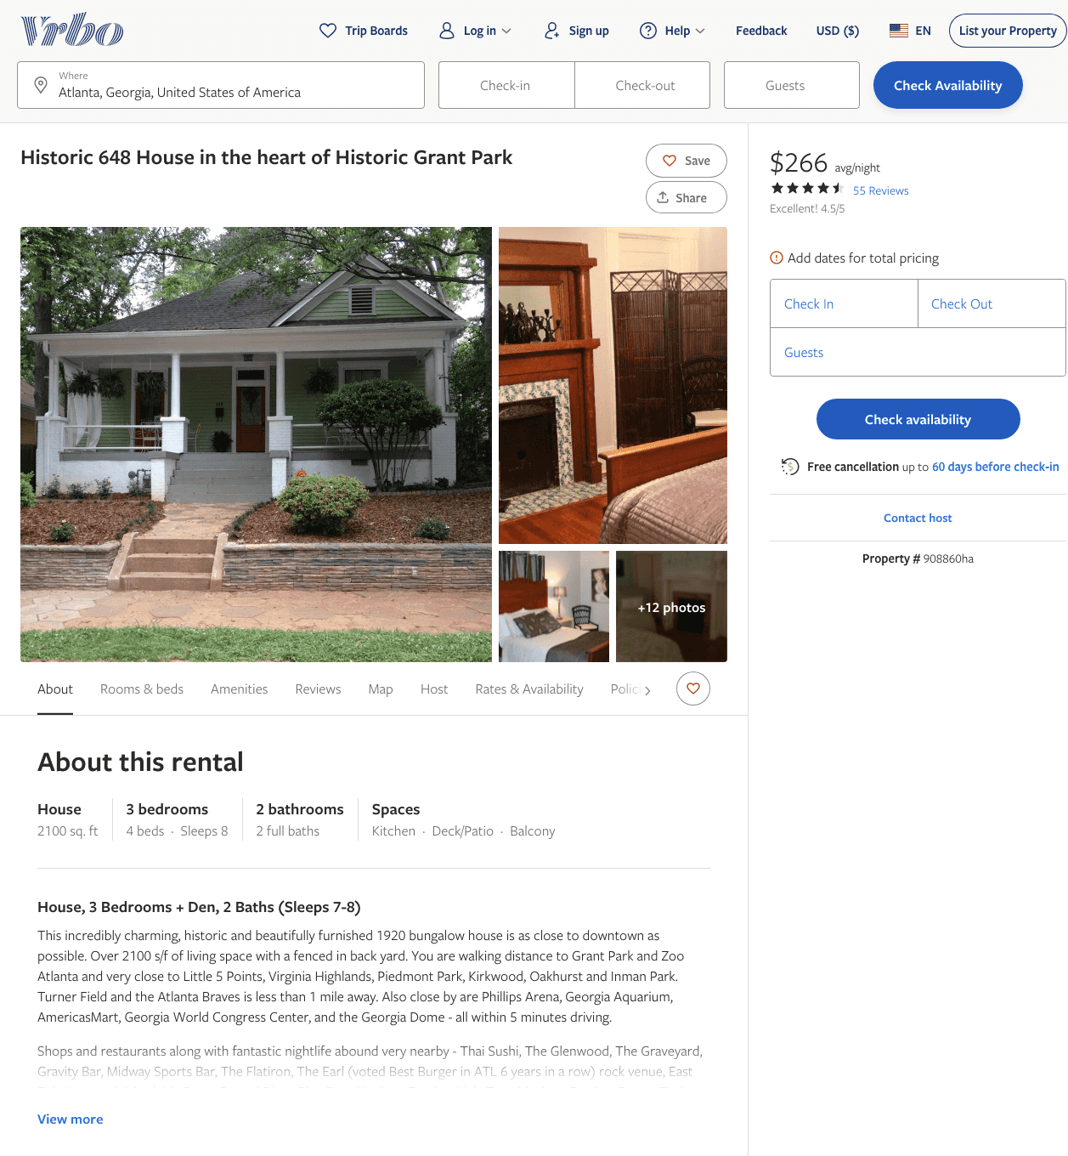
Listing 908860
3
8
$266 - $295
4.551724
3
David Walens
https://www.vrbo.com/908860ha
Aug 2022

Slide 9
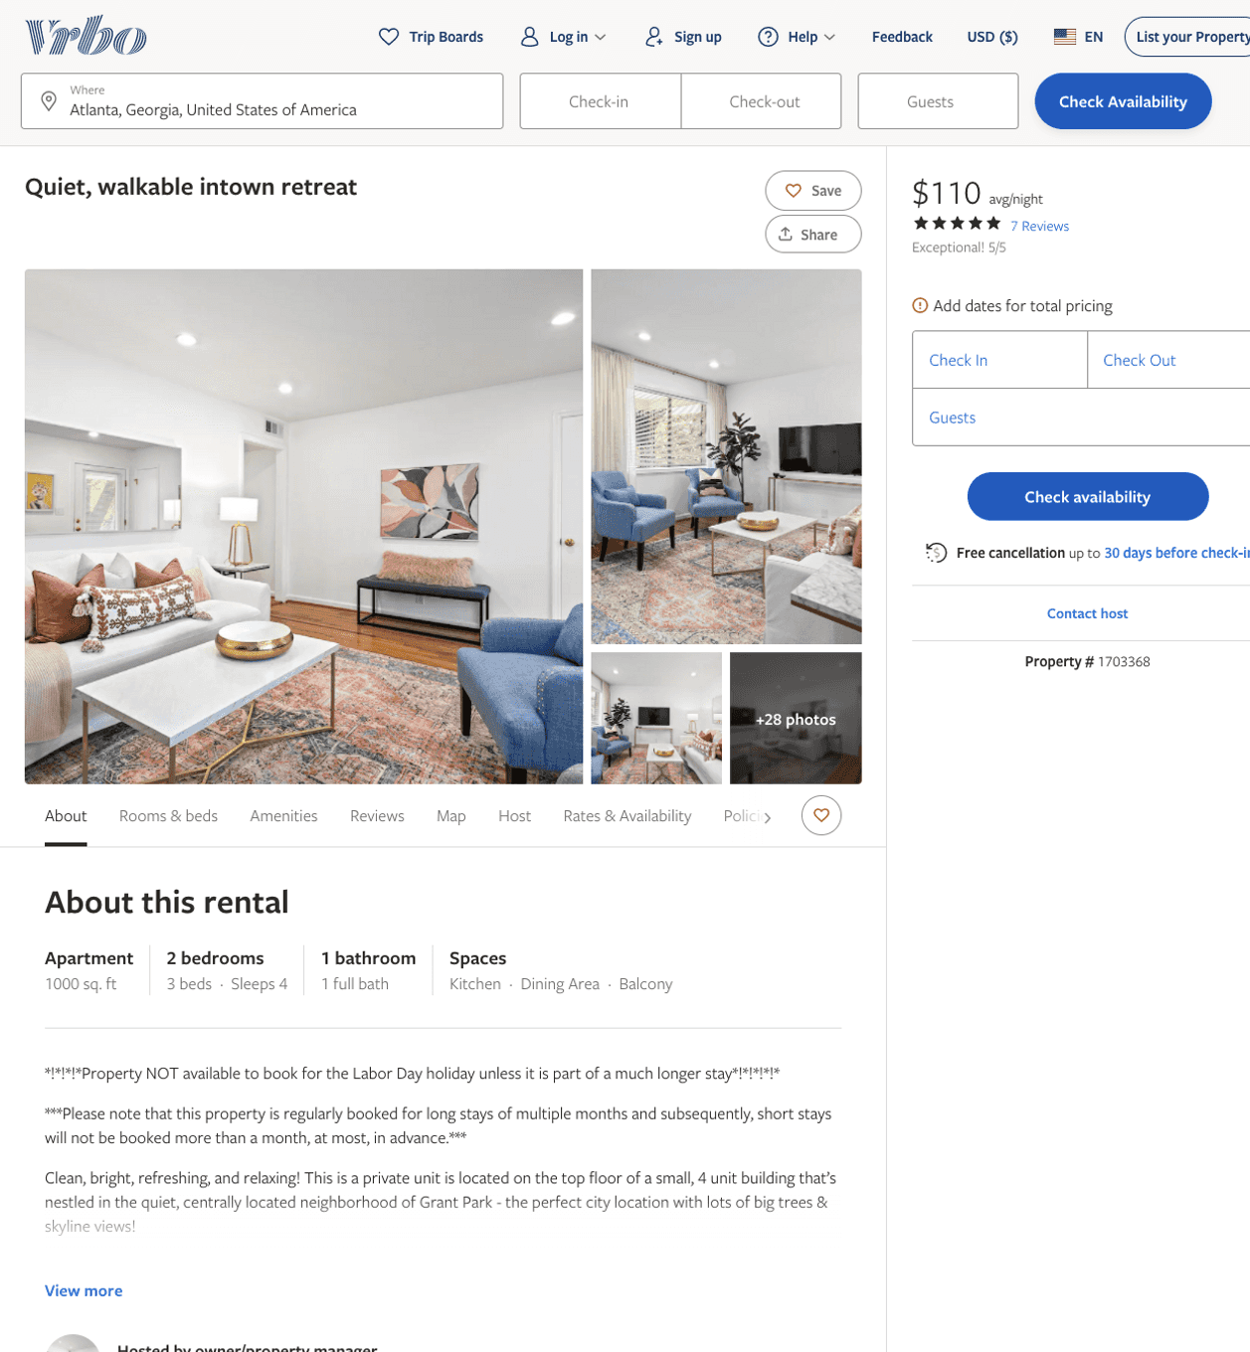
Listing 1703368
2
4
$110
5
4
owner/property manager
https://www.vrbo.com/1703368
Aug 2022

Slide 10
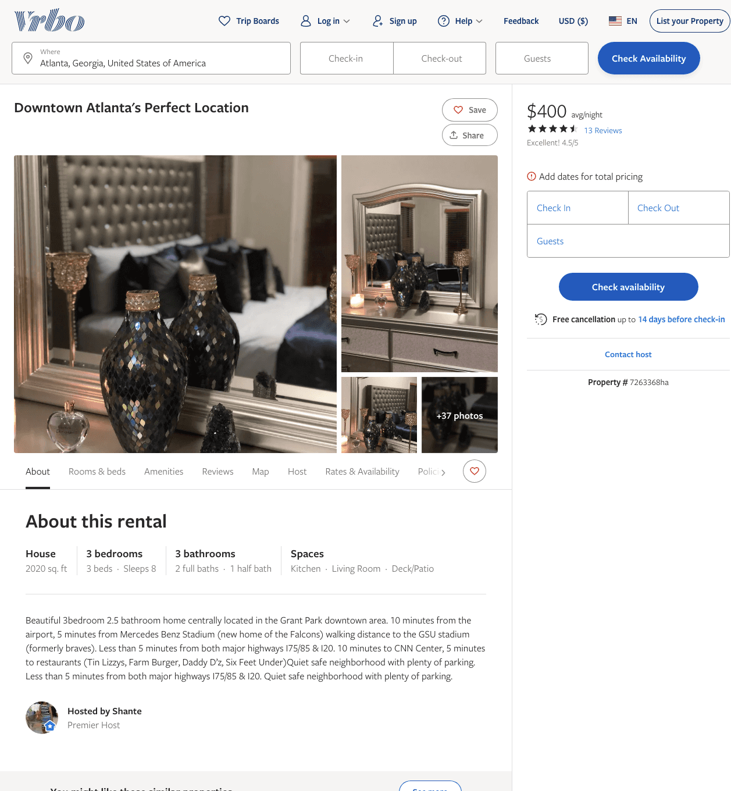
Listing 7263368
3
8
$300 - $400
4.6666665
2
Shante
https://www.vrbo.com/7263368ha
Aug 2022

Slide 11
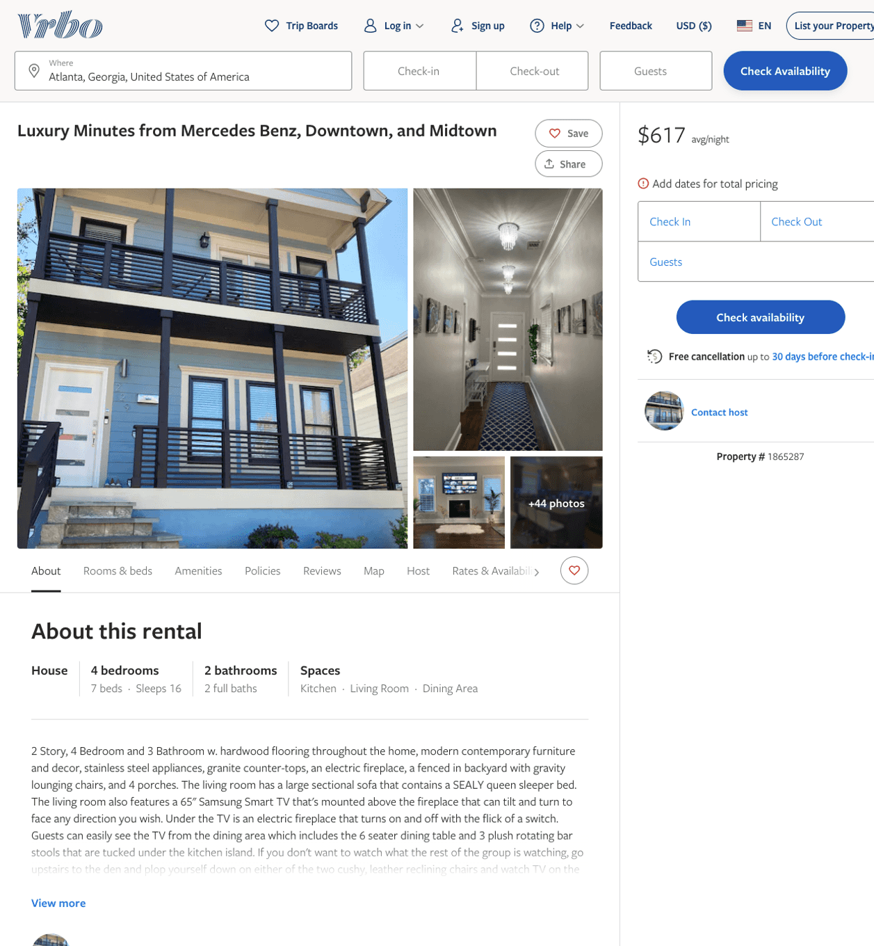
Listing 1865287
4
16
$537 - $741
3
https://www.vrbo.com/1865287
Aug 2022

Slide 12
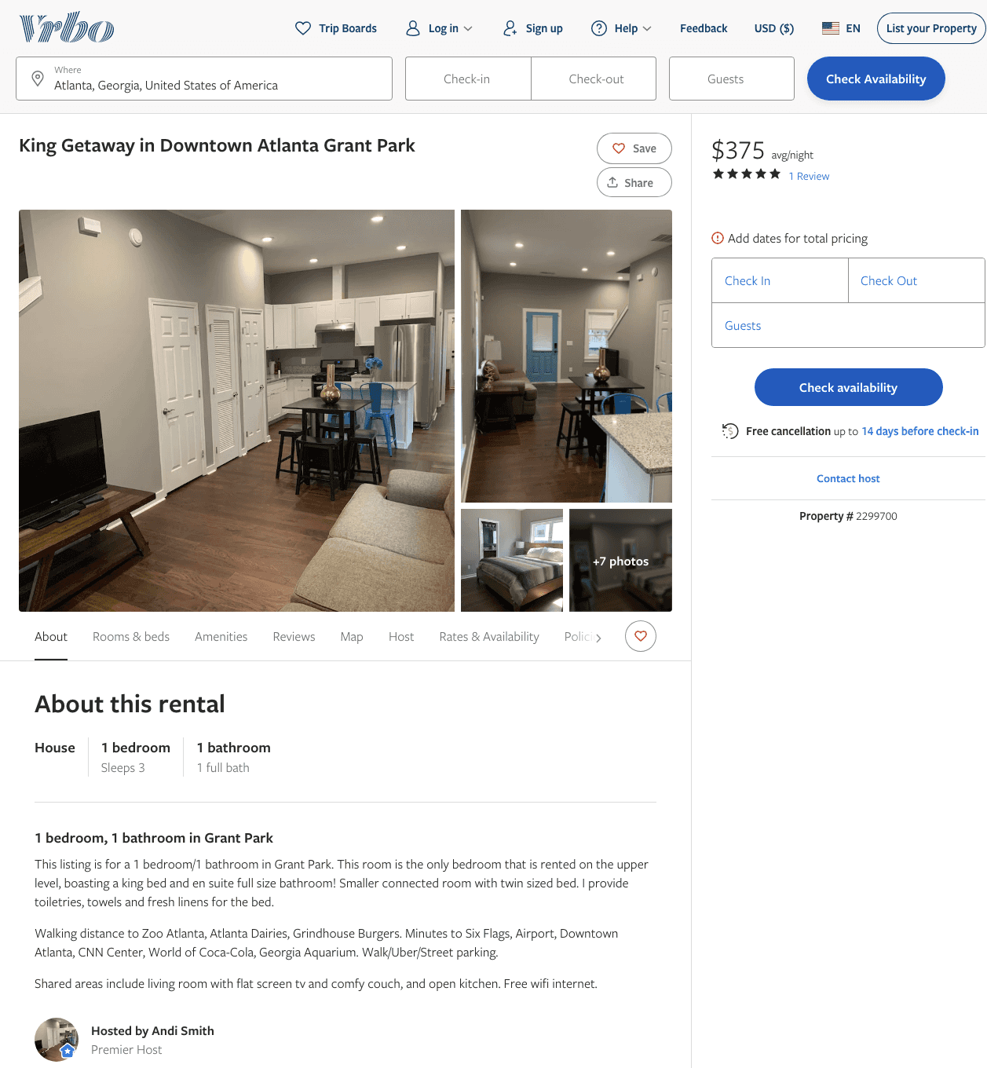
Listing 2299700
1
3
$375 - $90
5
1
Andi Smith
https://www.vrbo.com/2299700
Aug 2022

Slide 13
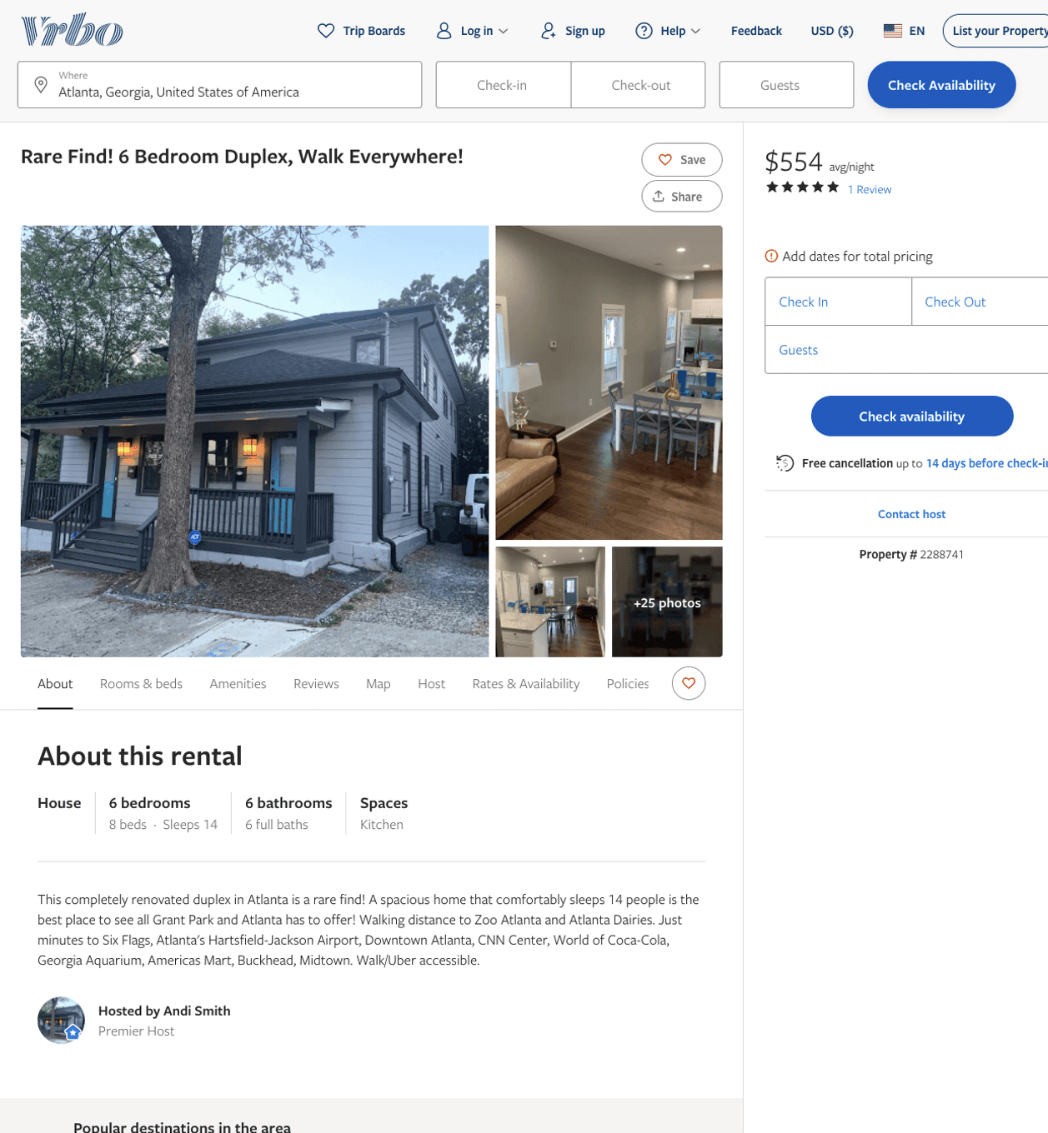
Listing 2288741
6
14
$450 - $554
5
1
Andi Smith
https://www.vrbo.com/2288741
Aug 2022

Slide 14
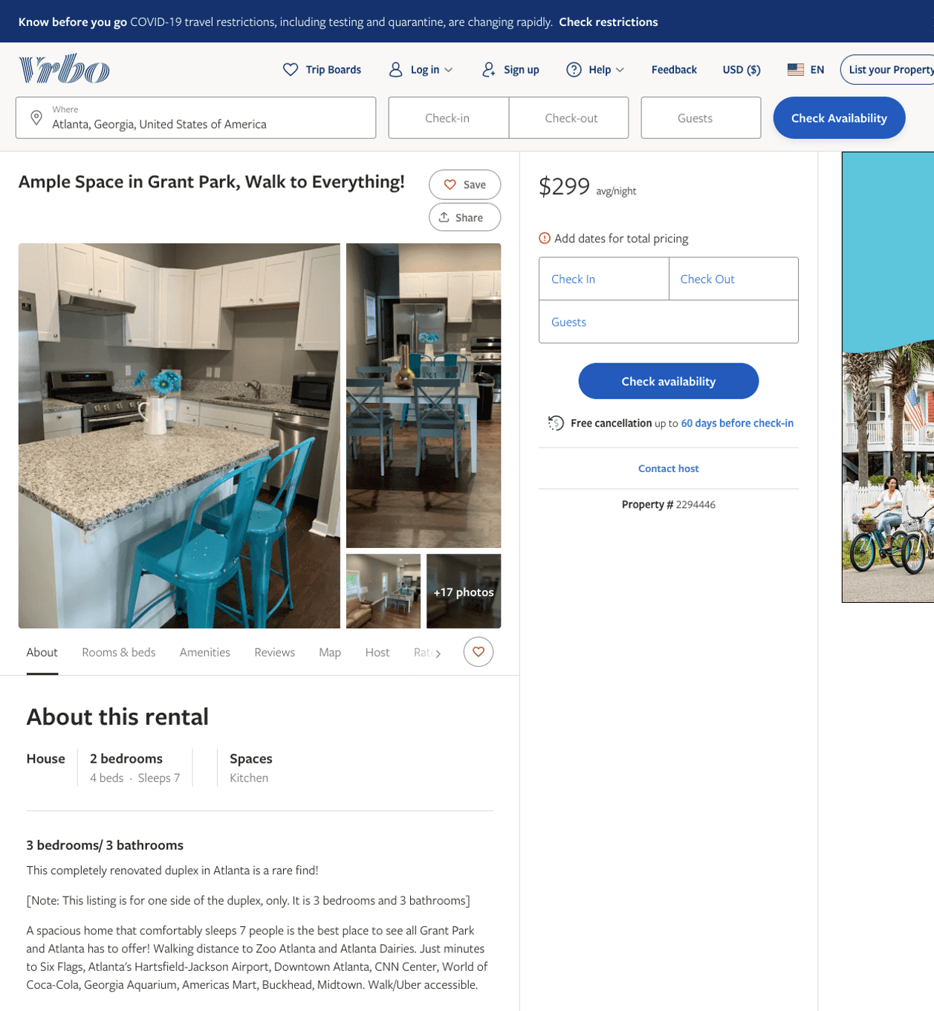
Listing 2294446
3
7
$268 - $343
4.5
1
Andi Smith
https://www.vrbo.com/2294446
Aug 2022

Slide 15
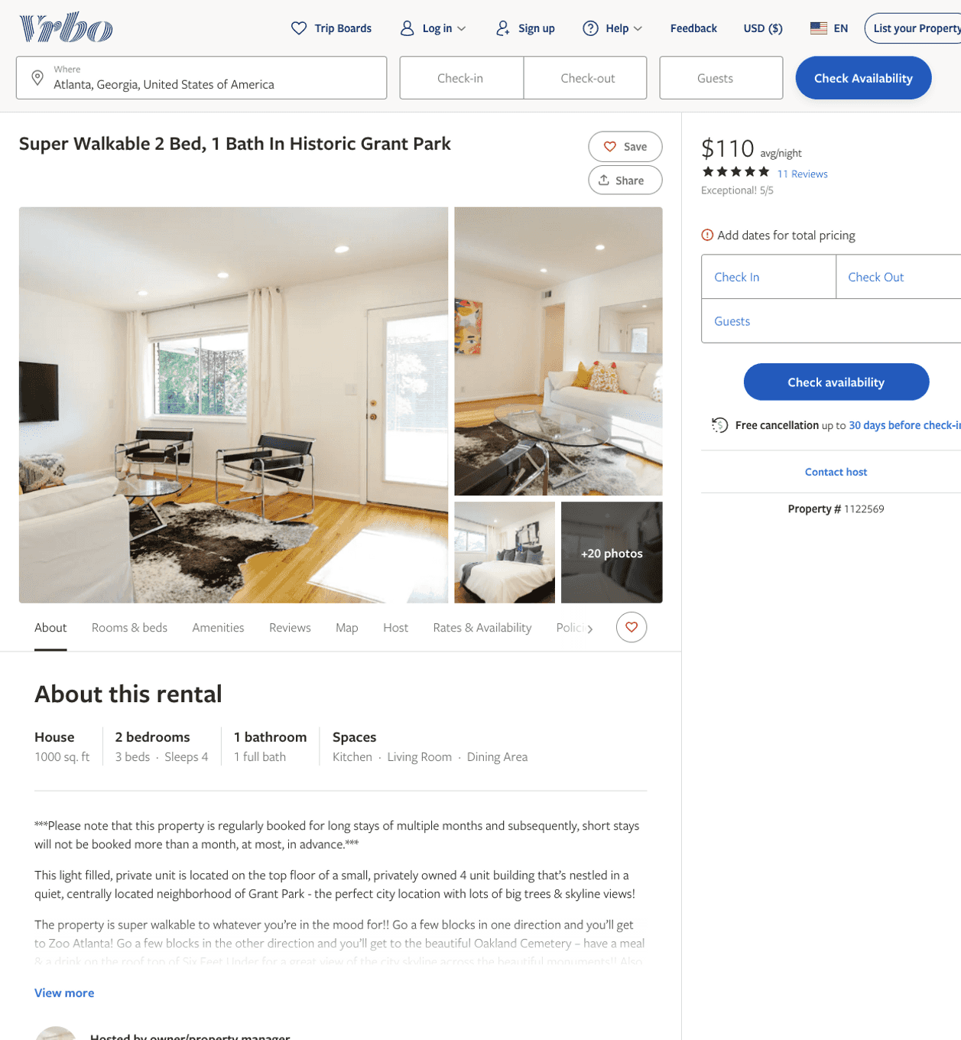
Listing 1122569
2
4
$110
5
4
owner/property manager
https://www.vrbo.com/1122569
Aug 2022

Slide 16
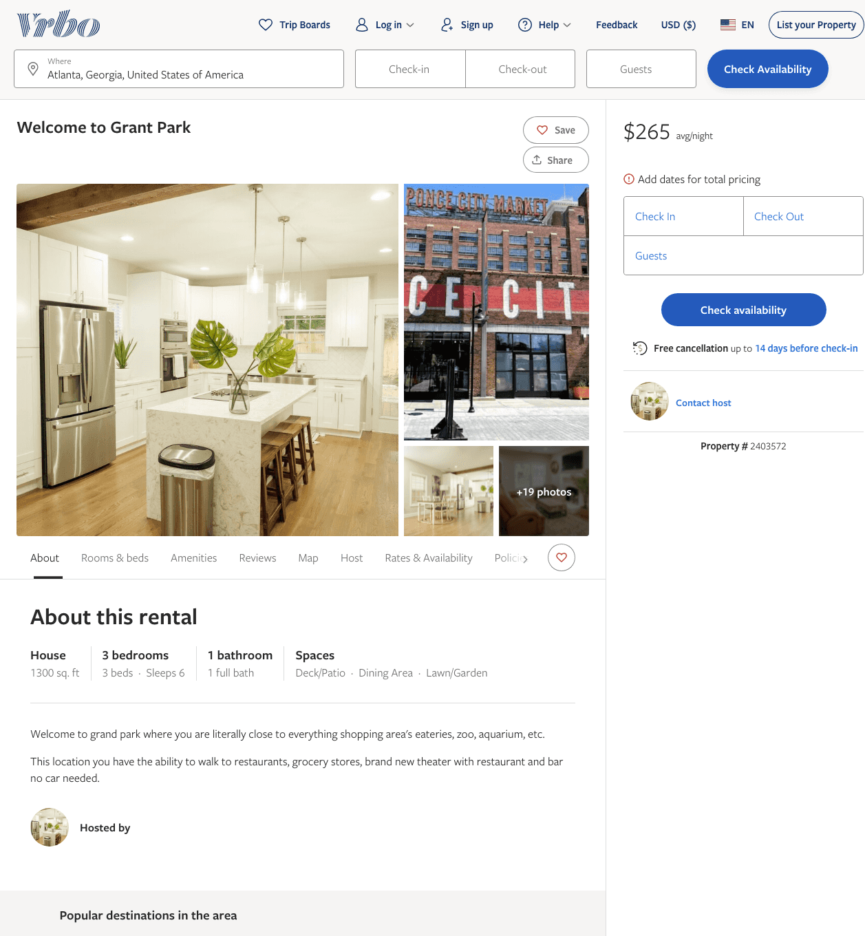
Listing 2403572
3
6
$229 - $270
4.6666665
3
https://www.vrbo.com/2403572
Aug 2022

Slide 17
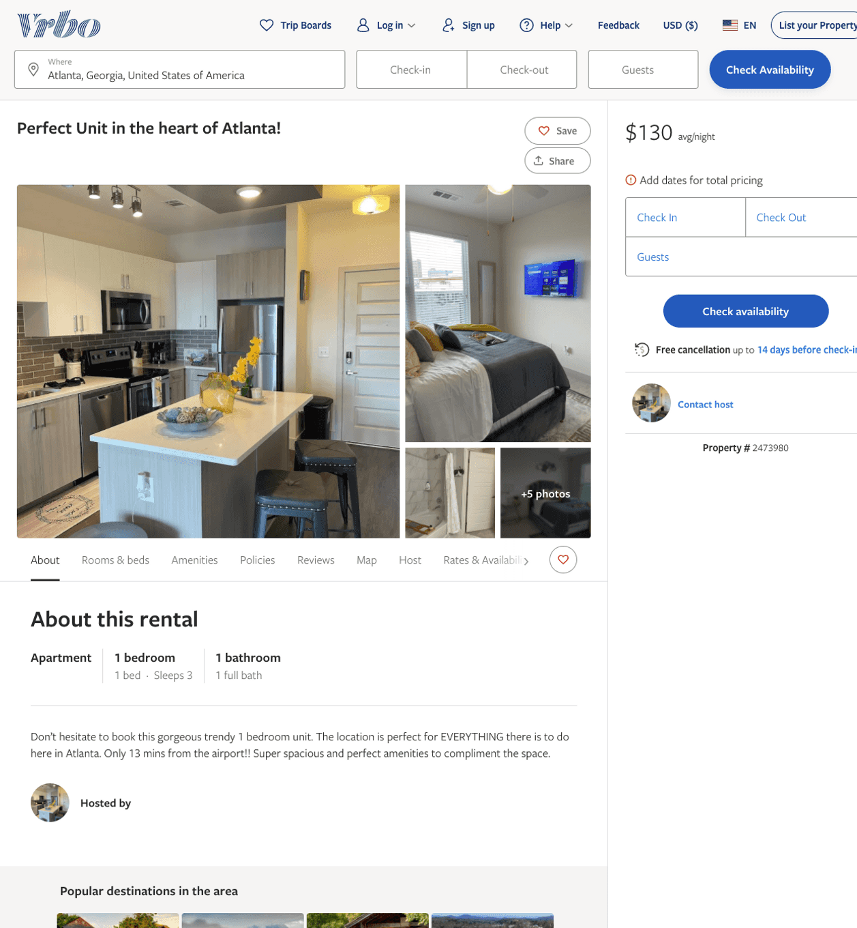
Listing 2473980
1
3
$109 - $140
2
https://www.vrbo.com/2473980
Aug 2022

Slide 18
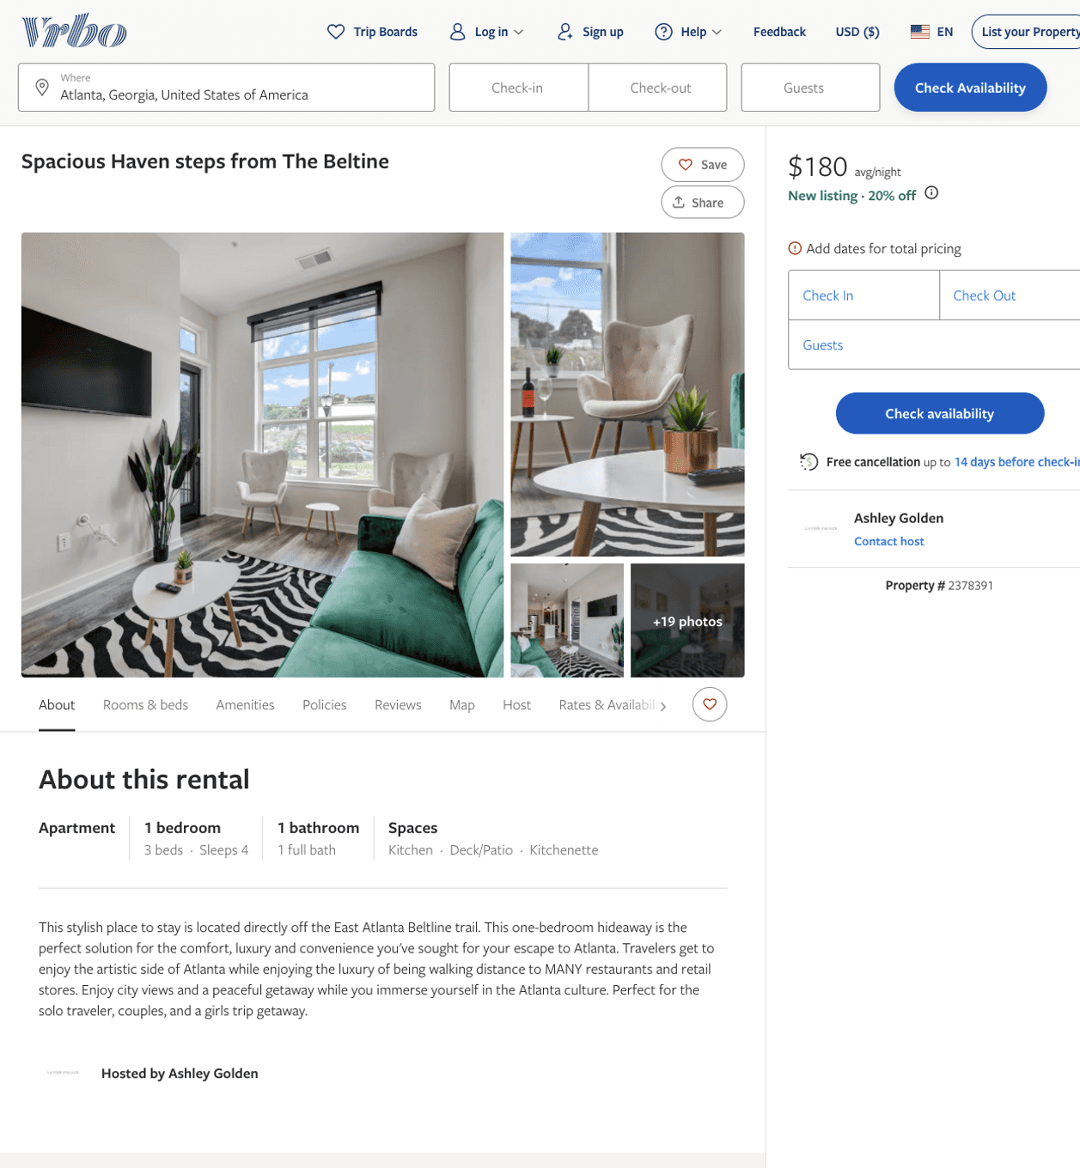
Listing 2378391
1
4
$180 - $198
1
Ashley Golden
https://www.vrbo.com/2378391
Aug 2022

Slide 19
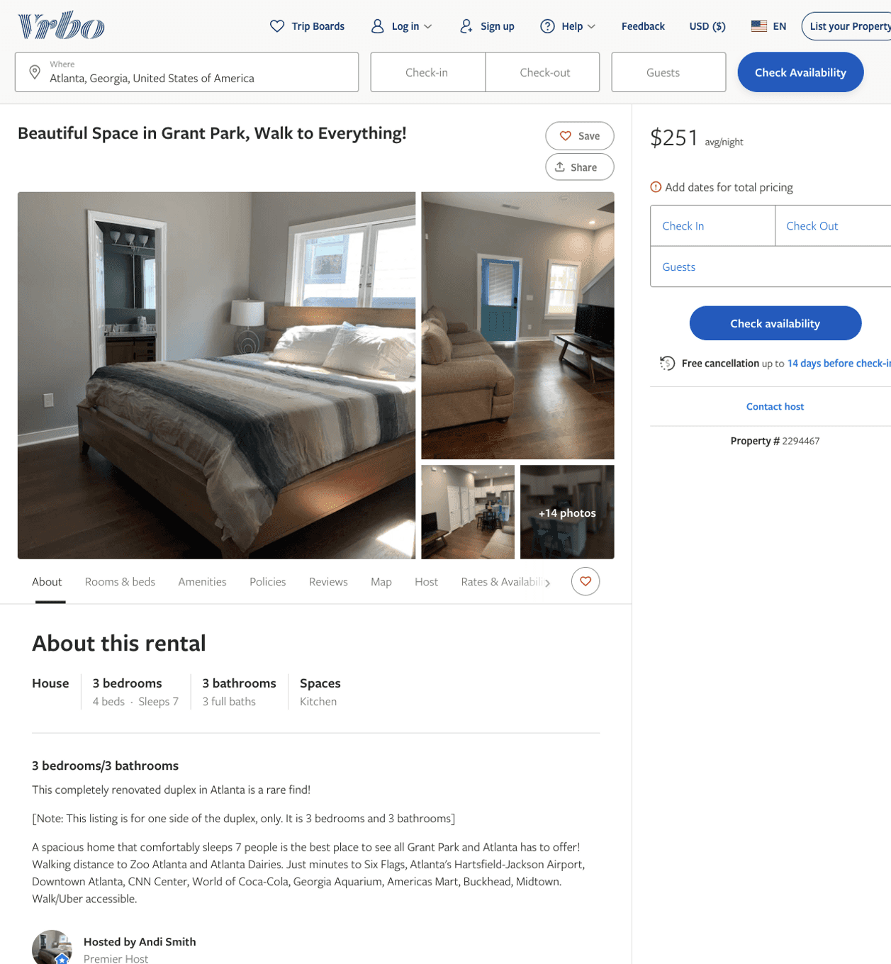
Listing 2294467
3
7
$188 - $289
1
Andi Smith
https://www.vrbo.com/2294467
Aug 2022

Slide 20
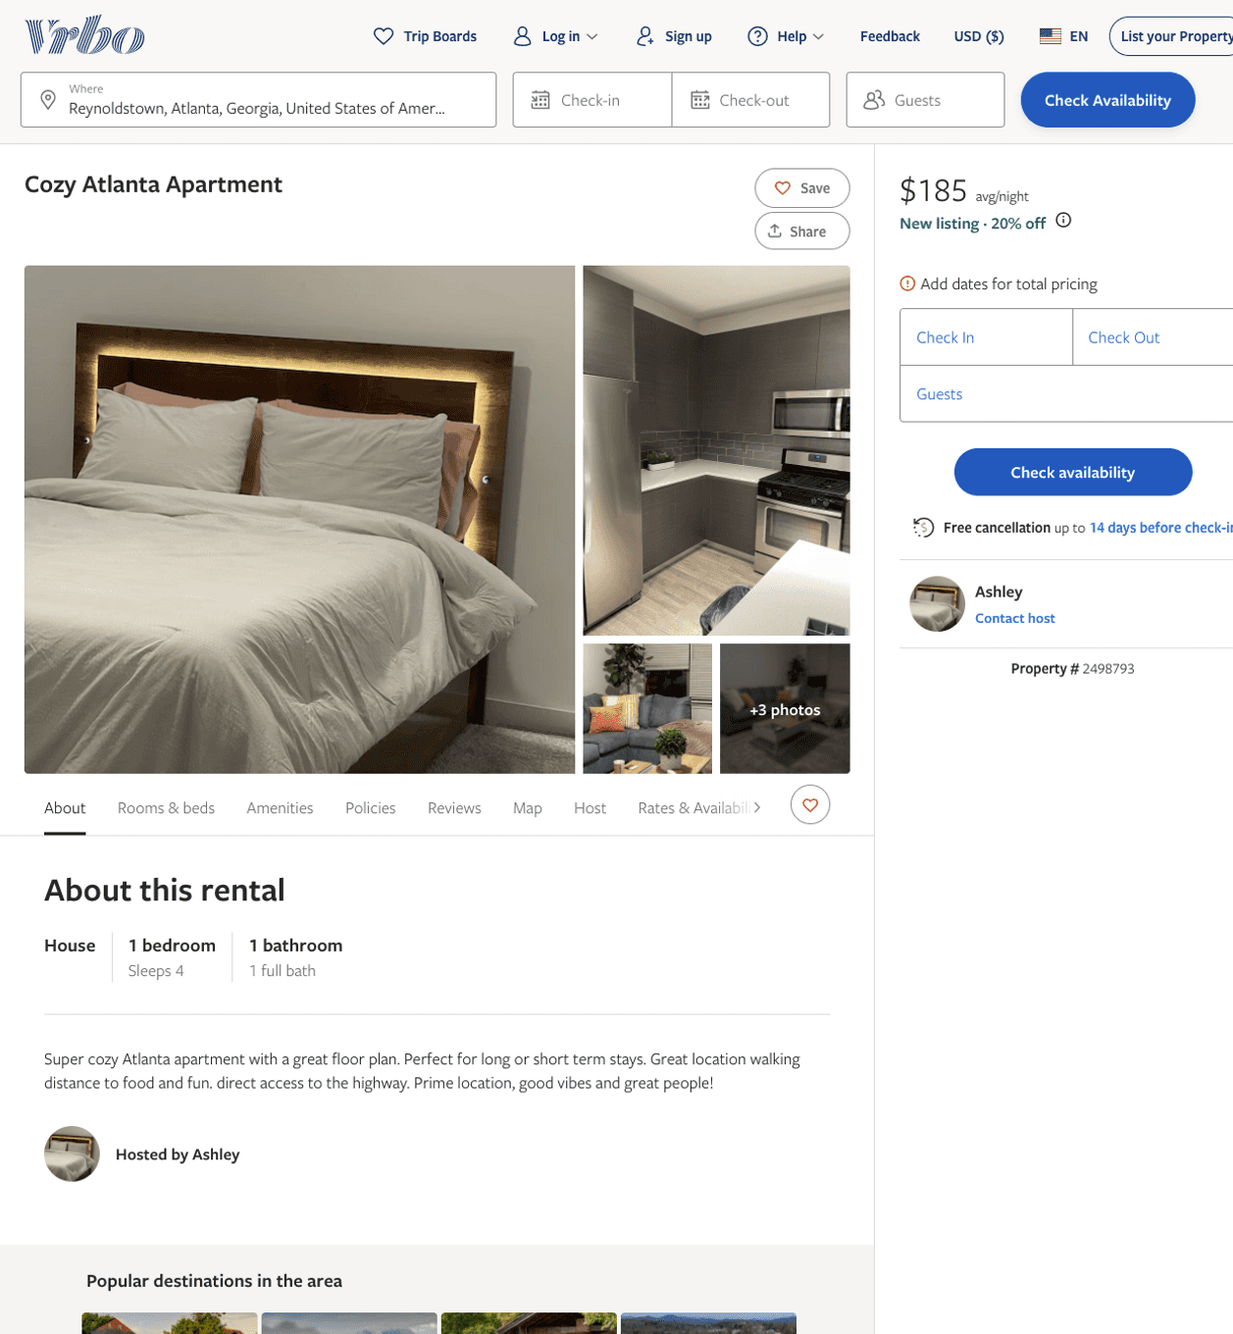
Listing 2498793
1
4
$181 - $185
30
Ashley
https://www.vrbo.com/2498793
Aug 2022

Slide 21
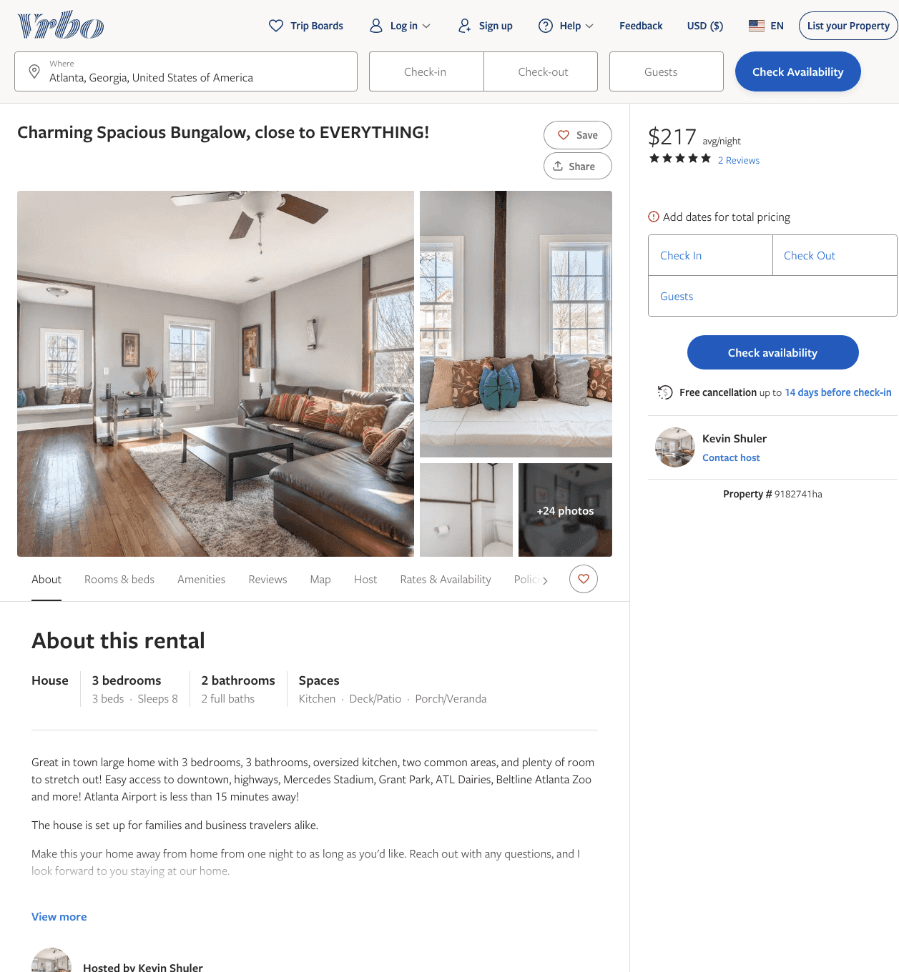
Listing 9182741
3
8
$200 - $219
5
2
Kevin Shuler
https://www.vrbo.com/9182741ha
Aug 2022

Slide 22
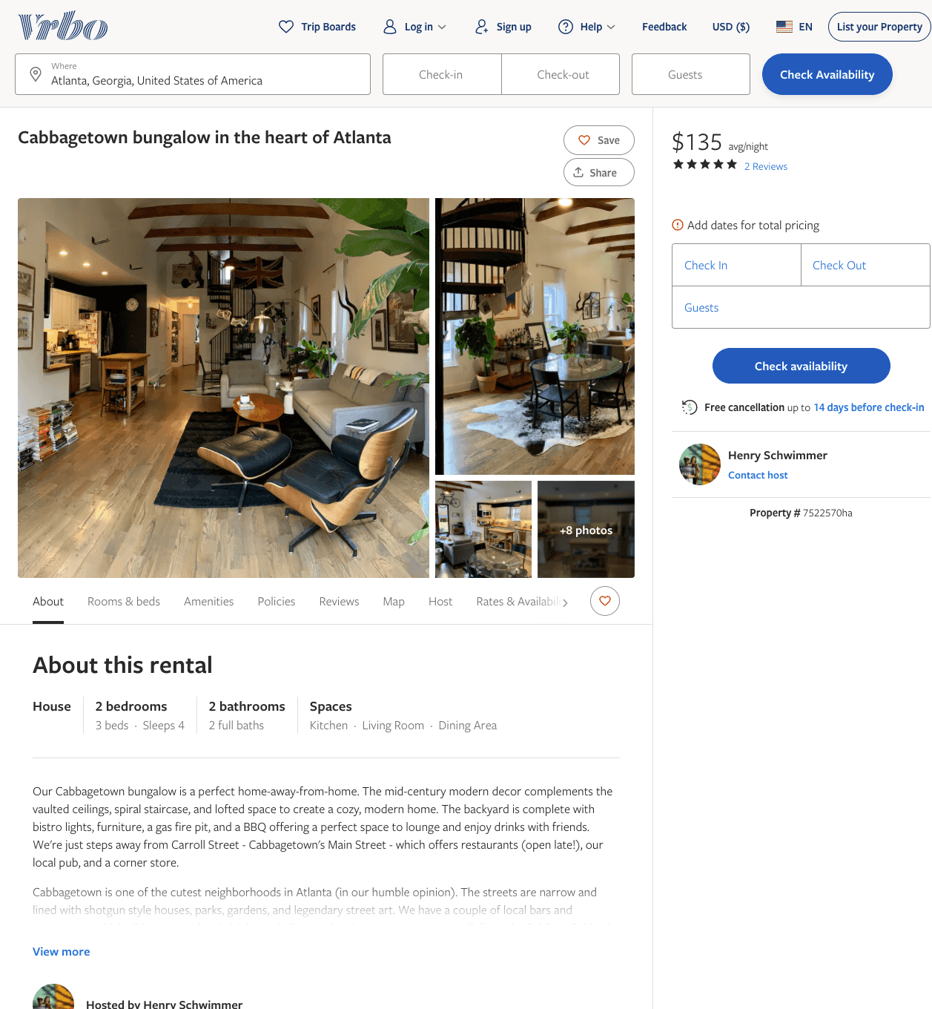
Listing 7522570
2
4
$135
5
2
Henry Schwimmer
https://www.vrbo.com/7522570ha
Aug 2022

Slide 23
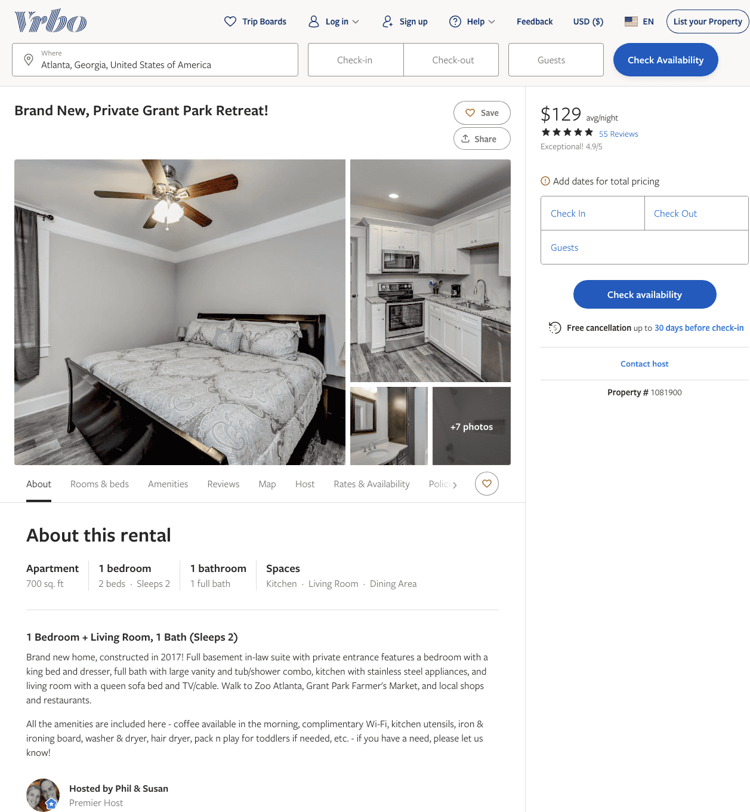
Listing 1081900
1
2
$116 - $129
4.952381
2
Phil & Susan
https://www.vrbo.com/1081900
Aug 2022

Slide 24
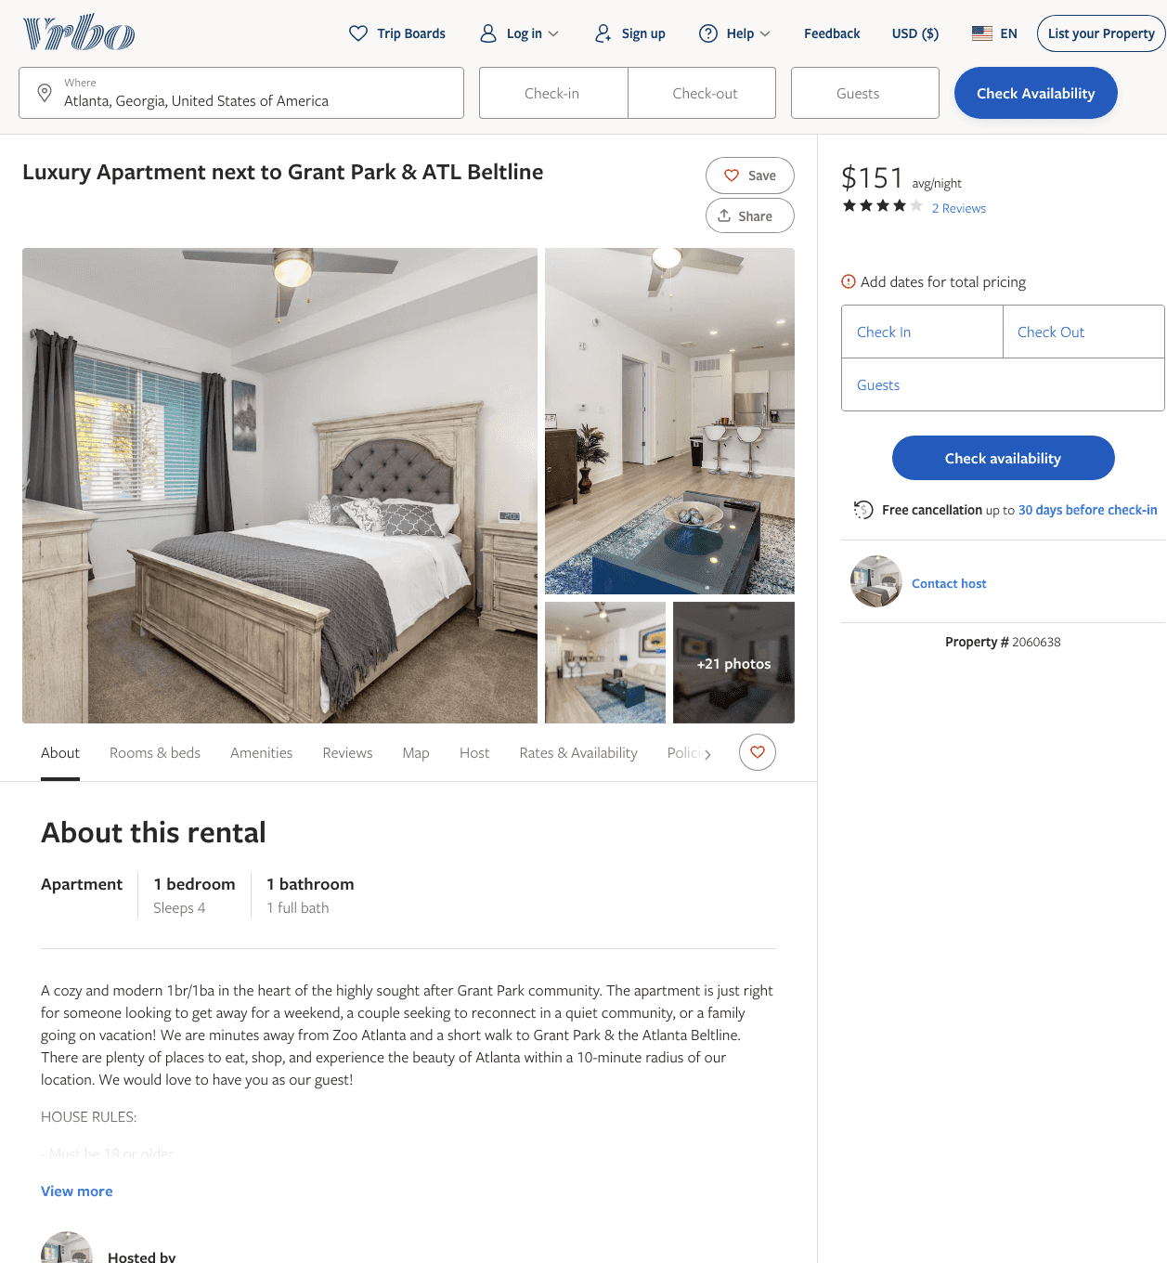
Listing 2060638
1
4
$104 - $151
4
1
Cedric Brown
https://www.vrbo.com/2060638
Aug 2022

Slide 25
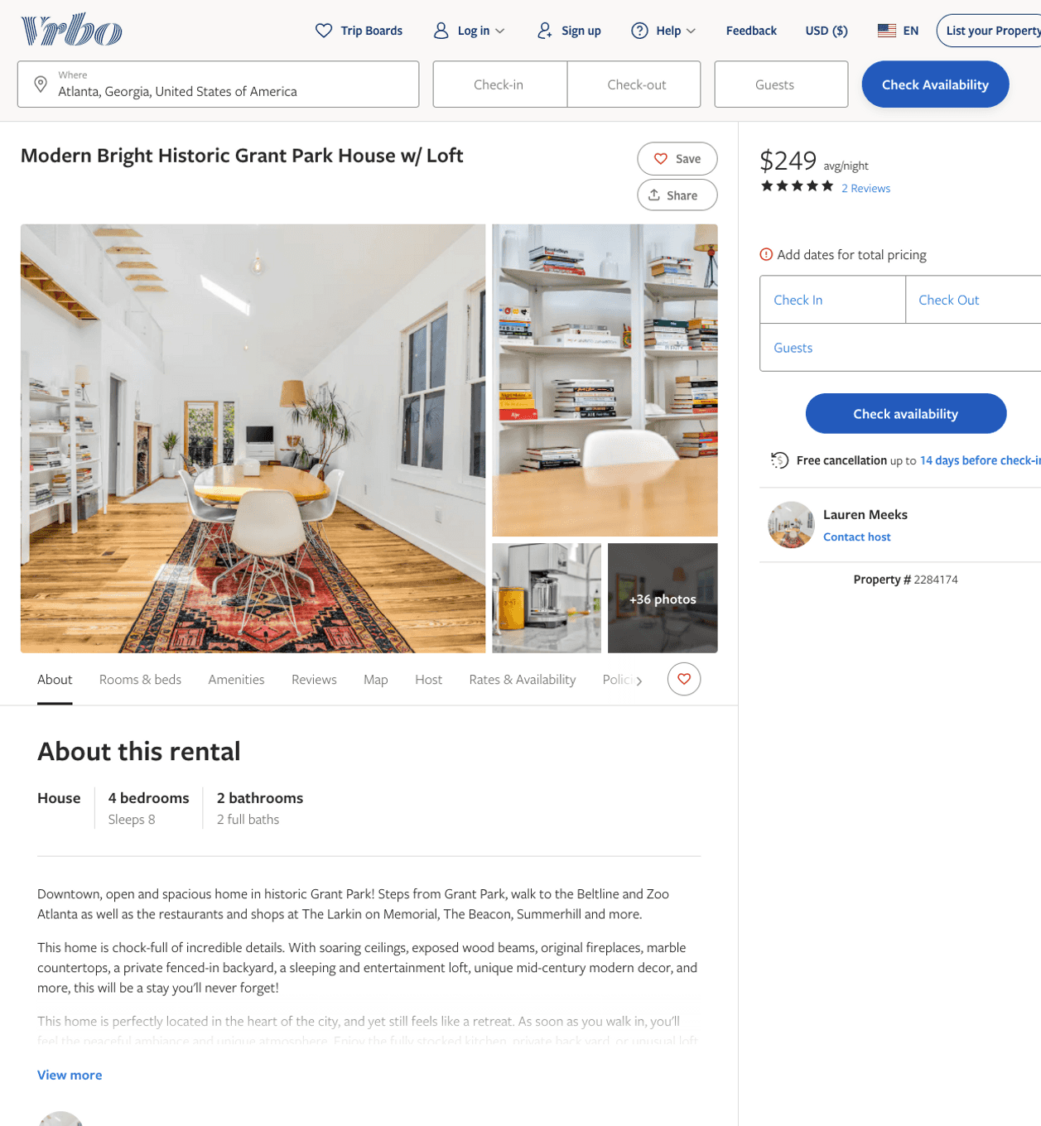
Listing 2284174
4
8
$244 - $330
5
2
Lauren Meeks
https://www.vrbo.com/2284174
Aug 2022

Slide 26
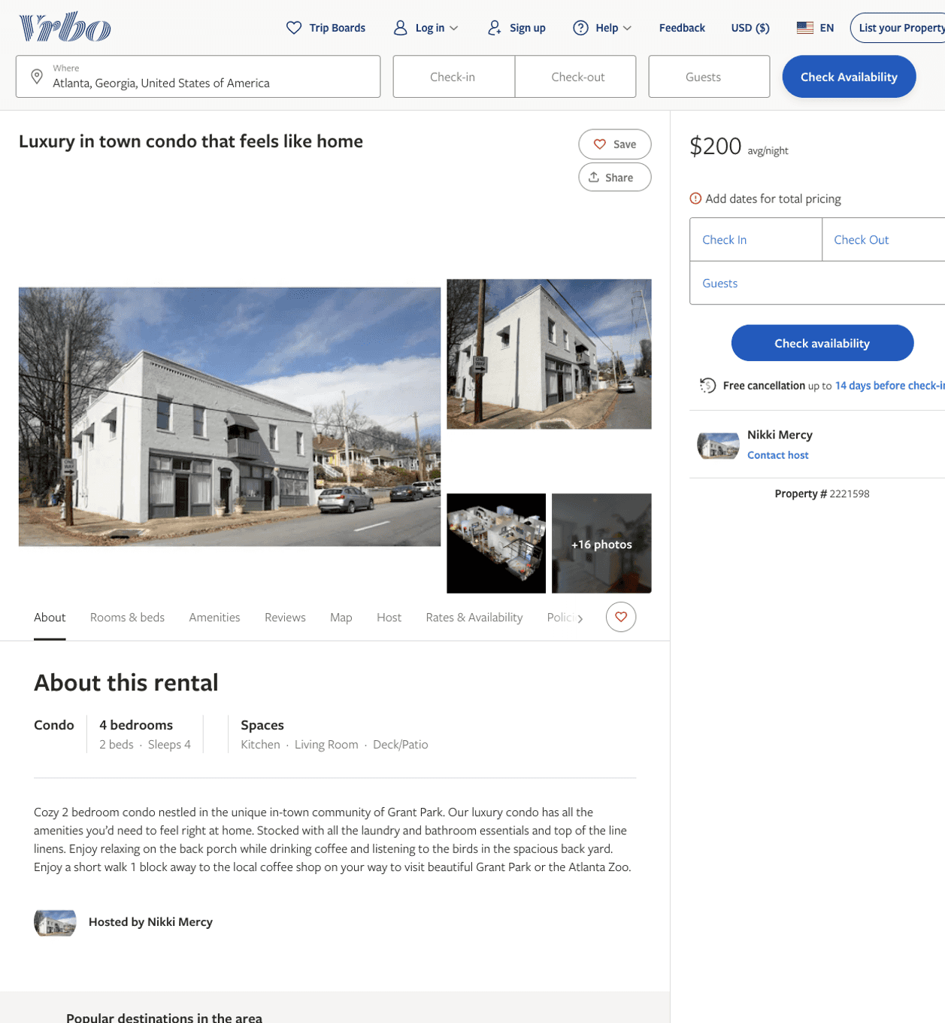
Listing 2221598
2
4
$200
14
Nikki Mercy
https://www.vrbo.com/2221598
Aug 2022

Slide 27
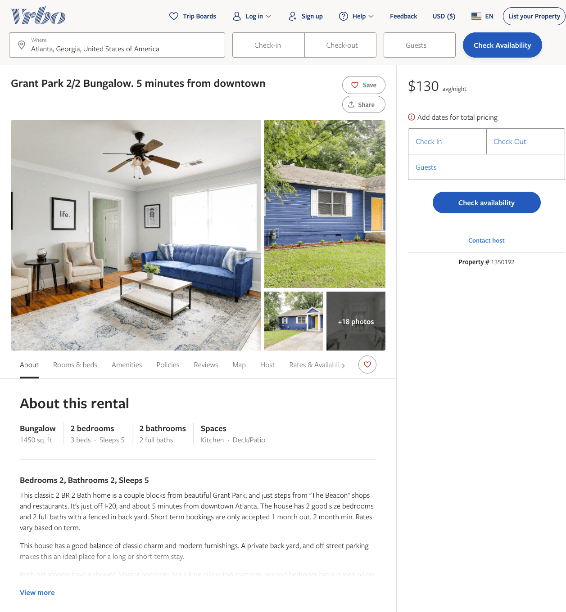
Listing 1350192
2
5
$130 - $151
4
Stewart Wyne
https://www.vrbo.com/1350192
Aug 2022

Slide 28
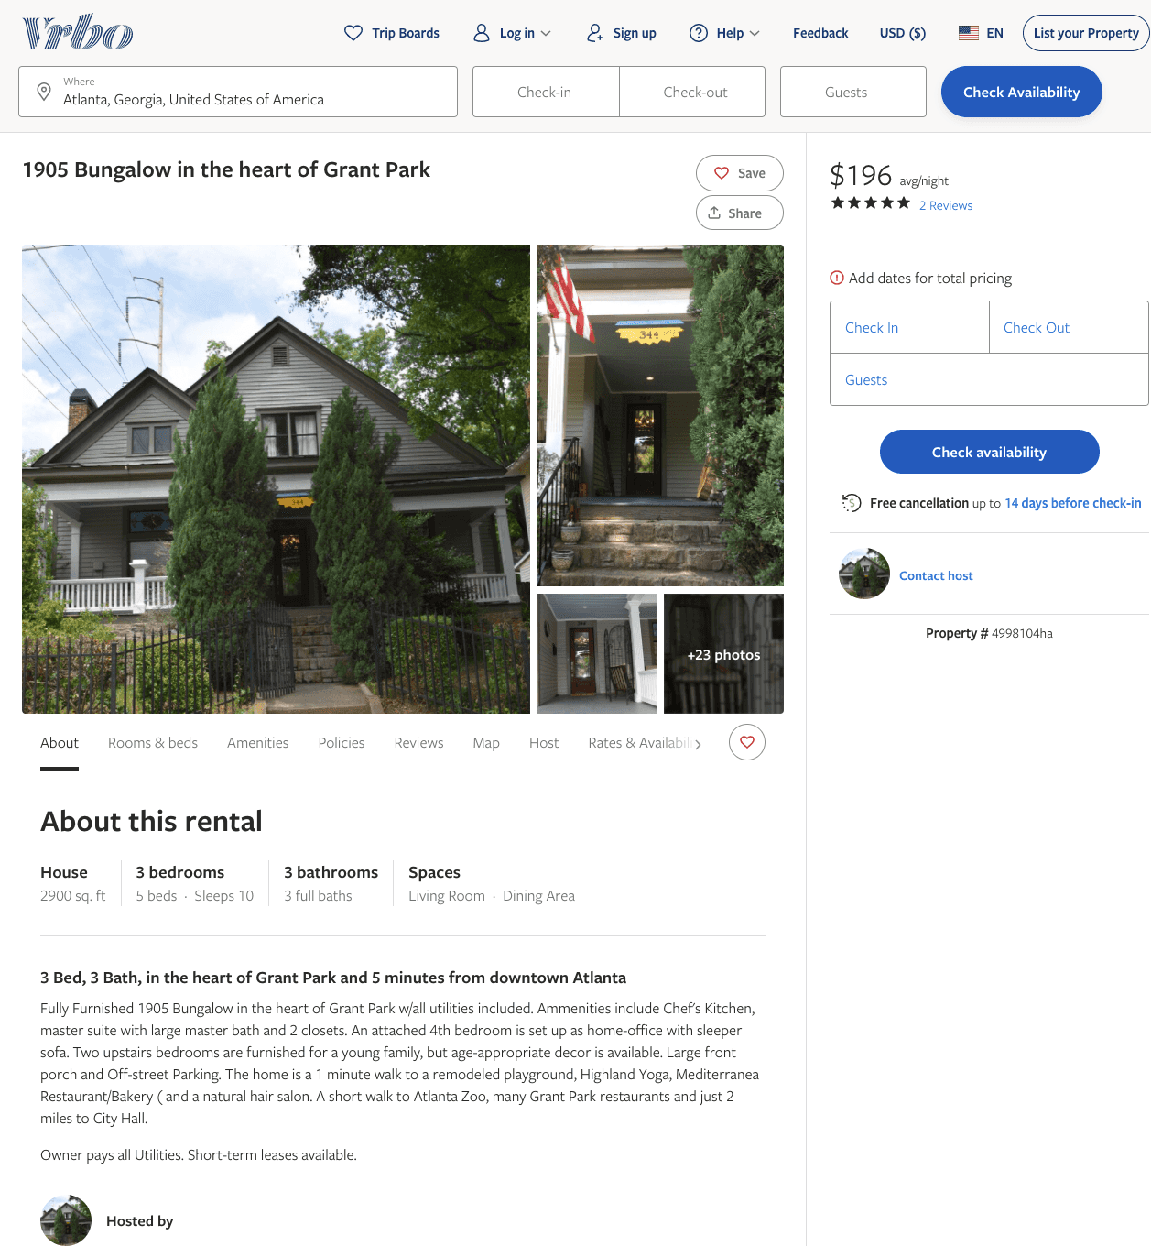
Listing 4998104
3
10
$196
5
9
https://www.vrbo.com/4998104ha
Aug 2022

Slide 29
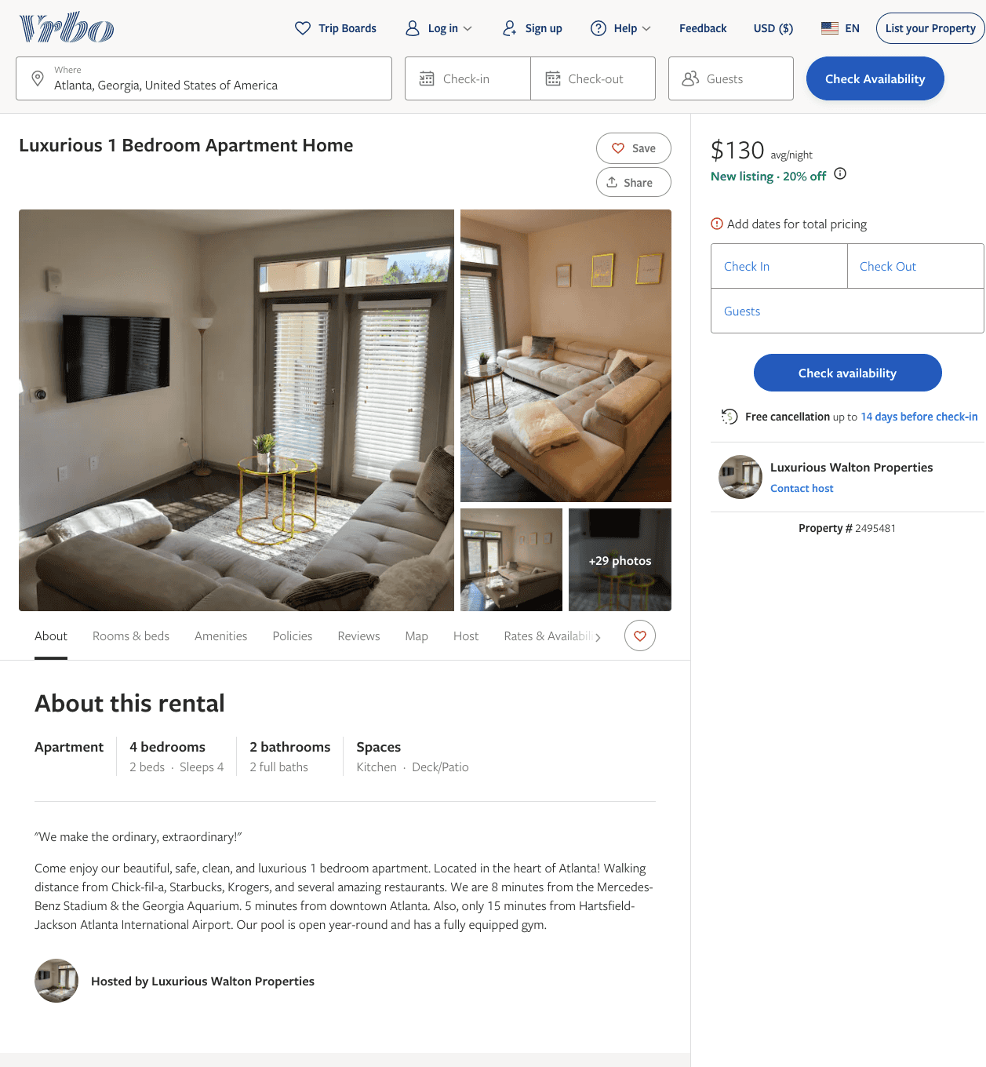
Listing 2495481
1
4
$100 - $96
5
2
Luxurious Walton Properties
https://www.vrbo.com/2495481
Aug 2022

Slide 30
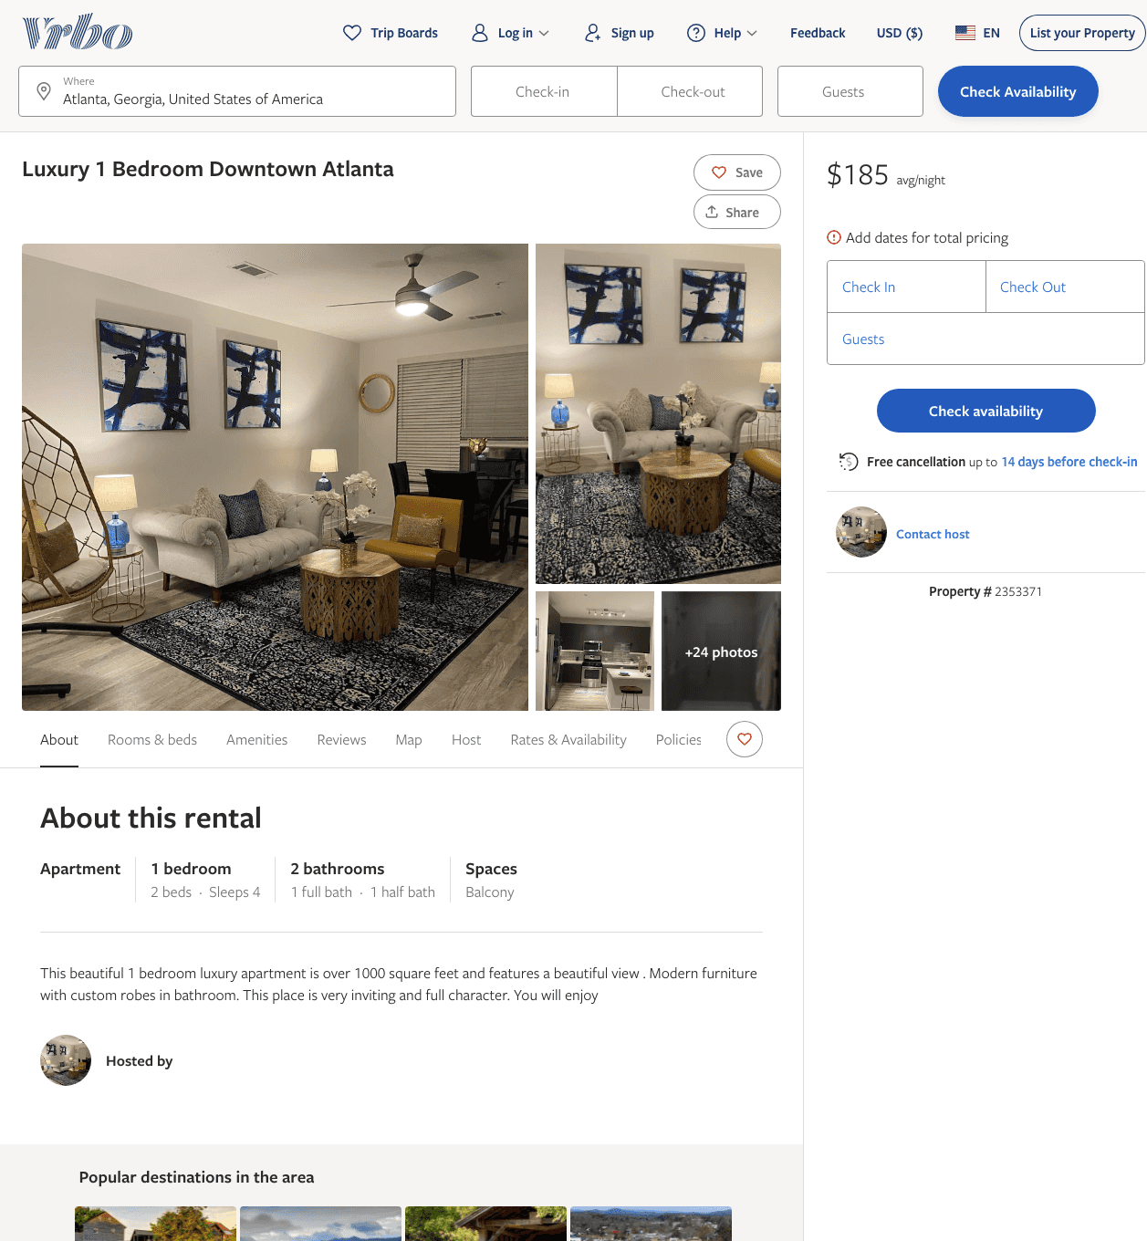
Listing 2353371
1
4
$185
2
1
https://www.vrbo.com/2353371
Aug 2022

Slide 31
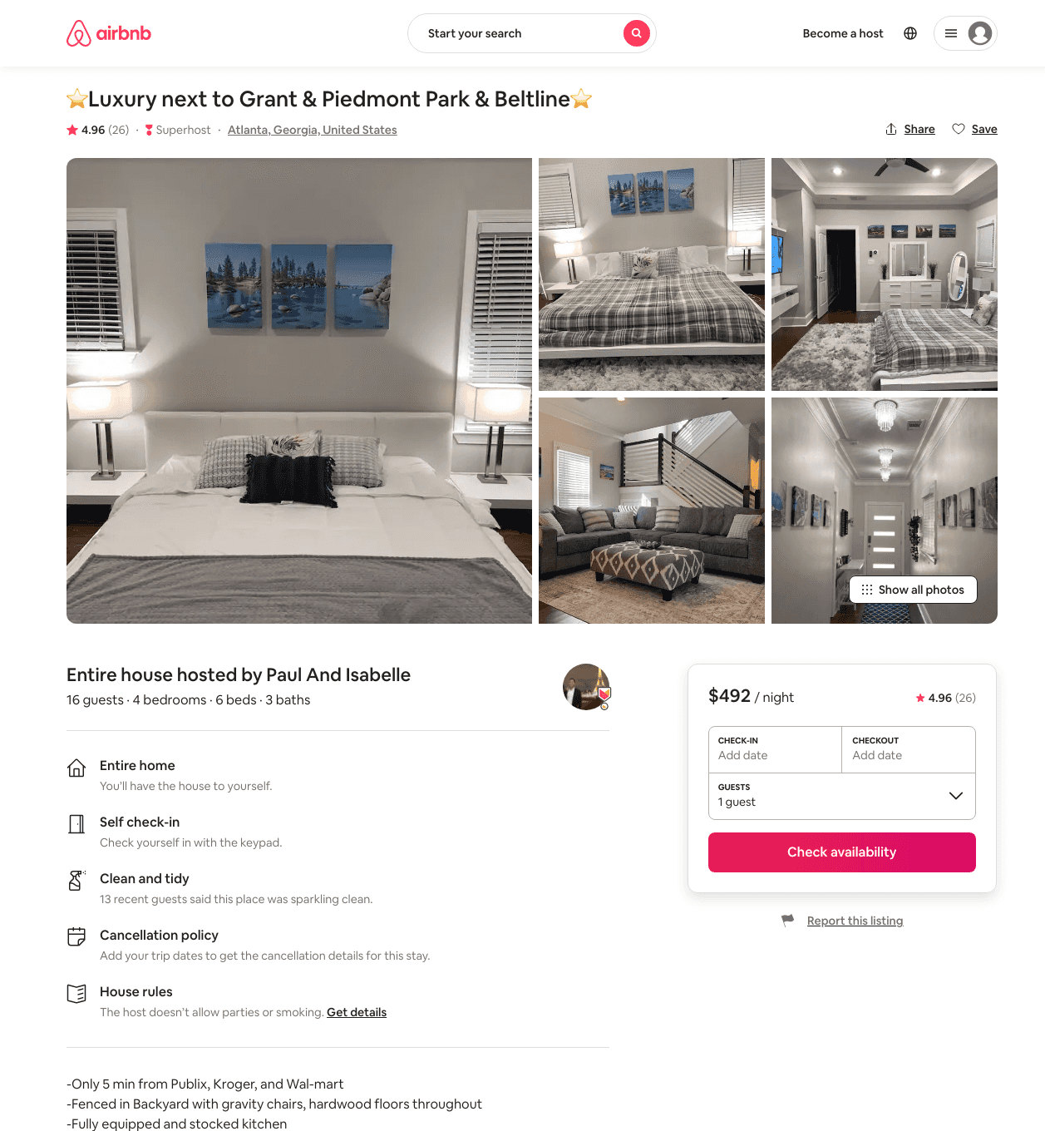
Listing 41579745
4
16
$277 - $588
4.94
3
Paul And Isabelle
10059301
2
https://www.airbnb.com/rooms/41579745
Aug 2022

Slide 32
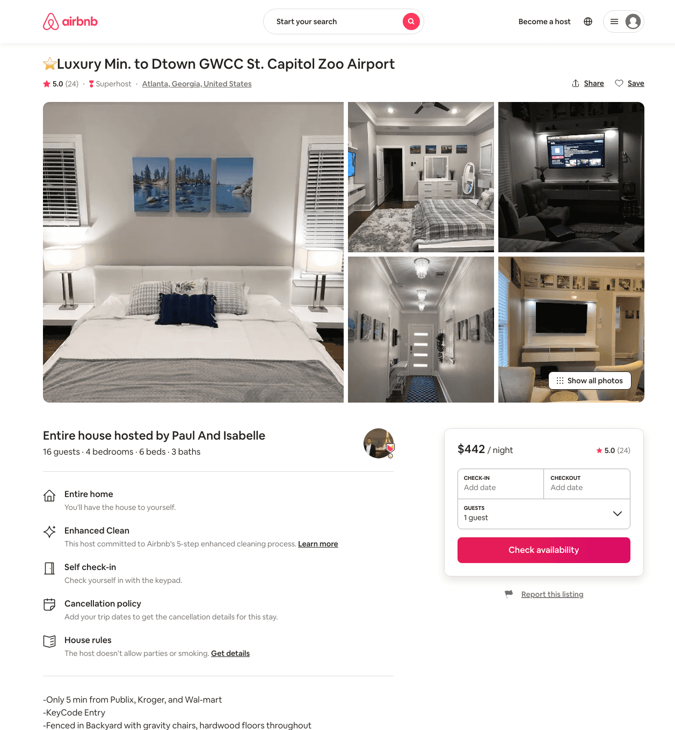
Listing 40740546
4
16
$392 - $969
5.0
3
Paul And Isabelle
10059301
2
https://www.airbnb.com/rooms/40740546
Aug 2022

Slide 33
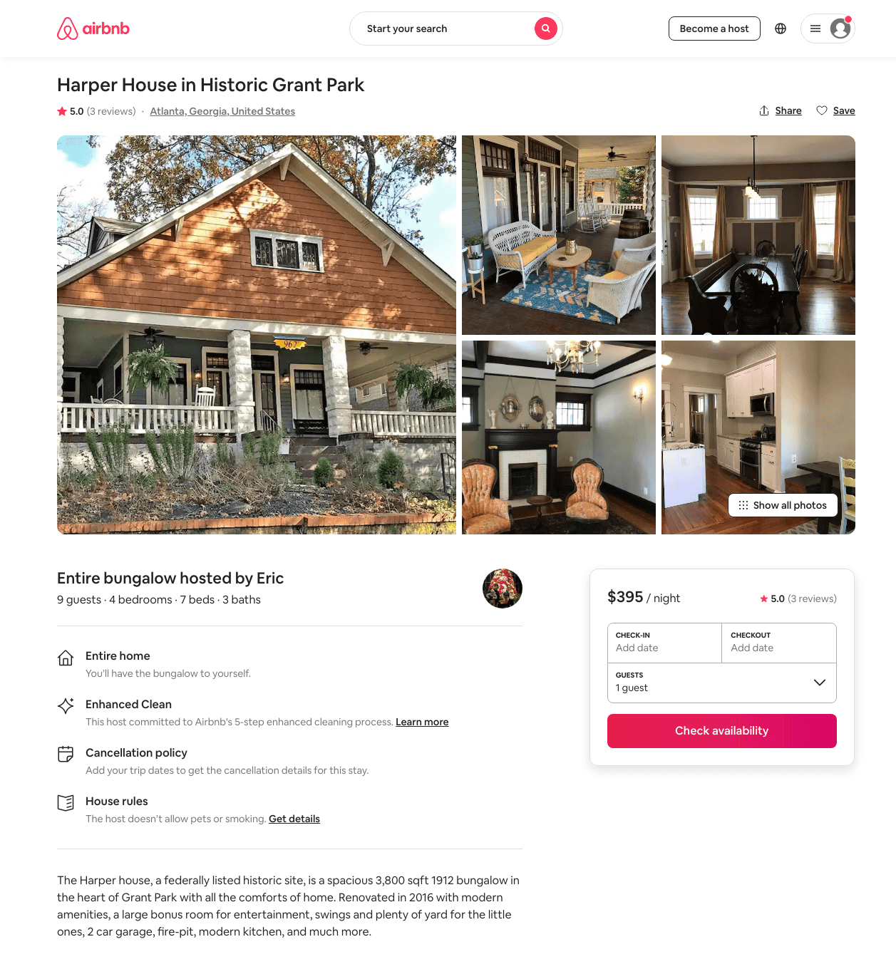
Listing 30667600
4
9
$395
5.0
14
Eric
8831749
1
https://www.airbnb.com/rooms/30667600
Aug 2022

Slide 34
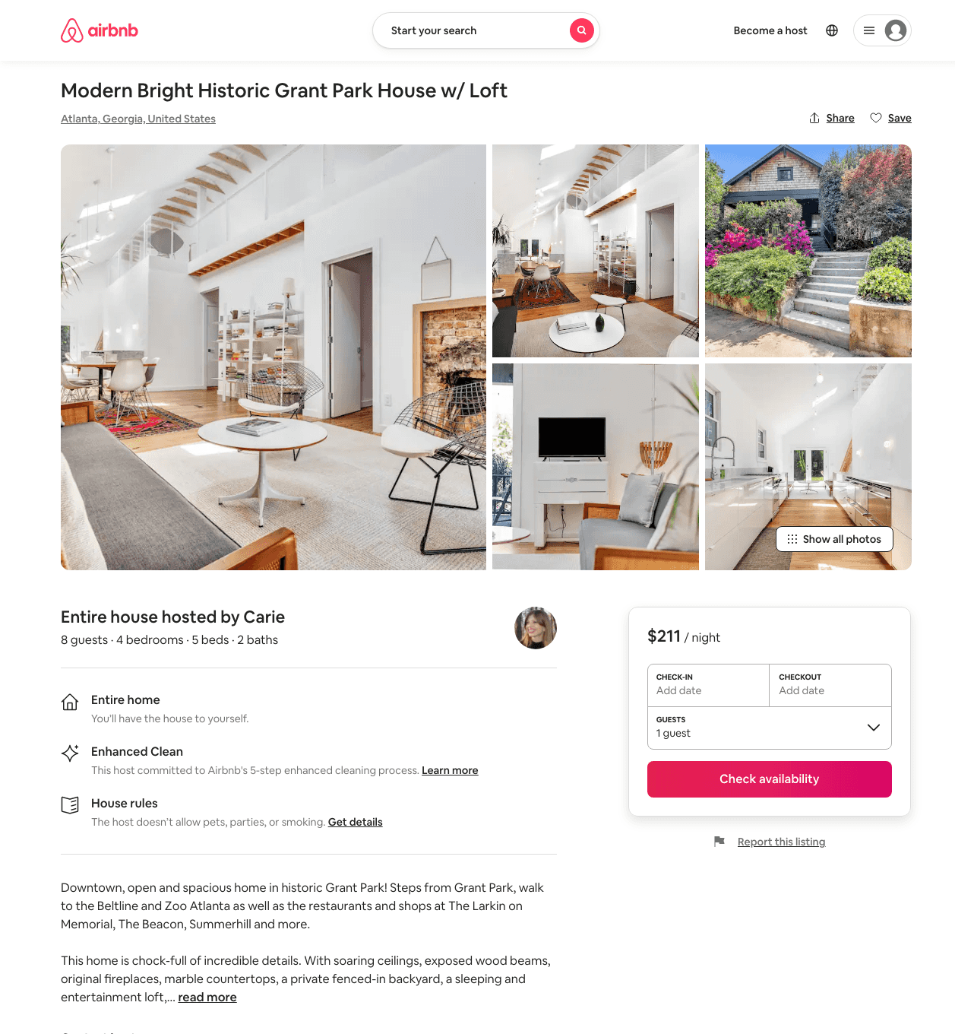
Listing 49170042
4
8
$195 - $394
4.85
2
Carie
13825427
1
https://www.airbnb.com/rooms/49170042
Aug 2022

Slide 35
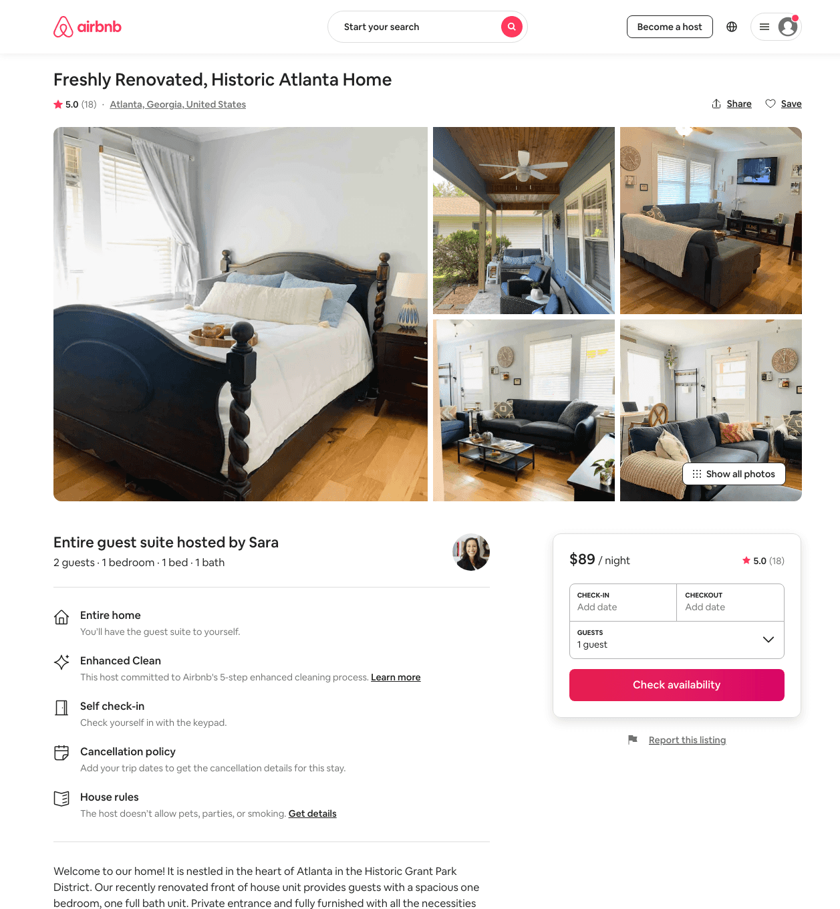
Listing 44402986
1
2
$88 - $119
4.99
1
Sara
267712469
1
https://www.airbnb.com/rooms/44402986
Aug 2022

Slide 36
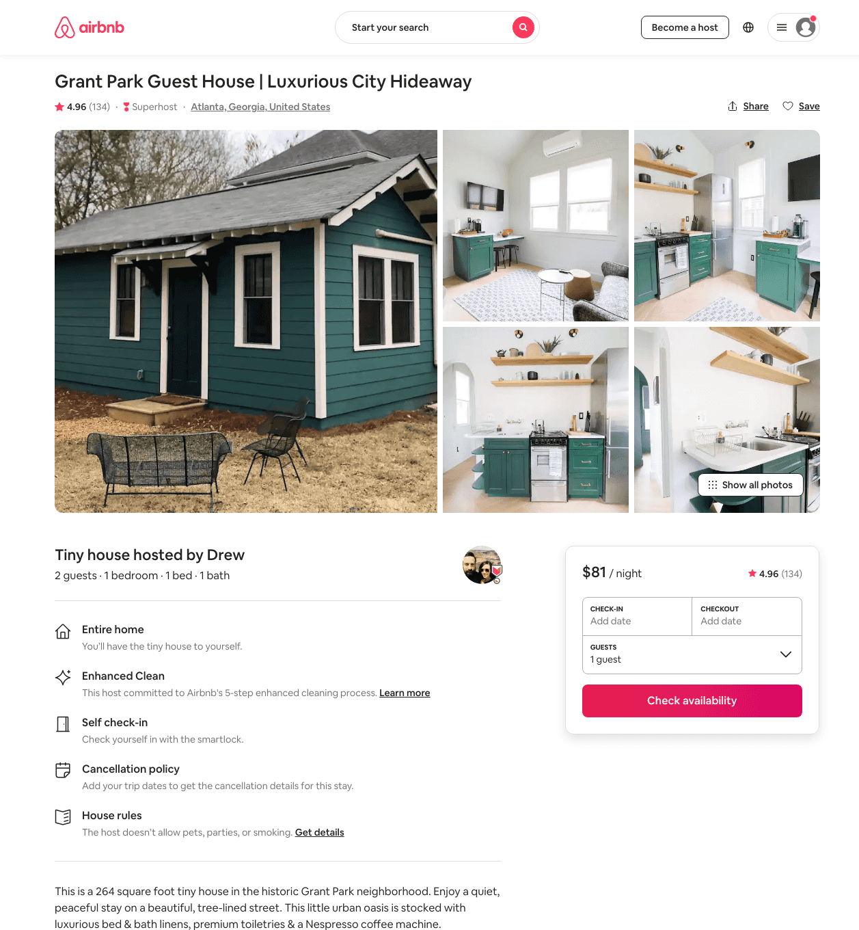
Listing 24120415
1
2
$81 - $91
4.96
2
Drew
175551049
1
https://www.airbnb.com/rooms/24120415
Aug 2022

Slide 37
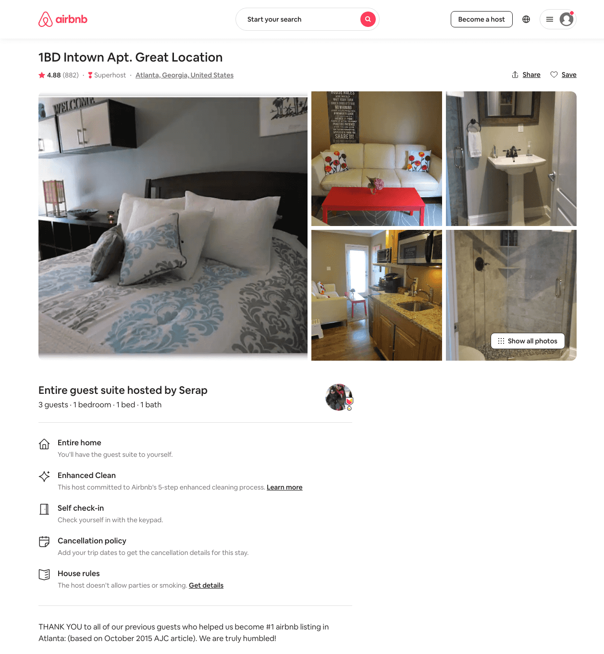
Listing 1994270
1
3
$86
4.87
1
Serap
9195747
1
https://www.airbnb.com/rooms/1994270
Aug 2022

Slide 38
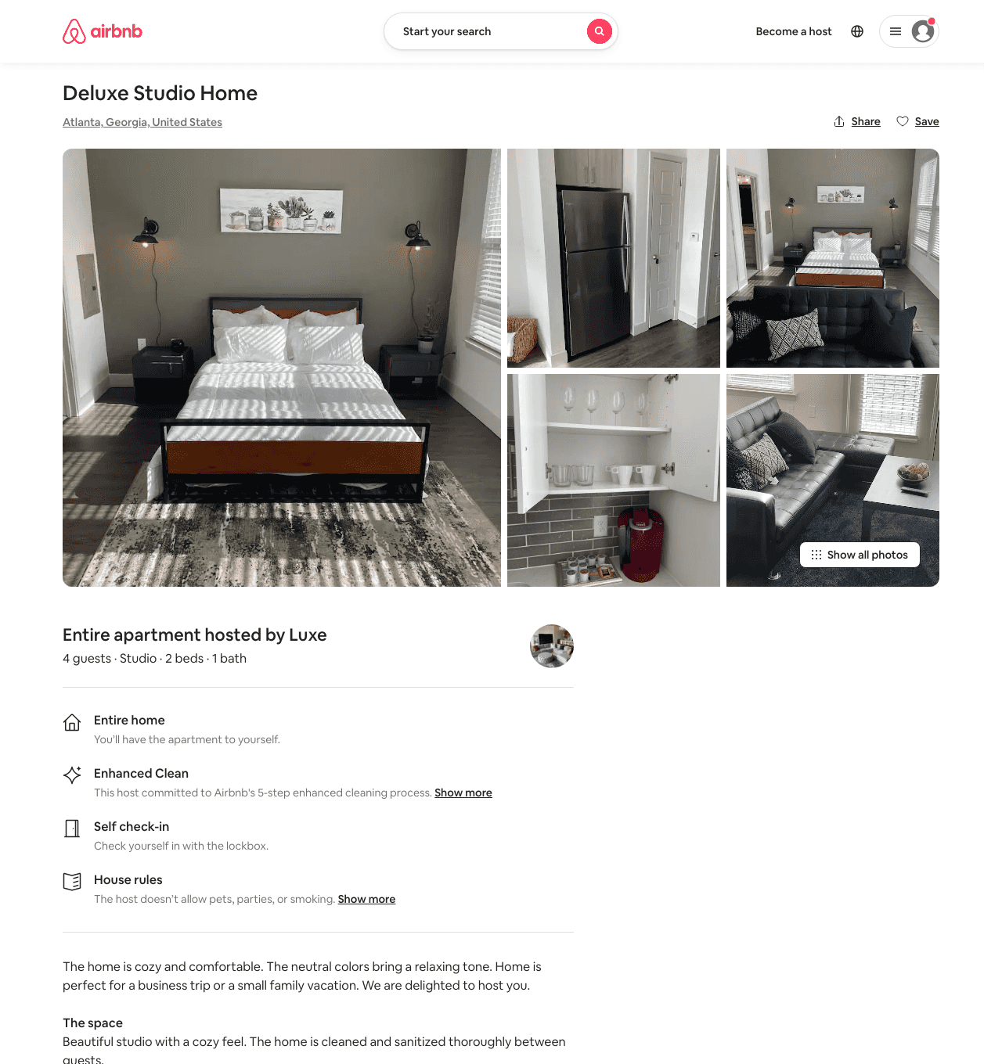
Listing 49907535
Studio
4
$65 - $123
4.65
1
Luxe
402203952
3
https://www.airbnb.com/rooms/49907535
Aug 2022

Slide 39
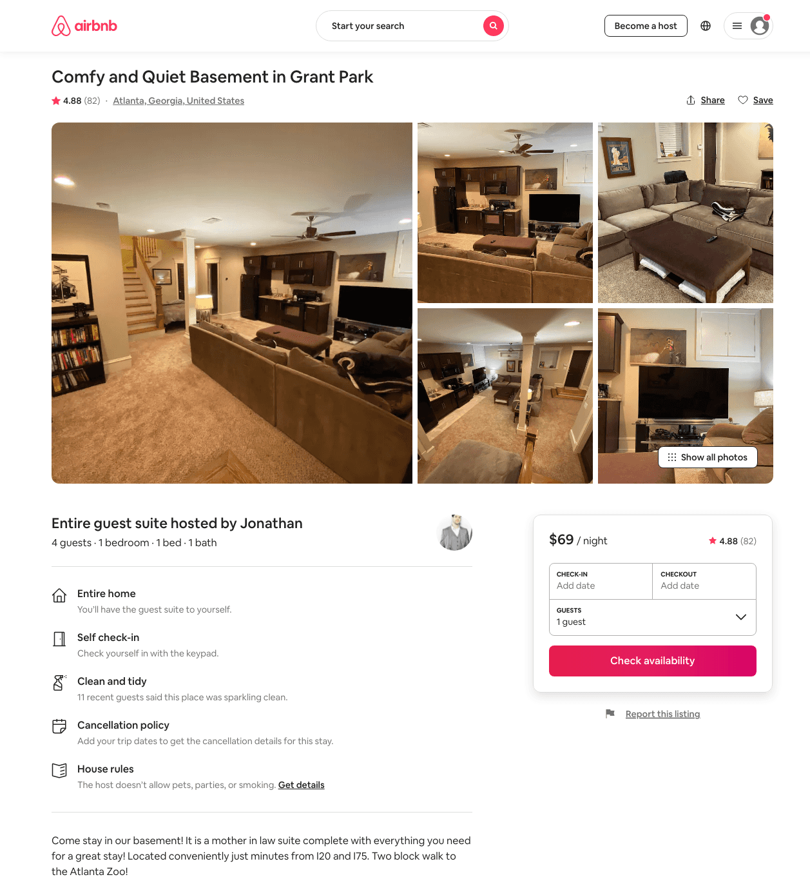
Listing 39060876
Studio
4
$70 - $81
4.79
1
Jonathan
15736612
1
https://www.airbnb.com/rooms/39060876
Aug 2022

Slide 40
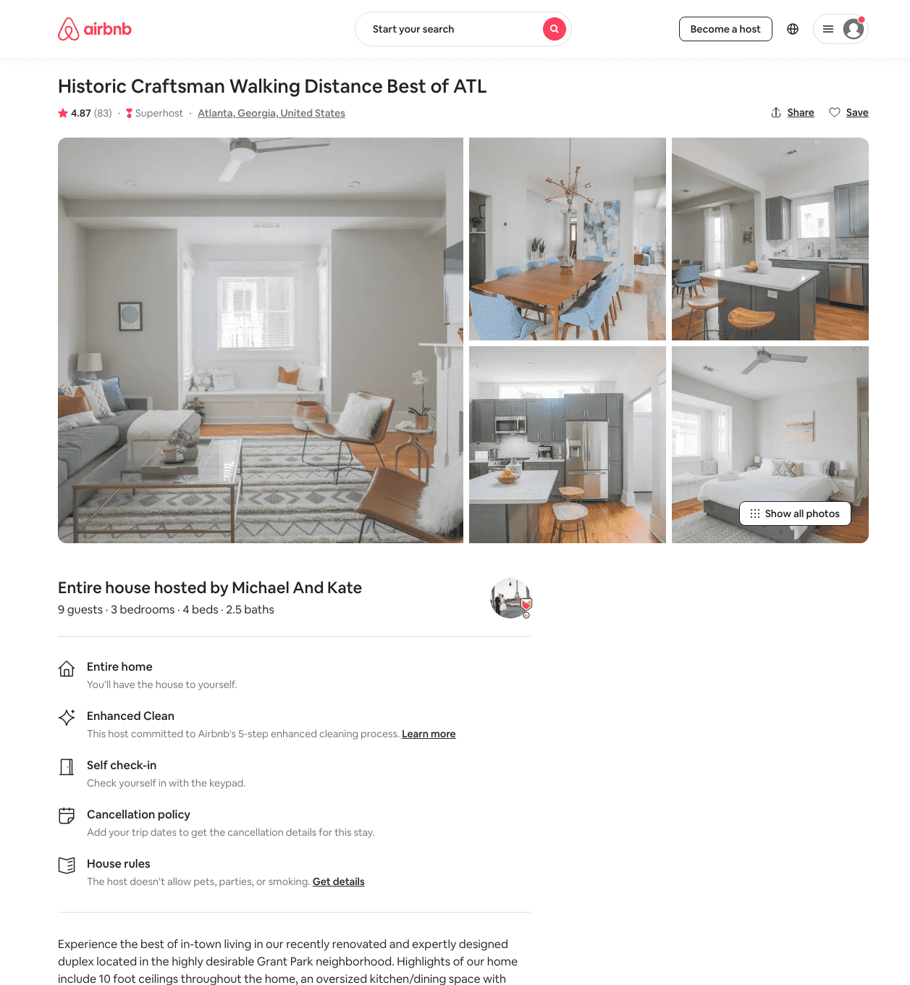
Listing 39940072
3
8
$132 - $299
4.91
2
Riaz
307872842
1
https://www.airbnb.com/rooms/39940072
Aug 2022

Slide 41
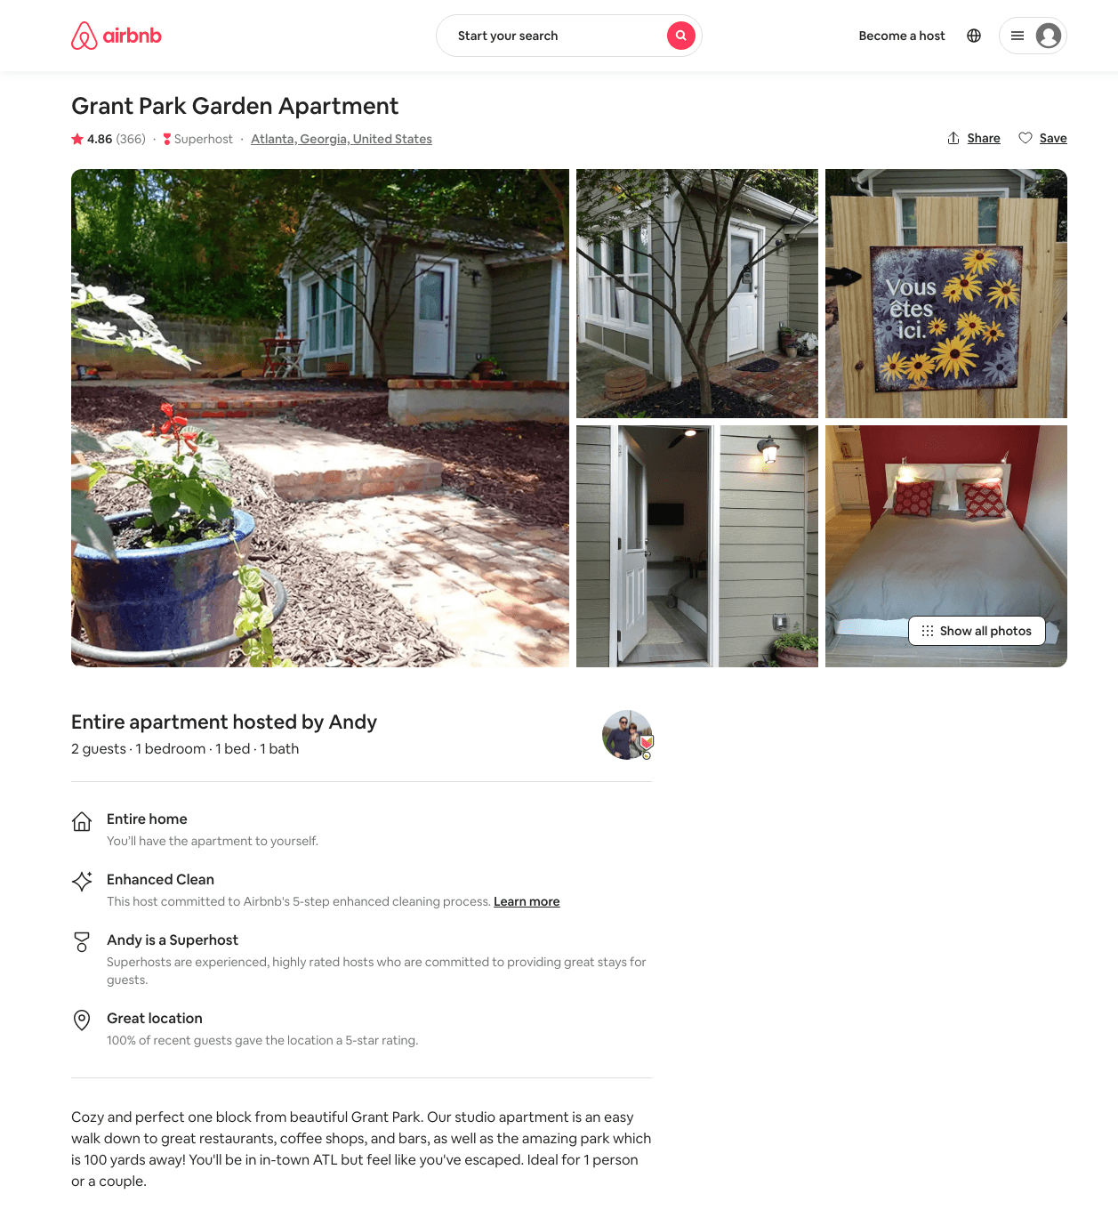
Listing 6729310
1
2
$81 - $93
4.85
2
Andy
7632523
1
https://www.airbnb.com/rooms/6729310
Aug 2022

Slide 42
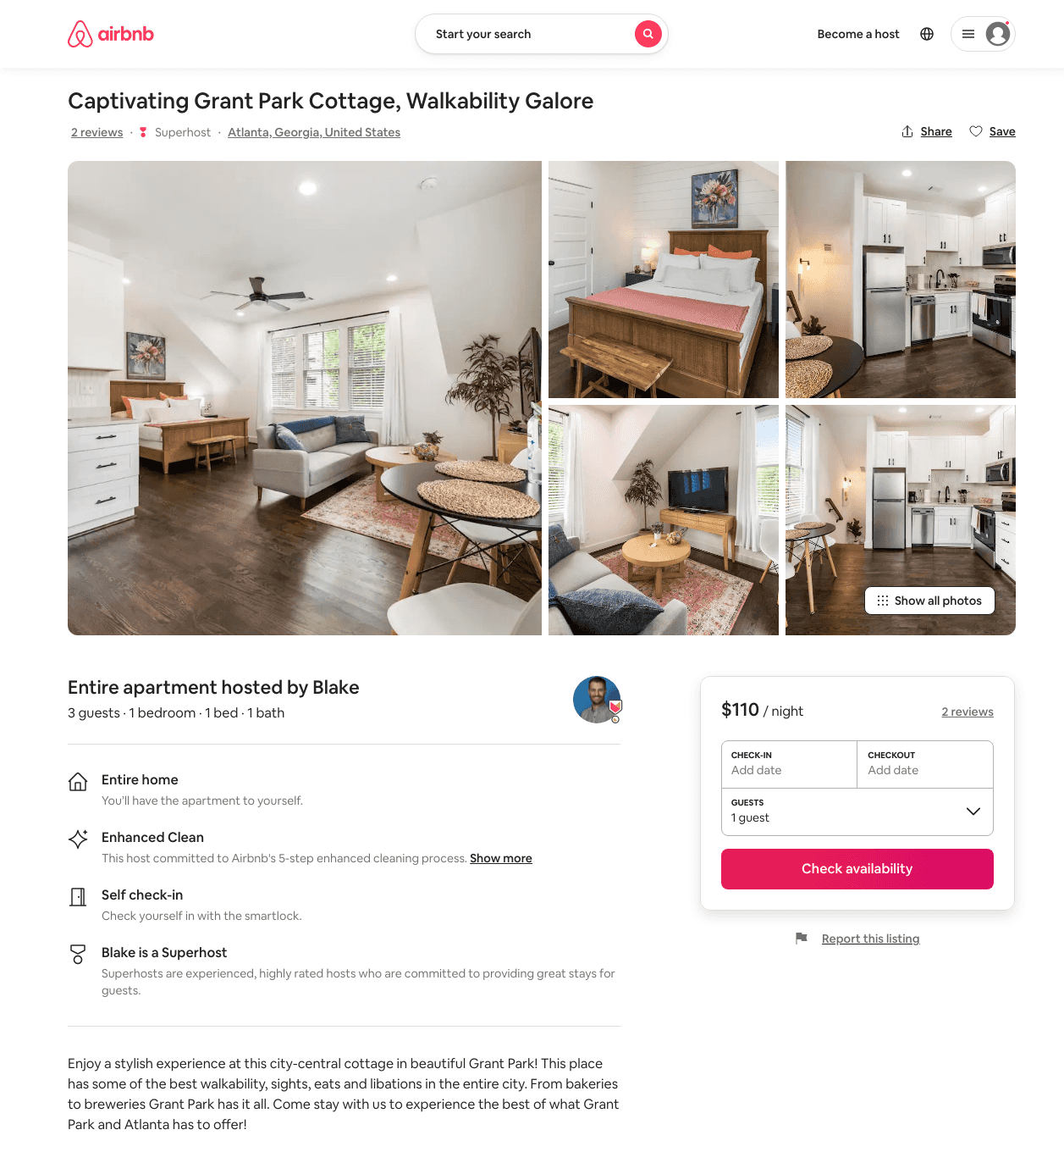
Listing 50062117
1
3
$85 - $114
4.82
2
Blake
81660490
10
https://www.airbnb.com/rooms/50062117
Aug 2022

Slide 43
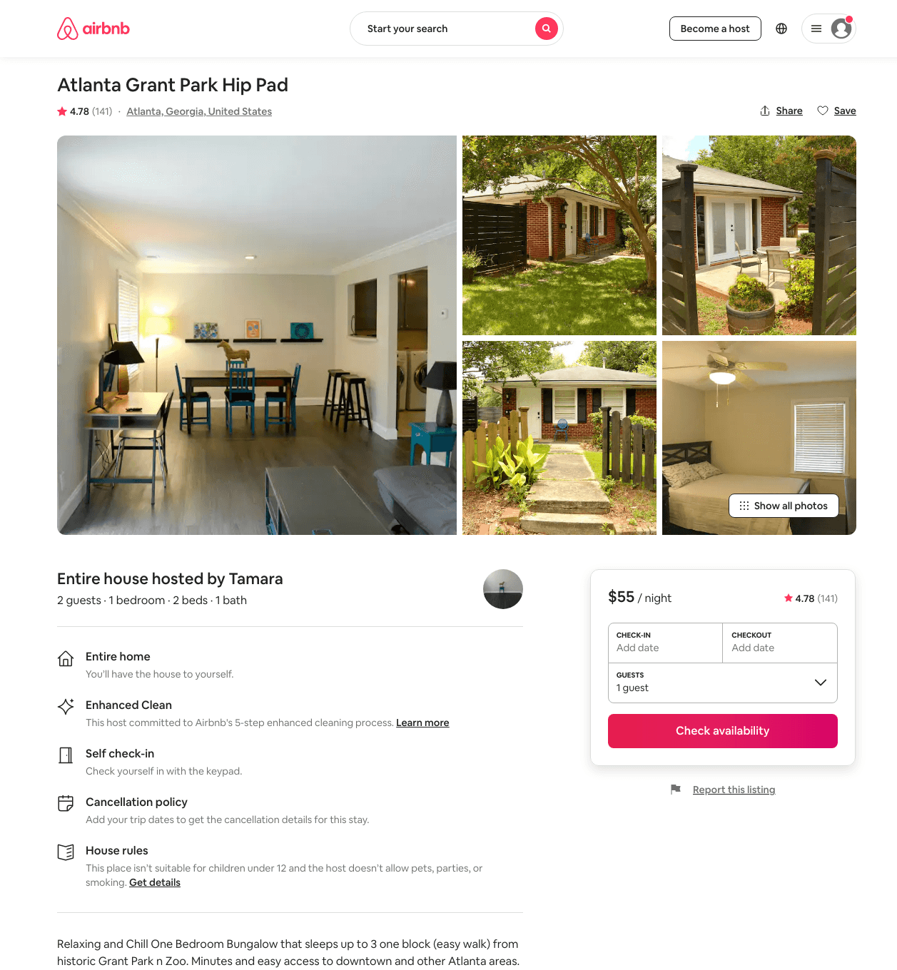
Listing 19128569
1
2
$55 - $114
4.78
3
Tamara
4525727
3
https://www.airbnb.com/rooms/19128569
Aug 2022

Slide 44
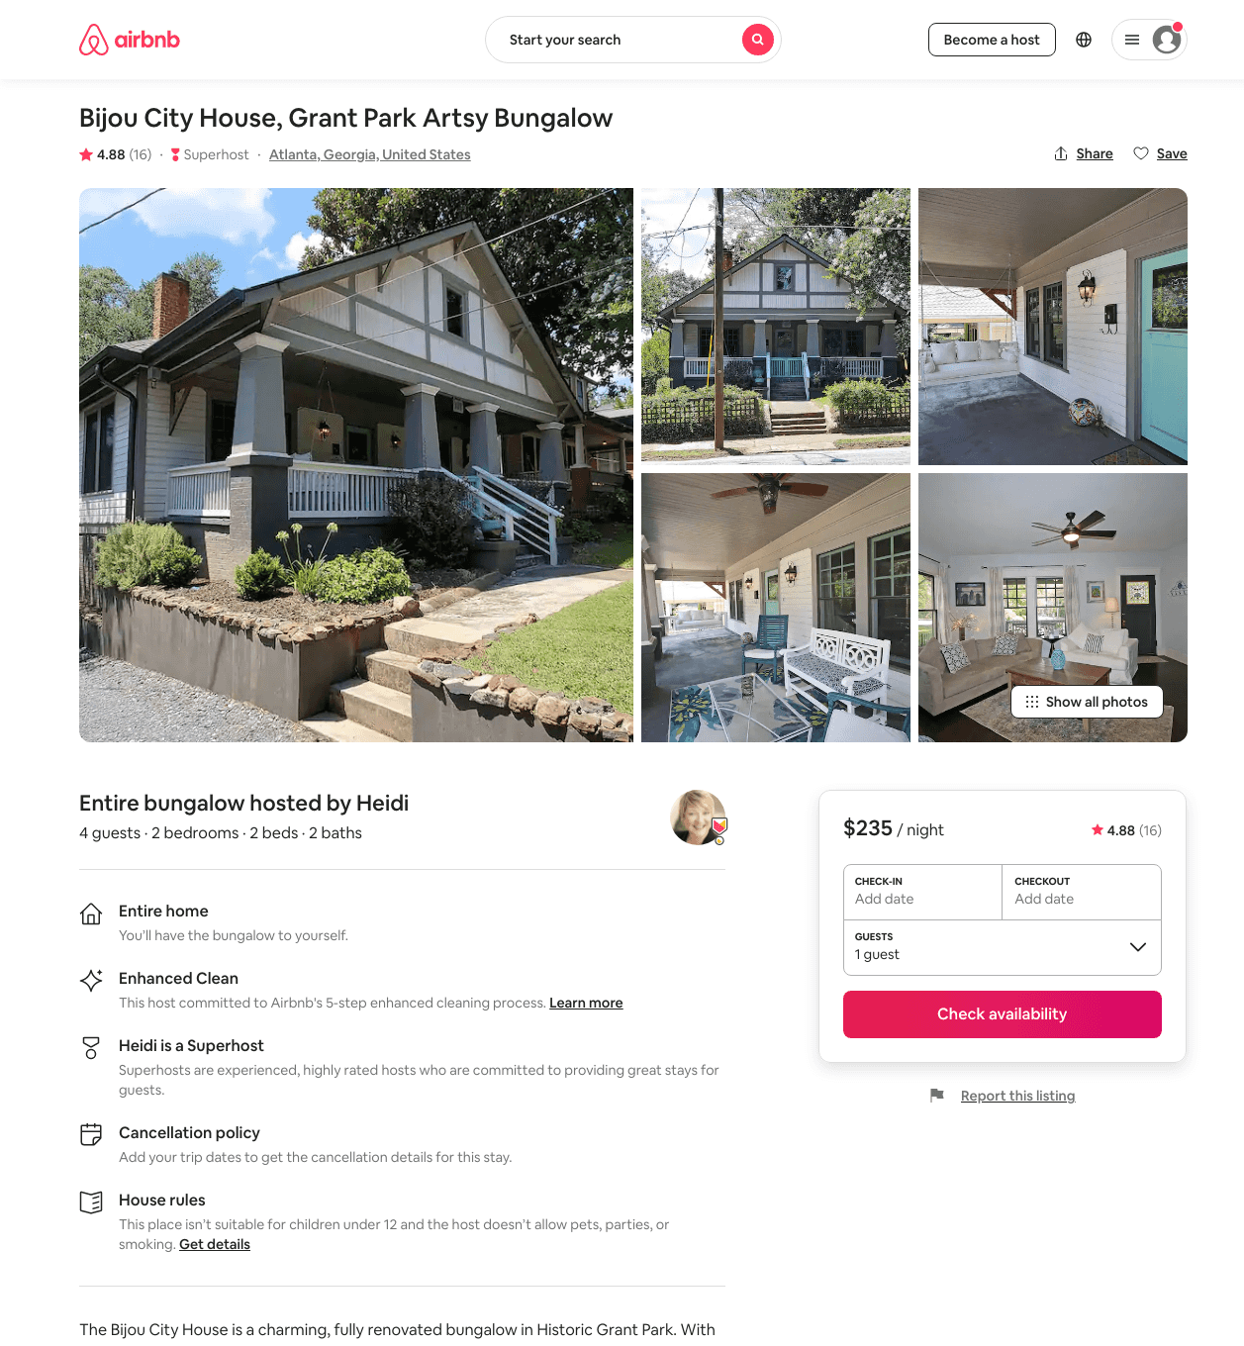
Listing 45470803
2
4
$235 - $238
4.86
2
Heidi
91582024
6
https://www.airbnb.com/rooms/45470803
Aug 2022

Slide 45
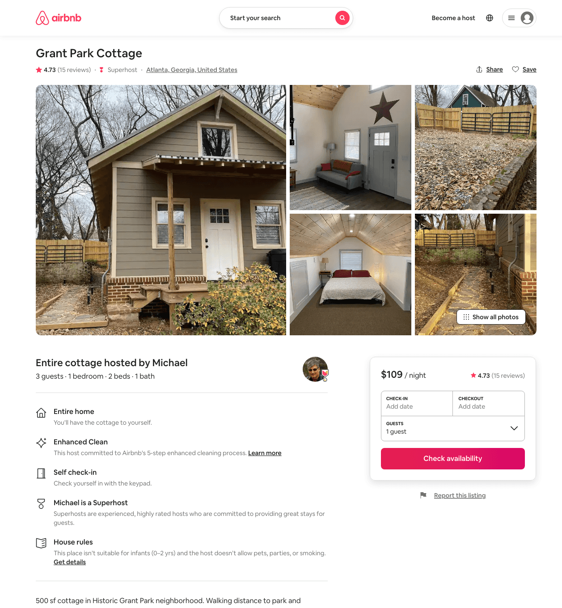
Listing 44609765
1
3
$99 - $130
4.84
2
Michael
231276165
1
https://www.airbnb.com/rooms/44609765
Aug 2022

Slide 46
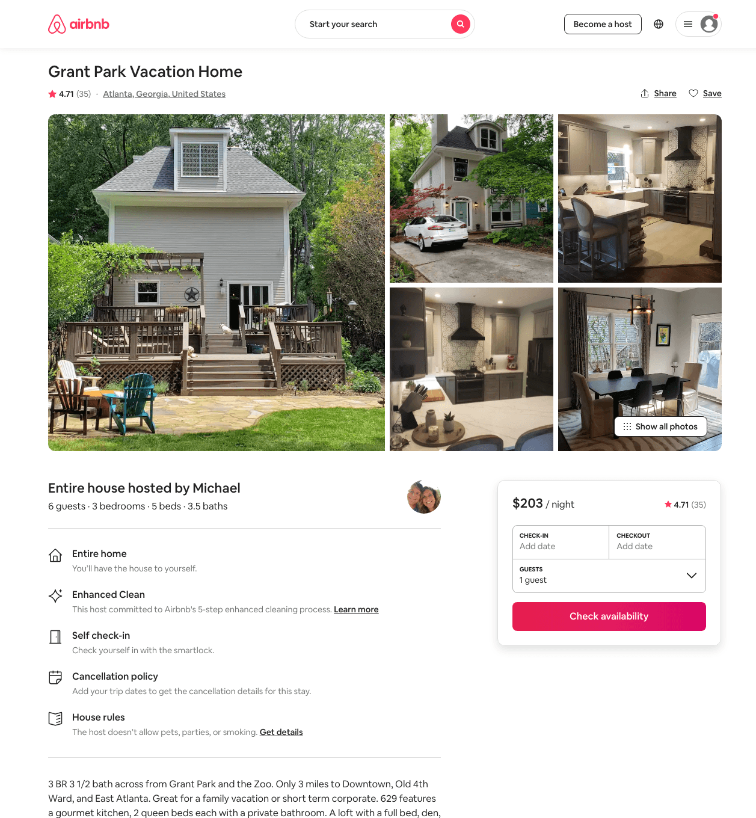
Listing 34840257
3
6
$191 - $275
4.78
3
Michael
27643298
1
https://www.airbnb.com/rooms/34840257
Aug 2022

Slide 47
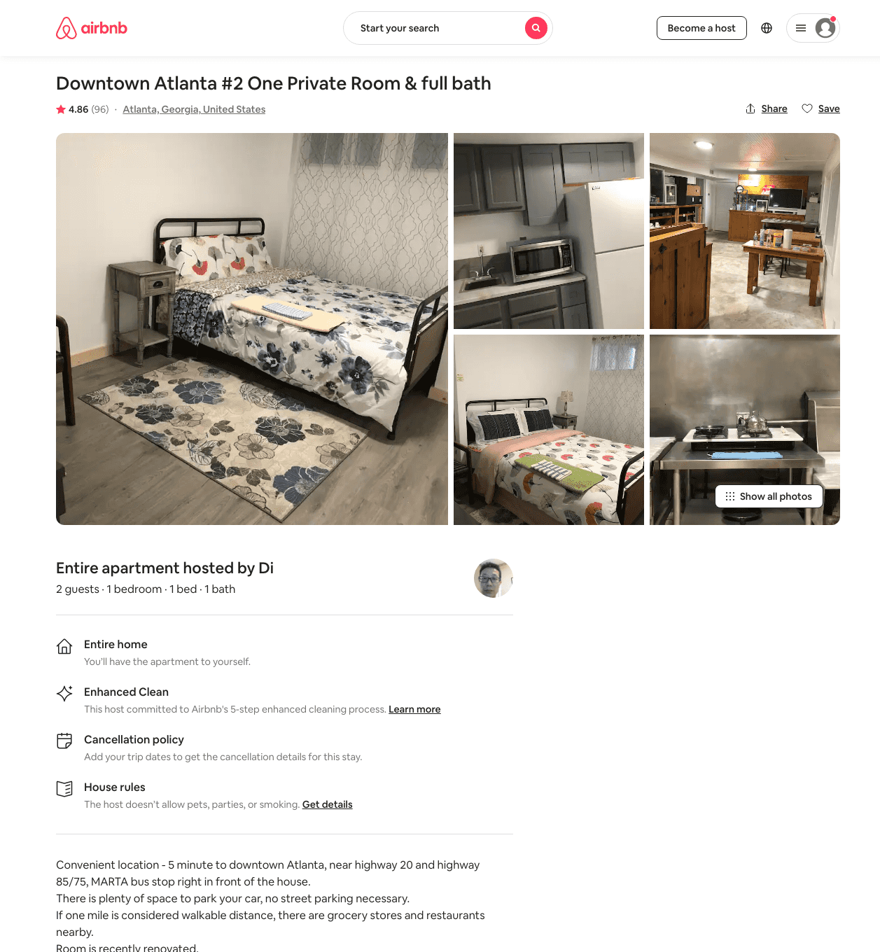
Listing 31993772
1
2
$52 - $70
4.84
1
Di
67365102
3
https://www.airbnb.com/rooms/31993772
Jul 2022

Slide 48
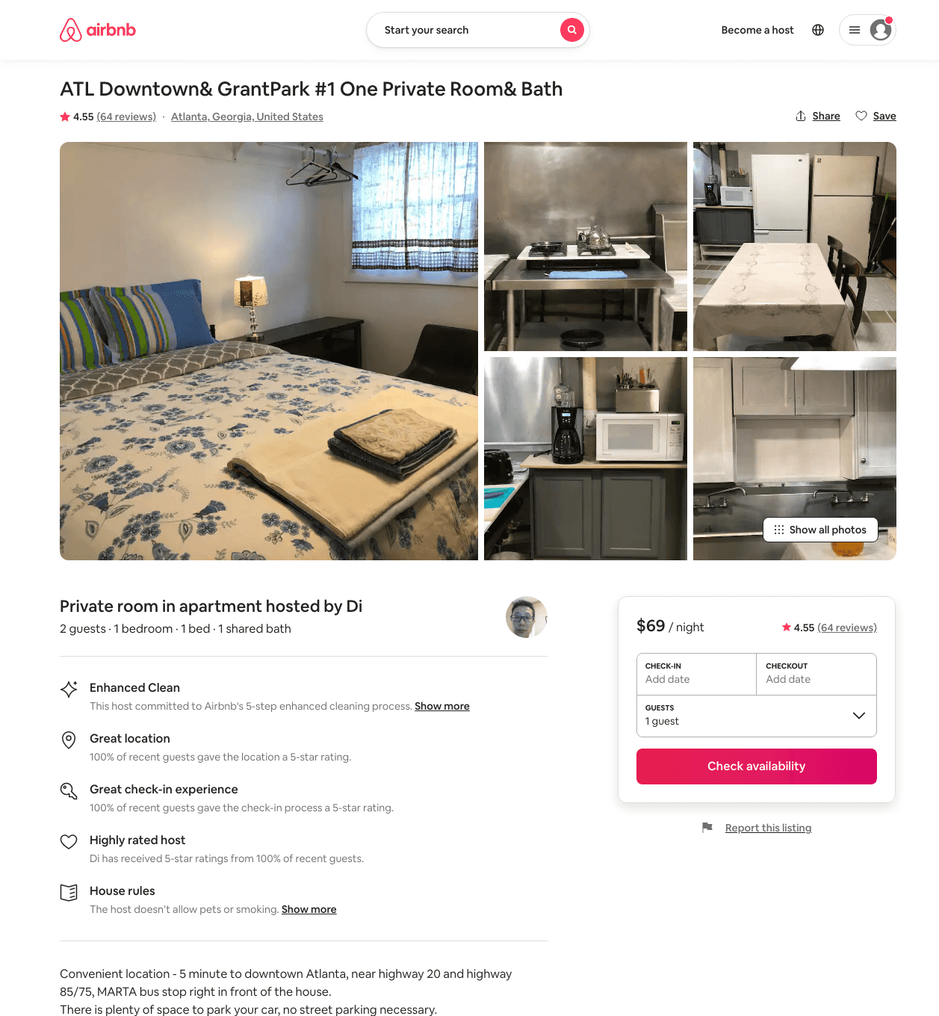
Listing 31897993
1
2
$52 - $70
4.67
1
Di
67365102
3
https://www.airbnb.com/rooms/31897993
Jul 2022

Slide 49
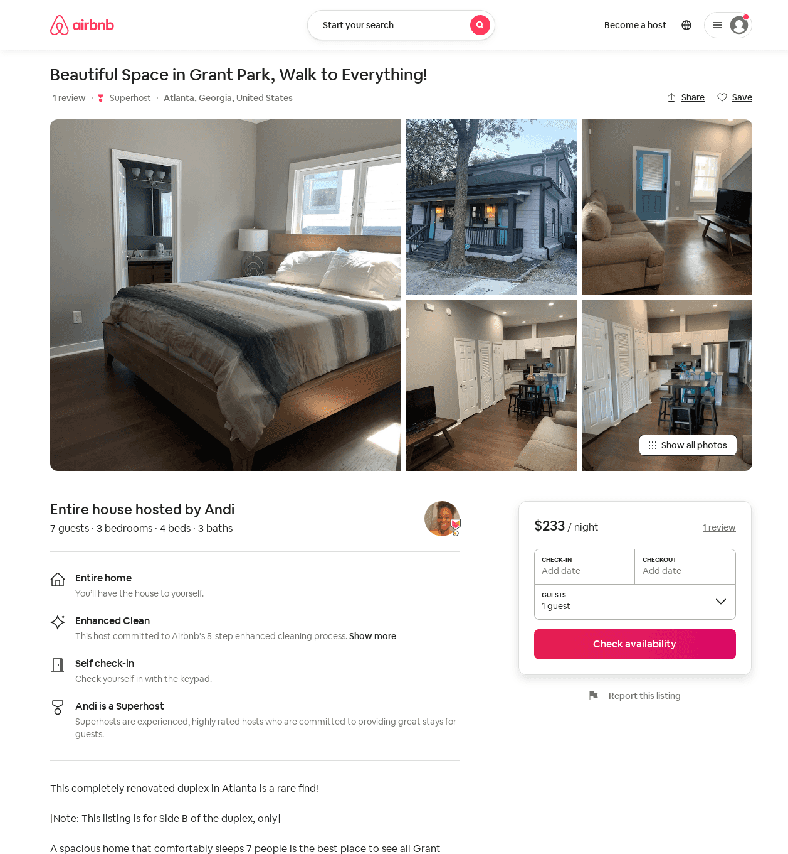
Listing 49471132
3
7
$175 - $289
4.89
1
Andi
132103752
7
https://www.airbnb.com/rooms/49471132
Aug 2022

Slide 50
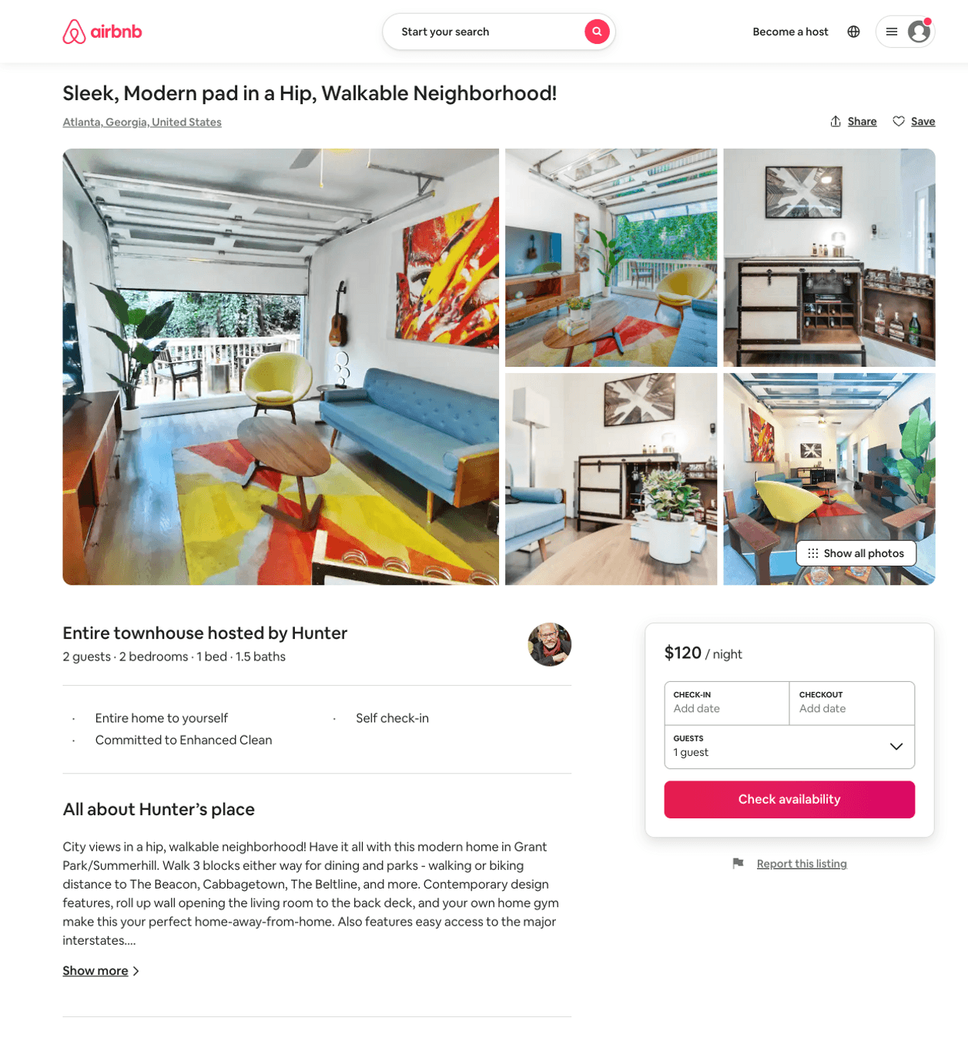
Listing 48343347
2
2
$120 - $130
5.0
31
Hunter
22733192
1
https://www.airbnb.com/rooms/48343347
Aug 2022

Slide 51
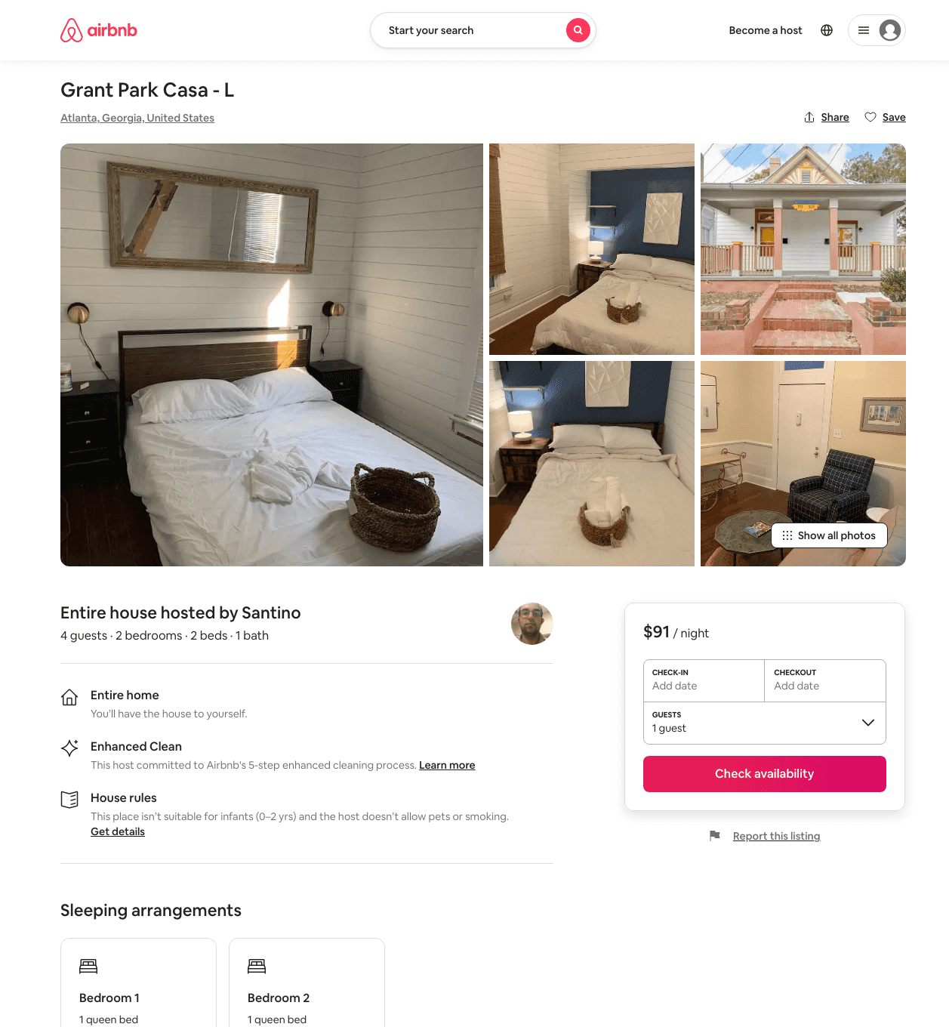
Listing 49157458
2
4
$83 - $119
4.81
21
Santino
38352091
2
https://www.airbnb.com/rooms/49157458
Aug 2022

Slide 52
Listing 47927770
3
6
$121 - $216
4.75
1
Maya
3531733
1
https://www.airbnb.com/rooms/47927770
Aug 2022

Slide 53
Listing 8532478
3
10
$123 - $209
4.81
2
Susan & Deji
9970005
1
https://www.airbnb.com/rooms/8532478
Aug 2022

Slide 54
Listing 31207796
2
6
$139
4.97
1
Gigi
45459553
1
https://www.airbnb.com/rooms/31207796
Aug 2022

Slide 55
Listing 18755686
1
2
$129
4.97
2
Phil & Susan
8057517
1
https://www.airbnb.com/rooms/18755686
Jun 2022

Slide 56
Listing 33586633
1
1
$40 - $46
4.46
14
Kelly
139330113
2
https://www.airbnb.com/rooms/33586633
Aug 2022

Slide 57
Listing 44267646
7
15
$701 - $1102
5.0
3
Peter
161047659
1
https://www.airbnb.com/rooms/44267646
Aug 2022

Slide 58
Listing 49080958
6
14
$341 - $655
4.89
1
Andi
132103752
7
https://www.airbnb.com/rooms/49080958
Aug 2022

Slide 59
Listing 29026413
3
6
$650 - $1329
5.0
2
Monica
17266151
2
https://www.airbnb.com/rooms/29026413
Aug 2022

Slide 60
Listing 48611137
2
5
$160 - $255
4.90
2
Minty
3976298
79
https://www.airbnb.com/rooms/48611137
Aug 2022

Slide 61
Listing 30927379
1
2
$125 - $206
5.0
2
Eli
92711068
2
https://www.airbnb.com/rooms/30927379
Aug 2022

Slide 62
Listing 42293607
1
3
$94 - $218
5.0
4
Taylor
79718319
1
https://www.airbnb.com/rooms/42293607
Aug 2022

Slide 63
Listing 47842764
2
4
$139 - $164
4.98
2
Nicole
69105159
1
https://www.airbnb.com/rooms/47842764
Jul 2022

Slide 64
Listing 24993534
Studio
4
$91 - $147
4.98
2
Jack
185025999
1
https://www.airbnb.com/rooms/24993534
Aug 2022

Slide 65
Listing 48822939
6
16
$505 - $736
5.0
3
Rory
350506020
9
https://www.airbnb.com/rooms/48822939
Aug 2022

Slide 66
Listing 29707148
4
10
$600
4
Quincy
27147063
3
https://www.airbnb.com/rooms/29707148
Aug 2022

Slide 67
Listing 49157656
1
2
$75 - $97
4.88
24
Santino
38352091
2
https://www.airbnb.com/rooms/49157656
Aug 2022

Slide 68
Listing 50768123
1
5
$85 - $142
4.86
2
Cherrelle
38269828
1
https://www.airbnb.com/rooms/50768123
Jun 2022

Slide 69
Listing 25440979
1
2
$56 - $132
4.72
3
Tamara
4525727
3
https://www.airbnb.com/rooms/25440979
Aug 2022

Slide 70
Listing 22000163
1
2
$102 - $114
5.0
2
Lindsey
20119664
1
https://www.airbnb.com/rooms/22000163
Aug 2022

Slide 71
Listing 11094712
1
5
$70
4.91
2
Ian
27414411
1
https://www.airbnb.com/rooms/11094712
Jun 2022

Slide 72
Listing 7658872
1
3
$97 - $150
4.90
2
Jim And Jeanne
20578221
1
https://www.airbnb.com/rooms/7658872
Aug 2022

Slide 73
Listing 11920065
1
2
$84 - $116
4.75
2
Catherine
14731488
1
https://www.airbnb.com/rooms/11920065
Aug 2022

Slide 74
Listing 14557184
1
2
$45 - $77
4.91
2
Terhas
61178792
1
https://www.airbnb.com/rooms/14557184
Aug 2022

Slide 75
Listing 7453539
1
2
$73
5.0
2
Cindy
25373416
1
https://www.airbnb.com/rooms/7453539
Aug 2022

Slide 76
Listing 49588258
1
3
$152 - $375
3.75
1
Andi
132103752
7
https://www.airbnb.com/rooms/49588258
Aug 2022

Slide 77
Listing 11910571
3
6
$225 - $2000
31
Lyn
24301339
1
https://www.airbnb.com/rooms/11910571
Jun 2022

Slide 78
Listing 217338
1
3
$250
4.95
6
M. C.
1007214
2
https://www.airbnb.com/rooms/217338
Aug 2022

Slide 79
Listing 50794354
1
2
$37 - $70
4.97
1
Arthur
229116947
1
https://www.airbnb.com/rooms/50794354
Aug 2022

Slide 80
Listing 36202103
Studio
3
$84 - $94
5.0
3
Sara
265782426
1
https://www.airbnb.com/rooms/36202103
Jun 2022

Slide 81
Listing 4845946
3
6
$143 - $219
4.90
1
William
21699193
1
https://www.airbnb.com/rooms/4845946
Aug 2022

Slide 82
Listing 31545222
Studio
2
$75 - $85
4.90
5
J.
65083876
1
https://www.airbnb.com/rooms/31545222
Aug 2022

Slide 83
Listing 50854550
1
2
$112 - $192
4.96
2
Mignon
79071941
2
https://www.airbnb.com/rooms/50854550
Aug 2022

Slide 84
Listing 26875248
2
3
$120 - $122
4.89
6
Sarah
104884
1
https://www.airbnb.com/rooms/26875248
Aug 2022

Slide 85
Listing 29215625
2
4
$111 - $125
4.93
4
Robert & Moraima
21127804
2
https://www.airbnb.com/rooms/29215625
Jun 2022

Slide 86
Listing 23681877
2
4
$132 - $153
4.98
2
Elizabeth
177354207
1
https://www.airbnb.com/rooms/23681877
Aug 2022

Slide 87
Listing 49577064
1
2
$144 - $375
5.0
1
Andi
132103752
7
https://www.airbnb.com/rooms/49577064
Jun 2022

Slide 88
Listing 21408900
4
10
$140 - $198
4.75
3
Hope
124143732
9
https://www.airbnb.com/rooms/21408900
Aug 2022

Slide 89
Listing 48168292
2
4
$139 - $149
4.96
2
Heidi
91582024
6
https://www.airbnb.com/rooms/48168292
Jun 2022

Slide 90
Listing 39320613
1
2
$99 - $174
5.0
30
Renata
296746092
2
https://www.airbnb.com/rooms/39320613
Aug 2022

Slide 91
Listing 14929957
2
4
$115 - $149
4.90
3
Glenn
16280161
1
https://www.airbnb.com/rooms/14929957
Aug 2022

Slide 92
Listing 16237921
3
8
$225 - $295
4.82
3
David
4489413
1
https://www.airbnb.com/rooms/16237921
Jun 2022

Slide 93
Listing 51002146
2
4
$99 - $315
4.88
2
Nancy
21482238
2
https://www.airbnb.com/rooms/51002146
Aug 2022

Slide 94
Listing 16025718
2
3
$189 - $241
4.80
4
Jim
104240900
1
https://www.airbnb.com/rooms/16025718
Jun 2022

Slide 95
Listing 49687132
1
2
$69 - $91
4.95
2
Mia
22378680
2
https://www.airbnb.com/rooms/49687132
Aug 2022

Slide 96
Listing 50991573
1
2
$70 - $200
4.60
3
Alex And Christina
20605441
40
https://www.airbnb.com/rooms/50991573
Aug 2022

Slide 97
Listing 51023252
1
3
$69 - $110
4.65
1
Paradise
191441686
12
https://www.airbnb.com/rooms/51023252
Aug 2022

Slide 98
Listing 10212123
2
7
$3000
3
Daniel
19354242
2
https://www.airbnb.com/rooms/10212123
Aug 2022

Slide 99
Listing 50156629
3
6
$181 - $304
4.91
3
Ashly
115142117
1
https://www.airbnb.com/rooms/50156629
Aug 2022

Slide 100
Listing 51281806
2
4
$138 - $219
5.0
2
Minty
3976298
79
https://www.airbnb.com/rooms/51281806
Aug 2022

Slide 101
Listing 51403058
1
2
$96 - $122
3
Justyna
975504
1
https://www.airbnb.com/rooms/51403058
Aug 2022

Slide 102
Listing 18812616
3
6
$109 - $286
4.93
2
Eli
92711068
2
https://www.airbnb.com/rooms/18812616
Aug 2022

Slide 103
Listing 31862341
3
6
$135 - $178
4.78
3
M. Barrett
7206739
1
https://www.airbnb.com/rooms/31862341
Aug 2022

Slide 104
Listing 31993906
1
2
$52 - $70
4.81
1
Di
67365102
3
https://www.airbnb.com/rooms/31993906
Jul 2022

Slide 105
Listing 11009576
1
4
$79 - $124
4.86
4
Quincy
27147063
3
https://www.airbnb.com/rooms/11009576
Aug 2022

Slide 106
Listing 35351752
4
12
$245 - $279
4.52
1
Ivan
124316071
1
https://www.airbnb.com/rooms/35351752
Jun 2022

Slide 107
Listing 10628095
2
5
$163 - $185
4.86
1
David
10051267
4
https://www.airbnb.com/rooms/10628095
Aug 2022

Slide 108
Listing 23882243
2
5
$116 - $225
4.62
58
Stewart
26798403
14
https://www.airbnb.com/rooms/23882243
Aug 2022

Slide 109
Listing 52269876
3
6
$560 - $950
1
Monica
17266151
2
https://www.airbnb.com/rooms/52269876
Aug 2022

Slide 110
Listing 19080311
2
4
$125 - $146
4.98
7
David
133230889
1
https://www.airbnb.com/rooms/19080311
Jun 2022

Slide 111
Listing 52457431
1
2
$81 - $120
4.73
1
Sierra
104147676
2
https://www.airbnb.com/rooms/52457431
Aug 2022

Slide 112
Listing 51583249
1
3
$87 - $119
4.68
1
Kanisha
178712833
1
https://www.airbnb.com/rooms/51583249
Aug 2022

Slide 113
Listing 28738391
2
4
$200 - $257
4.69
31
Rachel
75958418
1
https://www.airbnb.com/rooms/28738391
Aug 2022

Slide 114
Listing 52324914
1
2
$47 - $89
4.94
3
Tamara
4525727
3
https://www.airbnb.com/rooms/52324914
Aug 2022

Slide 115
Listing 52671830
2
6
$119 - $177
4.74
1
Aurelia
426370659
3
https://www.airbnb.com/rooms/52671830
Aug 2022

Slide 116
Listing 53613946
2
5
$163 - $219
4.88
2
Rba Living
97150171
6
https://www.airbnb.com/rooms/53613946
Aug 2022

Slide 117
Listing 53734674
3
8
$522 - $1500
5.0
2
Minty
3976298
79
https://www.airbnb.com/rooms/53734674
Aug 2022

Slide 118
Listing 53196168
1
2
$55 - $85
4.94
1
Courtney
102490003
1
https://www.airbnb.com/rooms/53196168
Aug 2022

Slide 119
Listing 53350824
3
6
$161 - $177
4.56
2
Sunny
23579940
3
https://www.airbnb.com/rooms/53350824
Jul 2022

Slide 120
Listing 53880850
2
6
$82 - $152
4.91
1
Karol
64976928
4
https://www.airbnb.com/rooms/53880850
Aug 2022

Slide 121
Listing 2591031
1
2
$116 - $158
4.8333335
1
Sheng Zhong
https://www.vrbo.com/2591031
Aug 2022

Slide 122
Listing 2598998
2
4
$121 - $199
5
2
Sheng Zhong
https://www.vrbo.com/2598998
Aug 2022

Slide 123
Listing 53829143
2
4
$95 - $144
5.0
1
Jackie
96553927
1
https://www.airbnb.com/rooms/53829143
Aug 2022

Slide 124
Listing 2605513
2
4
$165 - $99
4.25
2
Karol Jimenez
https://www.vrbo.com/2605513
Aug 2022

Slide 125
Listing 2620079
2
4
$152
5
1
Maria McNiece
https://www.vrbo.com/2620079
Aug 2022

Slide 126
Listing 32204525
1
2
$121 - $125
28
David & Jenn
46666704
24
https://www.airbnb.com/rooms/32204525
Aug 2022

Slide 127
Listing 53715942
1
2
$65 - $75
1
Christiane Tina
435050506
1
https://www.airbnb.com/rooms/53715942
Aug 2022

Slide 128
Listing 47795528
1
2
$110 - $134
4.39
1
LXK Stays
100582128
9
https://www.airbnb.com/rooms/47795528
Jun 2022

Slide 129
Listing 2739695
2
4
$183
5
1
James Lennon
https://www.vrbo.com/2739695
Aug 2022

Slide 130
Listing 12092455
1
2
$88 - $100
4.96
1
Susannah
55135021
1
https://www.airbnb.com/rooms/12092455
Aug 2022

Slide 131
Listing 1421400
2
4
$143
5
31
Rachel Sheehan
https://www.vrbo.com/1421400
Aug 2022

Slide 132
Listing 2821932
1
6
$187
2
https://www.vrbo.com/2821932
Aug 2022

Slide 133
Listing 2846093
4
8
$274
2
VNTR HOMES
https://www.vrbo.com/2846093
Aug 2022

Slide 134
Listing 2861499
1
4
$150
1
https://www.vrbo.com/2861499
Aug 2022

Slide 135
Listing 2872785
1
4
$200
5
https://www.vrbo.com/2872785
Aug 2022

Slide 136
Listing 2869632
4
10
$255
5
2
Jay Davis
https://www.vrbo.com/2869632
Aug 2022

Slide 137
Listing 2857144
3
6
$286
5
1
Michael Harvey
https://www.vrbo.com/2857144
Aug 2022

Slide 138
Listing 2889902
5
10
$169
5
2
Vacasa of Georgia
https://www.vrbo.com/2889902
Aug 2022

Slide 139
Listing 22530534
1
2
4.79
1
Rutu
165444241
1
https://www.airbnb.com/rooms/22530534
Aug 2022

Slide 140
Listing 2962121
1
2
$142
2
Minty Living
https://www.vrbo.com/2962121
Aug 2022

Slide 141
Listing 2962114
1
2
$92
2
Minty Living
https://www.vrbo.com/2962114
Aug 2022

Slide 142
Listing 2962093
3
5
$185
2
Minty Living
https://www.vrbo.com/2962093
Aug 2022

Slide 143
Listing 2962112
3
8
$458
2
Minty Living
https://www.vrbo.com/2962112
Aug 2022

