Slide 2
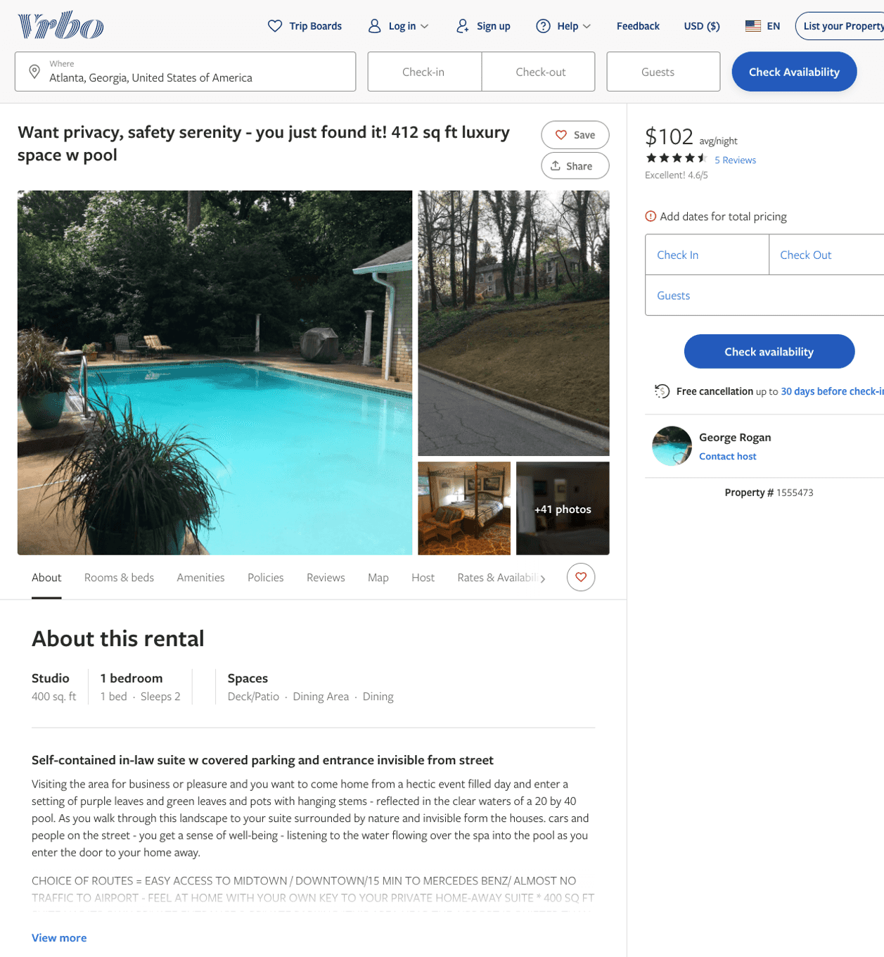
Listing 1555473
1
2
$100 - $200
4.6
2
George Rogan
https://www.vrbo.com/1555473
Aug 2022

Slide 3
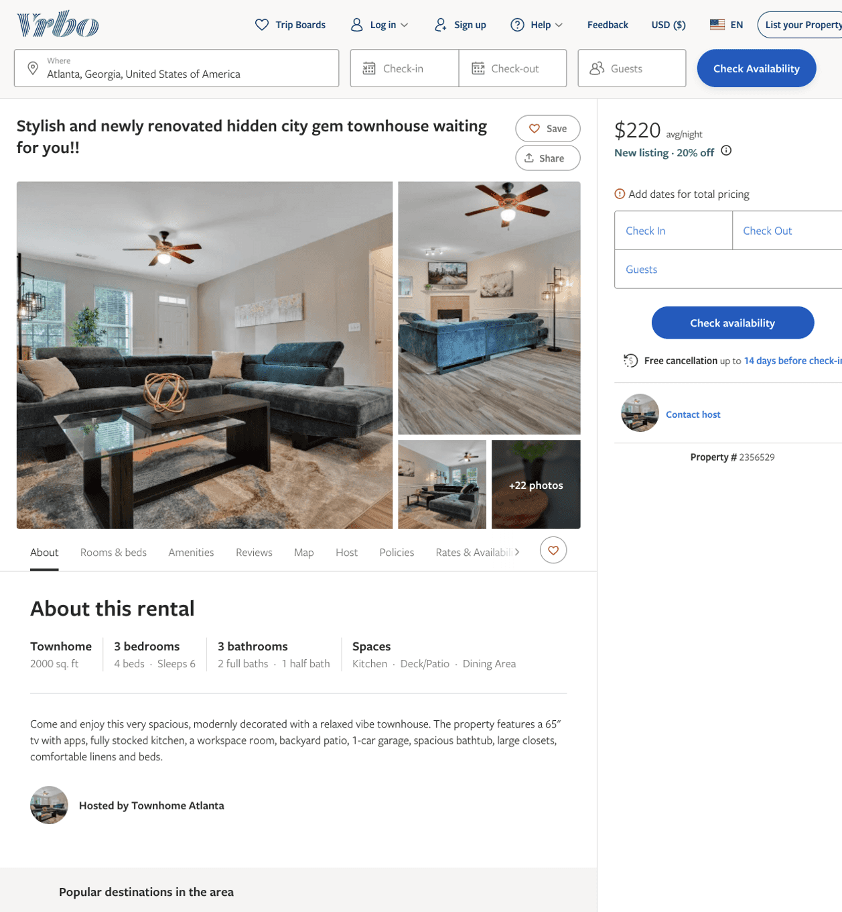
Listing 2356529
3
5
$129 - $220
5
15
Cortney W
https://www.vrbo.com/2356529
Aug 2022

Slide 4
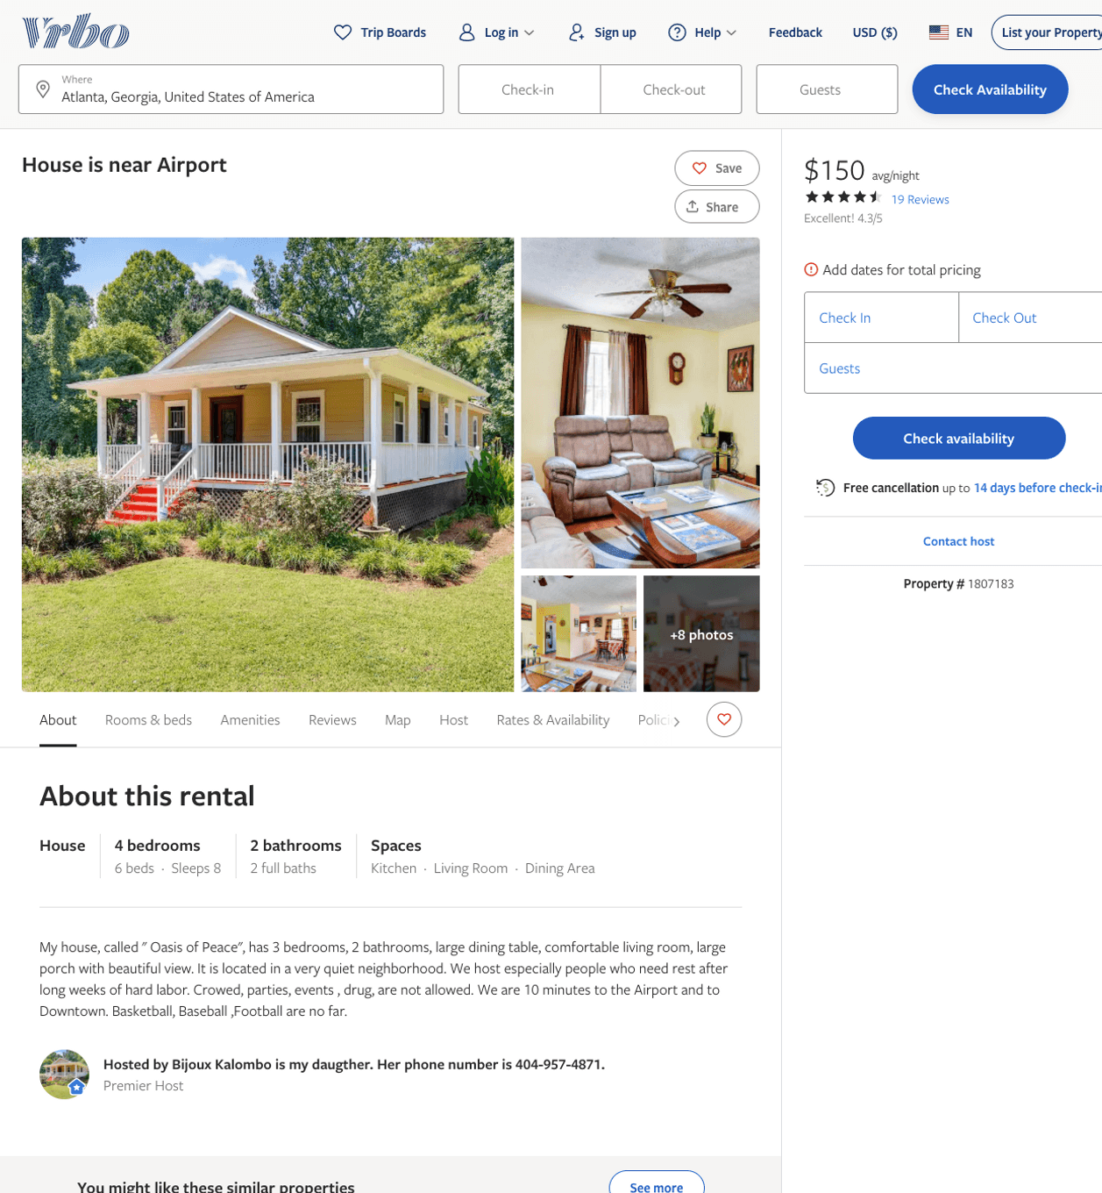
Listing 1807183
4
8
$150 - $180
4.111111
3
Bijoux Kalombo is my daugther. Her phone number is 404-957-4871.
https://www.vrbo.com/1807183
Aug 2022

Slide 5
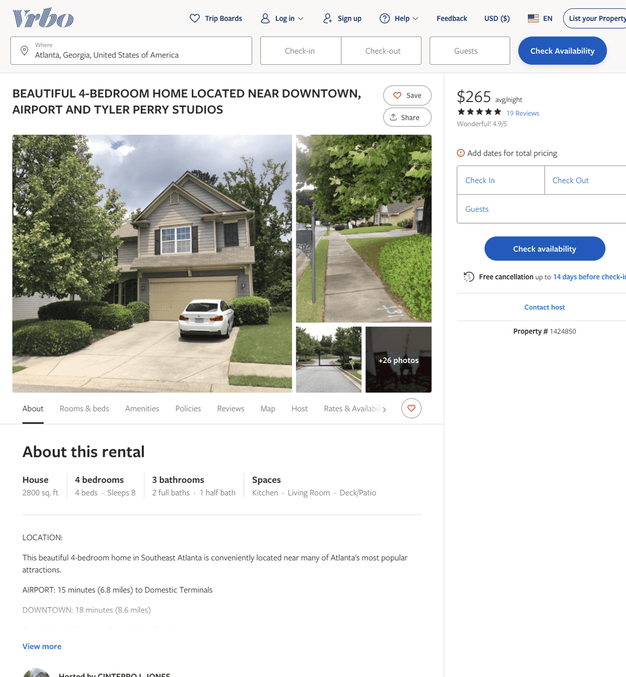
Listing 1424850
4
8
$270 - $320
4.928571
3
CINTERRO L JONES
https://www.vrbo.com/1424850
Aug 2022

Slide 6
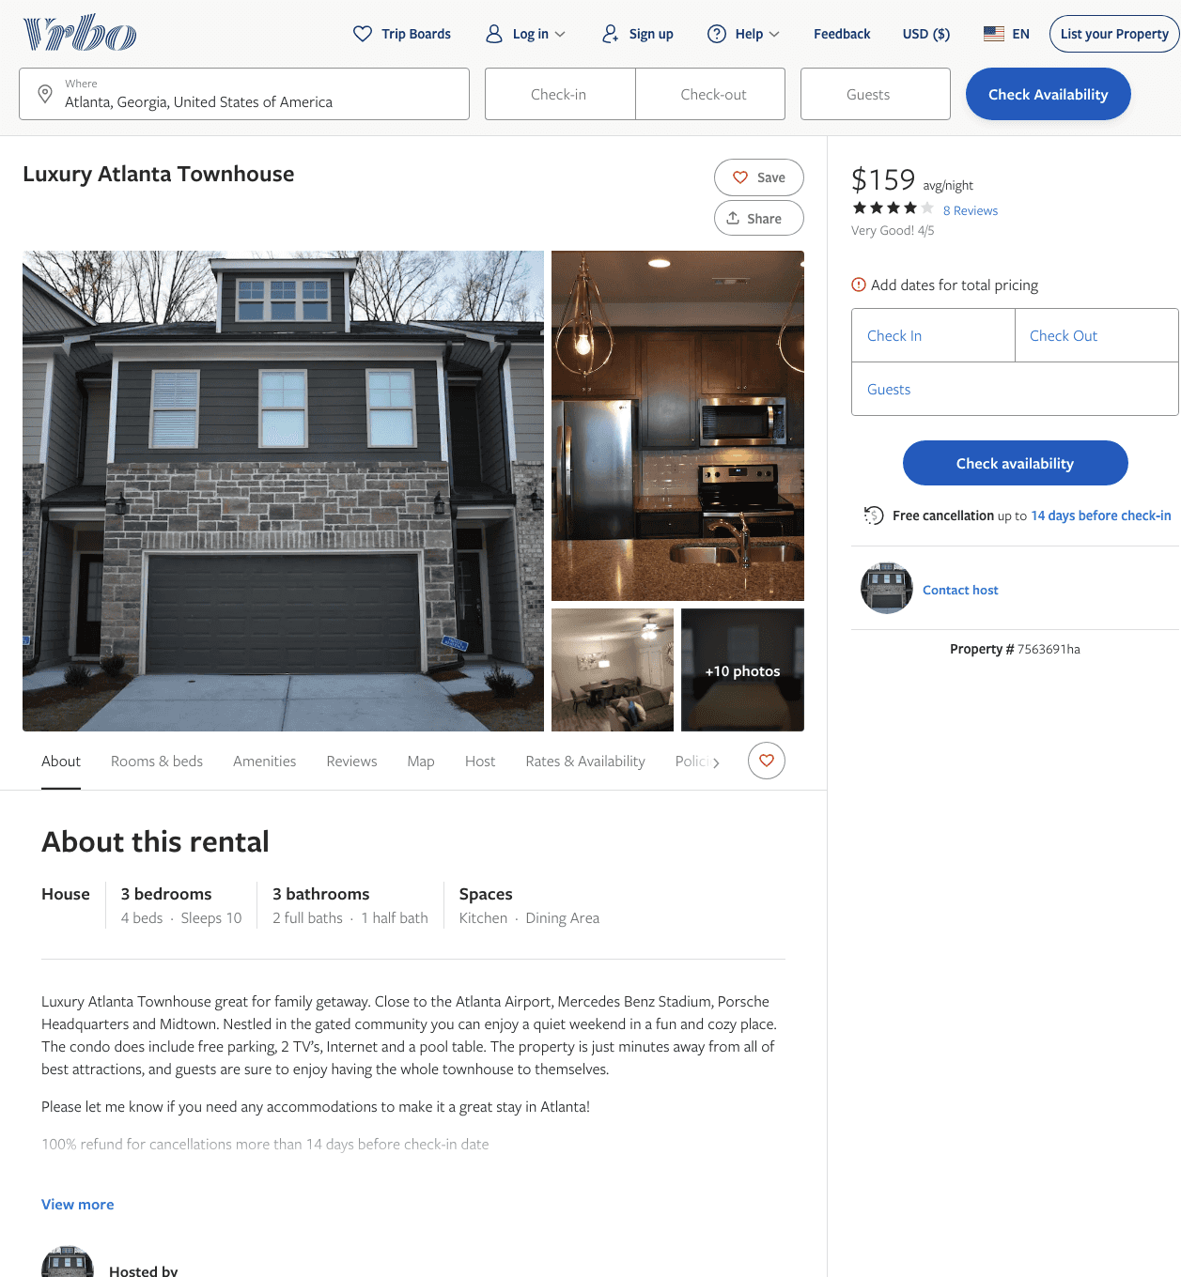
Listing 7563691
3
10
$159 - $243
3.5
1
Napoleon Robinson
https://www.vrbo.com/7563691ha
Aug 2022

Slide 7
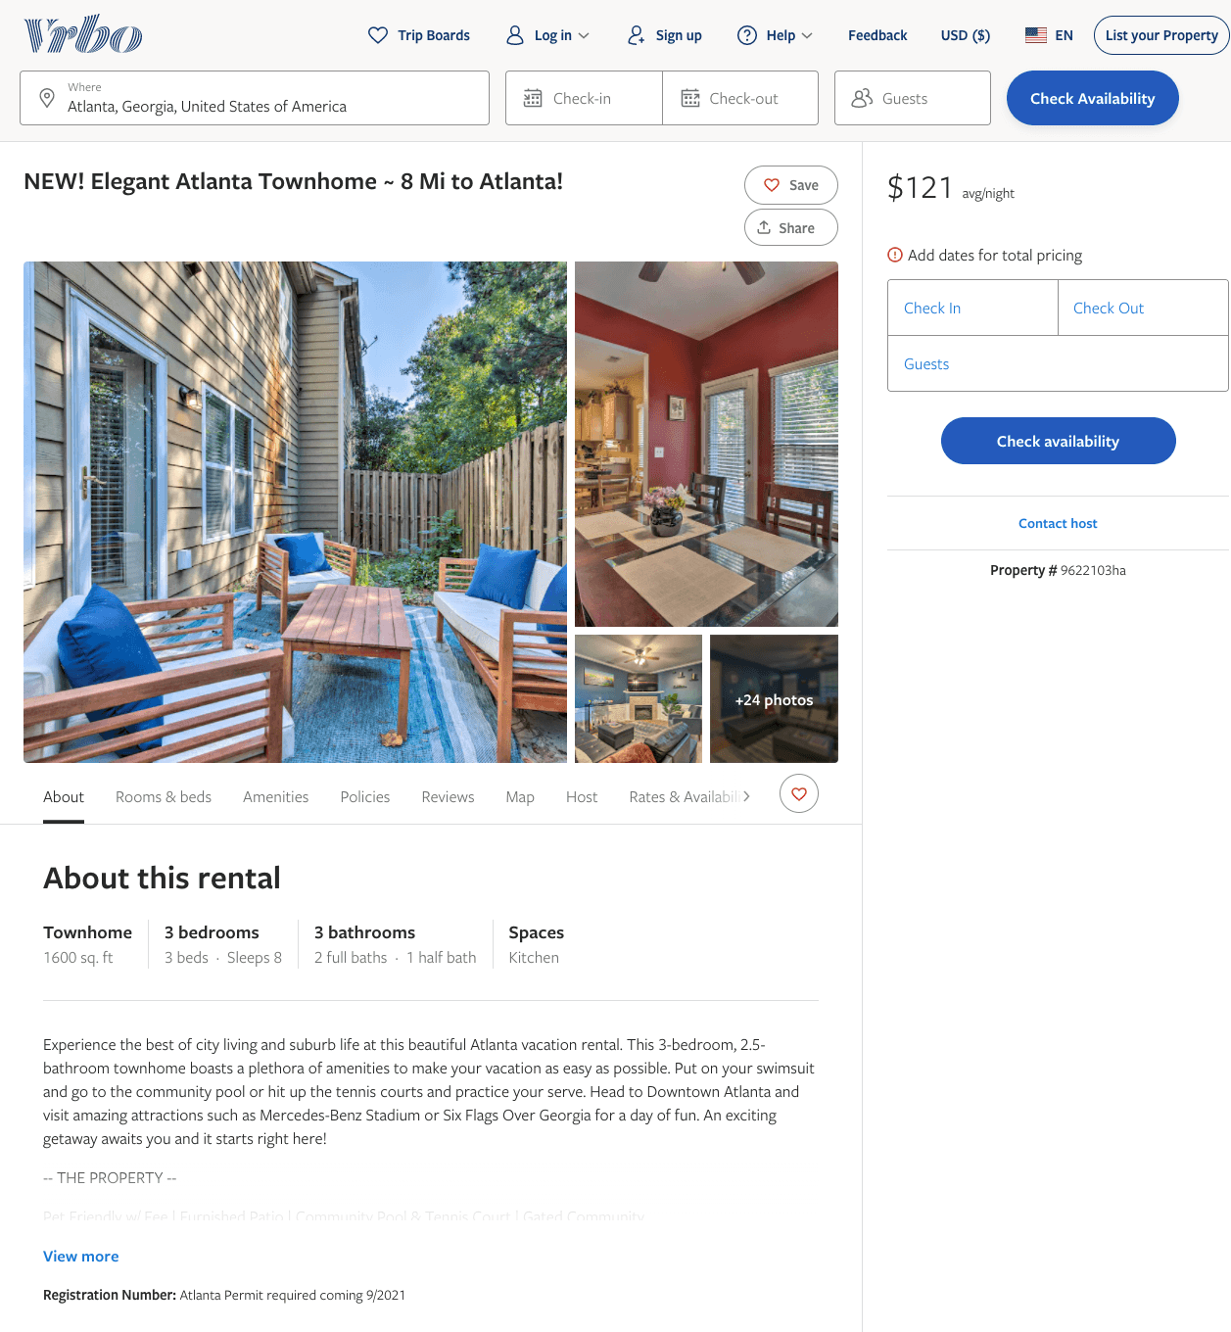
Listing 9622103
3
8
$106 - $174
5
2
Evolve
https://www.vrbo.com/9622103ha
Aug 2022

Slide 8
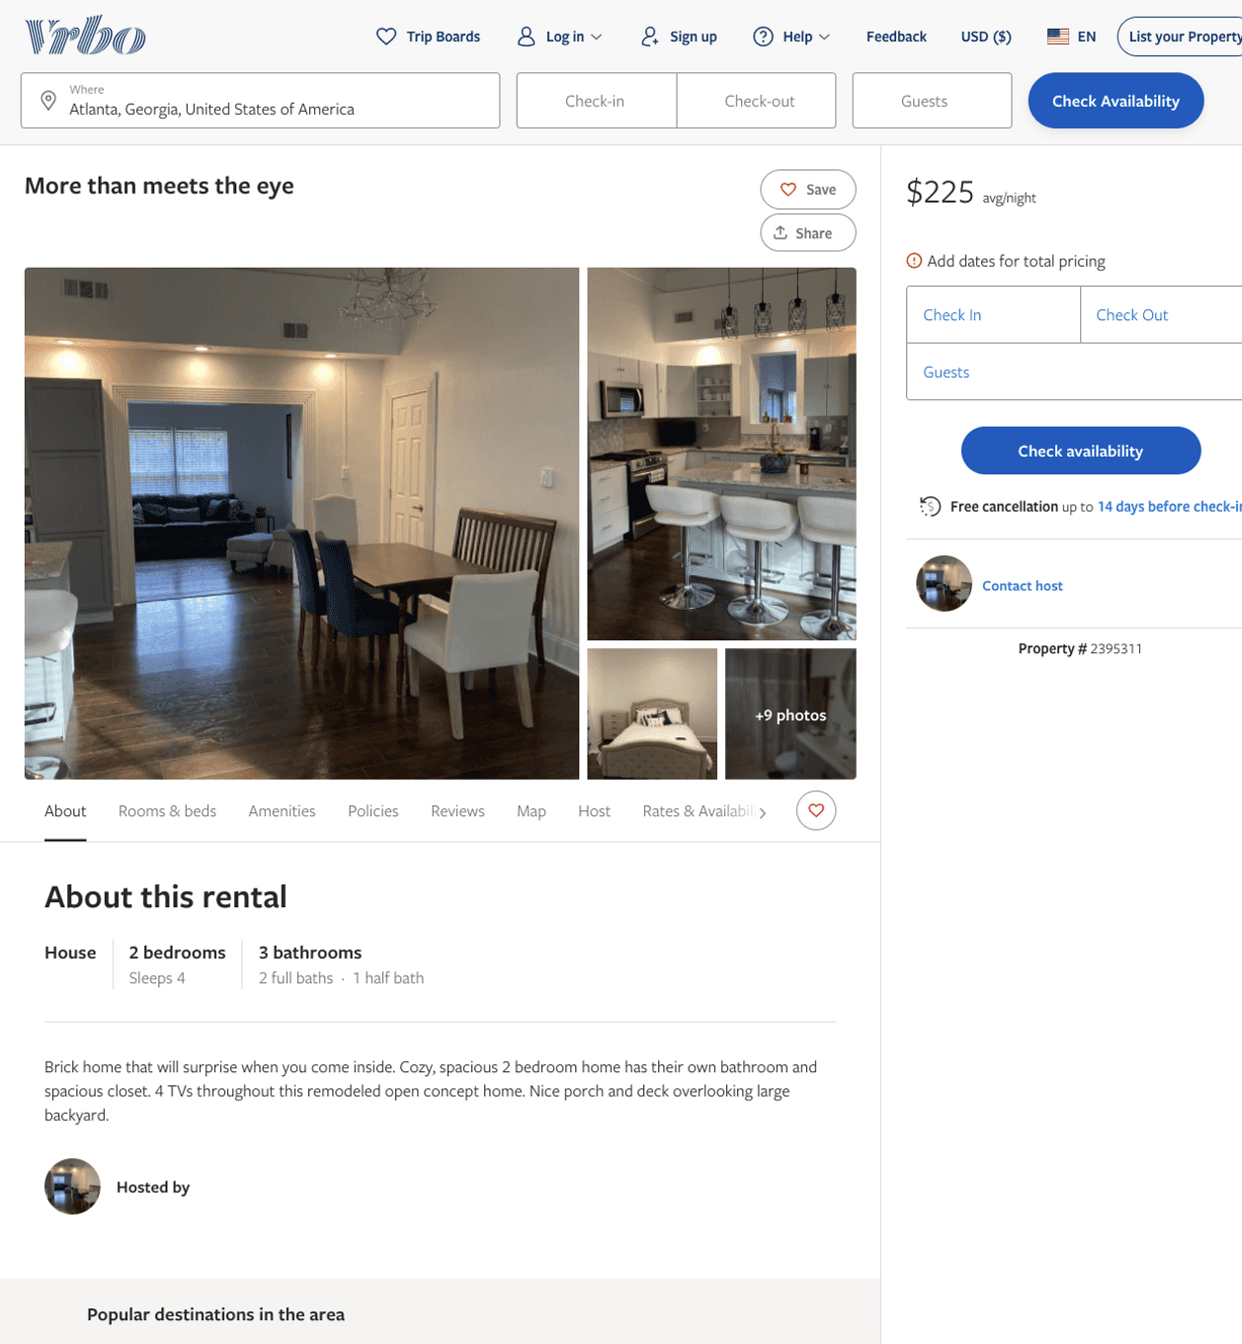
Listing 2395311
2
4
$225
2
https://www.vrbo.com/2395311
Aug 2022

Slide 9
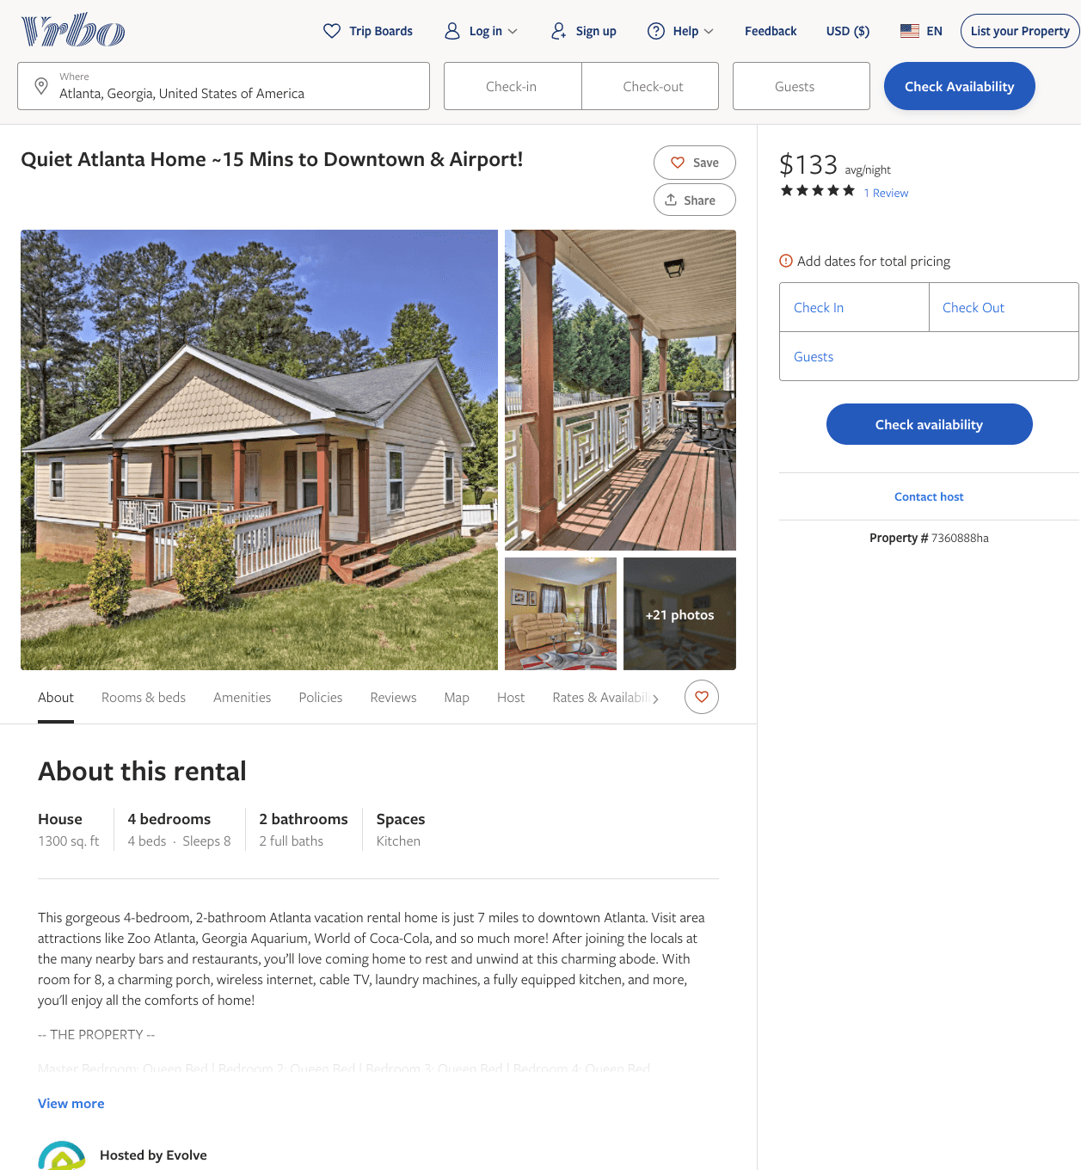
Listing 7360888
4
8
$133 - $190
5
7
Evolve
https://www.vrbo.com/7360888ha
Aug 2022

Slide 10
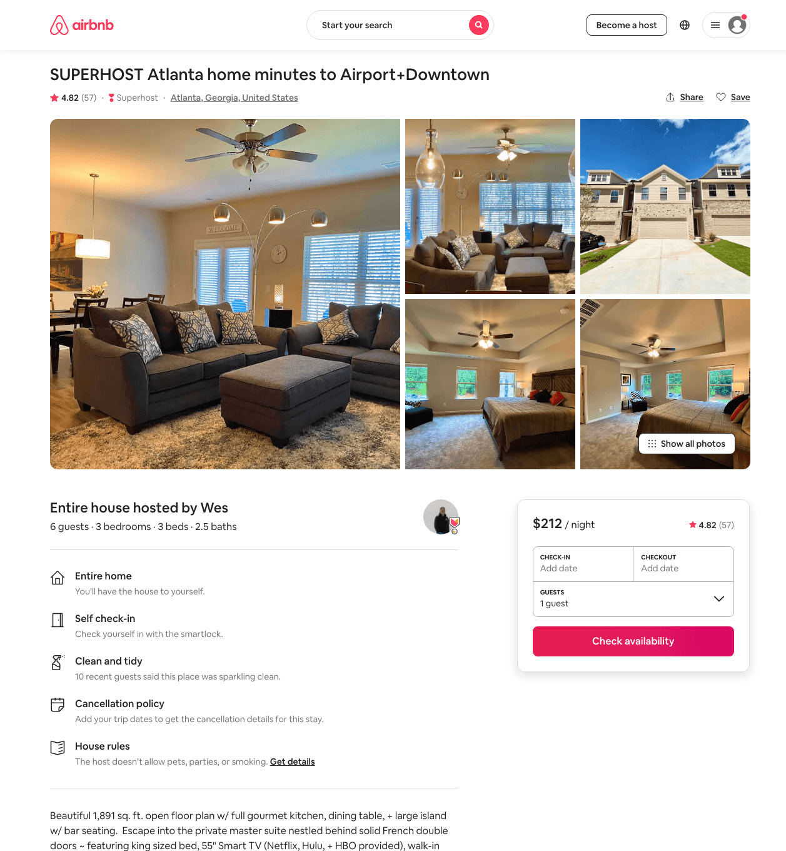
Listing 41862786
3
6
$103 - $267
4.90
2
Wes
99936845
1
https://www.airbnb.com/rooms/41862786
Aug 2022

Slide 11
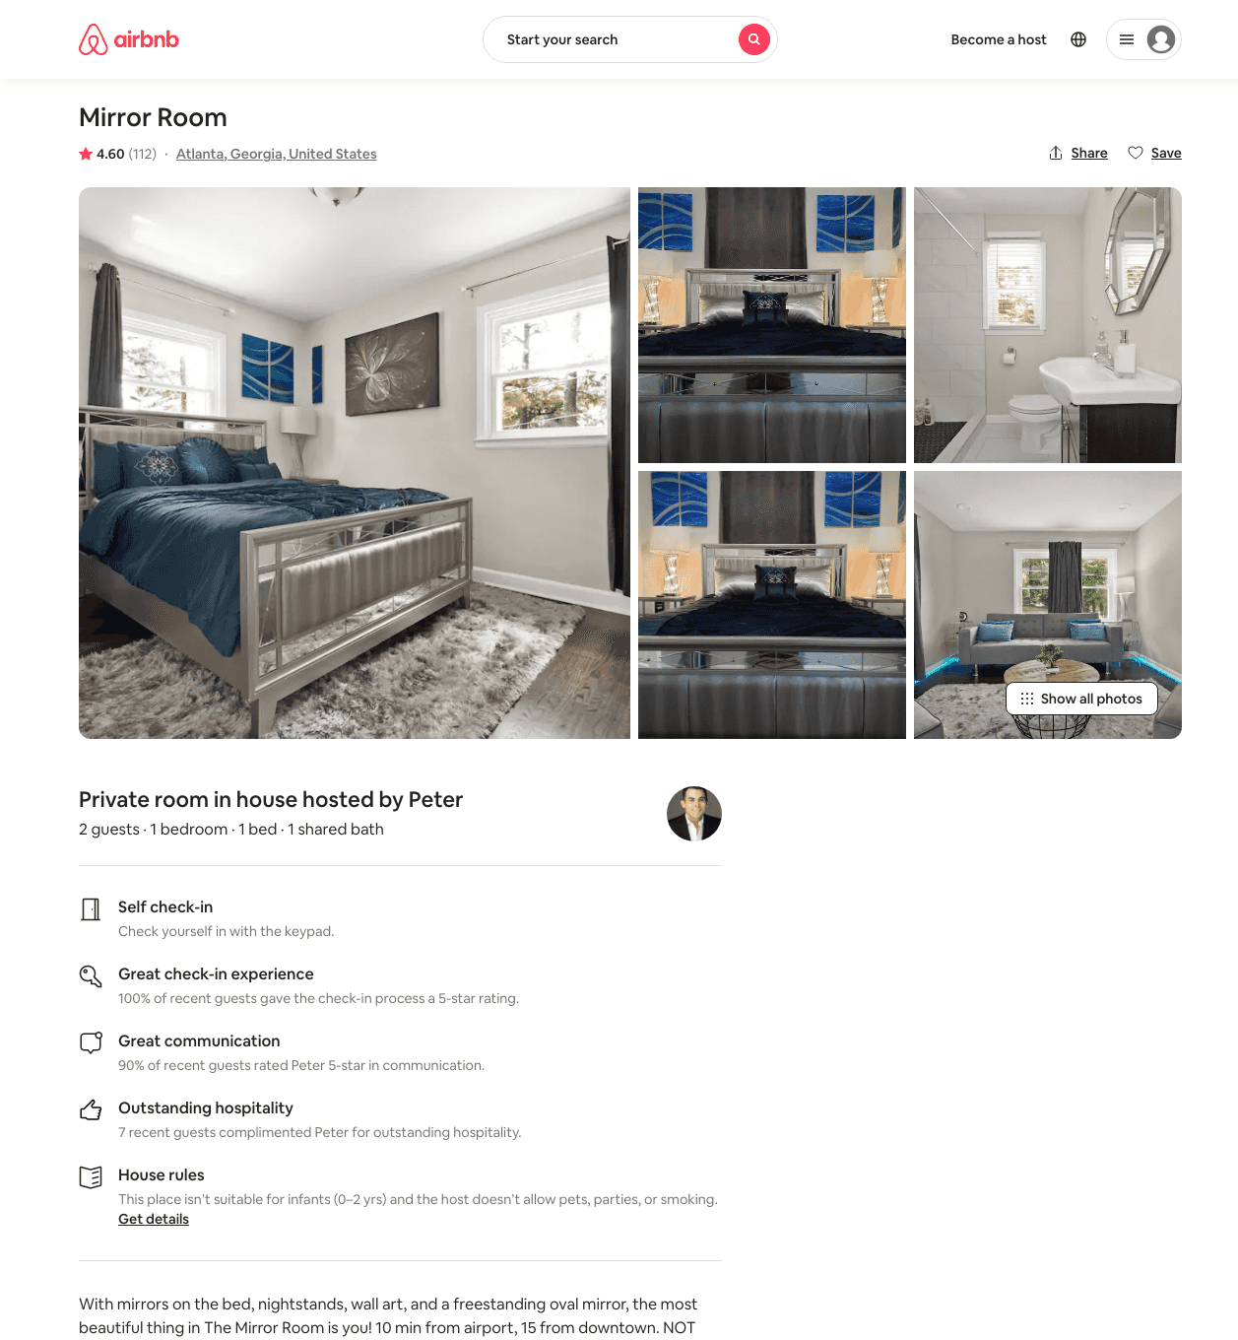
Listing 36103870
1
2
$34 - $45
4.63
1
Peter
81925843
4
https://www.airbnb.com/rooms/36103870
Aug 2022

Slide 12
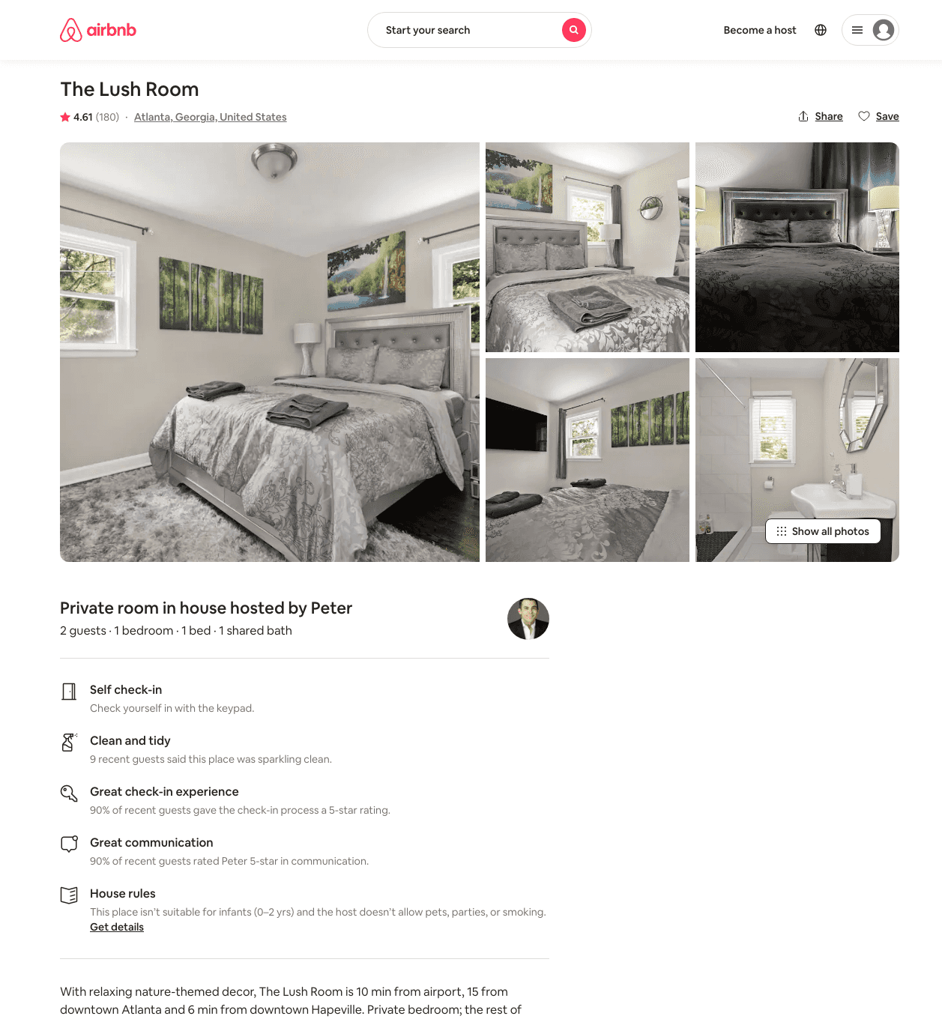
Listing 35513702
1
2
$33 - $43
4.53
1
Peter
81925843
4
https://www.airbnb.com/rooms/35513702
Aug 2022

Slide 13
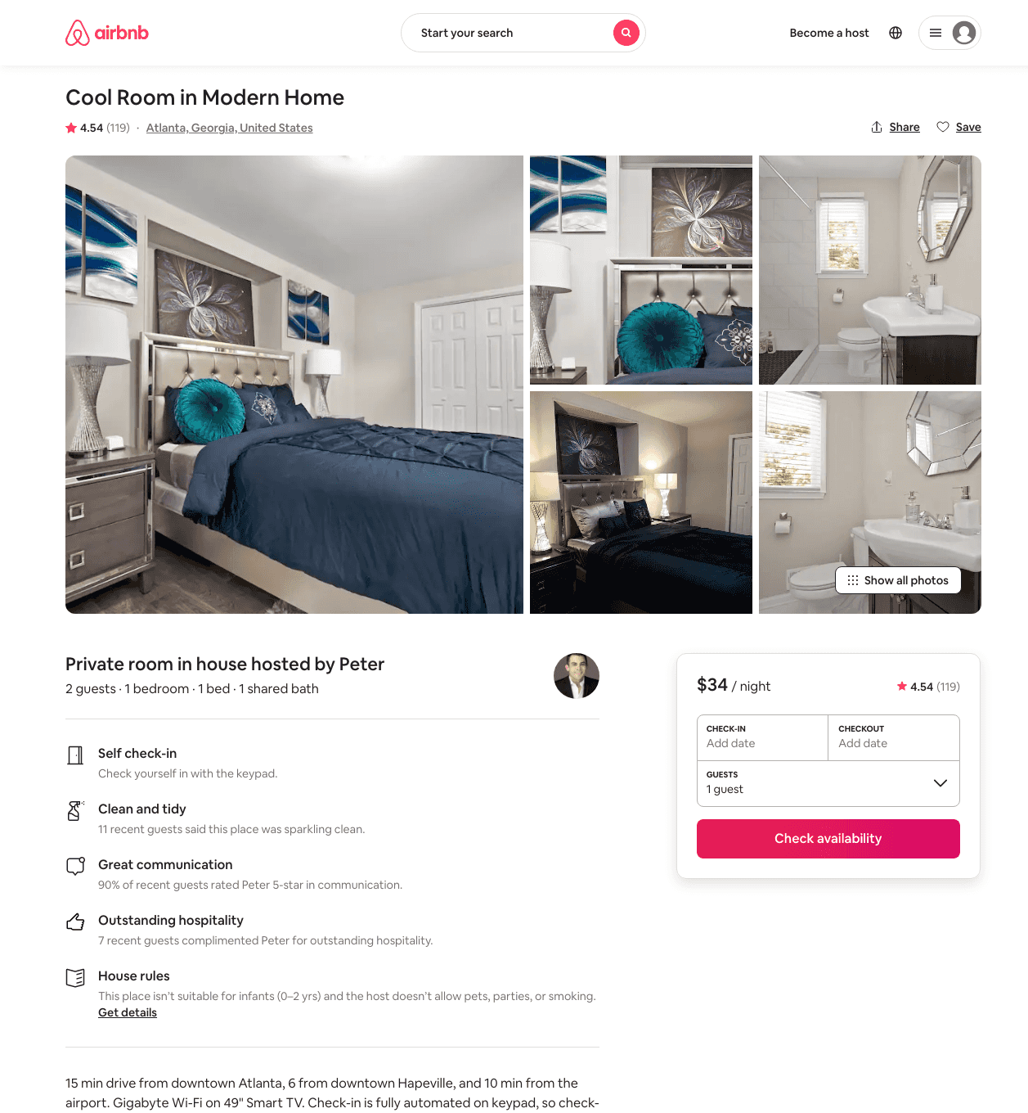
Listing 36203179
1
2
$33 - $42
4.50
1
Peter
81925843
4
https://www.airbnb.com/rooms/36203179
Aug 2022

Slide 14
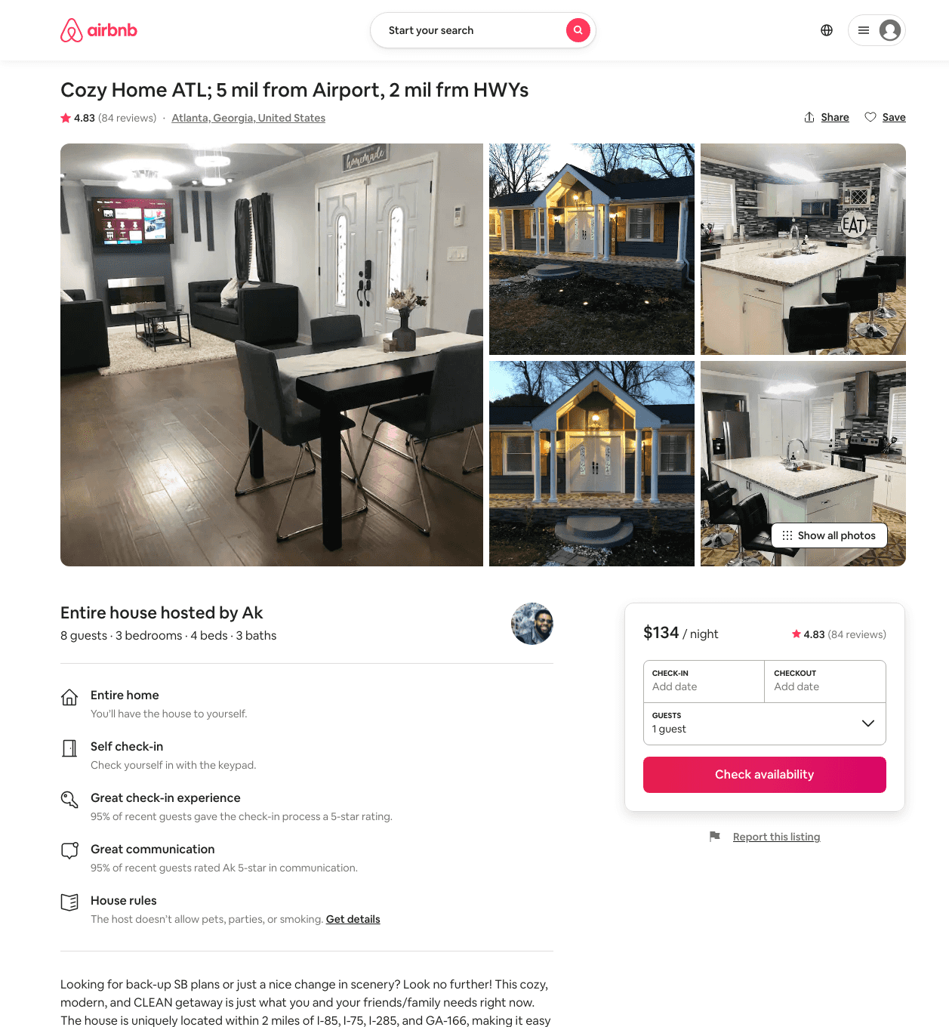
Listing 31598766
3
8
$127 - $166
4.68
3
Ak
236878123
1
https://www.airbnb.com/rooms/31598766
Aug 2022

Slide 15
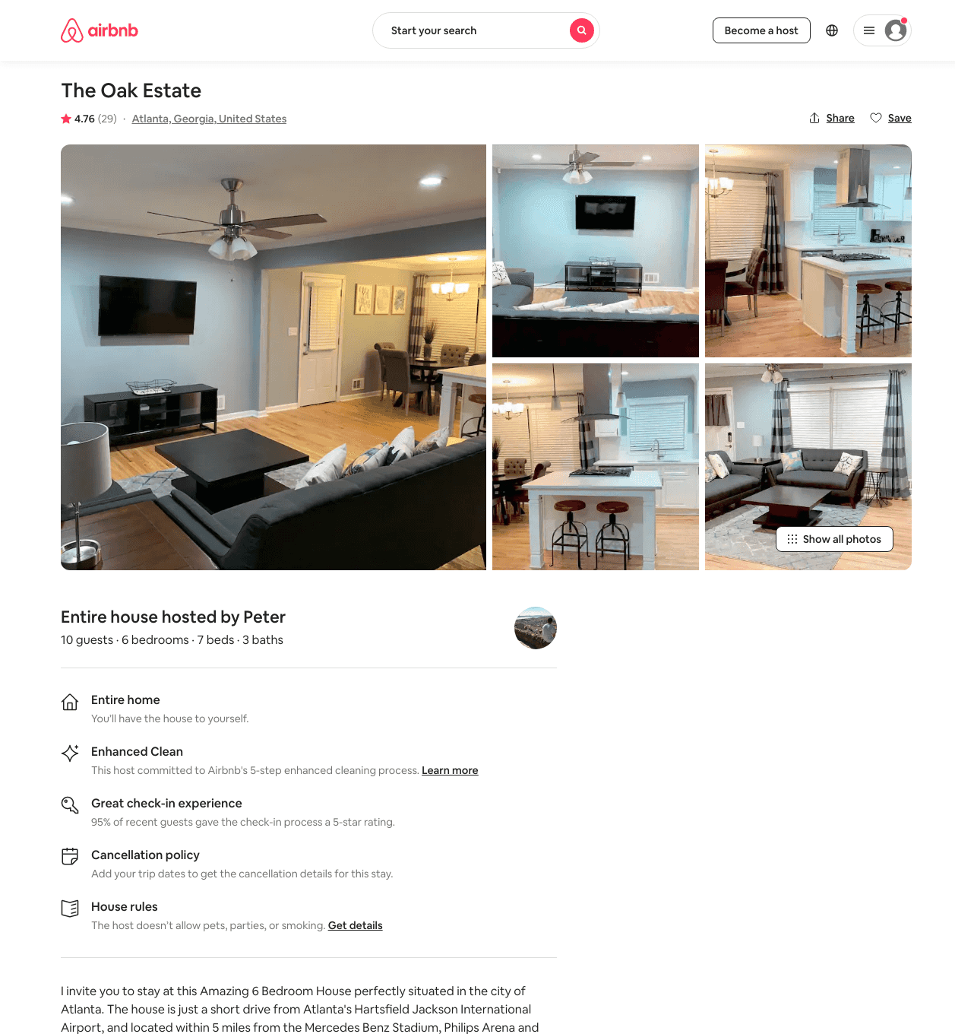
Listing 43003621
6
10
$256 - $353
4.49
2
Peter
13871809
2
https://www.airbnb.com/rooms/43003621
Aug 2022

Slide 16
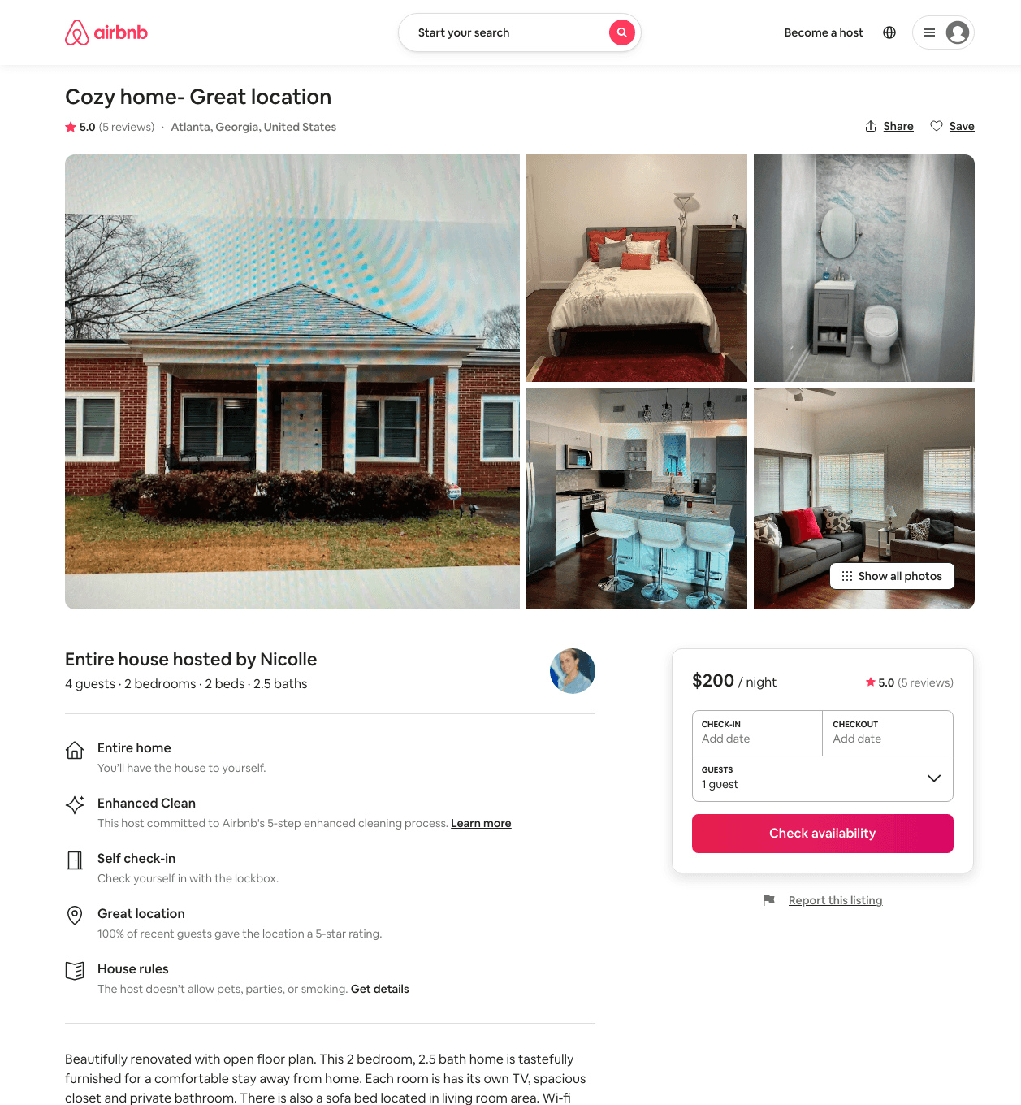
Listing 47594156
1
3
$200 - $232
4.60
2
Nicolle
52853655
1
https://www.airbnb.com/rooms/47594156
Jun 2022

Slide 17
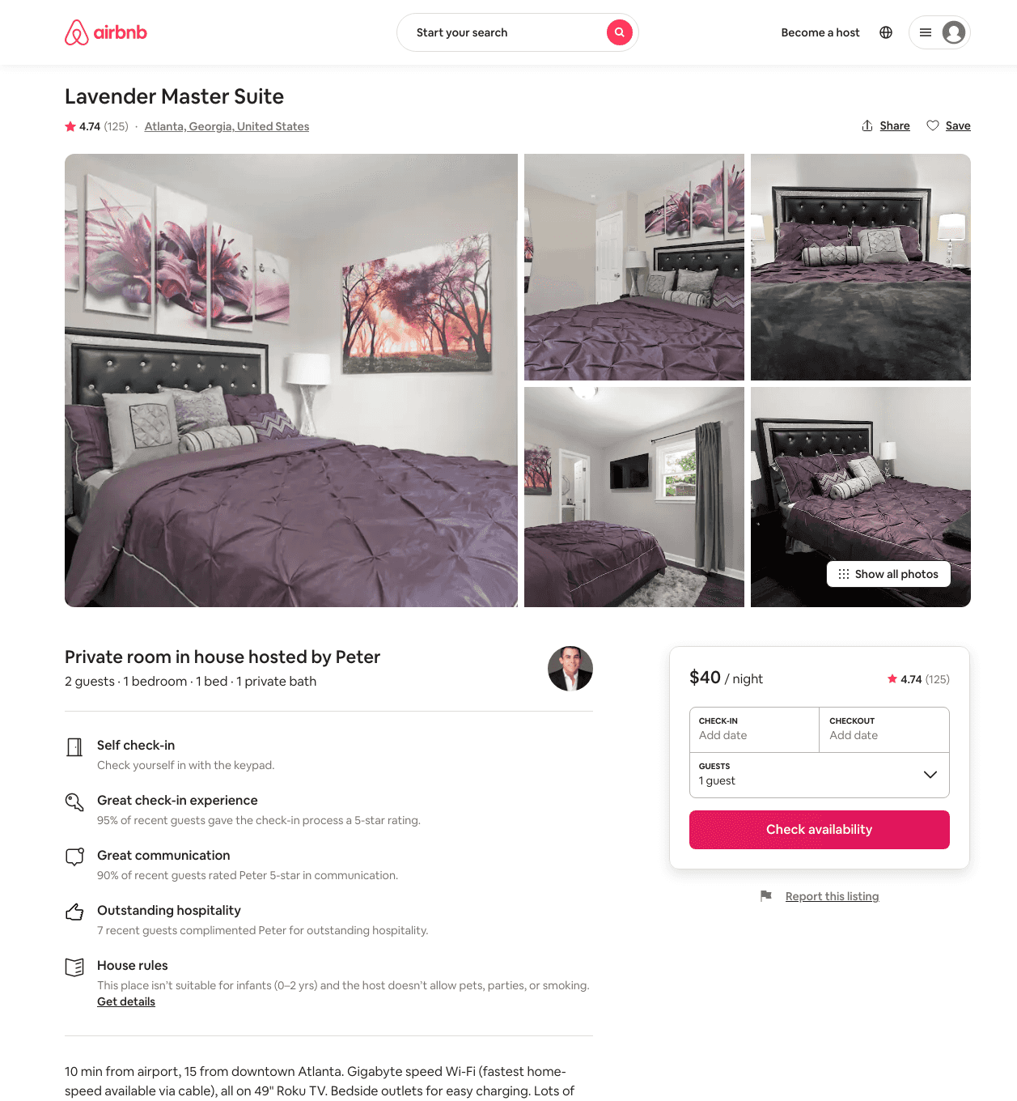
Listing 35731024
1
2
$39 - $52
4.61
1
Peter
81925843
4
https://www.airbnb.com/rooms/35731024
Aug 2022

Slide 18
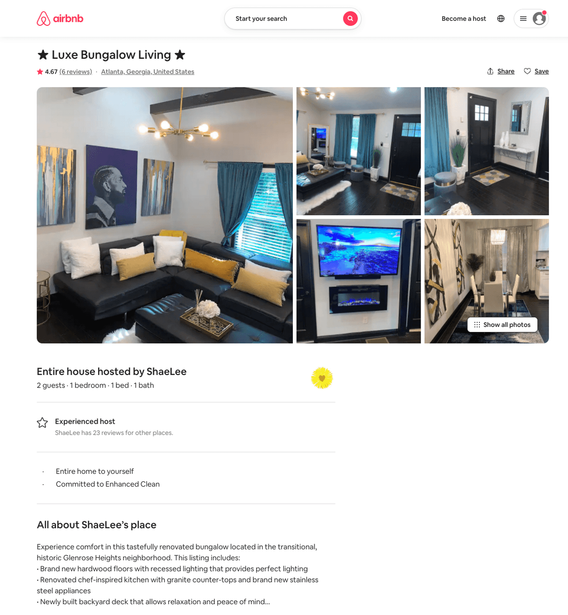
Listing 37461728
1
2
$103 - $114
4.79
1
ShaeLee
24984106
1
https://www.airbnb.com/rooms/37461728
Aug 2022

Slide 19
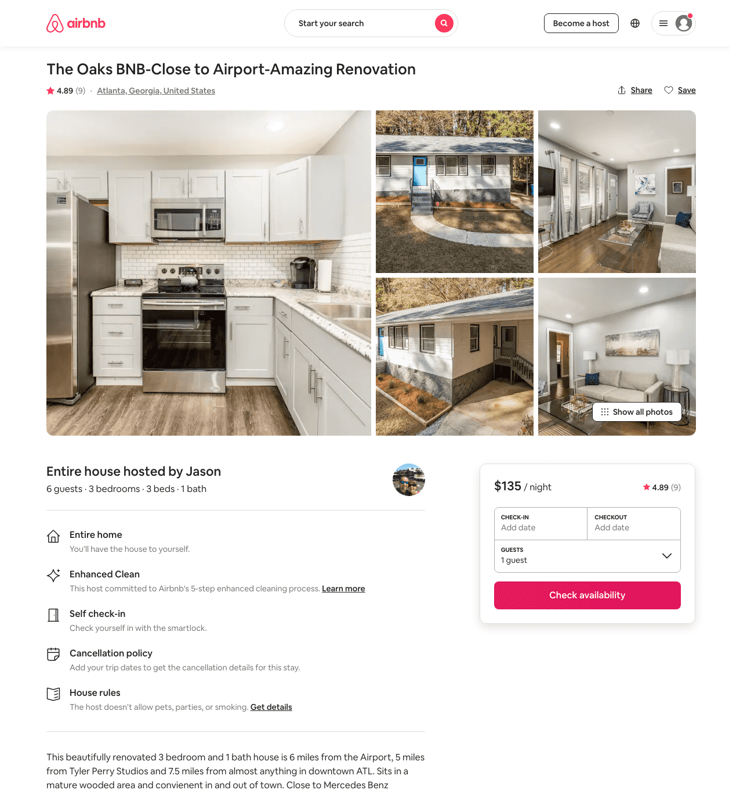
Listing 40233602
3
6
$135 - $185
4.37
2
Jason
136239447
4
https://www.airbnb.com/rooms/40233602
Jun 2022

Slide 20
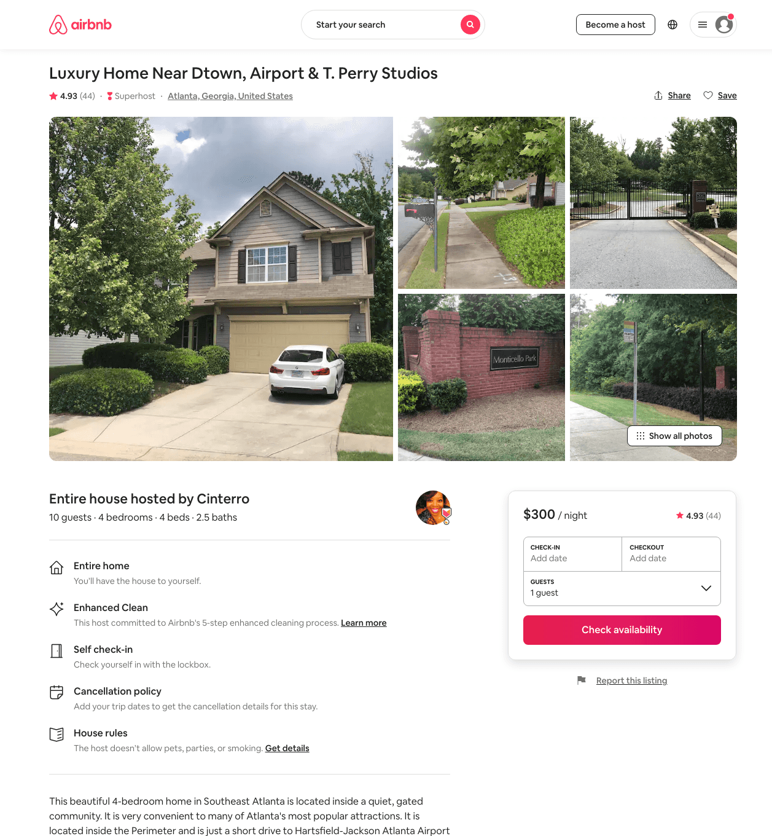
Listing 24073817
4
8
$171 - $275
4.94
3
Cinterro
42145337
1
https://www.airbnb.com/rooms/24073817
Aug 2022

Slide 21
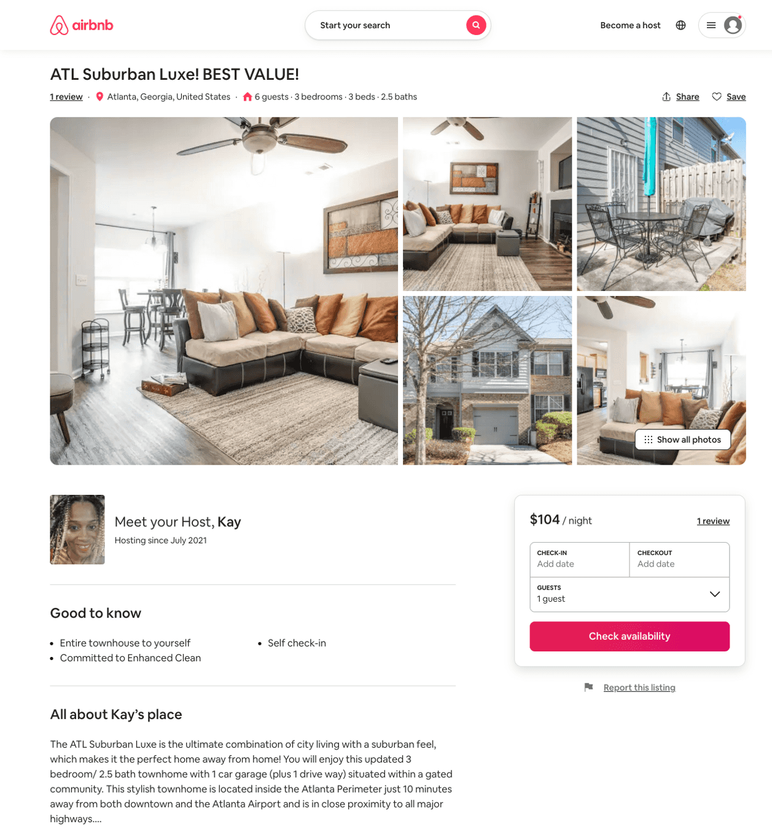
Listing 51194585
3
6
$102 - $187
4.91
3
Kay
414353414
1
https://www.airbnb.com/rooms/51194585
Aug 2022

Slide 22
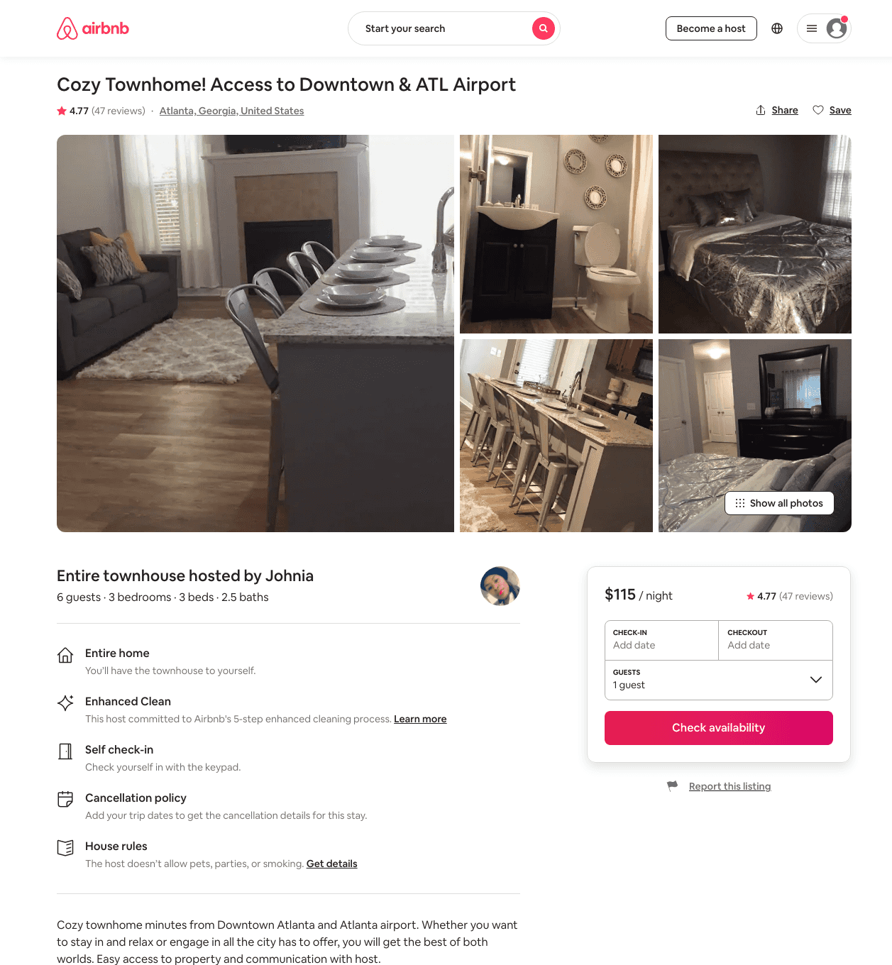
Listing 28805577
3
6
$115
4.77
5
Johnia
80976050
1
https://www.airbnb.com/rooms/28805577
Jul 2022

Slide 23
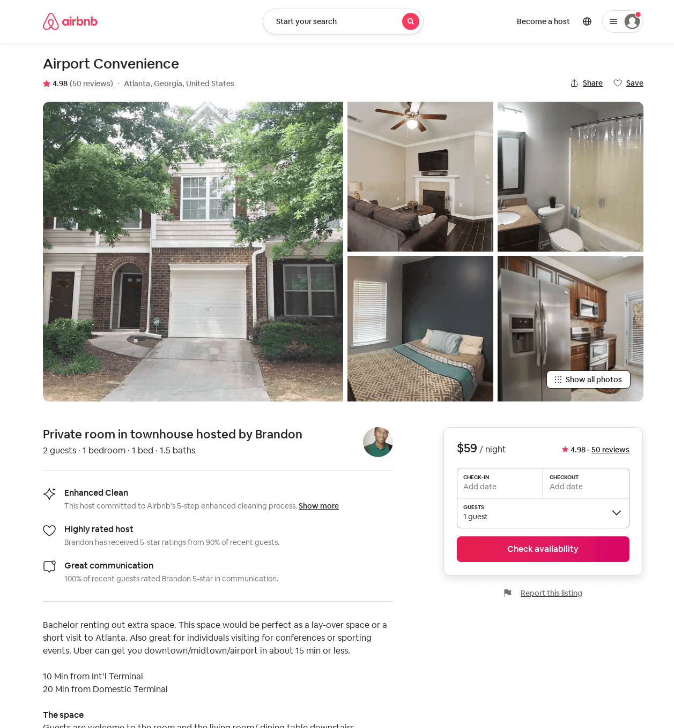
Listing 21243820
1
1
$52 - $59
4.91
1
Brandon
55534219
5
https://www.airbnb.com/rooms/21243820
Aug 2022

Slide 24
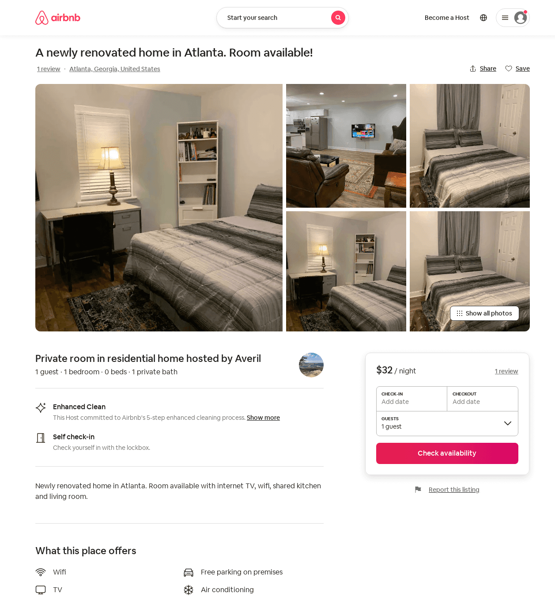
Listing 52610435
1
1
$32 - $62
4.86
1
Averil
164455446
3
https://www.airbnb.com/rooms/52610435
Aug 2022

Slide 25
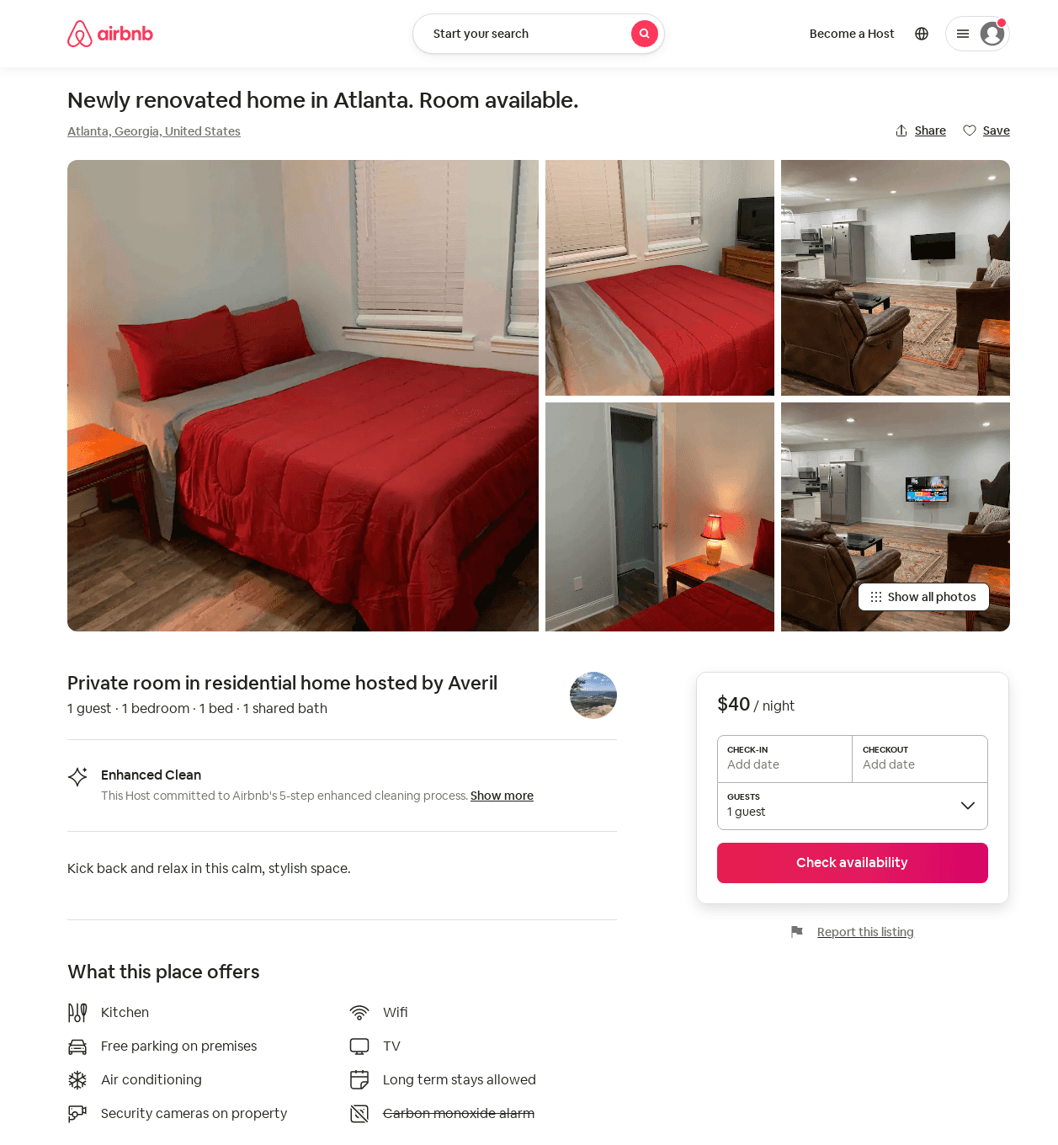
Listing 52609971
1
1
$32 - $69
4.79
1
Averil
164455446
3
https://www.airbnb.com/rooms/52609971
Aug 2022

Slide 26
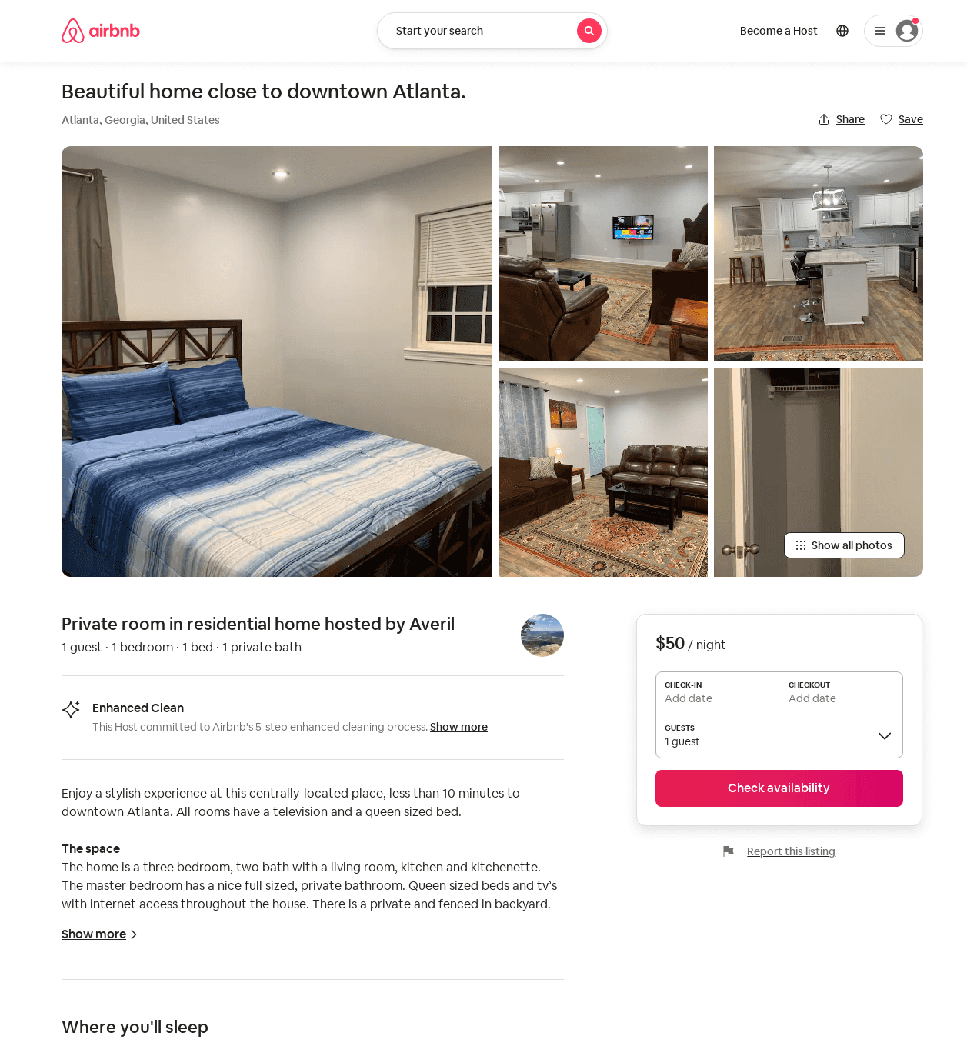
Listing 52547476
1
1
$33 - $62
4.87
1
Averil
164455446
3
https://www.airbnb.com/rooms/52547476
Aug 2022

Slide 27
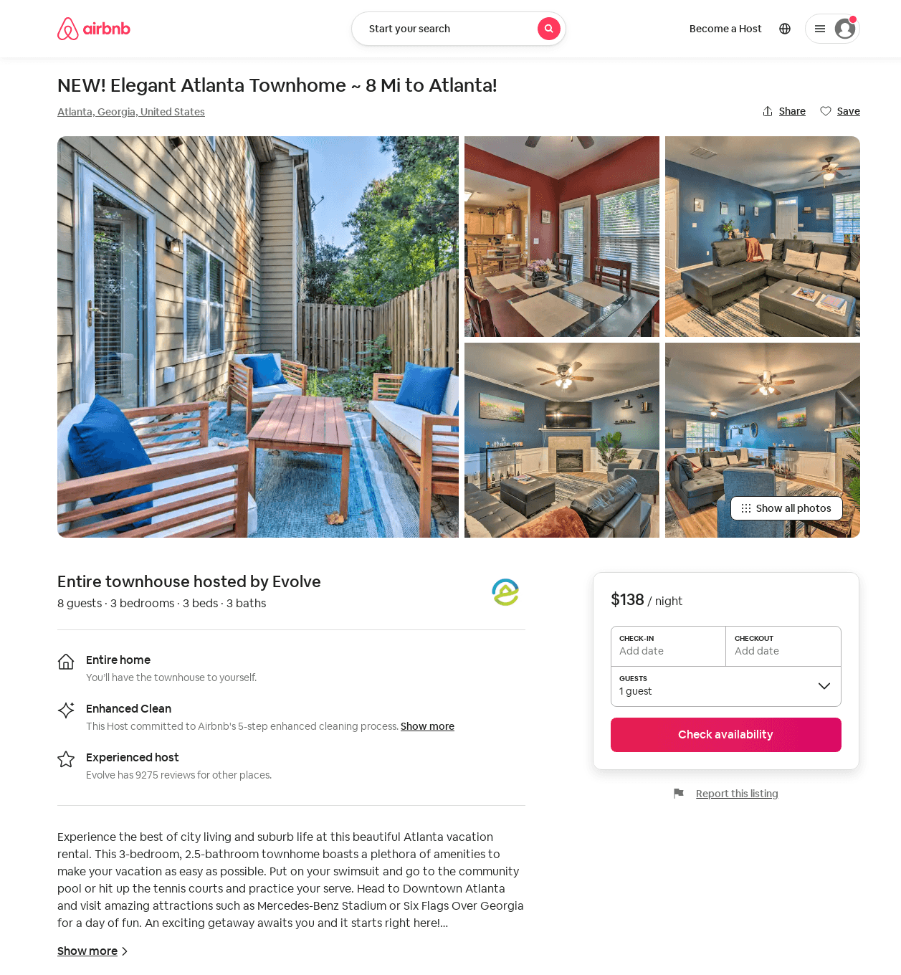
Listing 53061068
3
8
$122 - $160
4.75
2
Evolve
121682456
51
https://www.airbnb.com/rooms/53061068
Jul 2022

Slide 28
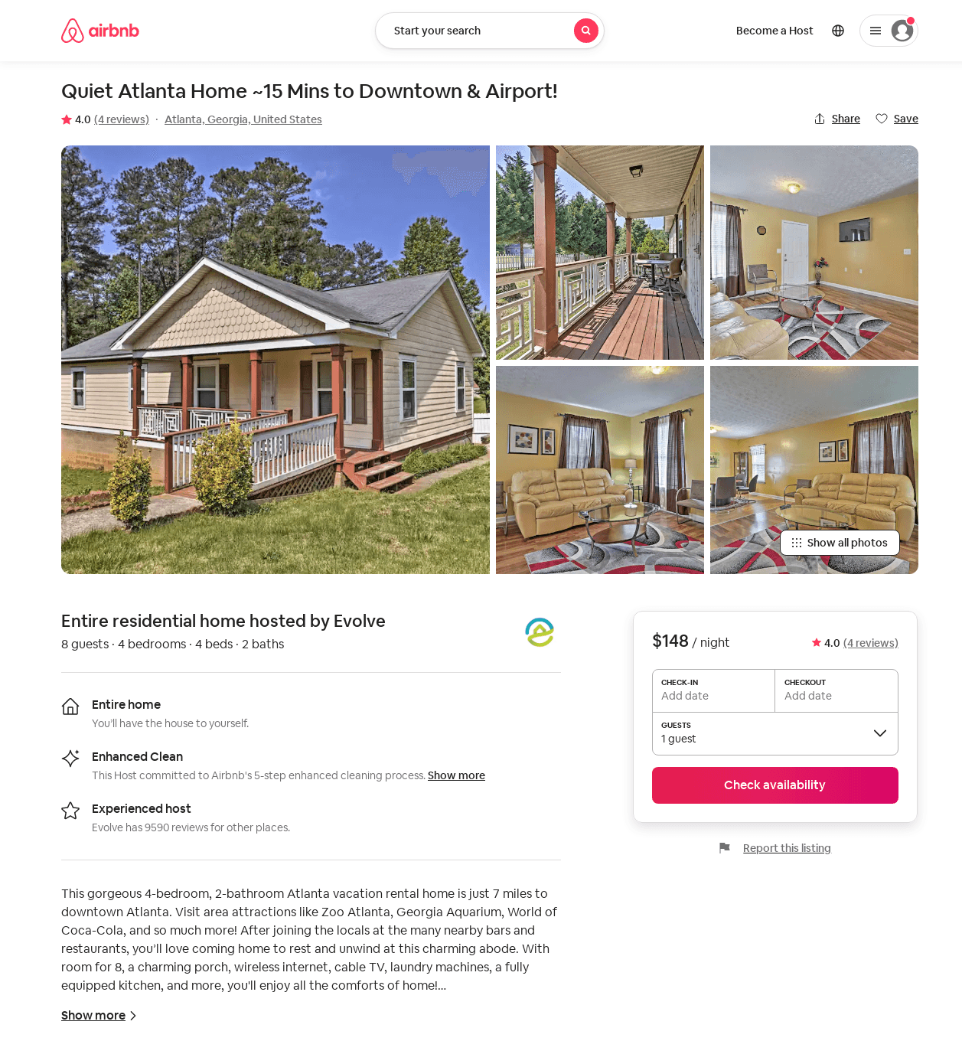
Listing 28783831
4
8
$148
4.0
7
Evolve
121682456
51
https://www.airbnb.com/rooms/28783831
Aug 2022

Slide 29
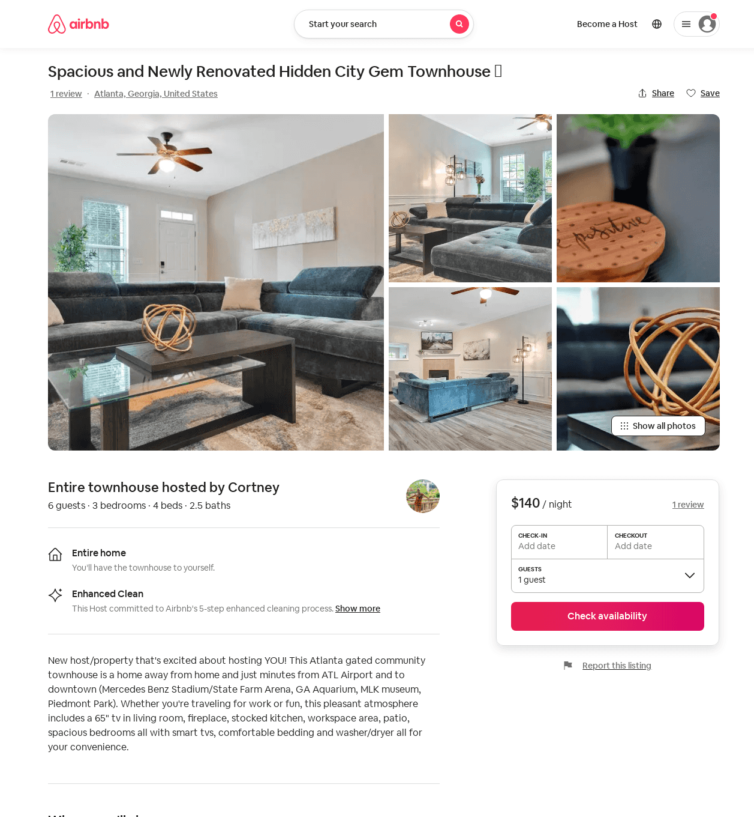
Listing 52887070
3
5
$132 - $168
4.94
2
Cortney
427893134
2
https://www.airbnb.com/rooms/52887070
Jul 2022

Slide 30
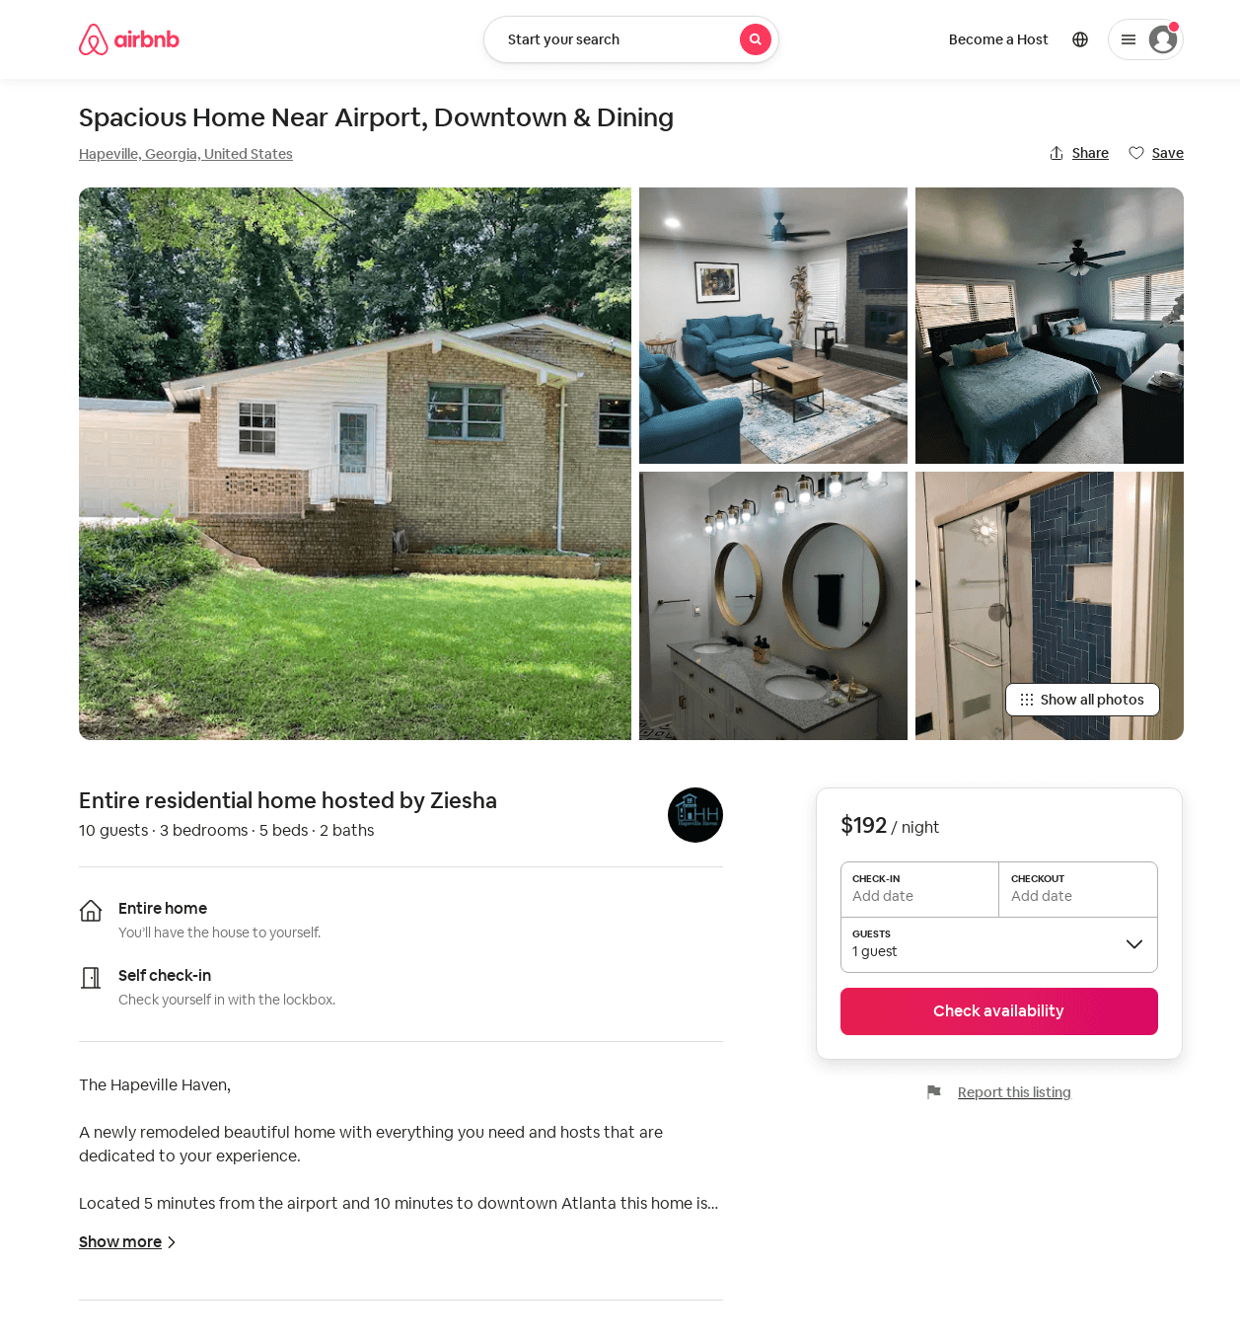
Listing 53437207
3
10
$173 - $207
4.87
3
Ziesha
415373257
1
https://www.airbnb.com/rooms/53437207
Aug 2022

Slide 31
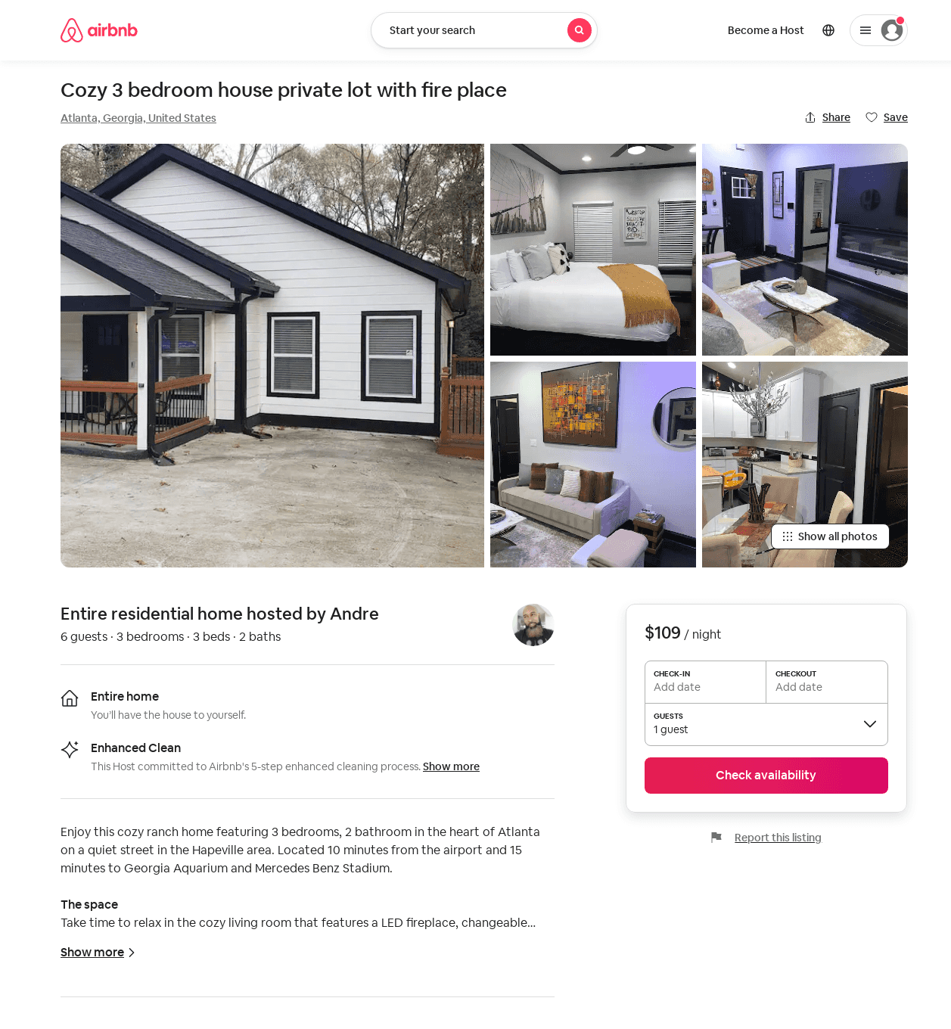
Listing 53518208
3
6
$109 - $197
4.71
1
Andre
406140313
1
https://www.airbnb.com/rooms/53518208
Aug 2022

Slide 32
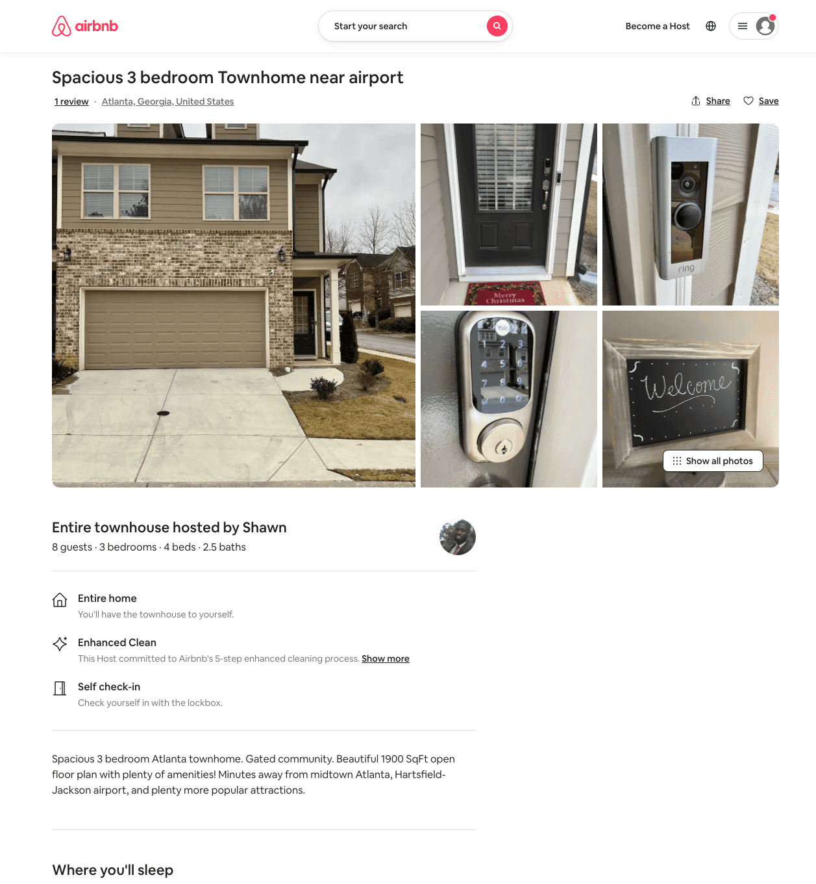
Listing 53569759
3
6
$150 - $248
5.0
2
Shawn
433816063
1
https://www.airbnb.com/rooms/53569759
Jun 2022

Slide 33
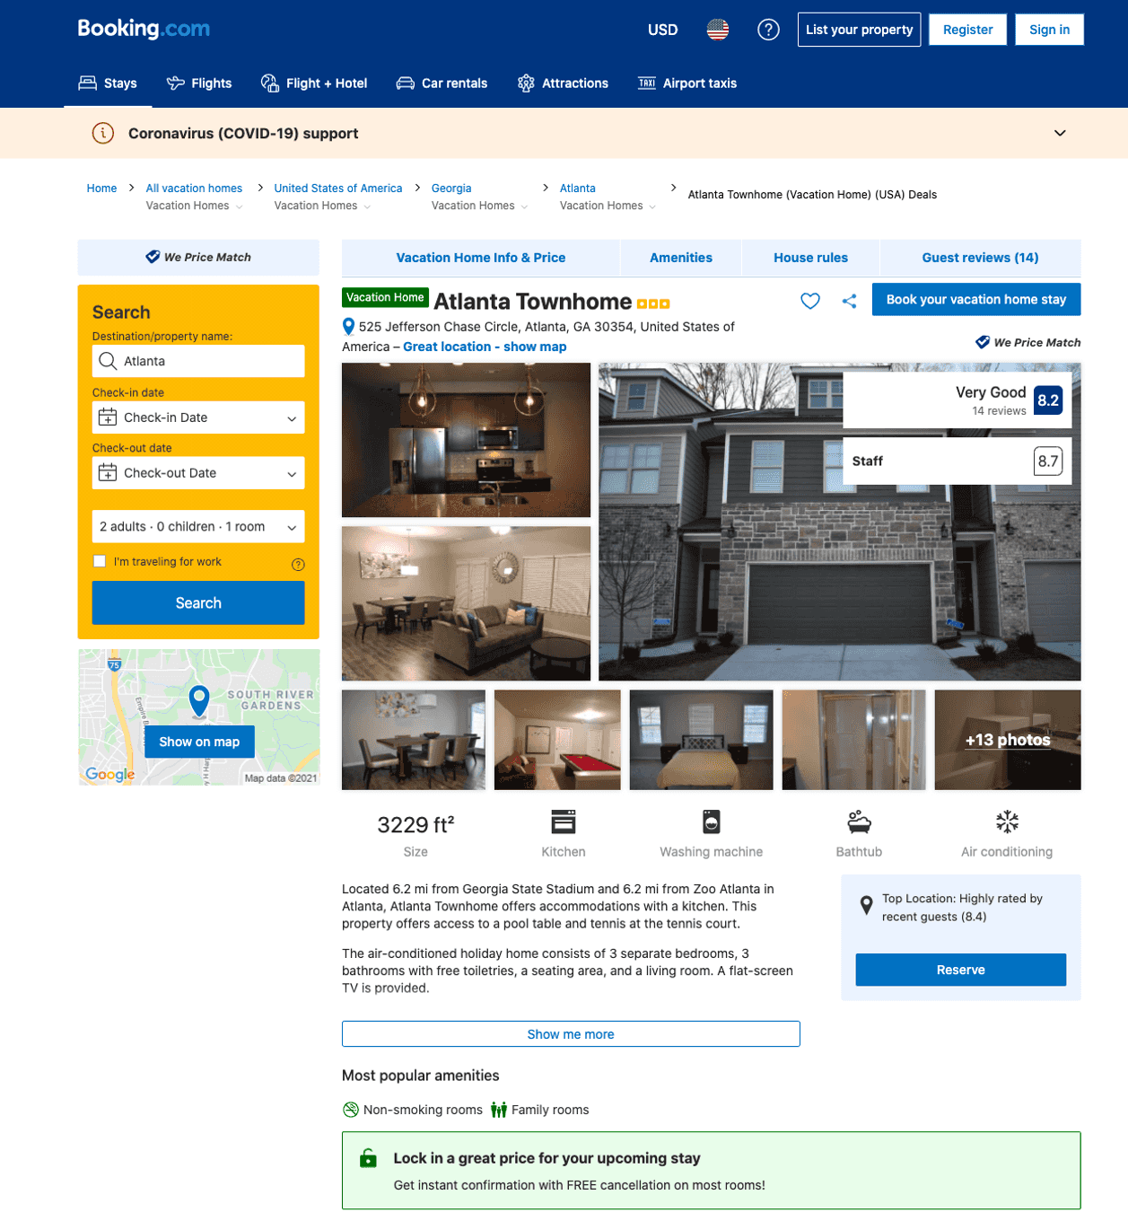
Listing atlanta-townhome-atlanta
undefined
6
8.5
https://www.booking.com/hotel/us/atlanta-townhome-atlanta.html
Sep 2022

Slide 34
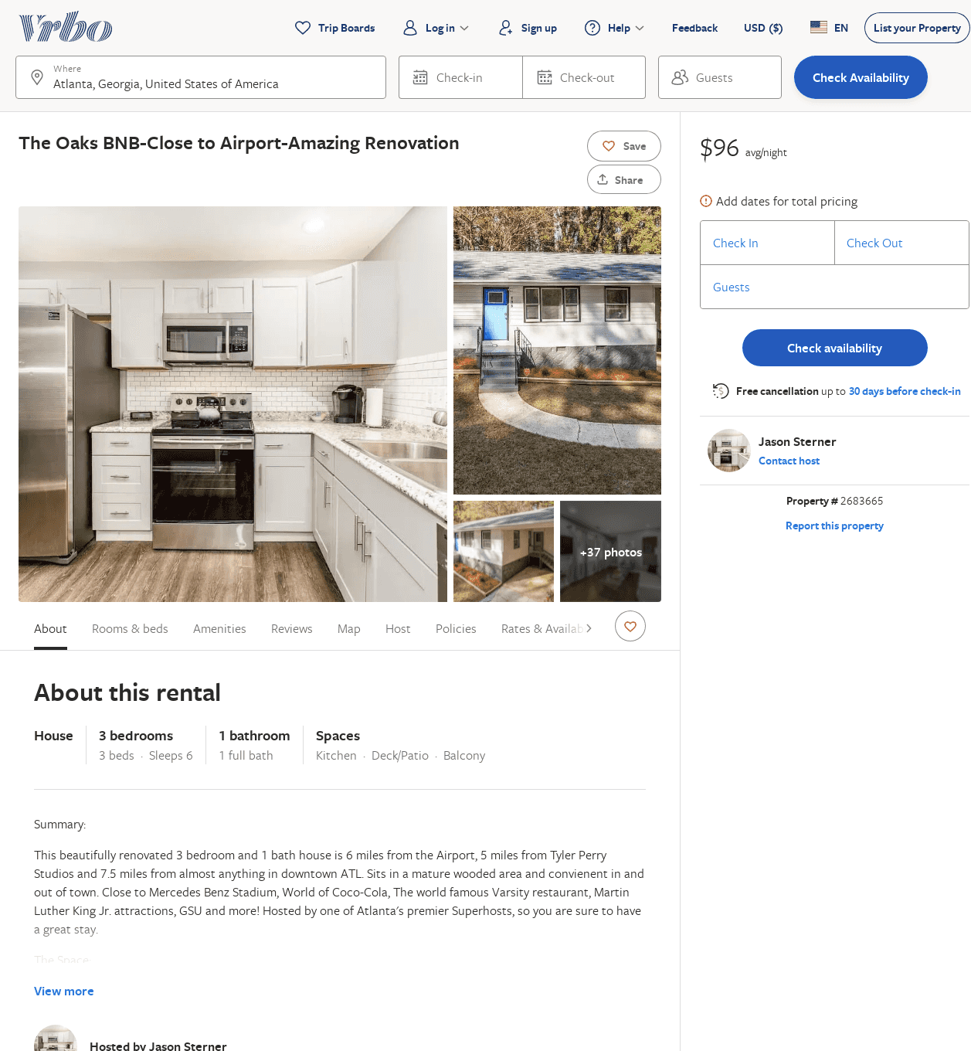
Listing 2683665
3
6
$155
1
2
Jason Sterner
https://www.vrbo.com/2683665
Aug 2022

Slide 35
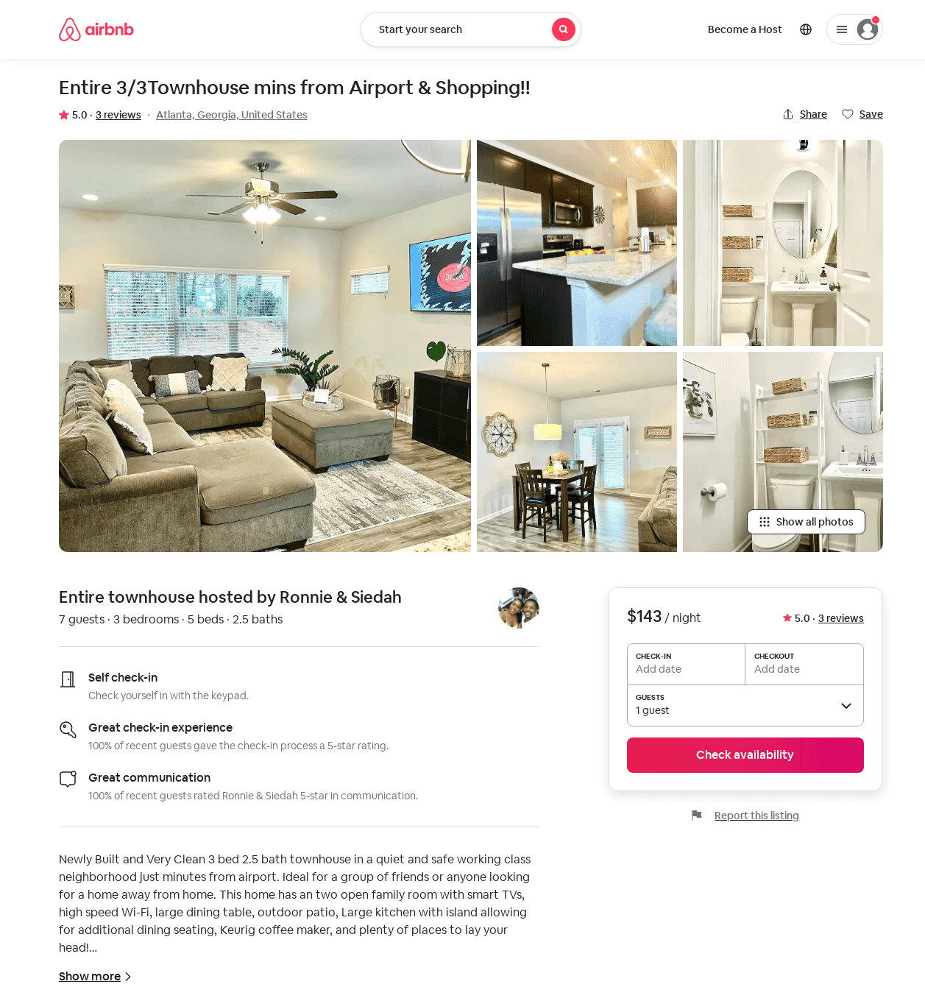
Listing 53324969
3
7
$111 - $182
4.90
2
Ronnie & Siedah
18778760
1
https://www.airbnb.com/rooms/53324969
Aug 2022

Slide 36
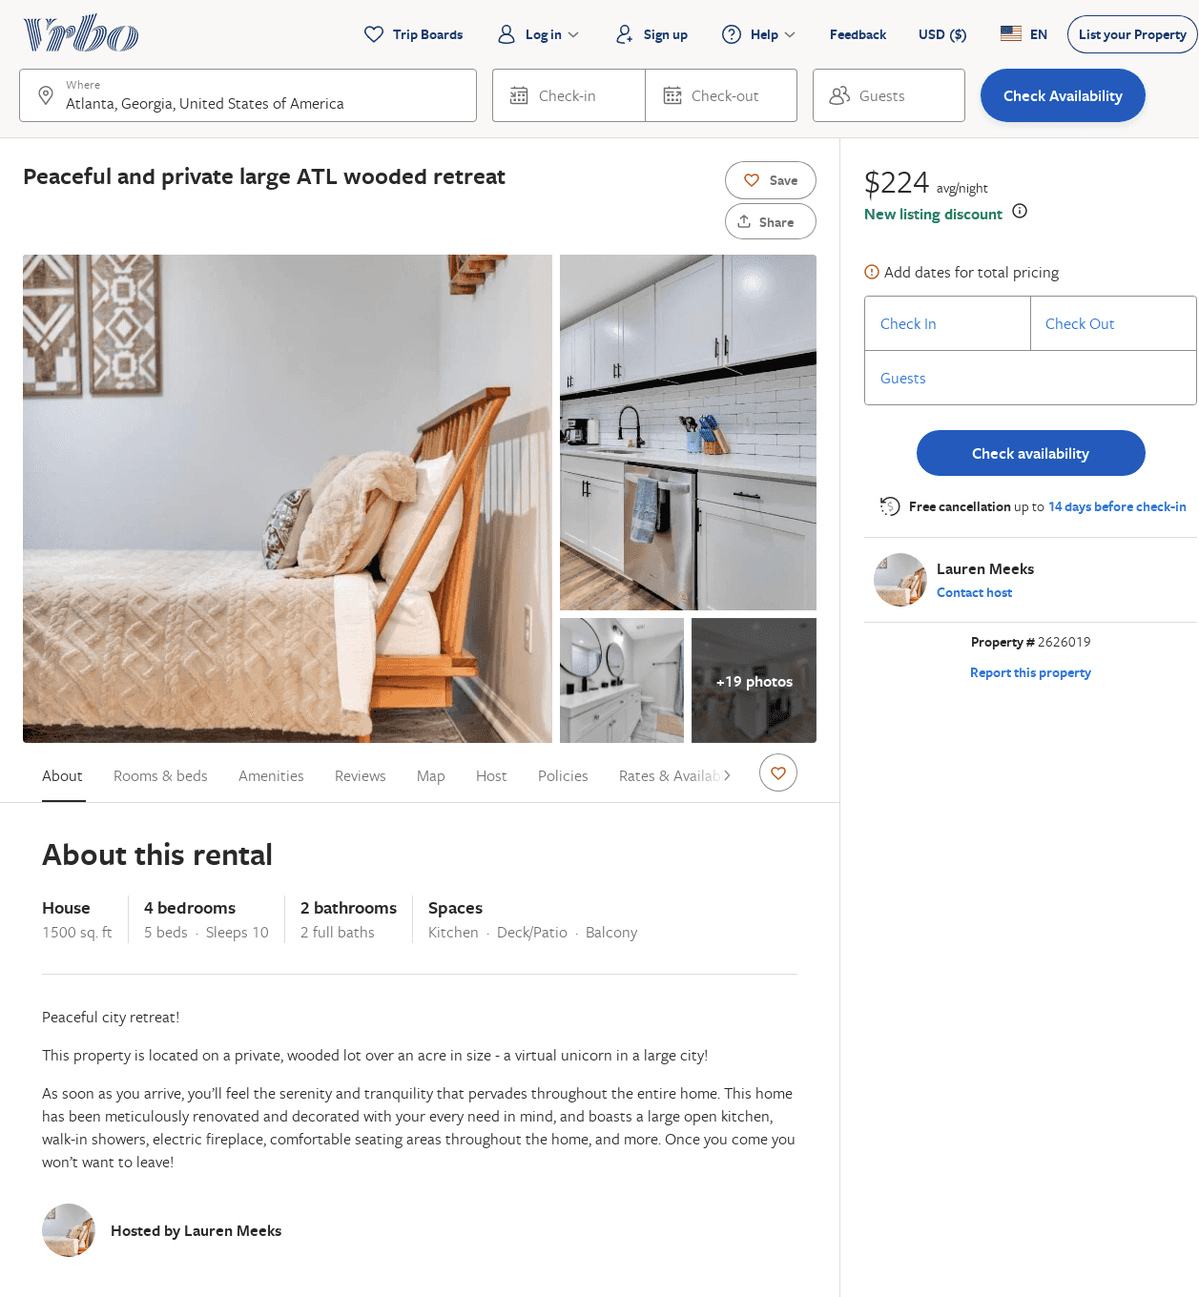
Listing 2626019
4
10
$207
2
Lauren Meeks
https://www.vrbo.com/2626019
Aug 2022

Slide 37
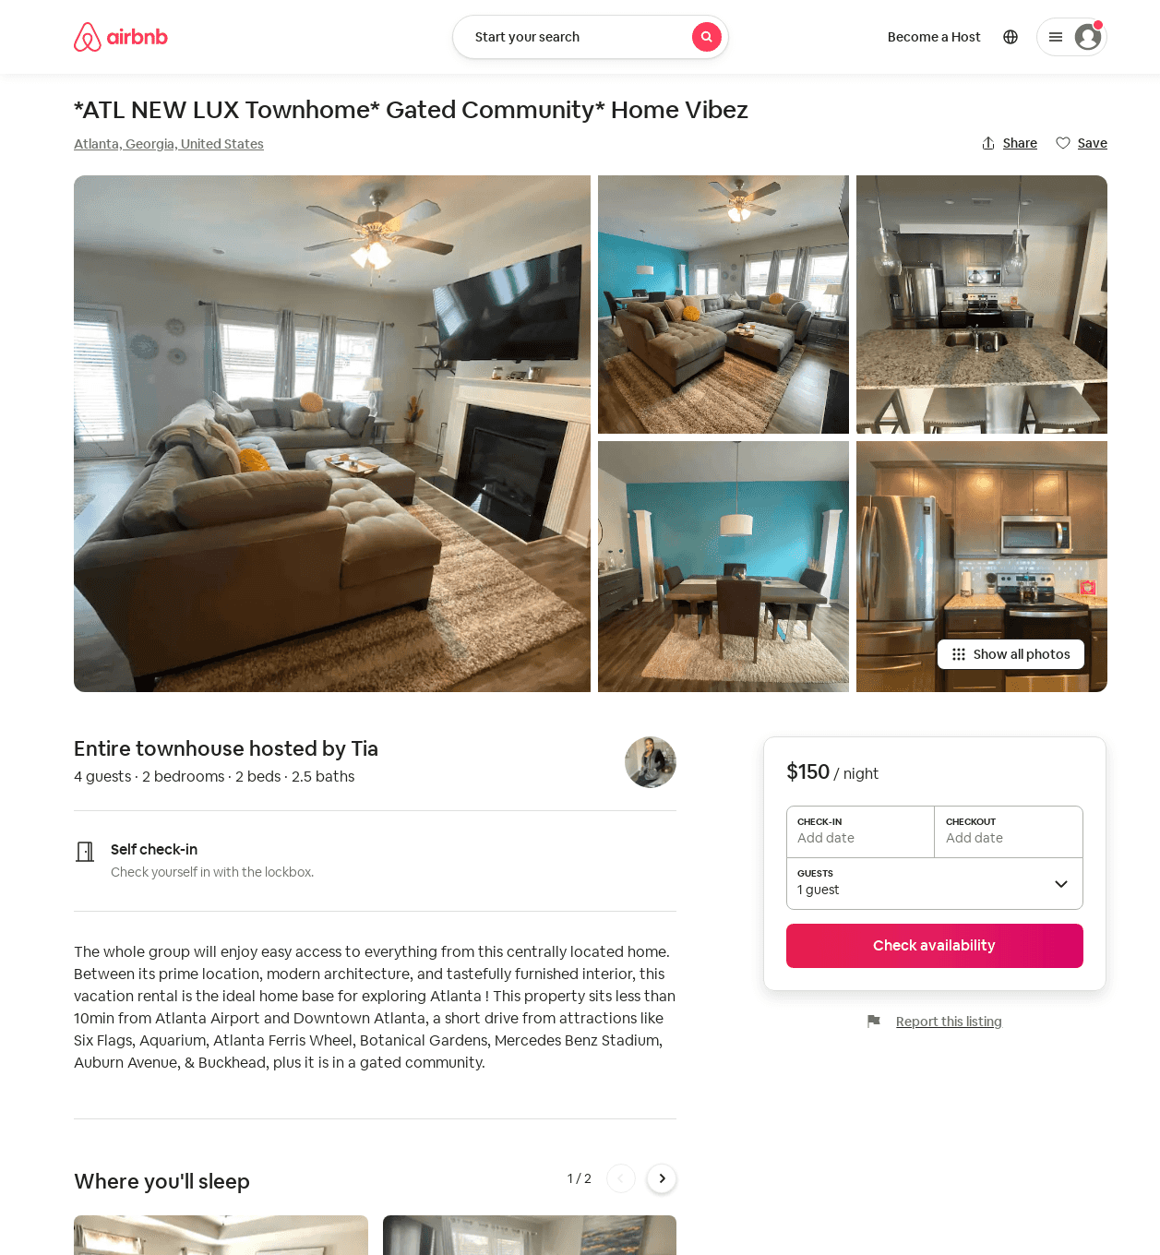
Listing 54288292
2
4
$110 - $150
4.80
2
Tia
188210499
1
https://www.airbnb.com/rooms/54288292
Aug 2022

Slide 38
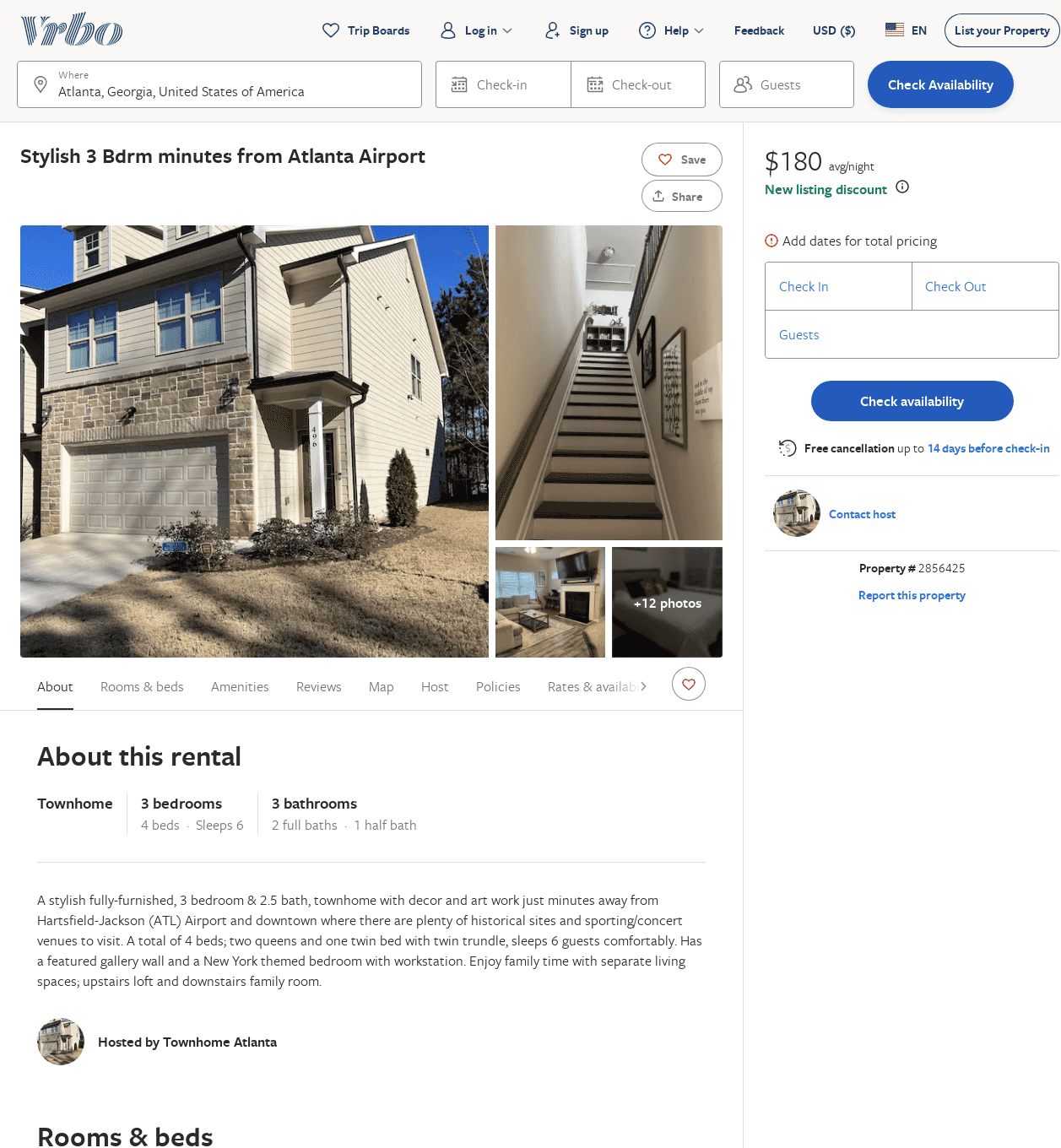
Listing 2856425
3
6
$162
4
2
https://www.vrbo.com/2856425
Aug 2022

Slide 39
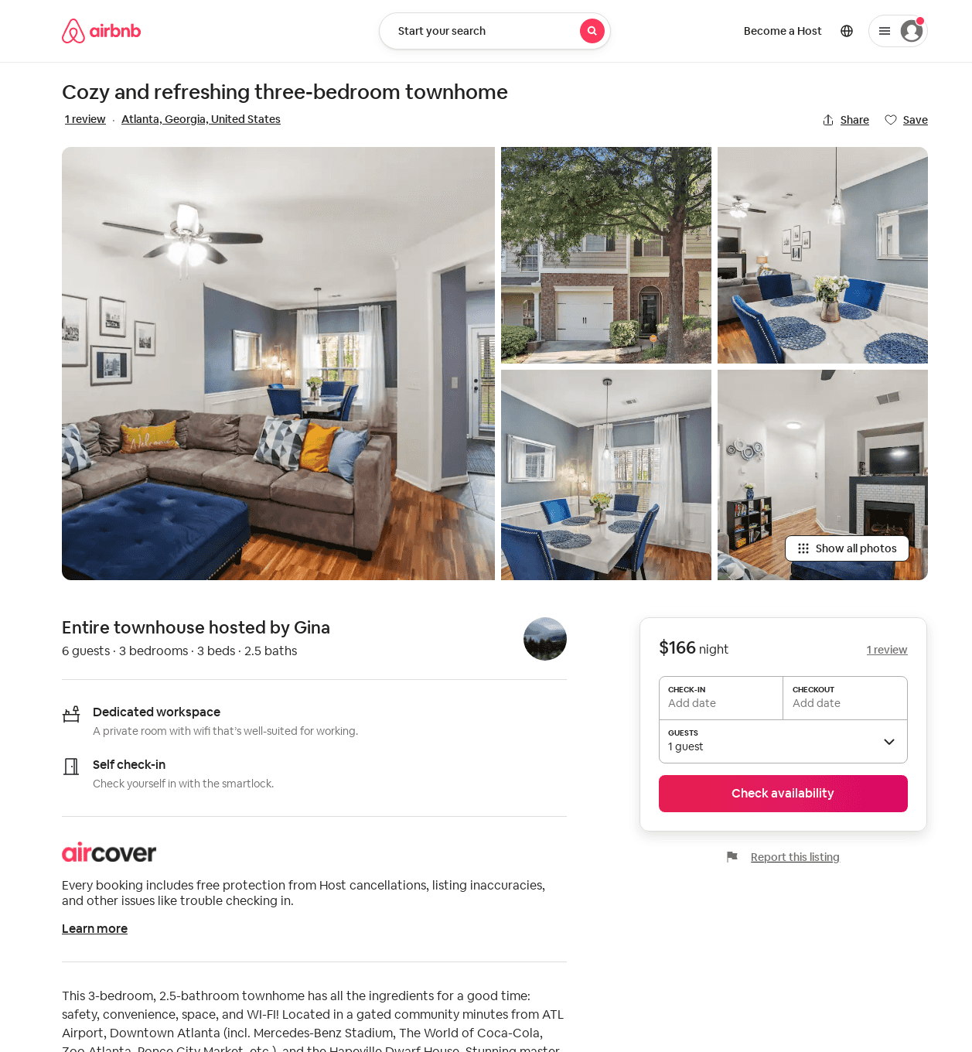
Listing 50673344
3
6
5.0
3
Gina
33869049
1
https://www.airbnb.com/rooms/50673344
Aug 2022

Slide 40
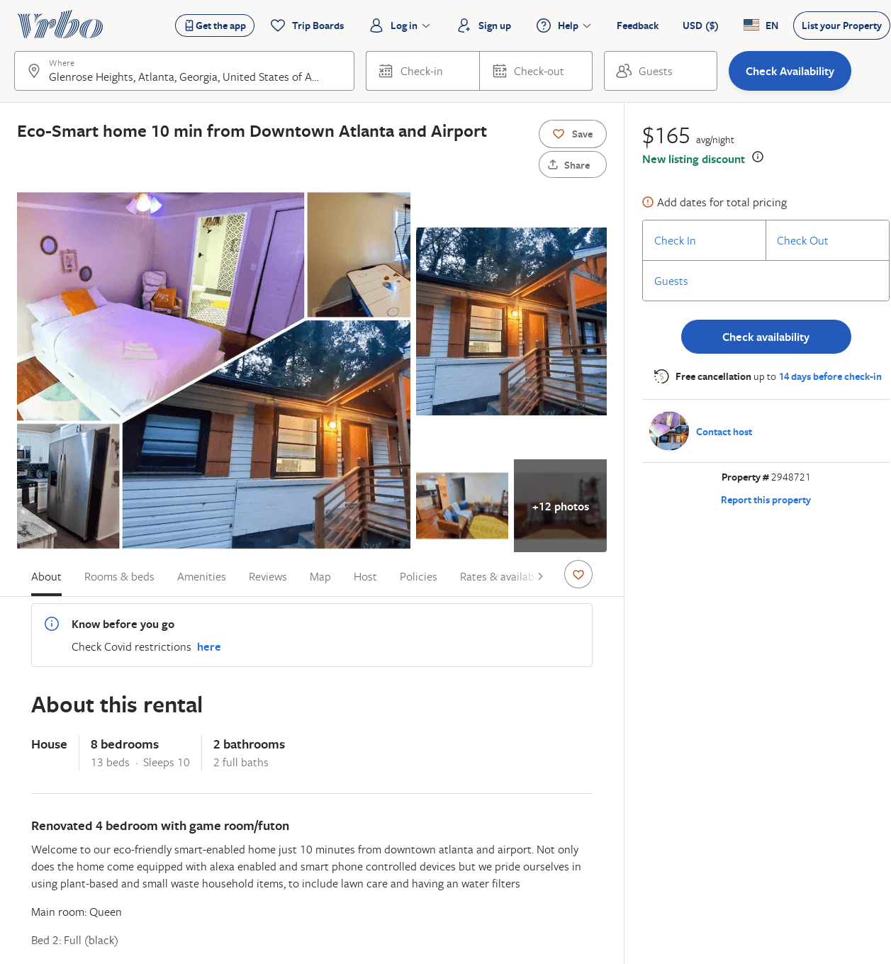
Listing 2948721
8
10
$151
1
makini thomas
https://www.vrbo.com/2948721
Aug 2022

Slide 41
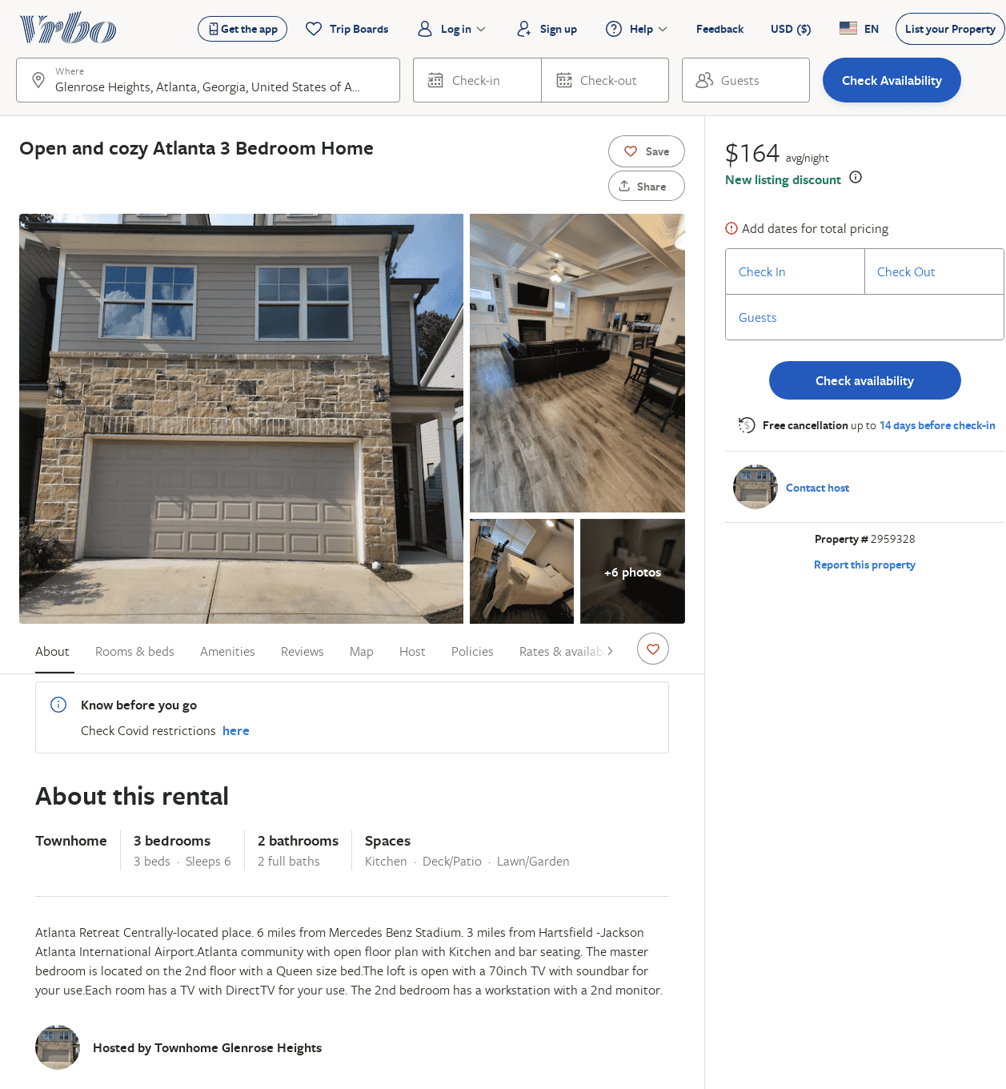
Listing 2959328
3
6
$164
2
https://www.vrbo.com/2959328
Aug 2022

