Slide 2
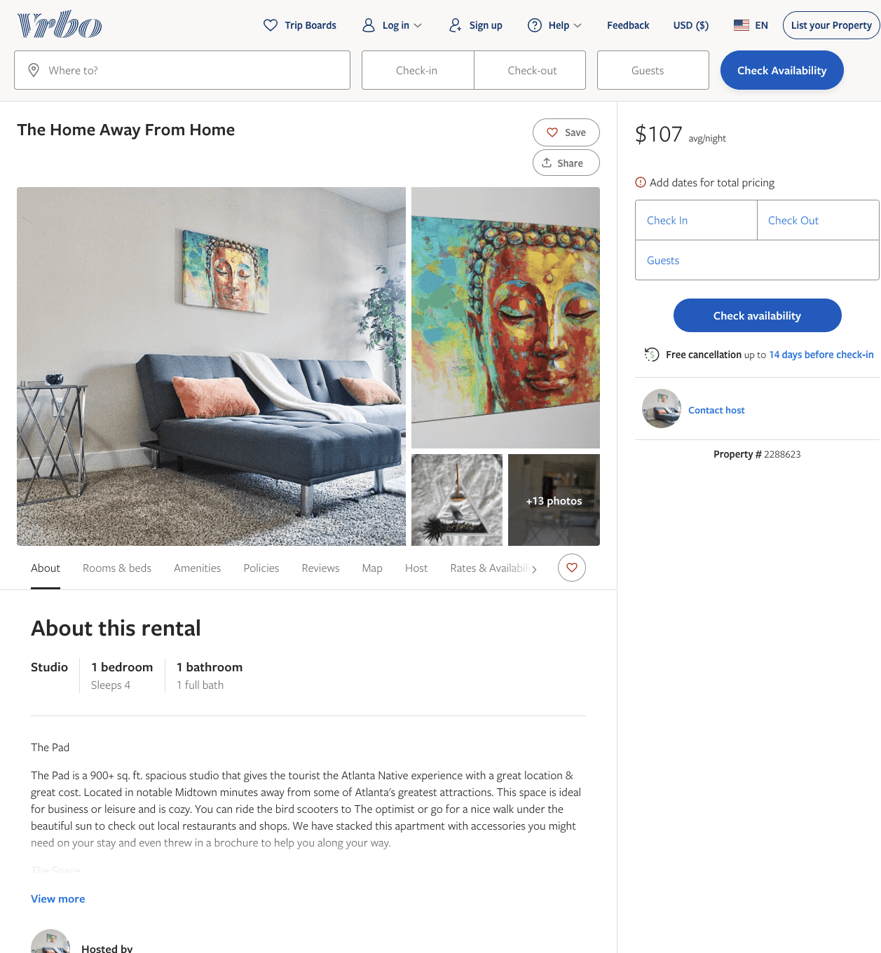
Listing 2288623
1
4
$107 - $99
1
2
https://www.vrbo.com/2288623
Aug 2022

Slide 3
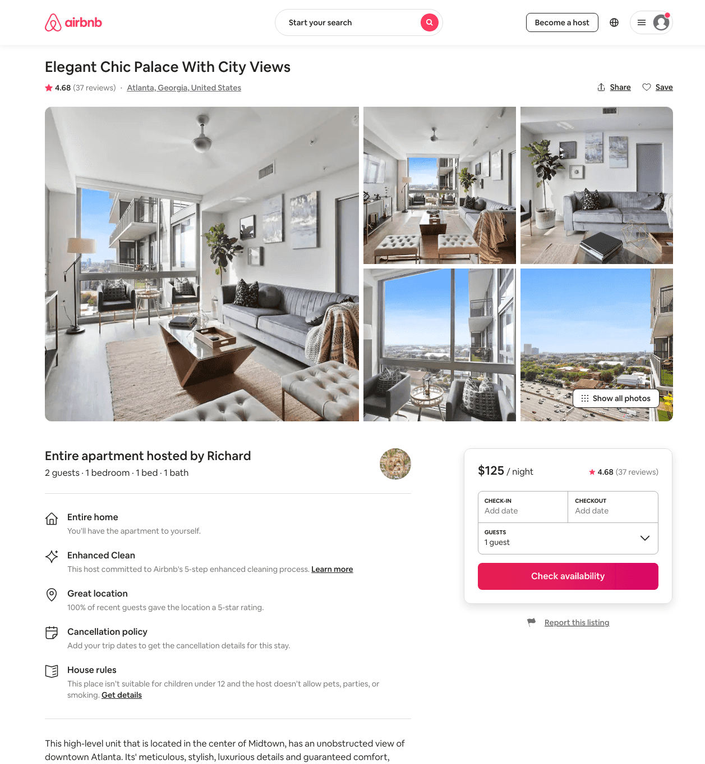
Listing 45959040
1
2
$108 - $141
4.81
1
Richard
309516005
5
https://www.airbnb.com/rooms/45959040
Jul 2022

Slide 4
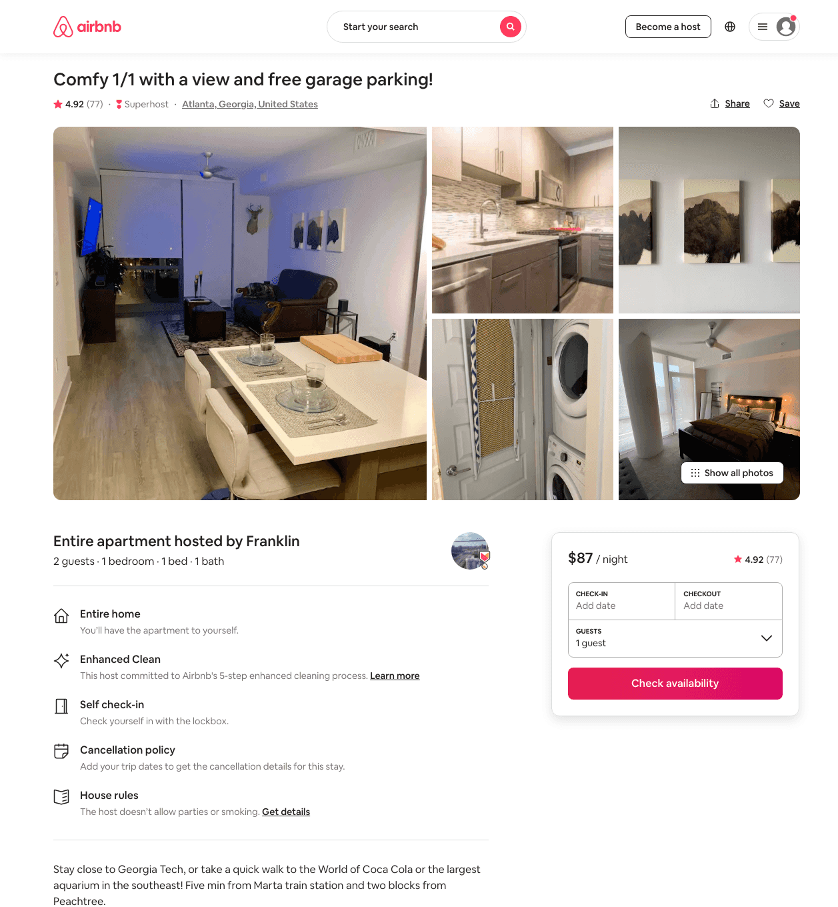
Listing 35466552
1
4
$92 - $136
4.91
1
Franklin
264768254
1
https://www.airbnb.com/rooms/35466552
Aug 2022

Slide 5
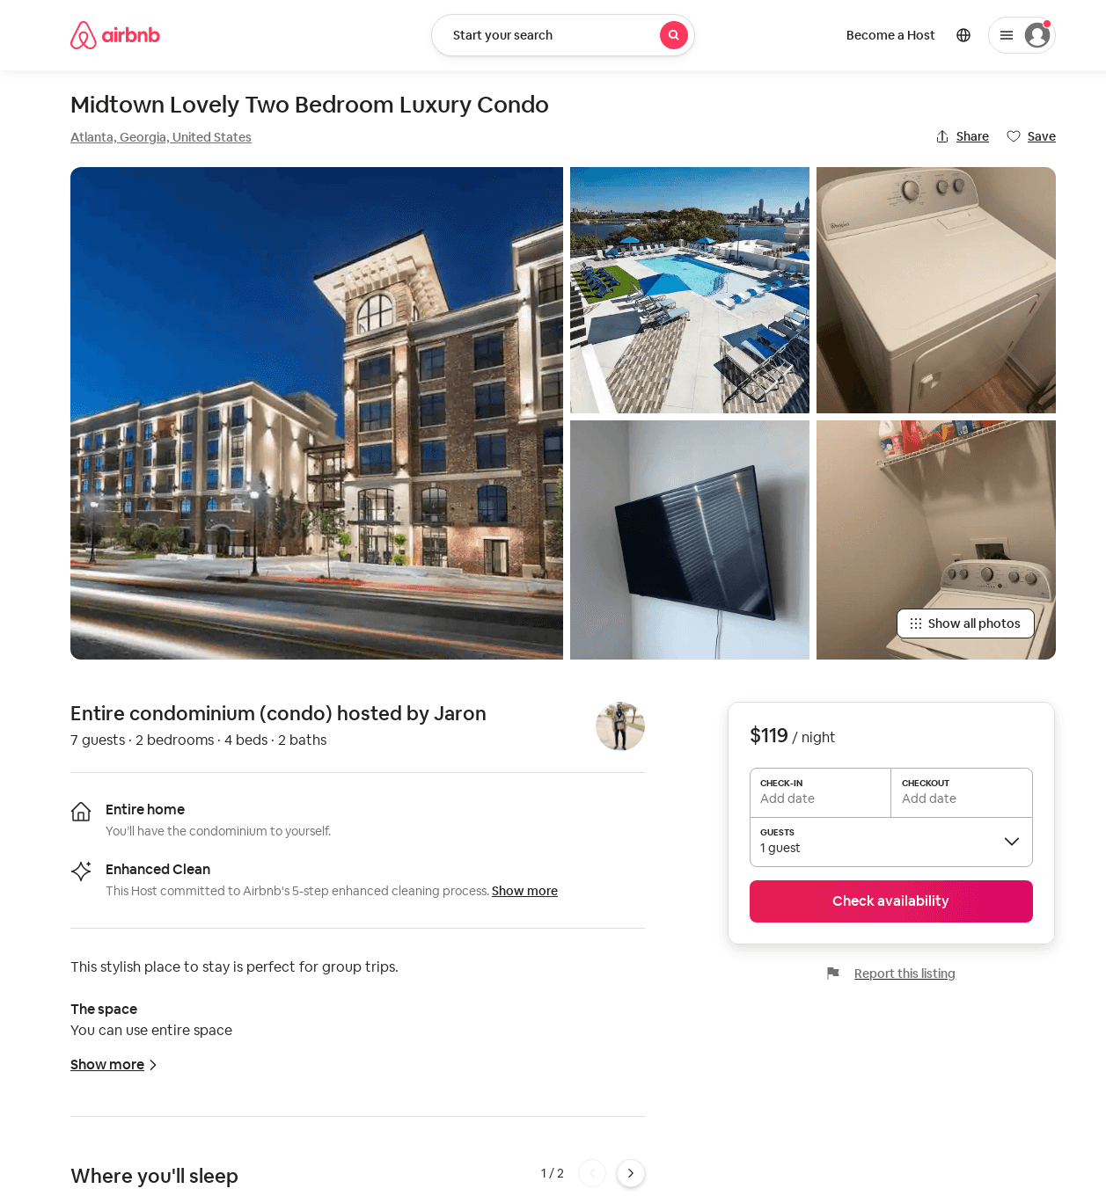
Listing 52514436
2
7
$109 - $400
4.57
2
Jaron
425050539
1
https://www.airbnb.com/rooms/52514436
Aug 2022

Slide 6
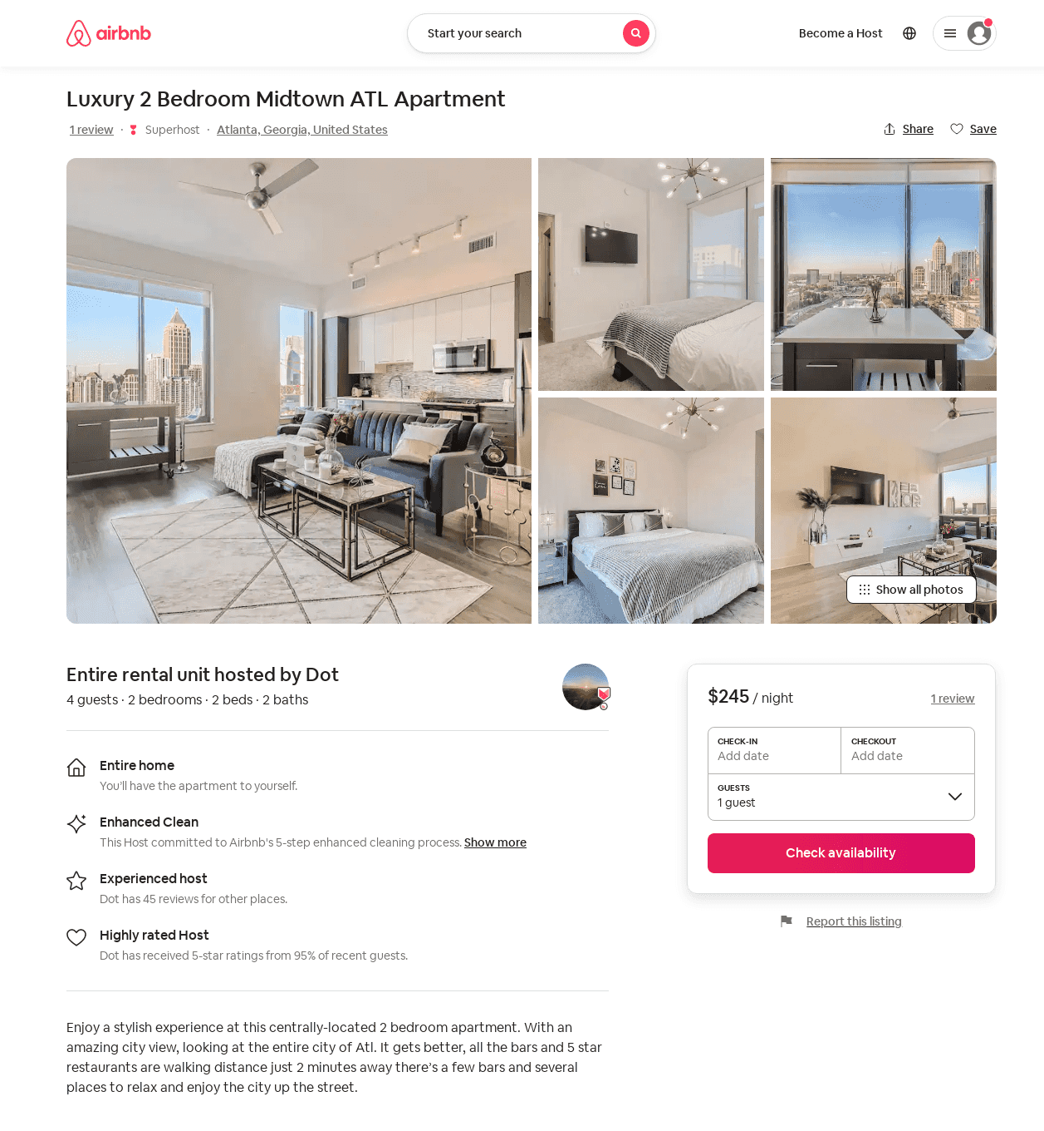
Listing 53493639
2
4
$220 - $330
4.87
1
Dot
157141647
2
https://www.airbnb.com/rooms/53493639
Aug 2022

Slide 7
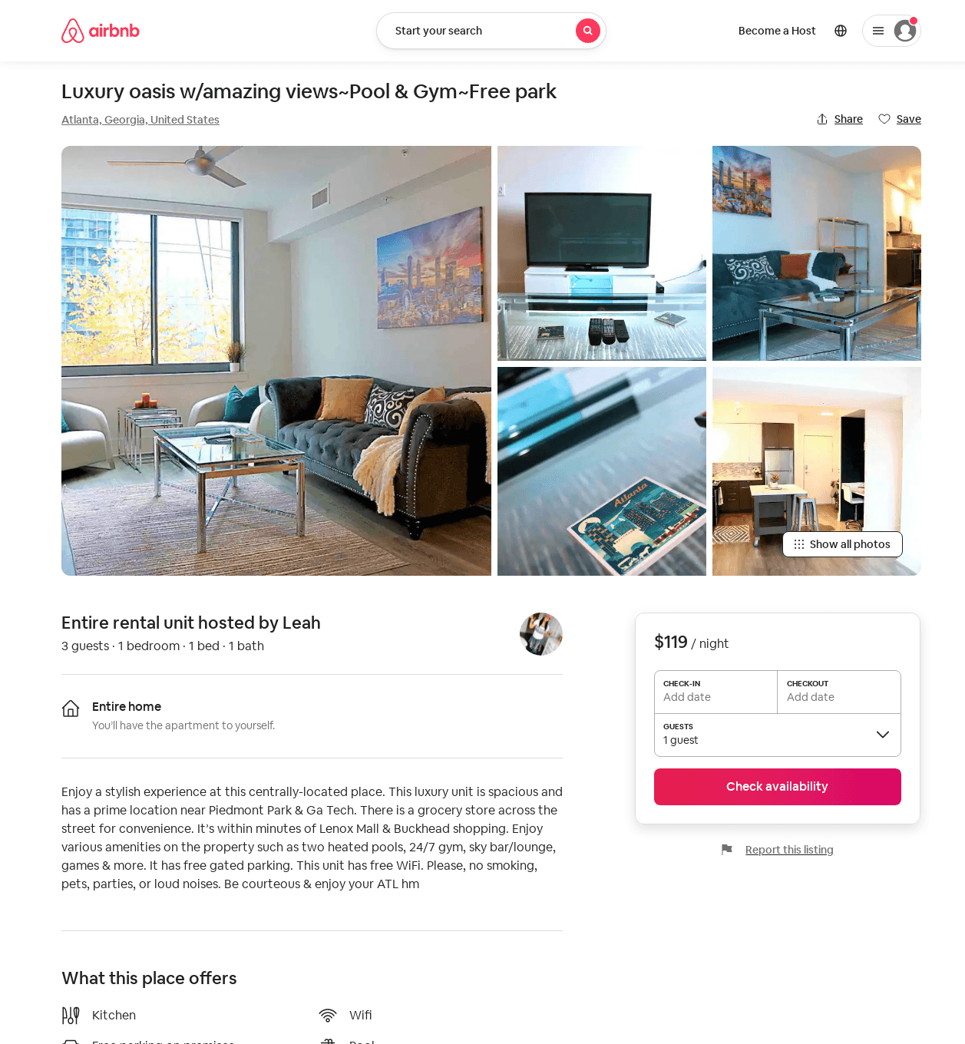
Listing 53690430
1
3
$79 - $148
4.89
2
Leah
118517596
1
https://www.airbnb.com/rooms/53690430
Aug 2022

Slide 8
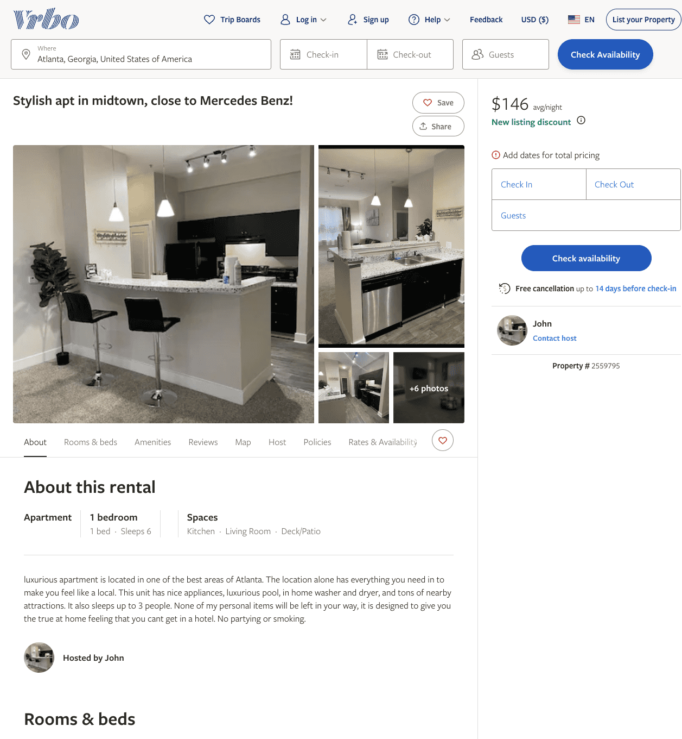
Listing 2559795
1
6
$146 - $150
2
John
https://www.vrbo.com/2559795
Aug 2022

Slide 9
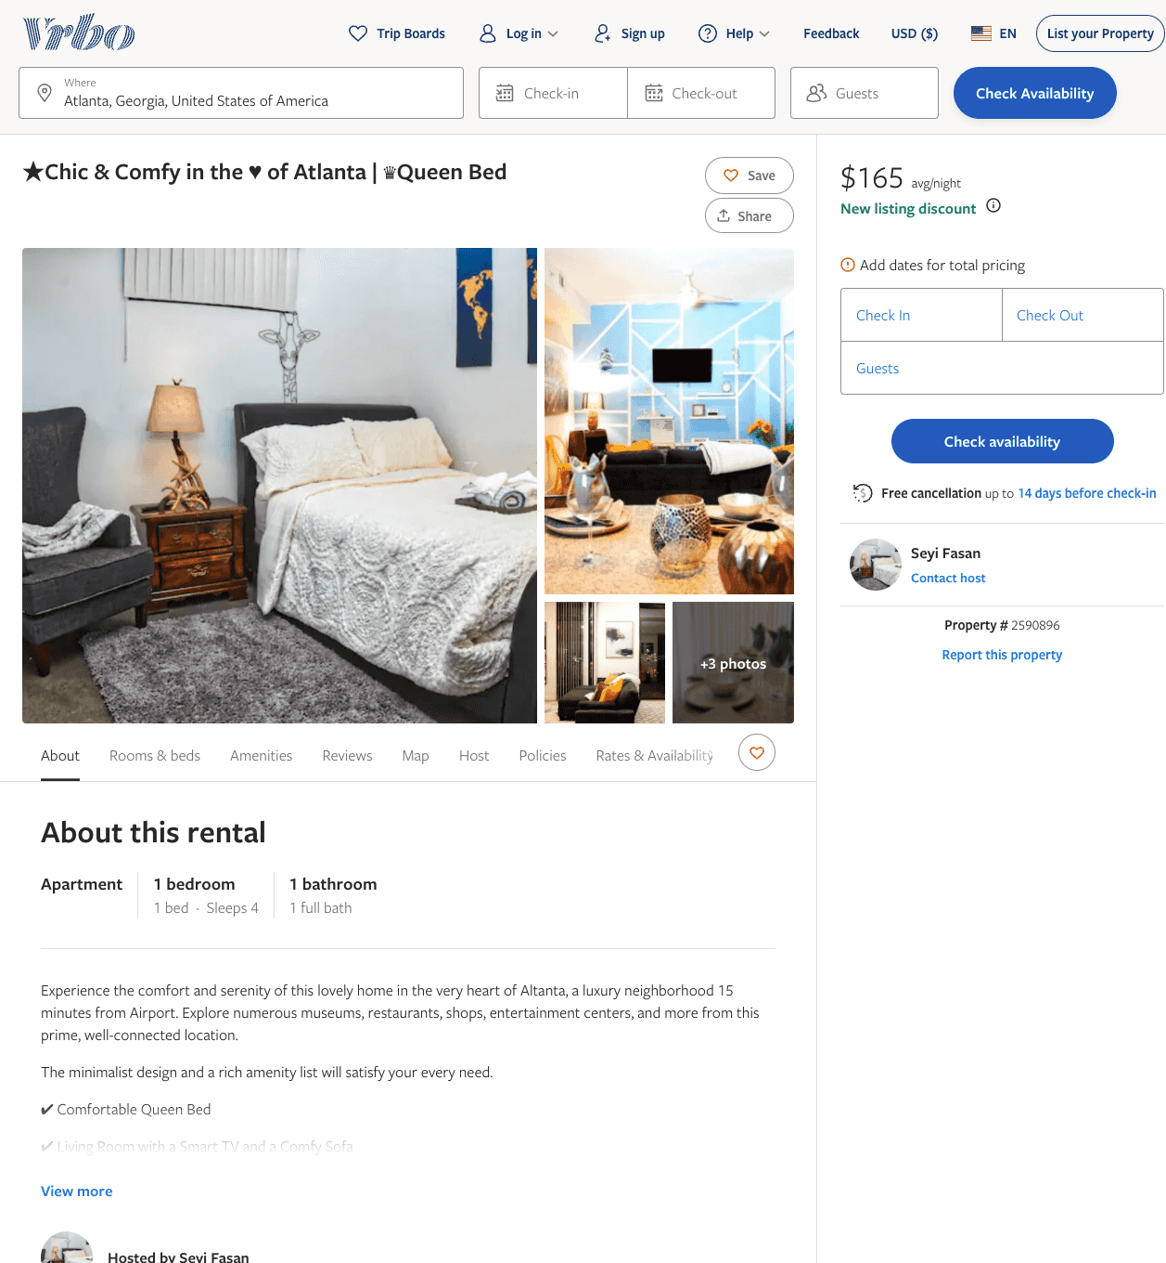
Listing 2590896
1
4
$165
2
Seyi Fasan
https://www.vrbo.com/2590896
Aug 2022

Slide 10
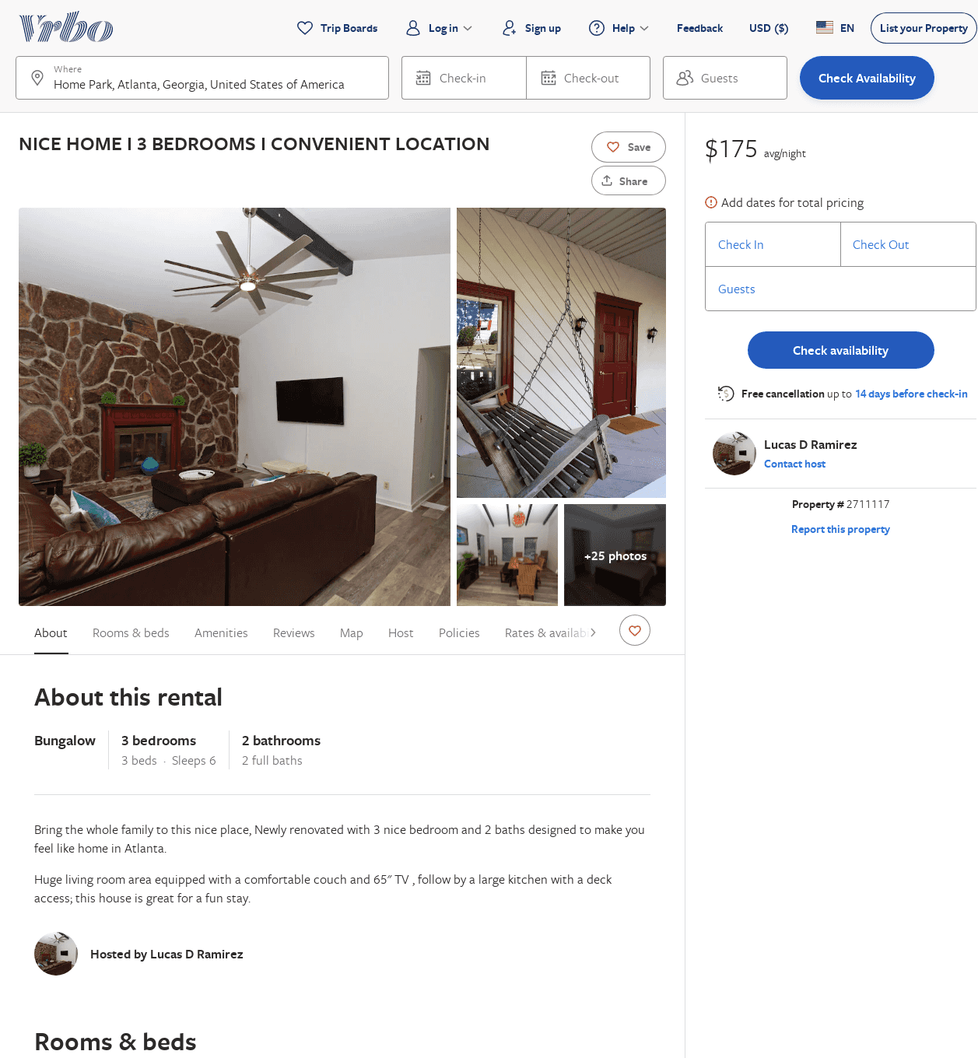
Listing 2711117
3
6
$213
3
Lucas D Ramirez
https://www.vrbo.com/2711117
Aug 2022

Slide 11
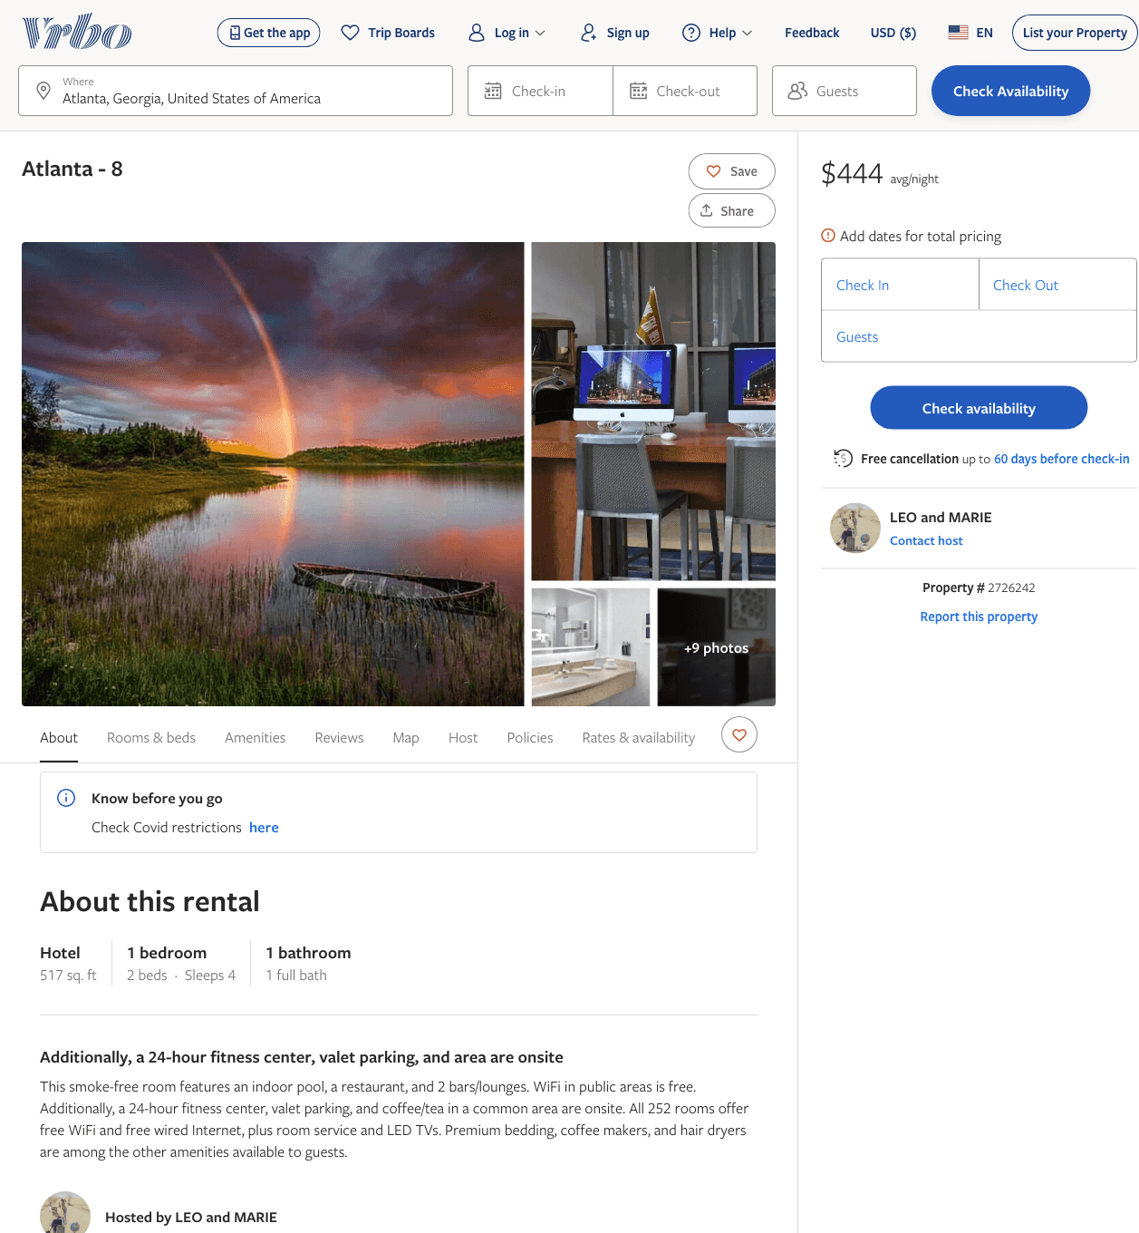
Listing 2726242
1
4
$444
2
LEO and MARIE
https://www.vrbo.com/2726242
Aug 2022

Slide 12
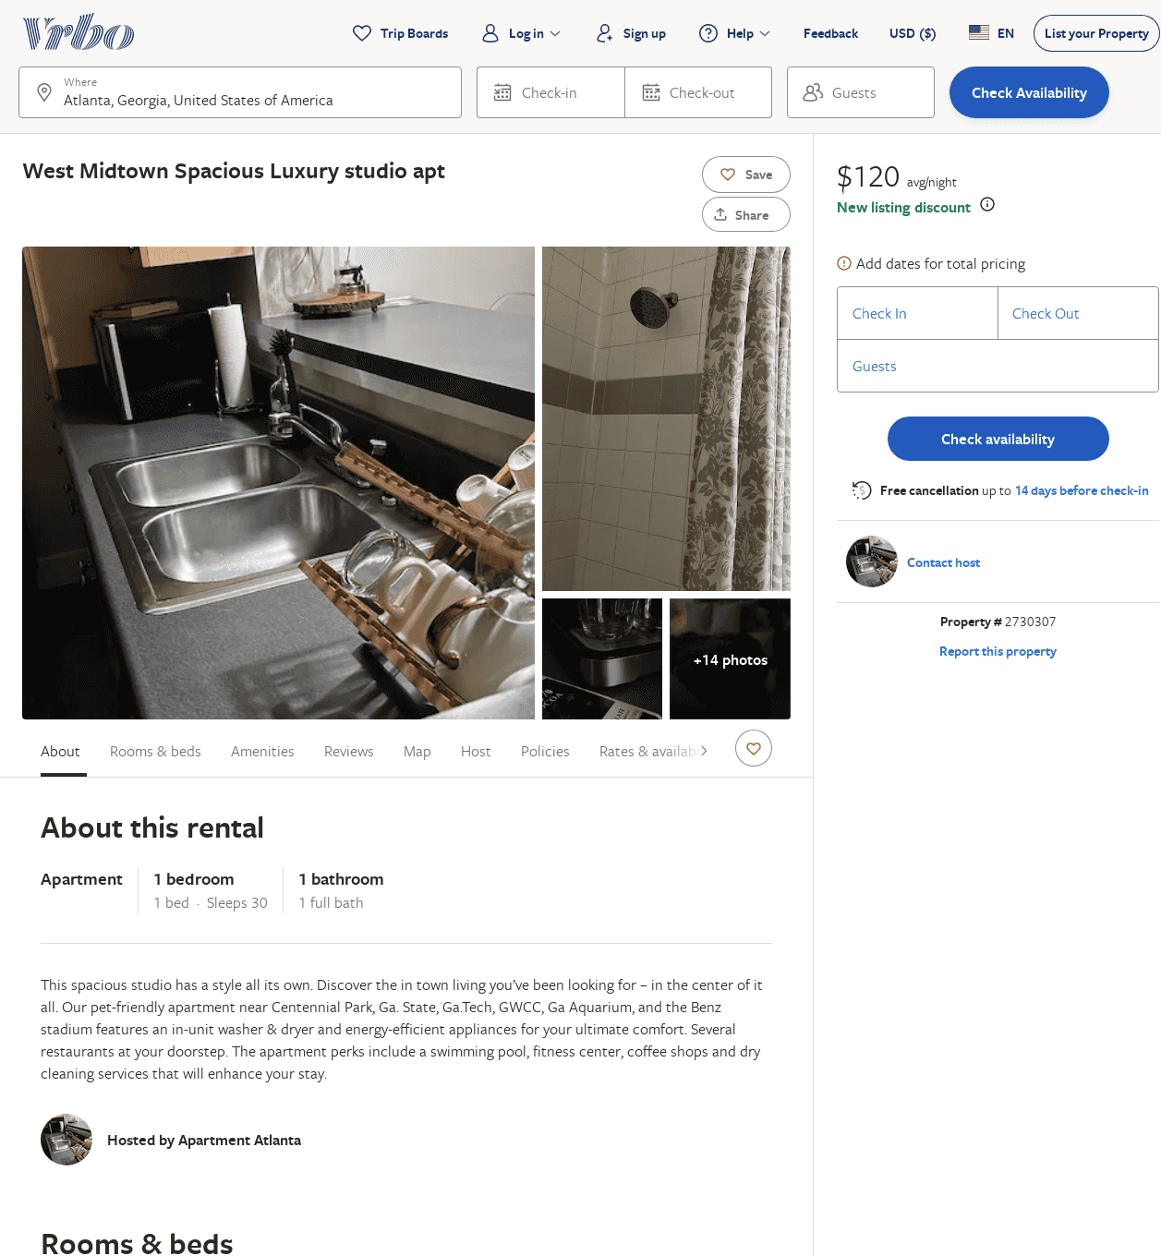
Listing 2730307
1
2
$125
4.6666665
2
https://www.vrbo.com/2730307
Aug 2022

Slide 13
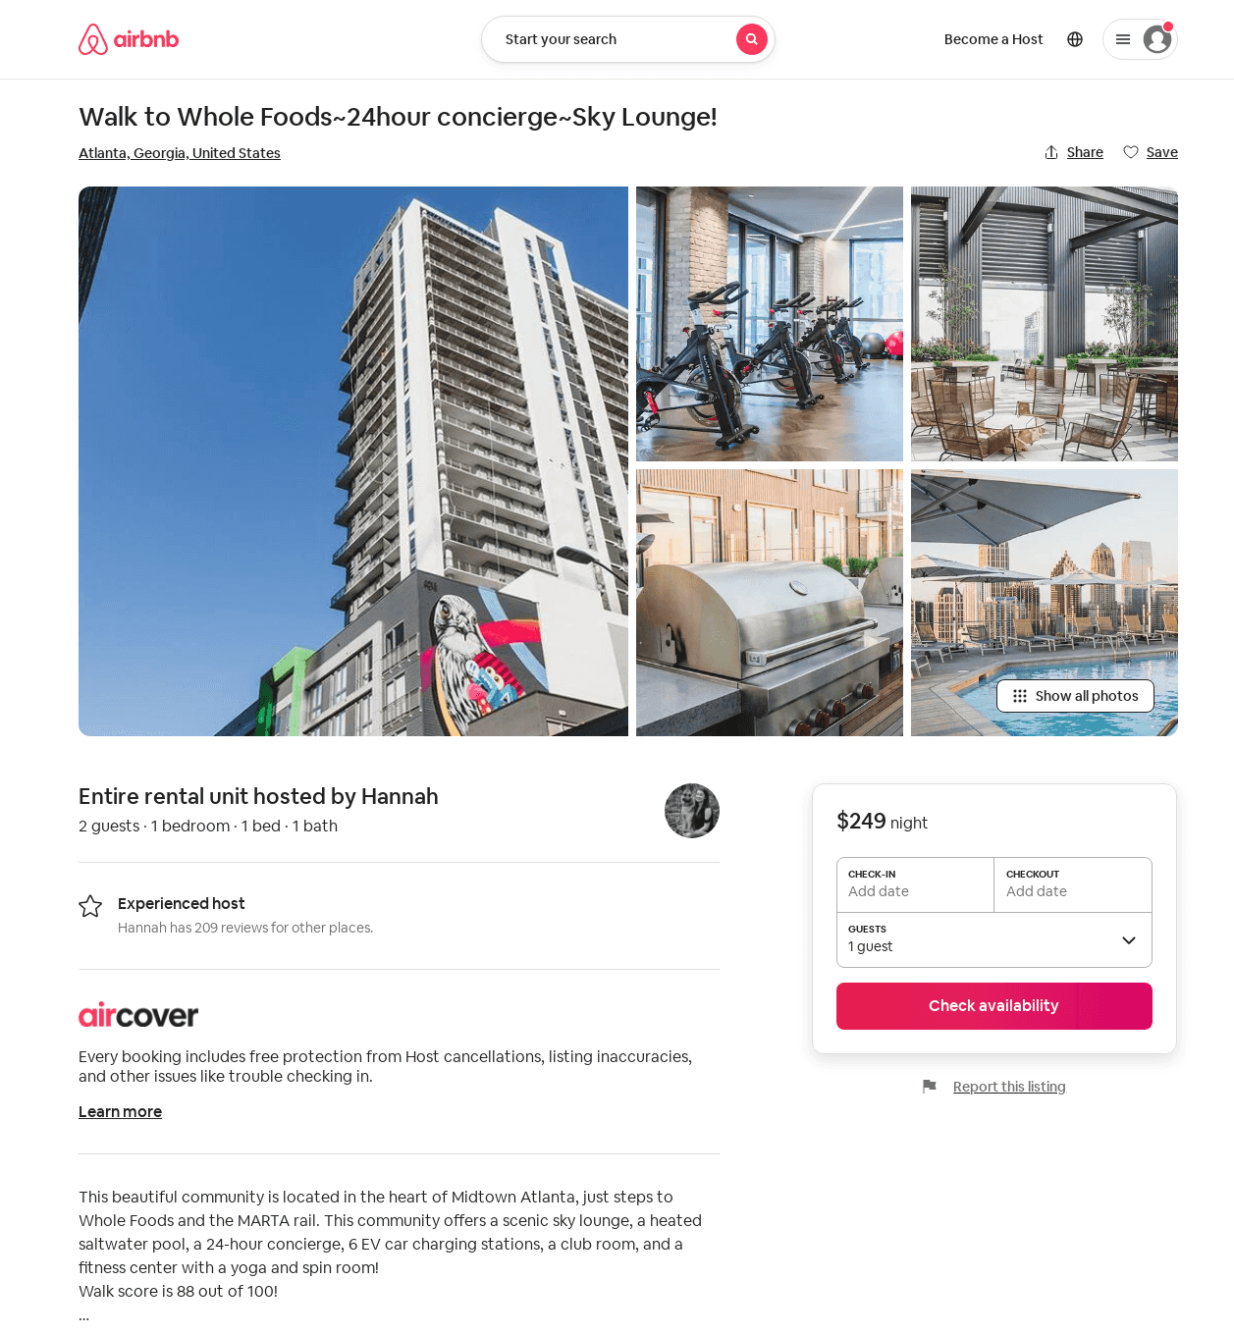
Listing 43389899
1
2
4
Hannah
152046386
9
https://www.airbnb.com/rooms/43389899
Aug 2022

