Slide 2
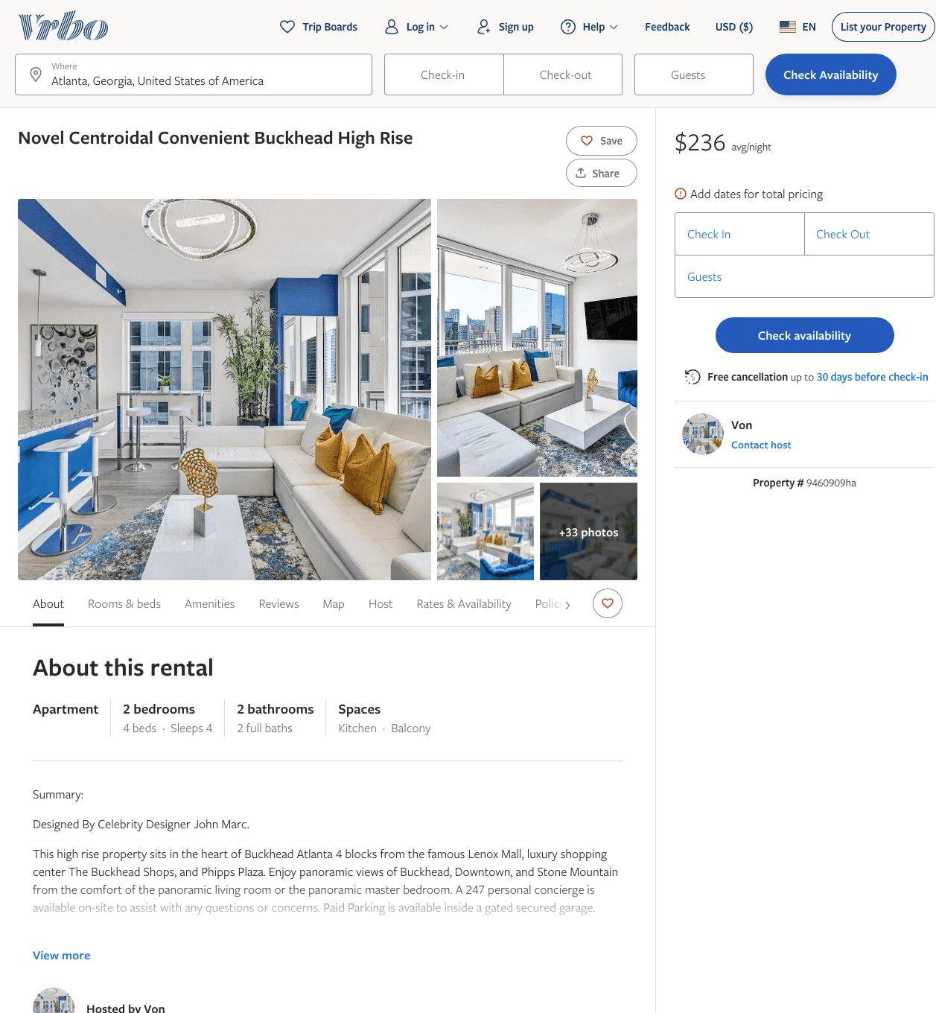
Listing 9460909
2
5
$195 - $283
5
1
Von
https://www.vrbo.com/9460909ha
Aug 2022

Slide 3
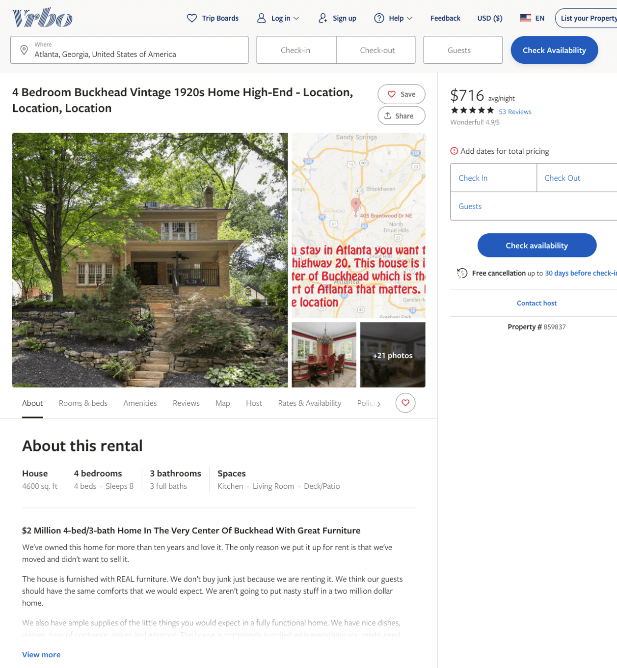
Listing 859837
4
8
$530 - $806
4.909091
4
Rick Latona
https://www.vrbo.com/859837
Aug 2022

Slide 4
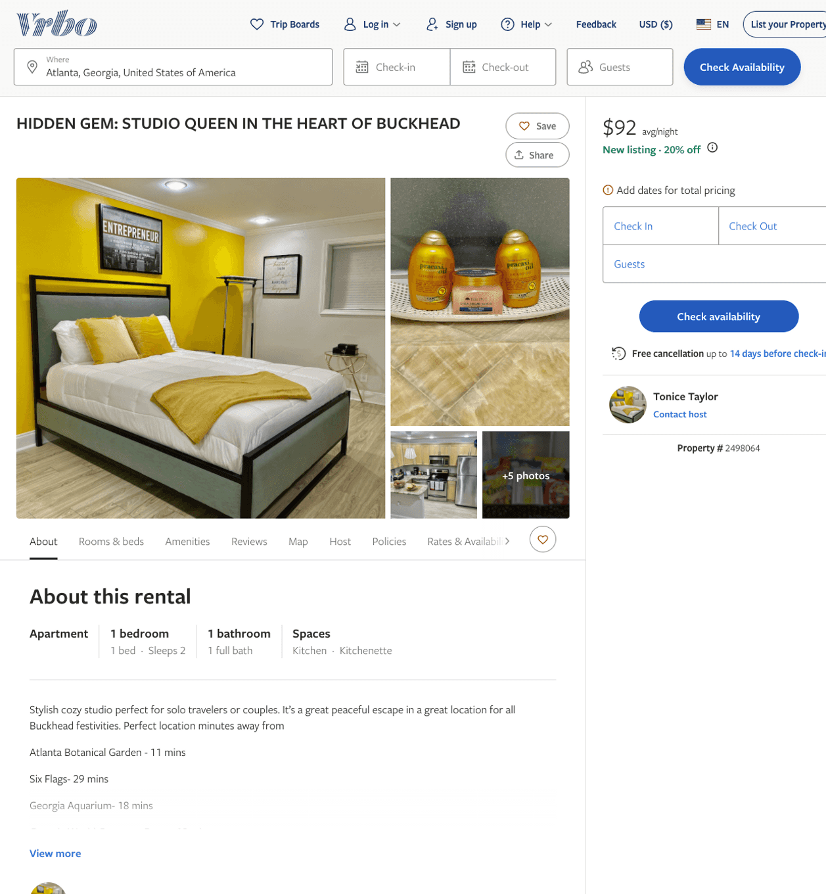
Listing 2498064
1
2
$100 - $94
2
Tonice Taylor
https://www.vrbo.com/2498064
Aug 2022

Slide 5
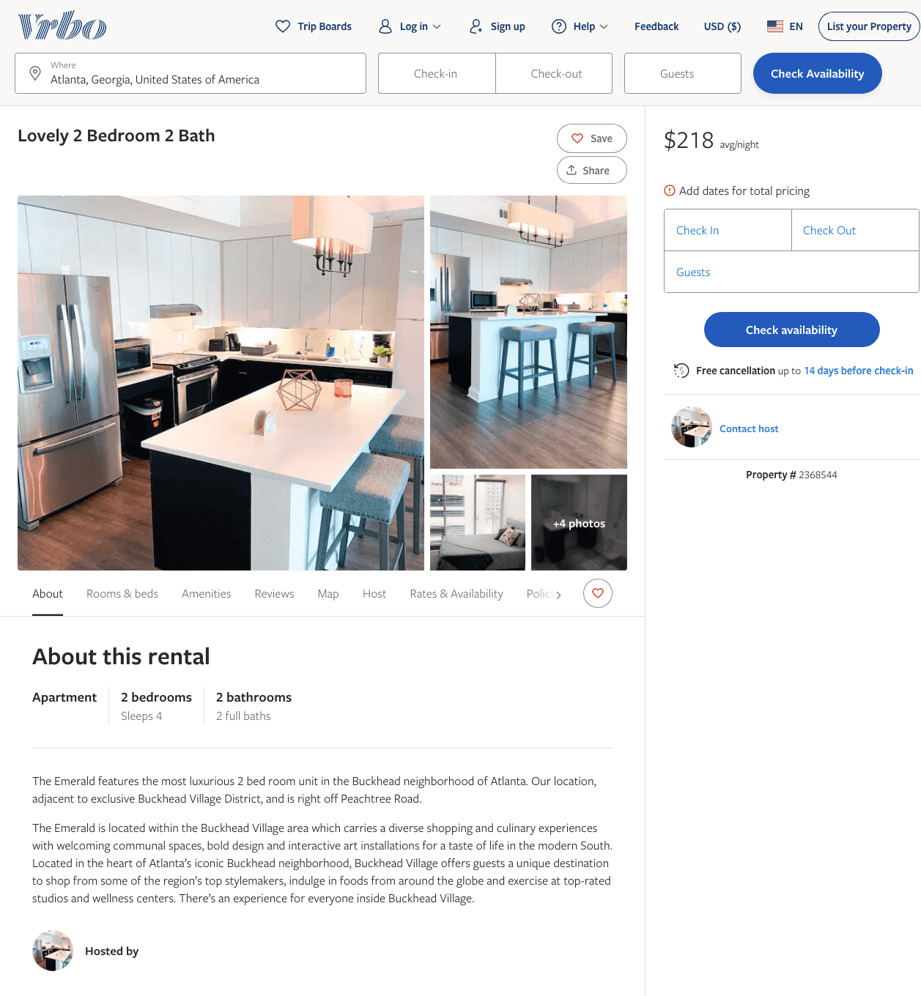
Listing 2368544
2
4
$217 - $218
2
https://www.vrbo.com/2368544
Aug 2022

Slide 6
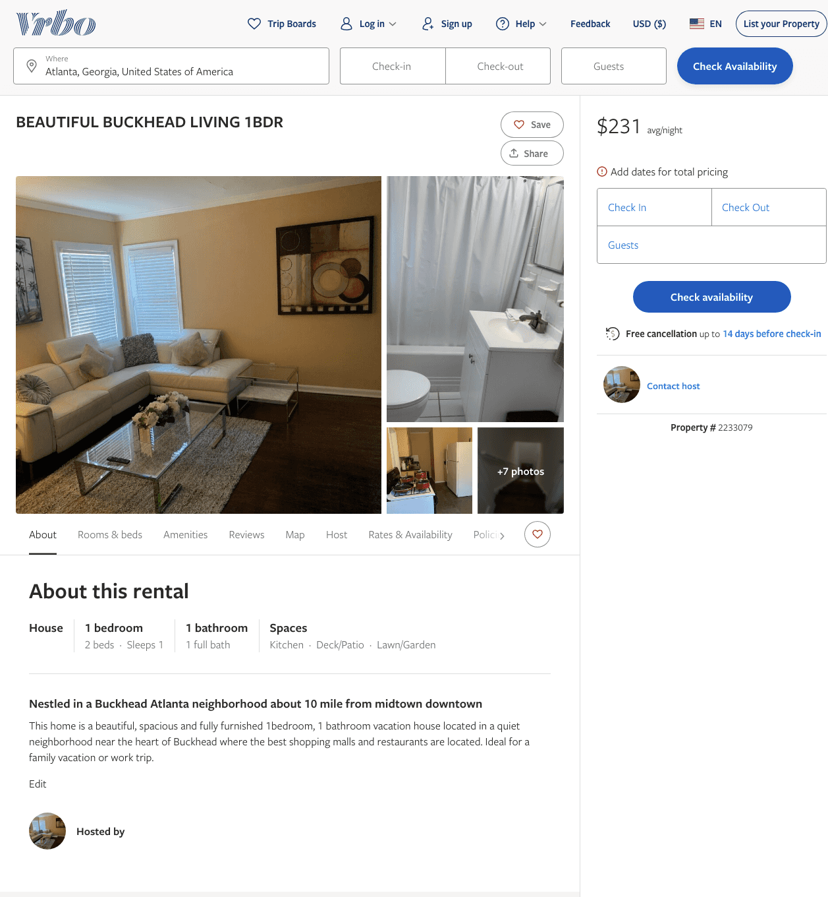
Listing 2233079
1
1
$231
3
https://www.vrbo.com/2233079
Aug 2022

Slide 7
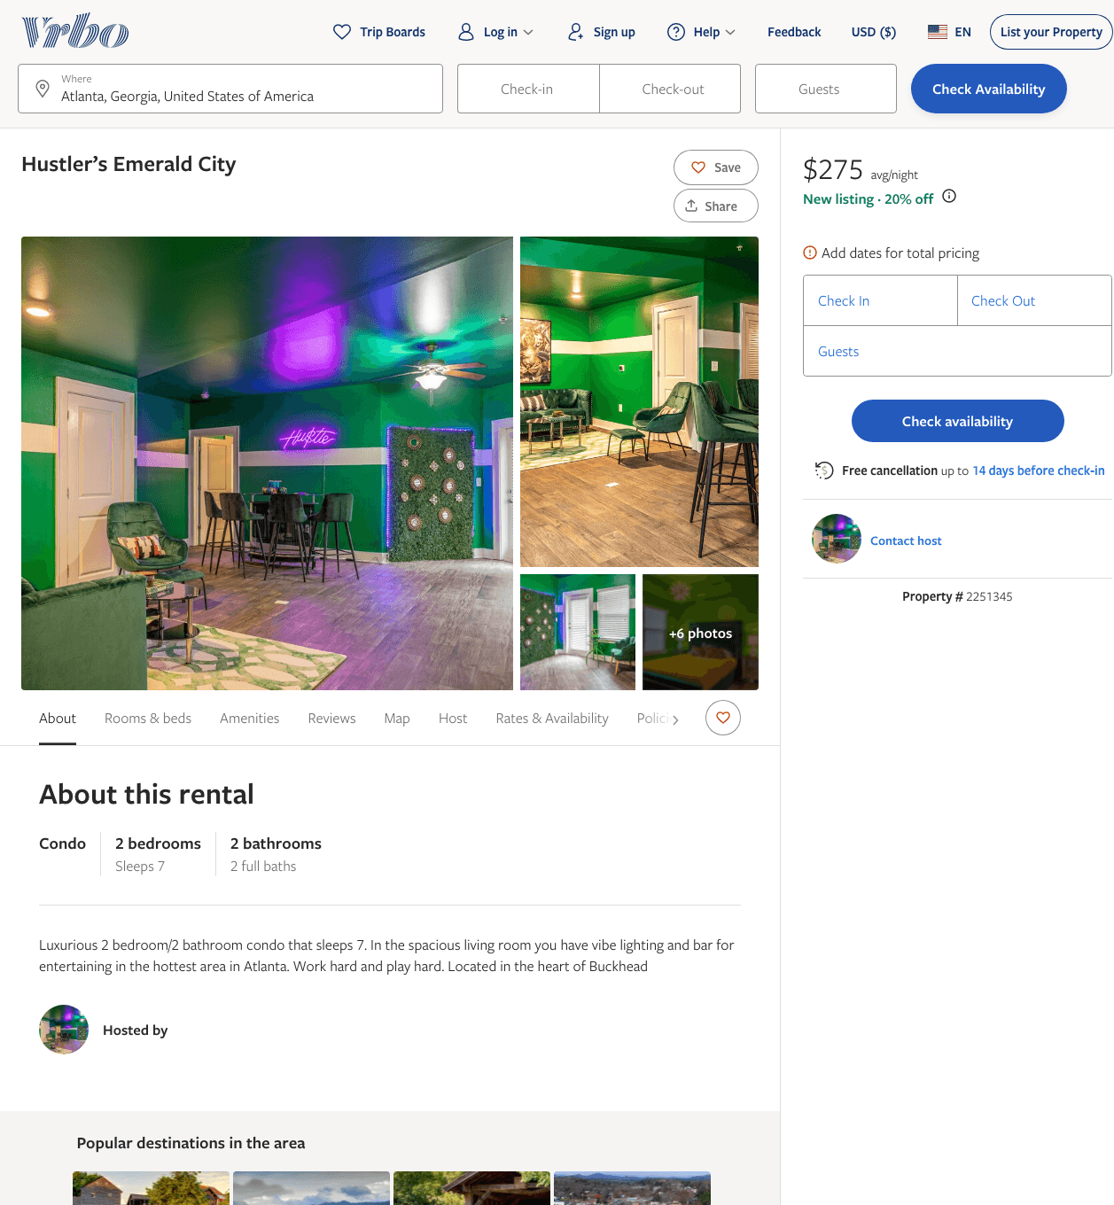
Listing 2251345
2
7
$275
2
https://www.vrbo.com/2251345
Aug 2022

Slide 8
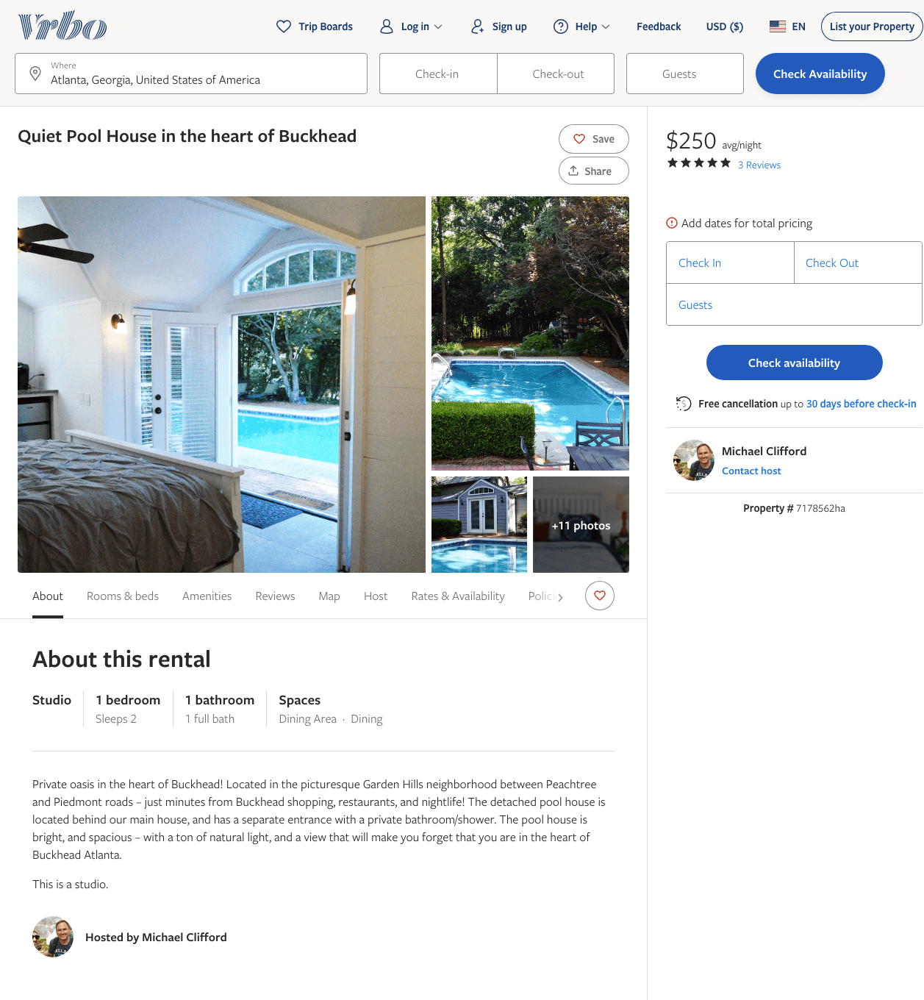
Listing 7178562
1
2
$250
5
1
Michael Clifford
https://www.vrbo.com/7178562ha
Aug 2022

Slide 9
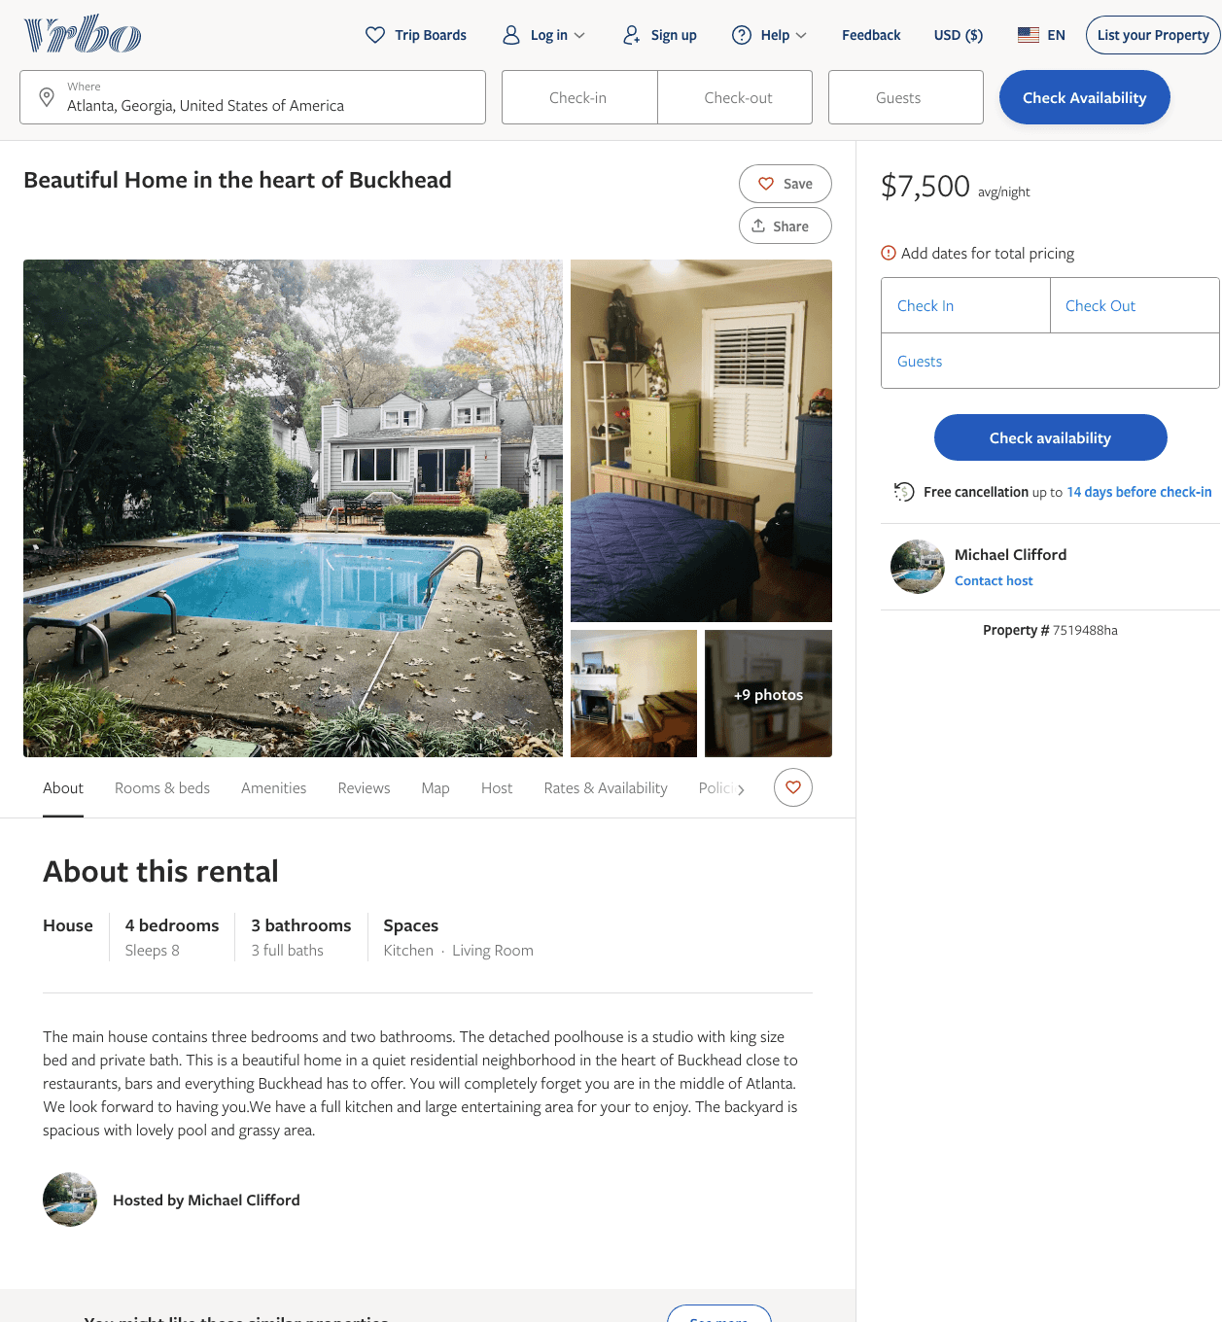
Listing 7519488
4
8
$7,500
3
Michael Clifford
https://www.vrbo.com/7519488ha
Aug 2022

Slide 10
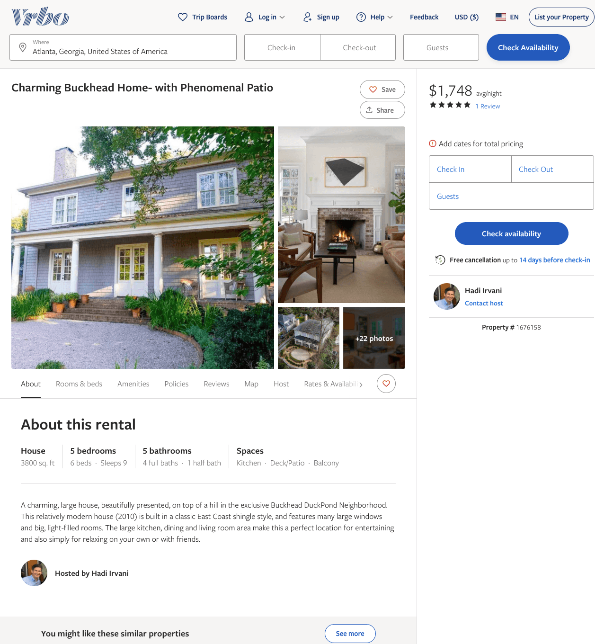
Listing 1676158
5
9
$1,748
5
3
Hadi Irvani
https://www.vrbo.com/1676158
Aug 2022

Slide 11
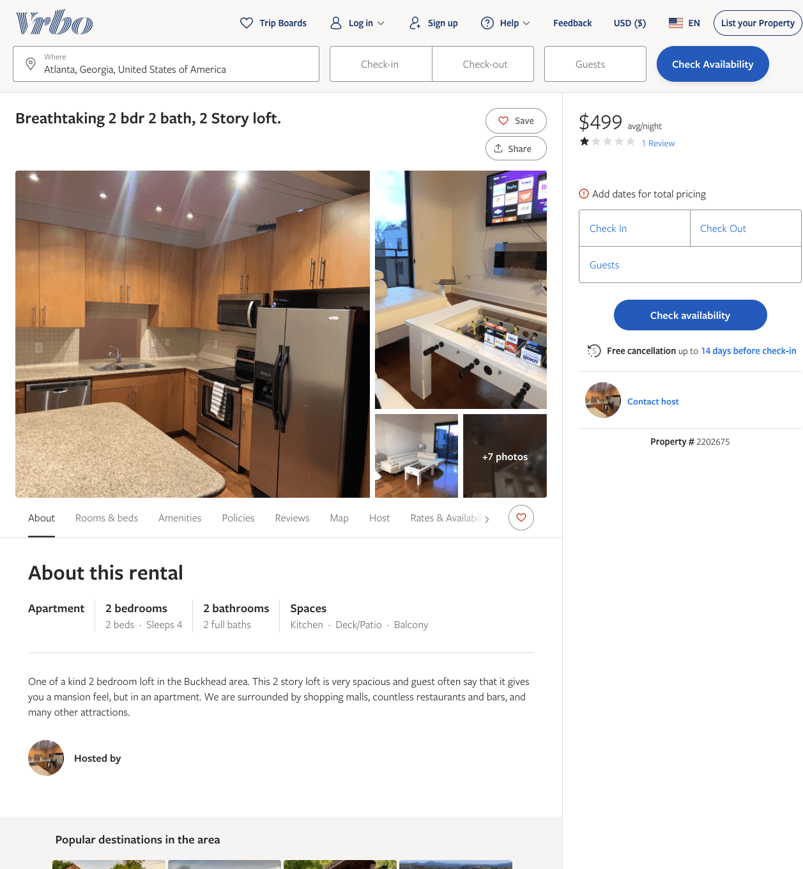
Listing 2202675
2
4
$499
1
1
https://www.vrbo.com/2202675
Aug 2022

Slide 12
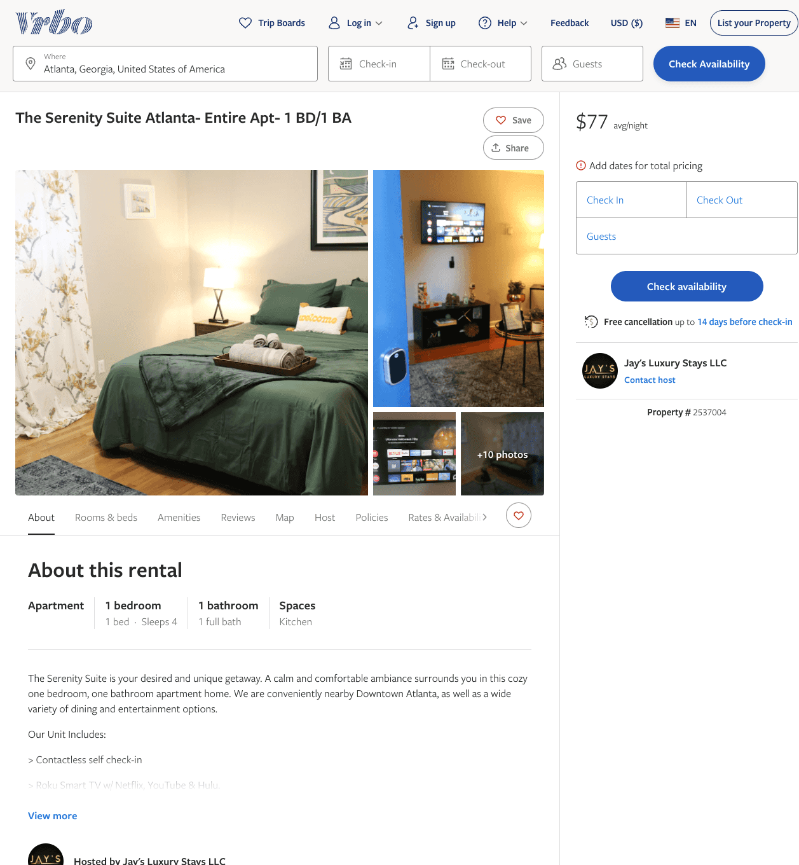
Listing 2537004
1
4
$65 - $77
1
Jay's Luxury Stays LLC
https://www.vrbo.com/2537004
Aug 2022

Slide 13
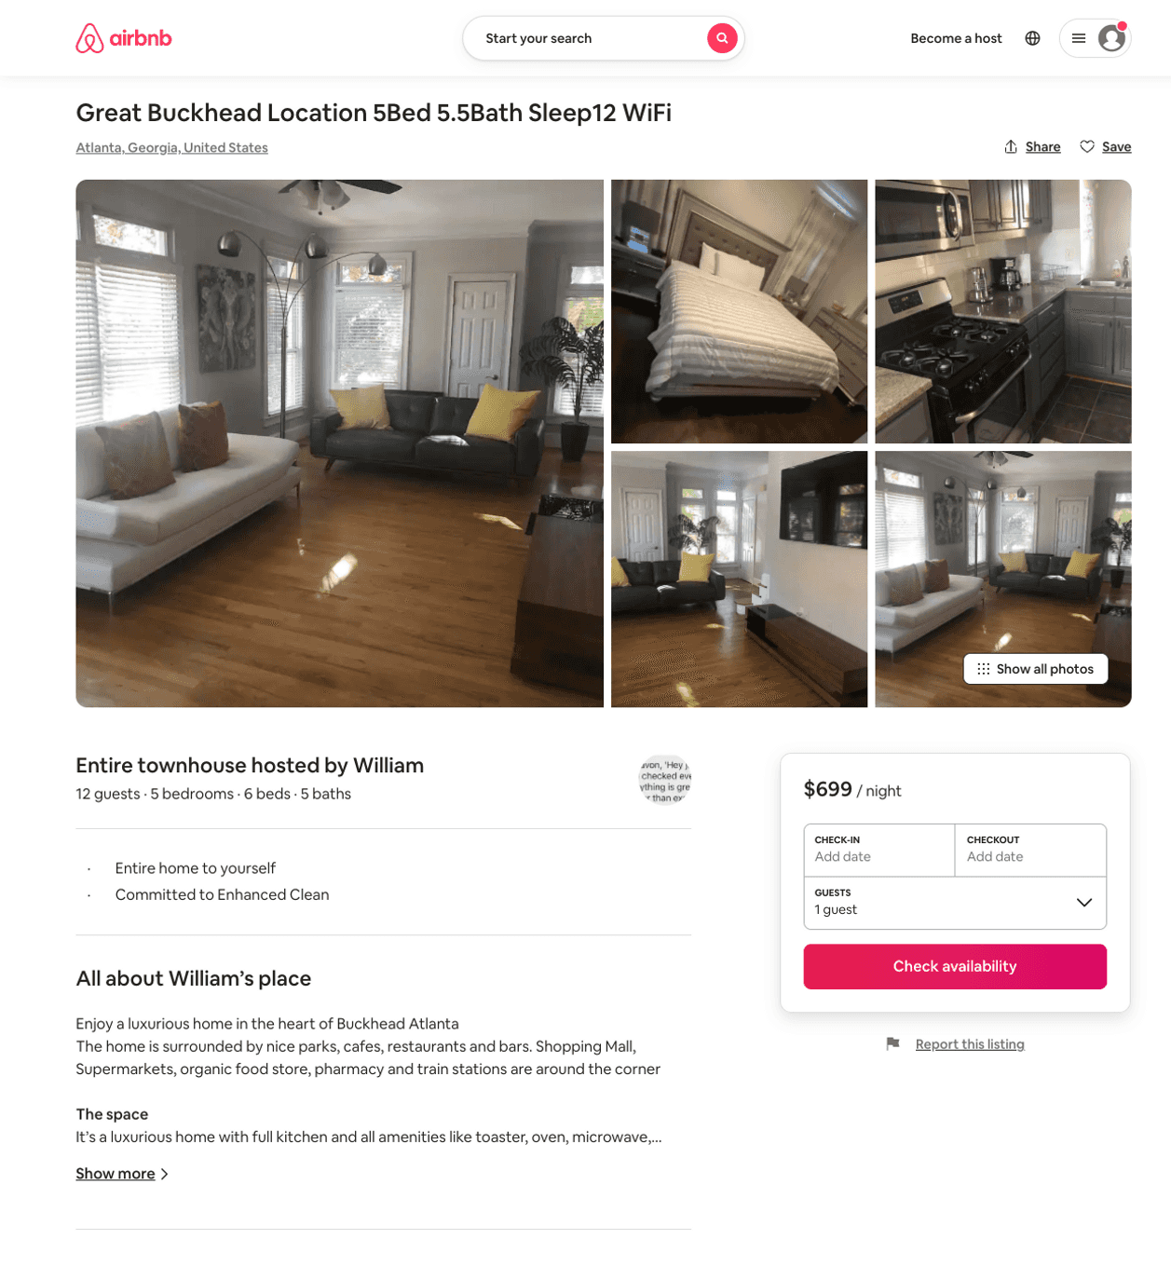
Listing 50574793
4
12
$399 - $699
2
William
373067383
7
https://www.airbnb.com/rooms/50574793
Aug 2022

Slide 14
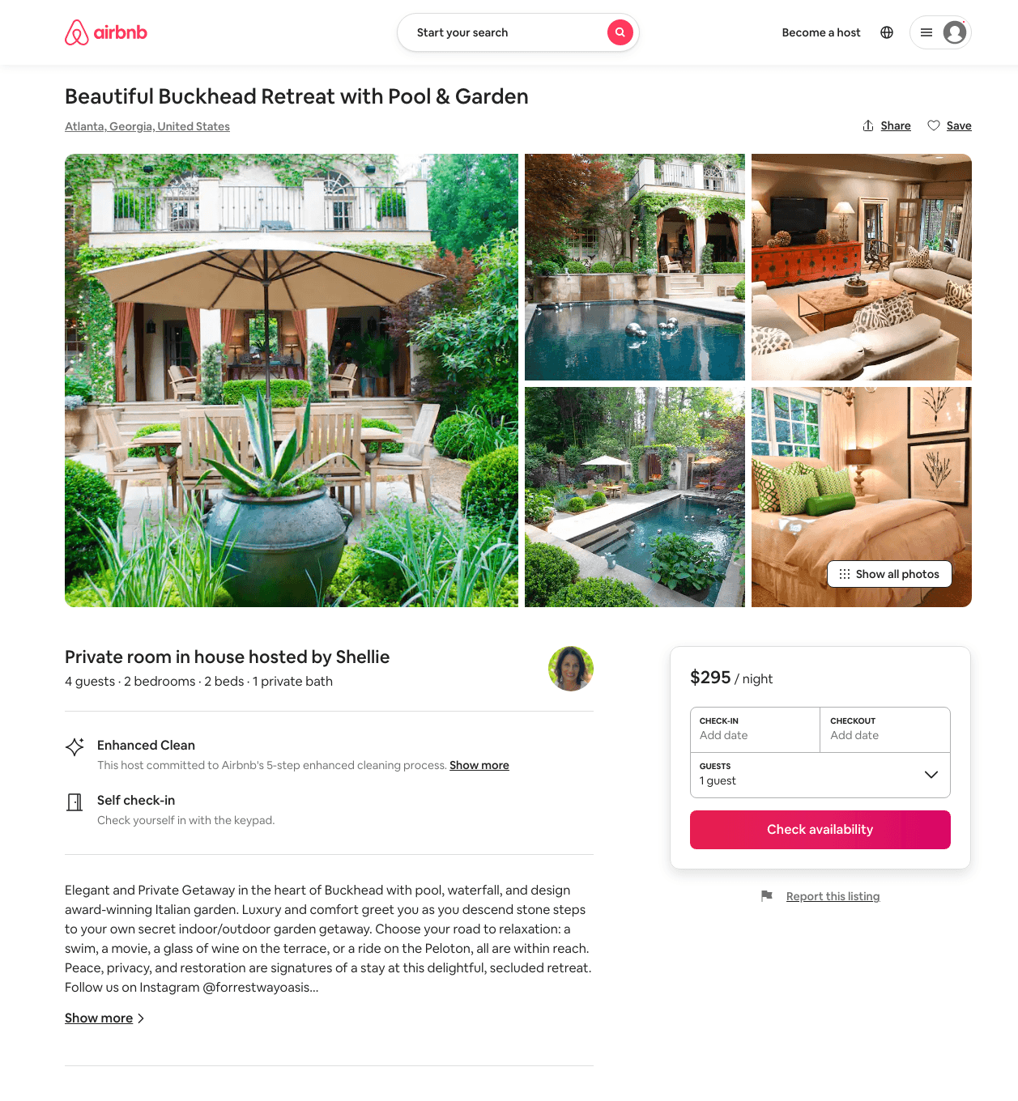
Listing 49788087
2
4
$236 - $373
5.0
2
Shellie
23717394
1
https://www.airbnb.com/rooms/49788087
Aug 2022

Slide 15
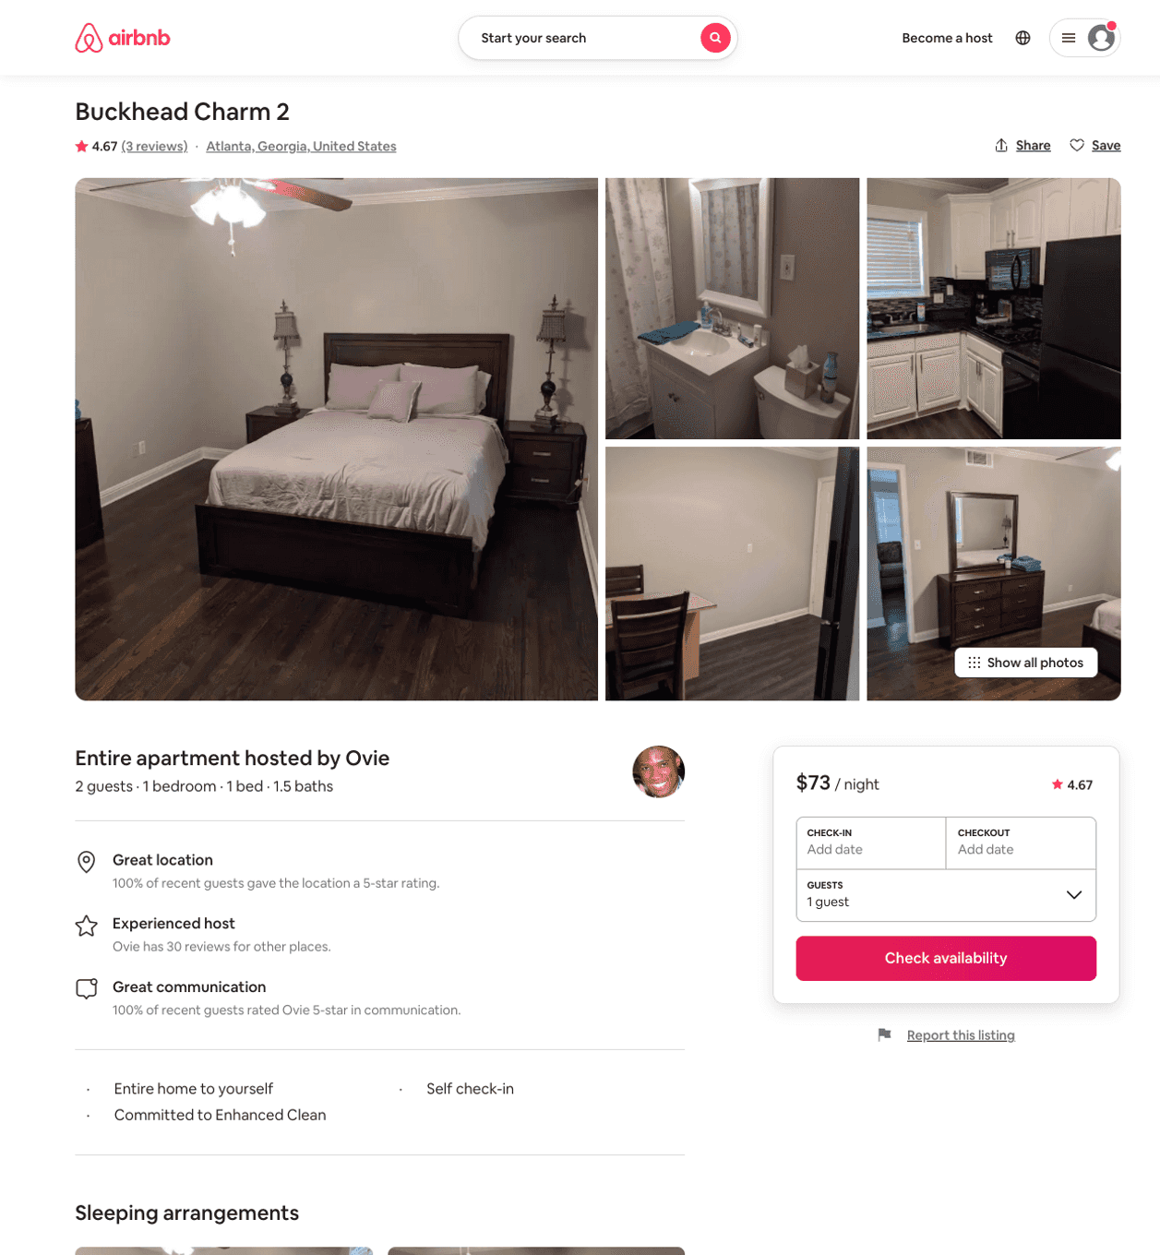
Listing 47071391
1
2
$73 - $89
4.46
2
Ovie
90453108
2
https://www.airbnb.com/rooms/47071391
Aug 2022

Slide 16
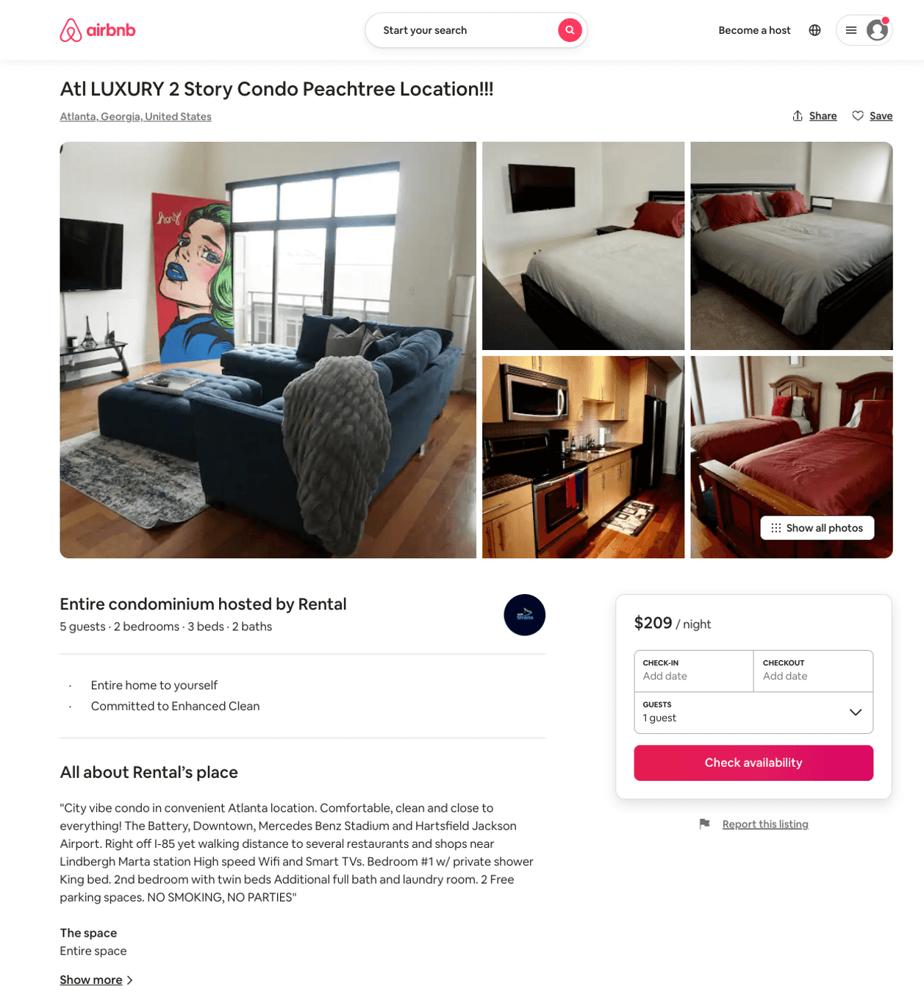
Listing 50343356
2
5
$117 - $221
4.50
1
Shaq
406565795
2
https://www.airbnb.com/rooms/50343356
Aug 2022

Slide 17
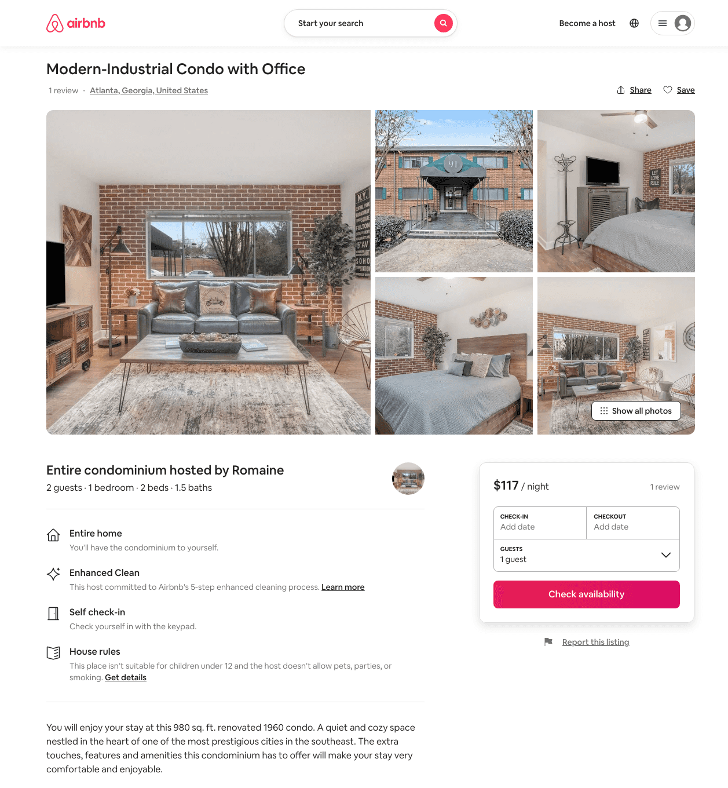
Listing 44357324
1
2
$117 - $132
120
Romaine
193296704
1
https://www.airbnb.com/rooms/44357324
Aug 2022

Slide 18
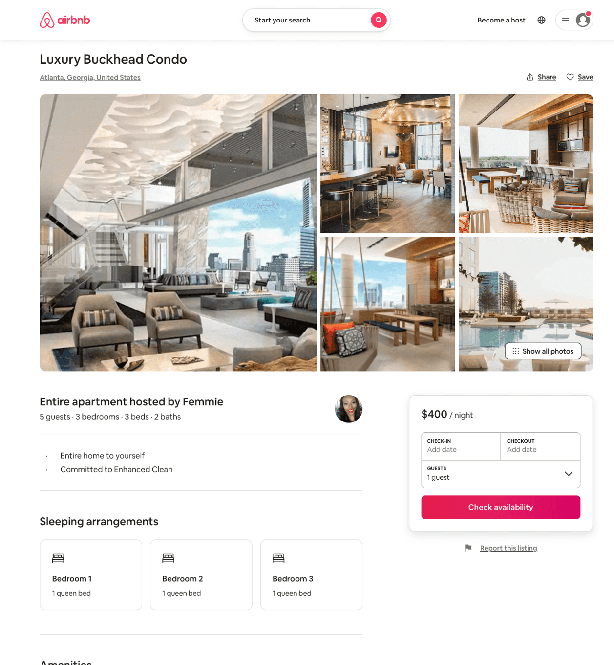
Listing 50401375
3
5
$440 - $600
3
Femmie
135206424
1
https://www.airbnb.com/rooms/50401375
Aug 2022

Slide 19
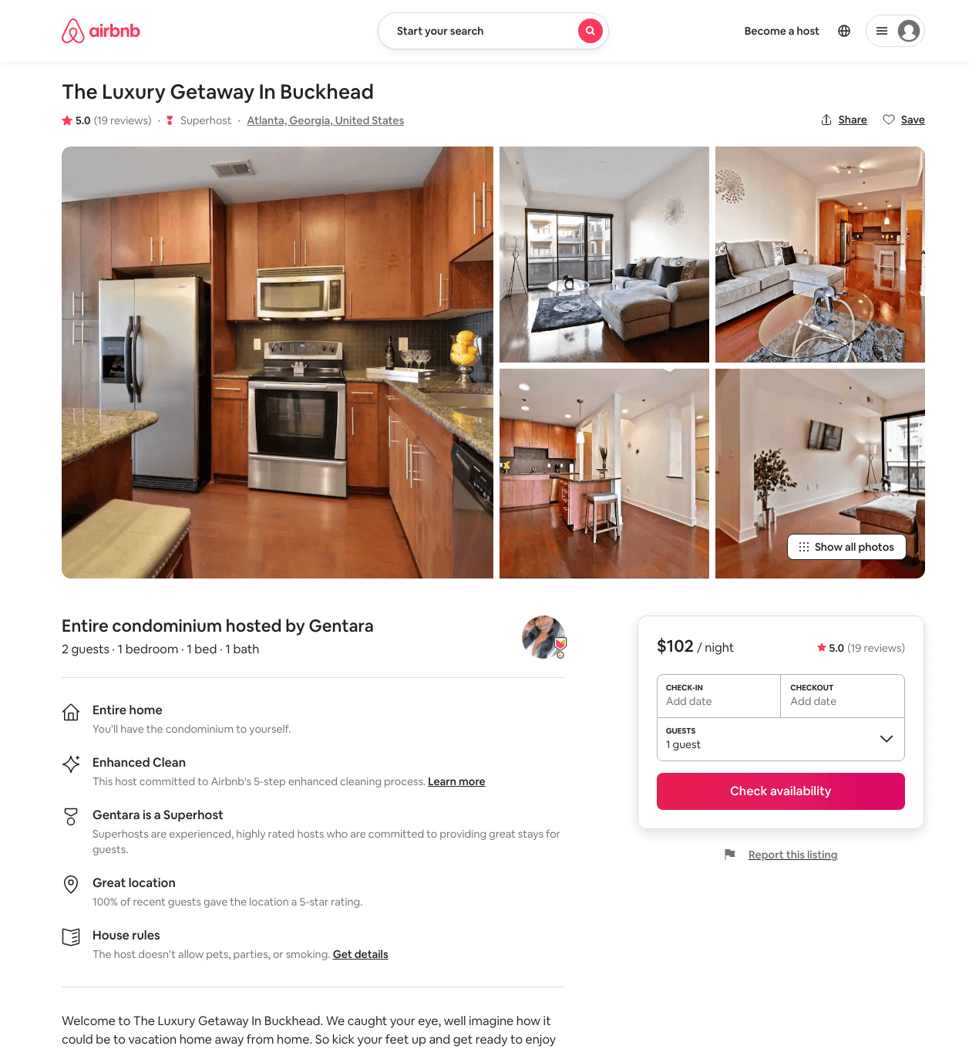
Listing 47760011
1
2
$70 - $133
4.67
1
THE Luxury Getaway
222588610
1
https://www.airbnb.com/rooms/47760011
Aug 2022

Slide 20
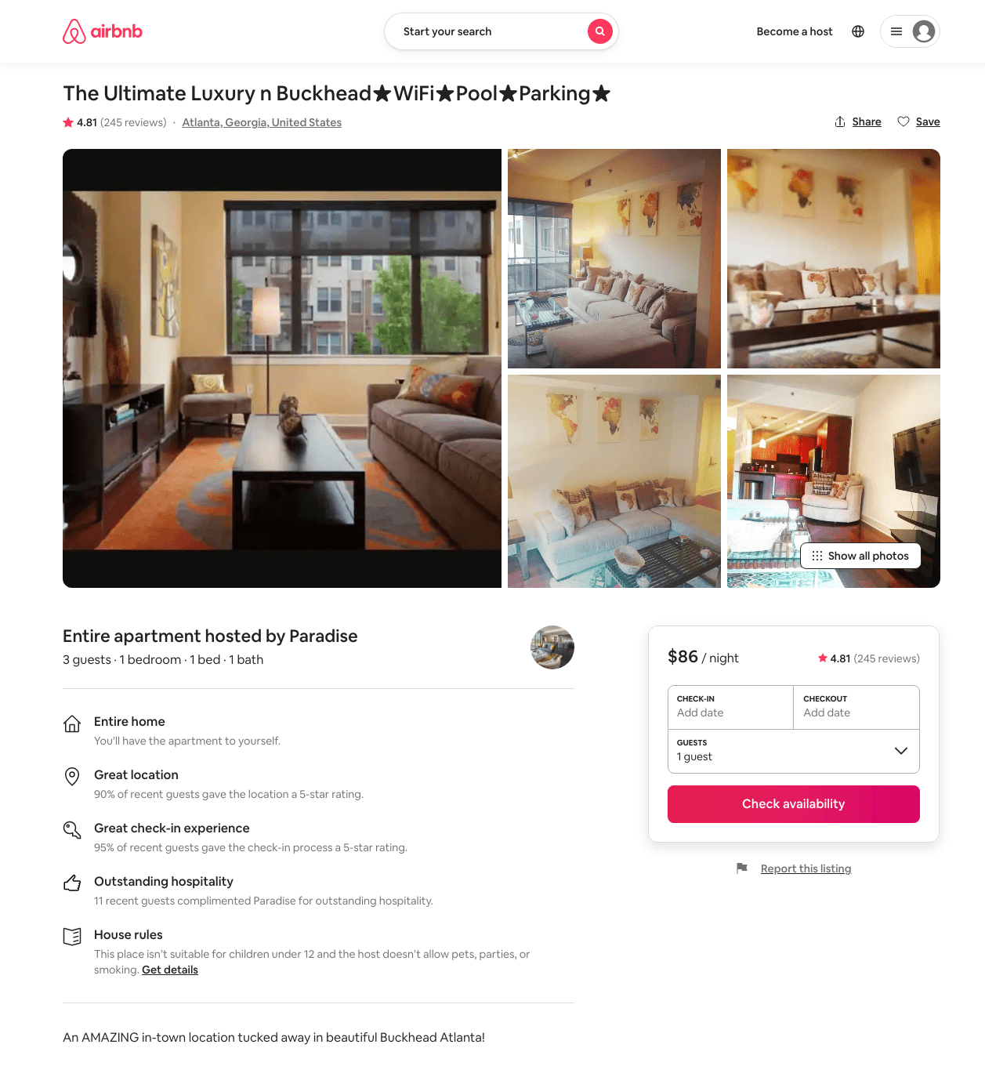
Listing 25419814
1
3
$65 - $104
4.72
1
Paradise
191441686
12
https://www.airbnb.com/rooms/25419814
Aug 2022

Slide 21
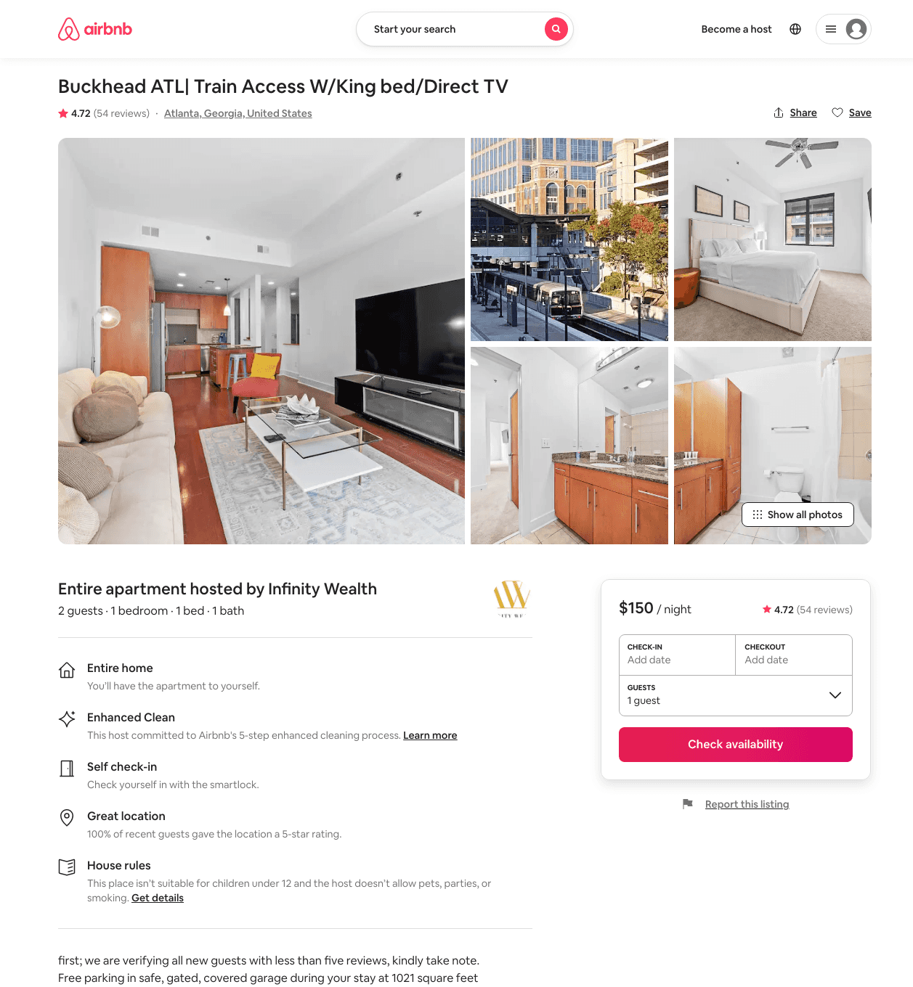
Listing 36196433
1
2
$90 - $170
4.71
2
Mbw
234541852
1
https://www.airbnb.com/rooms/36196433
Aug 2022

Slide 22
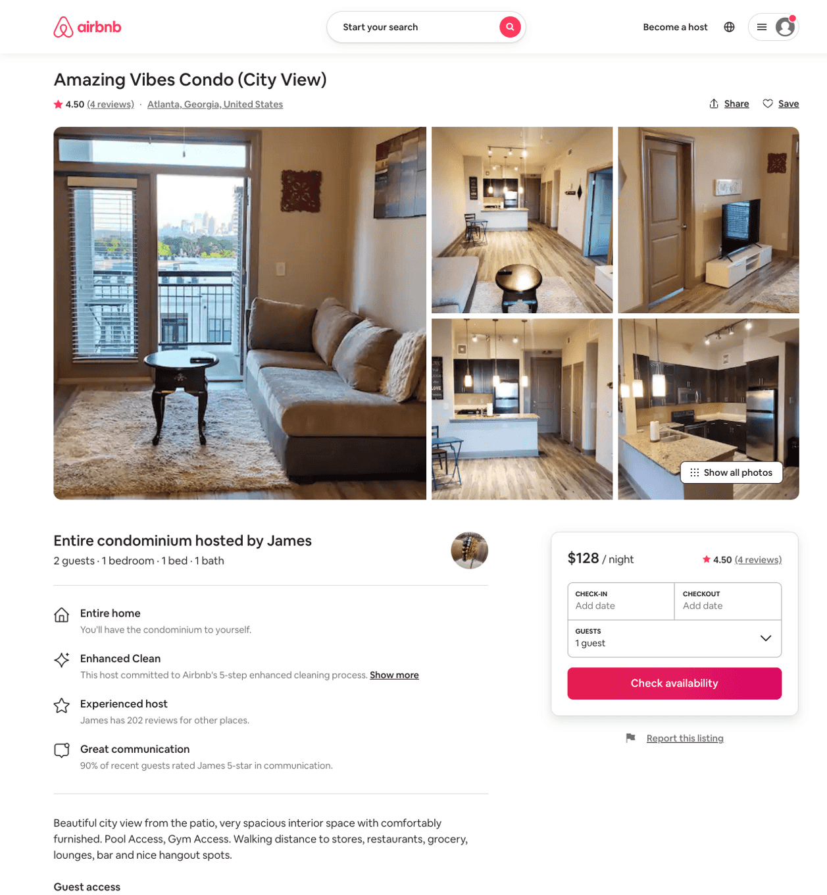
Listing 49969278
1
2
$105 - $168
4.37
2
James
227867184
4
https://www.airbnb.com/rooms/49969278
Aug 2022

Slide 23
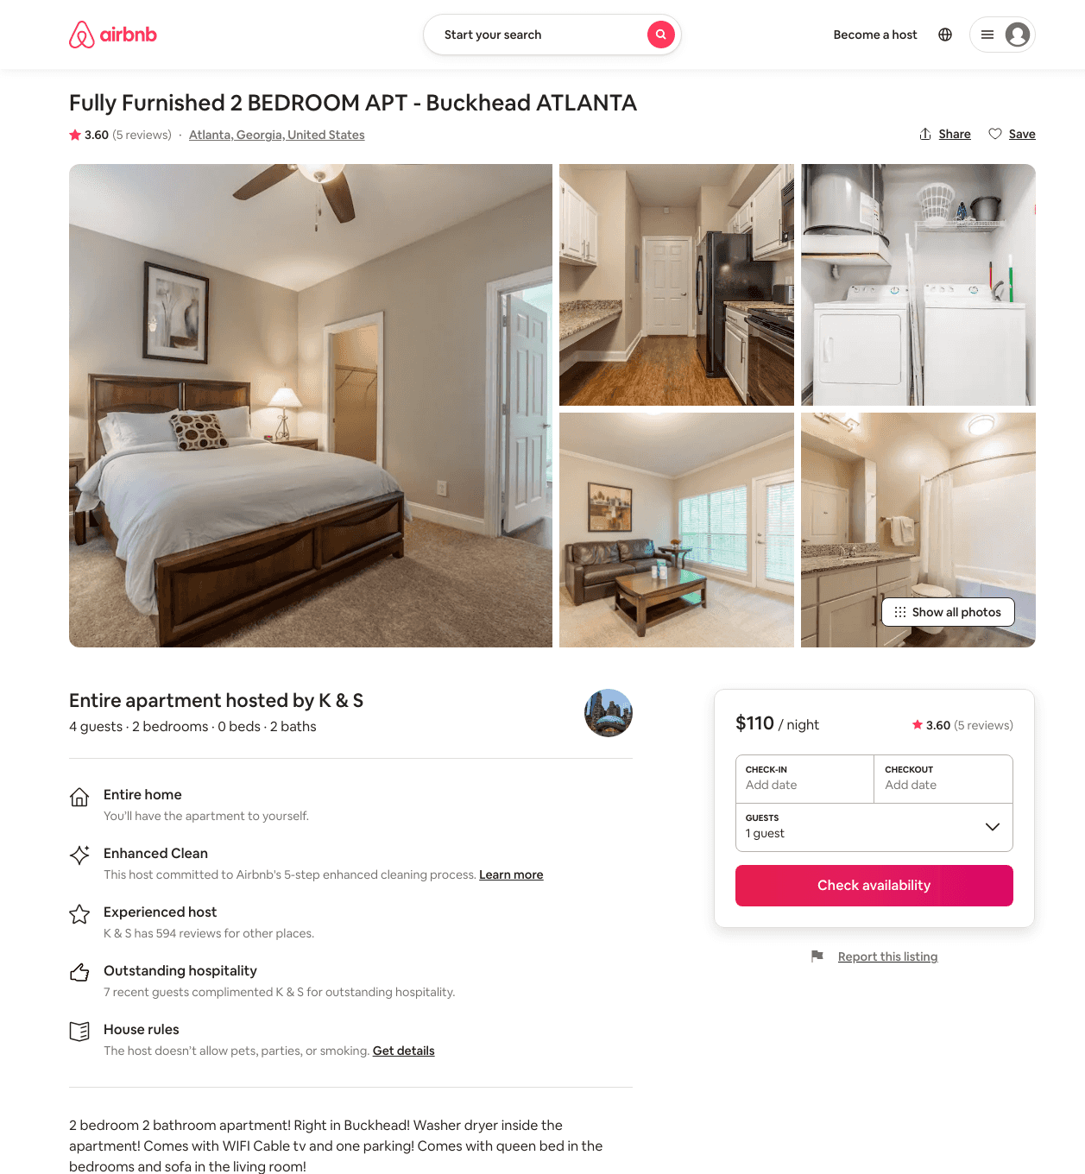
Listing 39125124
2
4
$90 - $129
3.60
10
K & S
89596337
7
https://www.airbnb.com/rooms/39125124
Jul 2022

Slide 24
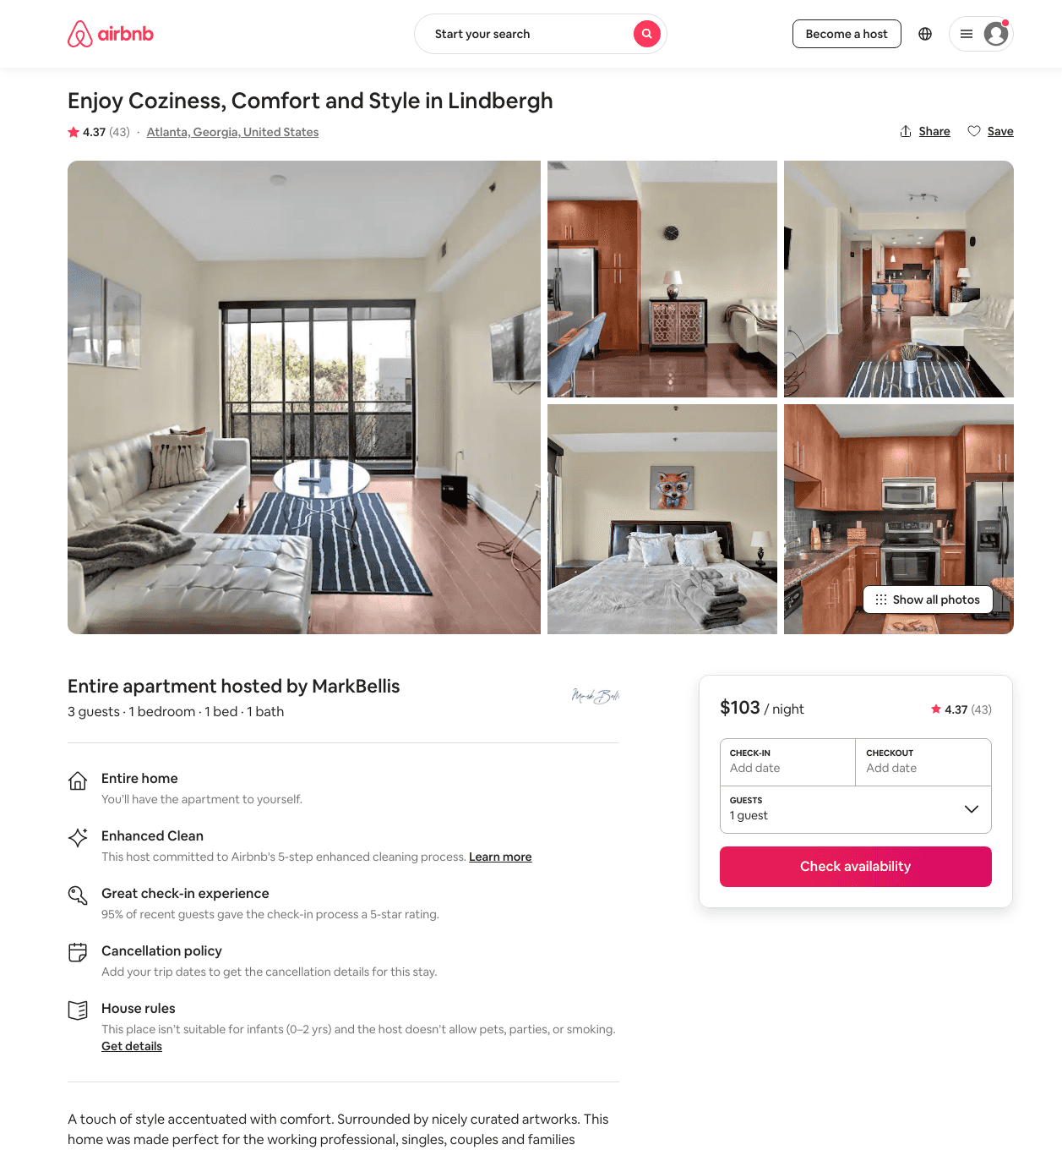
Listing 38850524
1
3
$82 - $110
4.12
1
MarkBellis
297379269
4
https://www.airbnb.com/rooms/38850524
Jun 2022

Slide 25
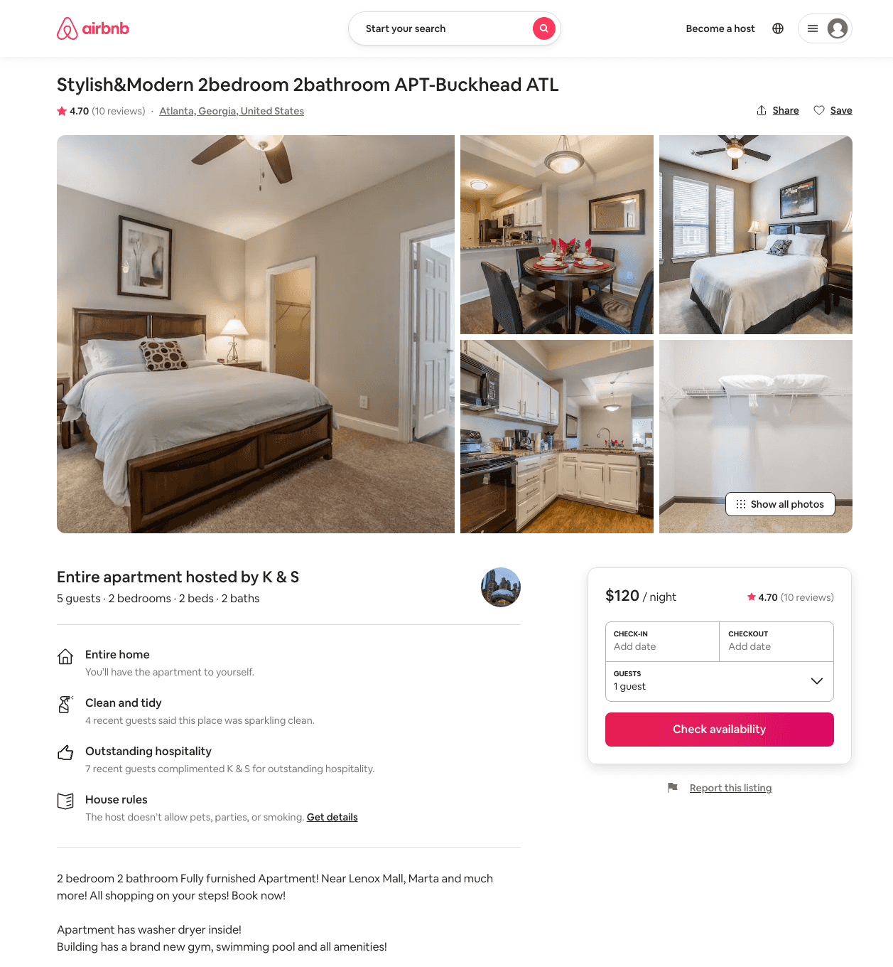
Listing 39030466
2
5
$100 - $141
4.73
7
K & S
89596337
7
https://www.airbnb.com/rooms/39030466
Aug 2022

Slide 26
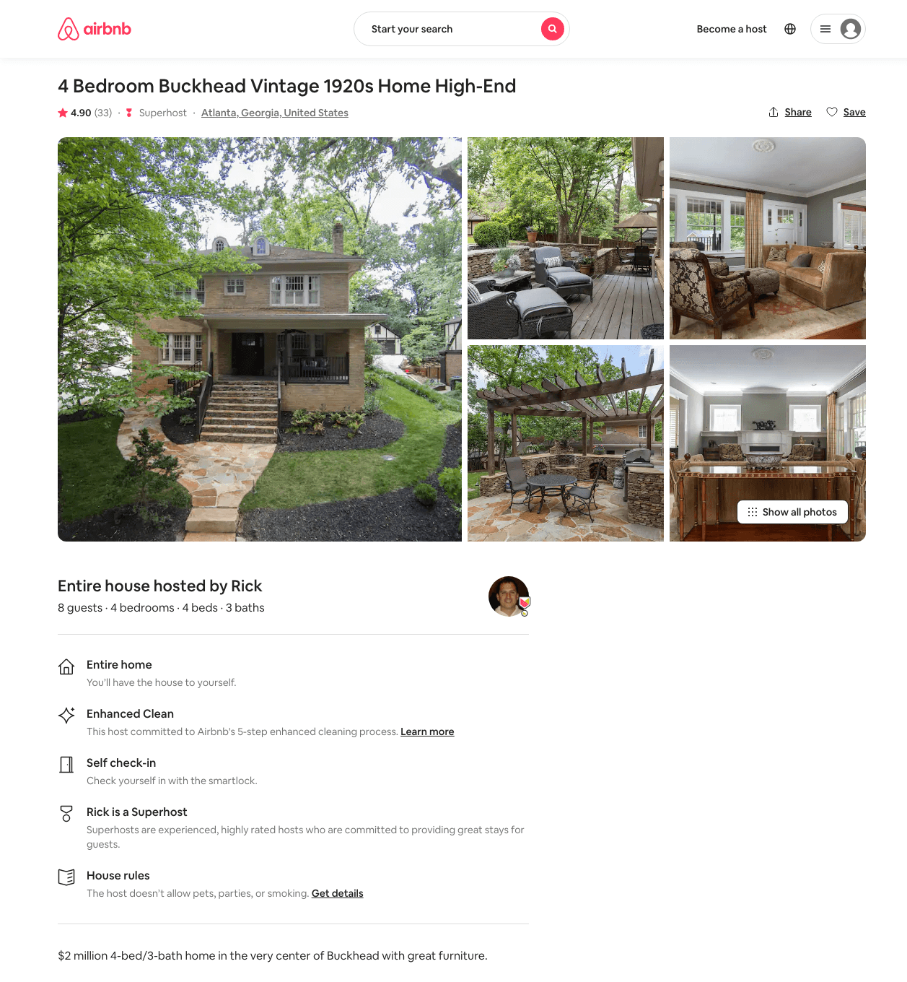
Listing 12857688
4
8
$595 - $1085
4.92
4
Rick
2521127
1
https://www.airbnb.com/rooms/12857688
Aug 2022

Slide 27
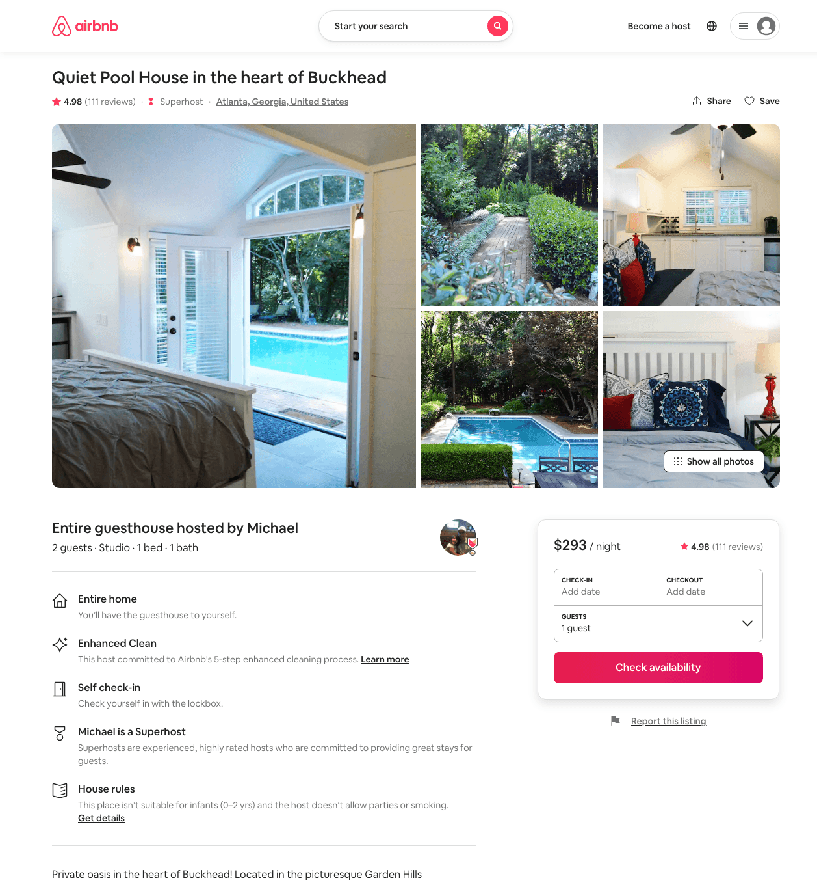
Listing 9207076
Studio
2
$293 - $1014
4.98
1
Michael
47719435
1
https://www.airbnb.com/rooms/9207076
Aug 2022

Slide 28
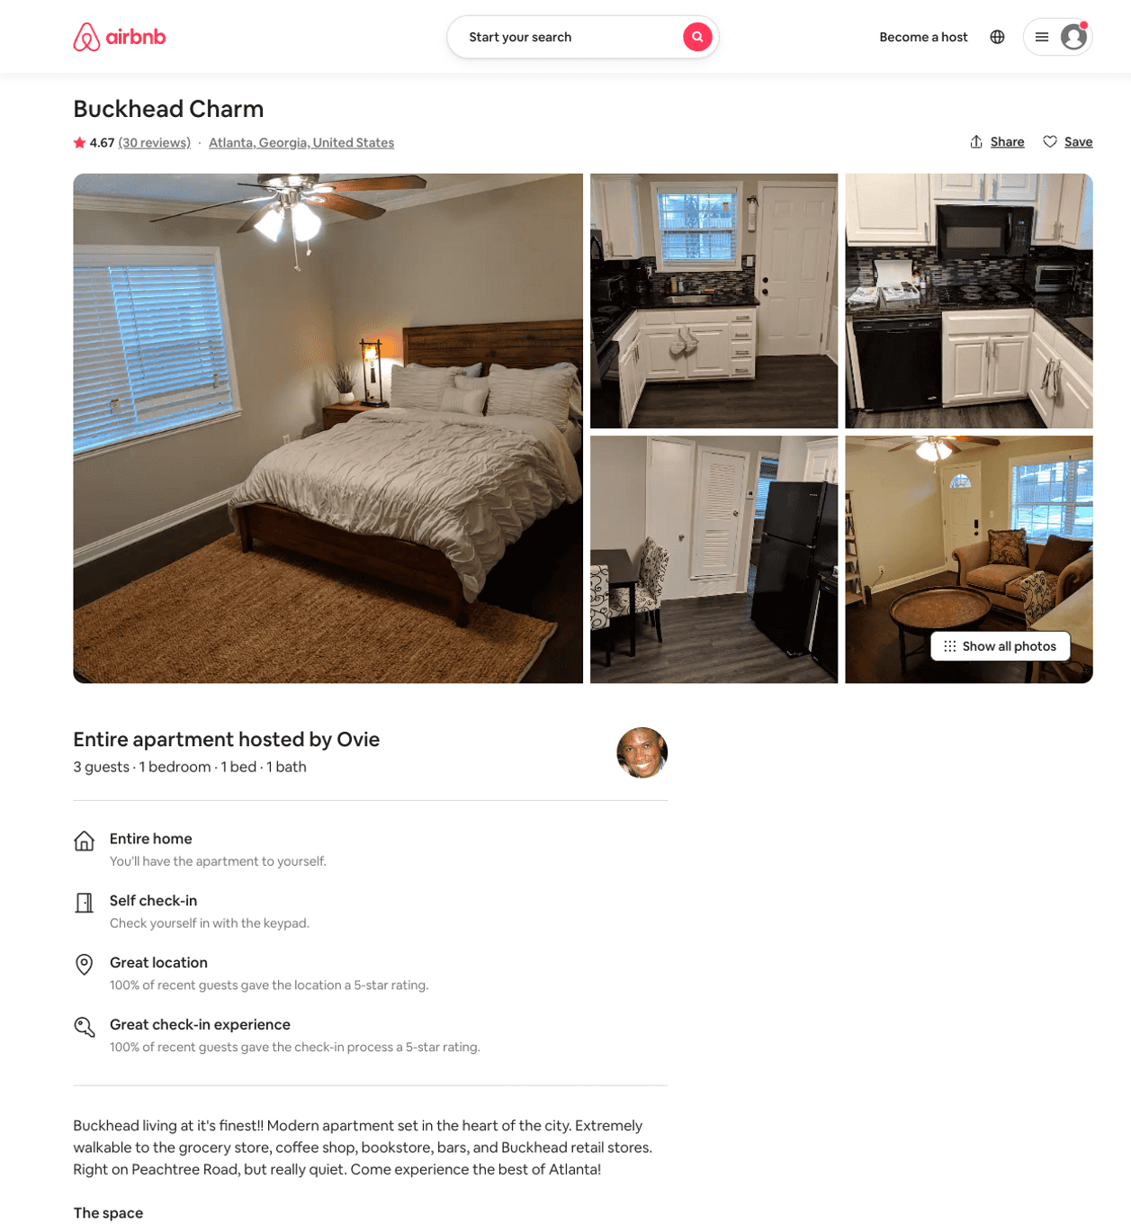
Listing 32571042
1
3
$80 - $86
4.70
2
Ovie
90453108
2
https://www.airbnb.com/rooms/32571042
Aug 2022

Slide 29
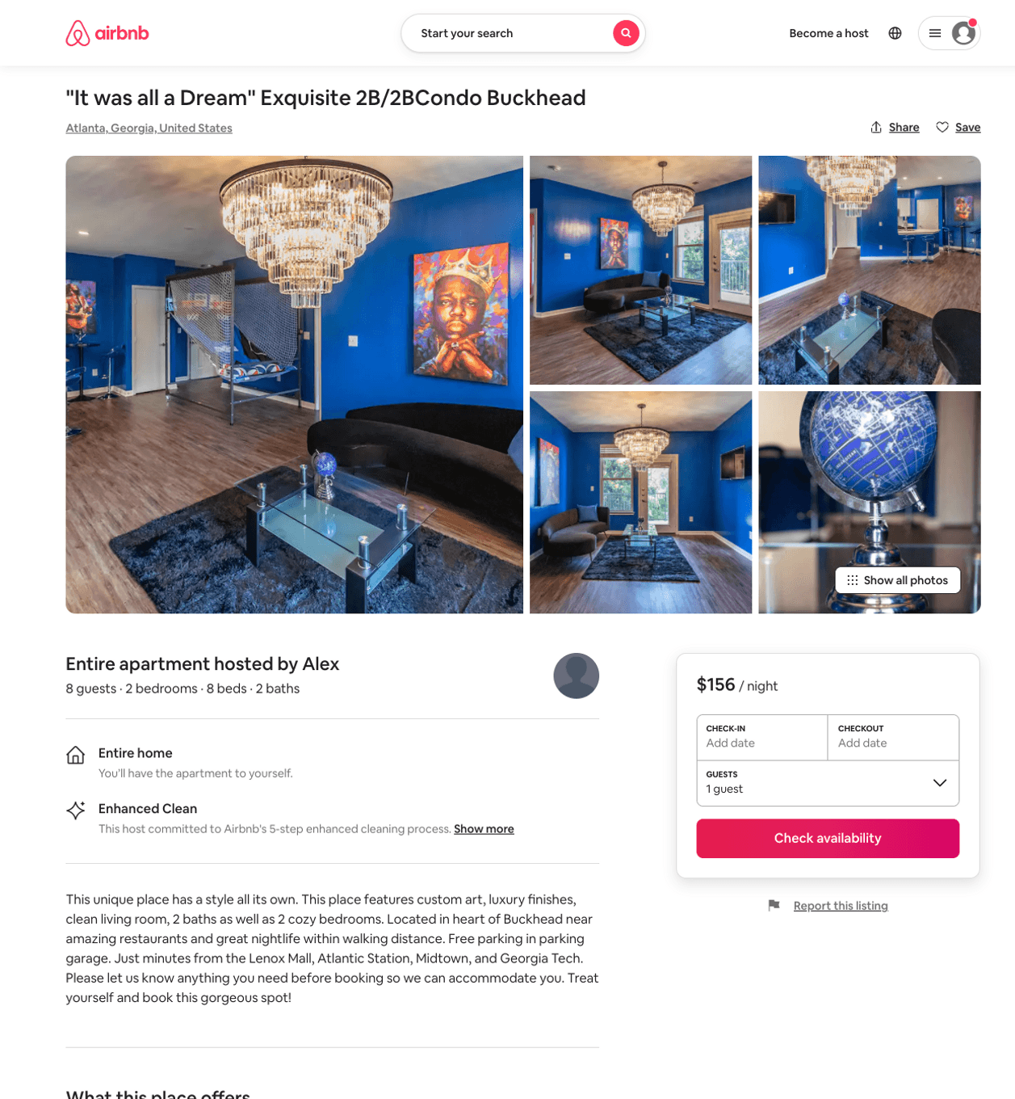
Listing 50941442
2
8
$129 - $251
4.35
1
Alex
411957415
2
https://www.airbnb.com/rooms/50941442
Aug 2022

Slide 30
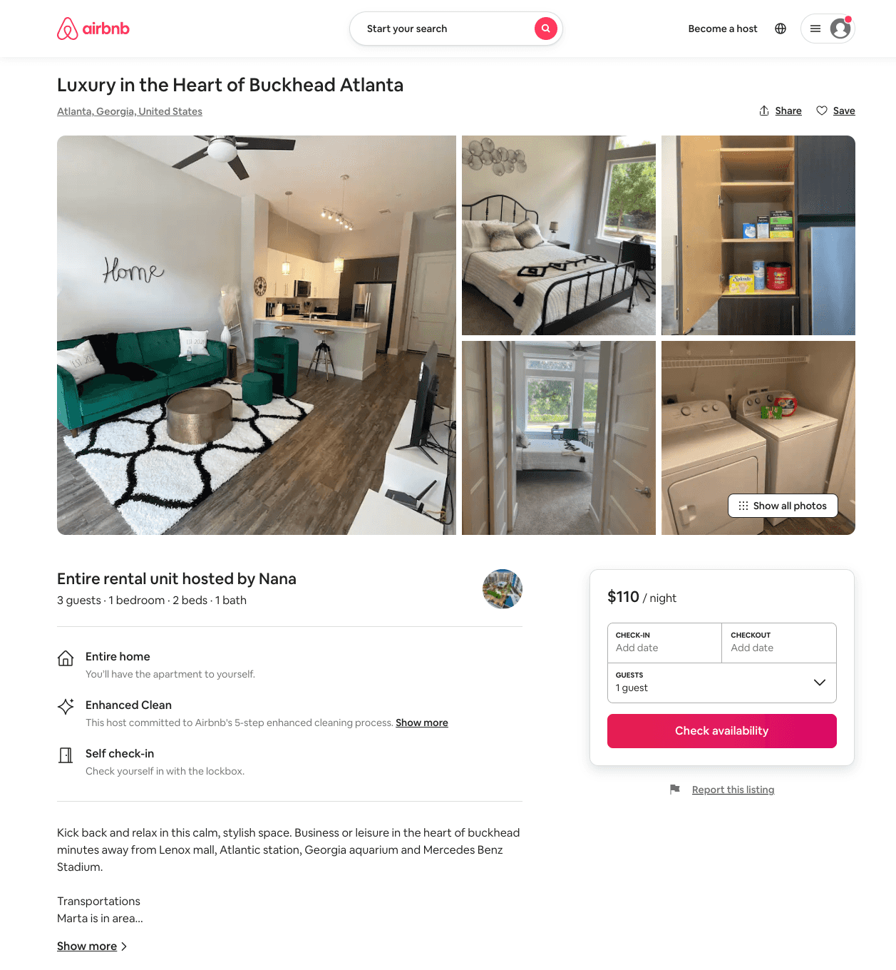
Listing 50446021
1
3
$98 - $314
4.89
2
Nana
165911361
1
https://www.airbnb.com/rooms/50446021
Jul 2022

Slide 31
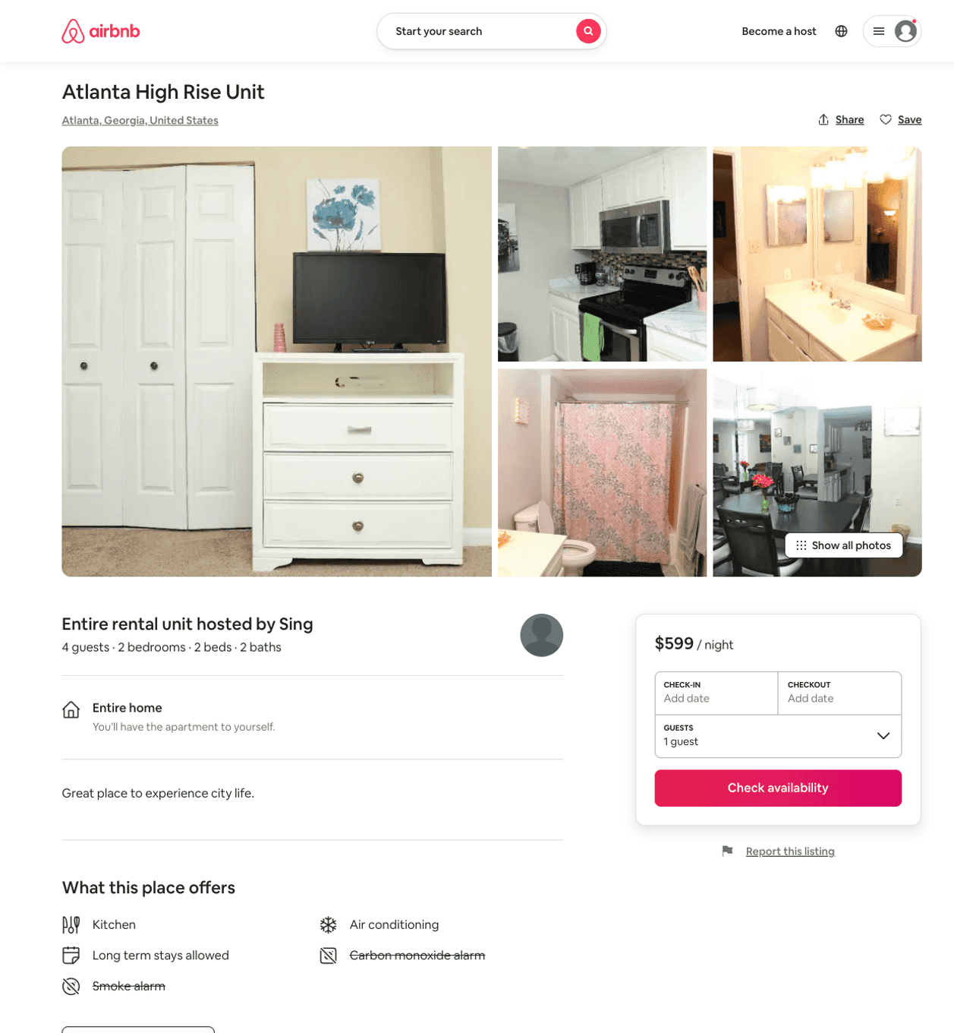
Listing 51392384
2
4
$599
7
Sing
395978145
1
https://www.airbnb.com/rooms/51392384
Aug 2022

Slide 32
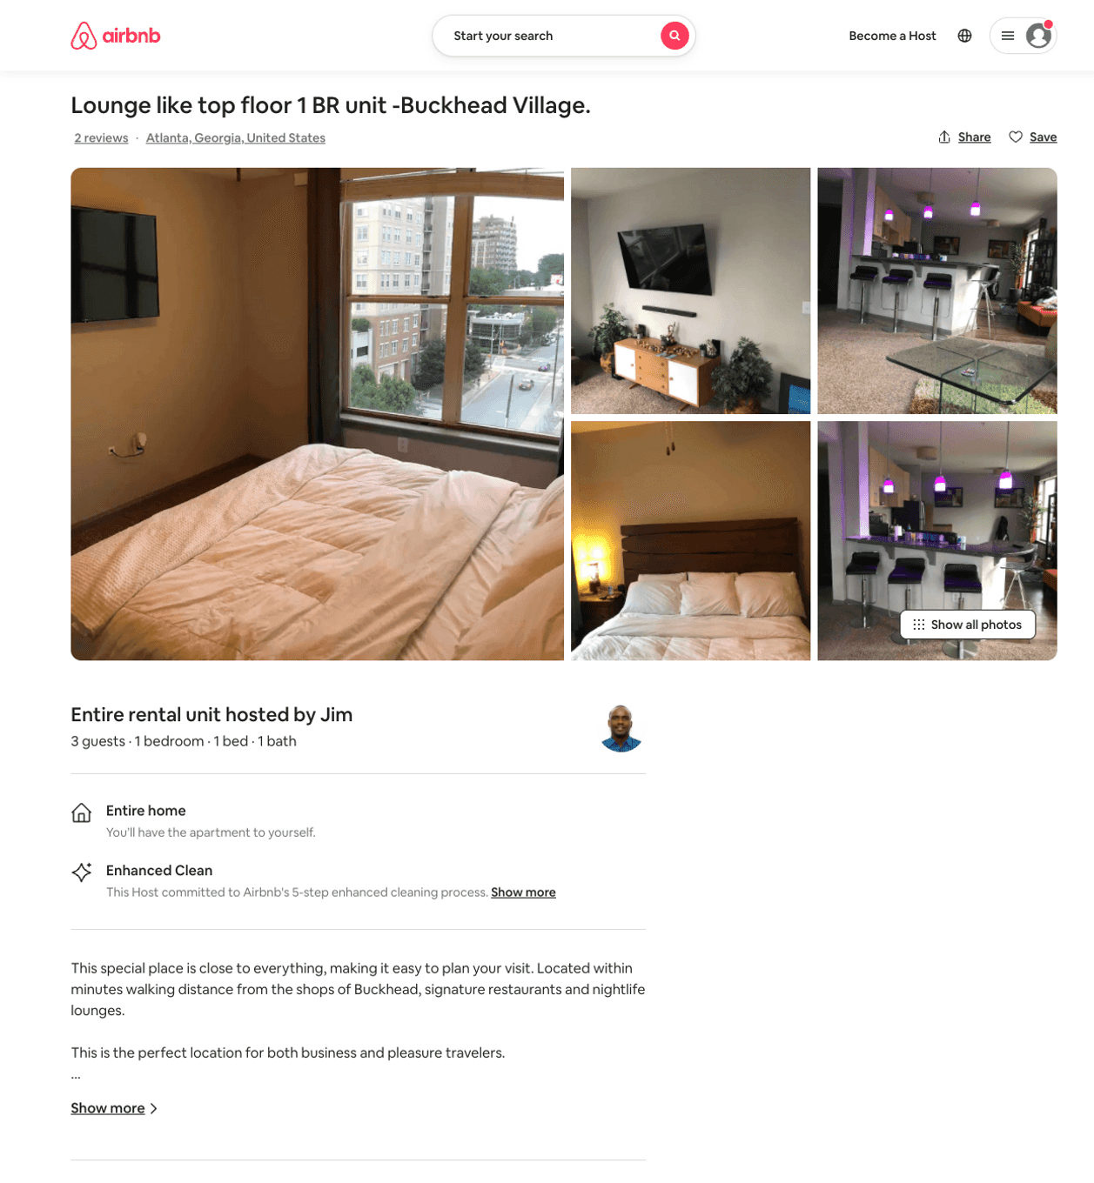
Listing 52253770
1
3
$89
3
Jim
59553533
1
https://www.airbnb.com/rooms/52253770
Aug 2022

Slide 33
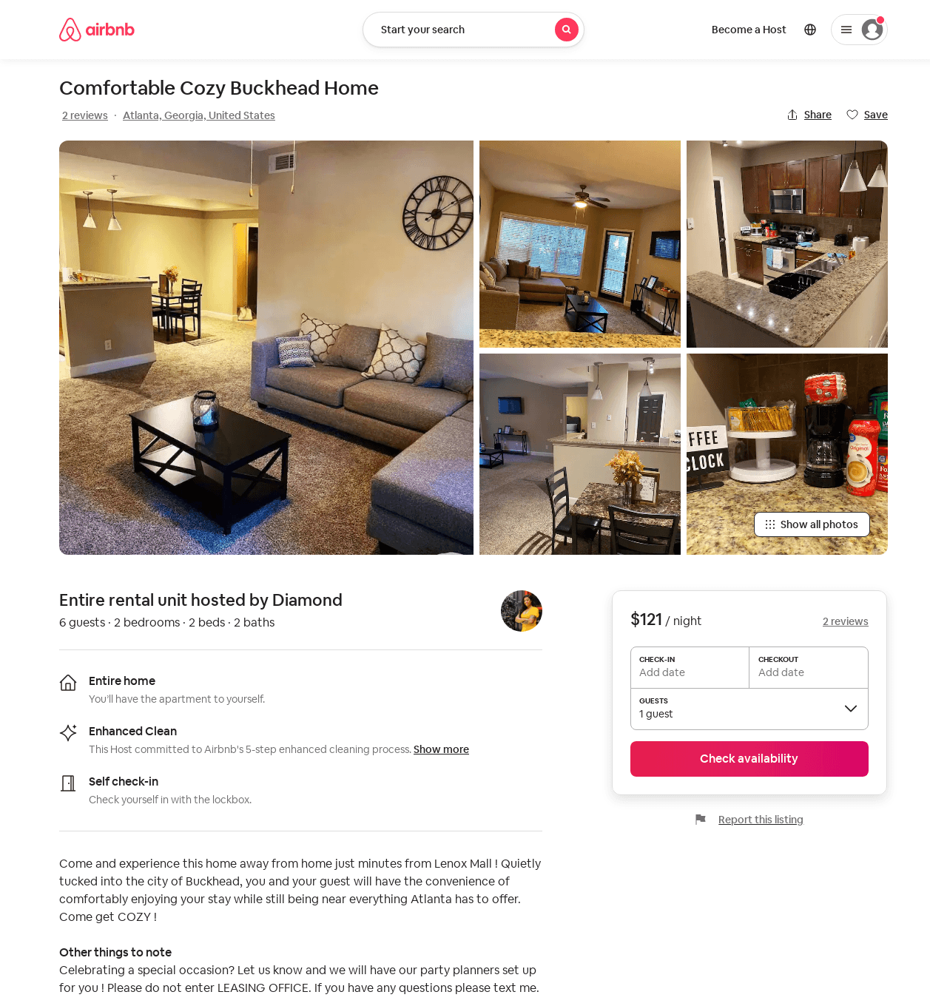
Listing 52336510
2
4
$80 - $141
4.59
1
Diamond
87255589
1
https://www.airbnb.com/rooms/52336510
Aug 2022

Slide 34
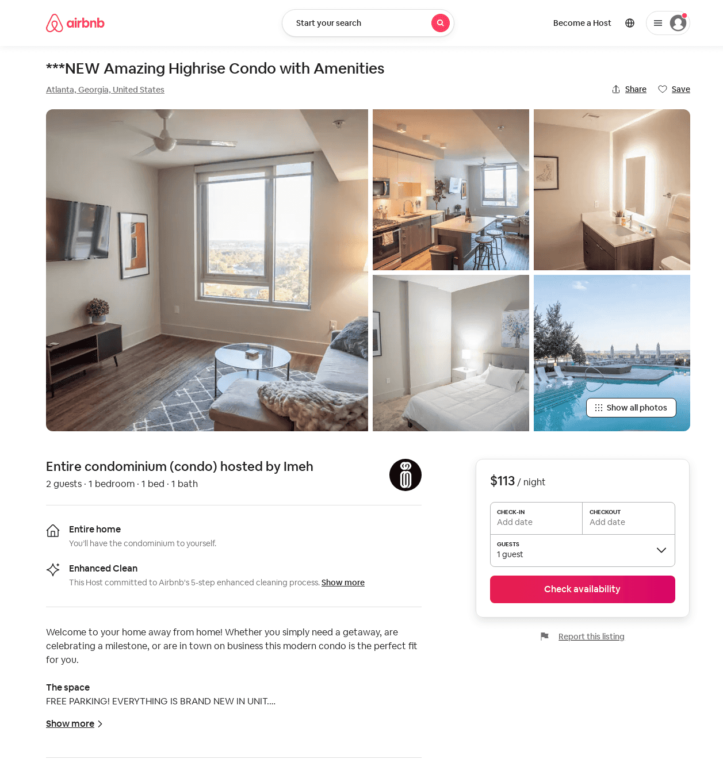
Listing 52791092
1
2
$94 - $152
4.74
1
Imeh
286057968
3
https://www.airbnb.com/rooms/52791092
Aug 2022

Slide 35
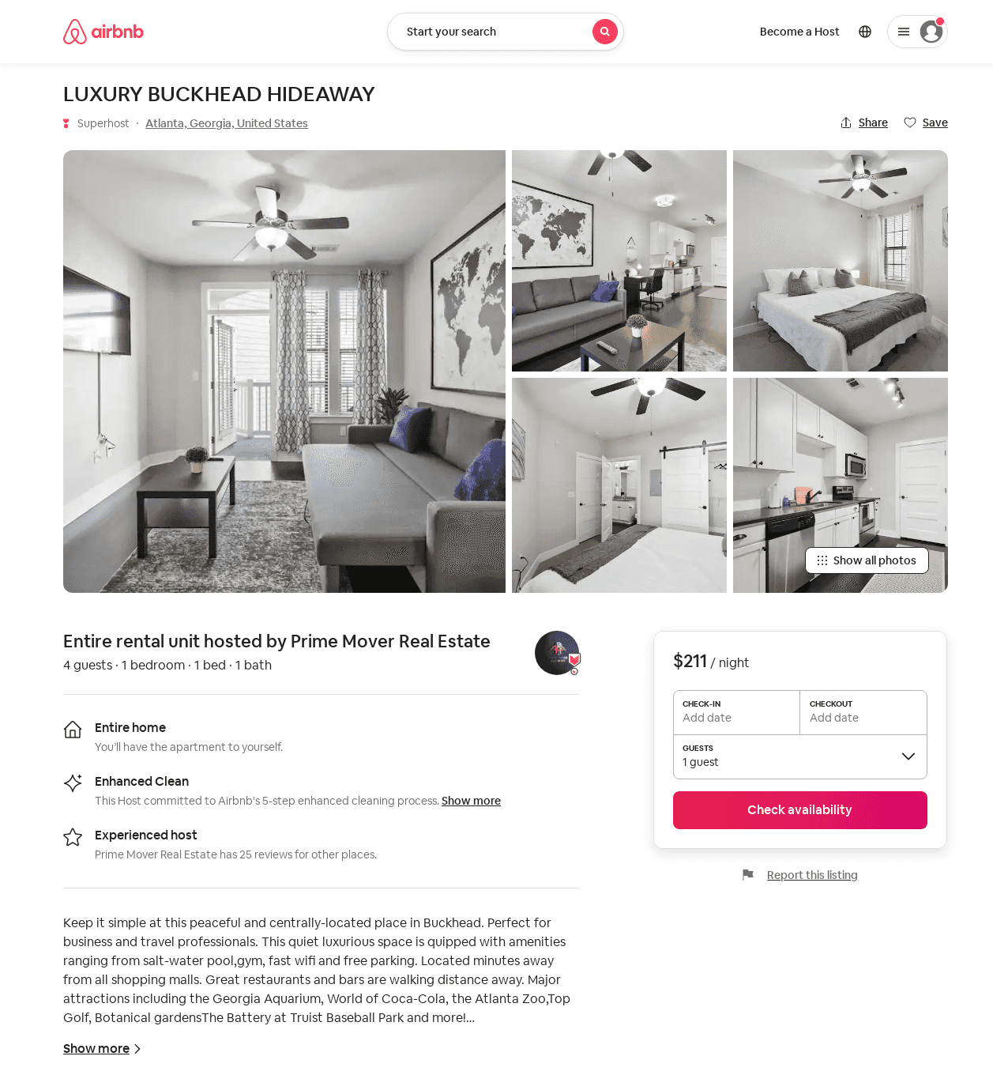
Listing 53427479
1
4
$107 - $211
5.0
1
Prime Mover Real Estate
283824970
3
https://www.airbnb.com/rooms/53427479
Aug 2022

Slide 36
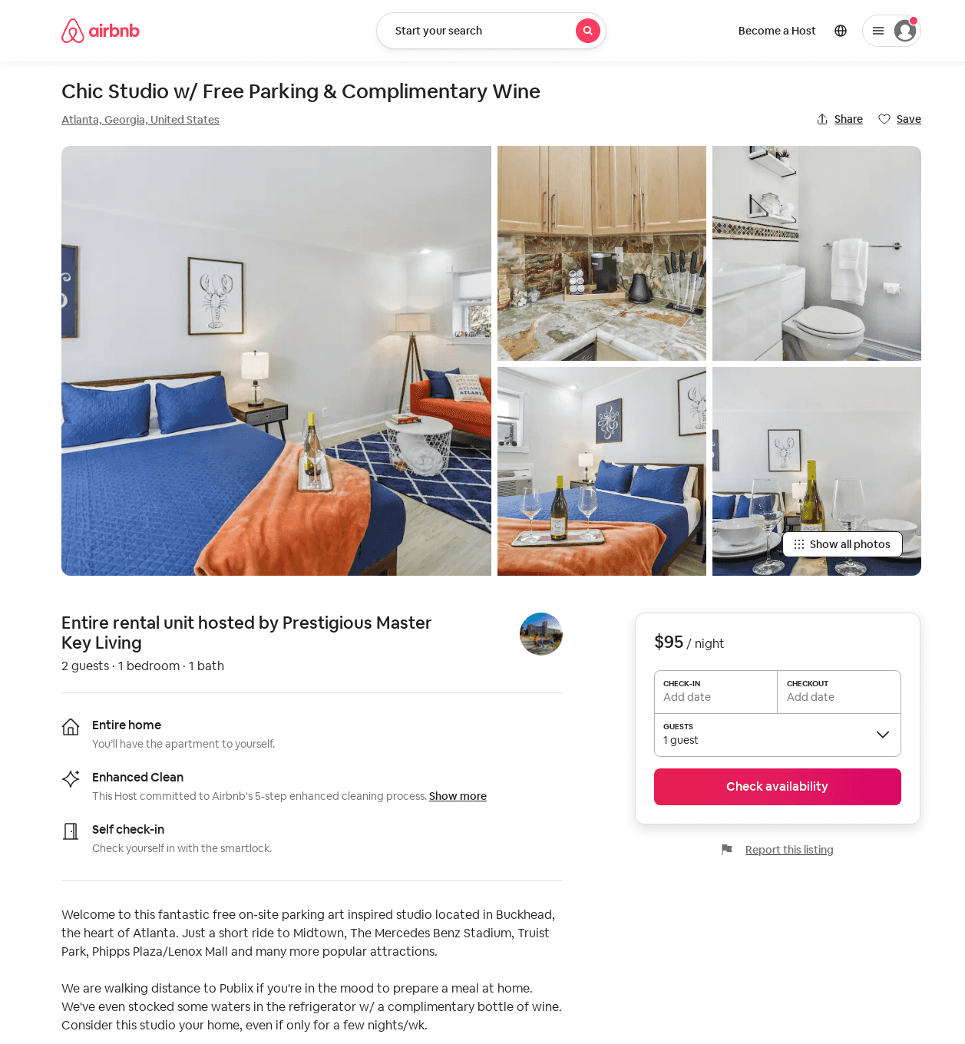
Listing 53481526
1
2
$68 - $117
4.94
1
Prestigious Master Key Living
425035103
1
https://www.airbnb.com/rooms/53481526
Aug 2022

Slide 37
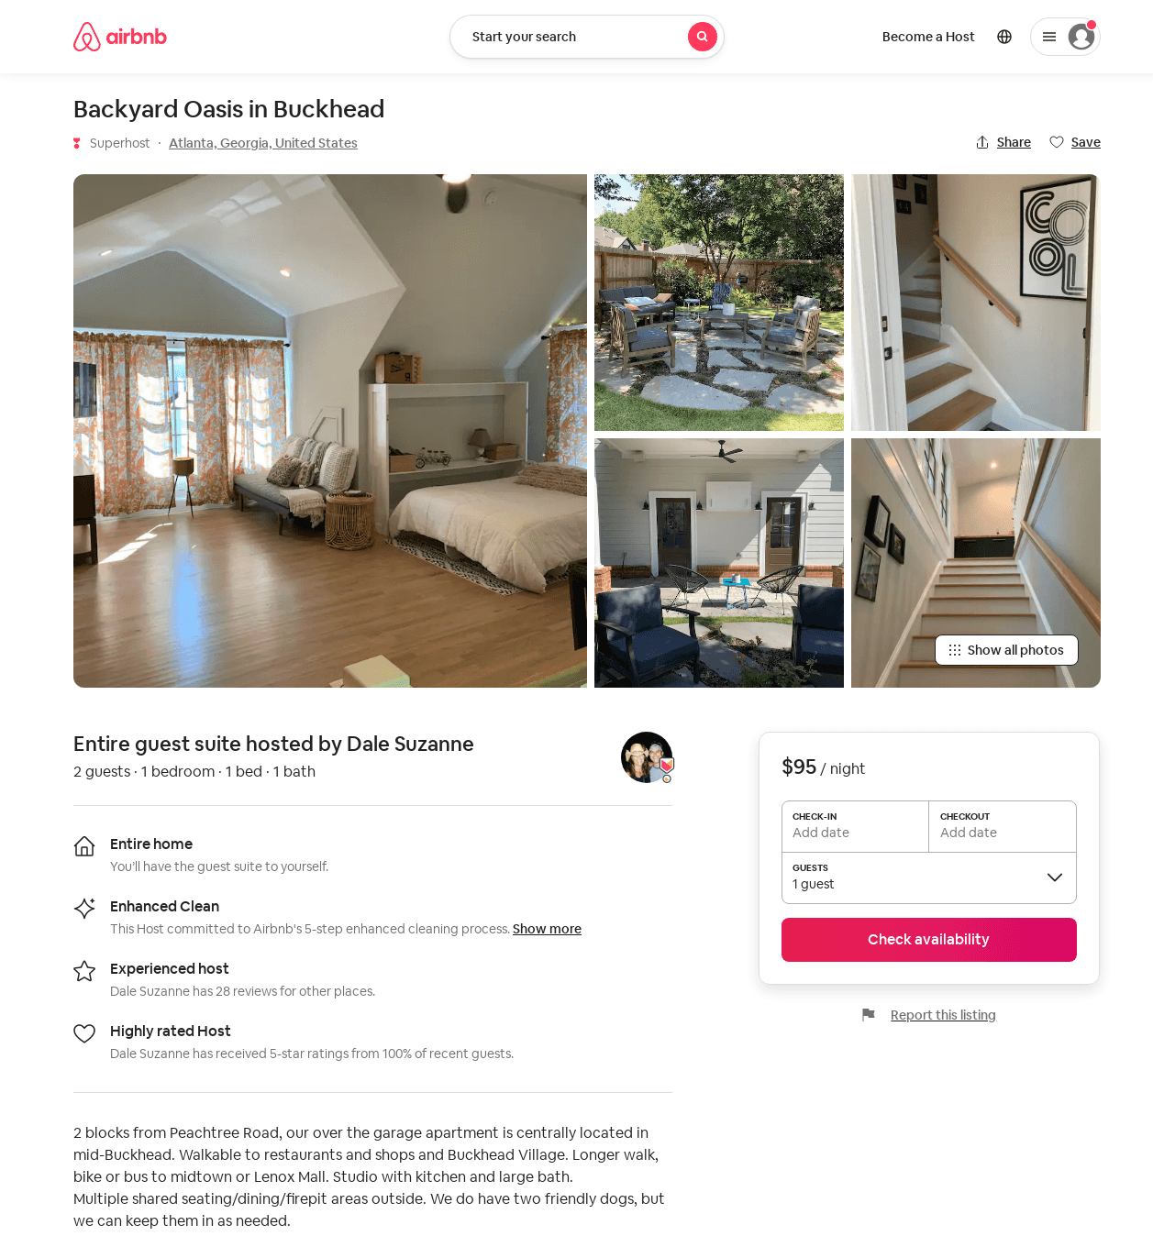
Listing 52718134
1
2
$81 - $117
5.0
2
Dale Suzanne
32159213
1
https://www.airbnb.com/rooms/52718134
Aug 2022

Slide 38
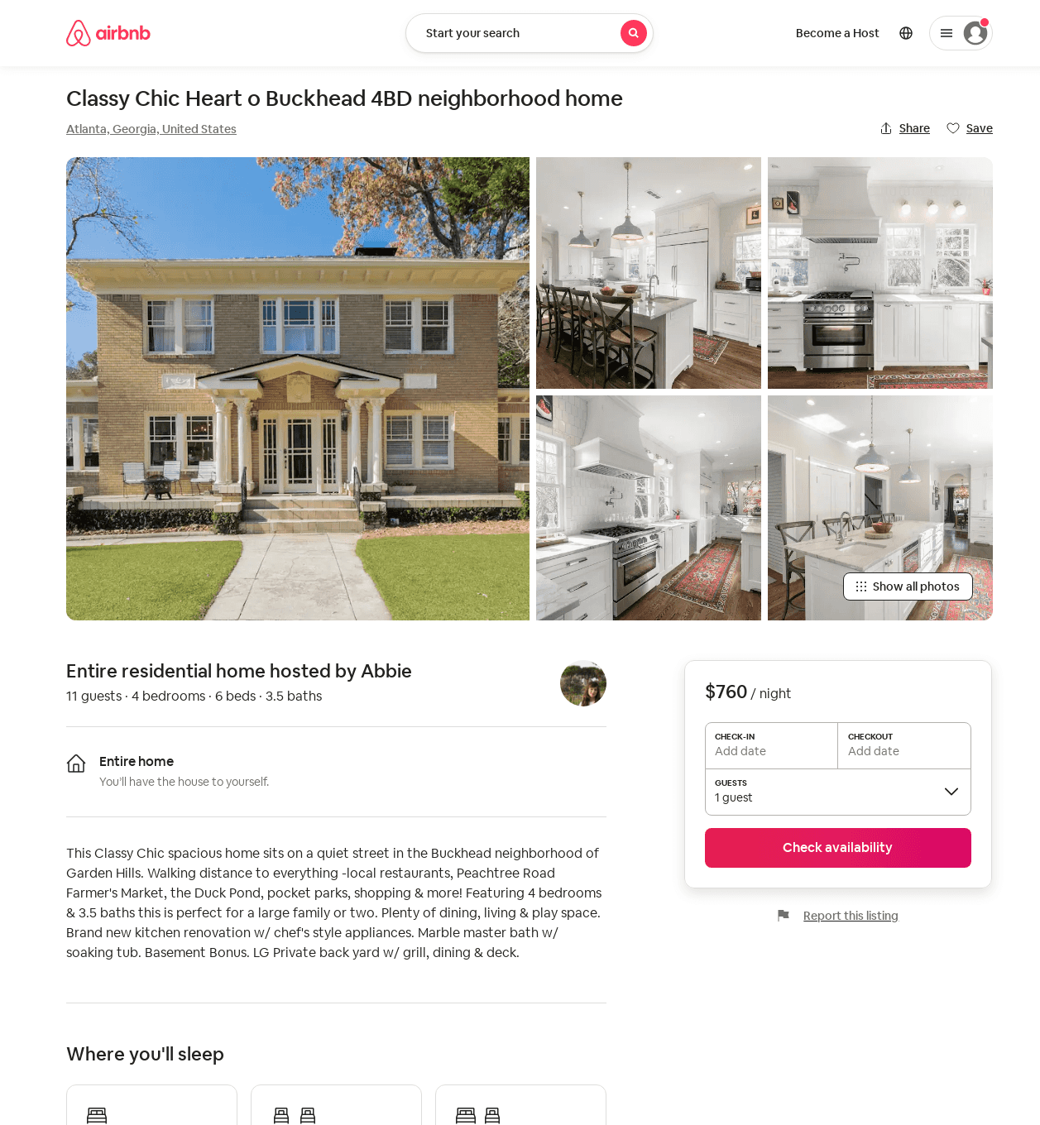
Listing 53647289
4
11
$760 - $950
7
Abbie
14016730
1
https://www.airbnb.com/rooms/53647289
Aug 2022

Slide 39
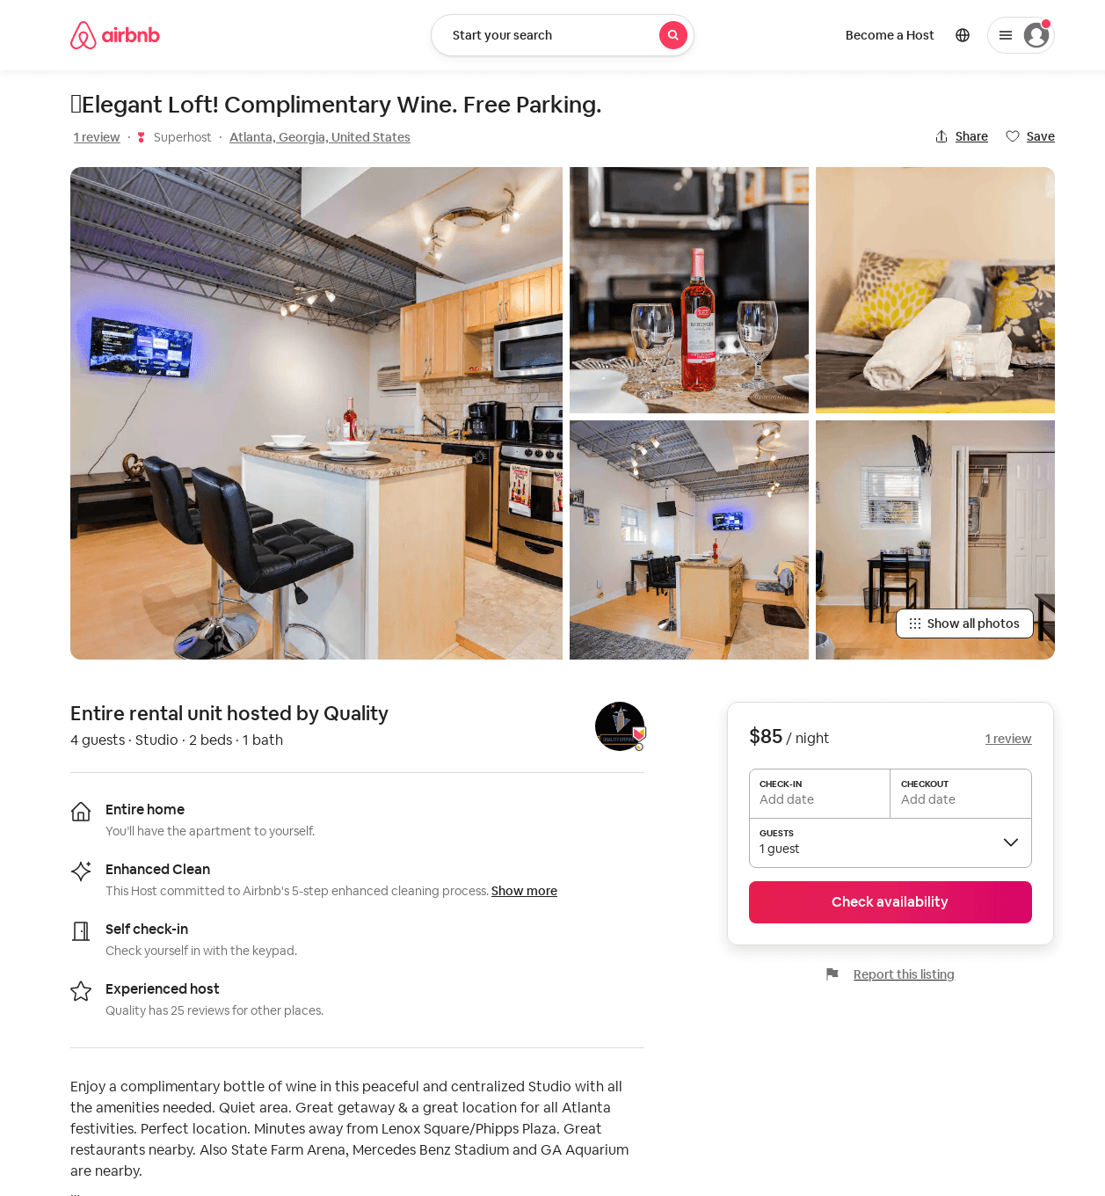
Listing 53594216
Studio
4
$75 - $106
4.67
1
Quality
404943996
3
https://www.airbnb.com/rooms/53594216
Aug 2022

Slide 40
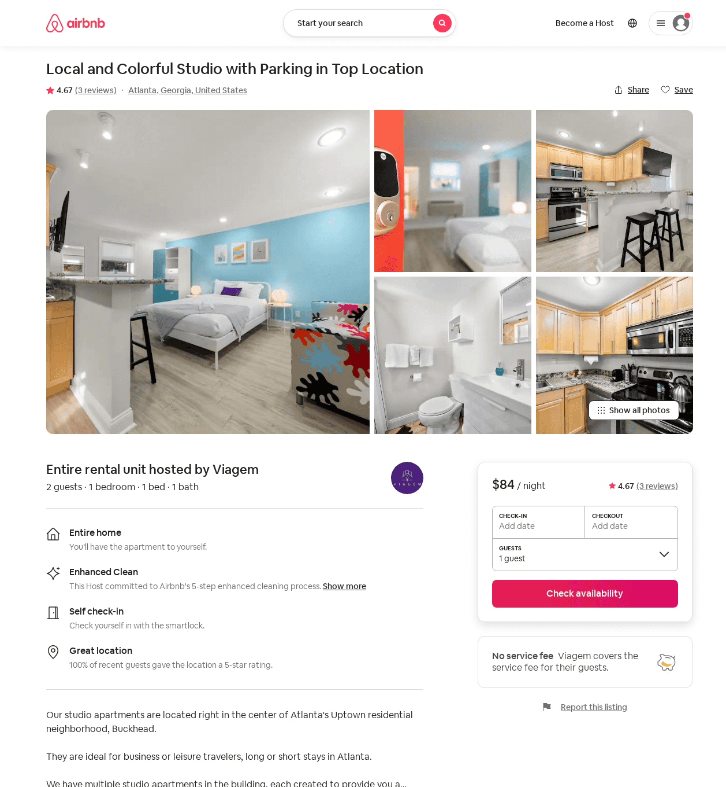
Listing 53699329
1
2
$61 - $115
4.40
2
Viagem
430023979
1
https://www.airbnb.com/rooms/53699329
Aug 2022

Slide 41
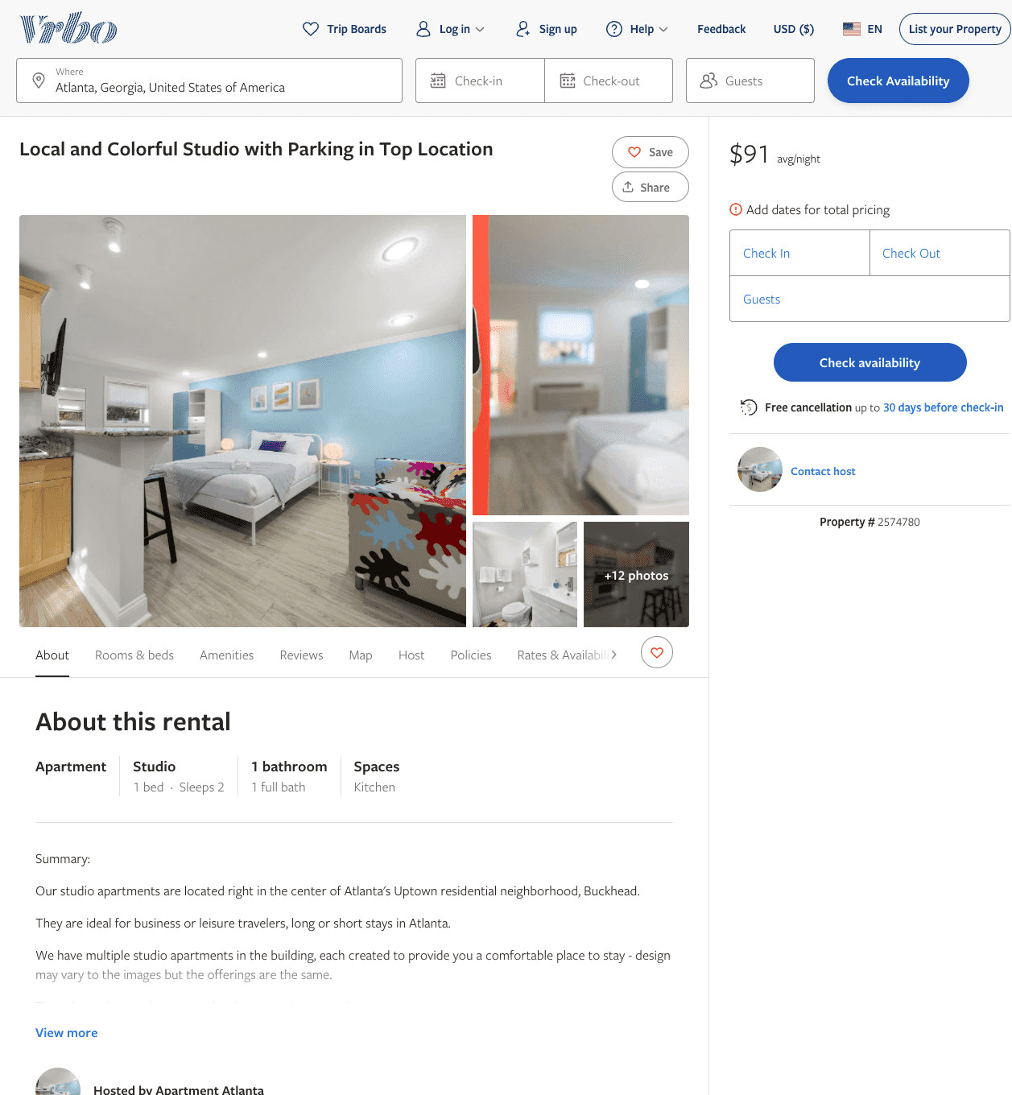
Listing 2574780
0
2
$101 - $91
5
2
Melissa Resillez
https://www.vrbo.com/2574780
Aug 2022

Slide 42
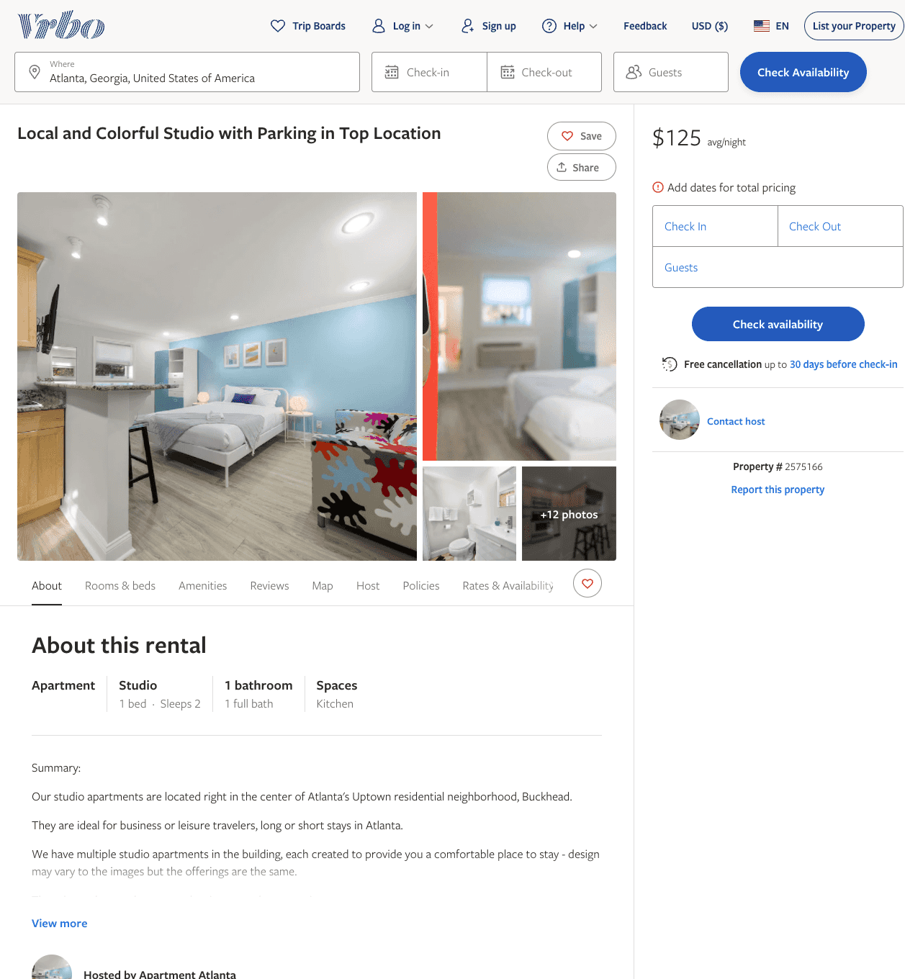
Listing 2575166
0
2
$107 - $91
2
Melissa Resillez
https://www.vrbo.com/2575166
Aug 2022

Slide 43
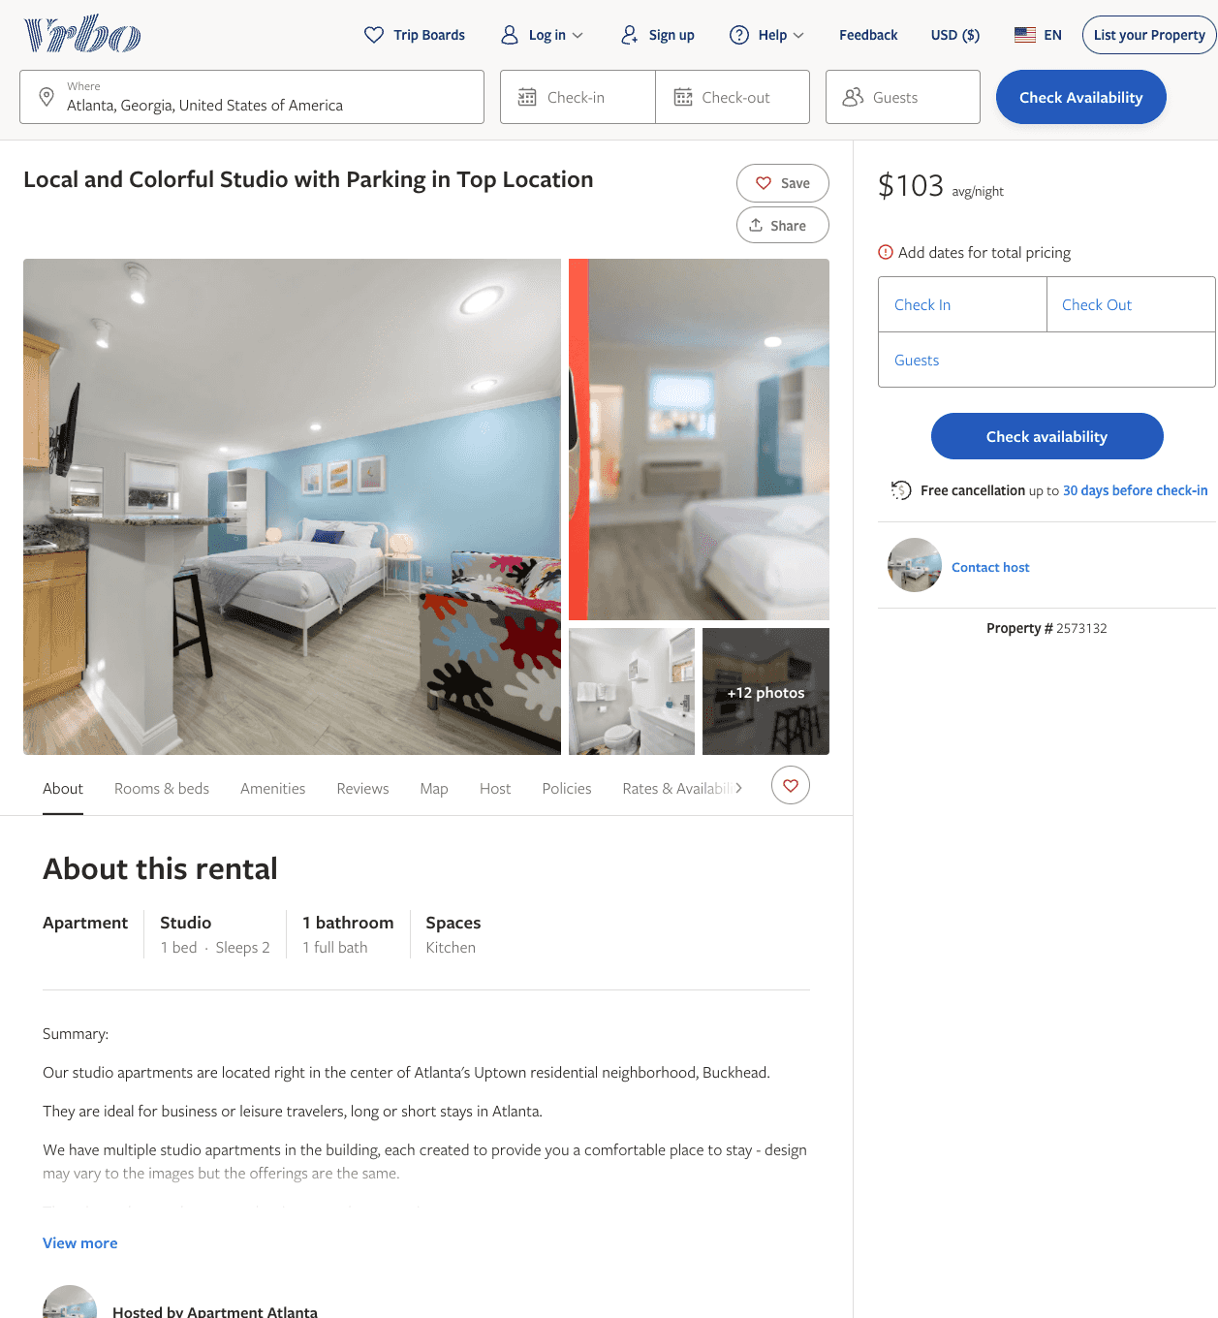
Listing 2573132
0
2
$103 - $92
5
2
Melissa Resillez
https://www.vrbo.com/2573132
Aug 2022

Slide 44
Listing 2573135
0
2
$102 - $92
2
Melissa Resillez
https://www.vrbo.com/2573135
Aug 2022

Slide 45
Listing 2573134
0
2
$102 - $91
2
Melissa Resillez
https://www.vrbo.com/2573134
Aug 2022

Slide 46
Listing 2573133
0
2
$104 - $93
2
Melissa Resillez
https://www.vrbo.com/2573133
Aug 2022

Slide 47
Listing 2573130
0
2
$104 - $93
2
Melissa Resillez
https://www.vrbo.com/2573130
Aug 2022

Slide 48
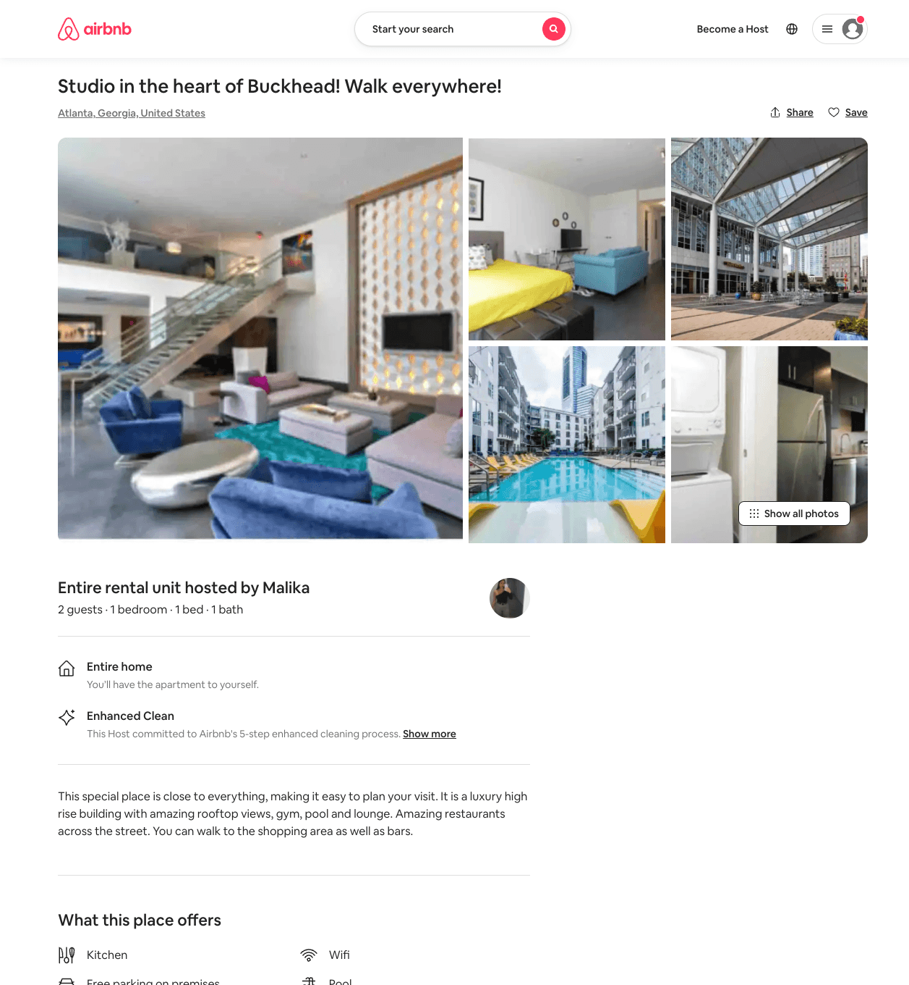
Listing 53999511
1
2
$65 - $94
4.40
30
Malika
390872332
7
https://www.airbnb.com/rooms/53999511
Aug 2022

Slide 49
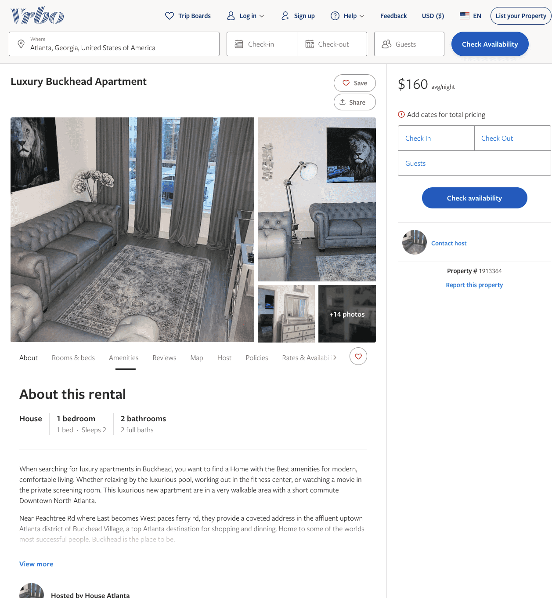
Listing 1913364
1
2
$160
1
https://www.vrbo.com/1913364
Aug 2022

Slide 50
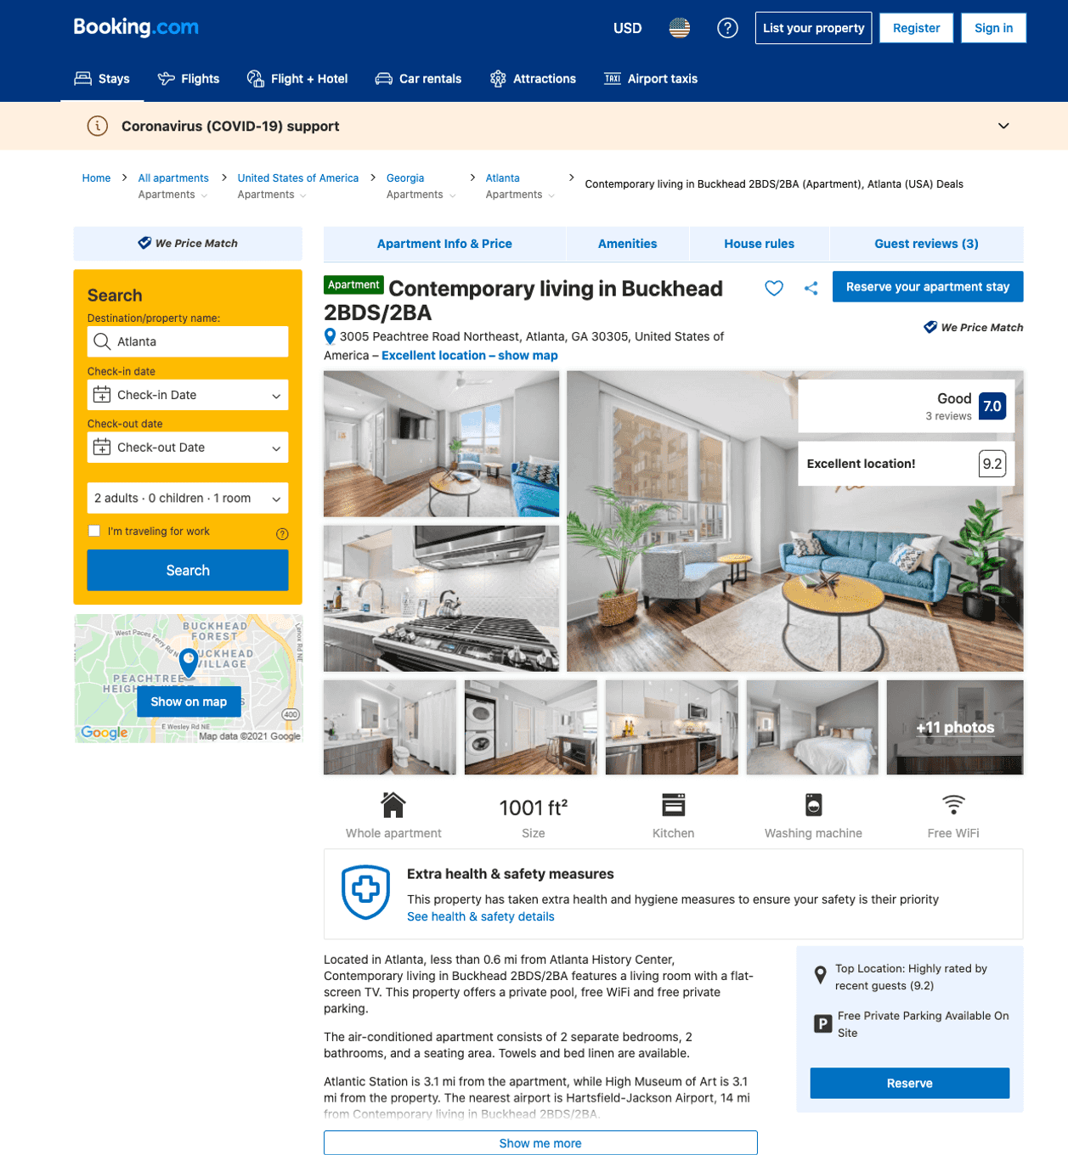
Listing contemporary-living-in-buckhead-2bds-47-2ba
undefined
4
8.2
https://www.booking.com/hotel/us/contemporary-living-in-buckhead-2bds-47-2ba.html
Sep 2022

Slide 51
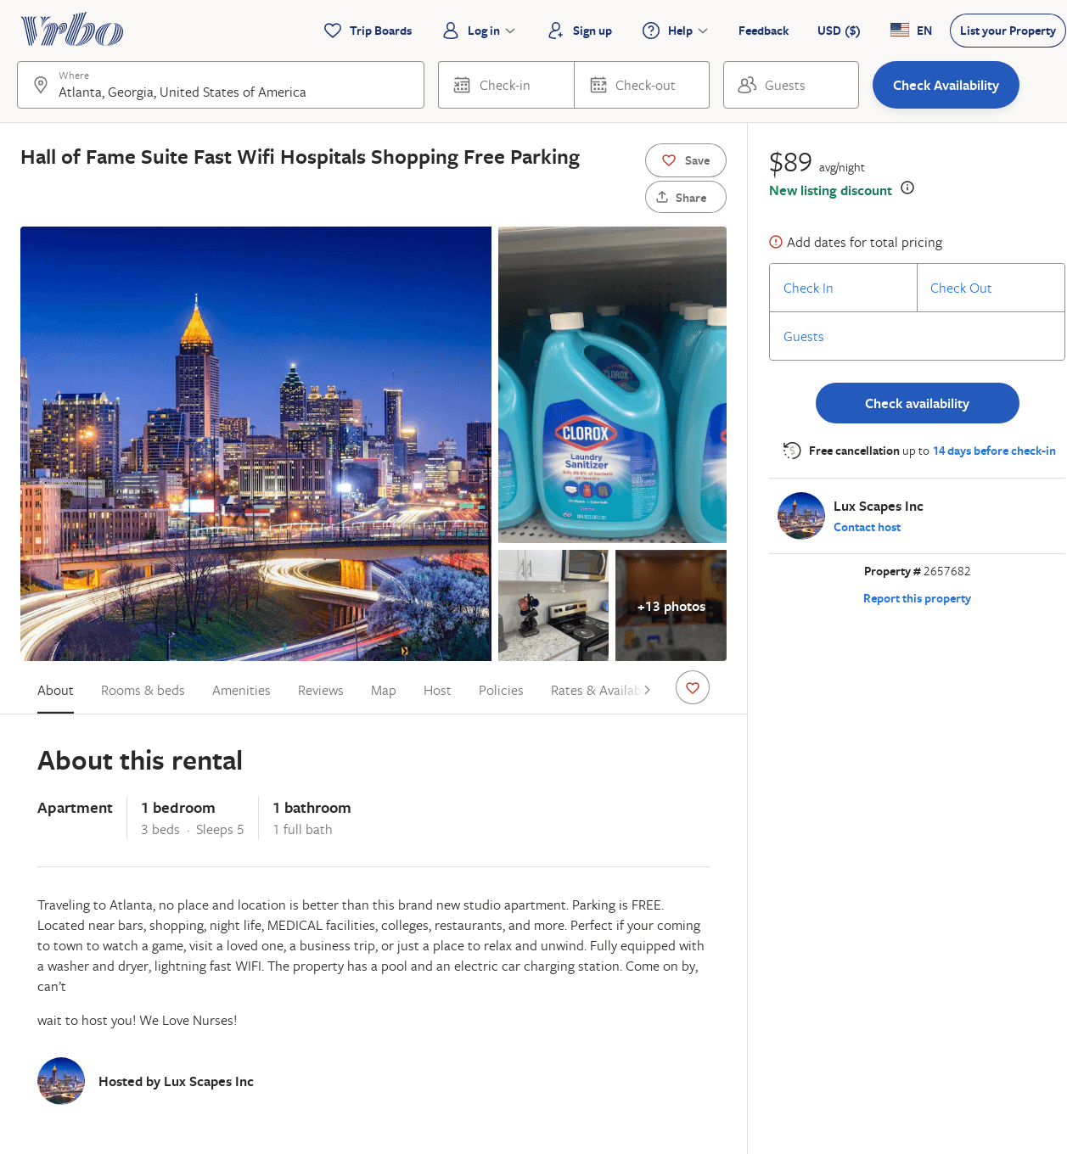
Listing 2657682
1
5
$103
1
Lux Scapes Inc
https://www.vrbo.com/2657682
Aug 2022

Slide 52
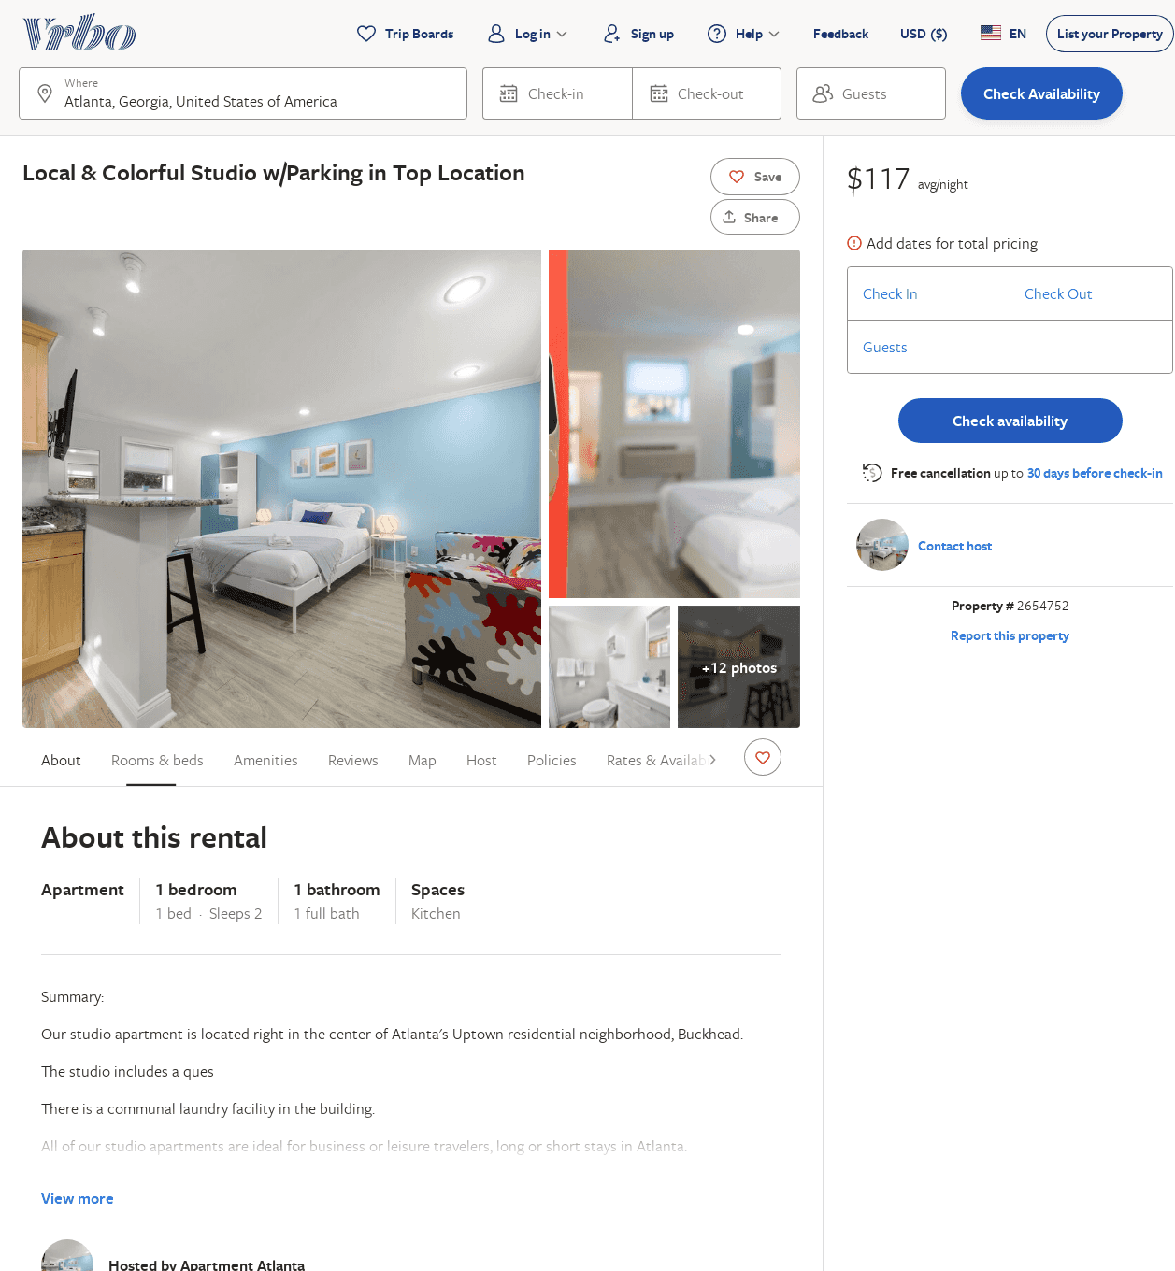
Listing 2654752
1
2
$49
2
Melissa Resillez
https://www.vrbo.com/2654752
Aug 2022

Slide 53
Listing 2649837
0
2
$69
2
Melissa Resillez
https://www.vrbo.com/2649837
Aug 2022

Slide 54
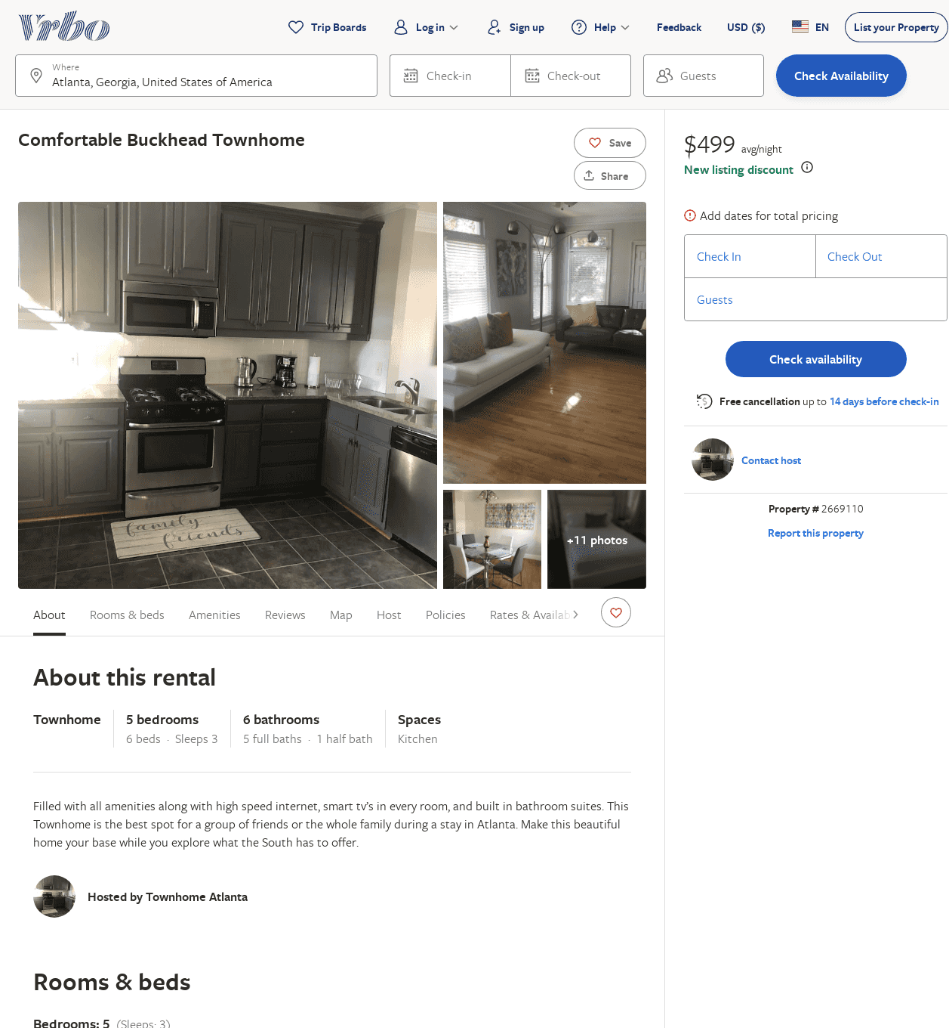
Listing 2669110
5
3
$499
3
Spare Space LLC
https://www.vrbo.com/2669110
Aug 2022

Slide 55
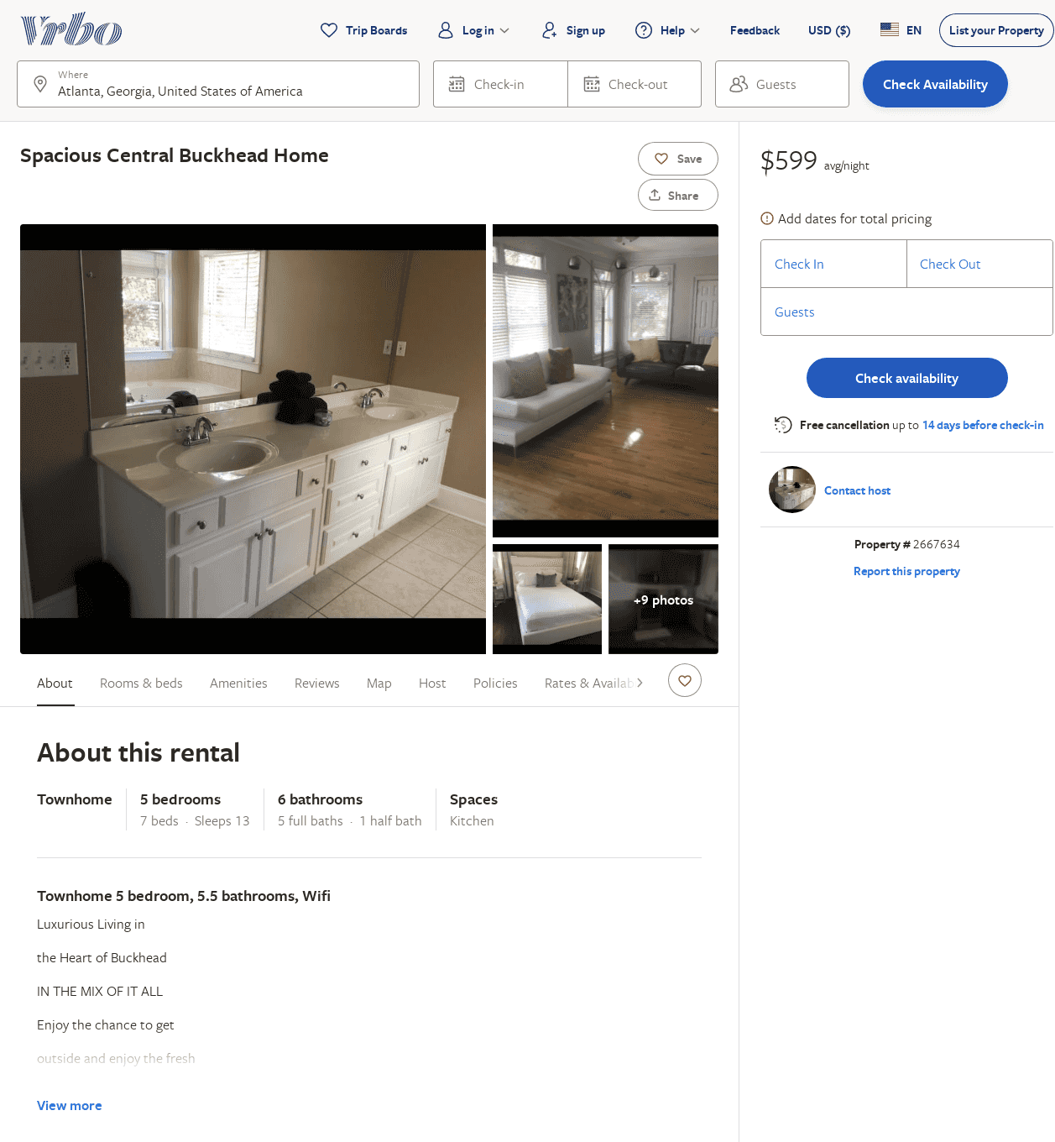
Listing 2667634
5
13
$599
1
Spare Space LLC
https://www.vrbo.com/2667634
Aug 2022

Slide 56
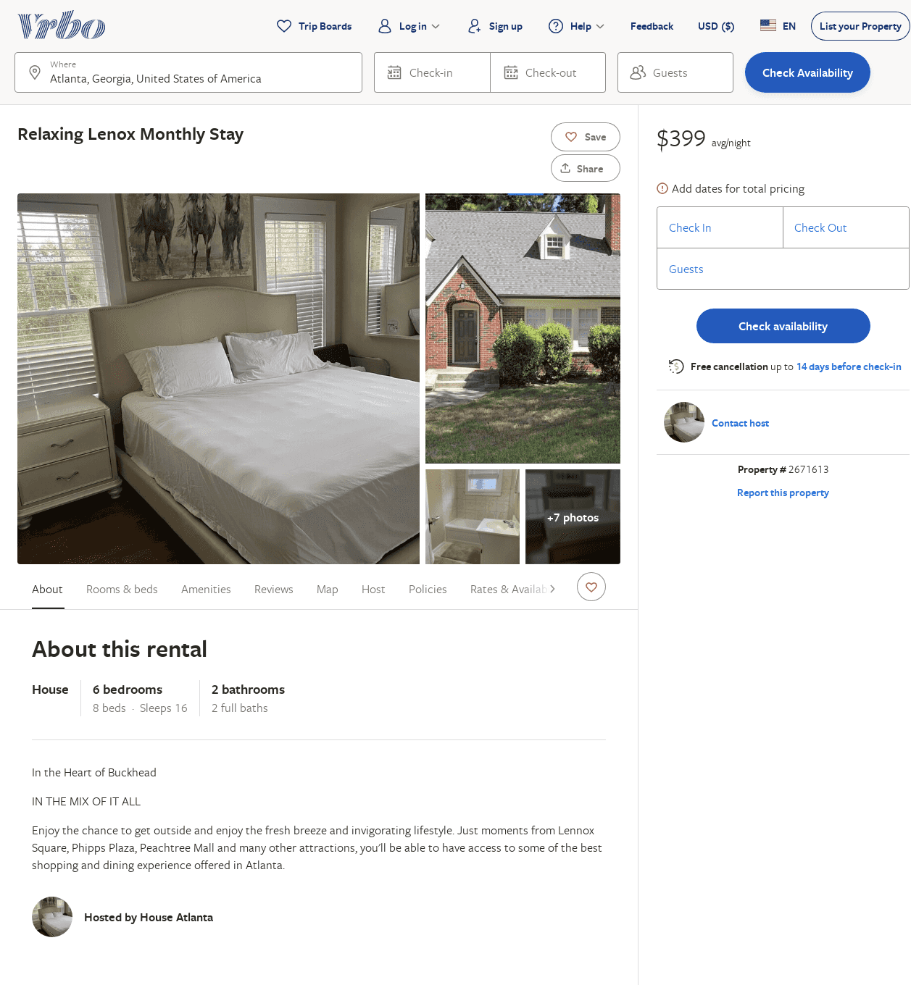
Listing 2671613
6
16
$399
28
Spare Space LLC
https://www.vrbo.com/2671613
Aug 2022

Slide 57
Listing 2671591
6
16
$599
3
Spare Space LLC
https://www.vrbo.com/2671591
Aug 2022

Slide 58
Listing 2693555
1
3
$110
1
https://www.vrbo.com/2693555
Aug 2022

Slide 59
Listing 2702952
1
3
$90
2
1
Lux Scapes Inc
https://www.vrbo.com/2702952
Aug 2022

Slide 60
Listing 2733930
2
6
$265
2
Lesley Jackson
https://www.vrbo.com/2733930
Aug 2022

Slide 61
Listing 2756191
1
3
$128
1
https://www.vrbo.com/2756191
Aug 2022

Slide 62
Listing 2718829
1
2
$79
2
https://www.vrbo.com/2718829
Aug 2022

Slide 63
Listing 2826404
6
12
$793
5
4
Preston Smith
https://www.vrbo.com/2826404
Aug 2022

Slide 64
Listing 13648109
5
10
$1250
2
Randy
57186799
1
https://www.airbnb.com/rooms/13648109
Aug 2022

Slide 65
Listing 11191265
1
2
$200
4.80
2
Mimi
58264476
2
https://www.airbnb.com/rooms/11191265
Jun 2022

Slide 66
Listing 2959862
3
12
$403
1
anthony williams
https://www.vrbo.com/2959862
Aug 2022

