Slide 2
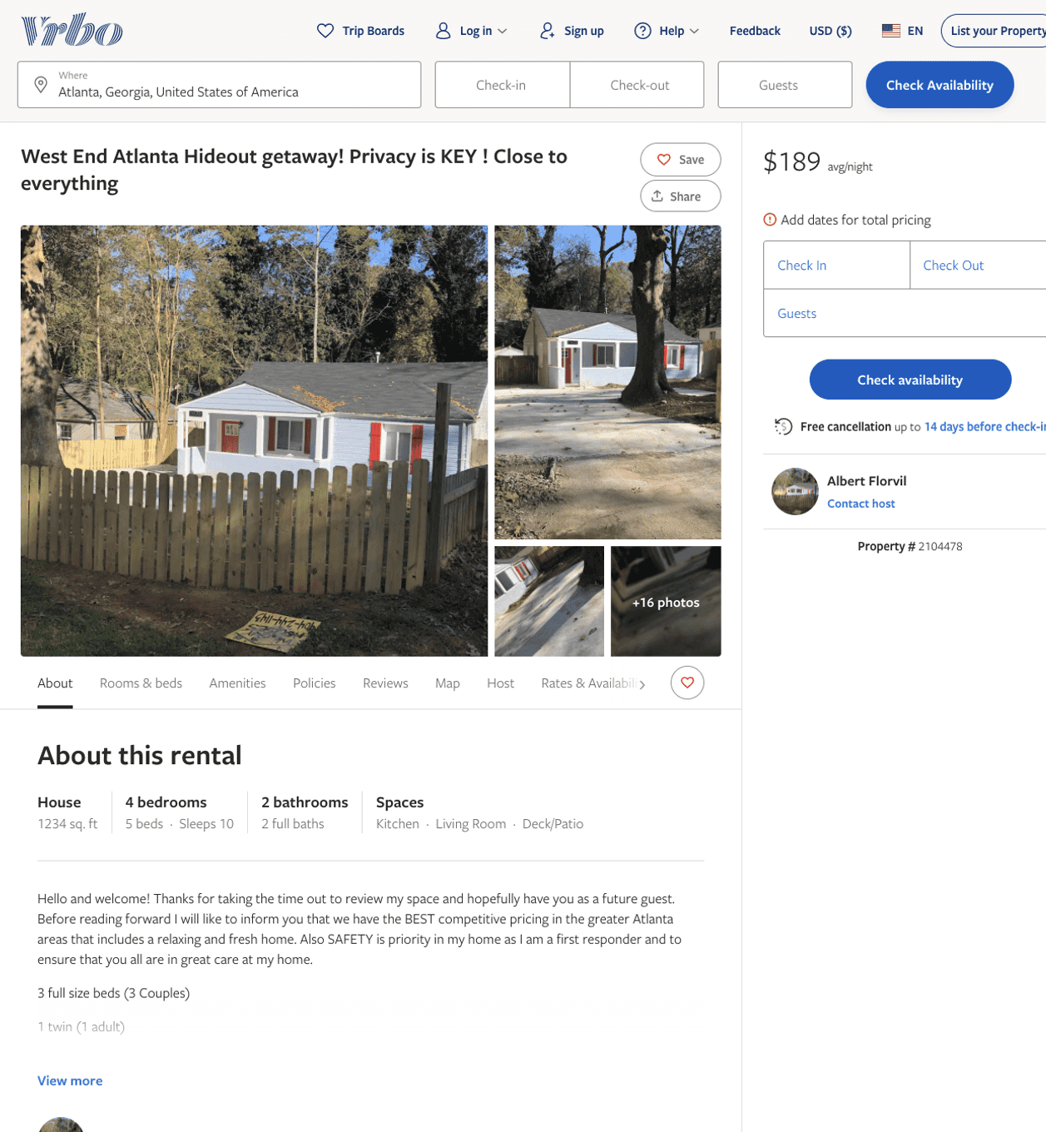
Listing 2104478
4
10
$114 - $90
4.5
3
Albert Florvil
https://www.vrbo.com/2104478
Aug 2022

Slide 3
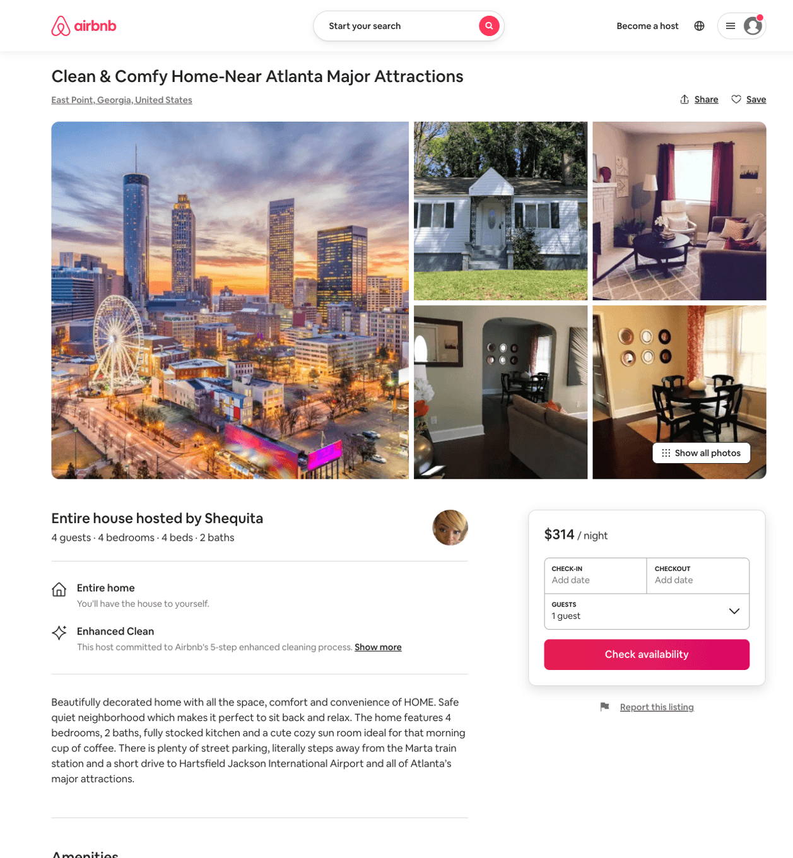
Listing 48645801
4
4
$314
2
Shequita
273129719
3
https://www.airbnb.com/rooms/48645801
Aug 2022

Slide 4
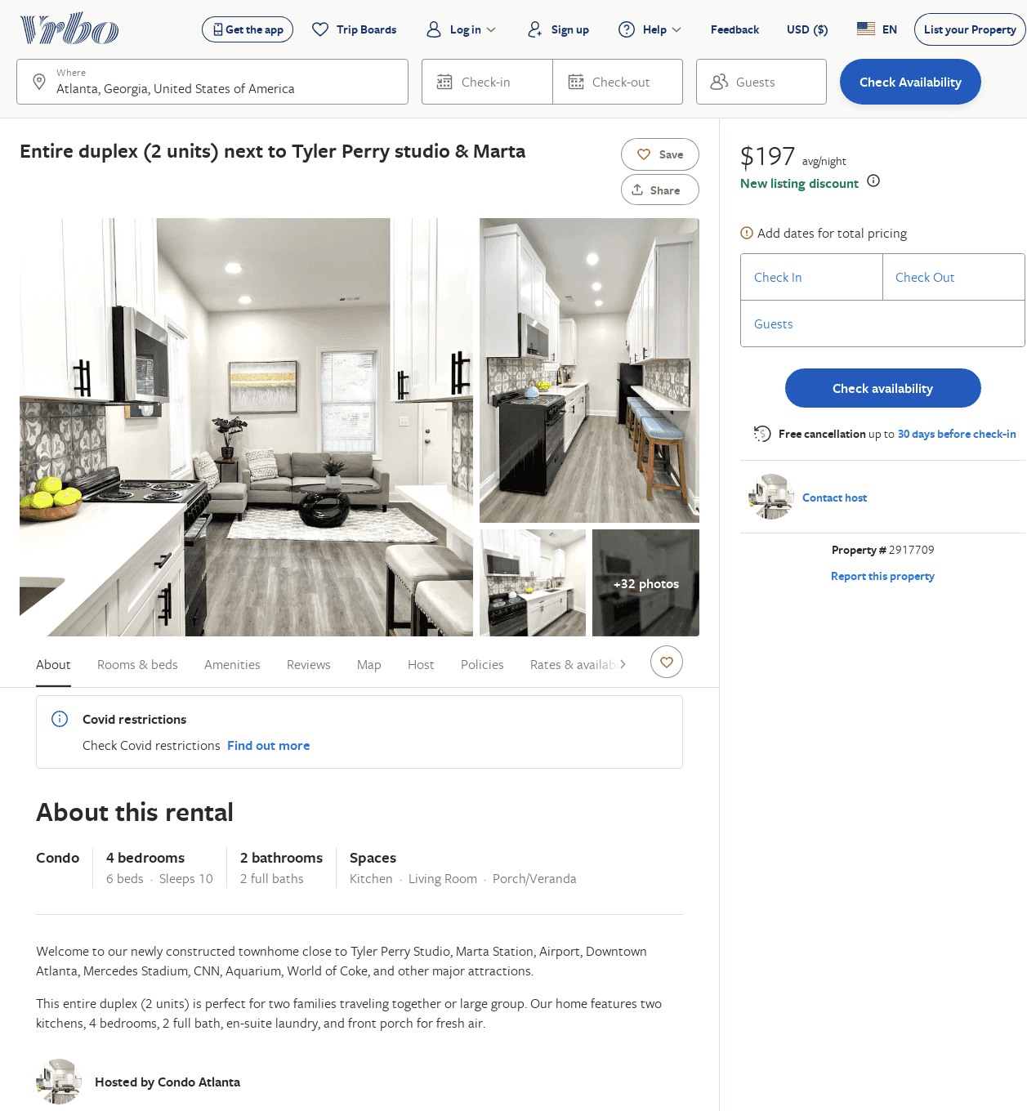
Listing 2917709
4
10
$179
2
https://www.vrbo.com/2917709
Aug 2022

