Slide 2
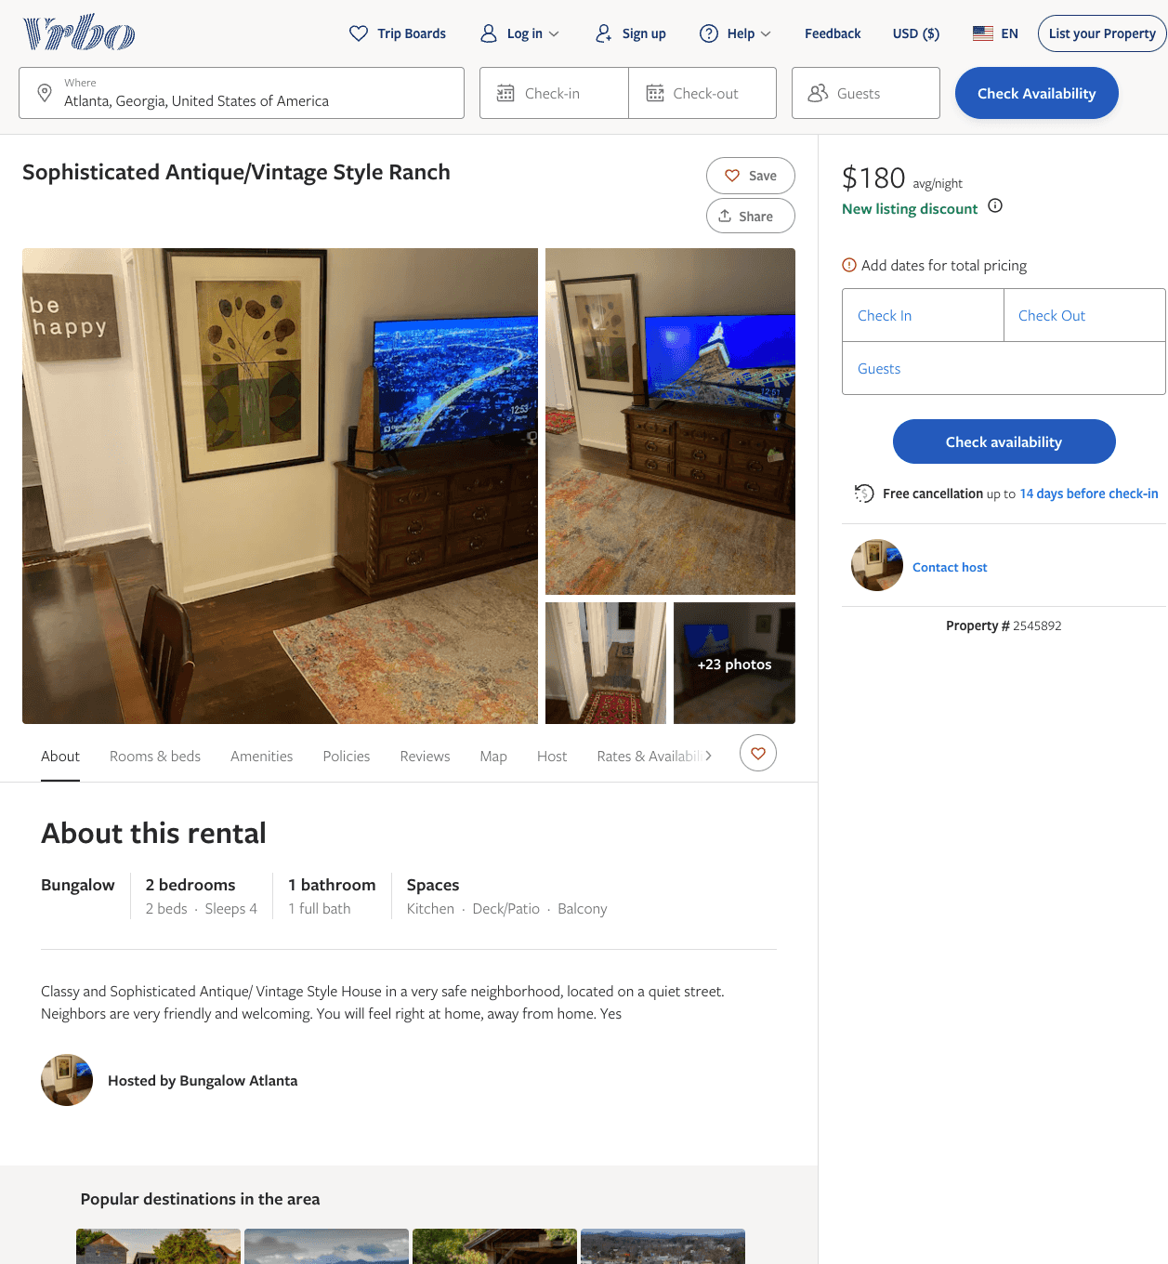
Listing 2545892
2
4
$155 - $180
3
2
Taorid
https://www.vrbo.com/2545892
Aug 2022

Slide 3
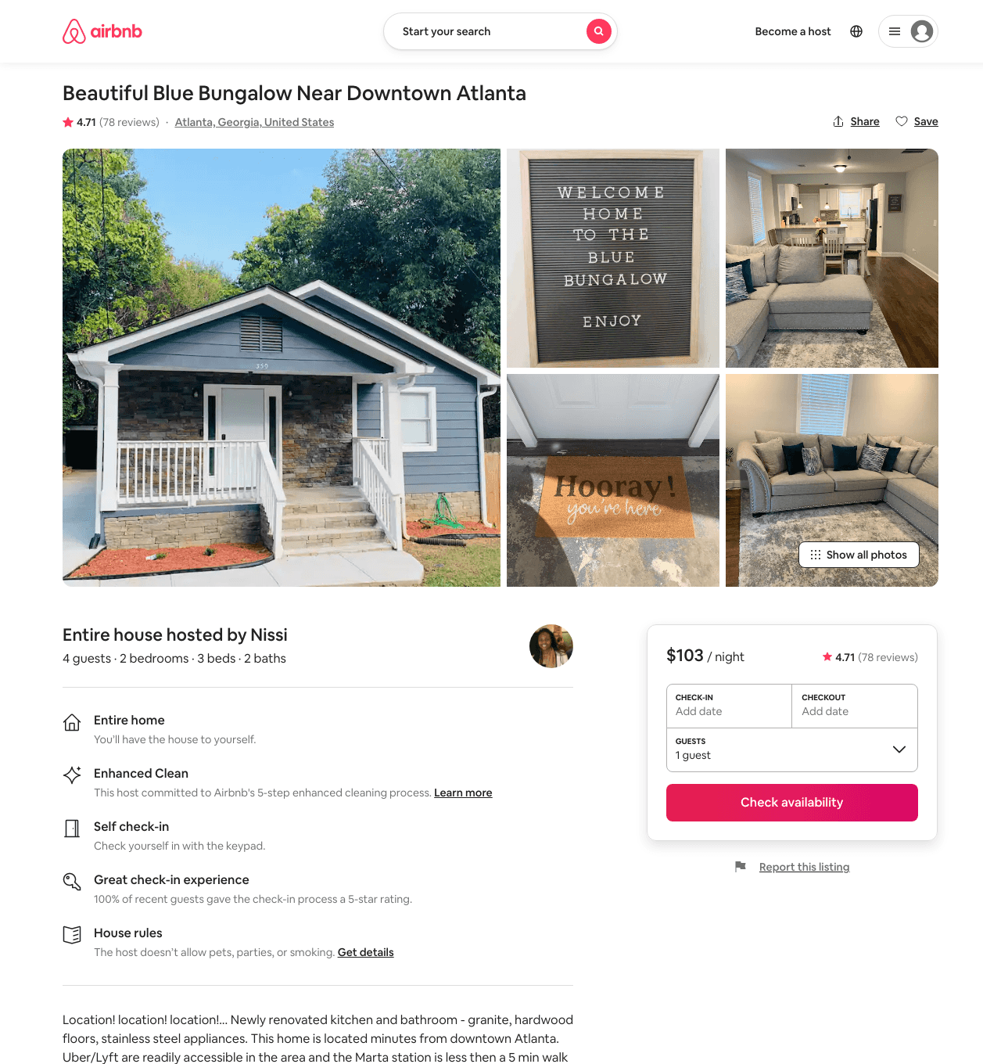
Listing 37678238
2
4
$79 - $116
4.66
2
Minnie Estates, Inc
95603129
1
https://www.airbnb.com/rooms/37678238
Aug 2022

Slide 4
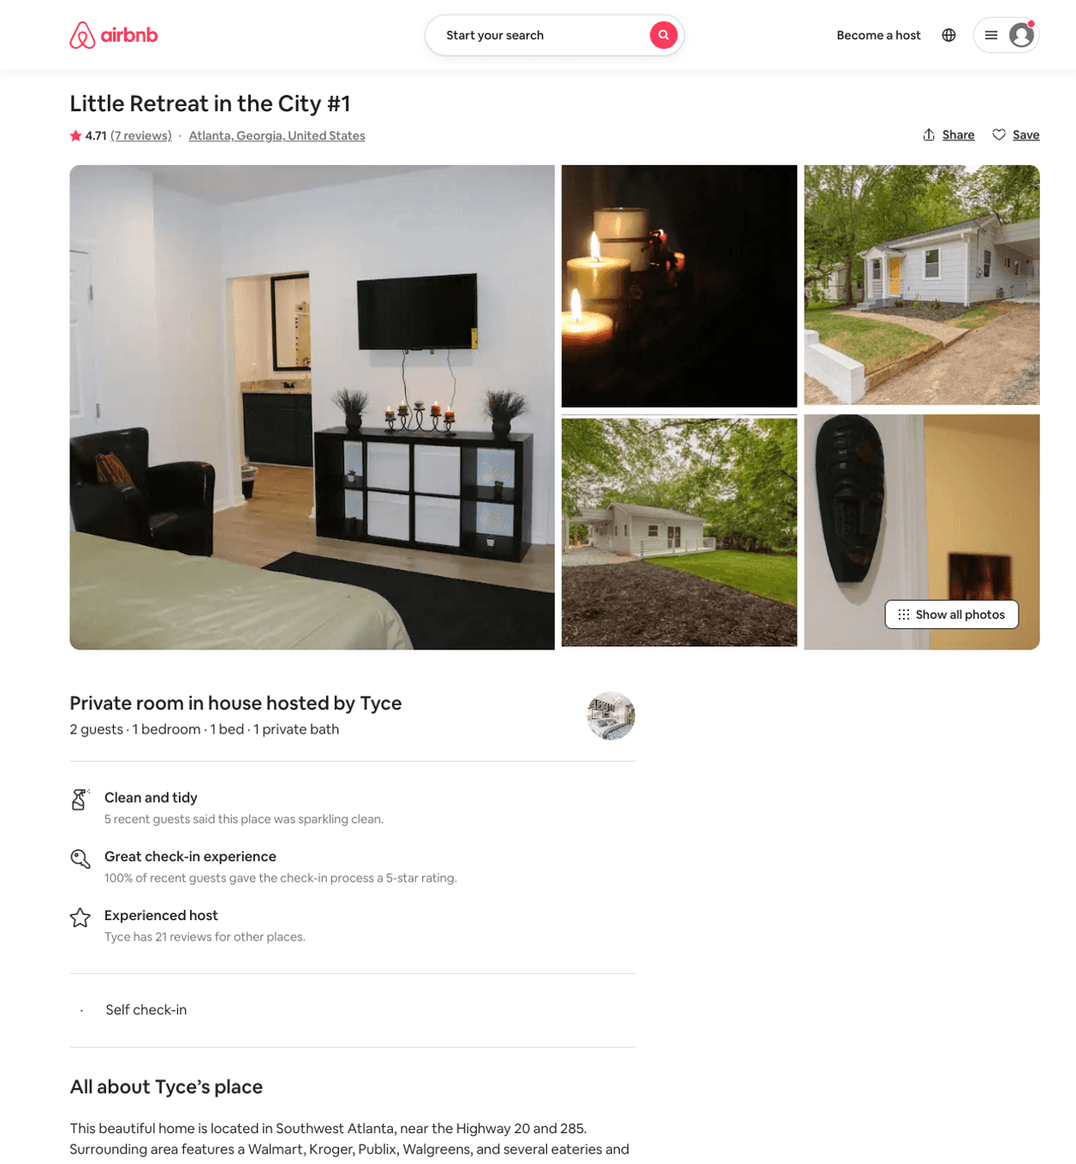
Listing 45851651
1
2
$30 - $59
4.78
3
Tyce
147425478
3
https://www.airbnb.com/rooms/45851651
Jun 2022

Slide 5
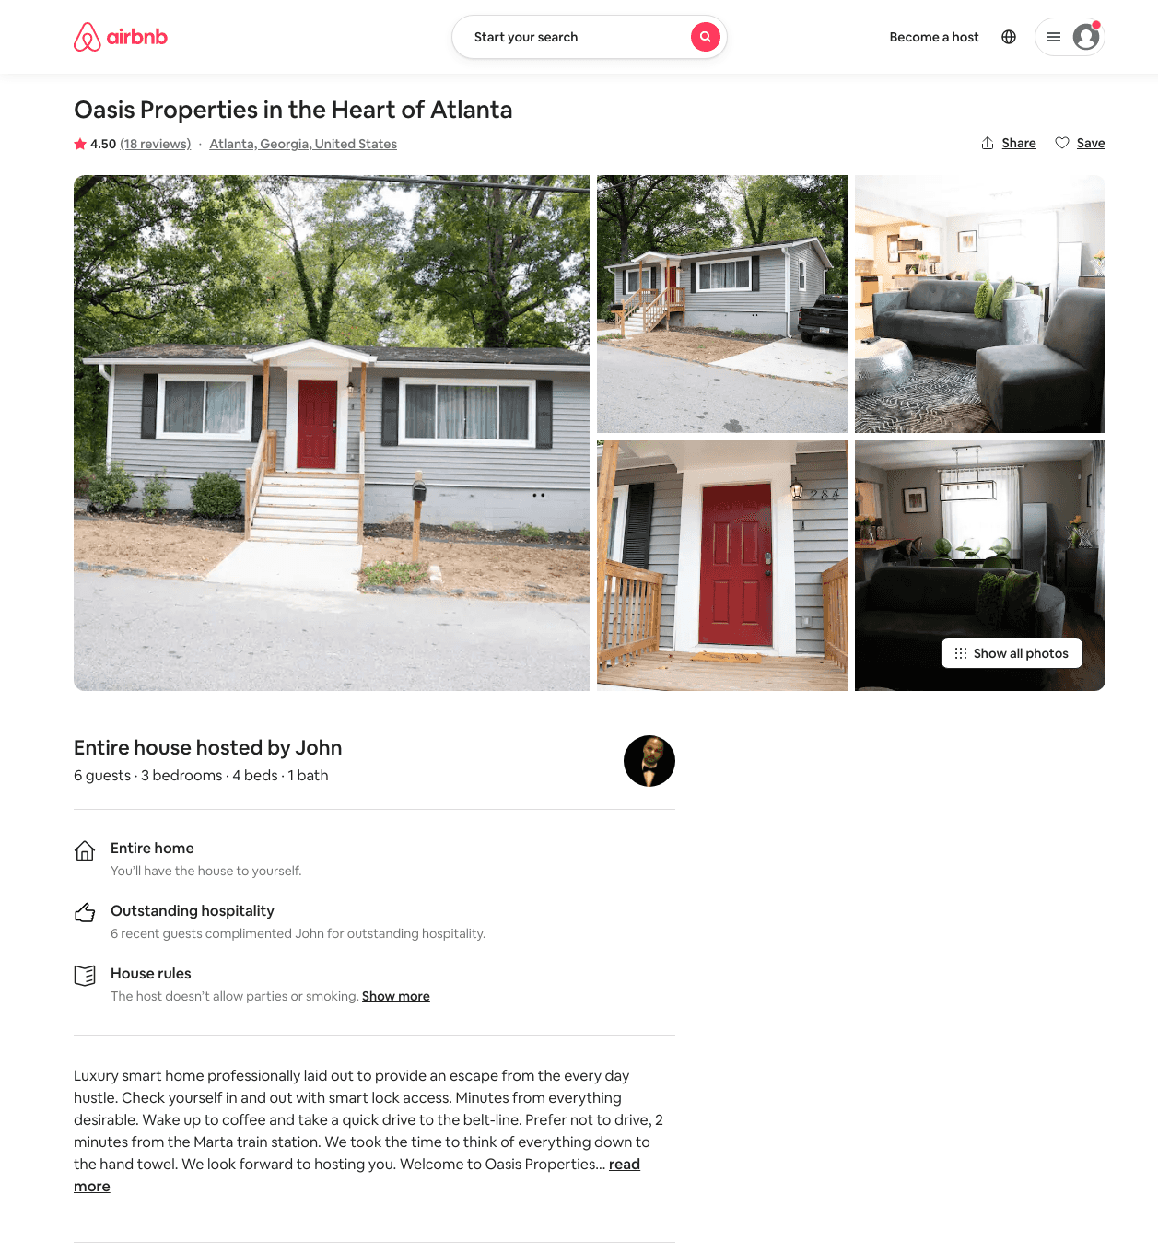
Listing 36273329
3
6
$139 - $142
4.60
1
John
45953228
1
https://www.airbnb.com/rooms/36273329
Aug 2022

Slide 6
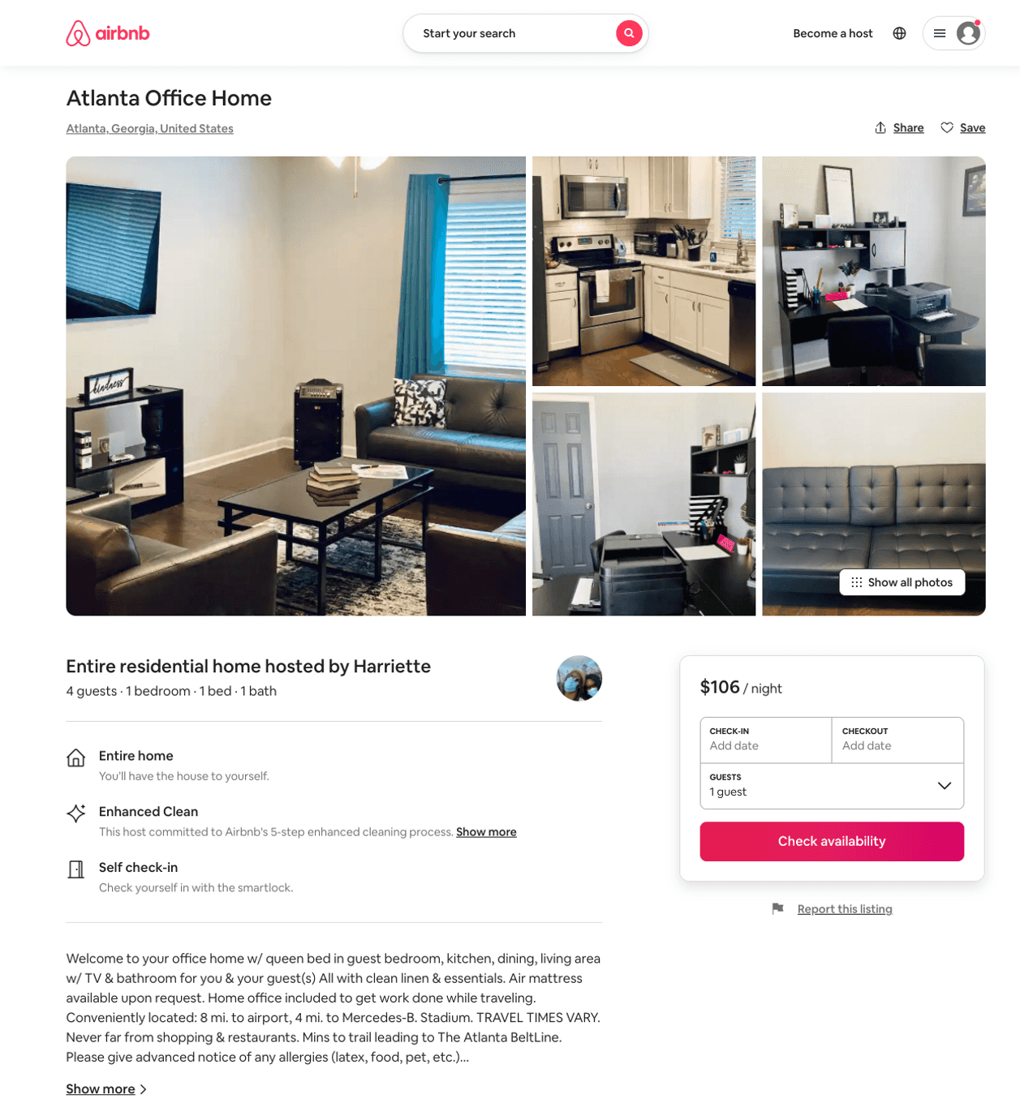
Listing 49318948
1
4
$71 - $118
5.0
2
OZ Financial
119785912
2
https://www.airbnb.com/rooms/49318948
Jul 2022

Slide 7
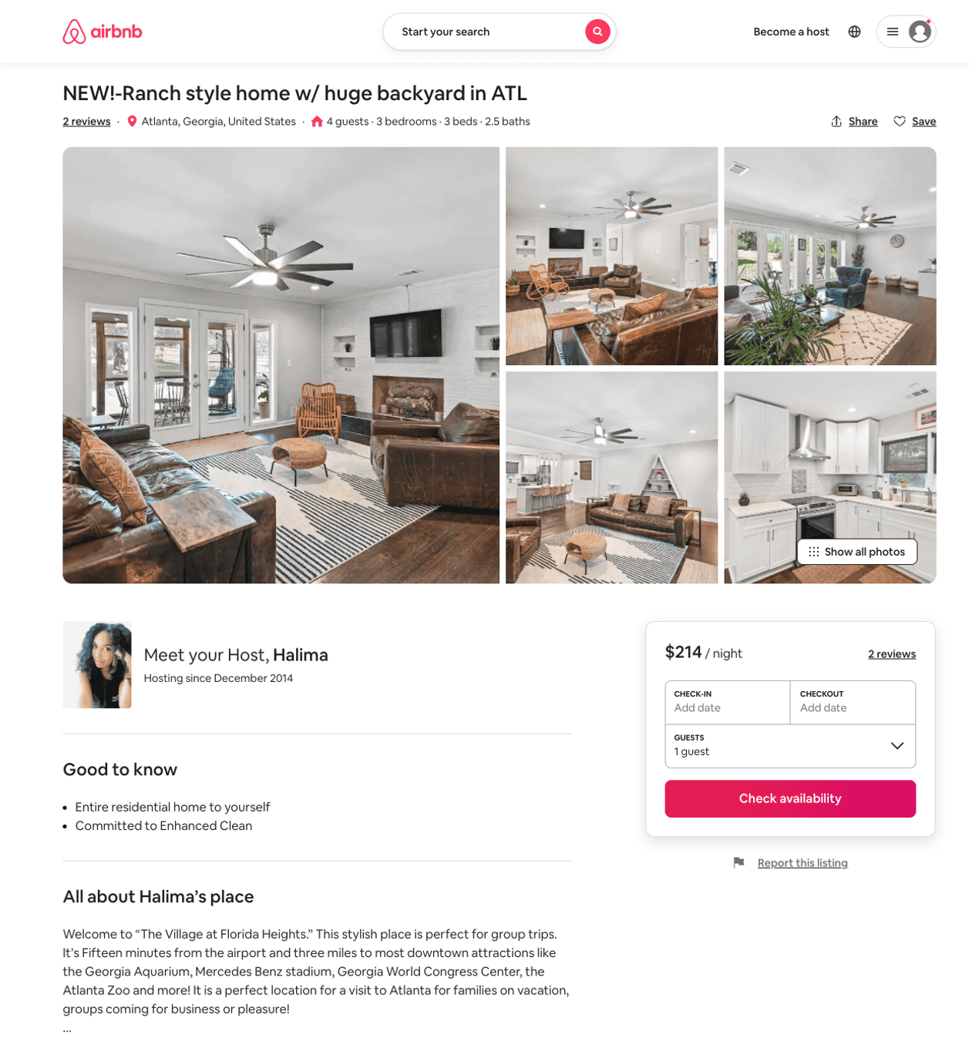
Listing 51811380
3
8
$152 - $242
4.90
2
Halima
24523312
1
https://www.airbnb.com/rooms/51811380
Aug 2022

Slide 8
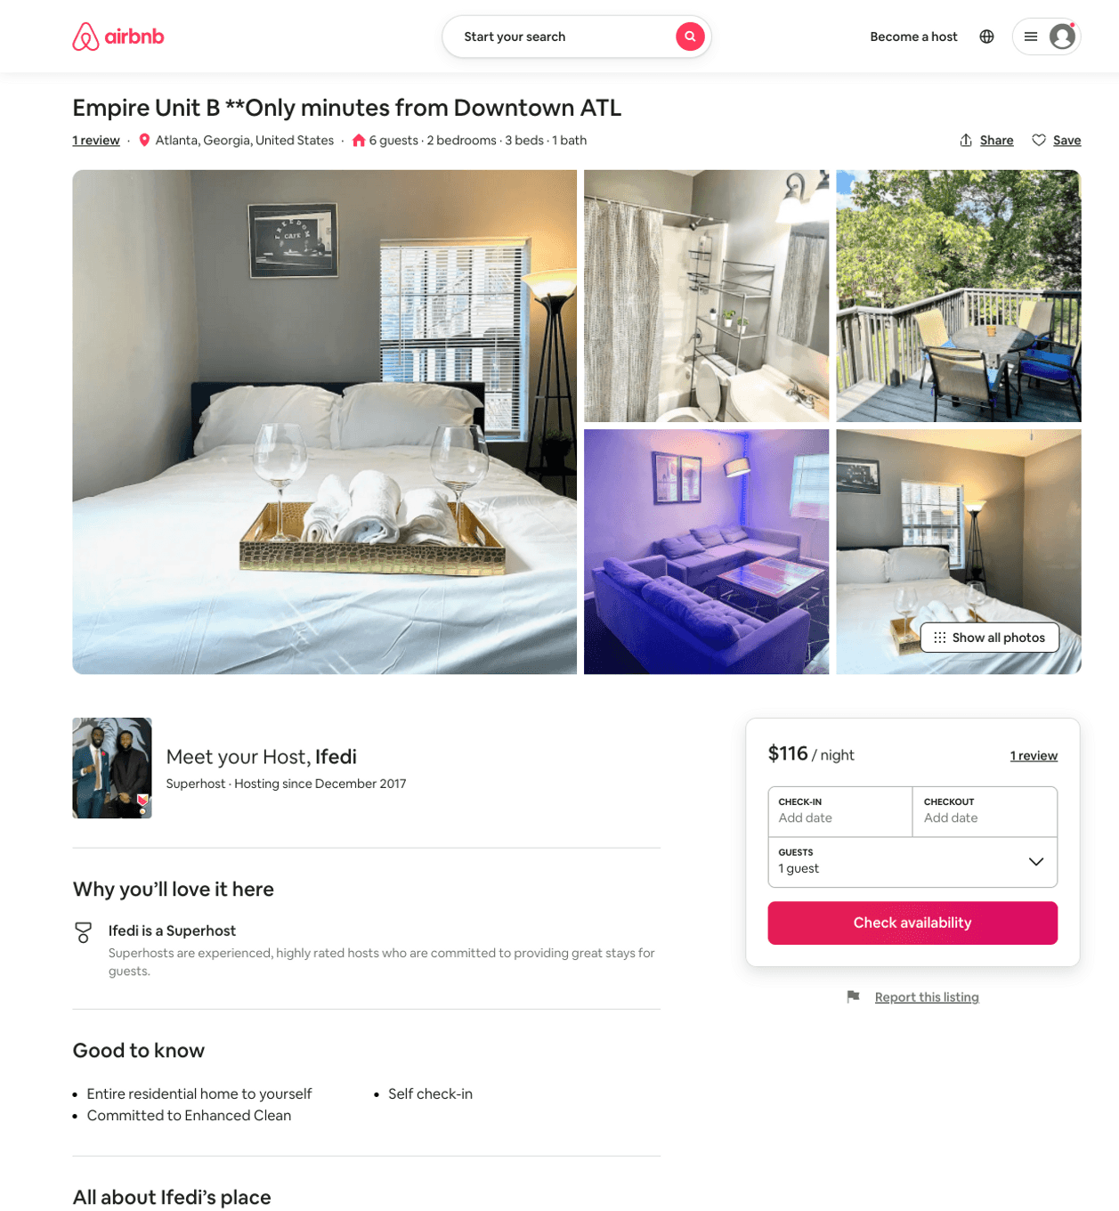
Listing 51638727
2
6
$70 - $119
4.43
1
Ifedi
164185019
2
https://www.airbnb.com/rooms/51638727
Jul 2022

Slide 9
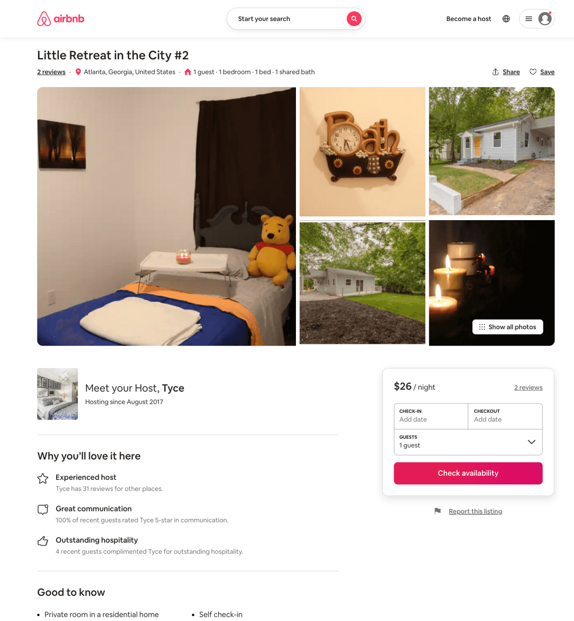
Listing 45851775
1
1
$25 - $38
4.23
1
Tyce
147425478
3
https://www.airbnb.com/rooms/45851775
Jul 2022

Slide 10
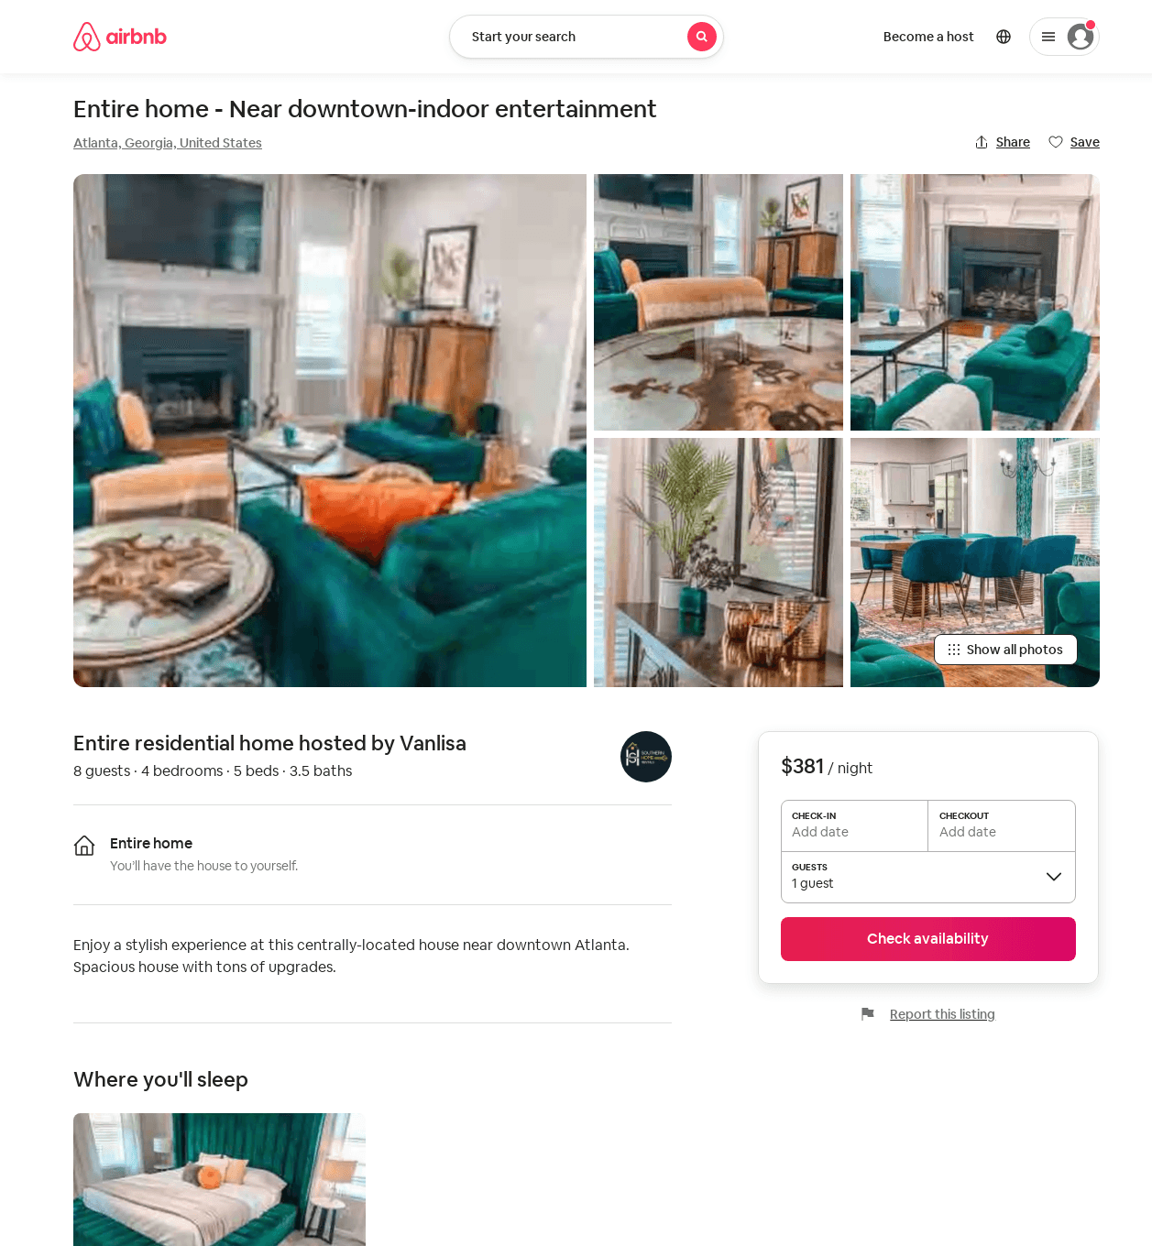
Listing 52469826
4
12
$200 - $414
4.79
2
Van
424715050
1
https://www.airbnb.com/rooms/52469826
Aug 2022

Slide 11
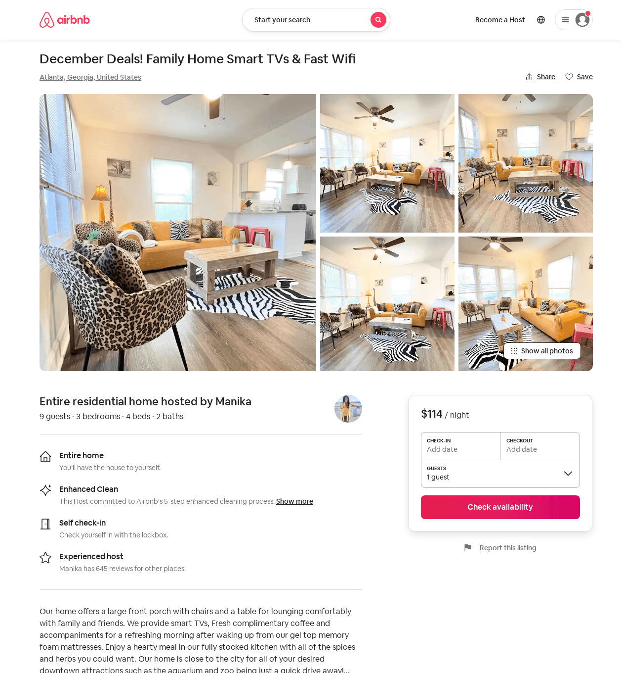
Listing 53618490
3
9
$107 - $141
4.15
2
Manika
49819100
11
https://www.airbnb.com/rooms/53618490
Aug 2022

Slide 12
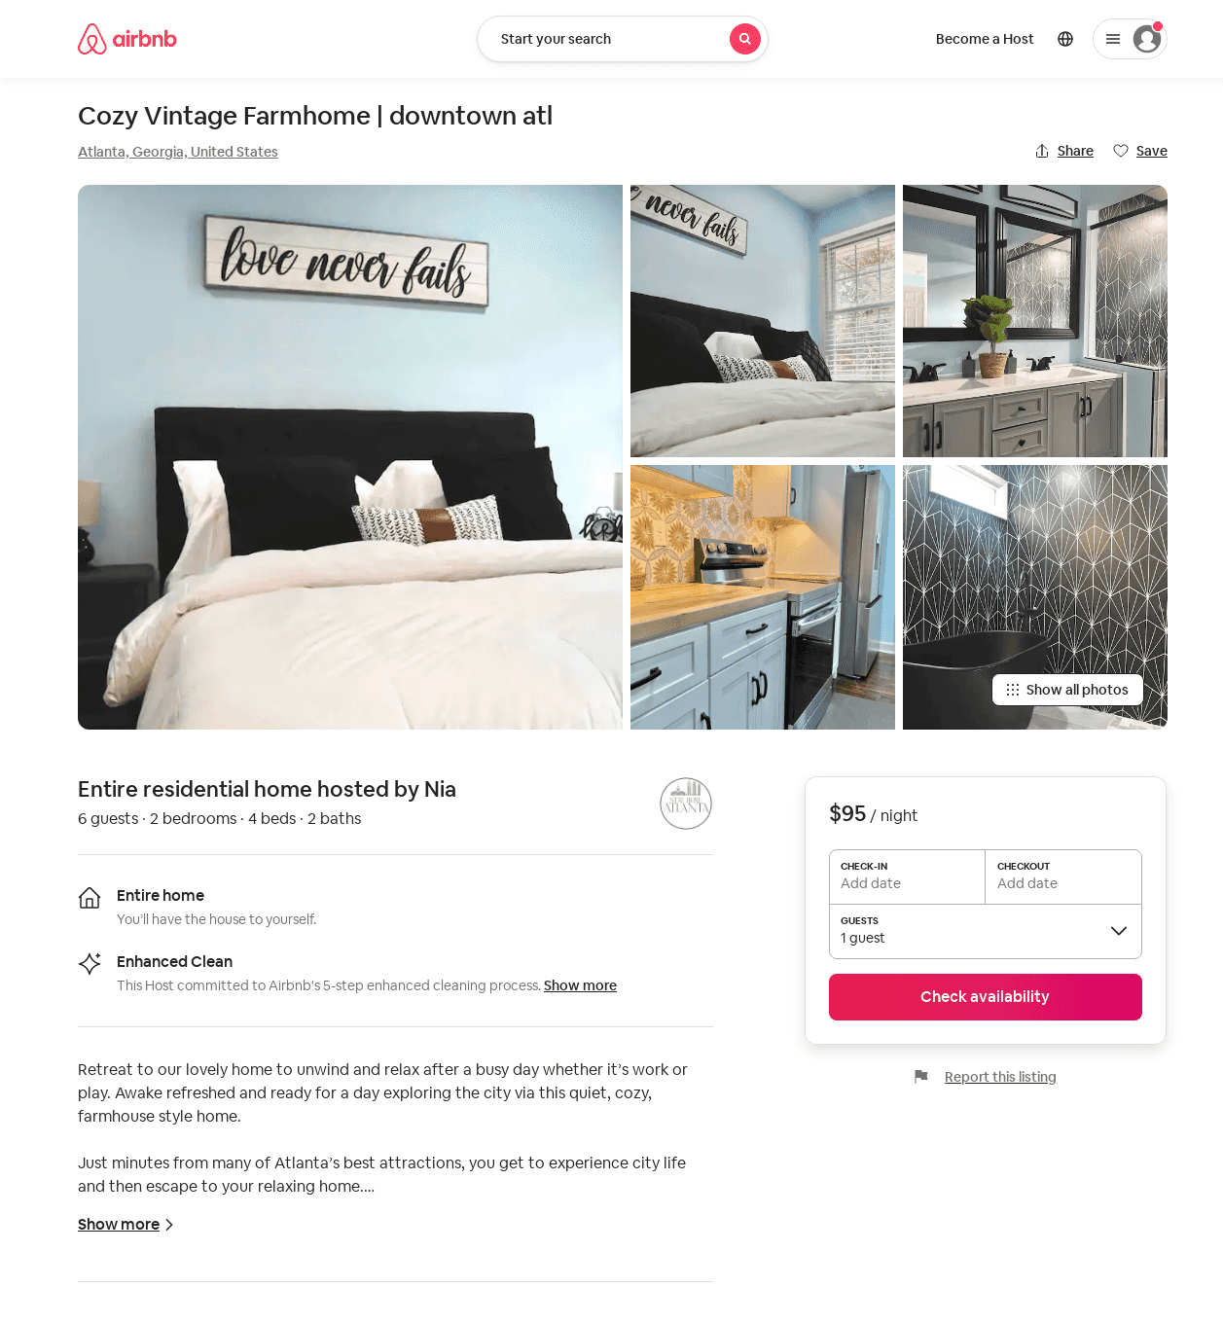
Listing 53613557
4
8
$95 - $131
4.88
2
Nia
133059144
1
https://www.airbnb.com/rooms/53613557
Aug 2022

Slide 13
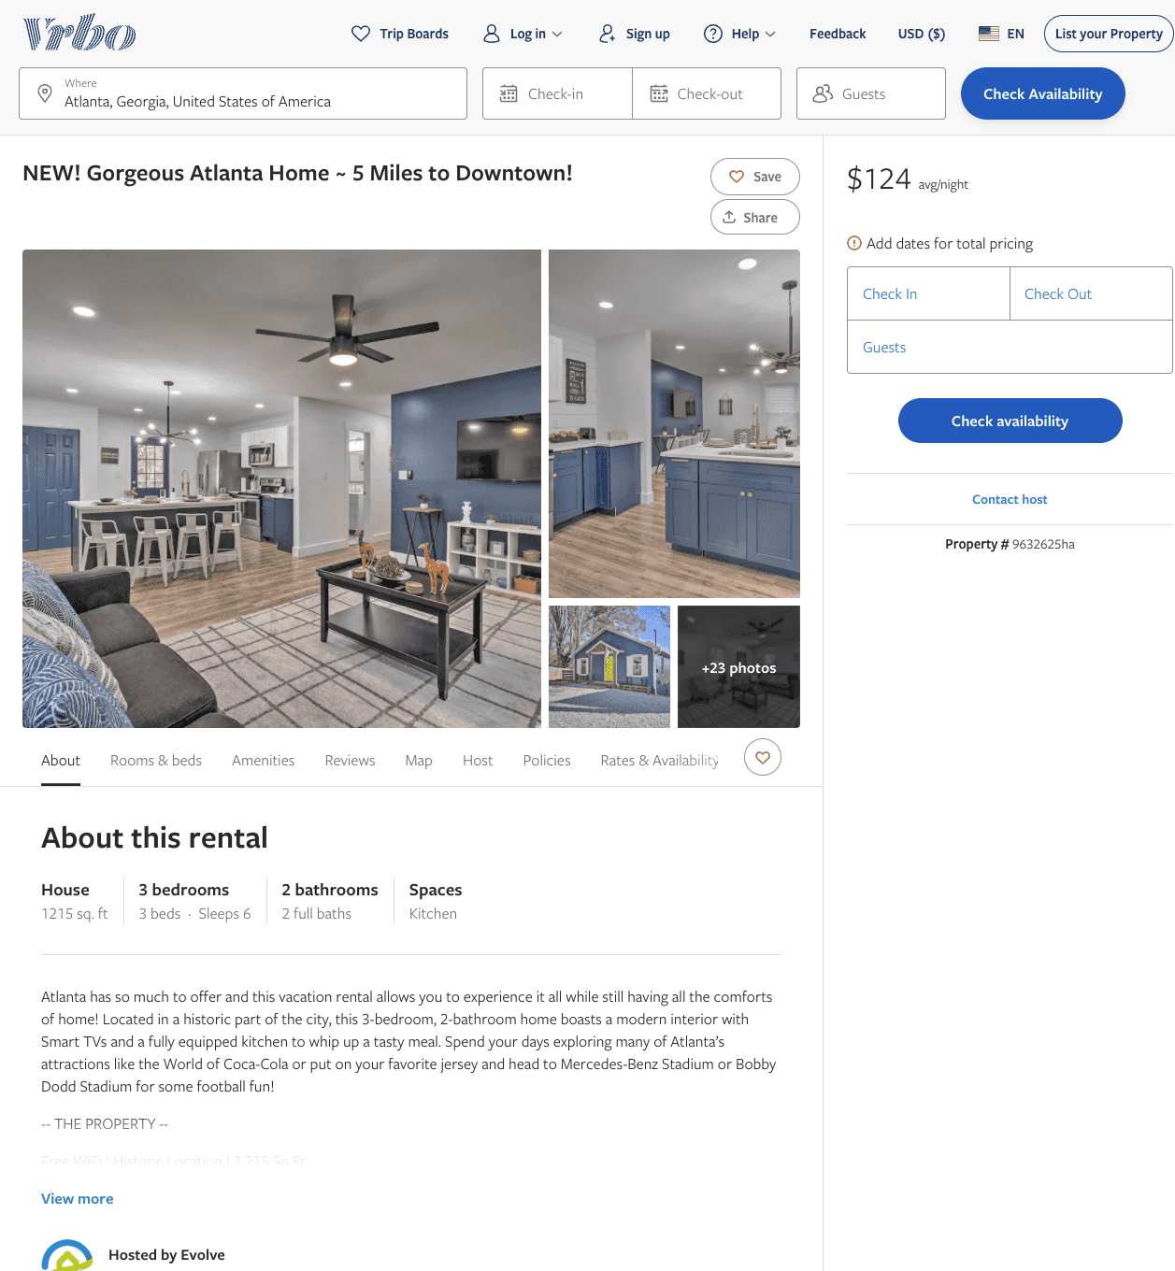
Listing 9632625
3
6
$124 - $150
4
2
Evolve
https://www.vrbo.com/9632625ha
Aug 2022

Slide 14
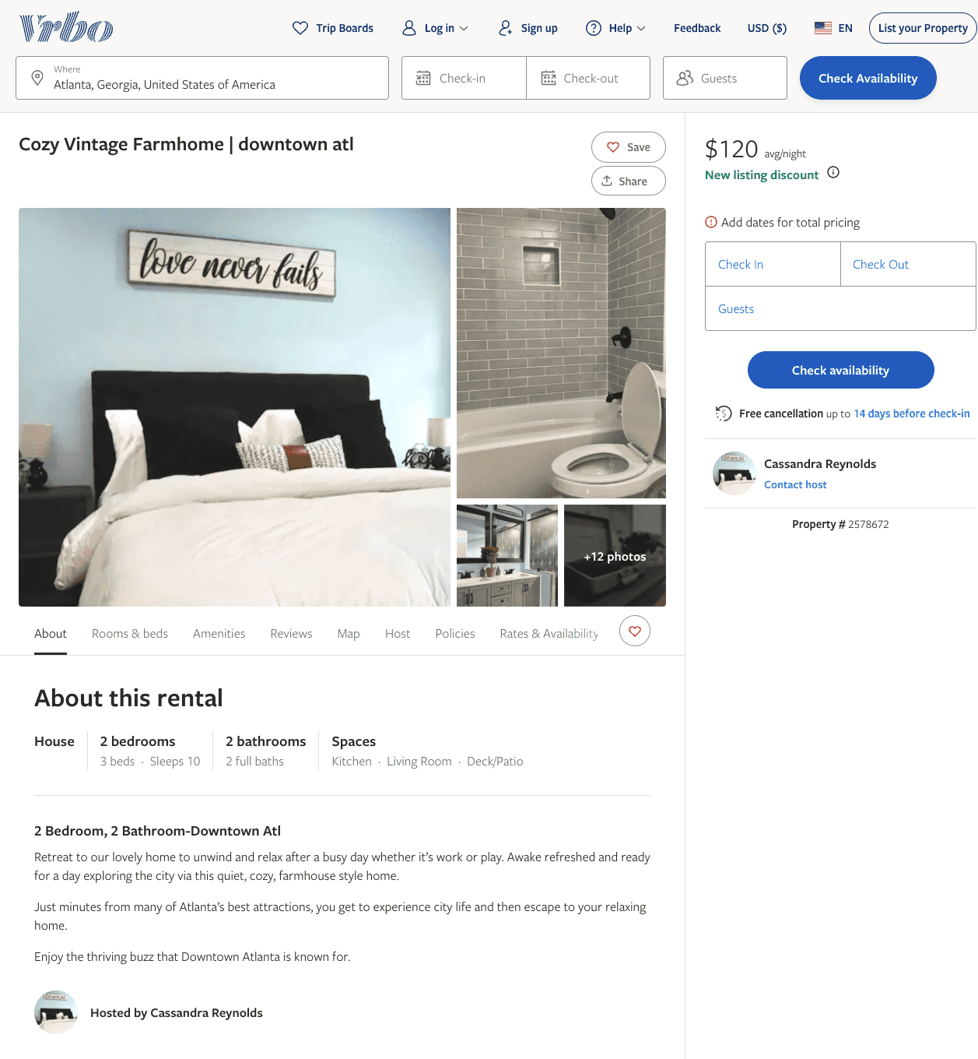
Listing 2578672
2
6
$120 - $212
5
1
Cassandra Reynolds
https://www.vrbo.com/2578672
Aug 2022

Slide 15
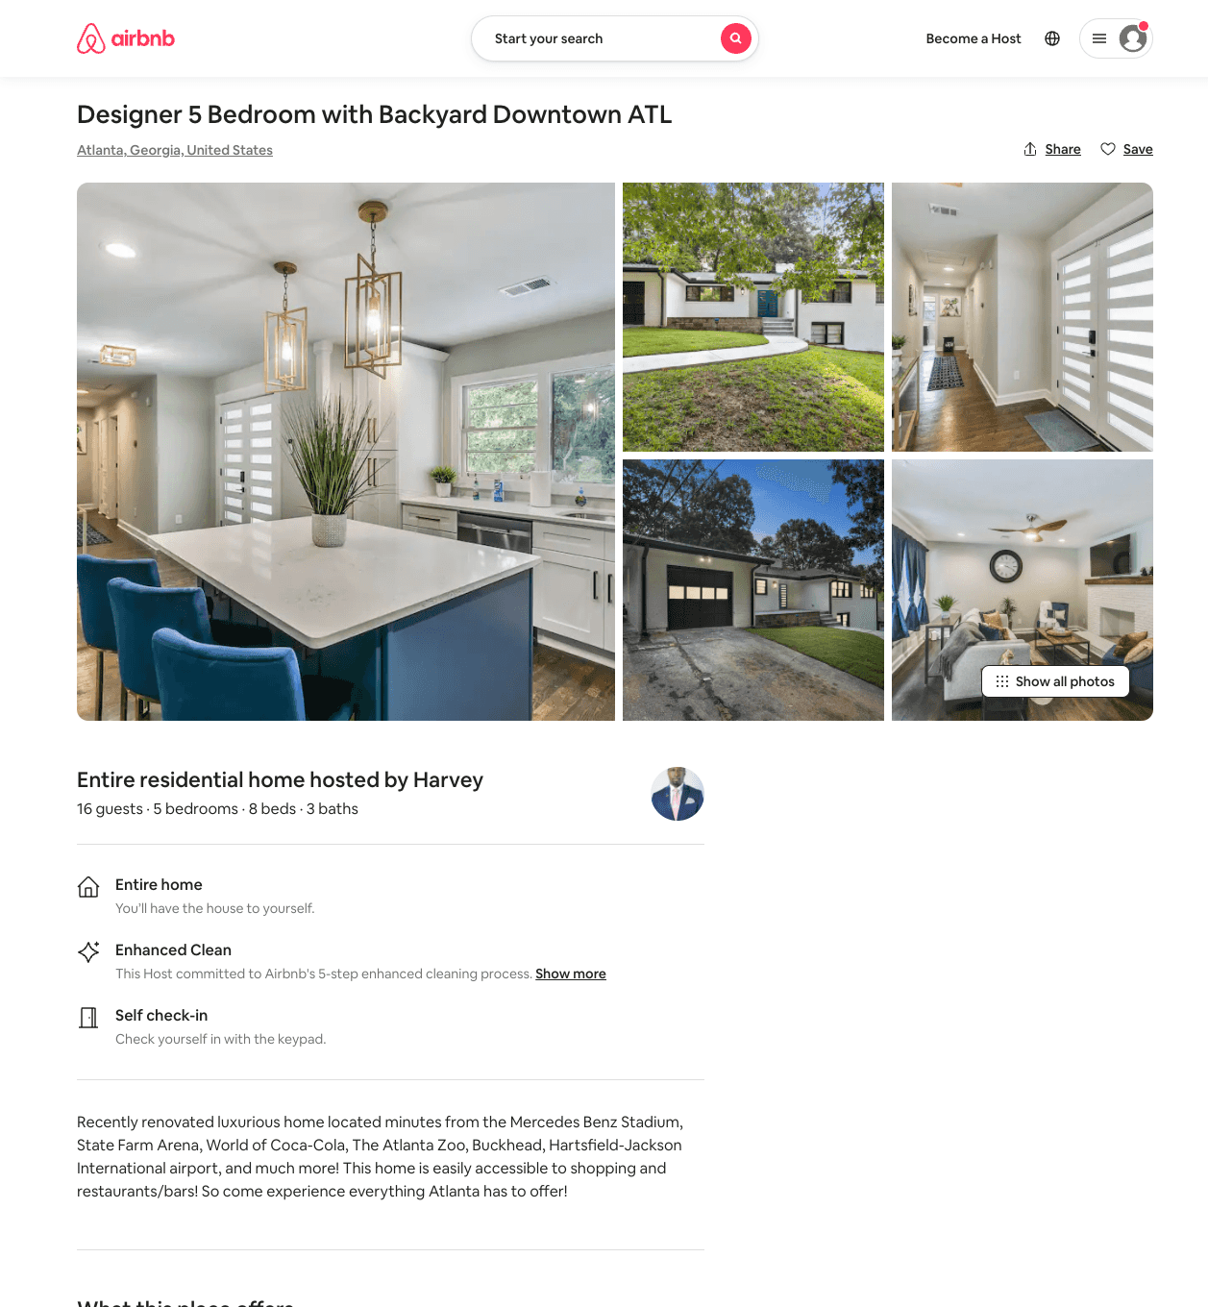
Listing 54014518
5
16
$275 - $452
5.0
4
Harvey
156339380
1
https://www.airbnb.com/rooms/54014518
Aug 2022

Slide 16
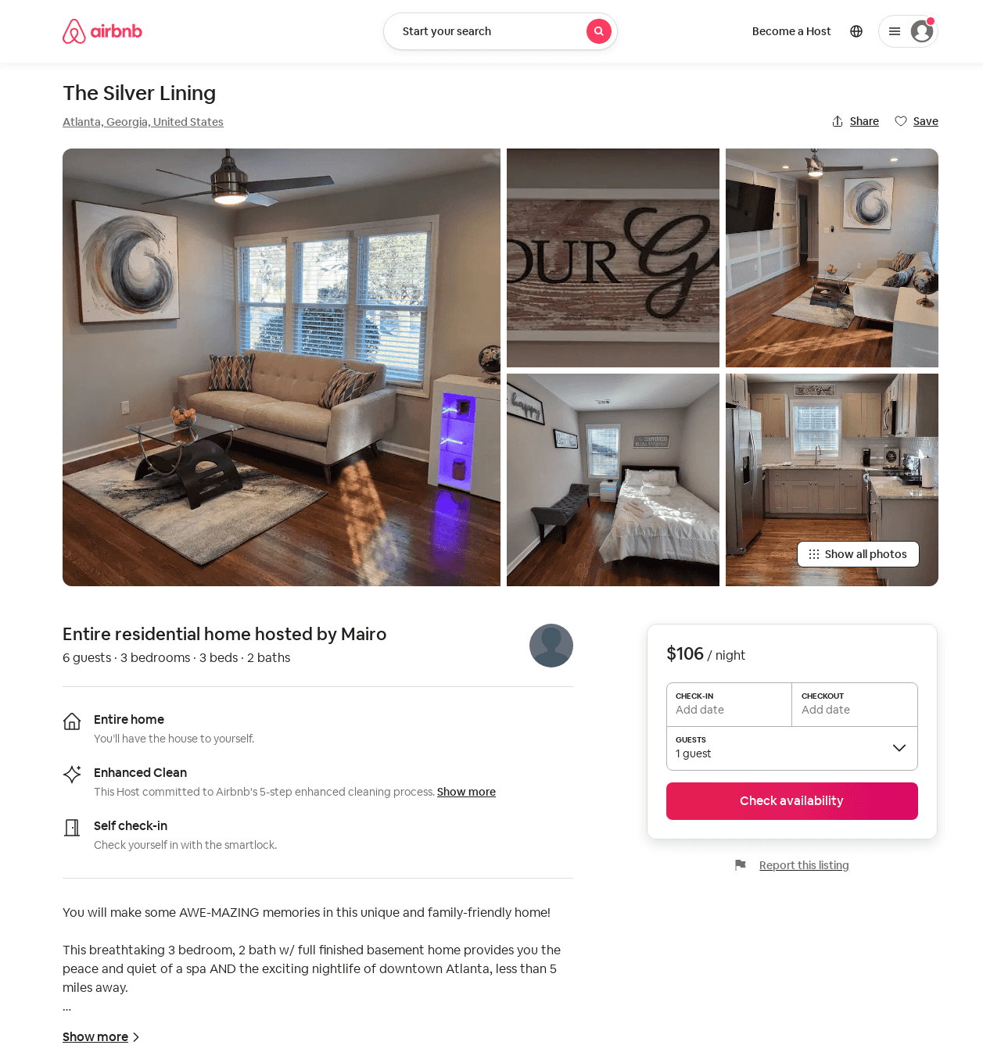
Listing 53241704
3
8
$106 - $188
4.86
1
Mairo
431044493
1
https://www.airbnb.com/rooms/53241704
Aug 2022

Slide 17
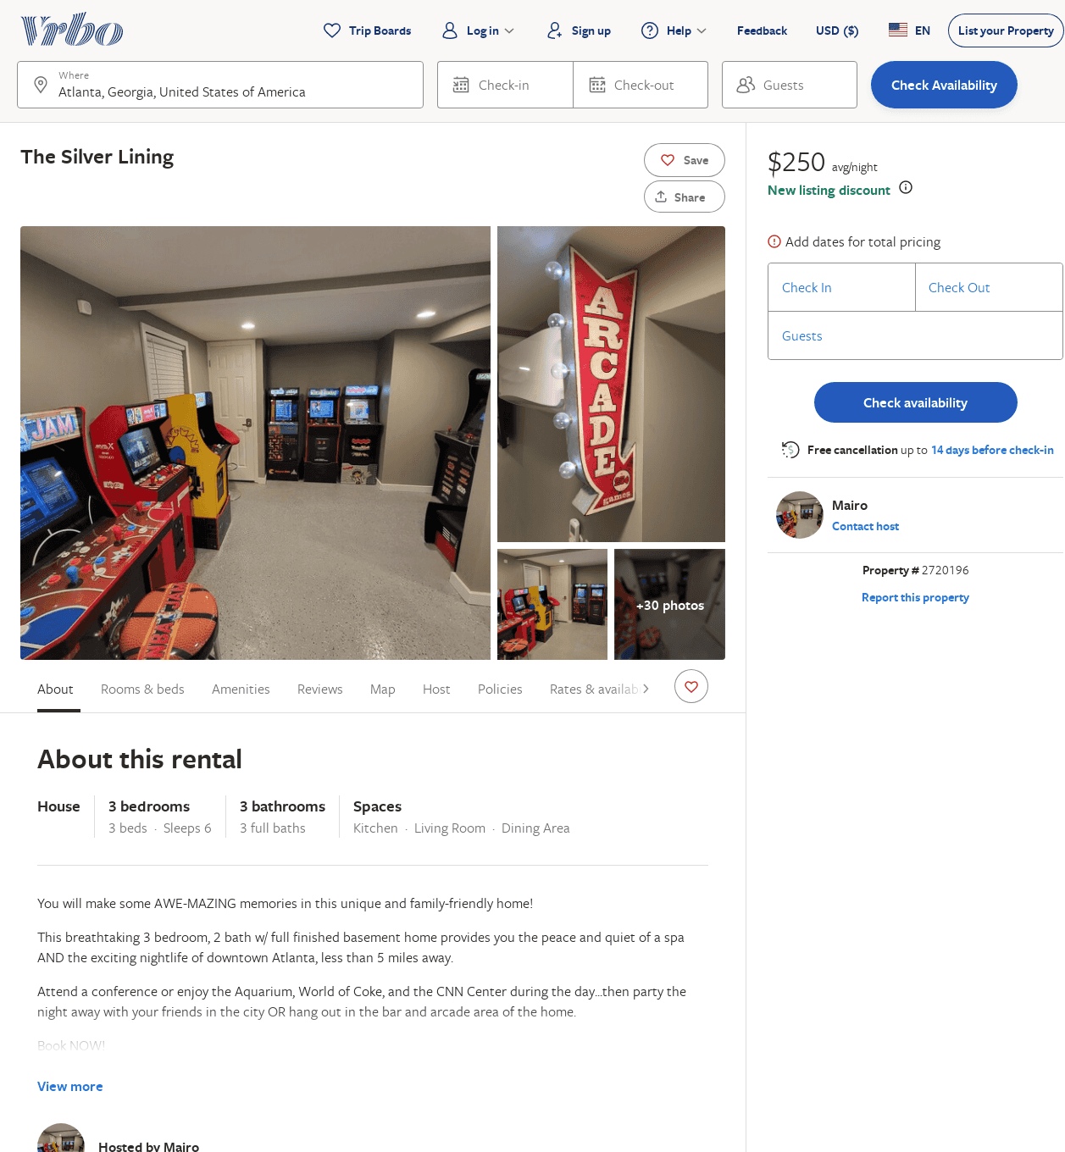
Listing 2720196
3
8
$250
2
Mairo
https://www.vrbo.com/2720196
Aug 2022

Slide 18
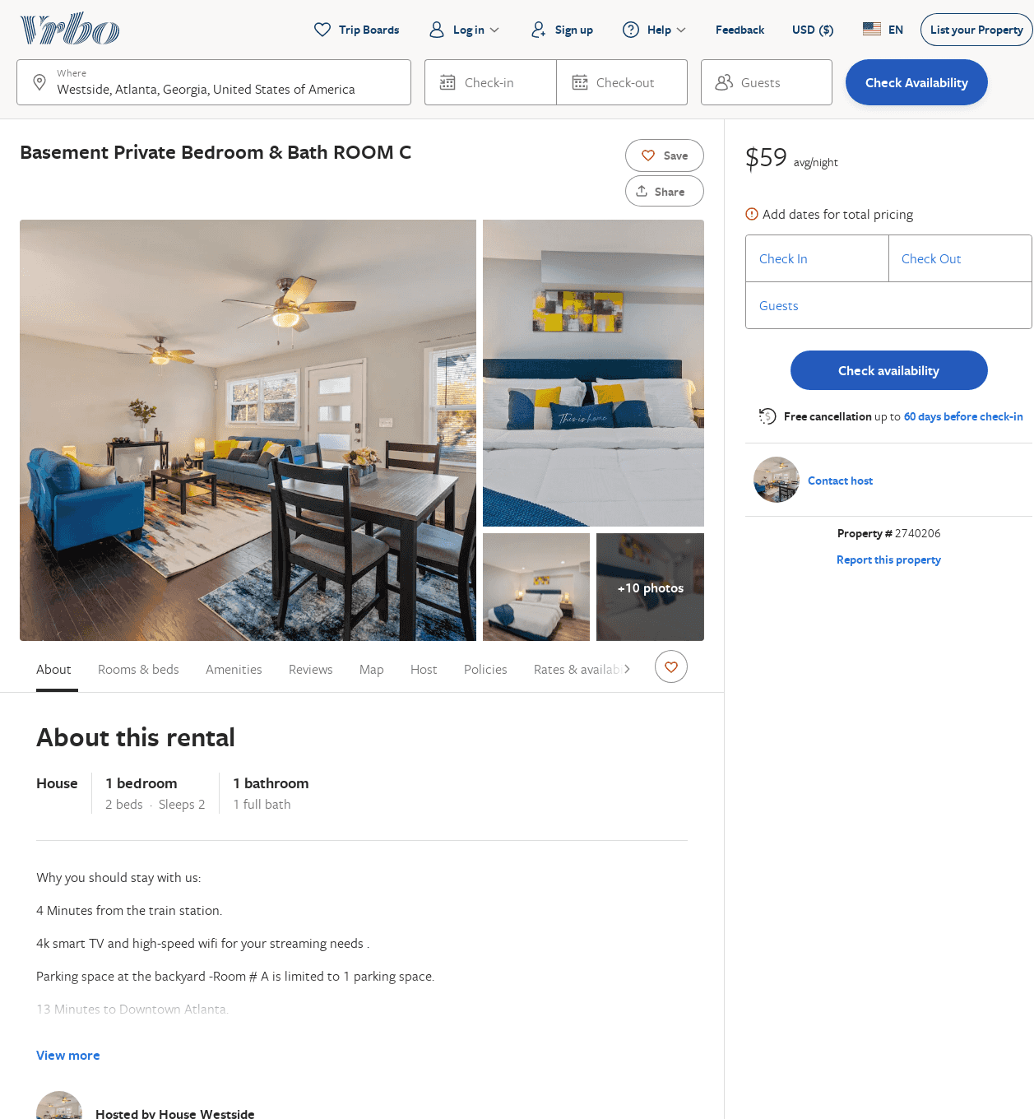
Listing 2740206
1
2
$89
5
2
ALEX
https://www.vrbo.com/2740206
Aug 2022

