Slide 2
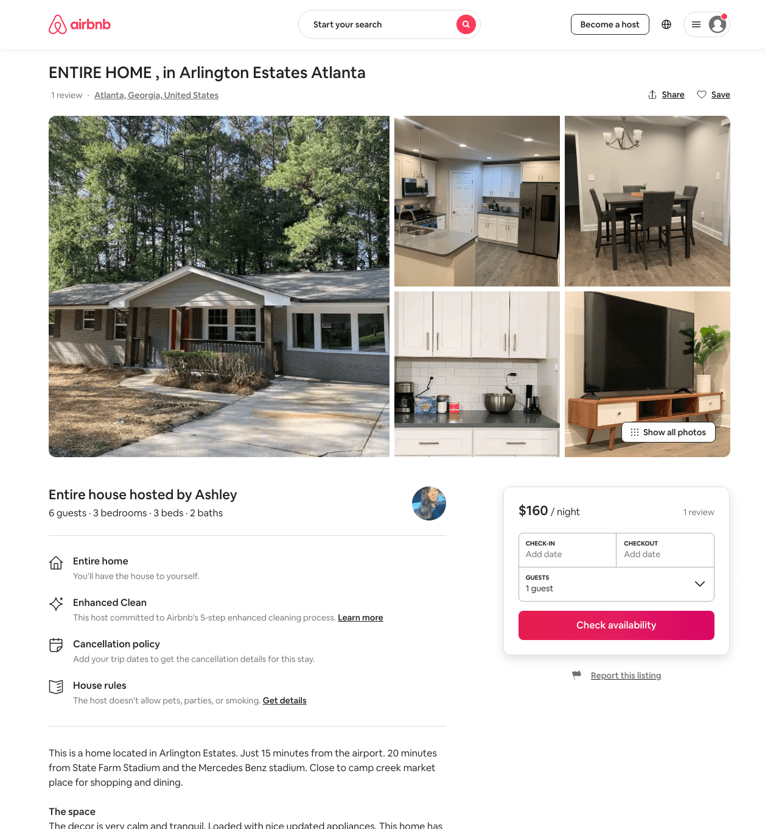
Listing 48276829
3
6
$135 - $233
4.69
1
Ashley
138017091
2
https://www.airbnb.com/rooms/48276829
Aug 2022

