Slide 2
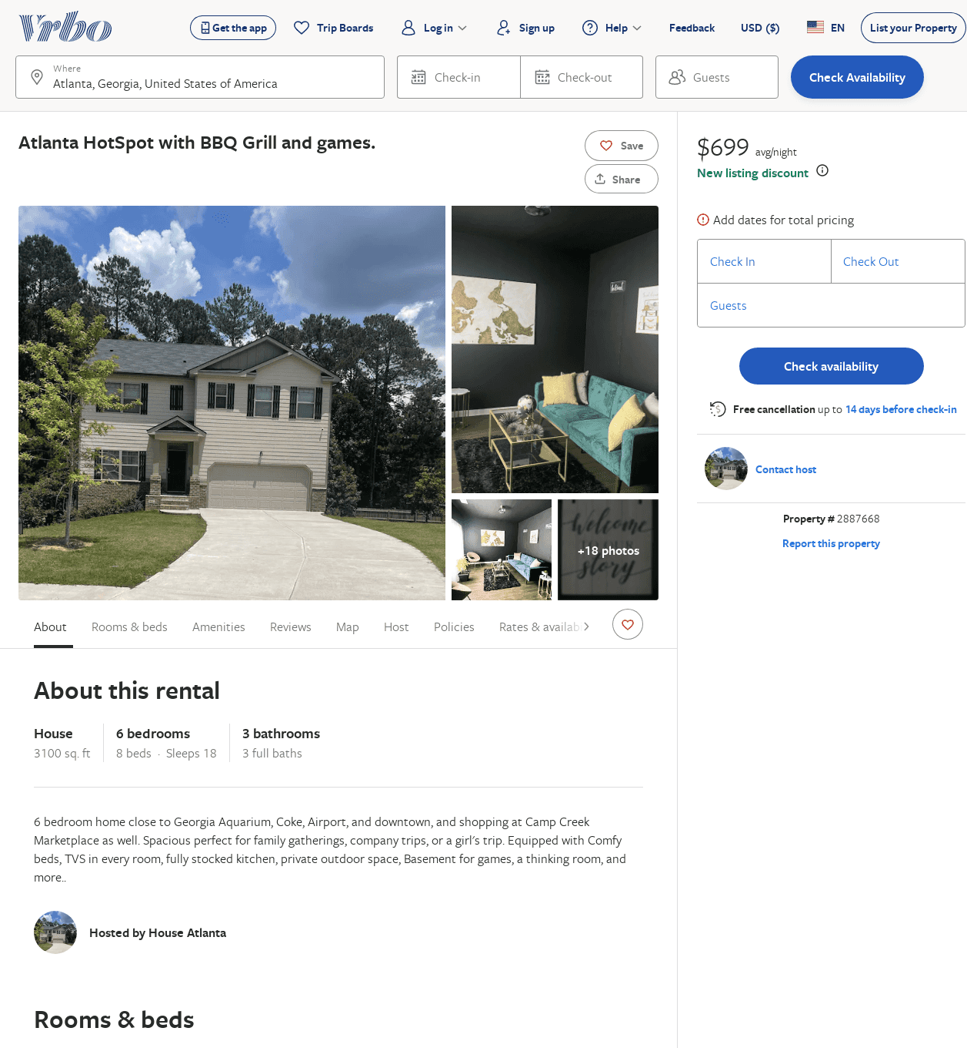
Listing 2887668
6
18
$678
5
2
https://www.vrbo.com/2887668
Aug 2022

