Slide 2
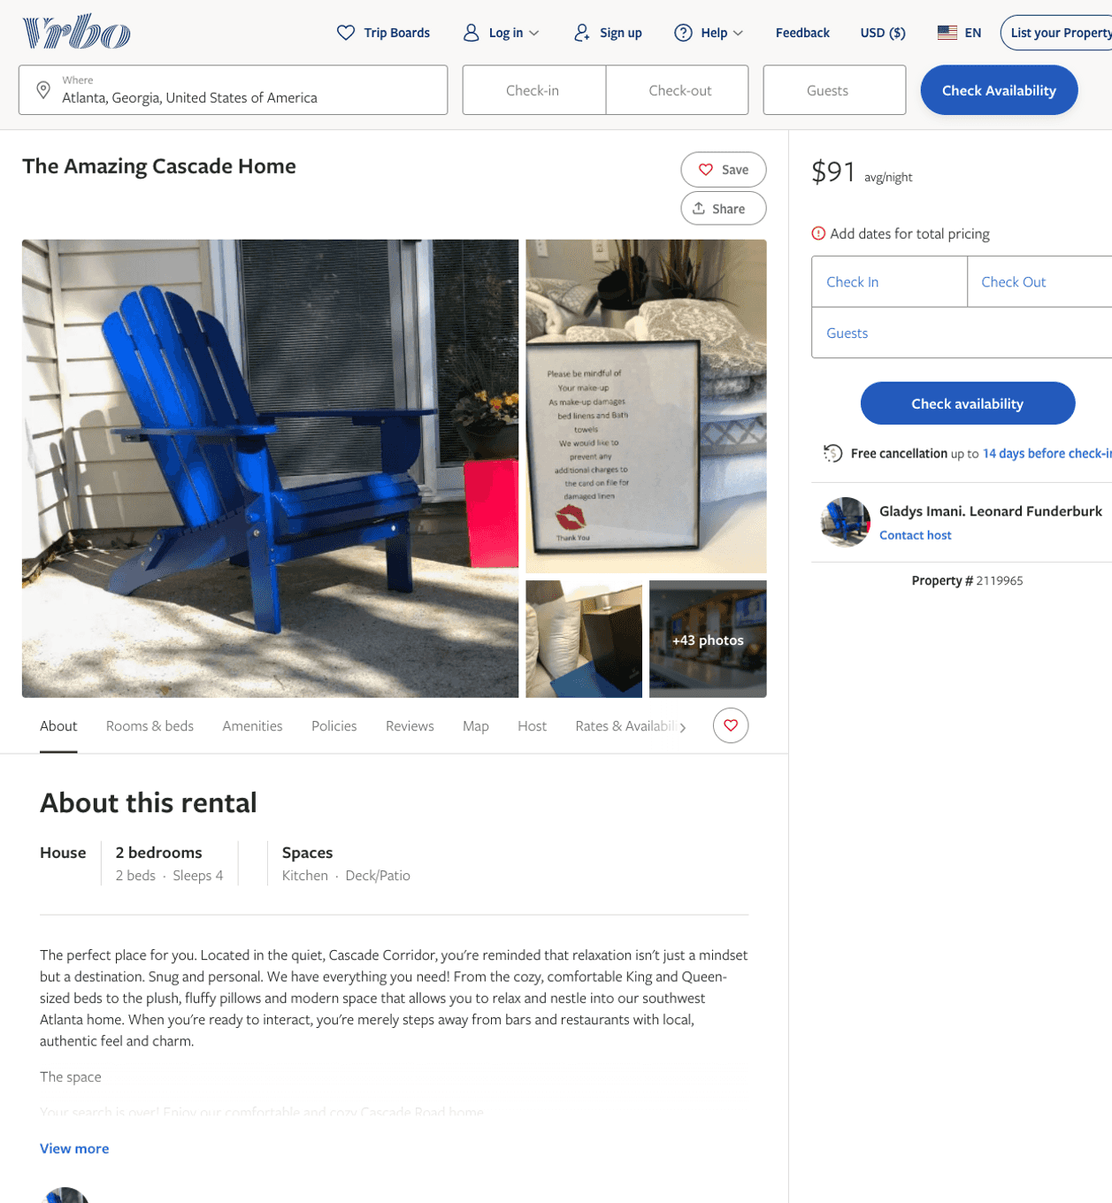
Listing 2119965
2
4
$90 - $92
3
Gladys Imani. Leonard Funderburk
https://www.vrbo.com/2119965
Aug 2022

Slide 3
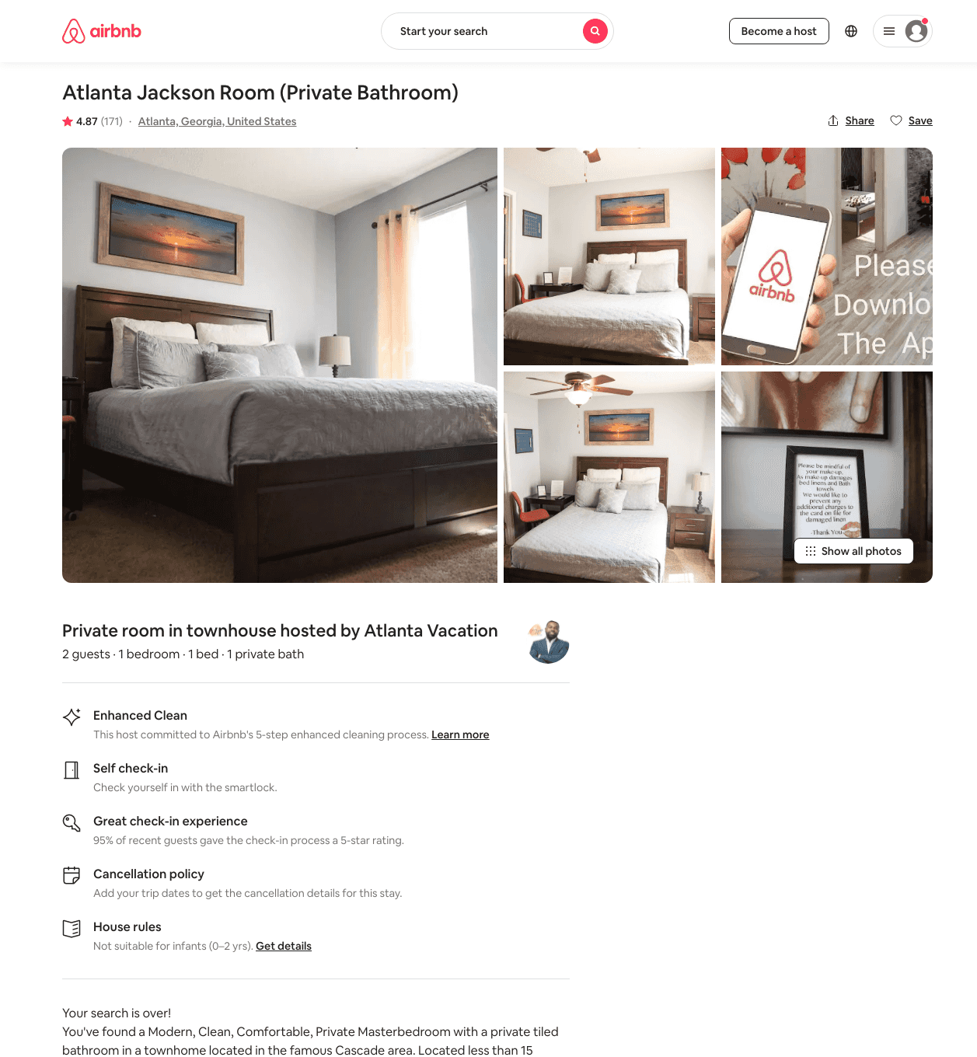
Listing 23480415
1
2
$50 - $63
4.85
2
Great Stays
22131062
4
https://www.airbnb.com/rooms/23480415
Aug 2022

Slide 4
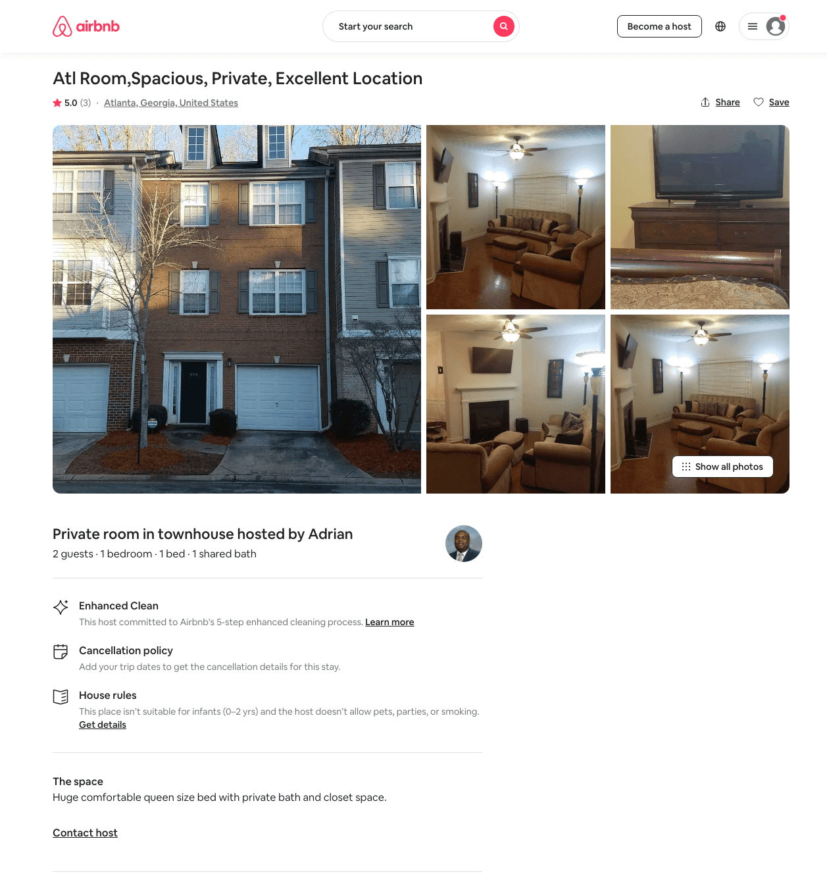
Listing 31368710
1
1
$60
5.0
2
Adrian
9369953
1
https://www.airbnb.com/rooms/31368710
Aug 2022

Slide 5
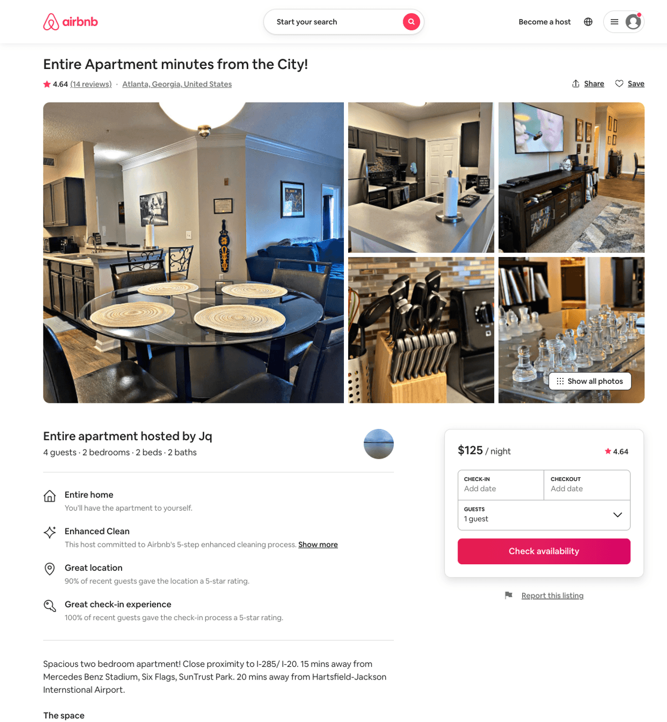
Listing 42687934
2
4
$125 - $128
4.63
2
Jq
272138597
1
https://www.airbnb.com/rooms/42687934
Aug 2022

Slide 6
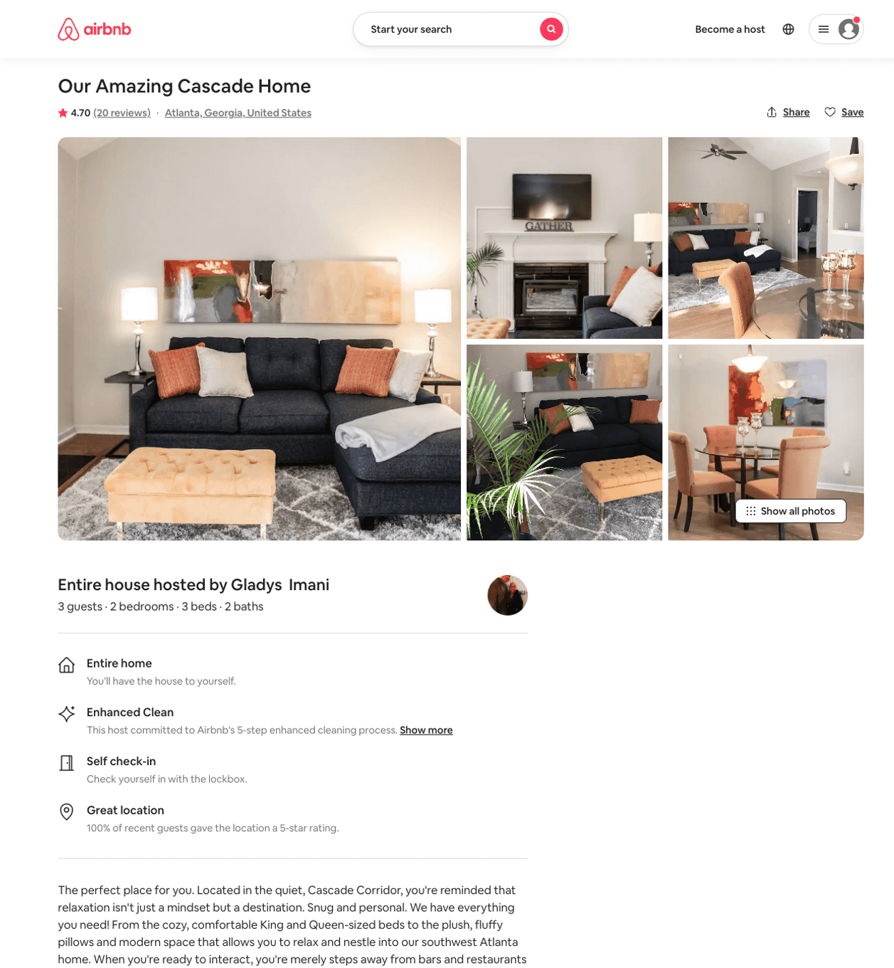
Listing 40529564
2
3
$94 - $119
4.55
3
Gladys Imani
11097394
2
https://www.airbnb.com/rooms/40529564
Aug 2022

Slide 7
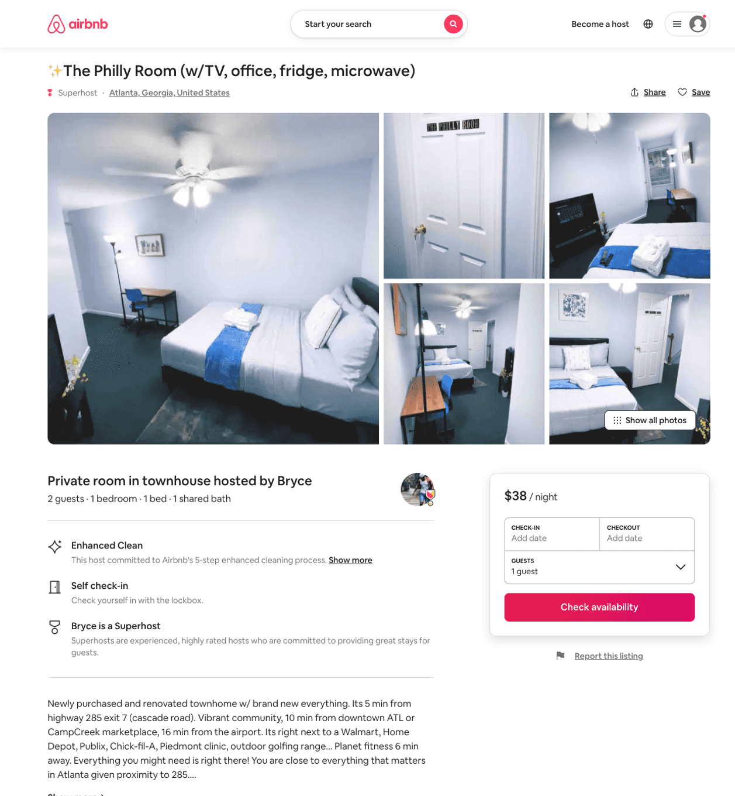
Listing 51643361
1
2
$37 - $40
4.88
1
Bold Living Solutions
233625726
7
https://www.airbnb.com/rooms/51643361
Jul 2022

Slide 8
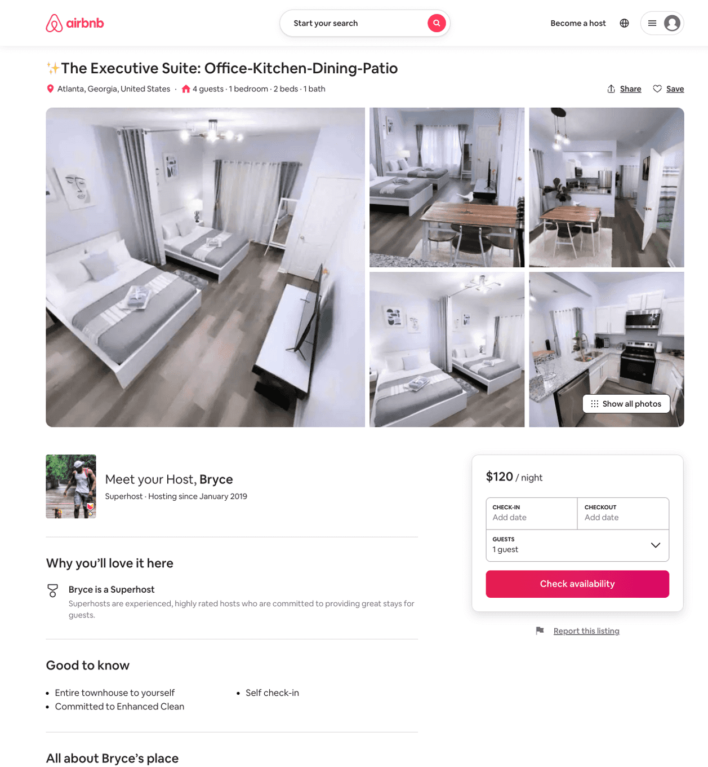
Listing 51852039
1
6
$75 - $120
4.88
1
Bold Living Solutions
233625726
7
https://www.airbnb.com/rooms/51852039
Aug 2022

Slide 9
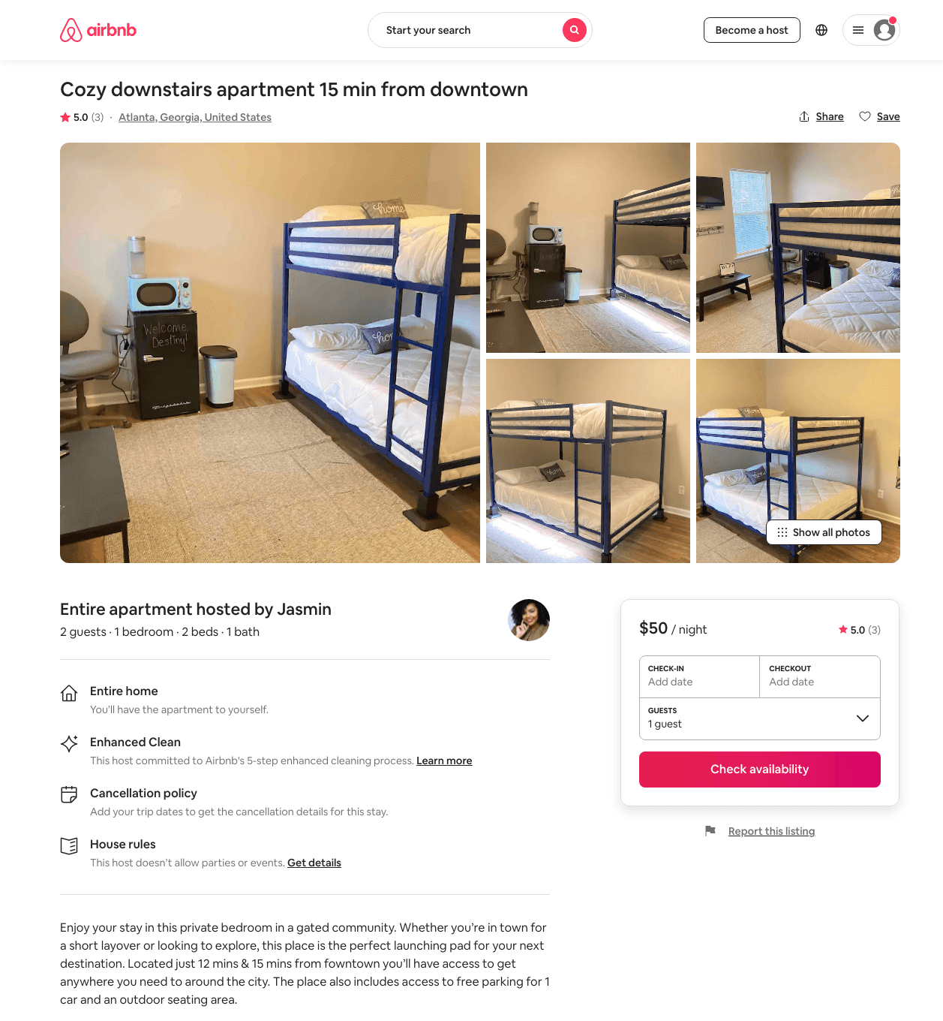
Listing 48470739
1
3
$55 - $65
4.85
2
Jasmin
391169170
1
https://www.airbnb.com/rooms/48470739
Jun 2022

Slide 10
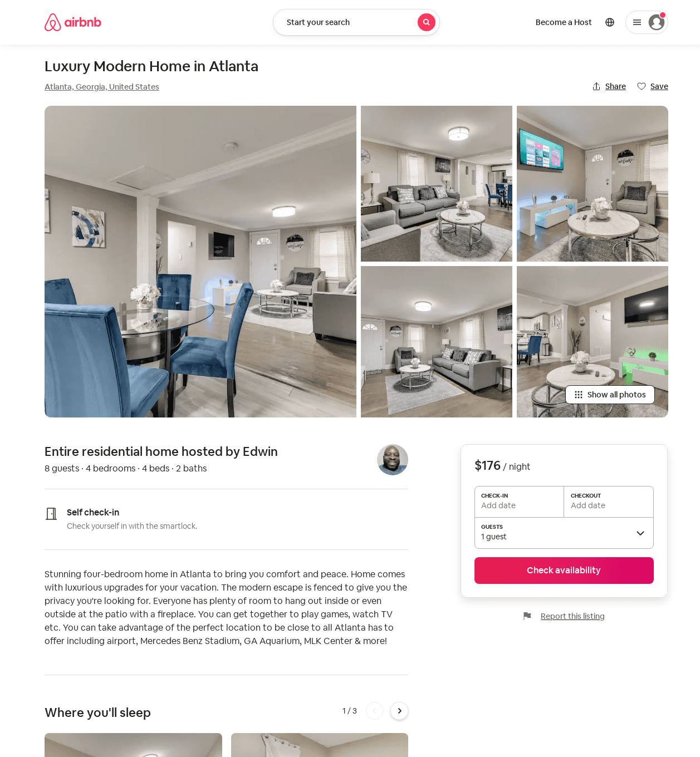
Listing 54061139
4
8
$160 - $224
4.71
2
Edwin
200764936
1
https://www.airbnb.com/rooms/54061139
Jul 2022

Slide 11
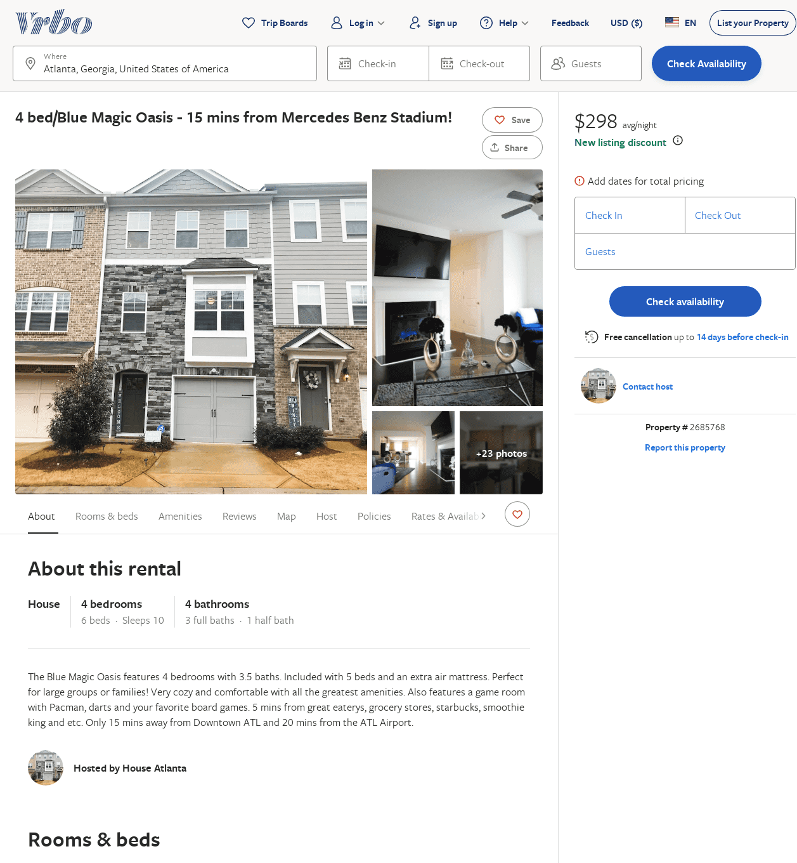
Listing 2685768
4
10
$272
4.857143
2
https://www.vrbo.com/2685768
Aug 2022

Slide 12
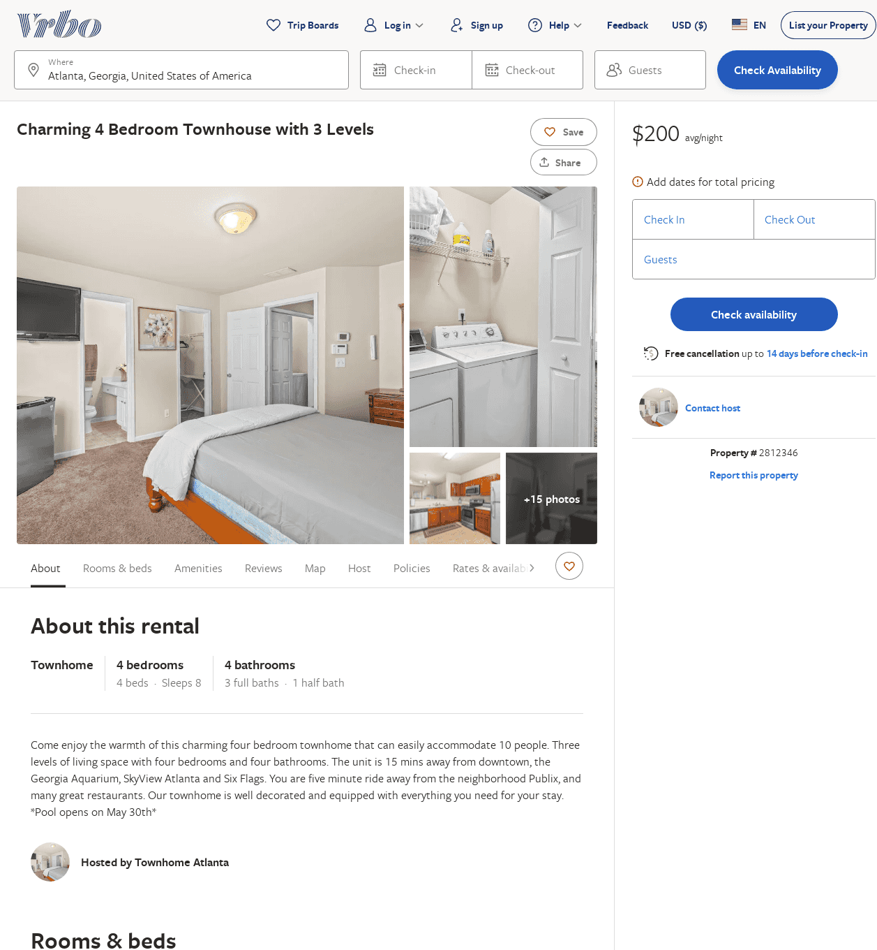
Listing 2812346
4
8
$200
4
2
https://www.vrbo.com/2812346
Aug 2022

Slide 13
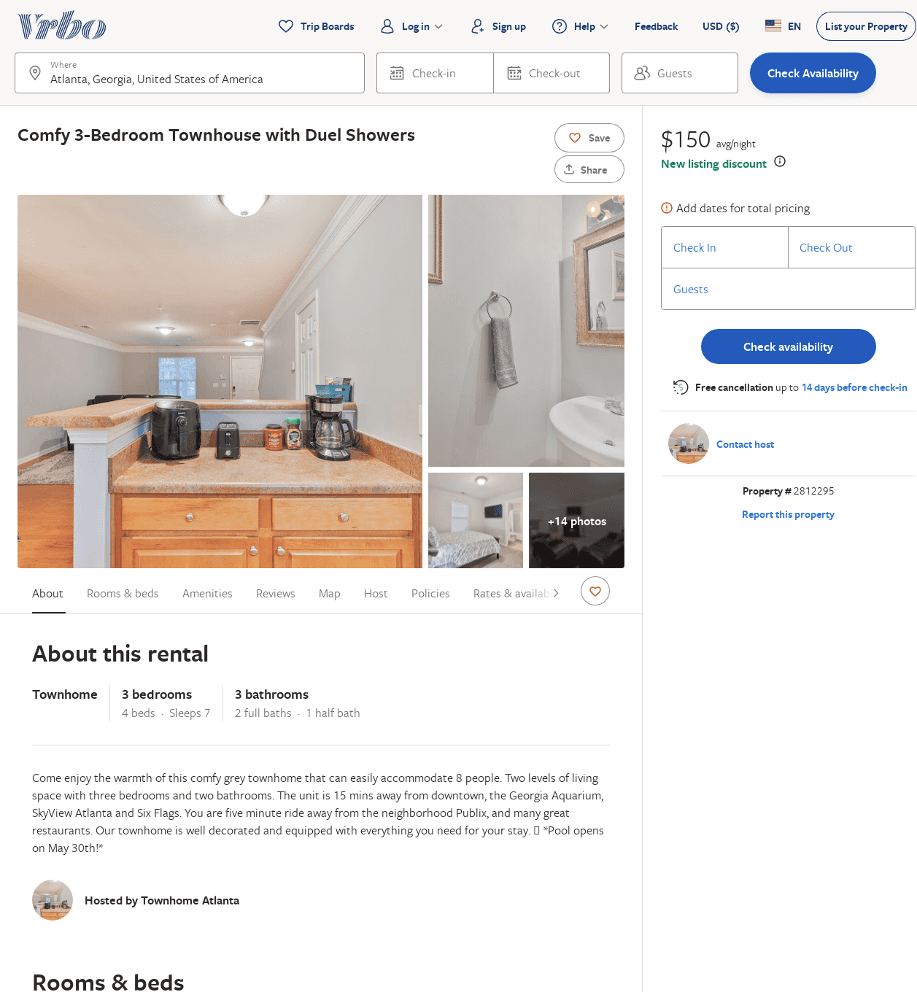
Listing 2812295
3
7
$150
5
2
https://www.vrbo.com/2812295
Aug 2022

