Slide 2
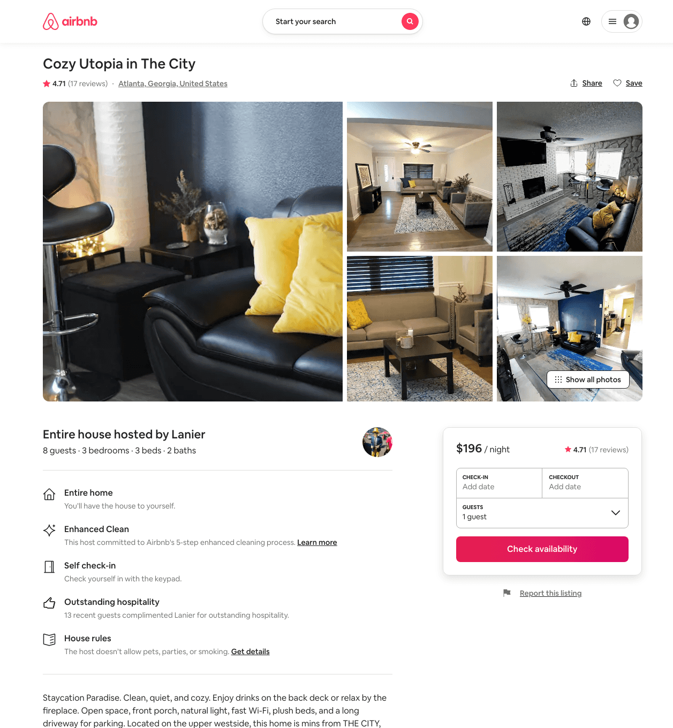
Listing 45740229
3
6
$196 - $264
4.55
2
Lanier
234598098
1
https://www.airbnb.com/rooms/45740229
Jun 2022

Slide 3
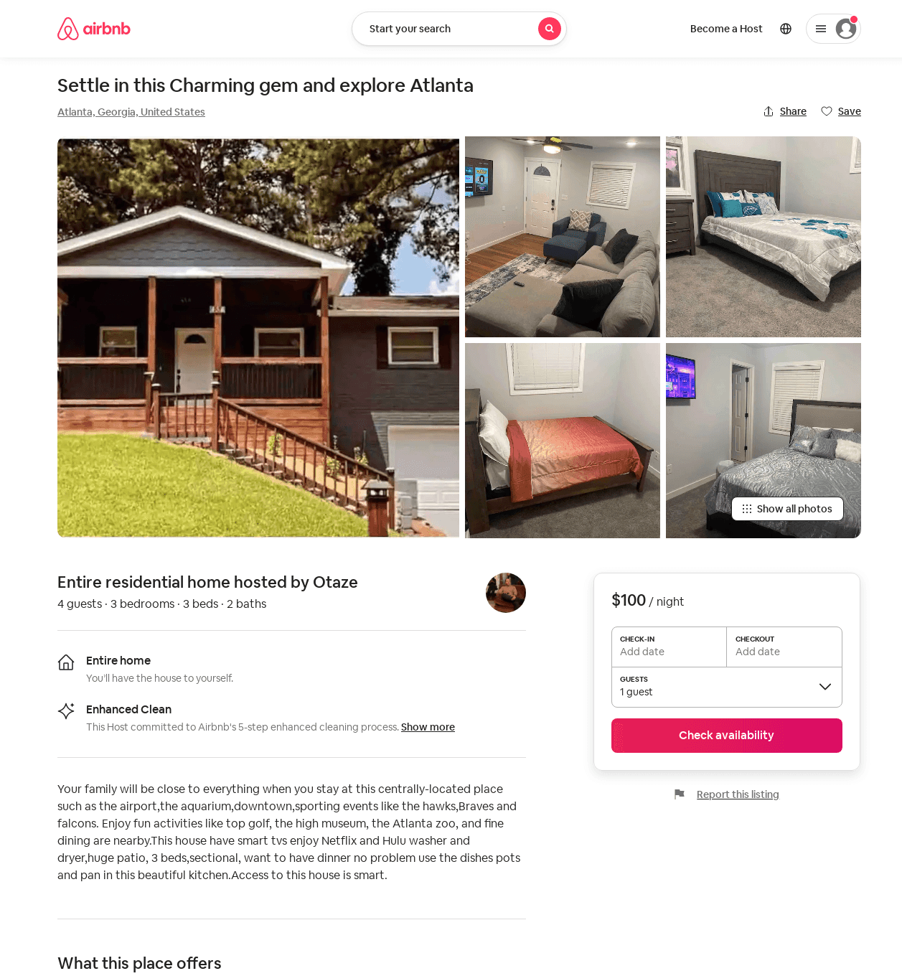
Listing 53647078
3
4
$80 - $115
4.52
3
Otaze
77366435
1
https://www.airbnb.com/rooms/53647078
Aug 2022

