Slide 2
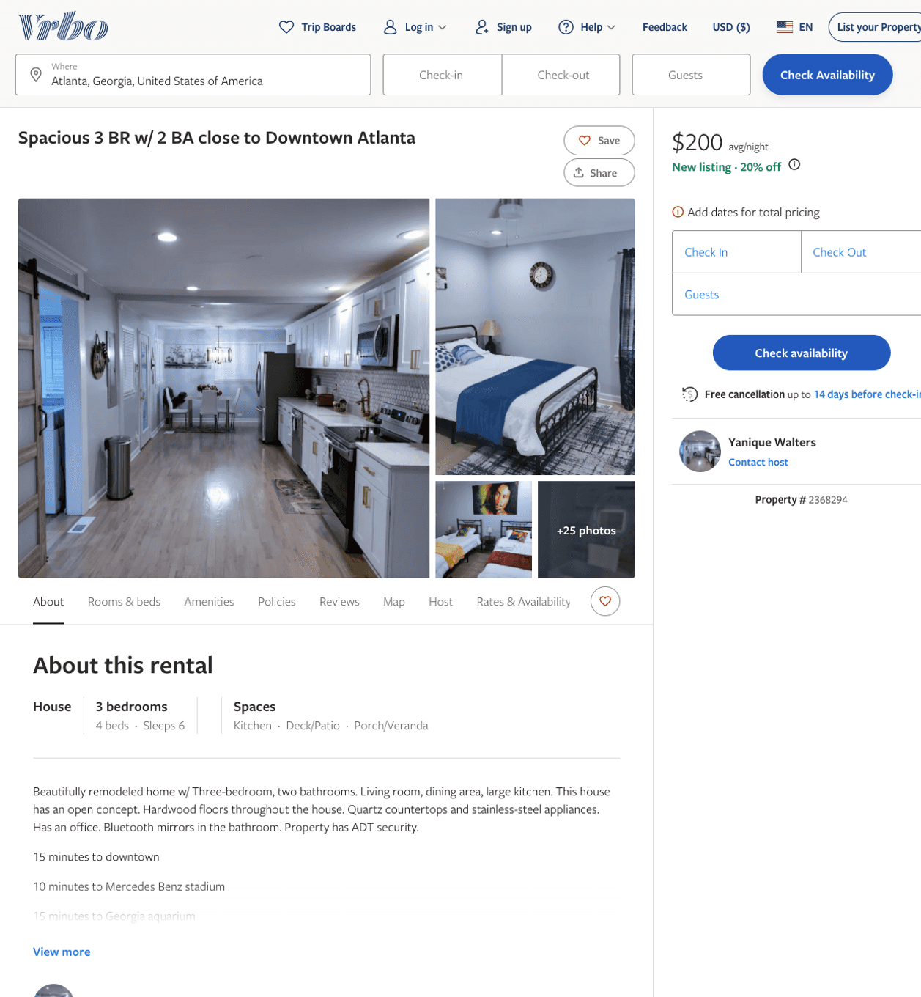
Listing 2368294
3
6
$180 - $200
2
Yanique Walters
https://www.vrbo.com/2368294
Aug 2022

