Slide 2
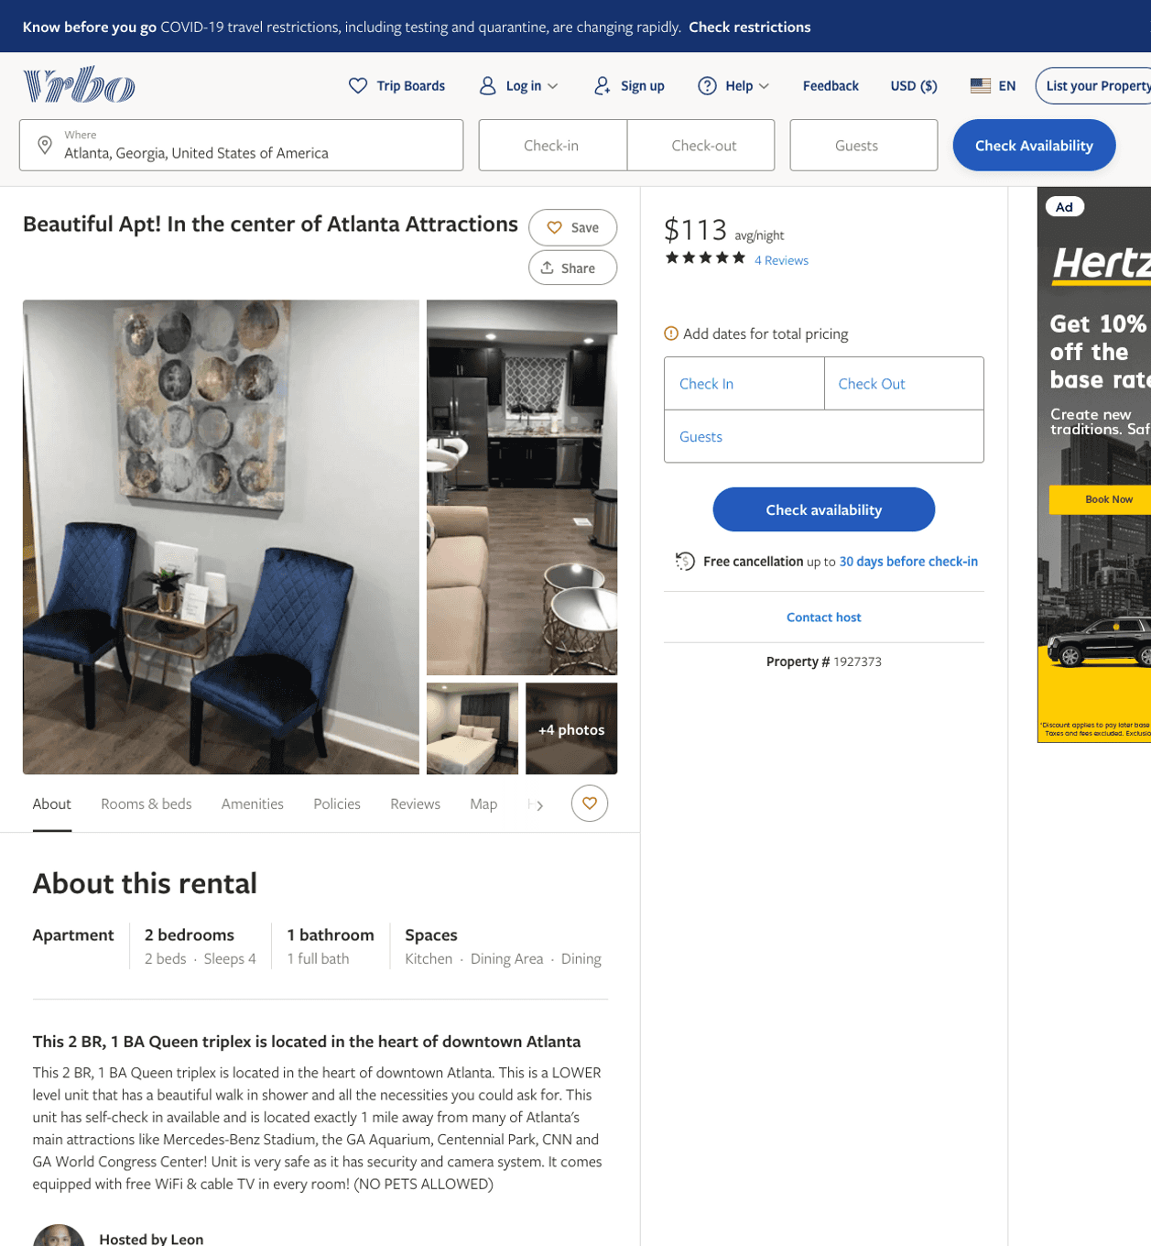
Listing 1927373
810 FOX ST NW
2
4
$100 - $137
5
1
Leon
https://www.vrbo.com/1927373
Aug 2022

Slide 3
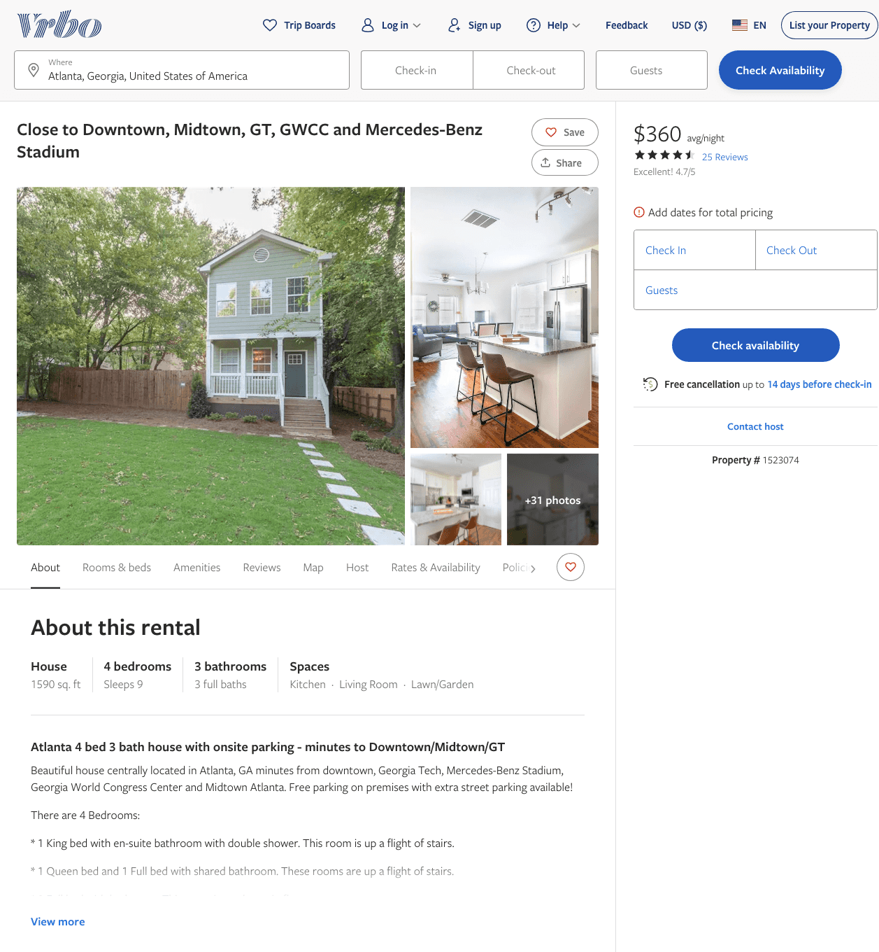
Listing 1523074
4
9
$235 - $392
4.7
3
Matt Harrison
https://www.vrbo.com/1523074
Aug 2022

Slide 4
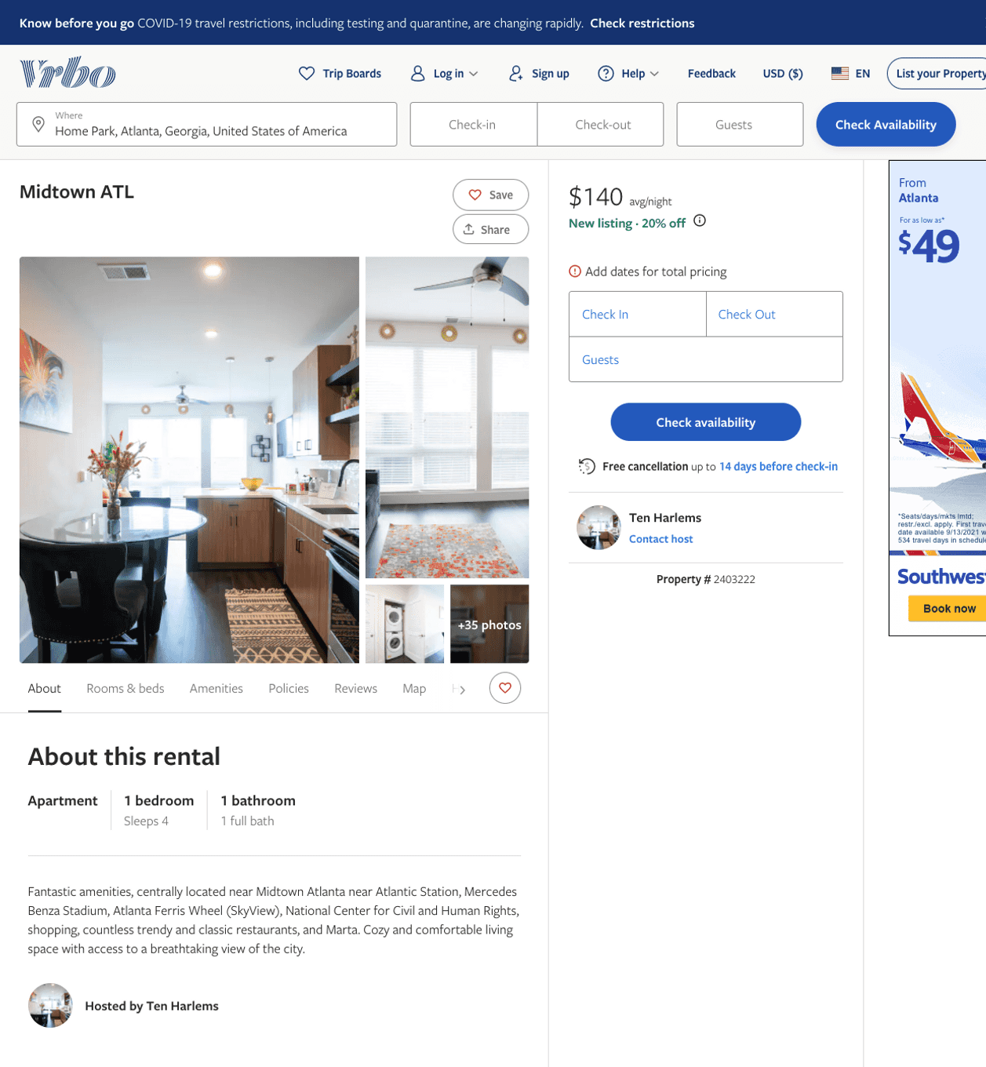
Listing 2403222
1
4
$115 - $140
1
Ten Harlems
https://www.vrbo.com/2403222
Aug 2022

Slide 5
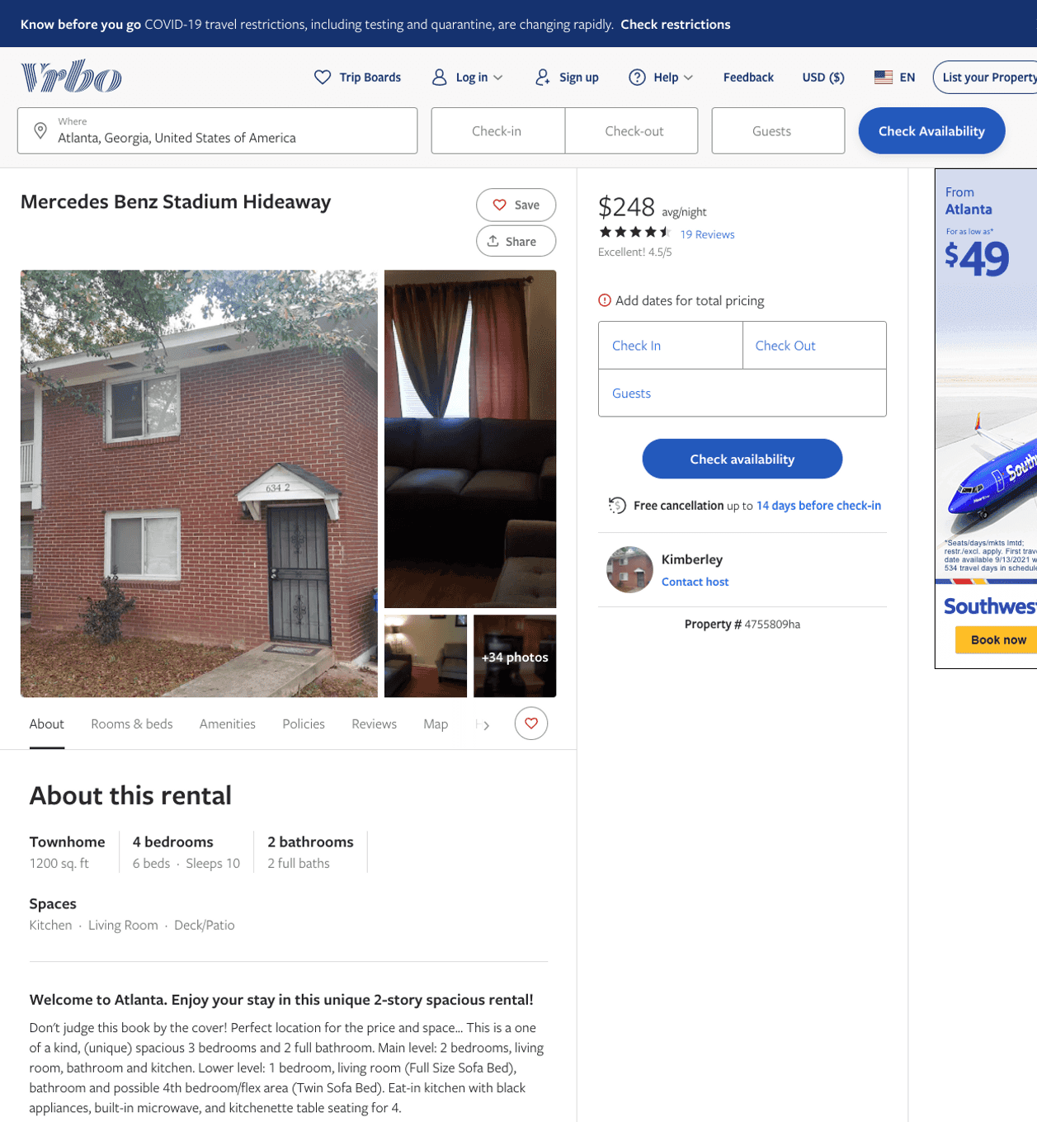
Listing 4755809
4
10
$219 - $238
4.55
2
Kimberley
https://www.vrbo.com/4755809ha
Aug 2022

Slide 6
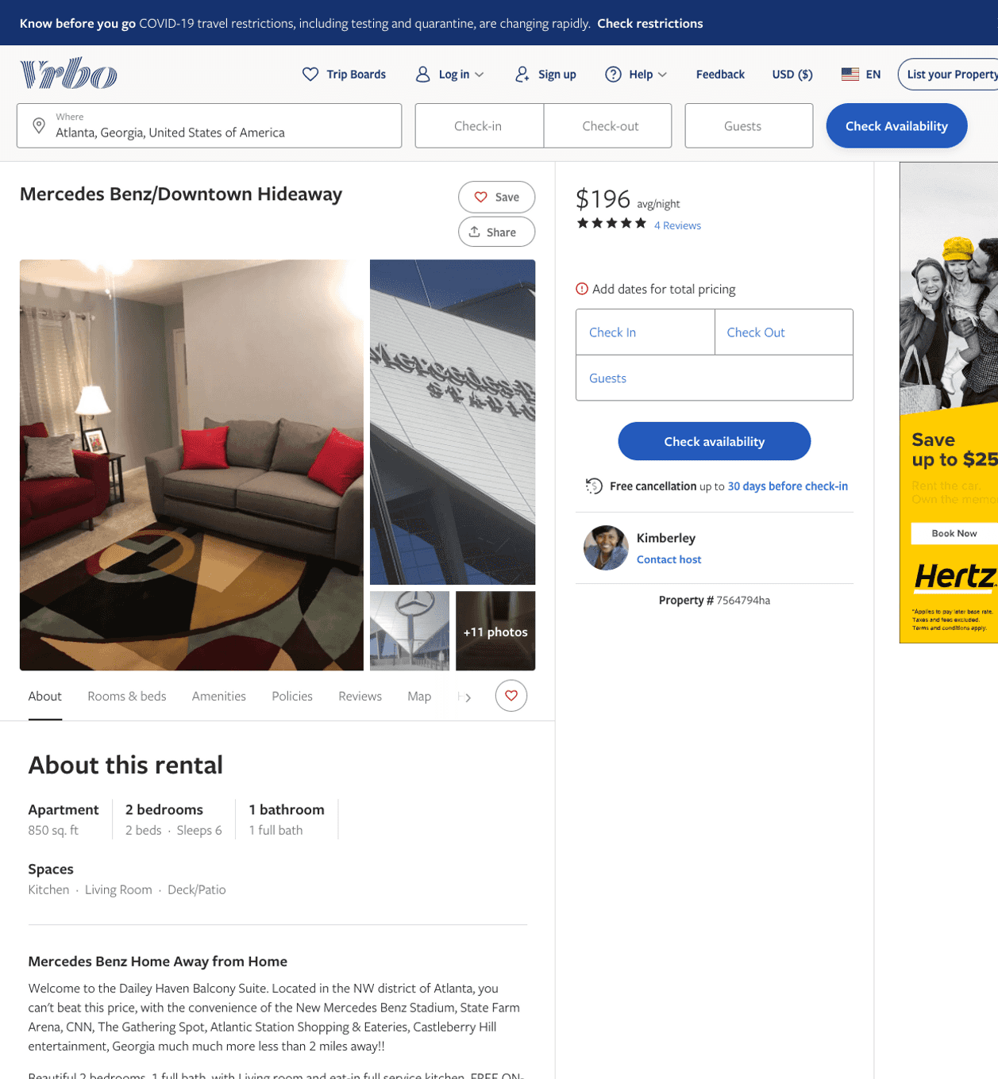
Listing 7564794
2
6
$188 - $207
5
2
Kimberley
https://www.vrbo.com/7564794ha
Aug 2022

Slide 7
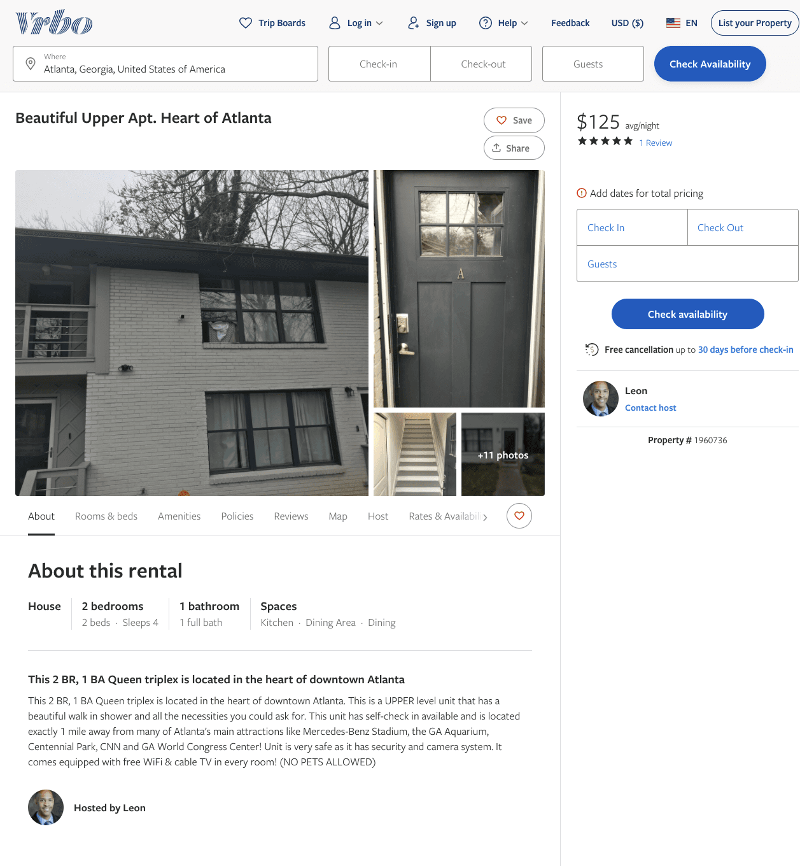
Listing 1960736
2
4
$125 - $138
5
2
Leon
https://www.vrbo.com/1960736
Aug 2022

Slide 8
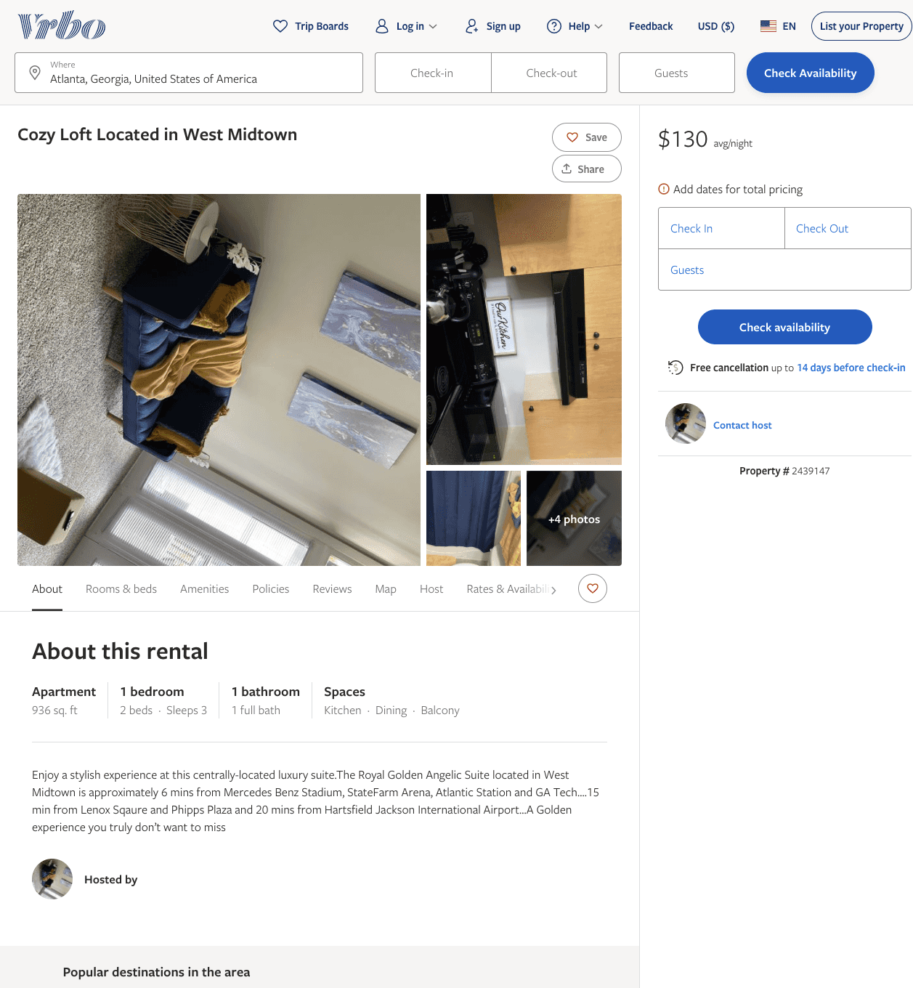
Listing 2439147
1
3
$128 - $150
2
https://www.vrbo.com/2439147
Aug 2022

Slide 9
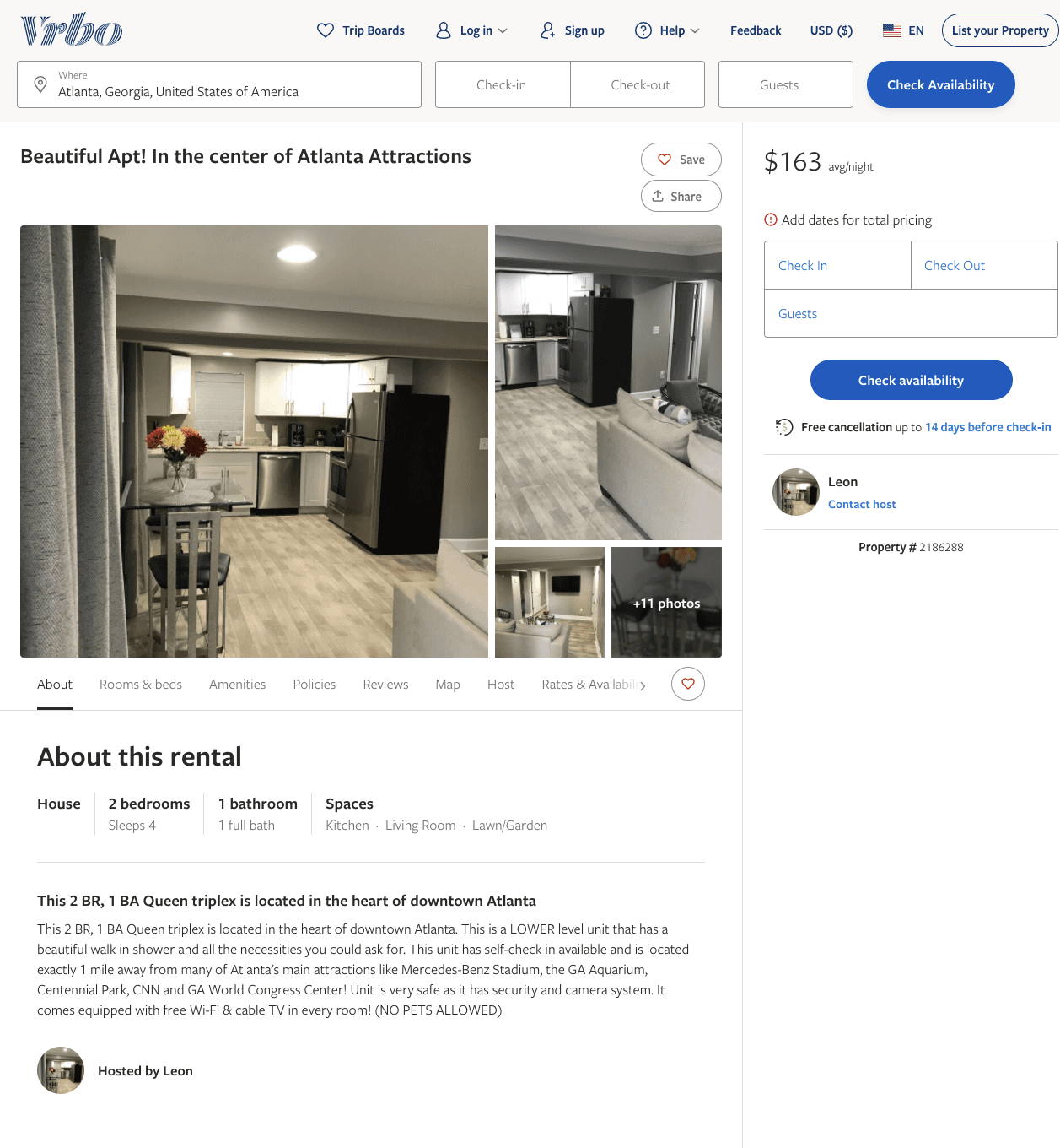
Listing 2186288
2
4
$100 - $167
2
Leon
https://www.vrbo.com/2186288
Aug 2022

Slide 10
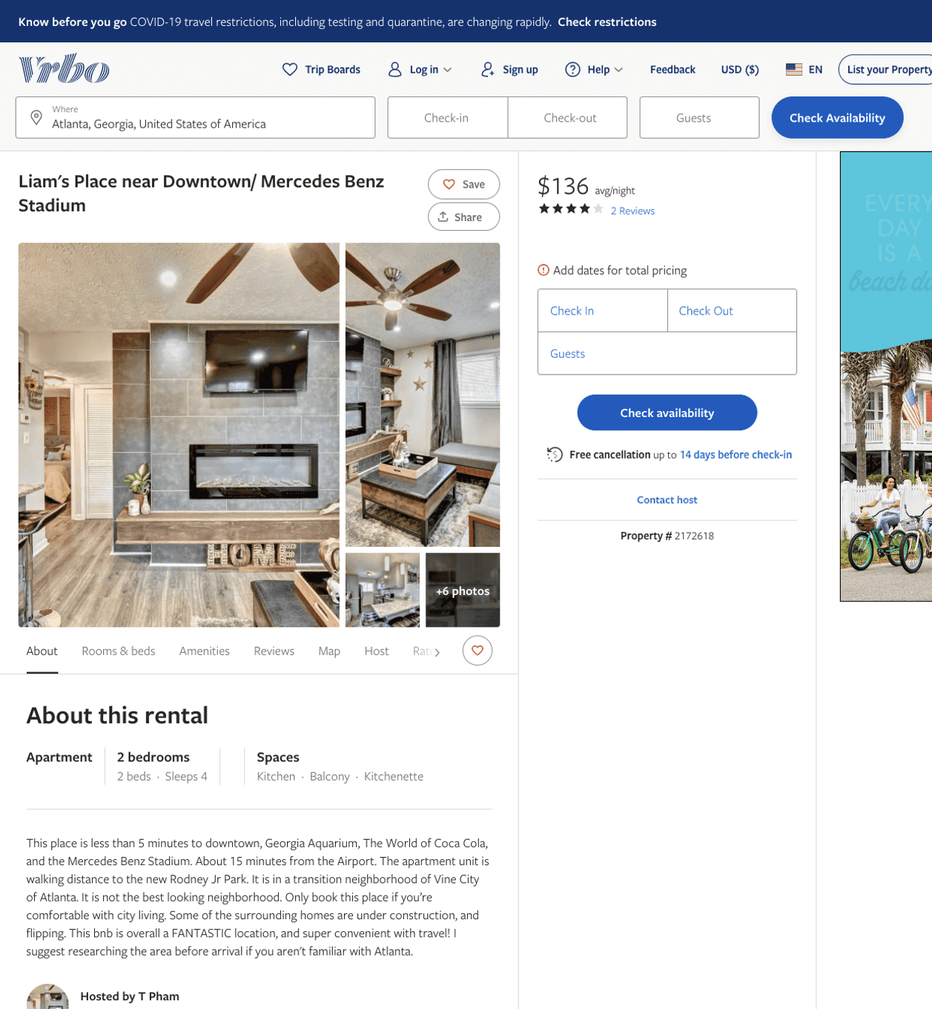
Listing 2172618
2
4
$107 - $136
3.625
2
T Pham
https://www.vrbo.com/2172618
Aug 2022

Slide 11
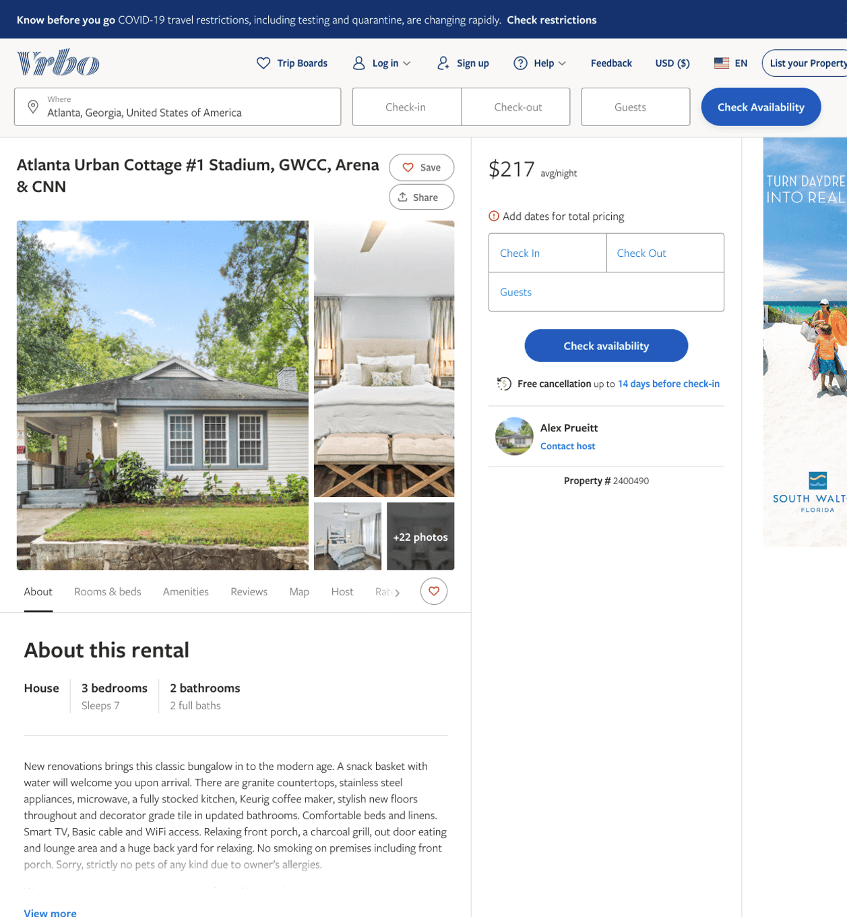
Listing 2400490
3
7
$217 - $219
4
3
Alex Prueitt
https://www.vrbo.com/2400490
Aug 2022

Slide 12
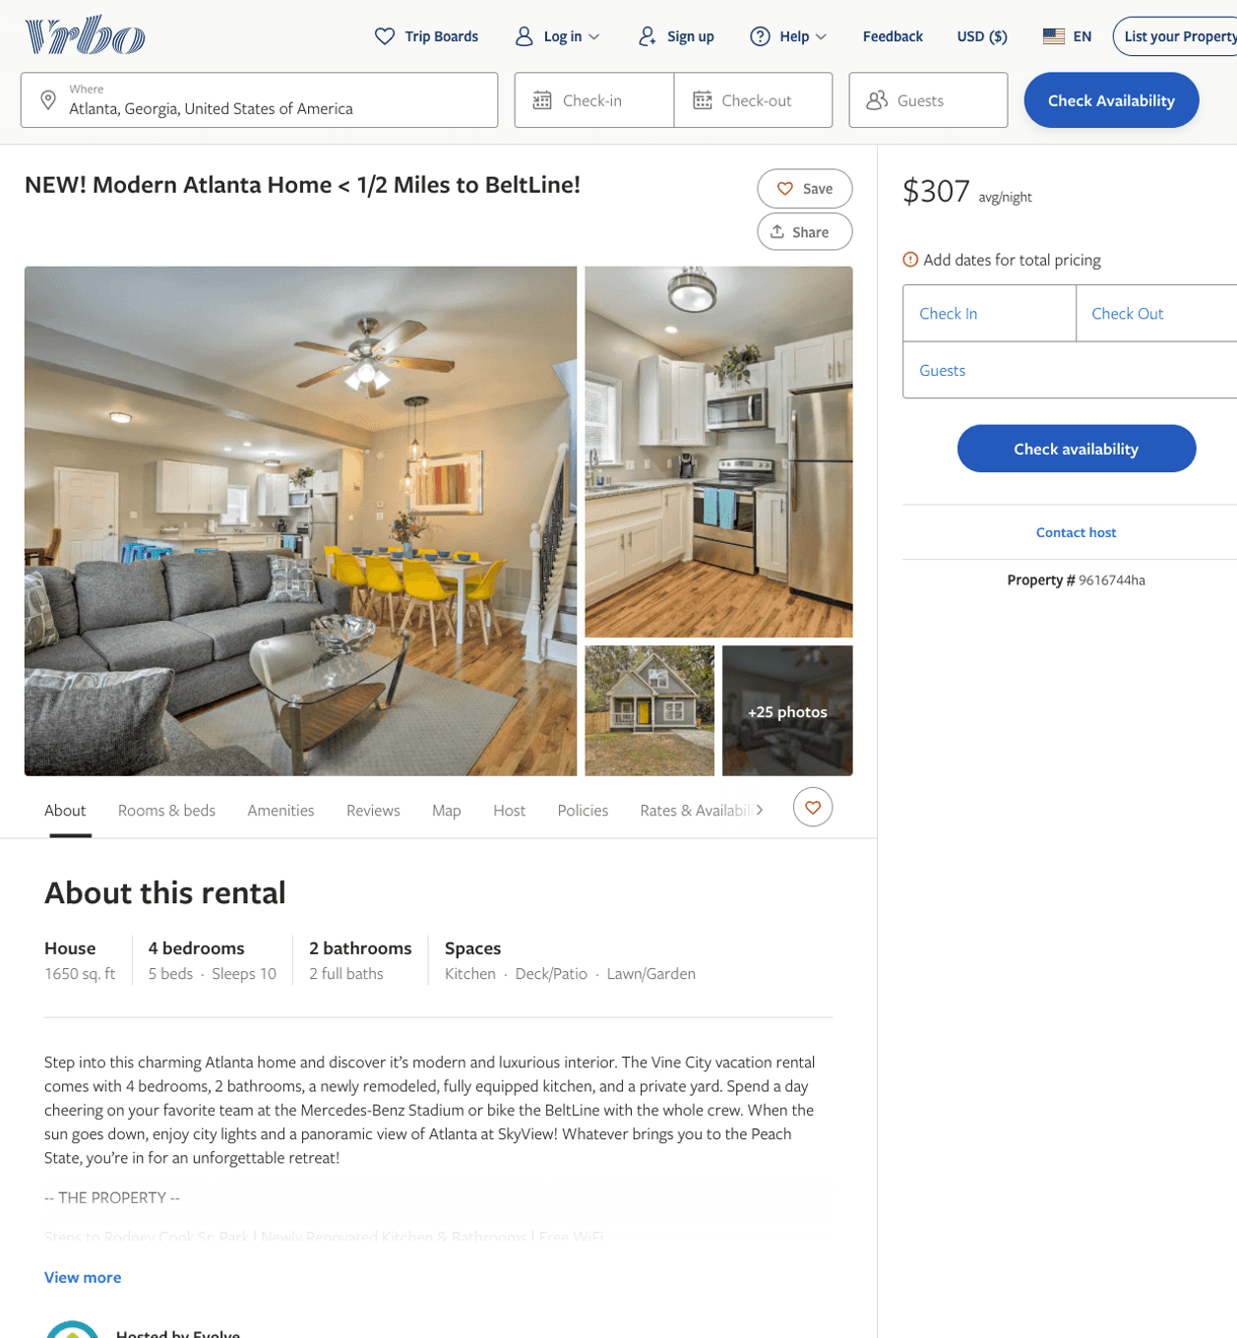
Listing 9616744
4
10
$248 - $355
4.6666665
2
Evolve
https://www.vrbo.com/9616744ha
Aug 2022

Slide 13
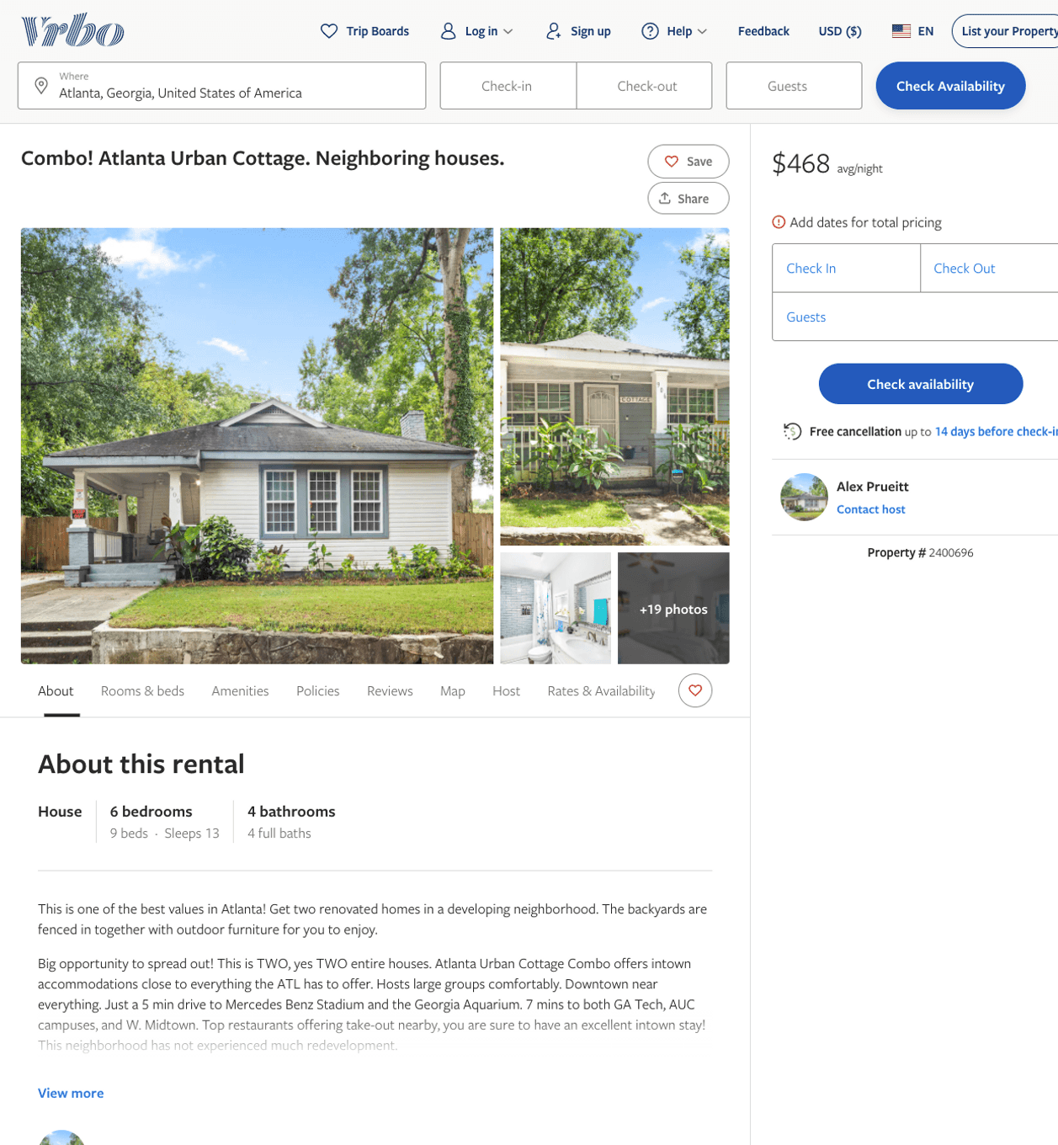
Listing 2400696
6
13
$433 - $483
4
3
Alex Prueitt
https://www.vrbo.com/2400696
Aug 2022

Slide 14
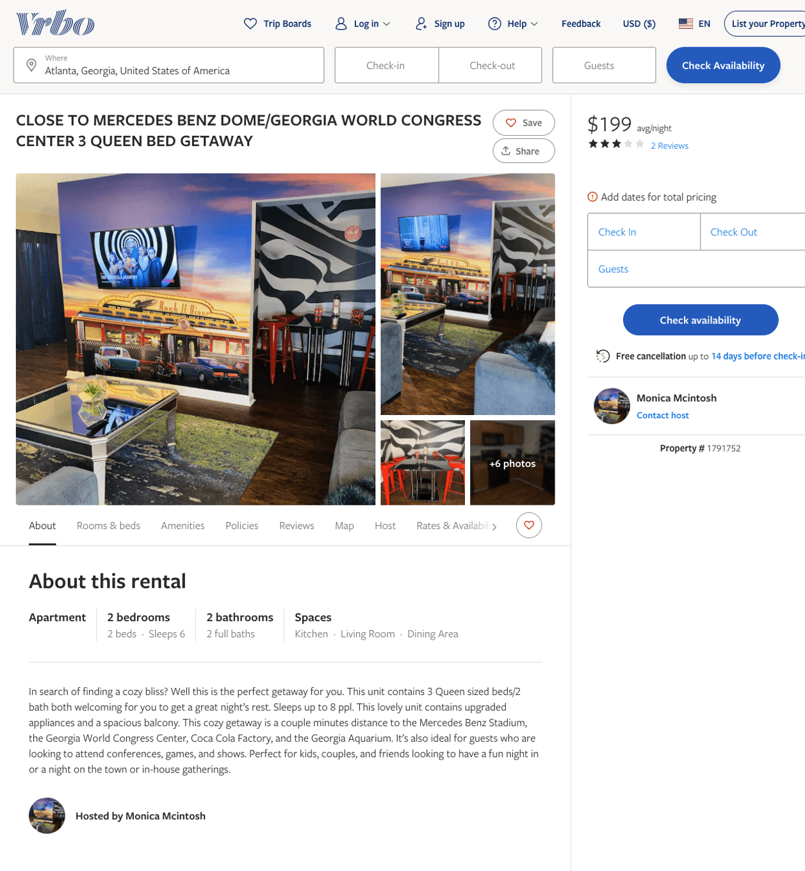
Listing 1791752
2
6
$179 - $199
3
1
Monica Mcintosh
https://www.vrbo.com/1791752
Aug 2022

Slide 15
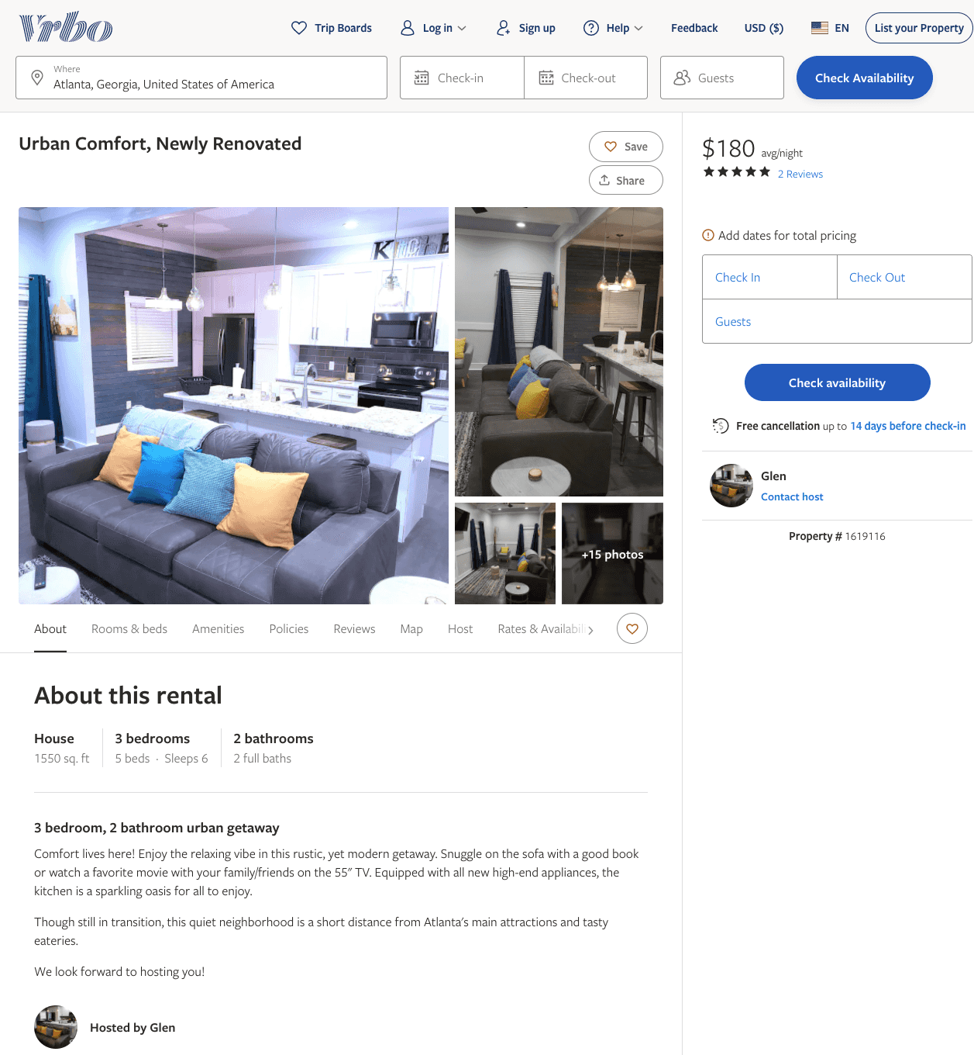
Listing 1619116
3
6
$180 - $478
5
1
Glen
https://www.vrbo.com/1619116
Aug 2022

Slide 16
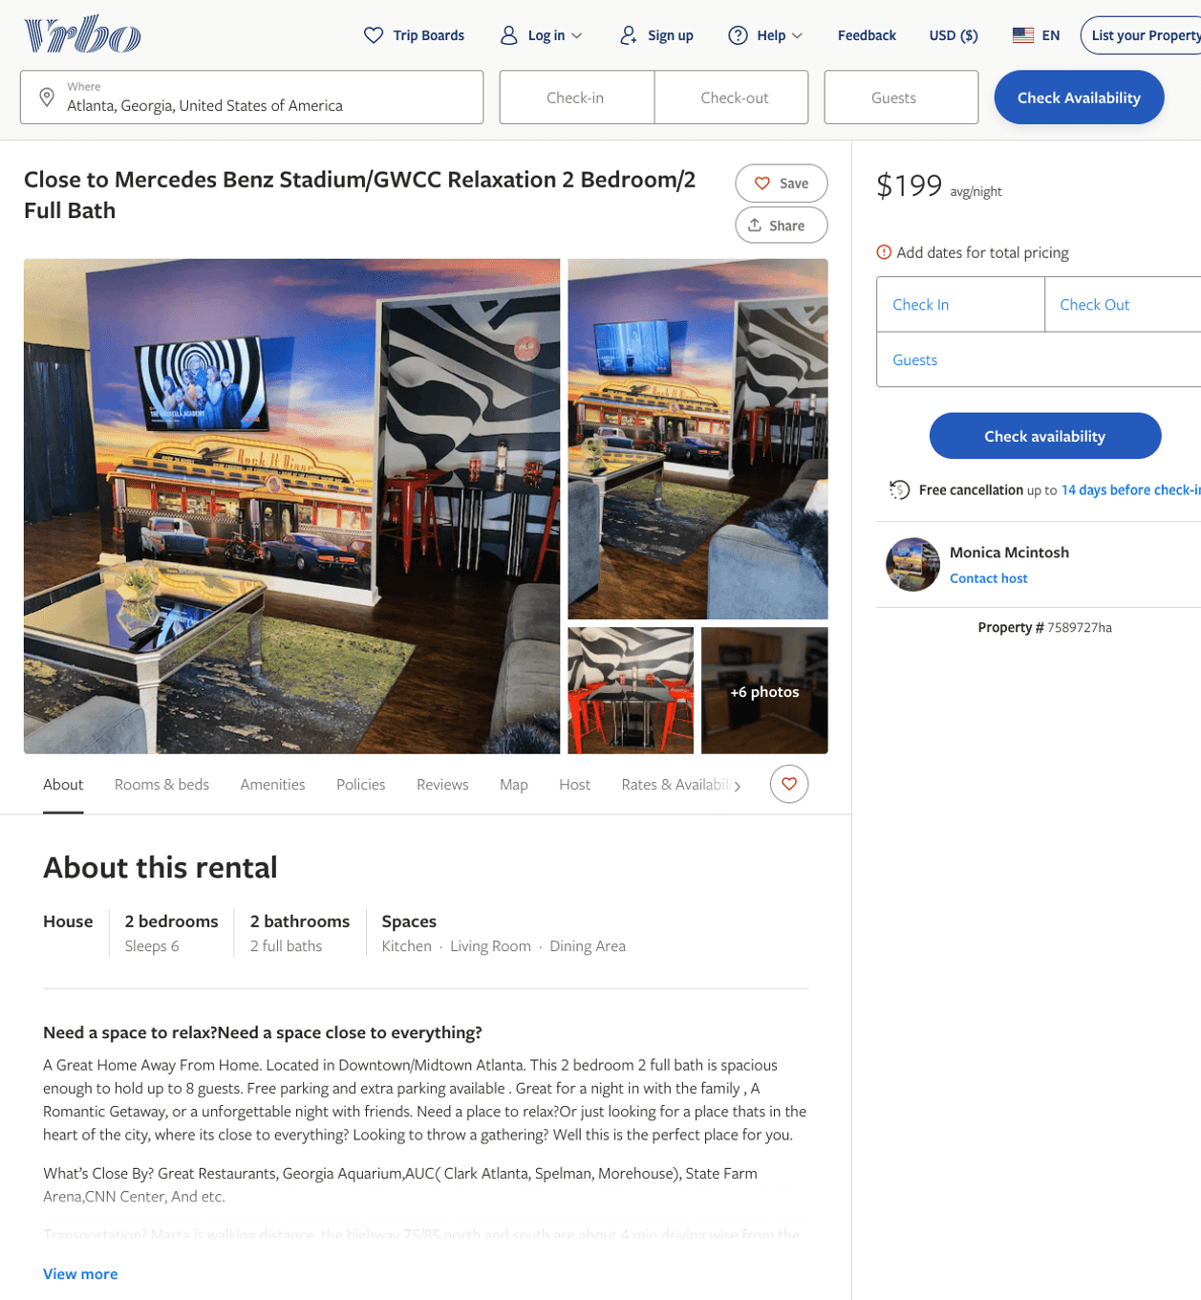
Listing 7589727
2
6
$179 - $199
1
Monica Mcintosh
https://www.vrbo.com/7589727ha
Aug 2022

Slide 17
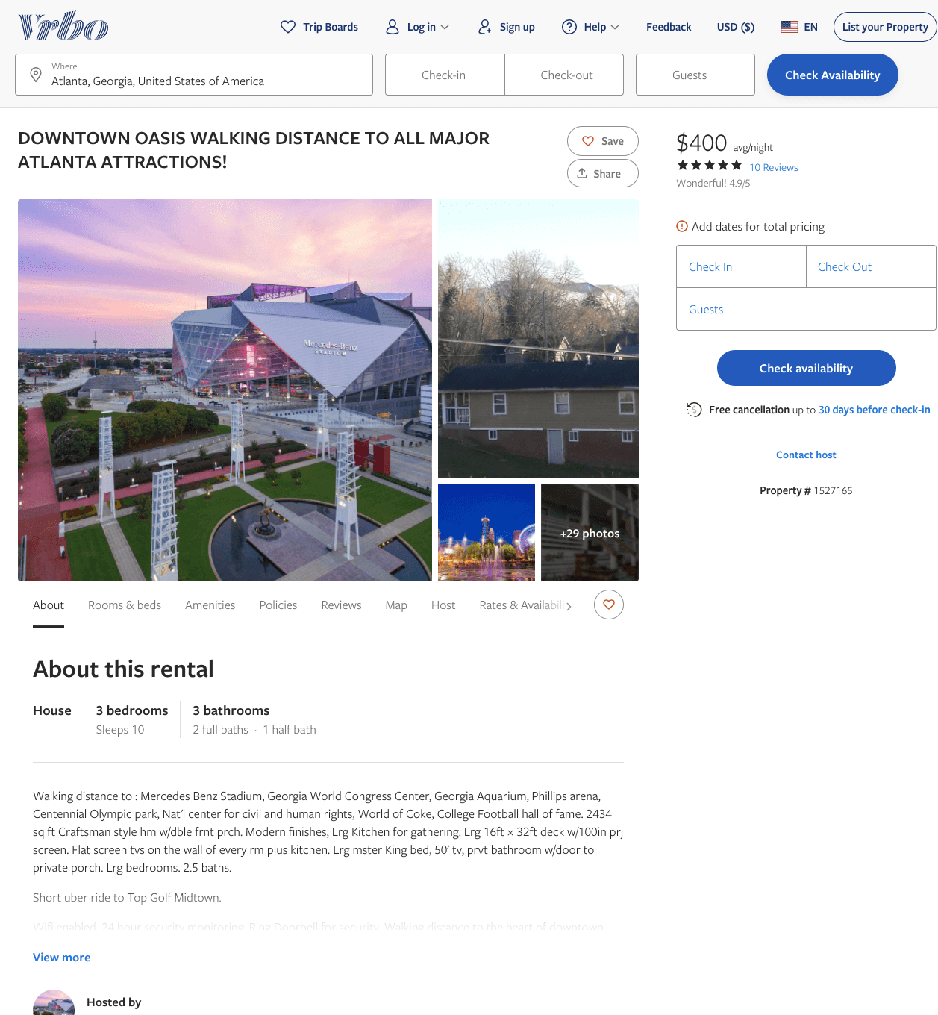
Listing 1527165
3
10
$400
4.9
1
https://www.vrbo.com/1527165
Aug 2022

Slide 18
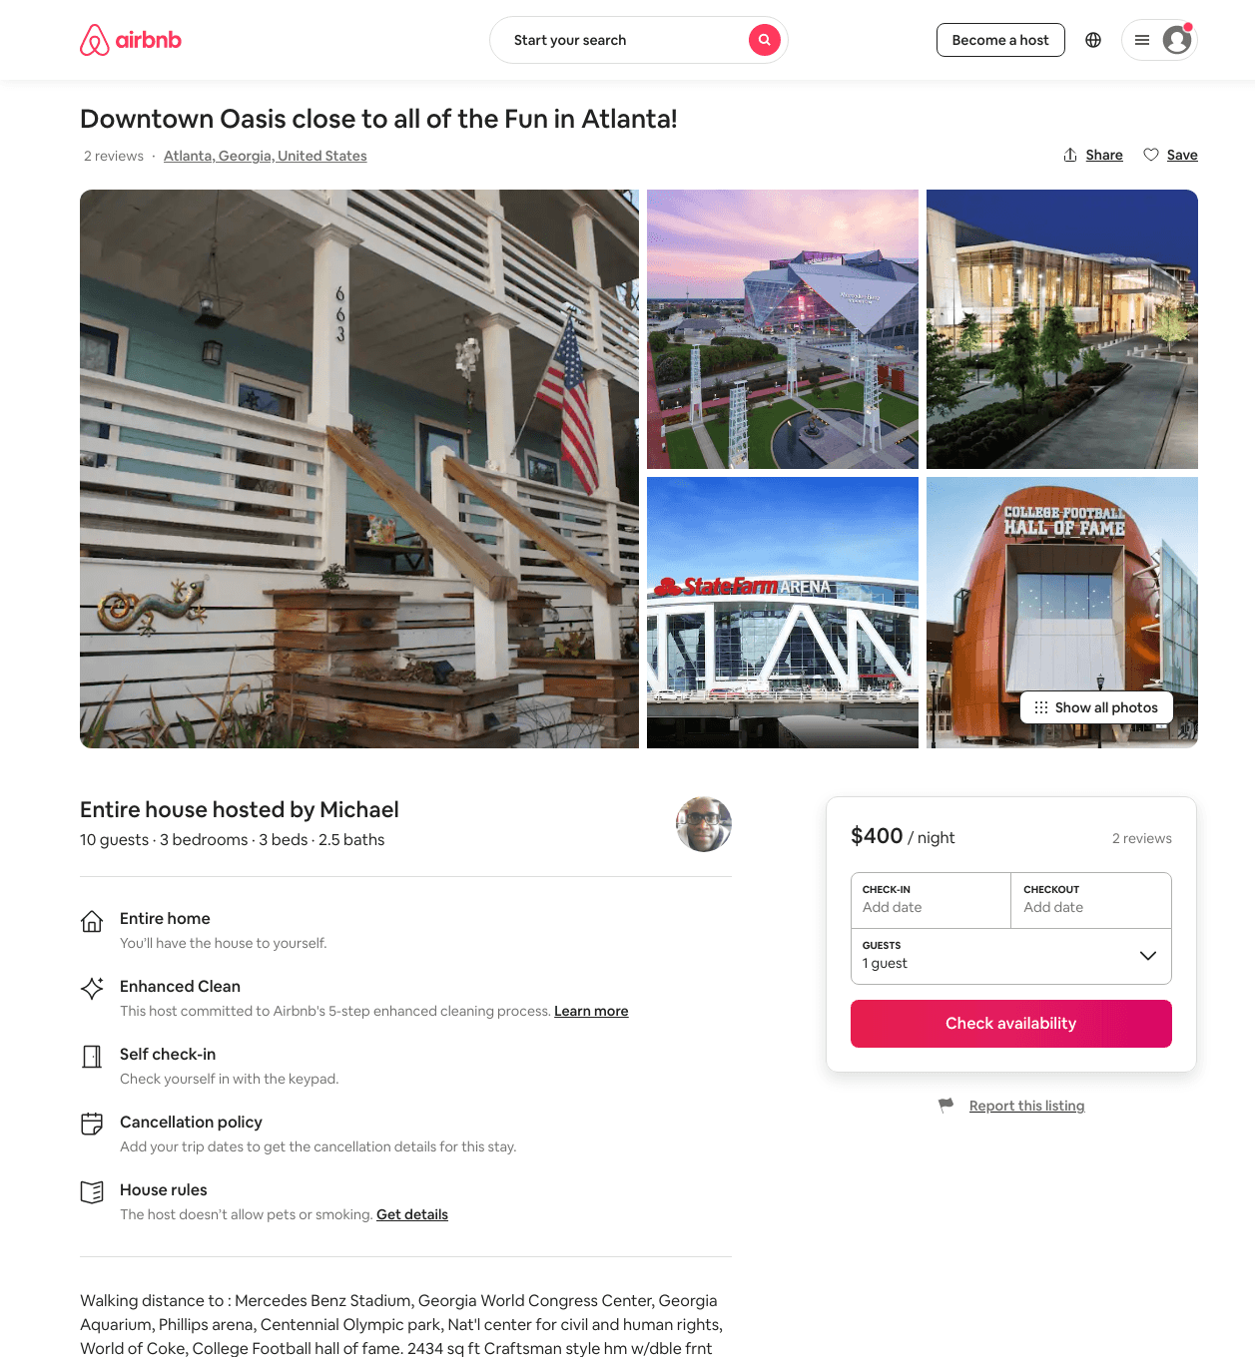
Listing 22397595
3
10
$400
2
Michael
163708682
1
https://www.airbnb.com/rooms/22397595
Aug 2022

Slide 19
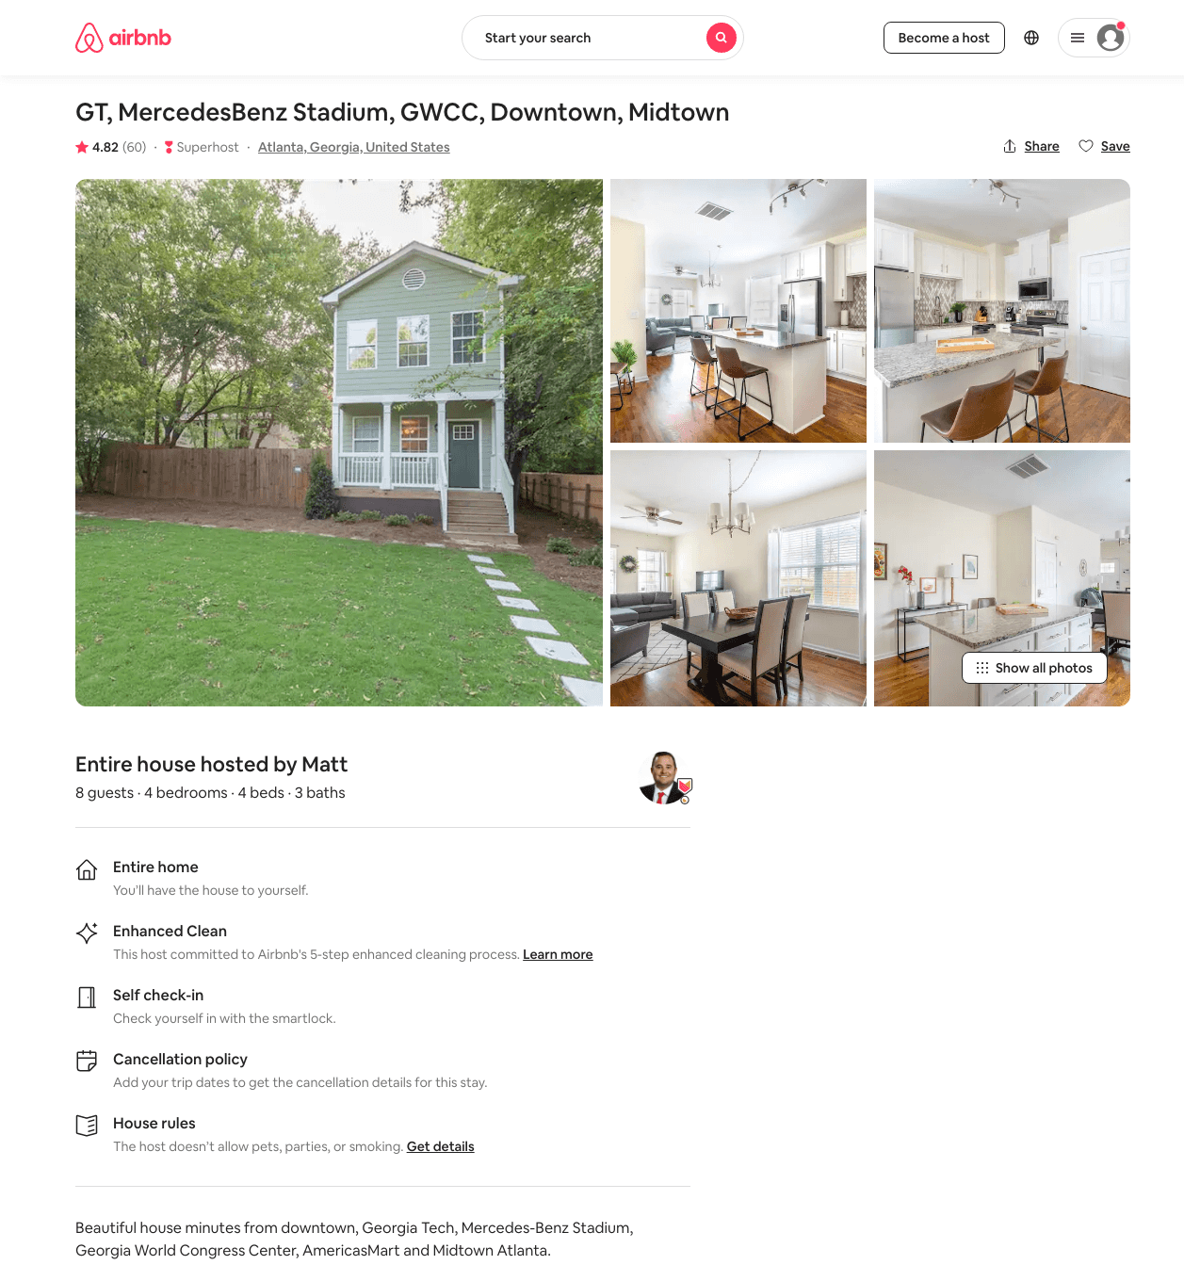
Listing 29359177
4
8
$189 - $445
4.85
3
Matt
150430543
4
https://www.airbnb.com/rooms/29359177
Aug 2022

Slide 20
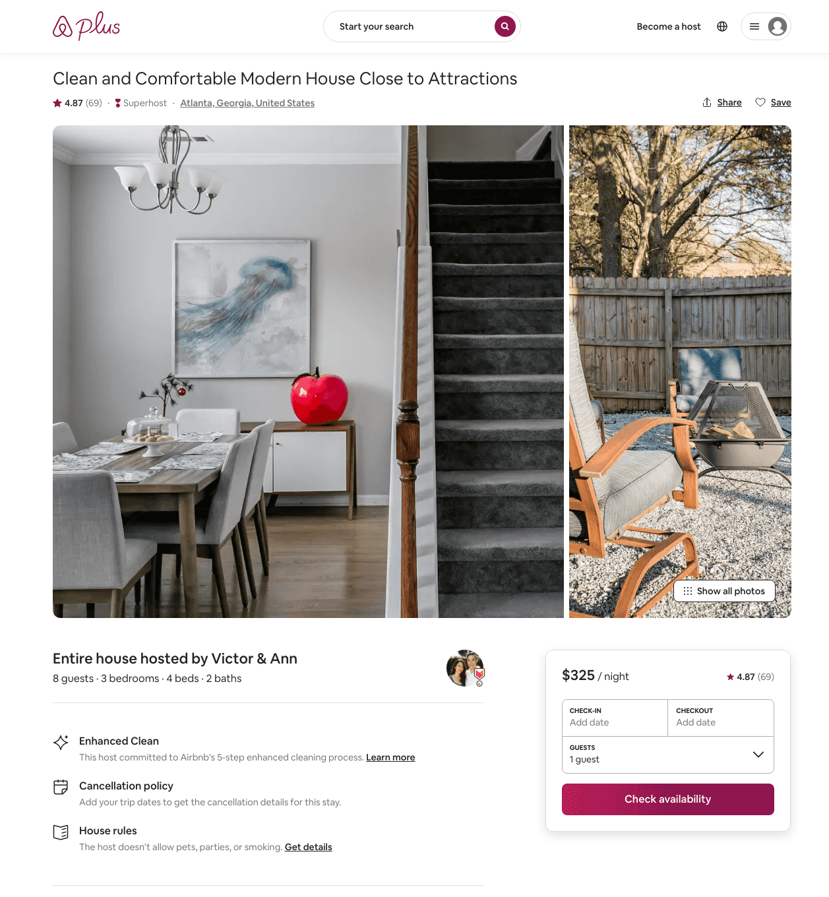
Listing 21439296
3
8
$300 - $414
4.82
2
Victor & Ann
16793482
2
https://www.airbnb.com/rooms/21439296
Aug 2022

Slide 21
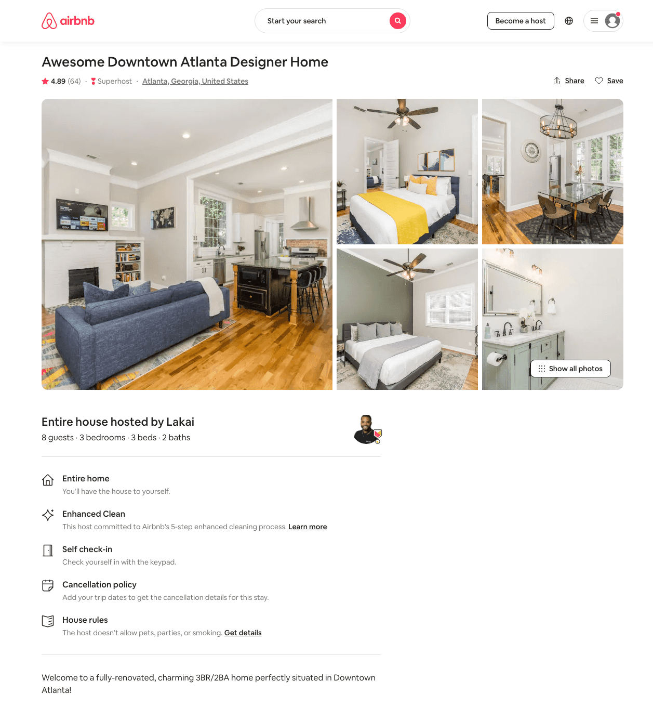
Listing 38932059
3
8
$205 - $321
4.93
1
Lakai
37547702
1
https://www.airbnb.com/rooms/38932059
Aug 2022

Slide 22
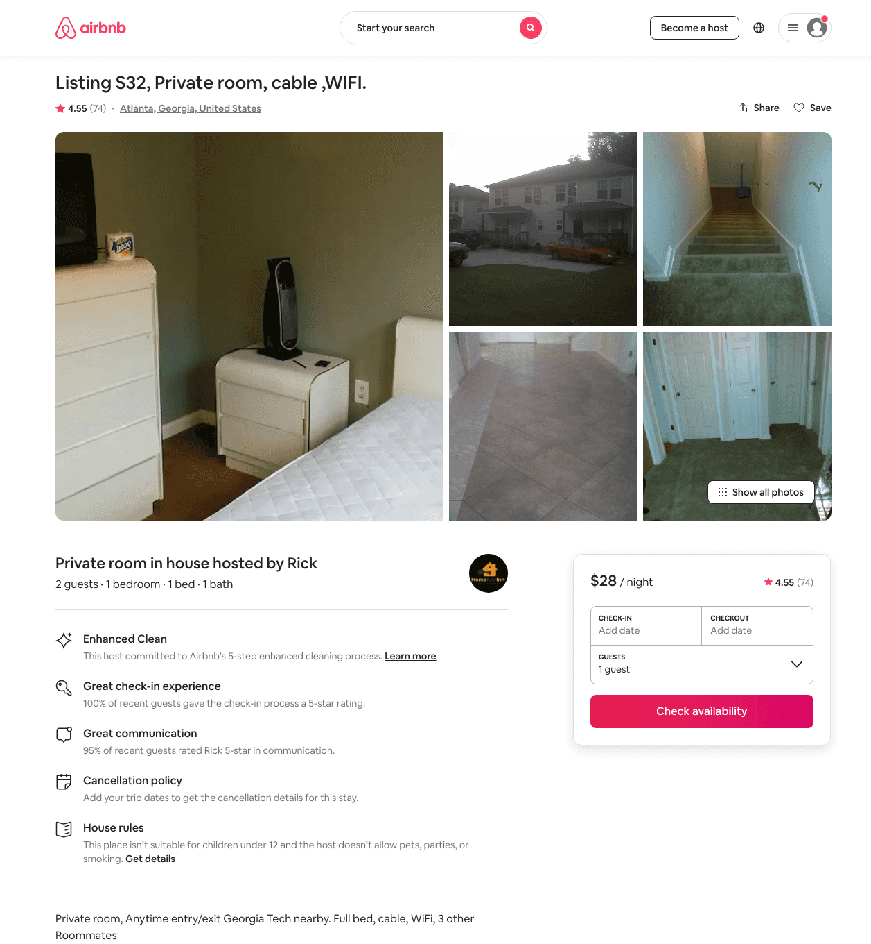
Listing 11115117
1
2
$28 - $31
4.49
1
Rick
42301069
34
https://www.airbnb.com/rooms/11115117
Jul 2022

Slide 23
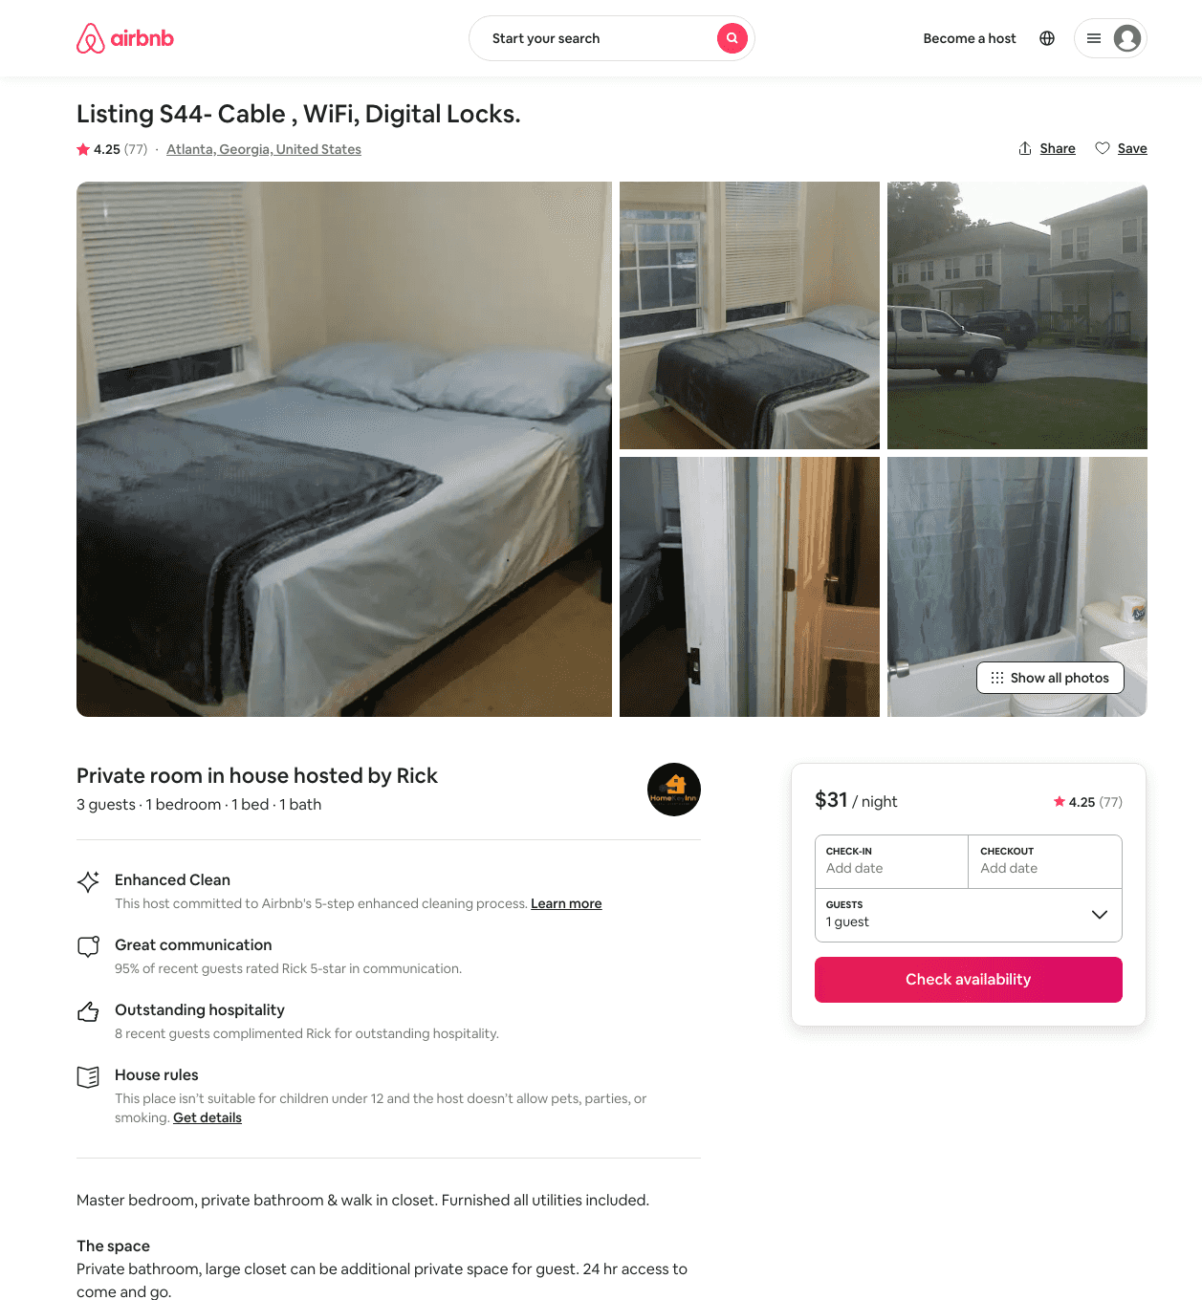
Listing 10114014
1
3
$31 - $32
4.28
2
Rick
42301069
34
https://www.airbnb.com/rooms/10114014
Aug 2022

Slide 24
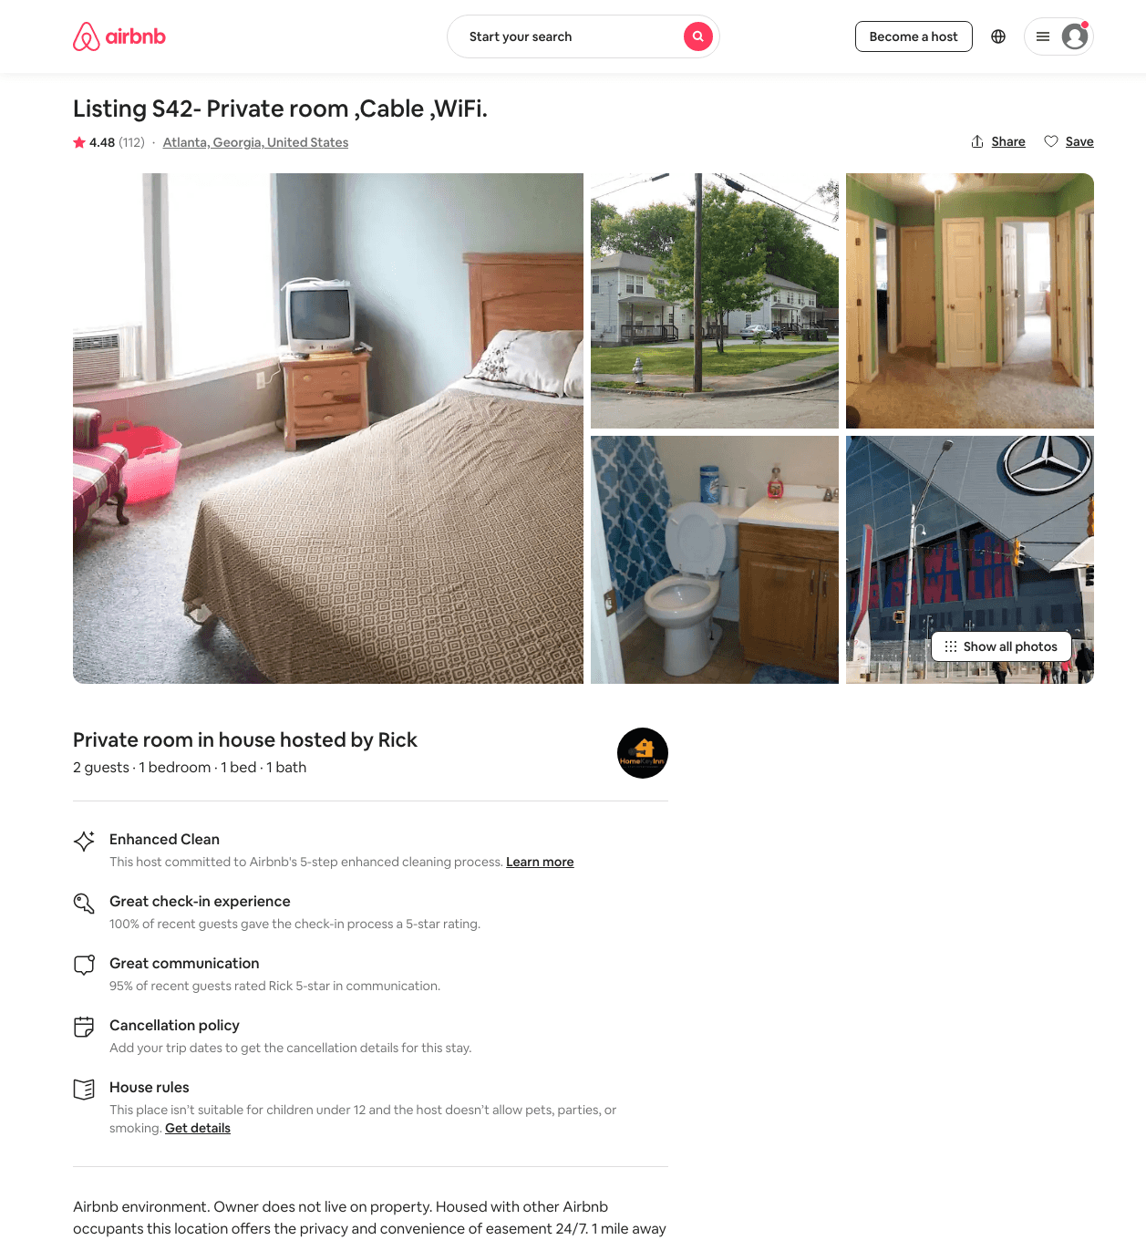
Listing 12806958
1
2
$30 - $62
4.42
2
Rick
42301069
34
https://www.airbnb.com/rooms/12806958
Aug 2022

Slide 25
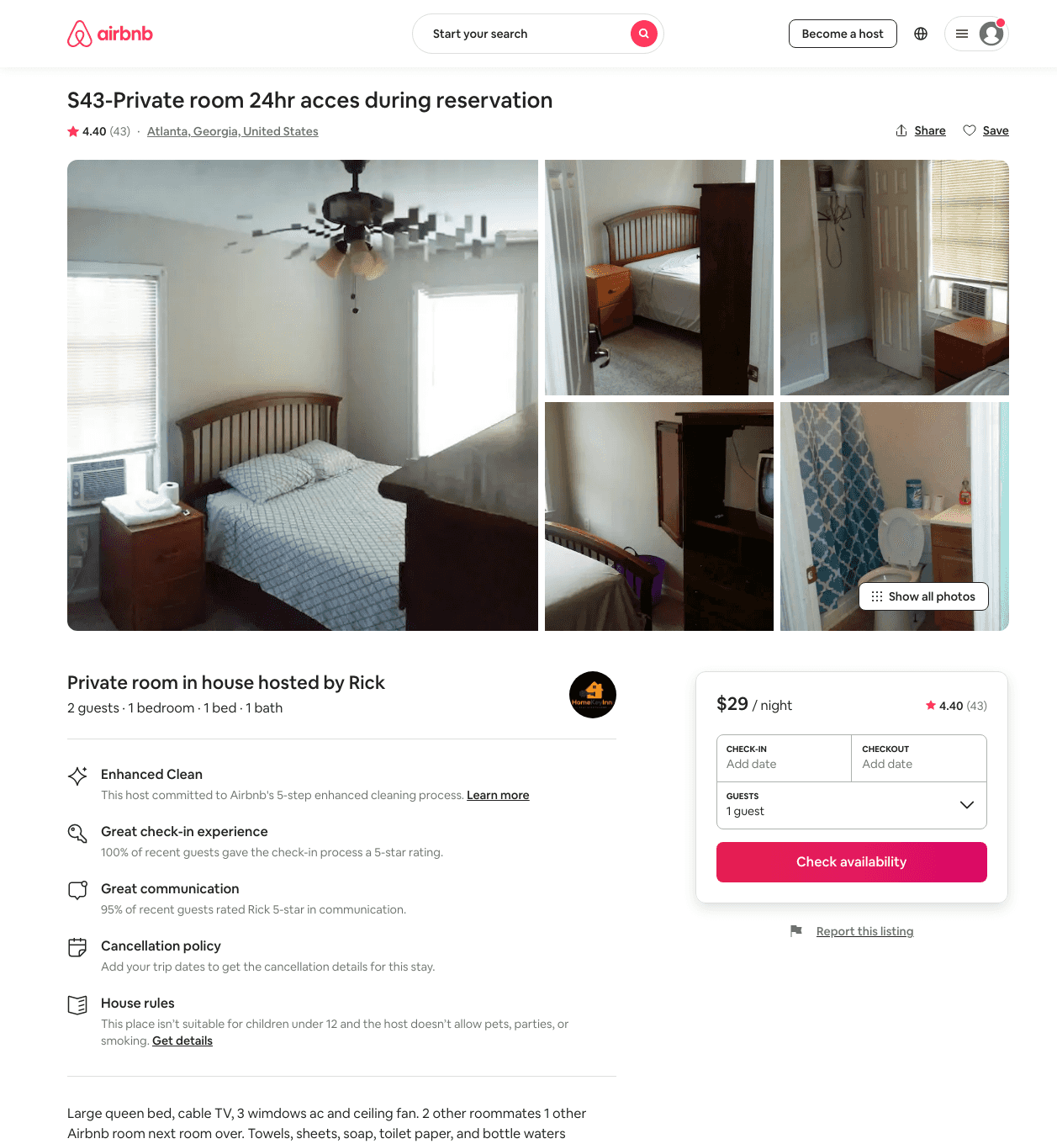
Listing 9558077
1
2
$29
4.42
2
Rick
42301069
34
https://www.airbnb.com/rooms/9558077
Aug 2022

Slide 26
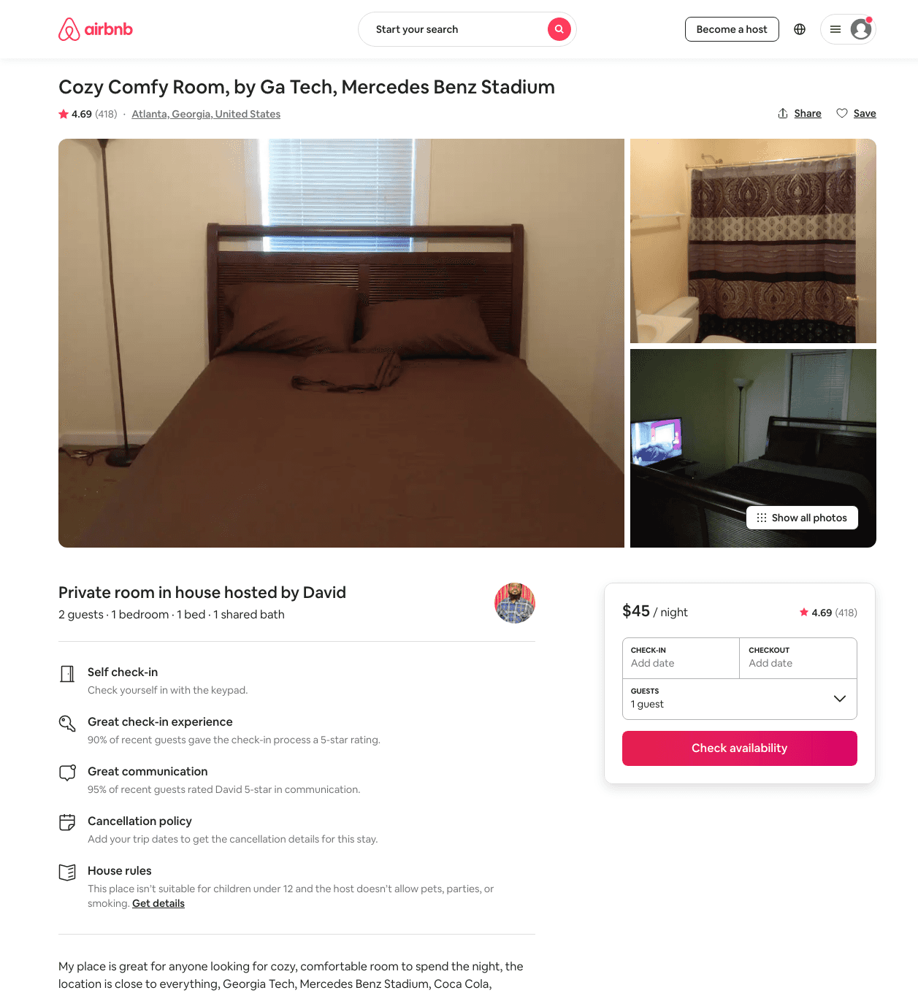
Listing 16738159
1
2
$45 - $71
4.66
1
David
31484622
2
https://www.airbnb.com/rooms/16738159
Aug 2022

Slide 27
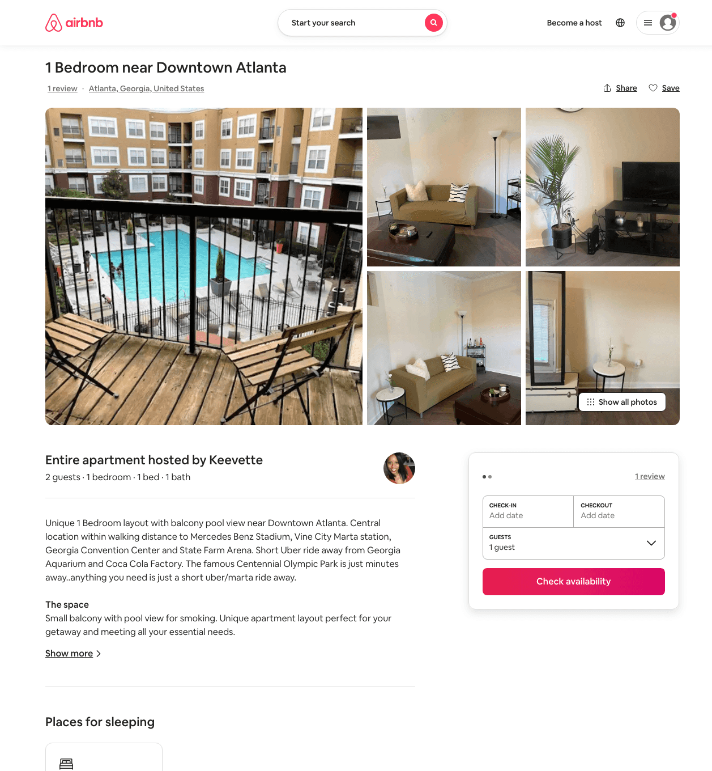
Listing 49949283
1
2
$67 - $97
4.62
2
Doniece
187960785
1
https://www.airbnb.com/rooms/49949283
Aug 2022

Slide 28
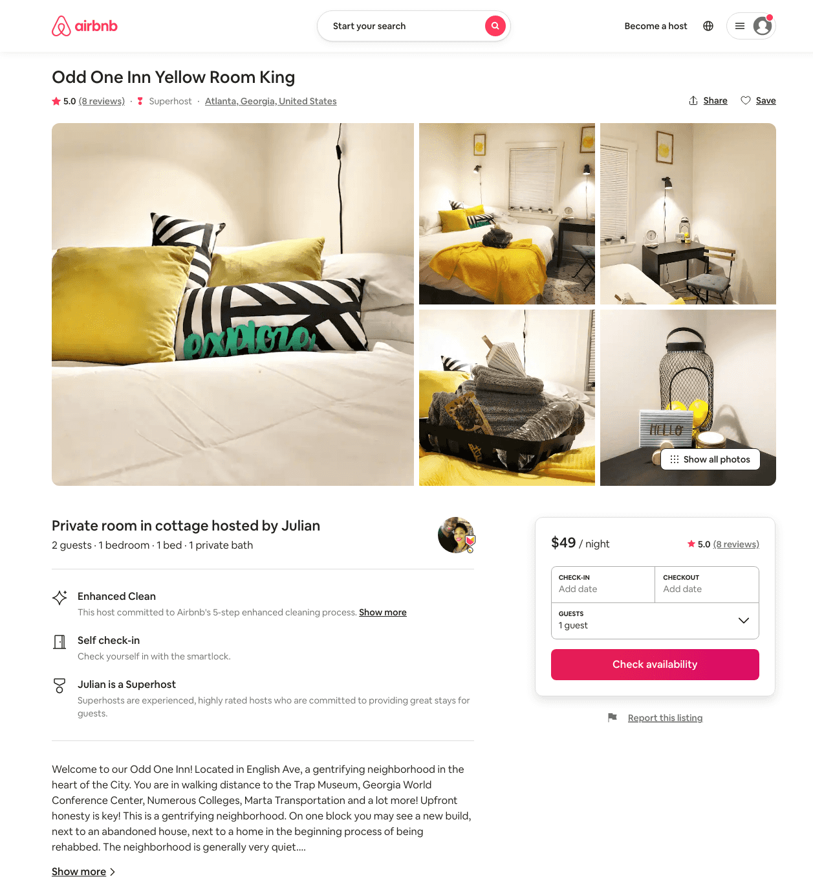
Listing 43096051
1
1
$46 - $57
5.0
30
Julian
13811025
5
https://www.airbnb.com/rooms/43096051
Aug 2022

Slide 29
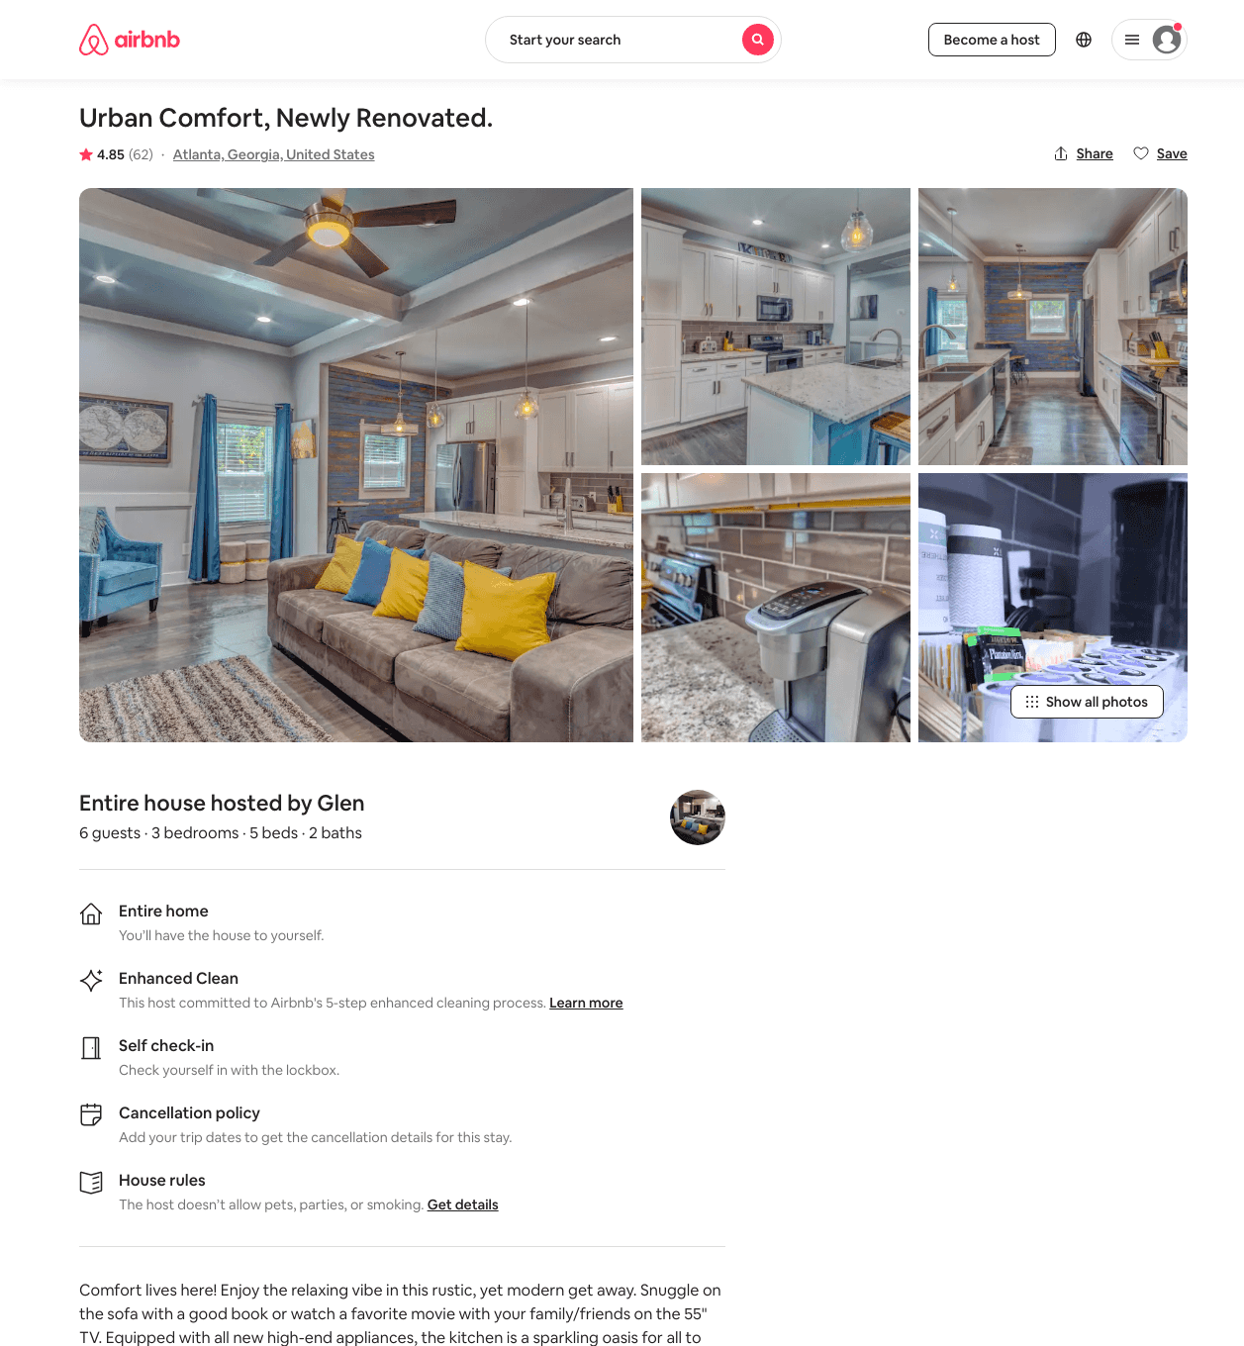
Listing 31830513
3
7
$216 - $335
4.83
2
Danielle
221755414
2
https://www.airbnb.com/rooms/31830513
Aug 2022

Slide 30
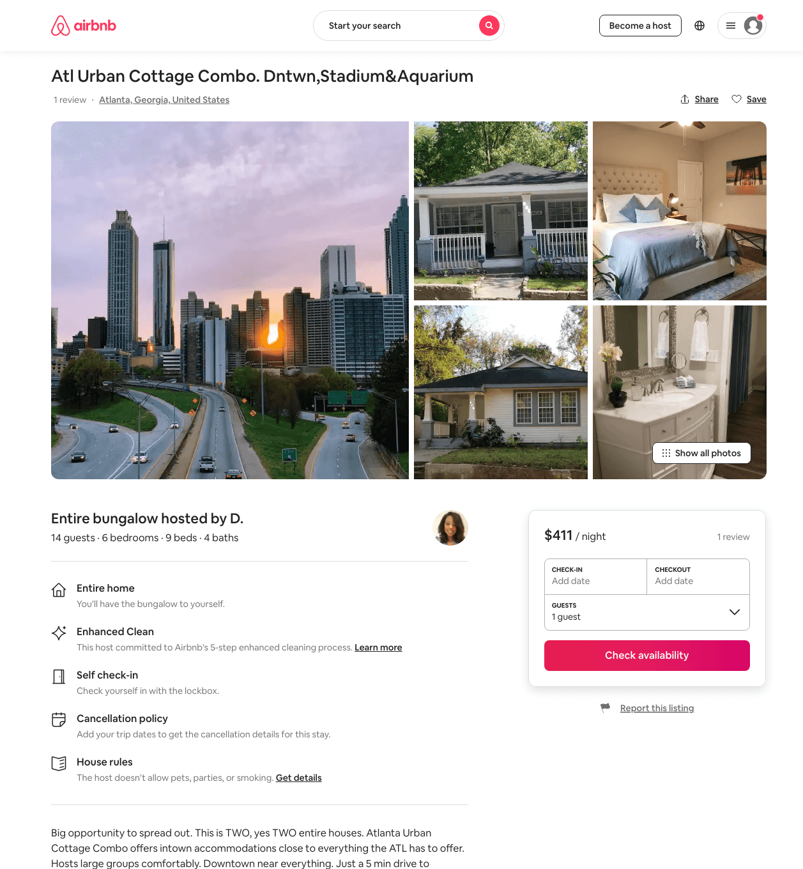
Listing 46216434
6
13
$377 - $619
4.78
2
D.
8209054
3
https://www.airbnb.com/rooms/46216434
Aug 2022

Slide 31
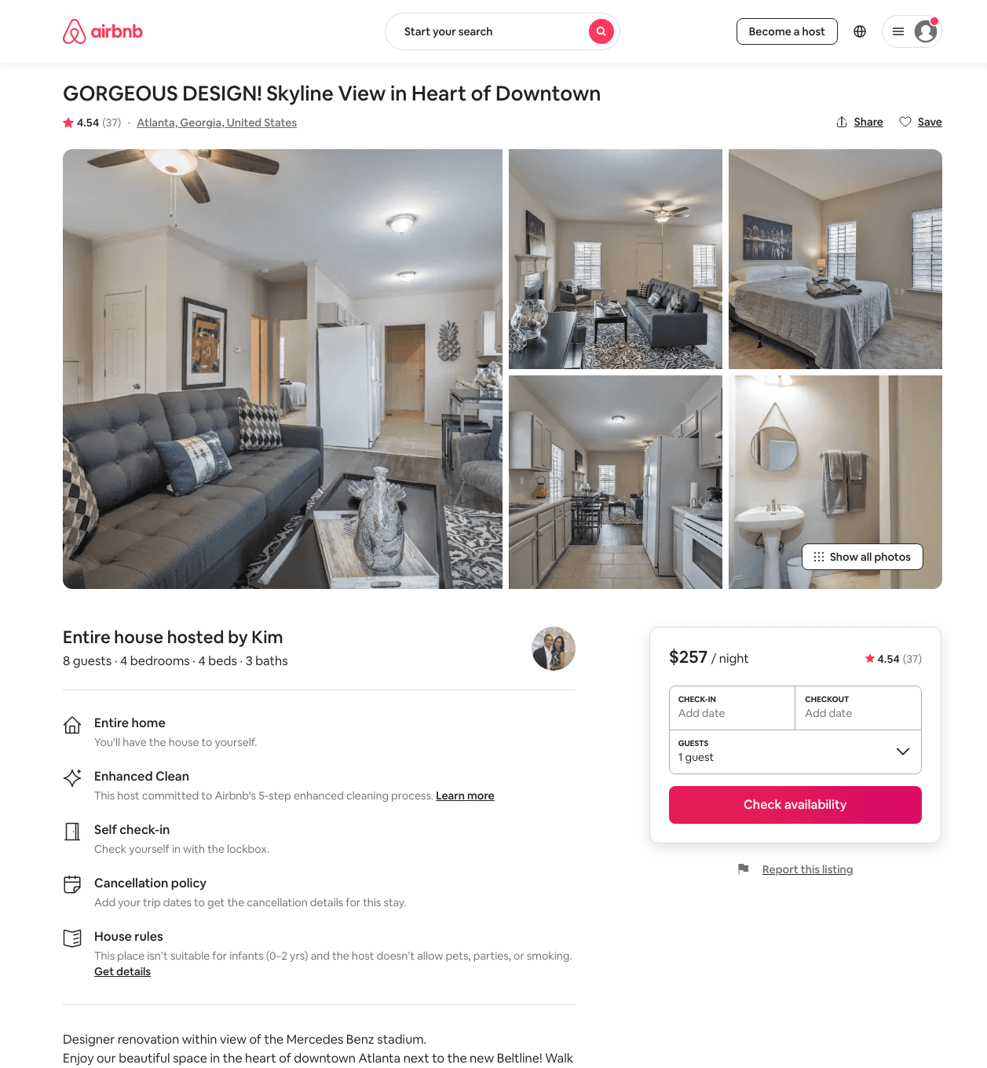
Listing 31932087
4
8
$226 - $253
4.40
2
Kim
124328425
4
https://www.airbnb.com/rooms/31932087
Jun 2022

Slide 32
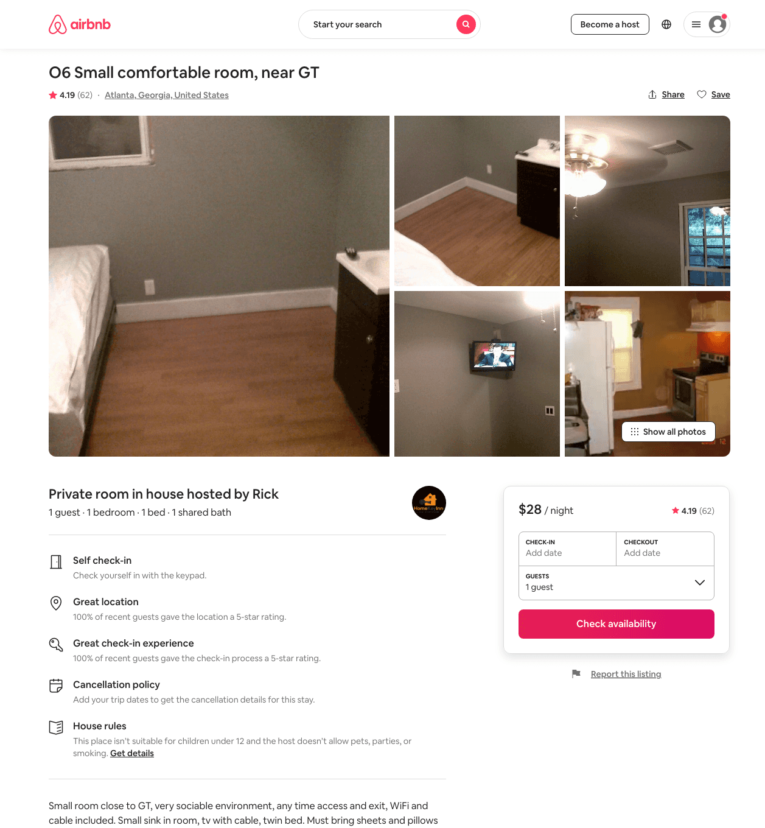
Listing 10744087
1
1
$27 - $31
4.19
2
Rick
42301069
34
https://www.airbnb.com/rooms/10744087
Aug 2022

Slide 33
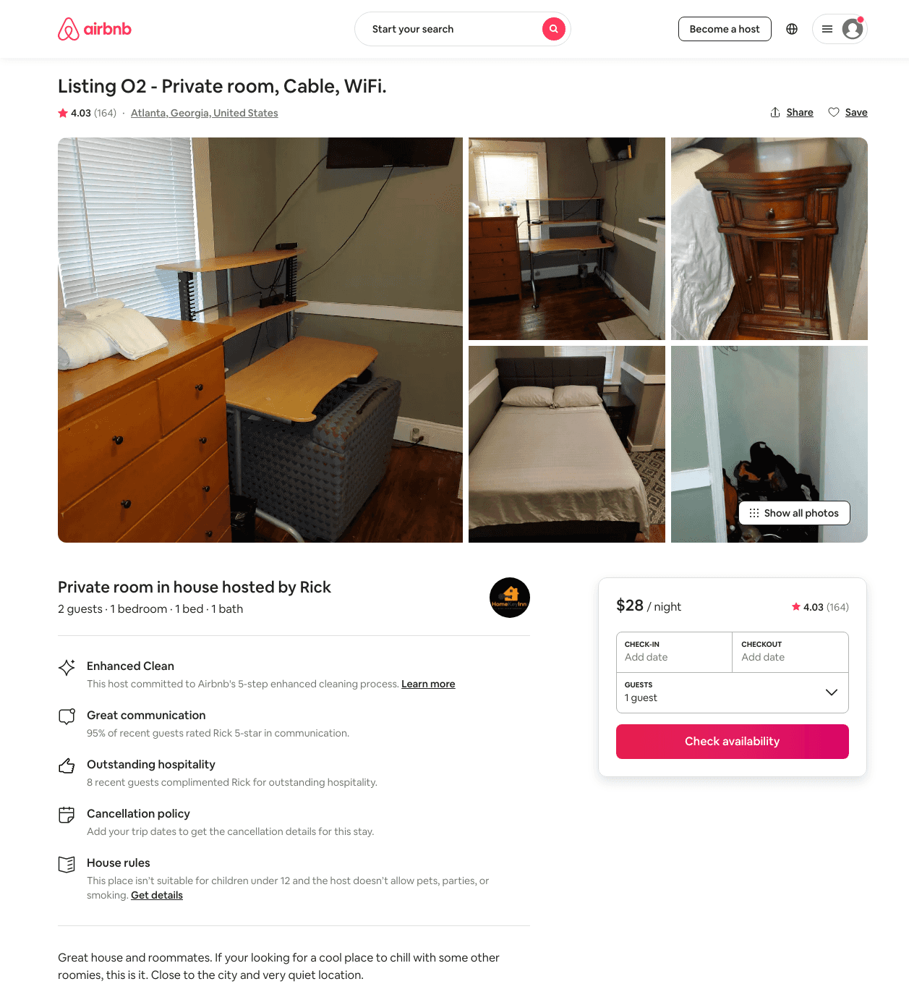
Listing 11555848
1
2
$28
4.09
2
Rick
42301069
34
https://www.airbnb.com/rooms/11555848
Aug 2022

Slide 34
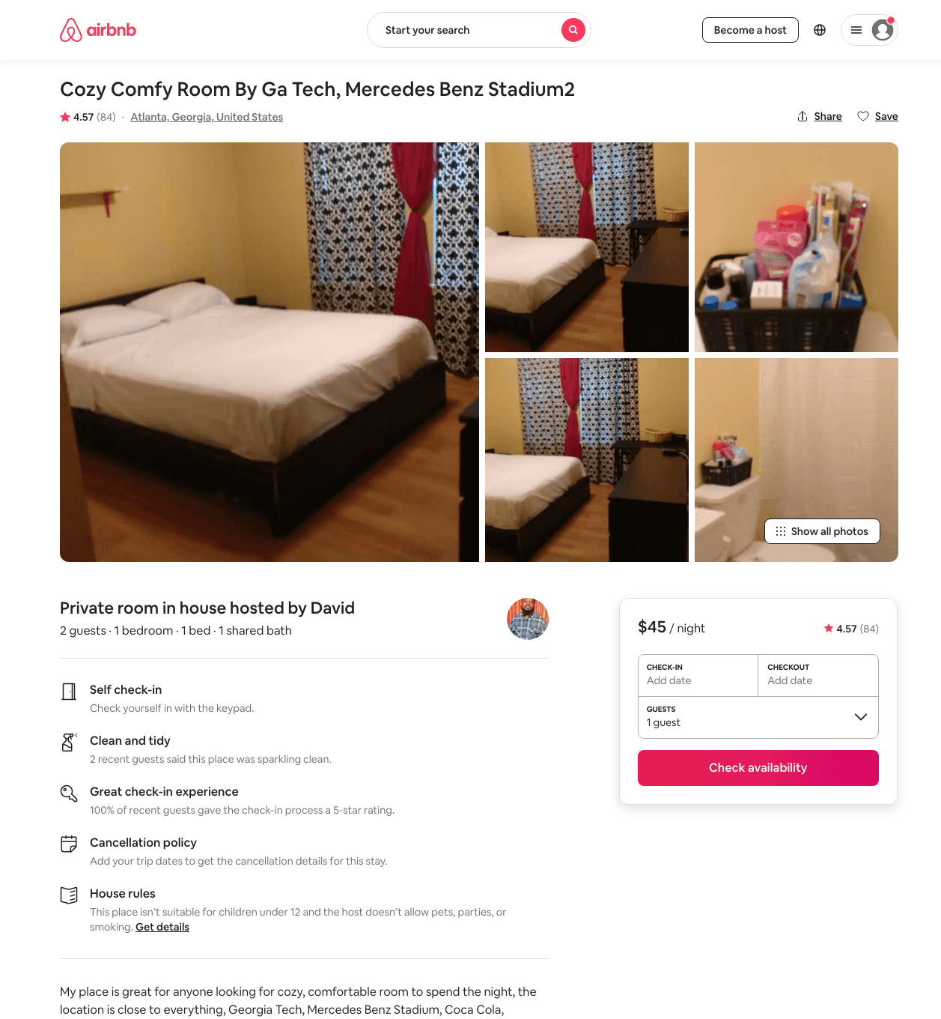
Listing 26237280
1
2
$45 - $58
4.52
1
David
31484622
2
https://www.airbnb.com/rooms/26237280
Aug 2022

Slide 35
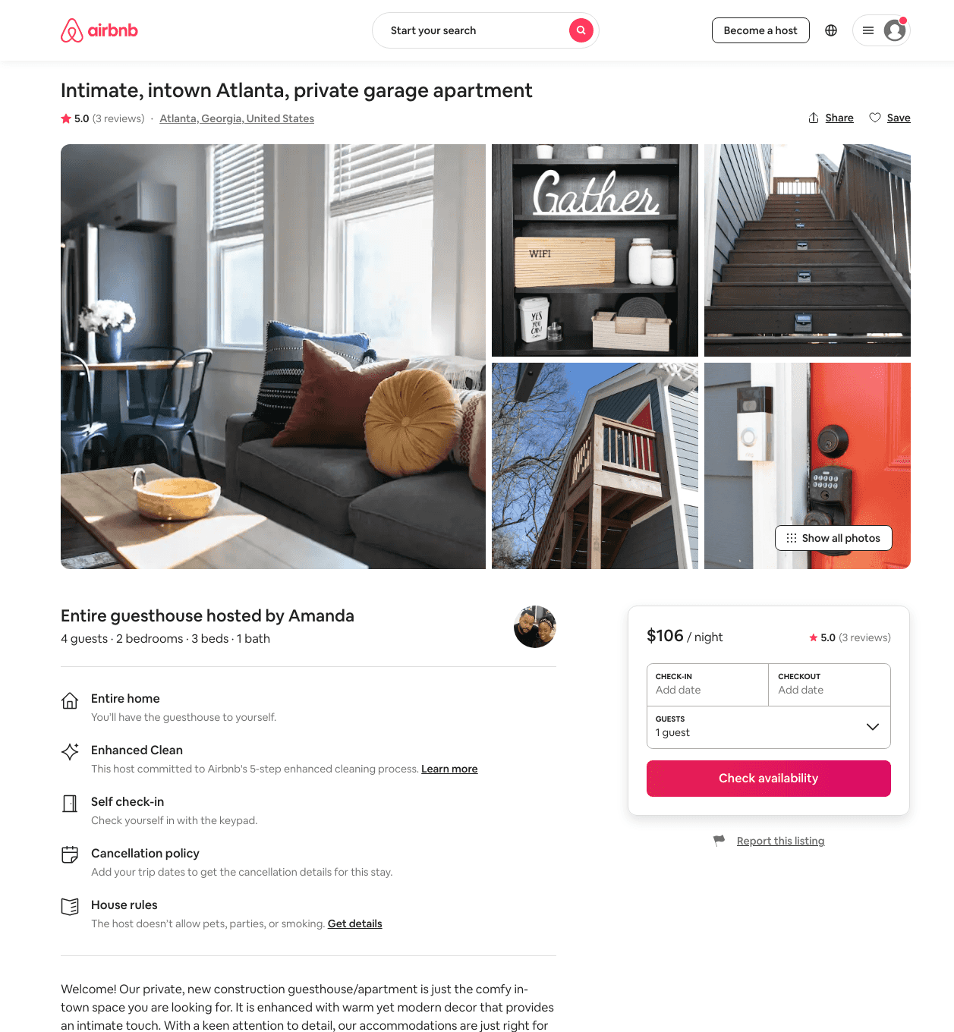
Listing 48903139
2
4
$69 - $109
4.77
2
Richard And Amanda
394442277
1
https://www.airbnb.com/rooms/48903139
Aug 2022

Slide 36
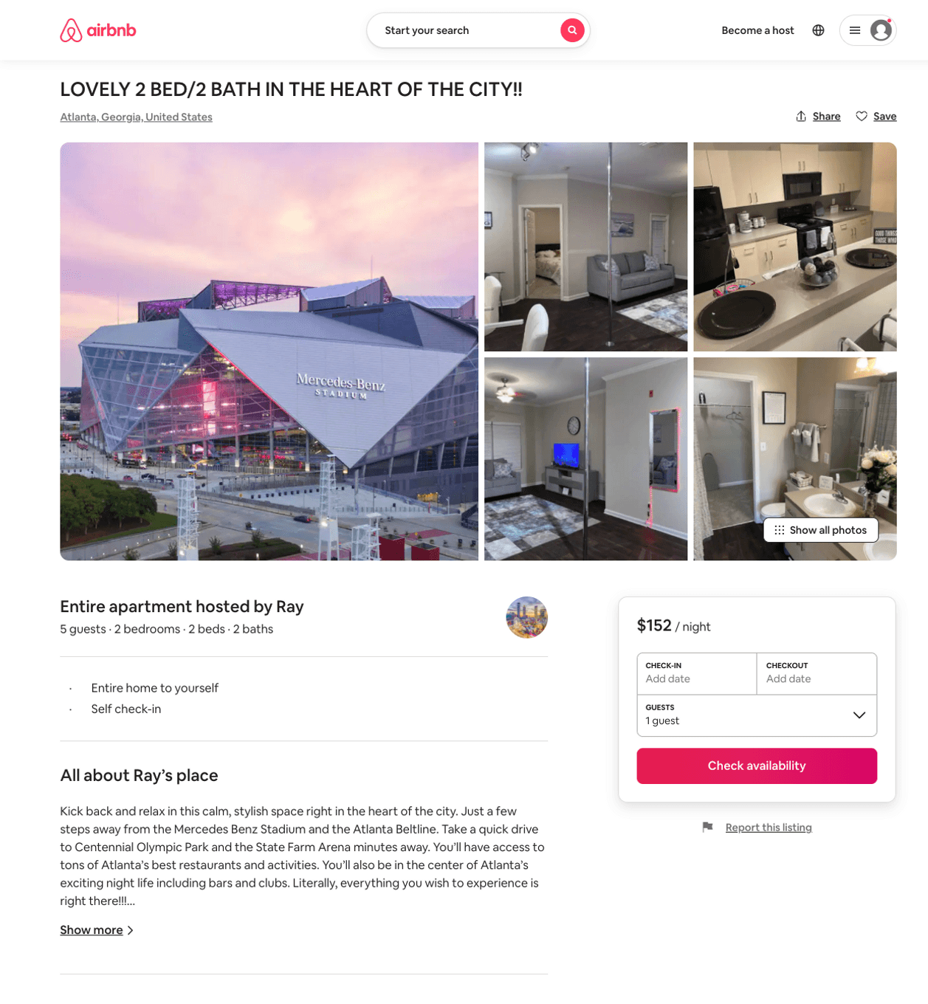
Listing 50845371
2
5
$84 - $161
4.22
2
Ray
214791975
2
https://www.airbnb.com/rooms/50845371
Jul 2022

Slide 37
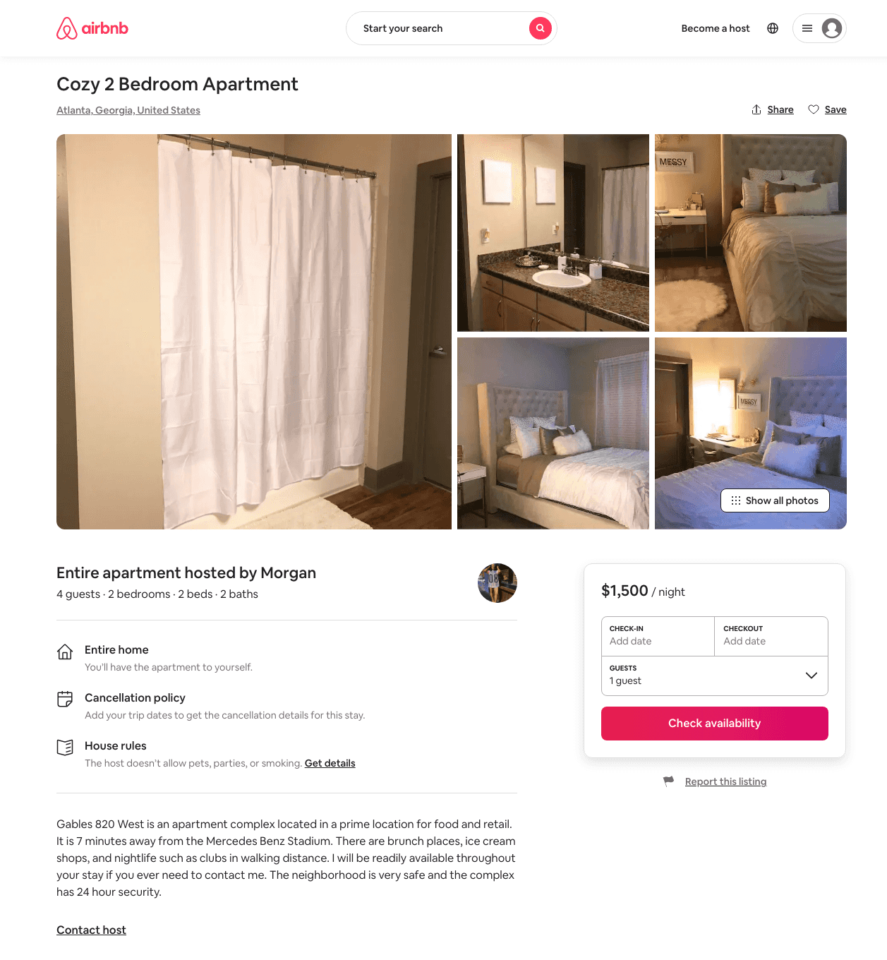
Listing 30987493
2
4
$1500
2
Morgan
150853277
1
https://www.airbnb.com/rooms/30987493
Aug 2022

Slide 38
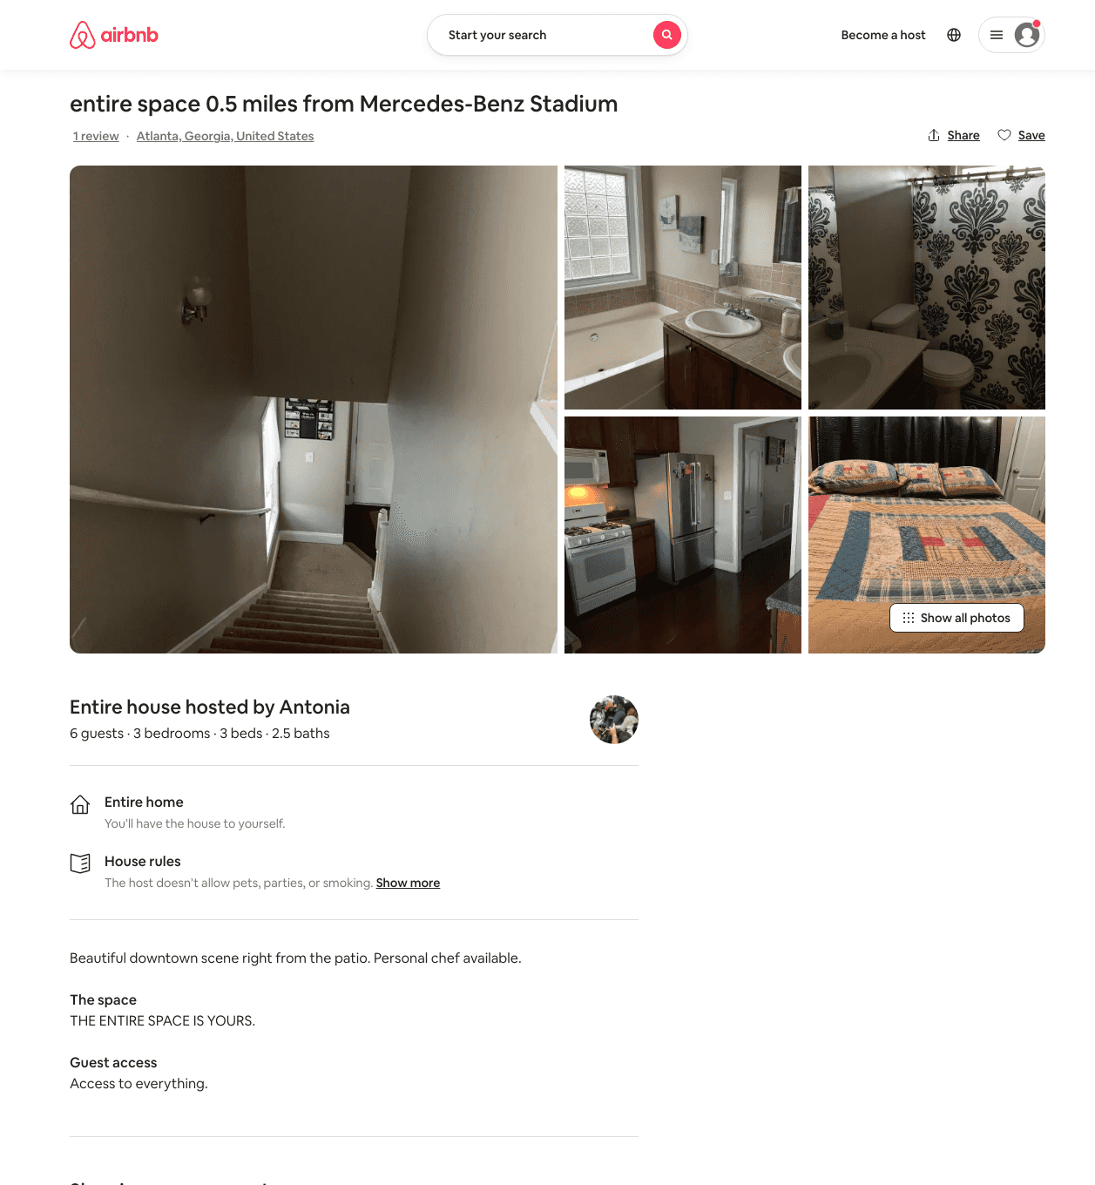
Listing 31960842
3
6
$850
2
Antonia
173579295
1
https://www.airbnb.com/rooms/31960842
Aug 2022

Slide 39
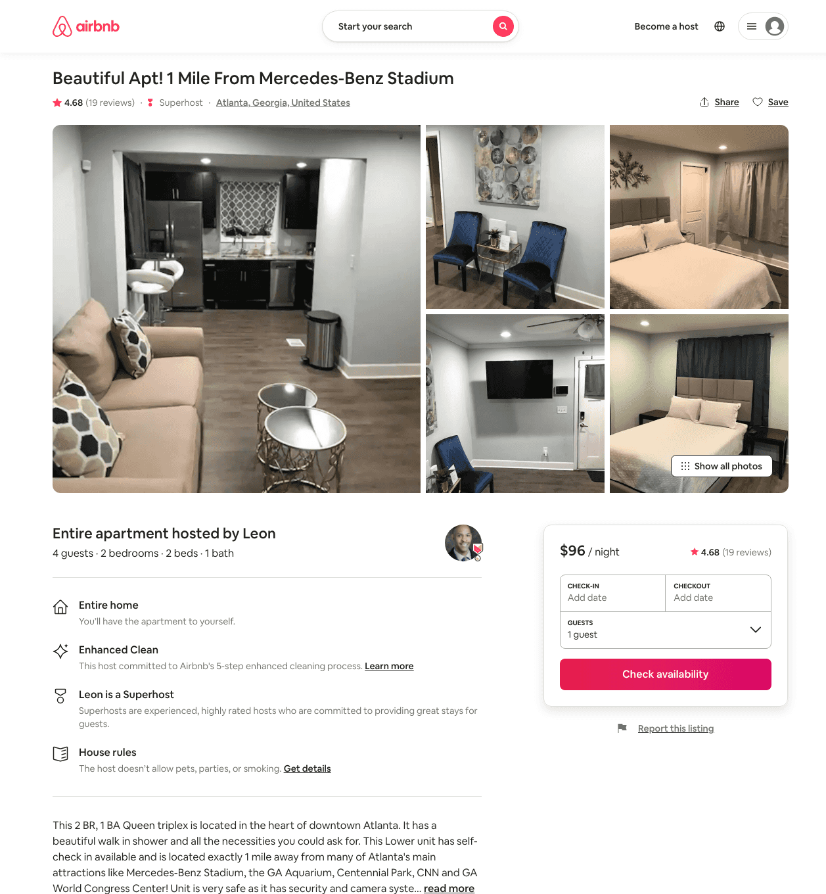
Listing 41801784
2
4
$96 - $121
4.64
2
Leon
330292329
3
https://www.airbnb.com/rooms/41801784
Aug 2022

Slide 40
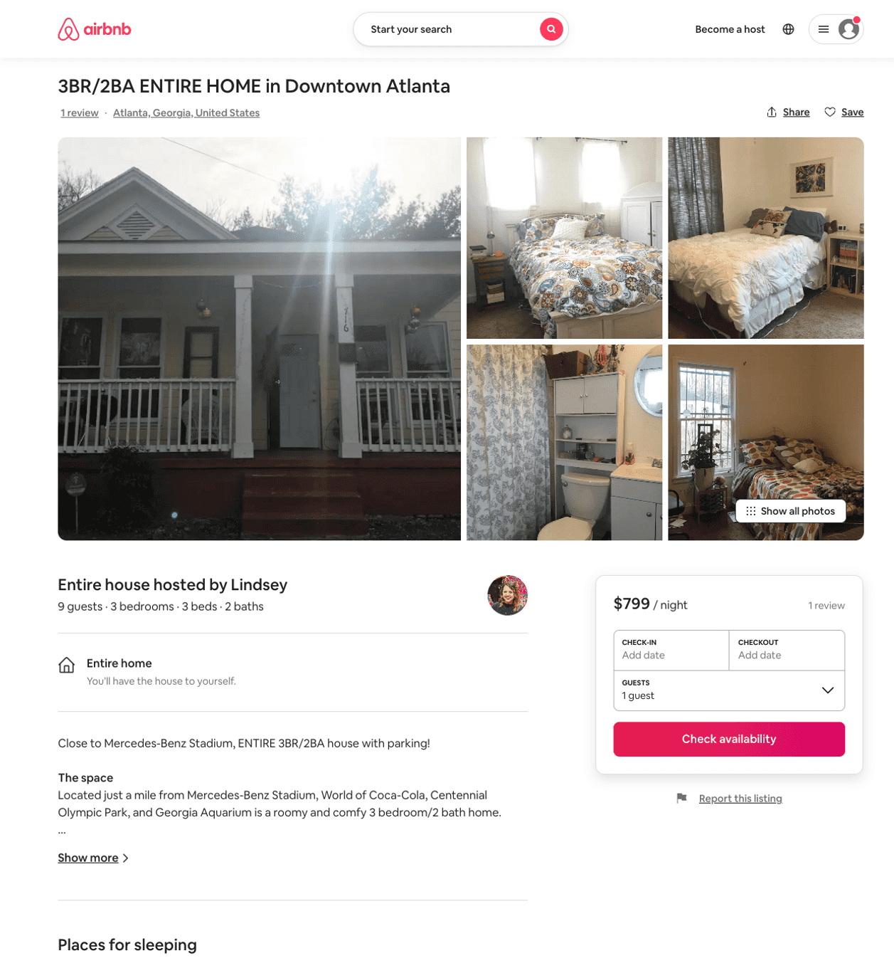
Listing 22545768
3
9
$799
2
Lindsey
15352934
1
https://www.airbnb.com/rooms/22545768
Aug 2022

Slide 41
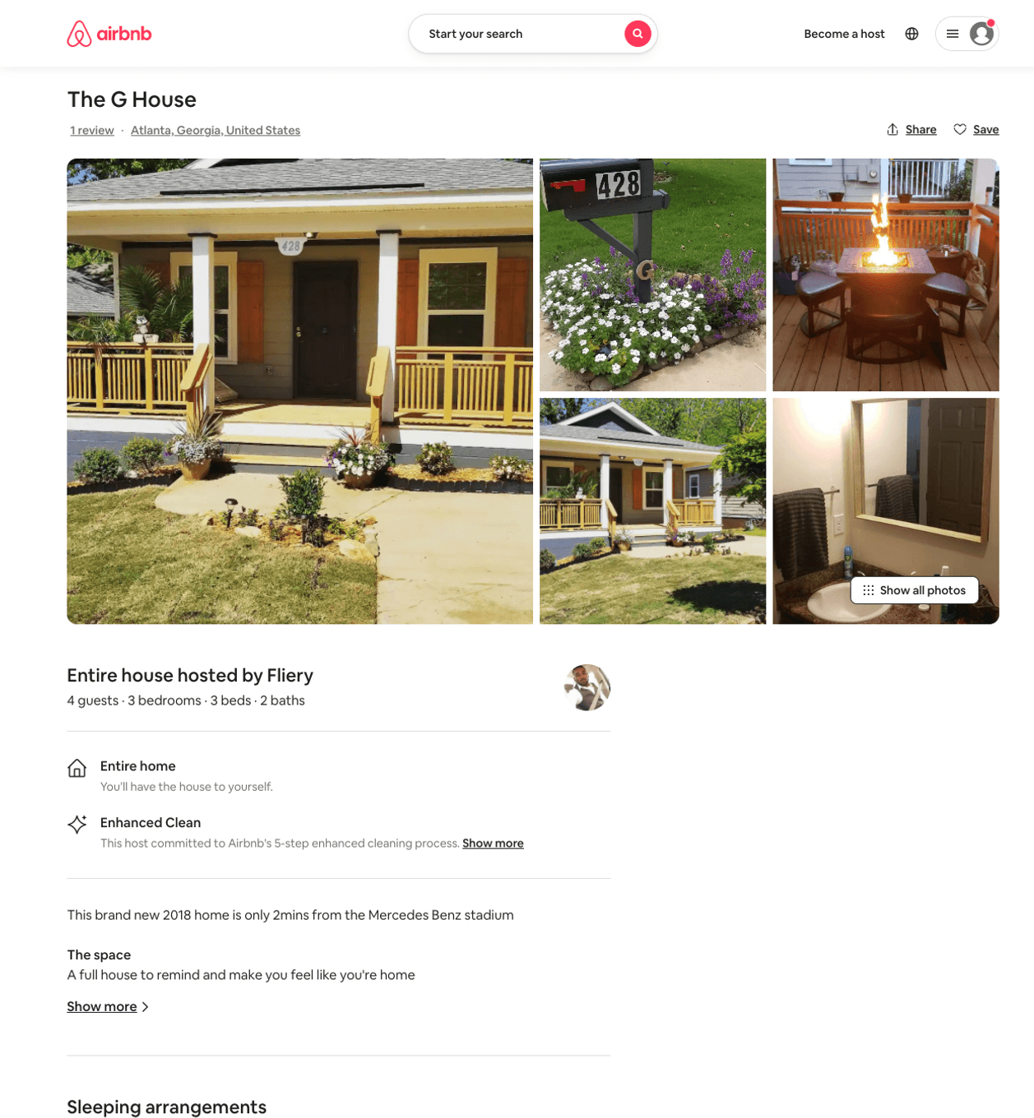
Listing 28816860
3
4
$298
1
Fliery
52706927
2
https://www.airbnb.com/rooms/28816860
Aug 2022

Slide 42
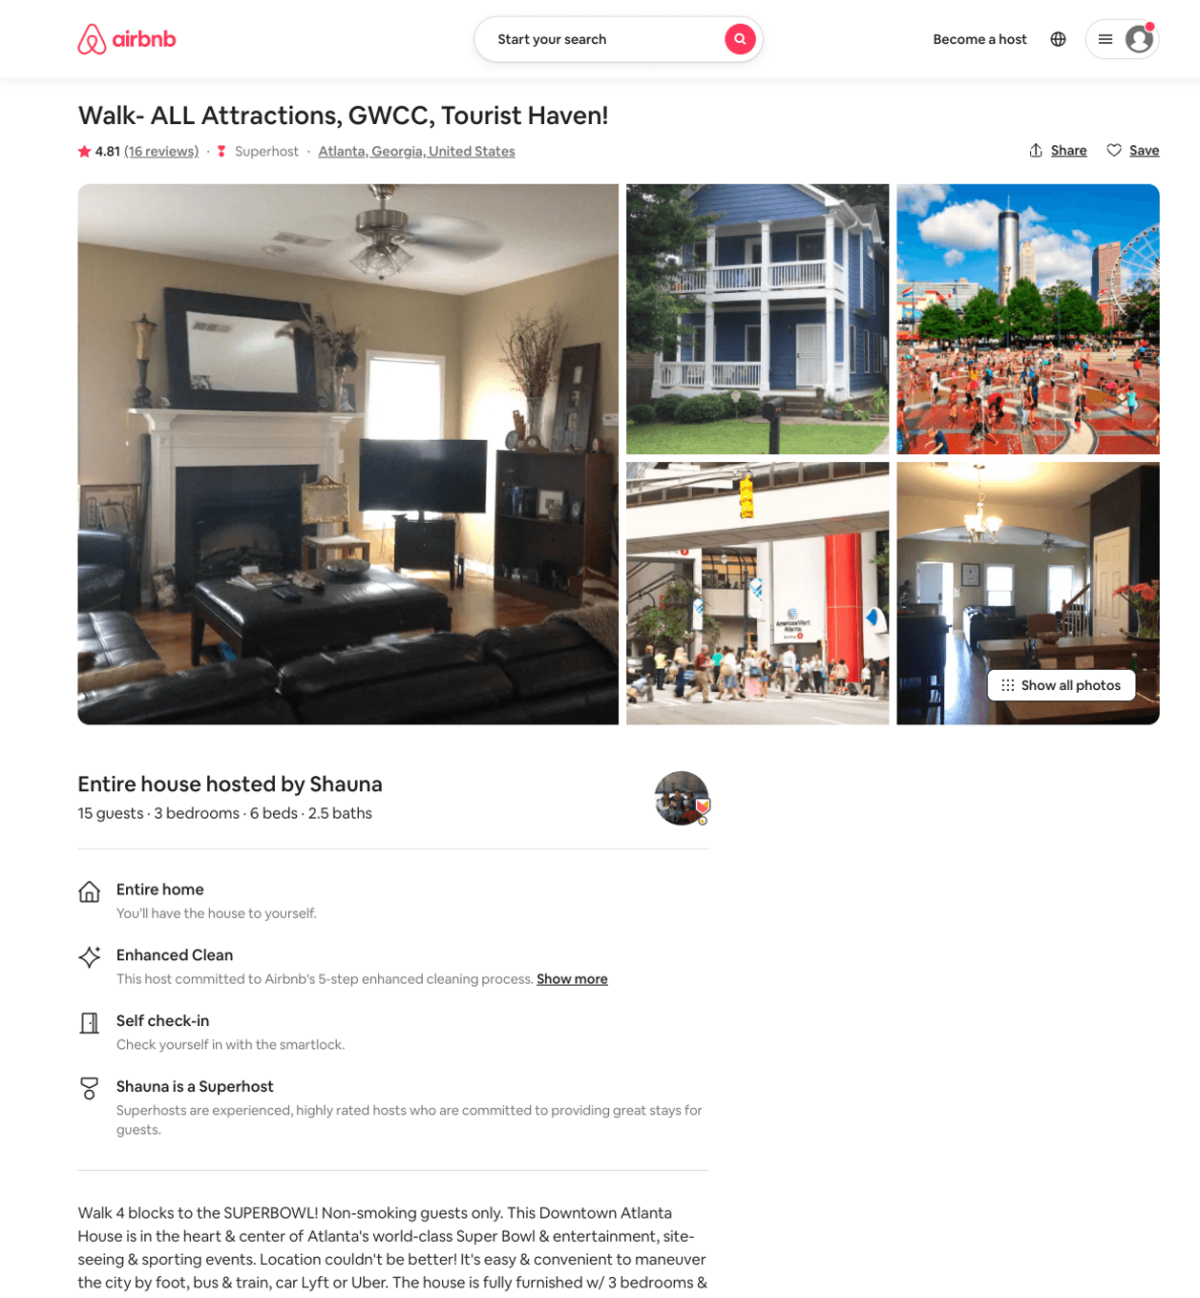
Listing 12973980
3
15
$300
4.81
1
Shauna
15667324
2
https://www.airbnb.com/rooms/12973980
Aug 2022

Slide 43
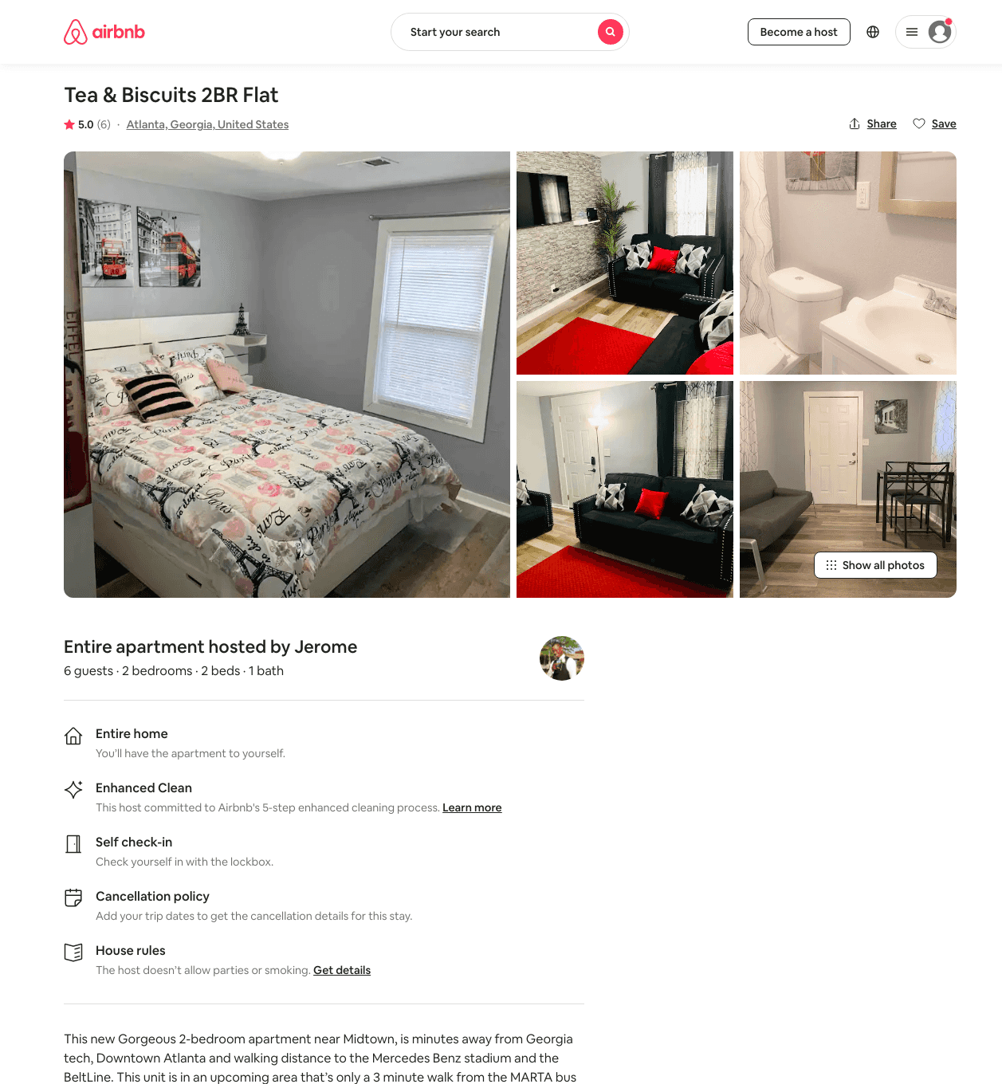
Listing 48471505
2
5
$62 - $100
4.81
1
Jerome
391185192
1
https://www.airbnb.com/rooms/48471505
Aug 2022

Slide 44
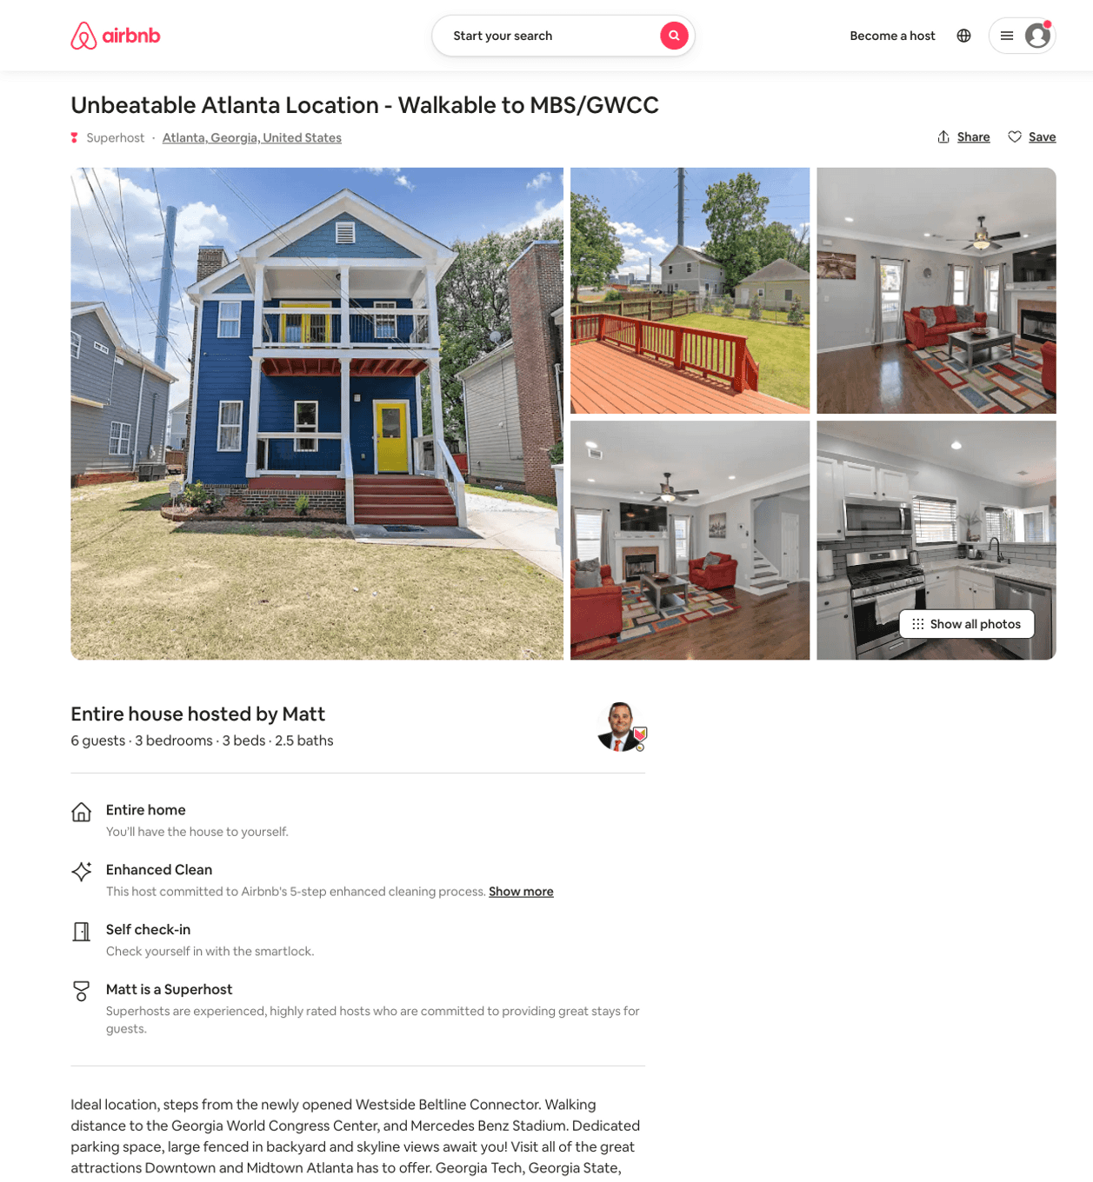
Listing 51001166
3
6
$213 - $628
4.73
3
Matt
150430543
4
https://www.airbnb.com/rooms/51001166
Aug 2022

Slide 45
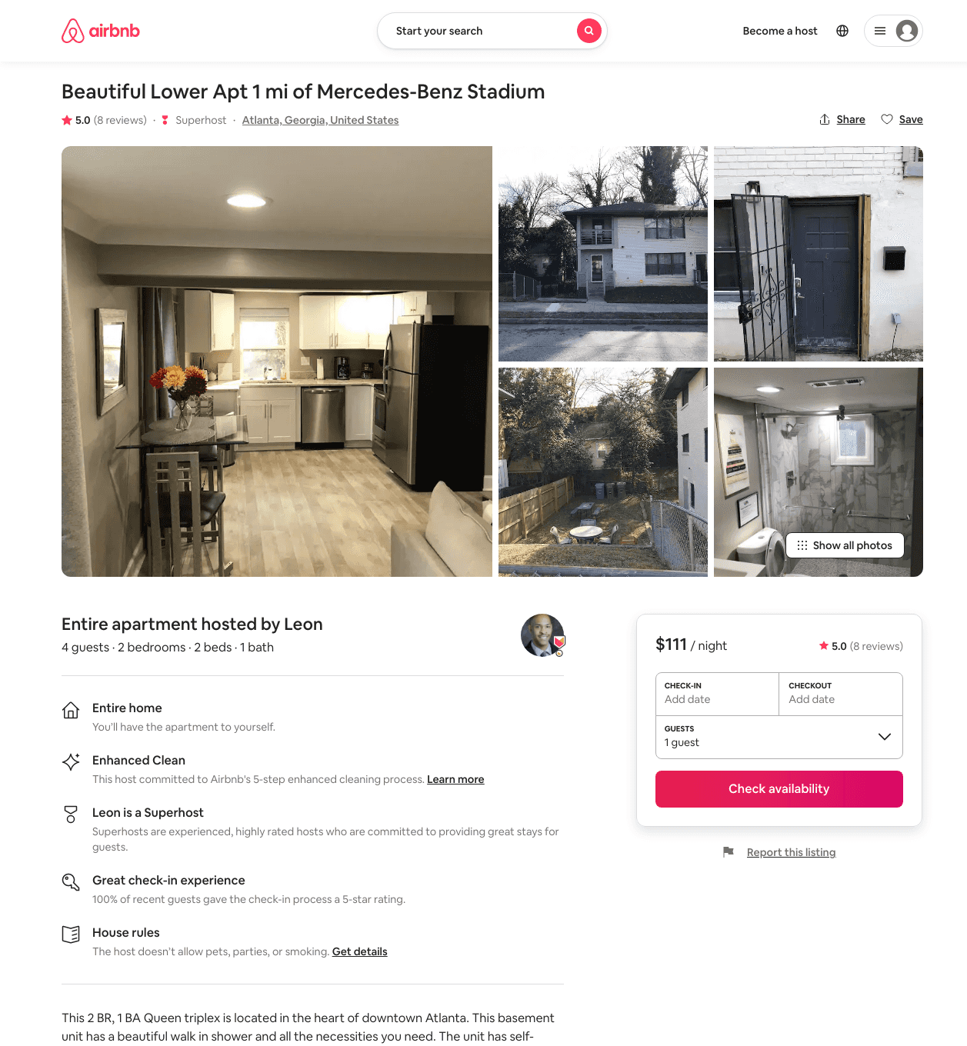
Listing 47532225
2
6
$96 - $126
4.88
2
Leon
330292329
3
https://www.airbnb.com/rooms/47532225
Jun 2022

Slide 46
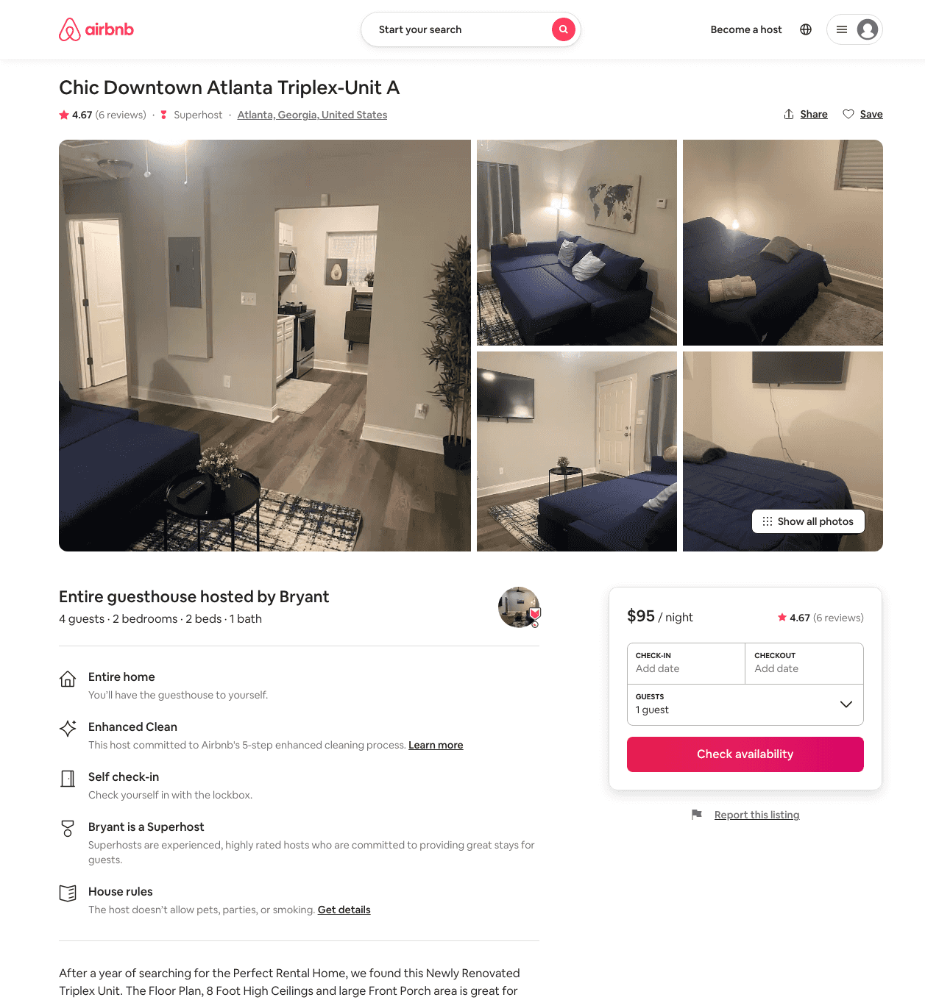
Listing 47391332
2
4
$82 - $98
4.66
14
Bryant
250716419
22
https://www.airbnb.com/rooms/47391332
Aug 2022

Slide 47
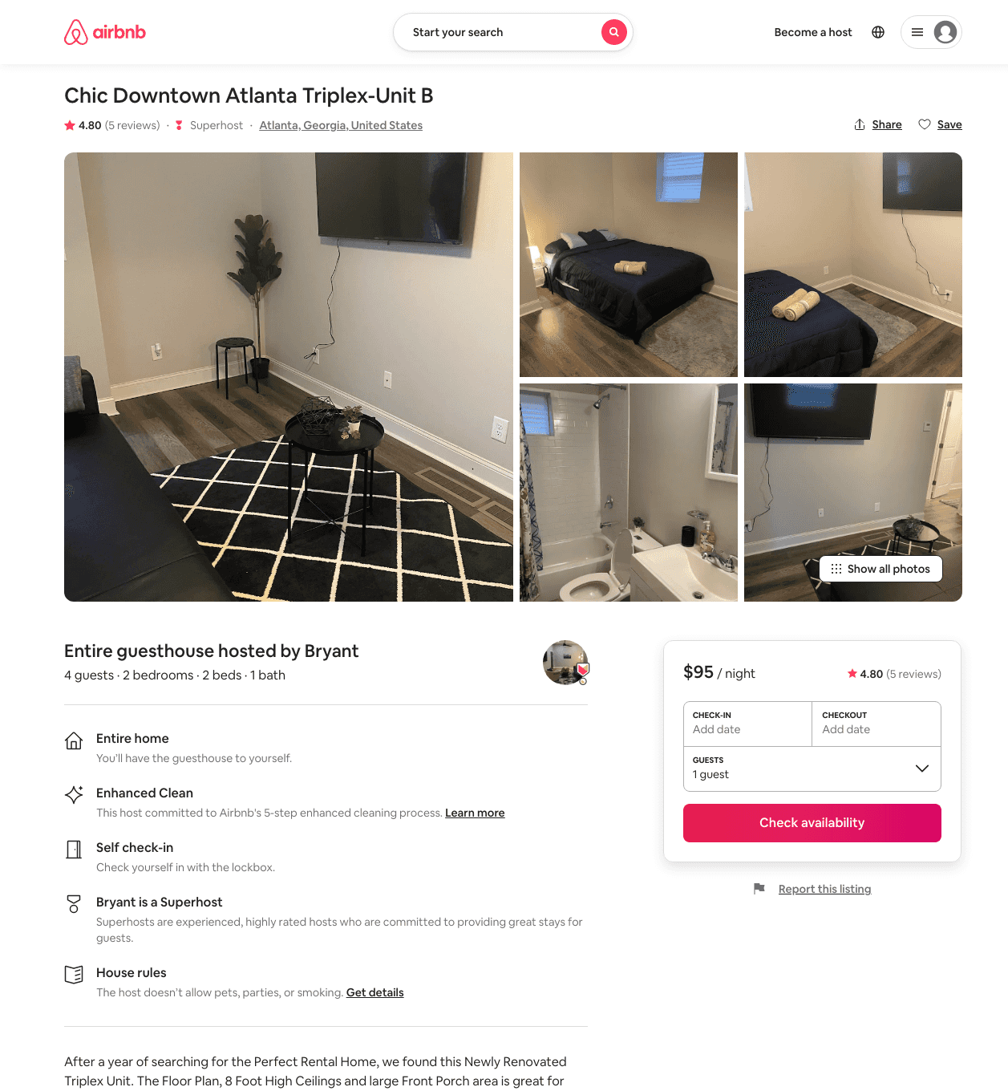
Listing 47390771
2
4
$91 - $109
4.57
2
Bryant
250716419
22
https://www.airbnb.com/rooms/47390771
Jun 2022

Slide 48
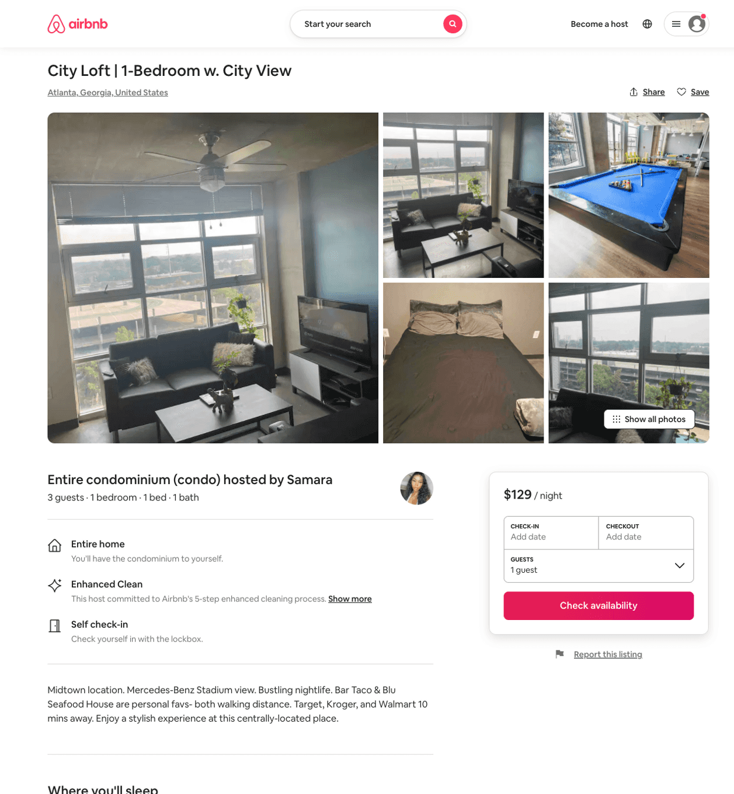
Listing 51363224
1
2
$115 - $150
3.33
2
Sammy
401818004
1
https://www.airbnb.com/rooms/51363224
Aug 2022

Slide 49
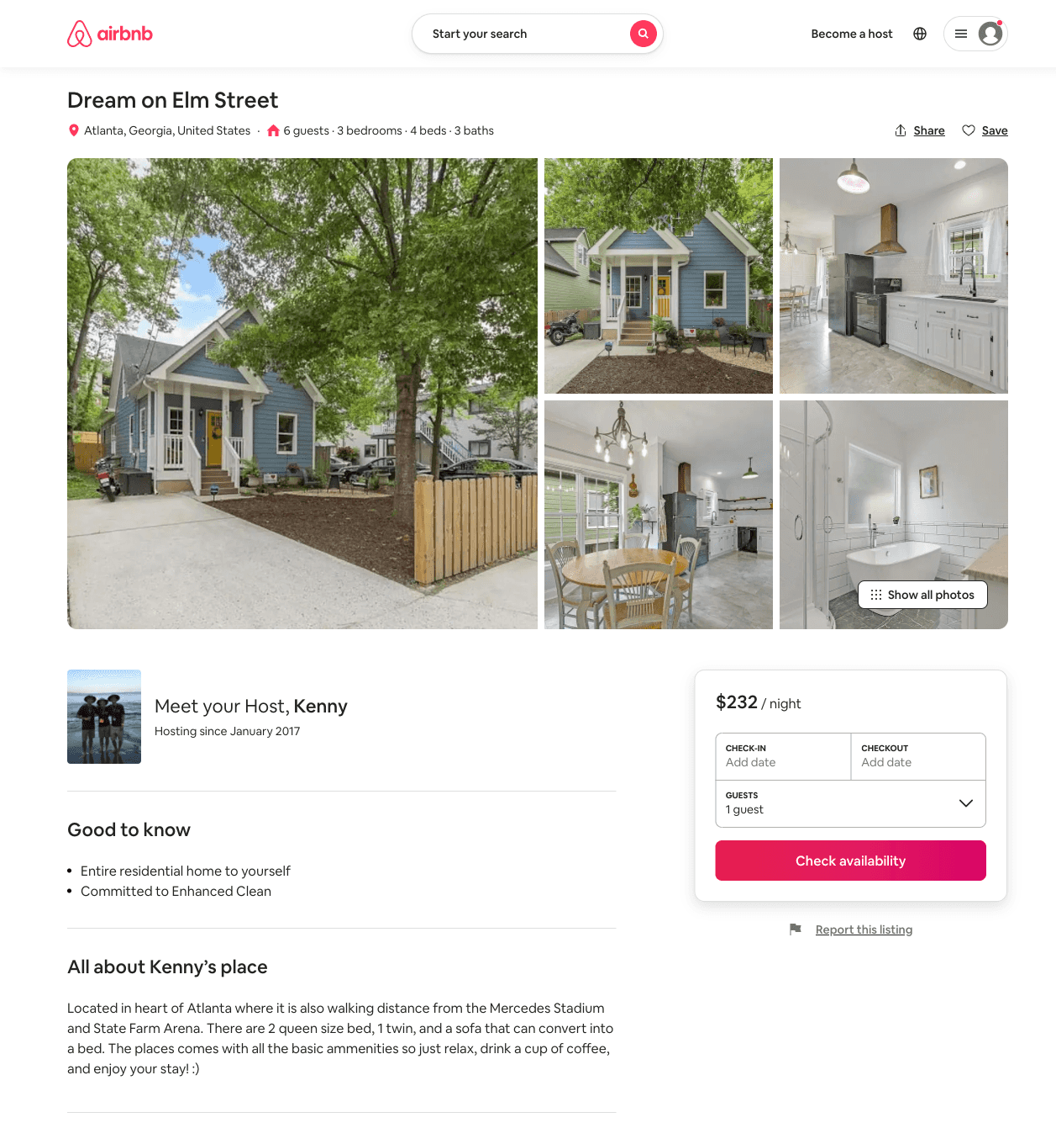
Listing 51537604
3
5
$158 - $250
5.0
1
Kenny
109358604
1
https://www.airbnb.com/rooms/51537604
Aug 2022

Slide 50
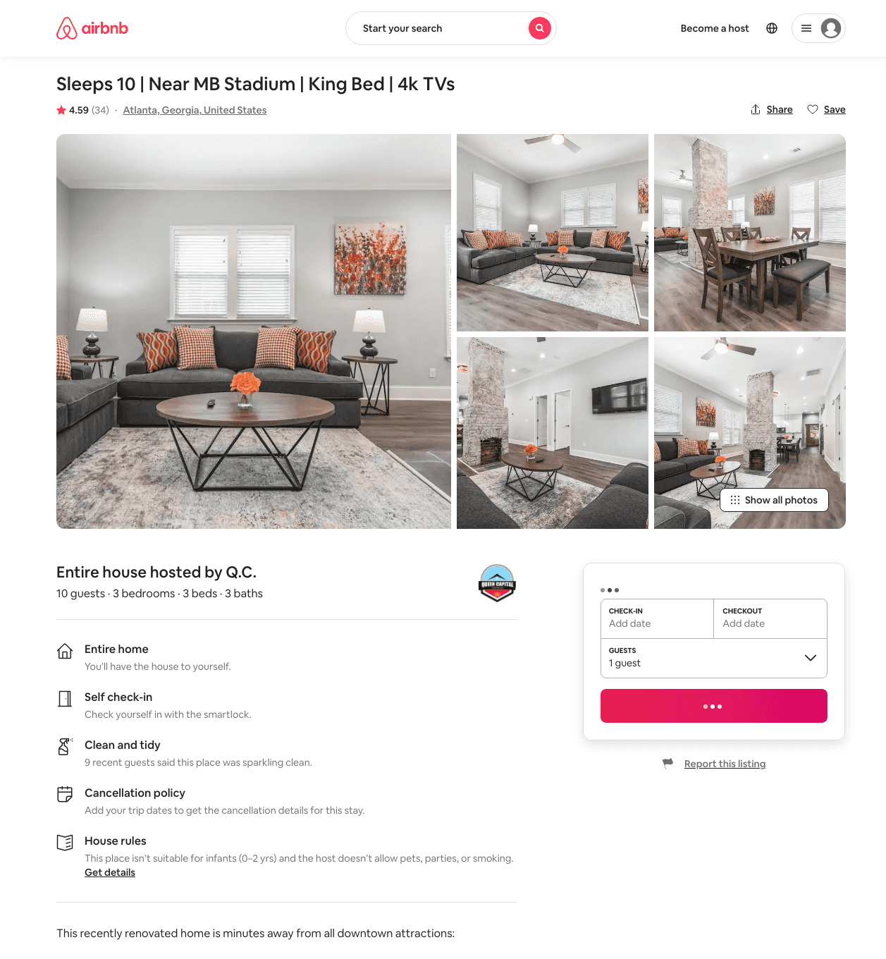
Listing 38678181
3
10
$135 - $232
4.13
2
Q.C.
278815354
5
https://www.airbnb.com/rooms/38678181
Aug 2022

Slide 51
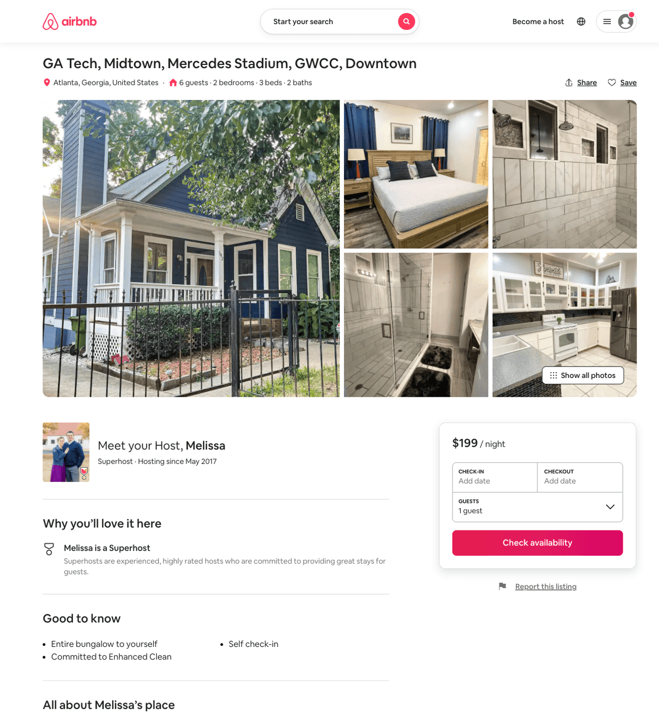
Listing 51930626
2
6
$142 - $414
4.93
1
Melissa
132553620
1
https://www.airbnb.com/rooms/51930626
Aug 2022

Slide 52
Listing 13865337
3
15
$600
4.88
1
Shauna
15667324
2
https://www.airbnb.com/rooms/13865337
Aug 2022

Slide 53
Listing 52185428
2
4
$136 - $157
5.0
2
Starr
130738639
1
https://www.airbnb.com/rooms/52185428
Jun 2022

Slide 54
Listing 48317765
3
5
$77 - $147
4.60
2
Jeff
360176866
1
https://www.airbnb.com/rooms/48317765
Jul 2022

Slide 55
Listing 51686977
2
4
$141
3.90
1
Alexis
349538864
1
https://www.airbnb.com/rooms/51686977
Aug 2022

Slide 56
Listing 34145089
2
5
$151 - $343
4.82
2
Danielle
221755414
2
https://www.airbnb.com/rooms/34145089
Aug 2022

Slide 57
Listing 45609745
2
5
$183 - $229
2
Kevin
73221651
3
https://www.airbnb.com/rooms/45609745
Aug 2022

Slide 58
Listing 52619705
1
2
$47 - $99
4.90
2
Kevin
73221651
3
https://www.airbnb.com/rooms/52619705
Aug 2022

Slide 59
Listing 11068399
1
2
$29 - $36
4.33
2
Rick
42301069
34
https://www.airbnb.com/rooms/11068399
Aug 2022

Slide 60
Listing 53029117
2
4
$106 - $143
4.36
3
Rnb
429282261
1
https://www.airbnb.com/rooms/53029117
Jul 2022

Slide 61
Listing 53026090
2
5
$161 - $175
5.0
2
Elijah
143241430
1
https://www.airbnb.com/rooms/53026090
Aug 2022

Slide 62
Listing 52986727
2
5
$140
3.67
1
Talia
350728092
2
https://www.airbnb.com/rooms/52986727
Aug 2022

Slide 63
Listing 1428221
4
10
$249 - $272
3.857143
1
Mary & Memo
https://www.vrbo.com/1428221
Aug 2022

Slide 64
Listing 2550924
5
14
$565
5
2
Kimberley
https://www.vrbo.com/2550924
Aug 2022

Slide 65
Listing 54083088
1
2
$80 - $107
4.75
1
Janice
155113171
4
https://www.airbnb.com/rooms/54083088
Aug 2022

Slide 66
Listing 54083166
1
3
$98
4.60
1
Janice
155113171
4
https://www.airbnb.com/rooms/54083166
Jun 2022

Slide 67
Listing a-room-for-you
undefined
2
7.5
https://www.booking.com/hotel/us/a-room-for-you.html
Sep 2022

Slide 68
Listing 50034276
2
5
$115
2
Justice
400025653
1
https://www.airbnb.com/rooms/50034276
Aug 2022

Slide 69
Listing 2647948
2
2
$189
5
2
Elijah King
https://www.vrbo.com/2647948
Aug 2022

Slide 70
Listing 2703288
1
2
$120
1
bigplay
https://www.vrbo.com/2703288
Aug 2022

Slide 71
Listing 12896340
1
2
$33 - $36
4.23
1
Rick
42301069
34
https://www.airbnb.com/rooms/12896340
Jun 2022

Slide 72
Listing 2720893
4
8
$119
5
2
Vacasa of Georgia
https://www.vrbo.com/2720893
Aug 2022

Slide 73
Listing 2725804
2
6
$129
2
https://www.vrbo.com/2725804
Aug 2022

Slide 74
Listing 2748391
3
6
$400
3.5
2
https://www.vrbo.com/2748391
Aug 2022

Slide 75
Listing 2763680
2
6
$201
5
1
Suite Retreat Properties
https://www.vrbo.com/2763680
Aug 2022

Slide 76
Listing 2755600
1
4
$168
2
https://www.vrbo.com/2755600
Aug 2022

Slide 77
Listing 2769359
4
10
$318
2
Lauren Meeks
https://www.vrbo.com/2769359
Aug 2022

Slide 78
Listing 2795537
1
2
$125
2
https://www.vrbo.com/2795537
Aug 2022

Slide 79
Listing 2861705
3
6
$157
4
1
https://www.vrbo.com/2861705
Aug 2022

Slide 80
Listing 52647974
2
4
$150
2
F
55920164
1
https://www.airbnb.com/rooms/52647974
Jun 2022

Slide 81
Listing 50268243
2
5
2
Eminent Rentals, LLC
271693445
2
https://www.airbnb.com/rooms/50268243
Aug 2022

Slide 82
Listing 12978767
1
4
$33
4.52
2
Rick
42301069
34
https://www.airbnb.com/rooms/12978767
Aug 2022

