Slide 2
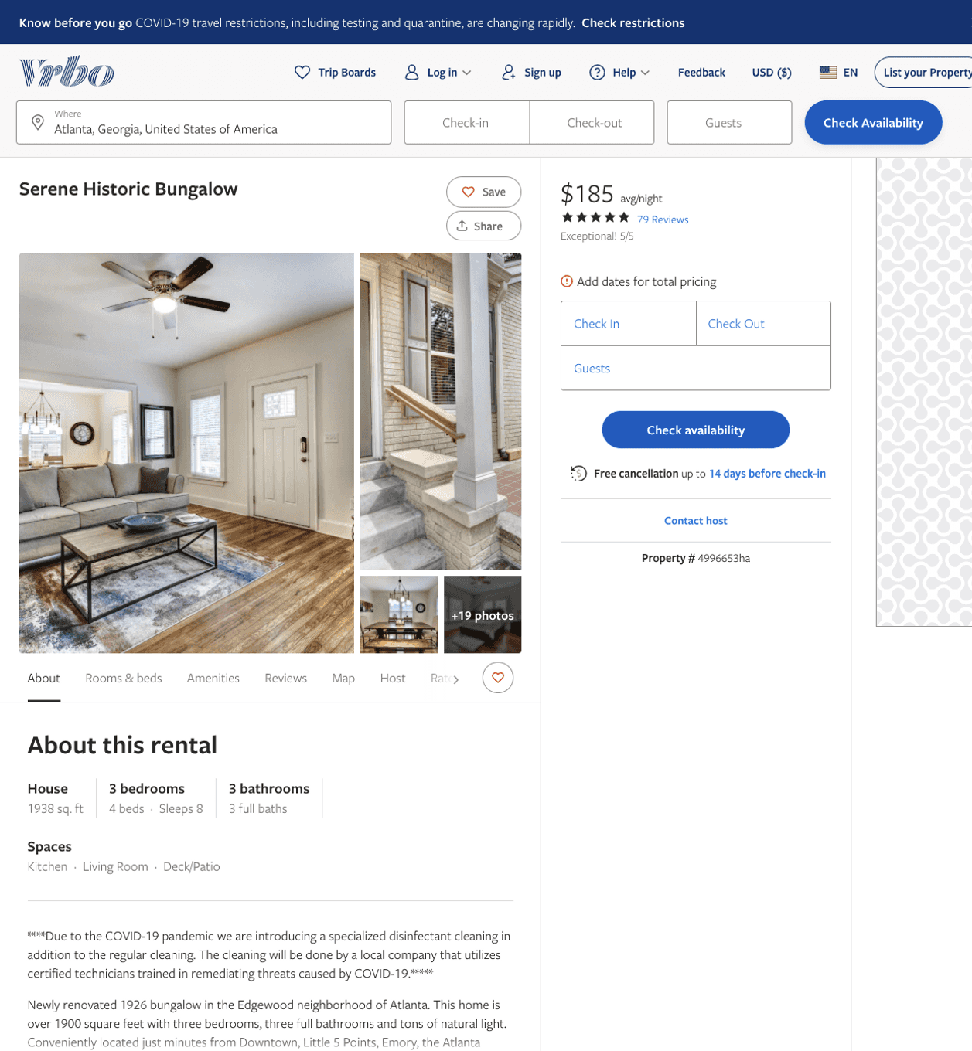
Listing 4996653
3
8
$161 - $218
4.980198
2
Justin Heard
https://www.vrbo.com/4996653ha
Aug 2022

Slide 3
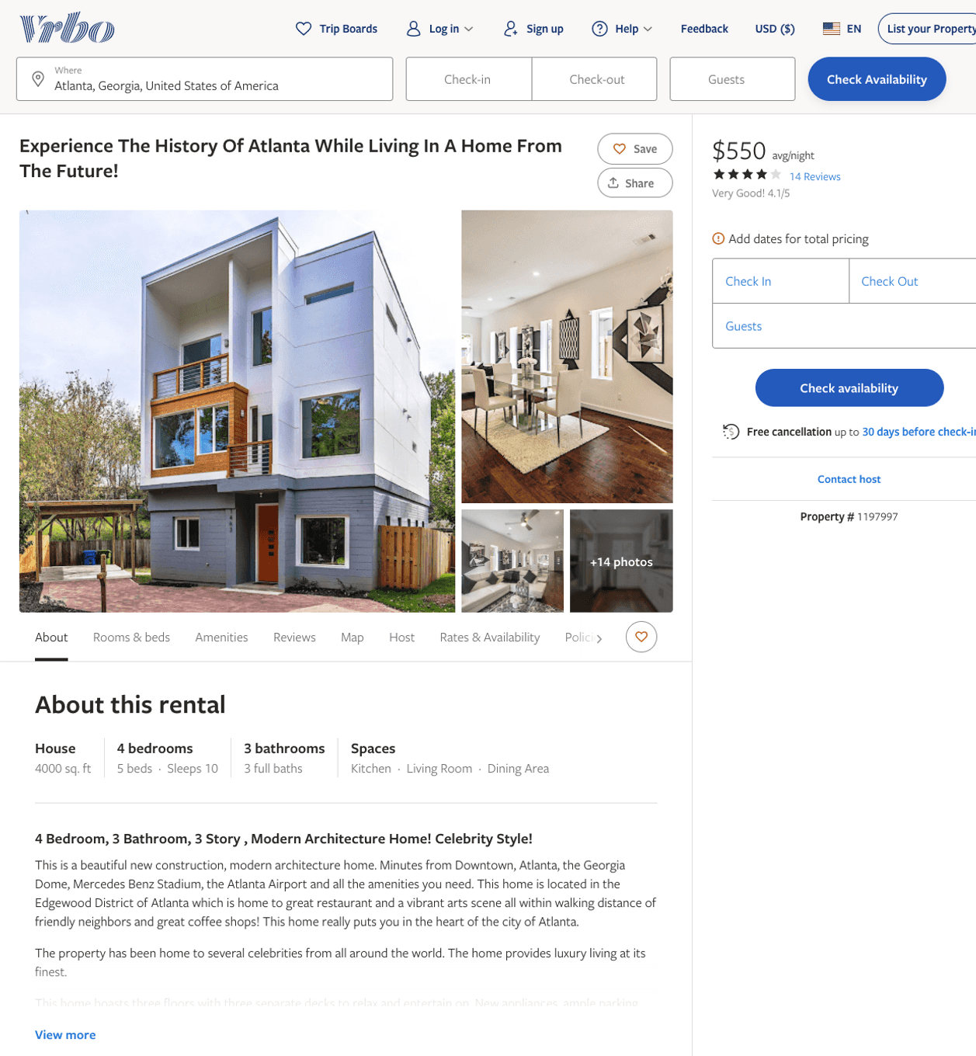
Listing 1197997
4
10
$550
4.125
1
Amy Walton
https://www.vrbo.com/1197997
Aug 2022

Slide 4
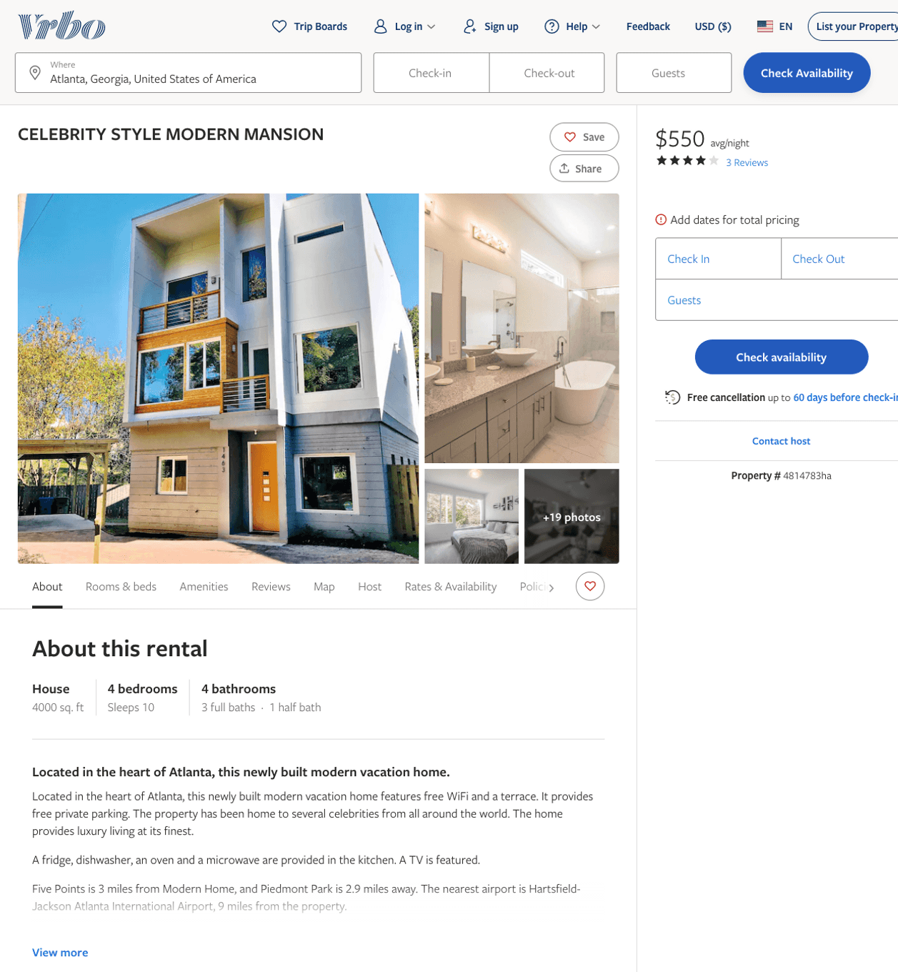
Listing 4814783
4
10
$550
4.6
1
https://www.vrbo.com/4814783ha
Aug 2022

Slide 5
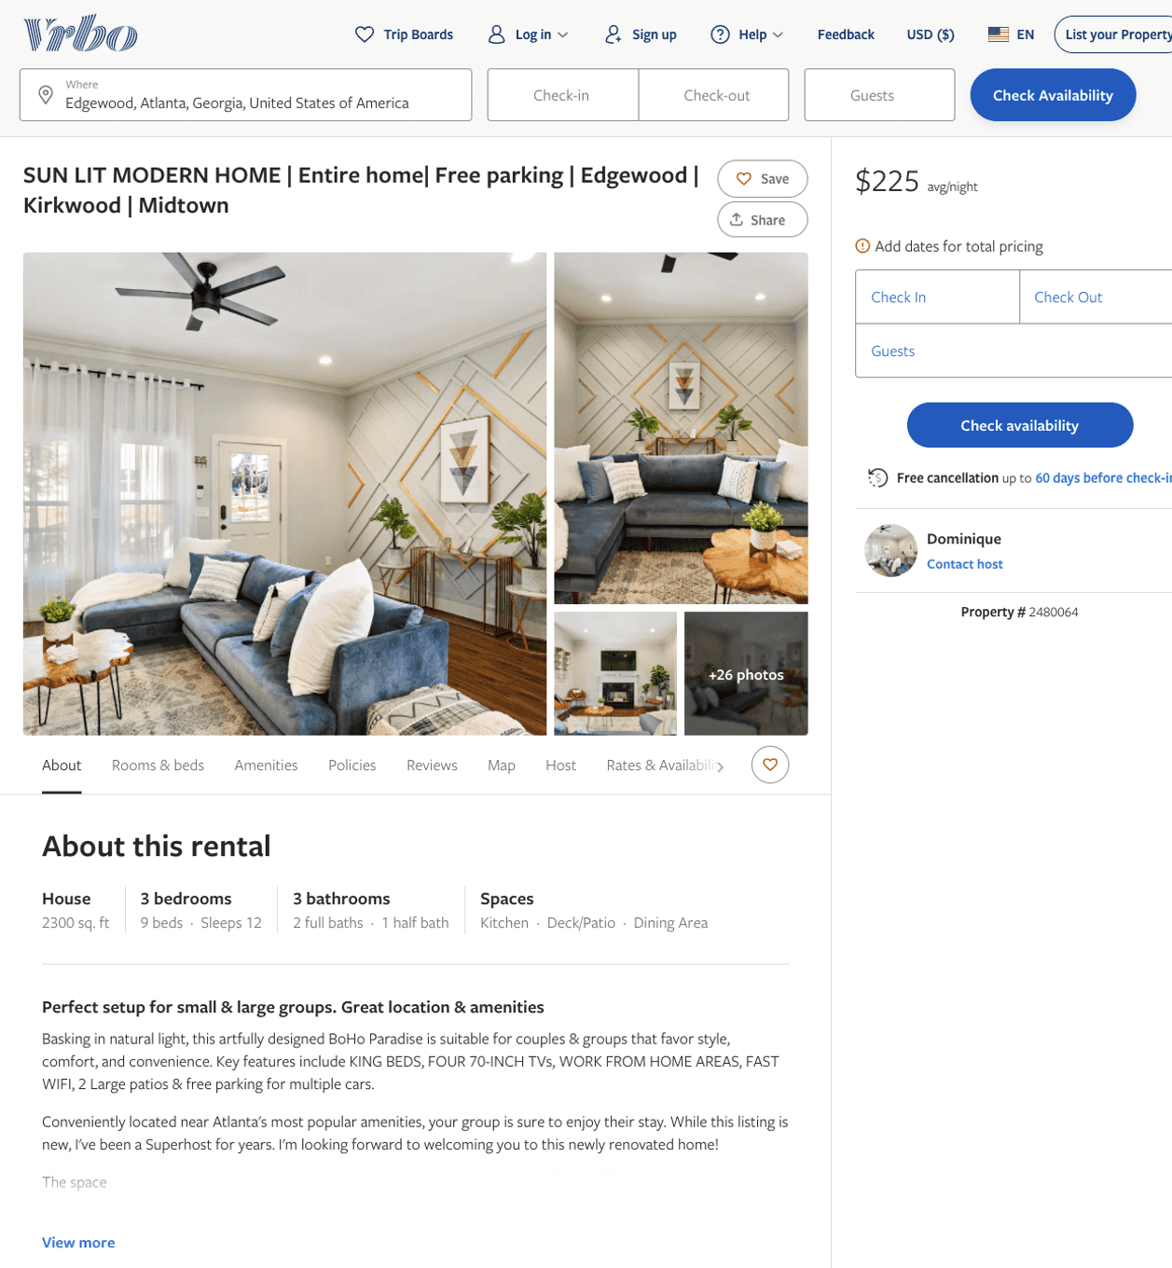
Listing 2480064
3
8
$225 - $359
5
1
Dominique
https://www.vrbo.com/2480064
Aug 2022

Slide 6
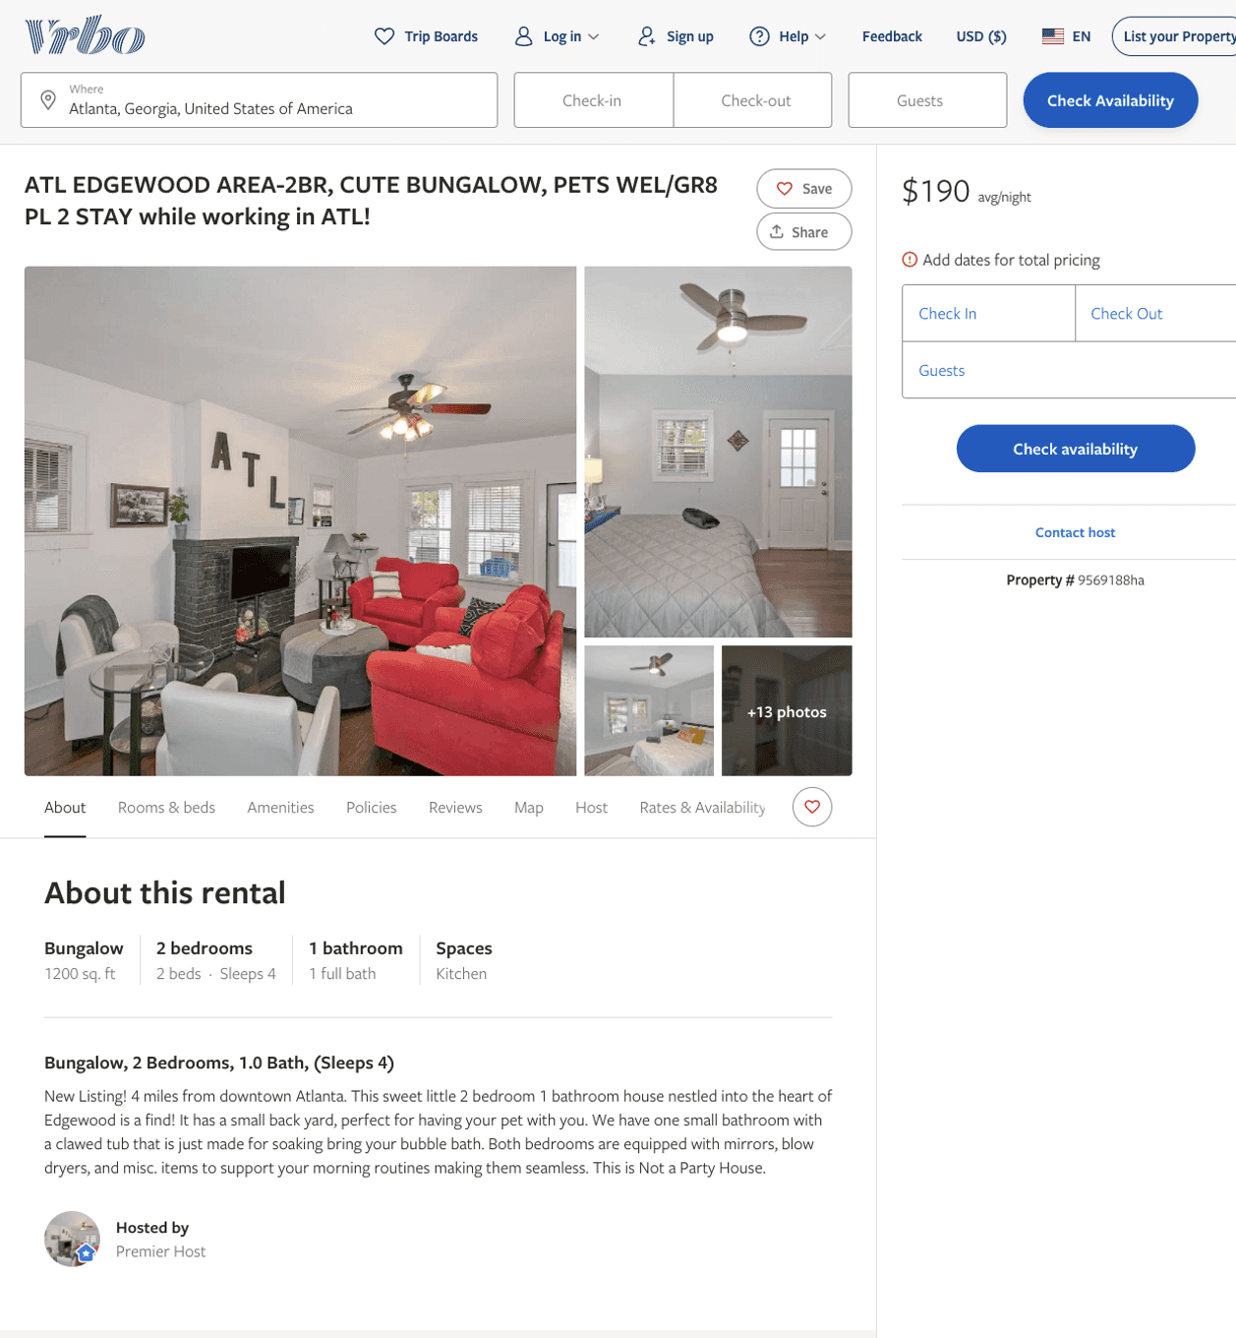
Listing 9569188
2
4
$127 - $207
5
1
https://www.vrbo.com/9569188ha
Aug 2022

Slide 7
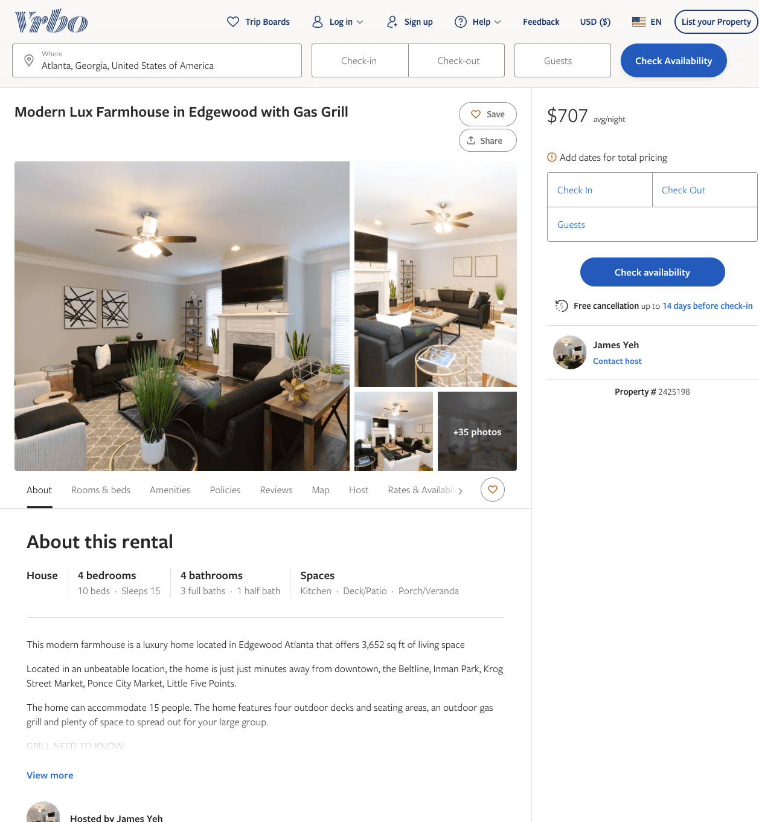
Listing 2425198
4
15
$375 - $625
4.785714
1
James and Anne
https://www.vrbo.com/2425198
Aug 2022

Slide 8
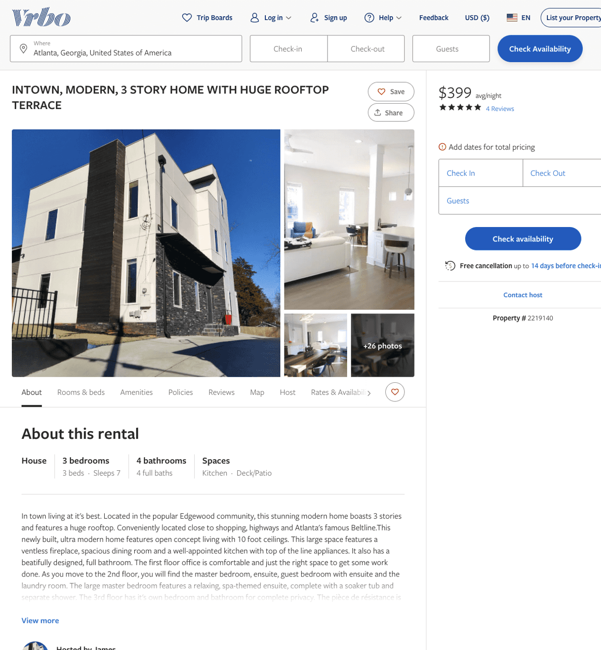
Listing 2219140
3
6
$358 - $399
4.8333335
2
James
https://www.vrbo.com/2219140
Aug 2022

Slide 9
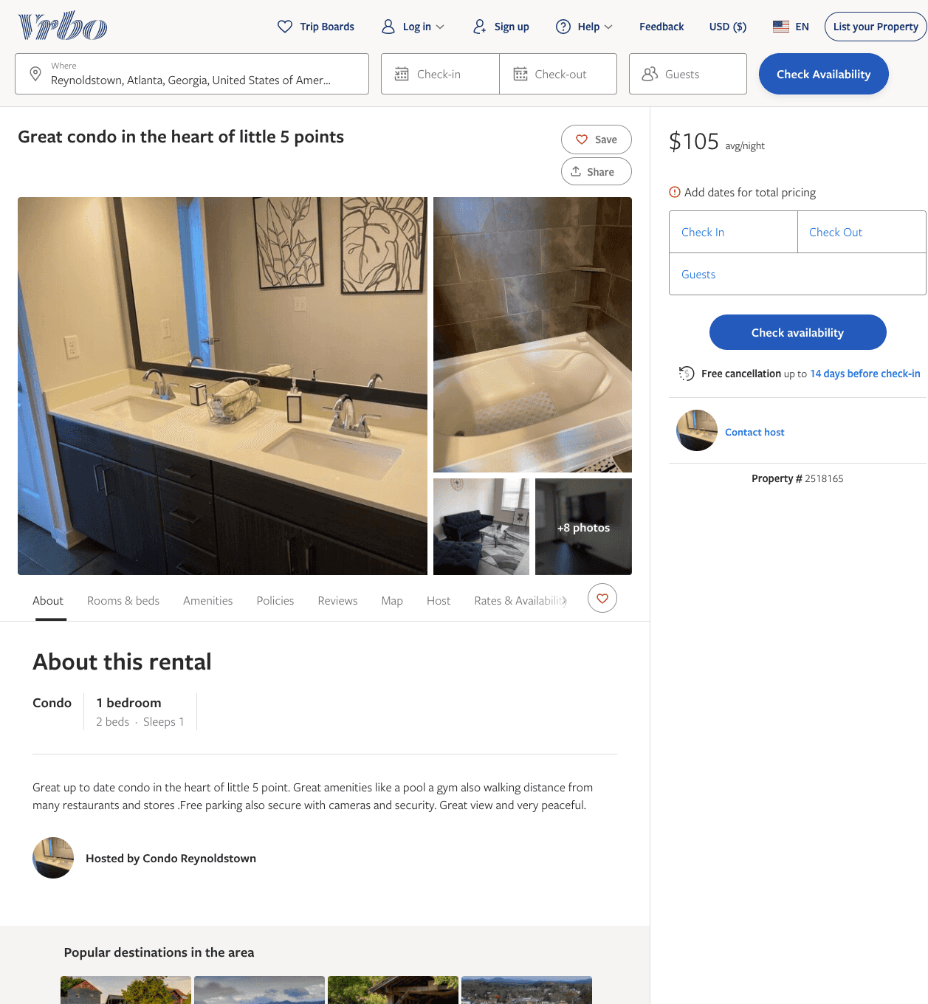
Listing 2518165
1
1
$100 - $150
1
https://www.vrbo.com/2518165
Aug 2022

Slide 10
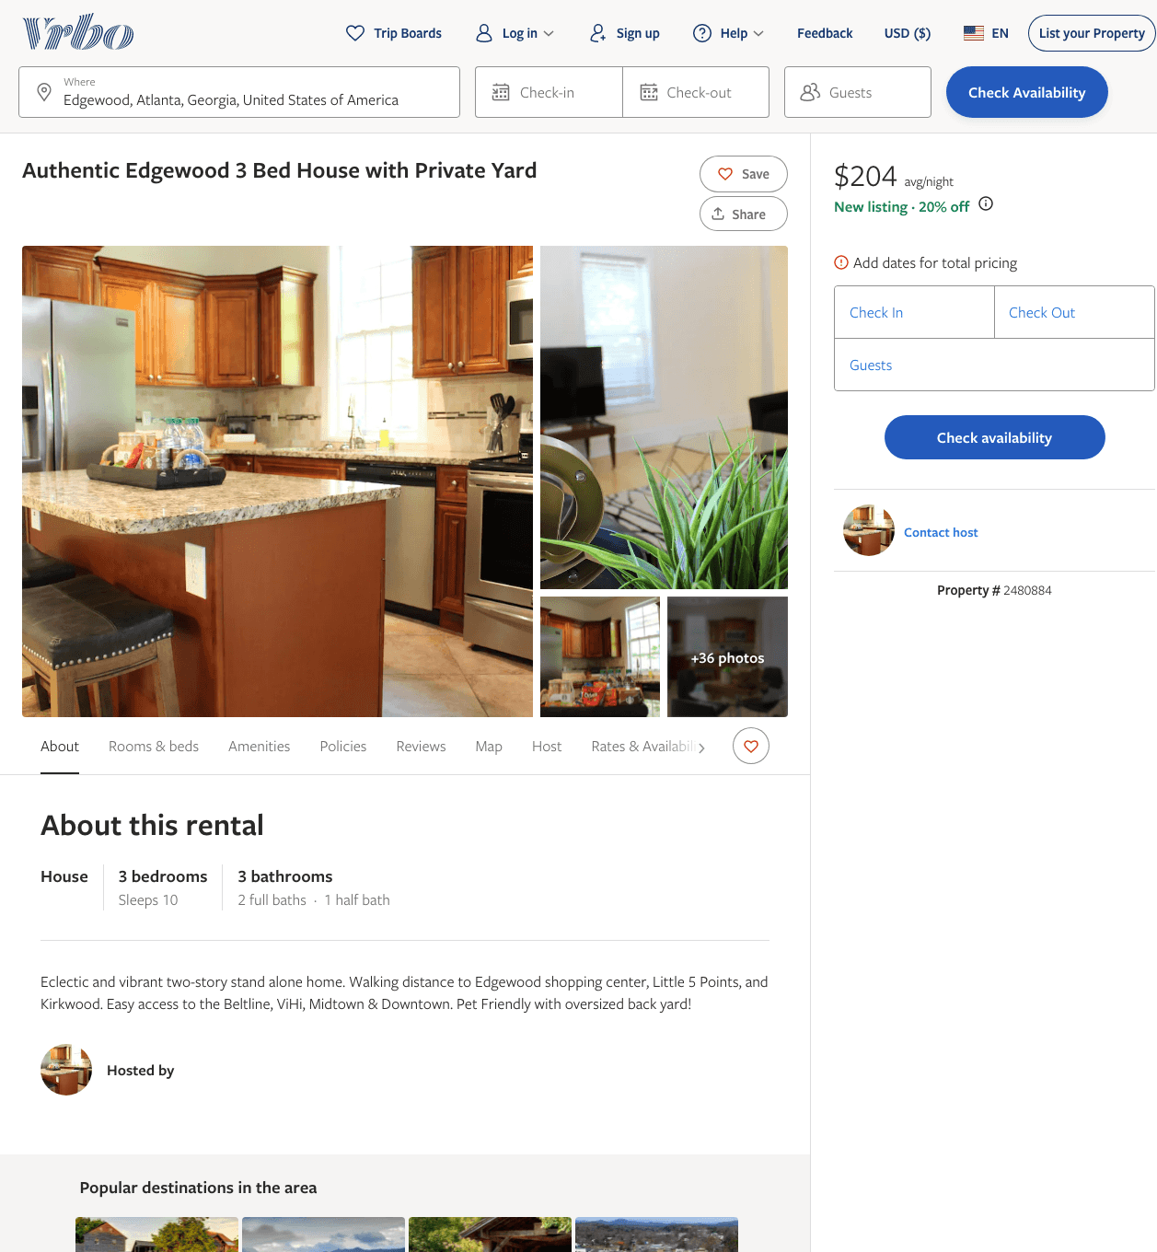
Listing 2480884
3
10
$204 - $266
5
https://www.vrbo.com/2480884
Aug 2022

Slide 11
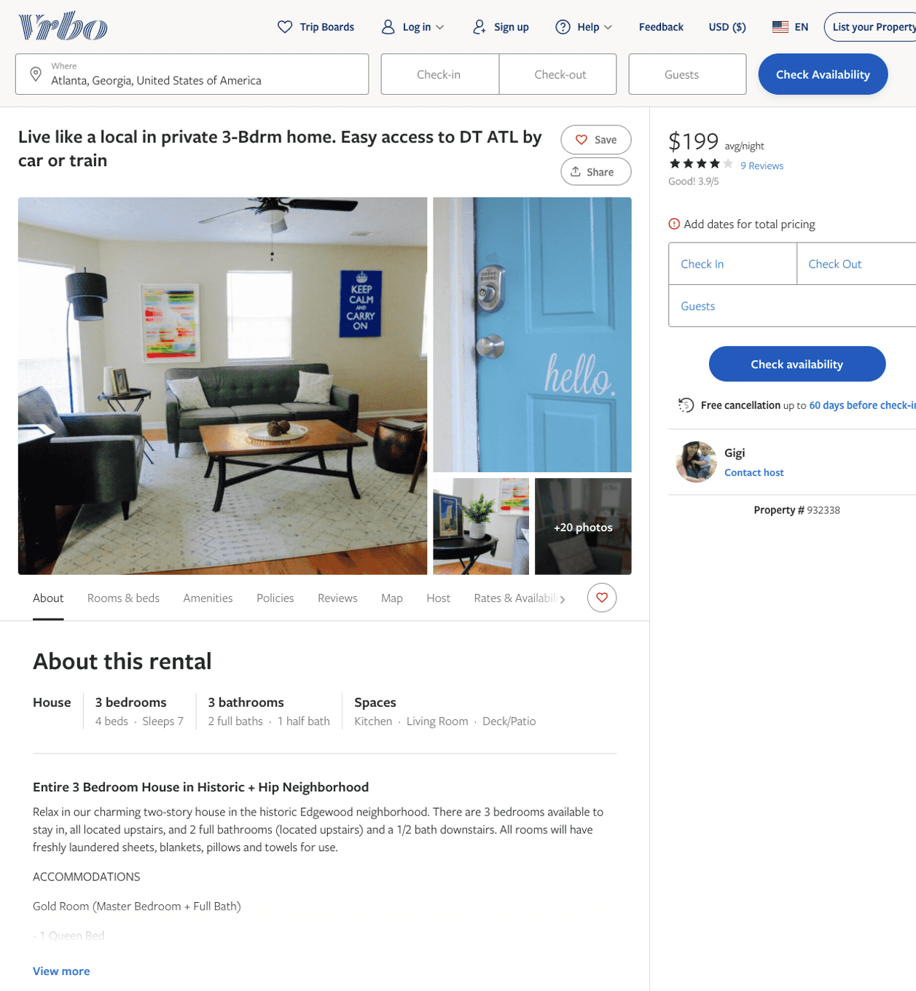
Listing 932338
3
7
$199
3.8888888
2
Gigi
https://www.vrbo.com/932338
Aug 2022

Slide 12
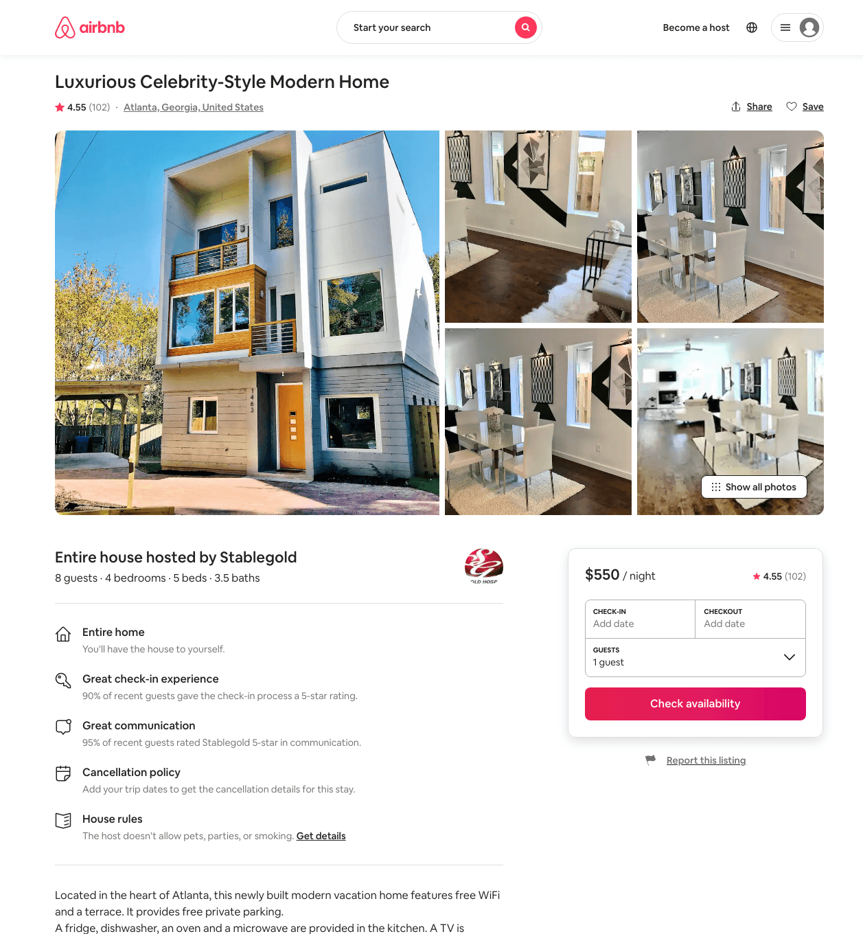
Listing 21588731
4
8
$499 - $636
4.55
1
Stablegold
156889225
1
https://www.airbnb.com/rooms/21588731
Aug 2022

Slide 13
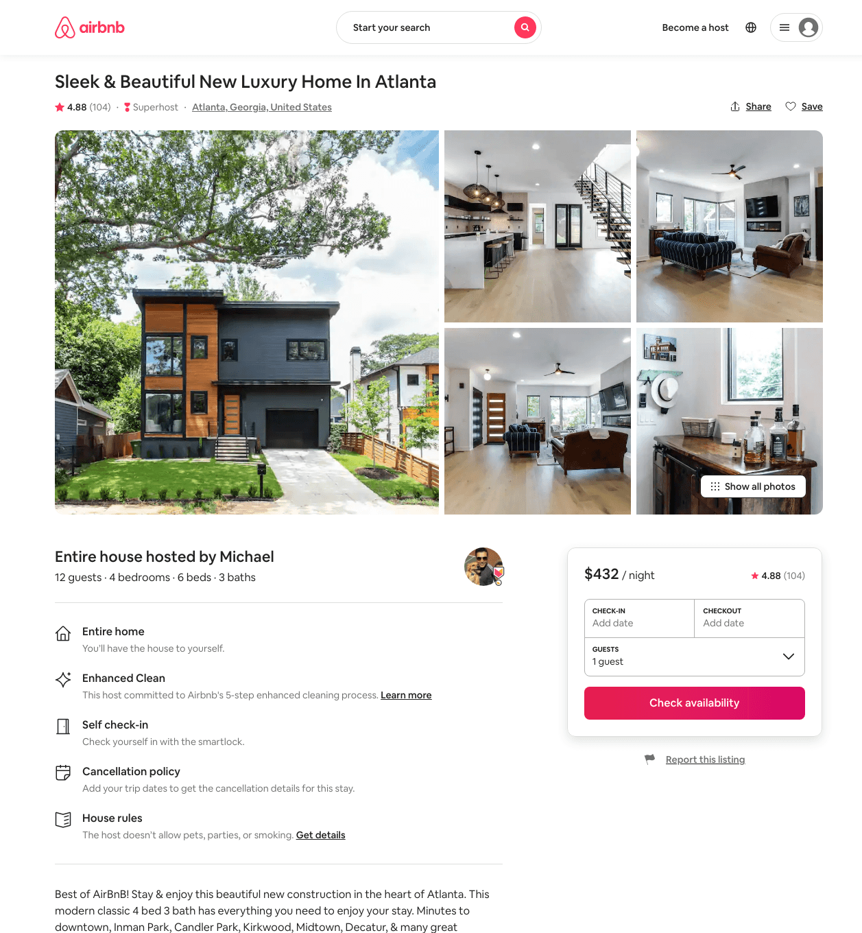
Listing 36431114
4
12
$271 - $506
4.91
1
Michael
143143166
5
https://www.airbnb.com/rooms/36431114
Aug 2022

Slide 14
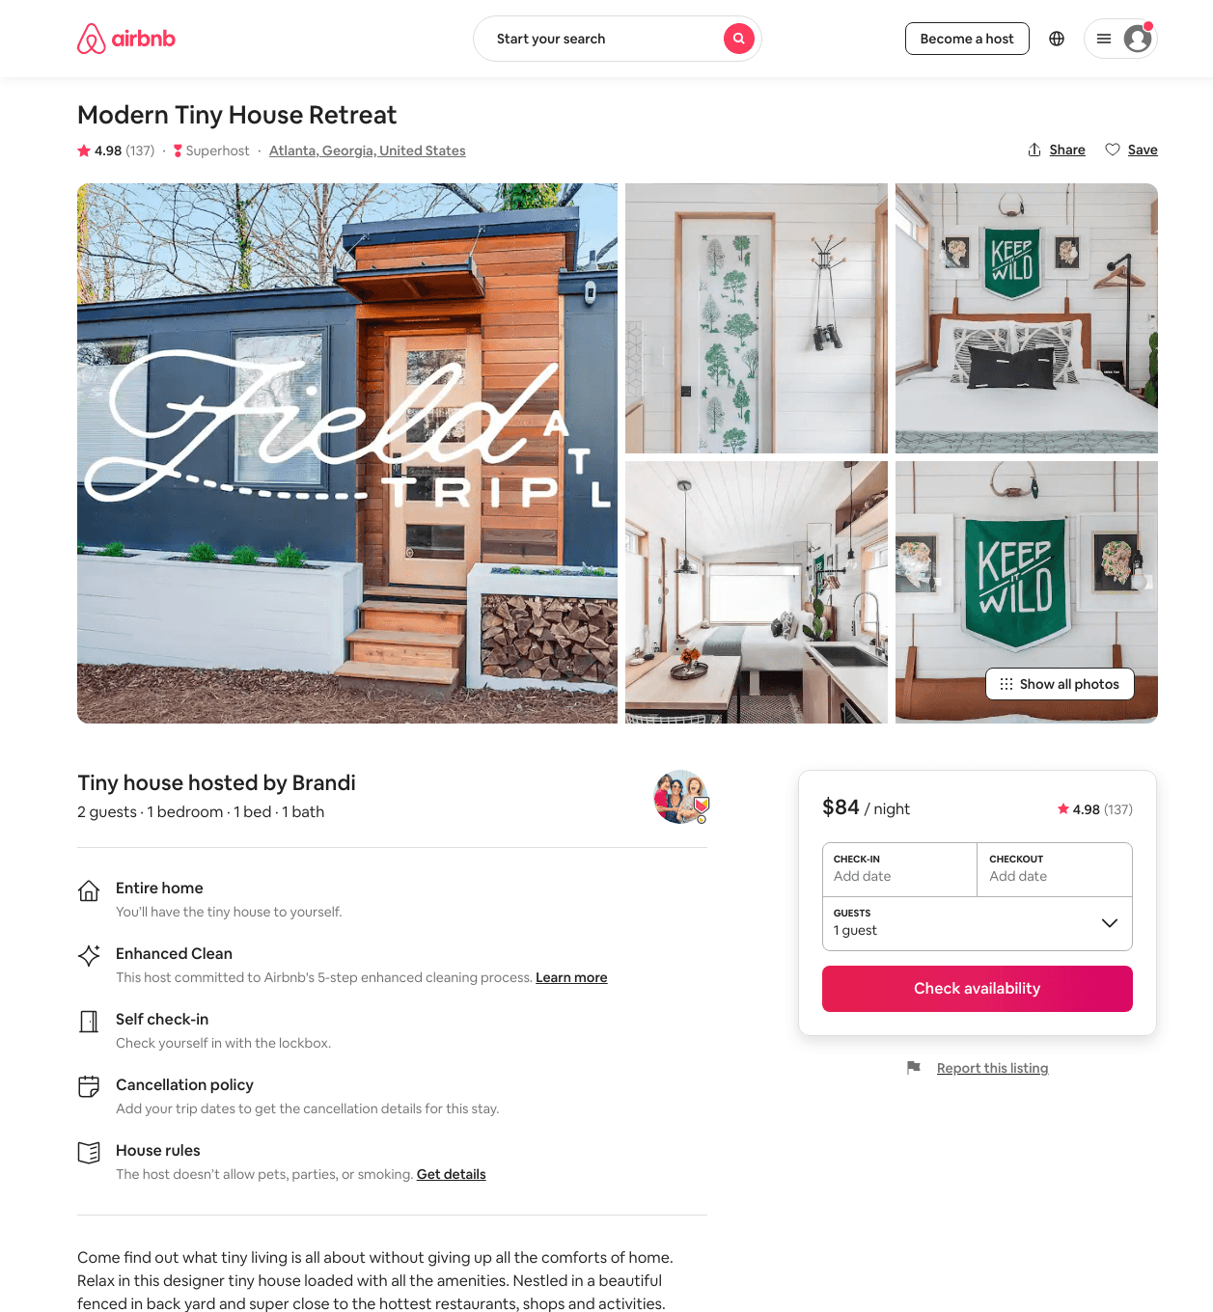
Listing 42111286
1
2
$80 - $107
4.98
2
Brandi
32982
2
https://www.airbnb.com/rooms/42111286
Aug 2022

Slide 15
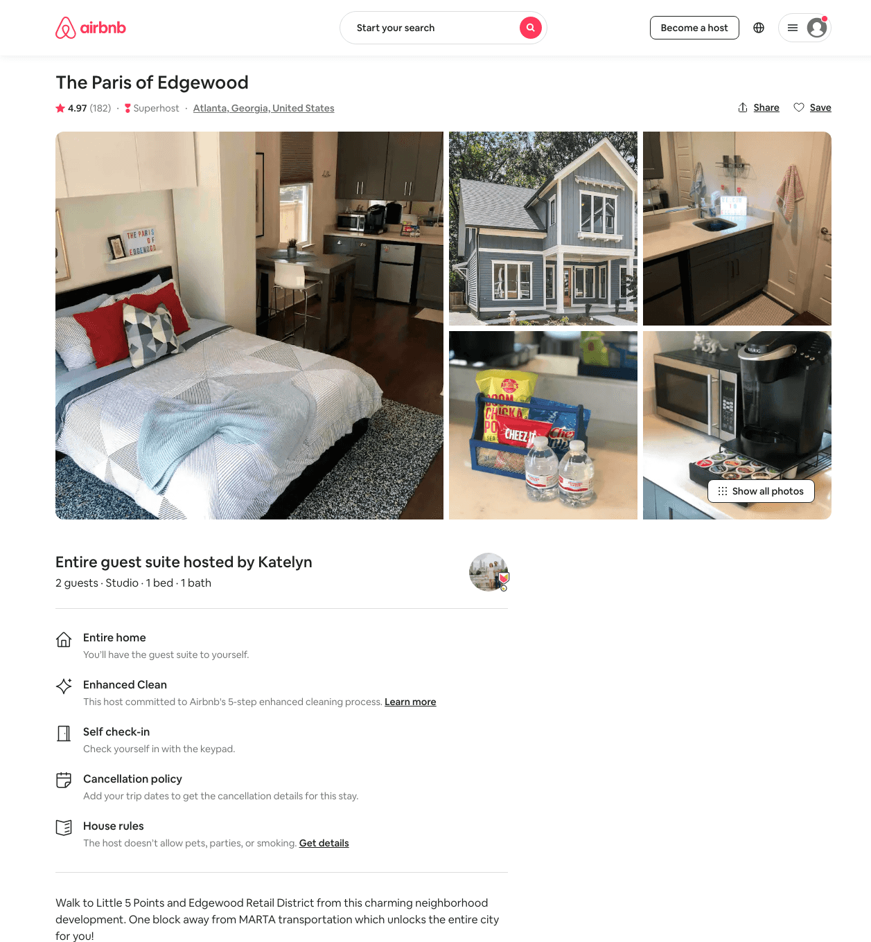
Listing 31404744
Studio
2
$75 - $95
4.97
2
Katelyn
50926147
1
https://www.airbnb.com/rooms/31404744
Aug 2022

Slide 16
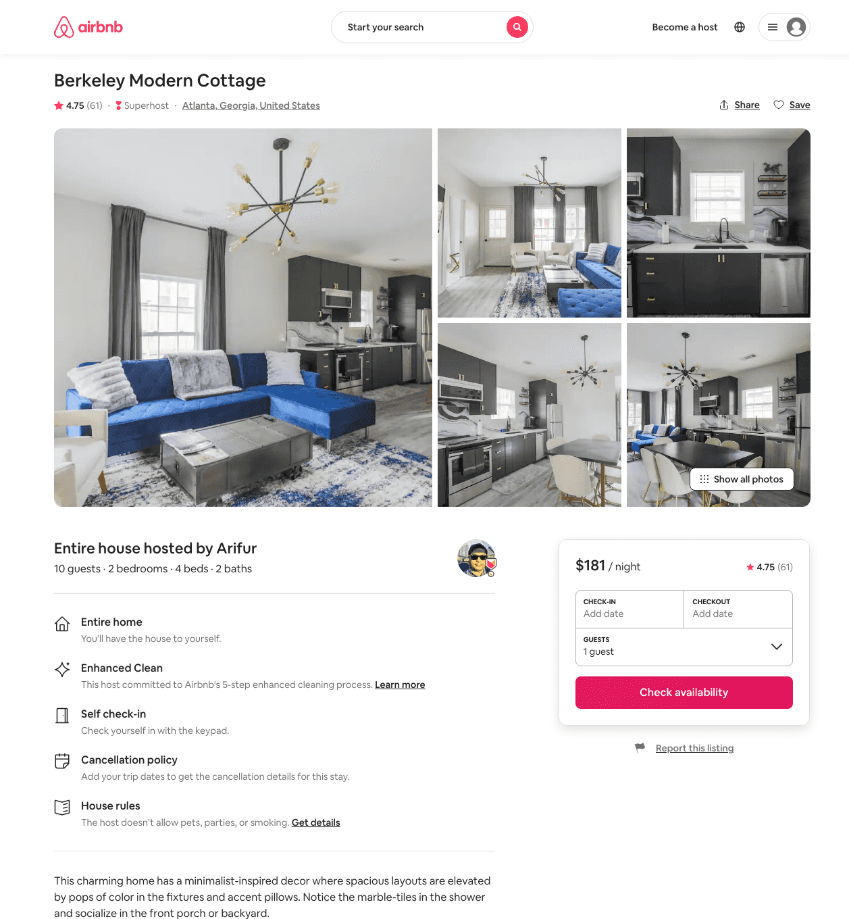
Listing 40900502
4
8
$164 - $302
4.86
3
Arifur
229448368
3
https://www.airbnb.com/rooms/40900502
Aug 2022

Slide 17
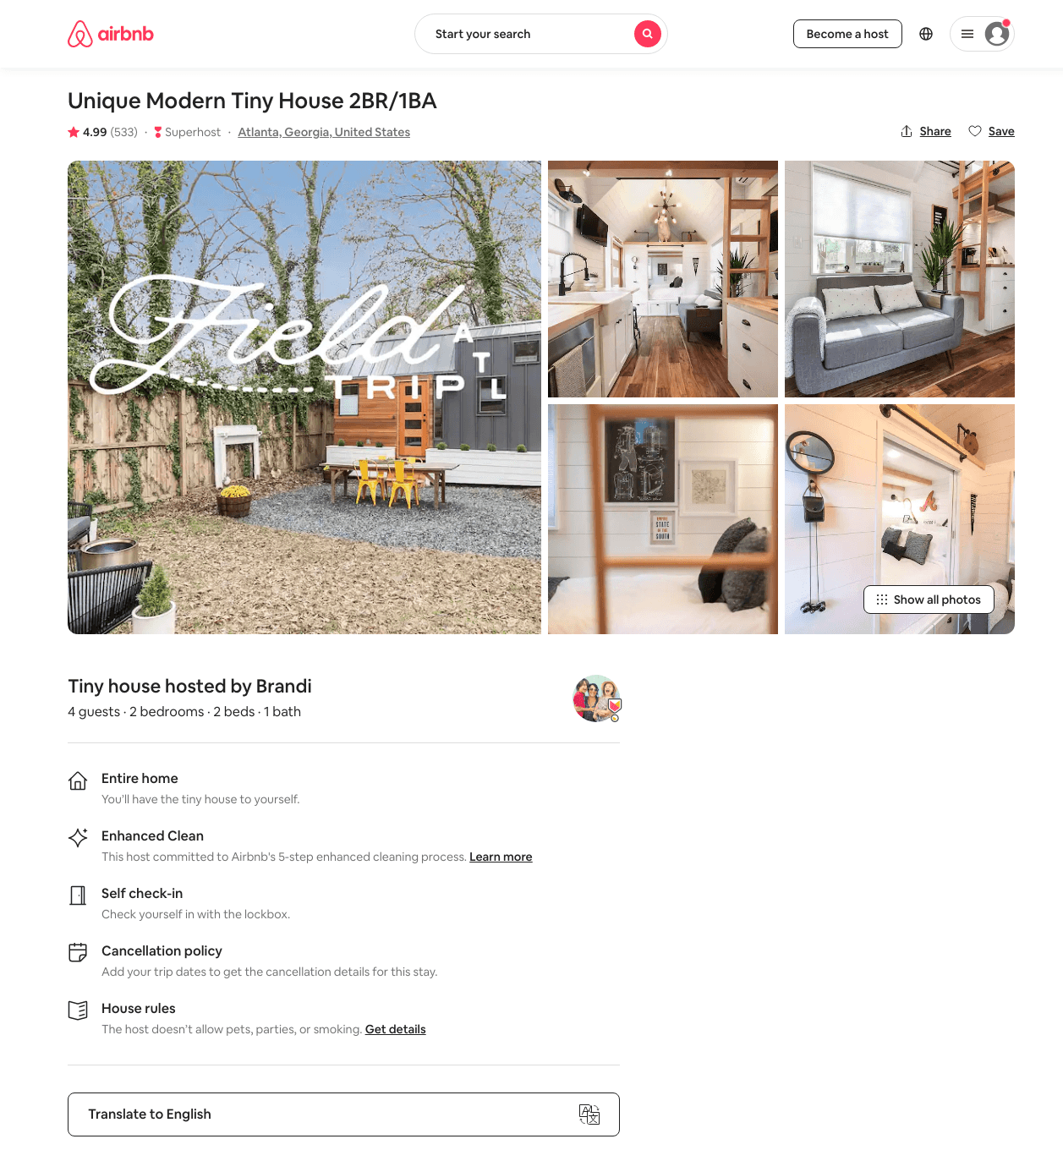
Listing 21921673
2
4
$93 - $126
4.99
2
Brandi
32982
2
https://www.airbnb.com/rooms/21921673
Aug 2022

Slide 18
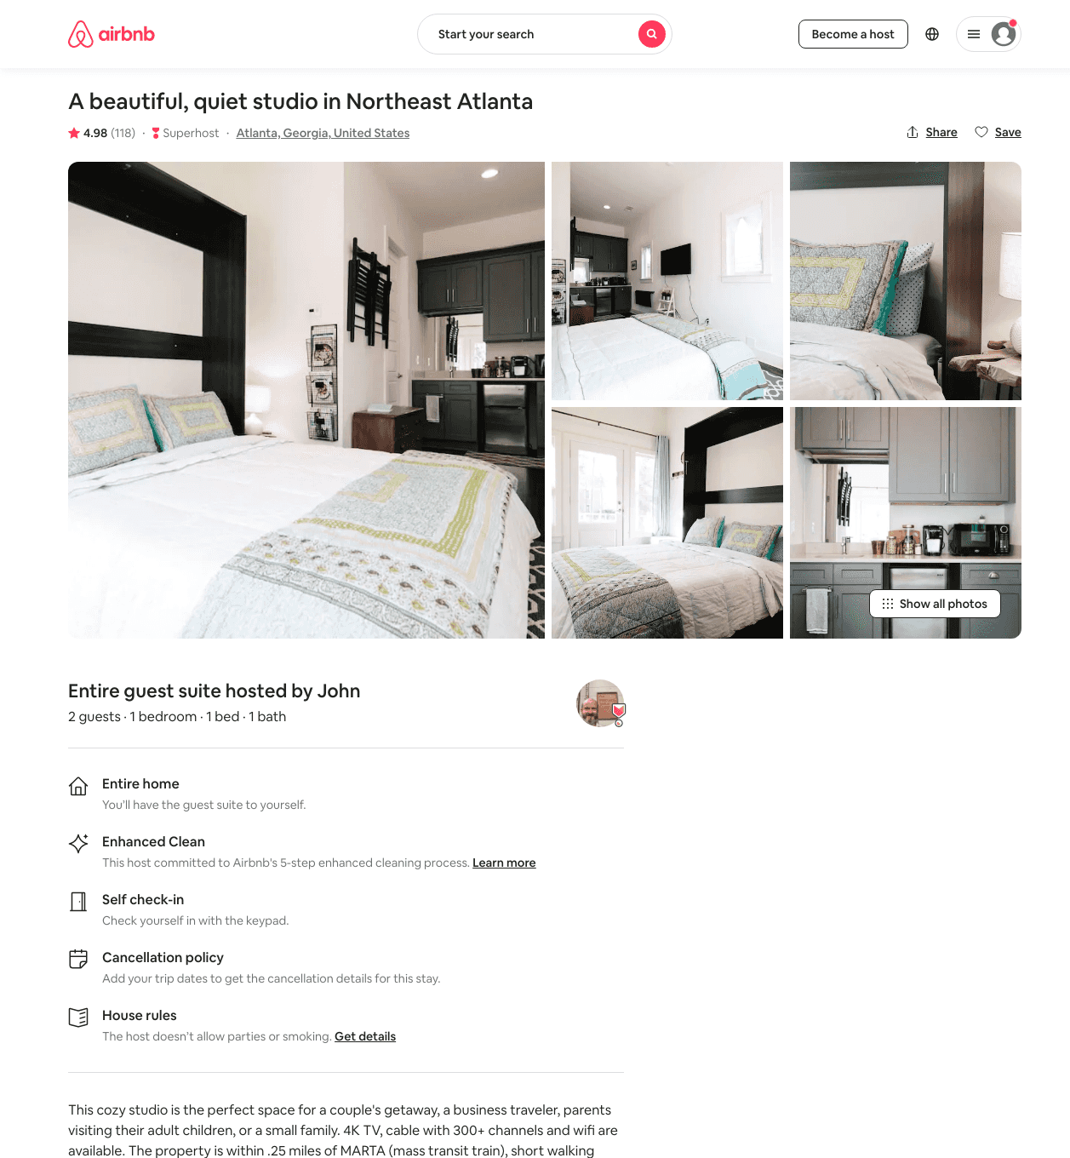
Listing 22518459
1
2
$69 - $88
4.99
2
John
148852942
1
https://www.airbnb.com/rooms/22518459
Jul 2022

Slide 19
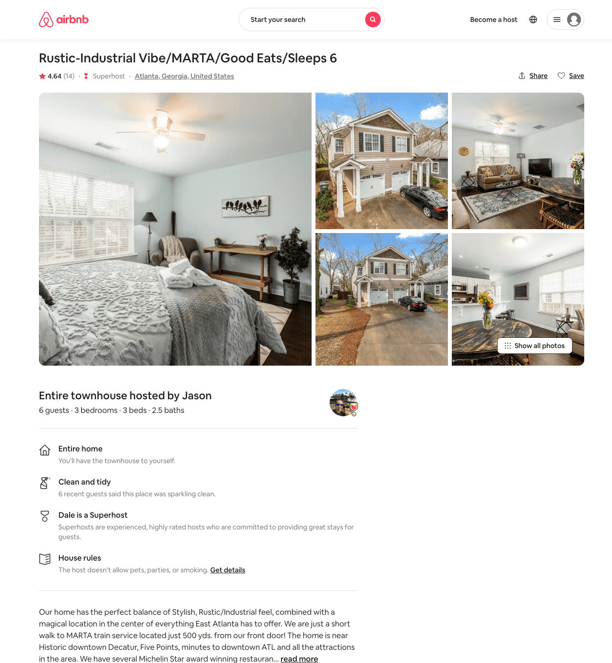
Listing 42290804
3
6
$151 - $214
4.67
5
Jason
136239447
4
https://www.airbnb.com/rooms/42290804
Jun 2022

Slide 20
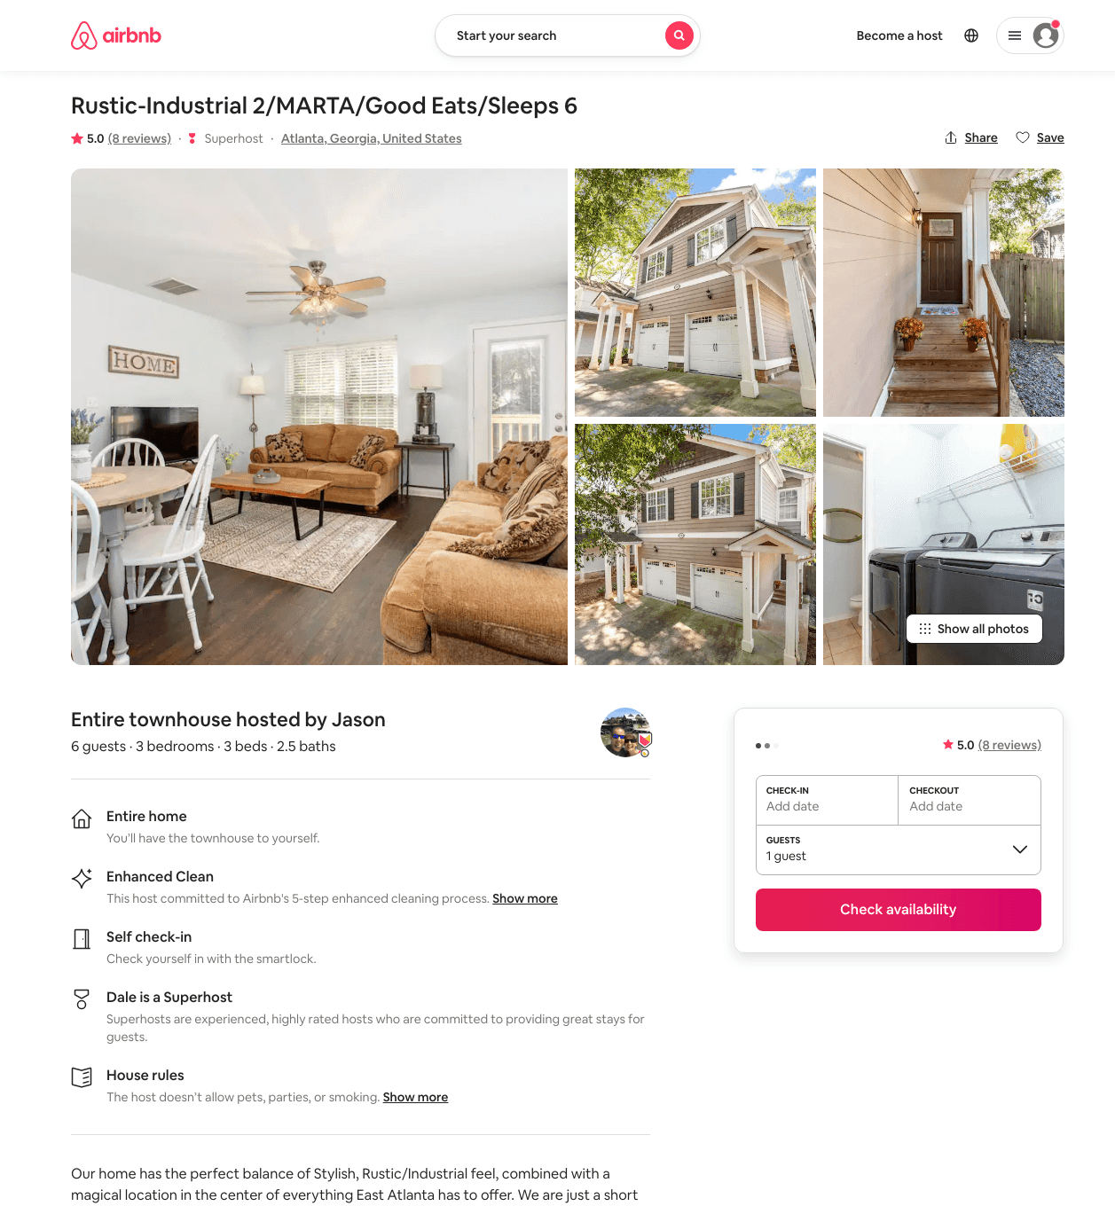
Listing 46194629
3
6
$158 - $202
4.91
5
Jason
136239447
4
https://www.airbnb.com/rooms/46194629
Aug 2022

Slide 21
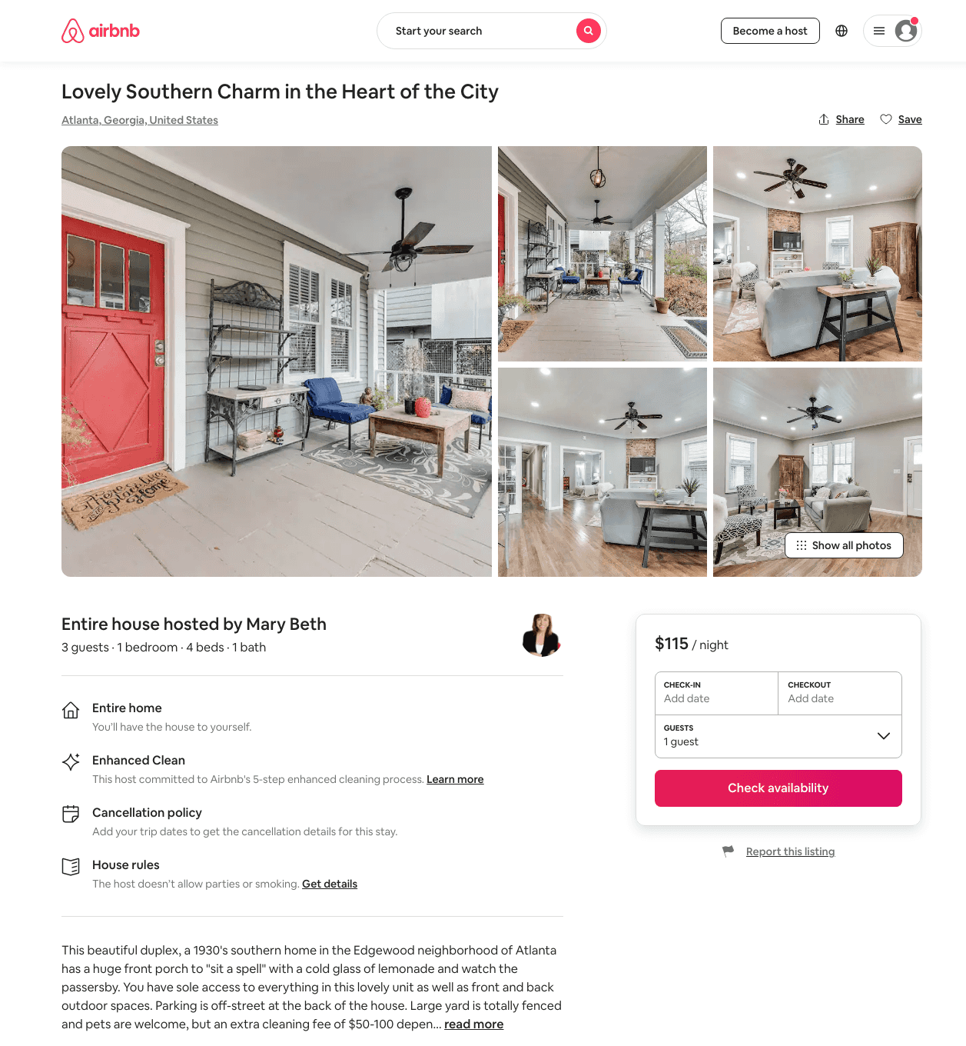
Listing 47550265
1
4
$109 - $125
4.93
3
Mary Beth
383642540
2
https://www.airbnb.com/rooms/47550265
Aug 2022

Slide 22
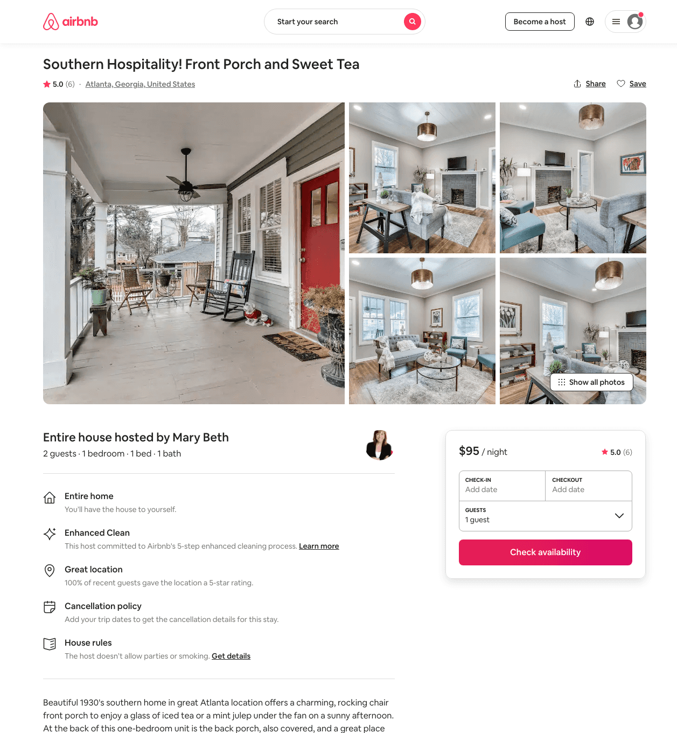
Listing 47531746
1
2
$95 - $117
4.94
3
Mary Beth
383642540
2
https://www.airbnb.com/rooms/47531746
Aug 2022

Slide 23
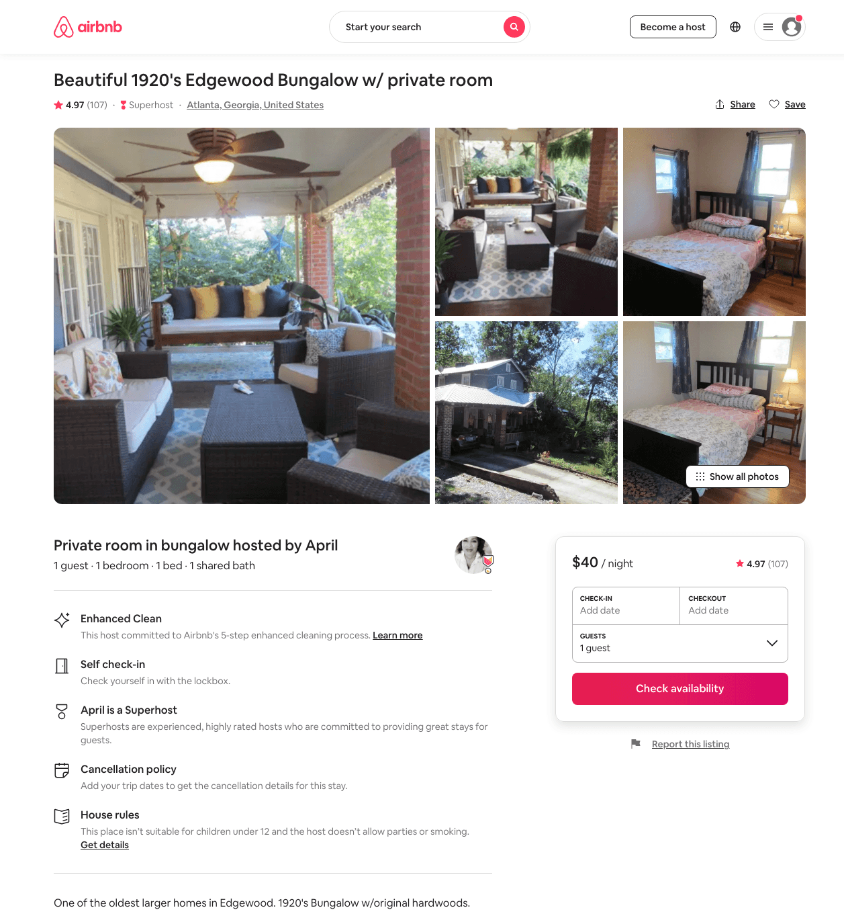
Listing 20982940
1
1
$40 - $49
4.97
1
April
151013413
2
https://www.airbnb.com/rooms/20982940
Aug 2022

Slide 24
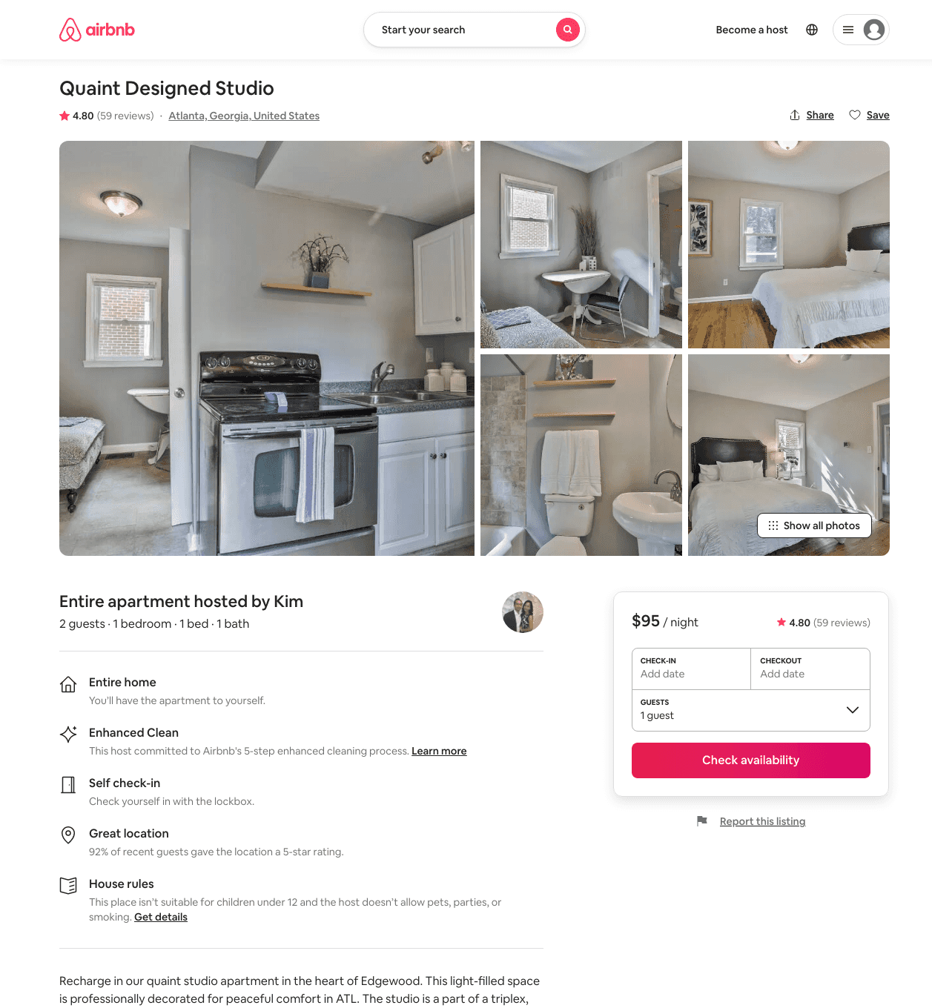
Listing 27747818
1
2
$87 - $103
4.74
3
Kim
124328425
4
https://www.airbnb.com/rooms/27747818
Aug 2022

Slide 25
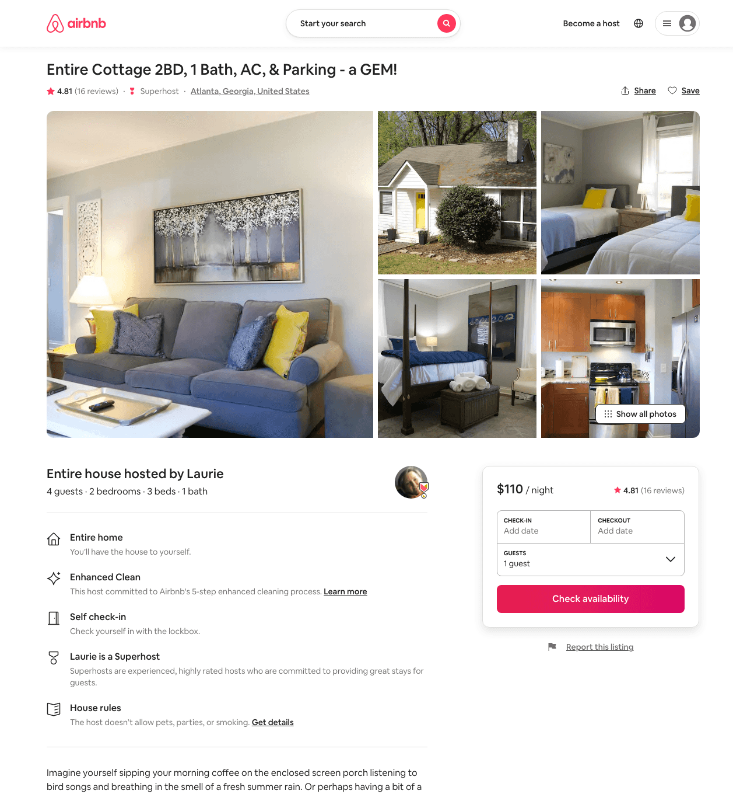
Listing 42933769
2
4
$110 - $169
4.95
2
Laurie
45852986
1
https://www.airbnb.com/rooms/42933769
Aug 2022

Slide 26
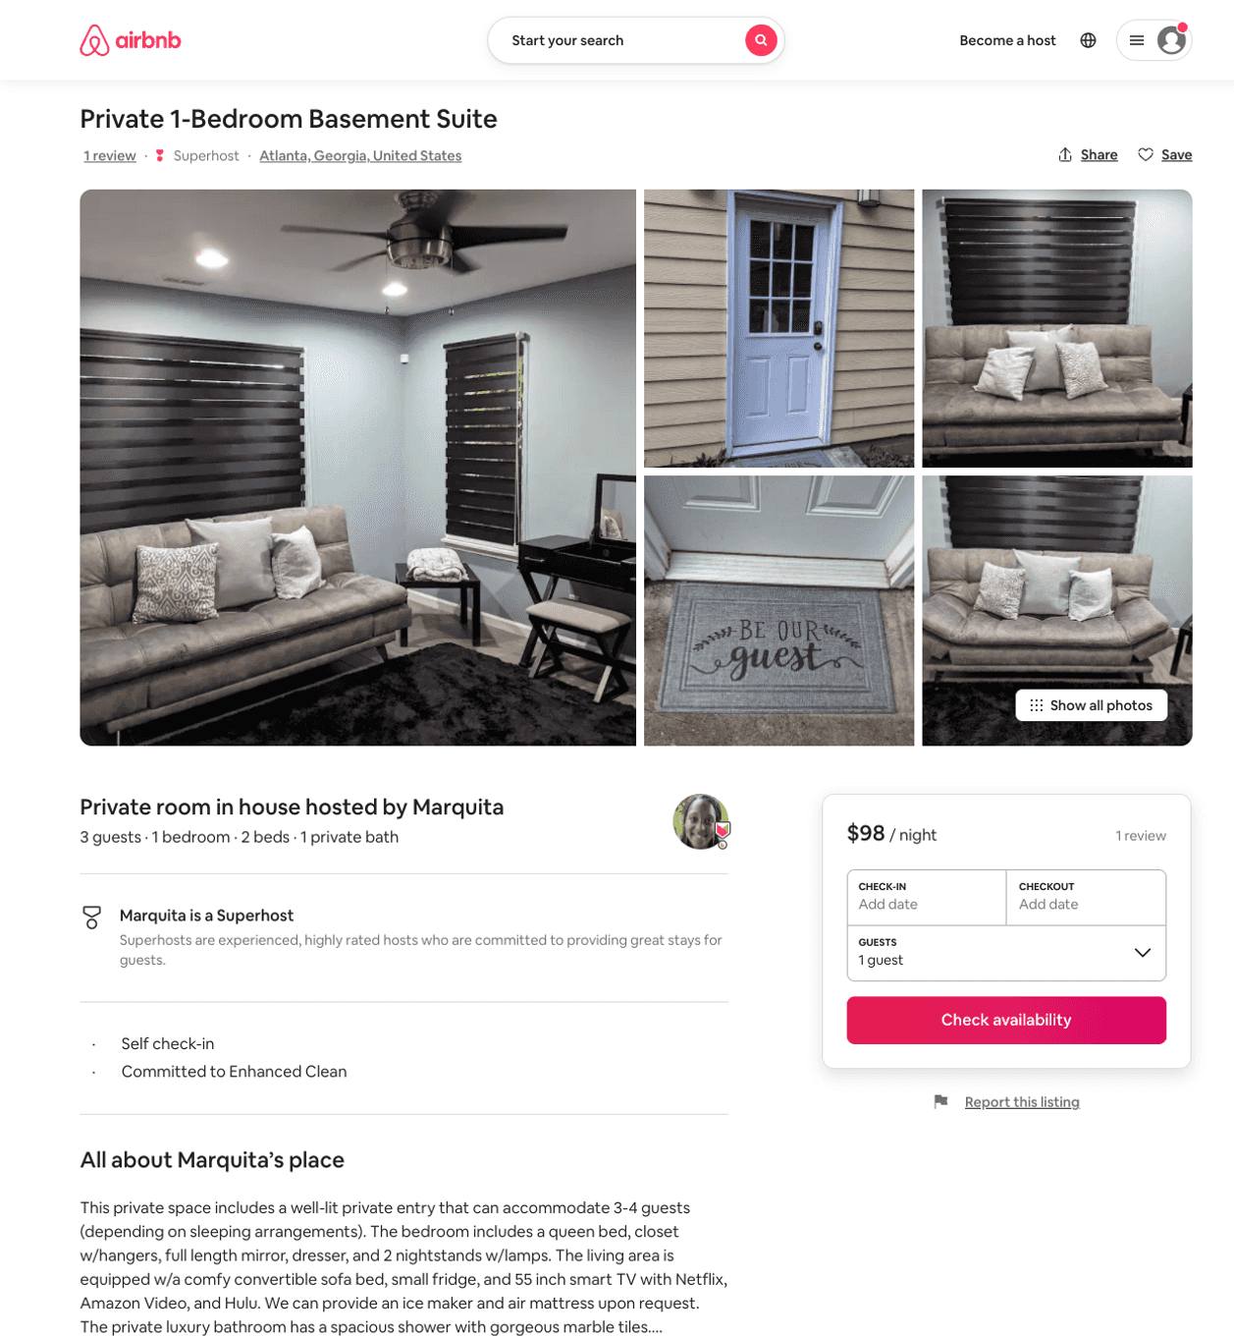
Listing 40844367
1
3
$93 - $107
5.0
1
Marquita
100797189
1
https://www.airbnb.com/rooms/40844367
Jun 2022

Slide 27
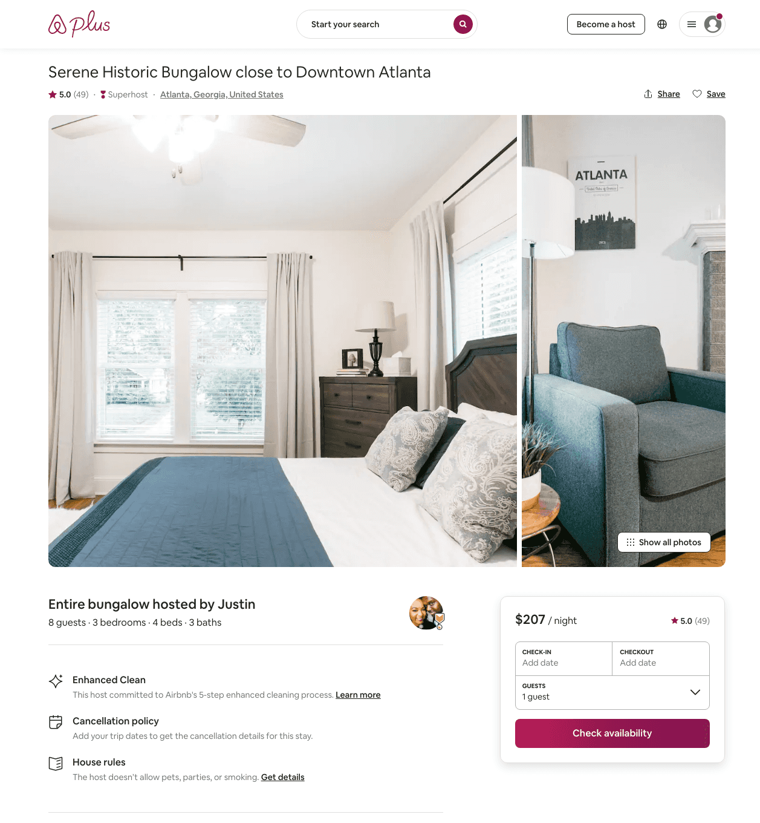
Listing 24448796
3
8
$179 - $233
5.0
1
Justin
177227655
1
https://www.airbnb.com/rooms/24448796
Aug 2022

Slide 28
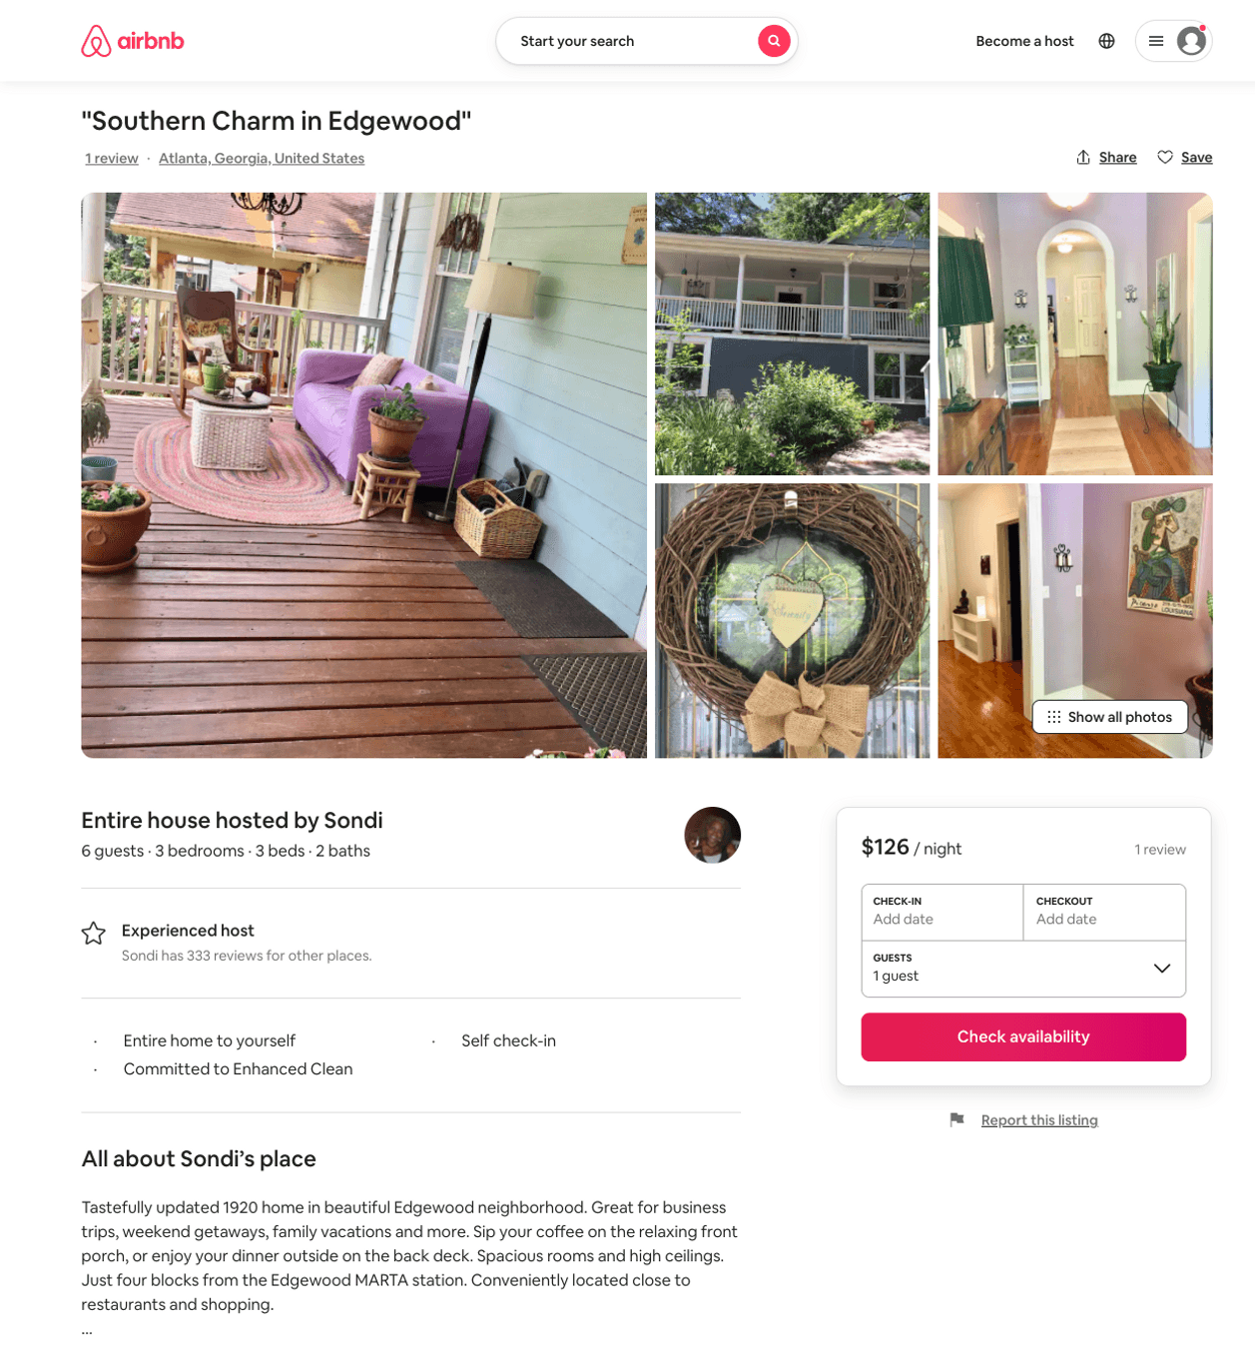
Listing 50509520
3
6
$120 - $182
4.94
3
Sondi
26149953
2
https://www.airbnb.com/rooms/50509520
Aug 2022

Slide 29
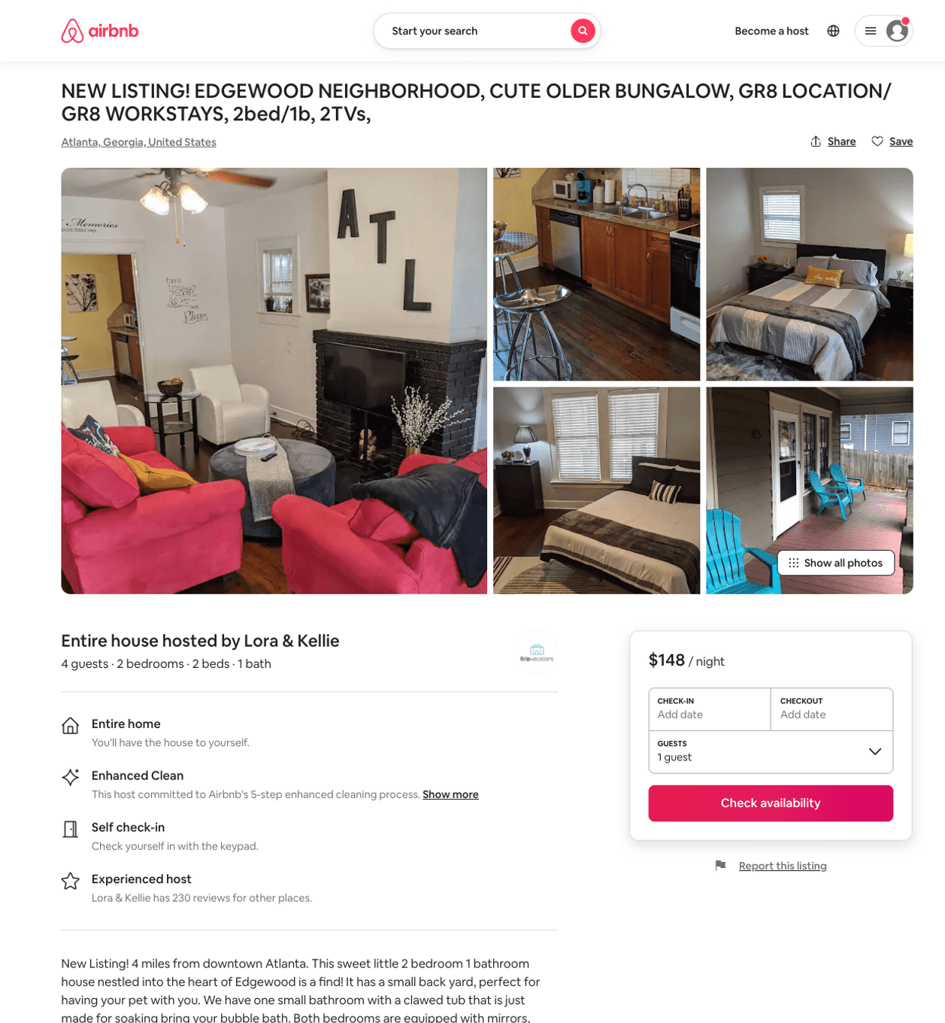
Listing 50211721
2
6
$122 - $253
4.91
1
Blitz Girlz
305467402
16
https://www.airbnb.com/rooms/50211721
Aug 2022

Slide 30
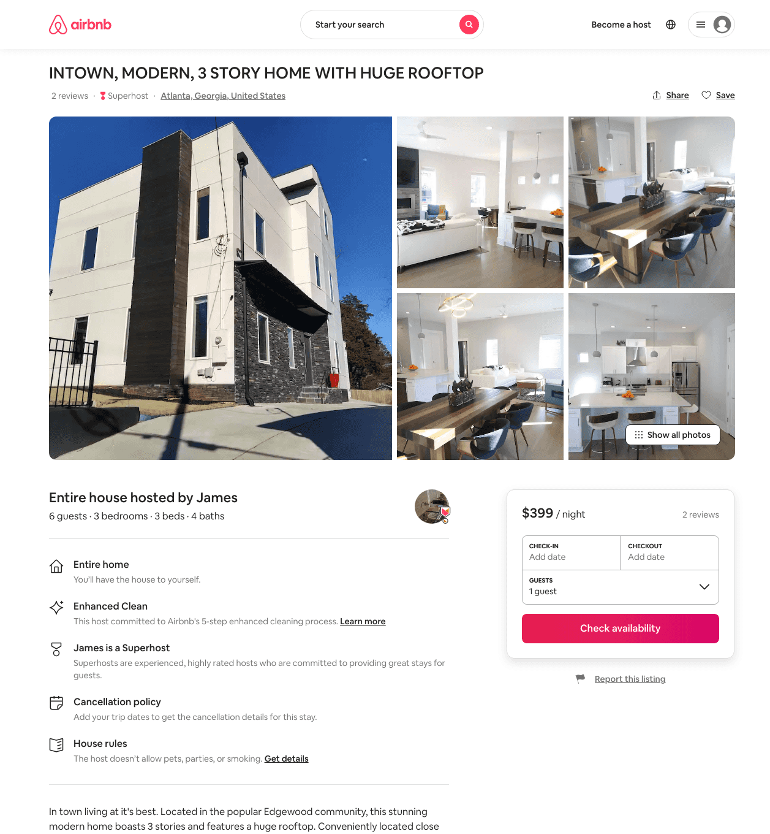
Listing 48270678
3
6
$325 - $399
5.0
2
James
26246650
1
https://www.airbnb.com/rooms/48270678
Aug 2022

Slide 31
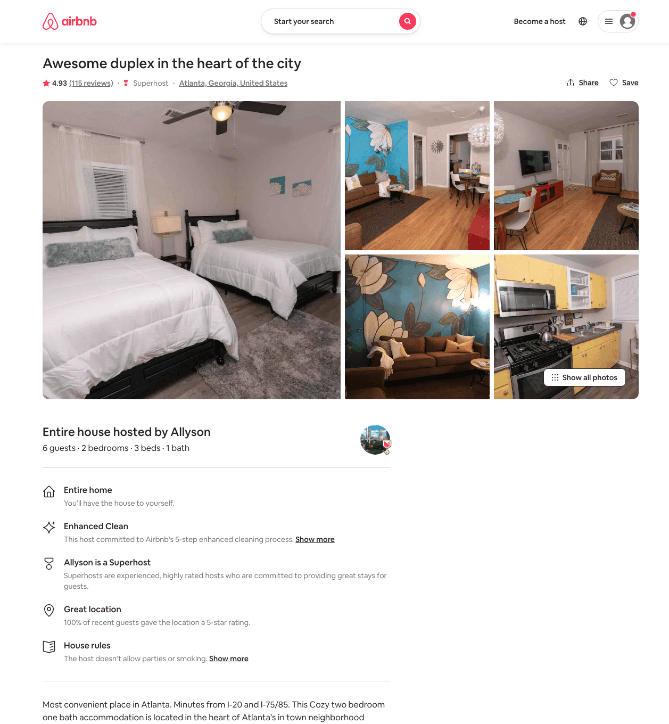
Listing 28079939
2
6
$89 - $129
4.90
7
Allyson
98796164
3
https://www.airbnb.com/rooms/28079939
Aug 2022

Slide 32
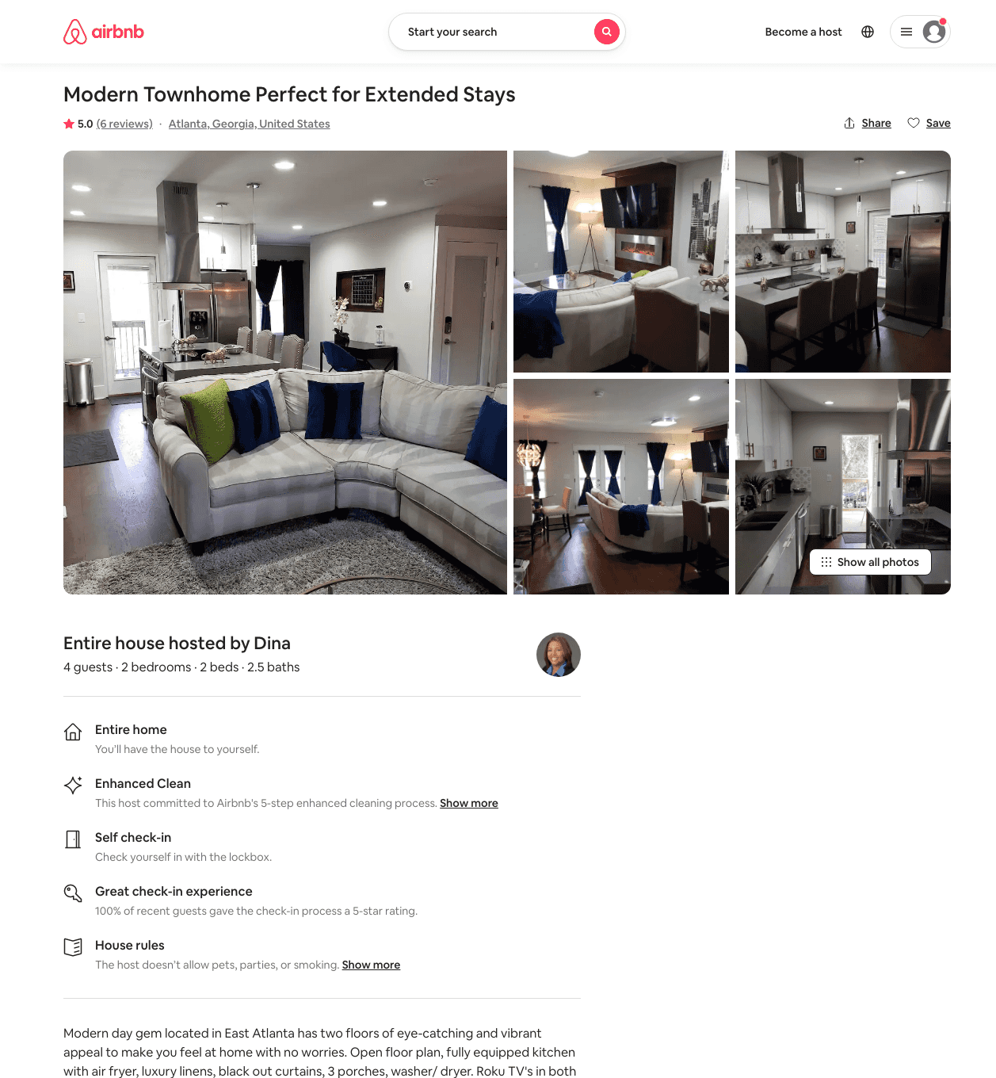
Listing 41644993
2
4
$170 - $225
4.92
3
Dina
68835115
1
https://www.airbnb.com/rooms/41644993
Jul 2022

Slide 33
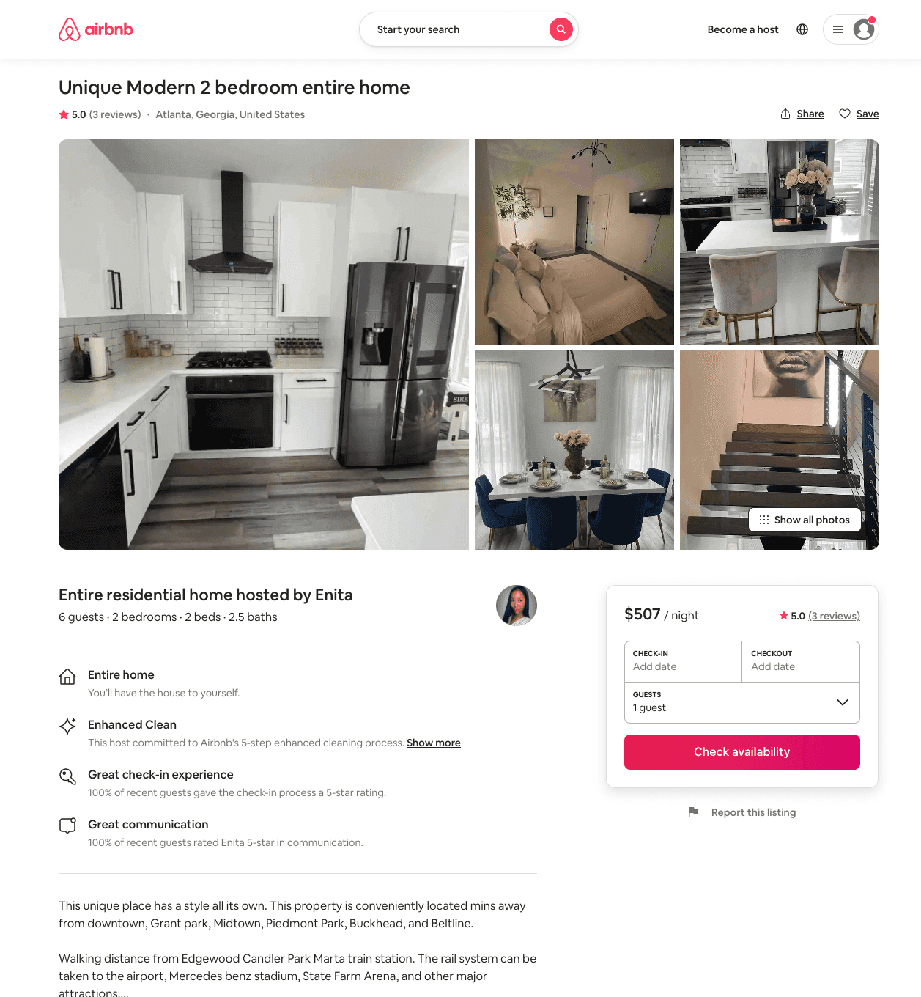
Listing 50746736
2
6
$159 - $507
5.0
1
Enita
42070082
2
https://www.airbnb.com/rooms/50746736
Aug 2022

Slide 34
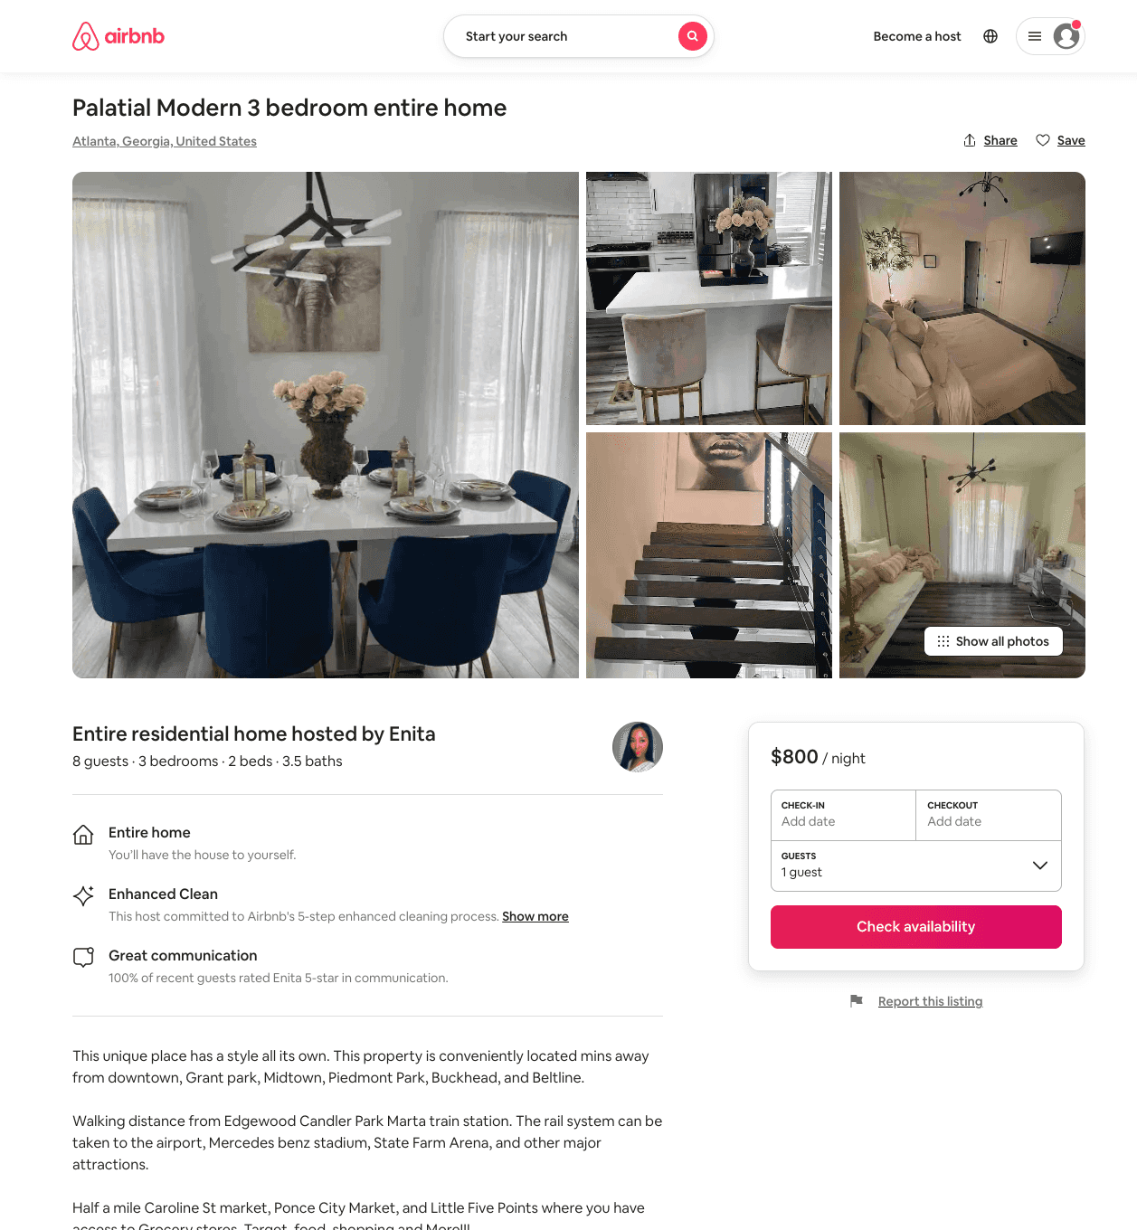
Listing 51105996
3
15
$800 - $857
1
Enita
42070082
2
https://www.airbnb.com/rooms/51105996
Aug 2022

Slide 35
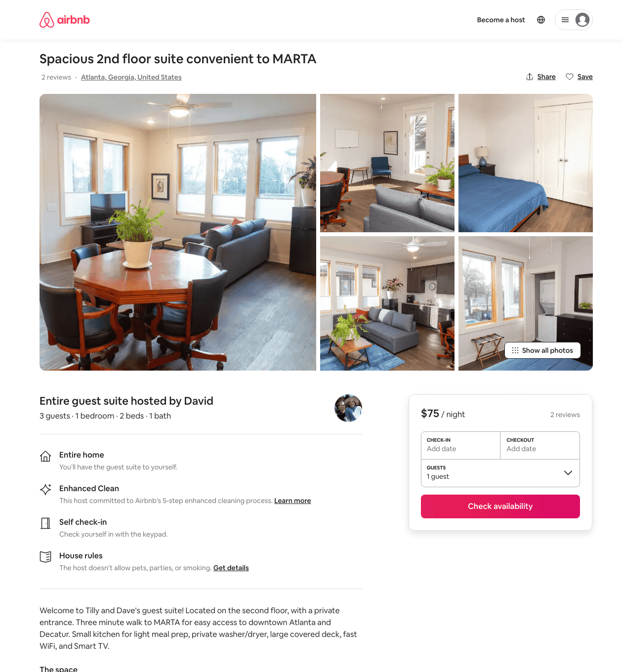
Listing 48069482
1
2
$66 - $102
4.94
2
David
7076799
1
https://www.airbnb.com/rooms/48069482
Aug 2022

Slide 36
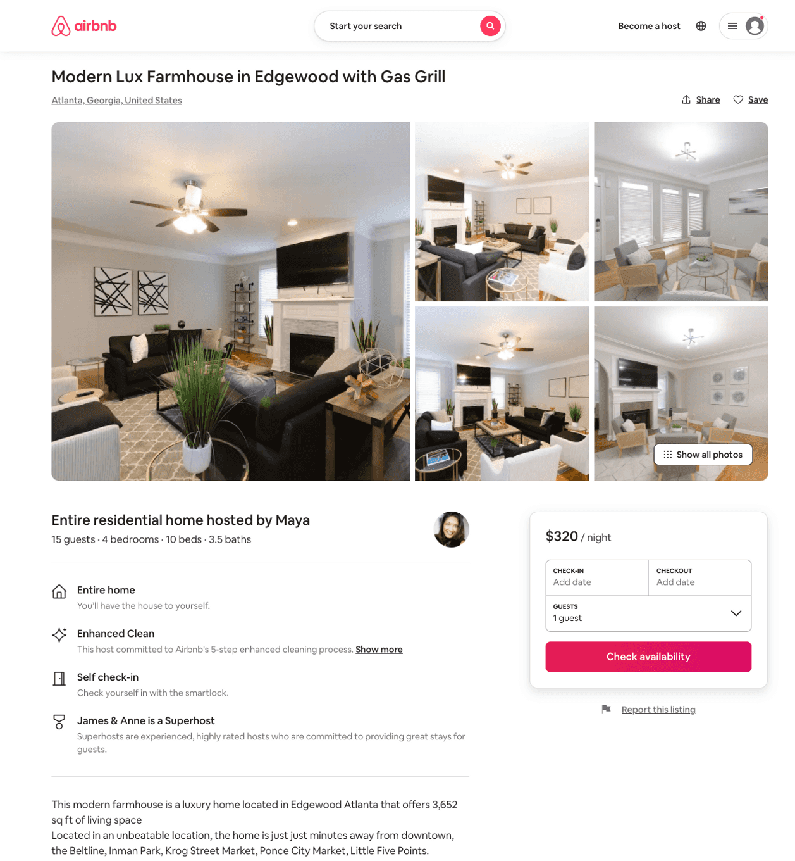
Listing 47831815
4
15
$243 - $400
4.85
1
John Mark
447555083
2
https://www.airbnb.com/rooms/47831815
Aug 2022

Slide 37
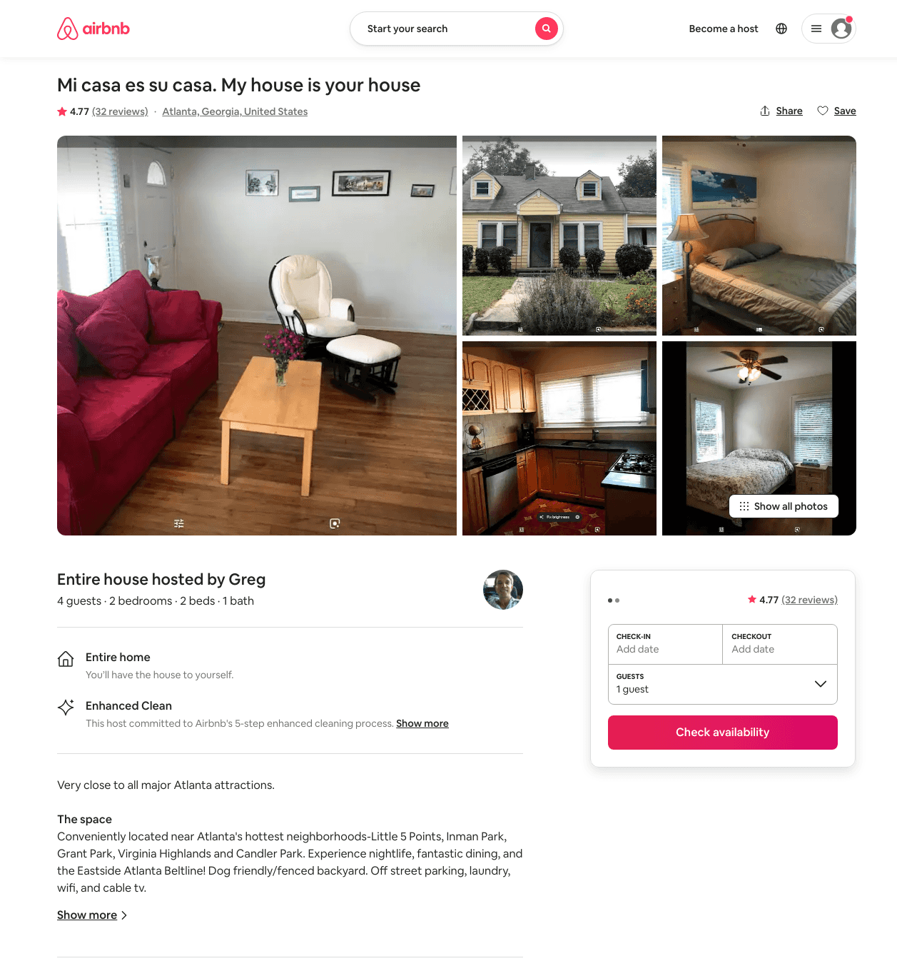
Listing 28386891
2
4
$60 - $105
4.65
3
Greg
5201215
1
https://www.airbnb.com/rooms/28386891
Jun 2022

Slide 38
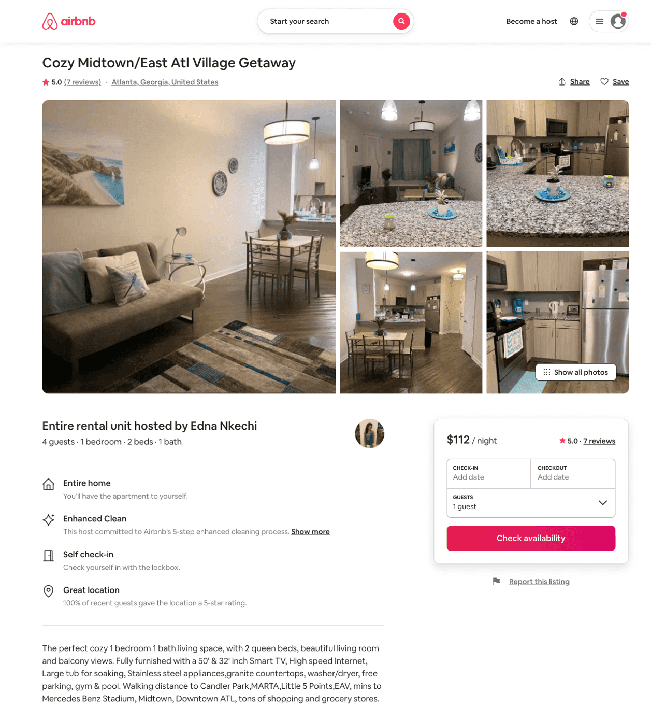
Listing 46218437
1
4
$111 - $184
5.0
2
Edna Nkechi
241786152
1
https://www.airbnb.com/rooms/46218437
Aug 2022

Slide 39
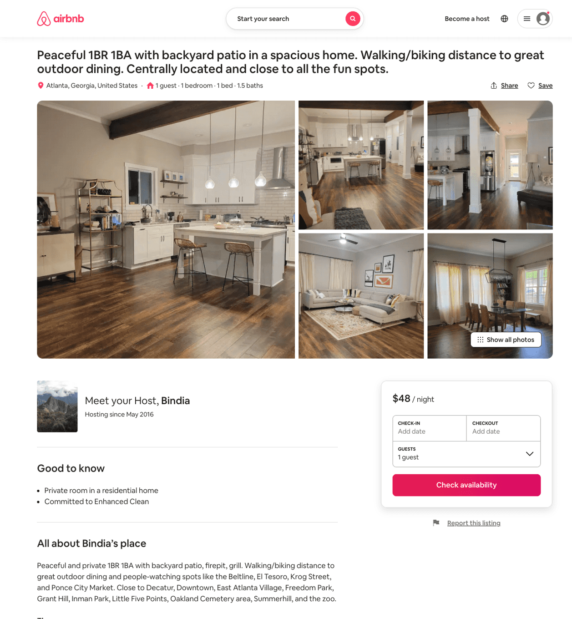
Listing 51892045
1
1
$39 - $75
4.92
1
Bindia
75080616
1
https://www.airbnb.com/rooms/51892045
Aug 2022

Slide 40
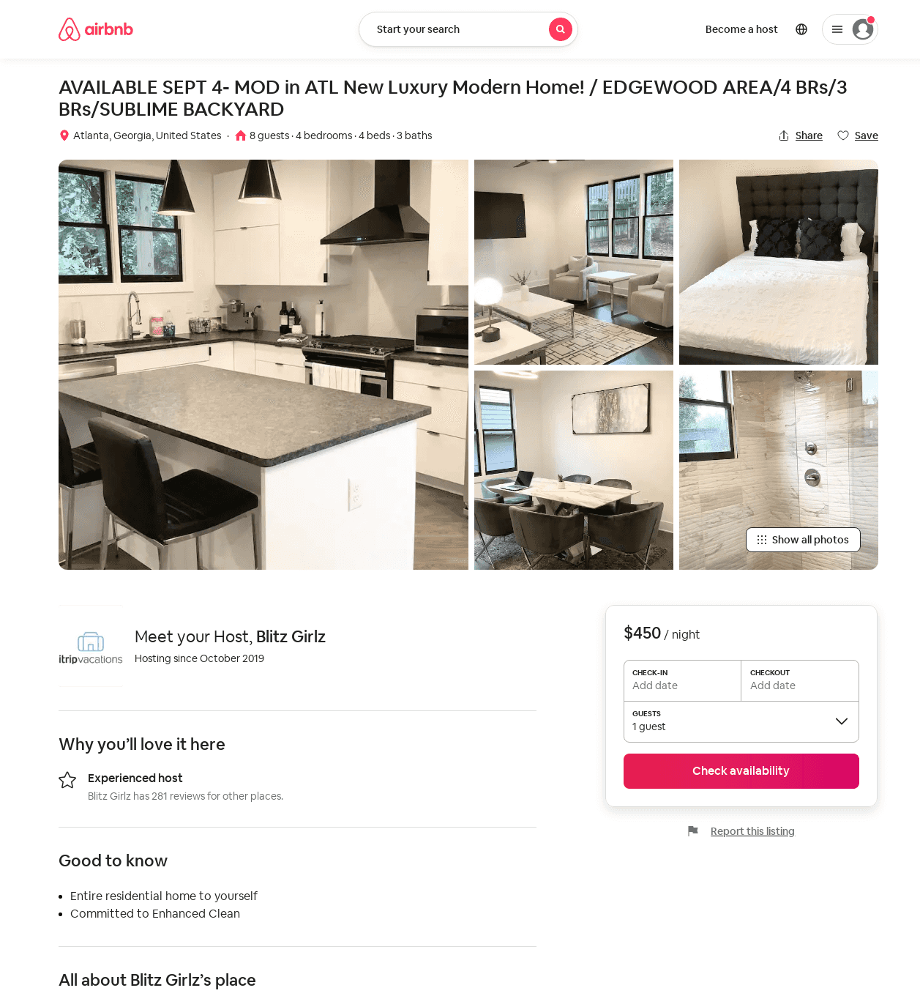
Listing 51761071
4
8
$261 - $528
4.90
2
Blitz Girlz
305467402
16
https://www.airbnb.com/rooms/51761071
Jul 2022

Slide 41
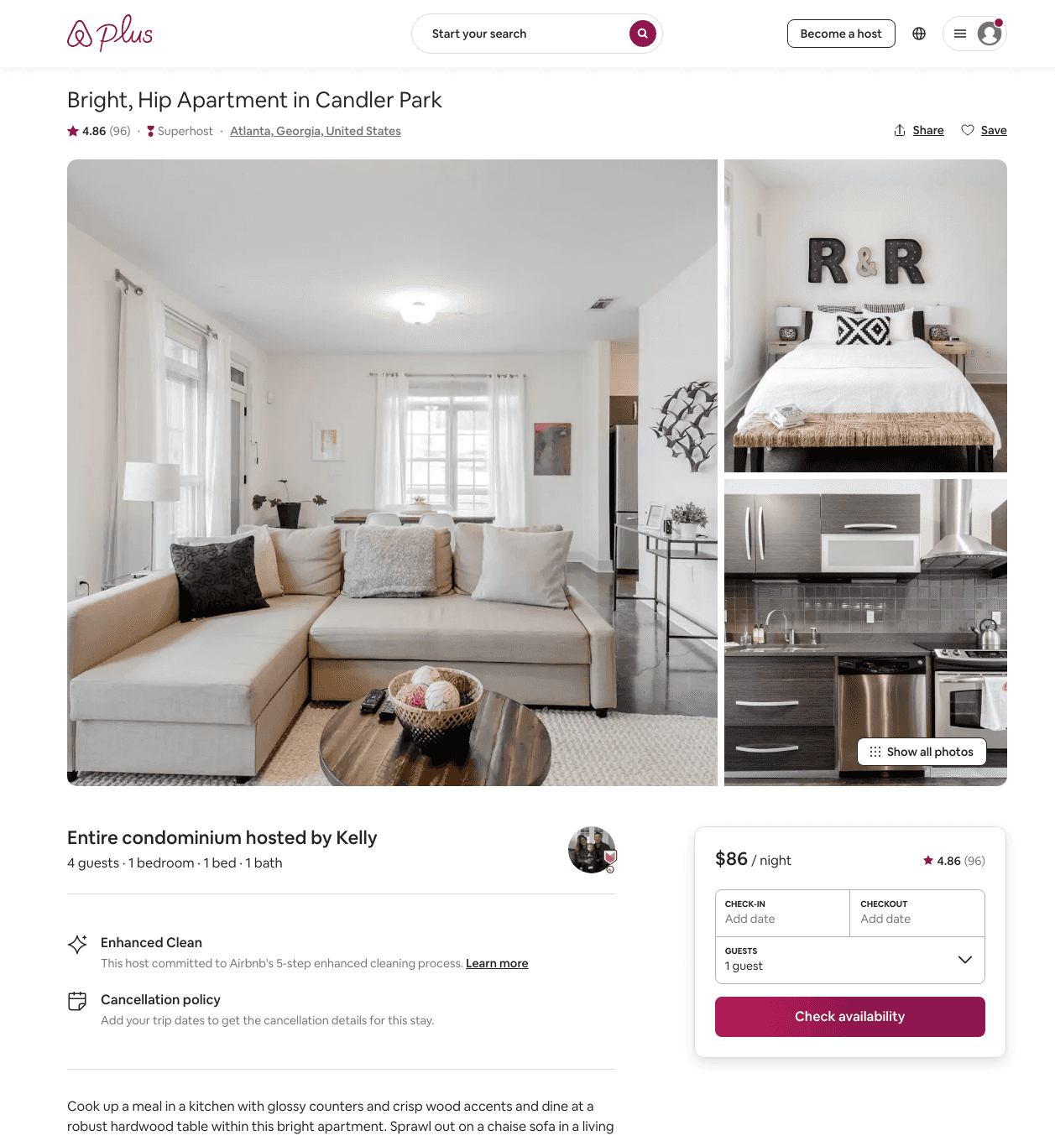
Listing 6129539
1
4
$86 - $140
4.86
30
Kelly
763026
3
https://www.airbnb.com/rooms/6129539
Jul 2022

Slide 42
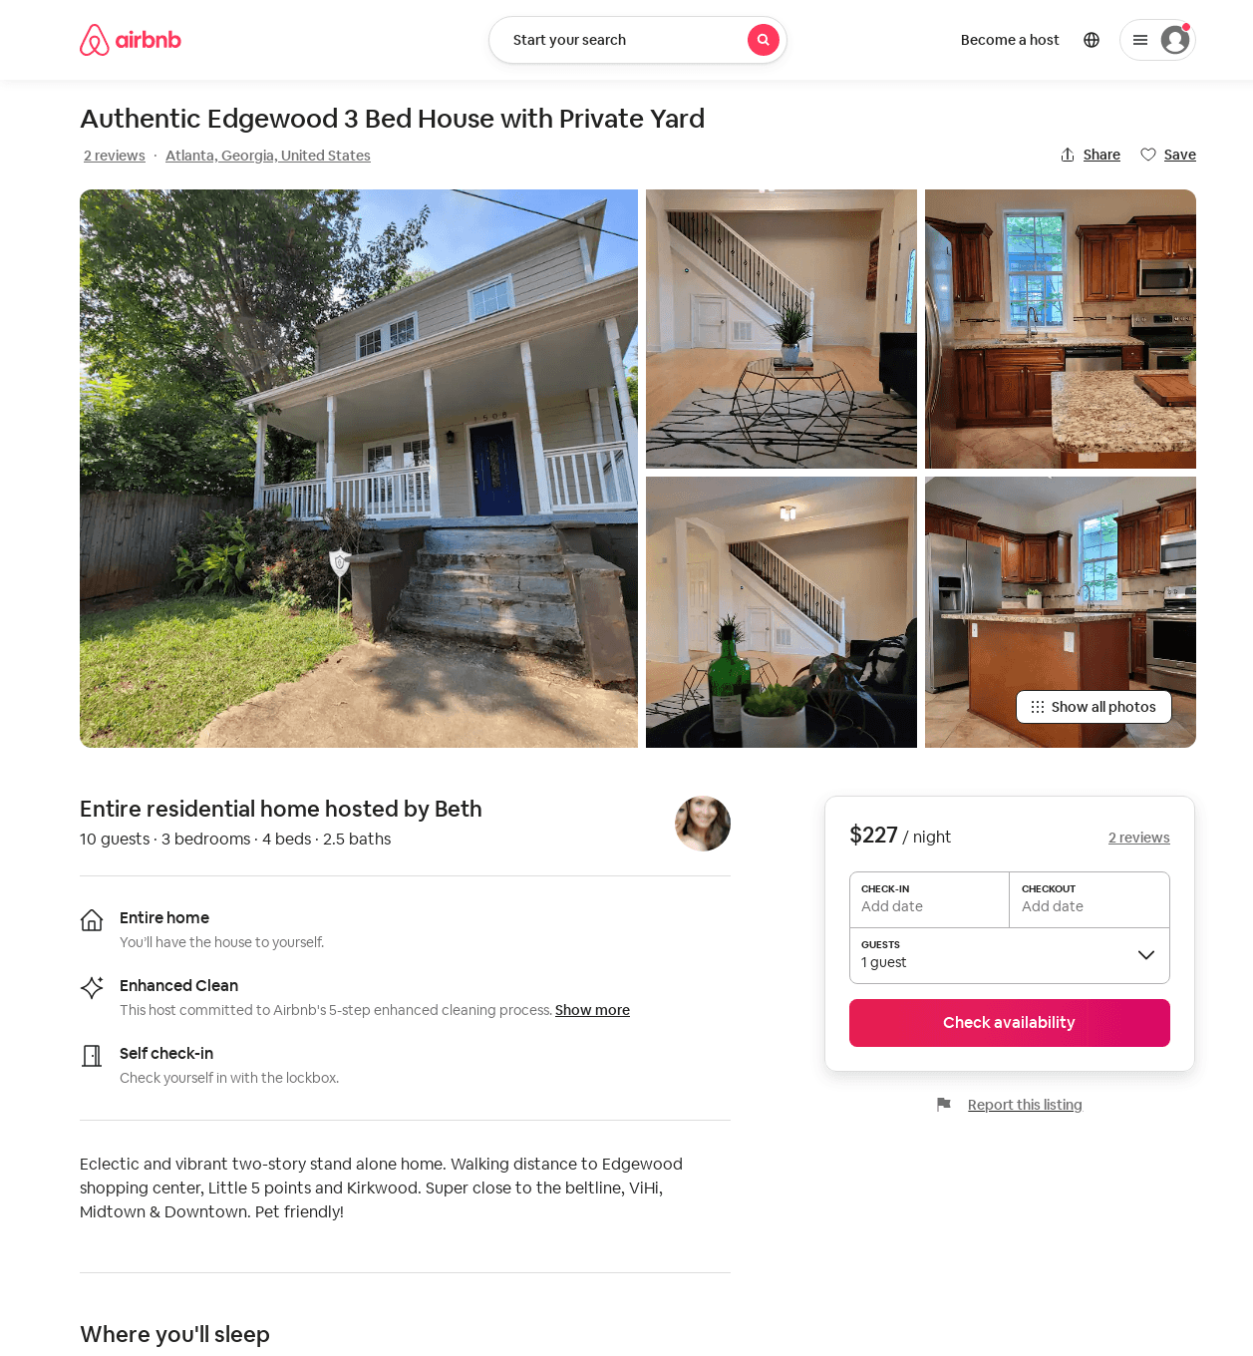
Listing 51091763
3
10
$227 - $400
5.0
7
Beth
203806418
1
https://www.airbnb.com/rooms/51091763
Aug 2022

Slide 43
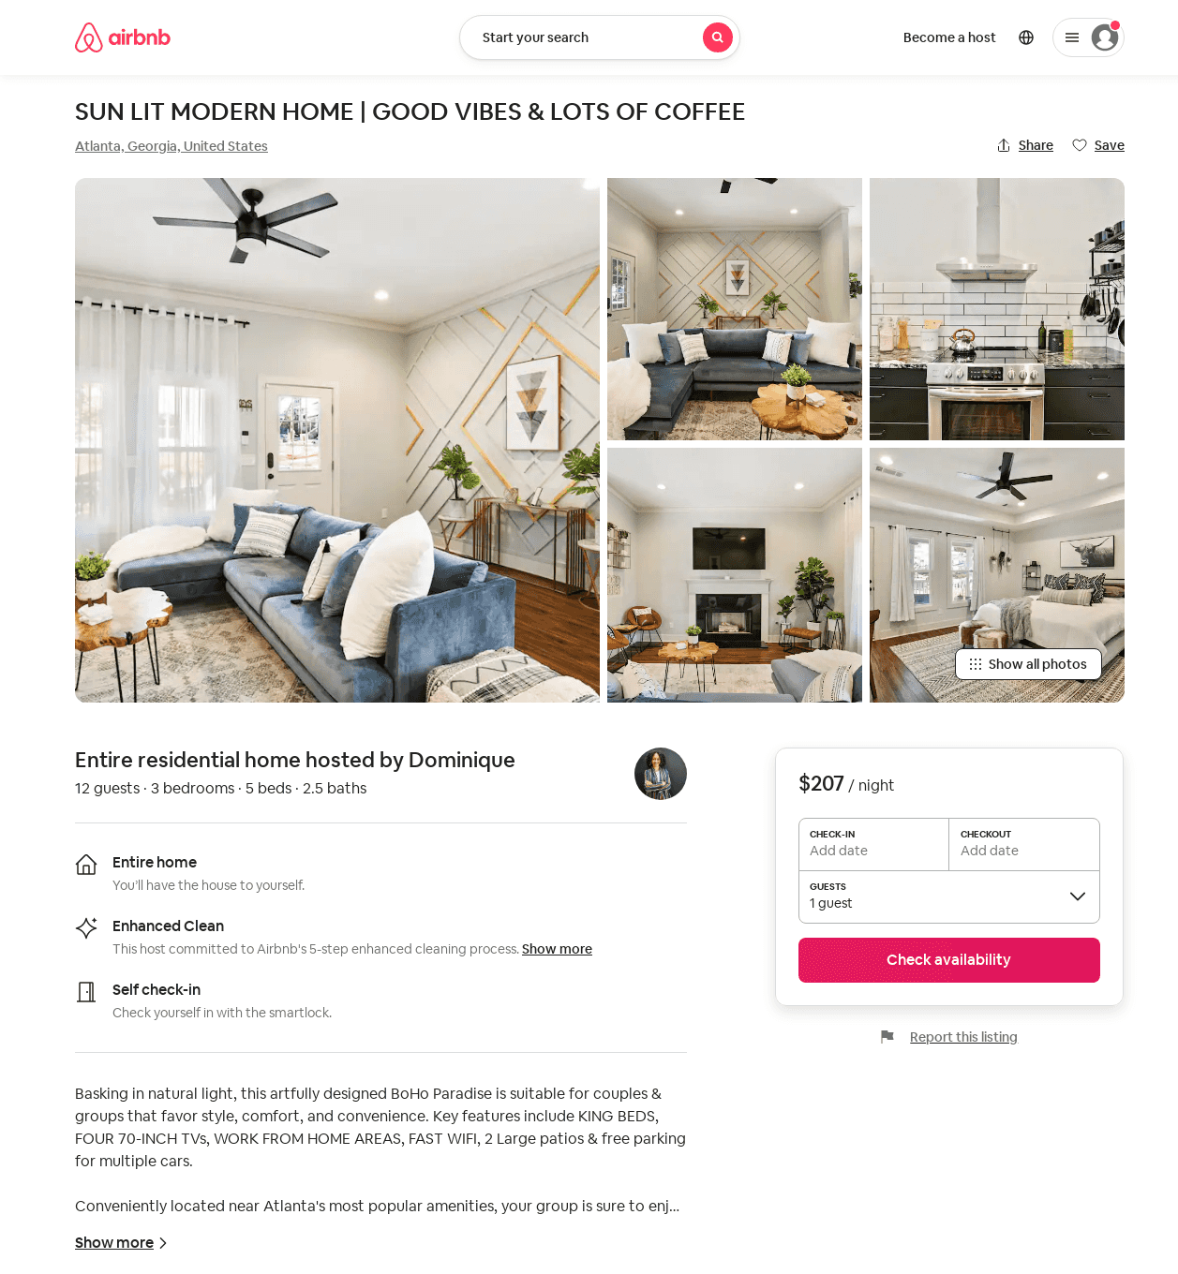
Listing 52453761
3
12
$148 - $288
5.0
2
Dominique
424570795
1
https://www.airbnb.com/rooms/52453761
Aug 2022

Slide 44
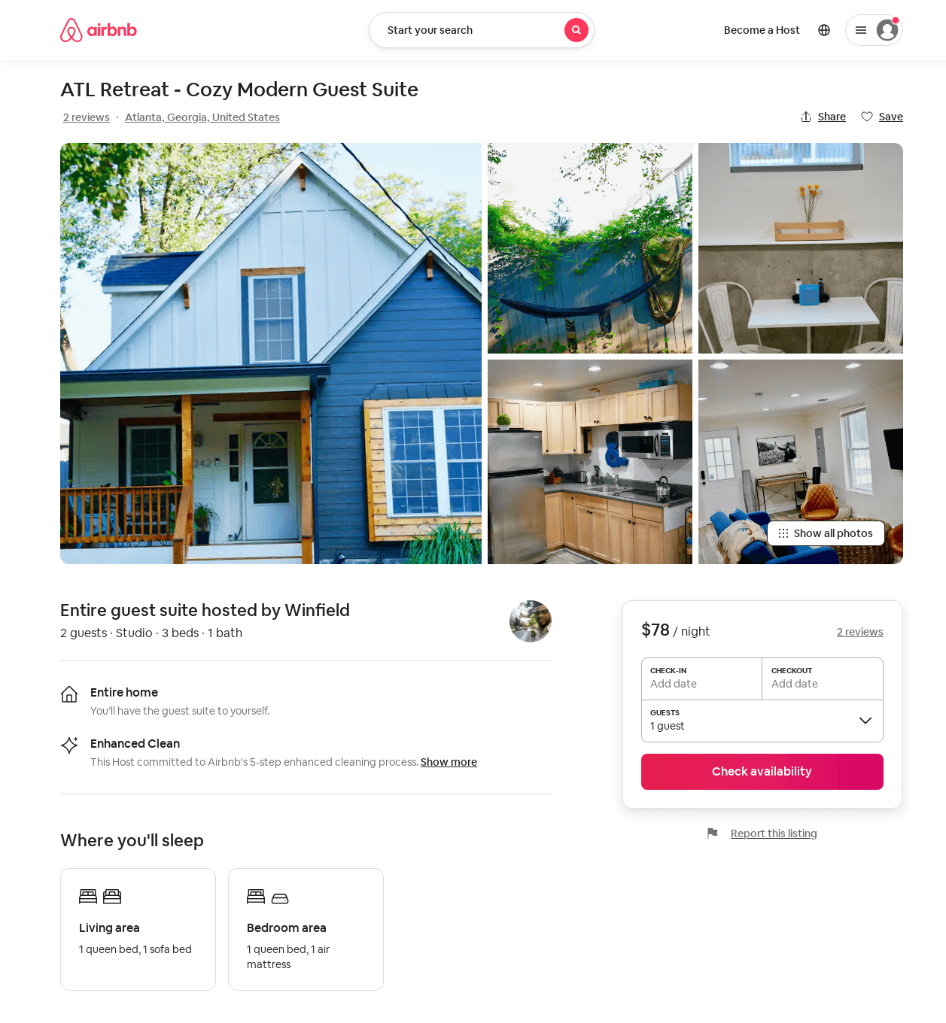
Listing 1659786
Studio
2
$76 - $78
4.85
1
Winfield
2148983
1
https://www.airbnb.com/rooms/1659786
Aug 2022

Slide 45
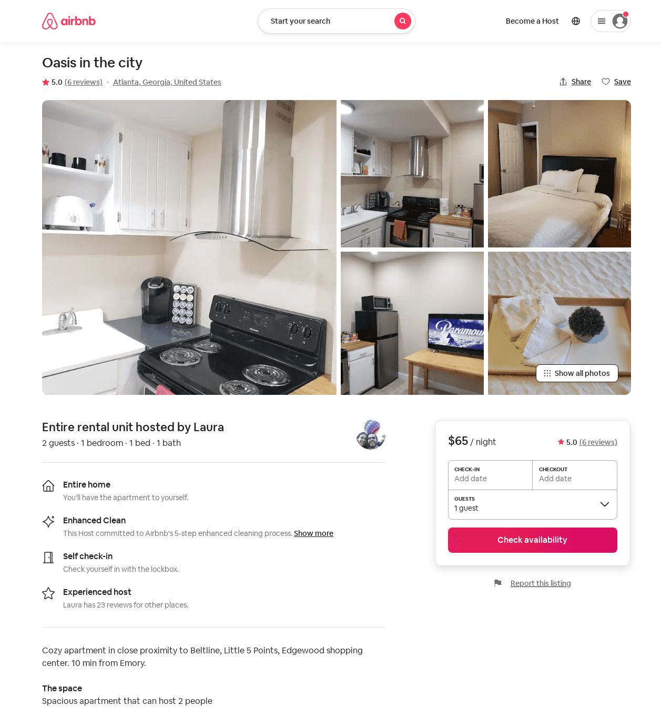
Listing 34564535
1
2
$55 - $70
5.0
31
Laura
234136513
1
https://www.airbnb.com/rooms/34564535
Aug 2022

Slide 46
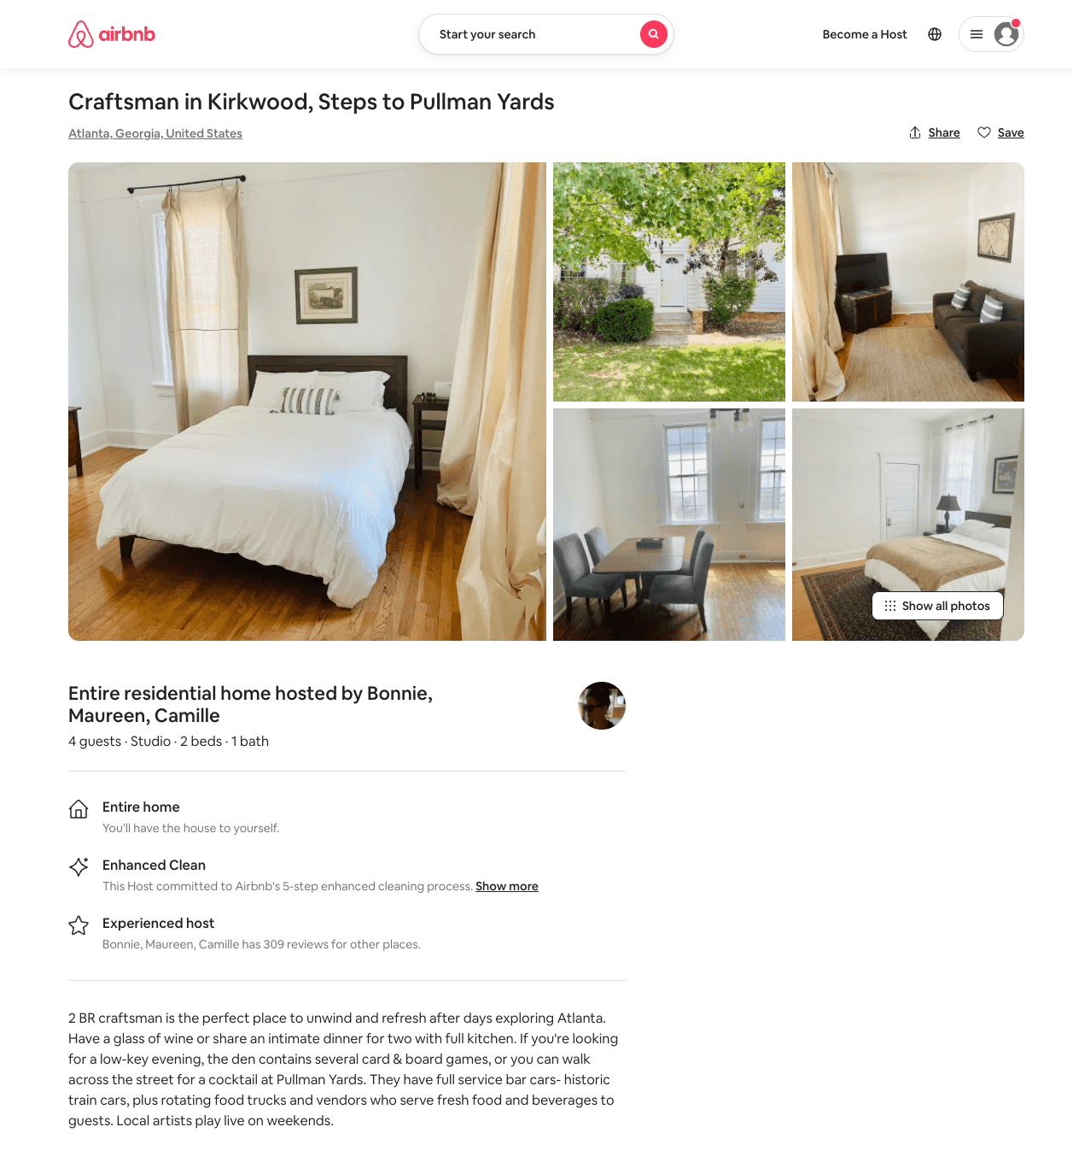
Listing 51845748
Studio
4
$128 - $150
3.67
1
Bonnie, Maureen, Camille
1349919
2
https://www.airbnb.com/rooms/51845748
Jun 2022

Slide 47
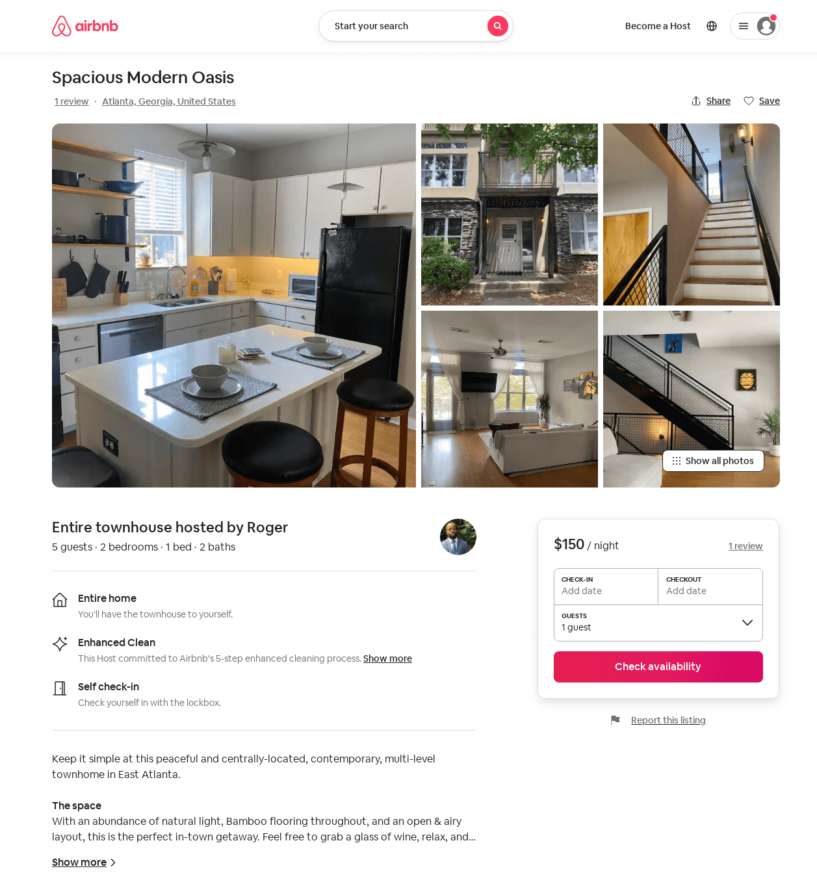
Listing 51988892
2
5
$86 - $175
4.60
2
Roger
15732760
1
https://www.airbnb.com/rooms/51988892
Jun 2022

Slide 48
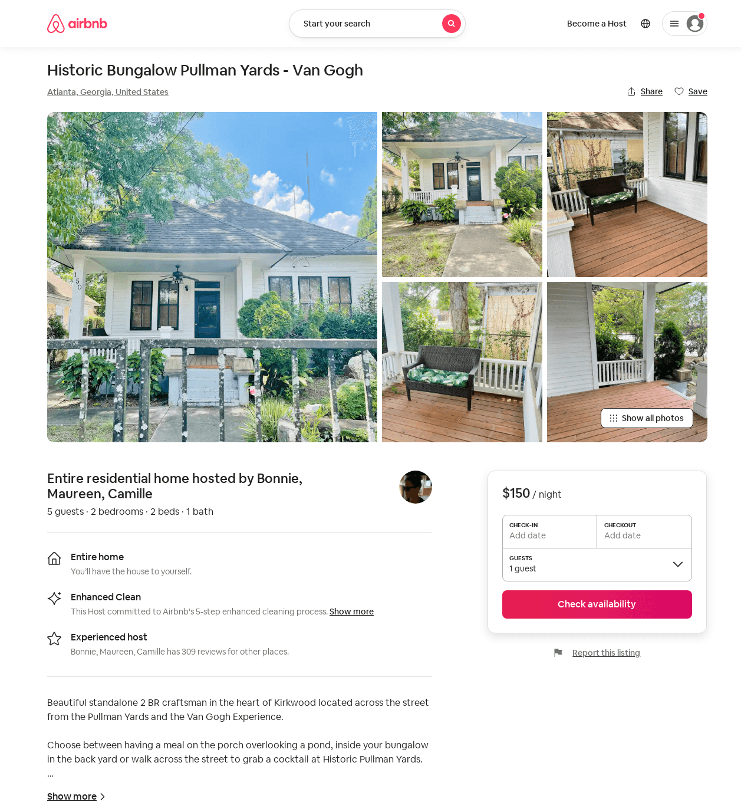
Listing 51843073
2
5
$110 - $150
4.20
1
Bonnie, Maureen, Camille
1349919
2
https://www.airbnb.com/rooms/51843073
Jun 2022

Slide 49
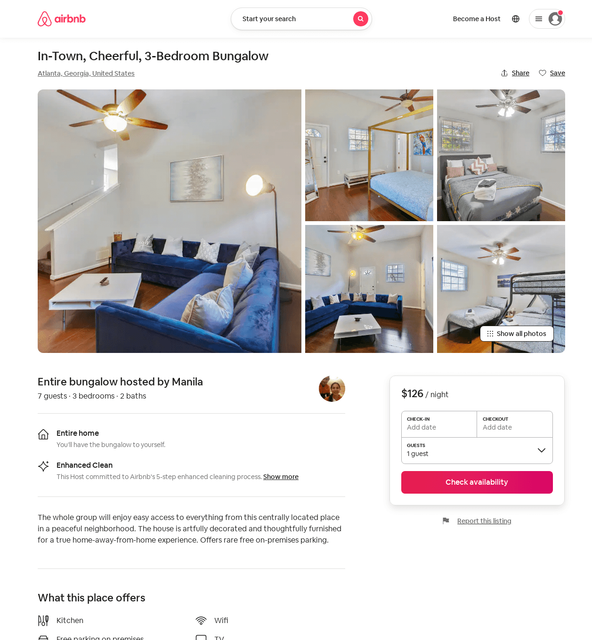
Listing 53524606
3
7
$126 - $182
4.0
31
Manila
411983279
1
https://www.airbnb.com/rooms/53524606
Aug 2022

Slide 50
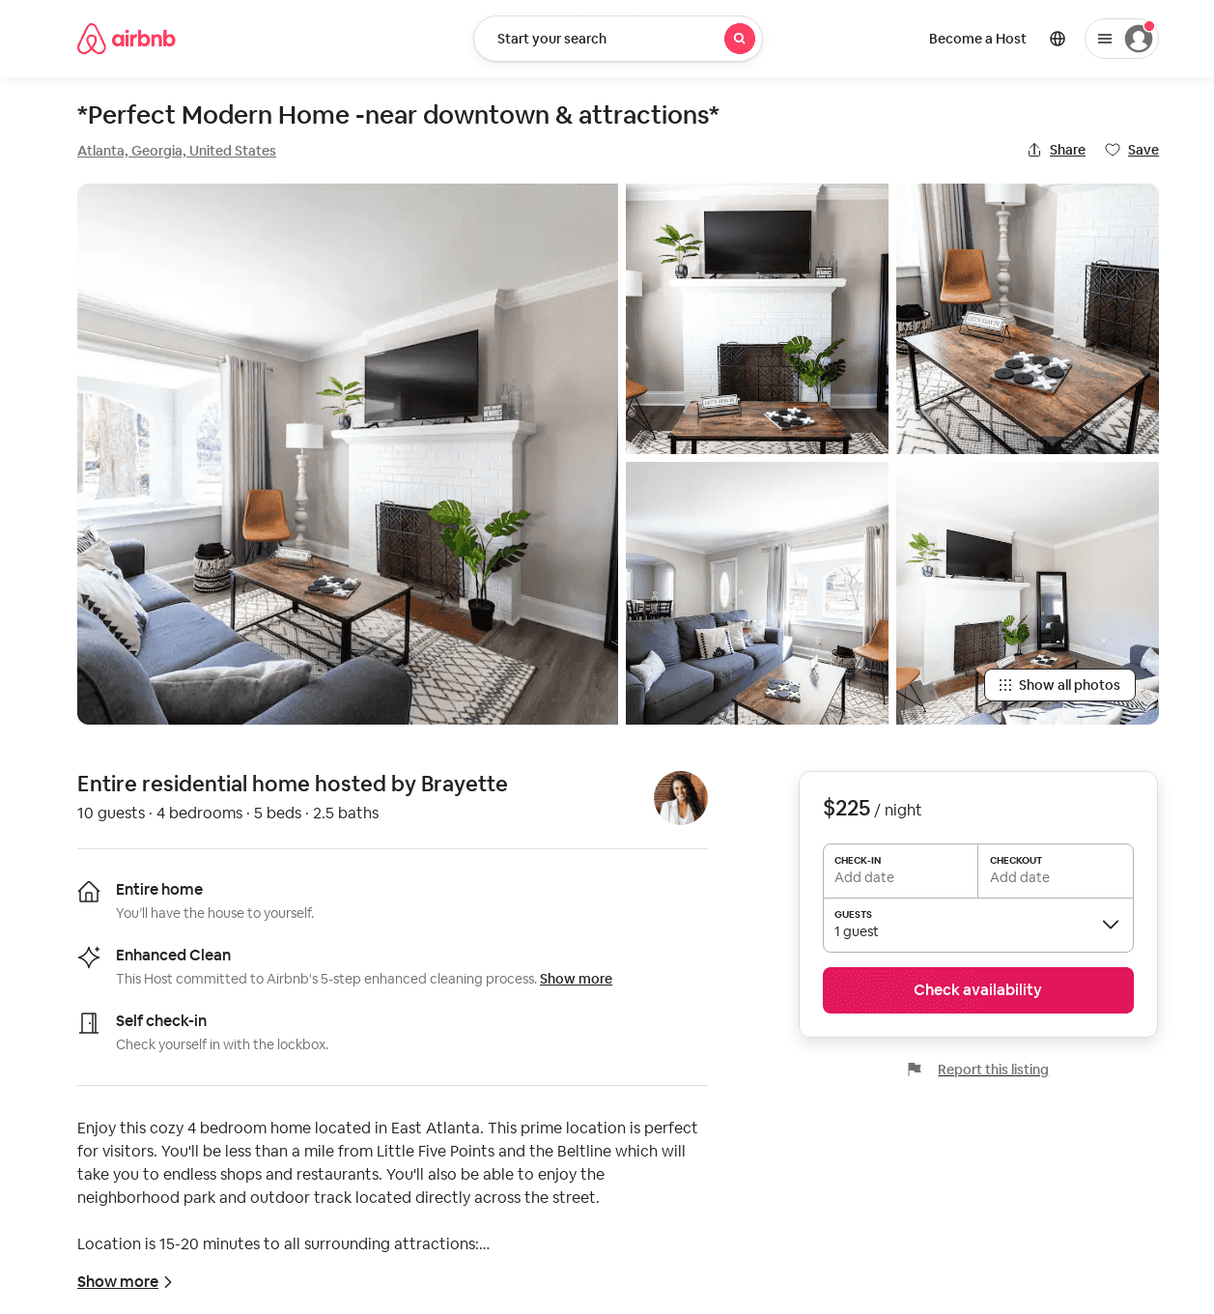
Listing 53851817
4
11
$138 - $235
4.59
1
Brayette
436218133
1
https://www.airbnb.com/rooms/53851817
Aug 2022

Slide 51
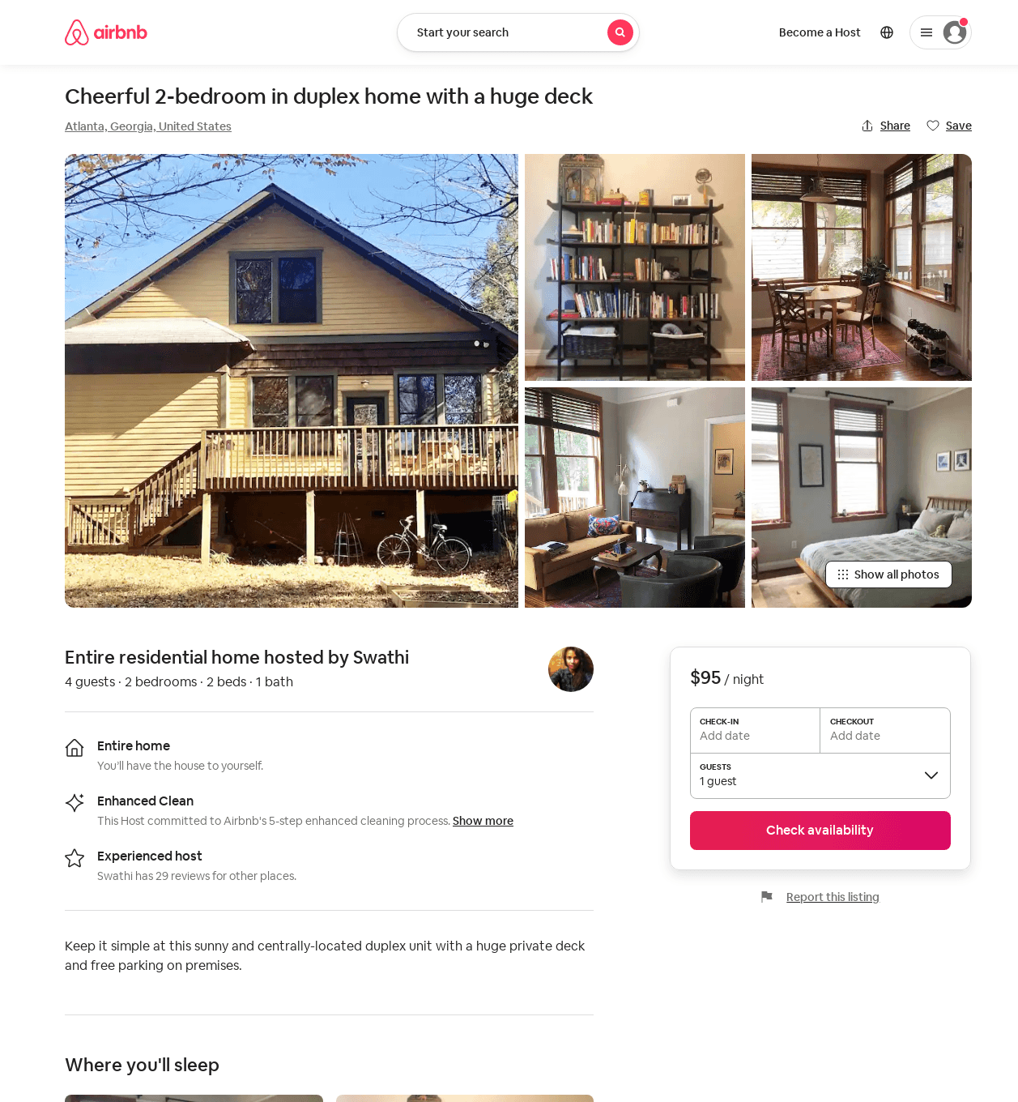
Listing 53716568
2
4
$95 - $106
3
Swathi
7249548
1
https://www.airbnb.com/rooms/53716568
Jun 2022

Slide 52
Listing 2586244
4
11
$144 - $242
4.6666665
1
Ikechukwu Nnanabu
https://www.vrbo.com/2586244
Aug 2022

Slide 53
Listing 54264625
2
5
$108 - $132
5.0
1
Caitlin
440047700
1
https://www.airbnb.com/rooms/54264625
Aug 2022

Slide 54
Listing 2653013
1
2
$85
2
Plushy Host
https://www.vrbo.com/2653013
Aug 2022

Slide 55
Listing 2683654
3
6
$190
5
Jason Sterner
https://www.vrbo.com/2683654
Aug 2022

Slide 56
Listing 2683643
3
6
$173
5
Jason Sterner
https://www.vrbo.com/2683643
Aug 2022

Slide 57
Listing 50952493
3
10
$360 - $473
5.0
3
Dean
97406794
1
https://www.airbnb.com/rooms/50952493
Jun 2022

Slide 58
Listing 596122954005435600
3
6
$164 - $218
4.75
1
Meha
457751943
1
https://www.airbnb.com/rooms/596122954005435600
Jul 2022

Slide 59
Listing 2747453
3
10
$238
4
1
https://www.vrbo.com/2747453
Aug 2022

Slide 60
Listing 9218335
1
1
$47
4.93
1
Sondi
26149953
2
https://www.airbnb.com/rooms/9218335
Aug 2022

Slide 61
Listing 2790561
3
8
$262
5
1
Dominique
https://www.vrbo.com/2790561
Aug 2022

Slide 62
Listing 2845392
3
6
$389
5
2
https://www.vrbo.com/2845392
Aug 2022

Slide 63
Listing 2849086
3
10
$345
3
https://www.vrbo.com/2849086
Aug 2022

Slide 64
Listing 6548056
1
2
5.0
2
Christian
34250519
1
https://www.airbnb.com/rooms/6548056
Jun 2022

Slide 65
Listing 25097012
2
6
4.86
5
Allyson
98796164
3
https://www.airbnb.com/rooms/25097012
Jun 2022

Slide 66
Listing 2928728
4
10
$125
2
Kele
https://www.vrbo.com/2928728
Aug 2022

Slide 67
Listing 52978538
2
5
2
Tayler
37088094
1
https://www.airbnb.com/rooms/52978538
Aug 2022

