Slide 2
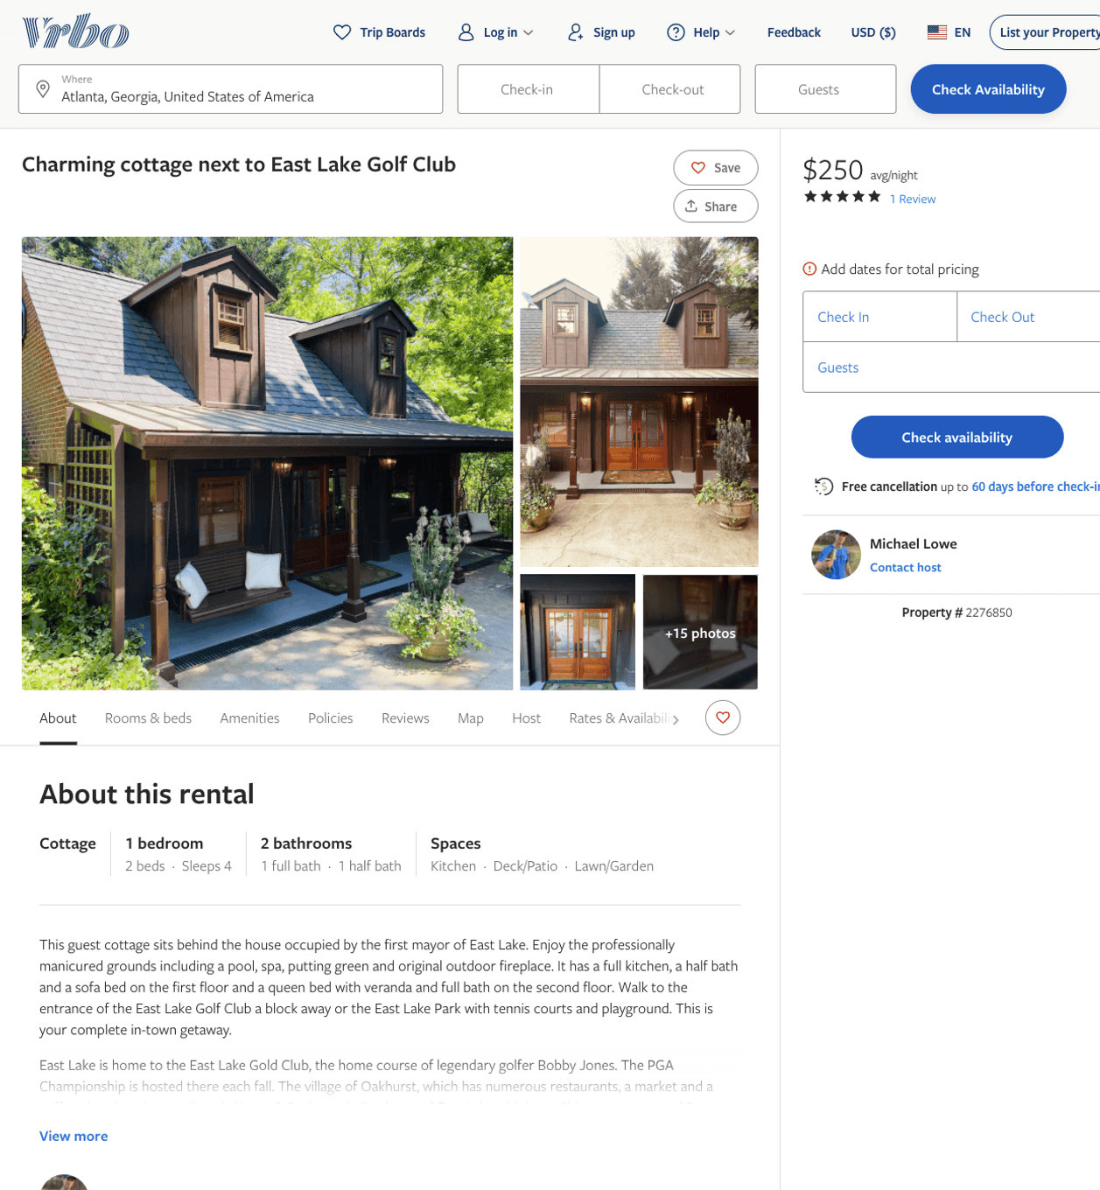
Listing 2276850
1
4
$238 - $250
5
2
Michael Lowe
https://www.vrbo.com/2276850
Aug 2022

Slide 3
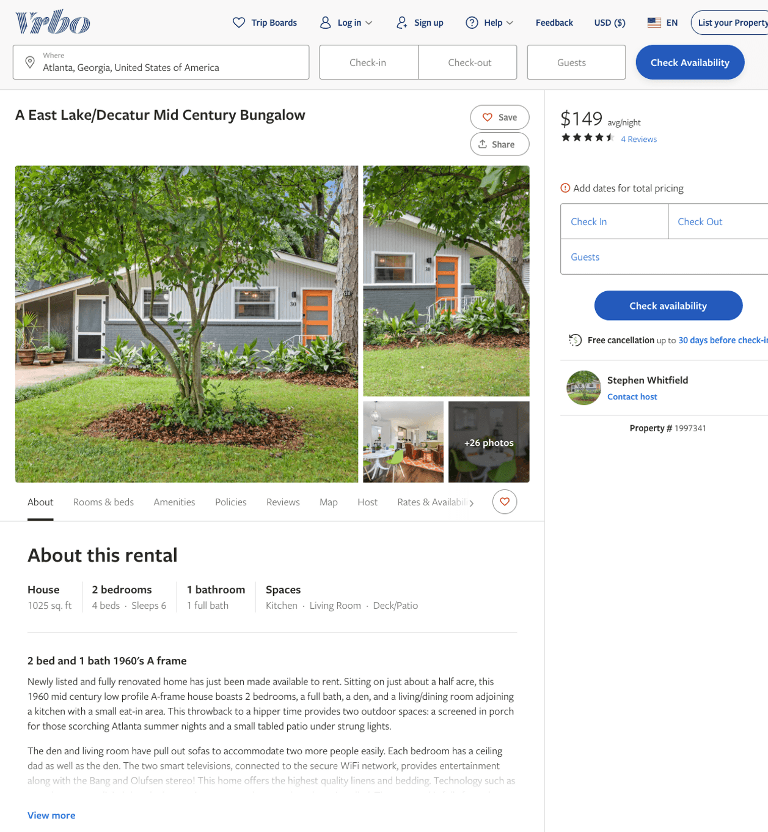
Listing 1997341
2
6
$135 - $178
4.571429
2
Stephen Whitfield
https://www.vrbo.com/1997341
Aug 2022

Slide 4
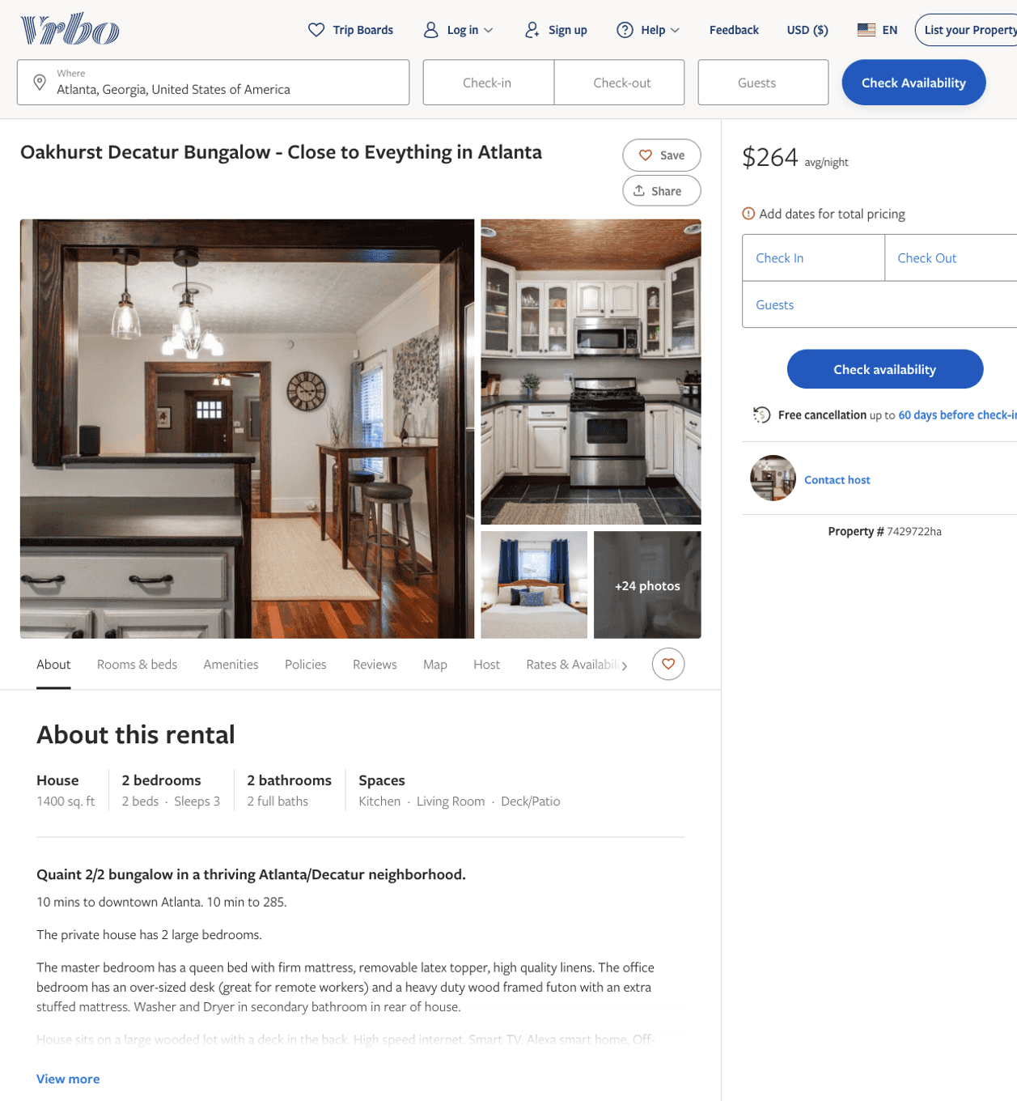
Listing 7429722
2
3
$264
4
https://www.vrbo.com/7429722ha
Aug 2022

Slide 5
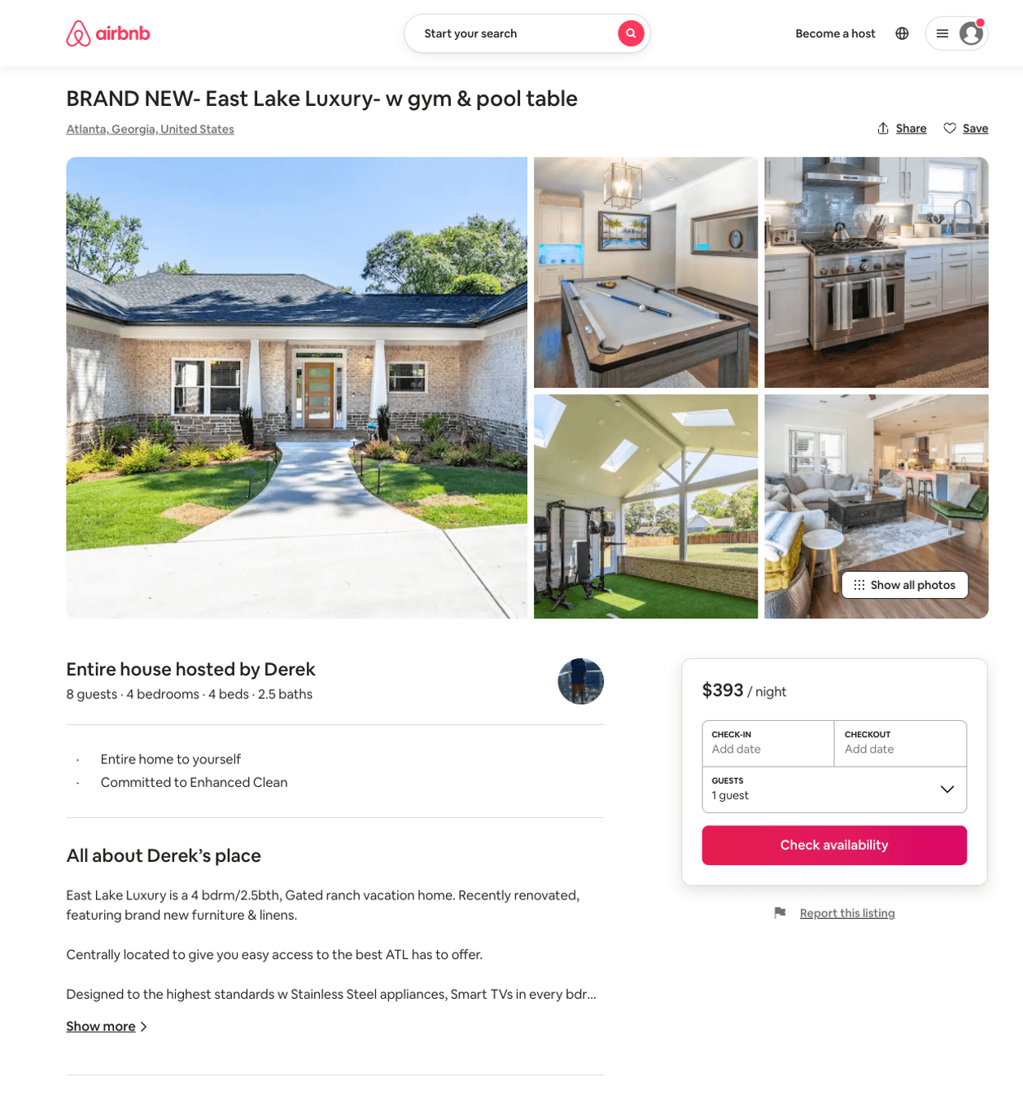
Listing 50308879
4
8
$258 - $434
5.0
4
Derek
406240977
1
https://www.airbnb.com/rooms/50308879
Aug 2022

Slide 6
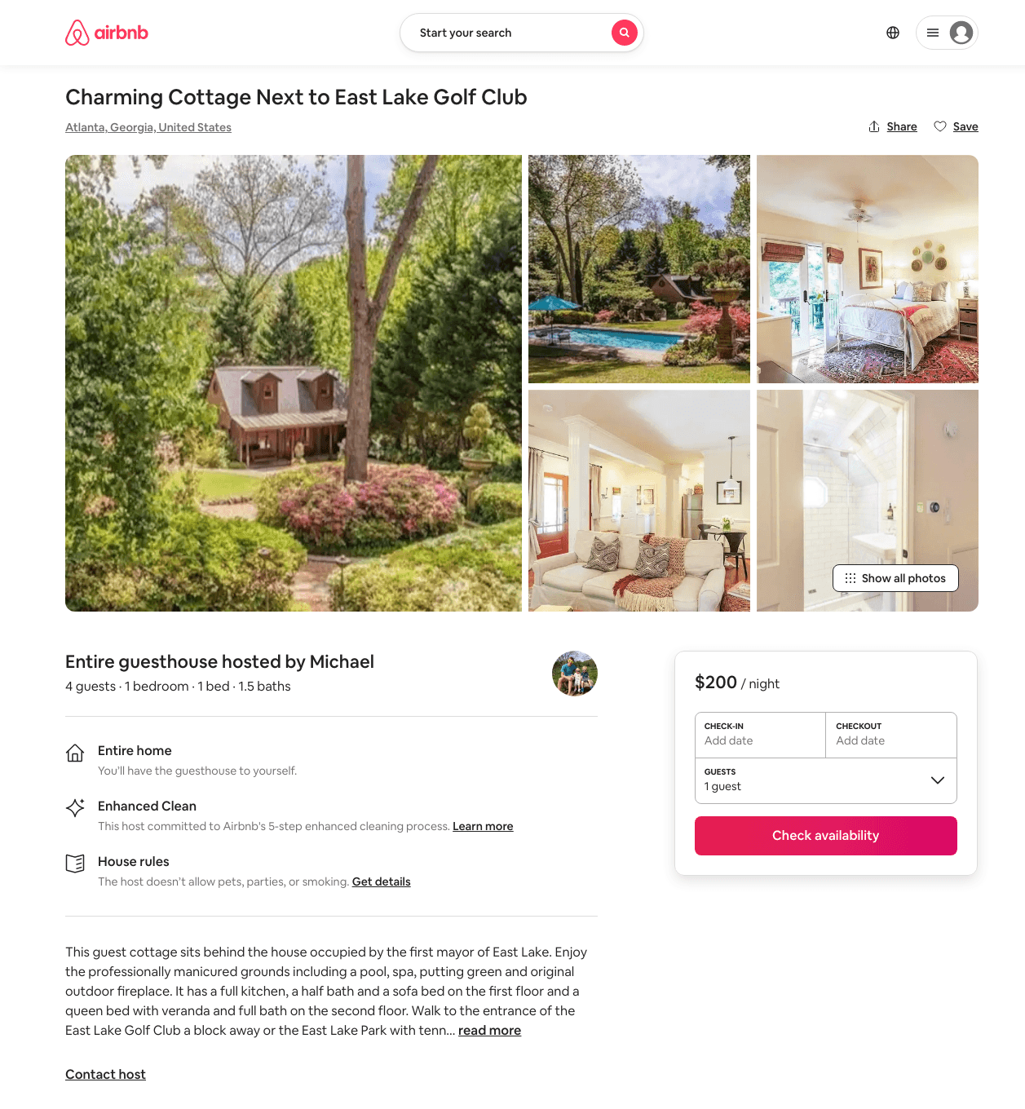
Listing 45876511
1
4
$200 - $521
4.90
2
Michael
39147821
1
https://www.airbnb.com/rooms/45876511
Aug 2022

Slide 7
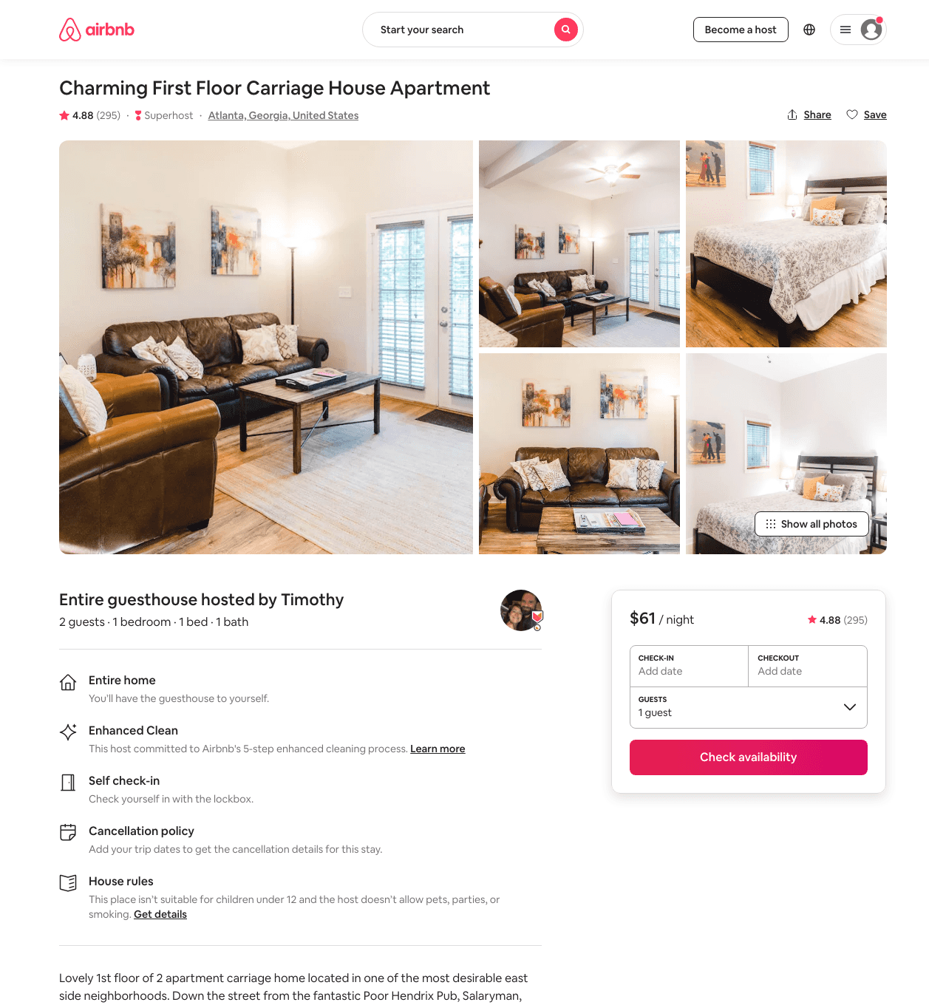
Listing 9046698
1
2
$60 - $96
4.88
1
Timothy
29262831
2
https://www.airbnb.com/rooms/9046698
Aug 2022

Slide 8
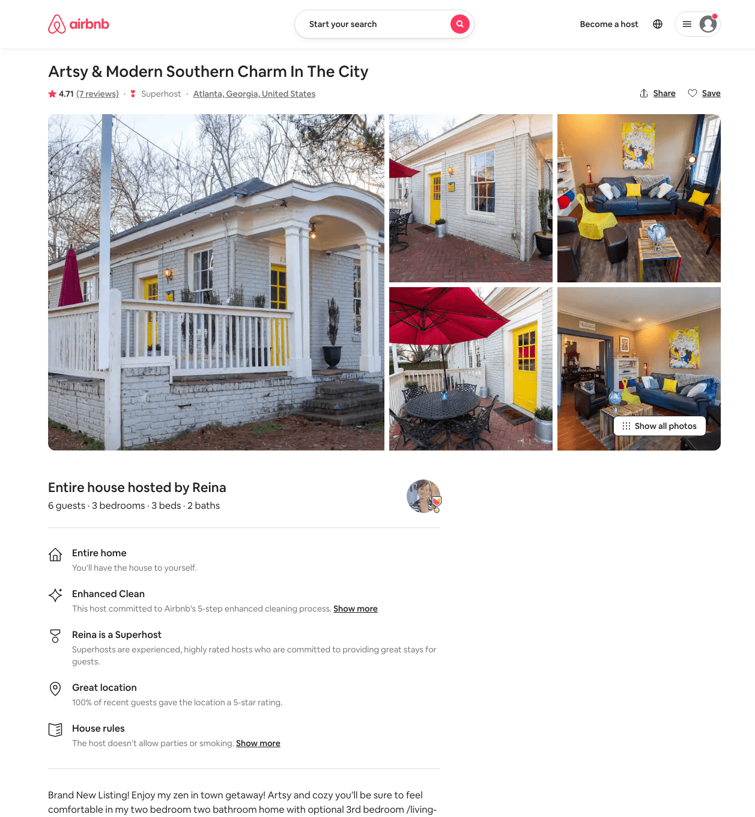
Listing 41981541
2
6
$106 - $226
4.88
1
Reina
19636176
3
https://www.airbnb.com/rooms/41981541
Aug 2022

Slide 9
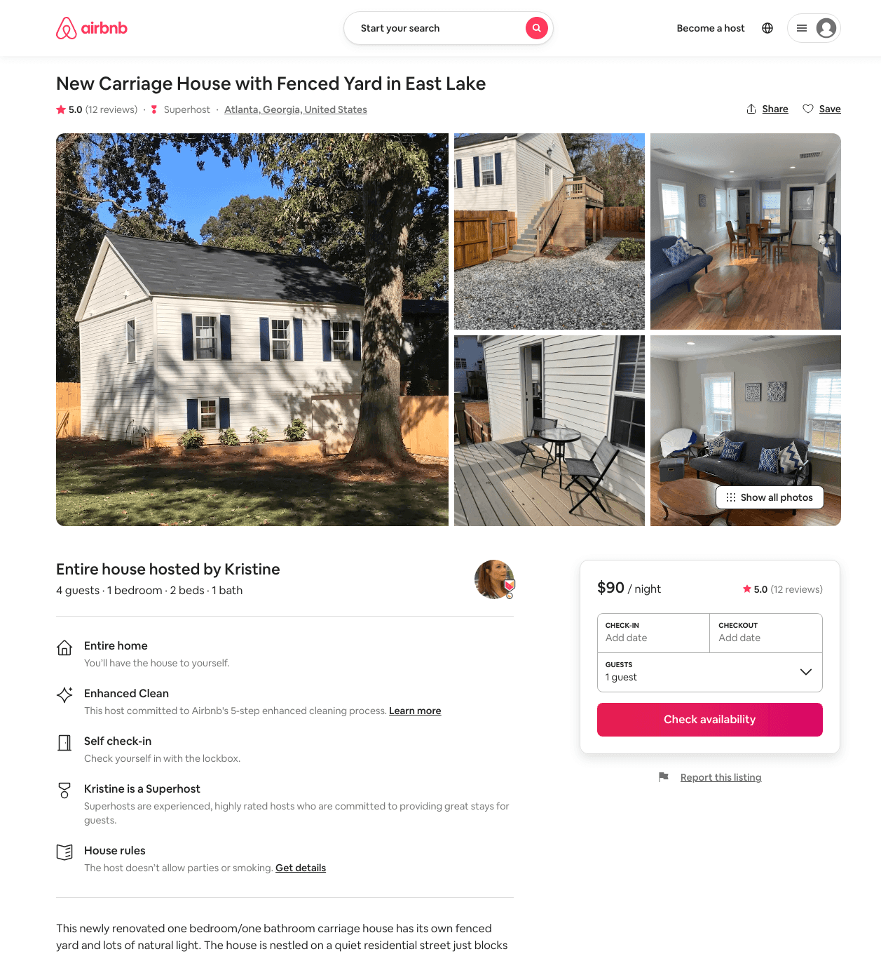
Listing 40118650
1
4
$90 - $111
5.0
2
Kristine
48950617
1
https://www.airbnb.com/rooms/40118650
Aug 2022

Slide 10
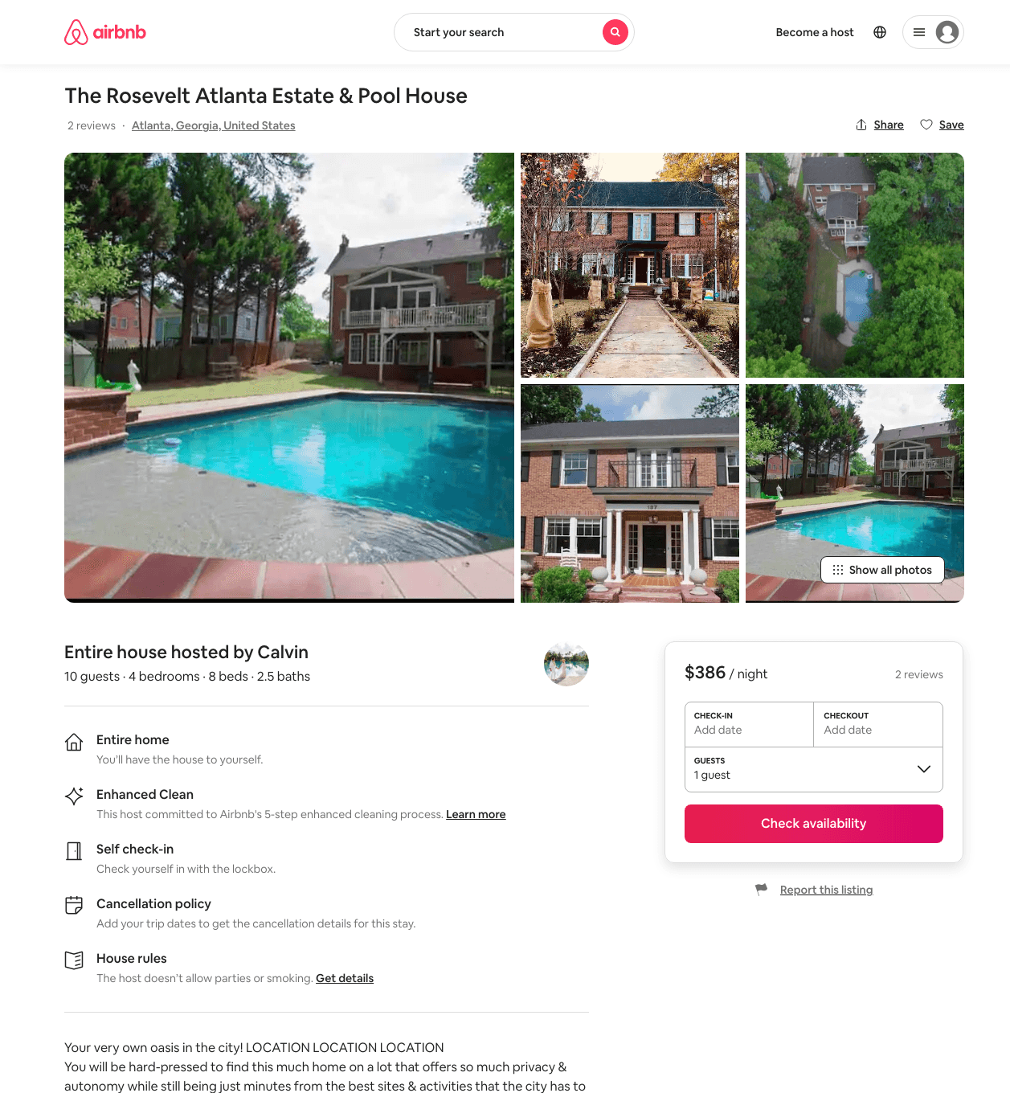
Listing 47308903
4
10
$384 - $605
4.67
3
Calvin
110863796
1
https://www.airbnb.com/rooms/47308903
Aug 2022

Slide 11
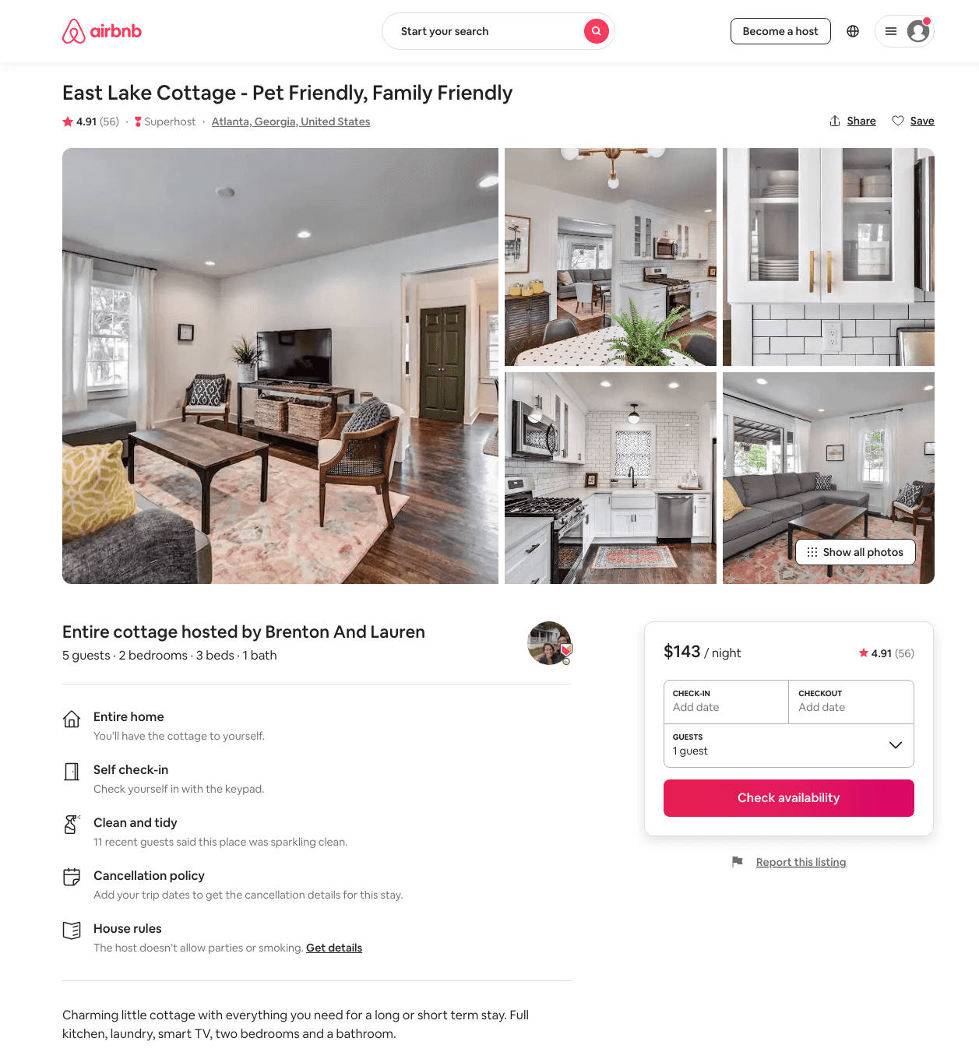
Listing 39973781
2
4
$109 - $153
4.84
2
Brenton And Lauren
2233744
1
https://www.airbnb.com/rooms/39973781
Aug 2022

Slide 12
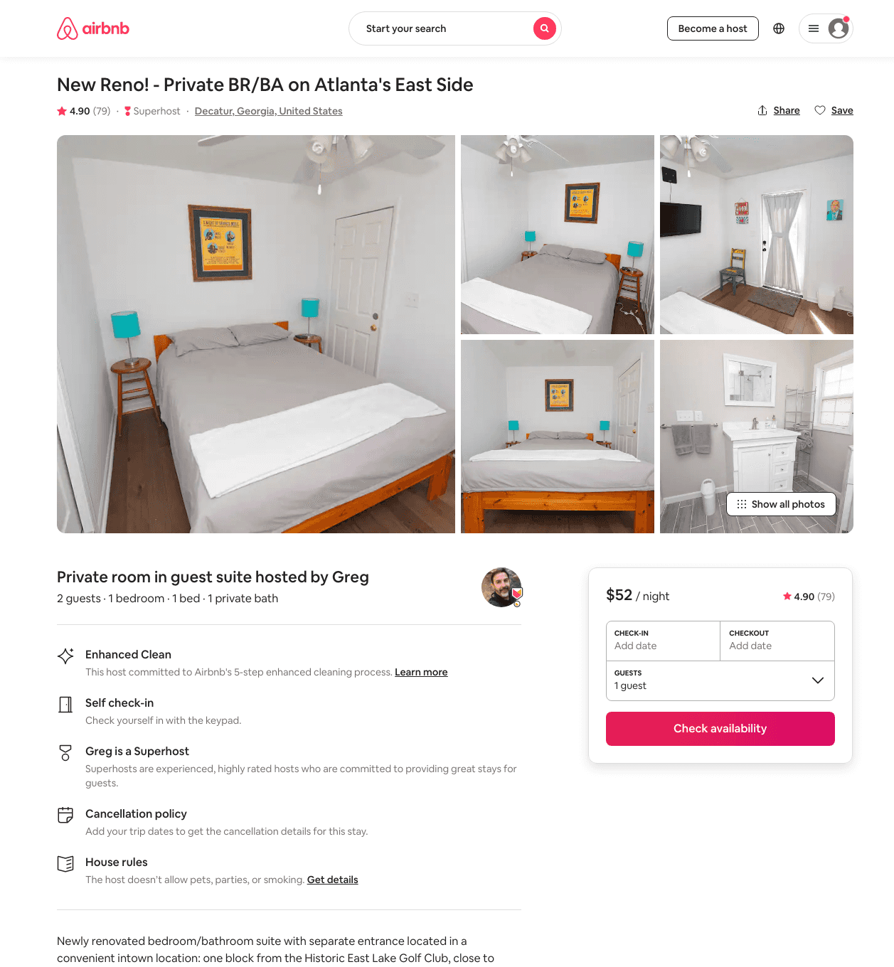
Listing 15135603
1
2
$50 - $101
4.91
2
Greg
35889857
1
https://www.airbnb.com/rooms/15135603
Aug 2022

Slide 13
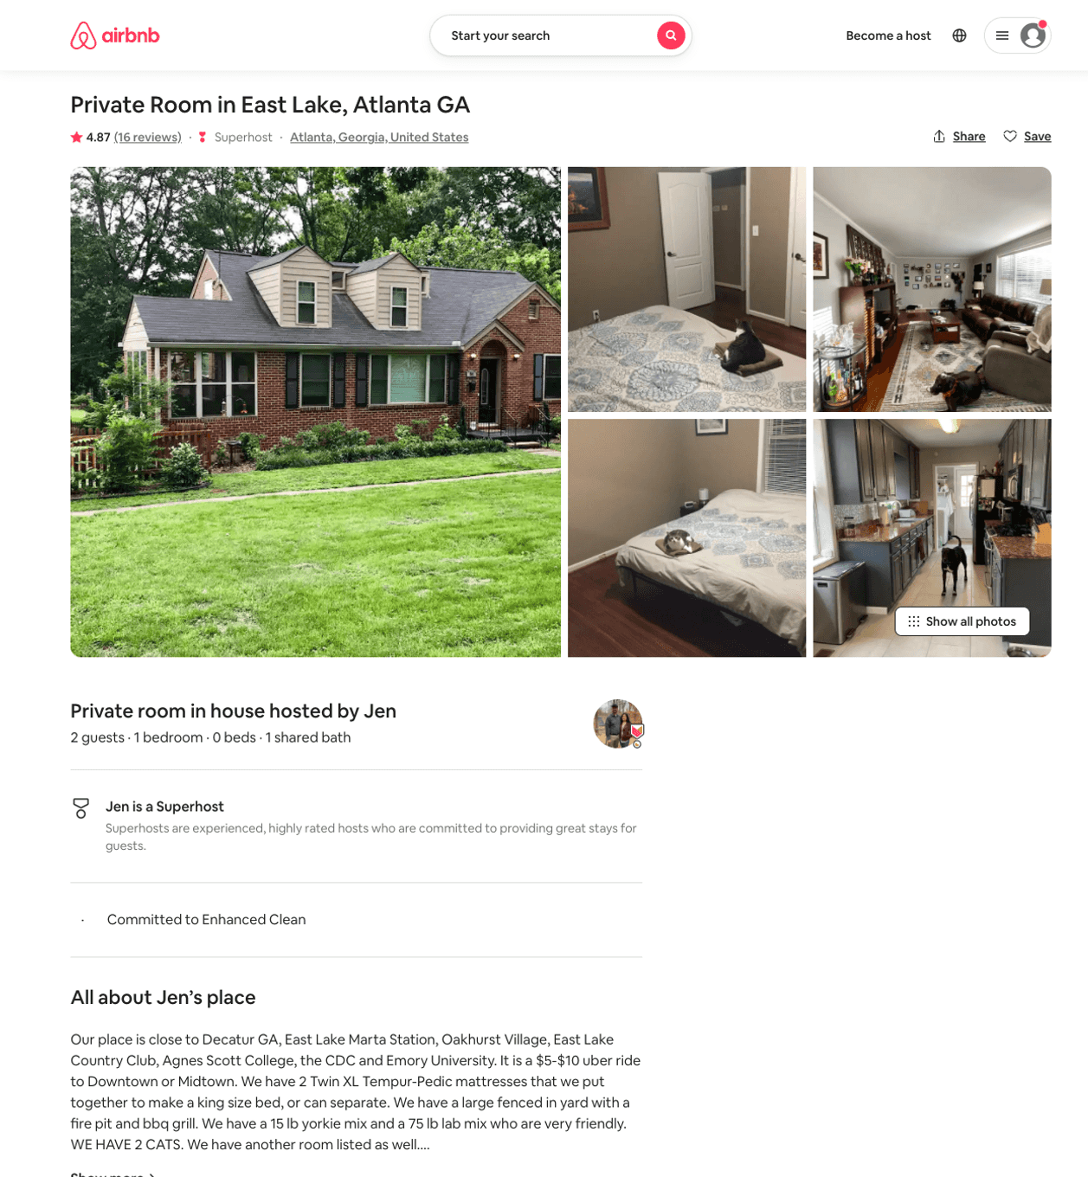
Listing 17035306
1
2
$43
4.85
7
Jen
25664310
2
https://www.airbnb.com/rooms/17035306
Aug 2022

Slide 14
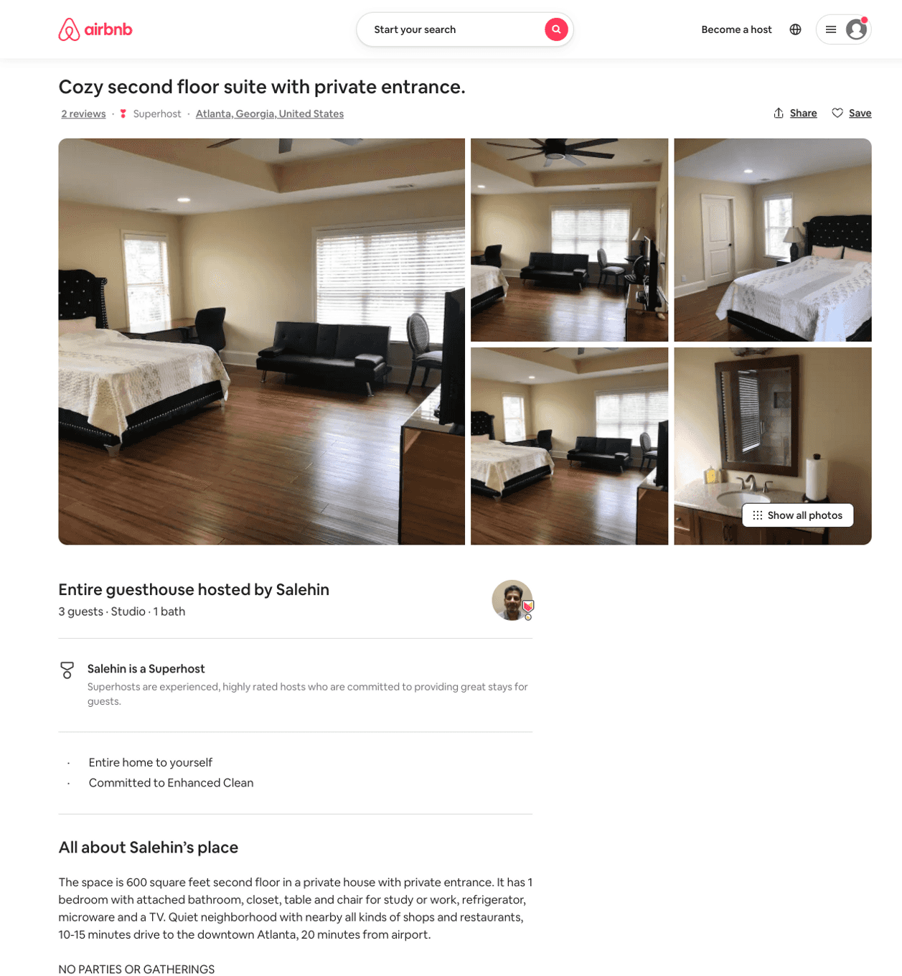
Listing 48748337
Studio
3
$99
3
Salehin
179328702
1
https://www.airbnb.com/rooms/48748337
Aug 2022

Slide 15
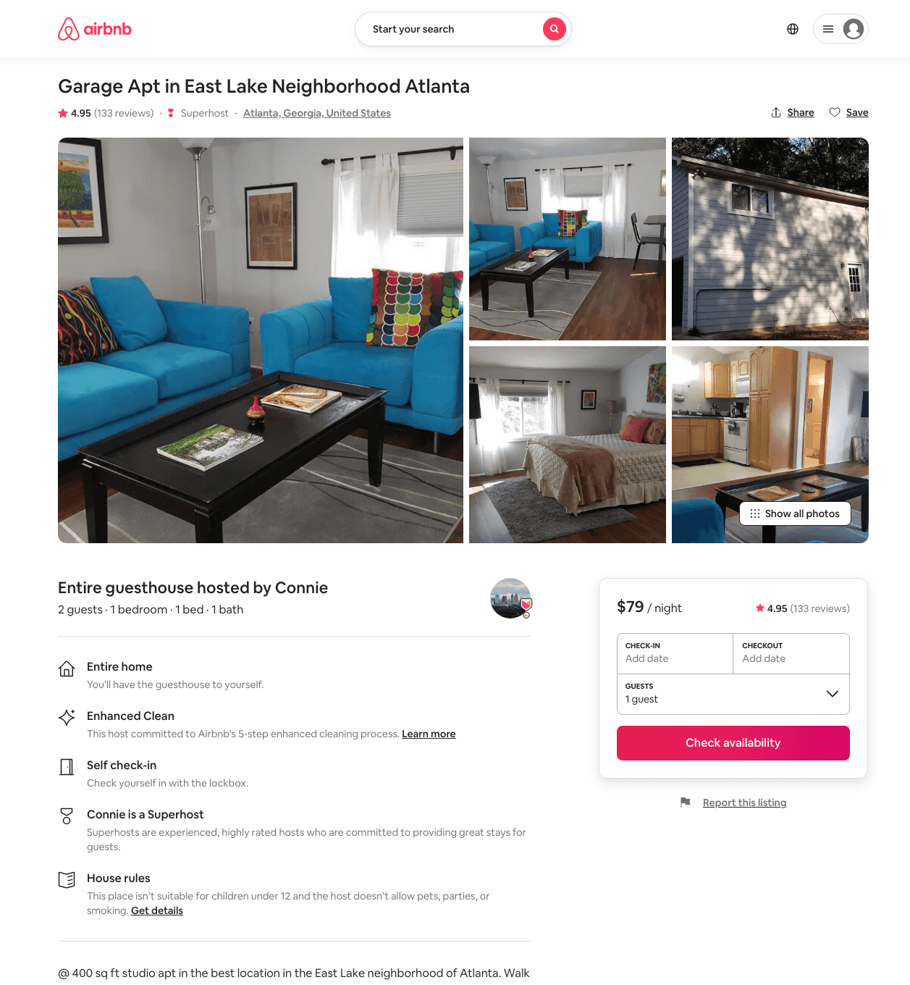
Listing 7881025
1
2
$79 - $132
4.94
3
Connie
6762241
1
https://www.airbnb.com/rooms/7881025
Aug 2022

Slide 16
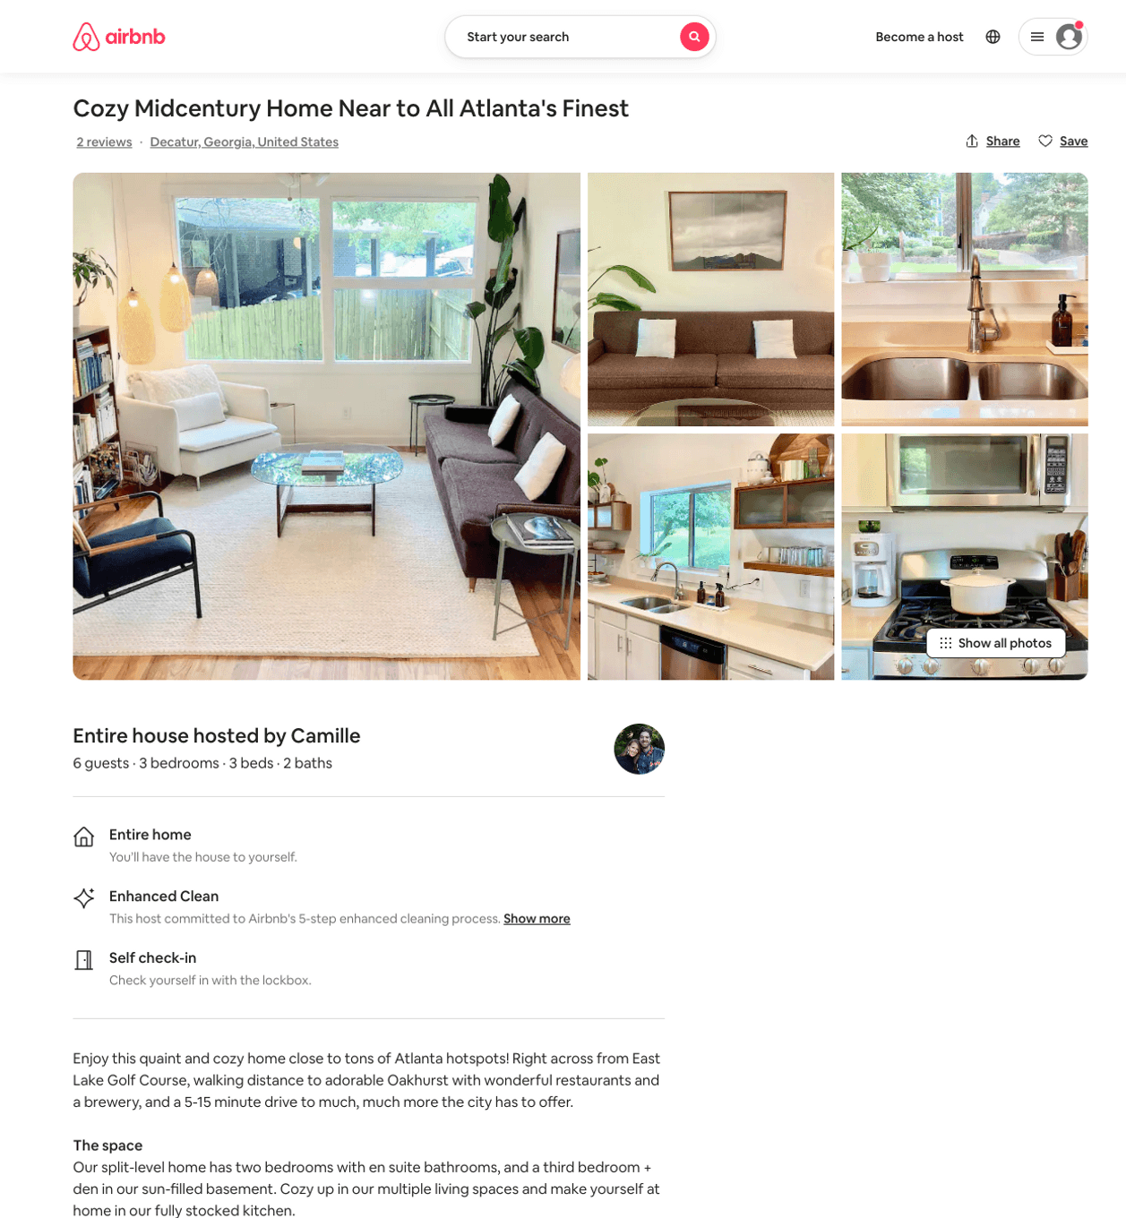
Listing 50676965
3
6
$151 - $586
5.0
2
Camille
5016095
1
https://www.airbnb.com/rooms/50676965
Aug 2022

Slide 17
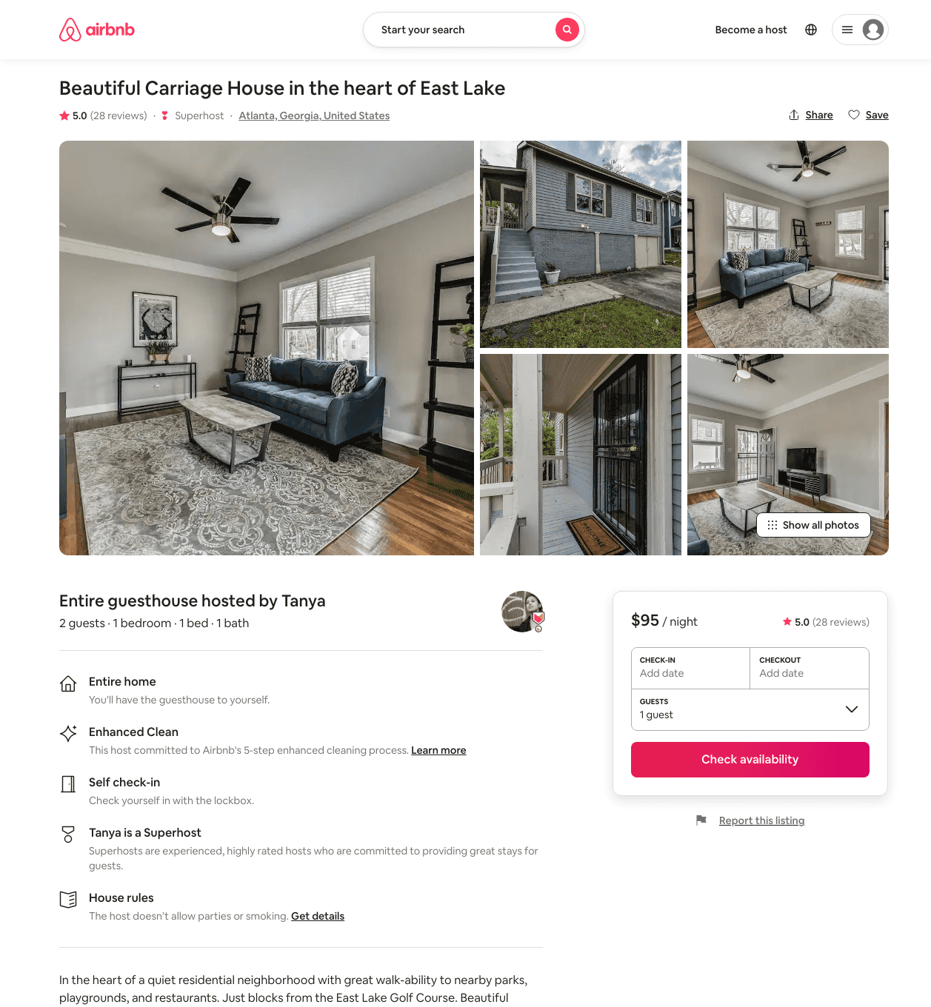
Listing 33373318
1
2
$95 - $110
4.93
2
Tanya
68156082
1
https://www.airbnb.com/rooms/33373318
Aug 2022

Slide 18
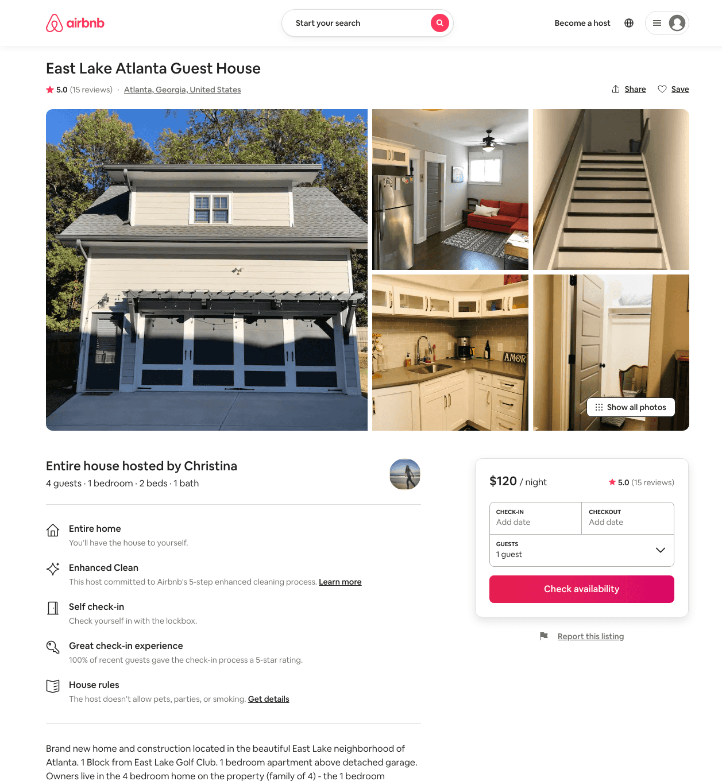
Listing 28443345
1
4
$117 - $122
4.97
2
Christina
31041570
1
https://www.airbnb.com/rooms/28443345
Aug 2022

Slide 19
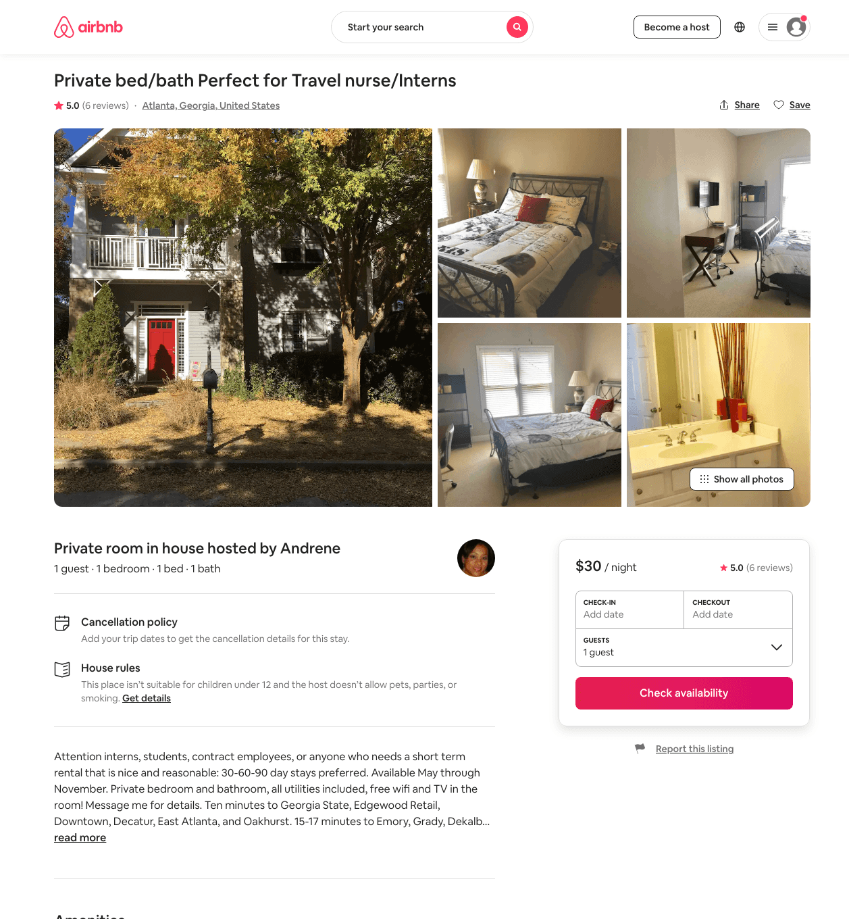
Listing 16064300
1
1
$30 - $35
5.0
15
Andrene
104639825
1
https://www.airbnb.com/rooms/16064300
Jun 2022

Slide 20
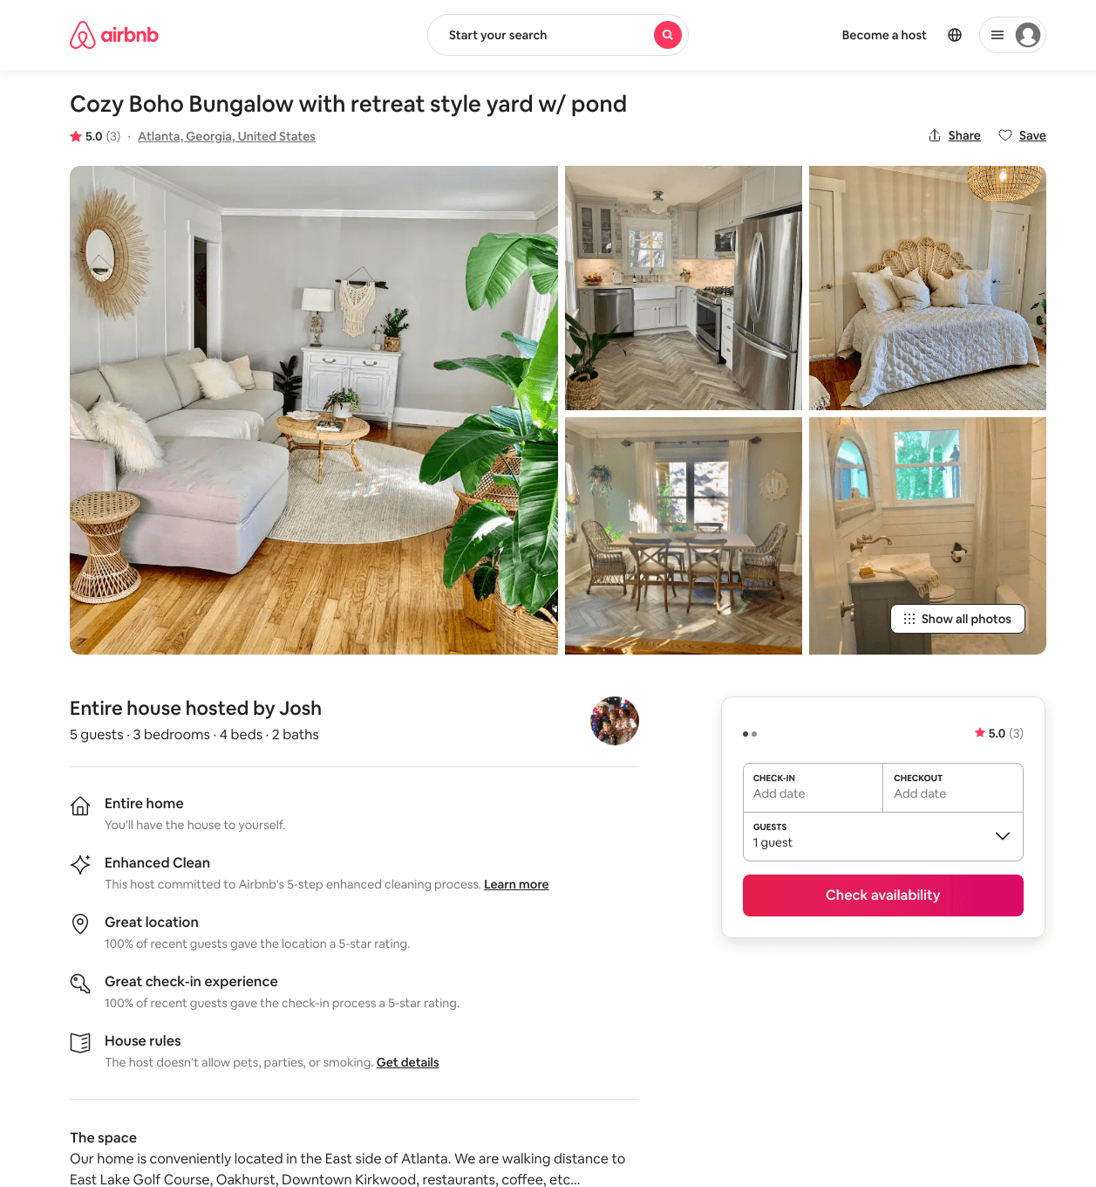
Listing 46466810
3
6
$250 - $341
4.87
2
Kerri And Josh
93368000
1
https://www.airbnb.com/rooms/46466810
Aug 2022

Slide 21
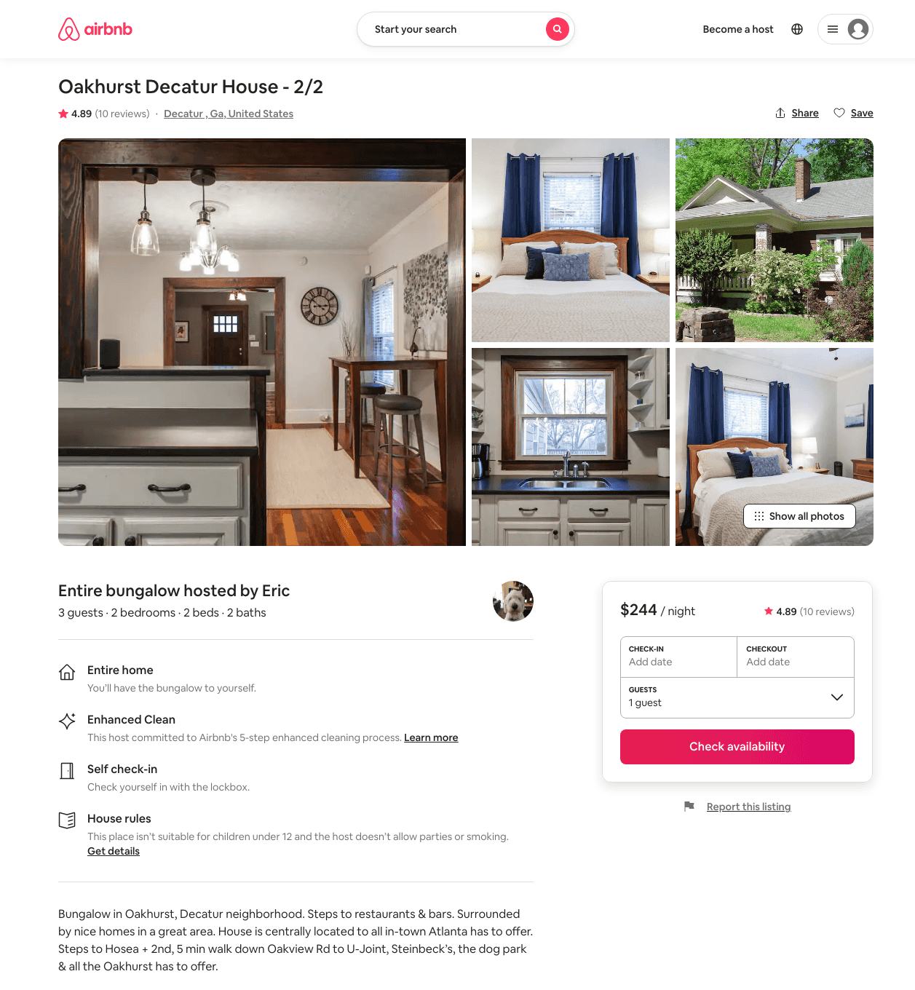
Listing 28014422
2
3
$244 - $339
4.89
3
Eric
211591623
1
https://www.airbnb.com/rooms/28014422
Aug 2022

Slide 22
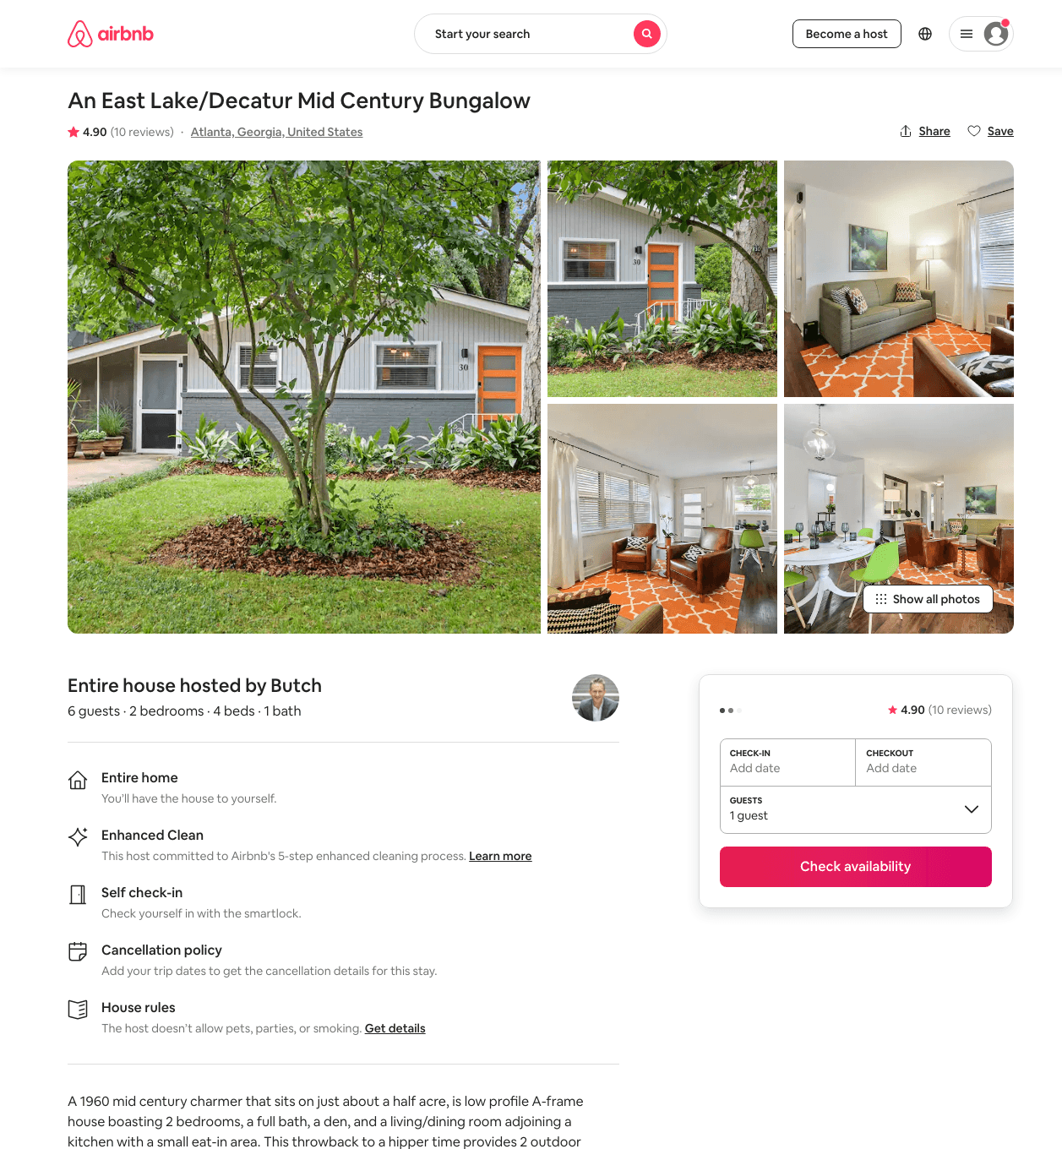
Listing 43773708
2
6
$150 - $208
4.83
2
Butch
51928084
1
https://www.airbnb.com/rooms/43773708
Jun 2022

Slide 23
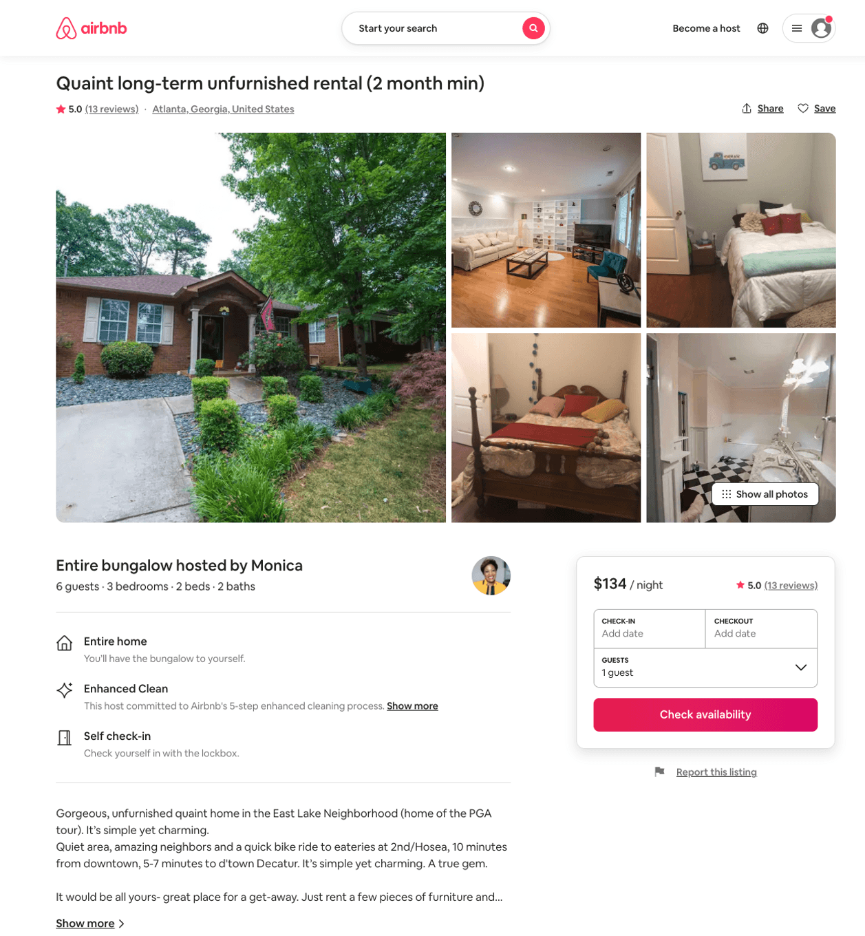
Listing 35911760
3
6
$134 - $200
5.0
4
Monica
270113391
1
https://www.airbnb.com/rooms/35911760
Aug 2022

Slide 24
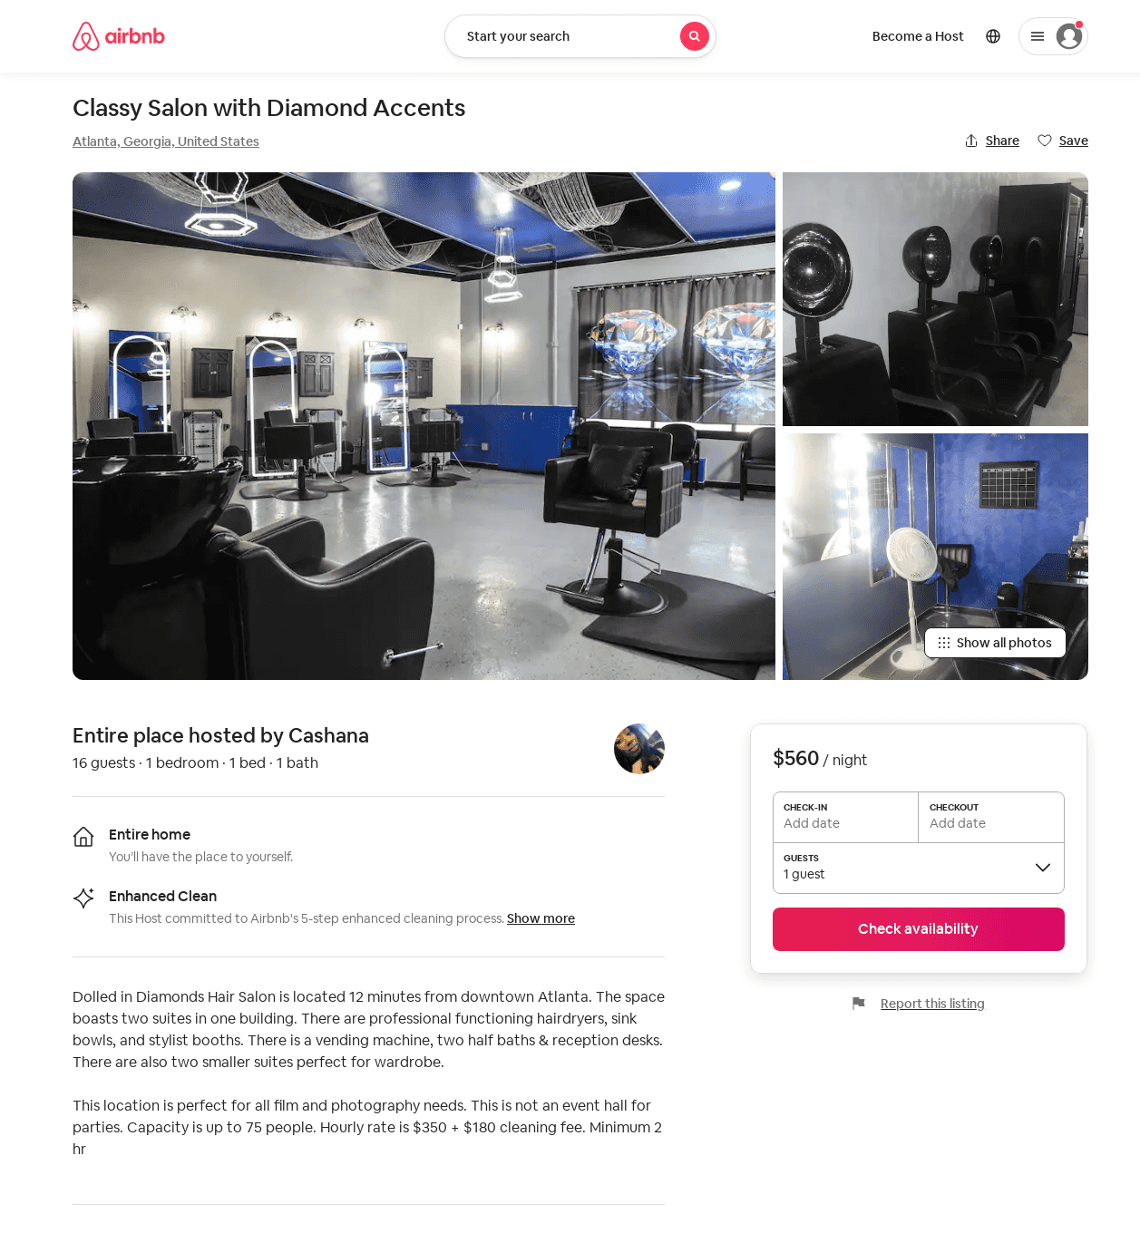
Listing 52650649
1
16
$560 - $700
1
Cashana
231958518
1
https://www.airbnb.com/rooms/52650649
Aug 2022

Slide 25
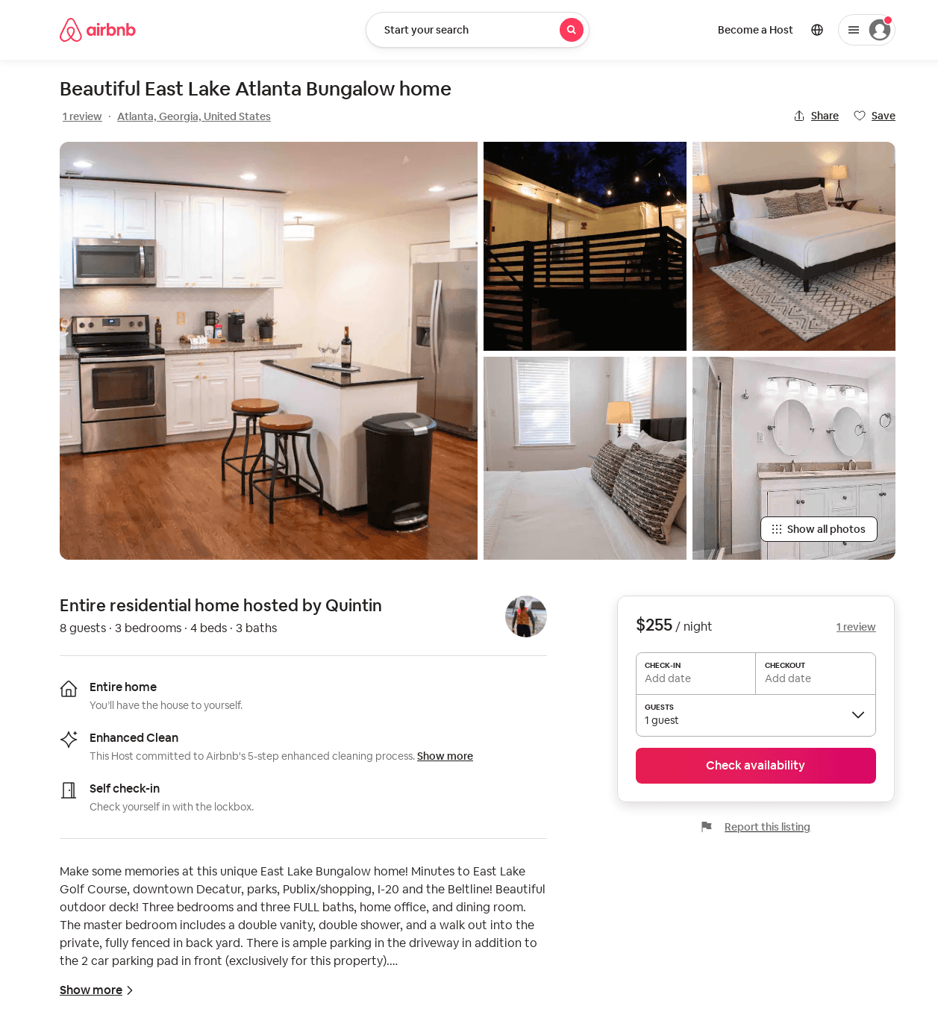
Listing 53362702
3
6
$120 - $278
4.84
2
Quintin
70083127
2
https://www.airbnb.com/rooms/53362702
Aug 2022

Slide 26
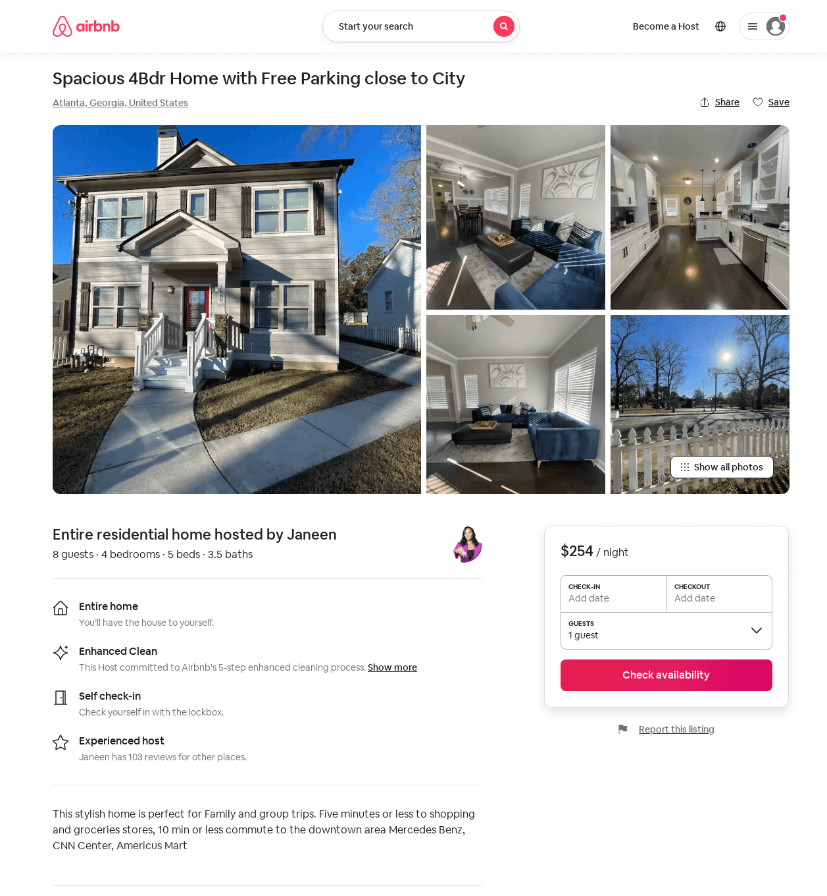
Listing 53800914
4
8
$163 - $254
4.88
3
Janeen
108938211
2
https://www.airbnb.com/rooms/53800914
Aug 2022

Slide 27
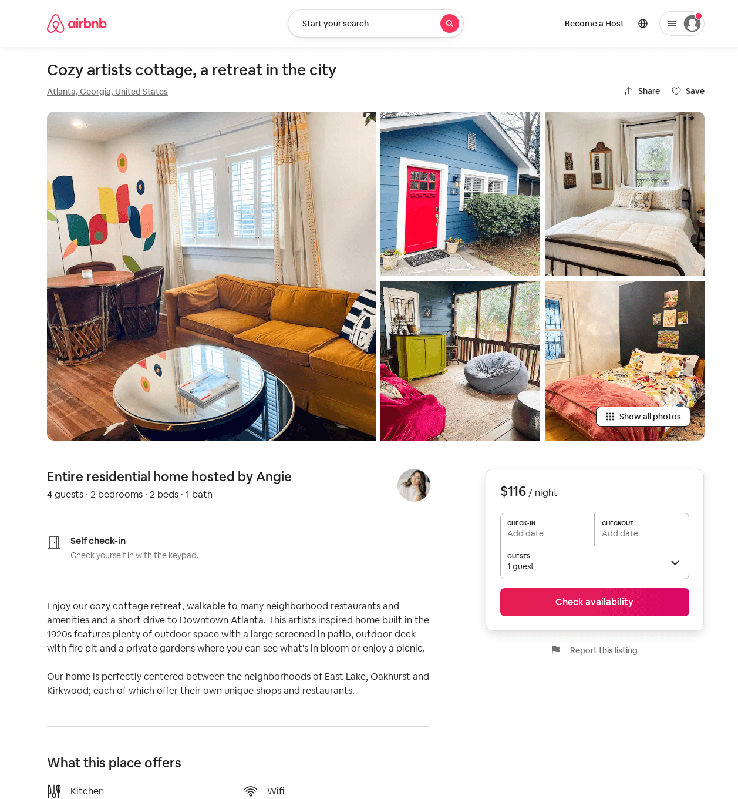
Listing 54224510
2
4
$116 - $146
4.88
2
Angie
29347614
1
https://www.airbnb.com/rooms/54224510
Aug 2022

Slide 28
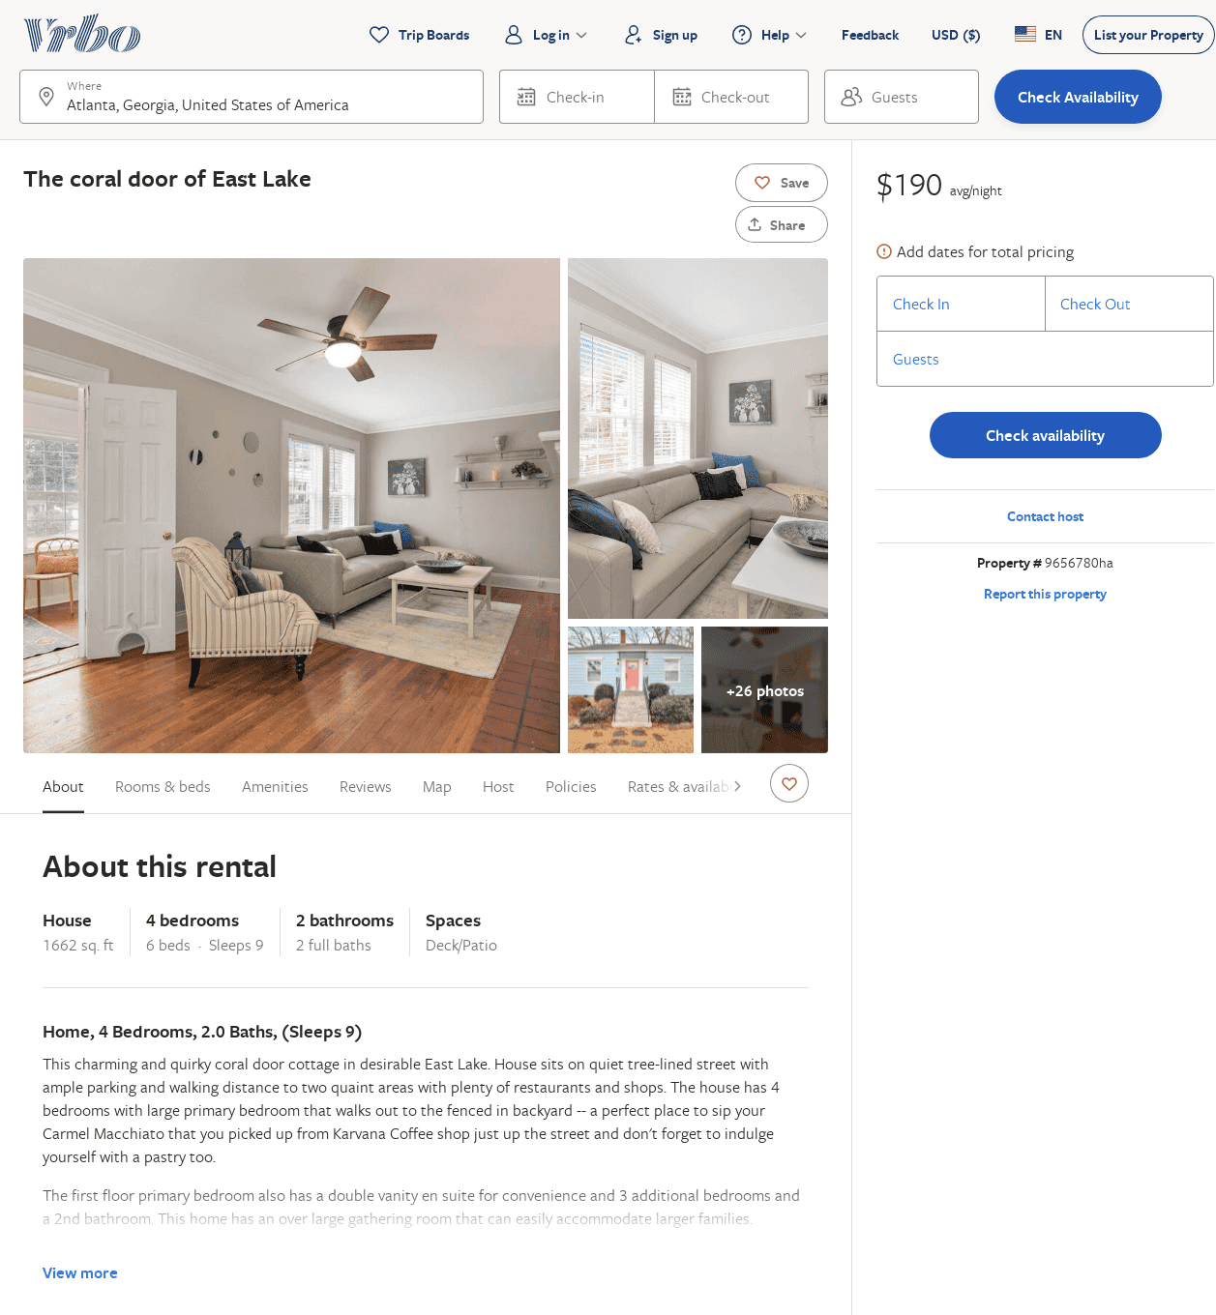
Listing 9656780
4
9
$198
5
1
Lora Clemens @ 201 953 5015 or Kellie Simpson @ 678 373 2426
https://www.vrbo.com/9656780ha
Aug 2022

Slide 29
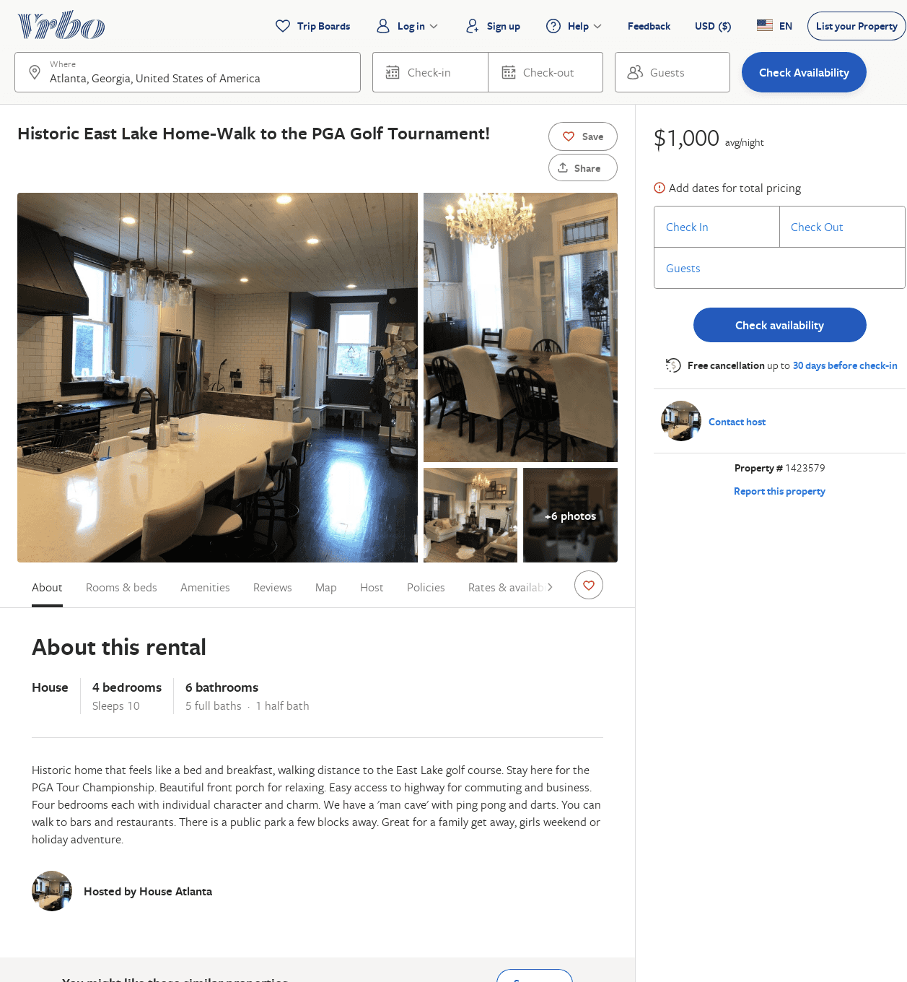
Listing 1423579
4
10
$1,000
2
https://www.vrbo.com/1423579
Aug 2022

Slide 30
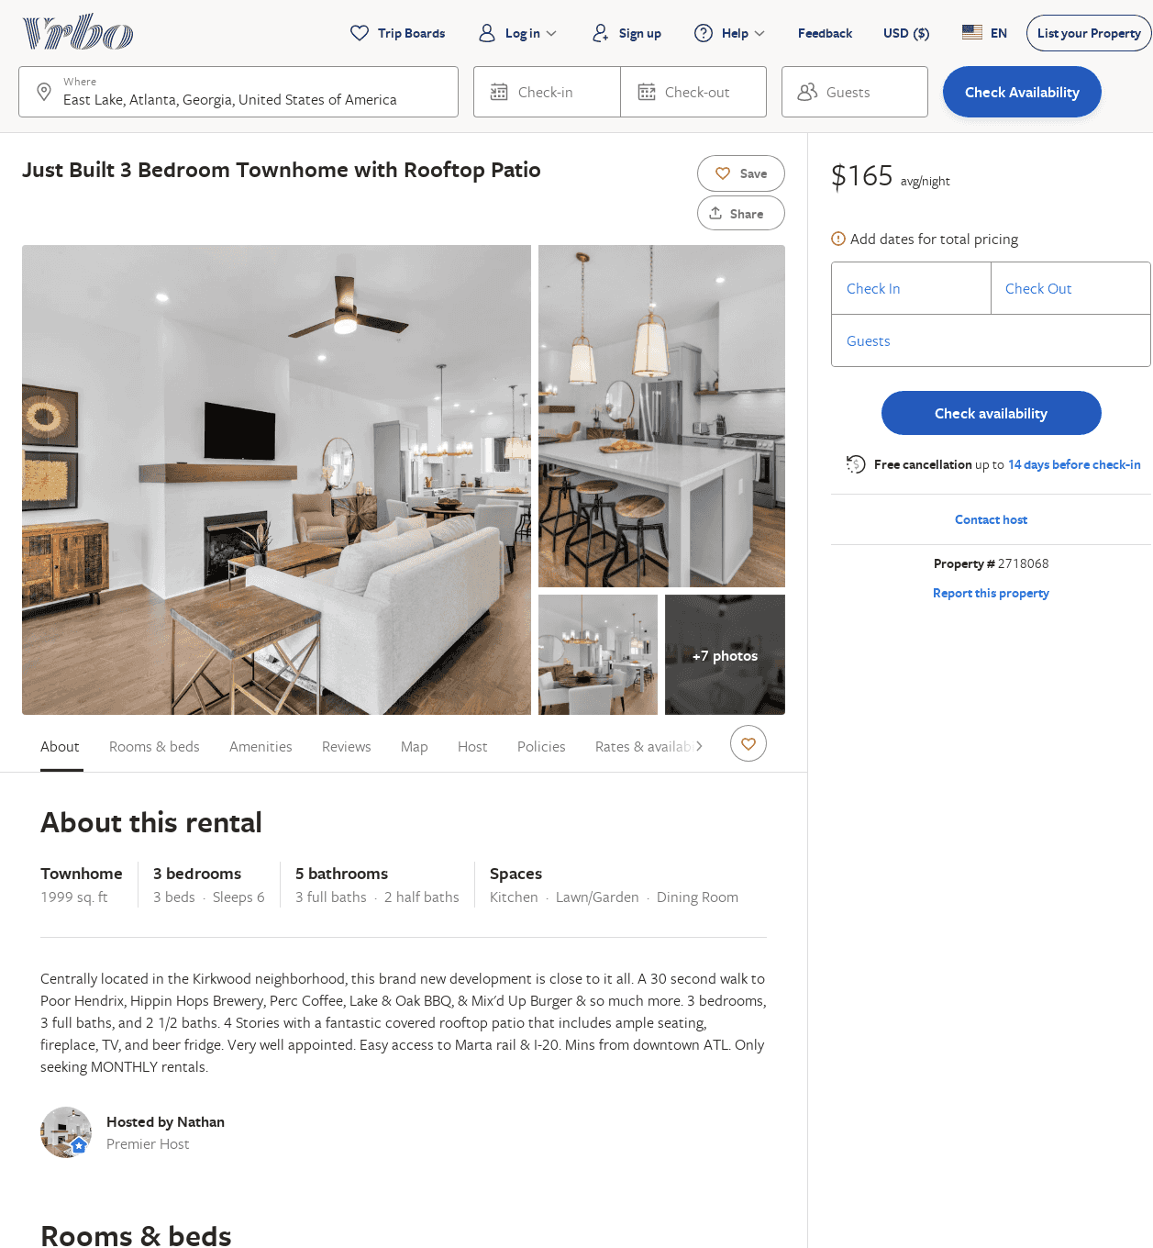
Listing 2718068
3
6
$165
30
Nathan
https://www.vrbo.com/2718068
Aug 2022

Slide 31
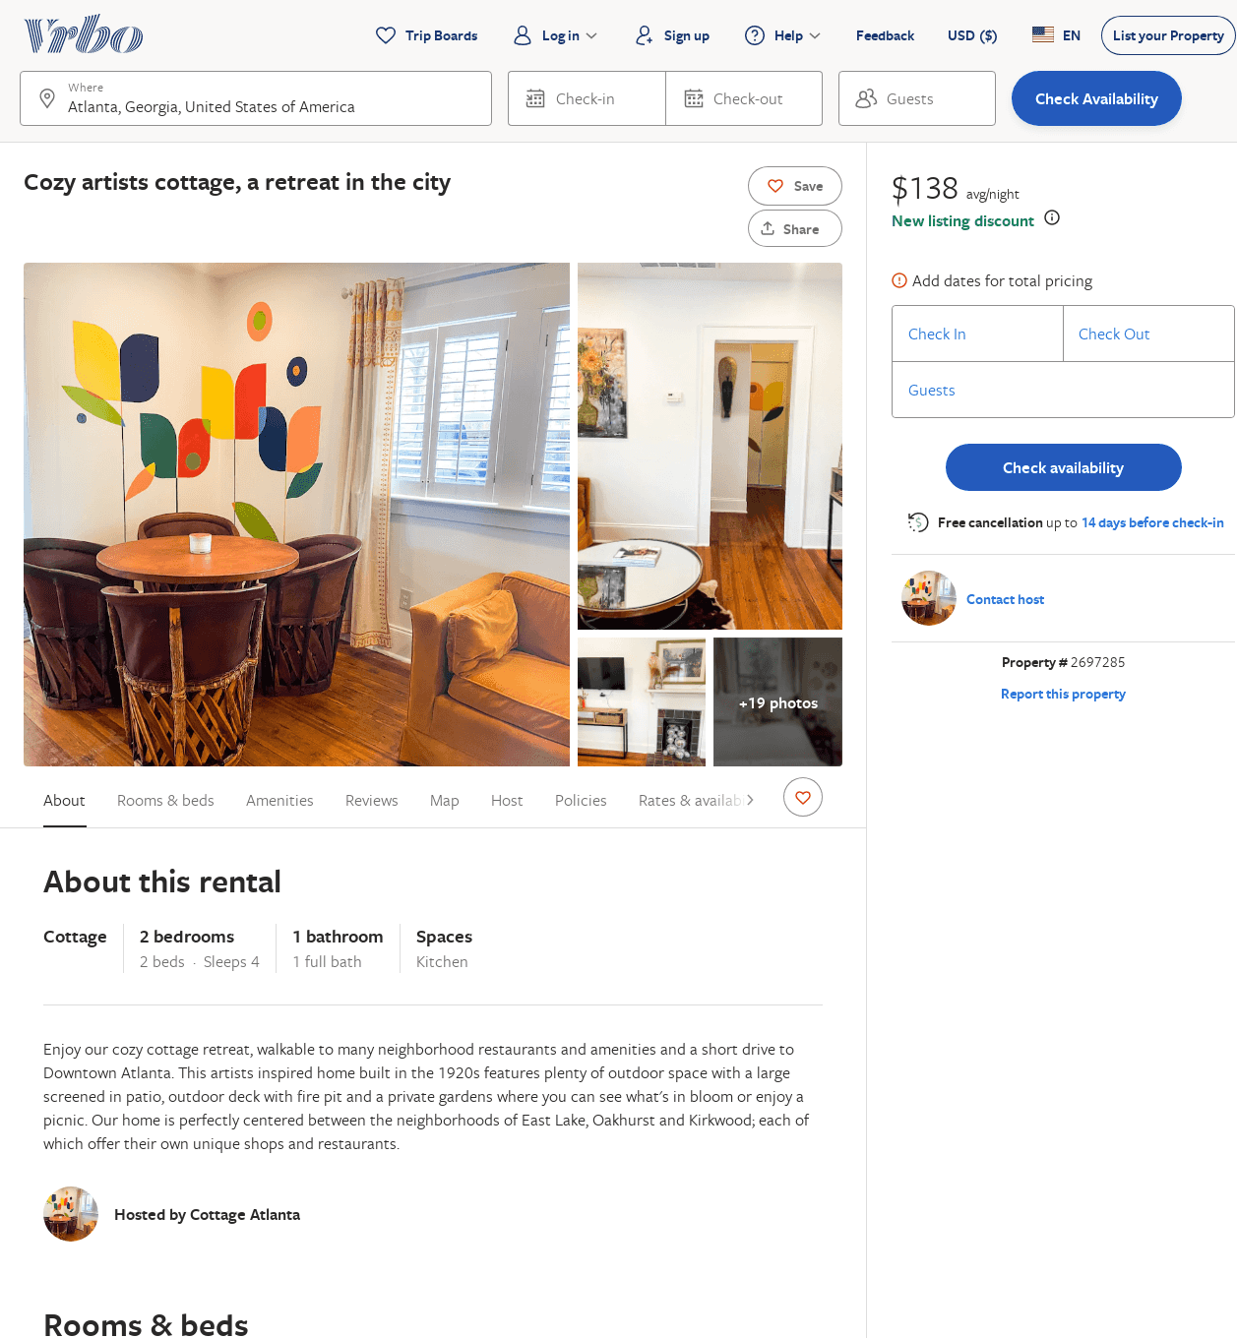
Listing 2697285
2
4
$130
3
https://www.vrbo.com/2697285
Aug 2022

Slide 32
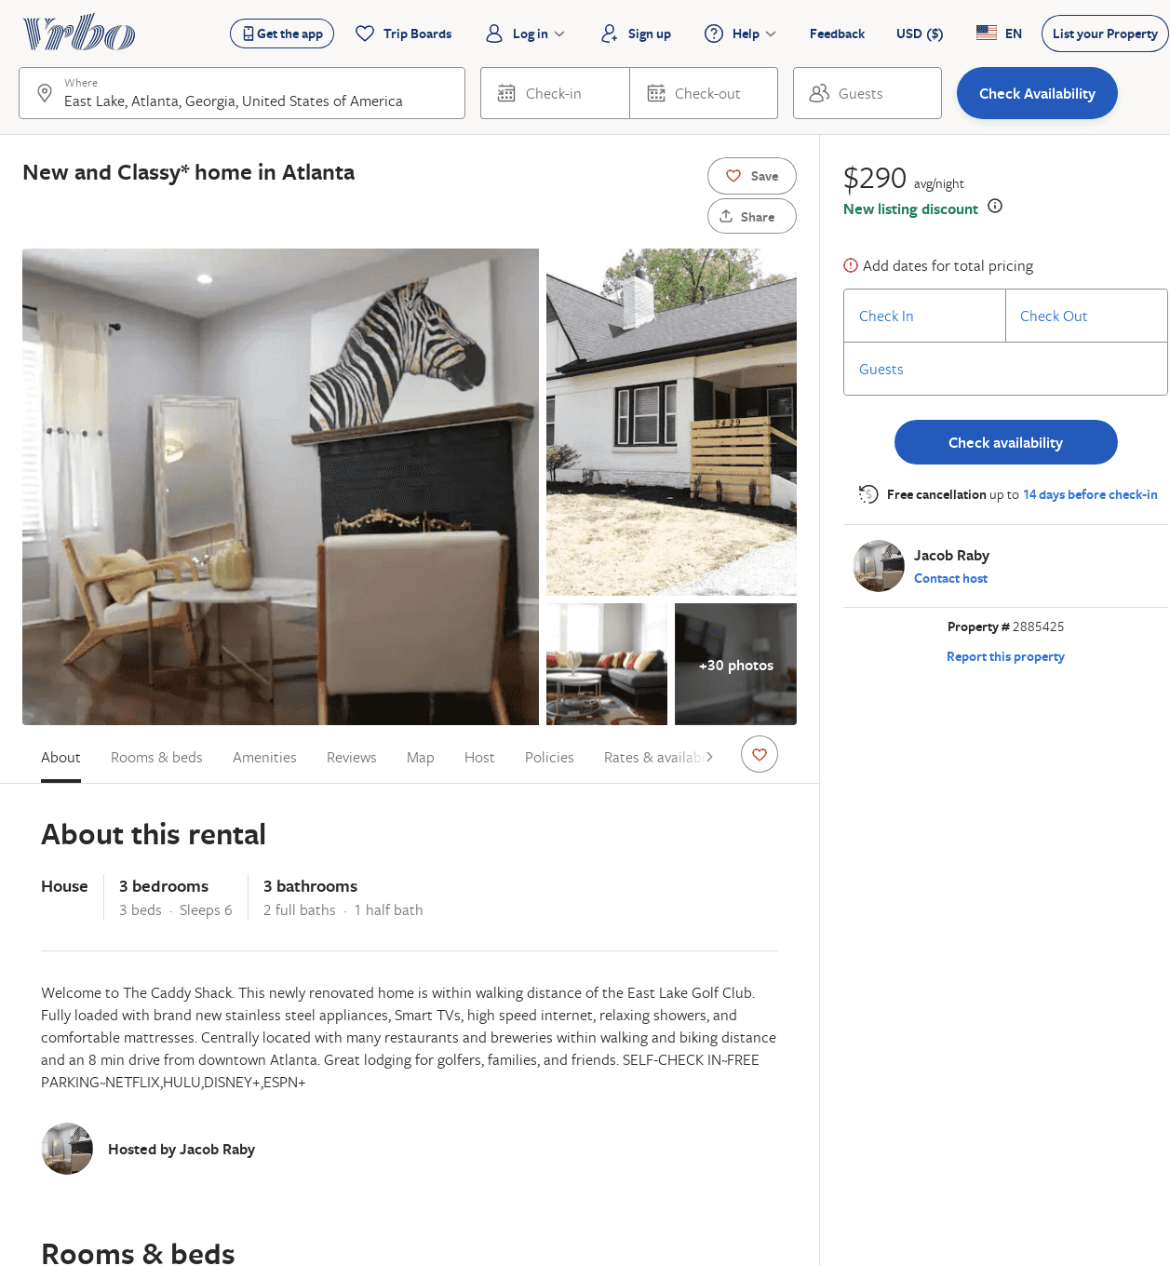
Listing 2885425
3
6
$290
2
Jacob Raby
https://www.vrbo.com/2885425
Aug 2022

Slide 33
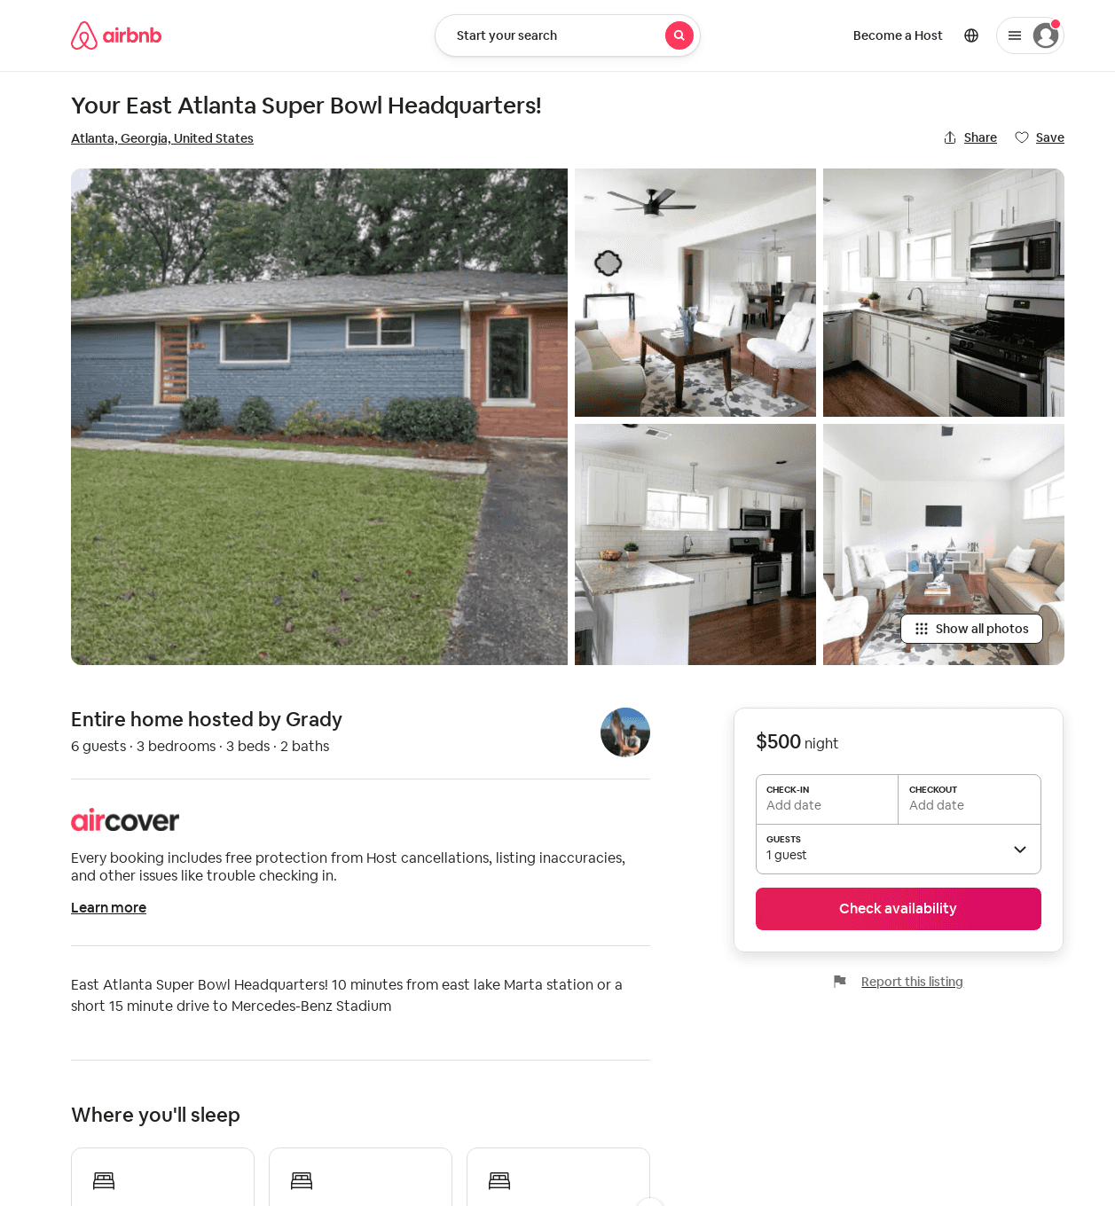
Listing 31833833
3
6
3
Grady
54673906
1
https://www.airbnb.com/rooms/31833833
Aug 2022

