Slide 2
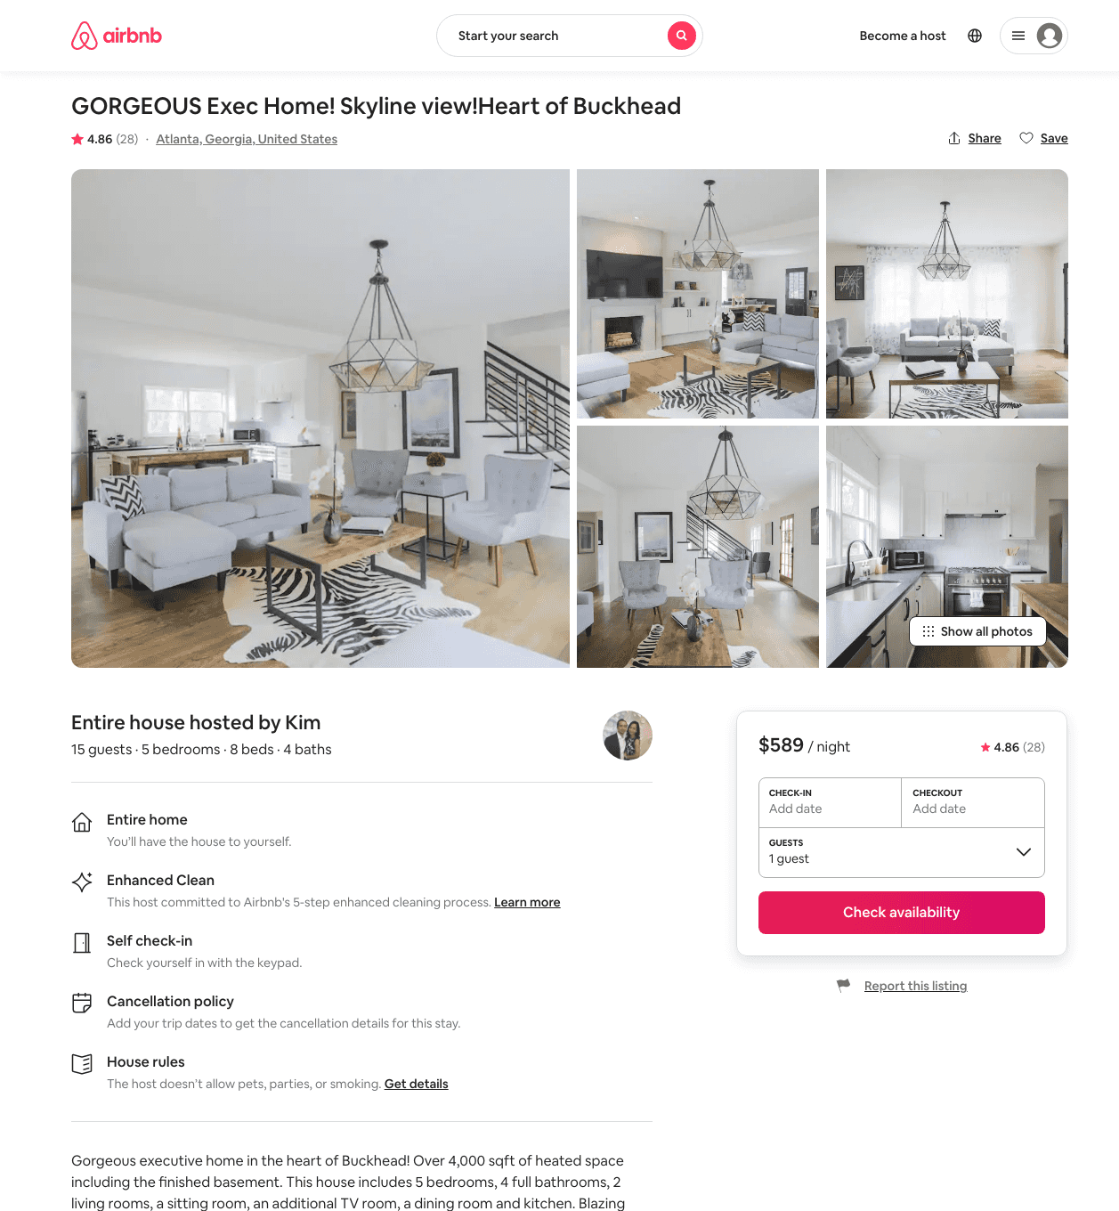
Listing 41154687
5
12
$535 - $678
4.60
3
Kim
124328425
4
https://www.airbnb.com/rooms/41154687
Aug 2022

Slide 3
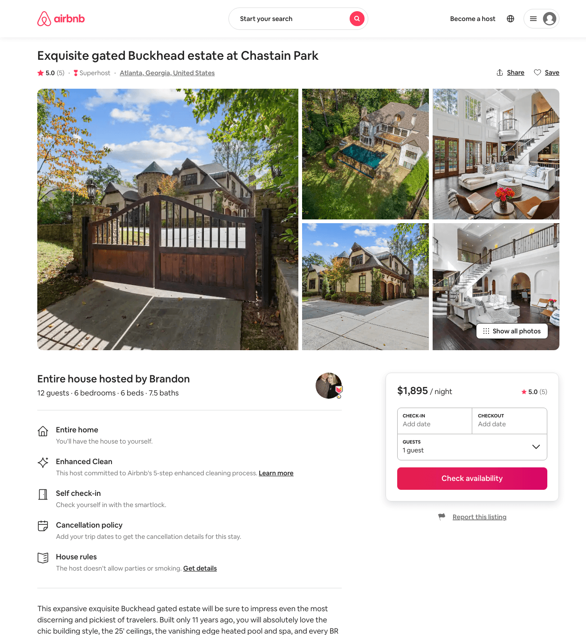
Listing 45985626
6
12
$1495 - $2495
5.0
5
Brandon
190997518
7
https://www.airbnb.com/rooms/45985626
Aug 2022

Slide 4
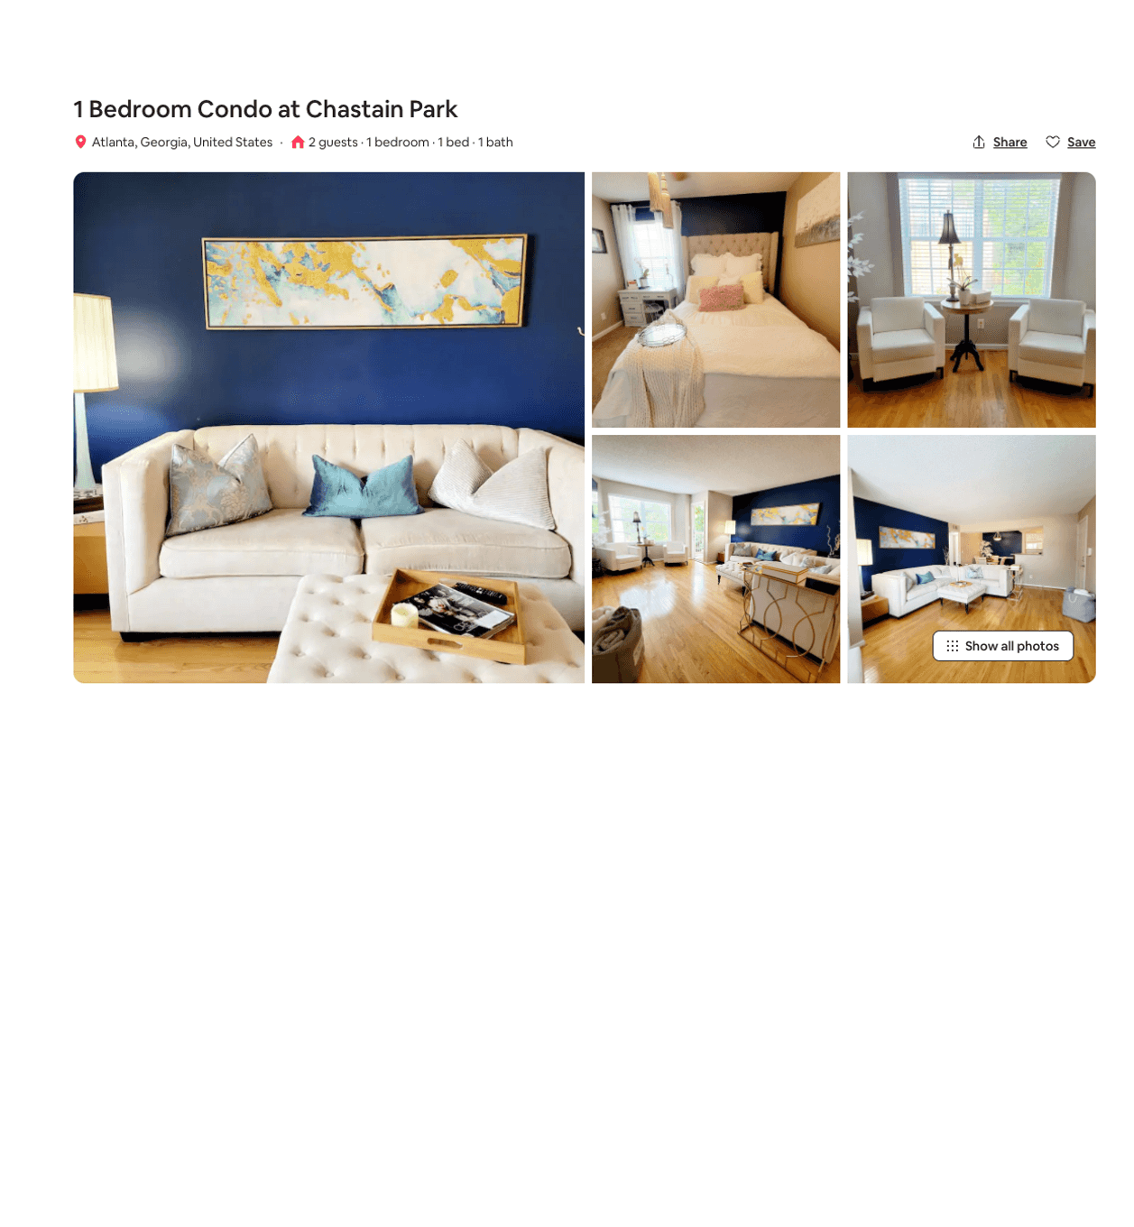
Listing 51300232
1
2
$85 - $132
5.0
30
Anna
276121861
1
https://www.airbnb.com/rooms/51300232
Jun 2022

Slide 5
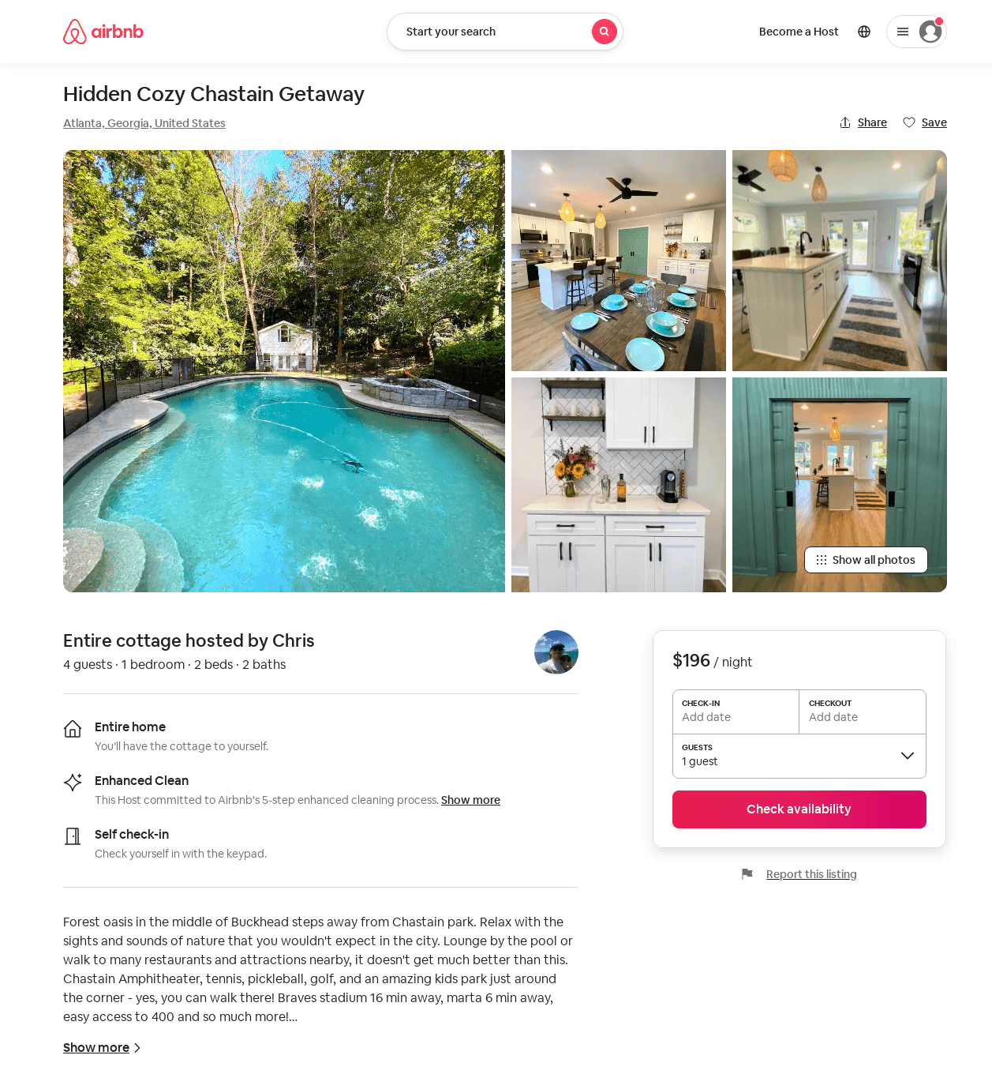
Listing 31733527
1
4
$196 - $281
5.0
2
Chris
30499875
1
https://www.airbnb.com/rooms/31733527
Aug 2022

