Slide 2
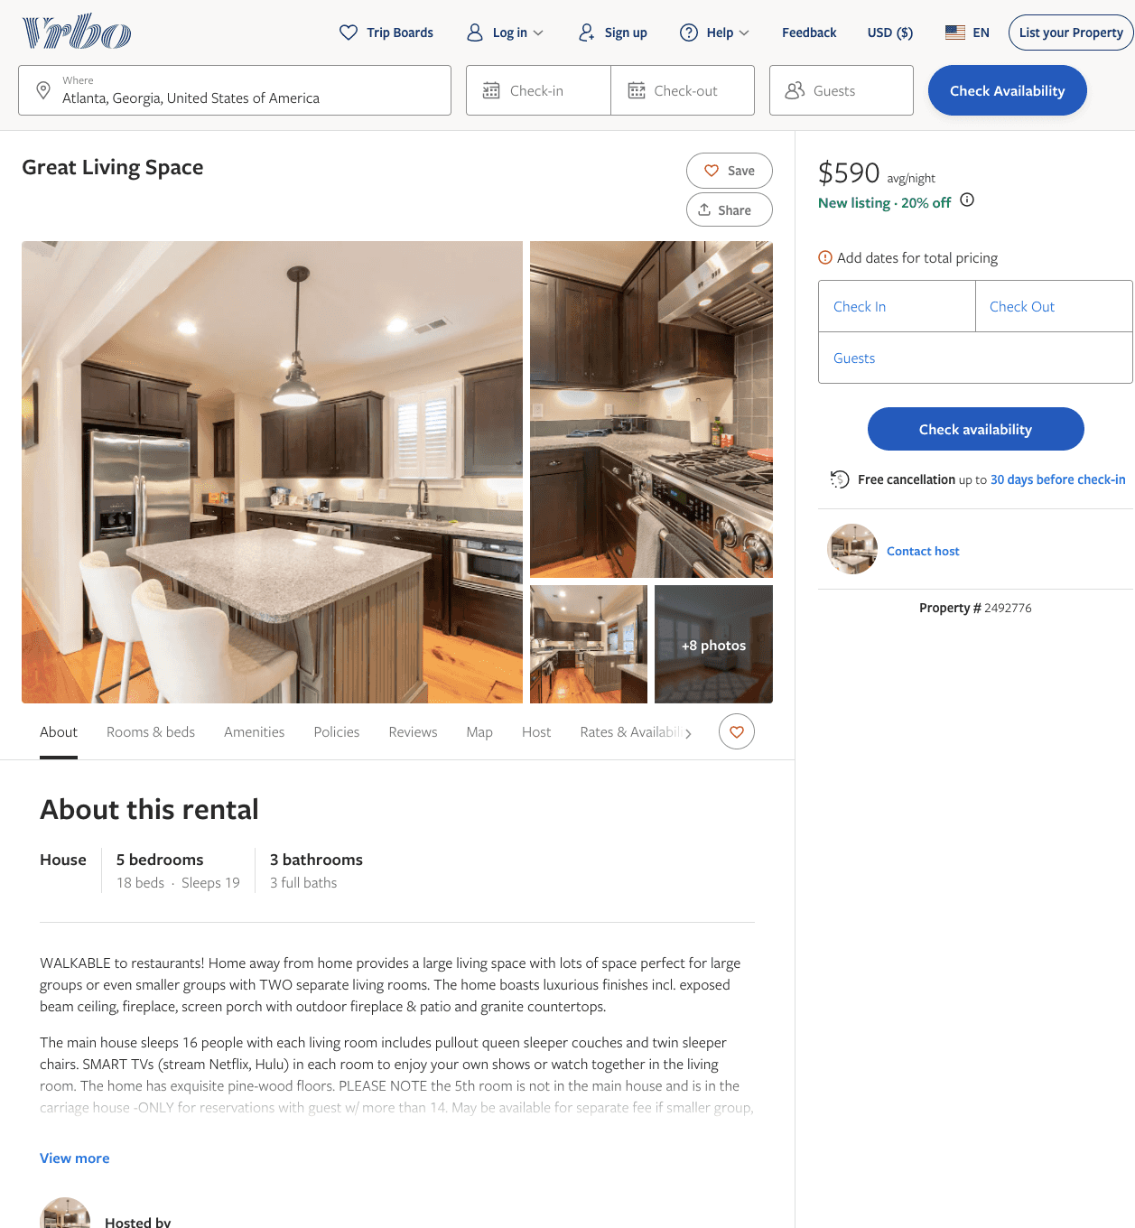
Listing 2492776
5
23
$533 - $648
5
1
https://www.vrbo.com/2492776
Aug 2022

Slide 3
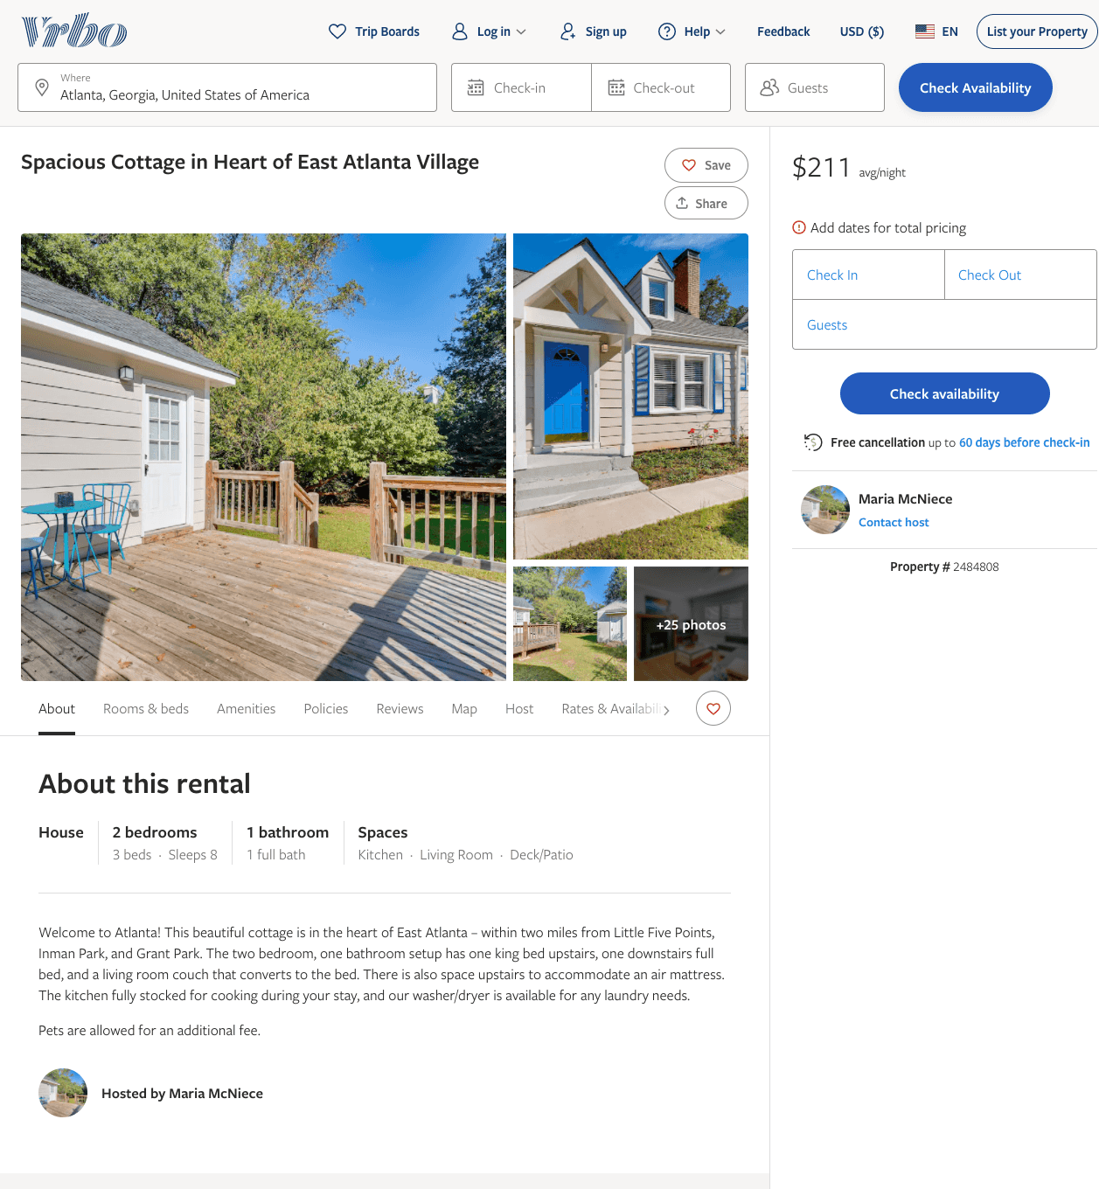
Listing 2484808
2
8
$182 - $260
5
1
Maria McNiece
https://www.vrbo.com/2484808
Aug 2022

Slide 4
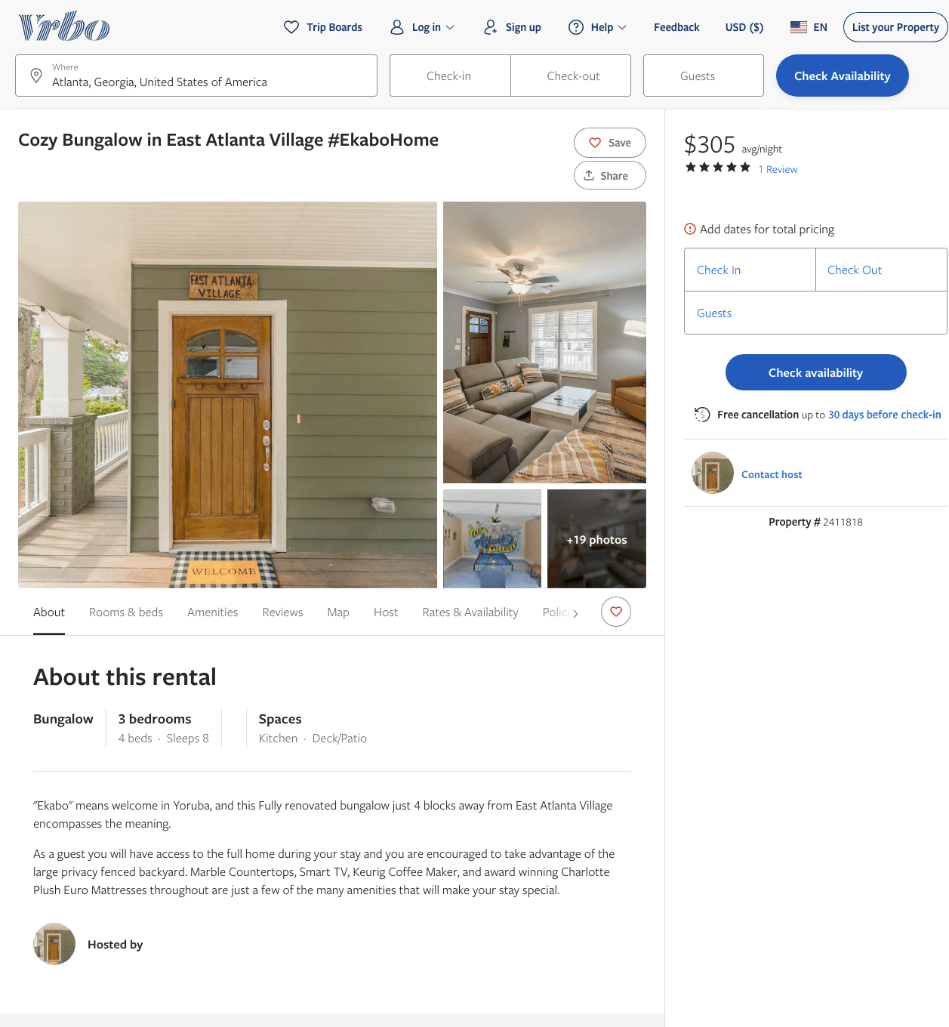
Listing 2411818
3
8
$175 - $305
4
1
Niyi
https://www.vrbo.com/2411818
Aug 2022

Slide 5
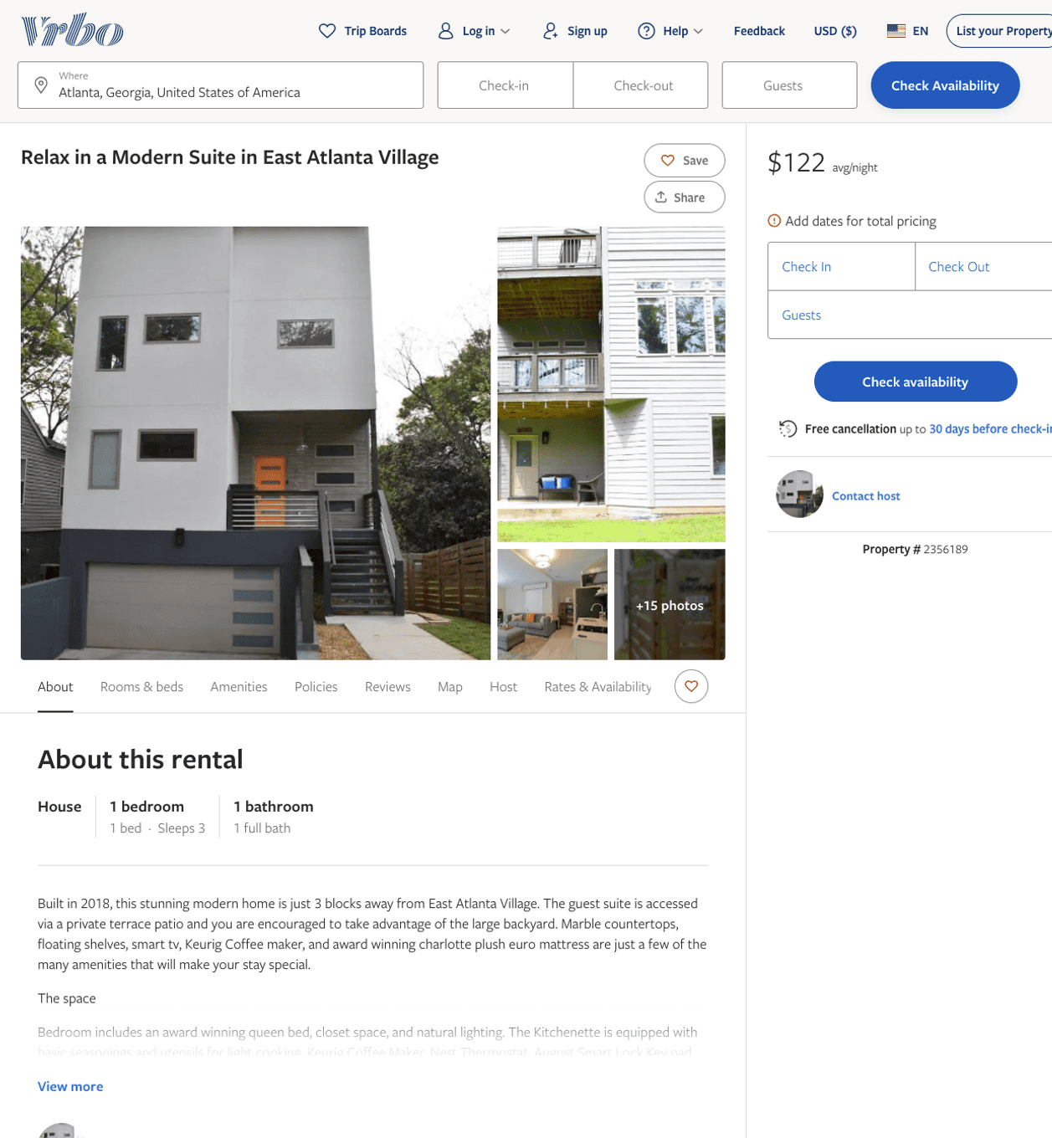
Listing 2356189
1
3
$101 - $129
5
1
Niyi
https://www.vrbo.com/2356189
Aug 2022

Slide 6
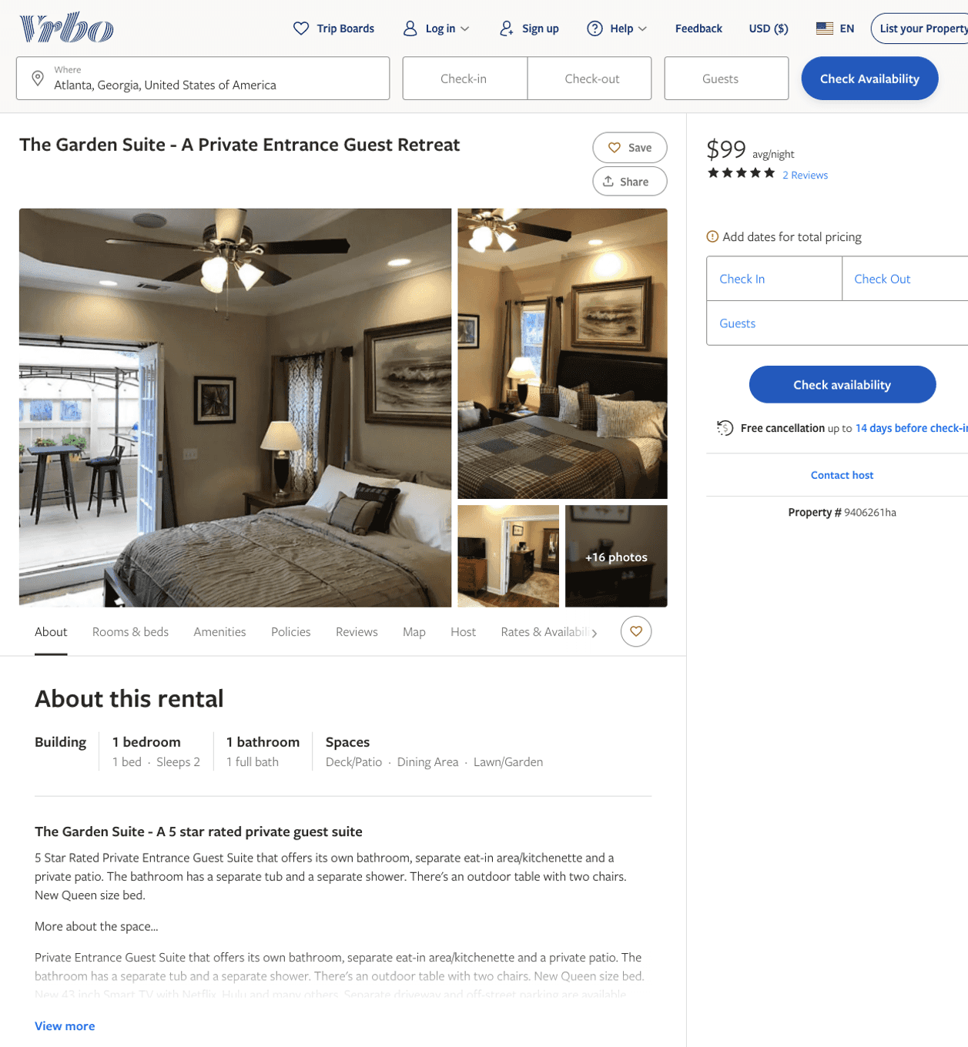
Listing 9406261
1
2
$99
4.75
1
Shaune Steven Stites
https://www.vrbo.com/9406261ha
Aug 2022

Slide 7
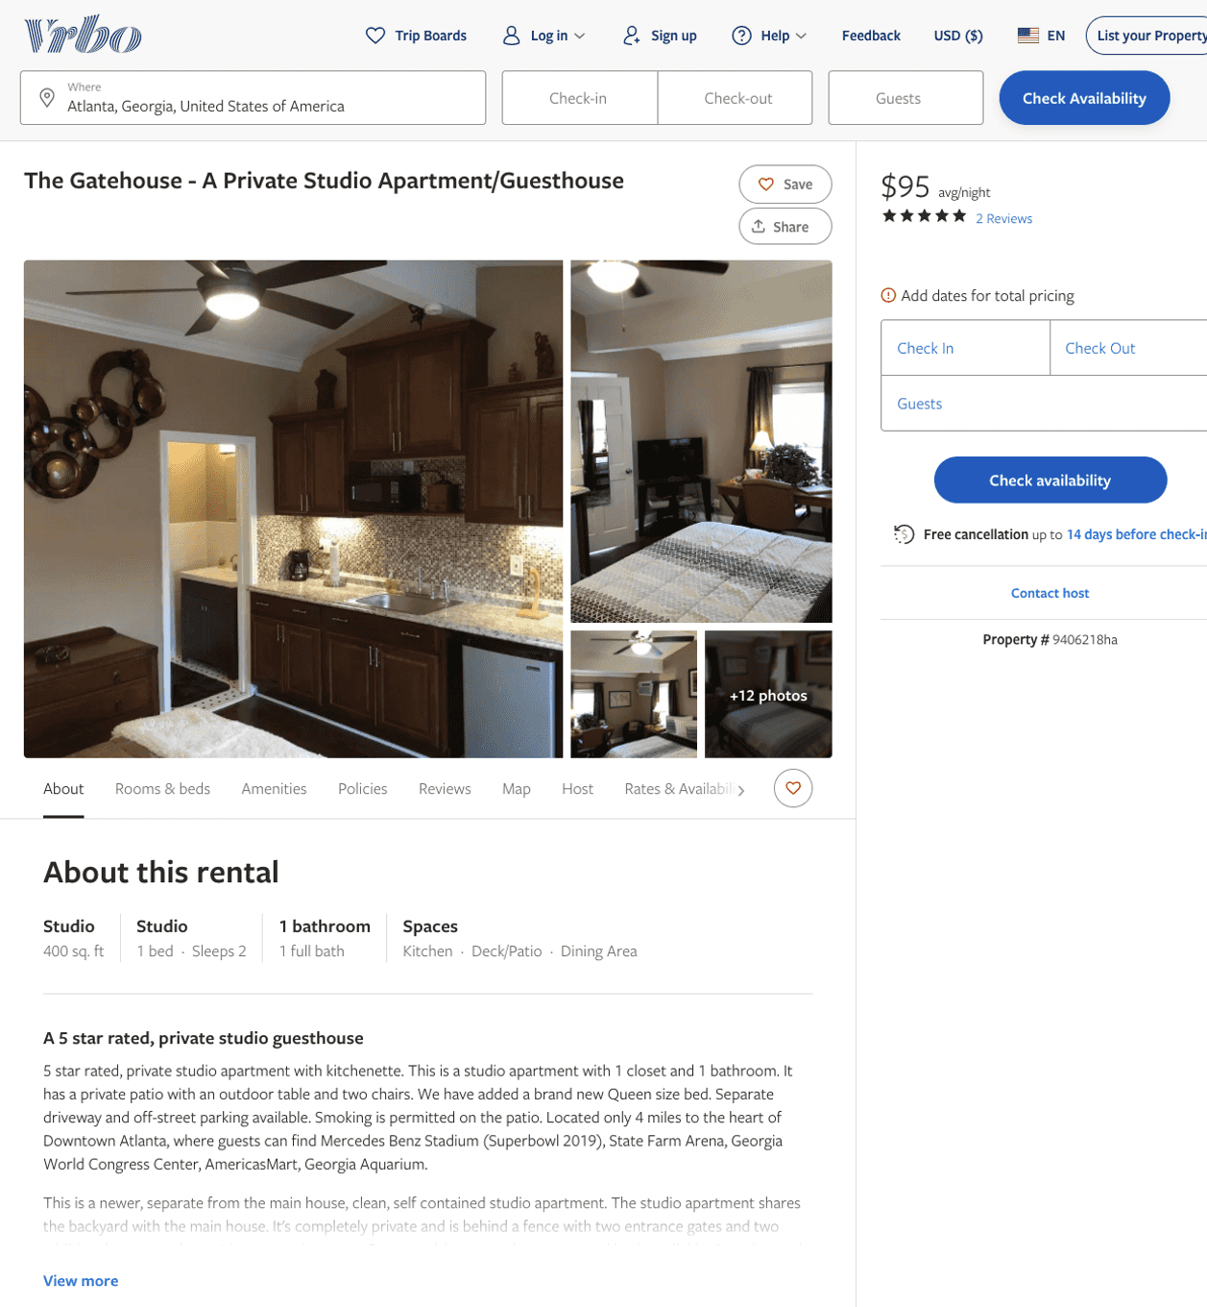
Listing 9406218
0
2
$95
5
1
Shaune Steven Stites
https://www.vrbo.com/9406218ha
Aug 2022

Slide 8
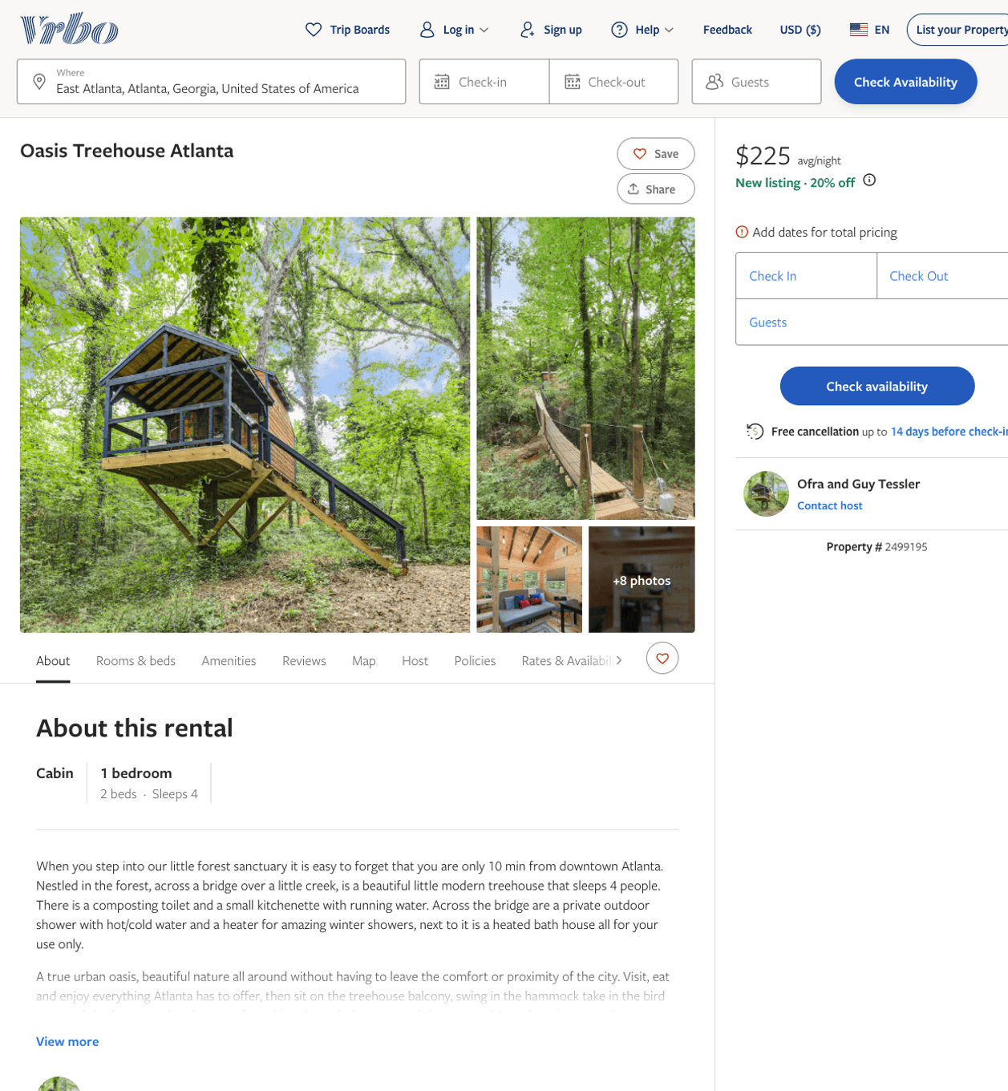
Listing 2499195
1
4
$225
5
1
Ofra and Guy Tessler
https://www.vrbo.com/2499195
Aug 2022

Slide 9
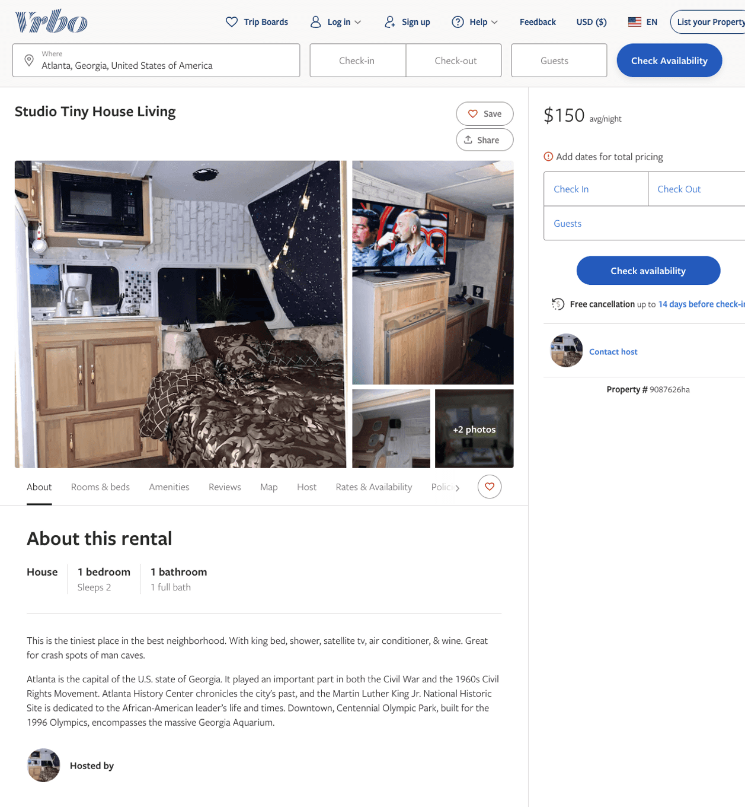
Listing 9087626
1
2
$150
1
https://www.vrbo.com/9087626ha
Aug 2022

Slide 10
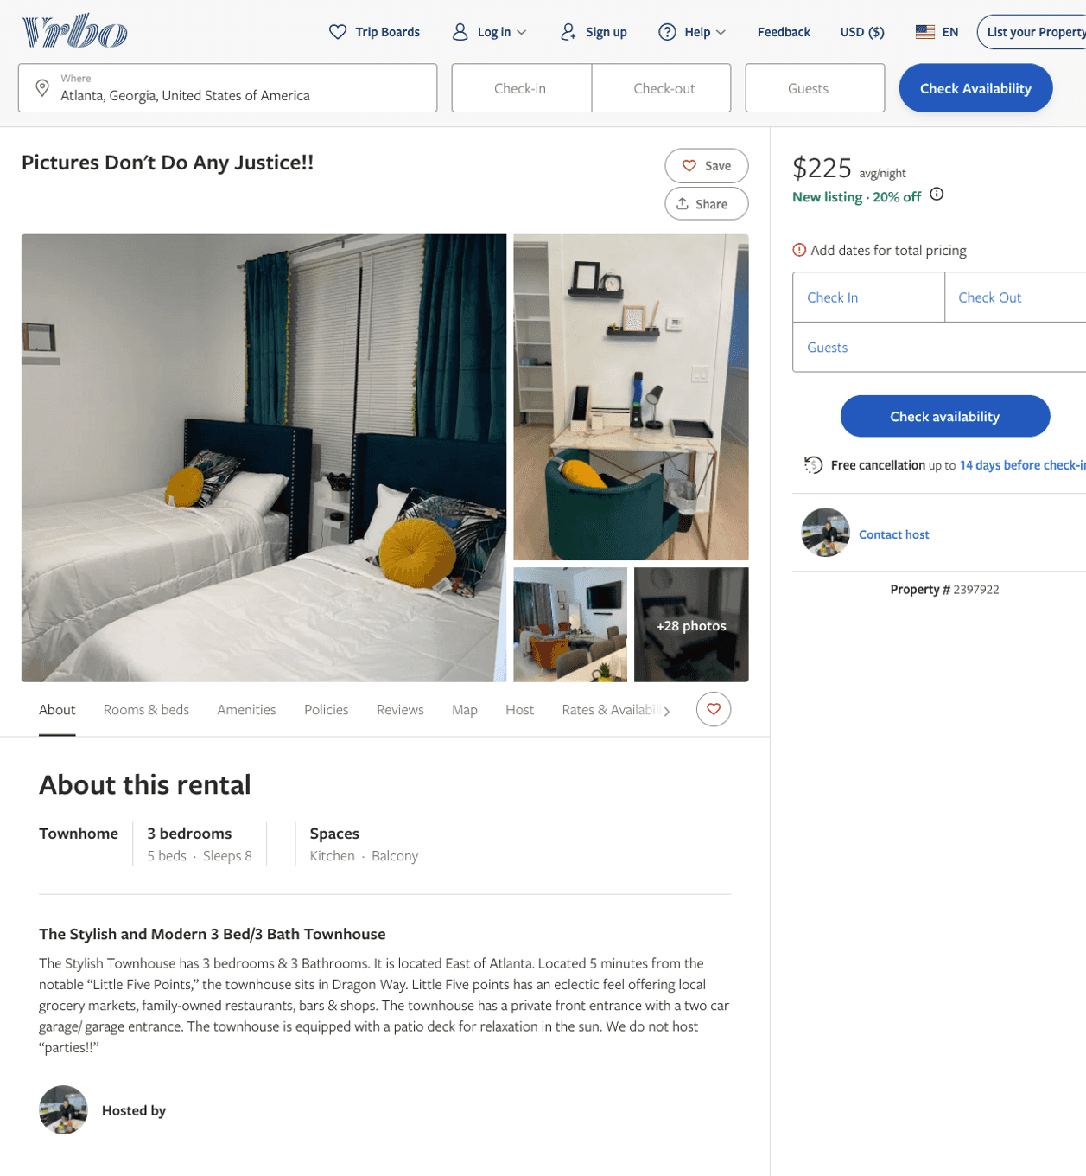
Listing 2397922
3
8
$219 - $899
5
1
https://www.vrbo.com/2397922
Aug 2022

Slide 11
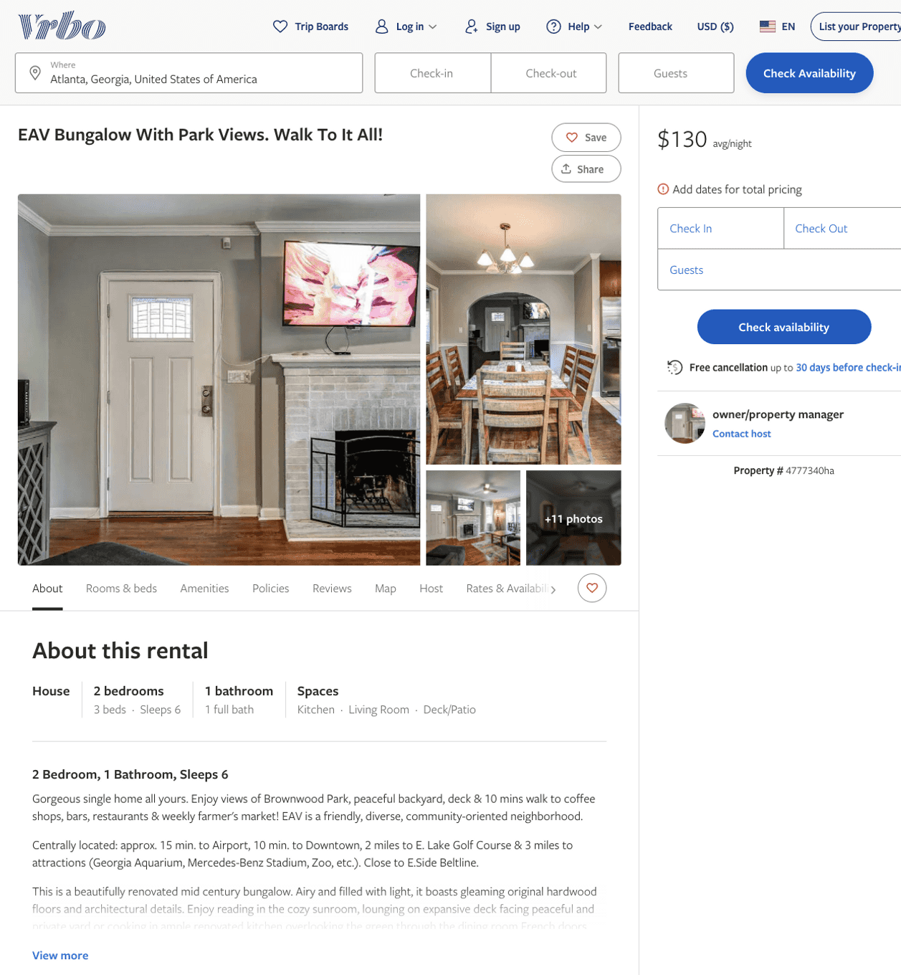
Listing 4777340
2
6
$130
2
owner/property manager
https://www.vrbo.com/4777340ha
Aug 2022

Slide 12
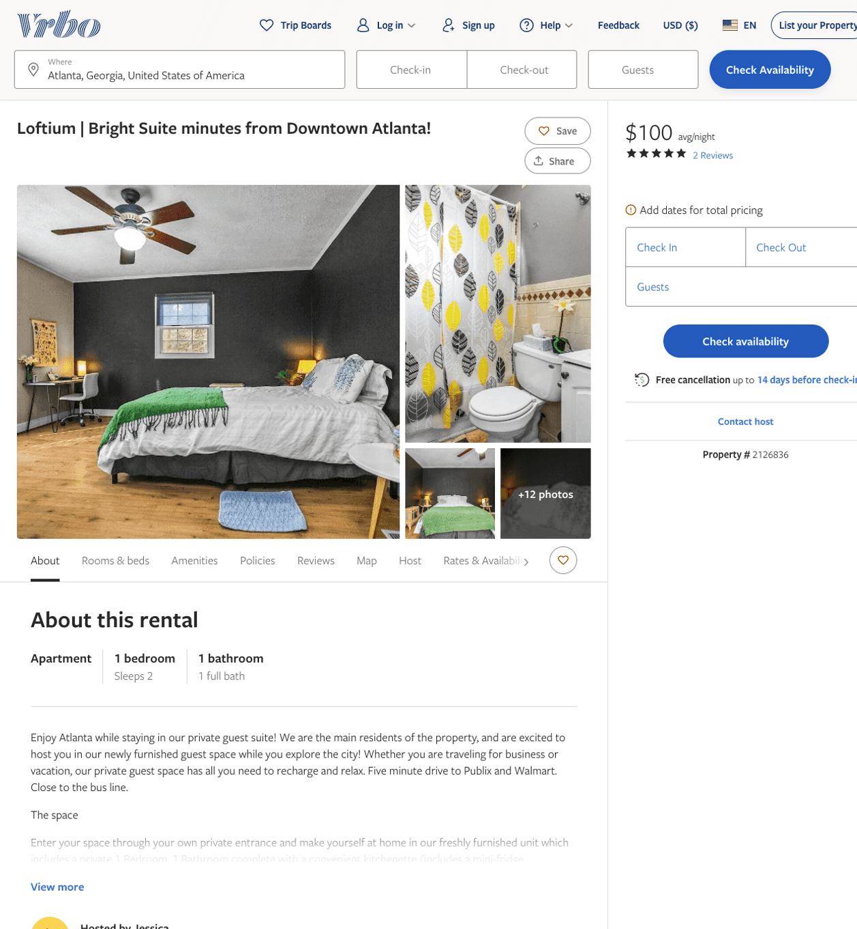
Listing 2126836
1
2
$100 - $99
4.2
3
Jessica
https://www.vrbo.com/2126836
Aug 2022

Slide 13
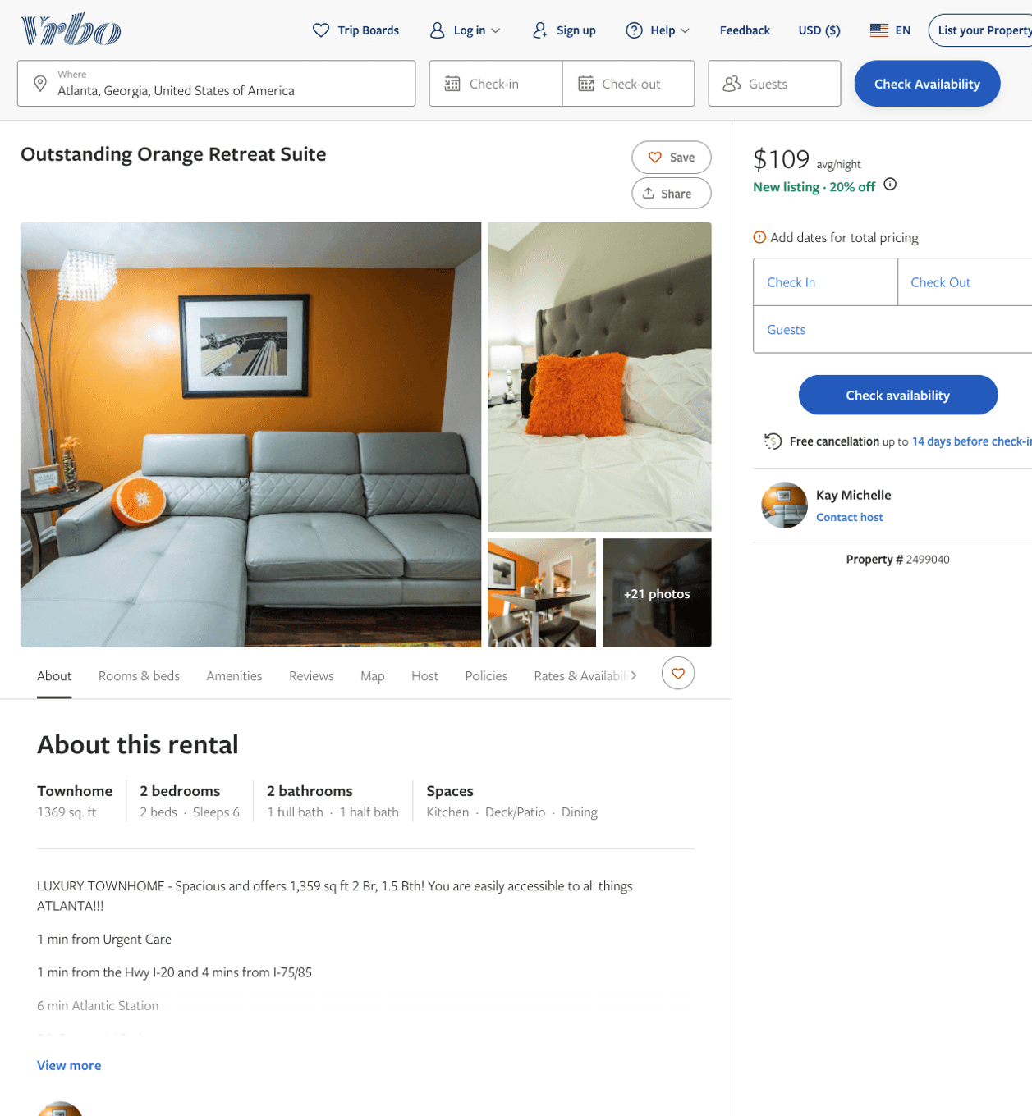
Listing 2499040
2
6
$109 - $119
3.8
2
Kay Michelle
https://www.vrbo.com/2499040
Aug 2022

Slide 14
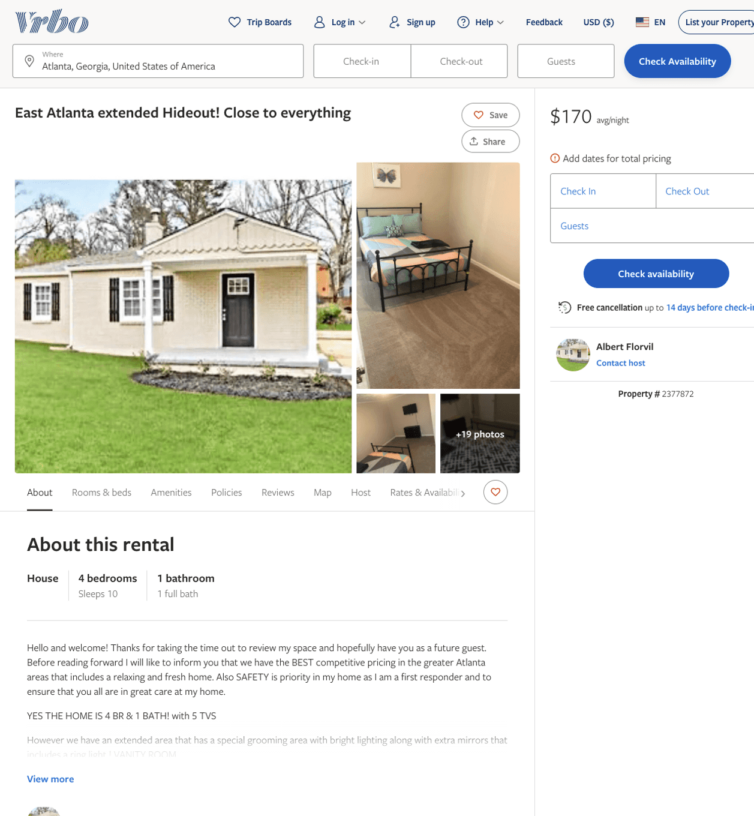
Listing 2377872
4
10
$170 - $192
3
Albert Florvil
https://www.vrbo.com/2377872
Aug 2022

Slide 15
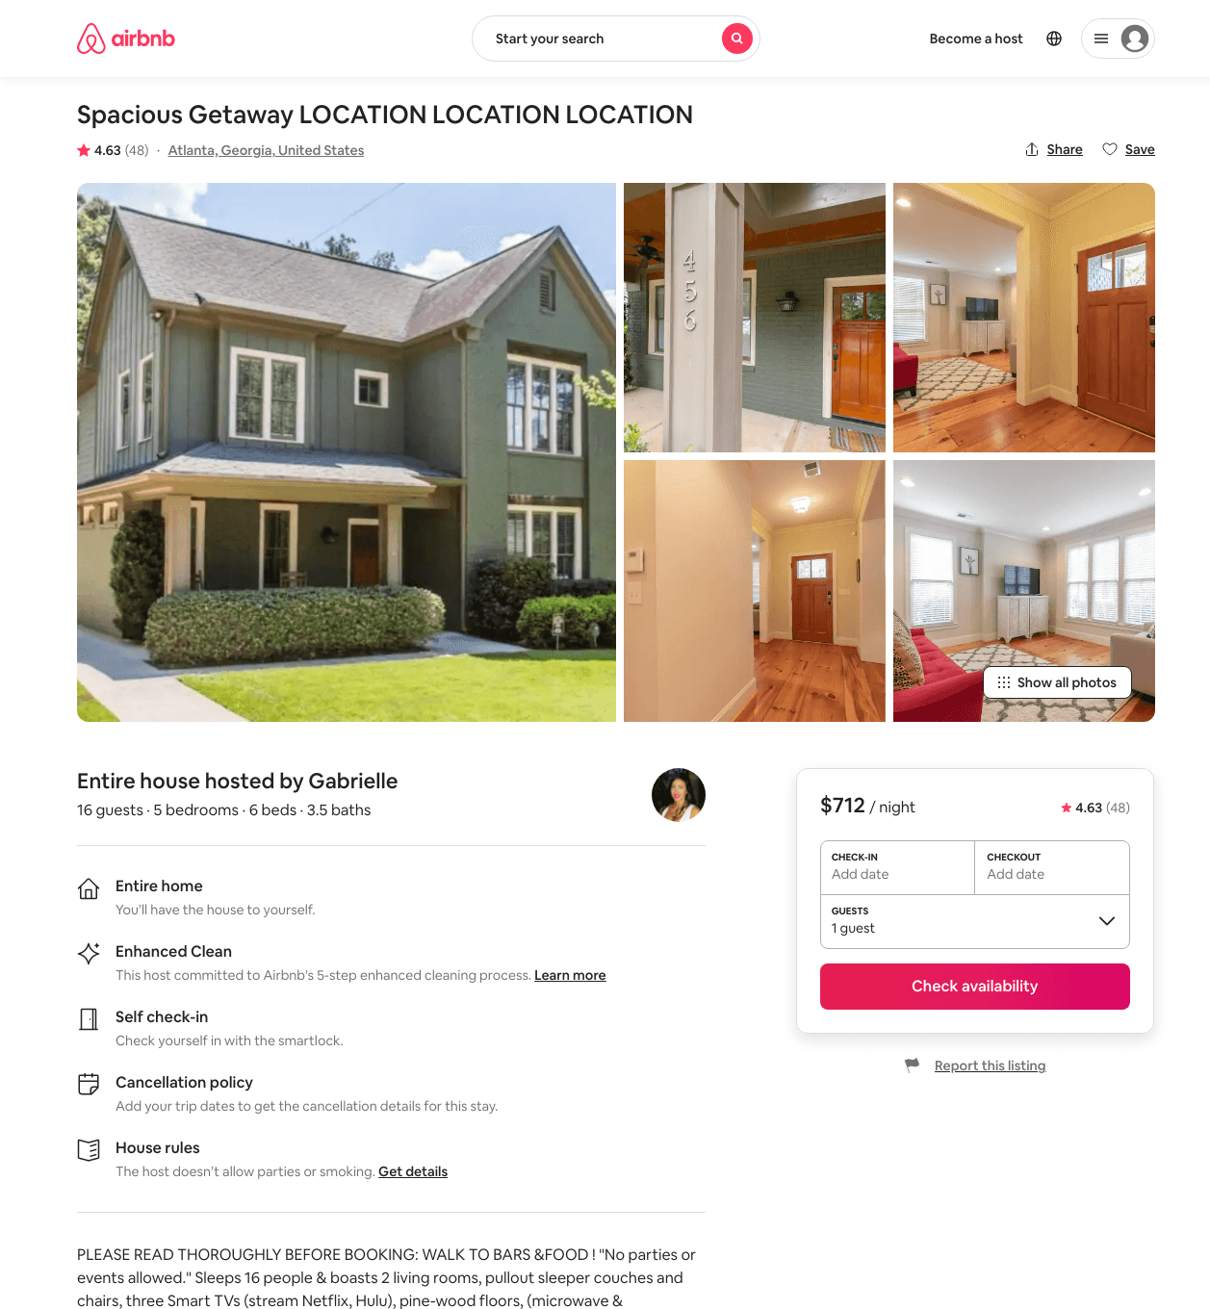
Listing 29661037
5
16
$424 - $1017
4.64
1
Gabrielle
219784806
1
https://www.airbnb.com/rooms/29661037
Aug 2022

Slide 16
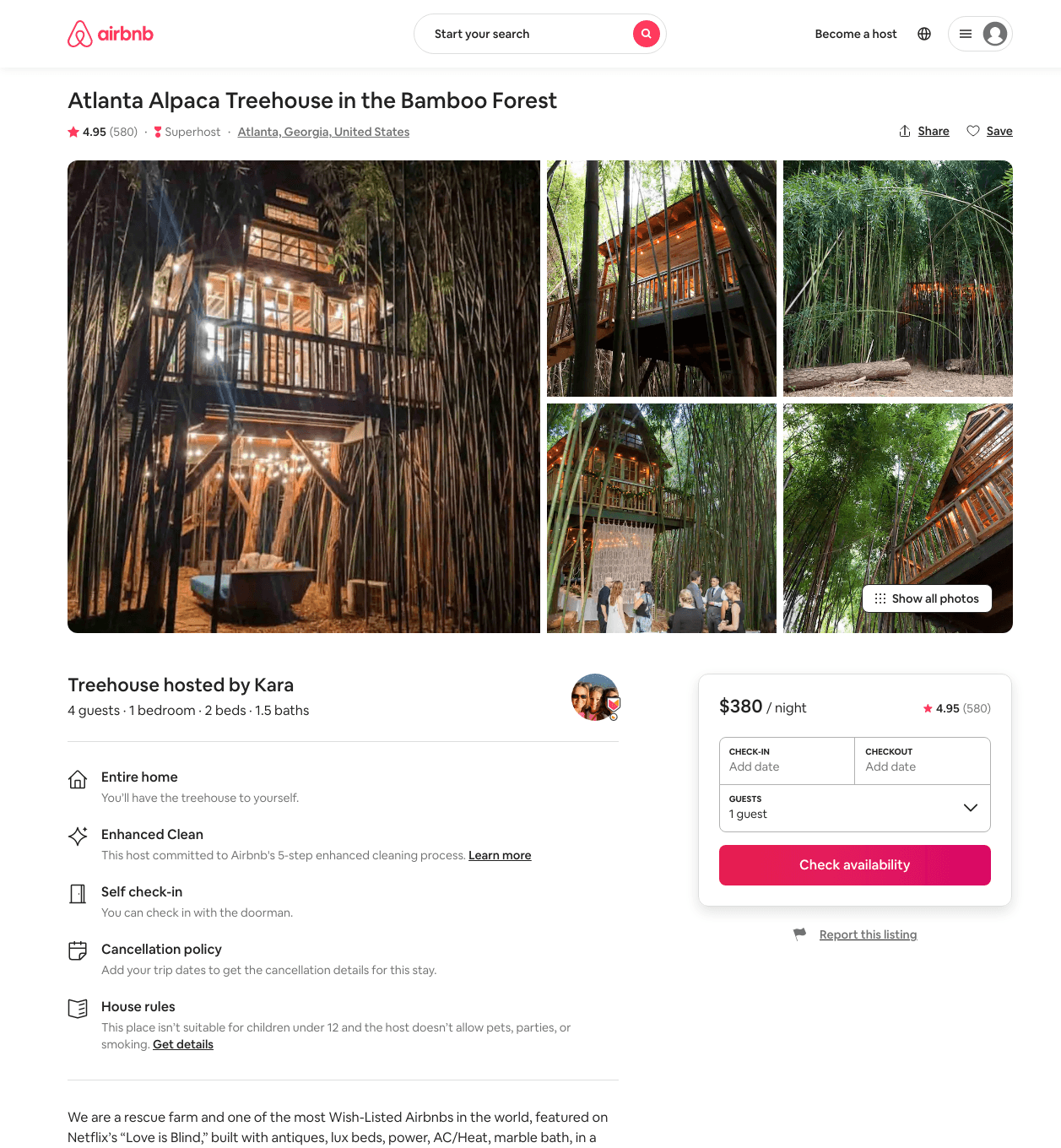
Listing 13245035
1
2
$380 - $434
4.95
1
Kara
74446190
3
https://www.airbnb.com/rooms/13245035
Aug 2022

Slide 17
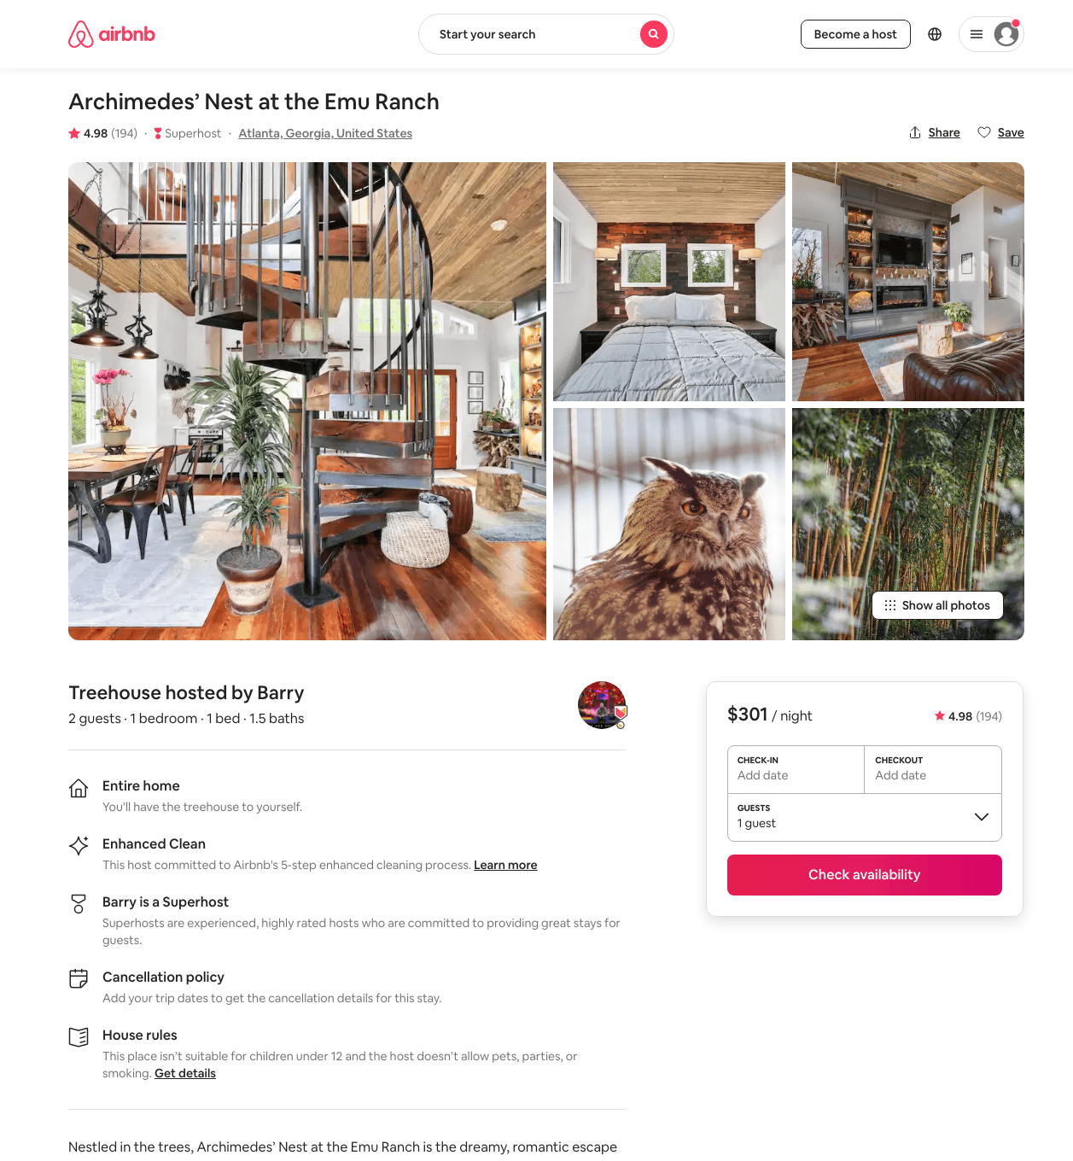
Listing 39725117
1
2
$301 - $359
4.97
1
Barry
34992298
2
https://www.airbnb.com/rooms/39725117
Aug 2022

Slide 18
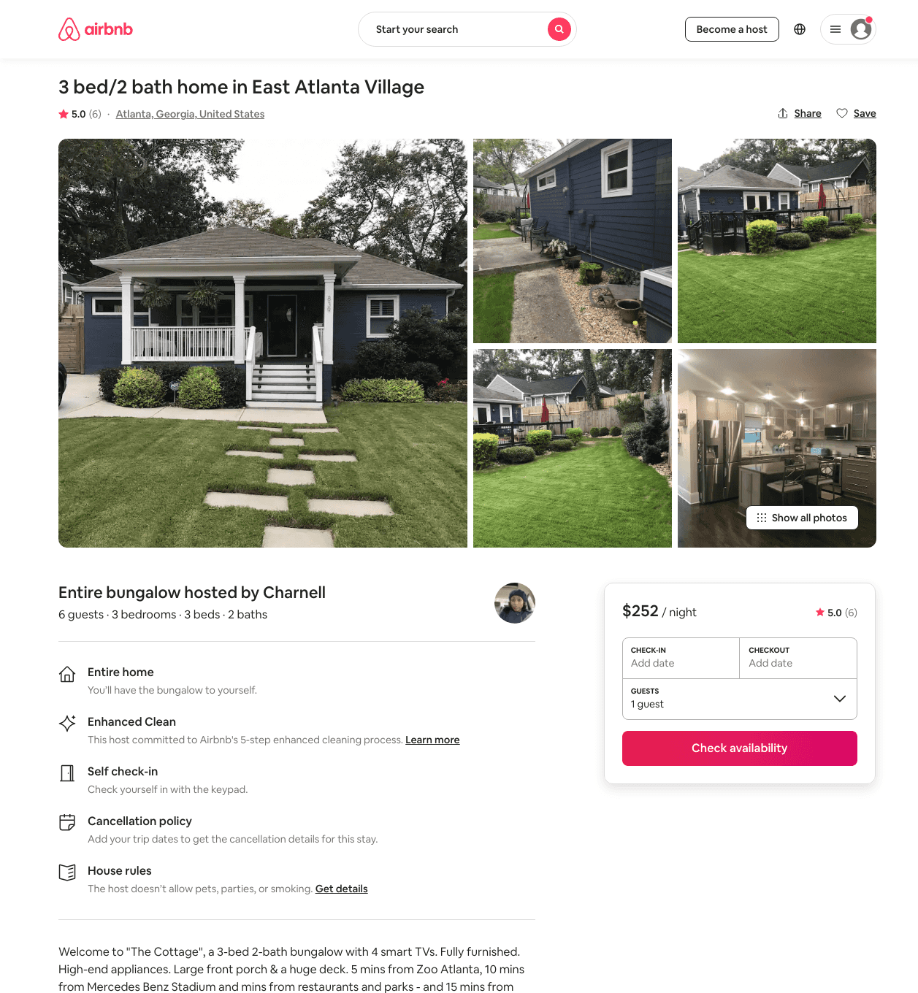
Listing 45086035
3
6
$203 - $261
4.86
2
Charnell
91499246
1
https://www.airbnb.com/rooms/45086035
Aug 2022

Slide 19
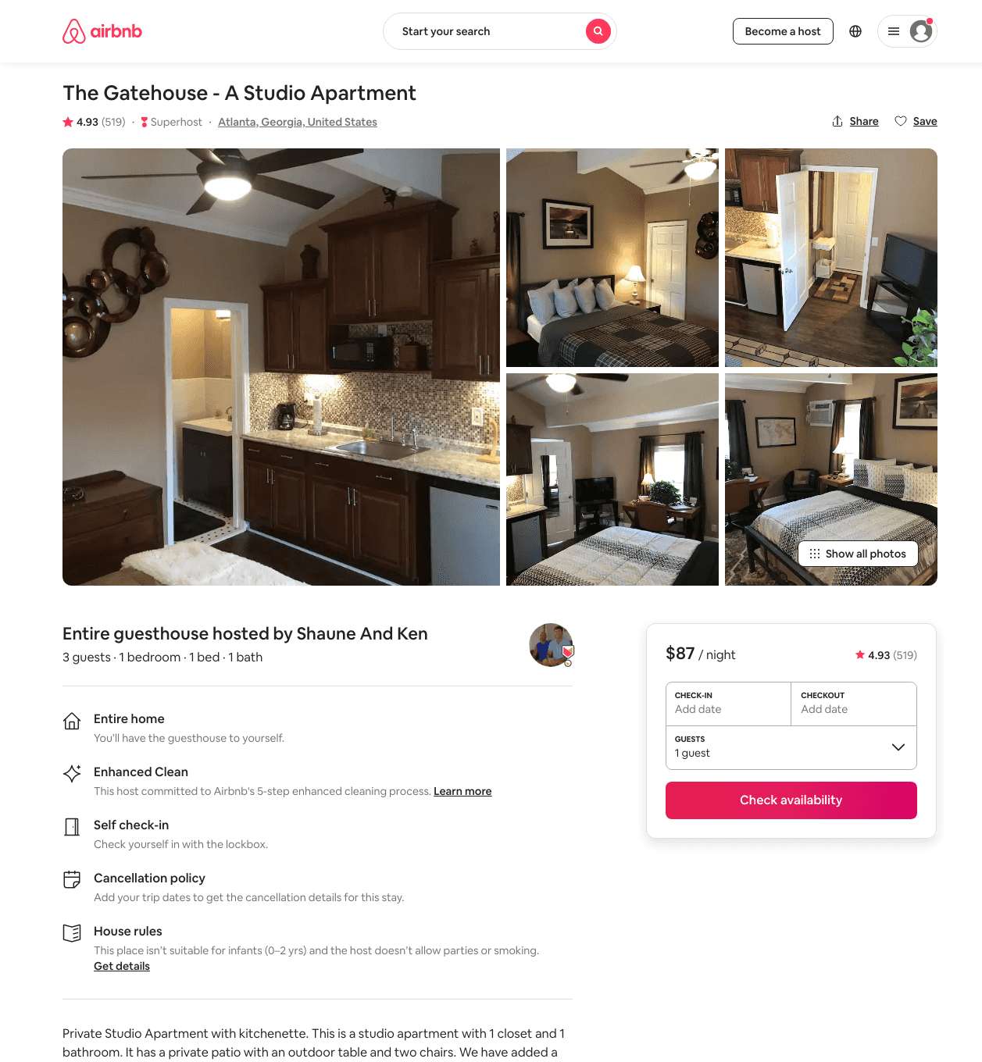
Listing 10306265
1
3
$79 - $92
4.92
1
Shaune And Ken
53028260
2
https://www.airbnb.com/rooms/10306265
Aug 2022

Slide 20
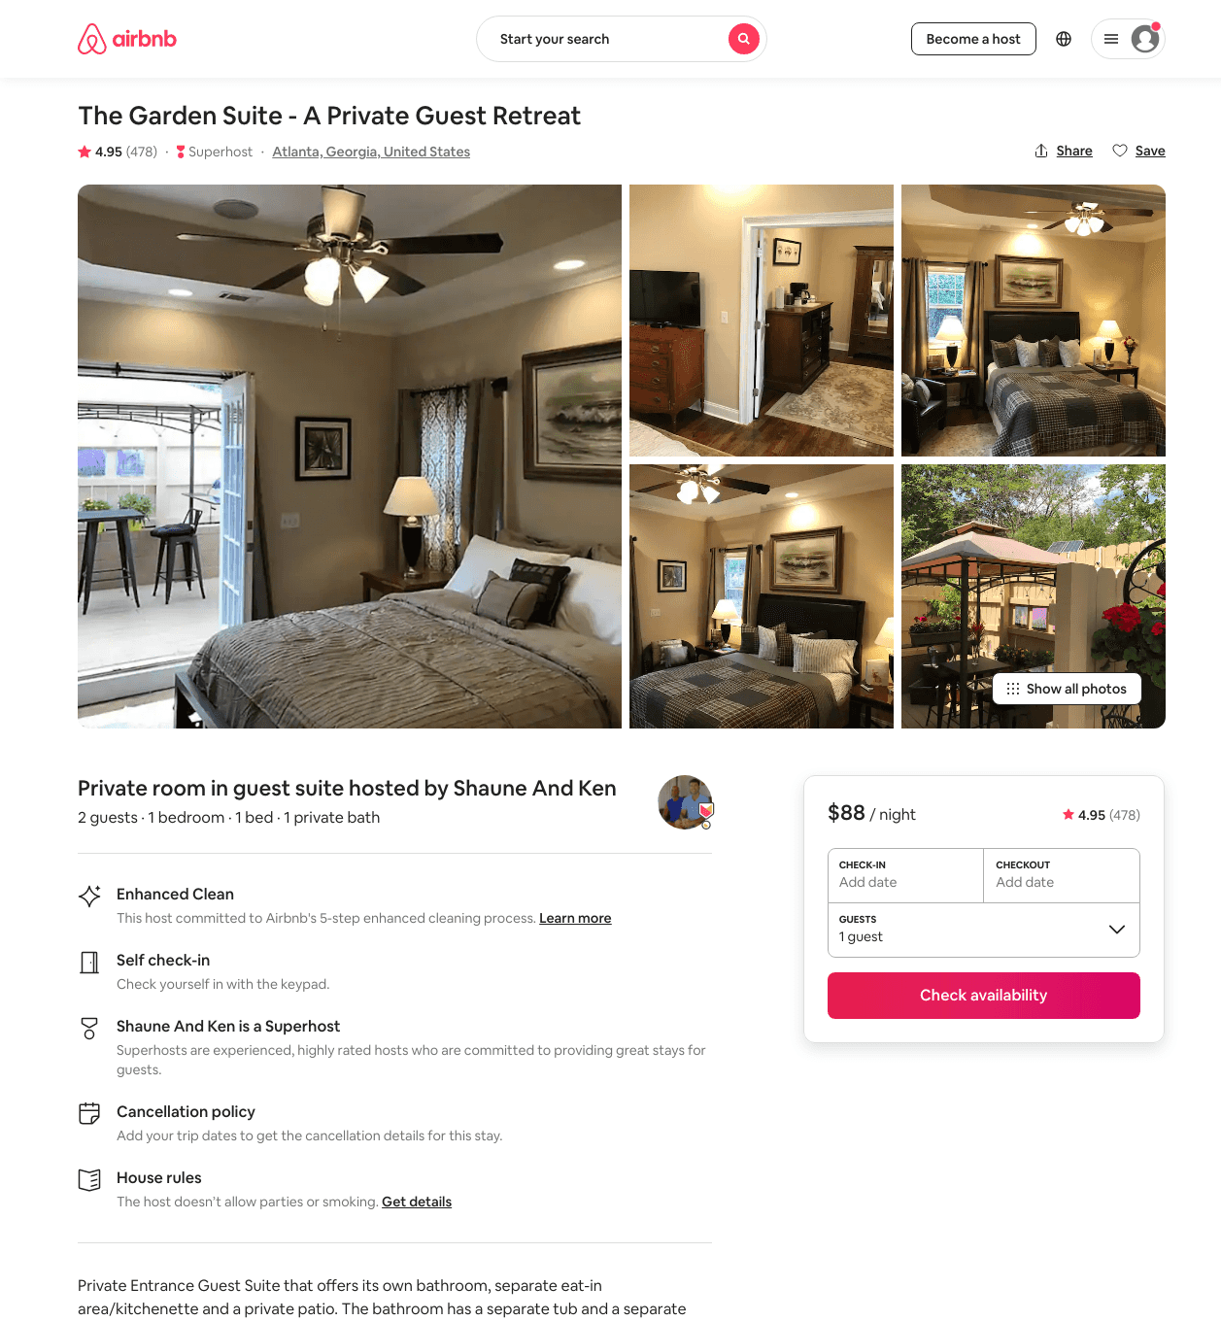
Listing 18289694
1
2
$77 - $96
4.95
1
Shaune And Ken
53028260
2
https://www.airbnb.com/rooms/18289694
Aug 2022

Slide 21
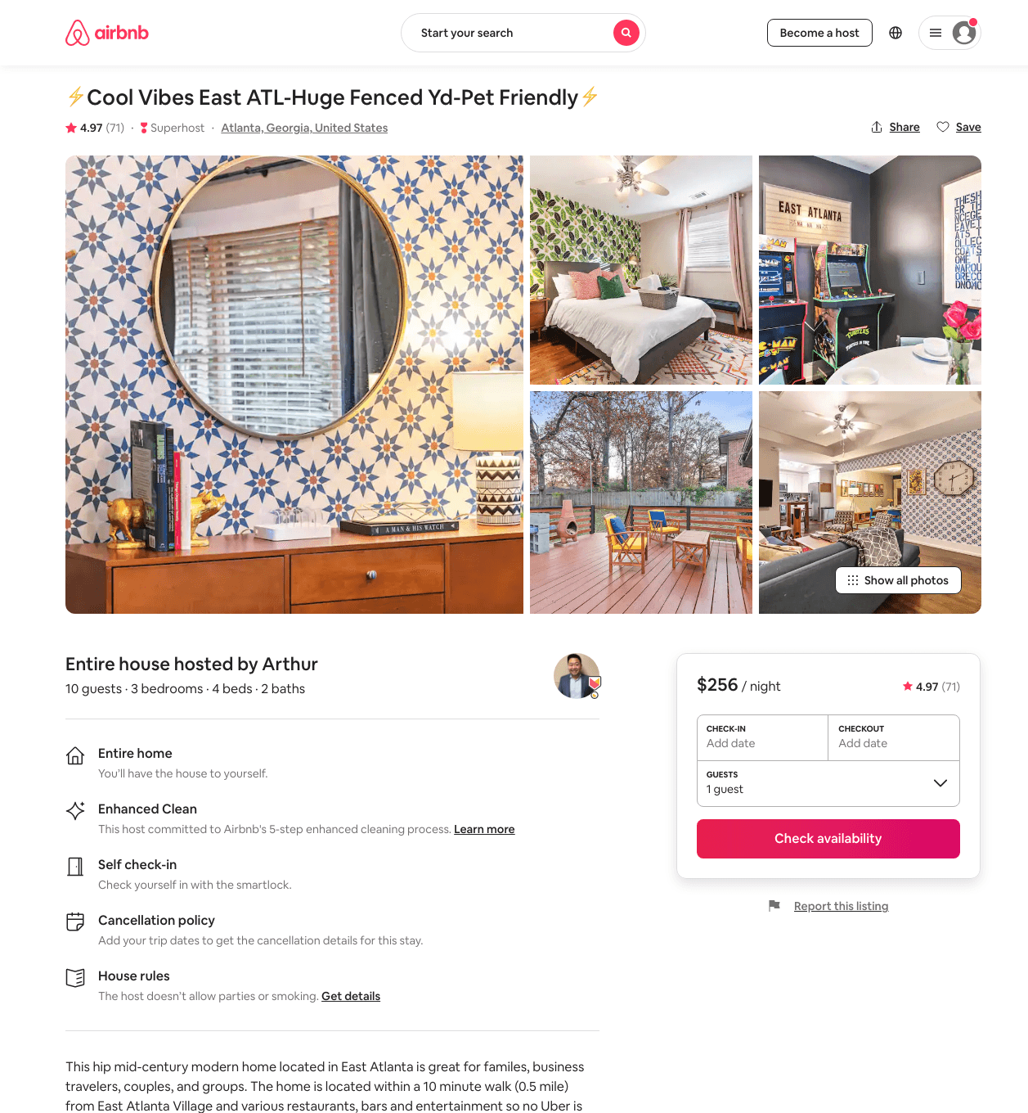
Listing 40132285
3
10
$184 - $264
4.96
2
Arthur
20905604
3
https://www.airbnb.com/rooms/40132285
Aug 2022

Slide 22
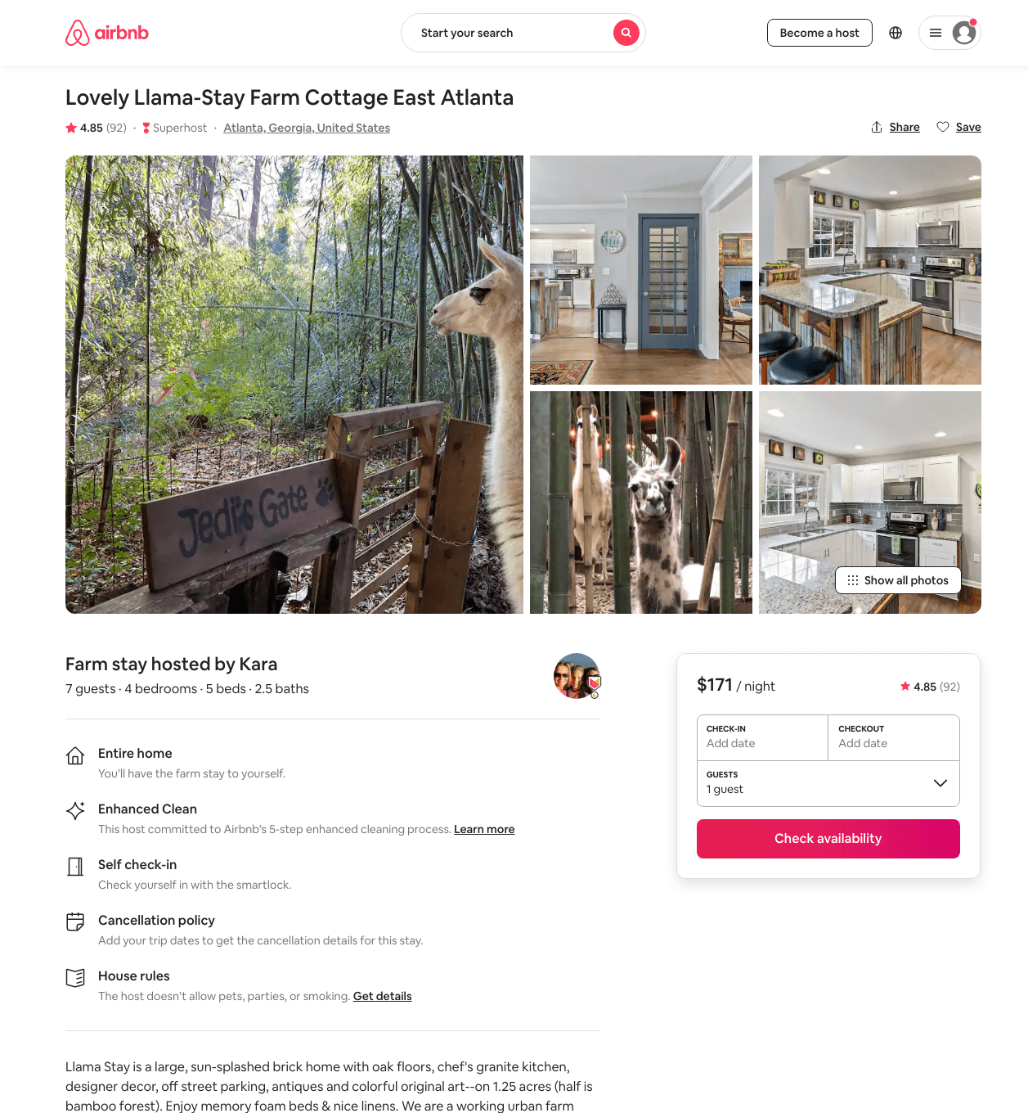
Listing 35620919
4
7
$156 - $216
4.81
2
Kara
74446190
3
https://www.airbnb.com/rooms/35620919
Aug 2022

Slide 23
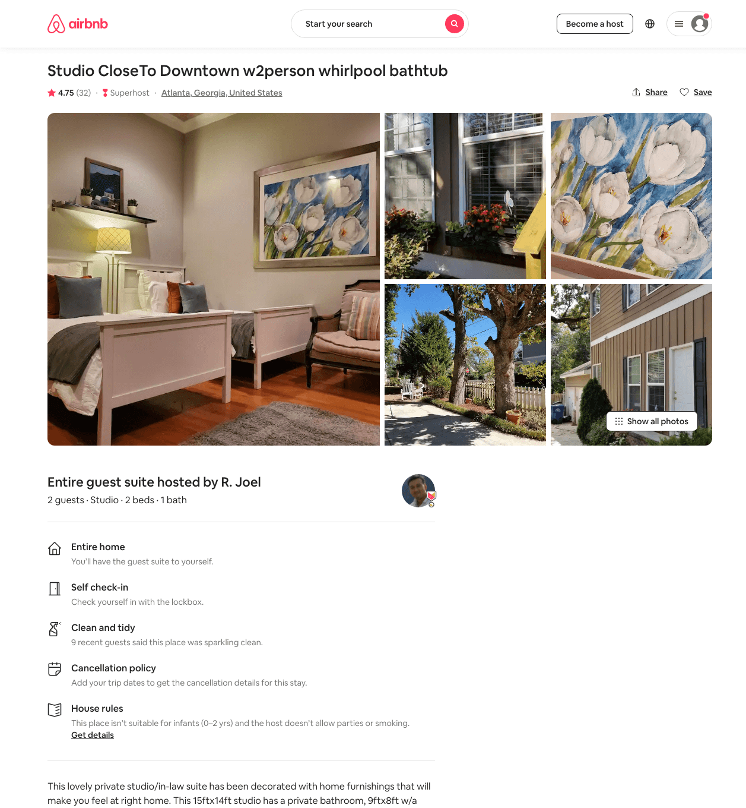
Listing 35468171
Studio
2
$69 - $83
4.80
1
R. Joel
212552482
1
https://www.airbnb.com/rooms/35468171
Aug 2022

Slide 24
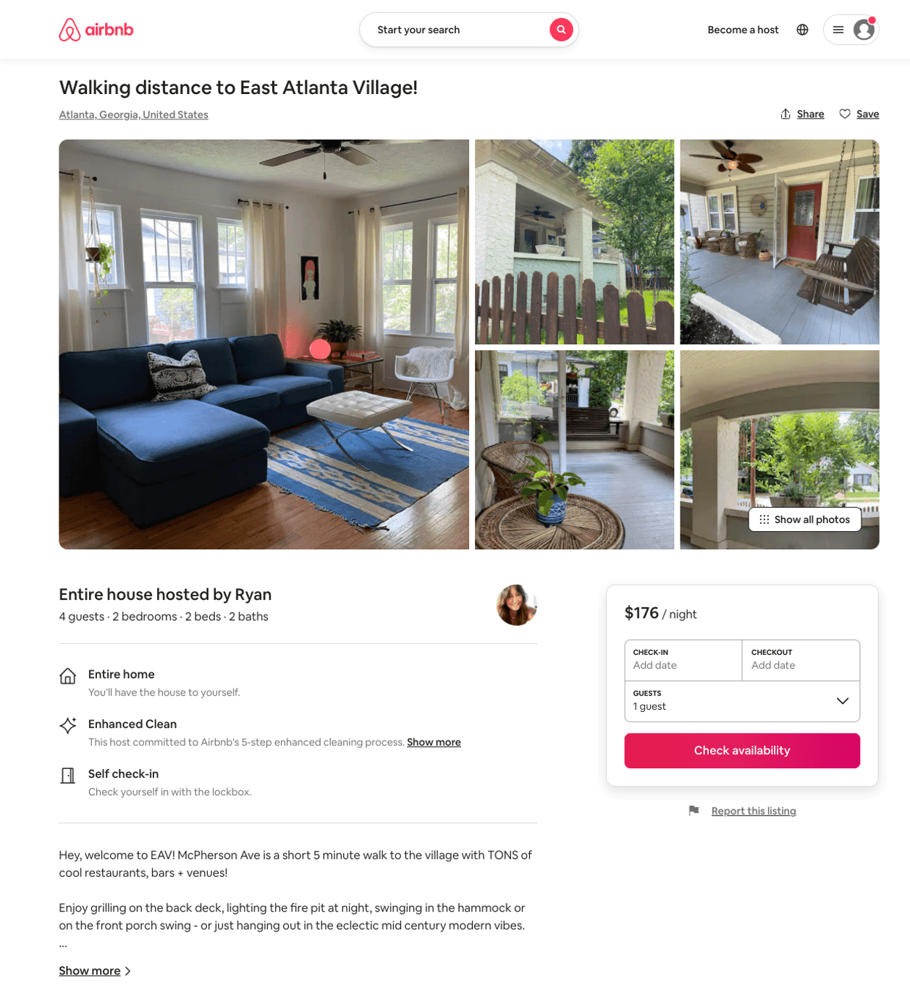
Listing 49190766
2
4
$150 - $209
4.85
2
Ryan
33036562
1
https://www.airbnb.com/rooms/49190766
Aug 2022

Slide 25
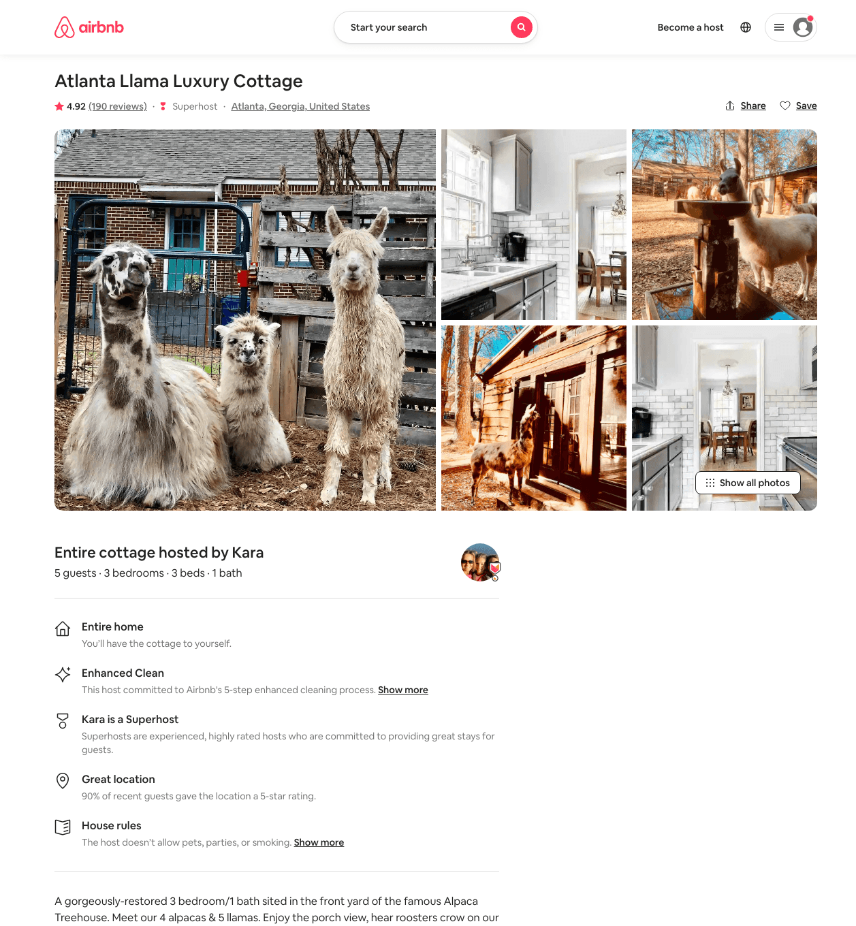
Listing 18132667
3
5
$152 - $199
4.90
2
Kara
74446190
3
https://www.airbnb.com/rooms/18132667
Aug 2022

Slide 26
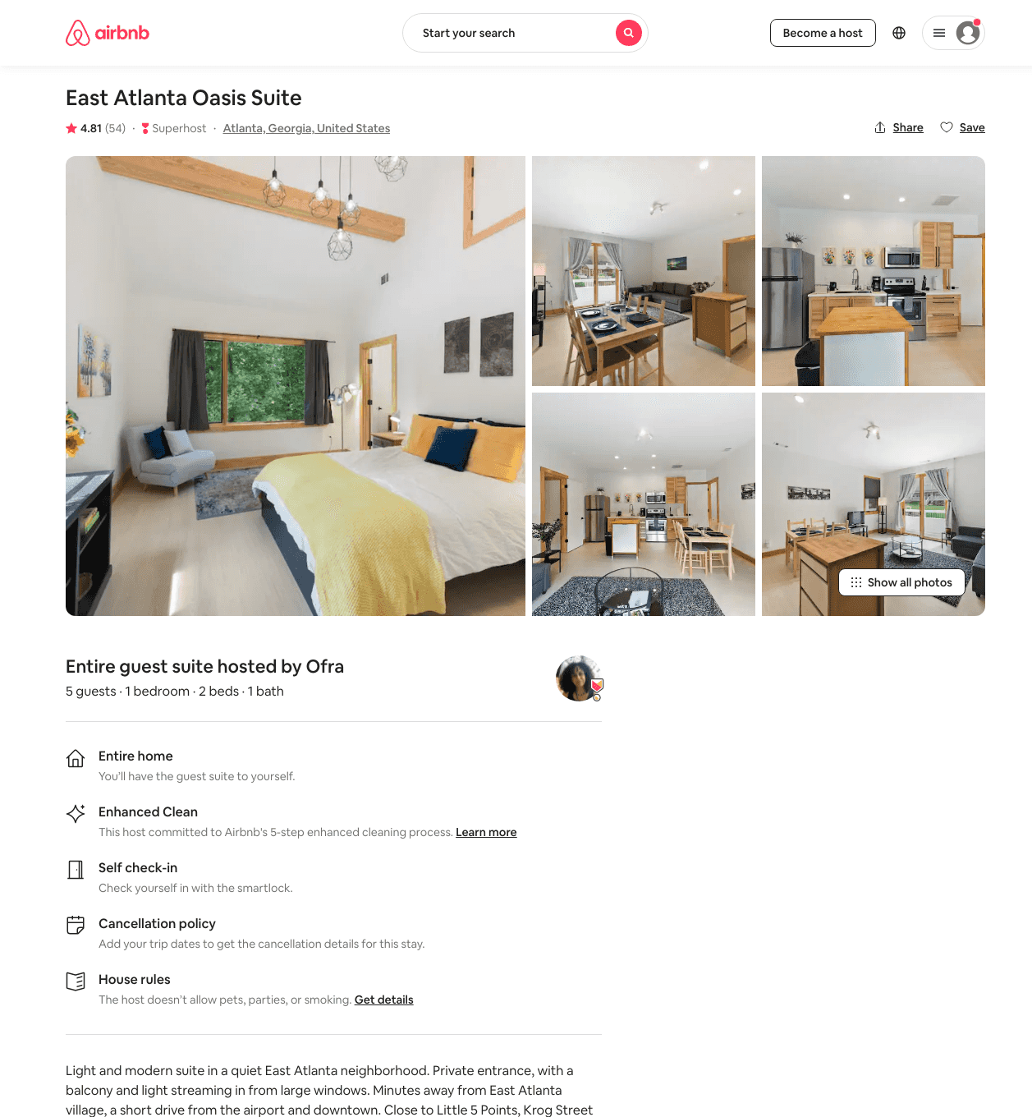
Listing 45412622
1
5
$95 - $106
4.88
1
Ofra
16925146
2
https://www.airbnb.com/rooms/45412622
Aug 2022

Slide 27
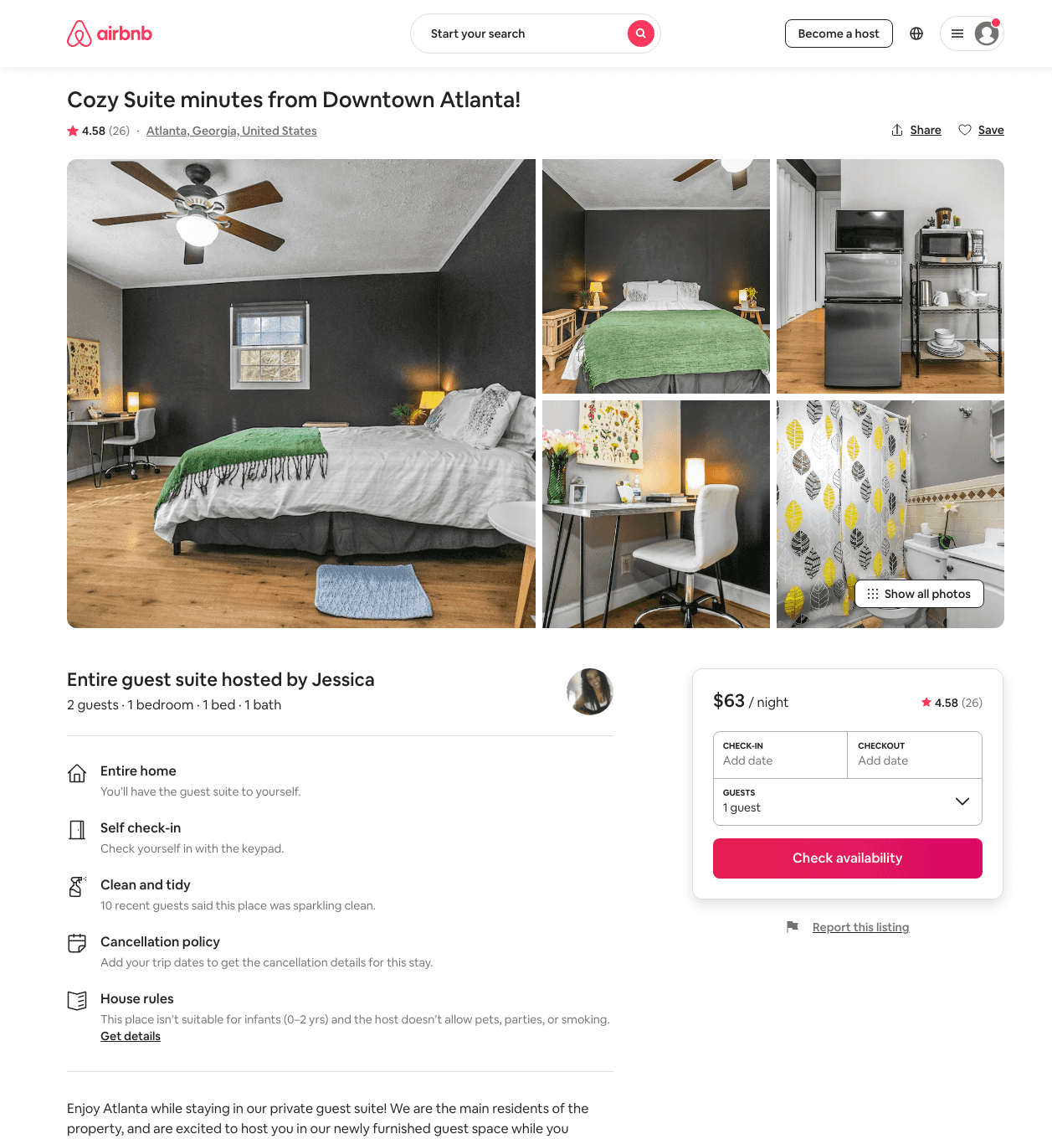
Listing 42042839
1
2
$45 - $78
4.68
1
Jessica
335041667
1
https://www.airbnb.com/rooms/42042839
Aug 2022

Slide 28
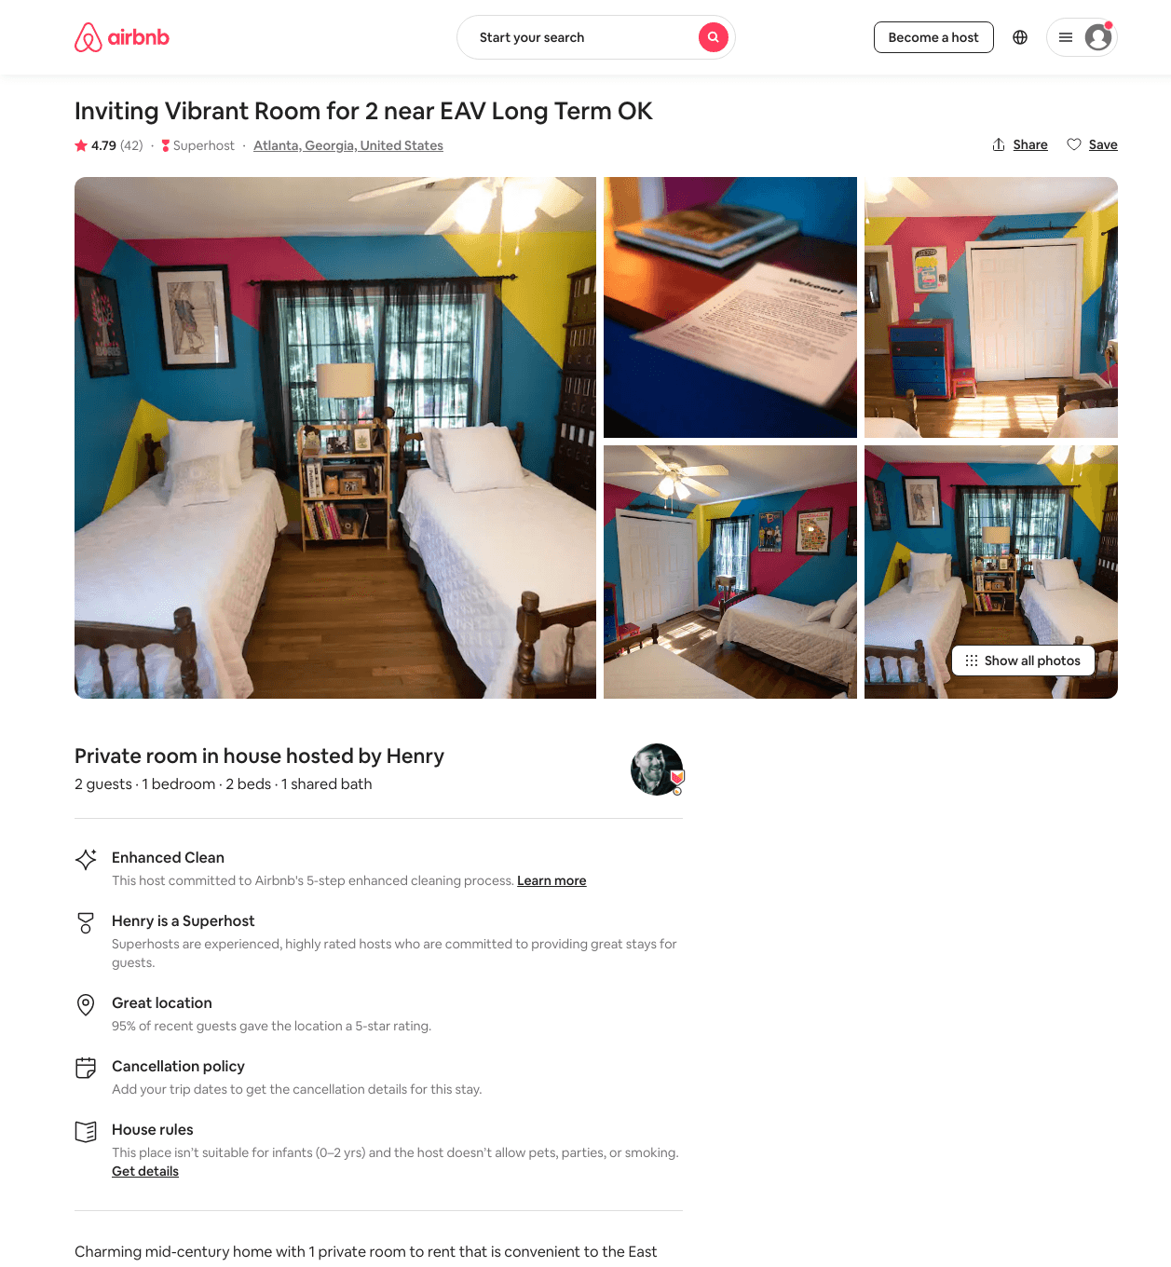
Listing 36753715
1
2
$45 - $62
4.80
1
Henry
135584507
3
https://www.airbnb.com/rooms/36753715
Jul 2022

Slide 29
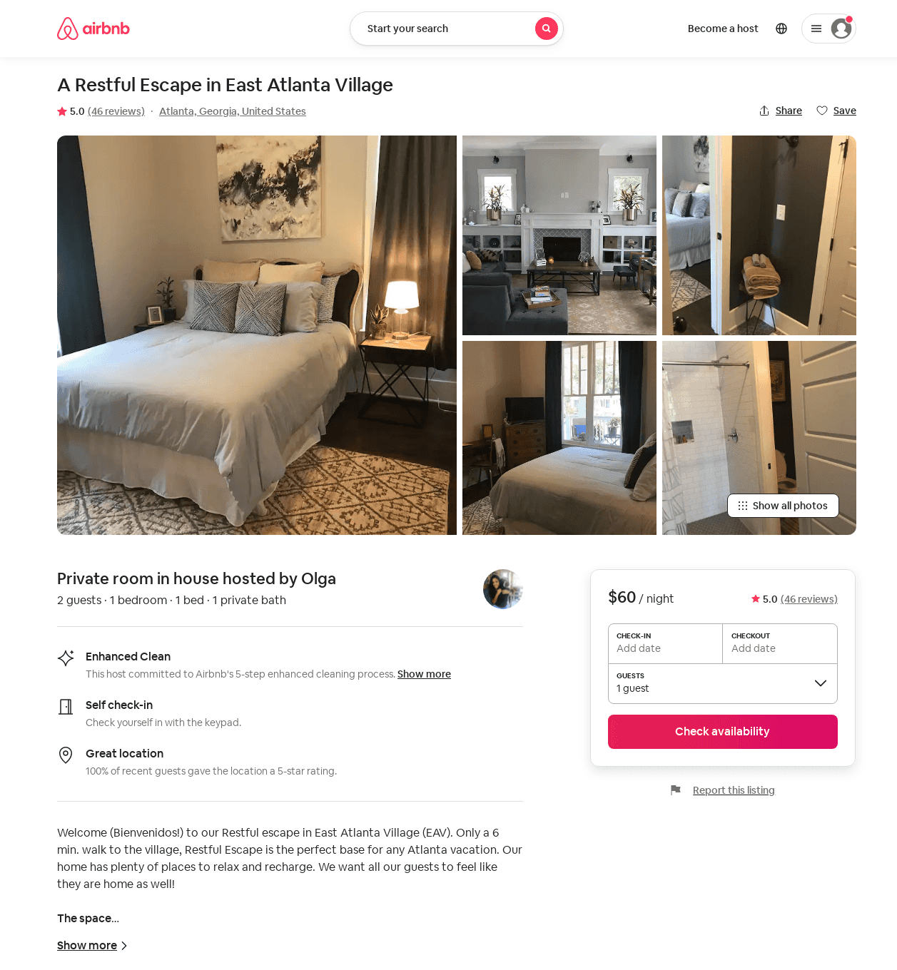
Listing 22983746
1
2
$60 - $80
5.0
1
Olga
67361542
1
https://www.airbnb.com/rooms/22983746
Aug 2022

Slide 30
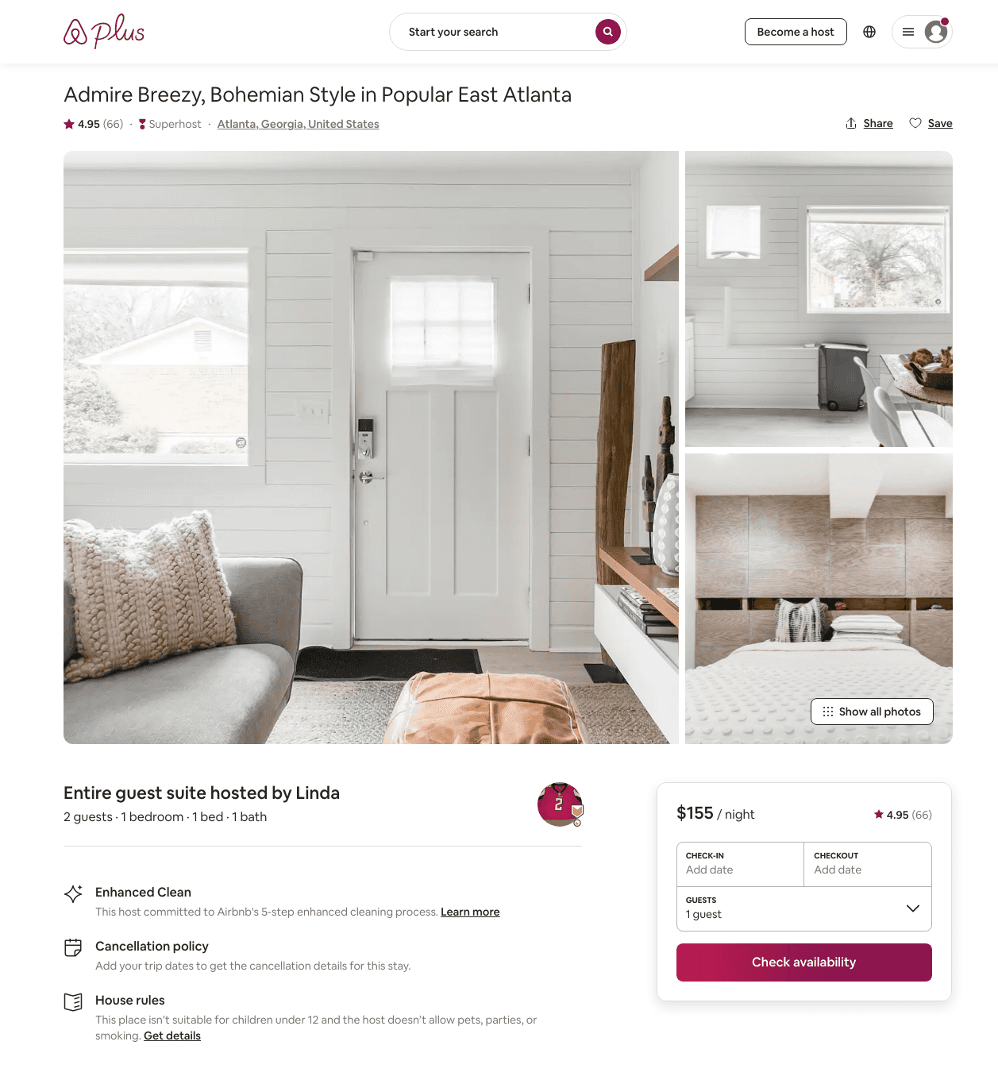
Listing 20874120
1
2
$143 - $165
4.99
2
Linda
52039586
1
https://www.airbnb.com/rooms/20874120
Aug 2022

Slide 31
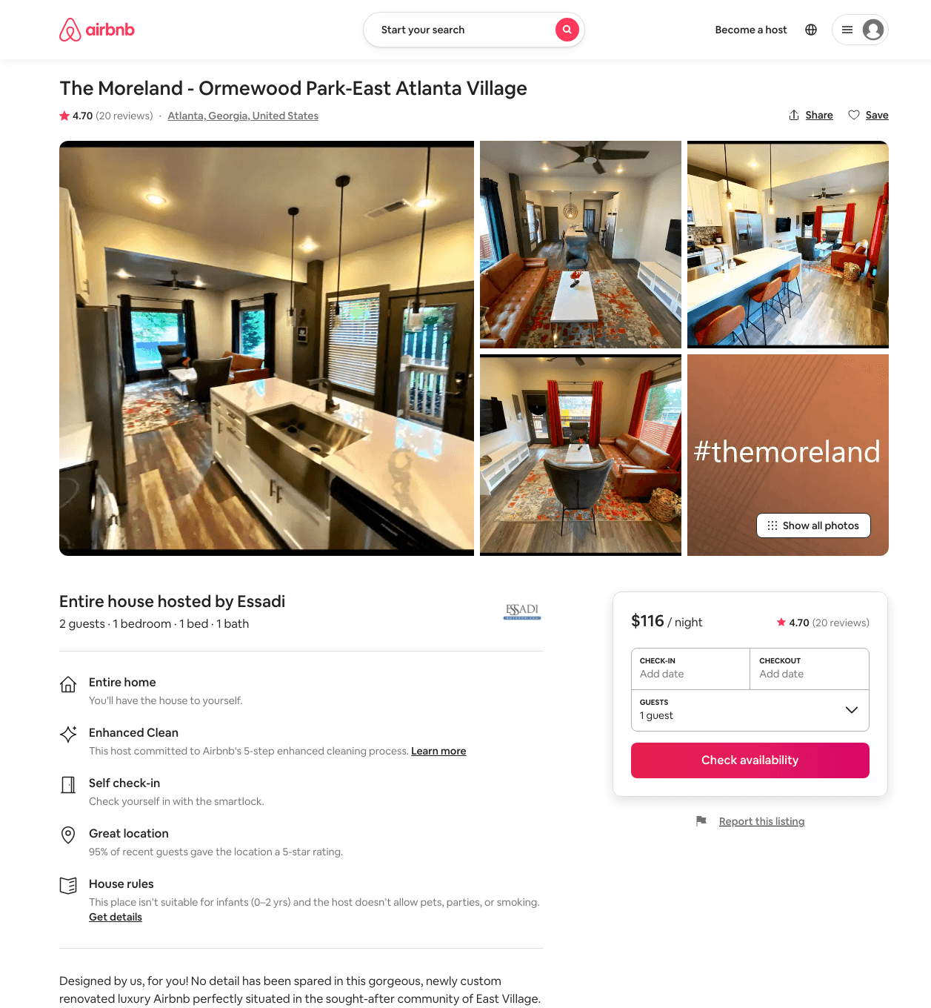
Listing 40760053
1
2
$116 - $166
4.86
1
Essadi
49830018
1
https://www.airbnb.com/rooms/40760053
Aug 2022

Slide 32
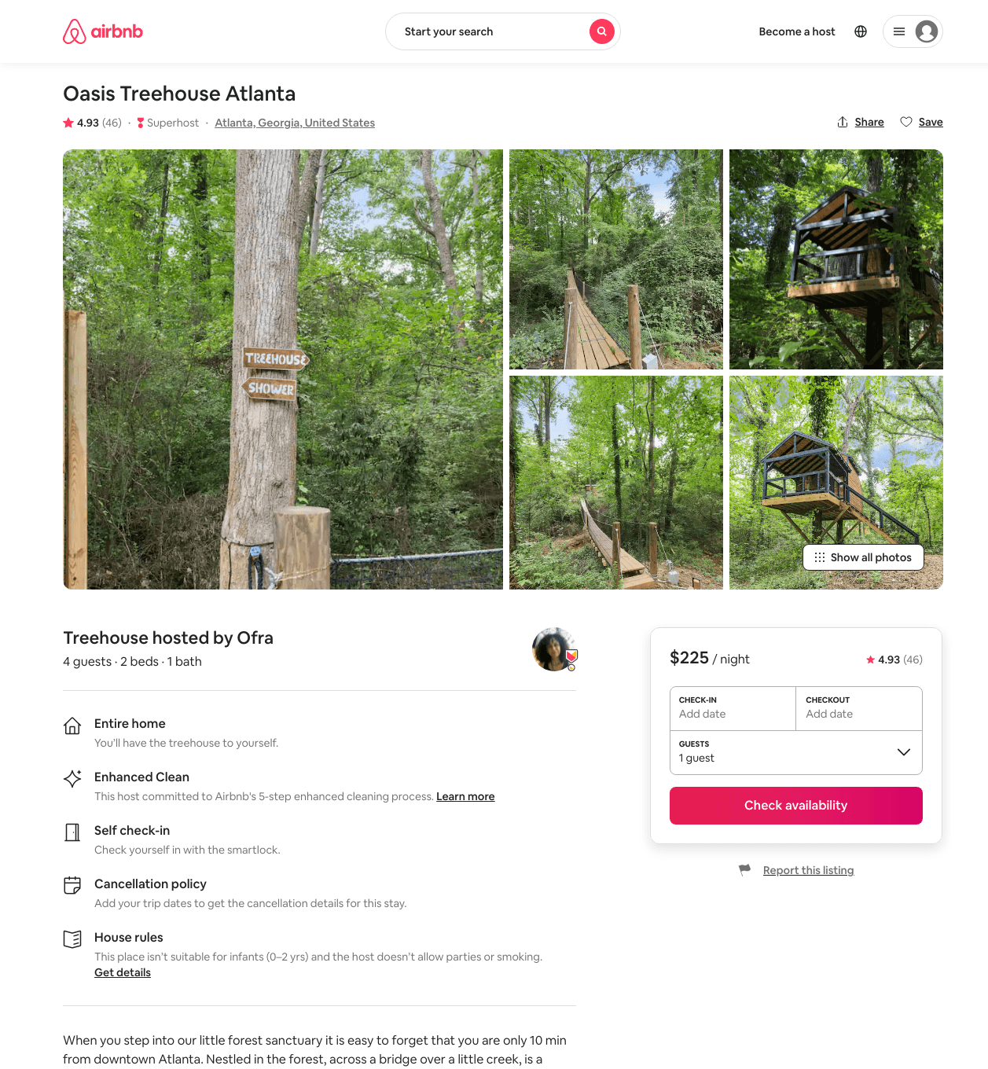
Listing 45423768
4
$225 - $237
4.97
1
Ofra
16925146
2
https://www.airbnb.com/rooms/45423768
Aug 2022

Slide 33
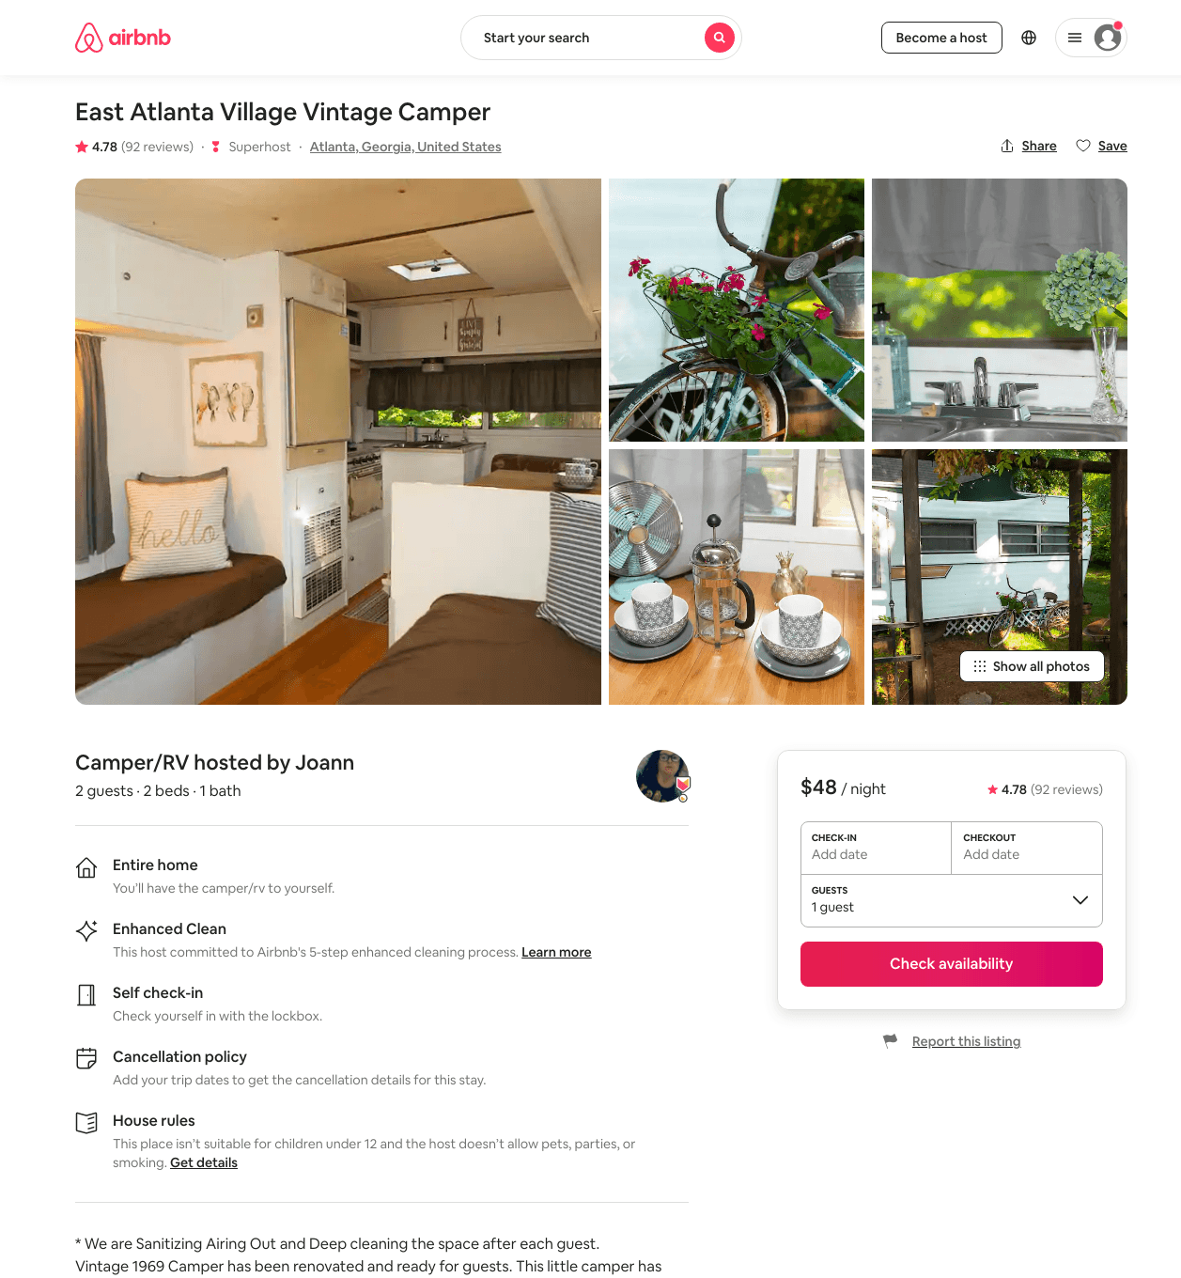
Listing 34966538
2
$48 - $54
4.78
2
Joann
95855164
1
https://www.airbnb.com/rooms/34966538
Jul 2022

Slide 34
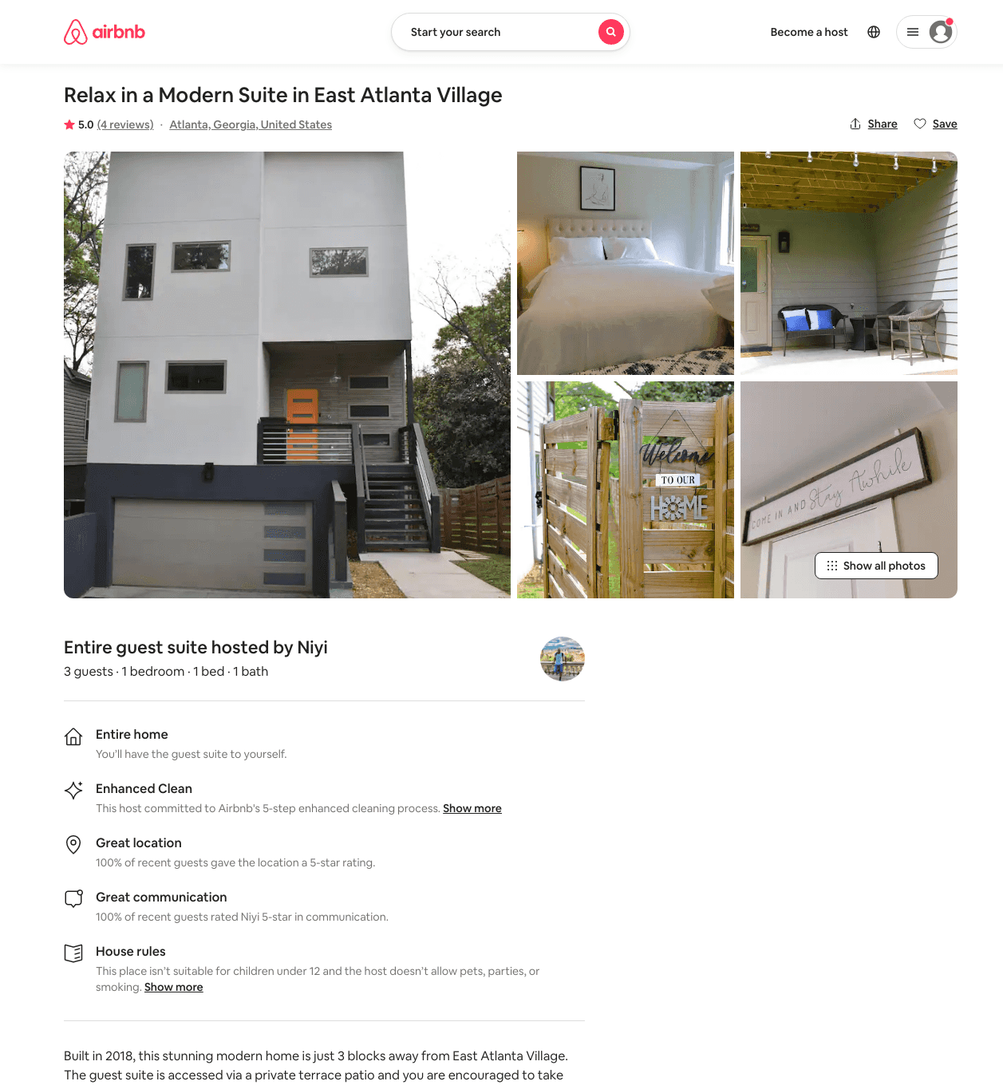
Listing 49267002
1
2
$84 - $108
4.78
2
Ni
83987647
2
https://www.airbnb.com/rooms/49267002
Aug 2022

Slide 35
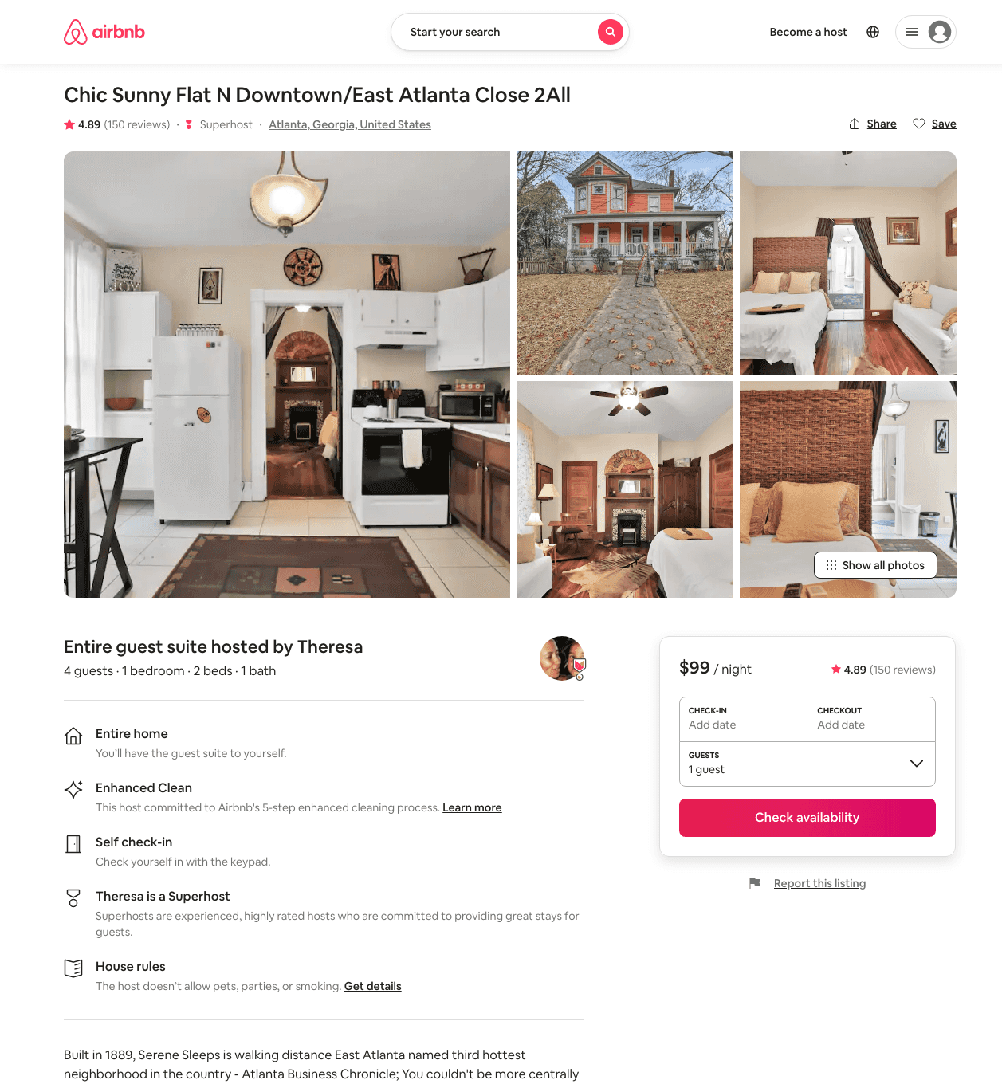
Listing 15134121
1
4
$89 - $187
4.91
1
Theresa
1695463
3
https://www.airbnb.com/rooms/15134121
Aug 2022

Slide 36
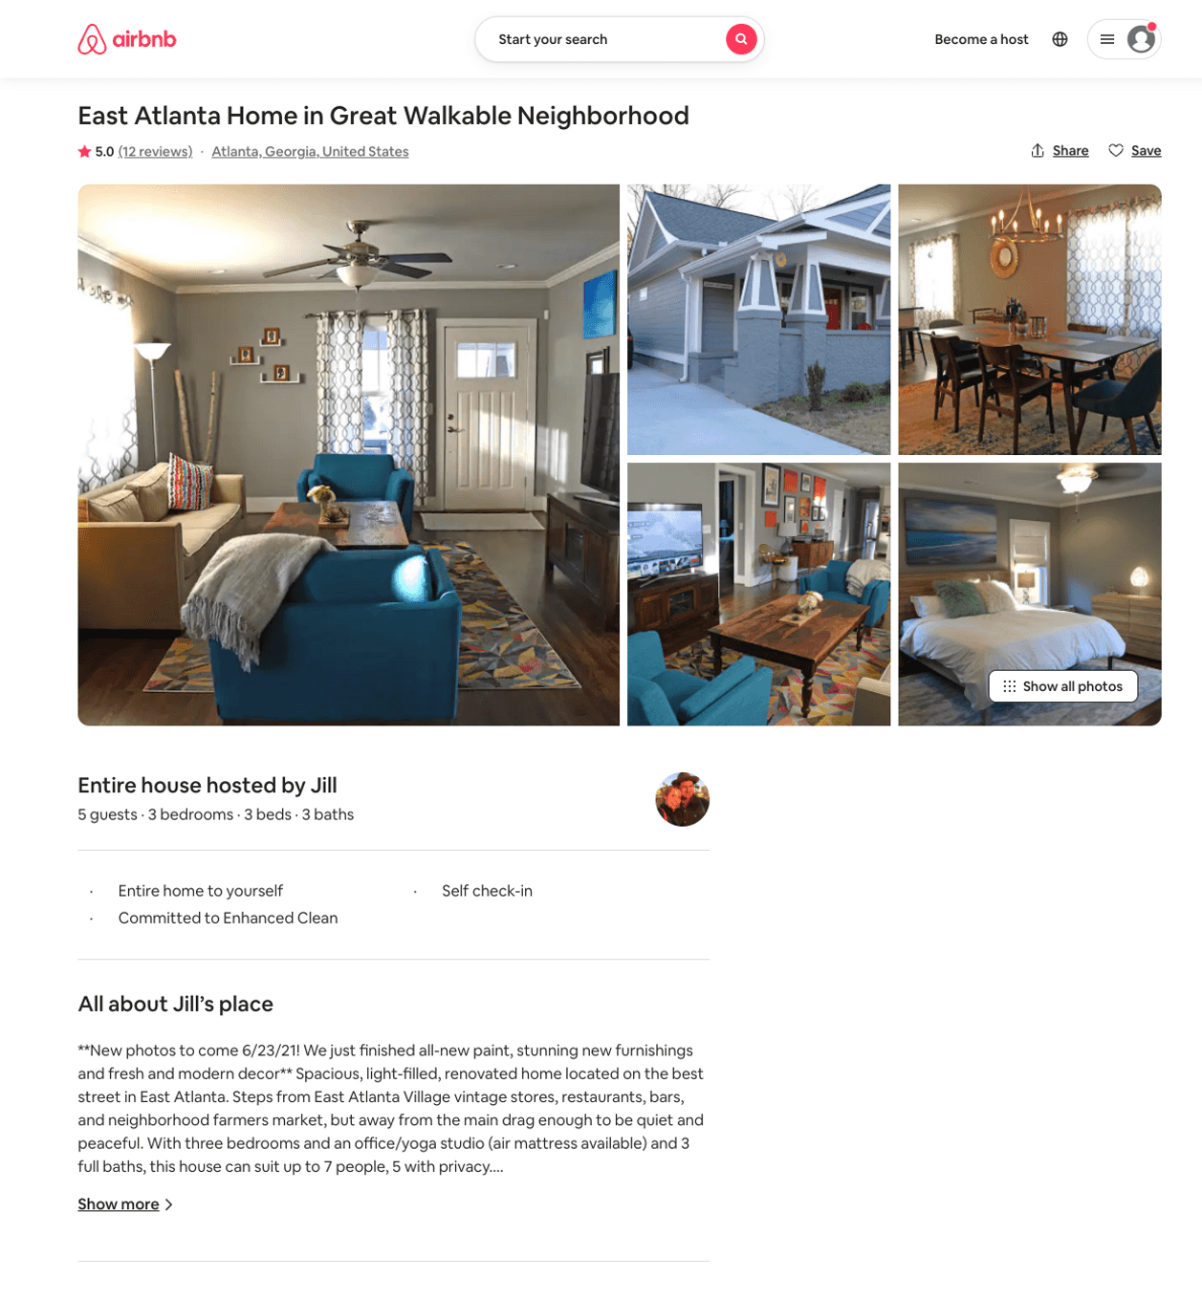
Listing 22955125
3
6
$170 - $256
5.0
2
Jill
5833143
1
https://www.airbnb.com/rooms/22955125
Aug 2022

Slide 37
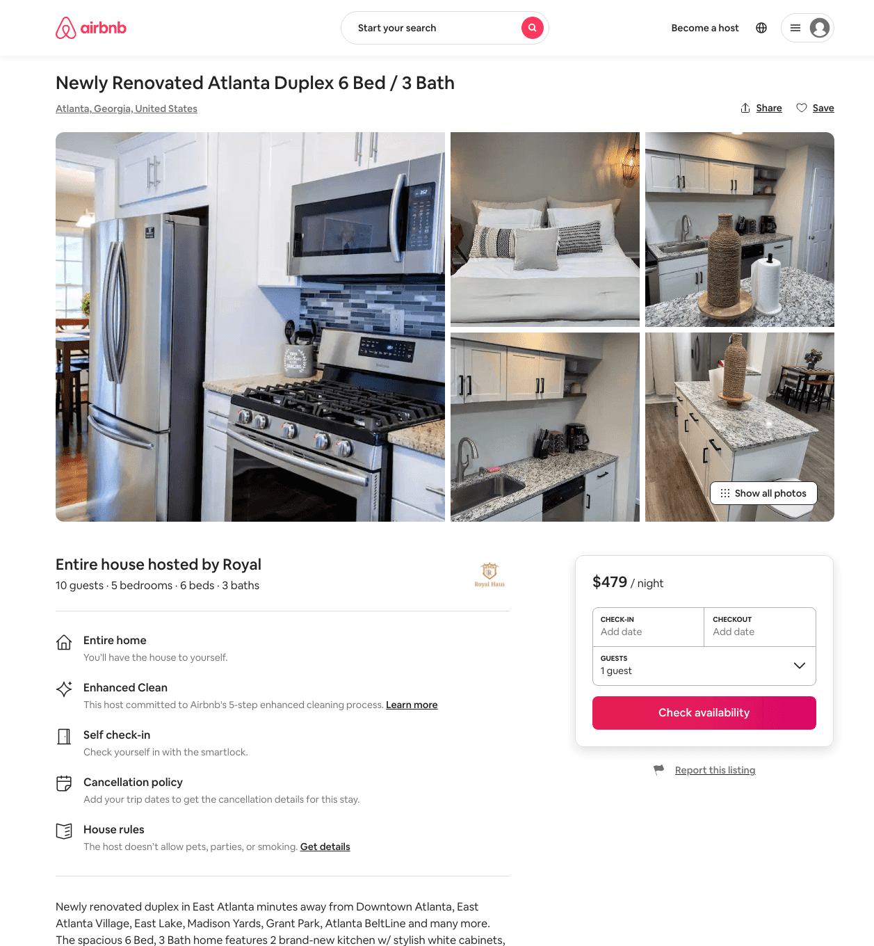
Listing 48721526
5
10
$320 - $503
4.14
3
Royal
22098841
4
https://www.airbnb.com/rooms/48721526
Aug 2022

Slide 38
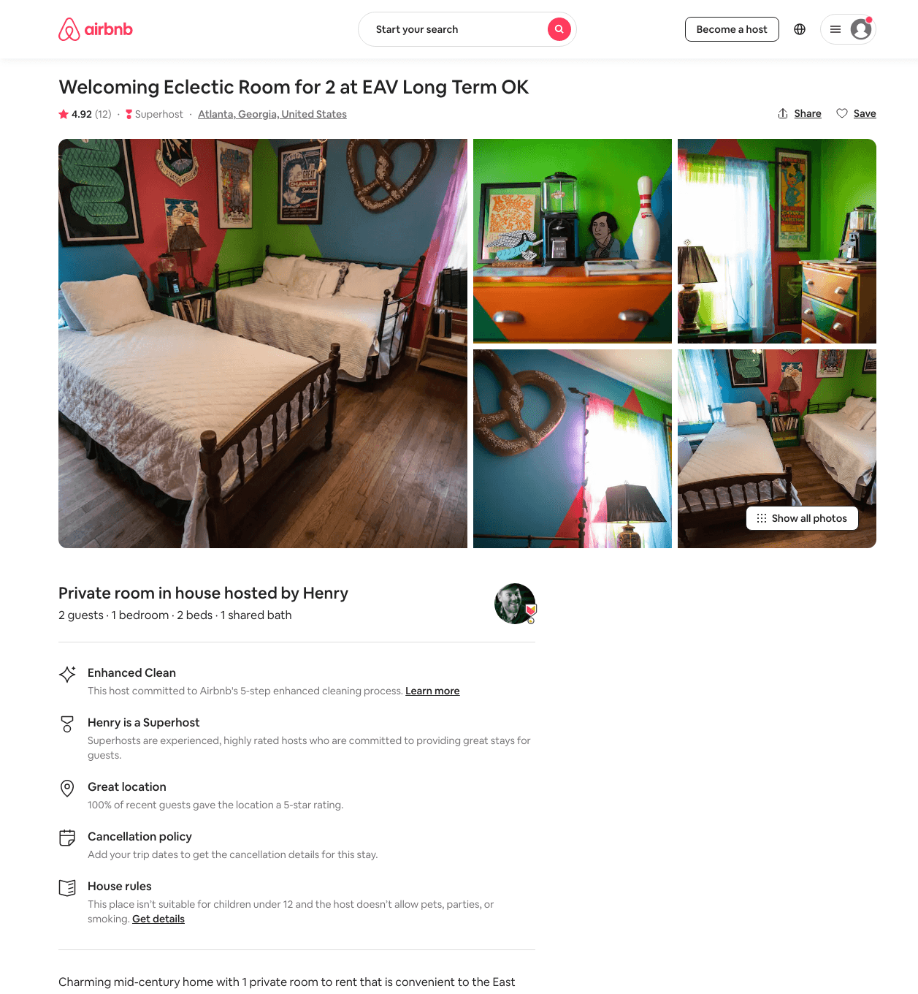
Listing 44070148
1
2
$50 - $58
4.84
1
Henry
135584507
3
https://www.airbnb.com/rooms/44070148
Jul 2022

Slide 39
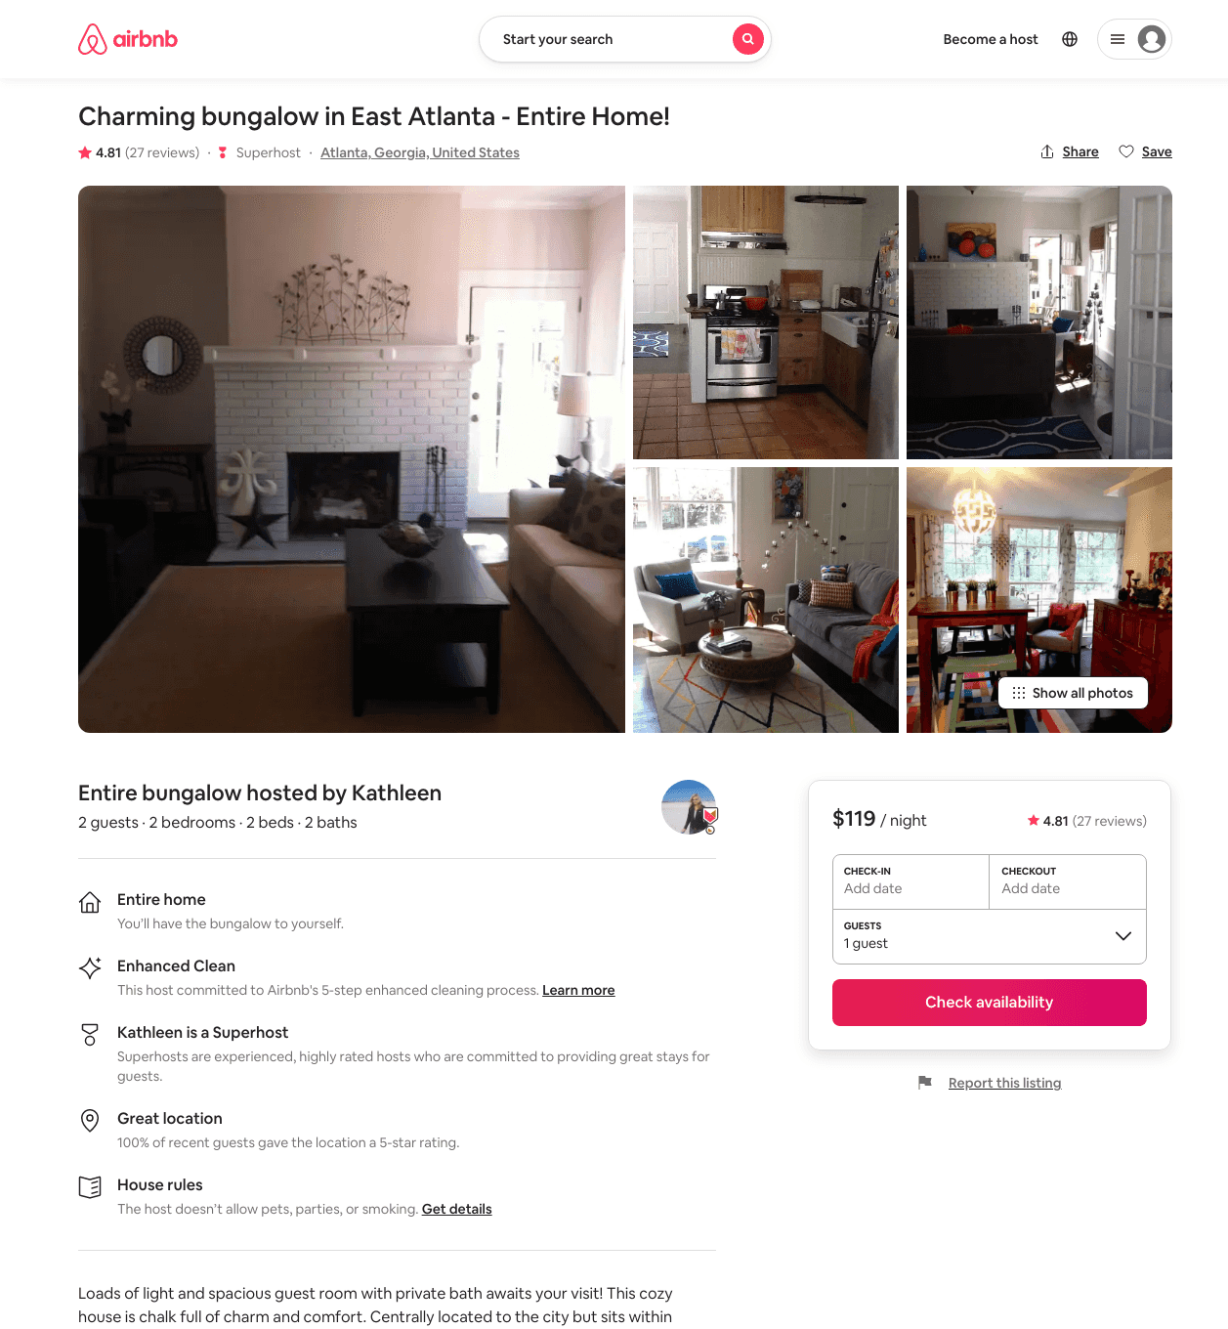
Listing 2685099
2
2
$119
4.83
45
Kathleen
13744517
1
https://www.airbnb.com/rooms/2685099
Aug 2022

Slide 40
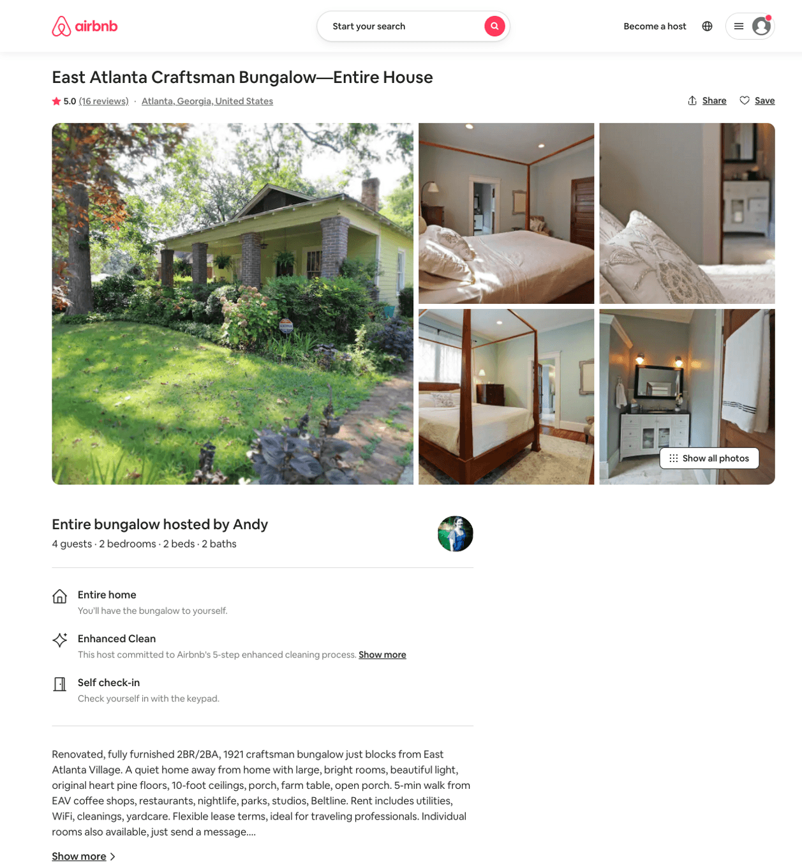
Listing 7075865
2
4
$299
5.0
3
Andy
37101220
3
https://www.airbnb.com/rooms/7075865
Aug 2022

Slide 41
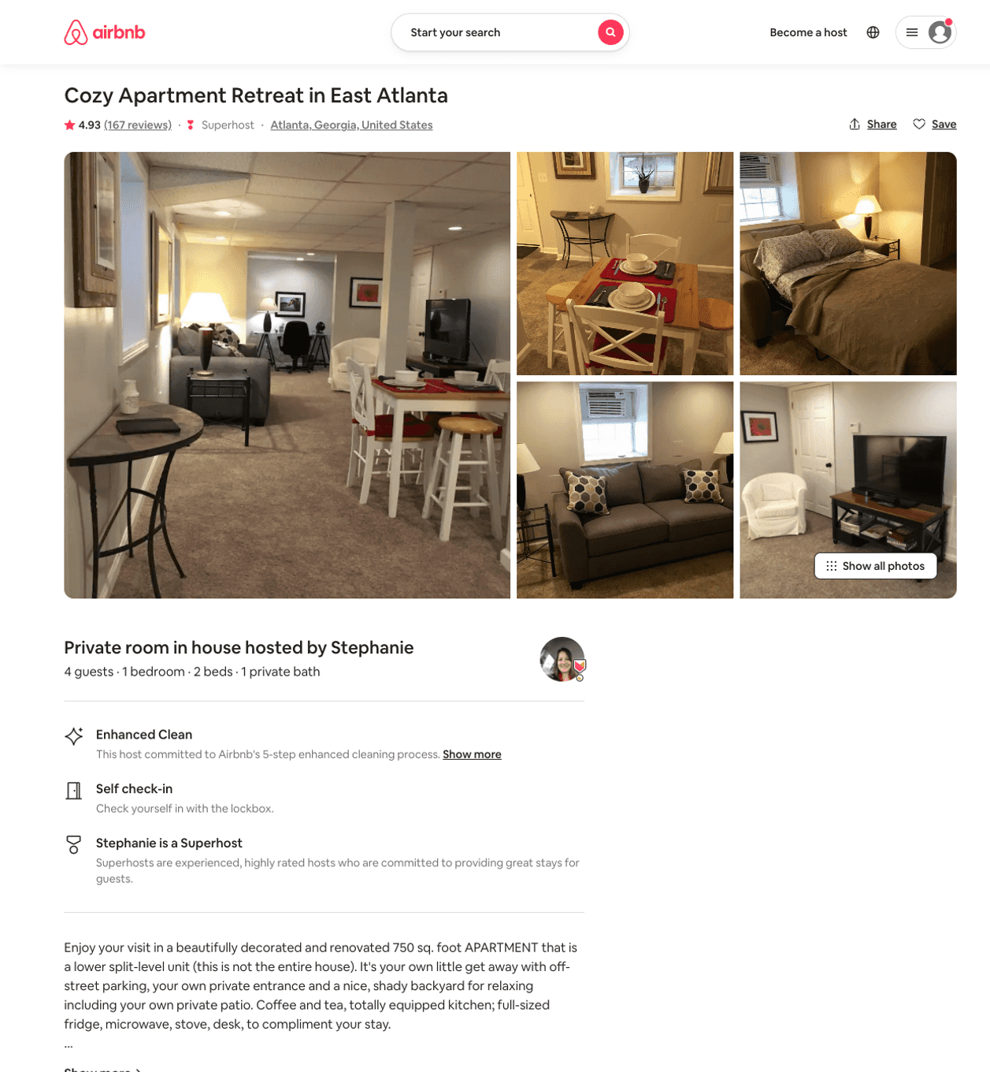
Listing 19217255
1
4
$79 - $96
4.93
2
Stephanie
25358464
1
https://www.airbnb.com/rooms/19217255
Aug 2022

Slide 42
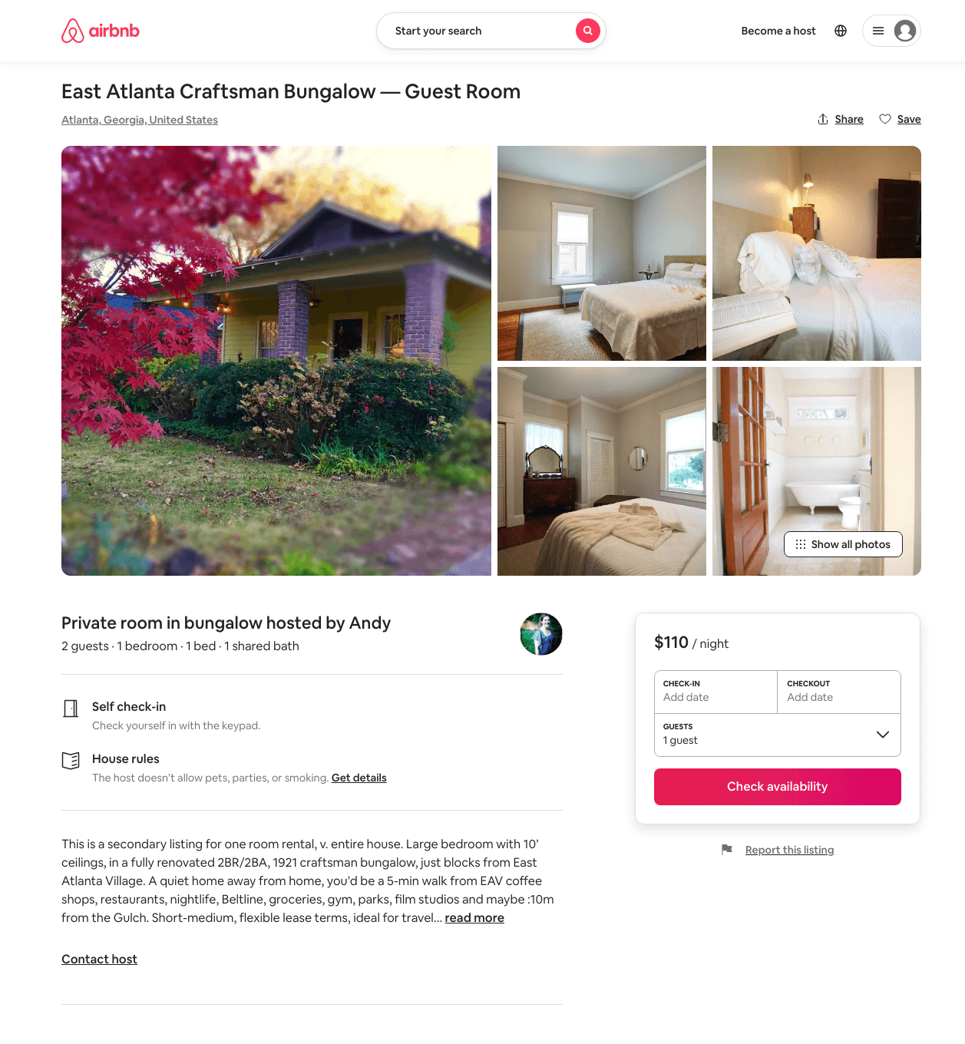
Listing 31364417
1
2
$110
1
Andy
37101220
3
https://www.airbnb.com/rooms/31364417
Jun 2022

Slide 43
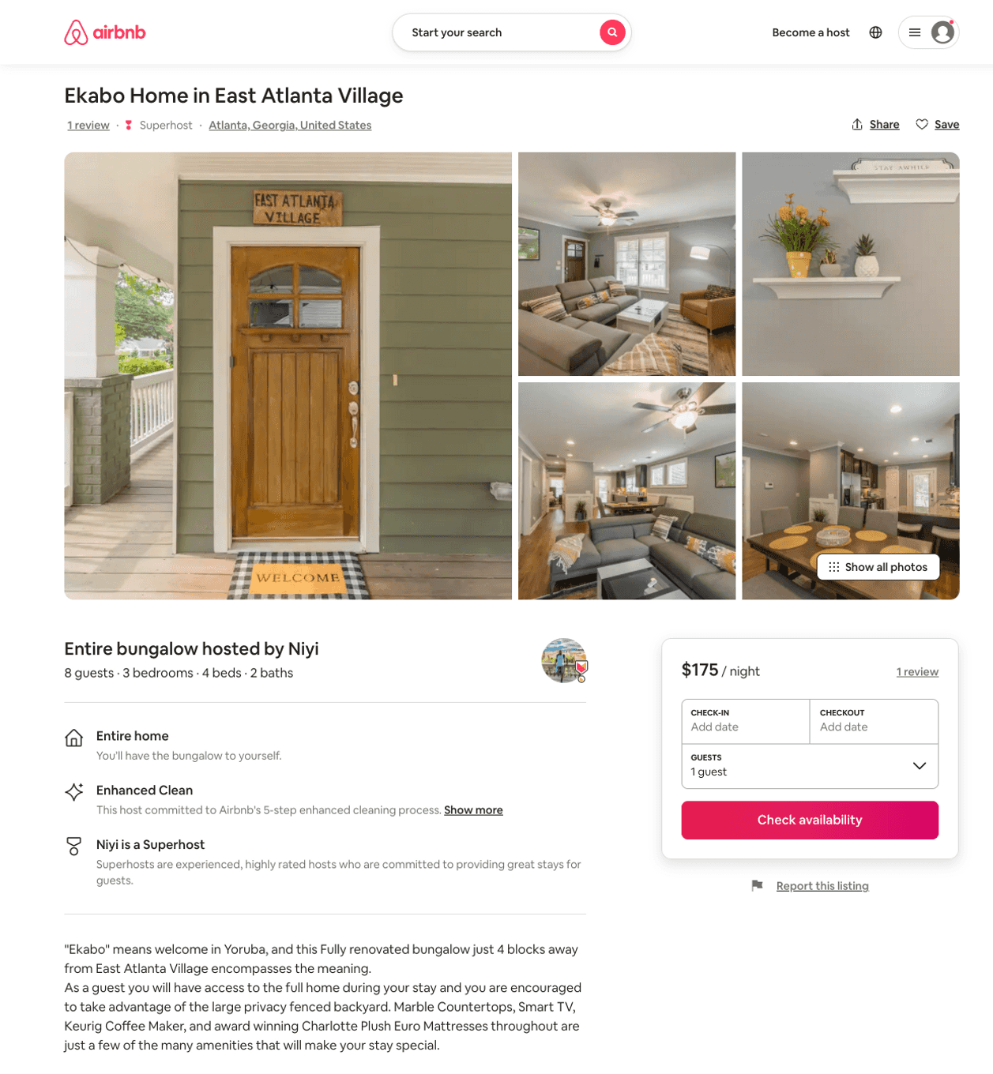
Listing 50652430
3
6
$113 - $239
4.77
2
Ni
83987647
2
https://www.airbnb.com/rooms/50652430
Aug 2022

Slide 44
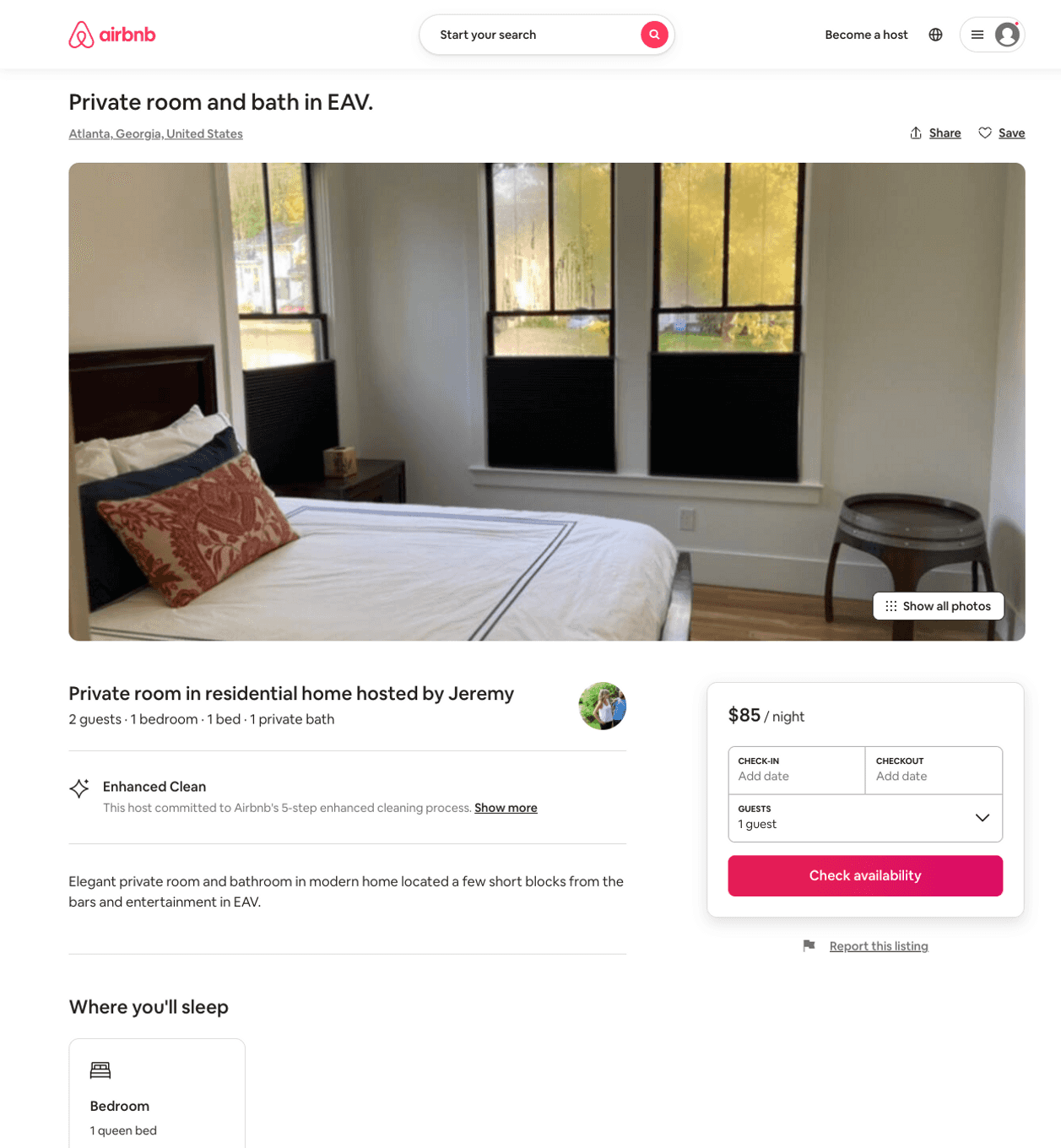
Listing 51613073
1
2
$85
30
Jeremy
418116744
1
https://www.airbnb.com/rooms/51613073
Aug 2022

Slide 45
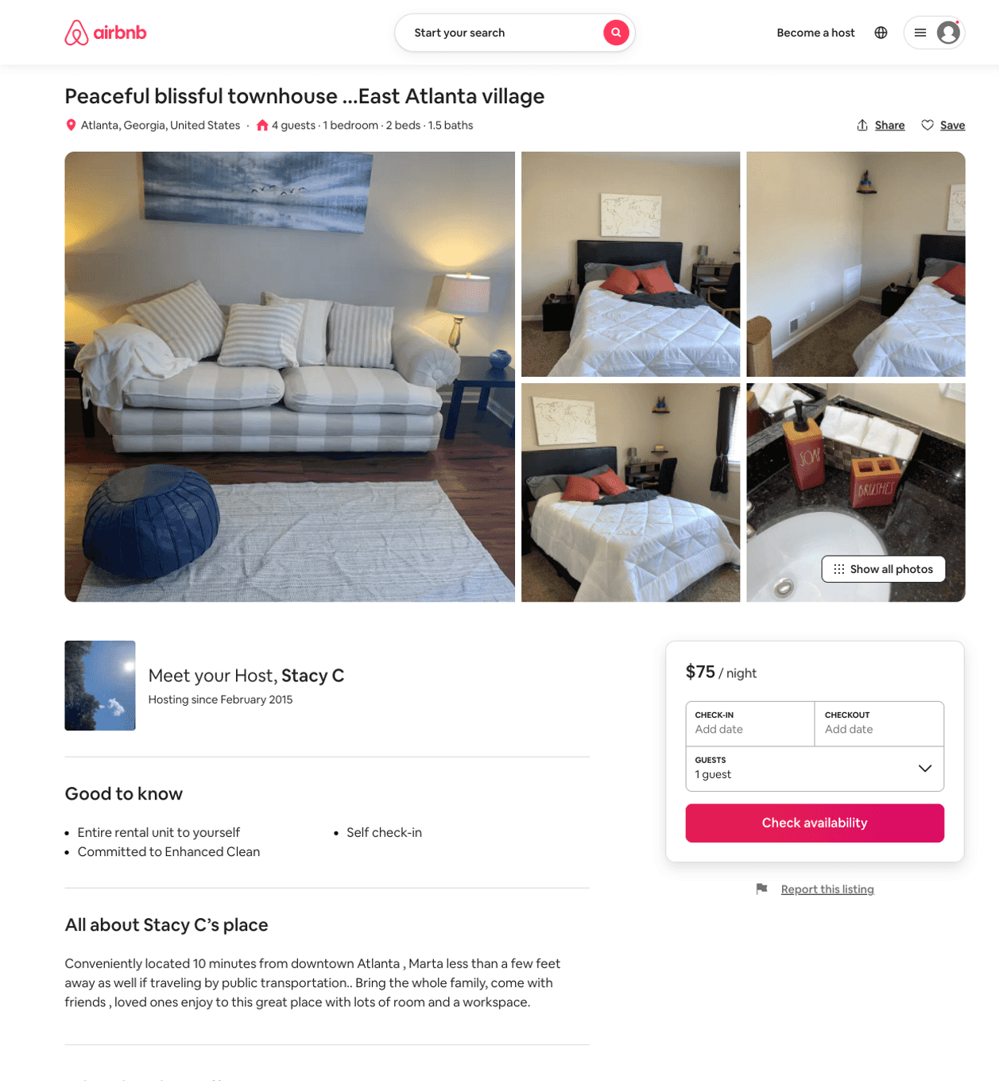
Listing 51900982
1
4
$67 - $111
4.68
1
Stacy C
27583508
1
https://www.airbnb.com/rooms/51900982
Aug 2022

Slide 46
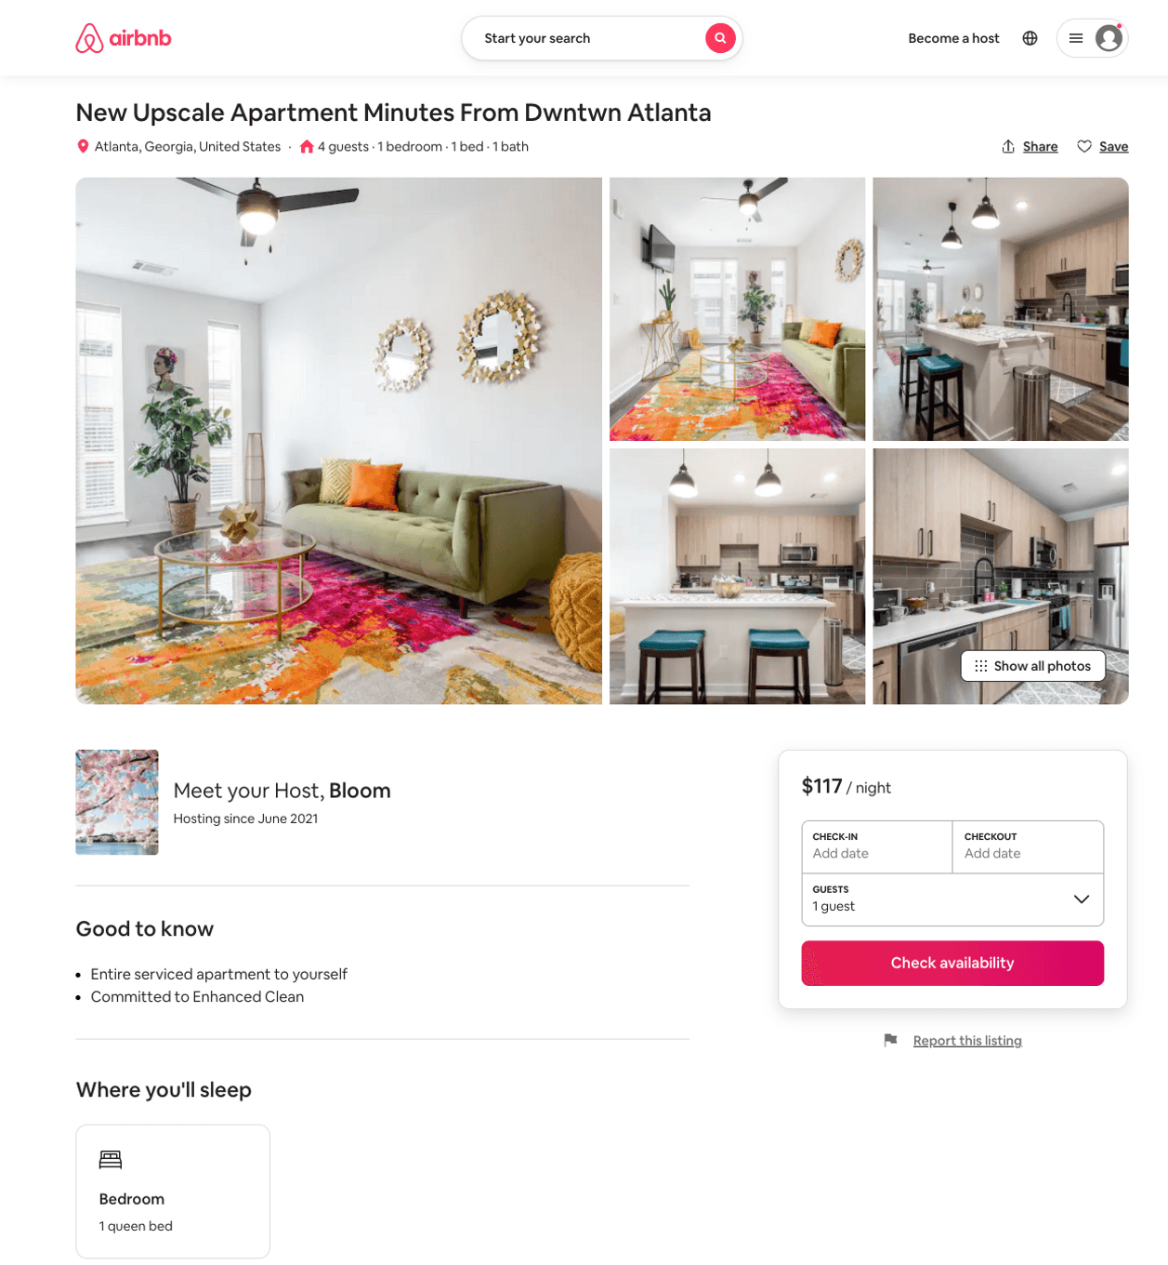
Listing 51925676
1
4
$10 - $179
4.90
1
Bloom
408393741
3
https://www.airbnb.com/rooms/51925676
Aug 2022

Slide 47
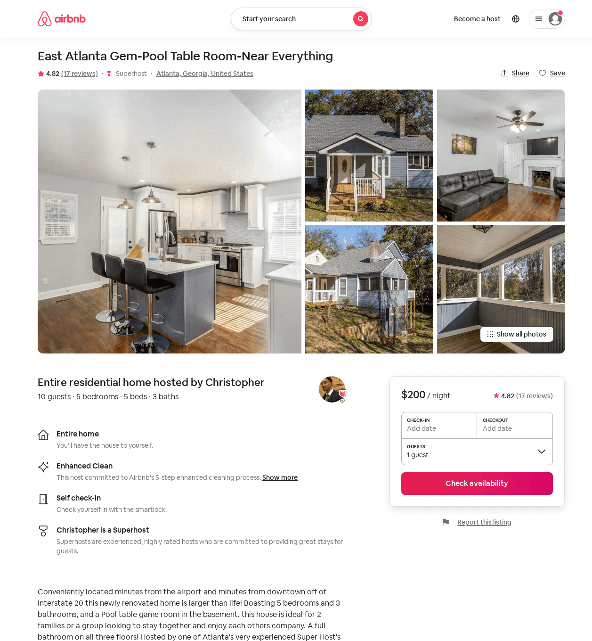
Listing 40327053
5
10
$200 - $362
4.73
3
Christopher
311626485
1
https://www.airbnb.com/rooms/40327053
Aug 2022

Slide 48
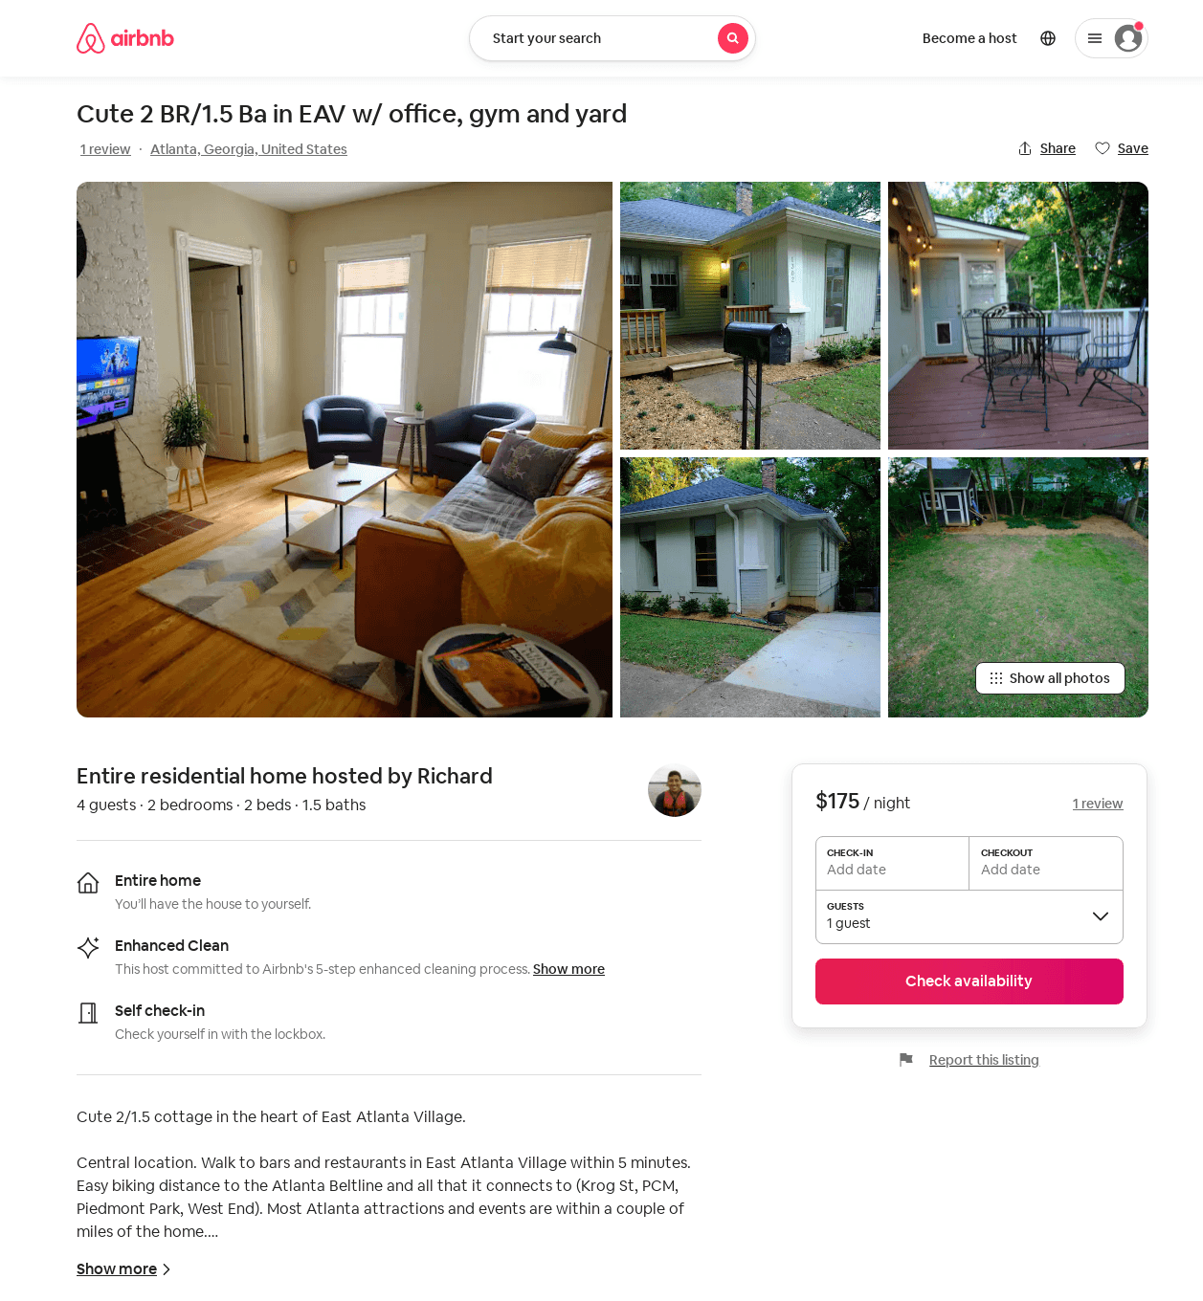
Listing 52129832
2
4
$146 - $194
4.87
1
Richard
19043444
1
https://www.airbnb.com/rooms/52129832
Aug 2022

Slide 49
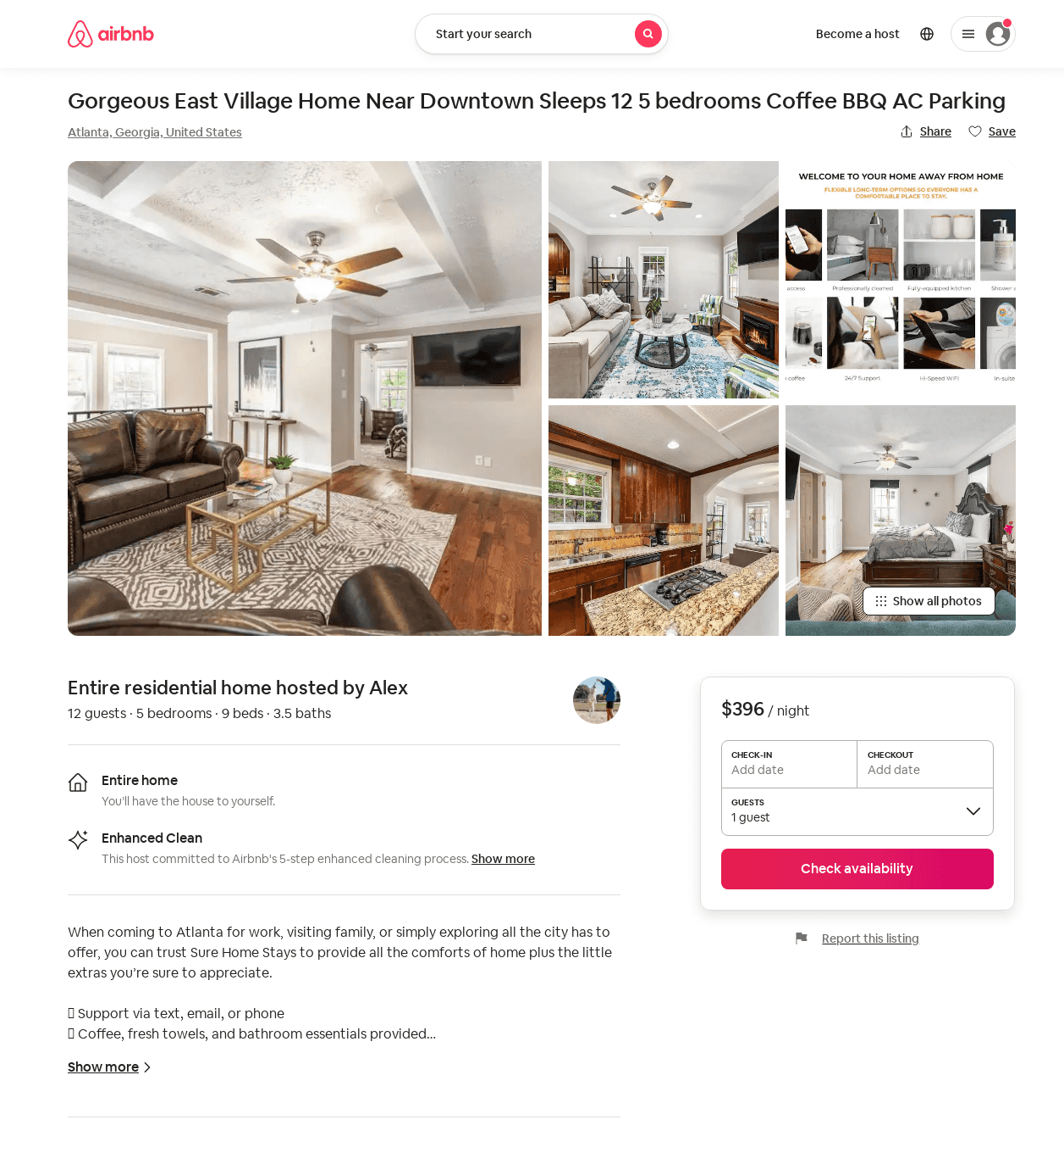
Listing 52490680
5
12
$235 - $430
4.60
1
Alex
424868164
1
https://www.airbnb.com/rooms/52490680
Aug 2022

Slide 50
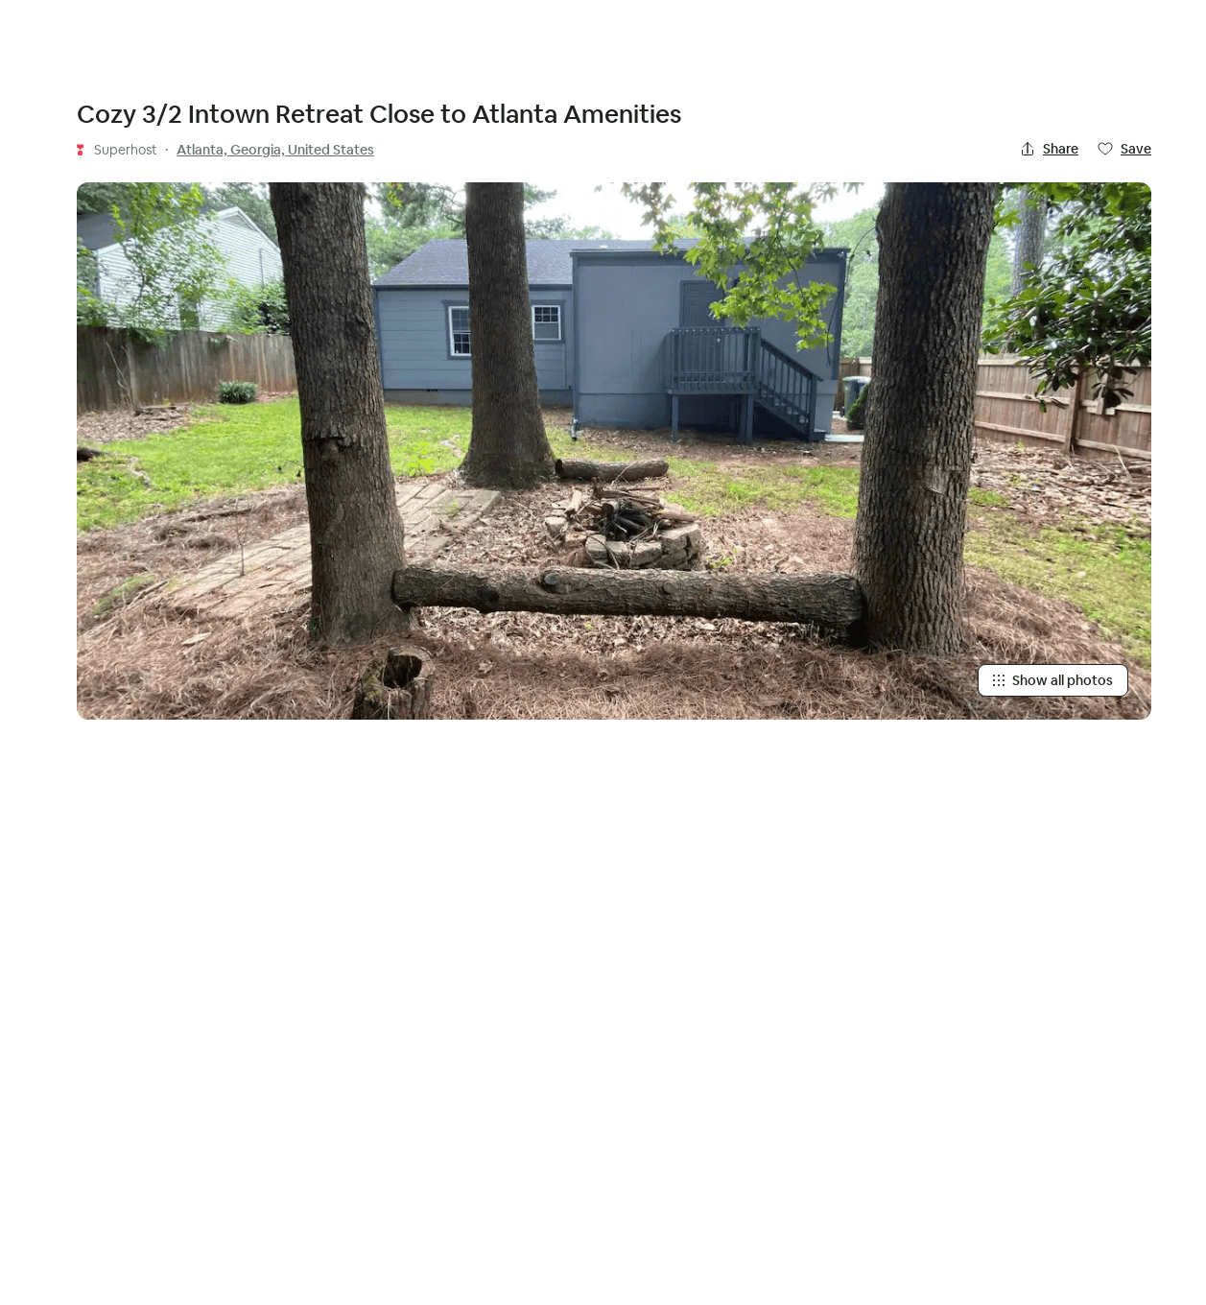
Listing 52878819
3
8
$120 - $244
4.93
2
Wei
6280569
3
https://www.airbnb.com/rooms/52878819
Aug 2022

Slide 51
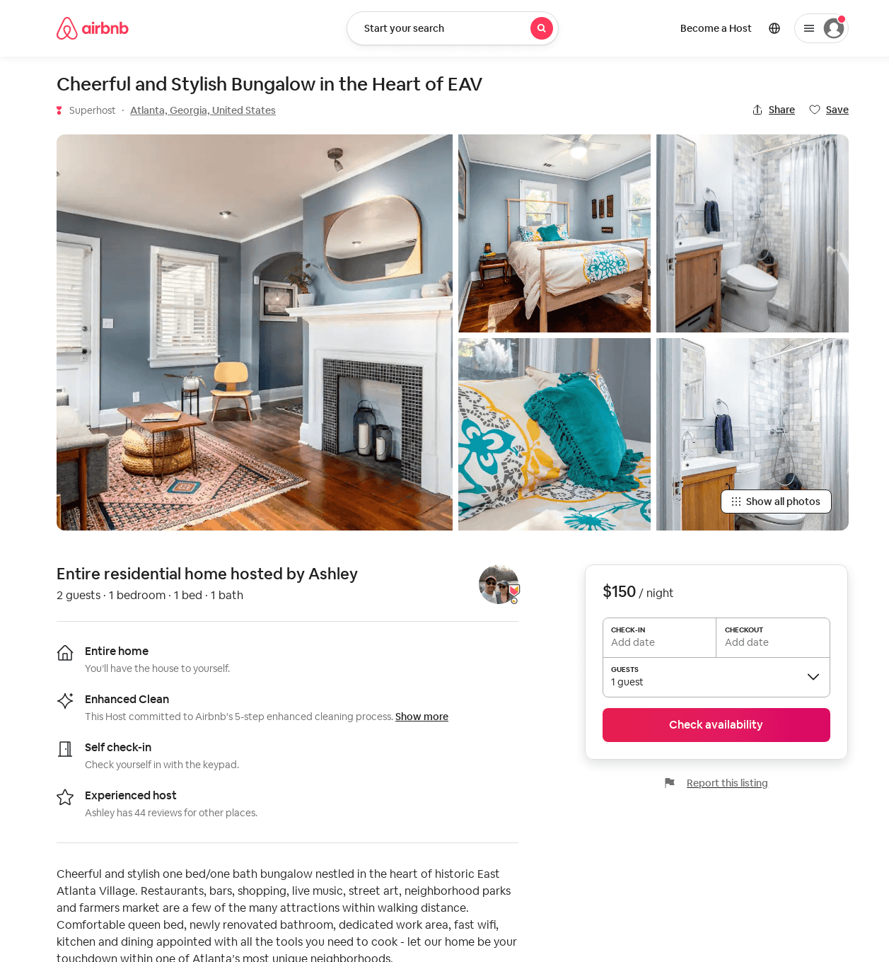
Listing 53127766
1
2
$150
30
Ashley
9510077
1
https://www.airbnb.com/rooms/53127766
Jul 2022

Slide 52
Listing 53396589
3
6
$160 - $300
5.0
3
Gina
193101601
2
https://www.airbnb.com/rooms/53396589
Aug 2022

Slide 53
Listing 51489353
2
4
$120 - $164
4.89
2
Preston
381836493
1
https://www.airbnb.com/rooms/51489353
Jun 2022

Slide 54
Listing 2558146
3
8
$154 - $252
4.6666665
1
4047911776
https://www.vrbo.com/2558146
Aug 2022

Slide 55
Listing 2595604
1
1
$93
2
https://www.vrbo.com/2595604
Aug 2022

Slide 56
Listing 40540966
5
10
$378 - $528
4.71
3
Royal
22098841
4
https://www.airbnb.com/rooms/40540966
Aug 2022

Slide 57
Listing 53357551
1
2
$73 - $104
4.98
1
Christian
61115676
1
https://www.airbnb.com/rooms/53357551
Aug 2022

Slide 58
Listing the-garden-suite-a-private-guest-retreat
undefined
2
9.2
https://www.booking.com/hotel/us/the-garden-suite-a-private-guest-retreat.html
Sep 2022

Slide 59
Listing magnificent-place-moreland
undefined
2
8.2
https://www.booking.com/hotel/us/magnificent-place-moreland.html
Sep 2022

Slide 60
Listing 2646978
1
4
$121
4
1
https://www.vrbo.com/2646978
Aug 2022

Slide 61
Listing 54303786
1
4
$70 - $90
4.92
3
Valerie
420611431
1
https://www.airbnb.com/rooms/54303786
Aug 2022

Slide 62
Listing 26863204
1
2
$64 - $66
5.0
1
Emily & Philip
30342372
2
https://www.airbnb.com/rooms/26863204
Jul 2022

Slide 63
Listing 16064605
4
8
$425
5.0
3
Sloane
10388877
1
https://www.airbnb.com/rooms/16064605
Aug 2022

Slide 64
Listing 2706132
1
4
$100
5
1
Rebecca Beasley
https://www.vrbo.com/2706132
Aug 2022

Slide 65
Listing 1546649
2
4
$85
28
Sadie Mauss
https://www.vrbo.com/1546649
Aug 2022

Slide 66
Listing 2750338
2
10
$350
2
https://www.vrbo.com/2750338
Aug 2022

Slide 67
Listing 26751693
3
5
$146 - $150
4.99
1
Emily & Philip
30342372
2
https://www.airbnb.com/rooms/26751693
Aug 2022

Slide 68
Listing 2870210
1
4
$144
2
Heather D
https://www.vrbo.com/2870210
Aug 2022

Slide 69
Listing 2860467
5
10
$359
5
2
Michael Harvey
https://www.vrbo.com/2860467
Aug 2022

Slide 70
Listing 2933454
3
6
$251
1
Maria McNiece
https://www.vrbo.com/2933454
Aug 2022

Slide 71
Listing 2941444
2
4
$150
1
Elissa Clouse
https://www.vrbo.com/2941444
Aug 2022

