Slide 2
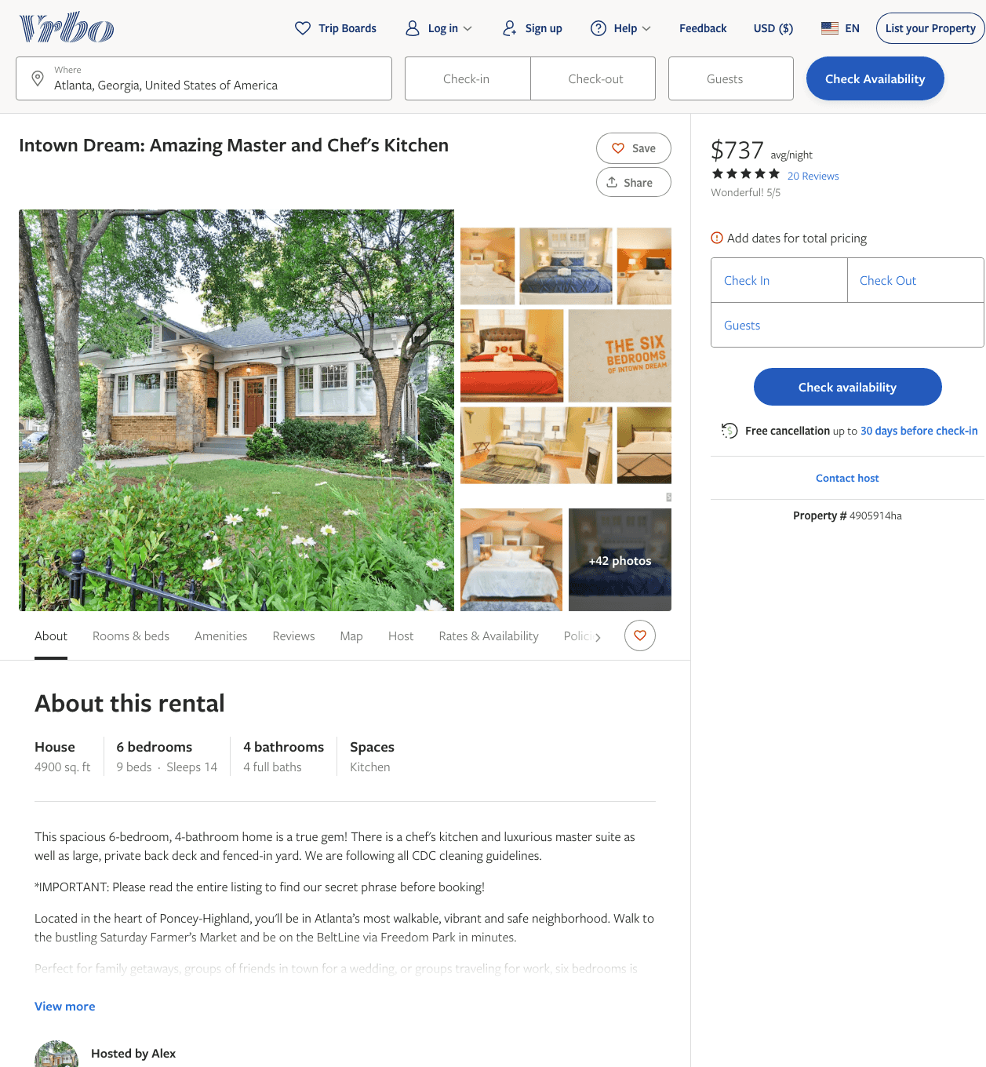
Listing 4905914
6
14
$667 - $849
4.8461537
3
Alex
https://www.vrbo.com/4905914ha
Aug 2022

Slide 3
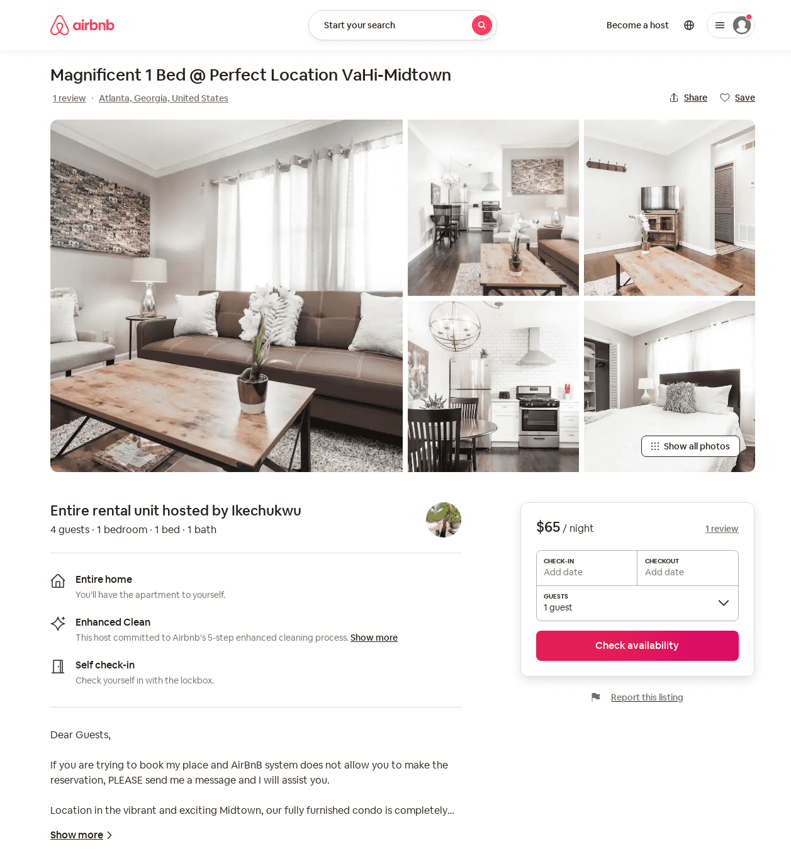
Listing 52206900
1
4
$65 - $160
4.21
1
City Living
60308095
1
https://www.airbnb.com/rooms/52206900
Jul 2022

Slide 4
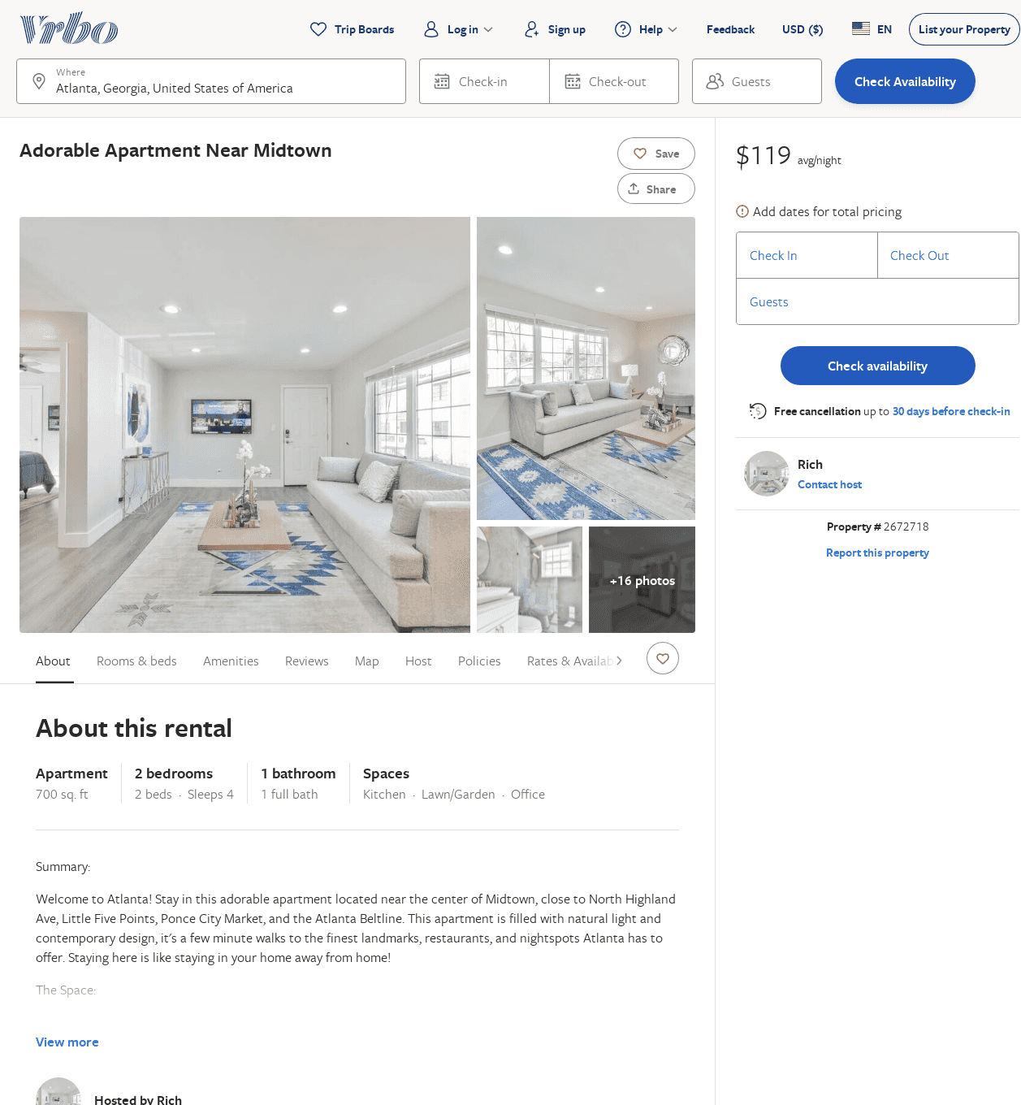
Listing 2672718
2
4
$237
5
2
Rich
https://www.vrbo.com/2672718
Aug 2022

Slide 5
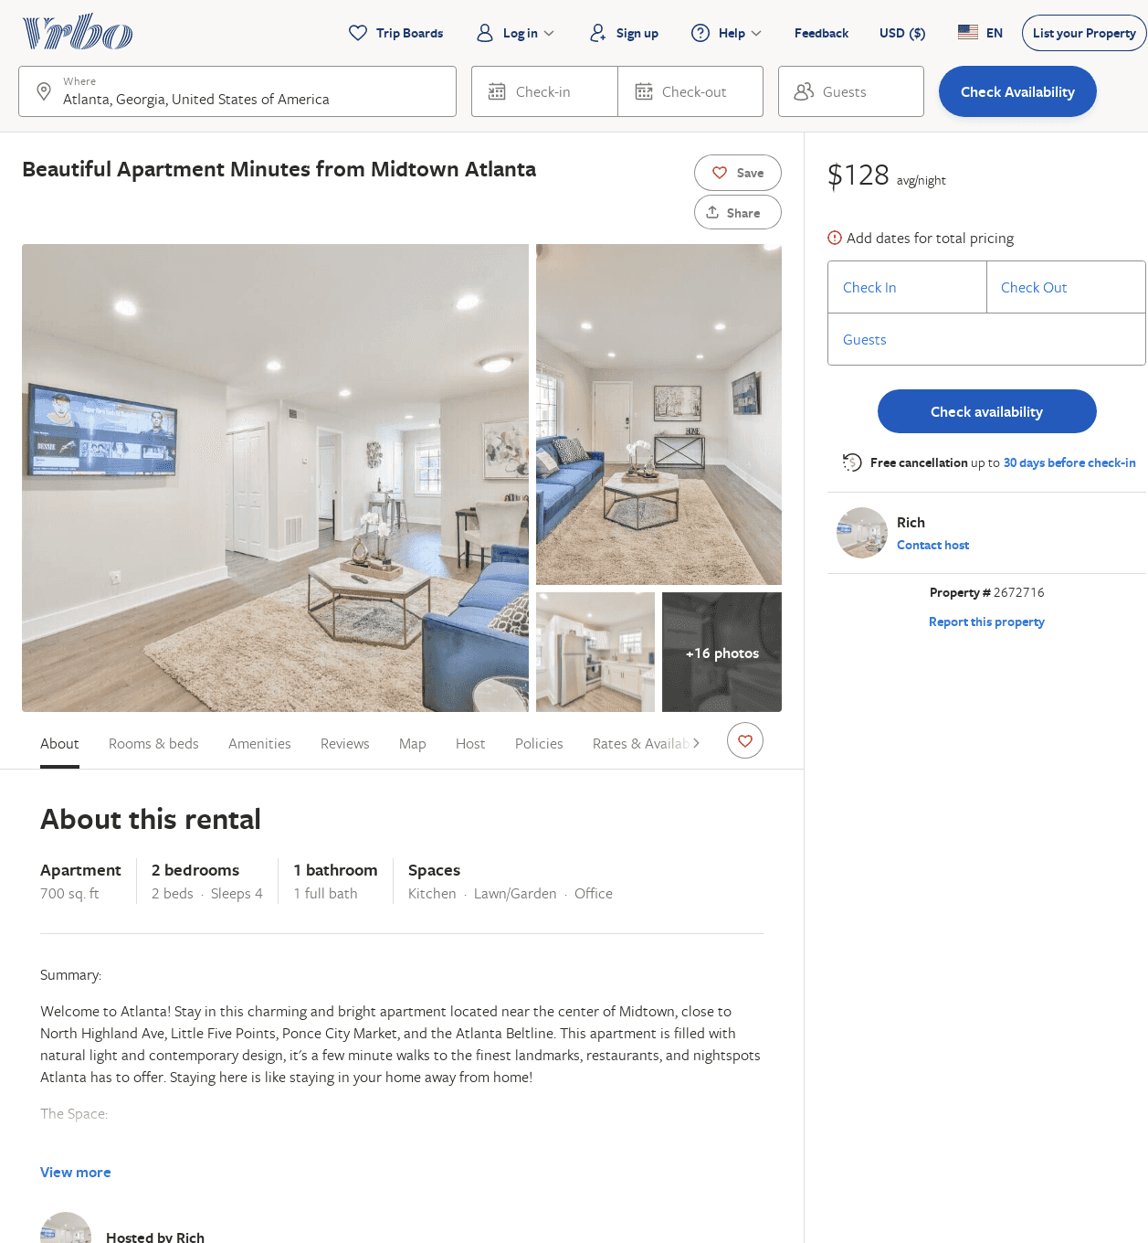
Listing 2672716
2
4
$244
4.6666665
2
Rich
https://www.vrbo.com/2672716
Aug 2022

Slide 6
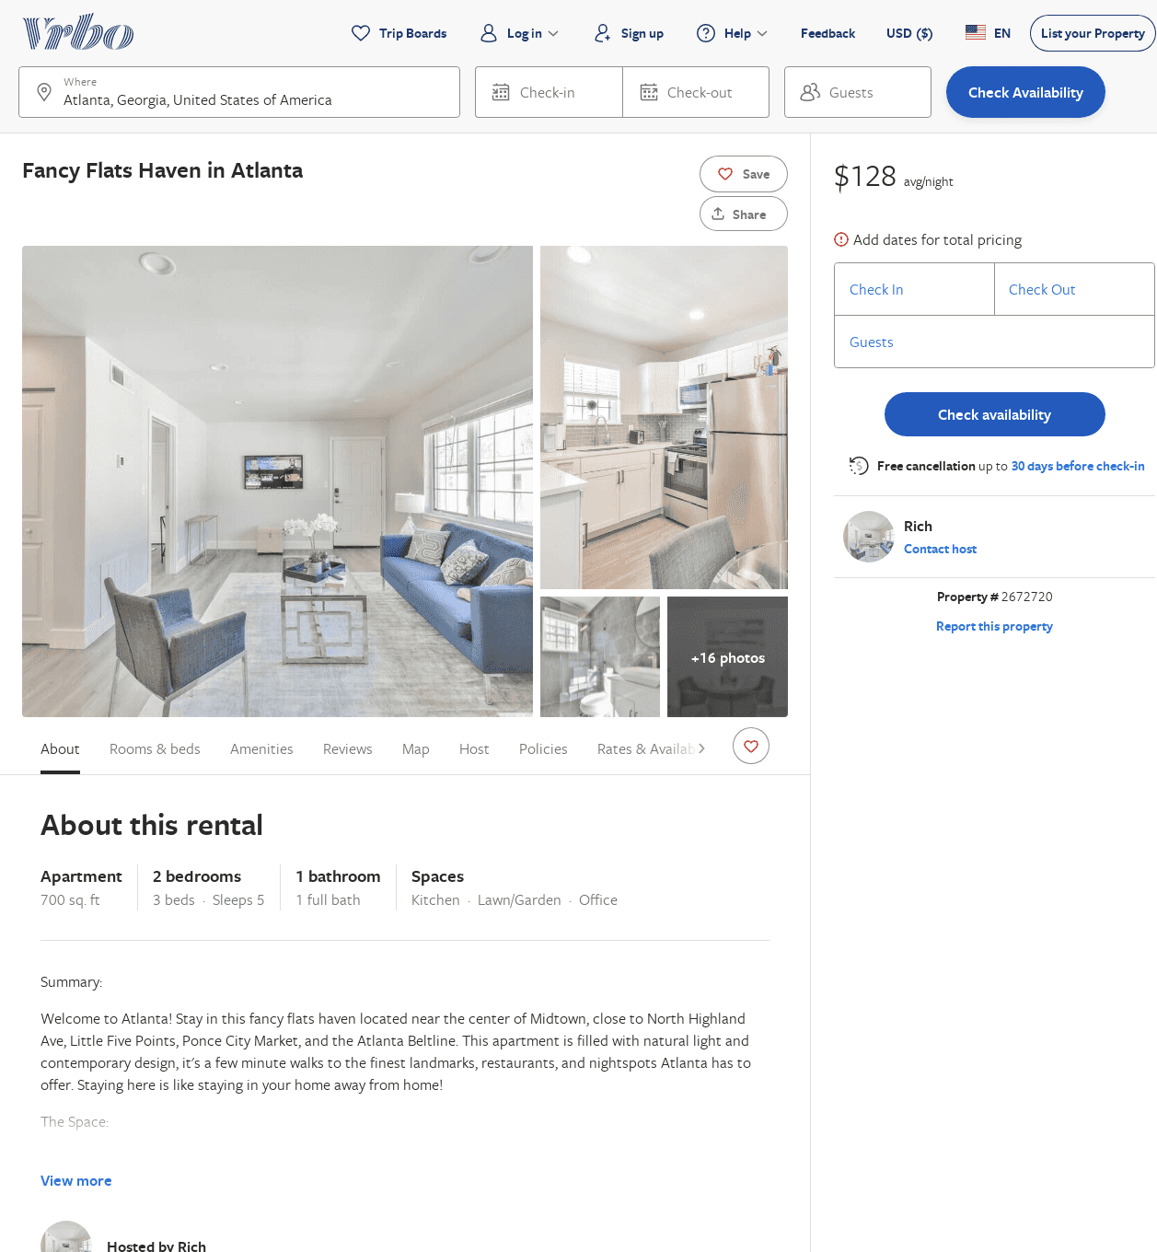
Listing 2672720
2
5
$273
2
Rich
https://www.vrbo.com/2672720
Aug 2022

Slide 7
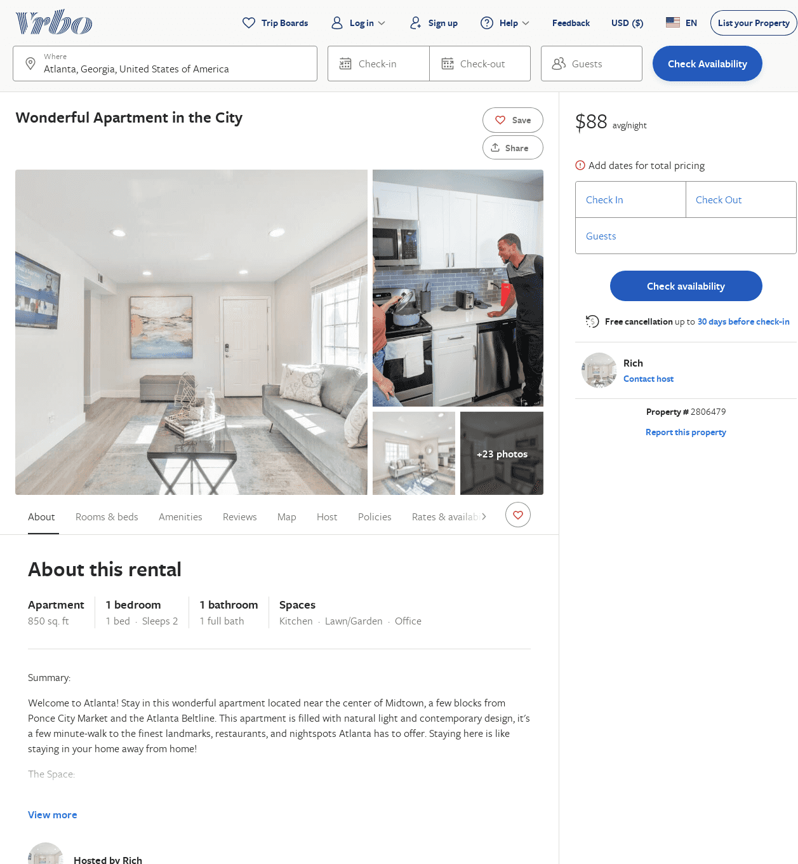
Listing 2806479
1
2
$129
2
Rich
https://www.vrbo.com/2806479
Aug 2022

Slide 8
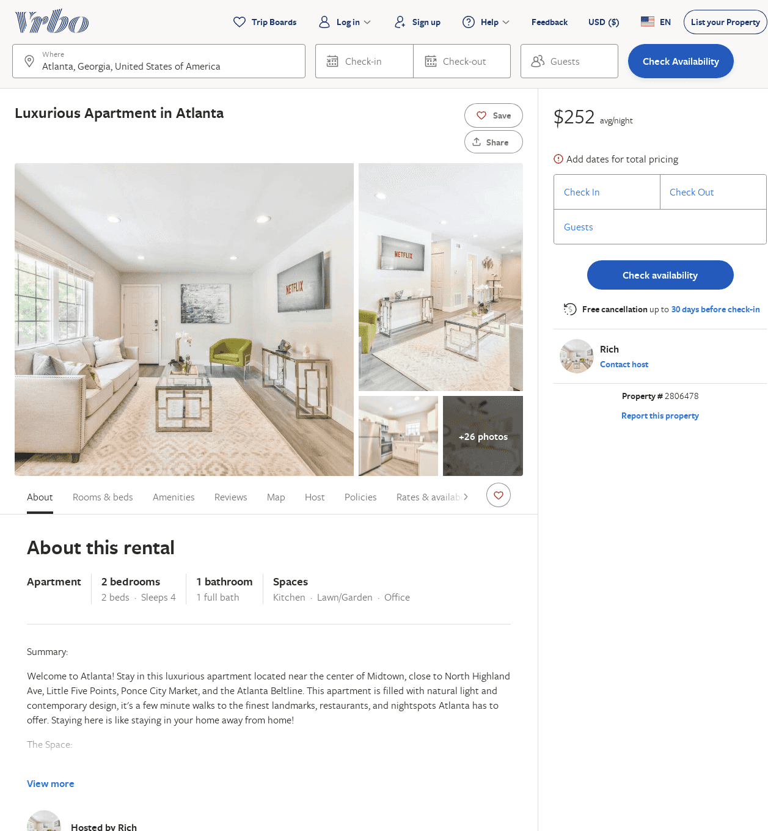
Listing 2806478
2
4
$242
2
Rich
https://www.vrbo.com/2806478
Aug 2022

Slide 9
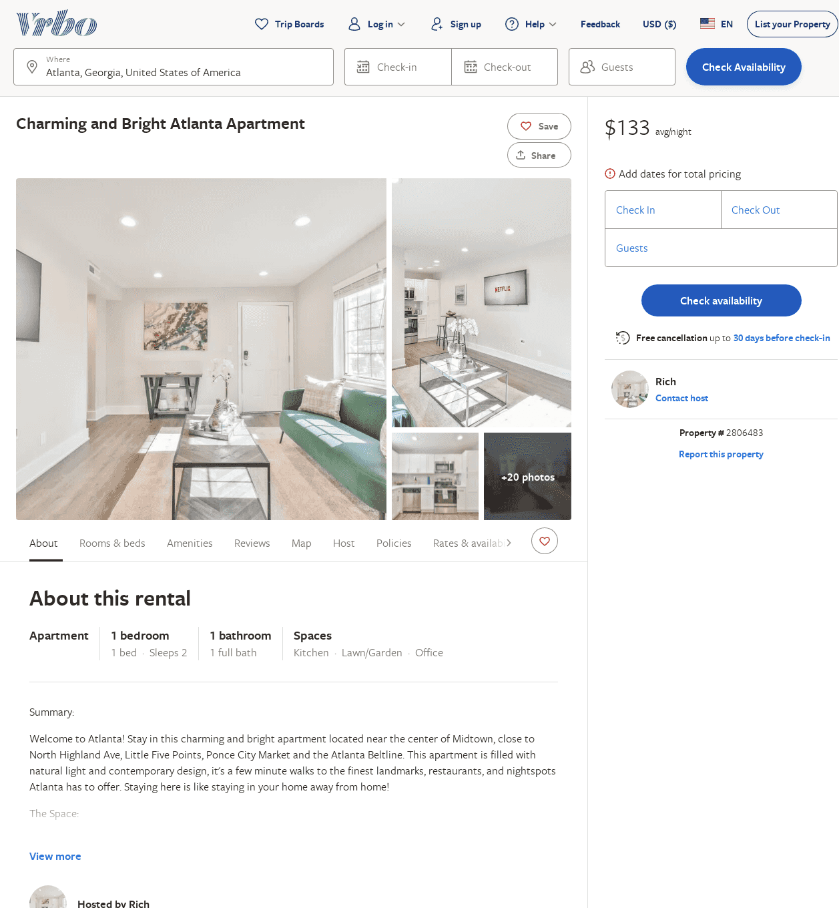
Listing 2806483
1
2
$169
2
Rich
https://www.vrbo.com/2806483
Aug 2022

Slide 10
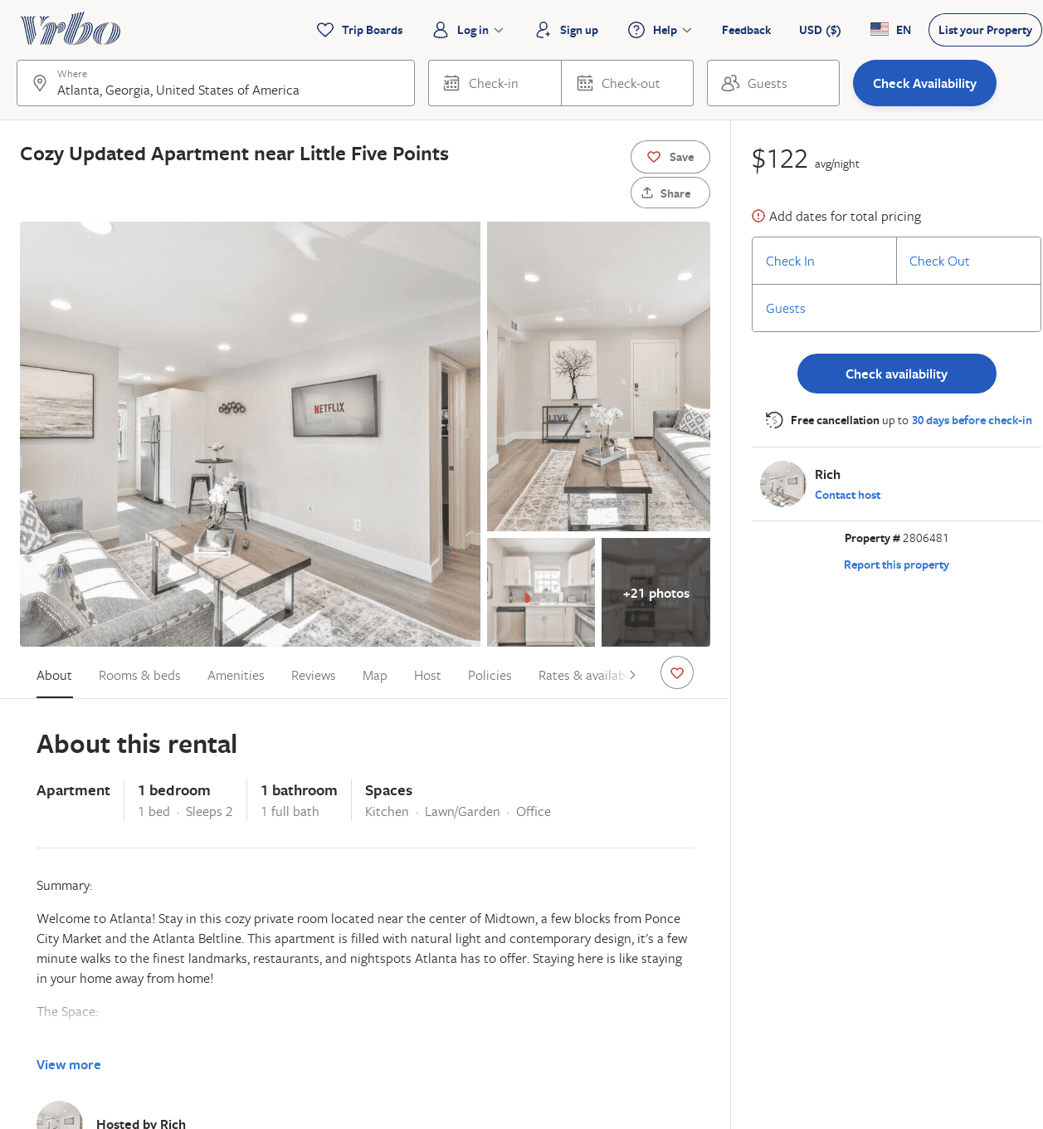
Listing 2806481
1
2
$172
2
Rich
https://www.vrbo.com/2806481
Aug 2022

Slide 11
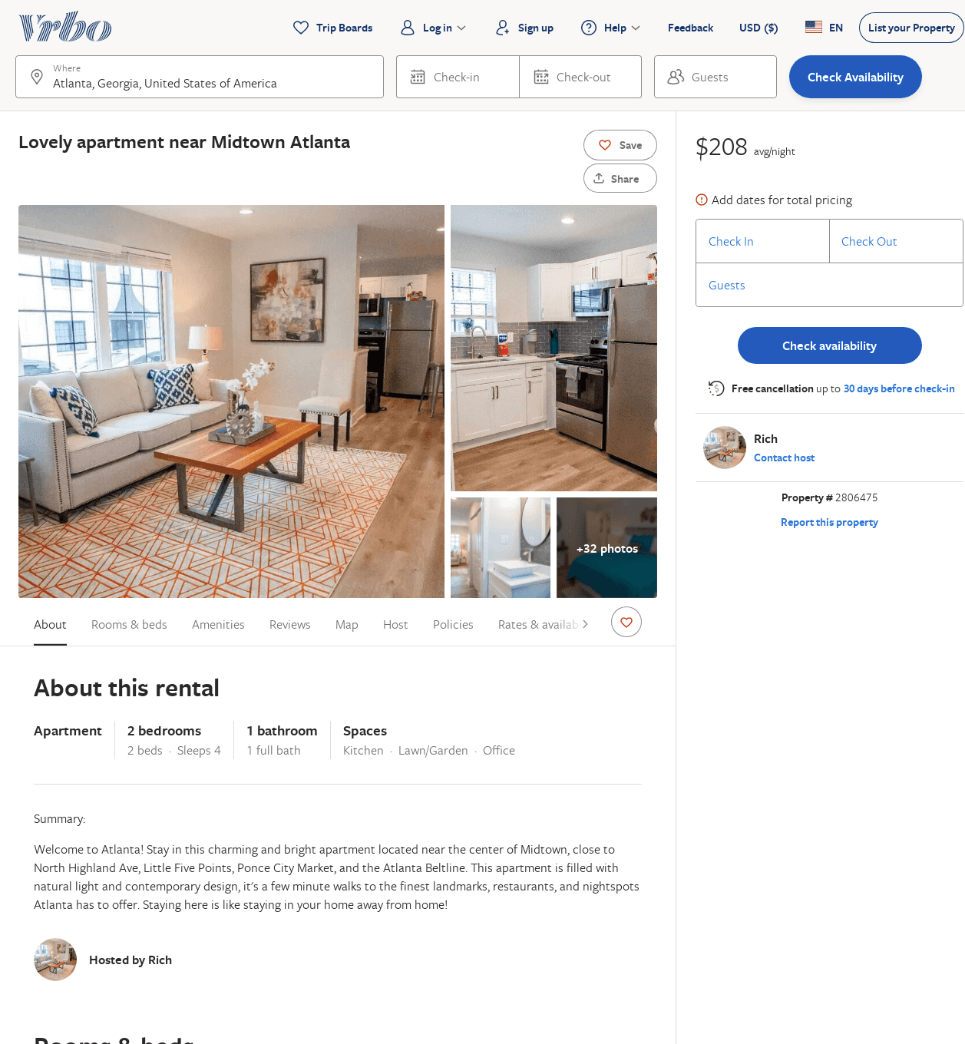
Listing 2806475
2
4
$264
2
Rich
https://www.vrbo.com/2806475
Aug 2022

Slide 12
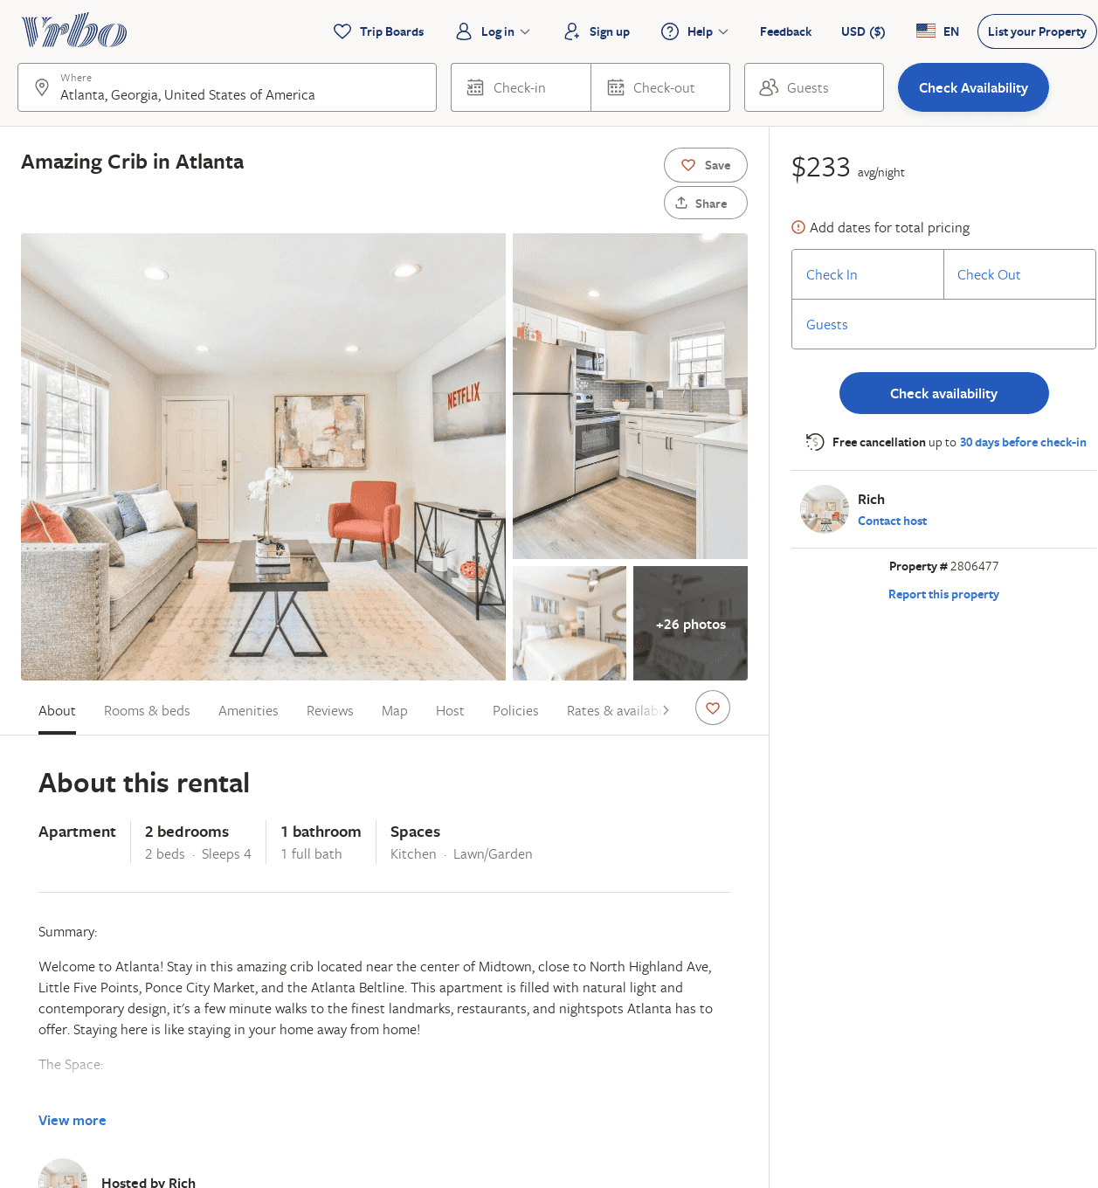
Listing 2806477
2
4
$271
2
Rich
https://www.vrbo.com/2806477
Aug 2022

Slide 13
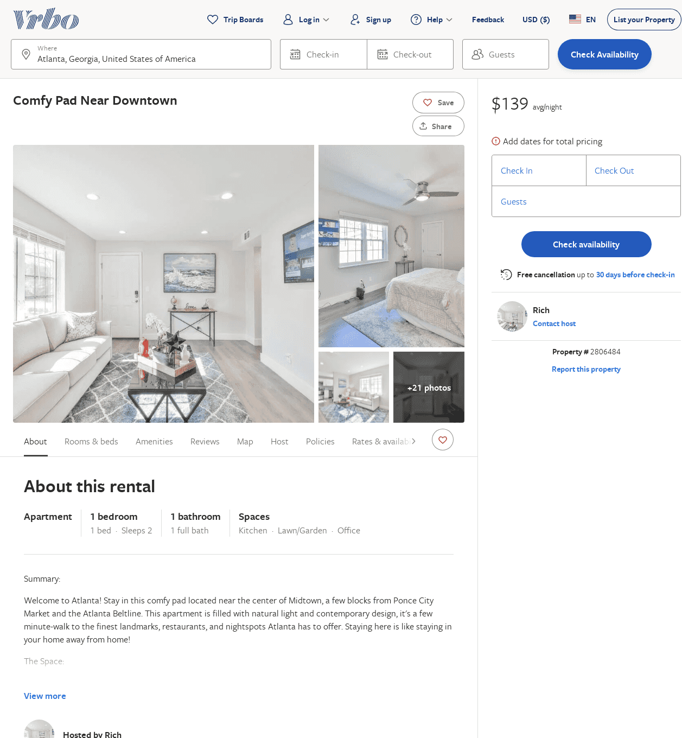
Listing 2806484
1
2
$176
2
Rich
https://www.vrbo.com/2806484
Aug 2022

