Slide 2
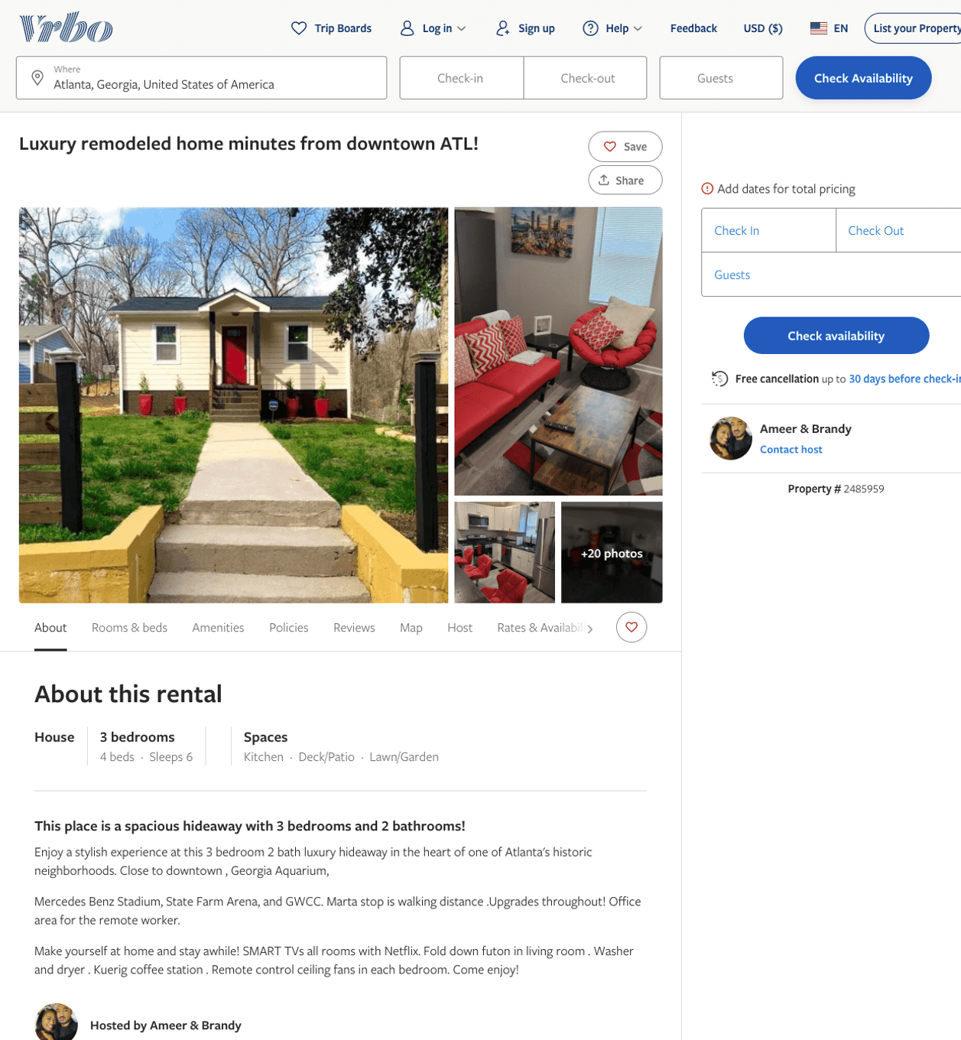
Listing 2485959
3
6
$151 - $260
5
2
Ameer & Brandy
https://www.vrbo.com/2485959
Aug 2022

Slide 3
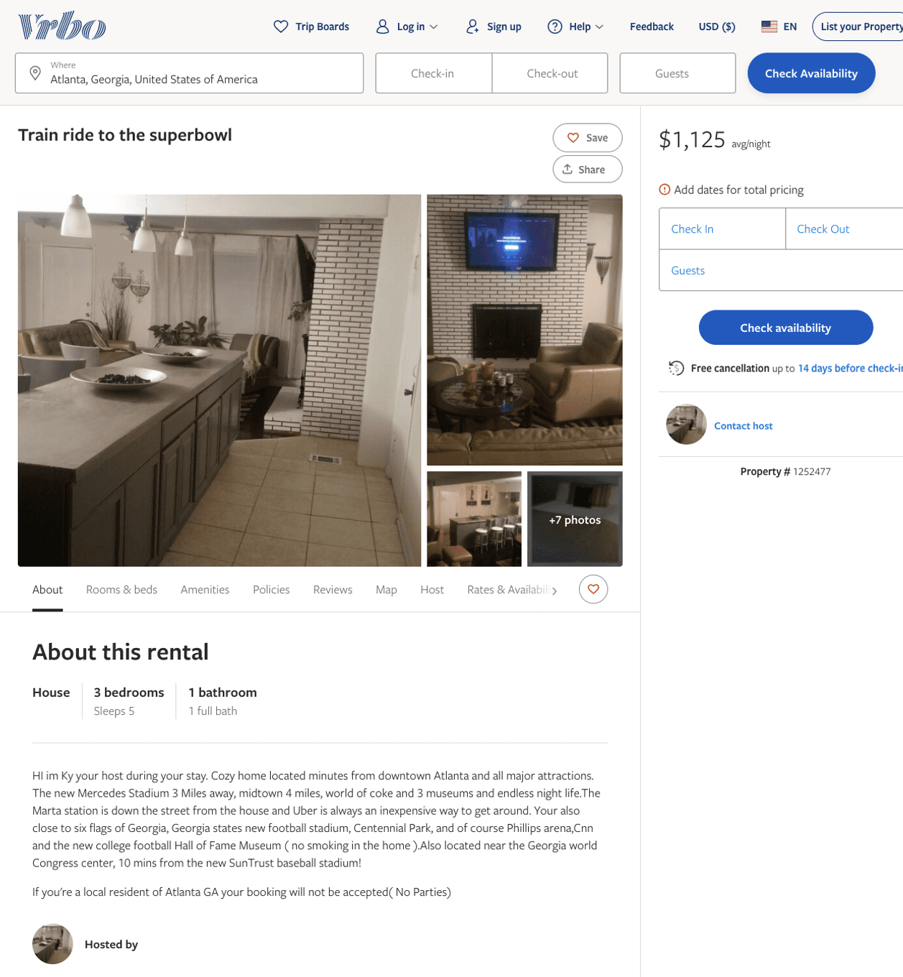
Listing 1252477
3
5
$1,125
5
https://www.vrbo.com/1252477
Aug 2022

Slide 4
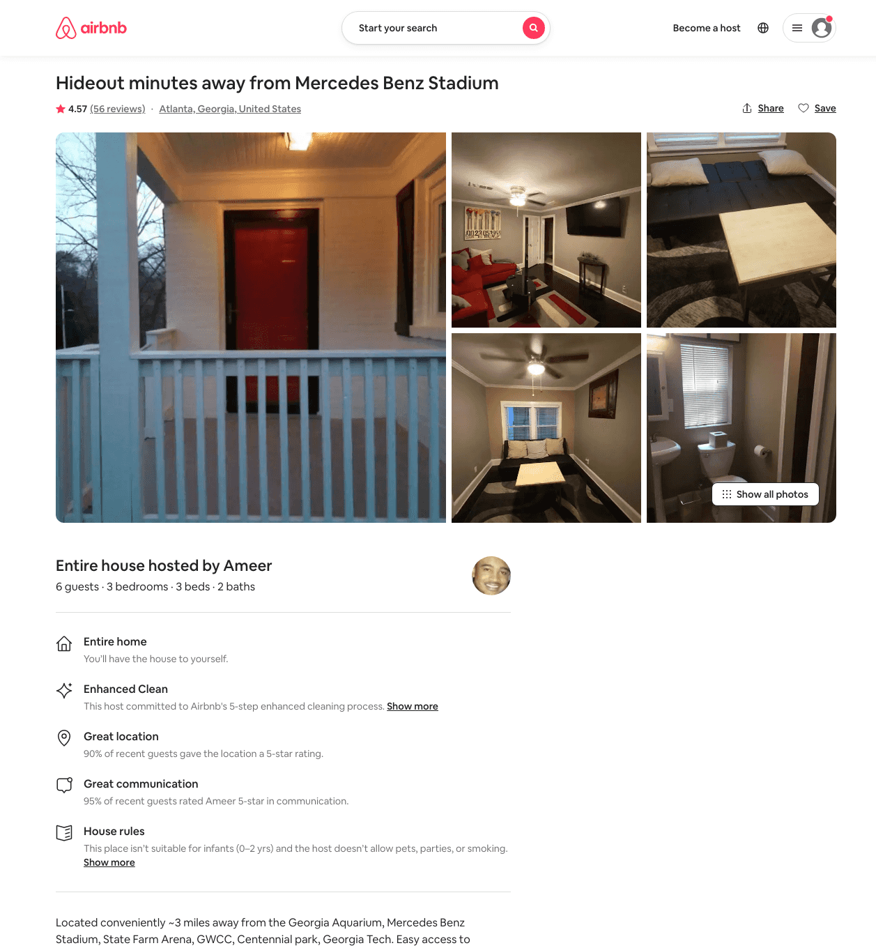
Listing 34231657
3
6
$139 - $250
4.59
2
Ameer & Brandy
109816166
2
https://www.airbnb.com/rooms/34231657
Aug 2022

Slide 5
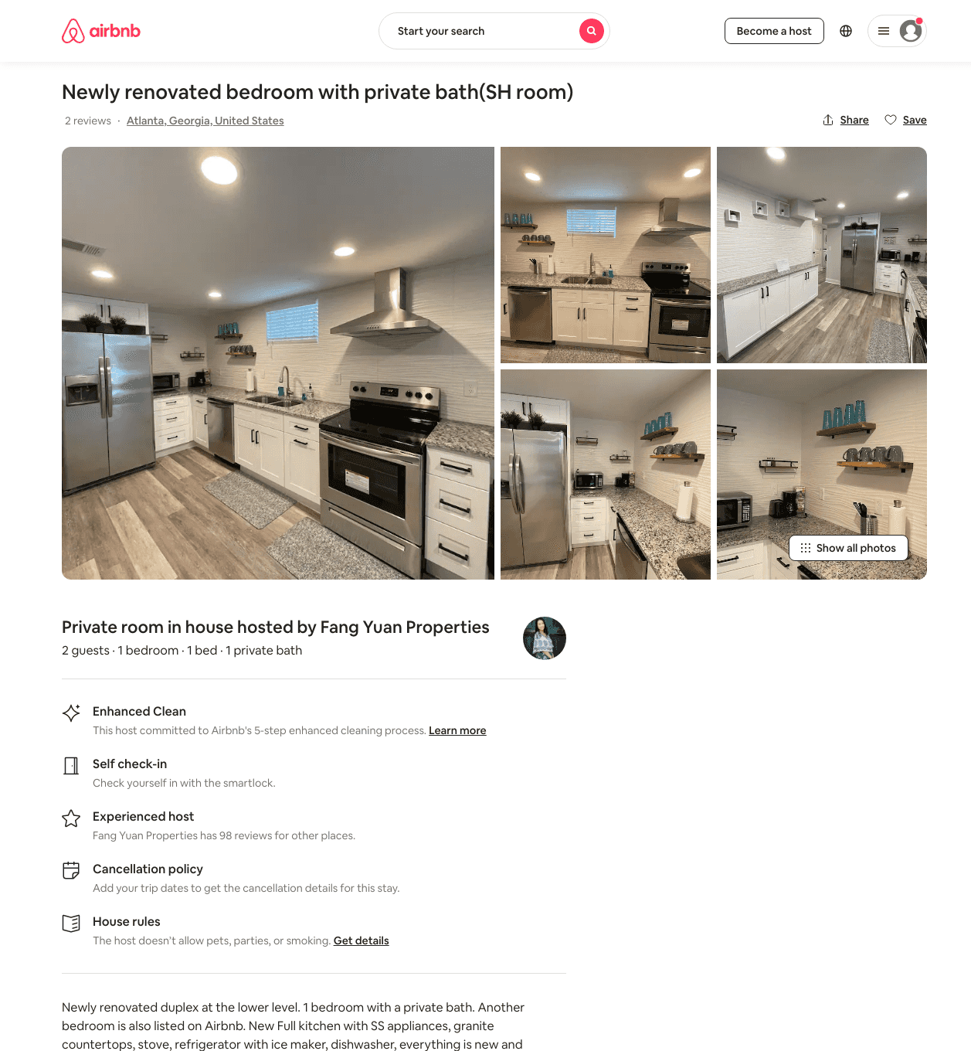
Listing 48602223
1
2
$43 - $69
4.72
1
Fang Yuan Properties
126122495
21
https://www.airbnb.com/rooms/48602223
Aug 2022

Slide 6
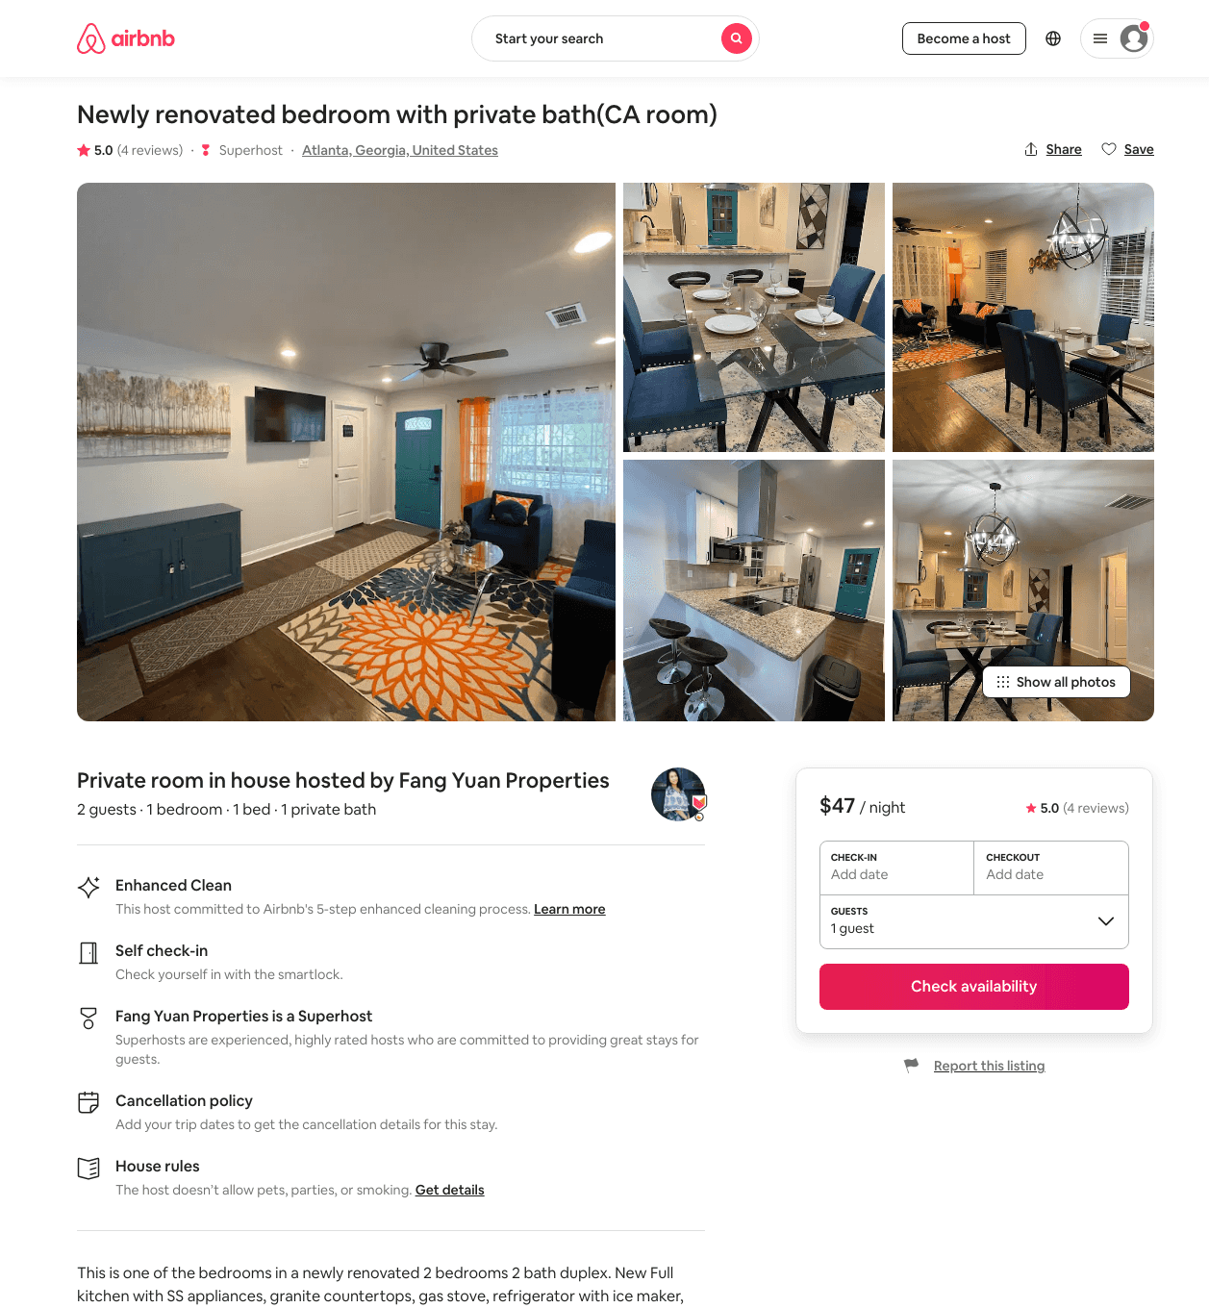
Listing 48487086
1
2
$43 - $65
4.67
1
Fang Yuan Properties
126122495
21
https://www.airbnb.com/rooms/48487086
Aug 2022

Slide 7
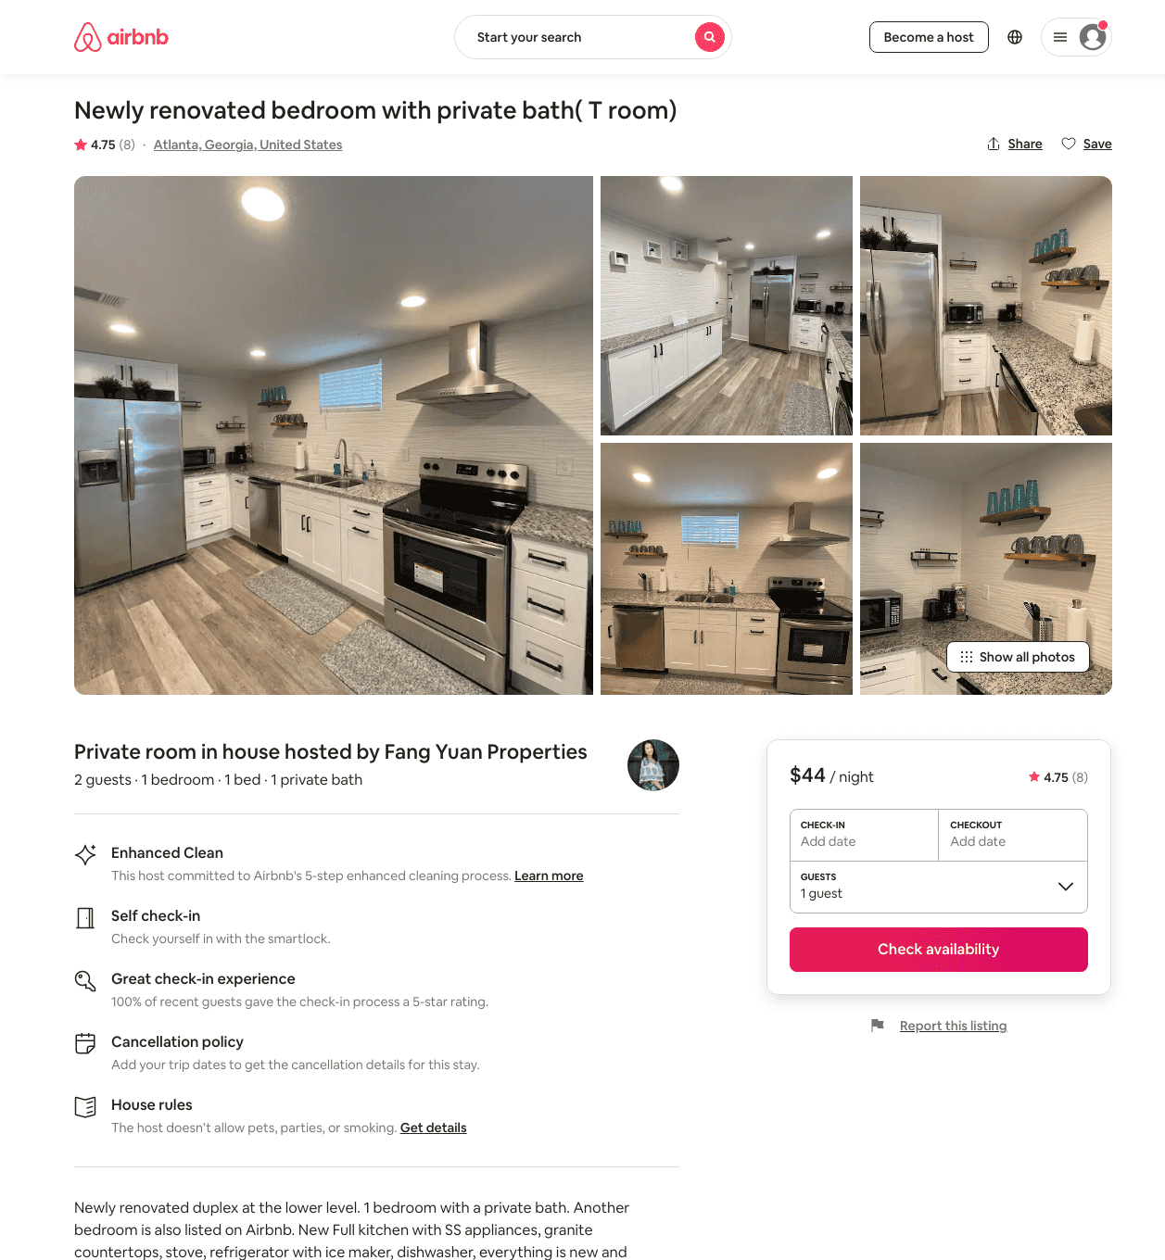
Listing 48507856
1
2
$42 - $76
4.79
1
Fang Yuan Properties
126122495
21
https://www.airbnb.com/rooms/48507856
Aug 2022

Slide 8
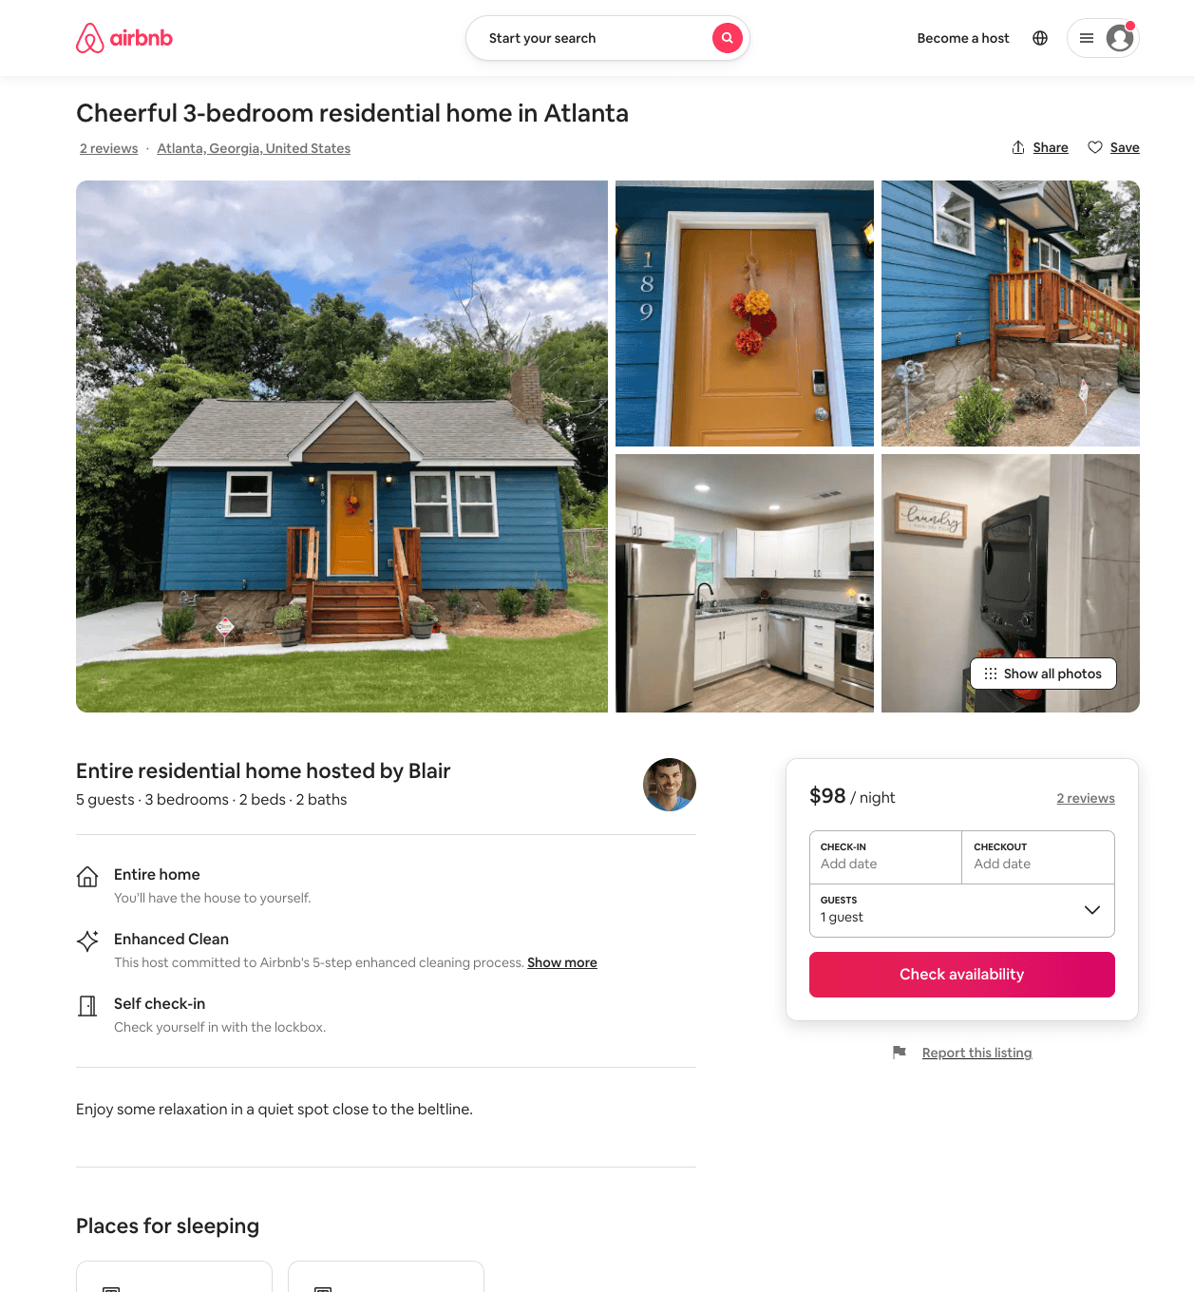
Listing 50807382
3
5
$98
5.0
1
Blair
217798065
2
https://www.airbnb.com/rooms/50807382
Aug 2022

Slide 9
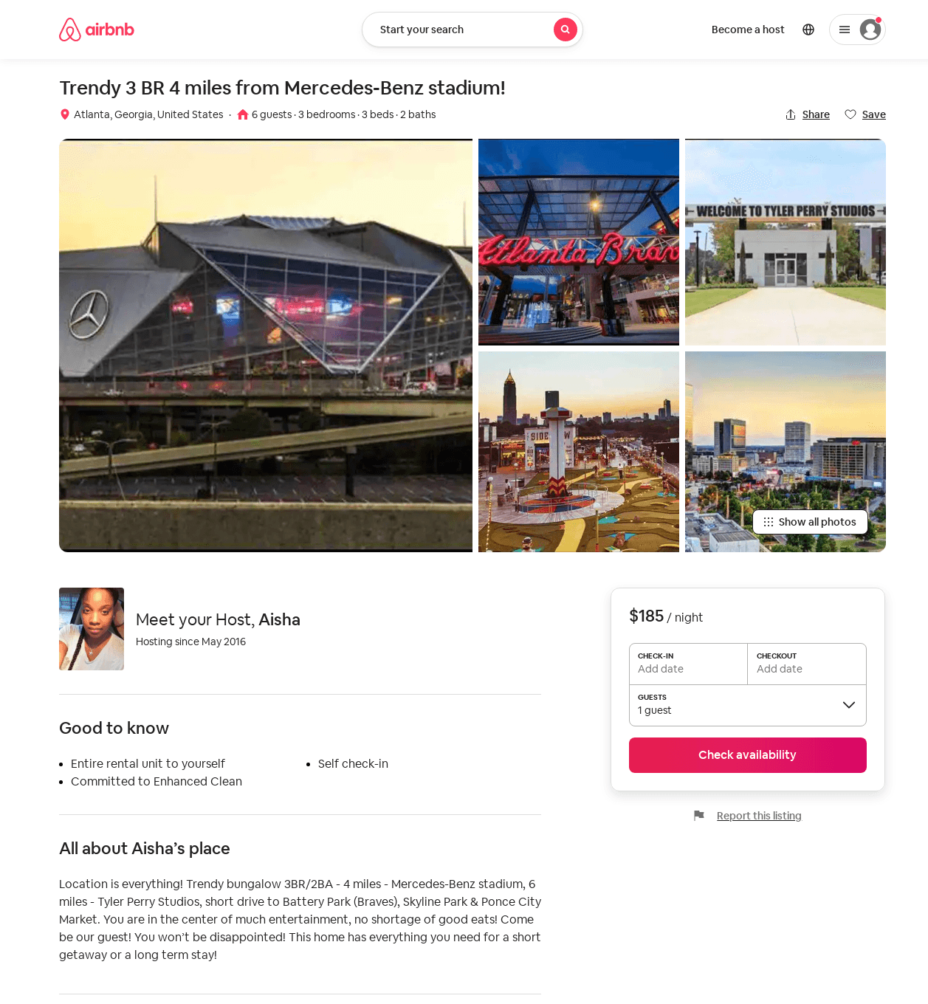
Listing 50396124
3
6
$134 - $267
4.70
2
Aisha
73761225
1
https://www.airbnb.com/rooms/50396124
Aug 2022

Slide 10
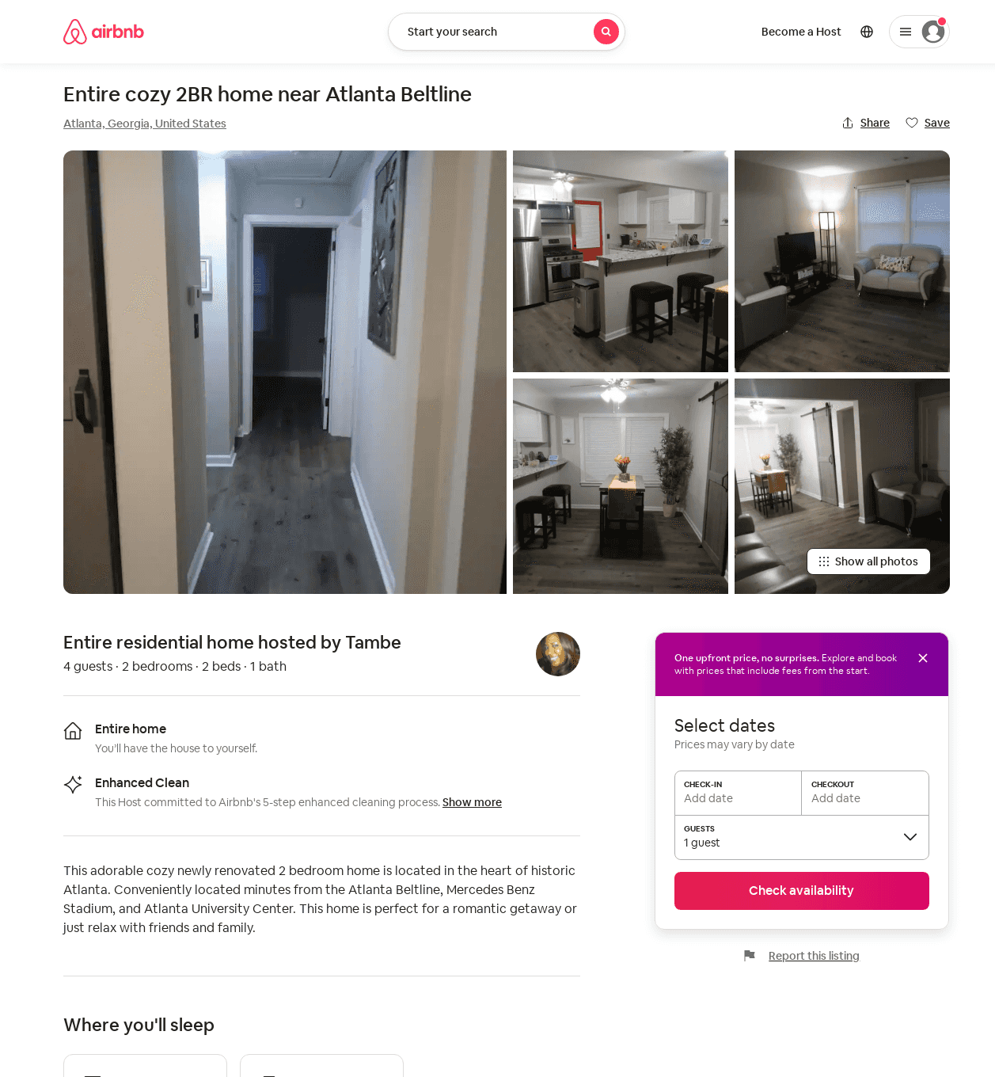
Listing 47741096
2
4
$72 - $109
4.58
1
Tambe
76743769
1
https://www.airbnb.com/rooms/47741096
Jun 2022

Slide 11
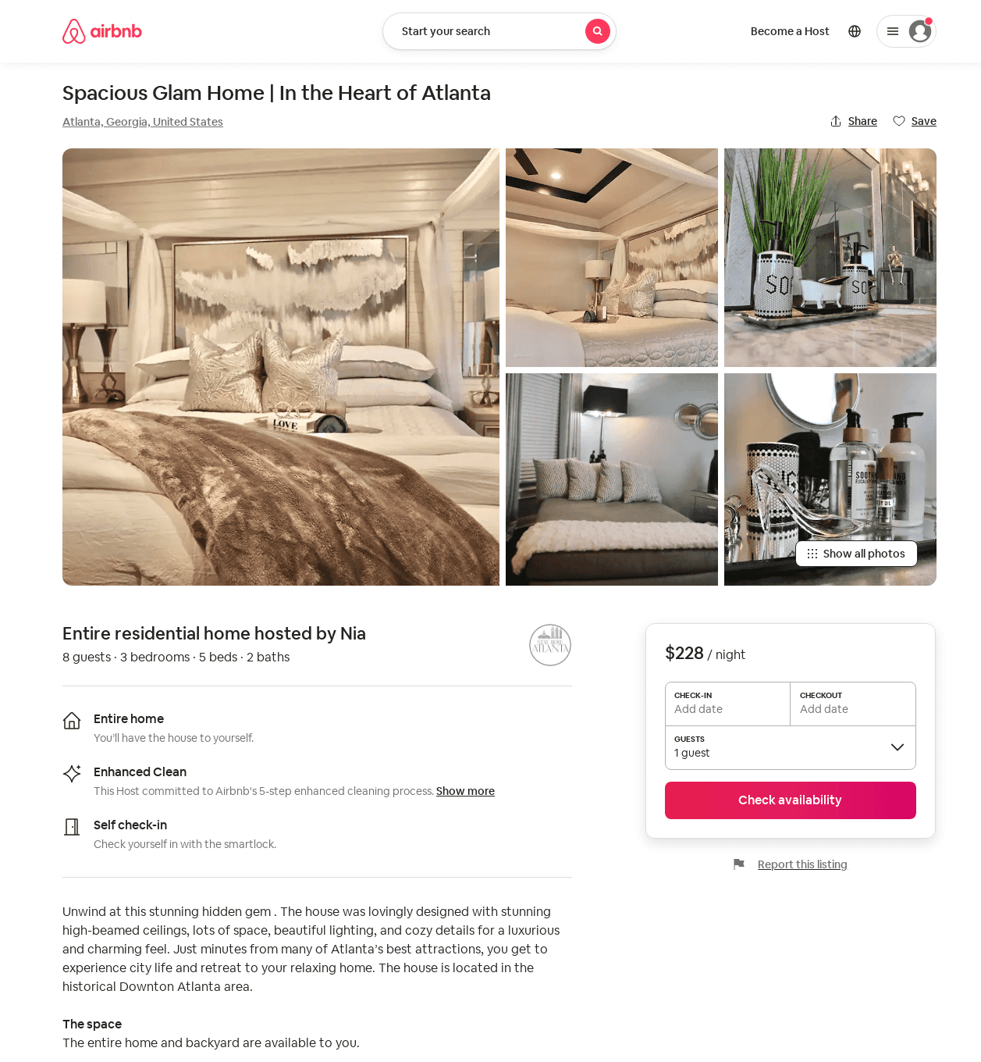
Listing 51311654
3
9
$168 - $328
4.98
2
Tammy
415561948
1
https://www.airbnb.com/rooms/51311654
Aug 2022

Slide 12
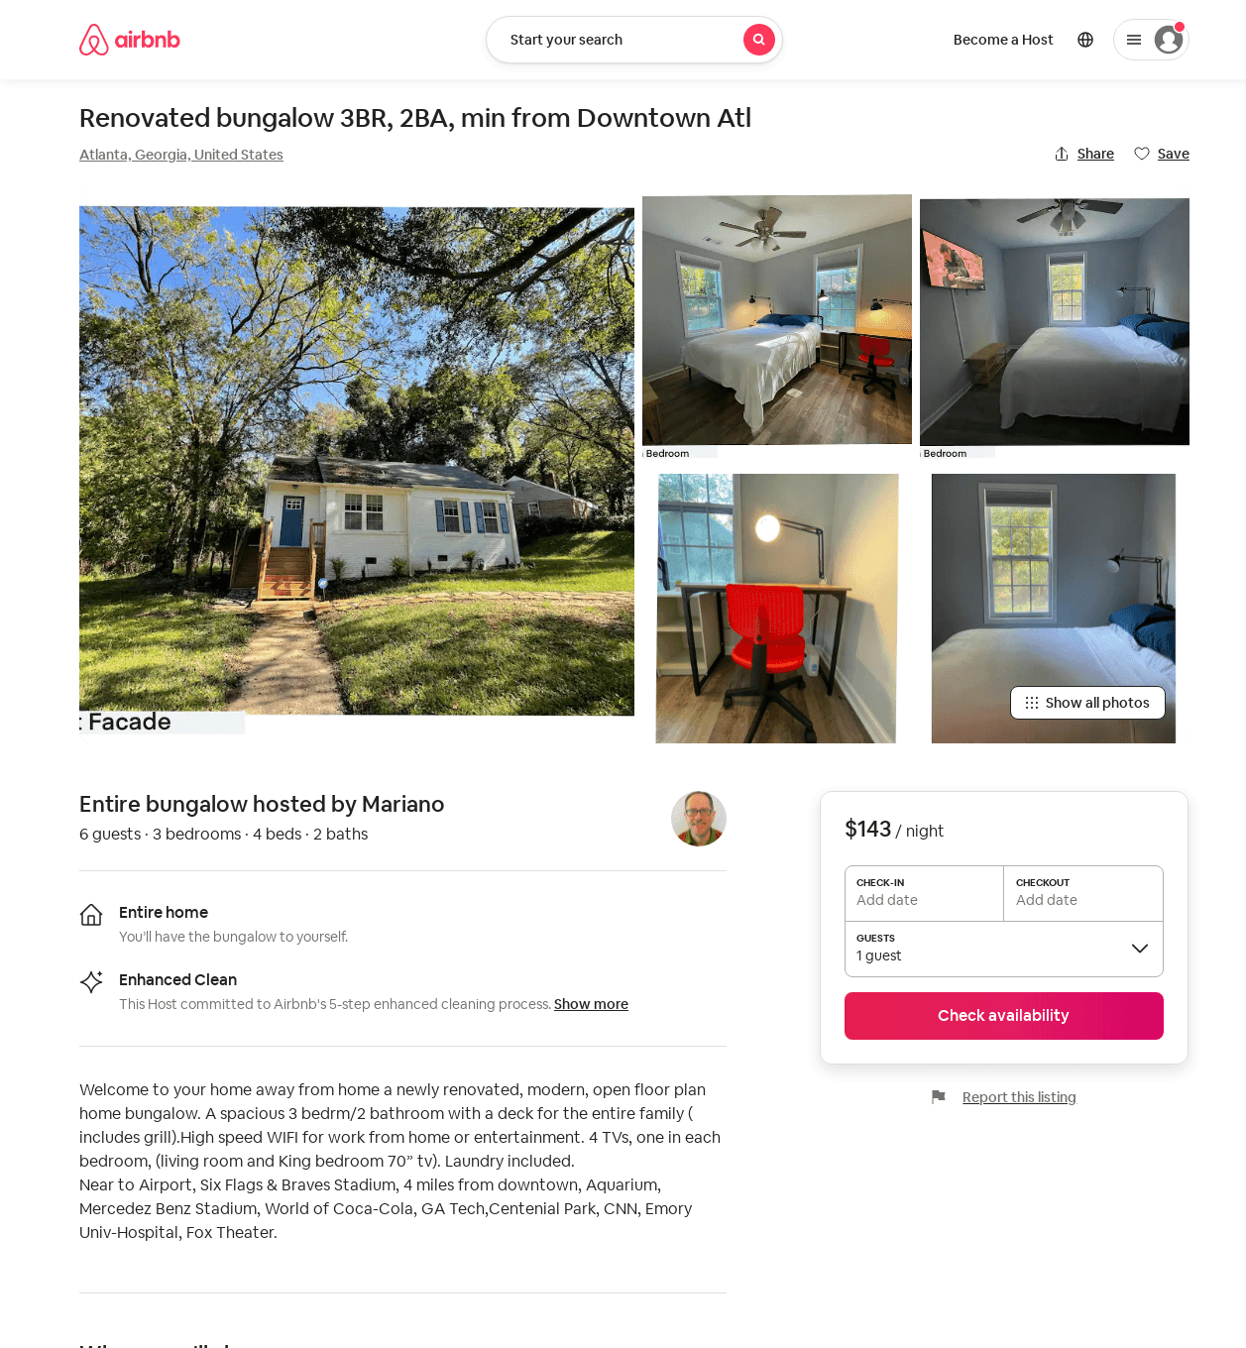
Listing 52914161
3
6
$104 - $148
4.91
2
Mariano
426525233
1
https://www.airbnb.com/rooms/52914161
Aug 2022

Slide 13
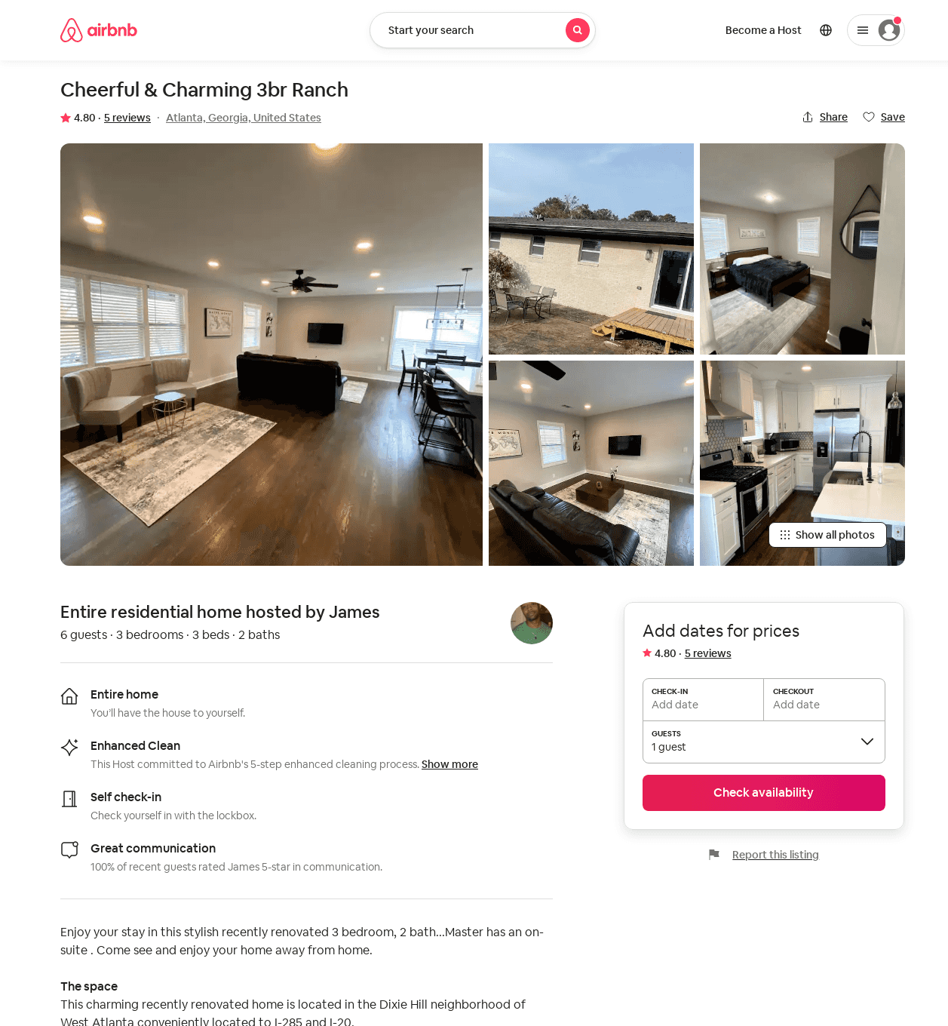
Listing 53747691
3
6
$110 - $141
4.78
1
James
51431332
1
https://www.airbnb.com/rooms/53747691
Aug 2022

Slide 14
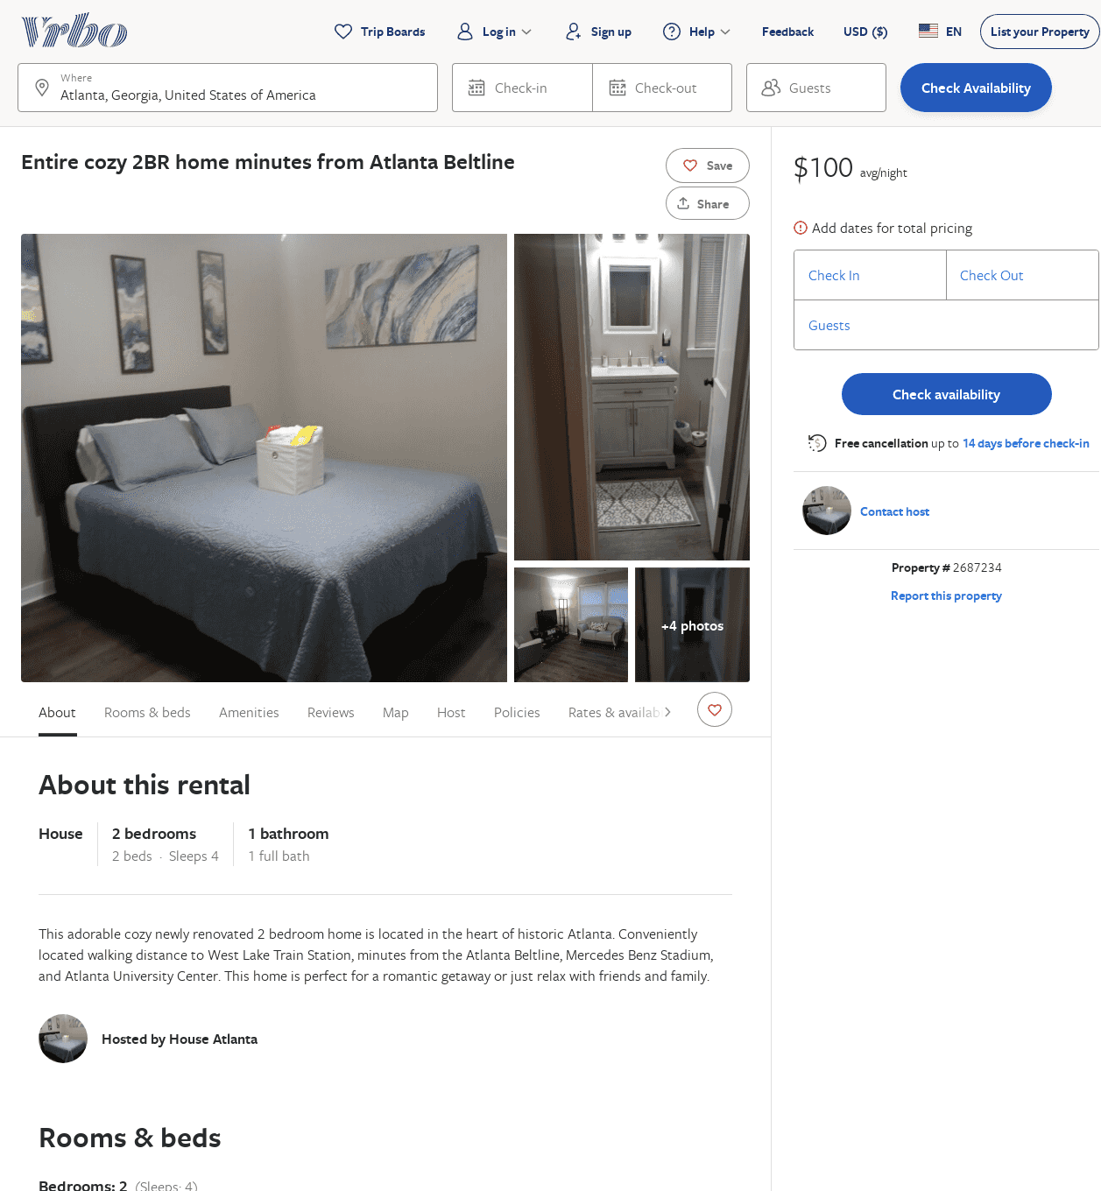
Listing 2687234
2
4
$125
5
1
https://www.vrbo.com/2687234
Aug 2022

Slide 15
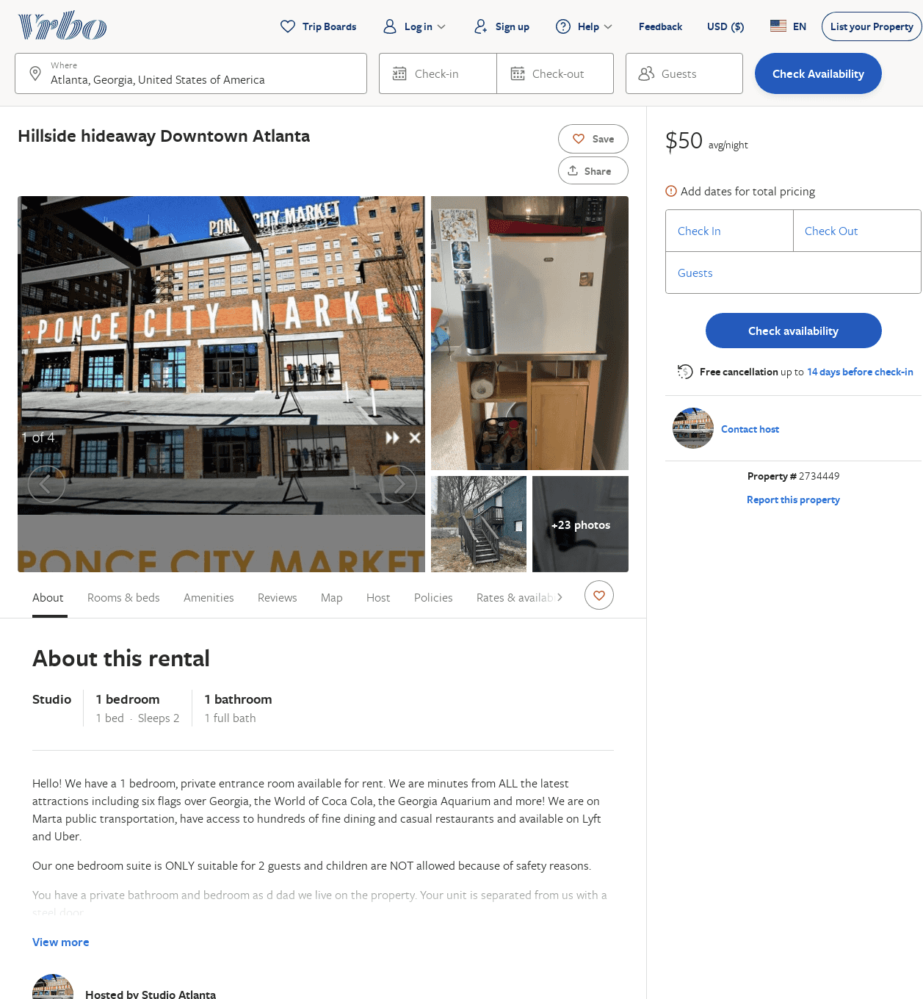
Listing 2734449
1
2
$50
1
https://www.vrbo.com/2734449
Aug 2022

Slide 16
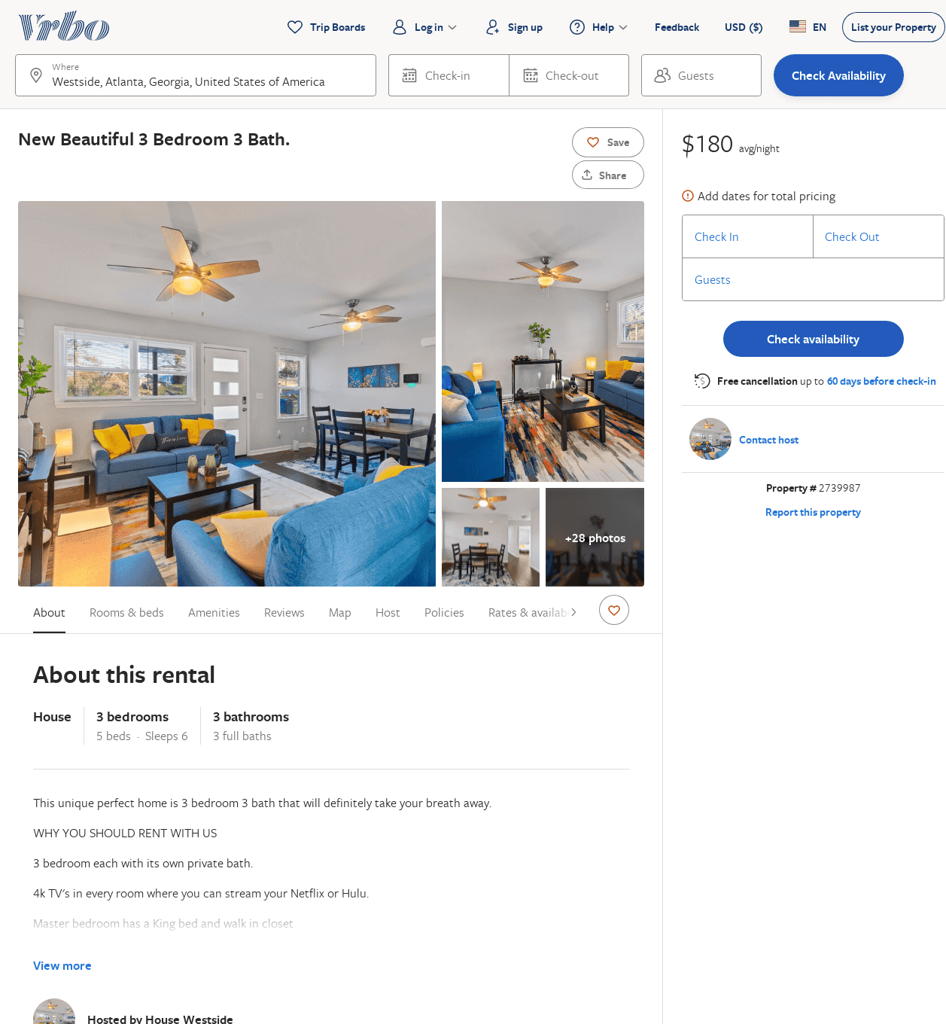
Listing 2739987
3
6
$180
2
ALEX
https://www.vrbo.com/2739987
Aug 2022

Slide 17
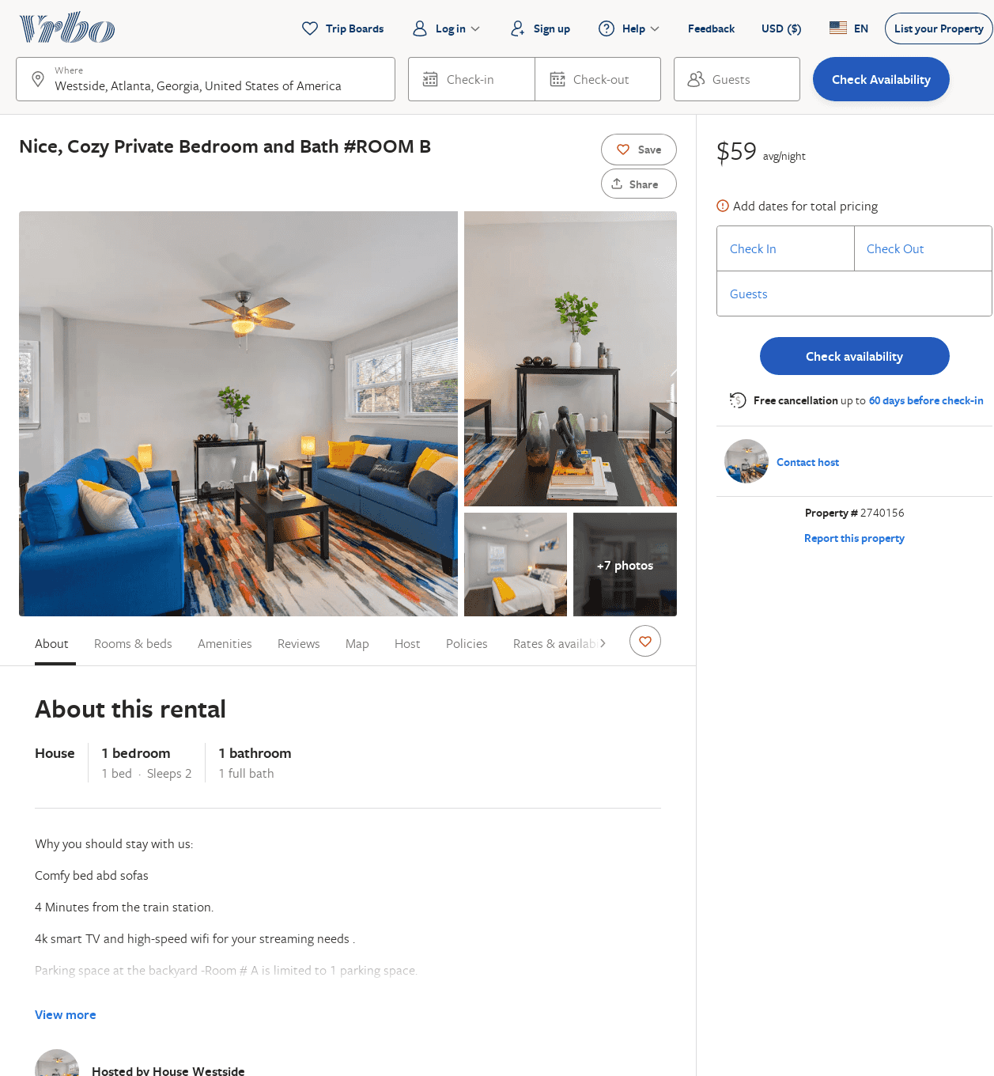
Listing 2740156
1
2
$58
4.142857
2
ALEX
https://www.vrbo.com/2740156
Aug 2022

Slide 18
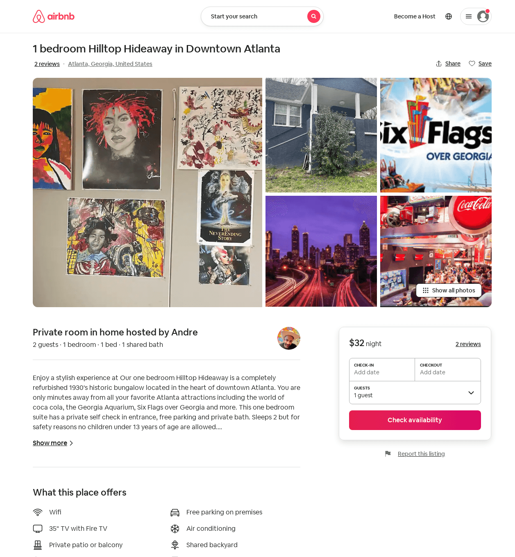
Listing 54231590
1
2
$32 - $46
4.86
1
Andre
416729012
1
https://www.airbnb.com/rooms/54231590
Aug 2022

Slide 19
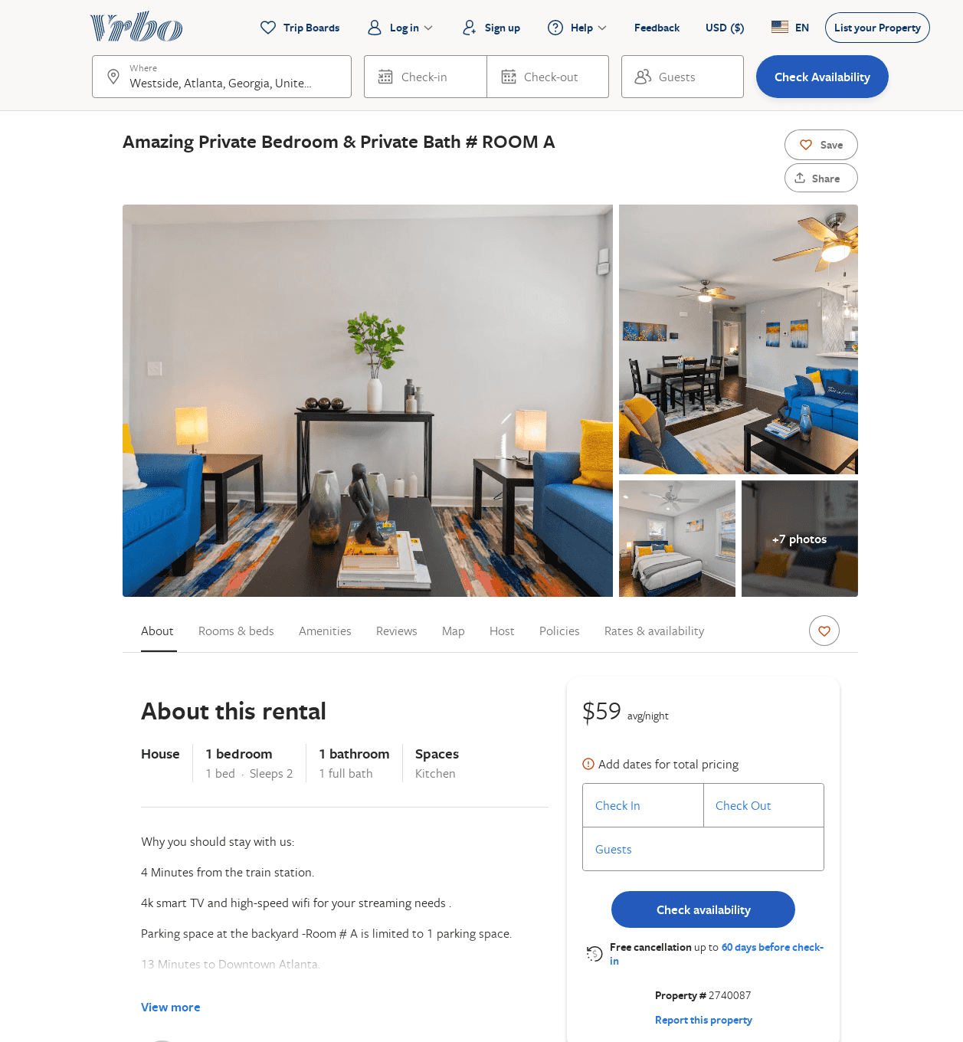
Listing 2740087
1
2
$59
5
2
ALEX
https://www.vrbo.com/2740087
Aug 2022

Slide 20
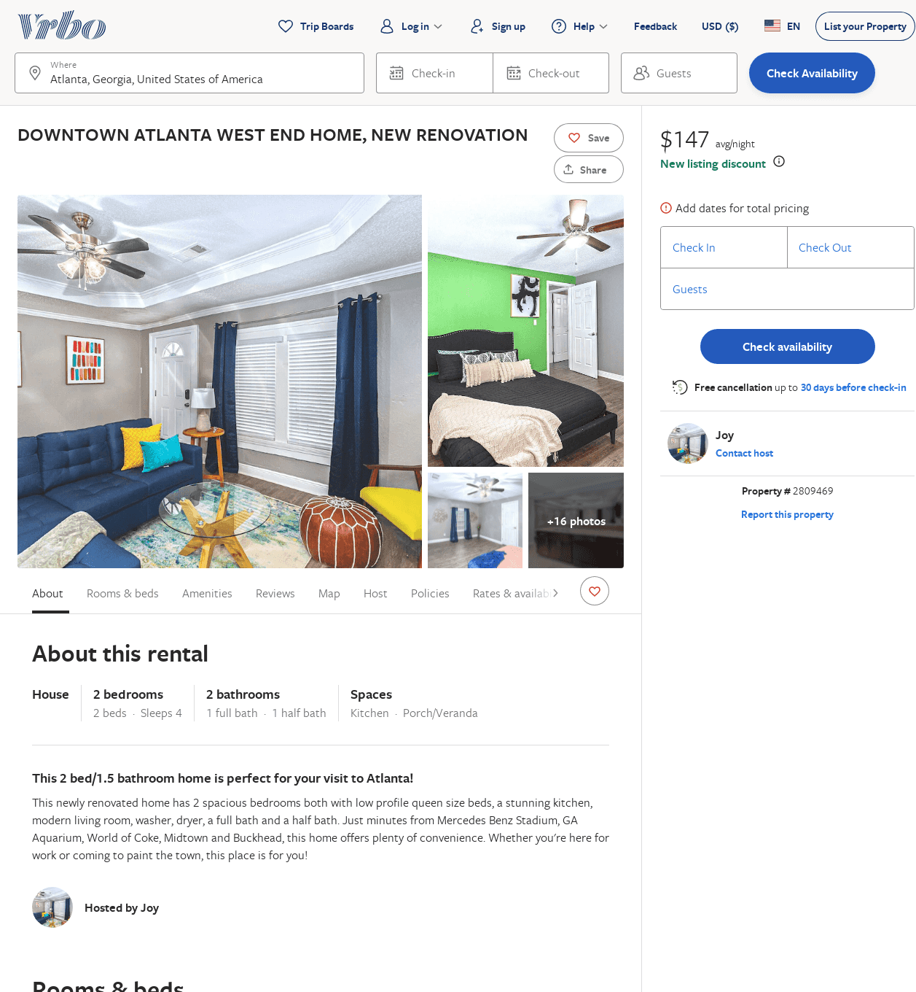
Listing 2809469
2
4
$143
5
3
Joy
https://www.vrbo.com/2809469
Aug 2022

Slide 21
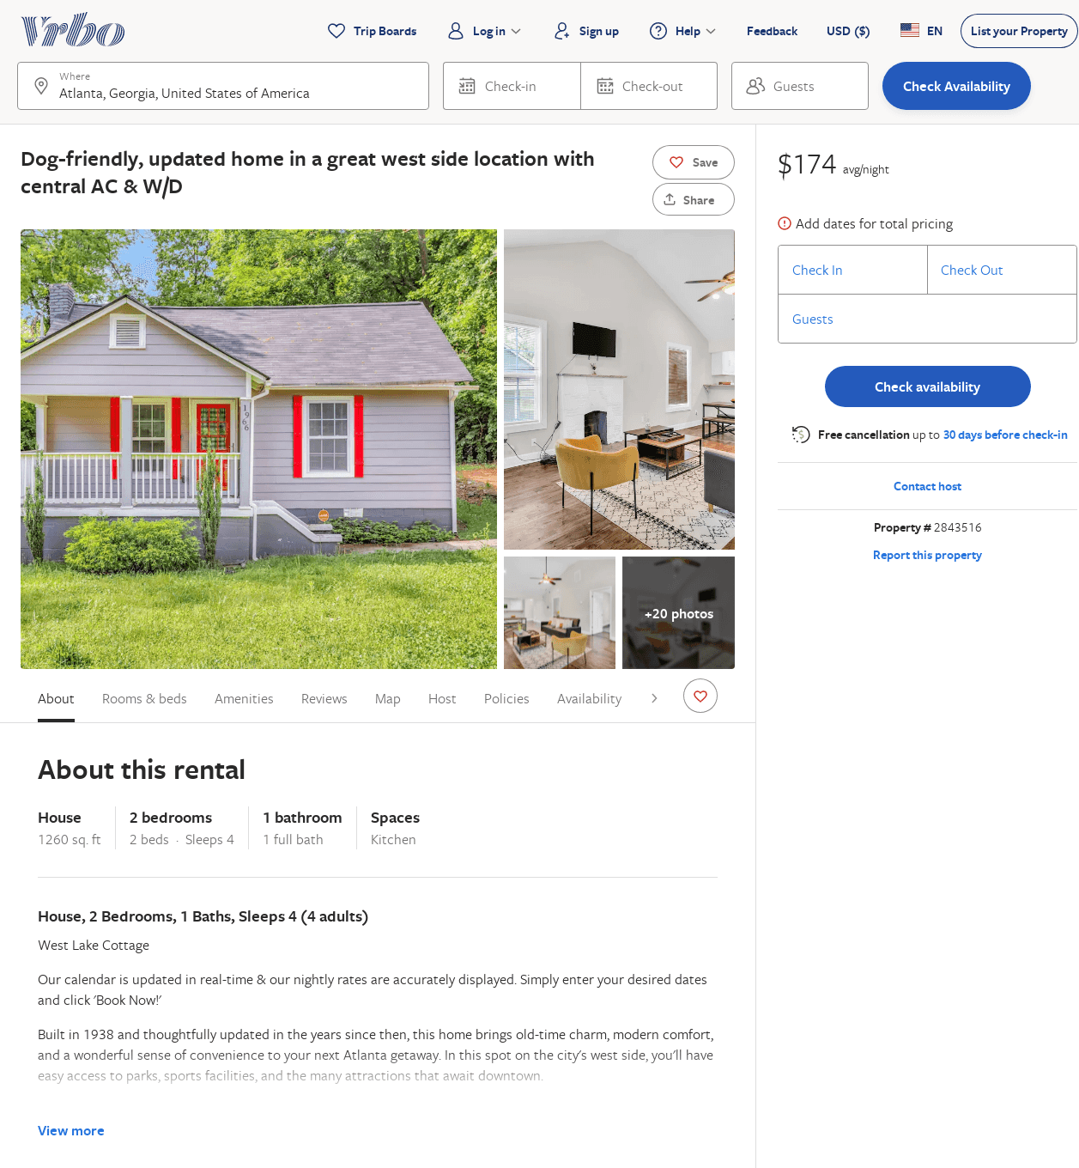
Listing 2843516
2
4
$122
2
Vacasa of Georgia
https://www.vrbo.com/2843516
Aug 2022

Slide 22
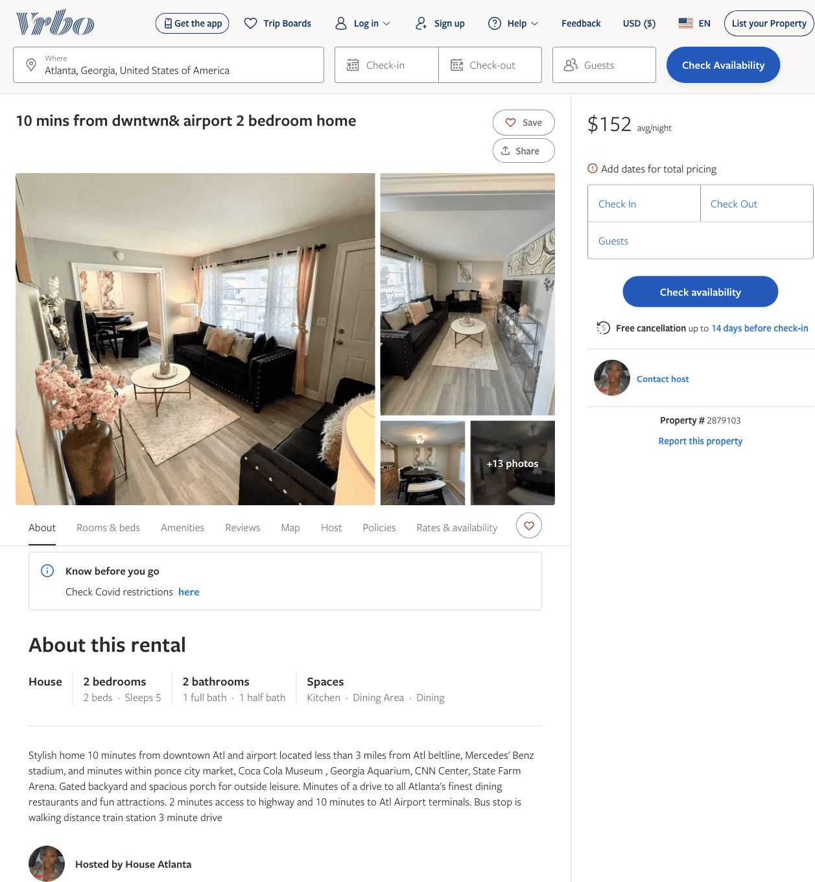
Listing 2879103
2
5
$152
2
https://www.vrbo.com/2879103
Aug 2022

Slide 23
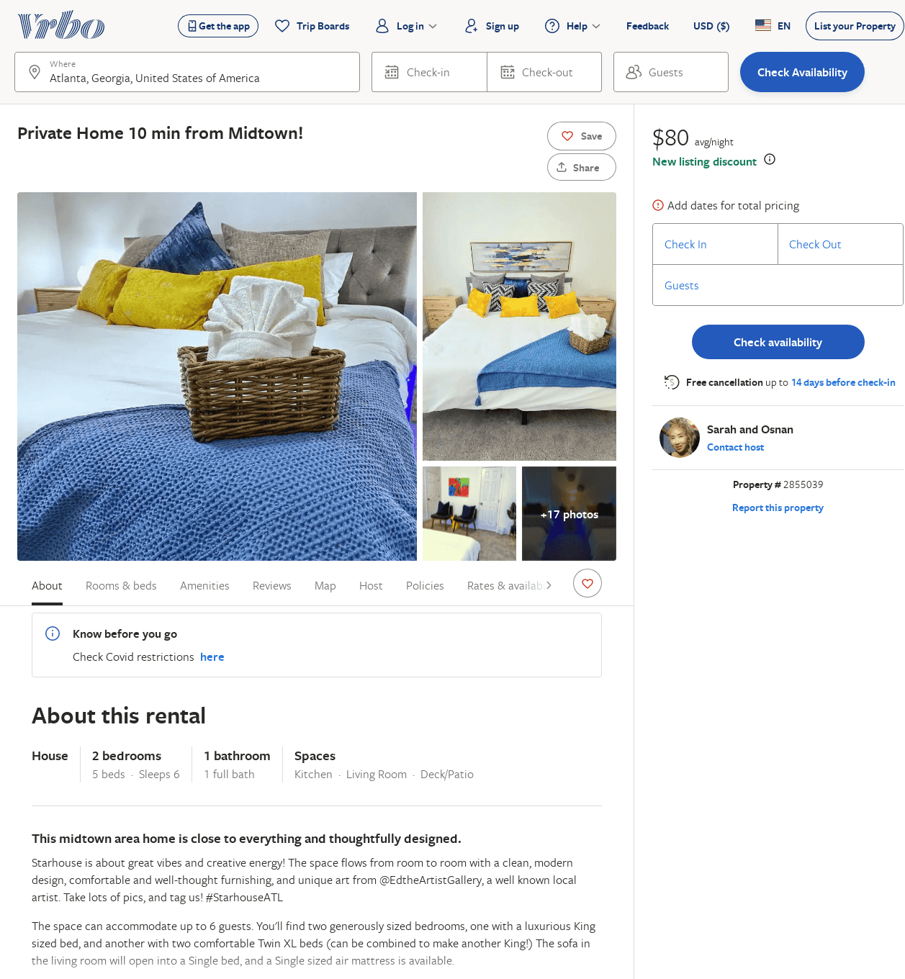
Listing 2855039
2
6
$80
4
Sarah and Osnan
https://www.vrbo.com/2855039
Aug 2022

