Slide 2
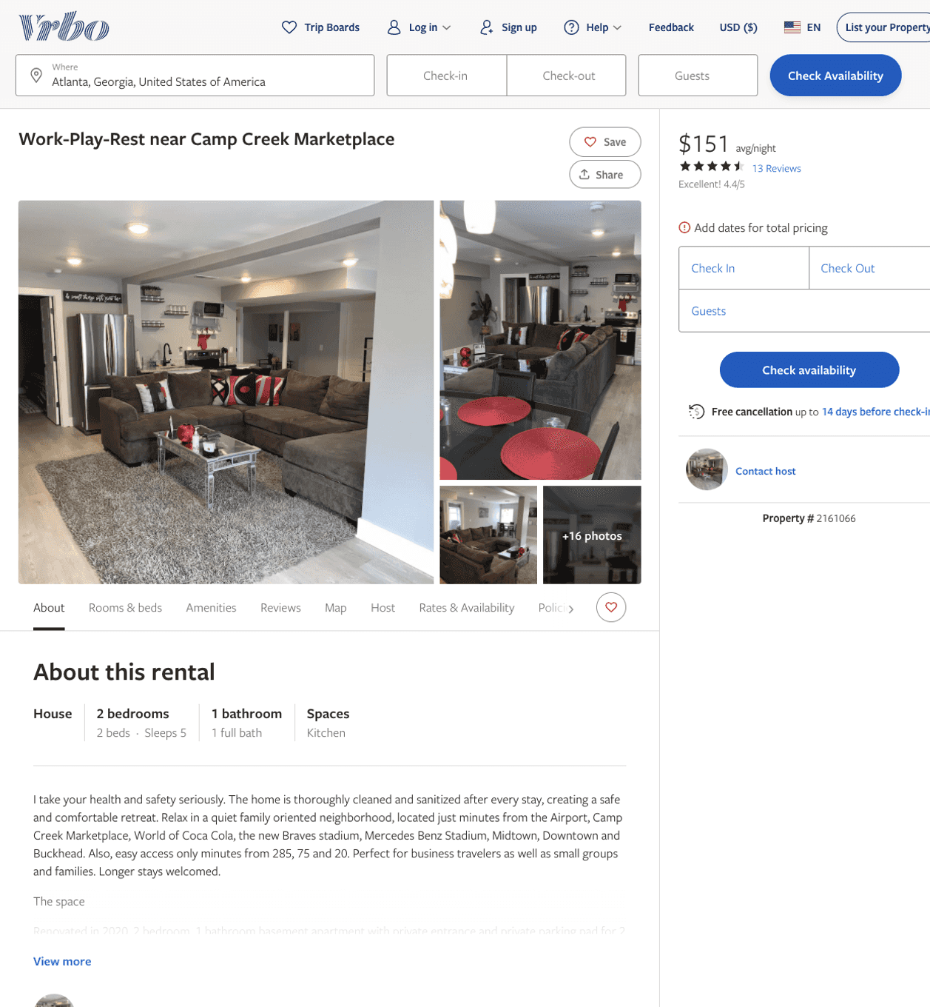
Listing 2161066
2
5
$118 - $161
4.470588
2
https://www.vrbo.com/2161066
Aug 2022

Slide 3
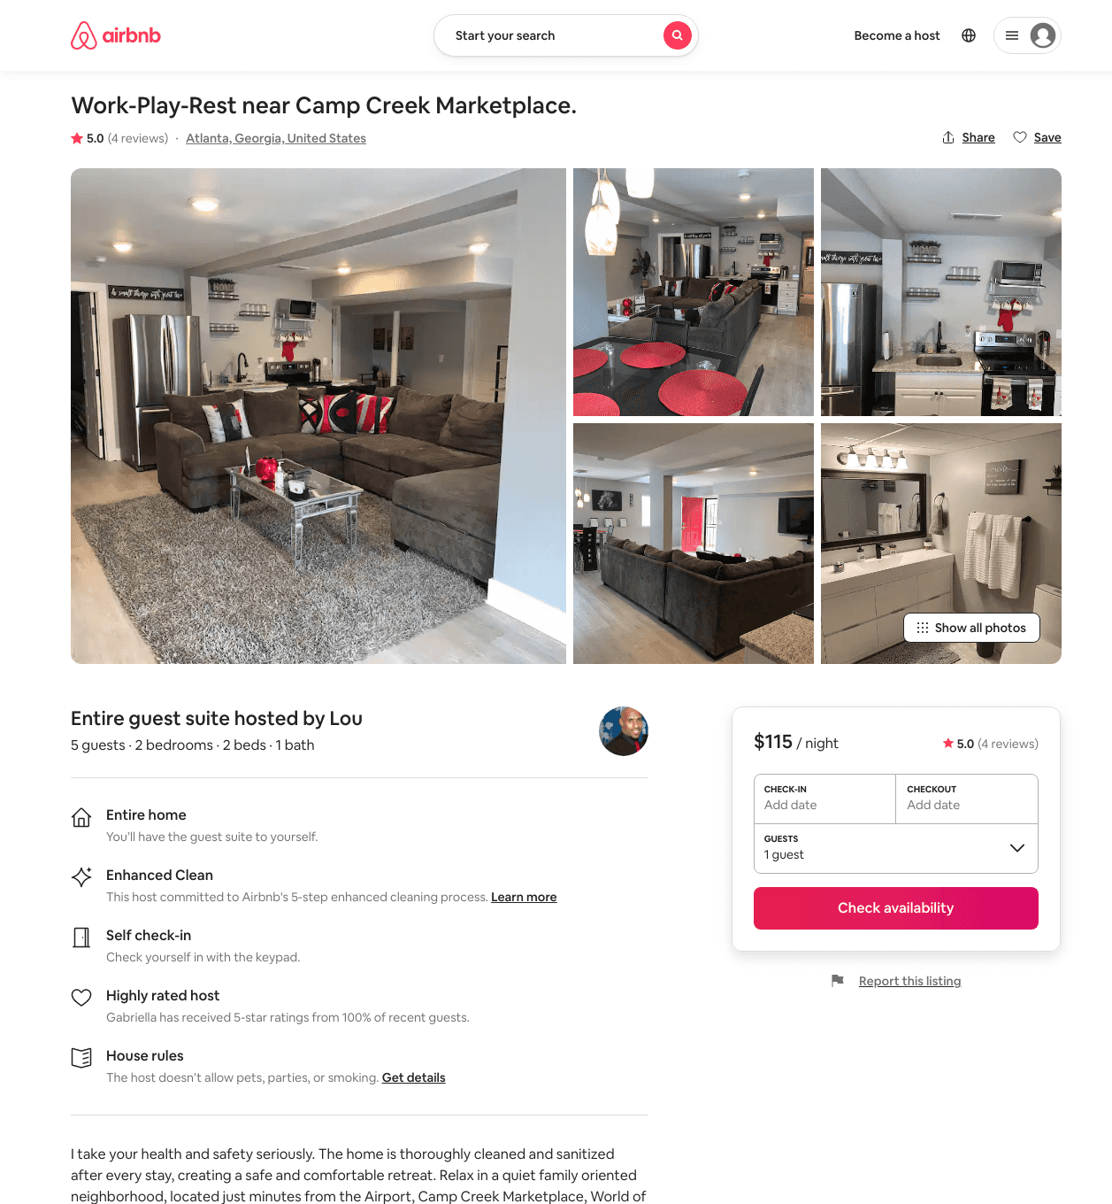
Listing 46637547
2
5
$99 - $115
4.80
3
Lou
220075781
1
https://www.airbnb.com/rooms/46637547
Aug 2022

Slide 4
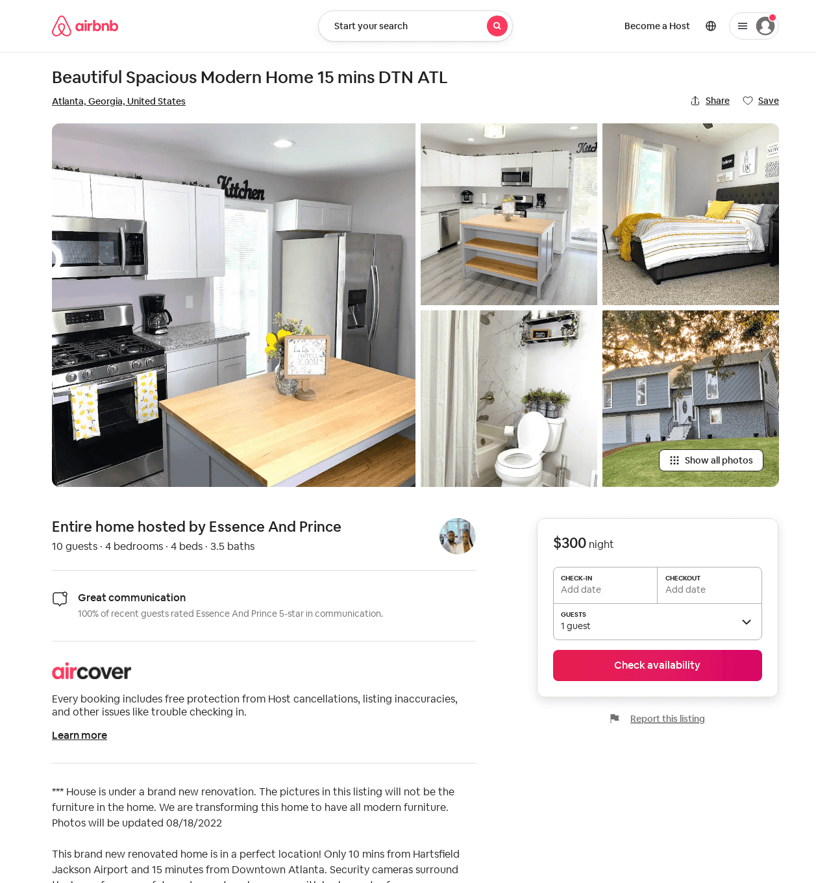
Listing 45286418
4
10
3
Essence And Prince
365980901
1
https://www.airbnb.com/rooms/45286418
Aug 2022

