Slide 2
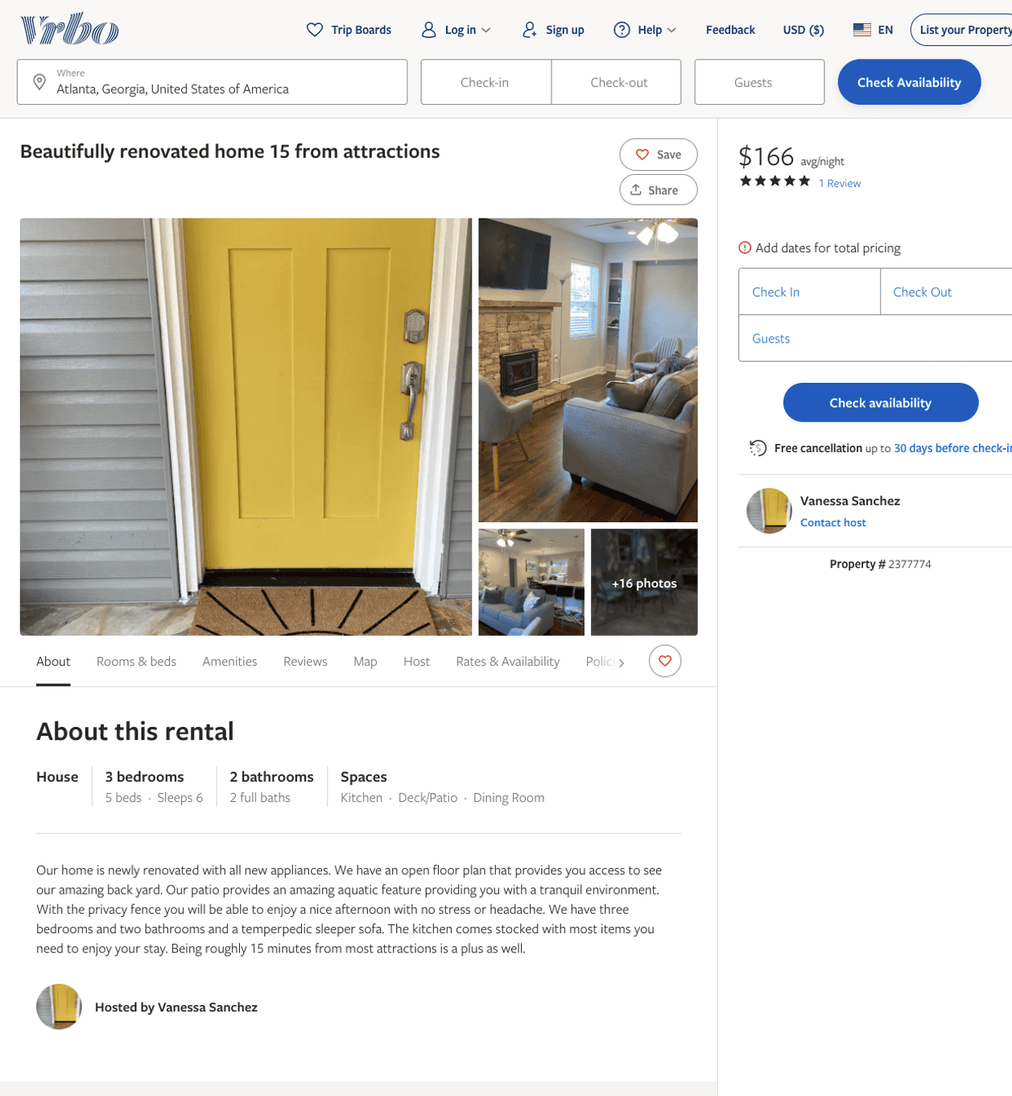
Listing 2377774
3
6
$170 - $250
4.6666665
2
Vanessa Sanchez
https://www.vrbo.com/2377774
Aug 2022

Slide 3
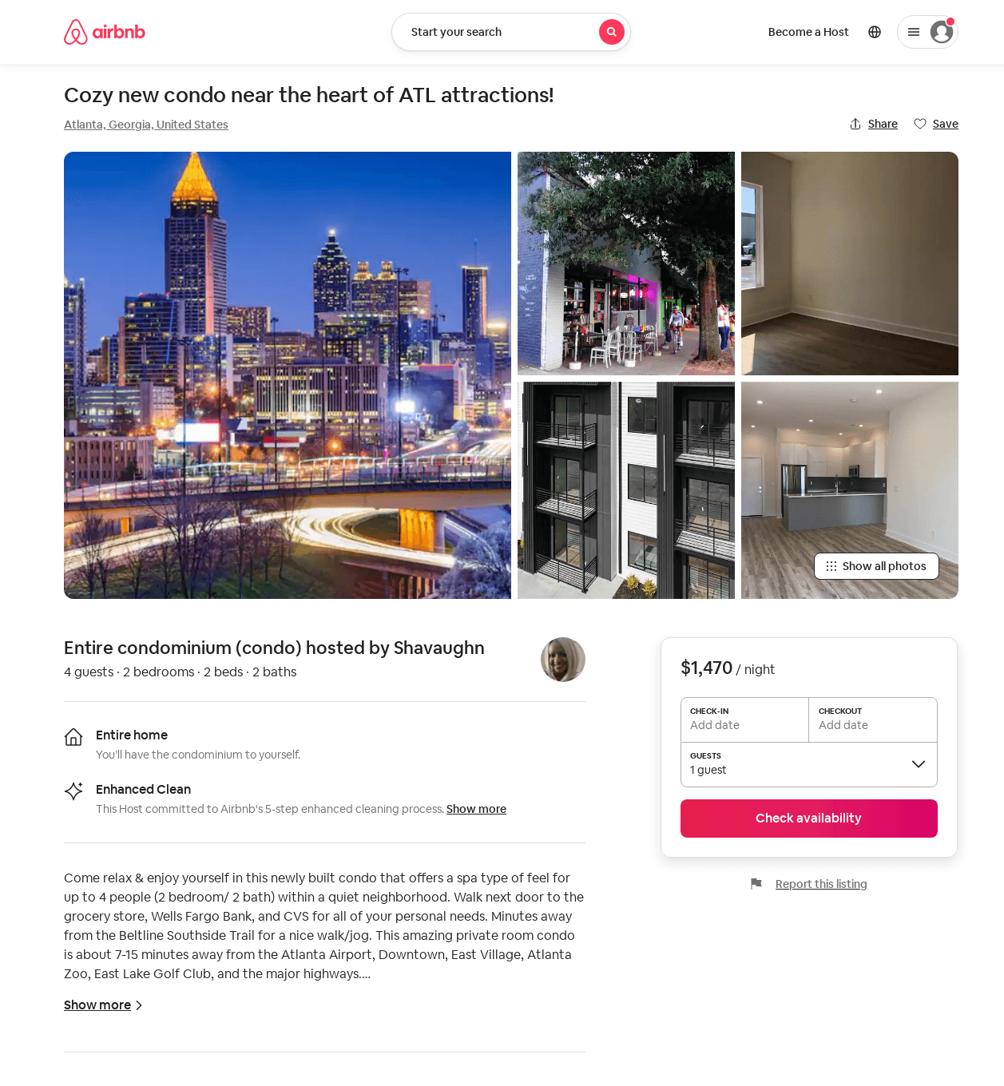
Listing 53384435
1
2
$82 - $1470
1
Shavaughn
432234906
2
https://www.airbnb.com/rooms/53384435
Aug 2022

Slide 4
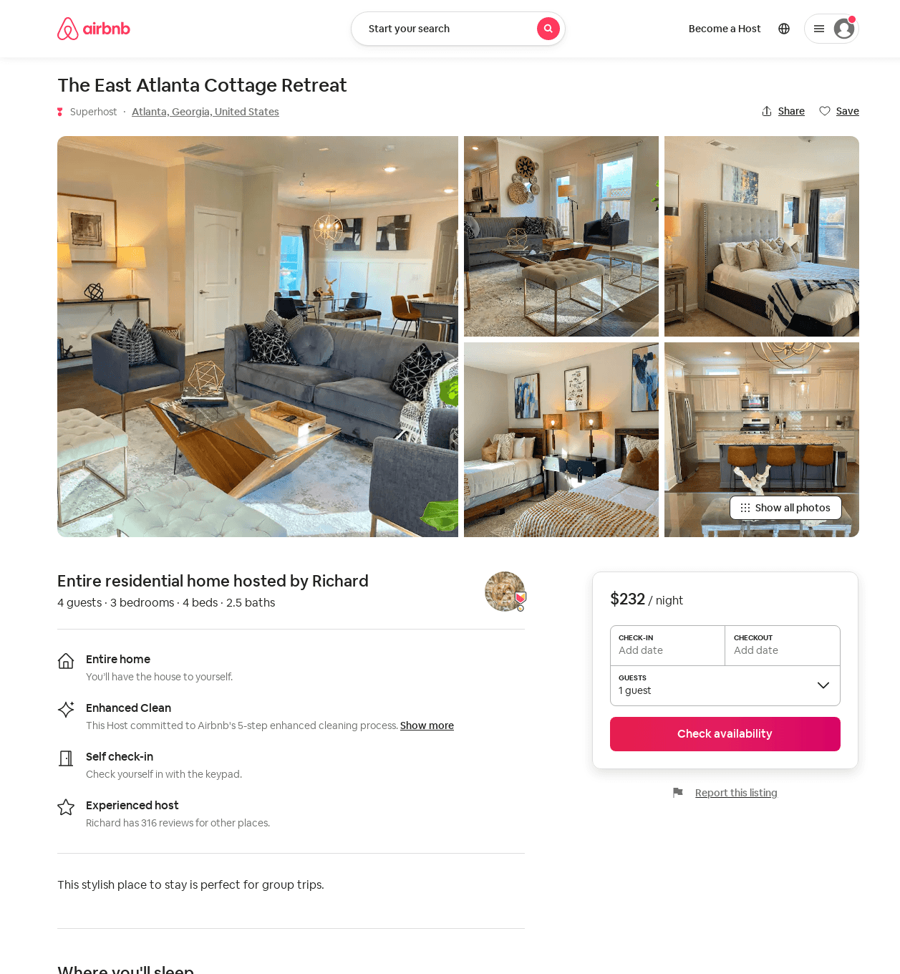
Listing 53903627
3
4
$170 - $264
4.73
1
Richard
309516005
5
https://www.airbnb.com/rooms/53903627
Aug 2022

Slide 5
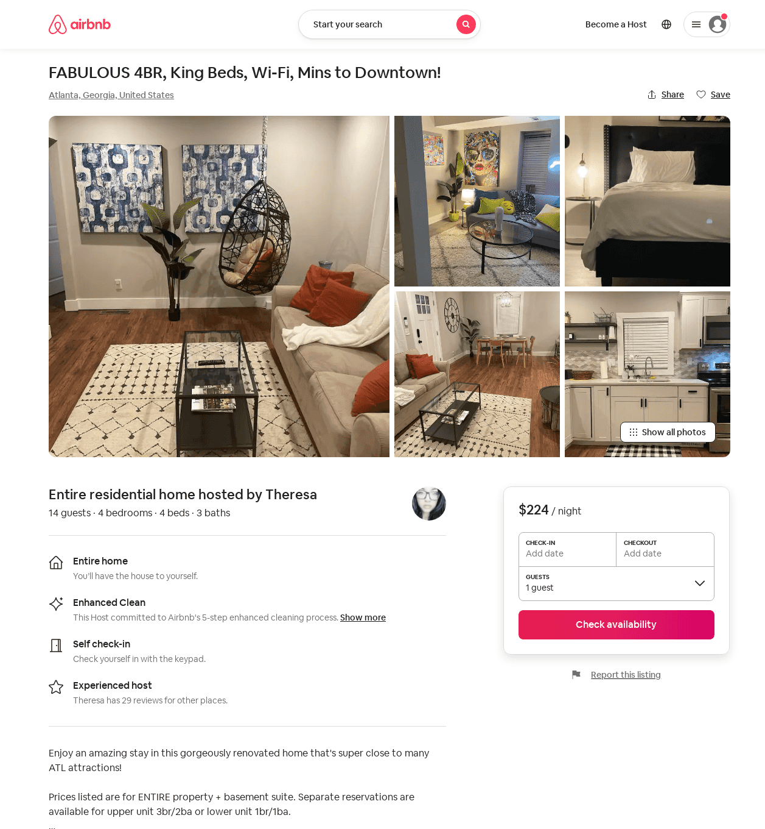
Listing 53941141
3
13
$149 - $334
4.90
1
Theresa
357521693
2
https://www.airbnb.com/rooms/53941141
Jun 2022

Slide 6
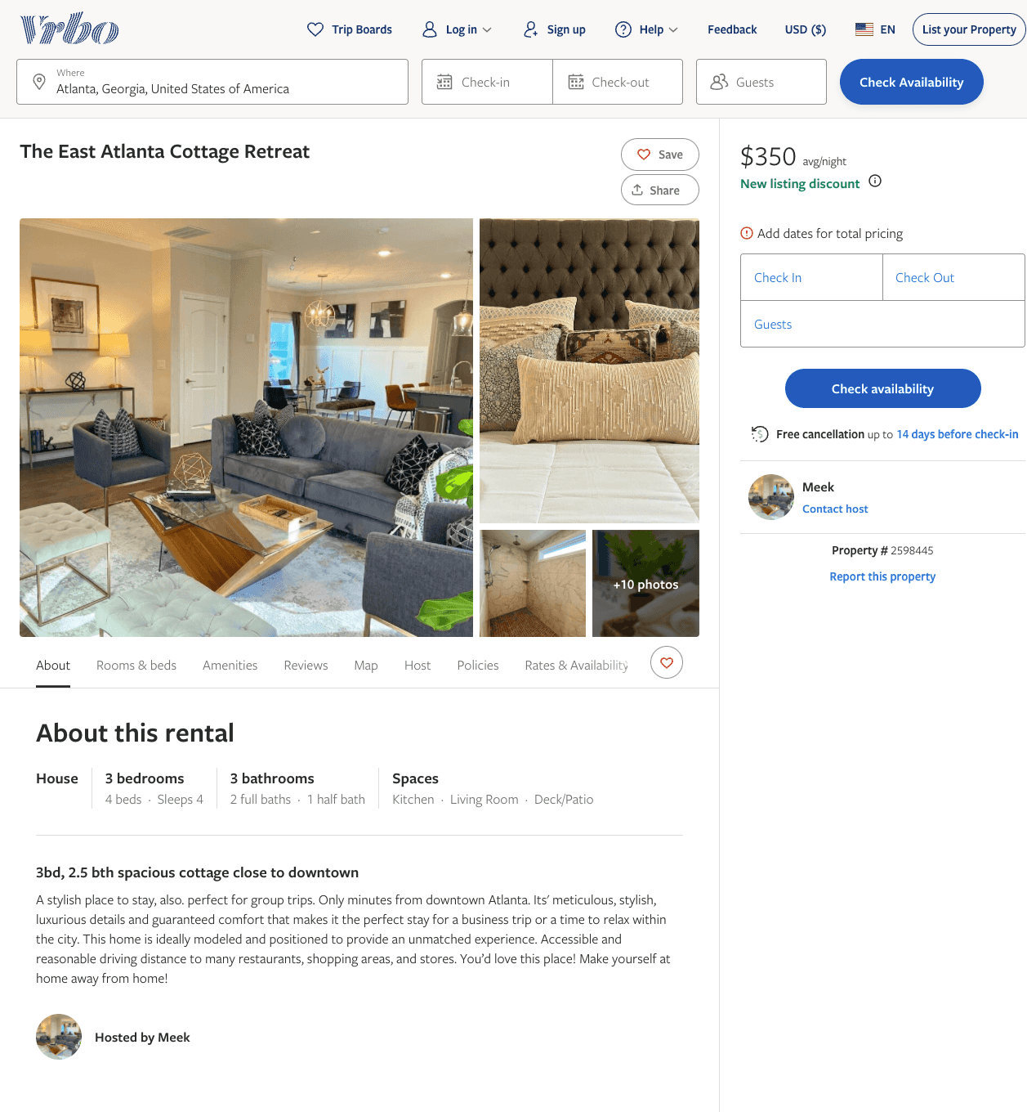
Listing 2598445
3
4
$211 - $350
5
3
Meek
https://www.vrbo.com/2598445
Aug 2022

Slide 7
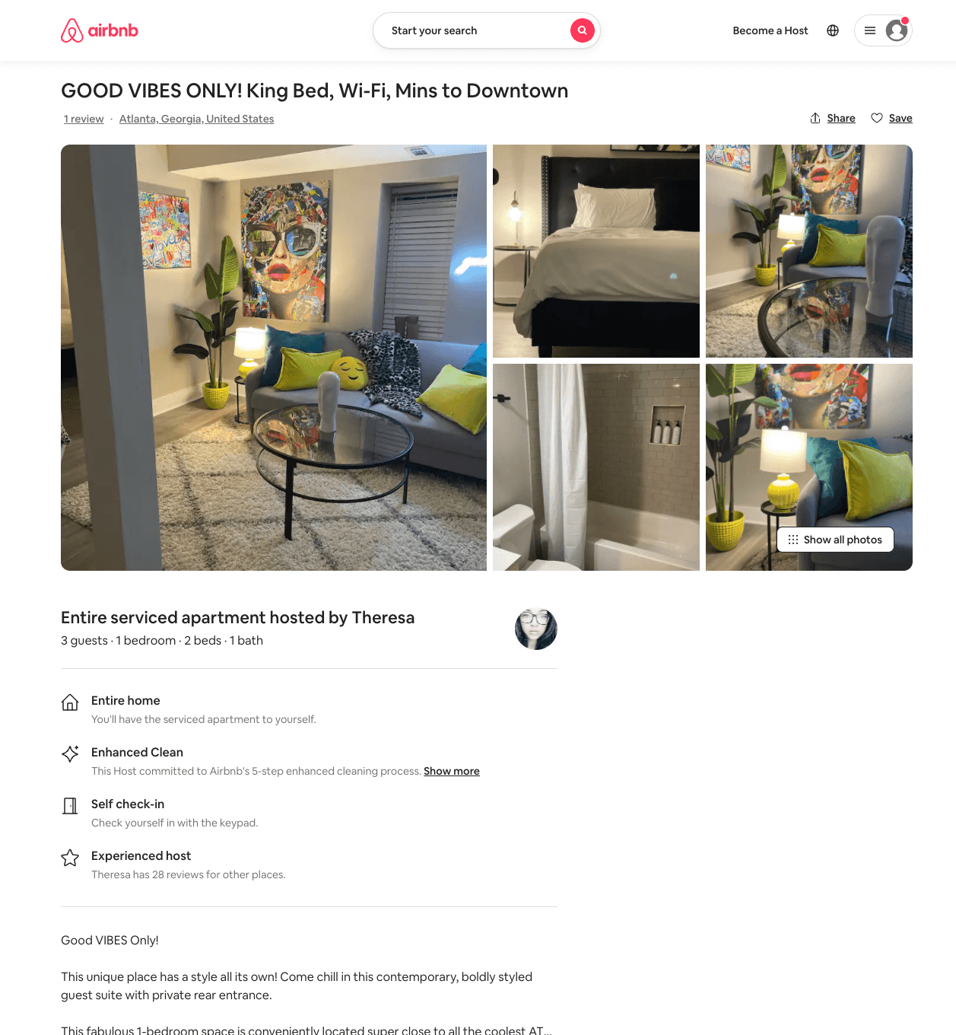
Listing 53942282
1
3
$59 - $97
4.75
1
Theresa
357521693
2
https://www.airbnb.com/rooms/53942282
Jun 2022

Slide 8
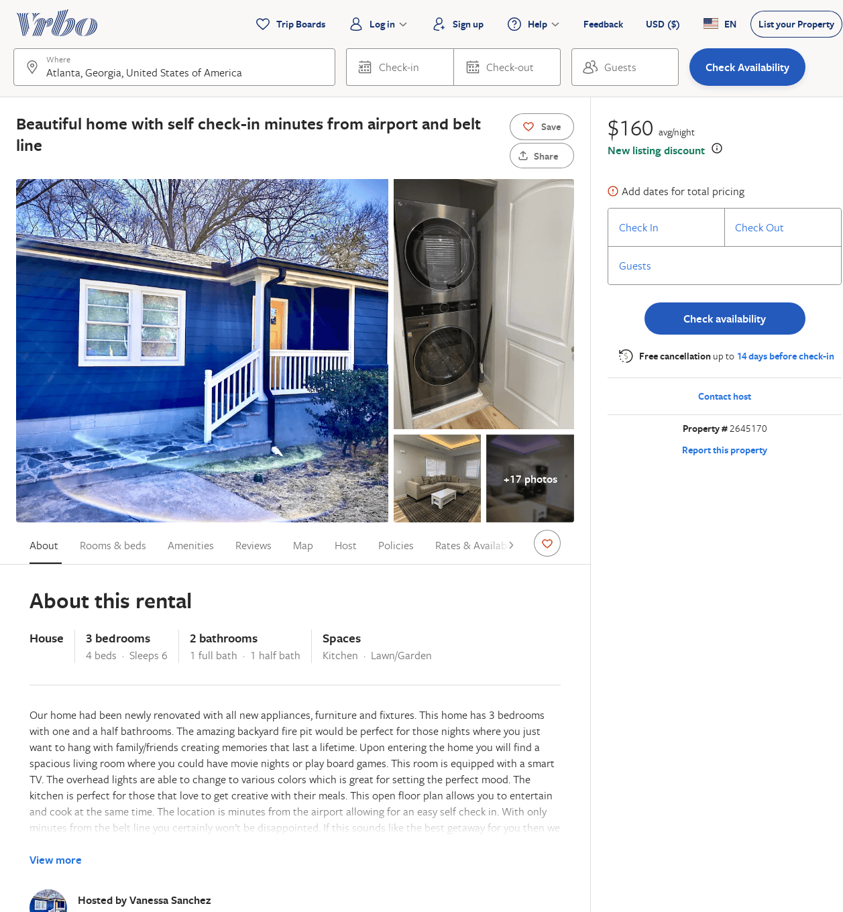
Listing 2645170
3
6
$156
5
3
Vanessa Sanchez
https://www.vrbo.com/2645170
Aug 2022

Slide 9
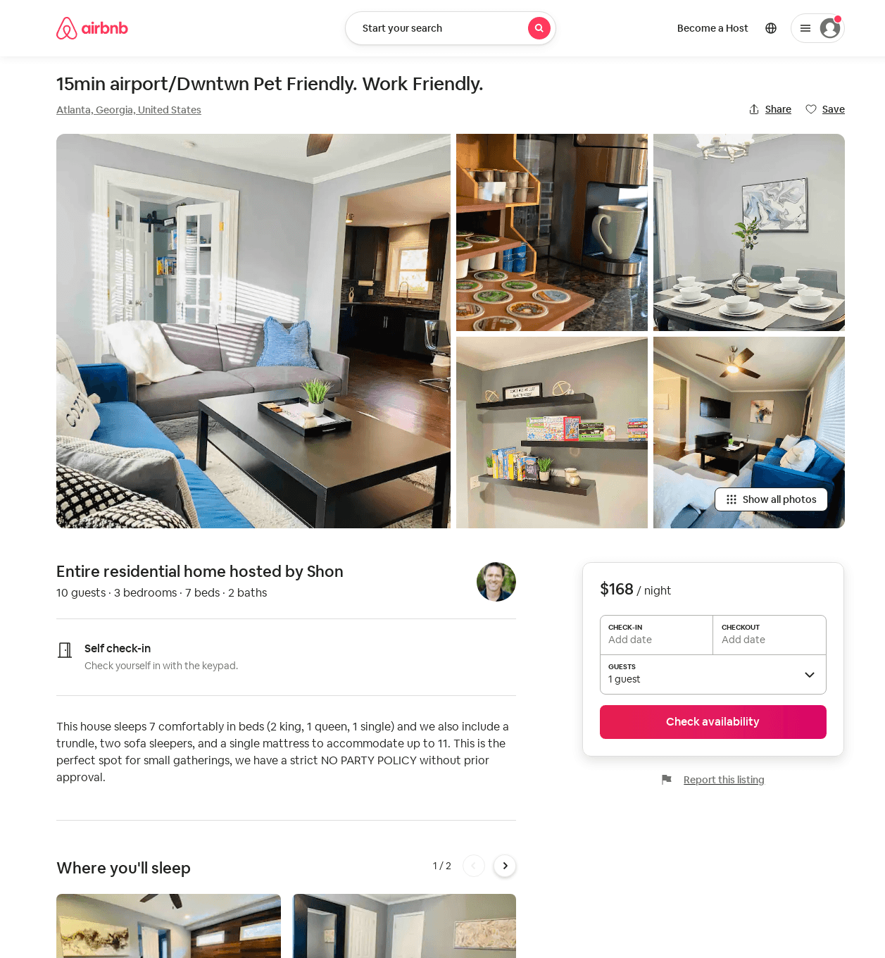
Listing 53883369
3
10
$145 - $168
4.65
2
Shon
90135039
1
https://www.airbnb.com/rooms/53883369
Aug 2022

Slide 10
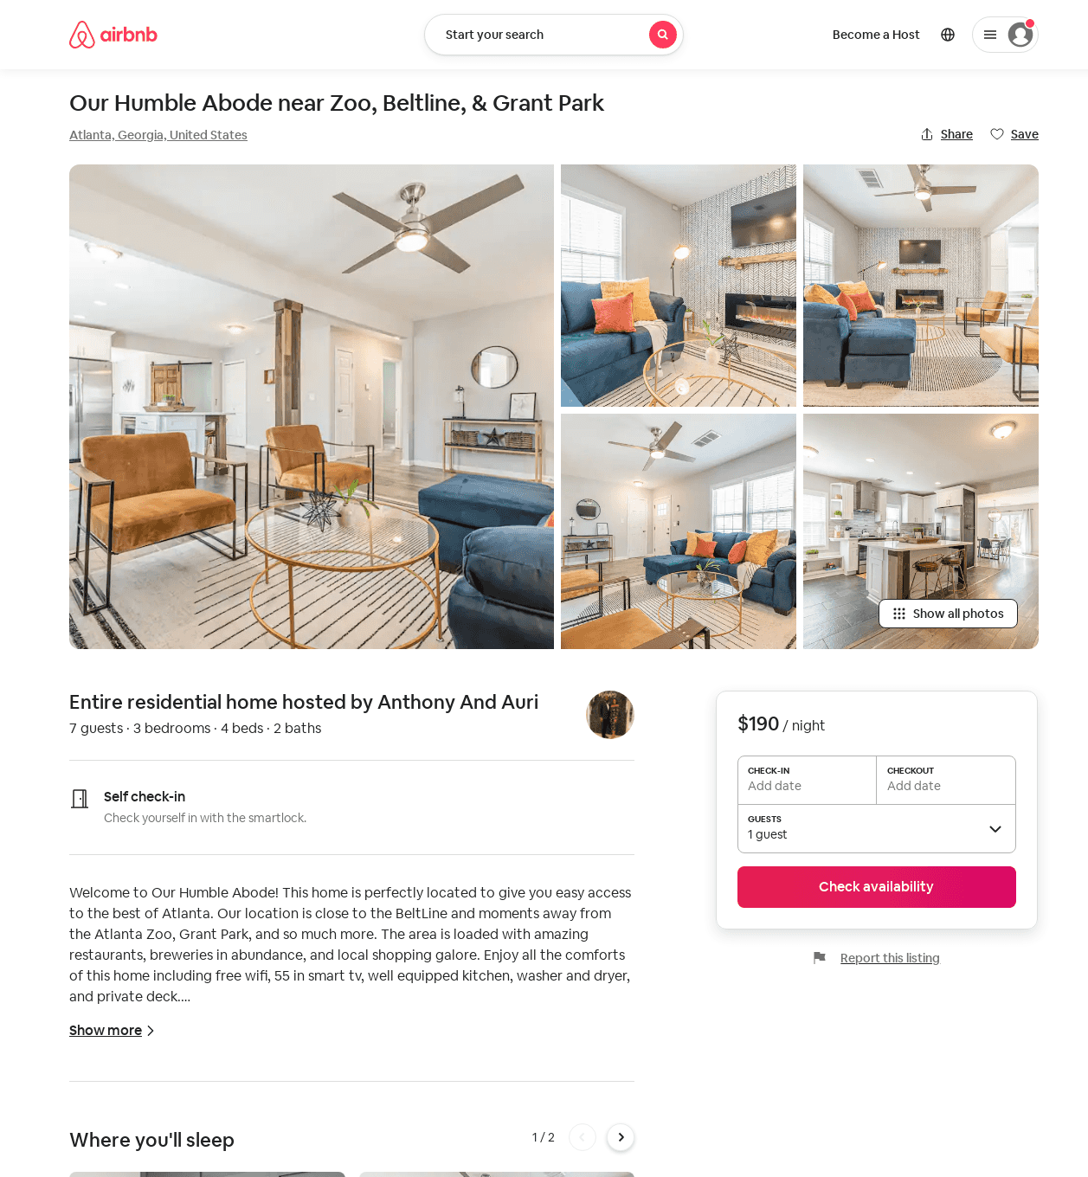
Listing 53276910
3
7
$165 - $242
4.89
2
Anthony And Auri
46935229
1
https://www.airbnb.com/rooms/53276910
Aug 2022

Slide 11
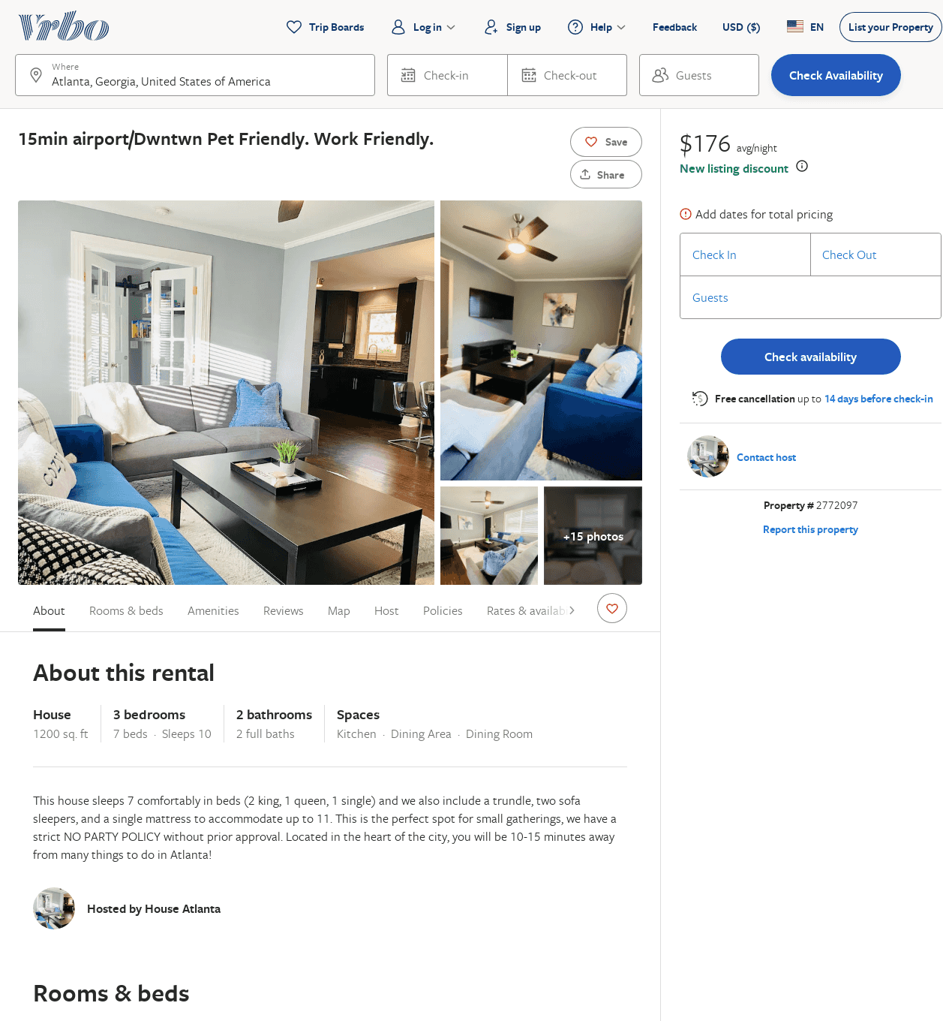
Listing 2772097
3
10
$140
2
https://www.vrbo.com/2772097
Aug 2022

