Slide 2
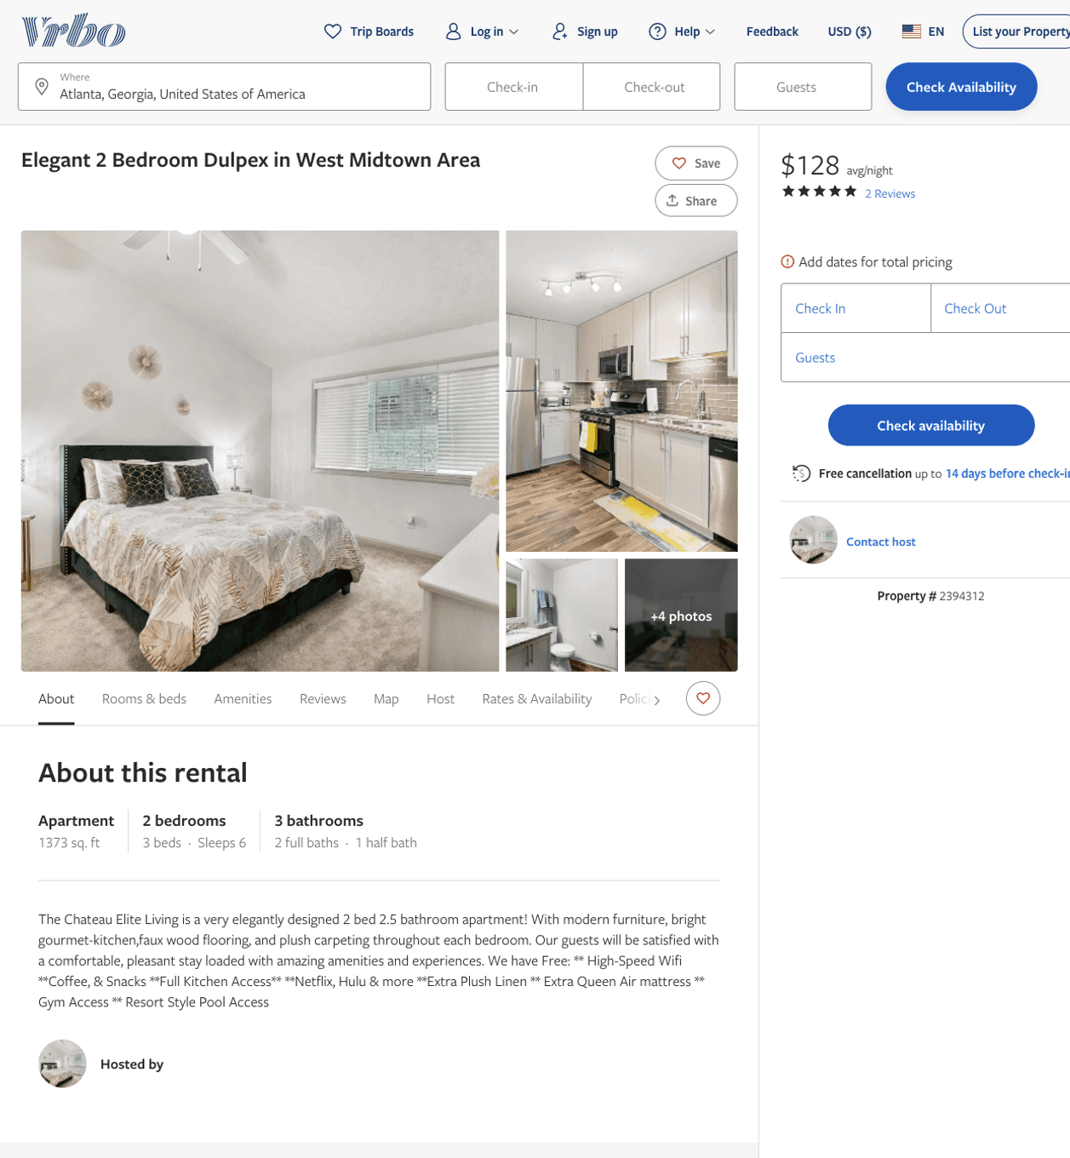
Listing 2394312
2
6
$128 - $157
5
2
Shaniqua Price
https://www.vrbo.com/2394312
Aug 2022

Slide 3
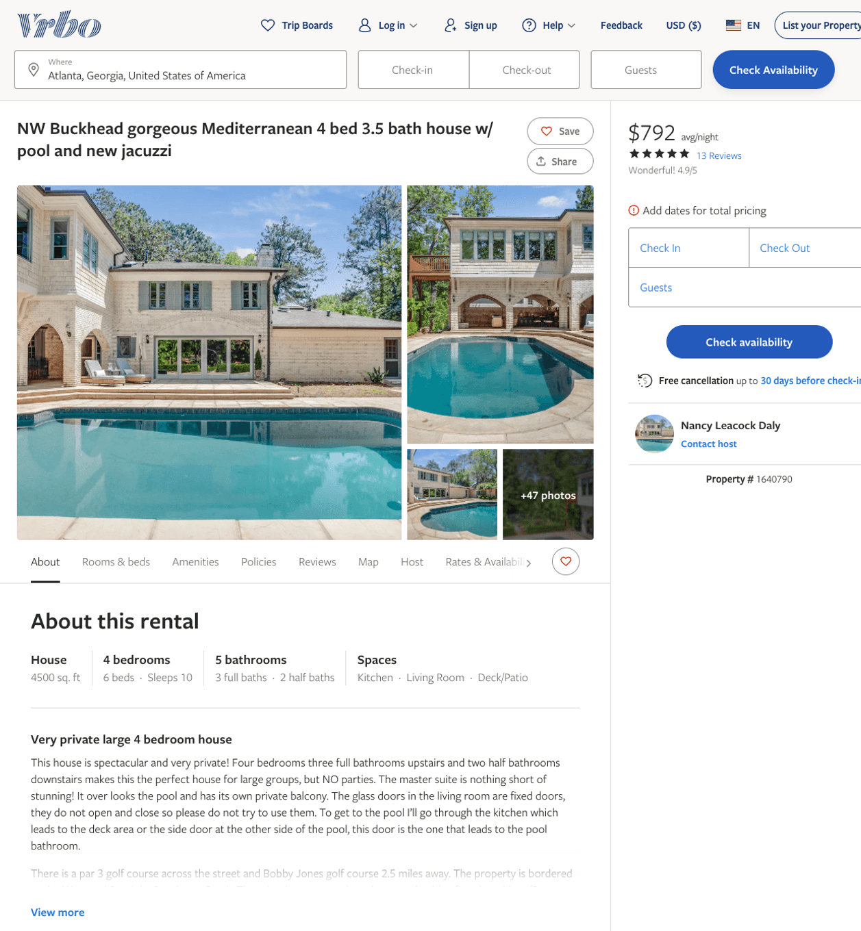
Listing 1640790
4
10
$683 - $975
4.9333334
30
Nancy Leacock Daly
https://www.vrbo.com/1640790
Aug 2022

Slide 4
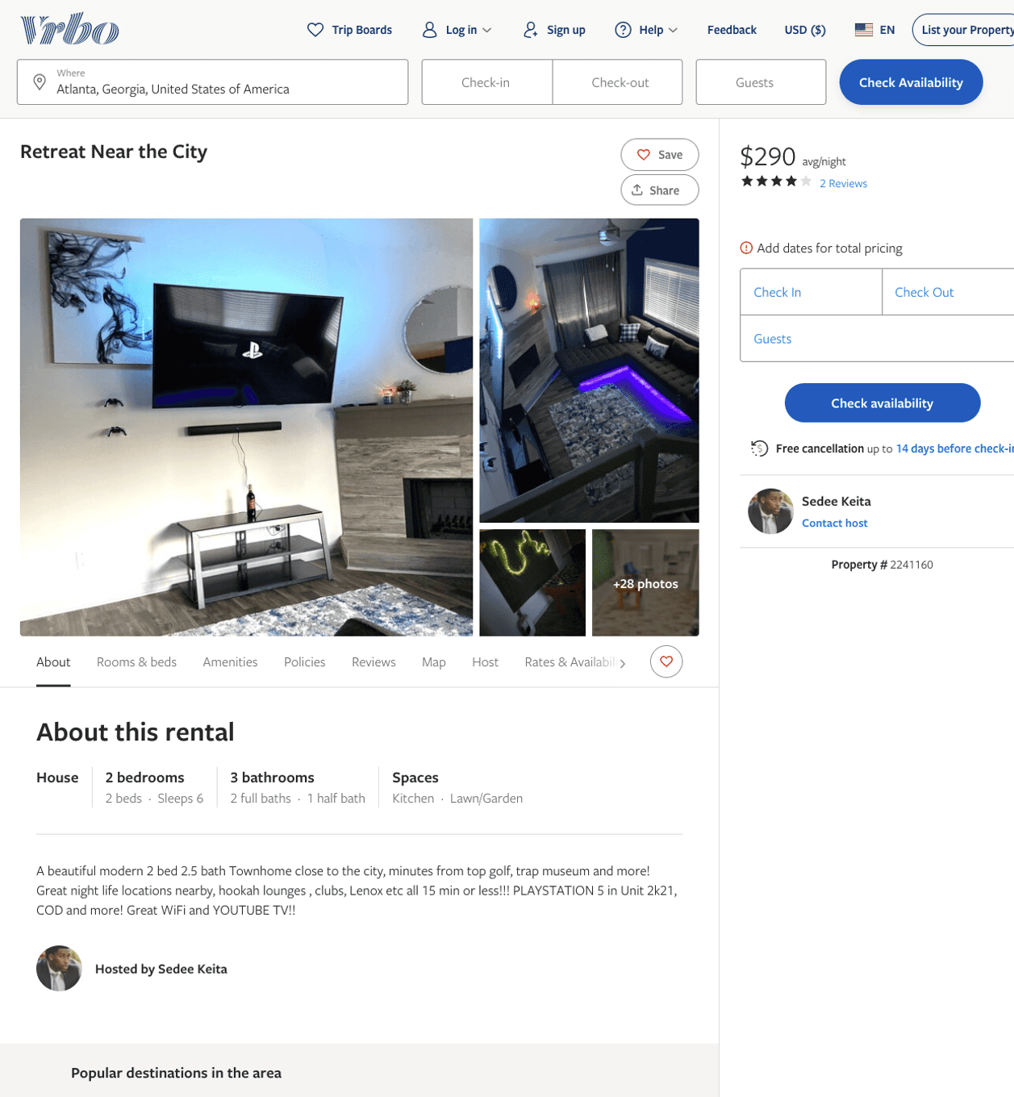
Listing 2241160
2
6
$290 - $320
4
2
Sedee Keita
https://www.vrbo.com/2241160
Aug 2022

Slide 5
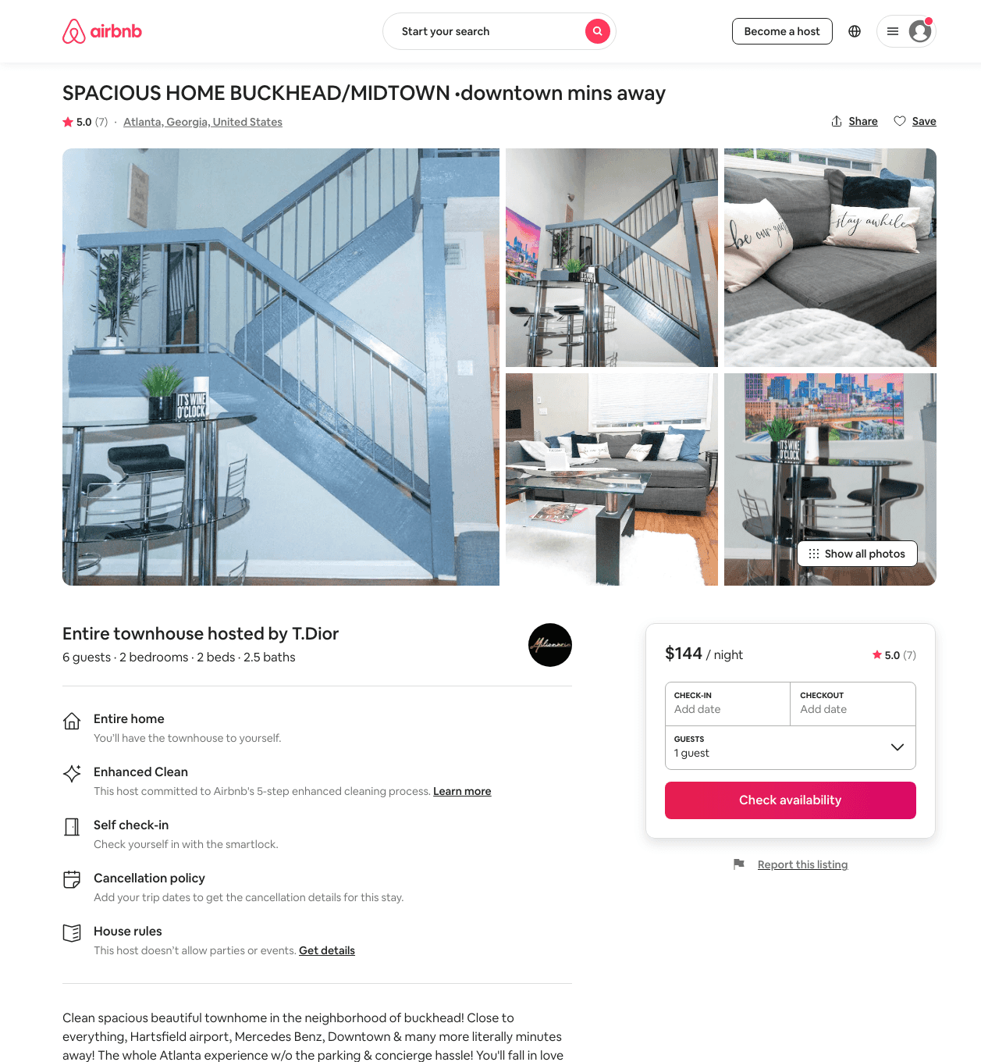
Listing 48074577
2
6
$133 - $193
4.74
2
Td
330381859
1
https://www.airbnb.com/rooms/48074577
Aug 2022

Slide 6
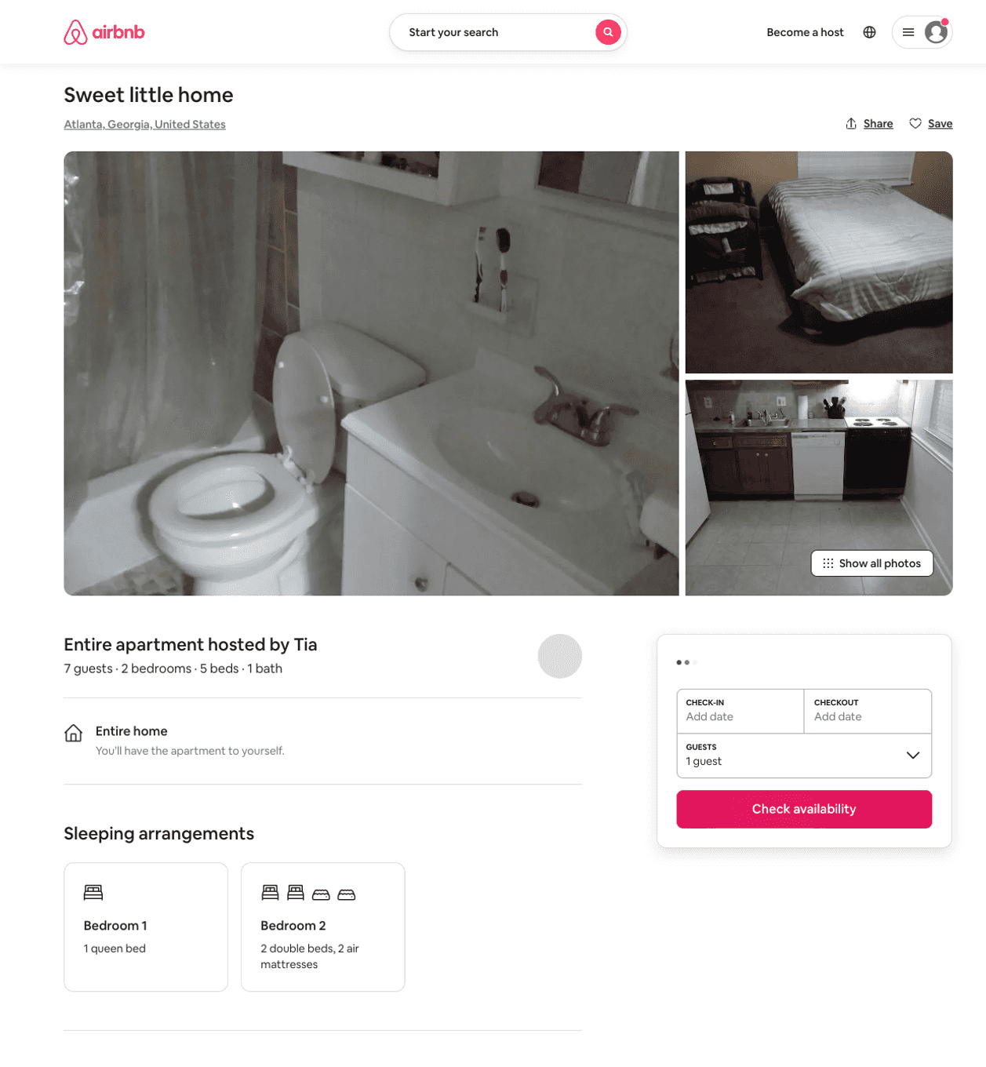
Listing 31337067
2
7
$300
1
Tia
234599773
1
https://www.airbnb.com/rooms/31337067
Aug 2022

Slide 7
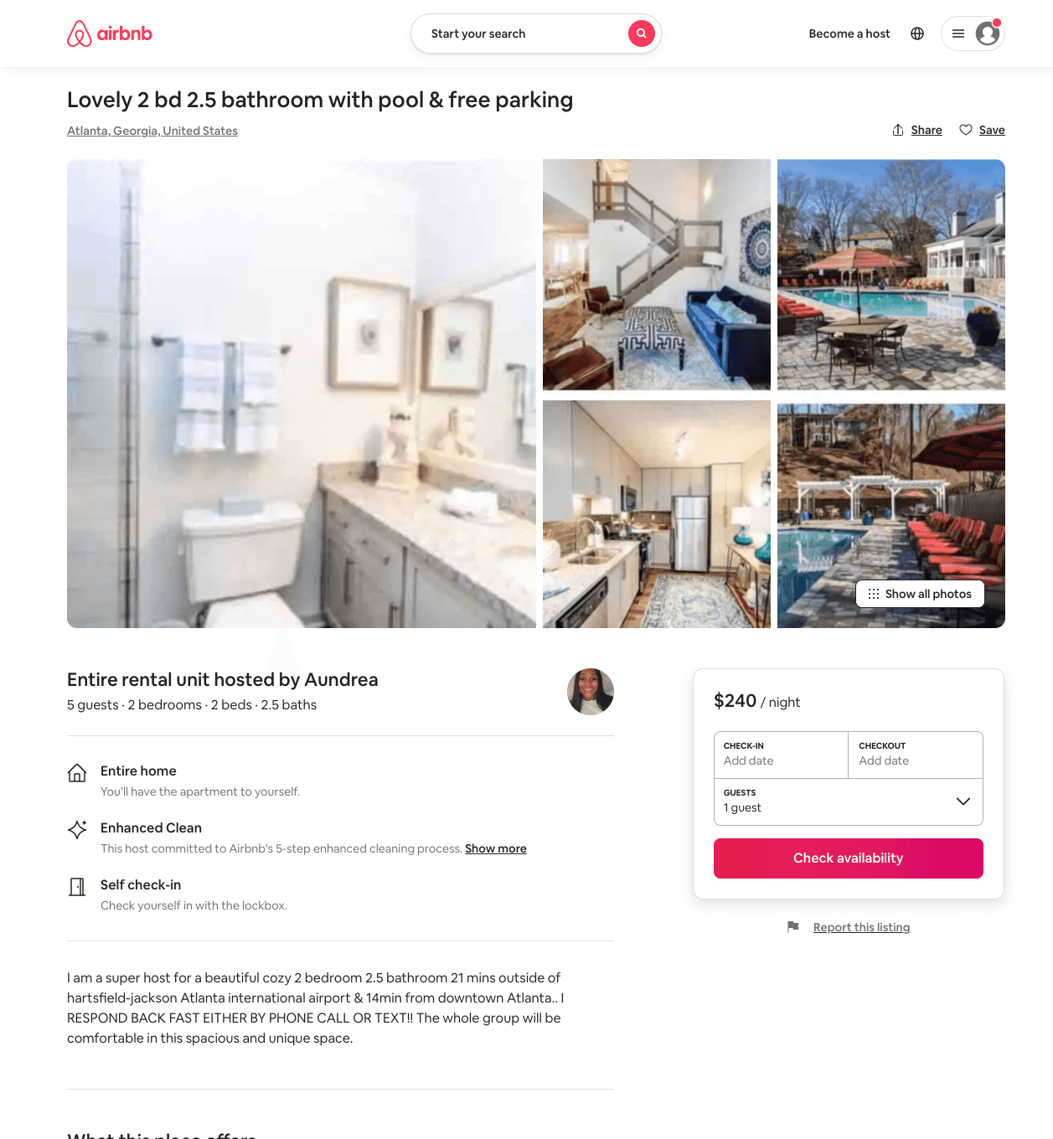
Listing 50714827
2
5
$185 - $240
5.0
2
Aundrea
128695316
2
https://www.airbnb.com/rooms/50714827
Aug 2022

Slide 8
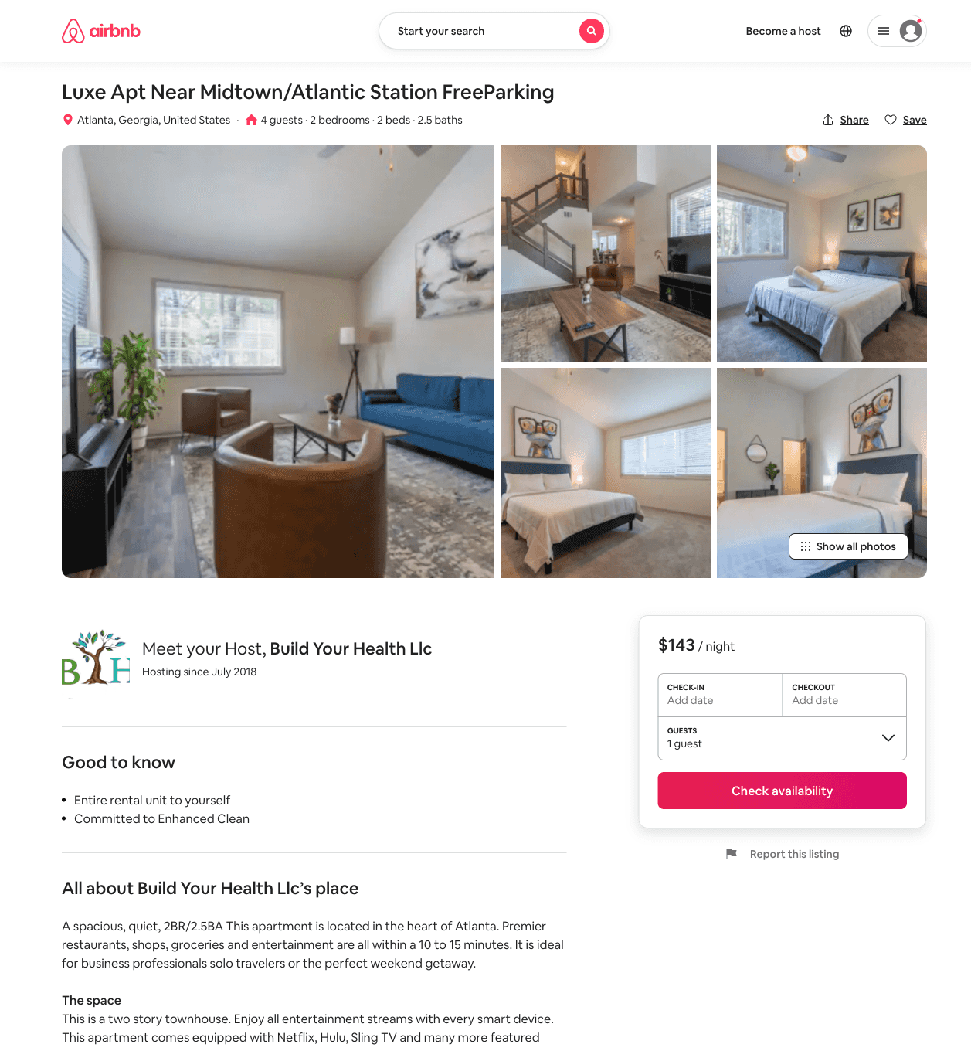
Listing 33946787
2
4
$84 - $193
4.30
2
Build Your Health Llc
199522649
2
https://www.airbnb.com/rooms/33946787
Aug 2022

Slide 9
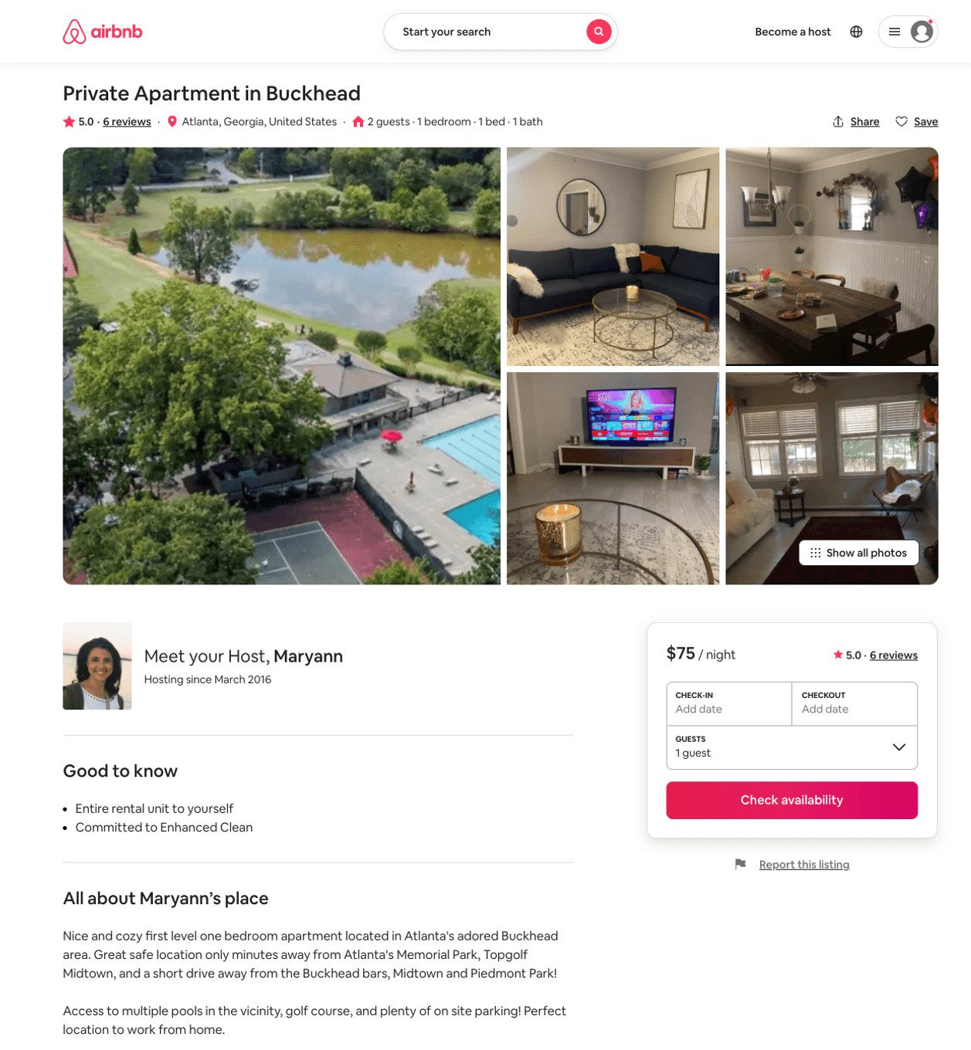
Listing 16375713
1
2
$65 - $75
5.0
181
Maryann
62709559
1
https://www.airbnb.com/rooms/16375713
Aug 2022

Slide 10
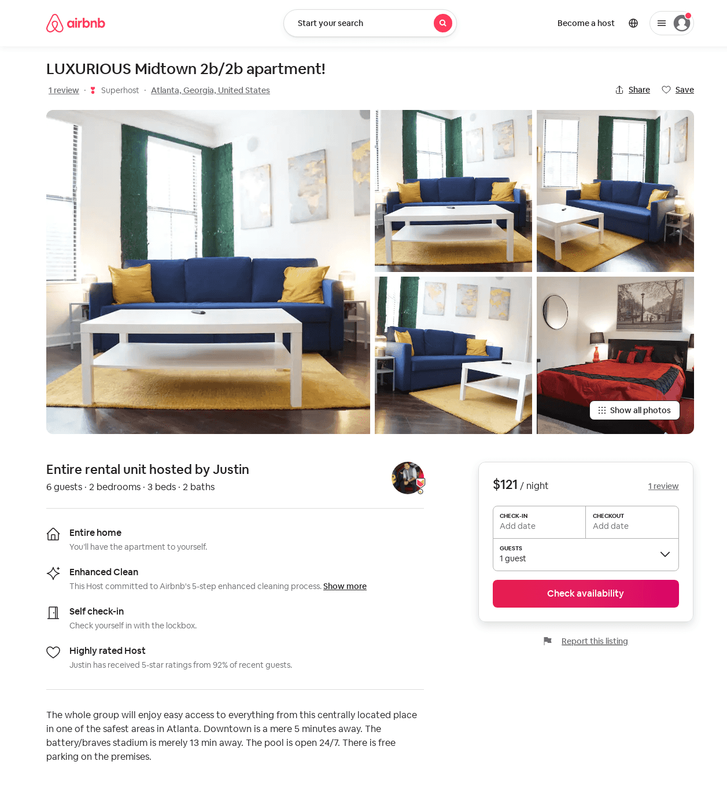
Listing 52720500
2
6
$79 - $131
4.35
1
Justin
103717743
3
https://www.airbnb.com/rooms/52720500
Jun 2022

Slide 11
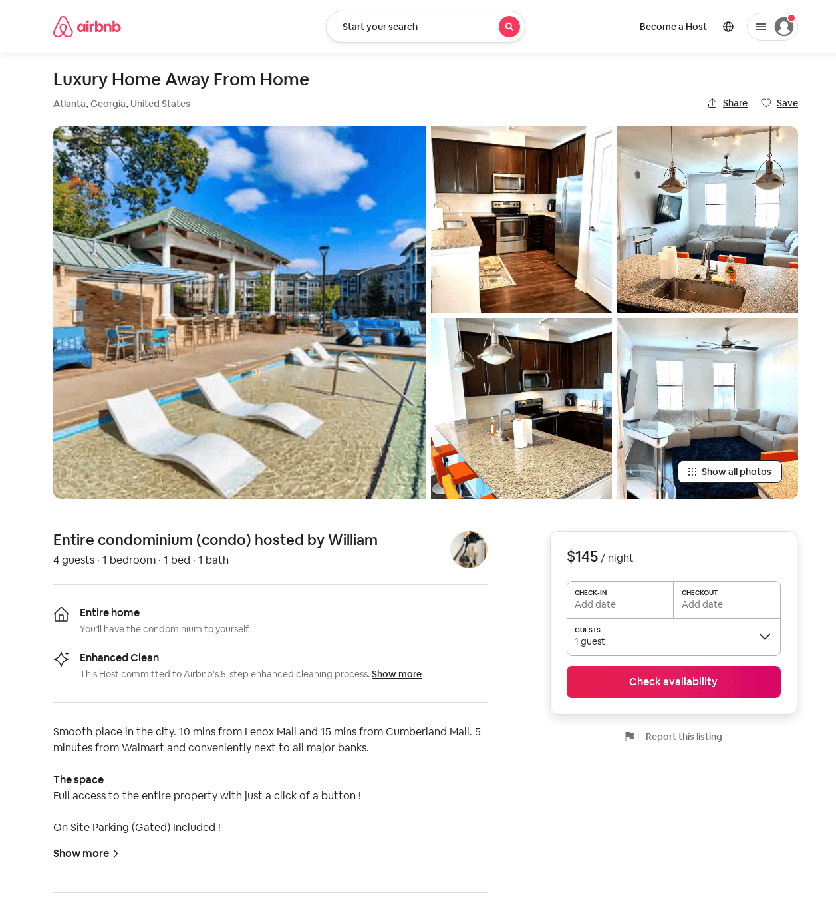
Listing 52777198
1
4
$96 - $138
4.90
2
William
149178938
1
https://www.airbnb.com/rooms/52777198
Jul 2022

Slide 12
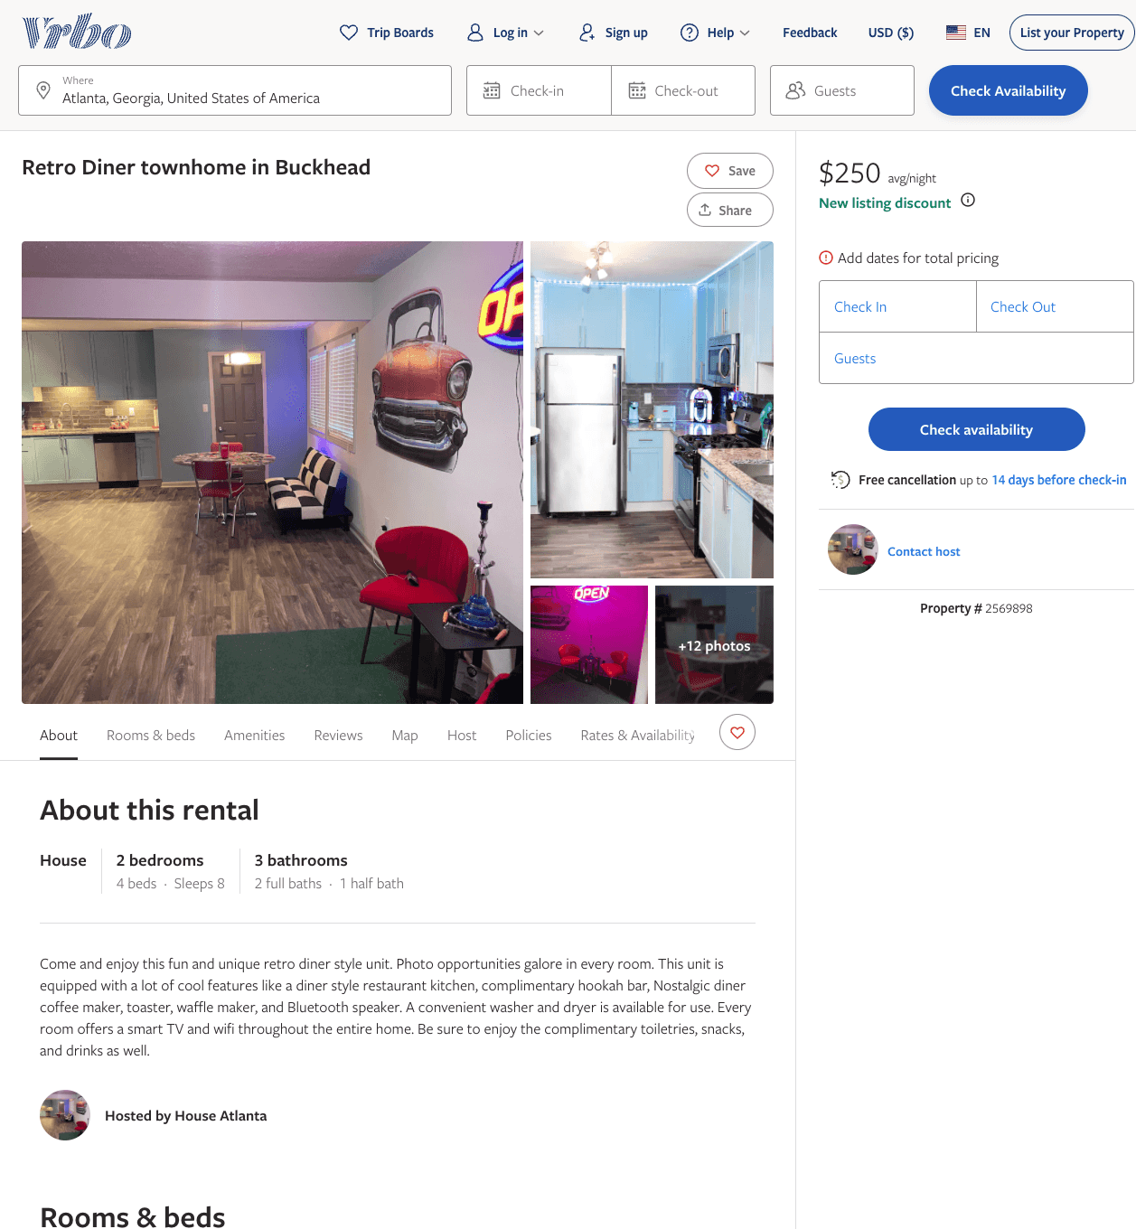
Listing 2569898
2
6
$233 - $250
3
1
https://www.vrbo.com/2569898
Aug 2022

Slide 13
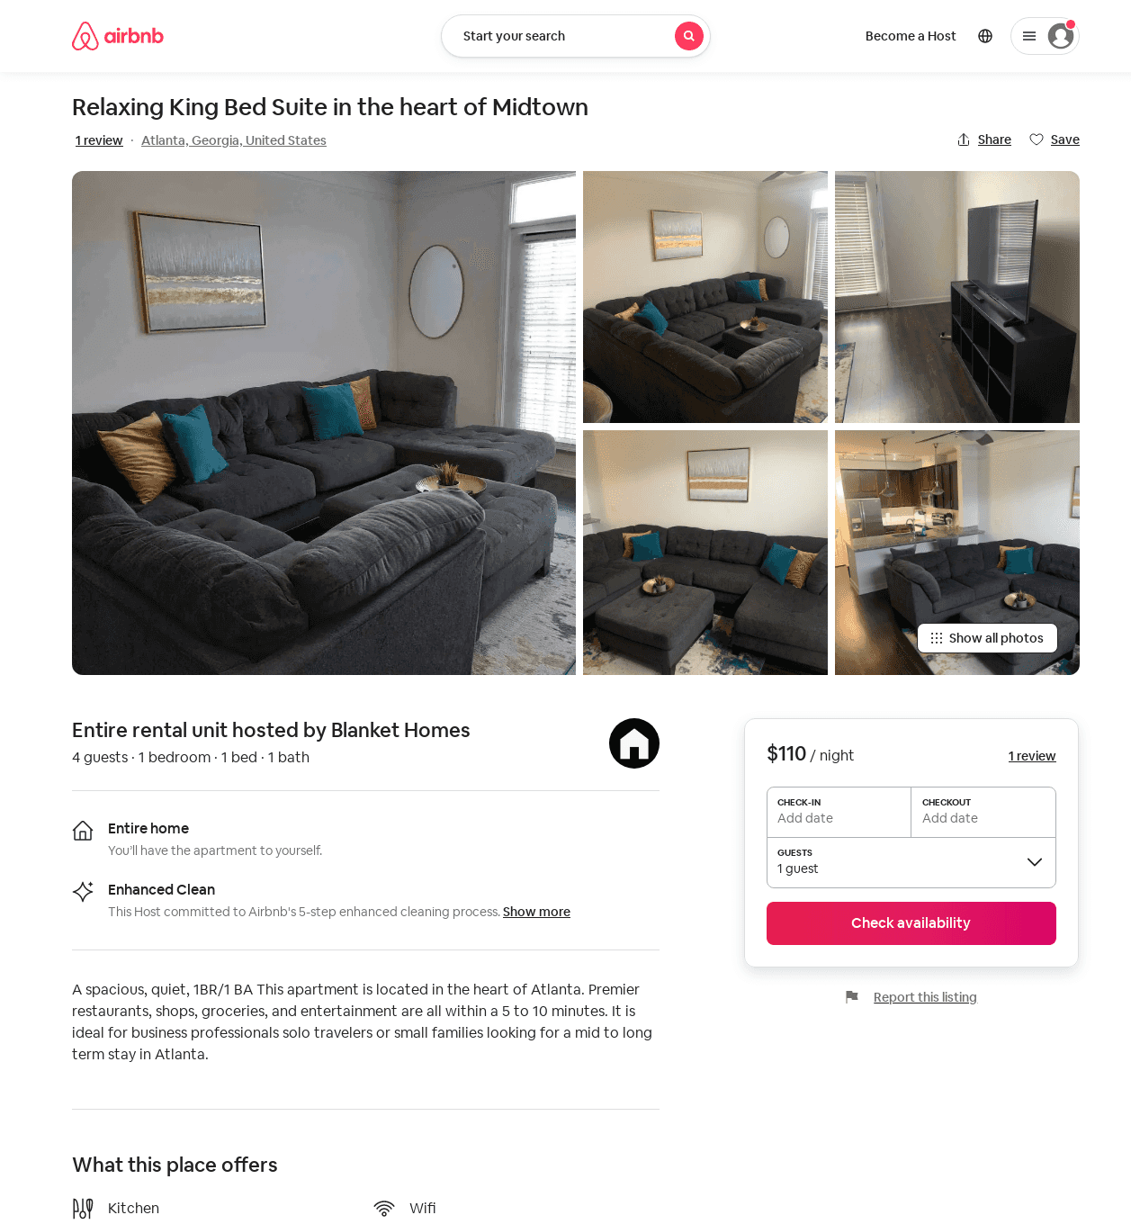
Listing 54015929
1
4
$79 - $110
5.0
3
Blanket Homes
96361154
1
https://www.airbnb.com/rooms/54015929
Aug 2022

Slide 14
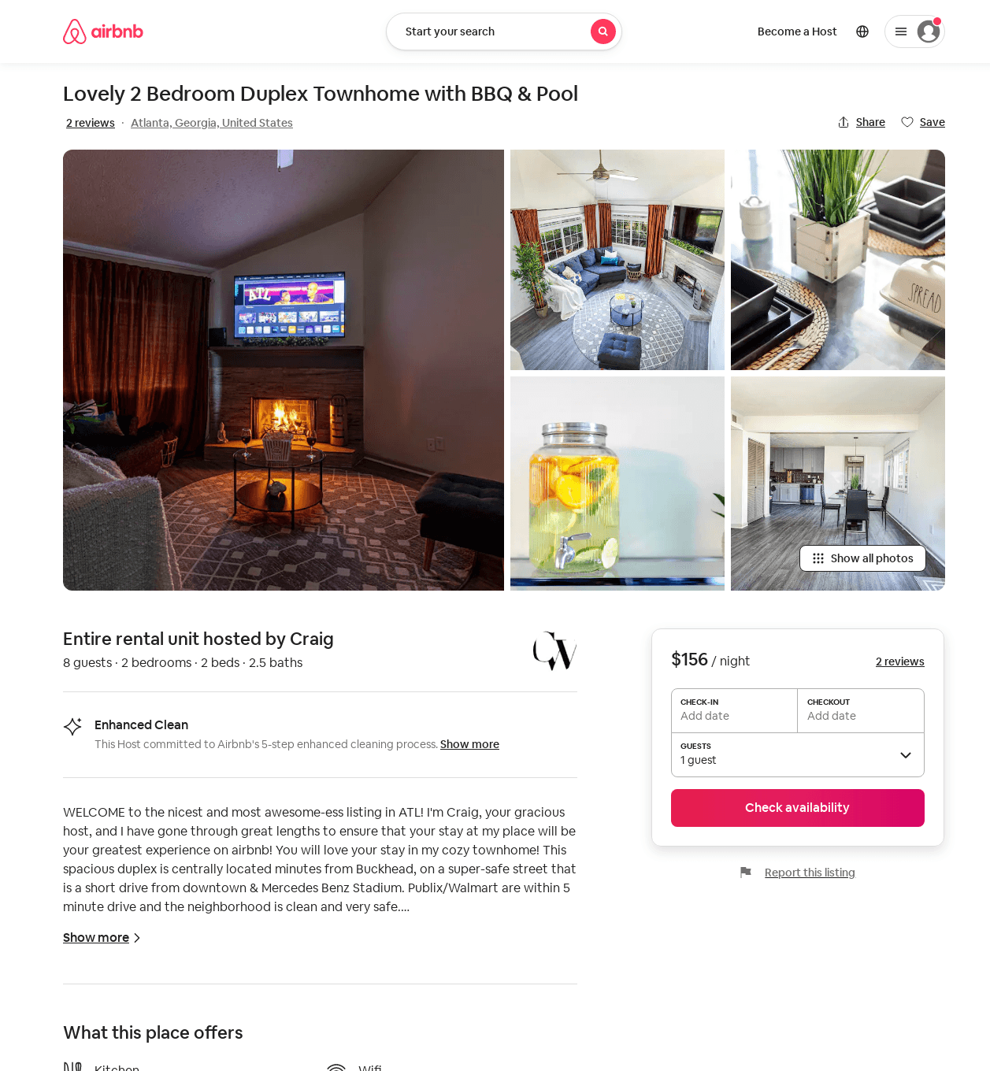
Listing 54381200
2
8
$156
4.57
2
Craig
441406914
1
https://www.airbnb.com/rooms/54381200
Aug 2022

Slide 15
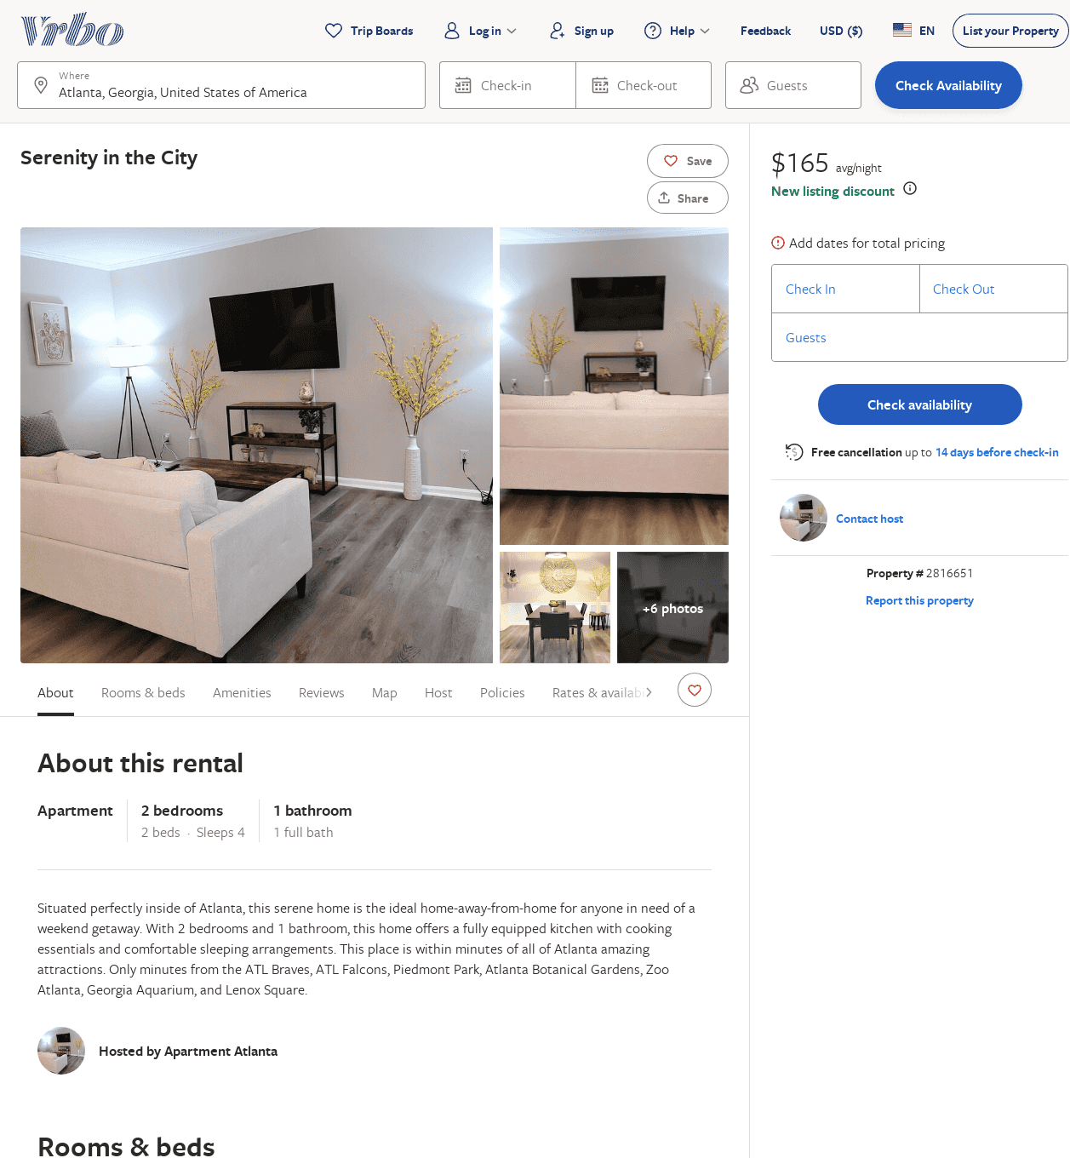
Listing 2816651
2
4
$131
2
https://www.vrbo.com/2816651
Aug 2022

Slide 16
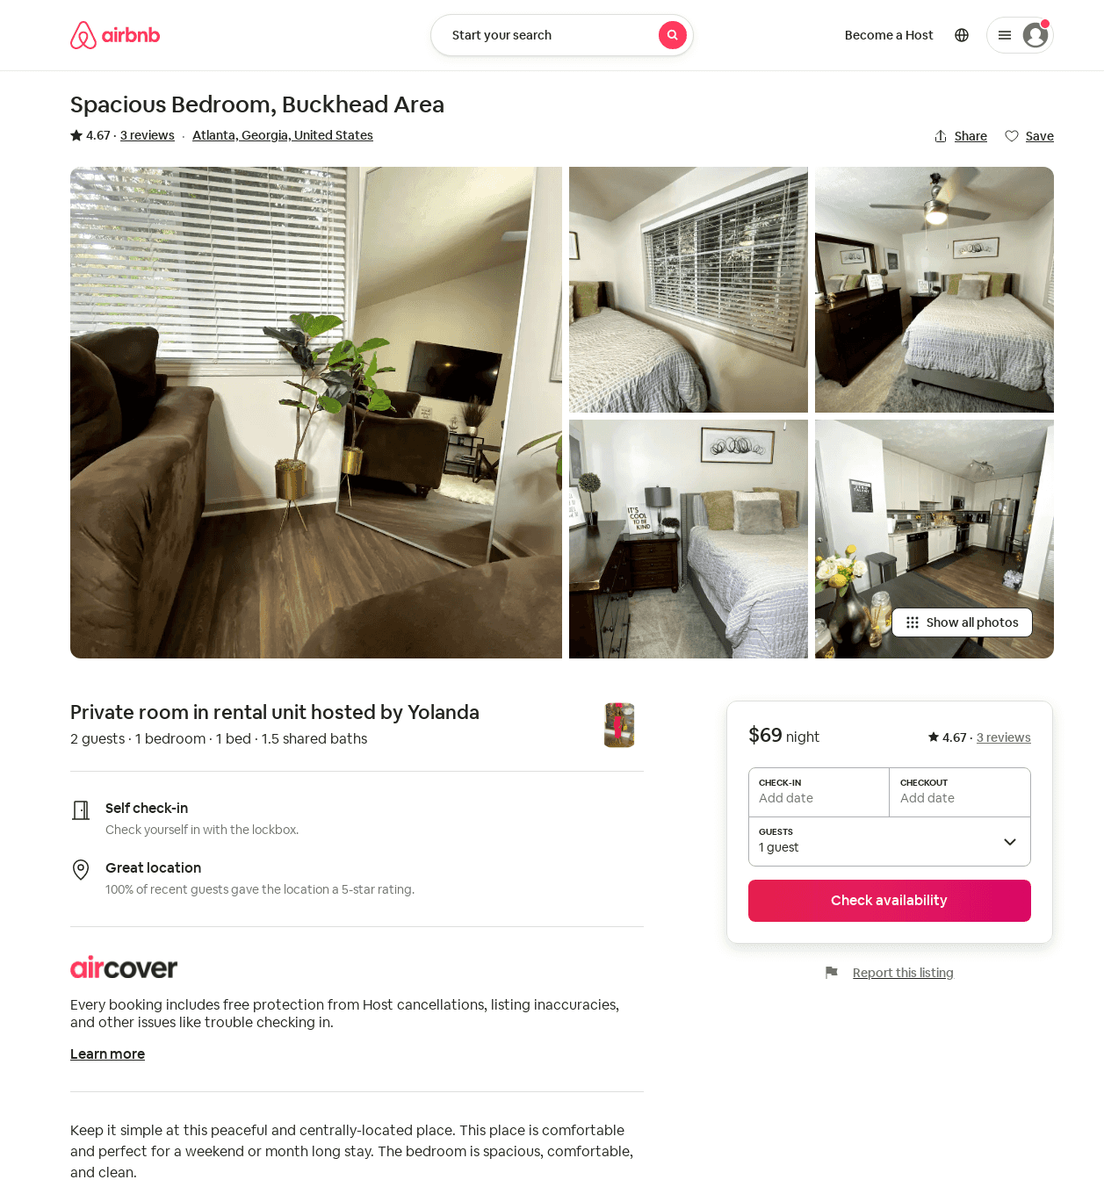
Listing 52316590
1
2
4.80
2
Yolanda
103542300
1
https://www.airbnb.com/rooms/52316590
Aug 2022

Slide 17
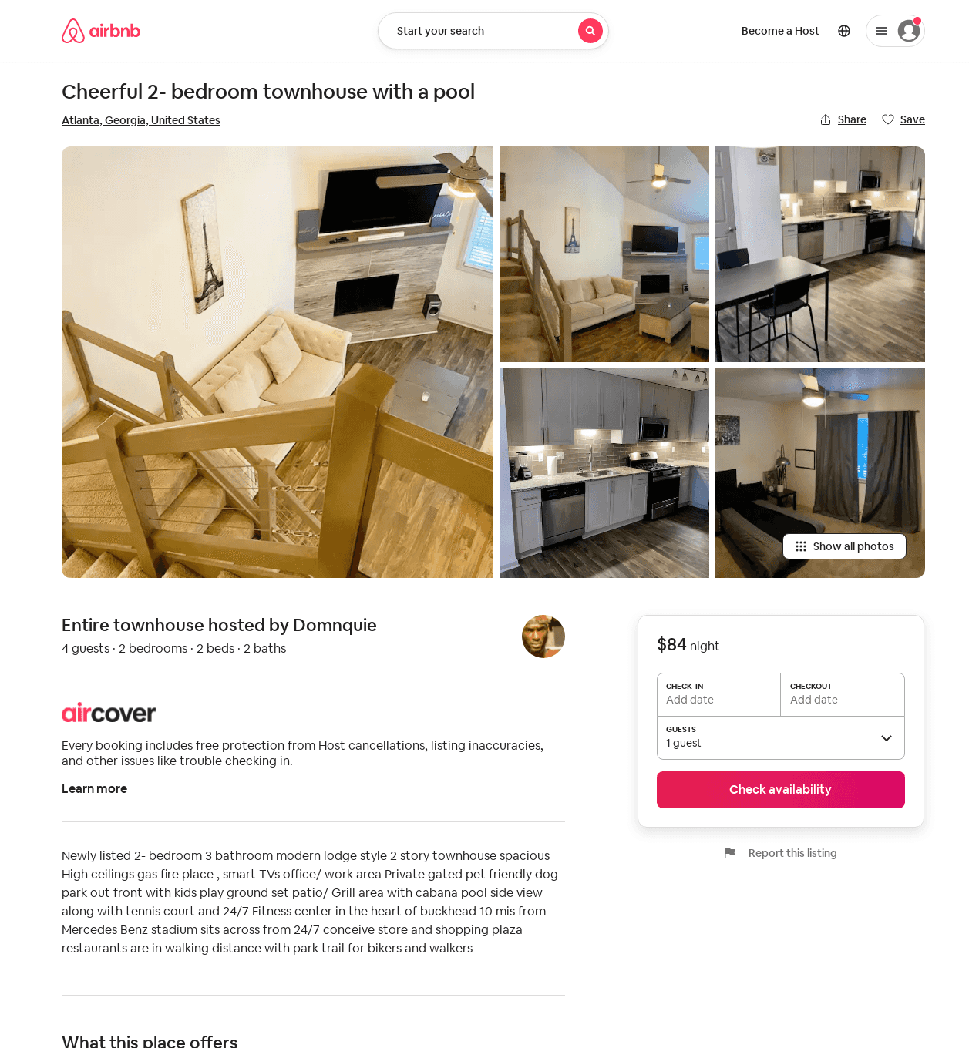
Listing 31826473
2
4
1
Domnquie
228428092
1
https://www.airbnb.com/rooms/31826473
Aug 2022

