Slide 2
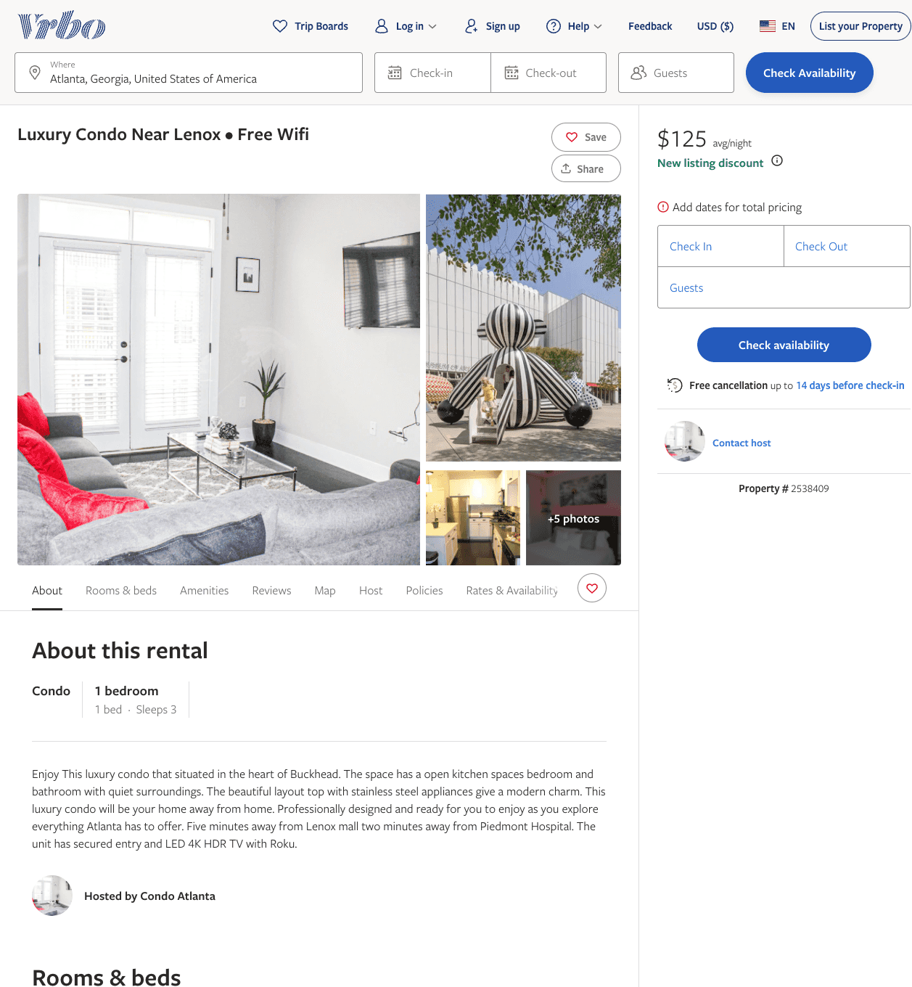
Listing 2538409
1
3
$125
2
https://www.vrbo.com/2538409
Aug 2022

Slide 3
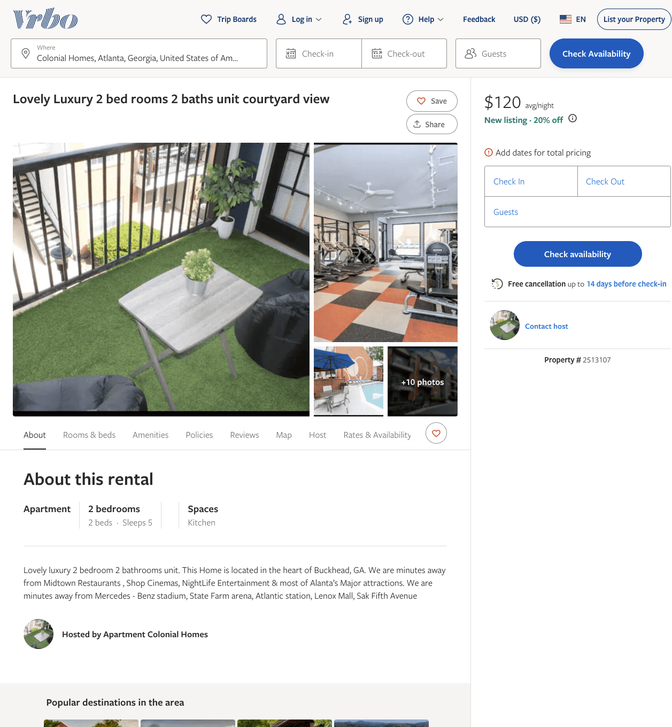
Listing 2513107
2
5
$120
14
https://www.vrbo.com/2513107
Aug 2022

Slide 4
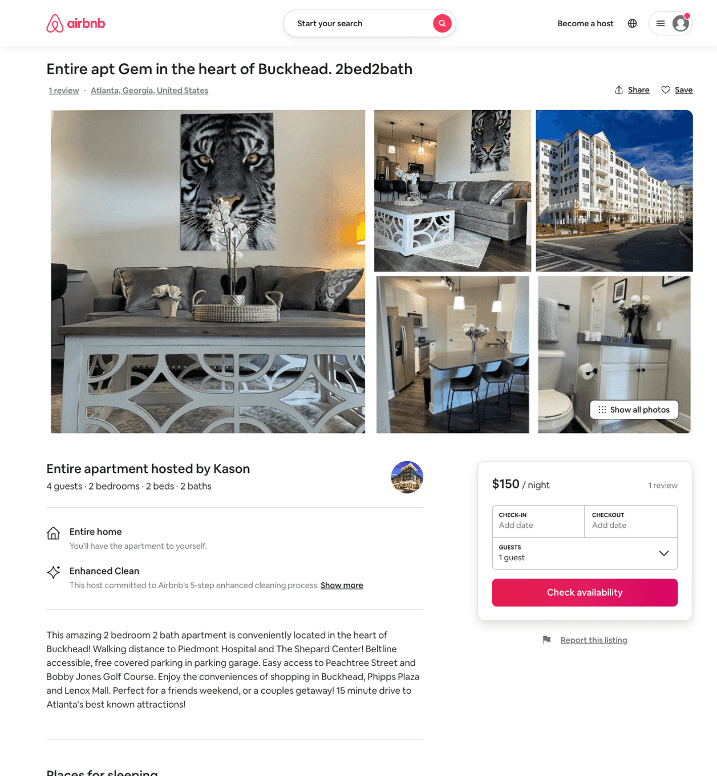
Listing 49932836
2
5
$129 - $187
4.97
3
Kason
402652470
3
https://www.airbnb.com/rooms/49932836
Aug 2022

Slide 5
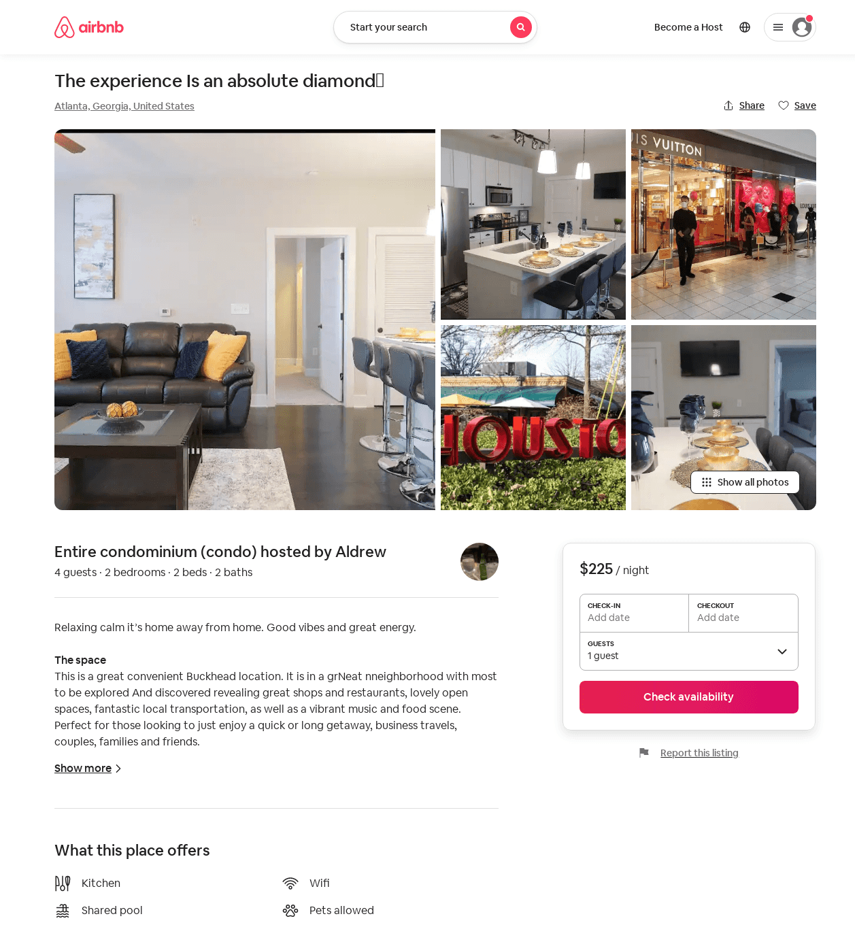
Listing 54222336
2
4
$164 - $225
4.43
2
Aldrew
184442607
1
https://www.airbnb.com/rooms/54222336
Aug 2022

