Slide 2
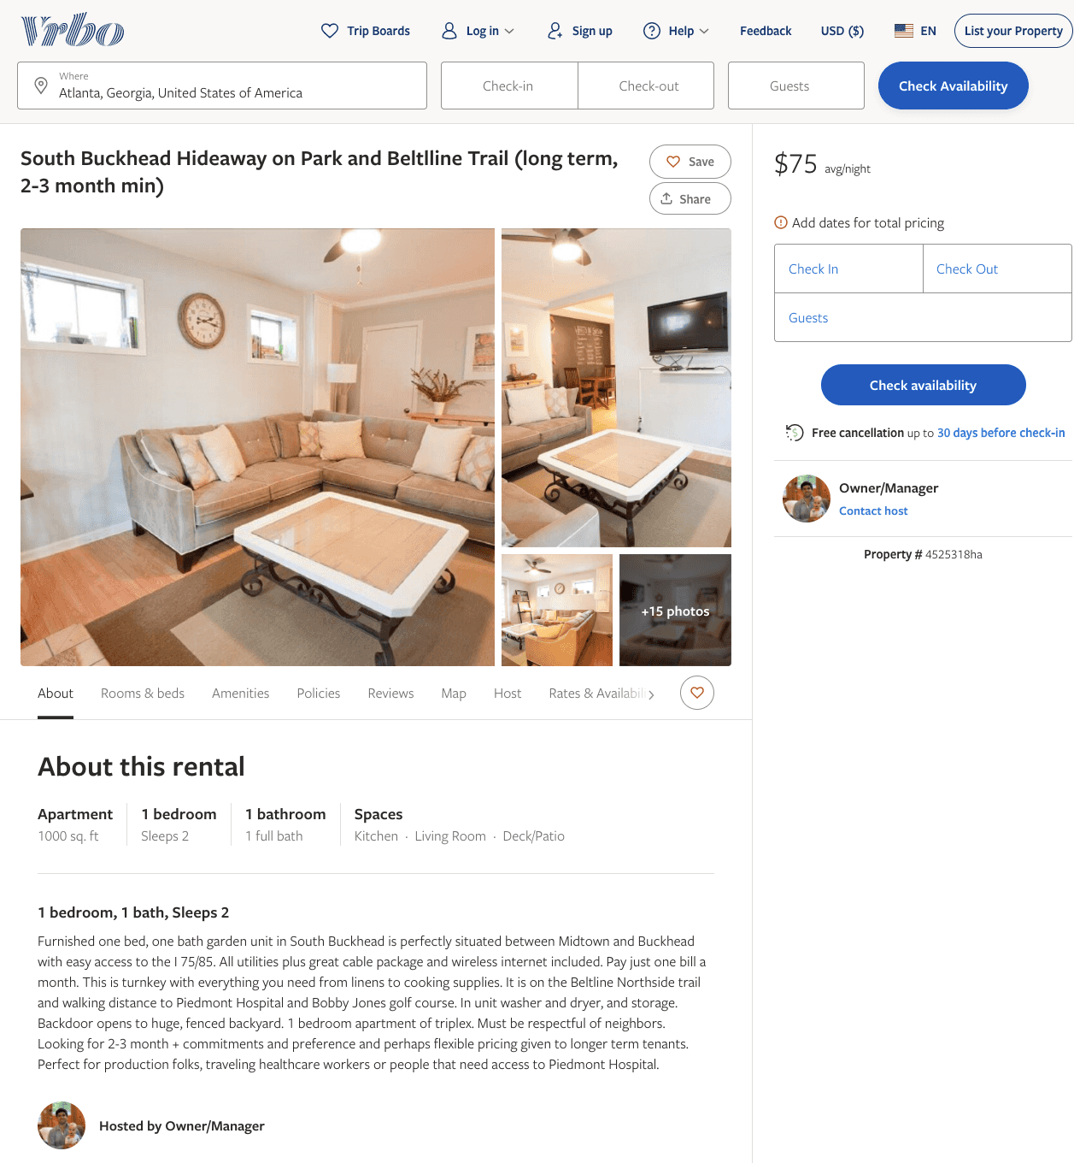
Listing 4525318
1
2
$75
20
Owner/Manager
https://www.vrbo.com/4525318ha
Aug 2022

Slide 3
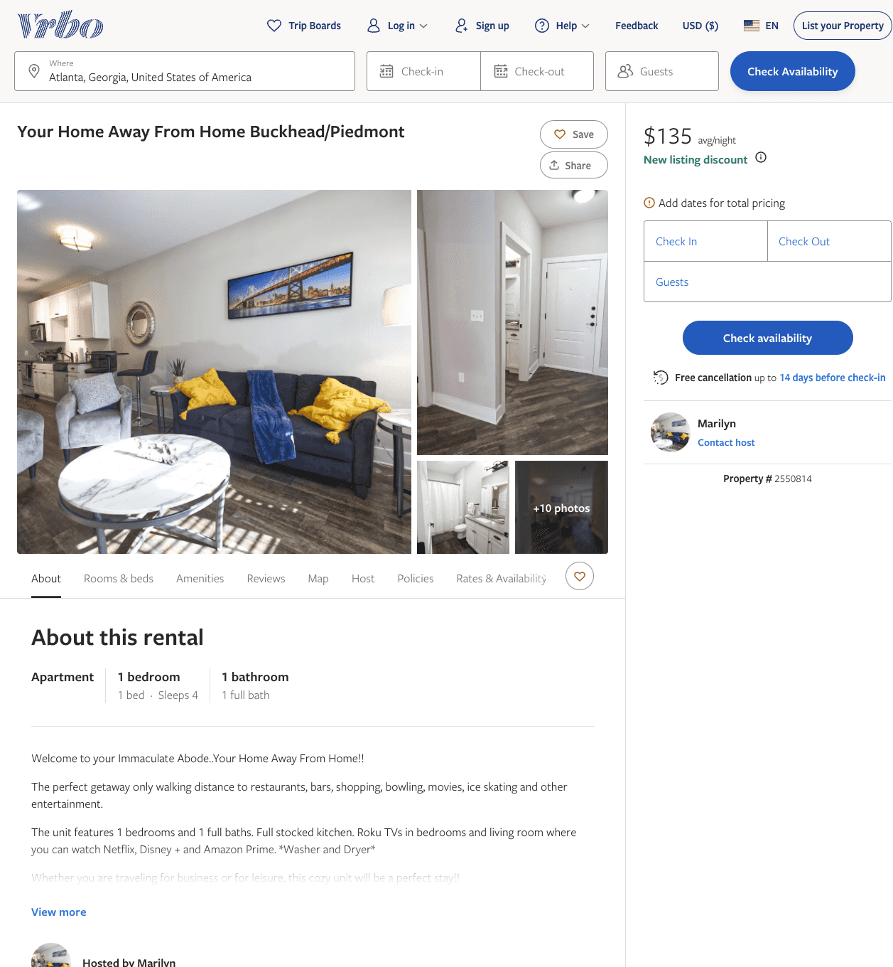
Listing 2550814
1
4
$135
5
Marilyn
https://www.vrbo.com/2550814
Aug 2022

Slide 4
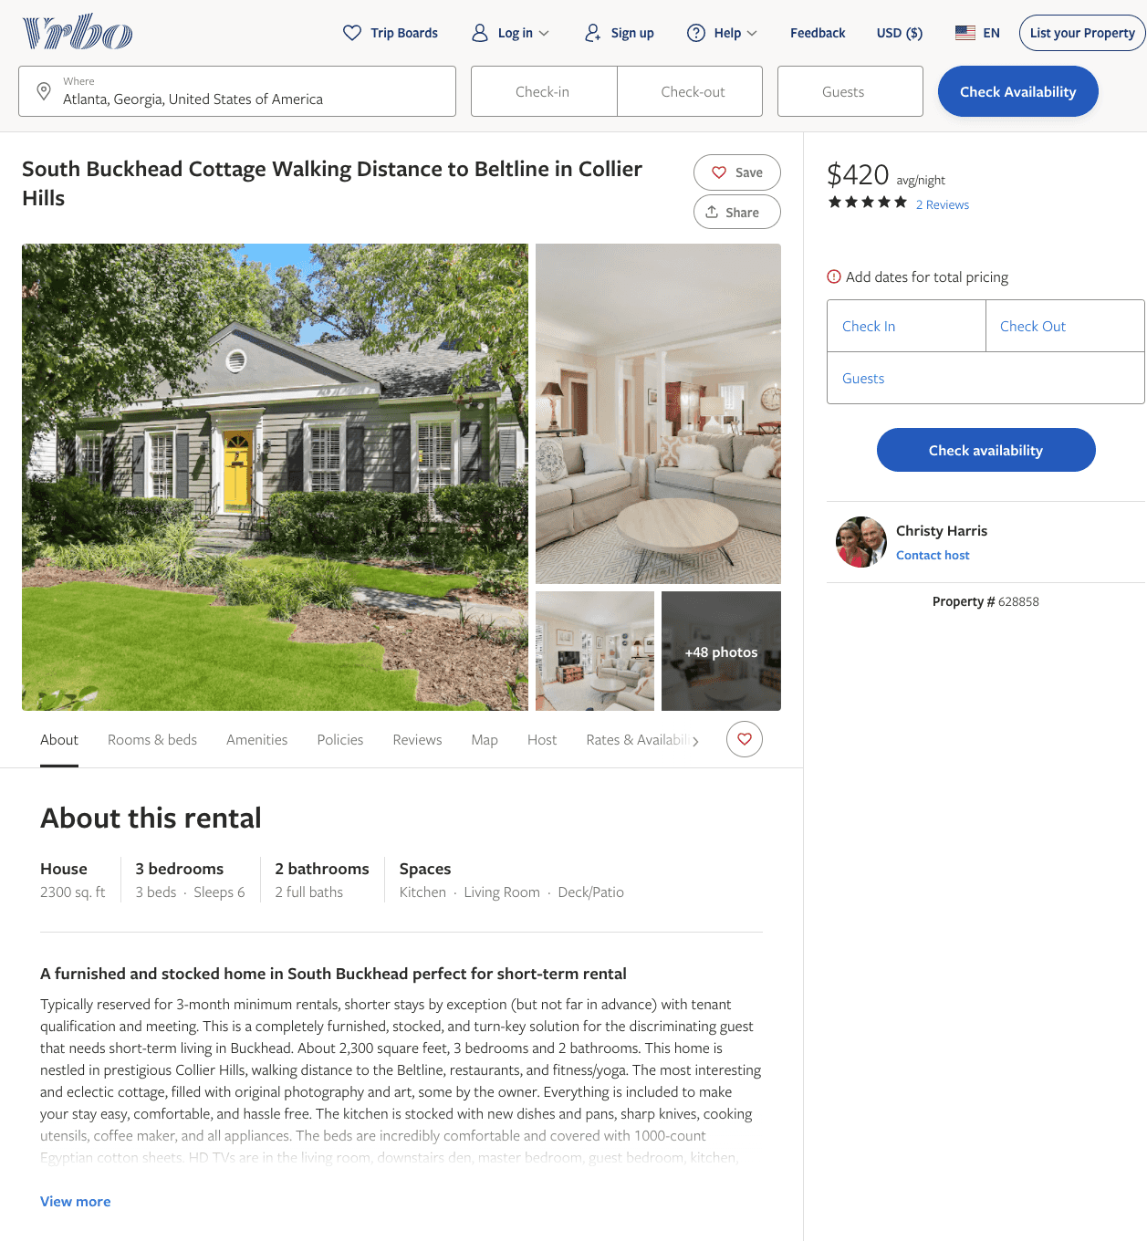
Listing 628858
3
6
$420
5
5
Christy Harris
https://www.vrbo.com/628858
Aug 2022

Slide 5
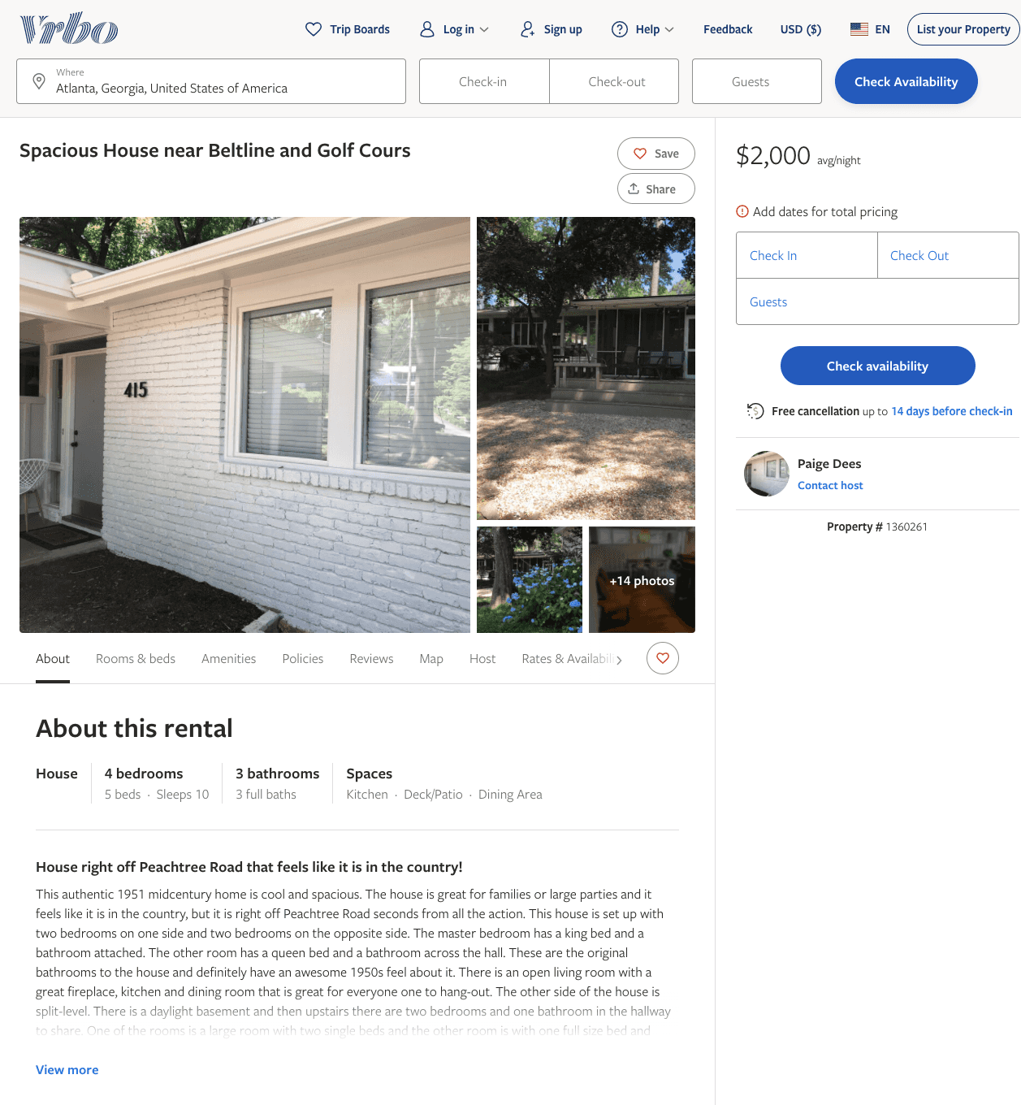
Listing 1360261
4
10
$2,000
3
Paige Dees
https://www.vrbo.com/1360261
Aug 2022

Slide 6
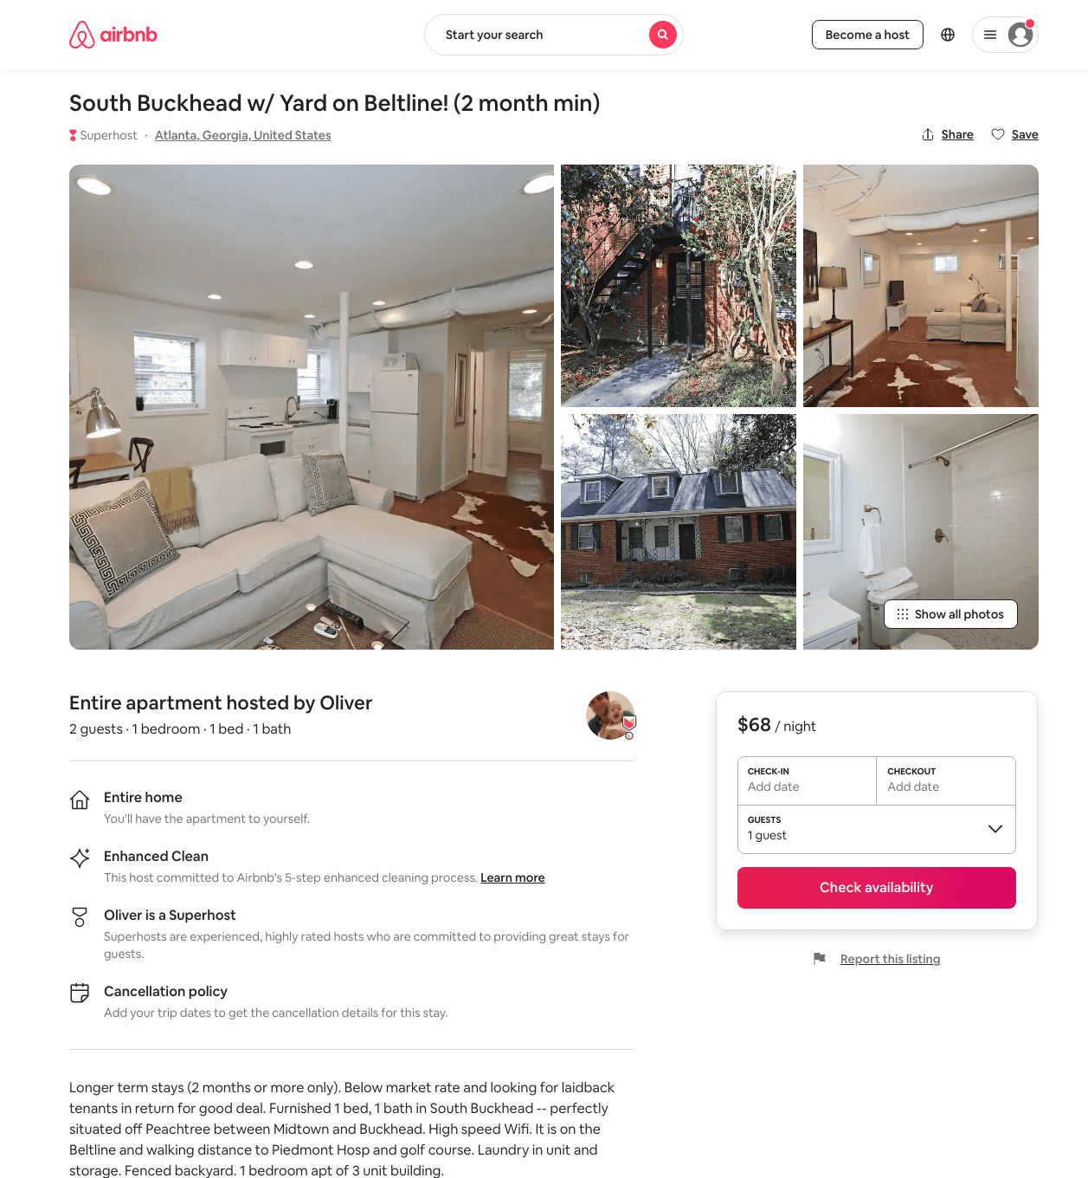
Listing 32438537
1
2
$68 - $76
45
Oliver
6591547
2
https://www.airbnb.com/rooms/32438537
Aug 2022

Slide 7
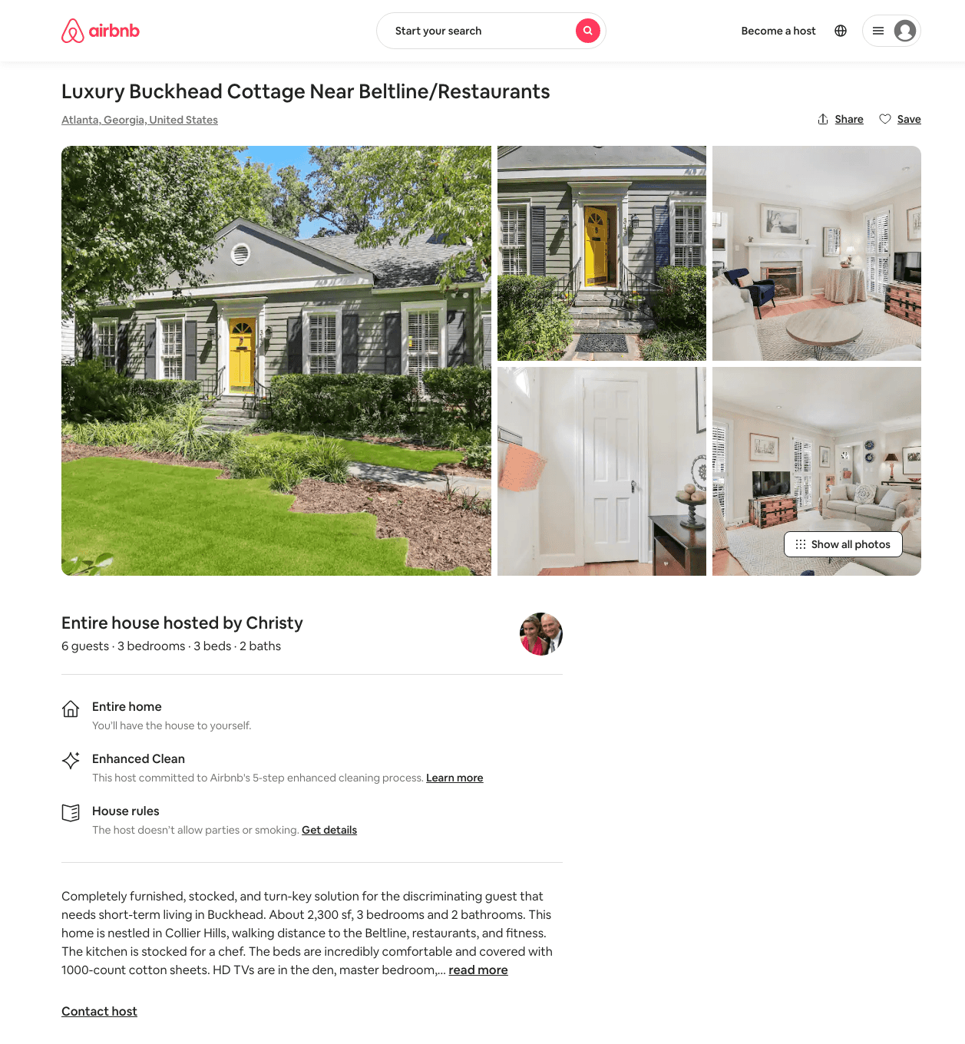
Listing 4192047
3
5
$600
30
Christy
21749915
3
https://www.airbnb.com/rooms/4192047
Aug 2022

Slide 8
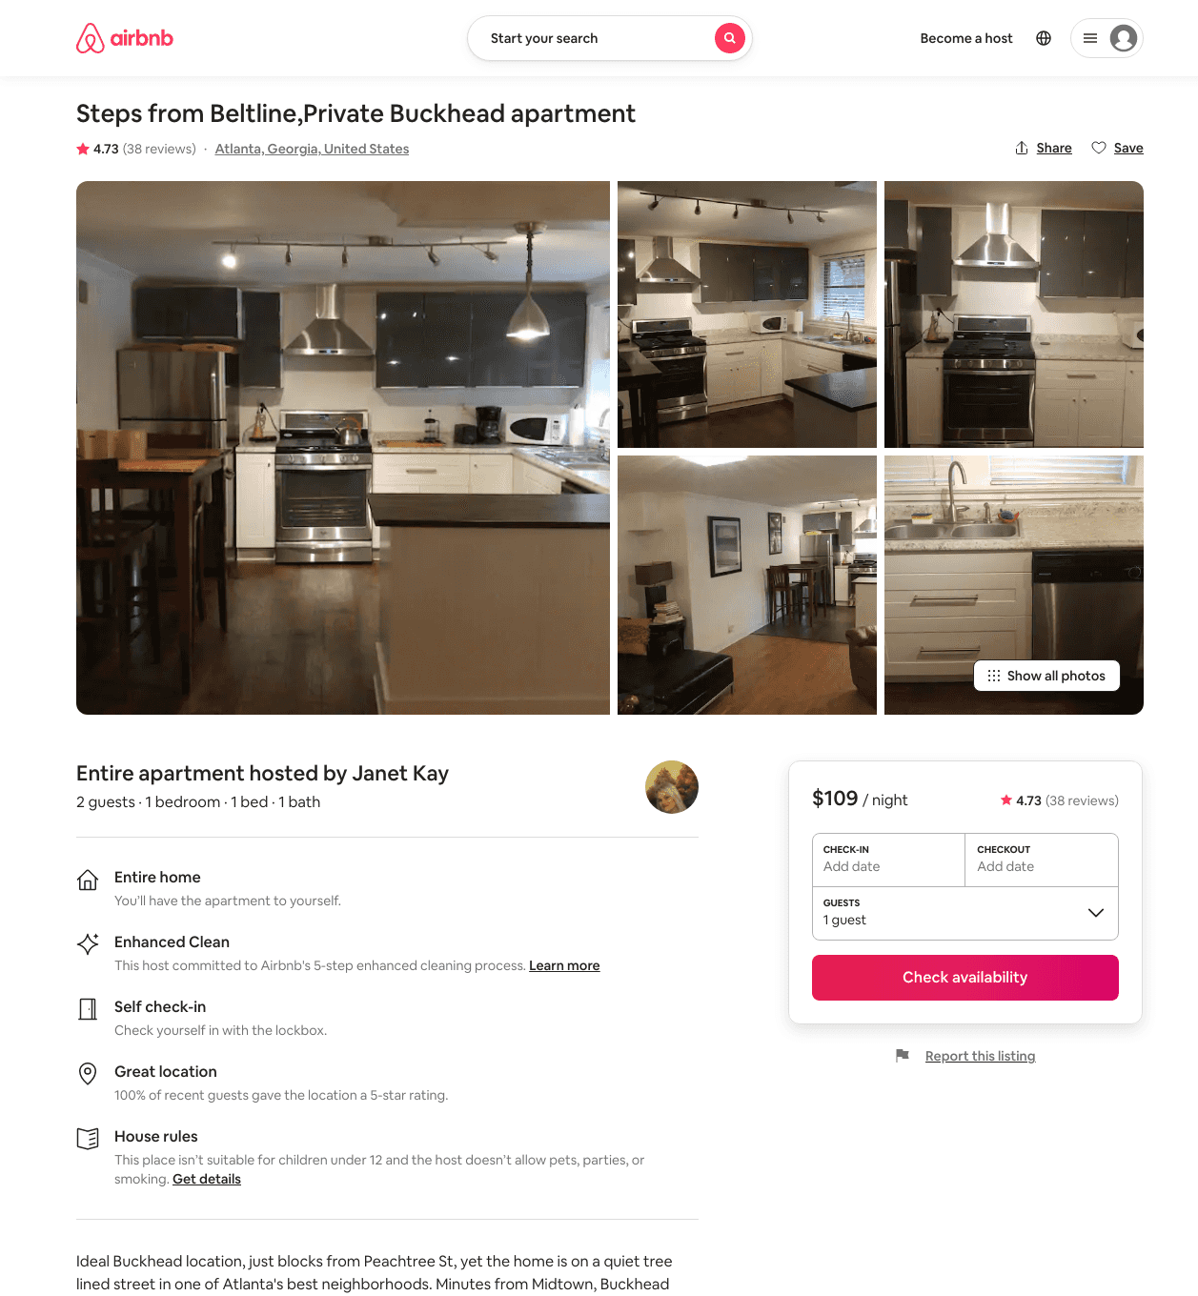
Listing 8868573
1
2
$109 - $116
4.75
7
Janet Kay
46421292
2
https://www.airbnb.com/rooms/8868573
Aug 2022

Slide 9
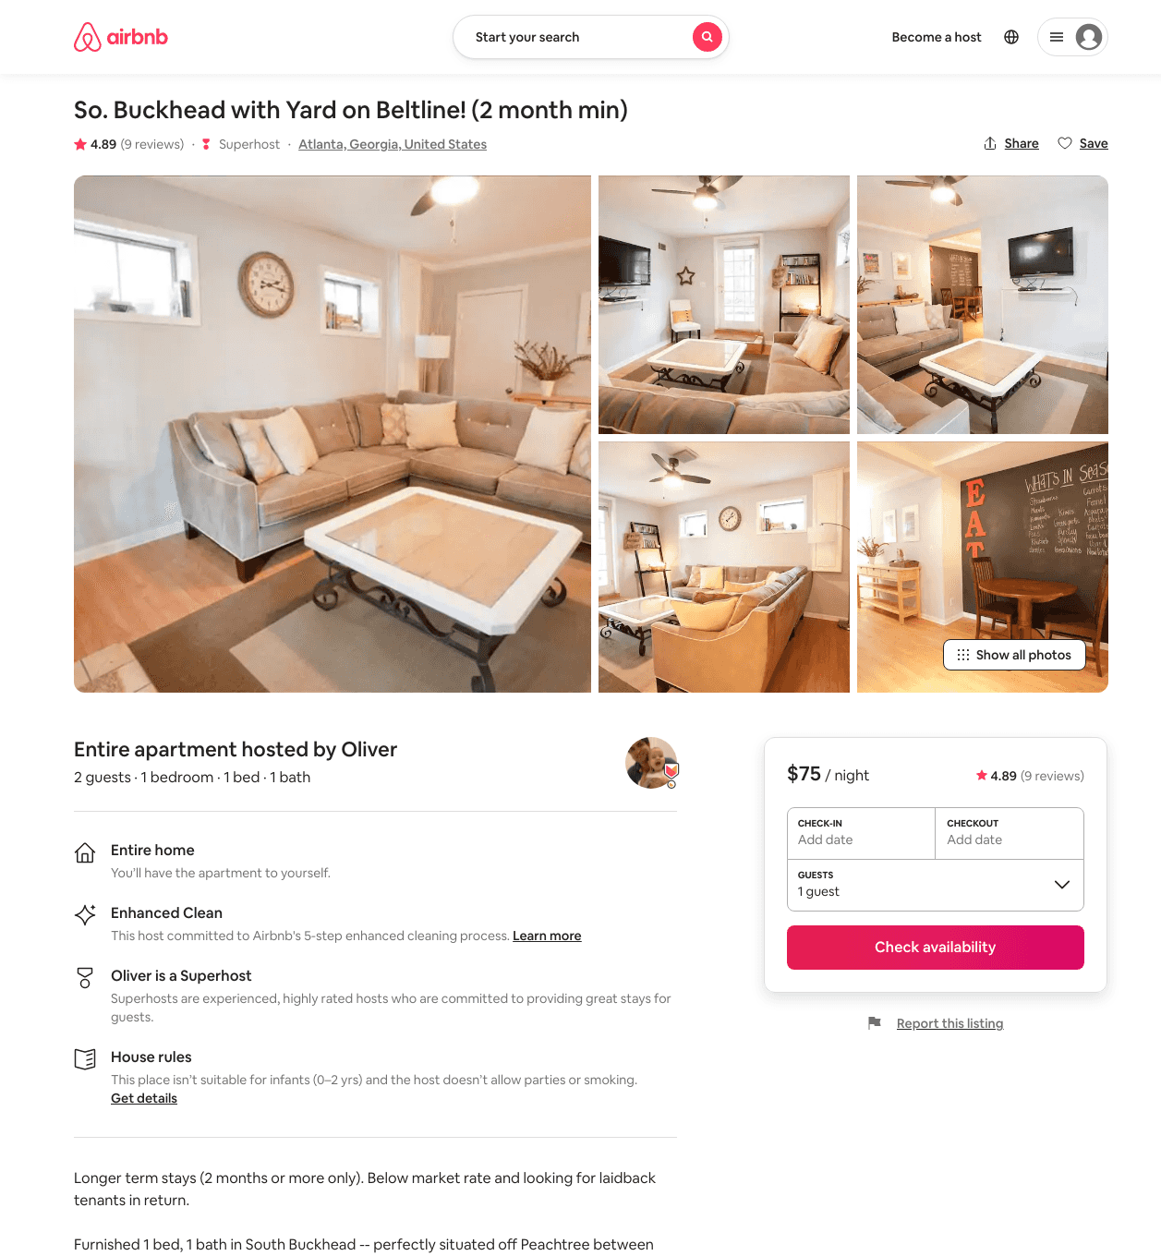
Listing 18306324
1
2
$75
4.90
7
Oliver
6591547
2
https://www.airbnb.com/rooms/18306324
Aug 2022

Slide 10
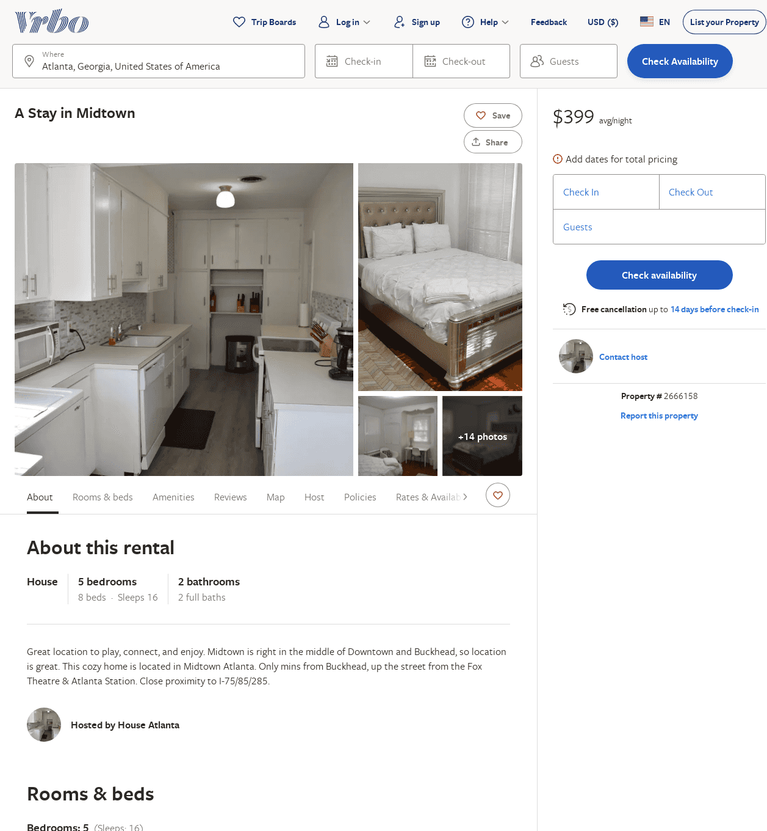
Listing 2666158
5
16
$566
1
Brandy
https://www.vrbo.com/2666158
Aug 2022

Slide 11
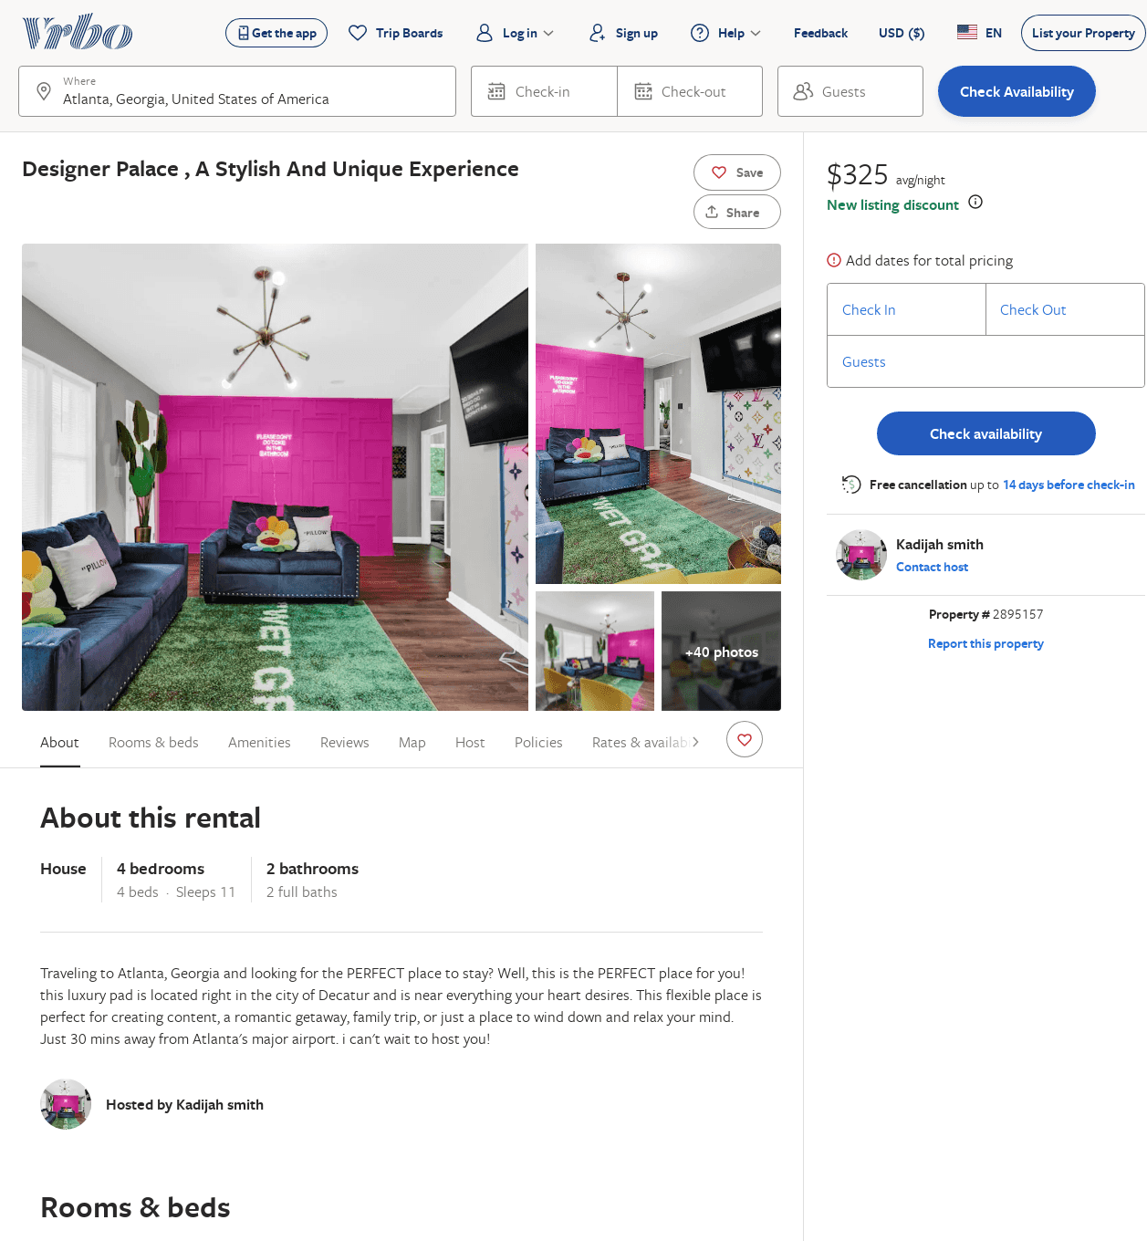
Listing 2895157
4
11
$333
2
Kadijah smith
https://www.vrbo.com/2895157
Aug 2022

