Slide 2
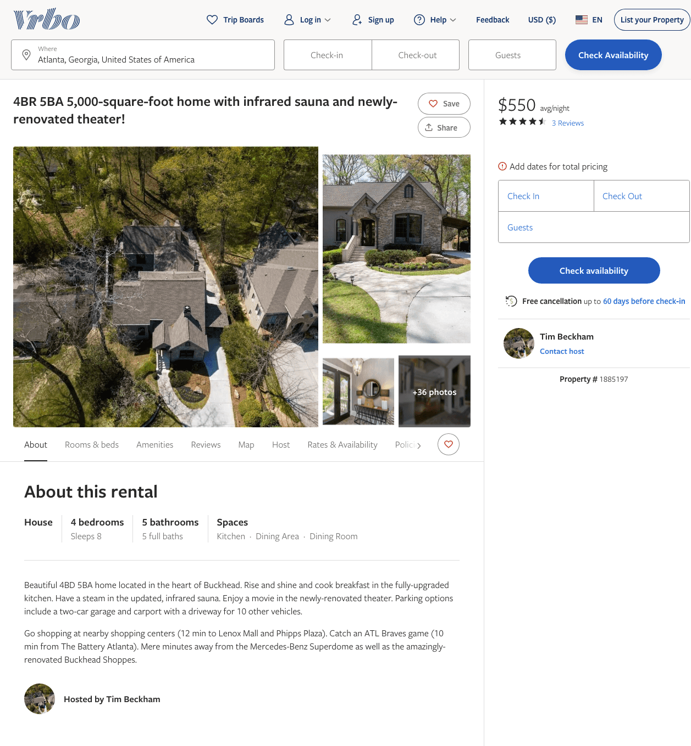
Listing 1885197
4
8
$550 - $600
4
2
Tim Beckham
https://www.vrbo.com/1885197
Aug 2022

Slide 3
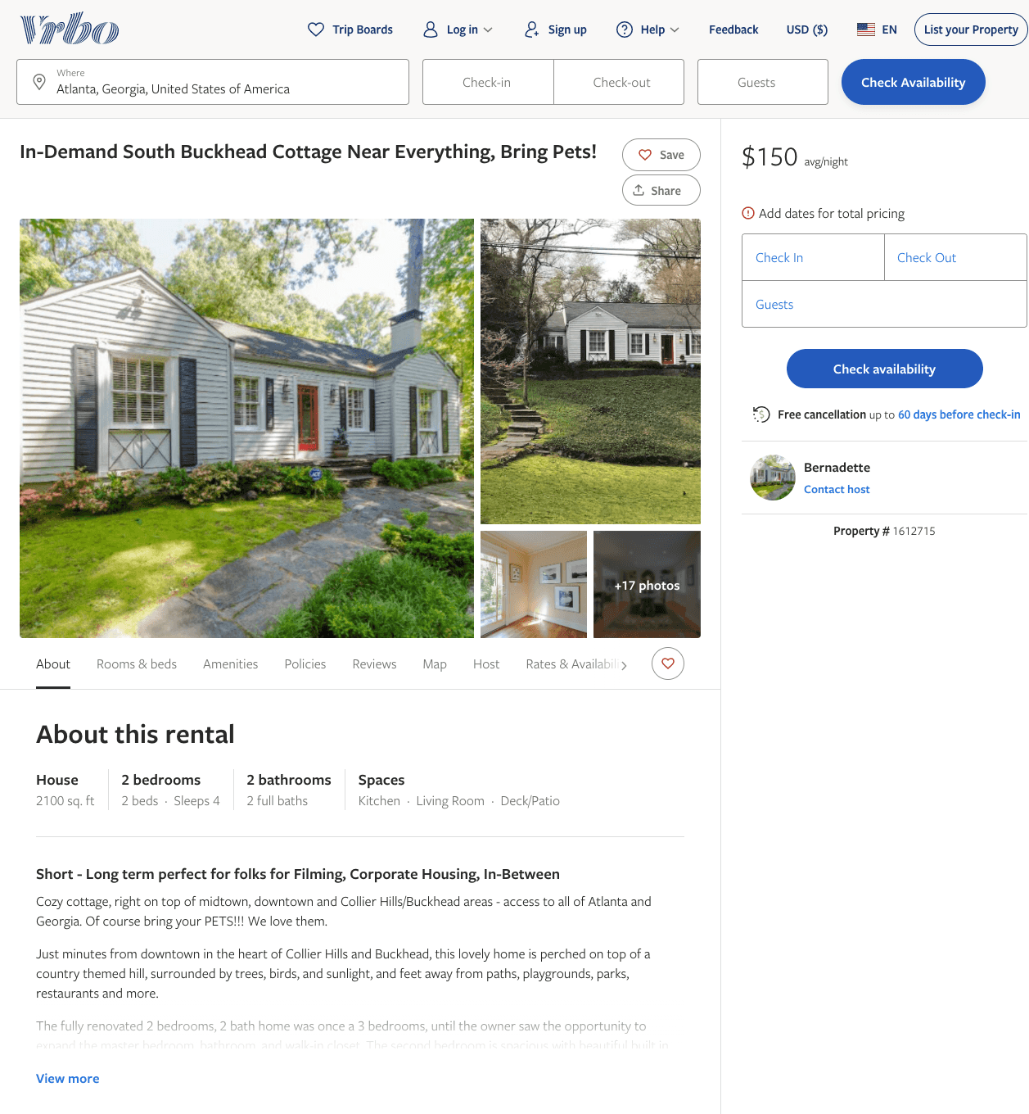
Listing 1612715
2
4
$150 - $160
30
Bernadette
https://www.vrbo.com/1612715
Aug 2022

Slide 4
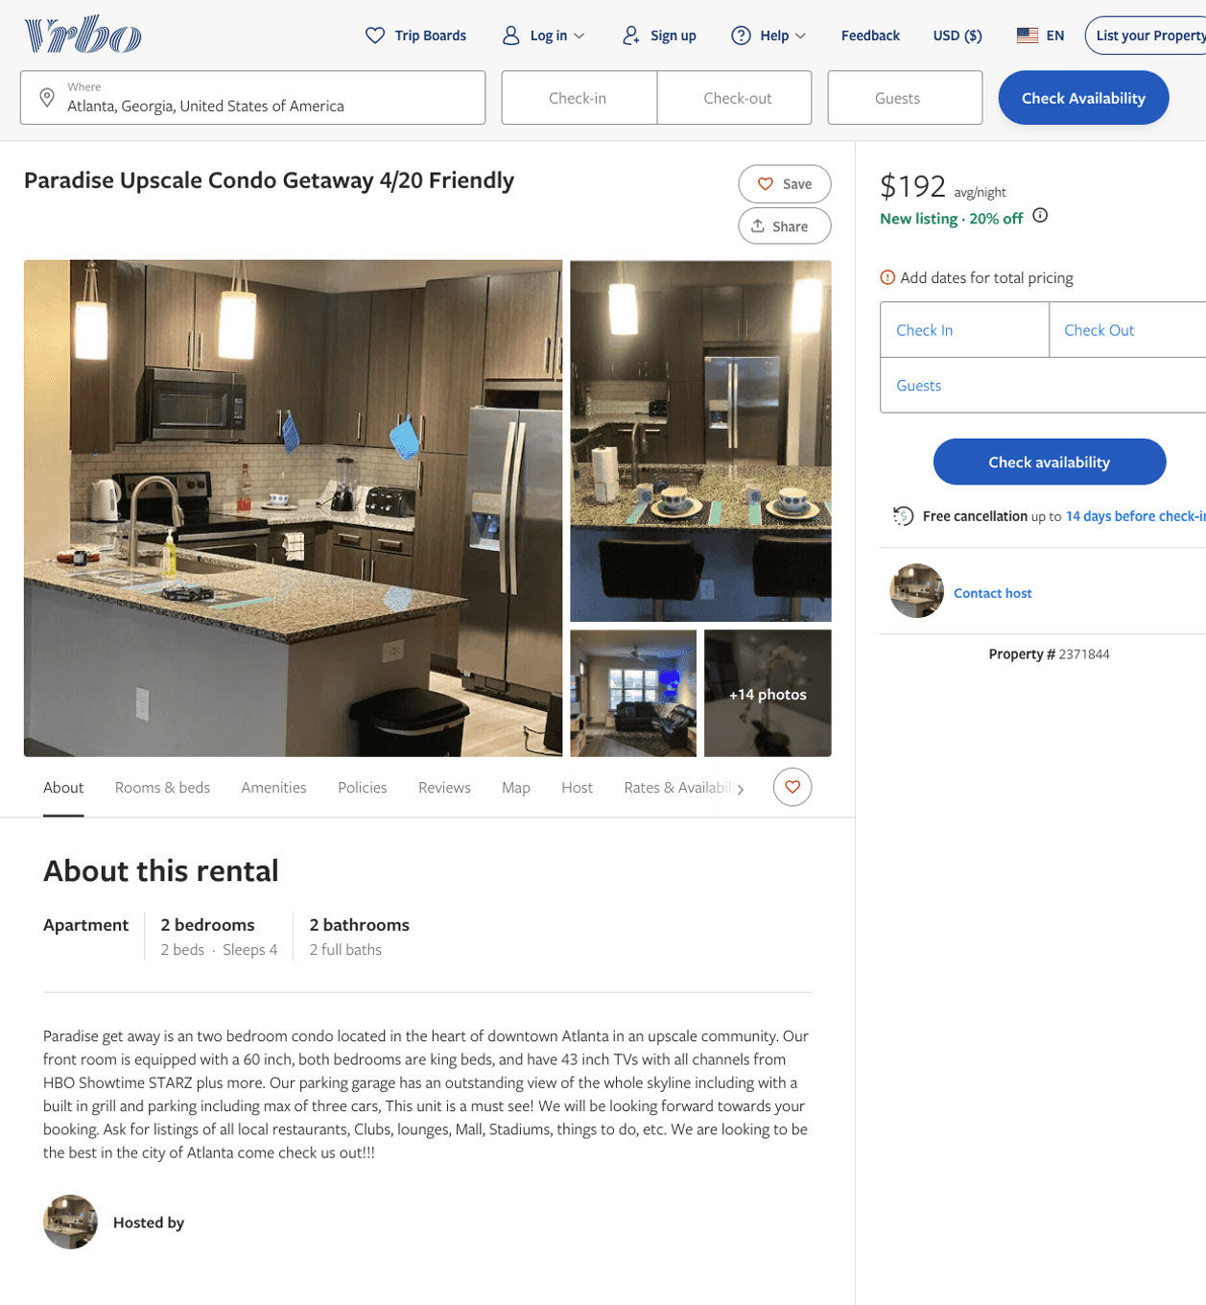
Listing 2371844
2
4
$132 - $200
3
Ryan Strong
https://www.vrbo.com/2371844
Aug 2022

Slide 5
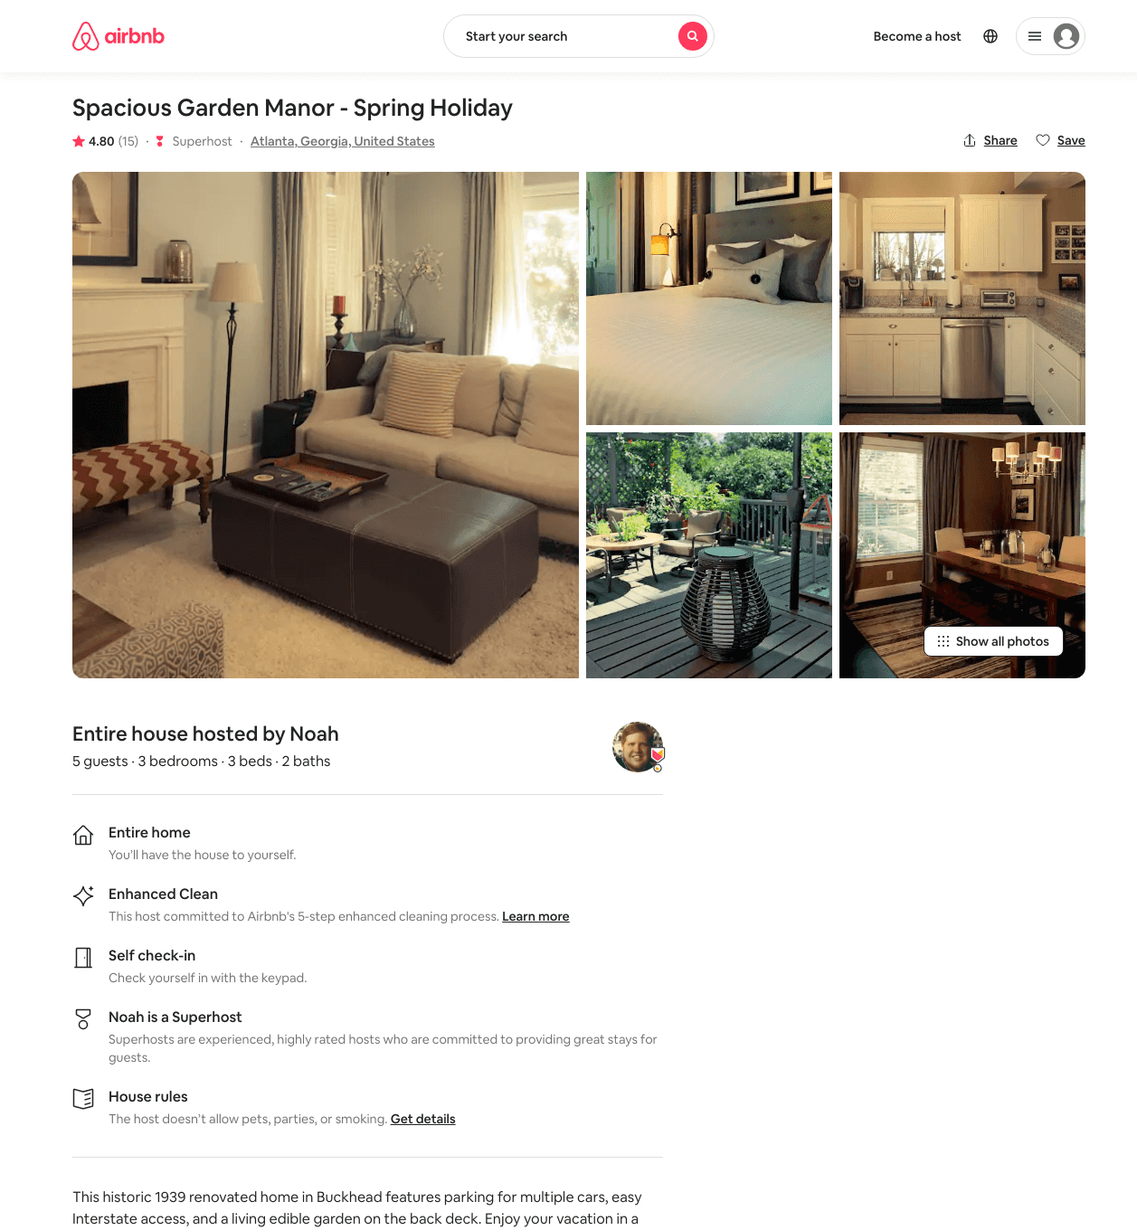
Listing 21398278
3
5
$450
4.79
5
Noah
20607506
1
https://www.airbnb.com/rooms/21398278
Aug 2022

Slide 6
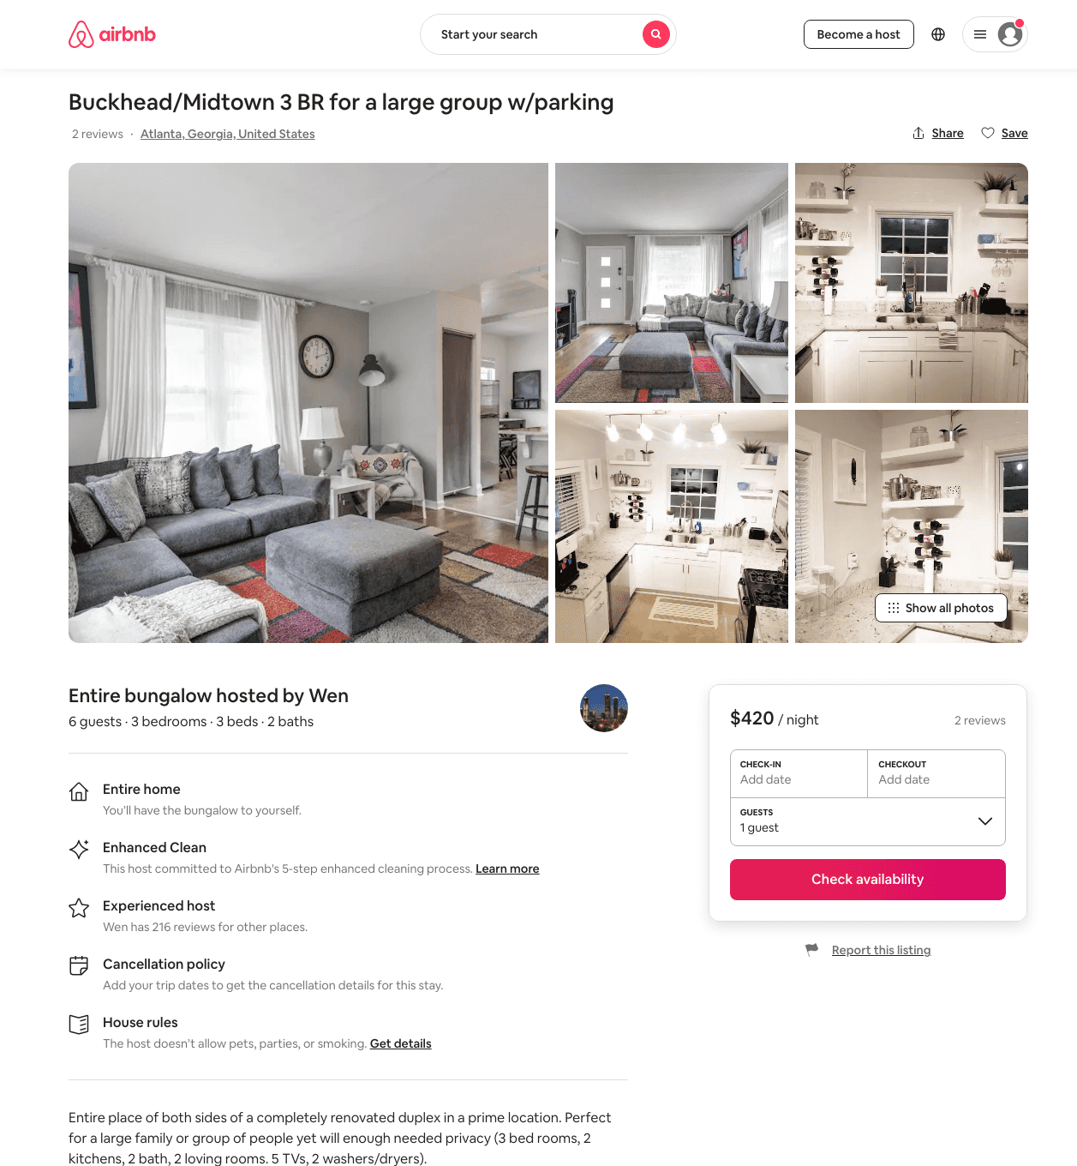
Listing 39267411
3
6
$186 - $420
3
Wen
51753341
4
https://www.airbnb.com/rooms/39267411
Aug 2022

Slide 7
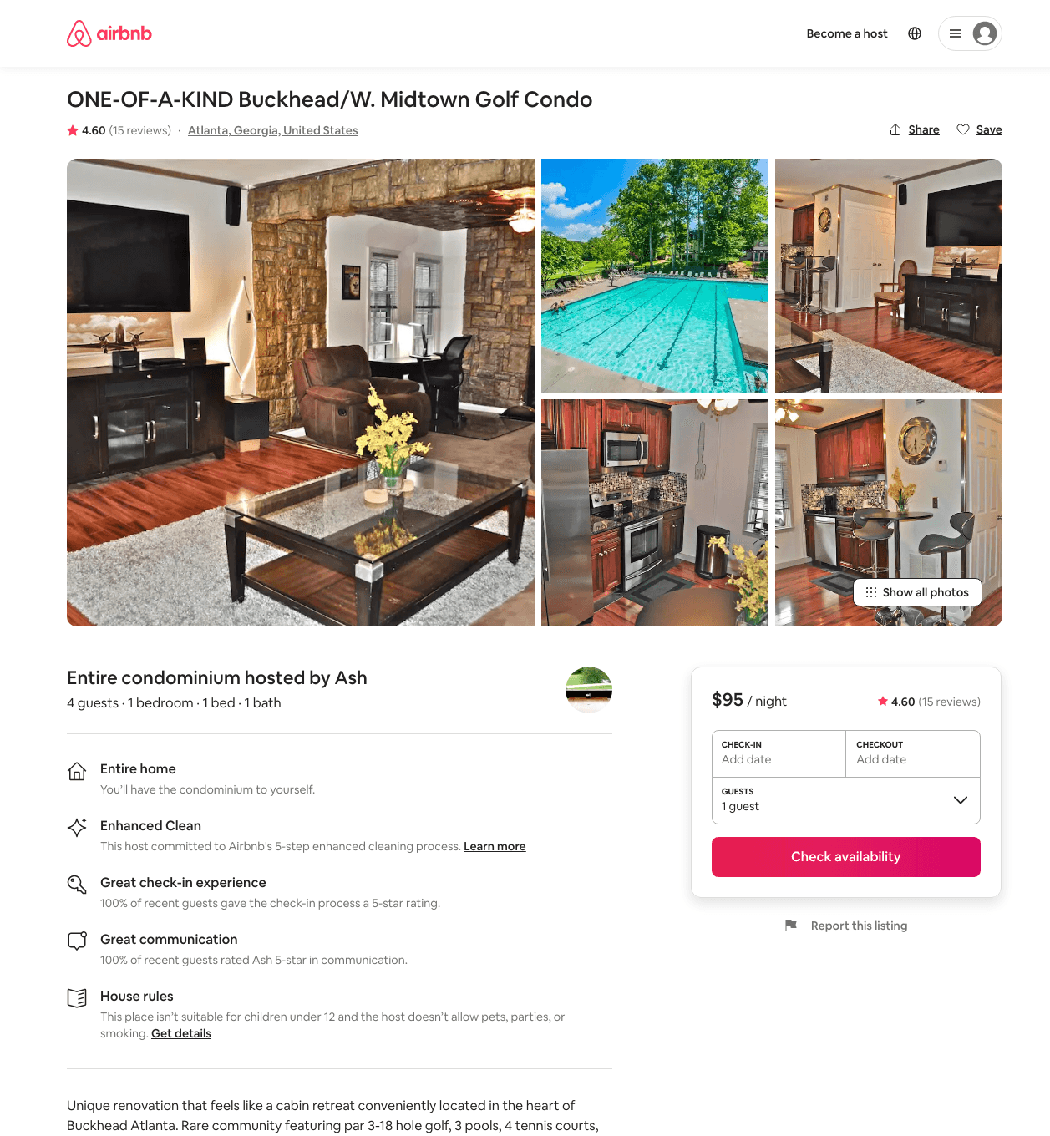
Listing 31924556
1
4
$95 - $97
4.67
10
Ash
169125503
2
https://www.airbnb.com/rooms/31924556
Aug 2022

Slide 8
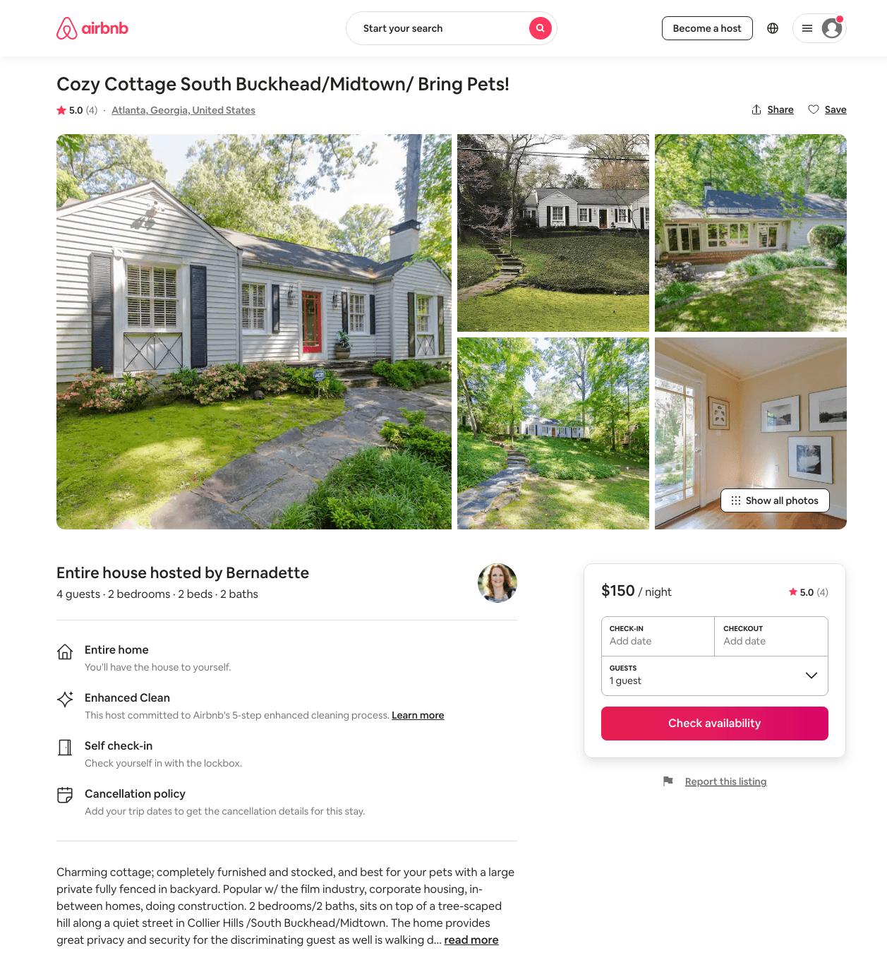
Listing 330245
2
4
$150 - $160
5.0
90
Bernadette
411534
1
https://www.airbnb.com/rooms/330245
Aug 2022

Slide 9
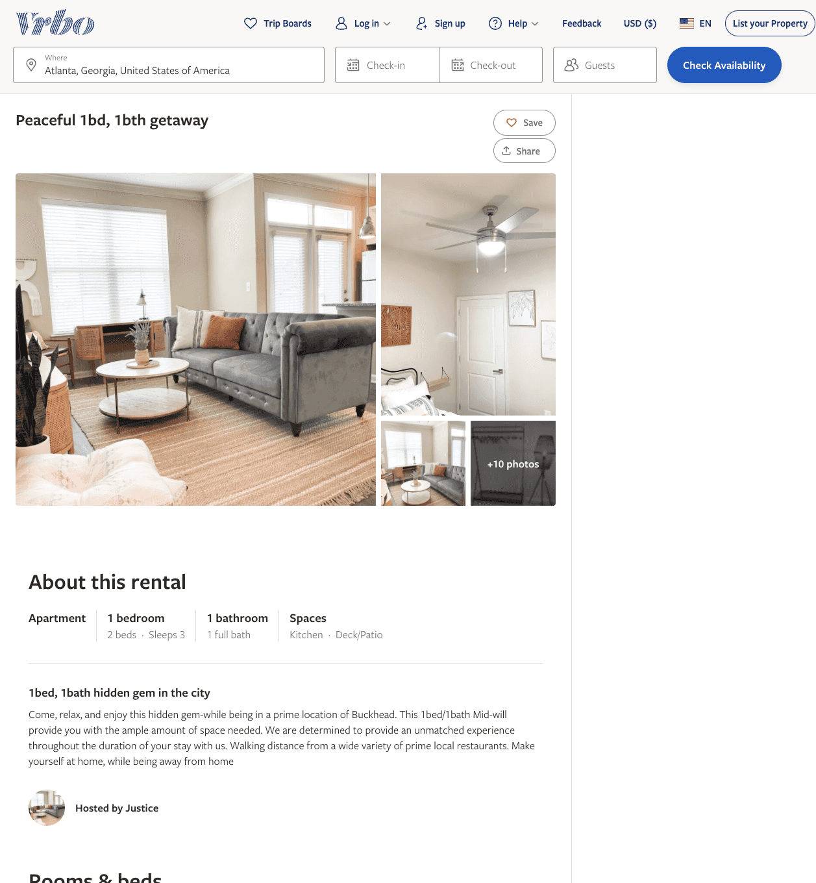
Listing 2607704
1
3
$125
1
Justice
https://www.vrbo.com/2607704
Aug 2022

Slide 10
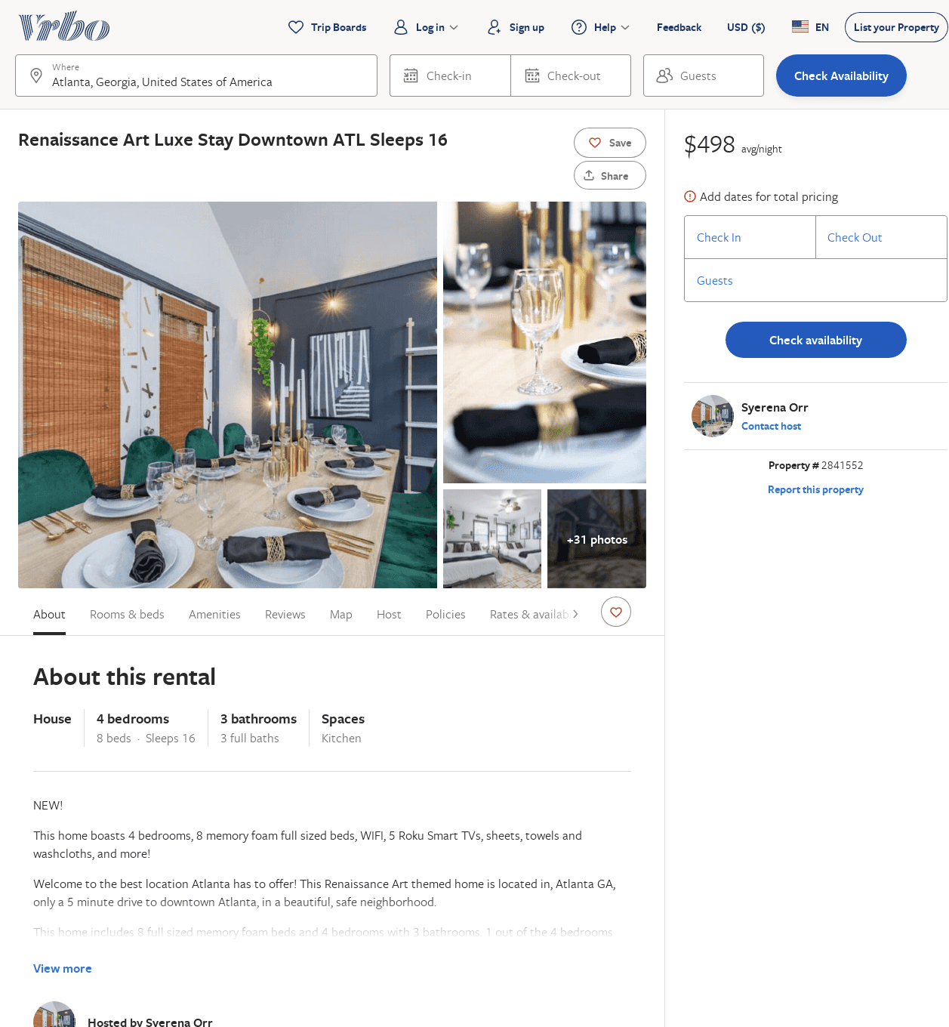
Listing 2841552
4
16
$430
2
Syerena Orr
https://www.vrbo.com/2841552
Aug 2022

