Slide 2
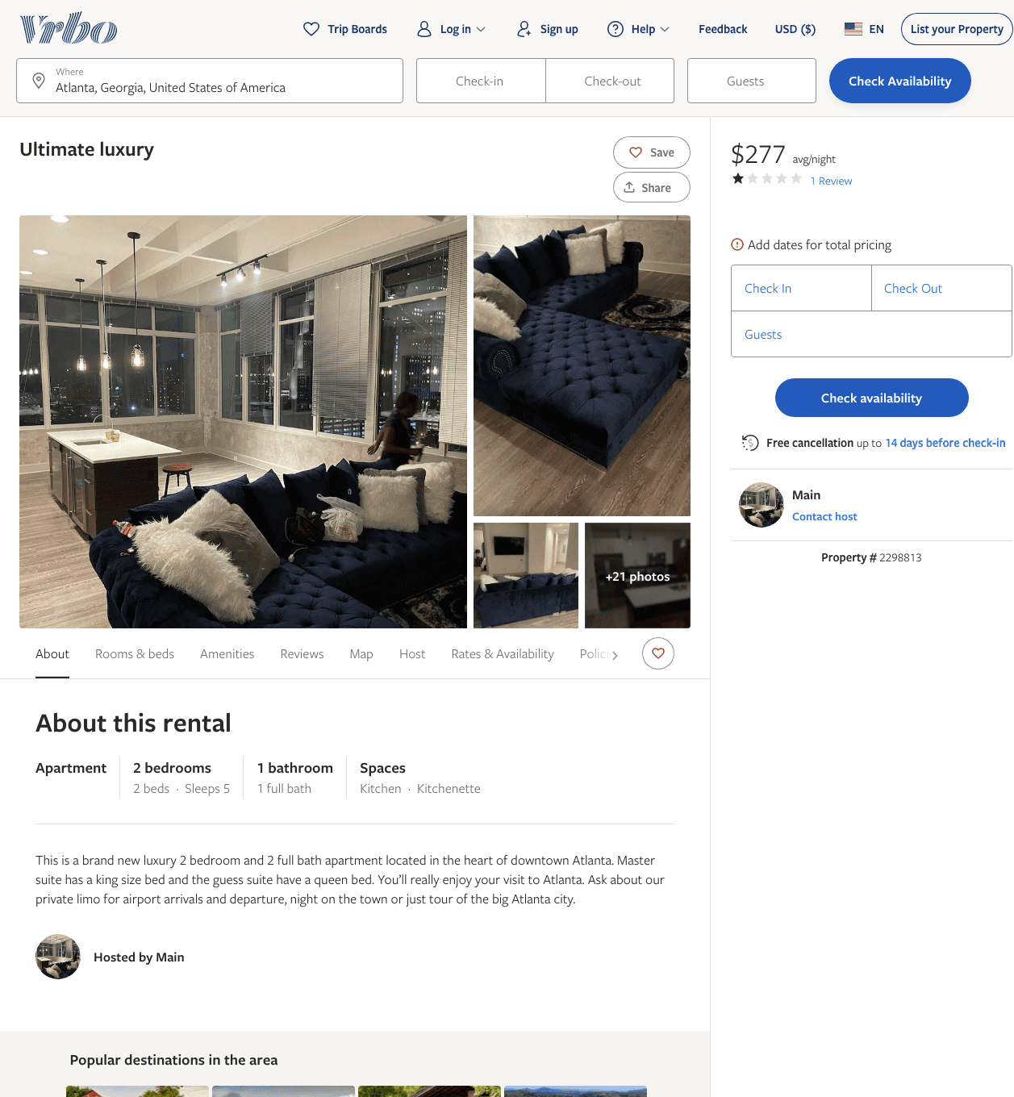
Listing 2298813
2
5
$277 - $309
1
2
Main
https://www.vrbo.com/2298813
Aug 2022

Slide 3
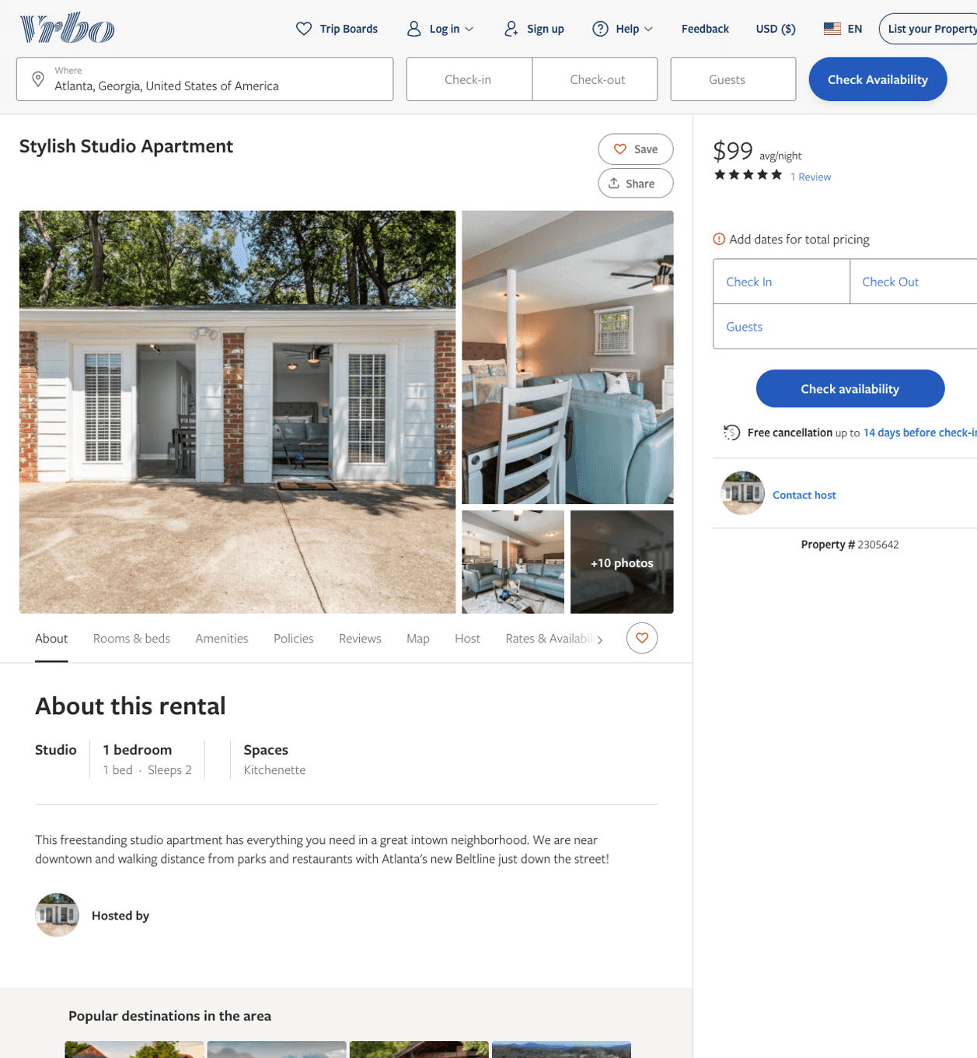
Listing 2305642
1
2
$99
5
3
https://www.vrbo.com/2305642
Aug 2022

Slide 4
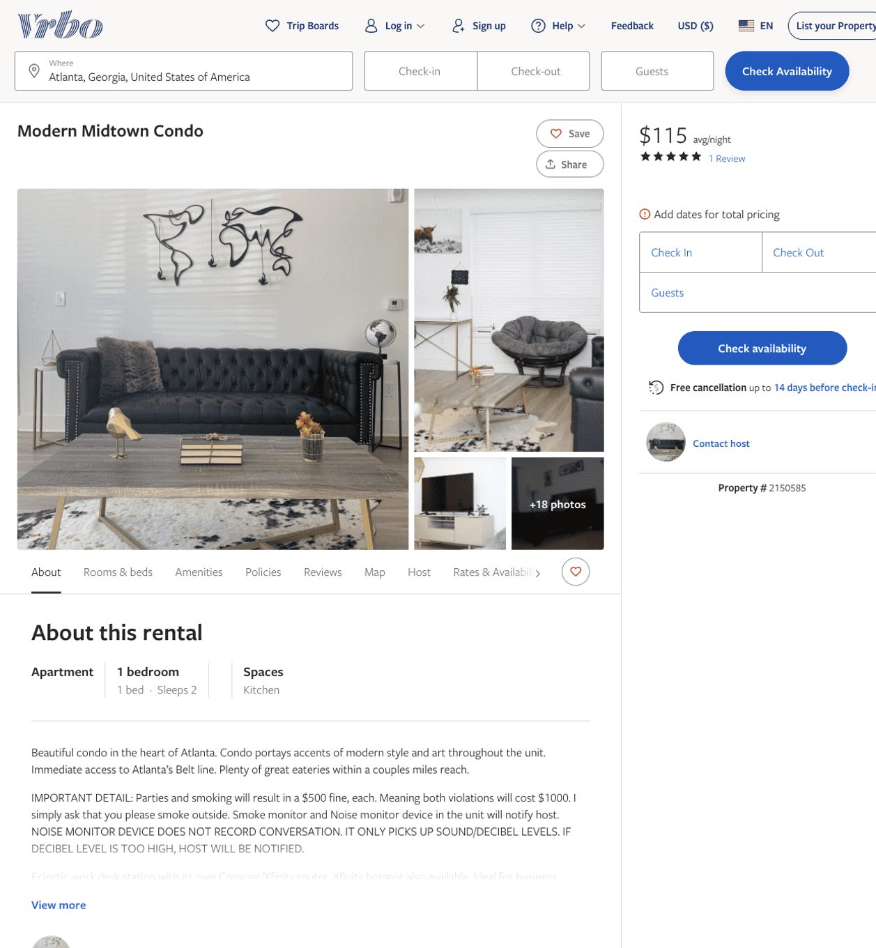
Listing 2150585
1
2
$115 - $137
5
3
https://www.vrbo.com/2150585
Aug 2022

Slide 5
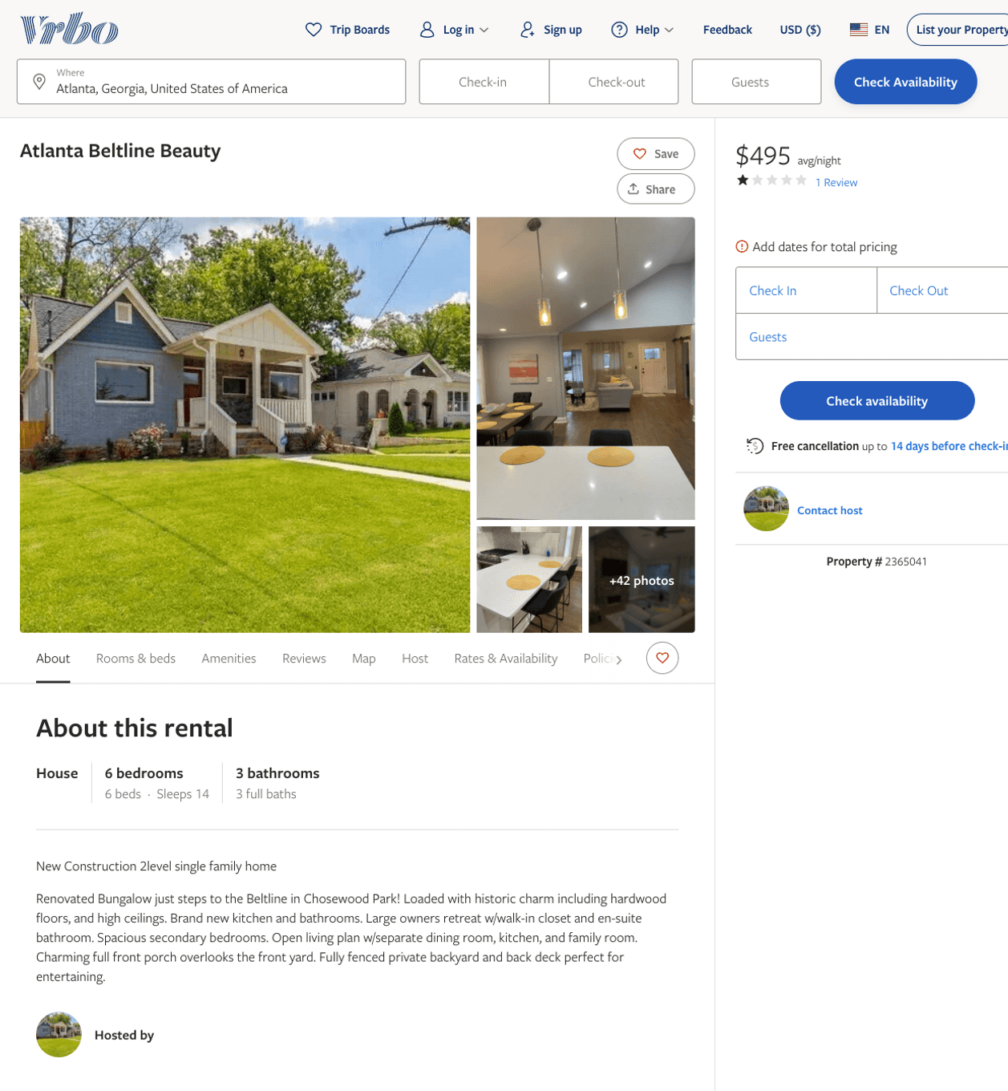
Listing 2365041
6
14
$495 - $552
3
2
https://www.vrbo.com/2365041
Aug 2022

Slide 6
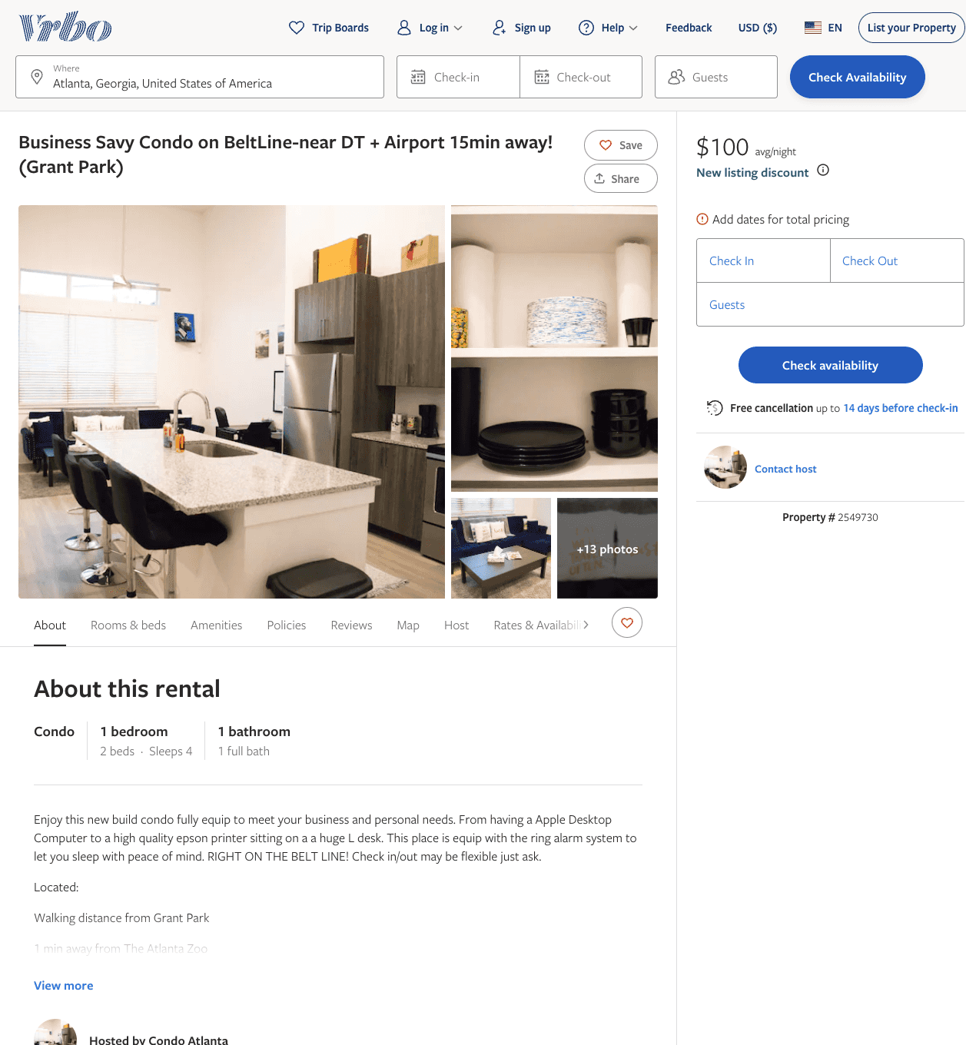
Listing 2549730
1
4
$100 - $135
4.5
3
https://www.vrbo.com/2549730
Aug 2022

Slide 7
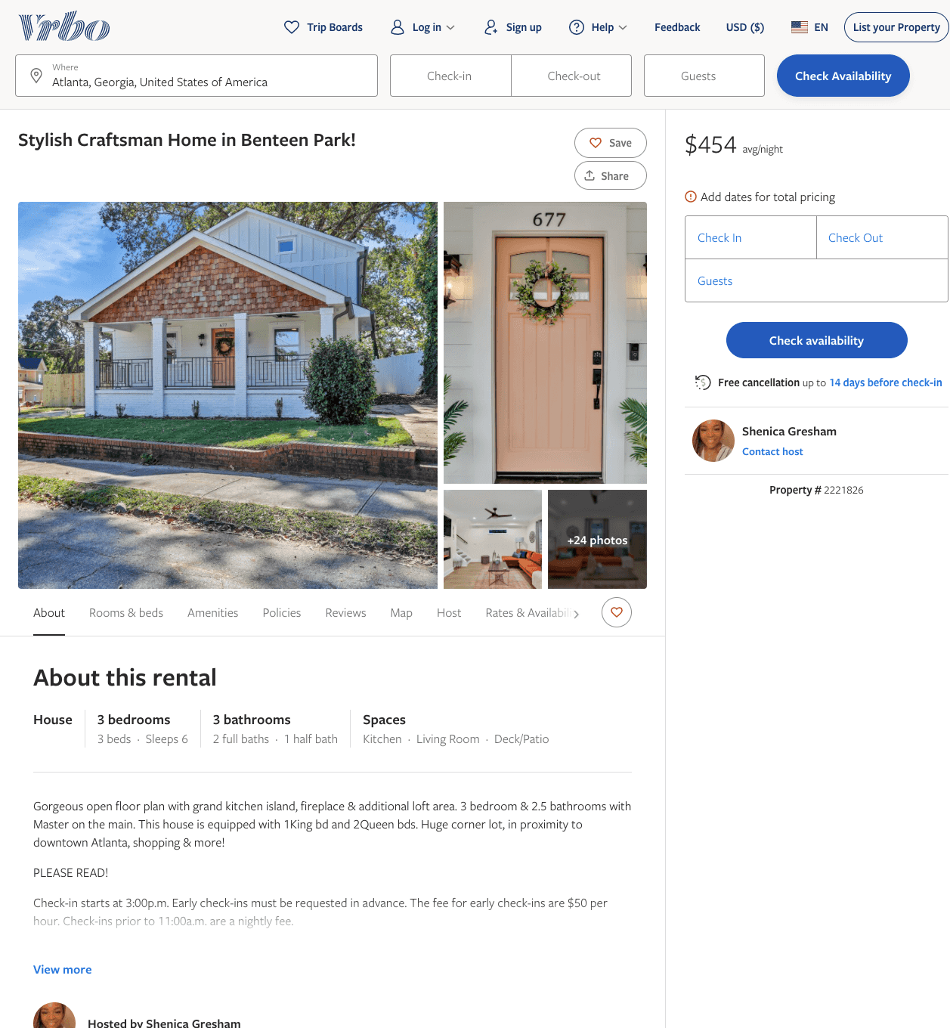
Listing 2221826
3
6
$446 - $467
3
Shenica Gresham
https://www.vrbo.com/2221826
Aug 2022

Slide 8
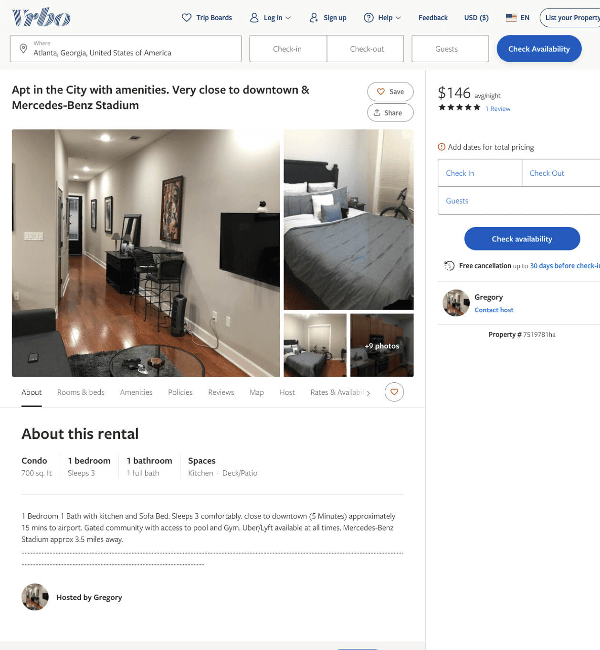
Listing 7519781
1
3
$146
5
1
Gregory
https://www.vrbo.com/7519781ha
Aug 2022

Slide 9
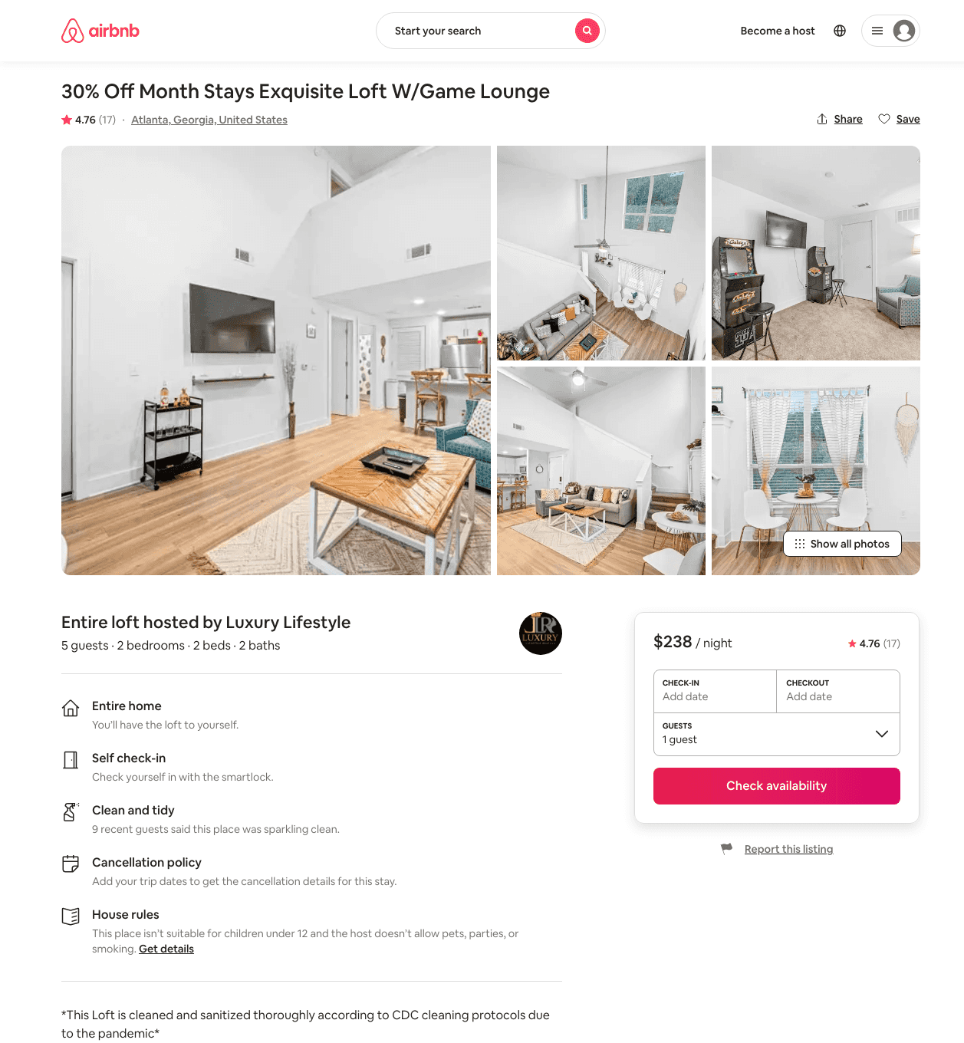
Listing 46733771
2
7
$136 - $3500
4.64
1
Luxury Lifestyle
105453470
6
https://www.airbnb.com/rooms/46733771
Aug 2022

Slide 10
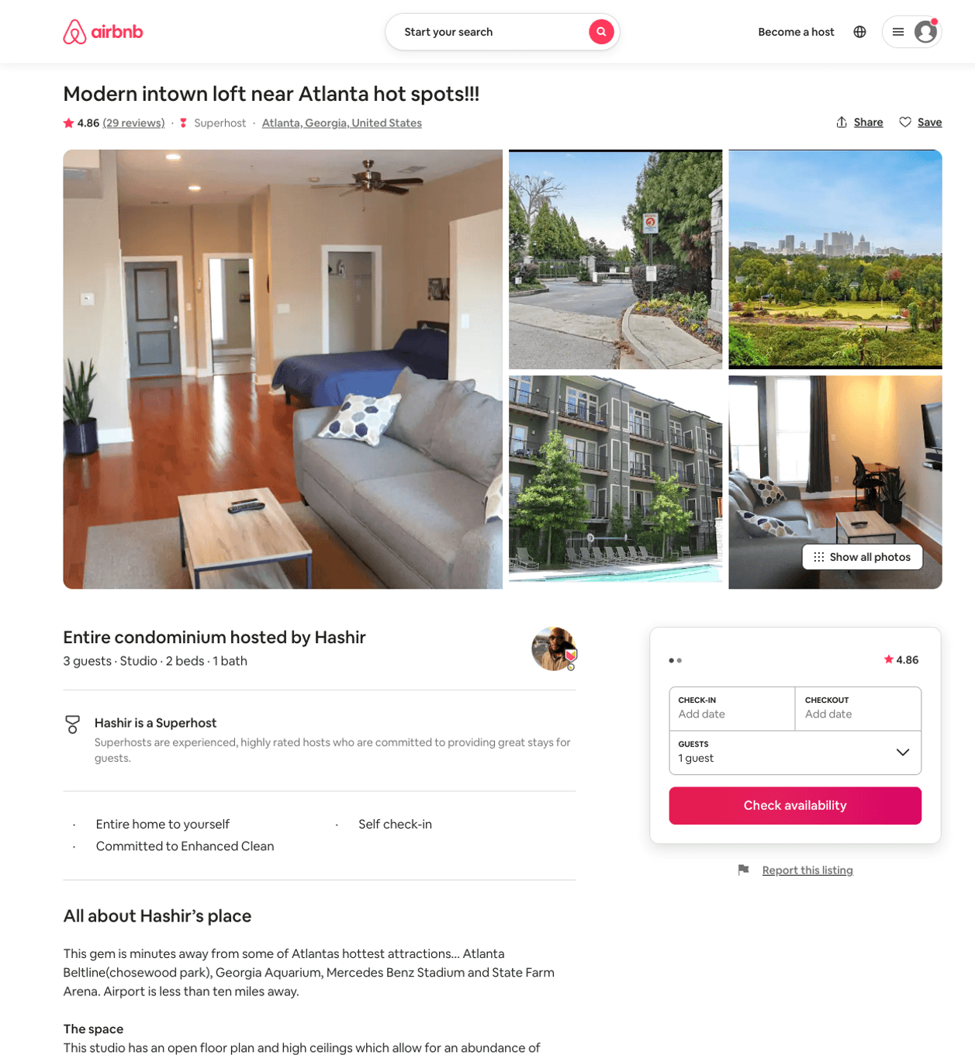
Listing 30713537
Studio
3
$85
4.81
30
Hashir
45909534
1
https://www.airbnb.com/rooms/30713537
Aug 2022

Slide 11
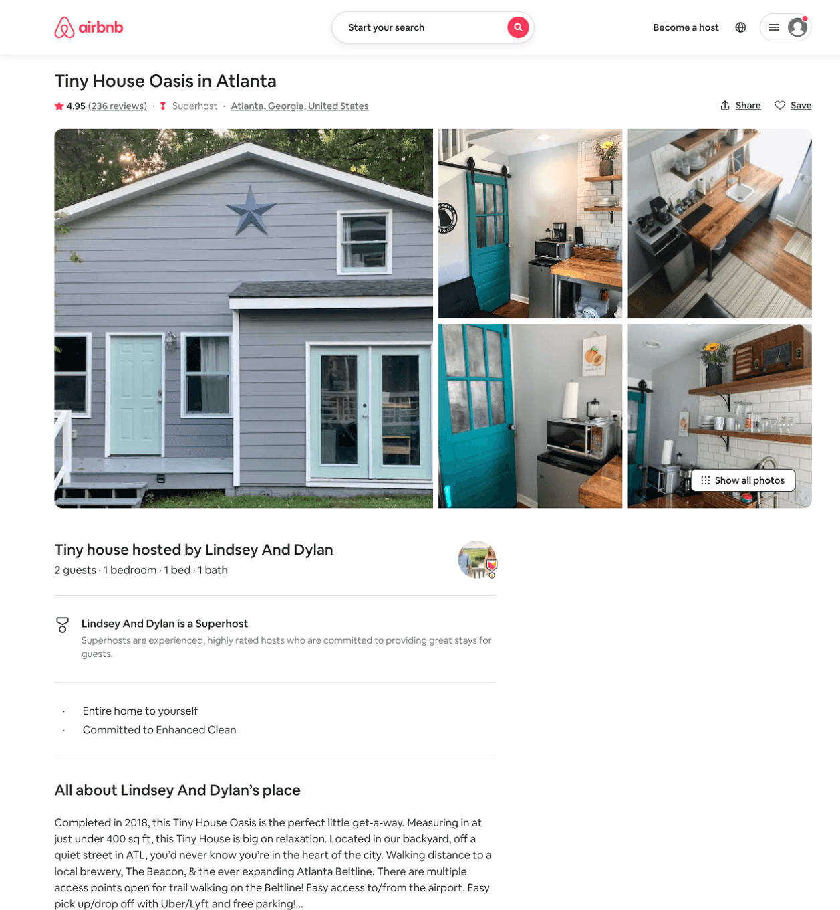
Listing 20265206
1
2
$75 - $81
4.95
5
Lindsey
57568985
1
https://www.airbnb.com/rooms/20265206
Jun 2022

Slide 12
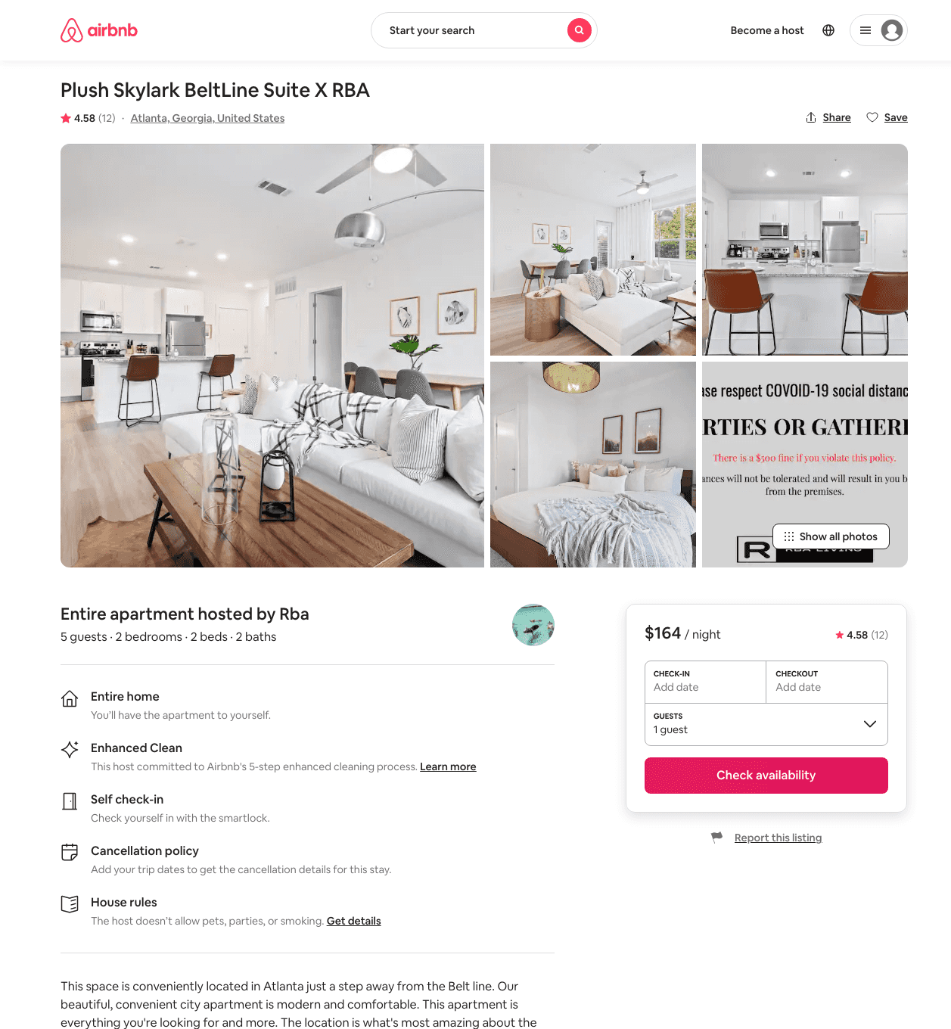
Listing 46368046
2
5
$139 - $209
4.66
2
Rba
627117
19
https://www.airbnb.com/rooms/46368046
Aug 2022

Slide 13
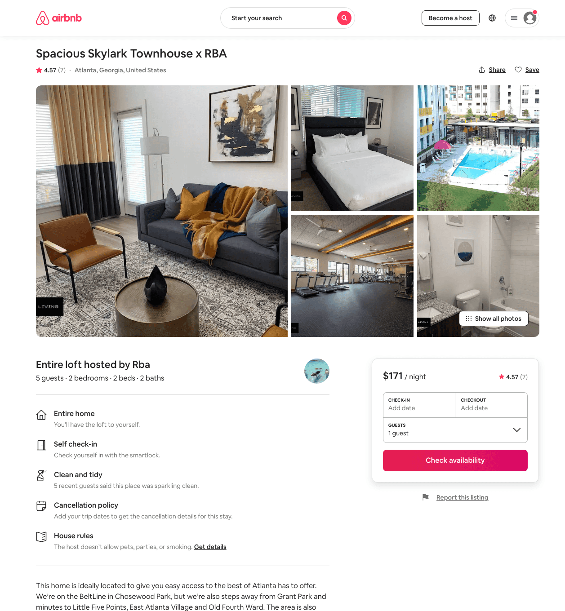
Listing 46965410
2
5
$133 - $202
4.54
2
Rba
627117
19
https://www.airbnb.com/rooms/46965410
Aug 2022

Slide 14
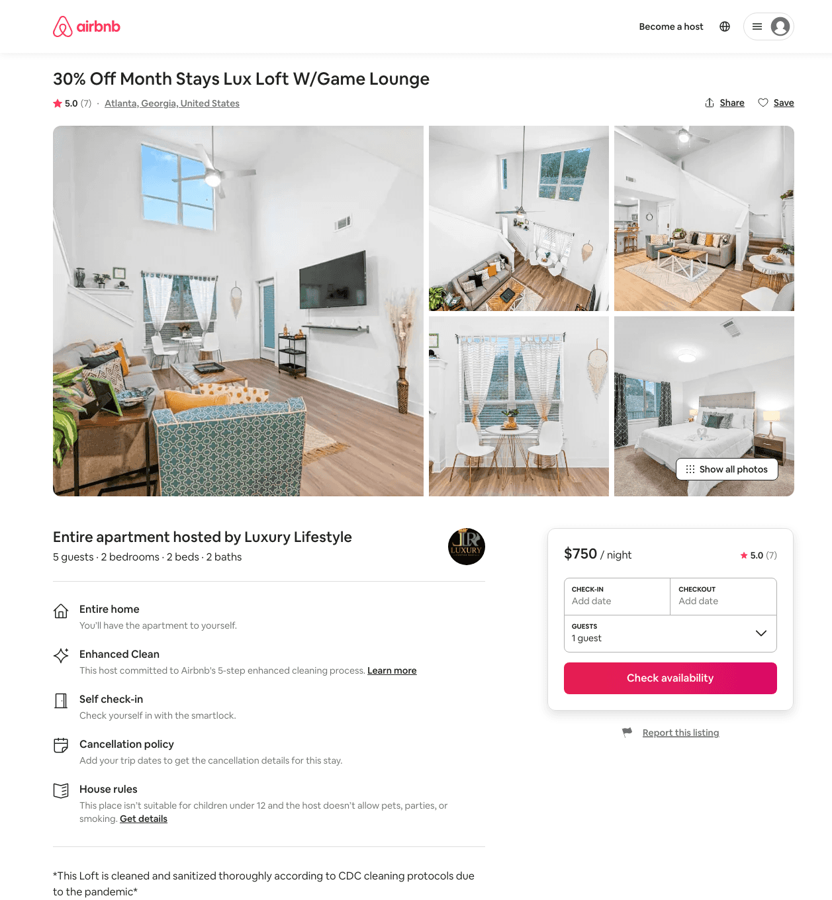
Listing 46757750
2
7
$128 - $3214
4.56
1
Luxury Lifestyle
105453470
6
https://www.airbnb.com/rooms/46757750
Aug 2022

Slide 15
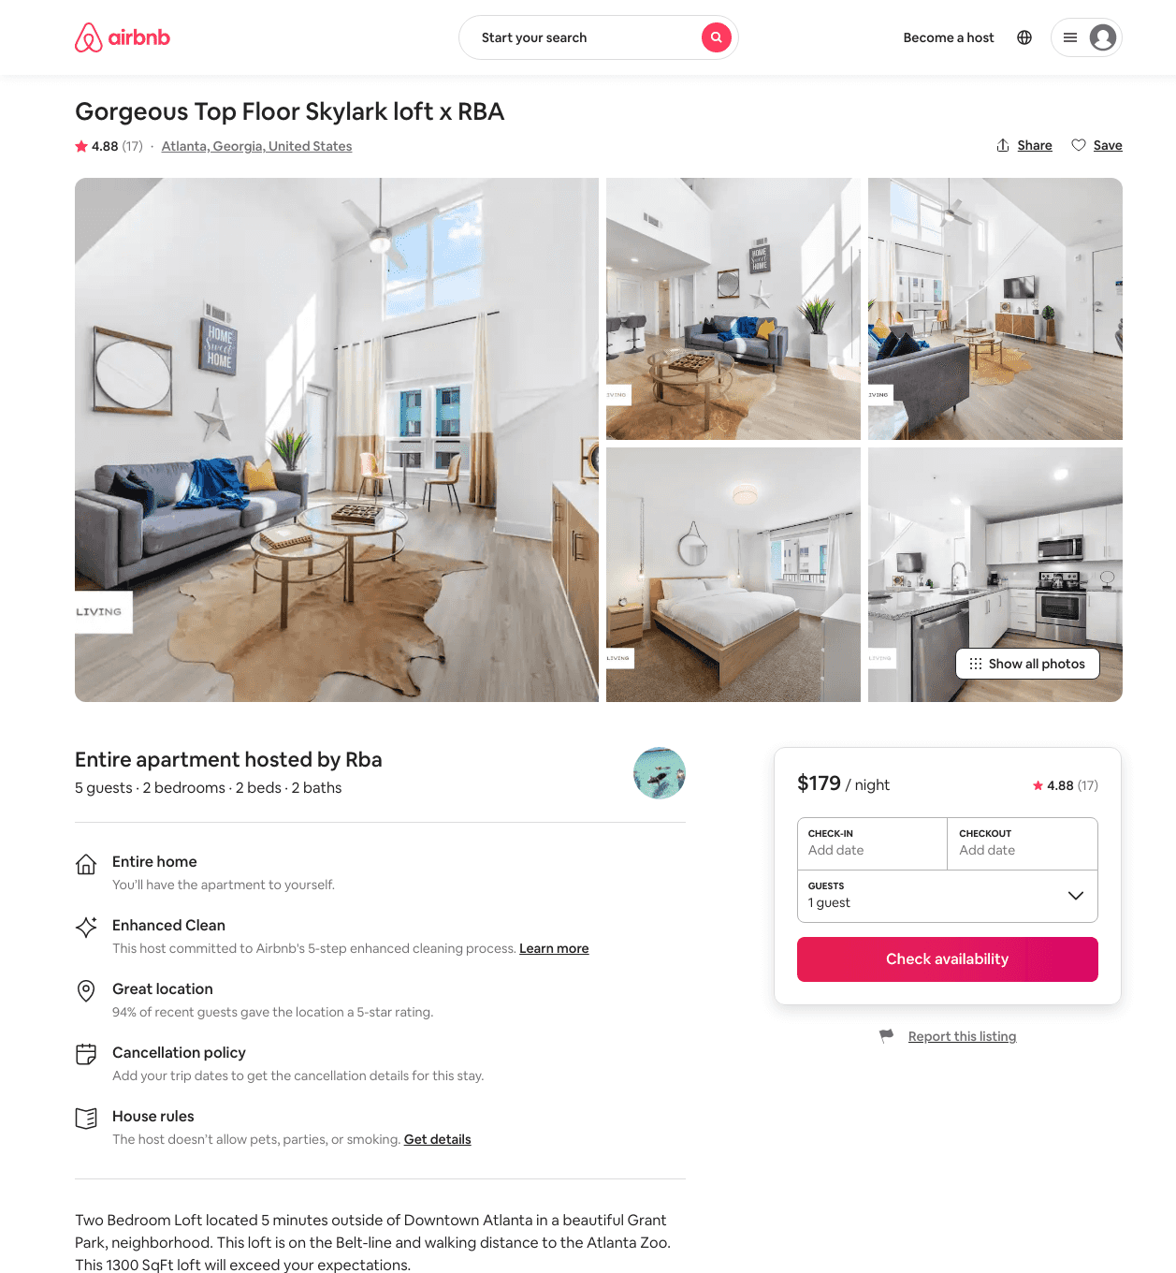
Listing 45925165
2
5
$152 - $224
4.59
2
Rba
627117
19
https://www.airbnb.com/rooms/45925165
Aug 2022

Slide 16
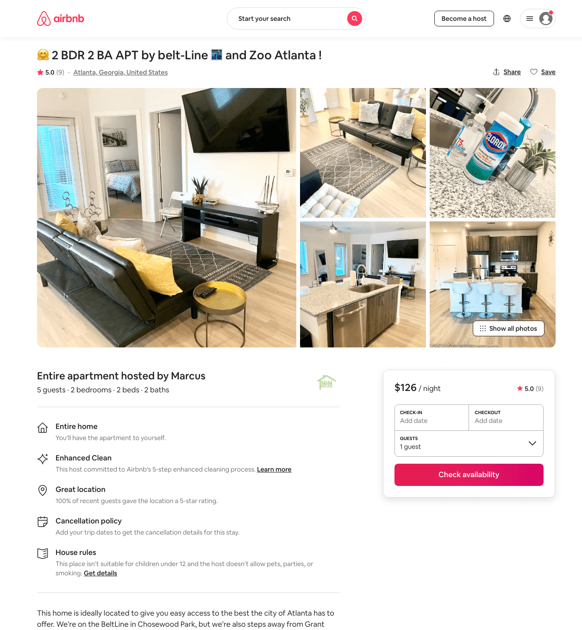
Listing 48285761
2
5
$106 - $300
4.97
2
Marcus
117627828
2
https://www.airbnb.com/rooms/48285761
Aug 2022

Slide 17
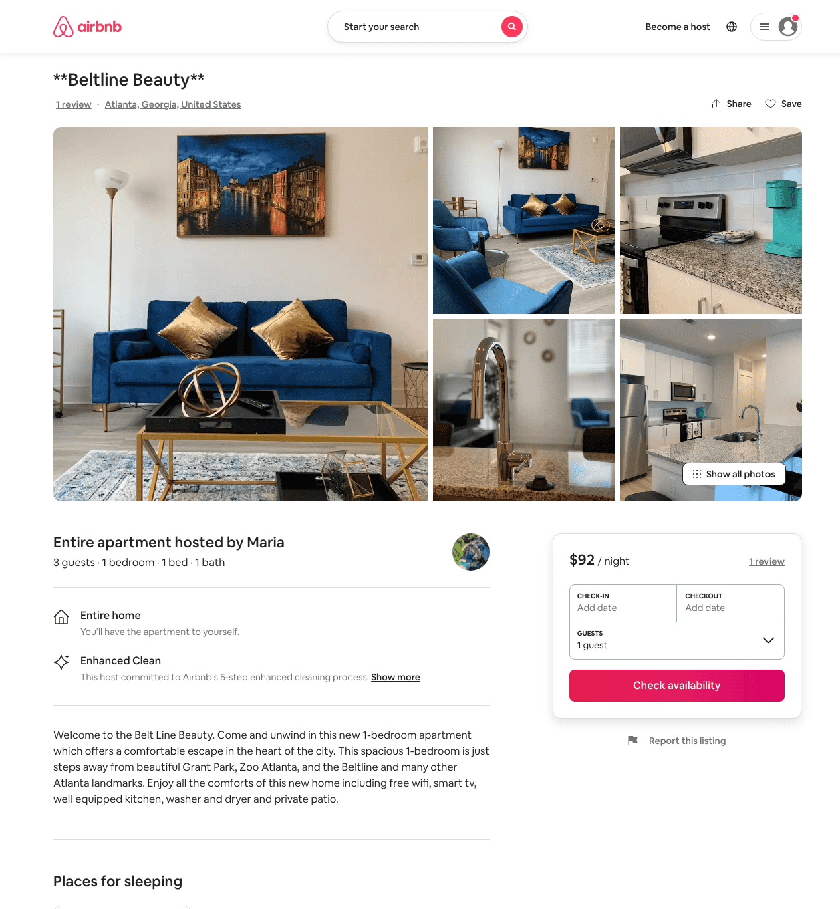
Listing 49932520
1
3
$87 - $130
4.88
1
Mj
402649269
1
https://www.airbnb.com/rooms/49932520
Aug 2022

Slide 18
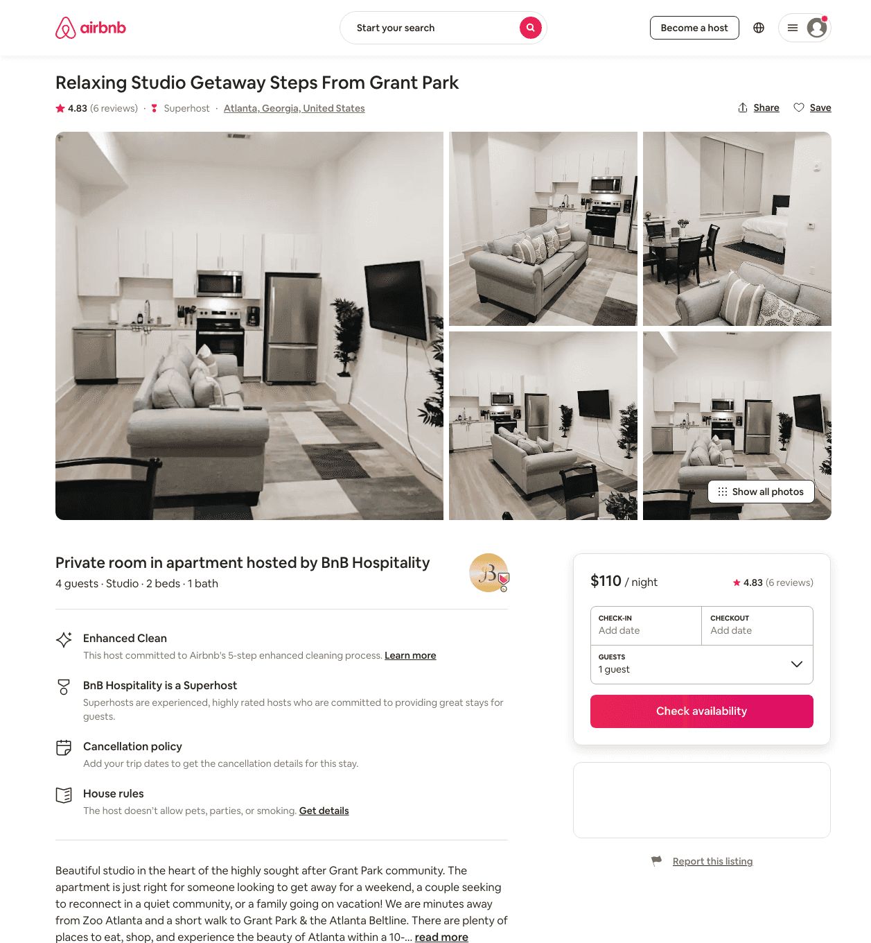
Listing 48129700
Studio
4
$86 - $159
4.44
1
Southern Comfort
331366792
25
https://www.airbnb.com/rooms/48129700
Aug 2022

Slide 19
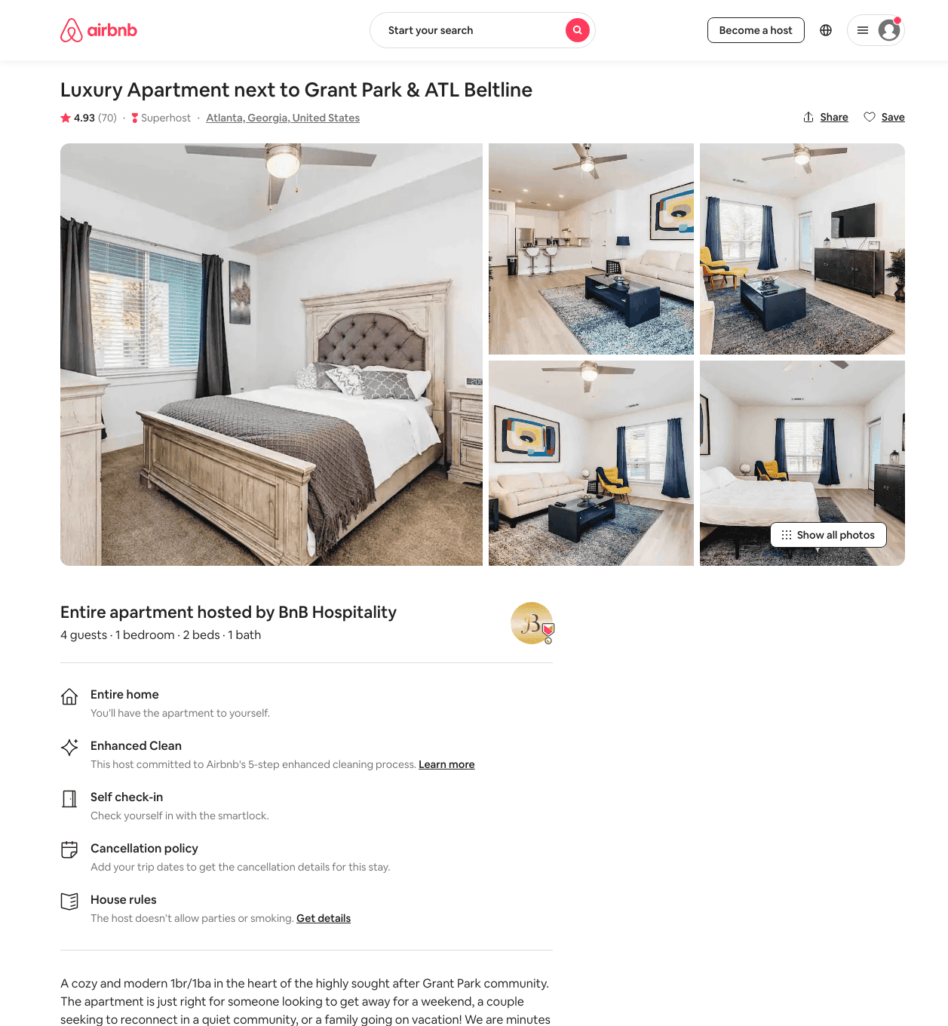
Listing 44492511
1
4
$85 - $179
4.54
1
Southern Comfort
331366792
25
https://www.airbnb.com/rooms/44492511
Aug 2022

Slide 20
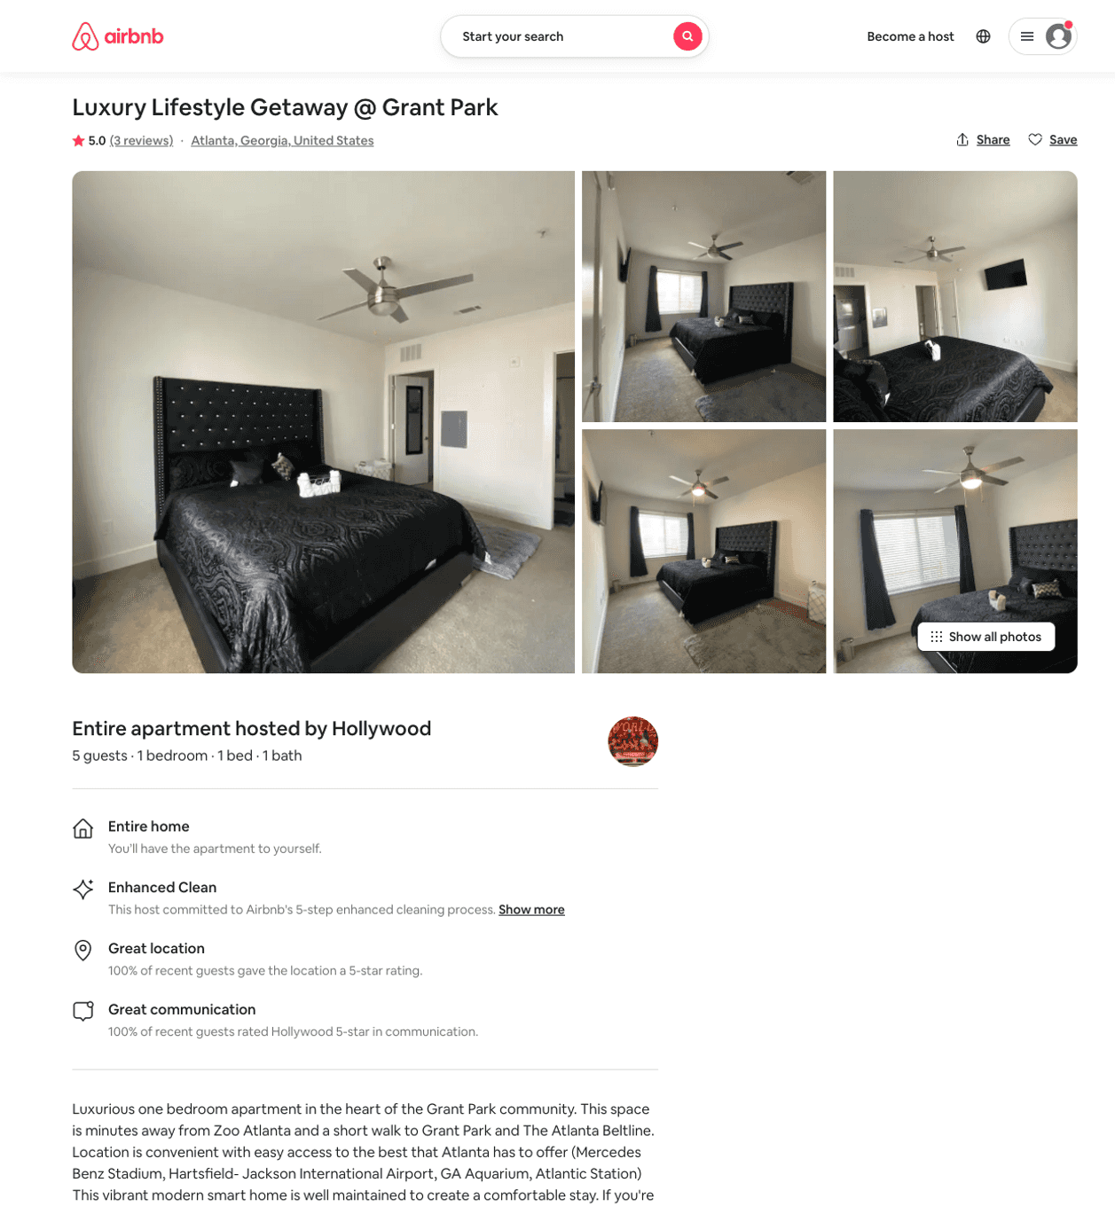
Listing 49831574
1
5
$125 - $151
4.60
1
Hollywood
239853939
1
https://www.airbnb.com/rooms/49831574
Aug 2022

Slide 21
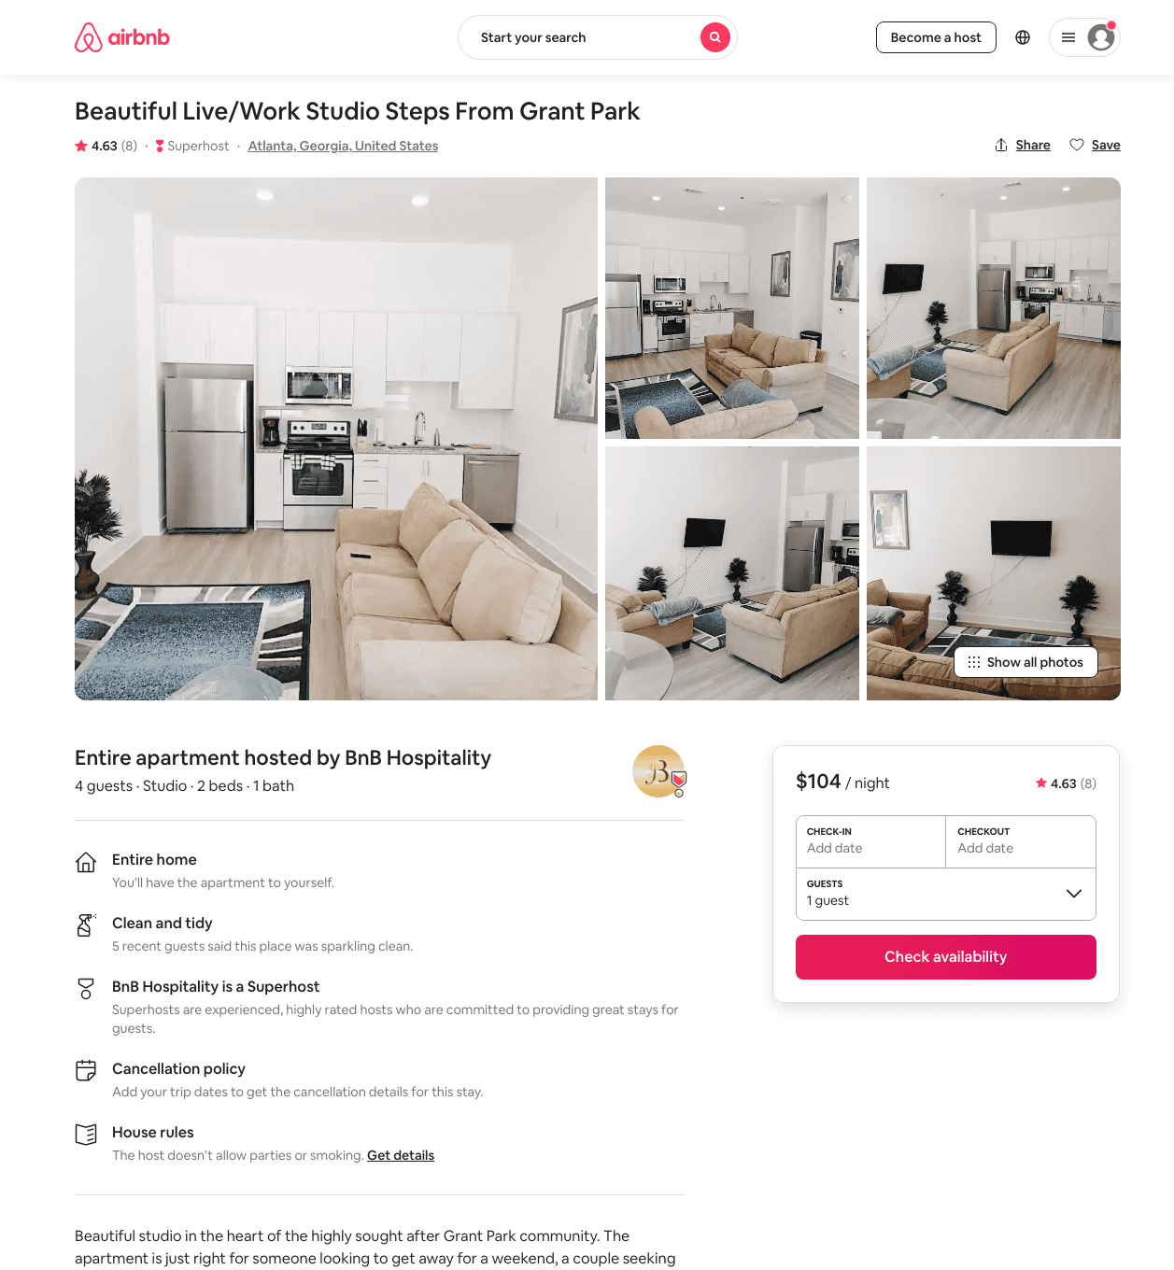
Listing 47908084
Studio
4
$99 - $168
4.38
1
Southern Comfort
331366792
25
https://www.airbnb.com/rooms/47908084
Aug 2022

Slide 22
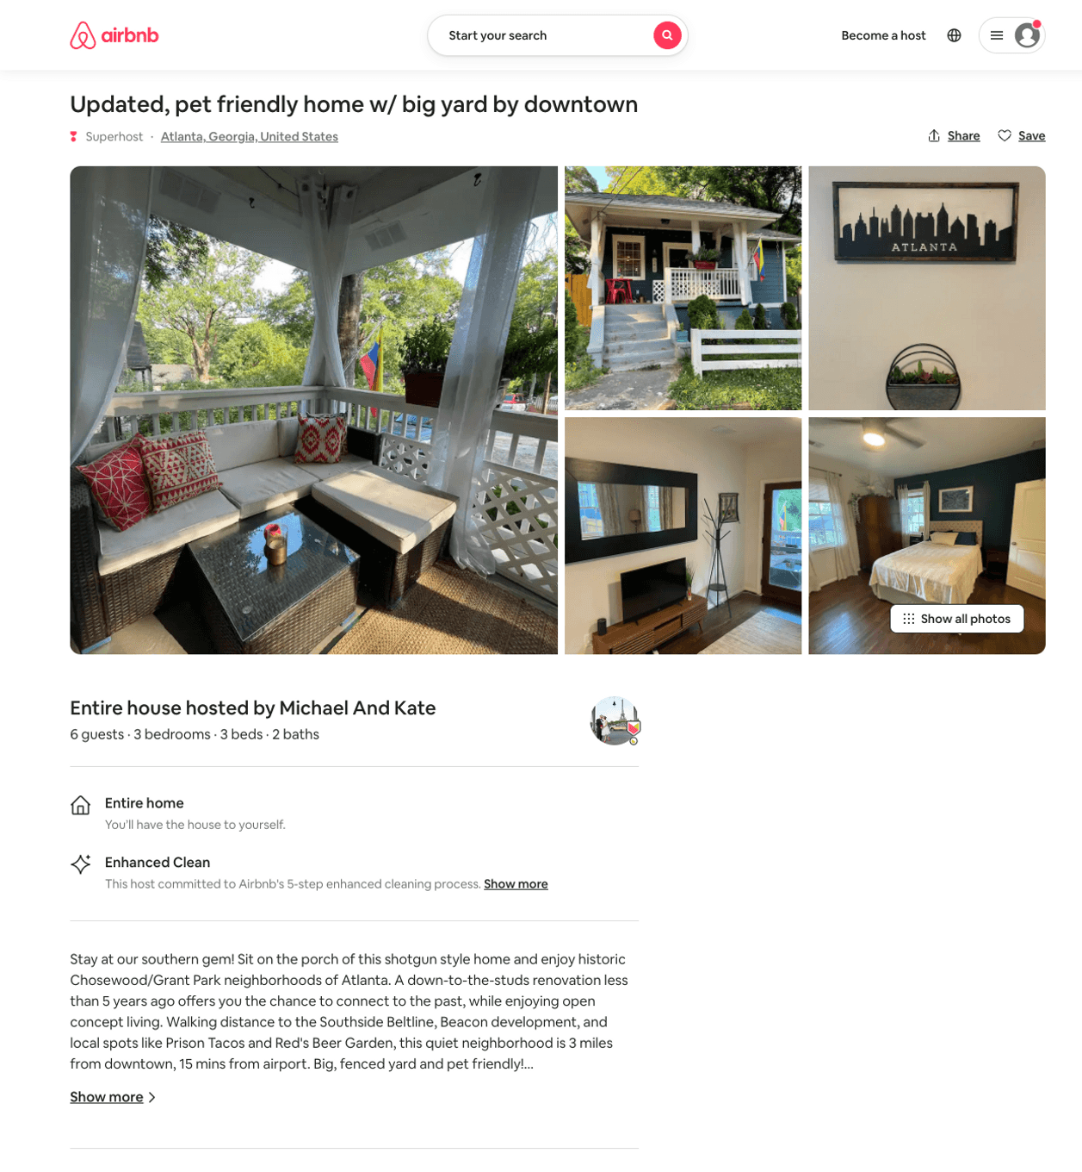
Listing 49324722
3
6
$140 - $427
4.89
30
Erin
70862789
1
https://www.airbnb.com/rooms/49324722
Aug 2022

Slide 23
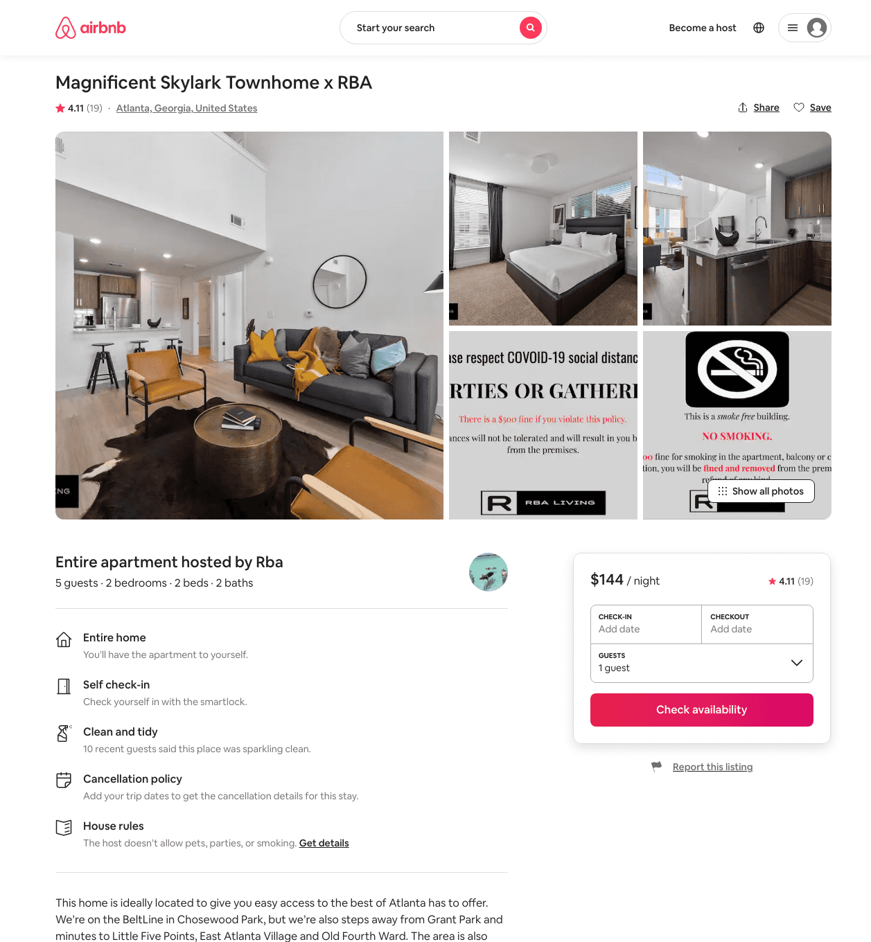
Listing 45001244
2
5
$130 - $182
4.22
2
Rba
627117
19
https://www.airbnb.com/rooms/45001244
Aug 2022

Slide 24
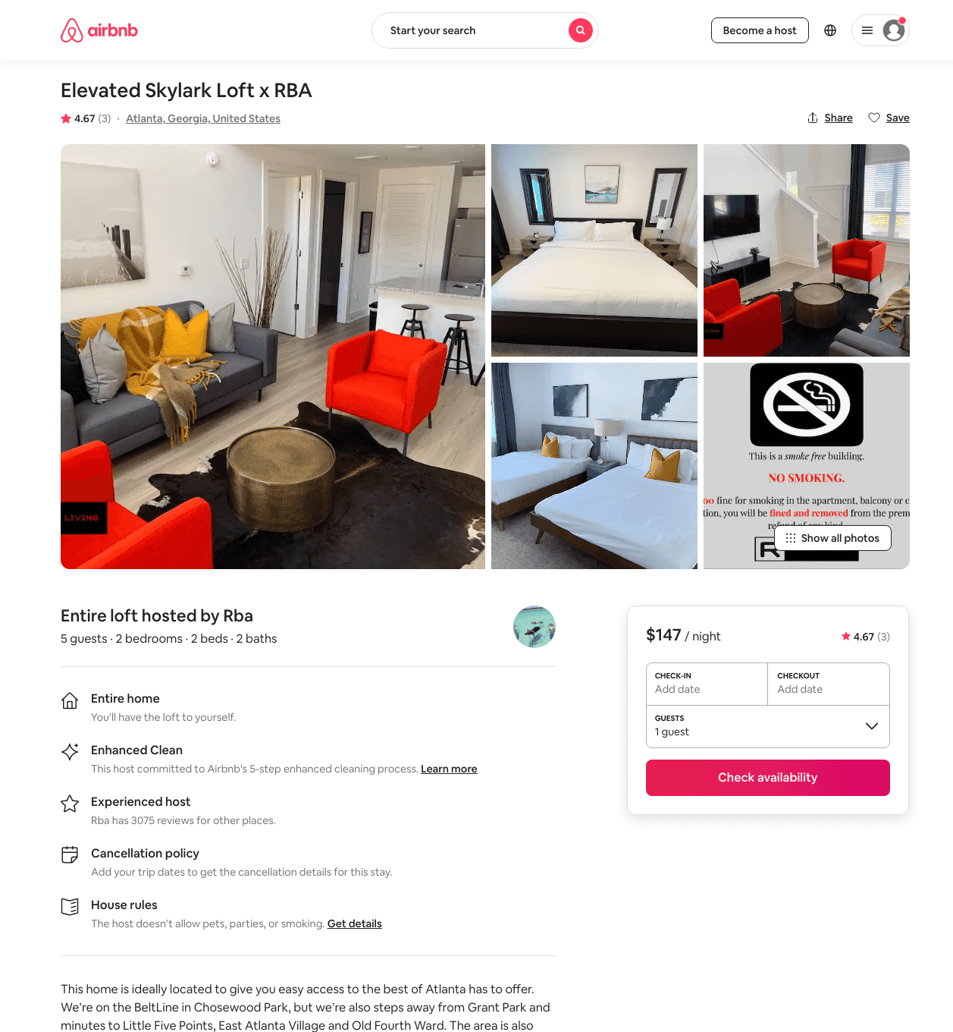
Listing 48095244
2
5
$136 - $187
4.49
2
Rba
627117
19
https://www.airbnb.com/rooms/48095244
Aug 2022

Slide 25
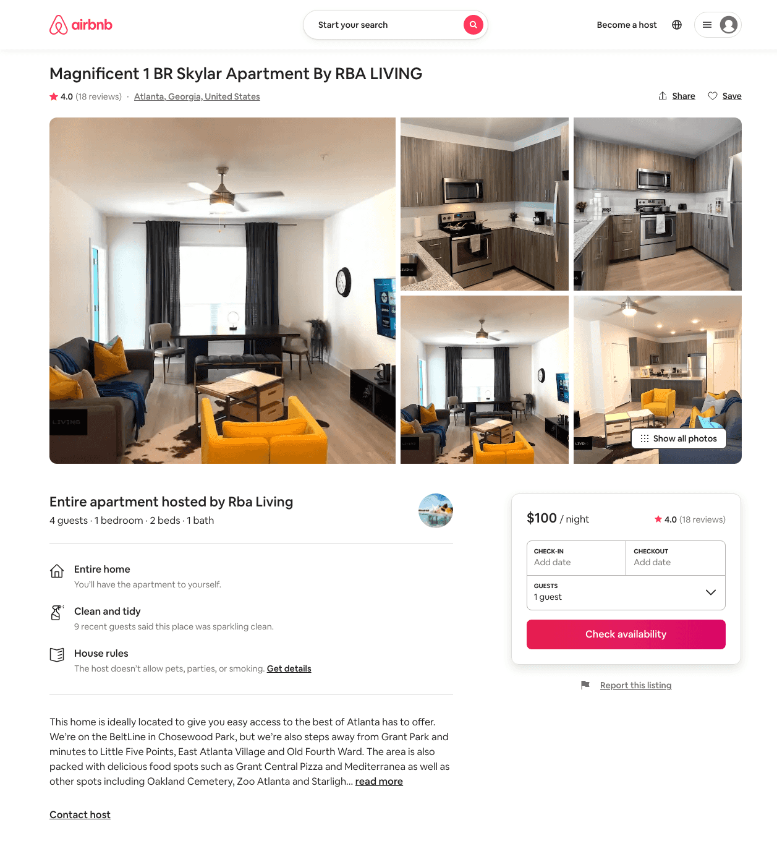
Listing 45409375
1
4
$87 - $123
4.24
2
Rba Living
97150171
6
https://www.airbnb.com/rooms/45409375
Aug 2022

Slide 26
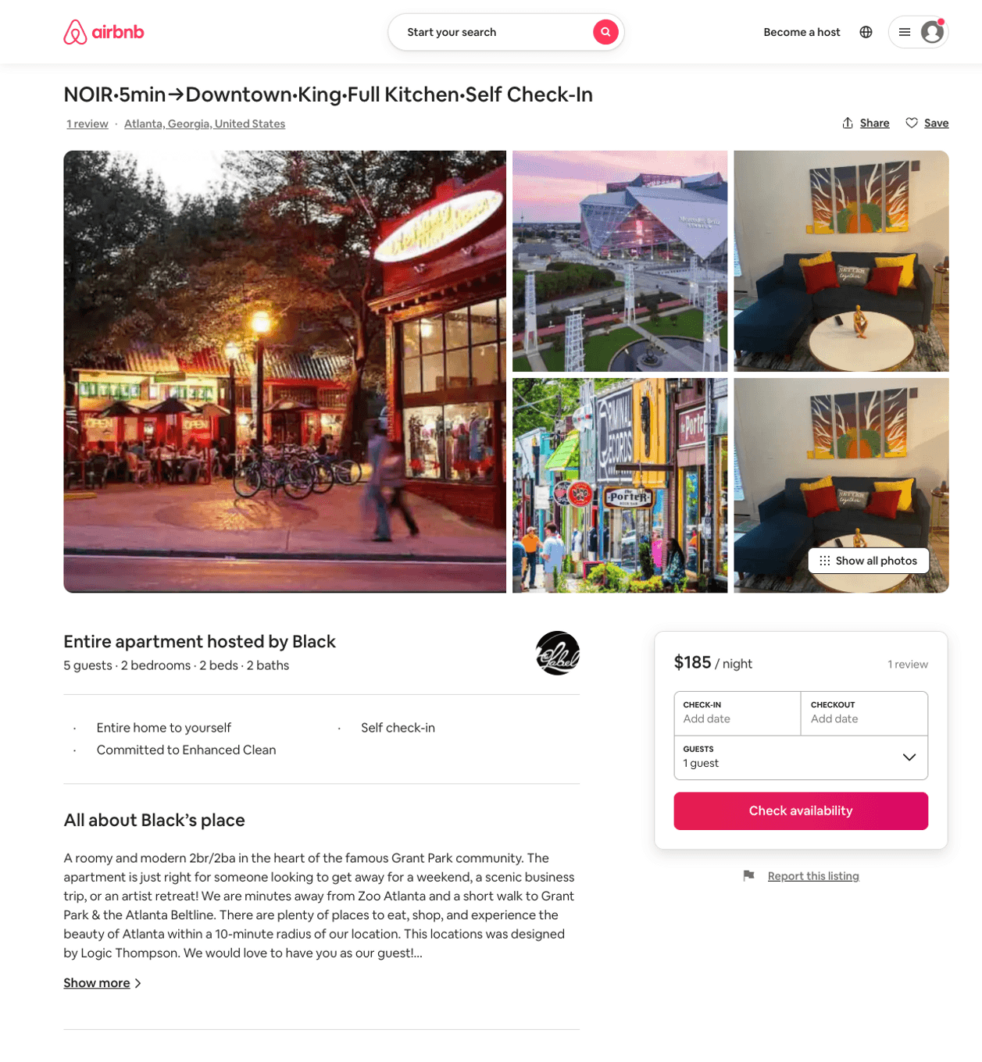
Listing 50263481
2
5
$114 - $187
4.75
2
Black
402329627
3
https://www.airbnb.com/rooms/50263481
Jun 2022

Slide 27
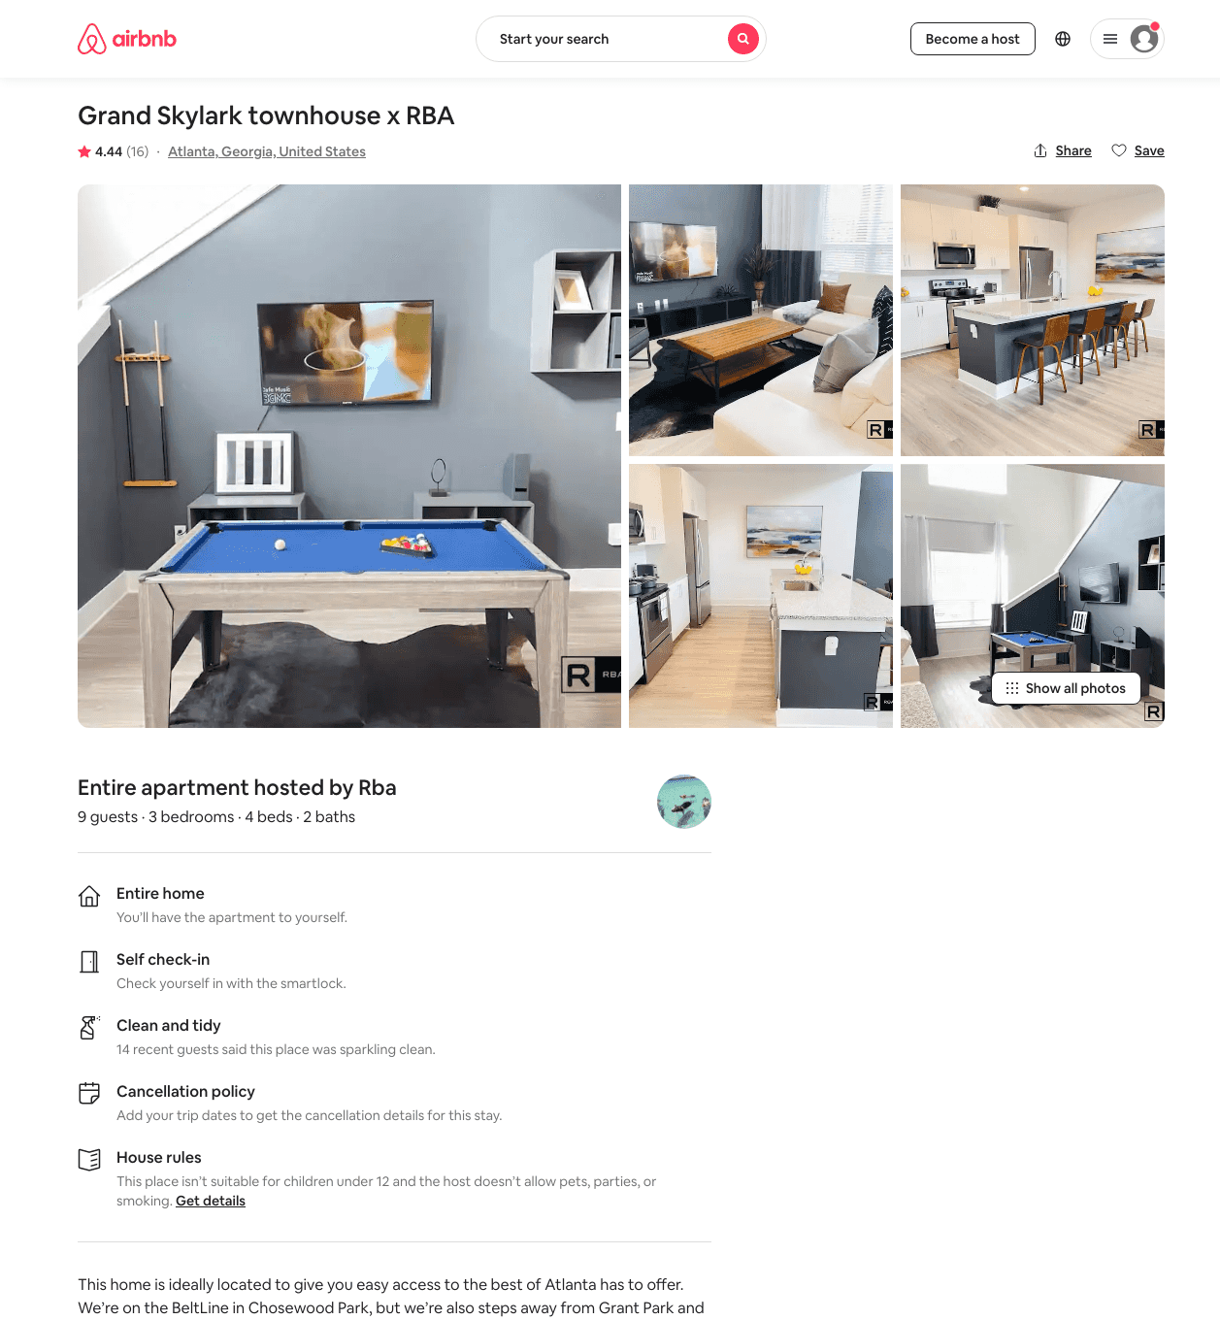
Listing 47515163
3
9
$173 - $309
4.49
2
Rba
627117
19
https://www.airbnb.com/rooms/47515163
Aug 2022

Slide 28
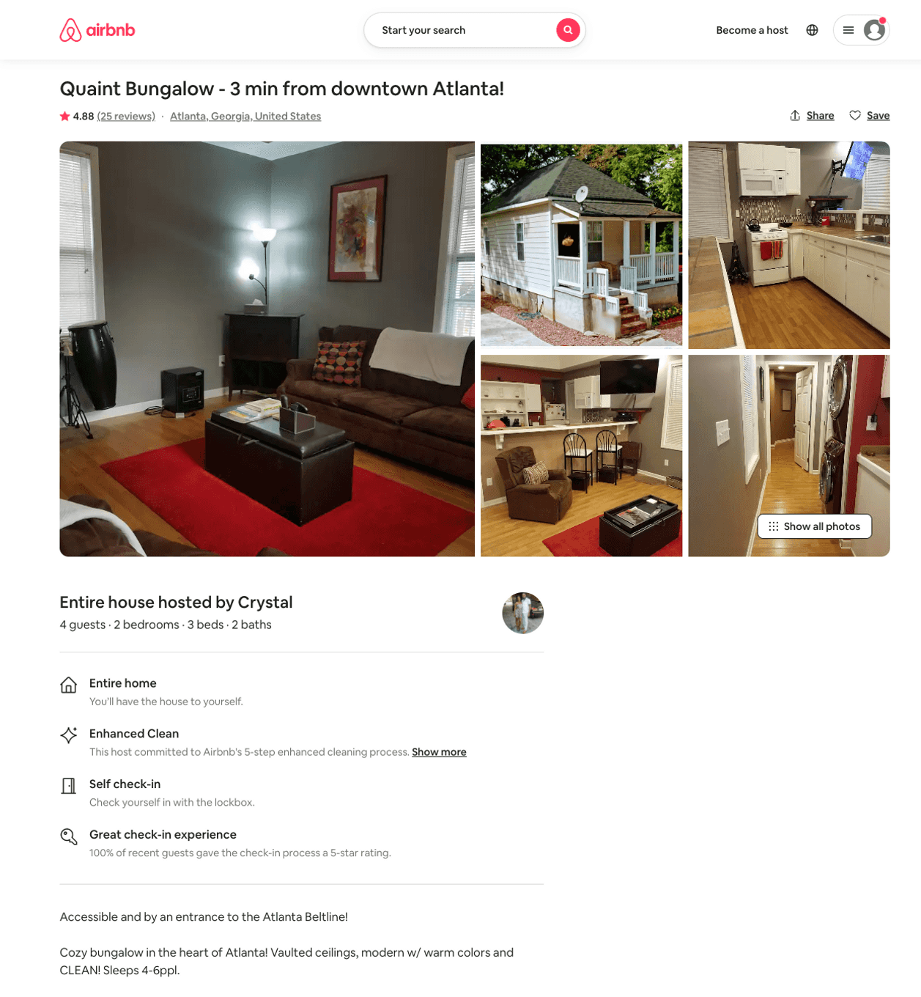
Listing 31362512
2
4
$85 - $88
4.90
30
Crystal
70489609
1
https://www.airbnb.com/rooms/31362512
Aug 2022

Slide 29
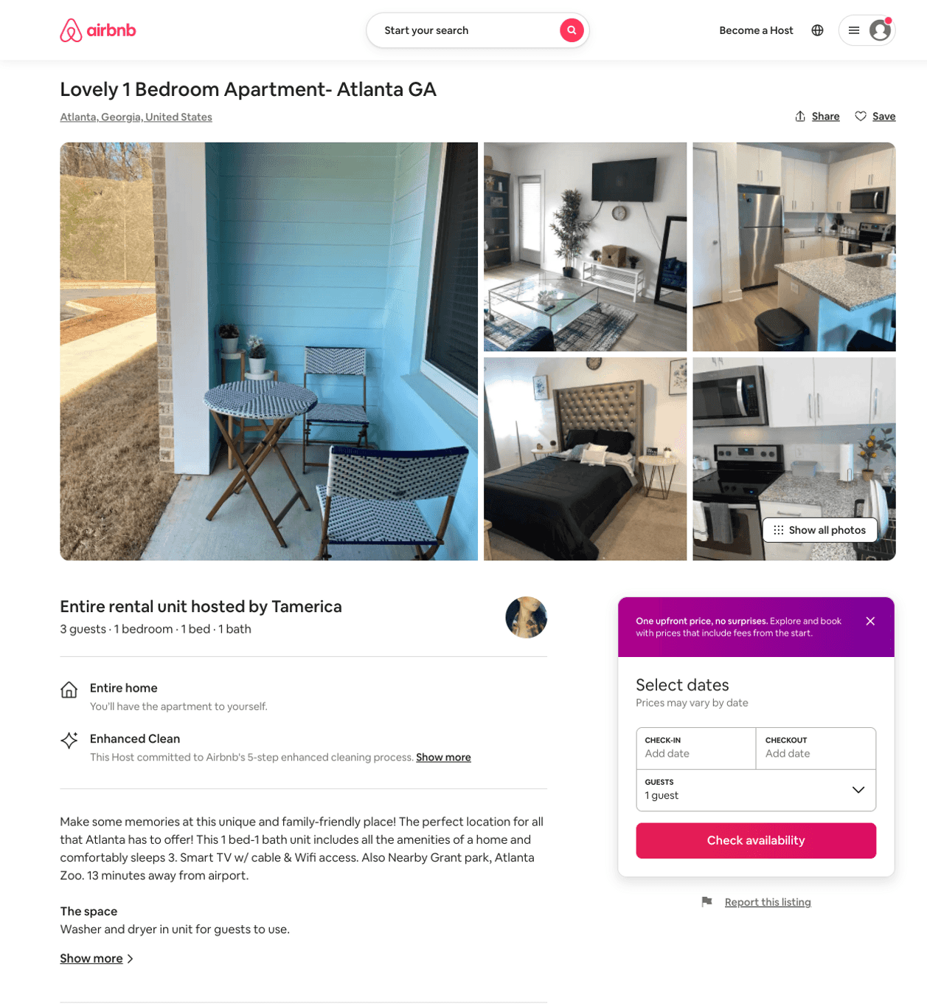
Listing 52221285
1
3
$100
2
Tamerica
411754003
2
https://www.airbnb.com/rooms/52221285
Jul 2022

Slide 30
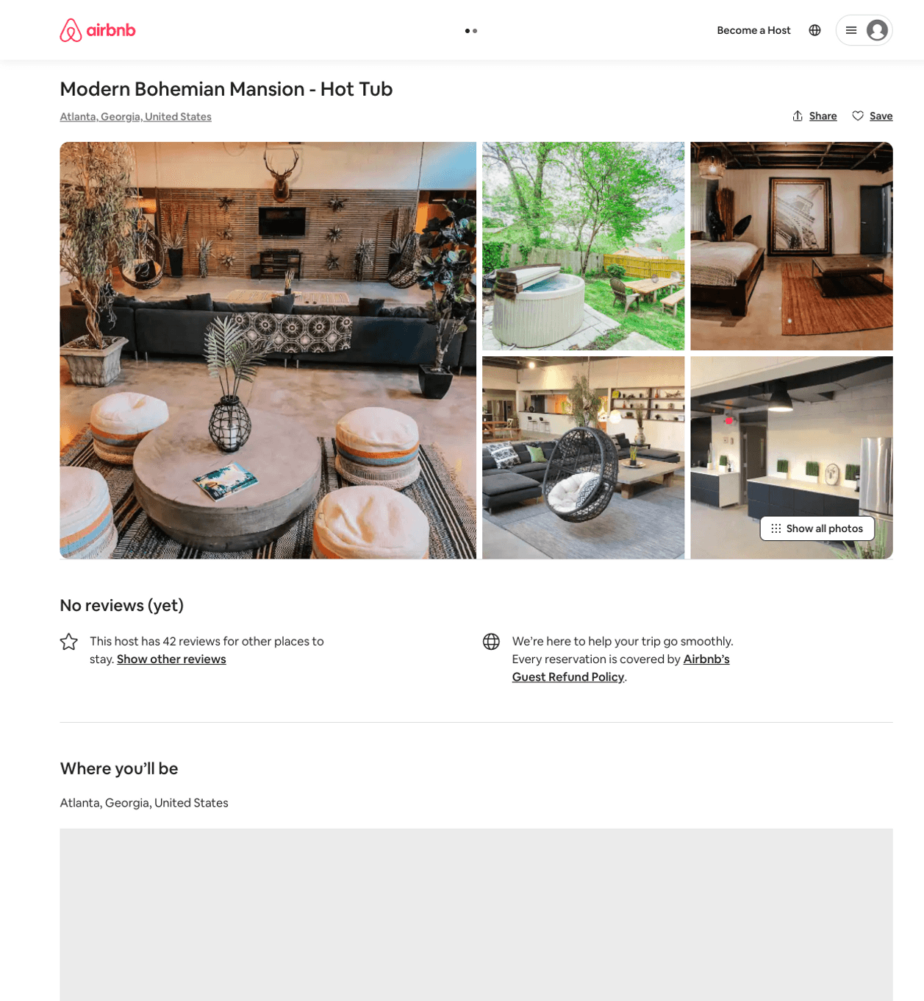
Listing 52581772
8
16
$665 - $907
4.25
3
Rory
350506020
9
https://www.airbnb.com/rooms/52581772
Aug 2022

Slide 31
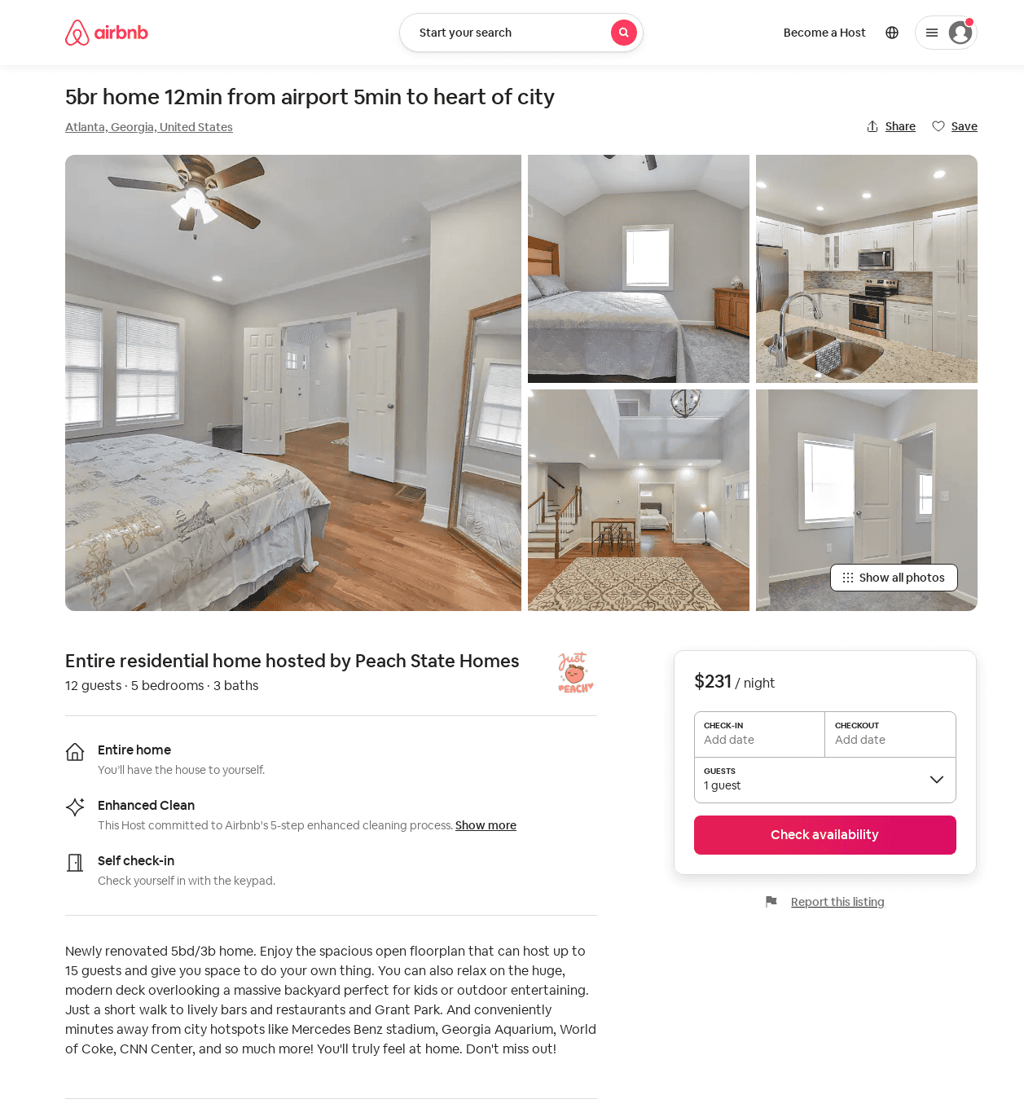
Listing 53047707
5
11
$231 - $313
4.66
2
Peach State Homes
429427946
1
https://www.airbnb.com/rooms/53047707
Aug 2022

Slide 32
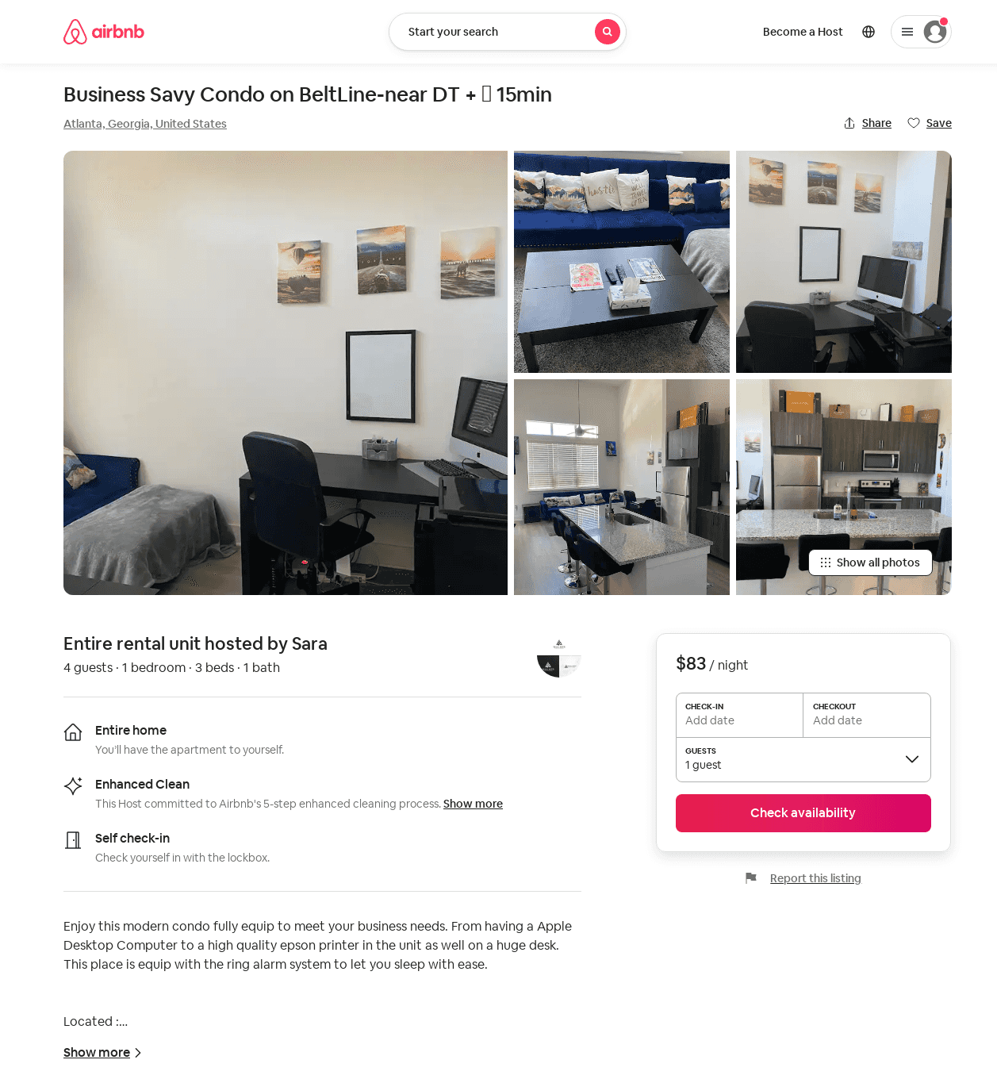
Listing 52877686
1
6
$75 - $154
4.87
1
Royal
367510474
1
https://www.airbnb.com/rooms/52877686
Jul 2022

Slide 33
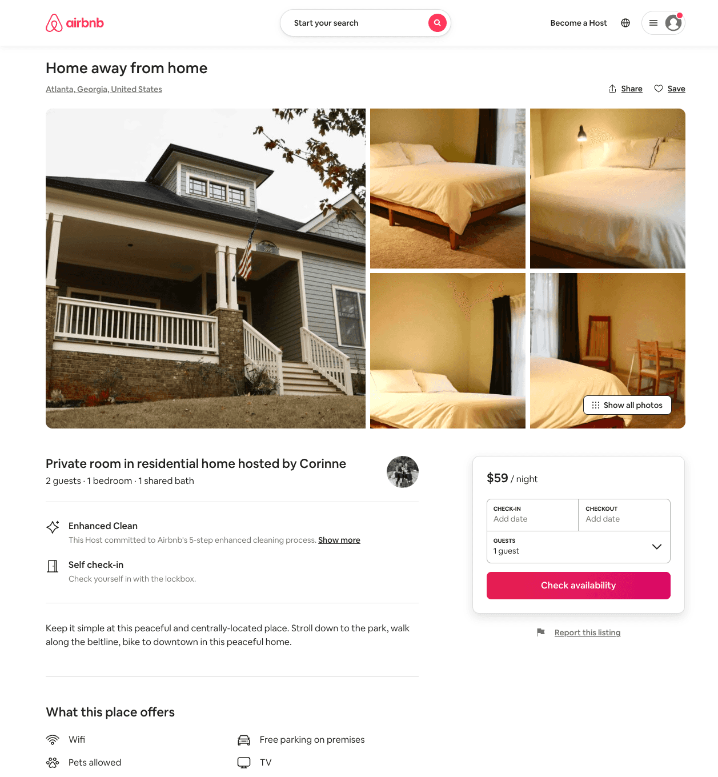
Listing 53204281
1
2
$59 - $67
4.91
2
Corinne
302071930
1
https://www.airbnb.com/rooms/53204281
Aug 2022

Slide 34
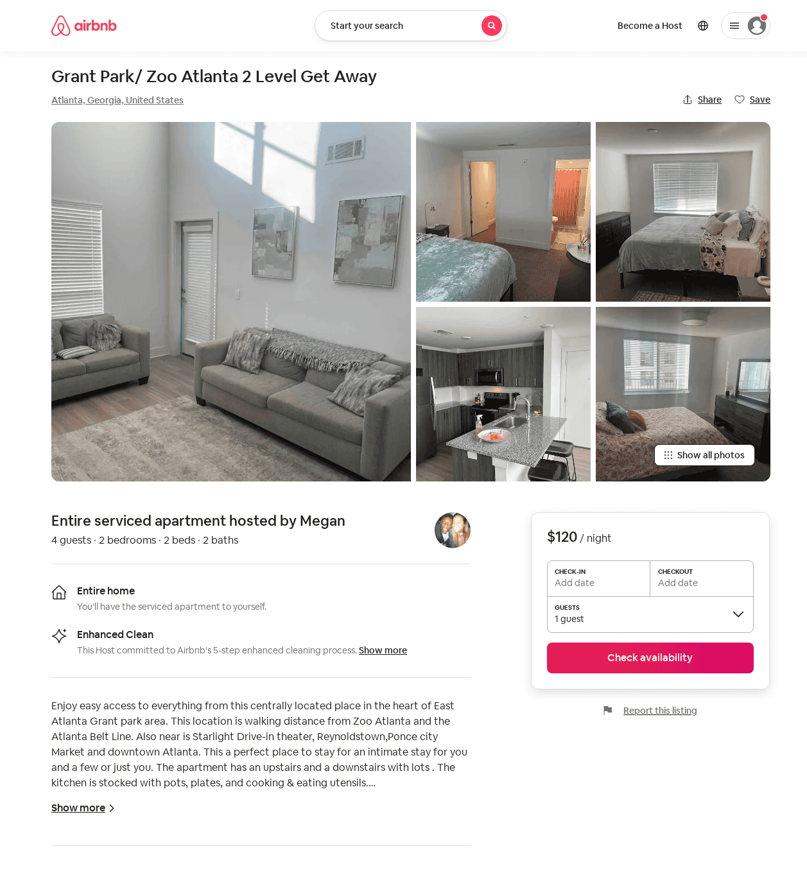
Listing 53559694
2
4
$119 - $175
4.33
1
Megan
25281547
1
https://www.airbnb.com/rooms/53559694
Aug 2022

Slide 35
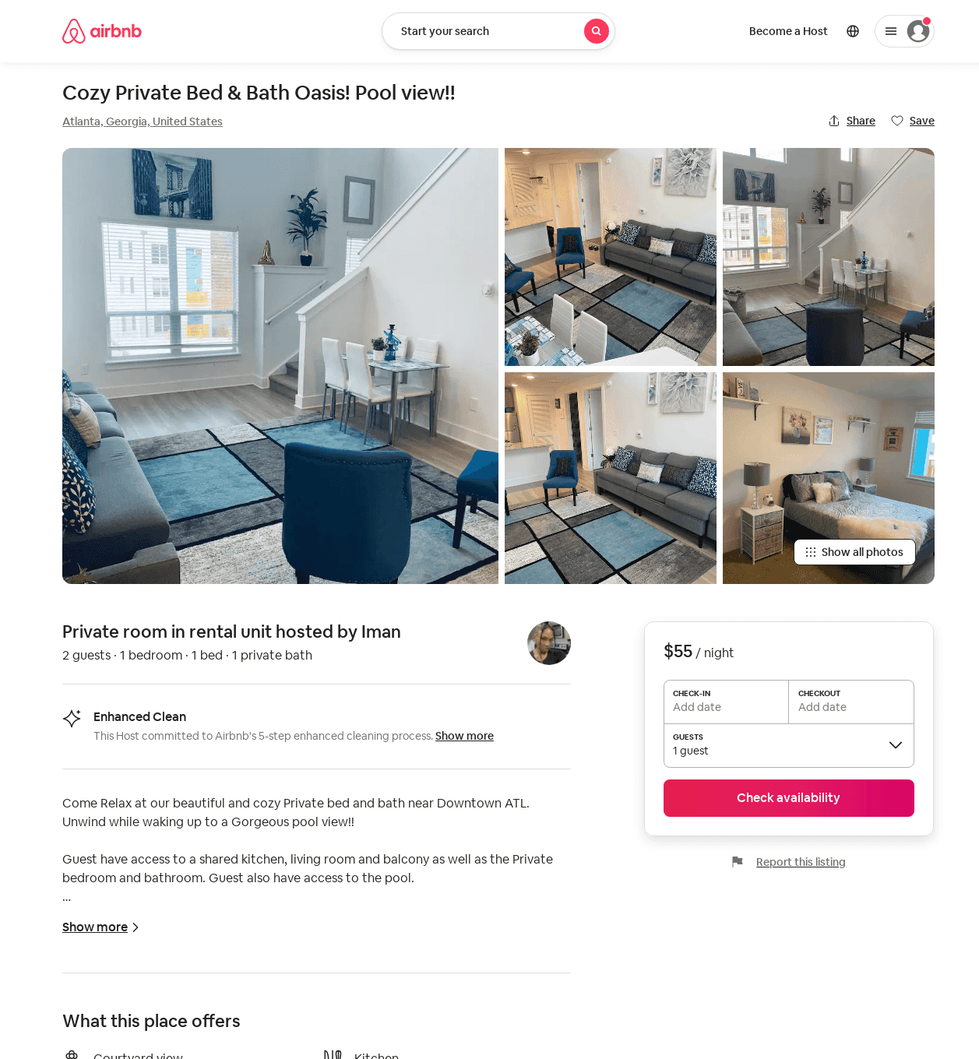
Listing 53759100
1
2
$55 - $56
2
Iman
133817936
1
https://www.airbnb.com/rooms/53759100
Jun 2022

Slide 36
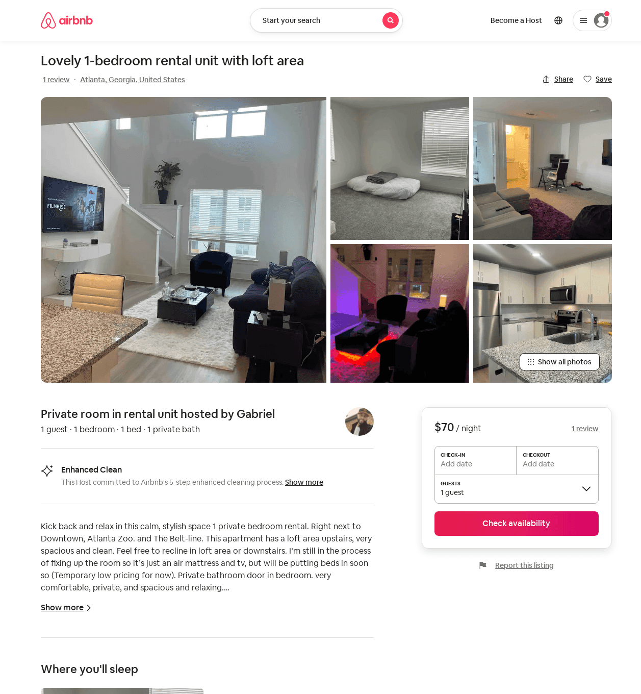
Listing 53735055
1
1
$32 - $70
4.63
1
Gabriel
376292829
1
https://www.airbnb.com/rooms/53735055
Aug 2022

Slide 37
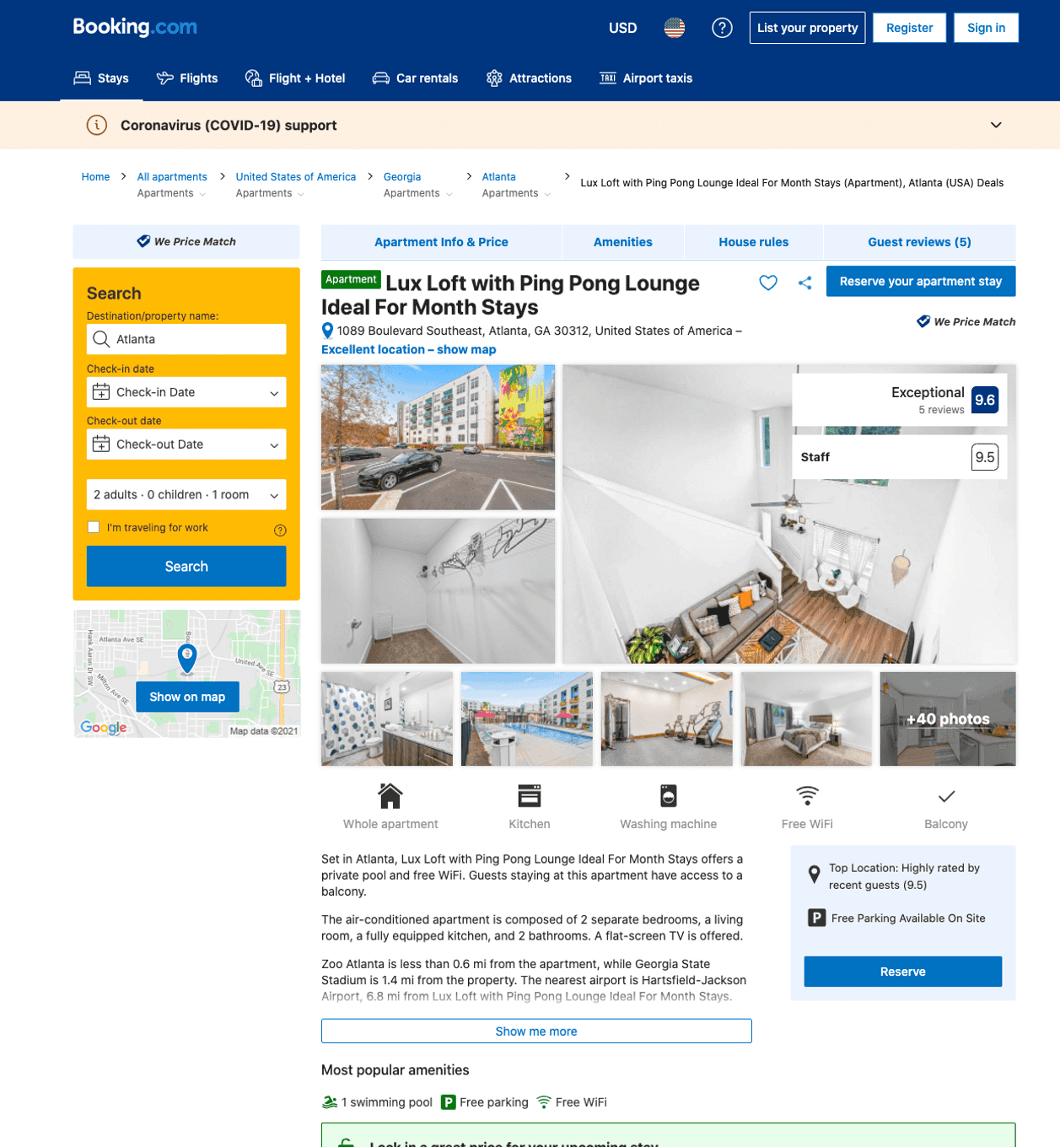
Listing lux-loft-with-ping-pong-lounge-ideal-for-month-stays
1099 BOULEVARD SE
undefined
1
9.6
https://www.booking.com/hotel/us/lux-loft-with-ping-pong-lounge-ideal-for-month-stays.html
Sep 2022

Slide 38
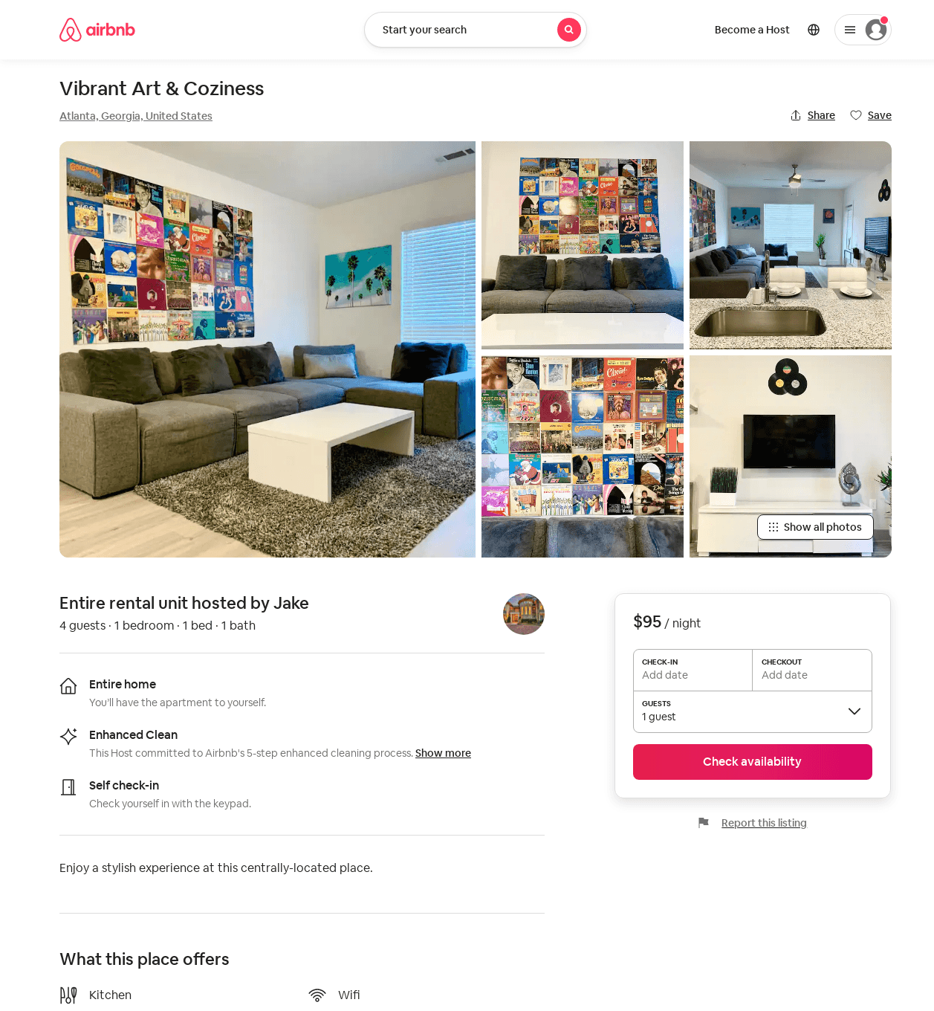
Listing 54295893
1
4
$95 - $98
1
Jake
401749675
3
https://www.airbnb.com/rooms/54295893
Aug 2022

Slide 39
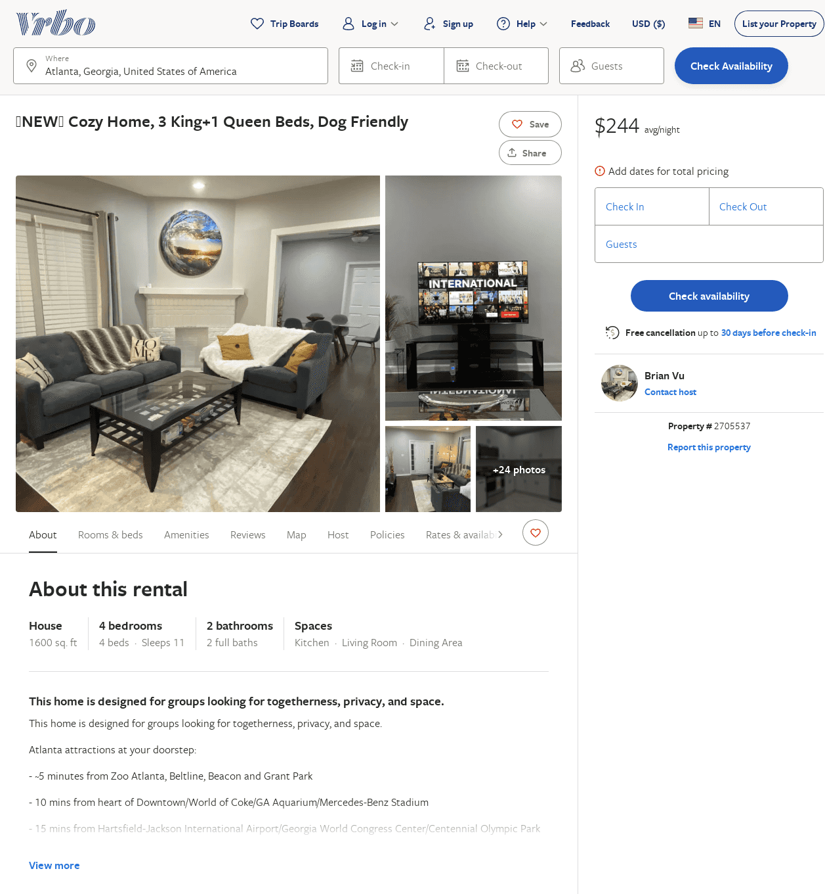
Listing 2705537
4
11
$389
2
Brian Vu
https://www.vrbo.com/2705537
Aug 2022

Slide 40
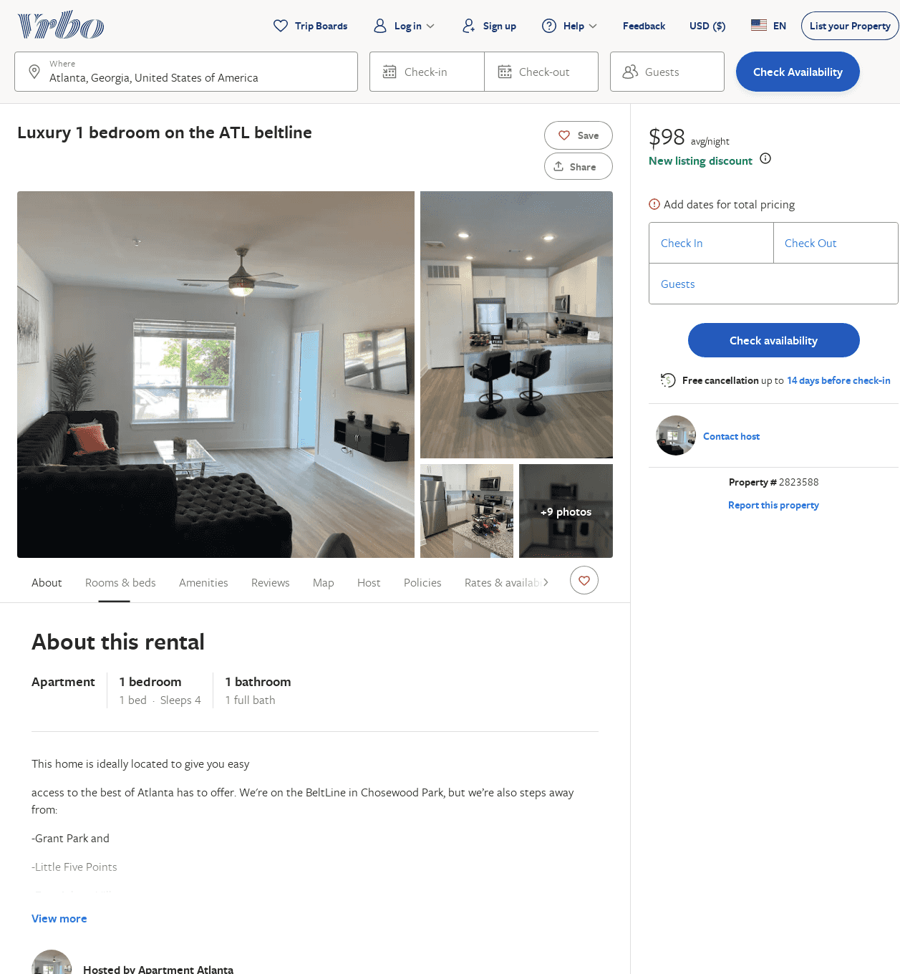
Listing 2823588
1
4
$156
2
ATL Living
https://www.vrbo.com/2823588
Aug 2022

Slide 41
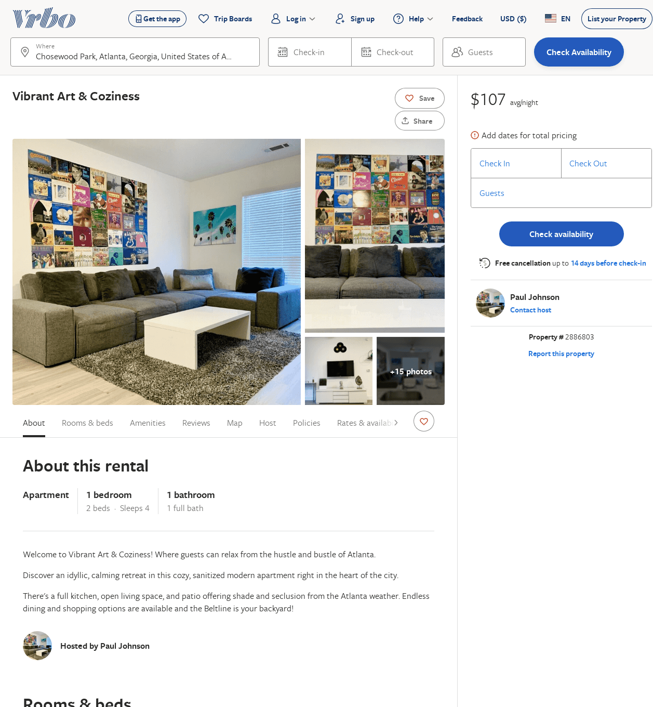
Listing 2886803
1
4
$103
1
Paul Johnson
https://www.vrbo.com/2886803
Aug 2022

Slide 42
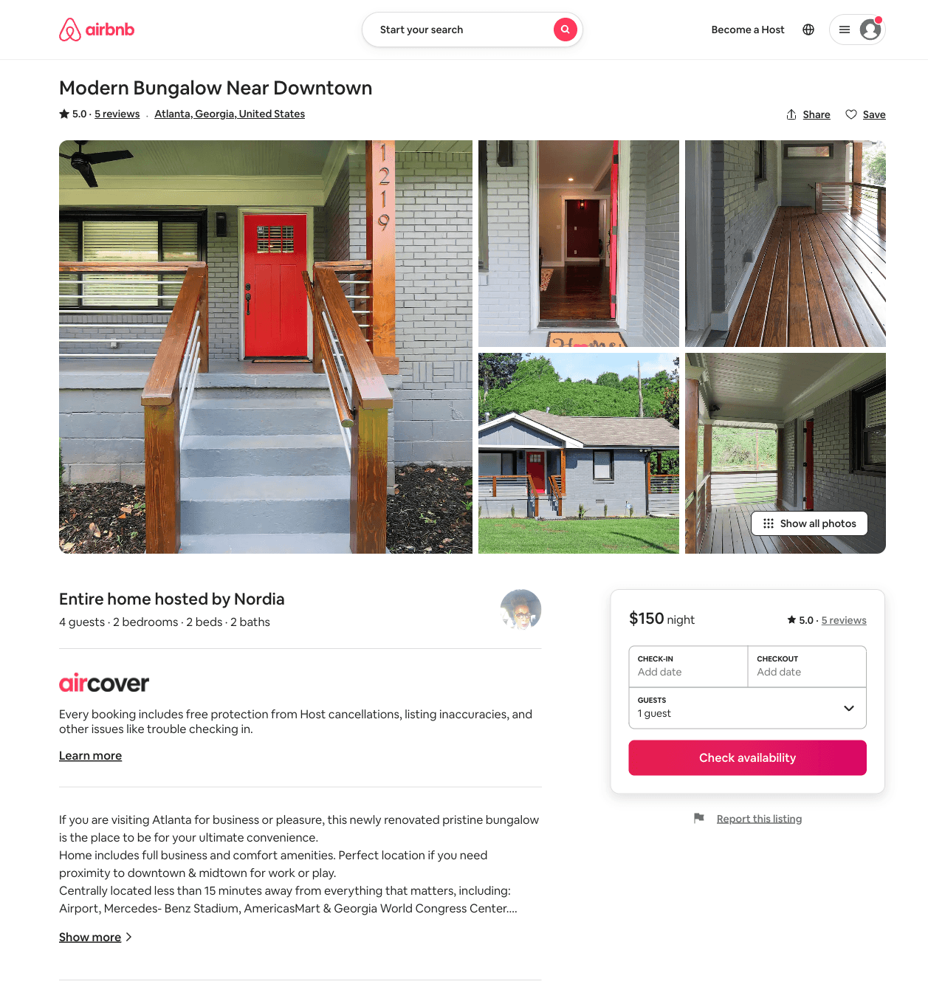
Listing 36004974
2
4
5.0
5
Nordia
143032919
1
https://www.airbnb.com/rooms/36004974
Aug 2022

Slide 43
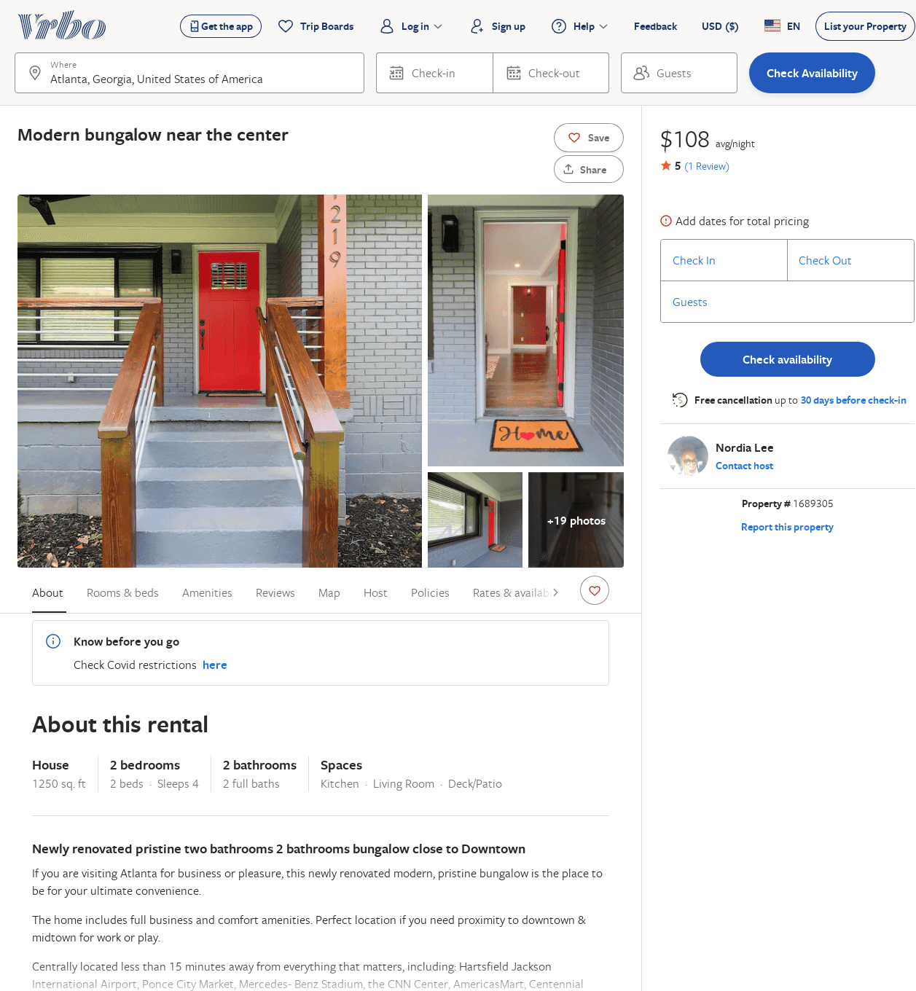
Listing 1689305
2
4
$108
5
5
Nordia Lee
https://www.vrbo.com/1689305
Aug 2022

