Slide 2
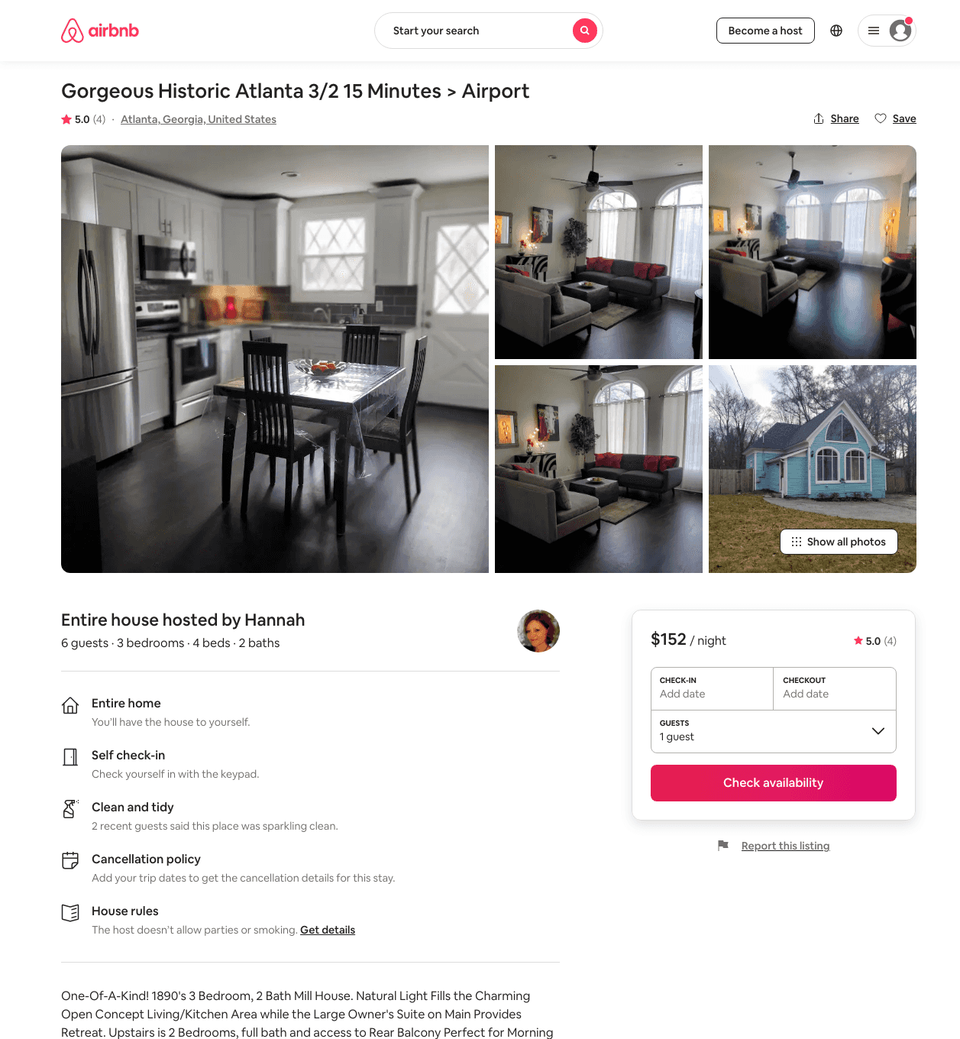
Listing 48171938
3
5
$132 - $196
4.91
10
Hannah
49618994
1
https://www.airbnb.com/rooms/48171938
Jun 2022

