Slide 2
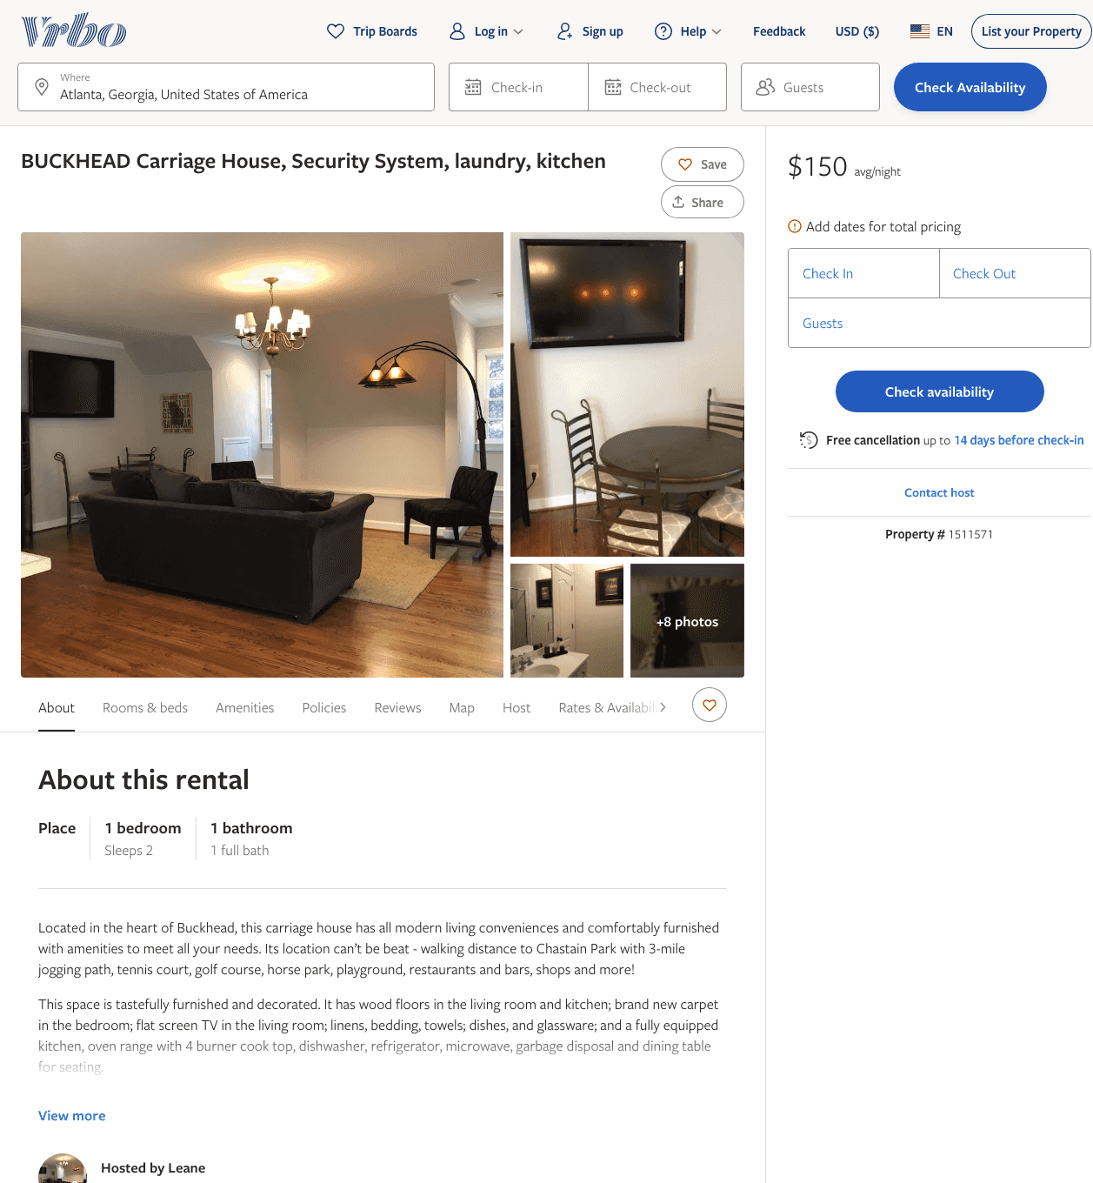
Listing 1511571
1
2
$150
30
Leane
https://www.vrbo.com/1511571
Aug 2022

Slide 3
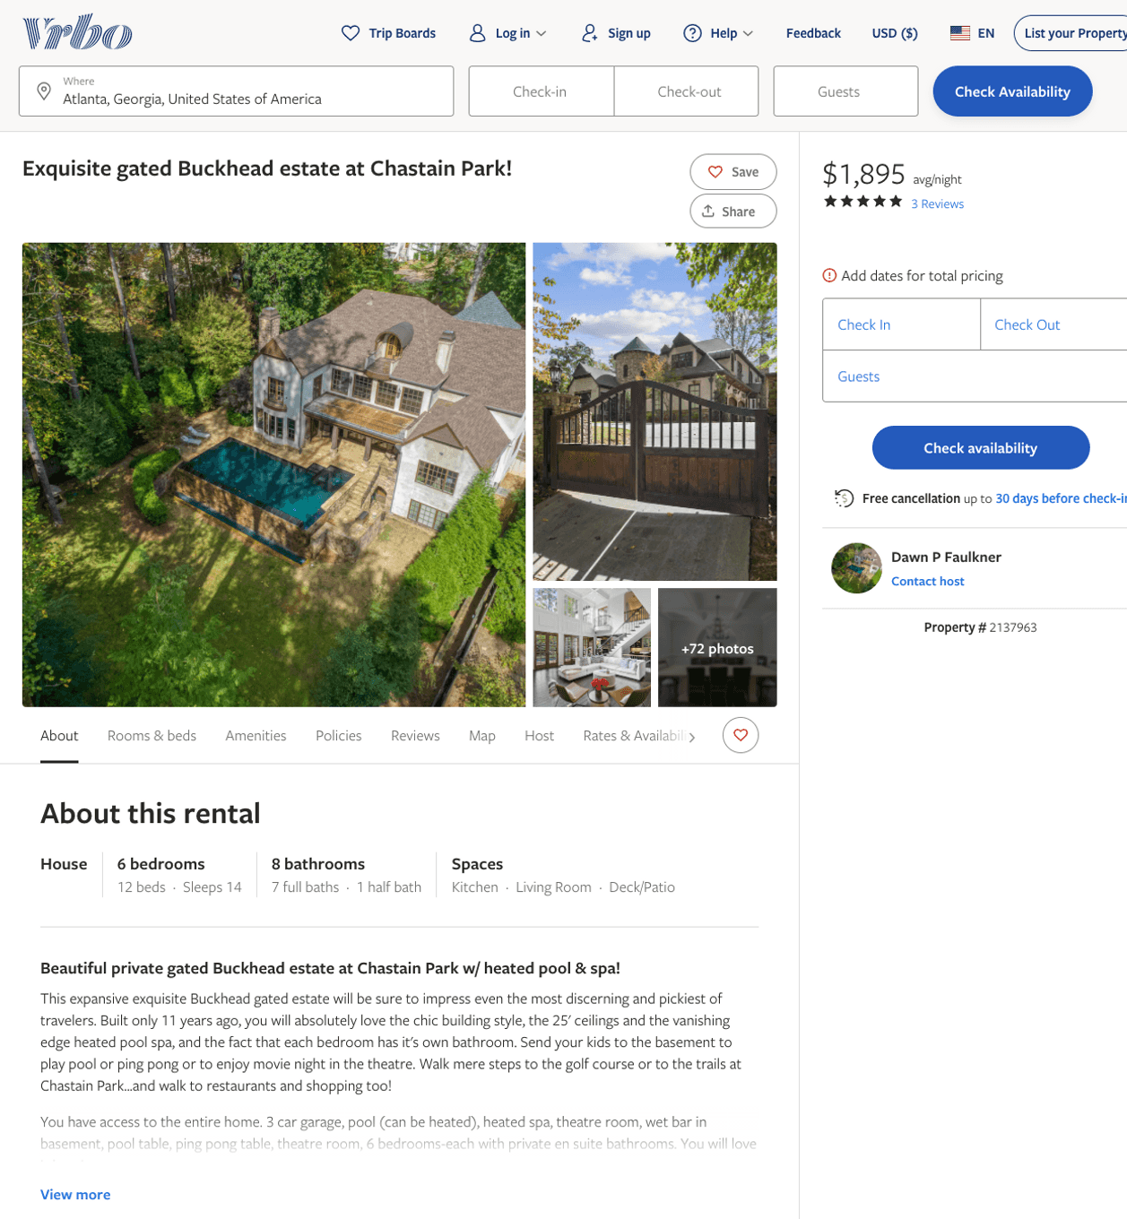
Listing 2137963
6
14
$1,500 - $1,895
5
5
Dawn P Faulkner
https://www.vrbo.com/2137963
Aug 2022

Slide 4
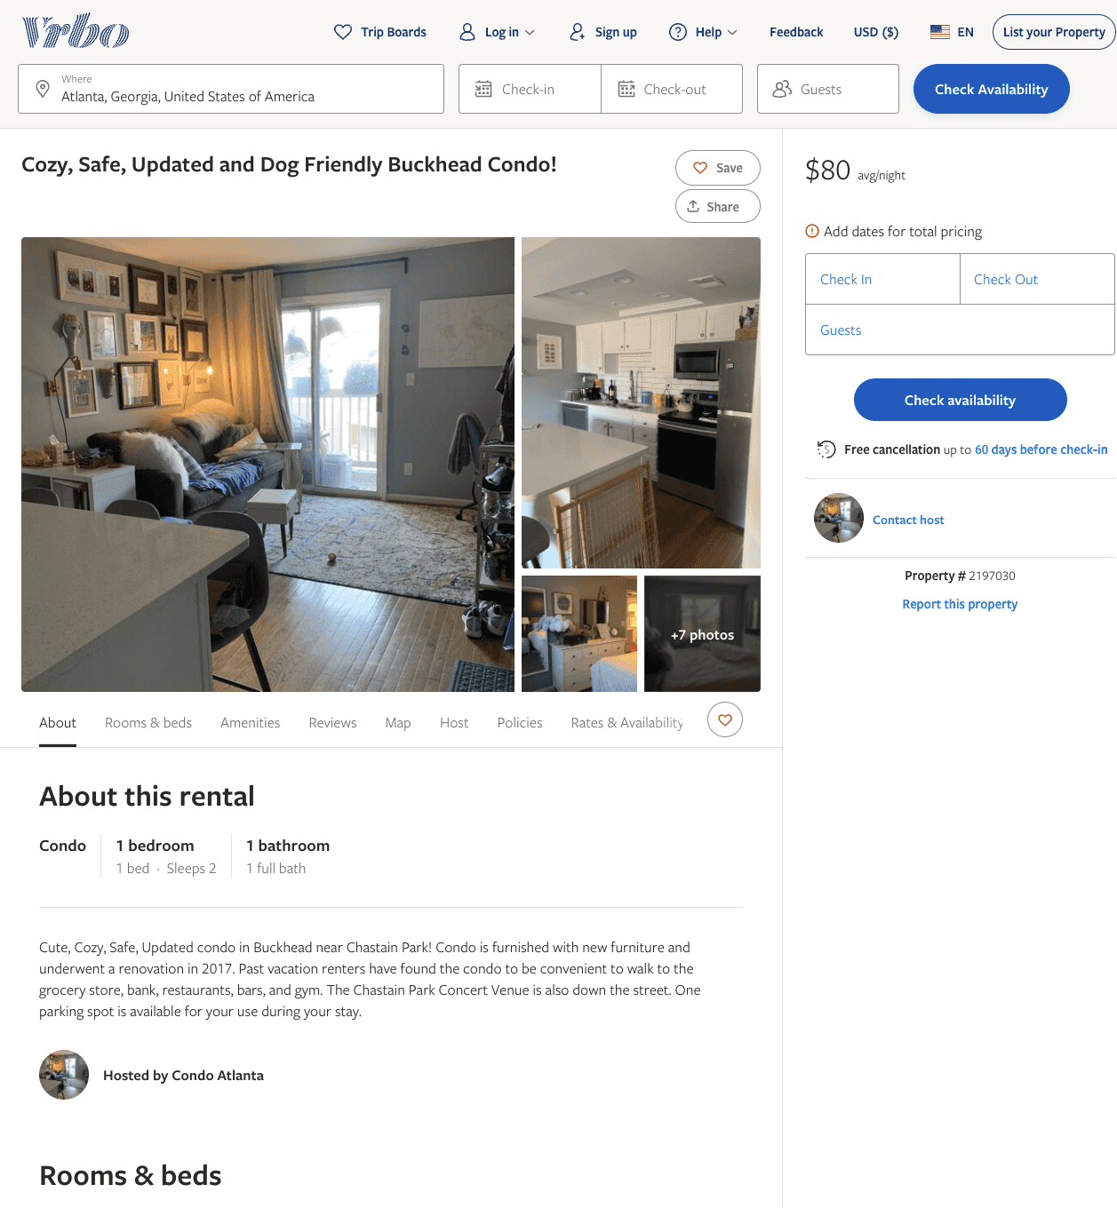
Listing 2197030
1
2
$80
7
https://www.vrbo.com/2197030
Aug 2022

