Slide 2
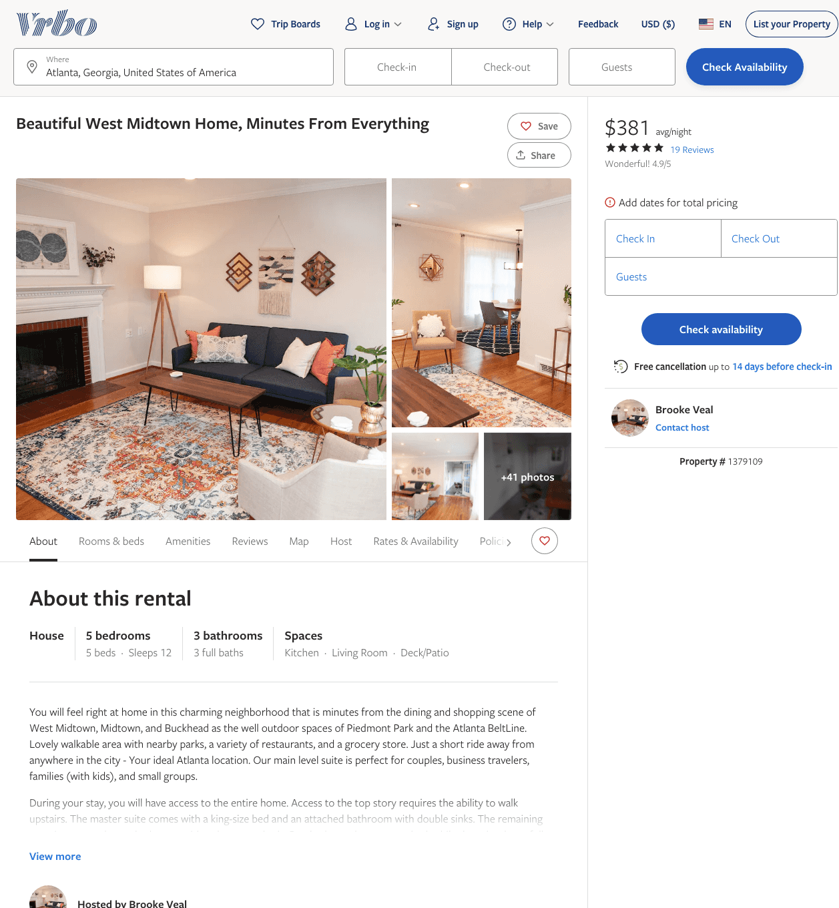
Listing 1379109
5
12
$356 - $395
4.928571
3
Brooke Veal
https://www.vrbo.com/1379109
Aug 2022

Slide 3
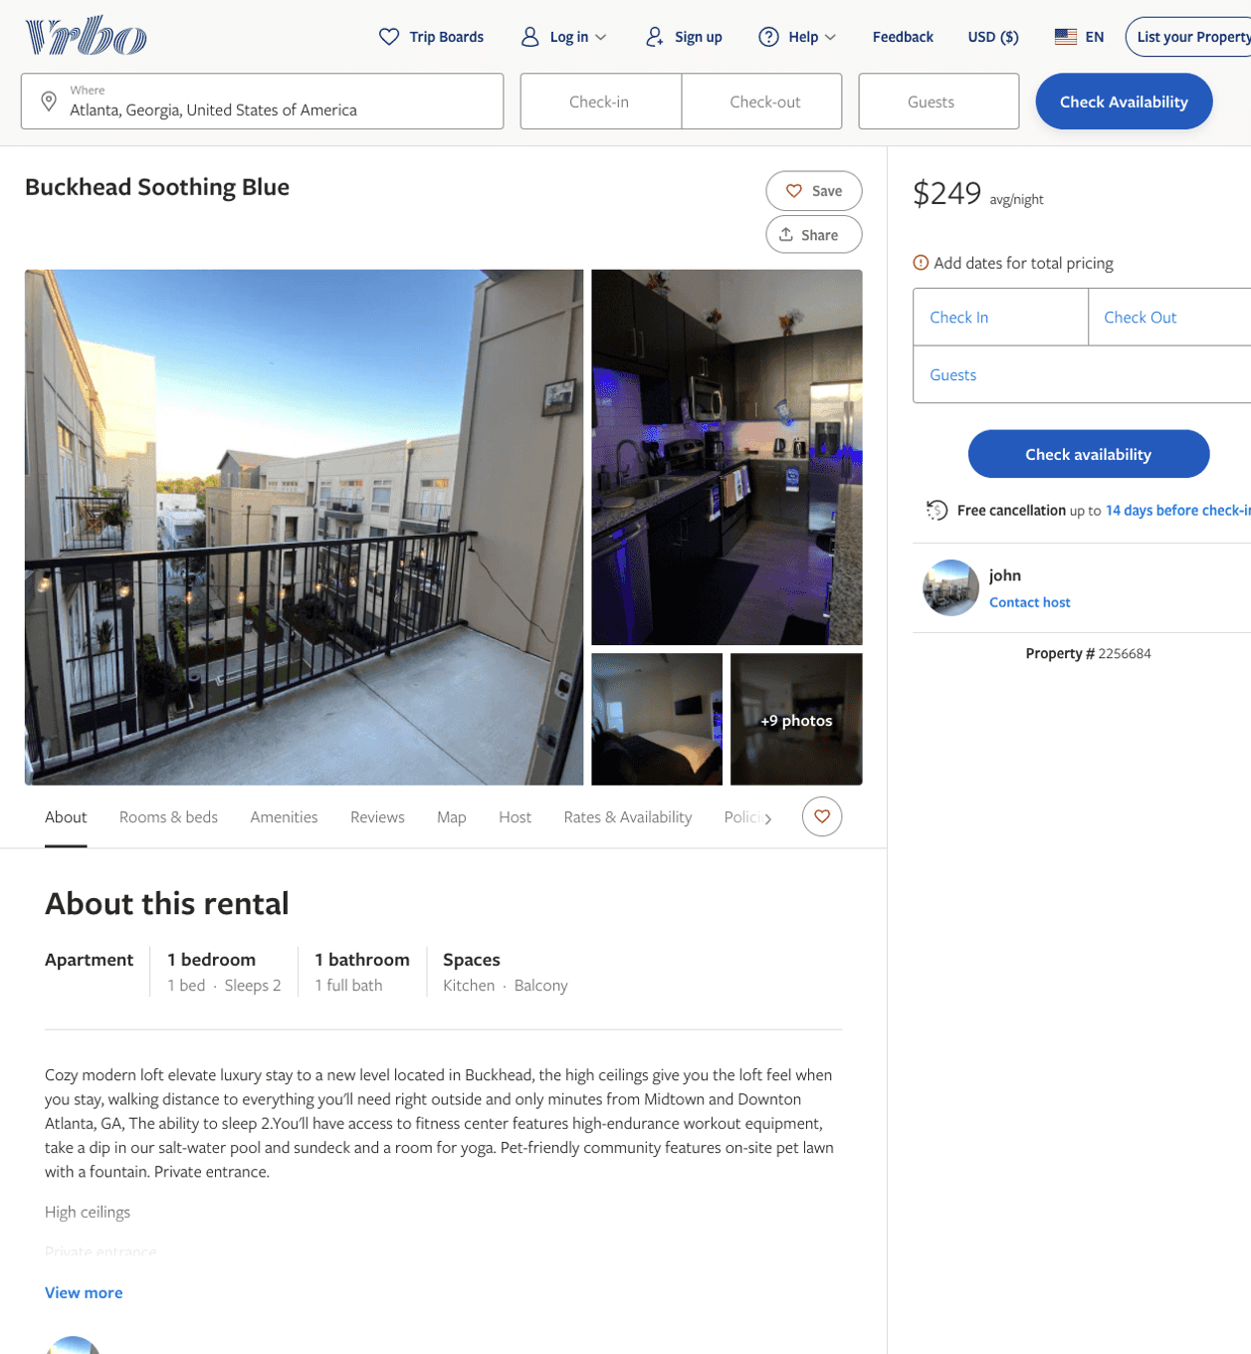
Listing 2256684
1
2
$232 - $249
1
john
https://www.vrbo.com/2256684
Aug 2022

Slide 4
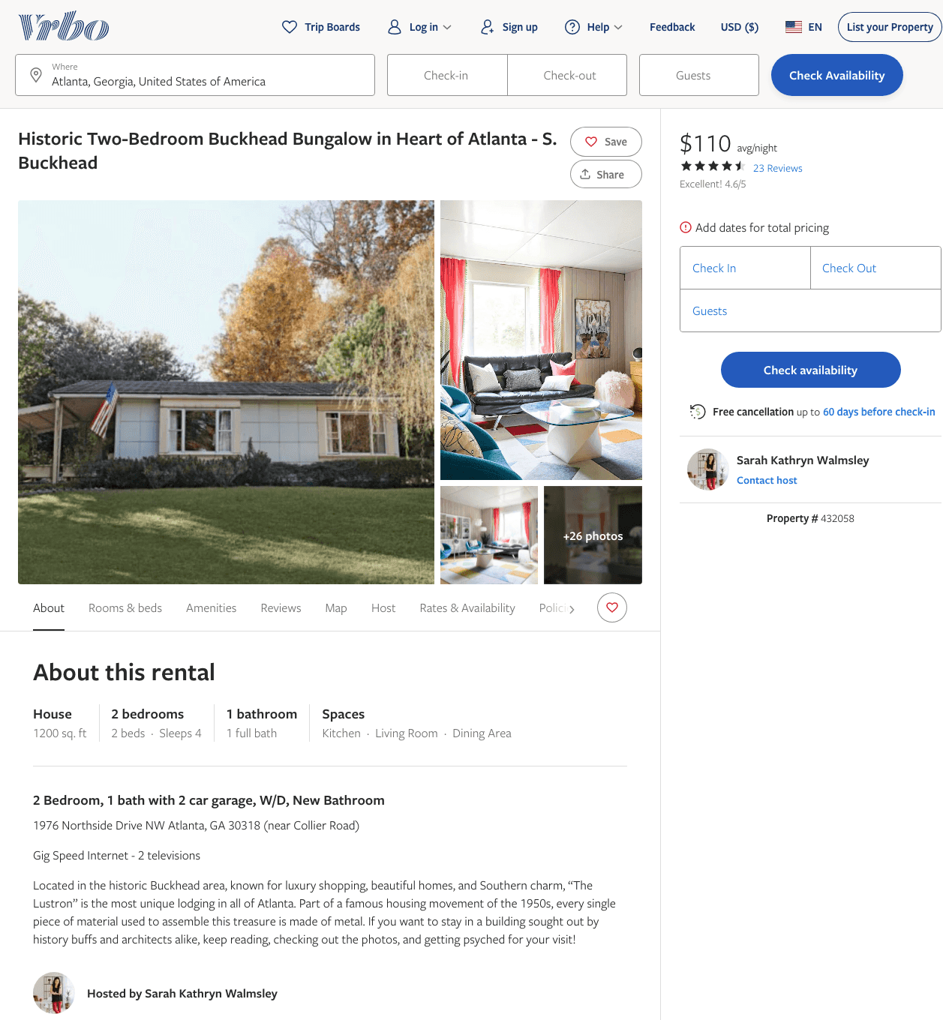
Listing 432058
2
4
$110 - $125
4.5652175
7
Sarah Kathryn Walmsley
https://www.vrbo.com/432058
Aug 2022

Slide 5
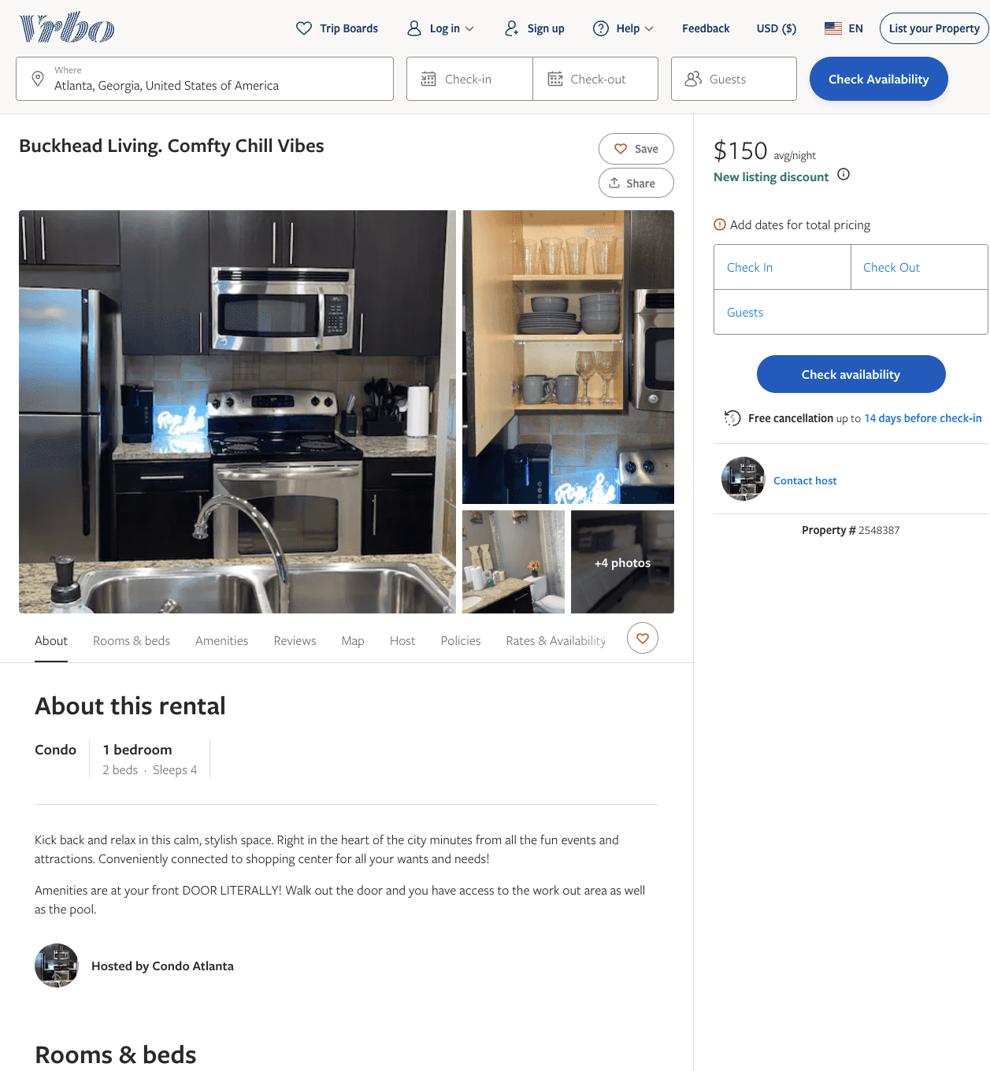
Listing 2548387
1
4
$150
2
https://www.vrbo.com/2548387
Aug 2022

Slide 6
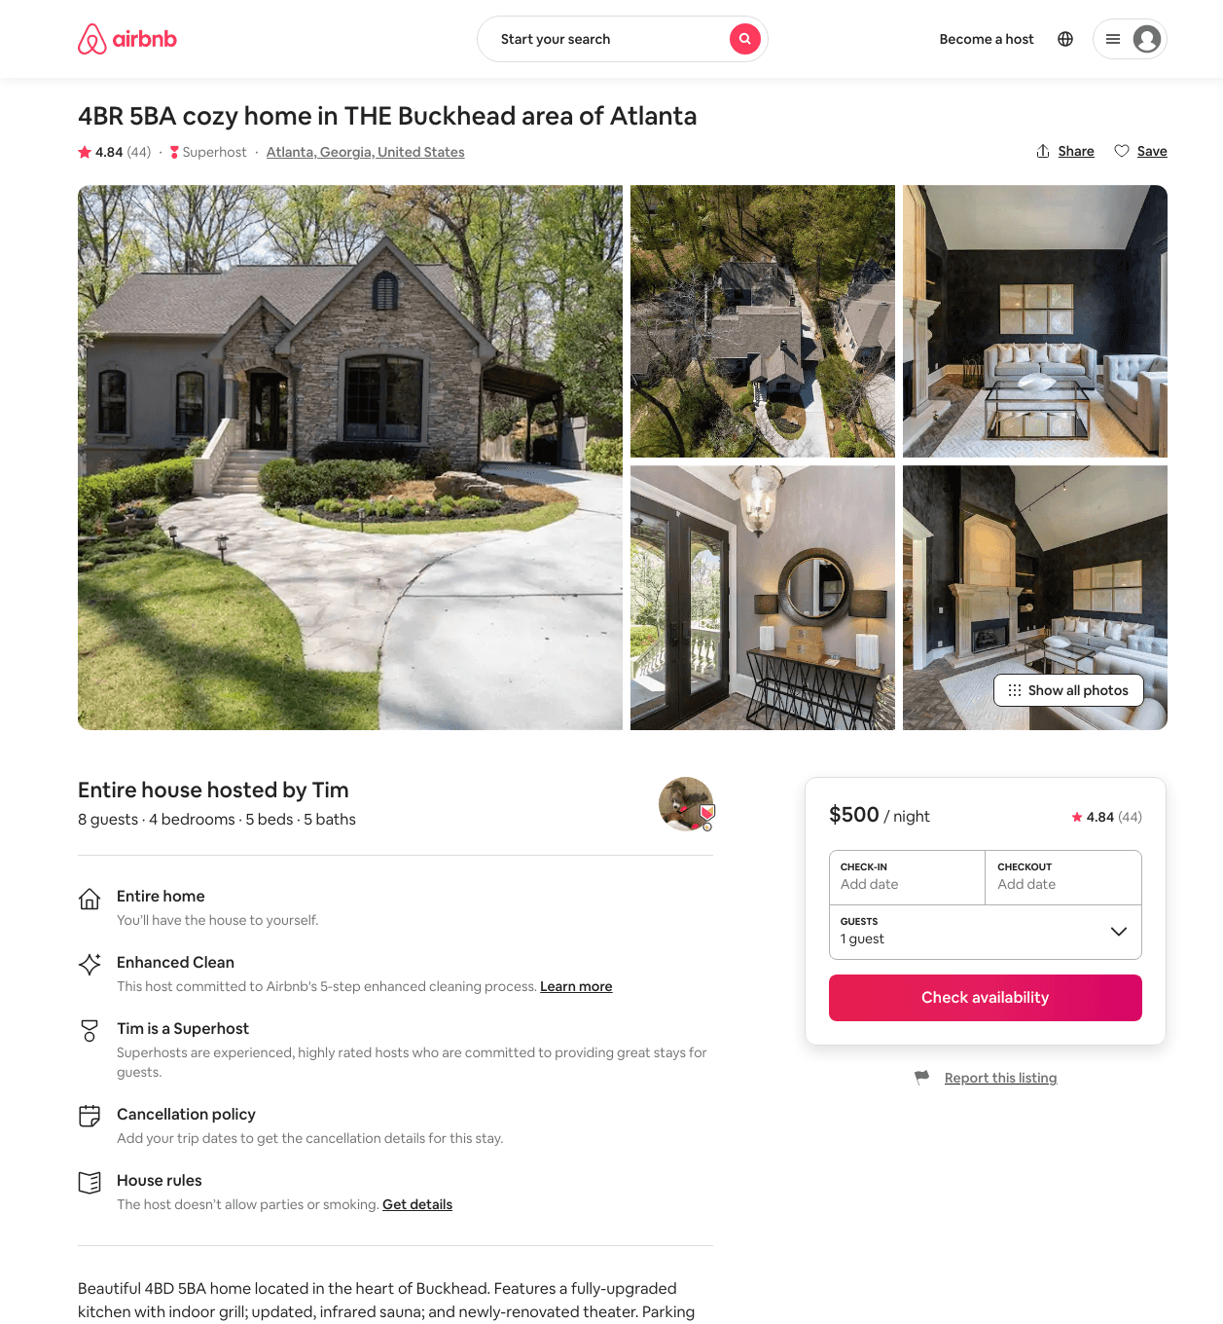
Listing 42834396
4
8
$441 - $929
4.76
3
Tim
285728912
1
https://www.airbnb.com/rooms/42834396
Aug 2022

Slide 7
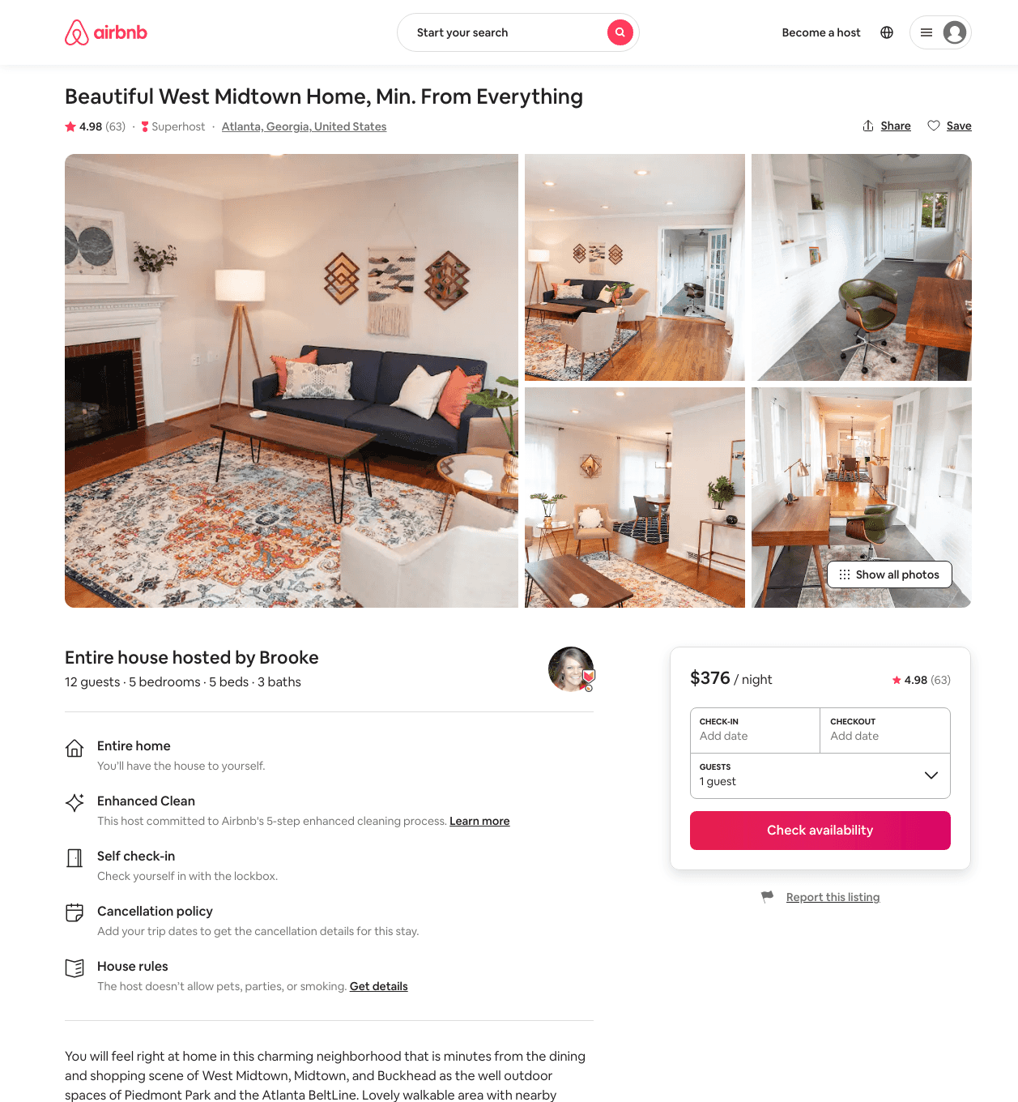
Listing 26424237
5
12
$350 - $509
4.98
3
Brooke
13795095
2
https://www.airbnb.com/rooms/26424237
Aug 2022

Slide 8
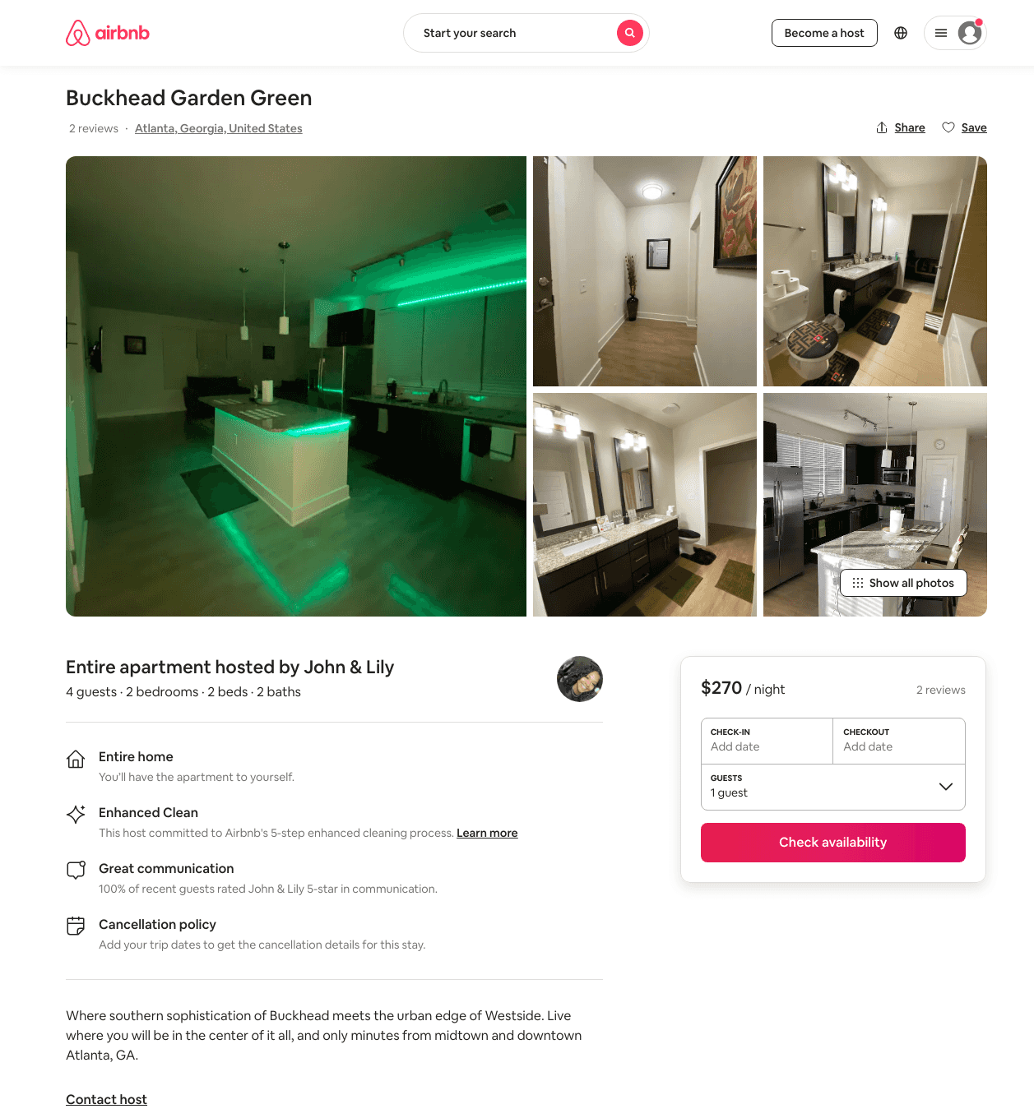
Listing 47264048
2
4
$178 - $308
5.0
2
John & Lily
370816058
4
https://www.airbnb.com/rooms/47264048
Jul 2022

Slide 9
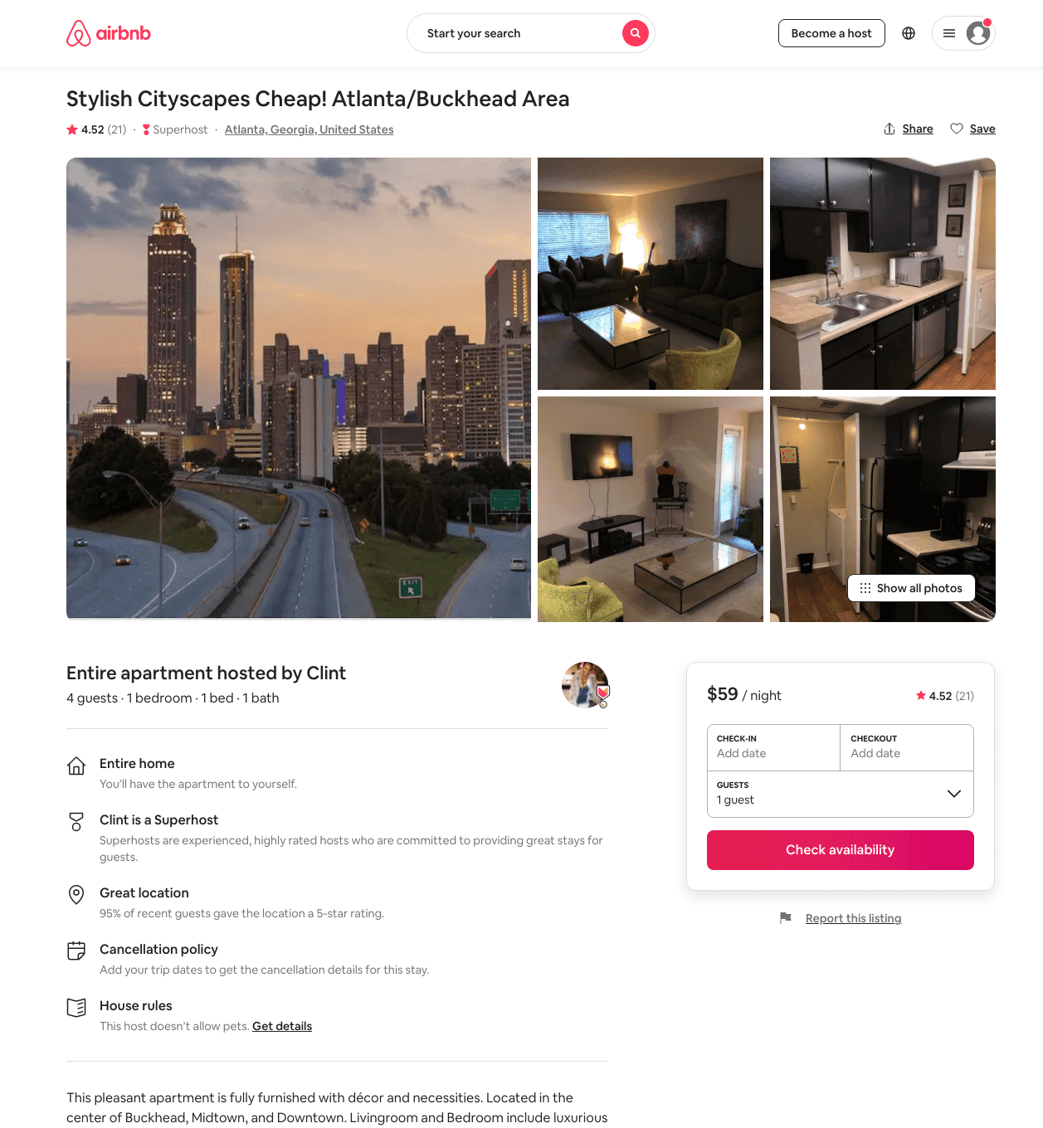
Listing 46585562
1
4
$47 - $98
4.49
1
Clint
376668101
1
https://www.airbnb.com/rooms/46585562
Aug 2022

Slide 10
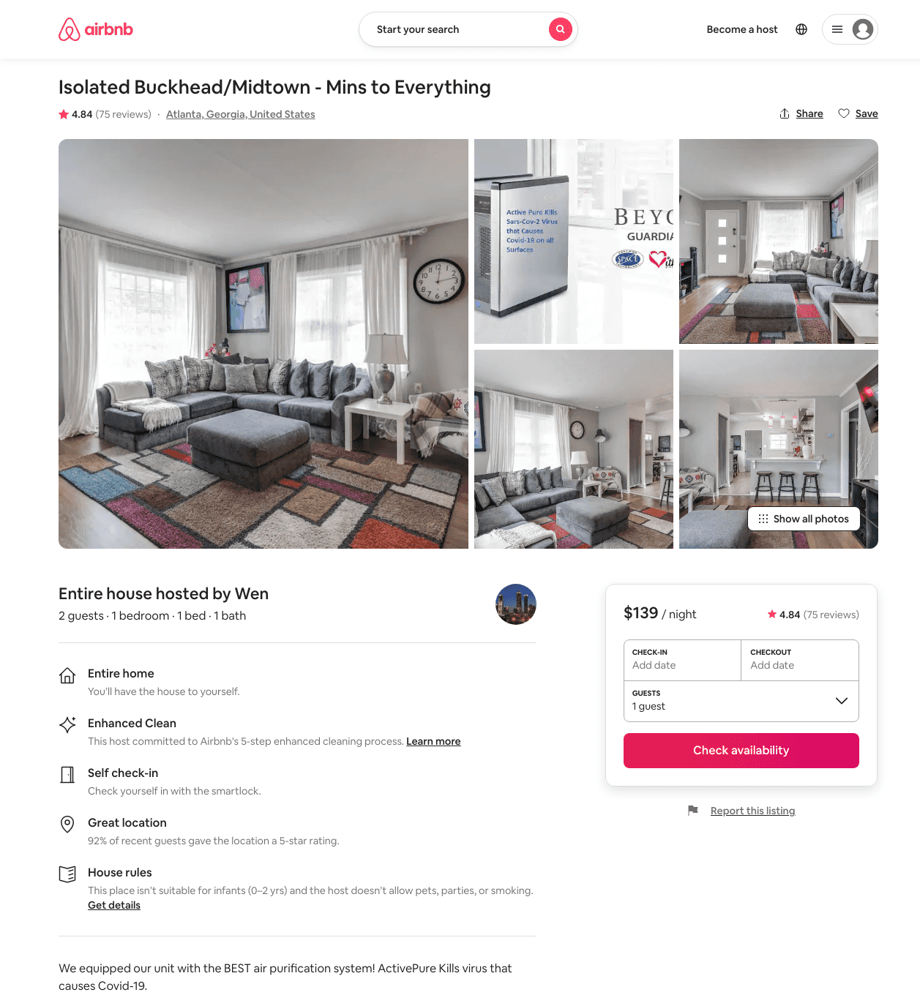
Listing 28033716
1
2
$96 - $139
4.79
2
Wen
51753341
4
https://www.airbnb.com/rooms/28033716
Aug 2022

Slide 11
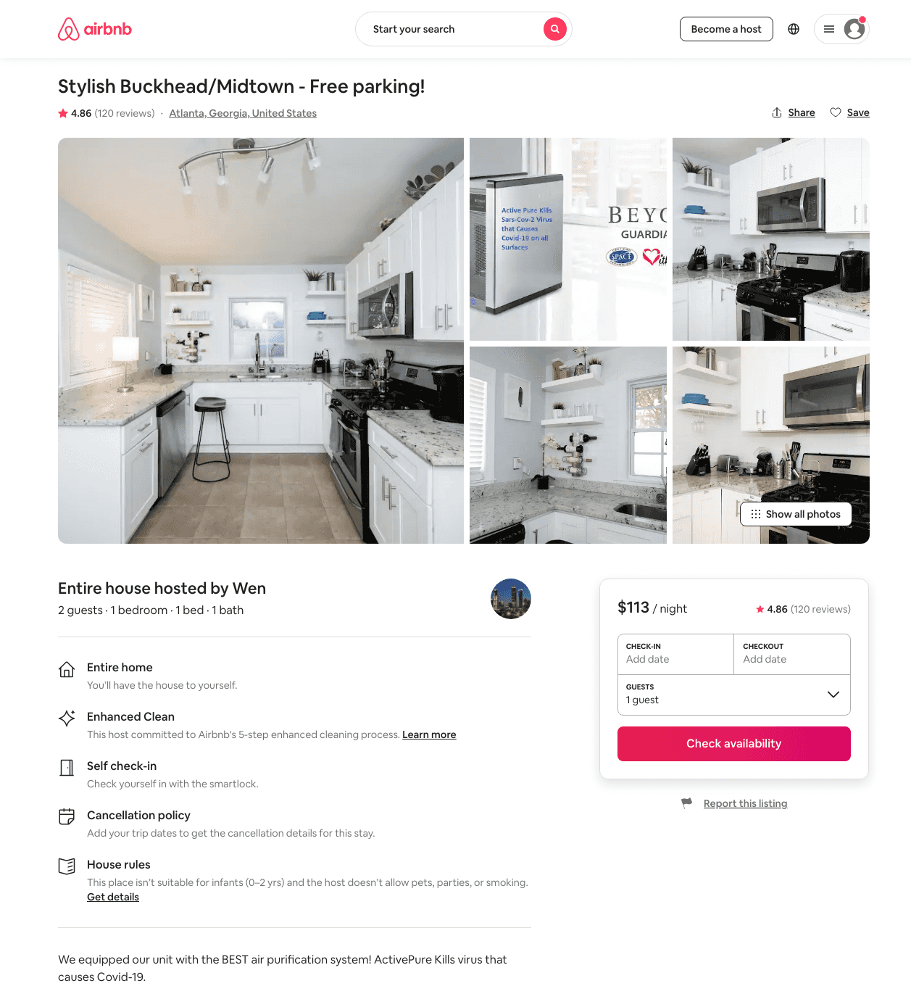
Listing 28893917
1
2
$94 - $434
4.82
2
Wen
51753341
4
https://www.airbnb.com/rooms/28893917
Aug 2022

Slide 12
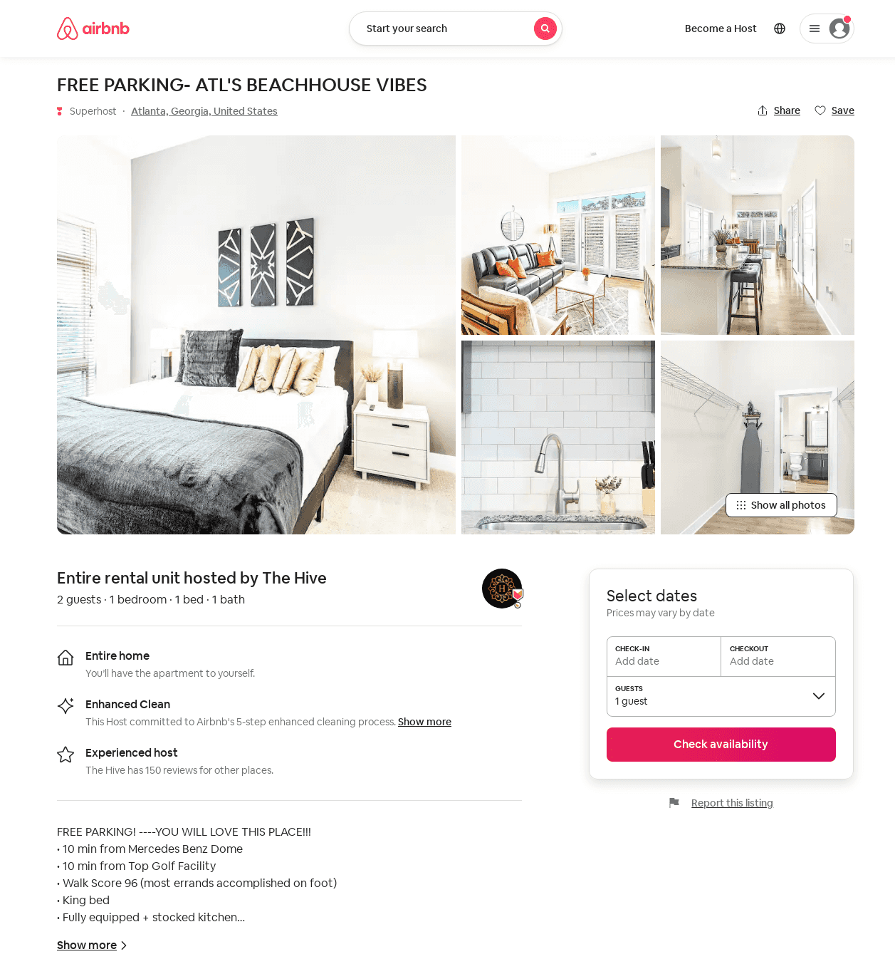
Listing 52570625
1
2
$92 - $147
4.75
1
The Hive
295549667
5
https://www.airbnb.com/rooms/52570625
Aug 2022

Slide 13
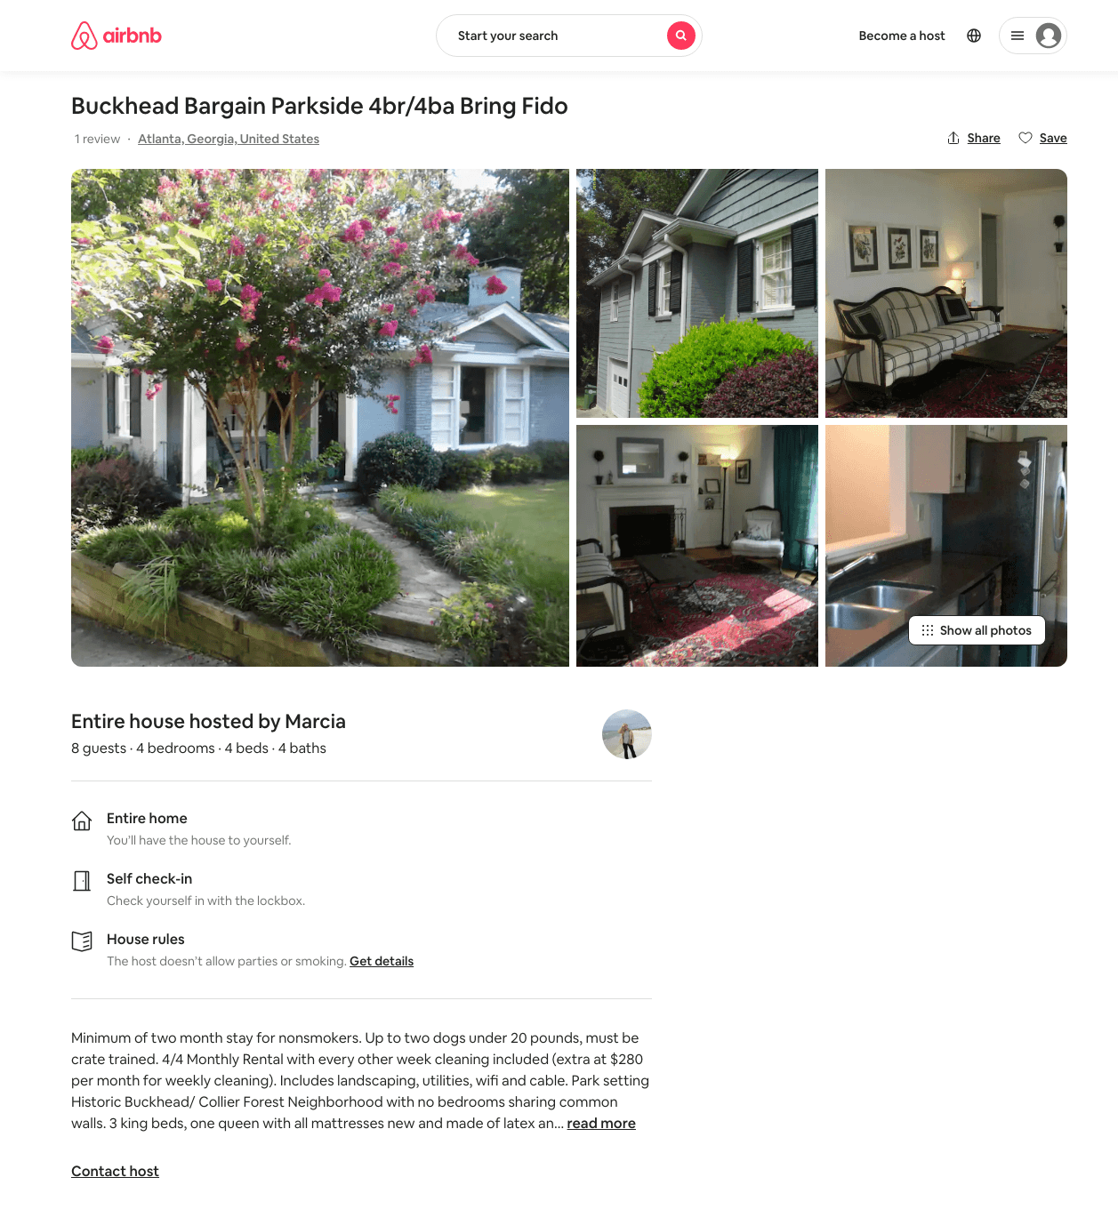
Listing 915913
4
8
$169
365
Marcia
4654286
1
https://www.airbnb.com/rooms/915913
Jun 2022

Slide 14
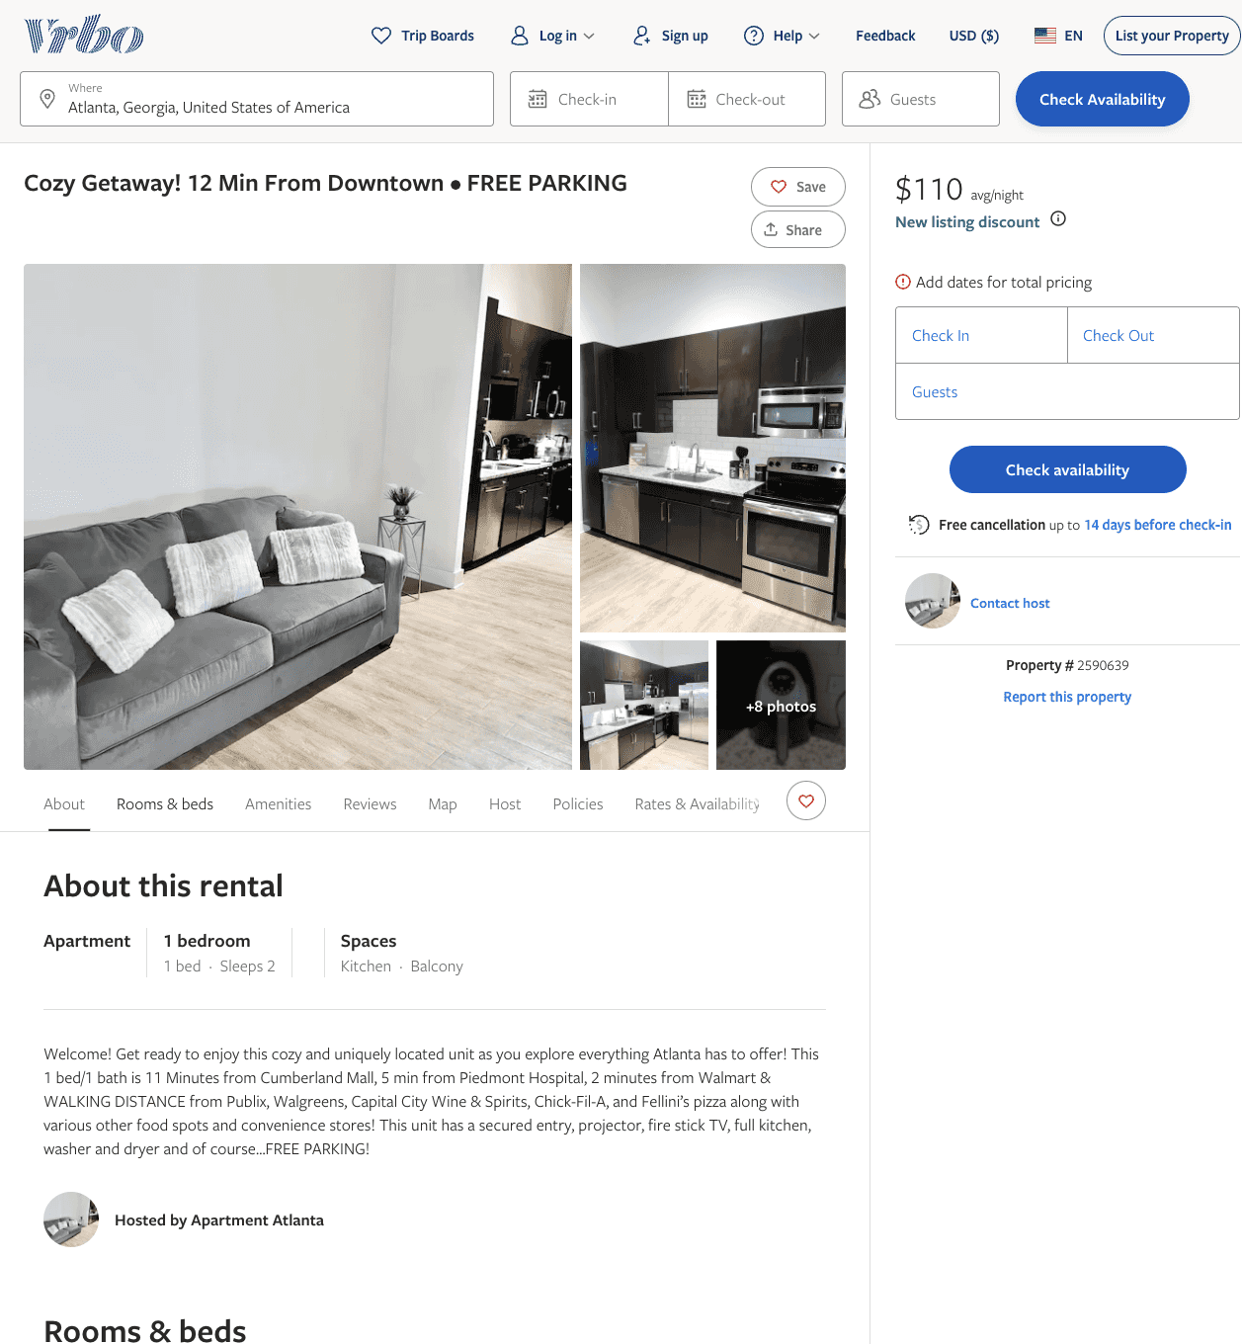
Listing 2590639
1
2
$110 - $94
5
2
Amani Hardy-Williams
https://www.vrbo.com/2590639
Aug 2022

Slide 15
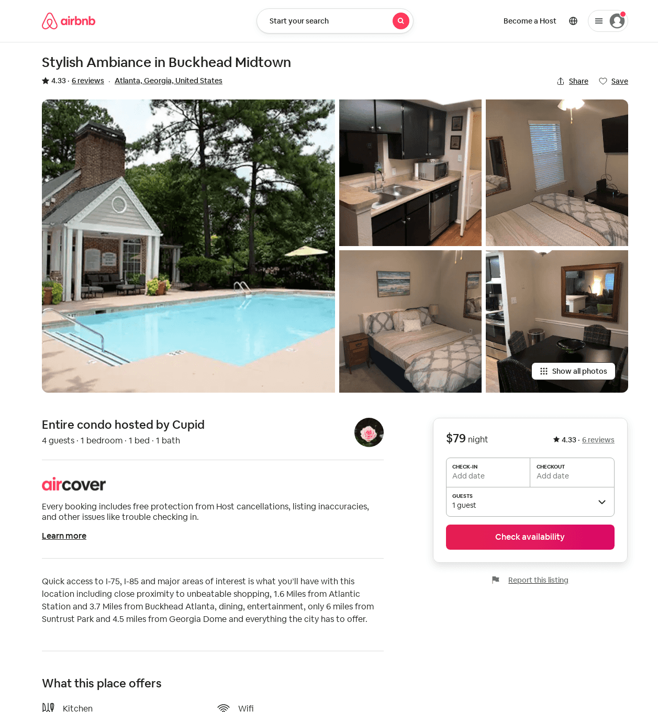
Listing 38650227
1
4
4.33
2
Cupid
55671203
2
https://www.airbnb.com/rooms/38650227
Aug 2022

