Slide 2
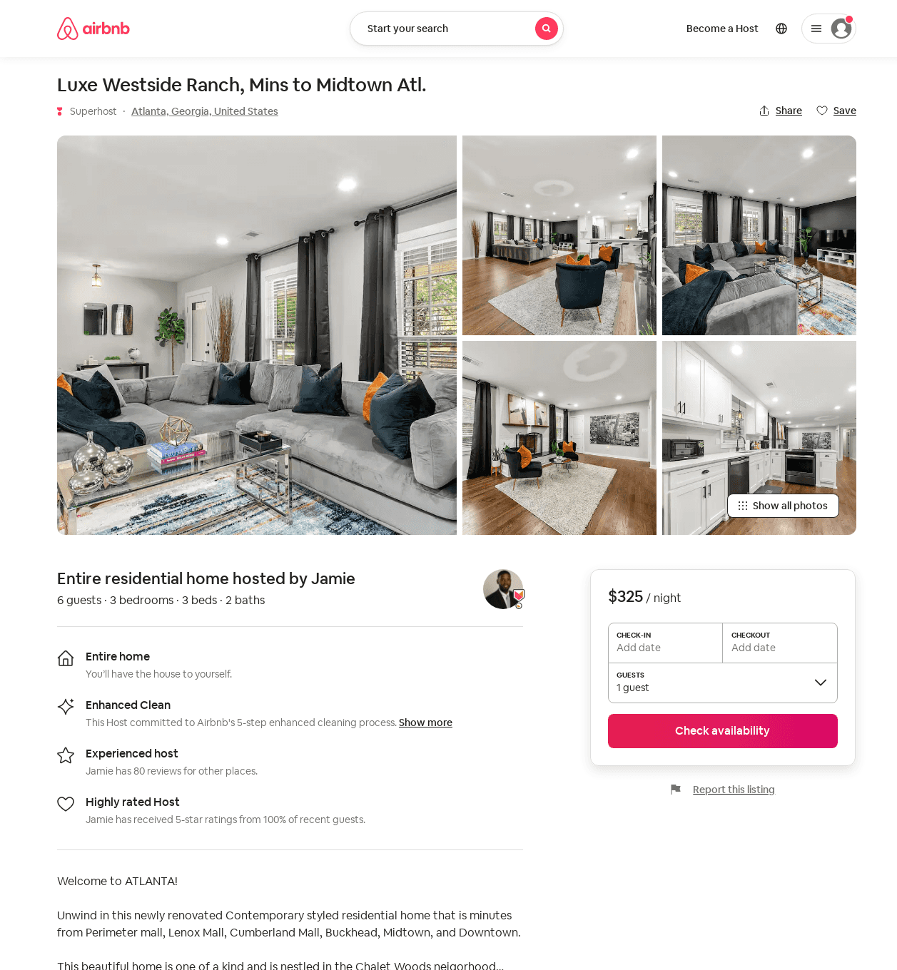
Listing 52865964
3
6
$220 - $339
5.0
4
Jamie
17497293
2
https://www.airbnb.com/rooms/52865964
Aug 2022

Slide 3
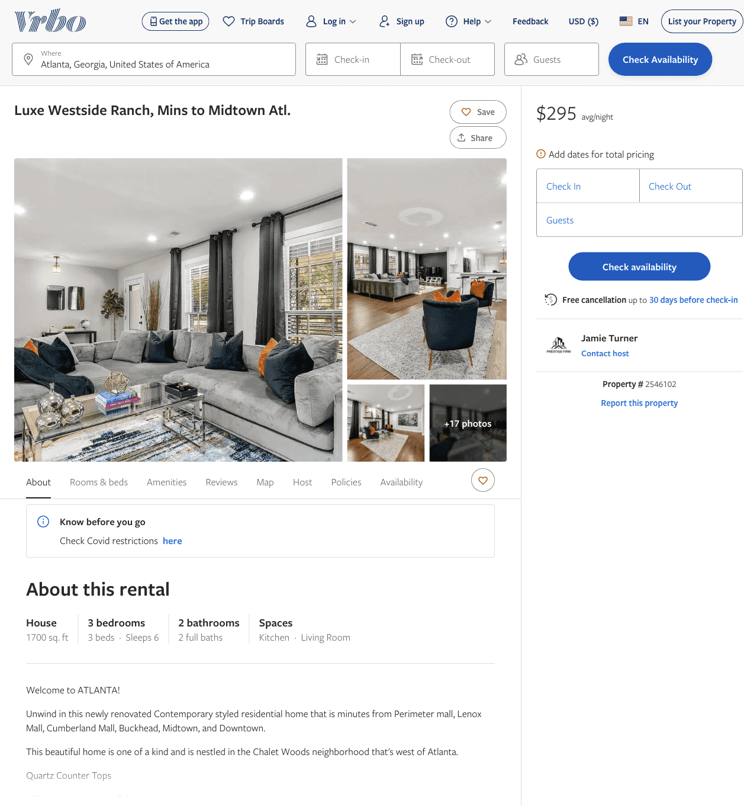
Listing 2546102
3
6
$295
4
Jamie Turner
https://www.vrbo.com/2546102
Aug 2022

Slide 4
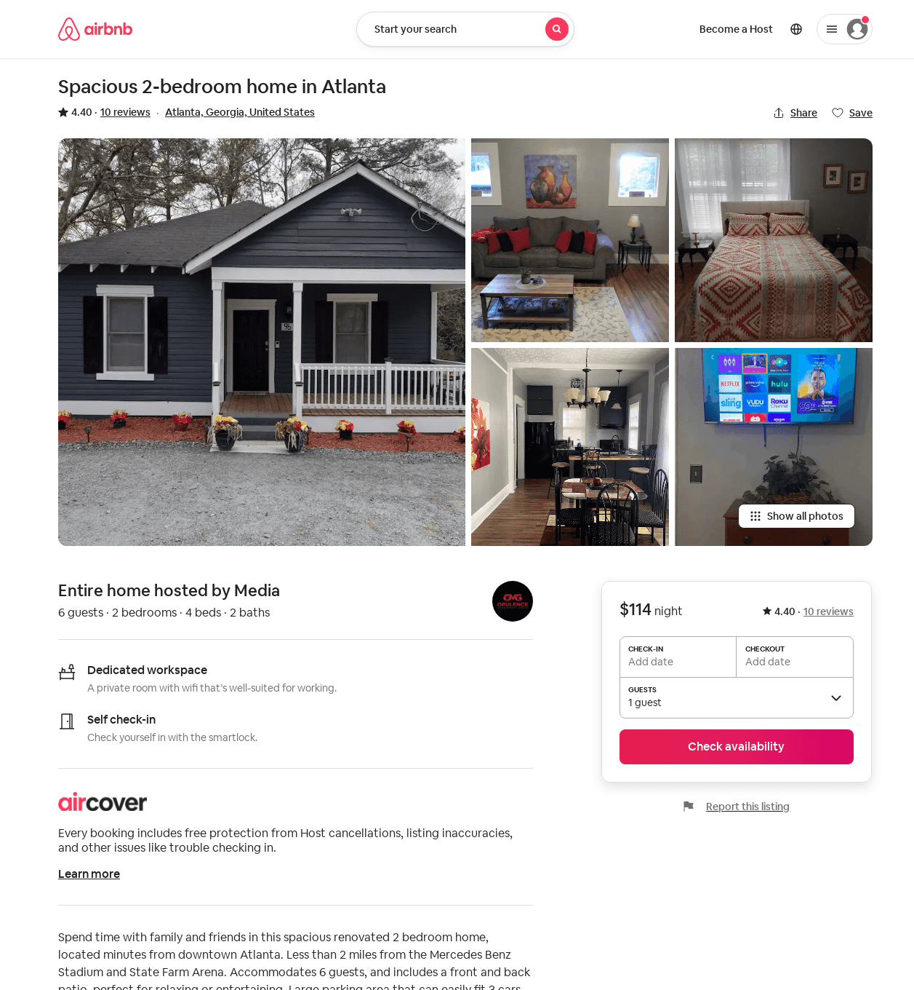
Listing 54368446
2
6
4.54
2
Media
137804110
2
https://www.airbnb.com/rooms/54368446
Aug 2022

