Slide 2
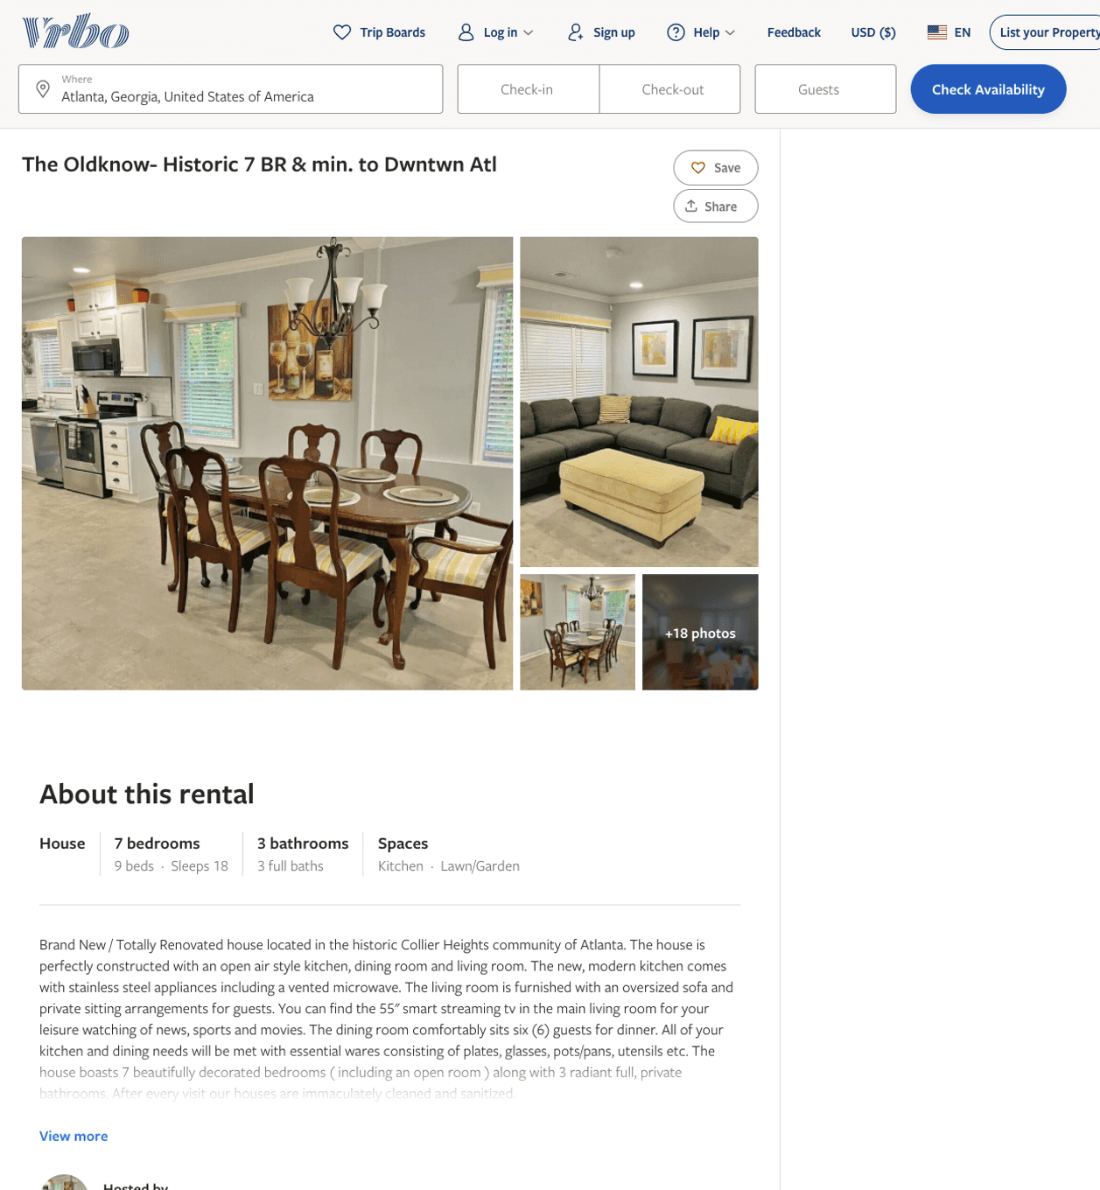
Listing 2082782
7
18
$364 - $476
4.7777777
2
Floyd Arthur
https://www.vrbo.com/2082782
Aug 2022

Slide 3
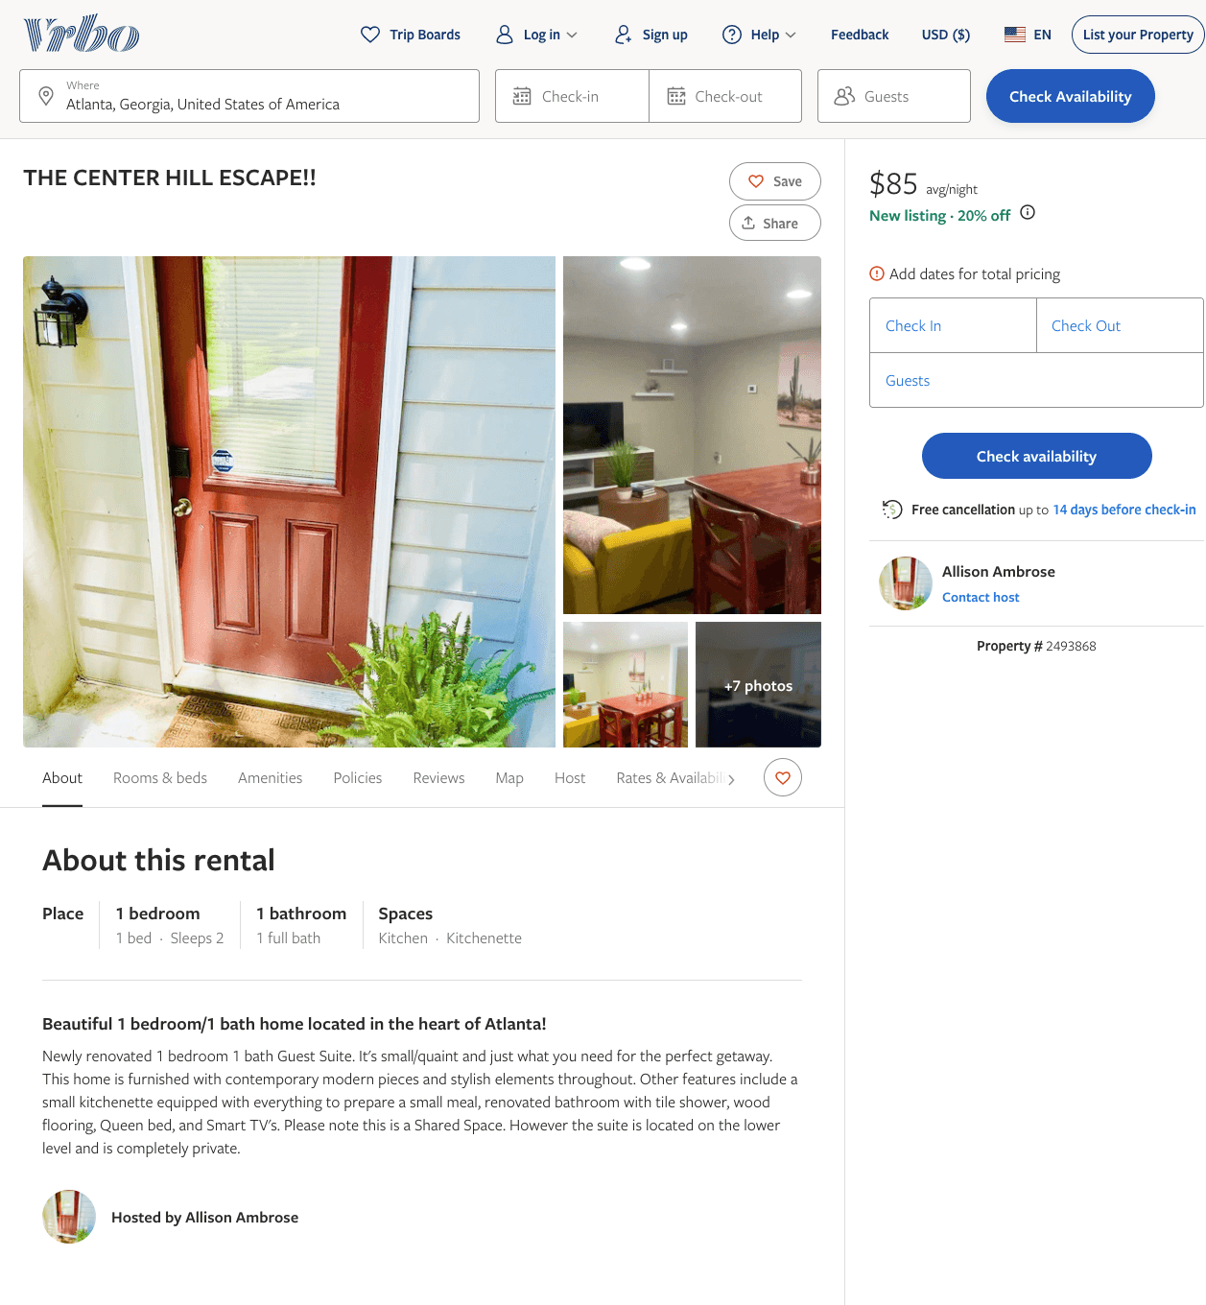
Listing 2493868
1
2
$84 - $85
2
Allison Ambrose
https://www.vrbo.com/2493868
Aug 2022

Slide 4
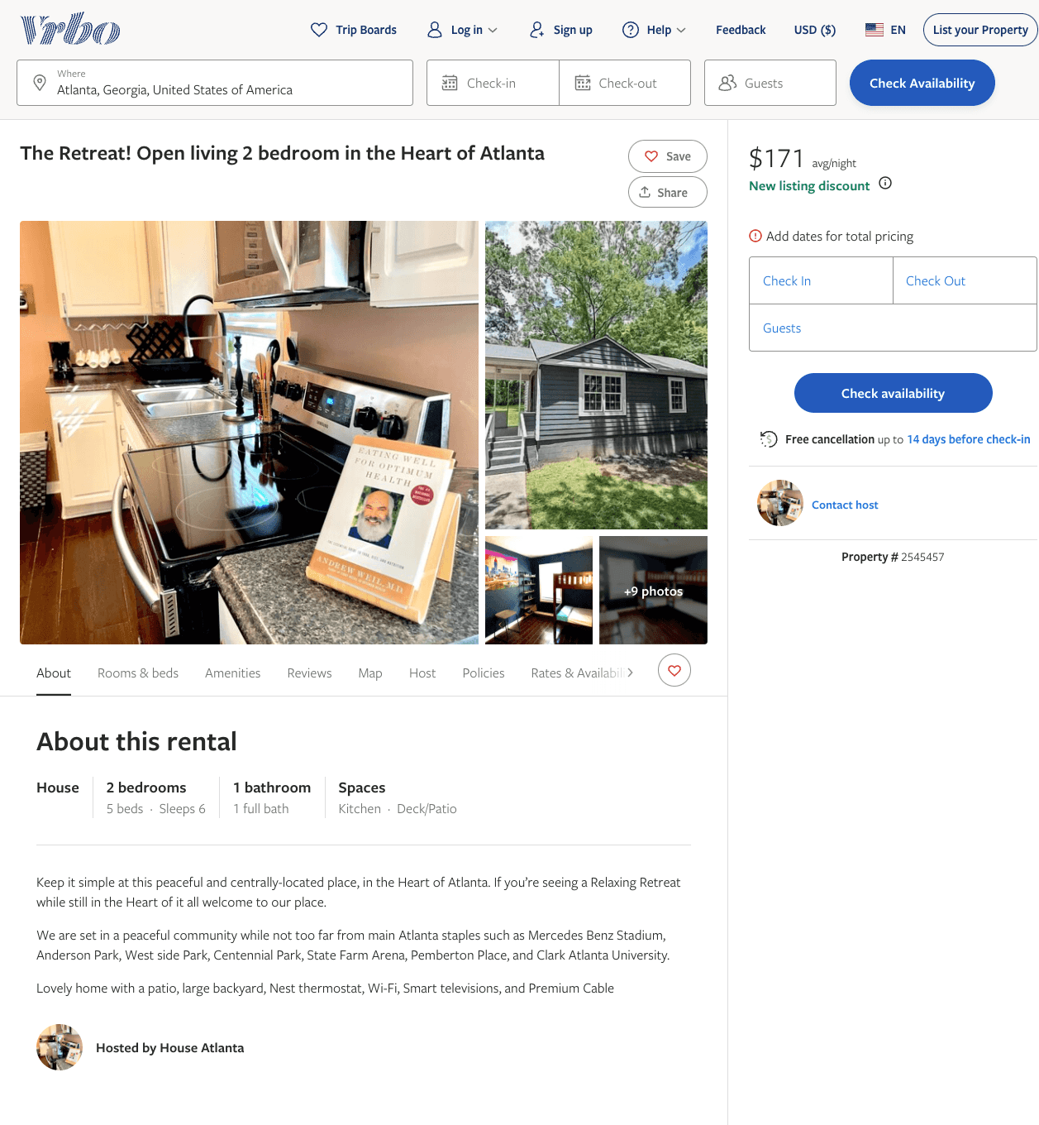
Listing 2545457
2
6
$171 - $197
3
Retreats Atlanta
https://www.vrbo.com/2545457
Aug 2022

Slide 5
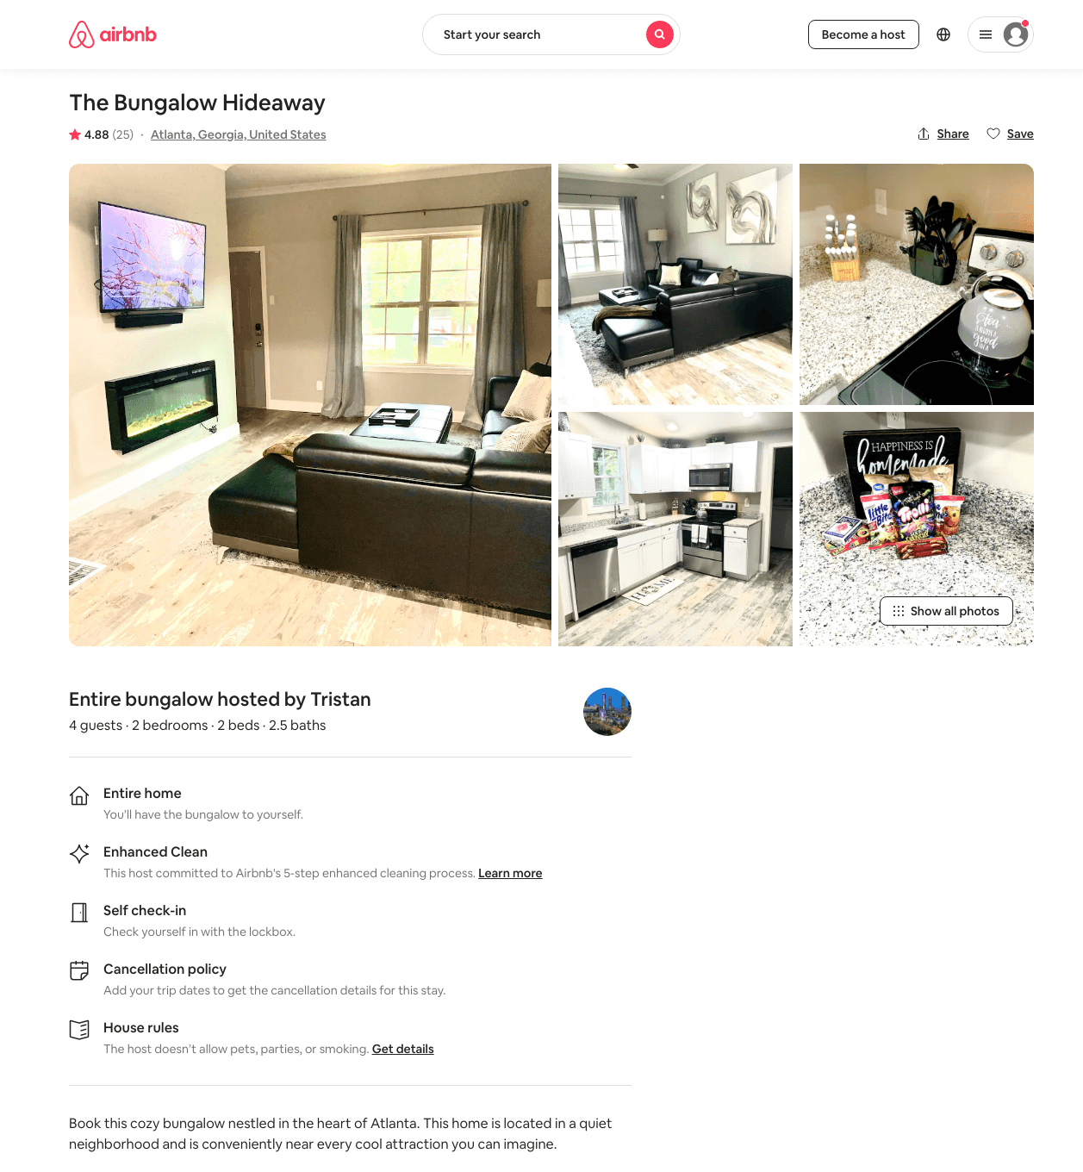
Listing 46451305
2
6
$89 - $183
4.84
2
Tristan
209028725
1
https://www.airbnb.com/rooms/46451305
Aug 2022

Slide 6
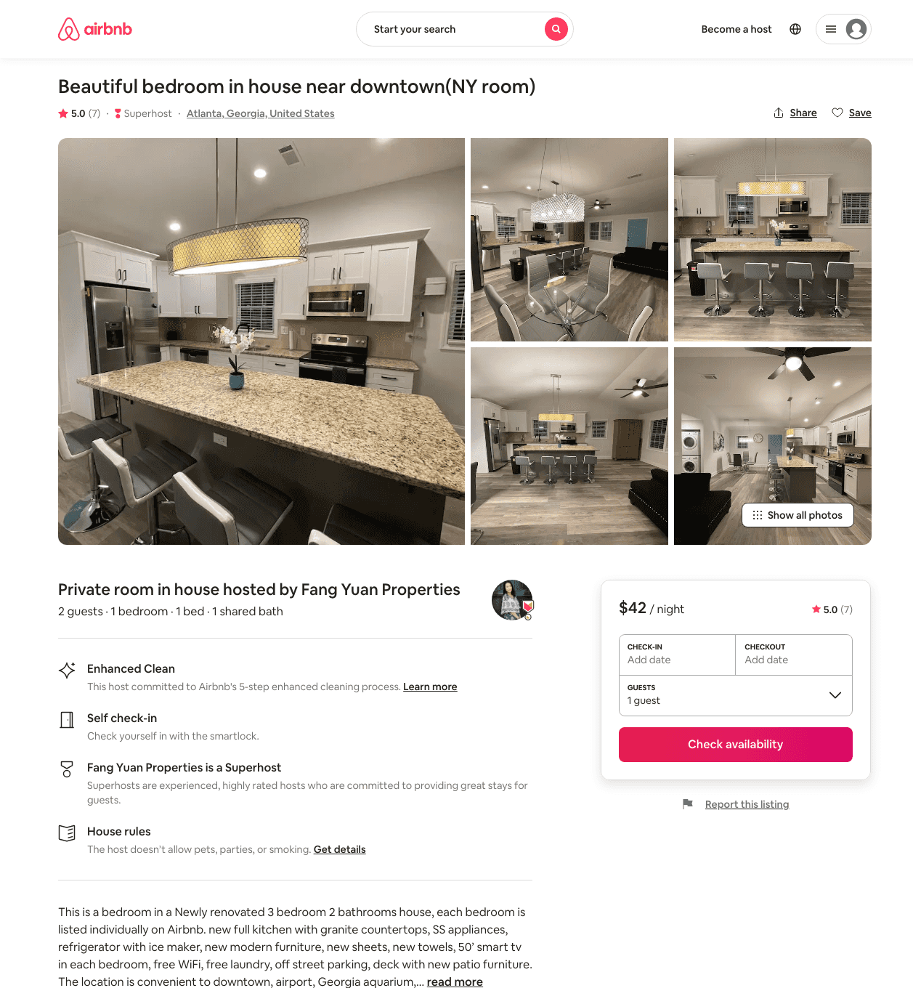
Listing 48372931
1
2
$39 - $67
4.81
1
Fang Yuan Properties
126122495
21
https://www.airbnb.com/rooms/48372931
Aug 2022

Slide 7
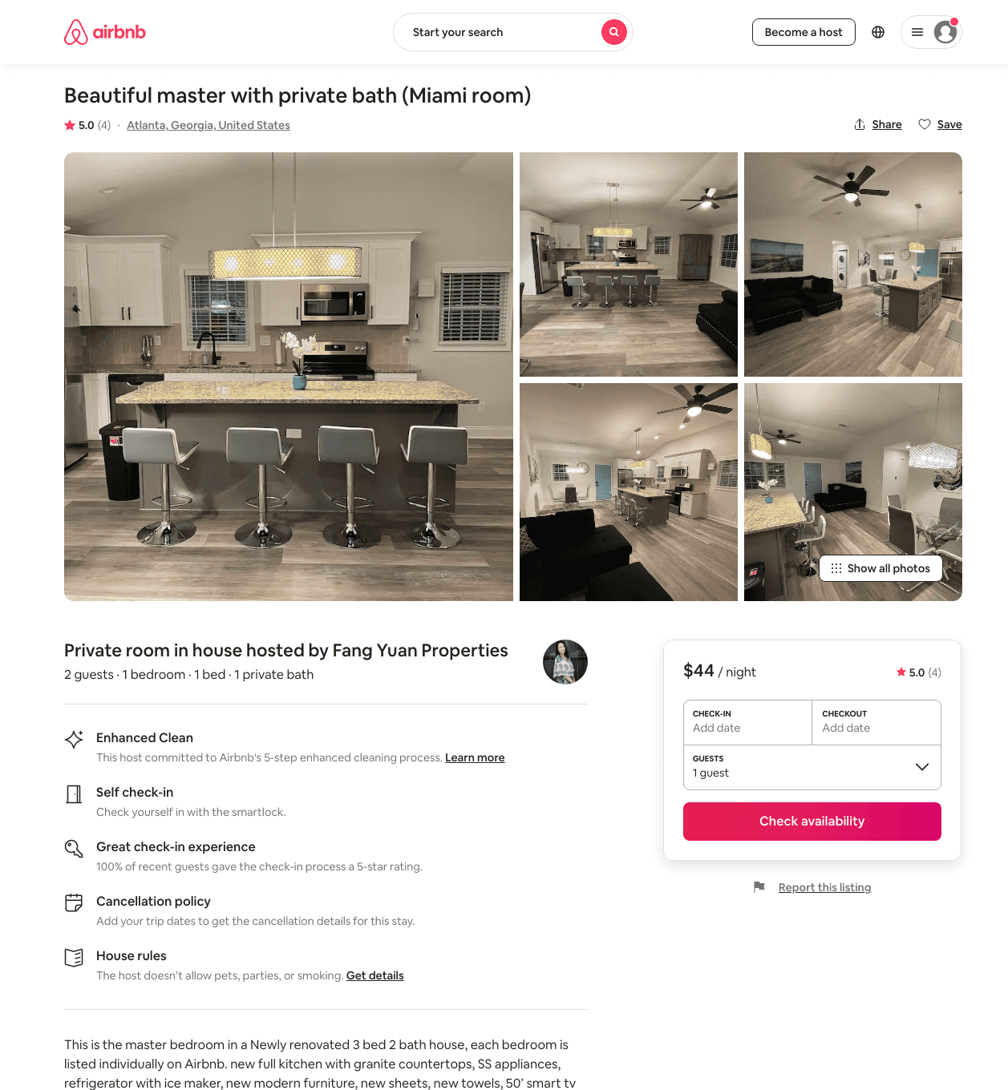
Listing 48372366
1
2
$43 - $70
4.68
1
Fang Yuan Properties
126122495
21
https://www.airbnb.com/rooms/48372366
Aug 2022

Slide 8
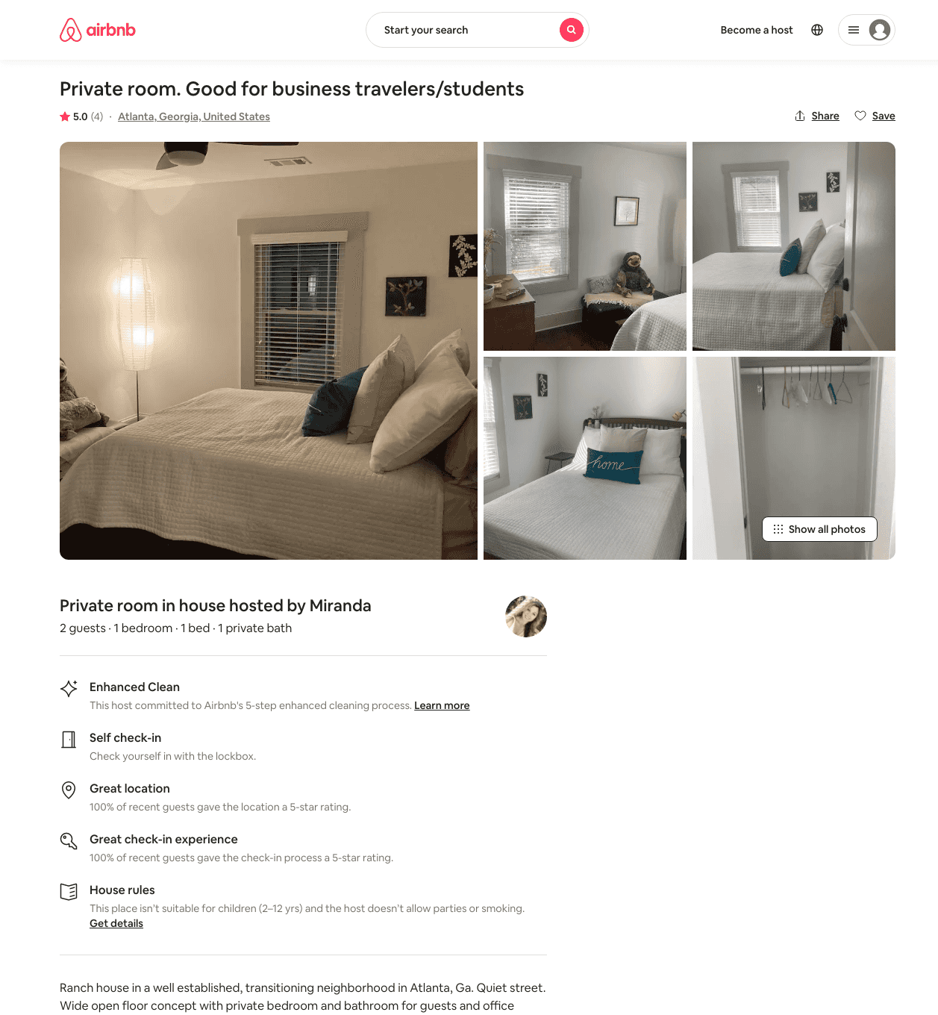
Listing 47847688
1
2
$34 - $47
4.91
3
Miranda
48218306
1
https://www.airbnb.com/rooms/47847688
Aug 2022

Slide 9
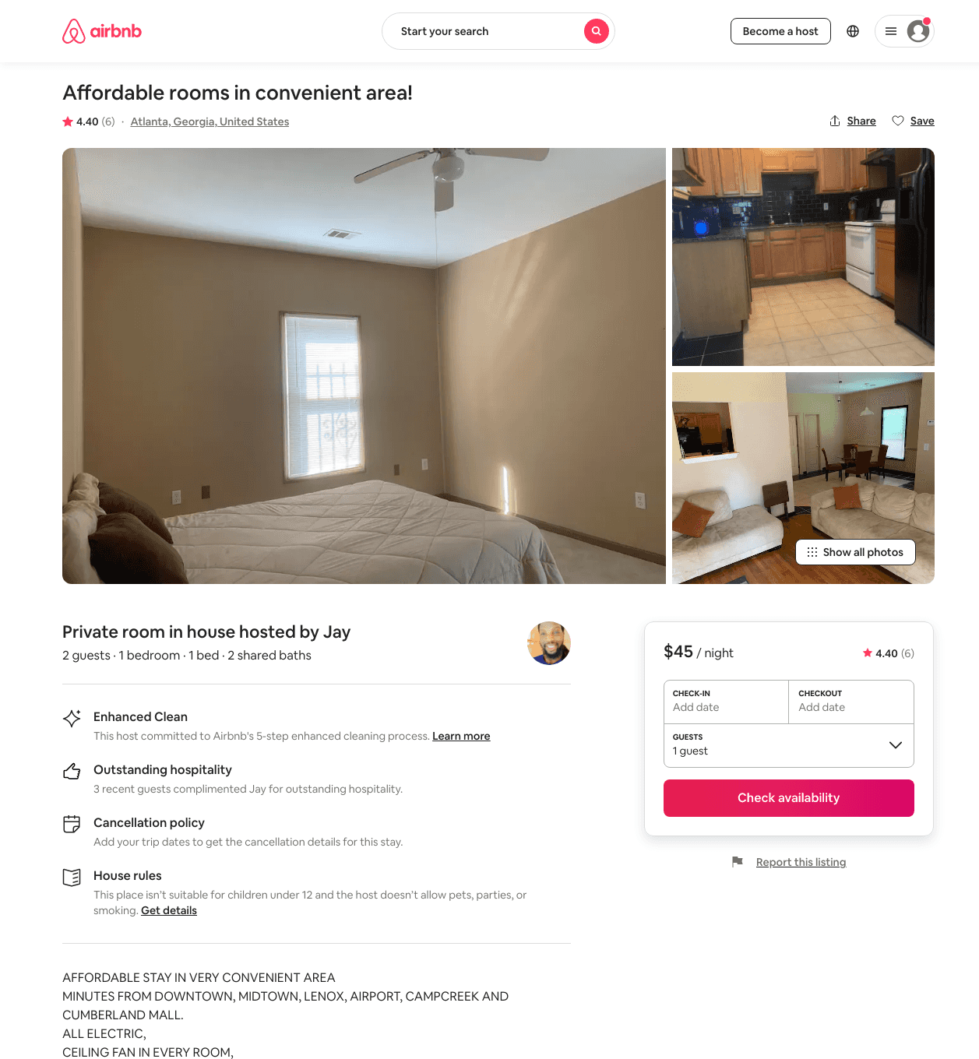
Listing 40871466
1
1
$42 - $61
4.69
7
Jay
318130008
3
https://www.airbnb.com/rooms/40871466
Aug 2022

Slide 10
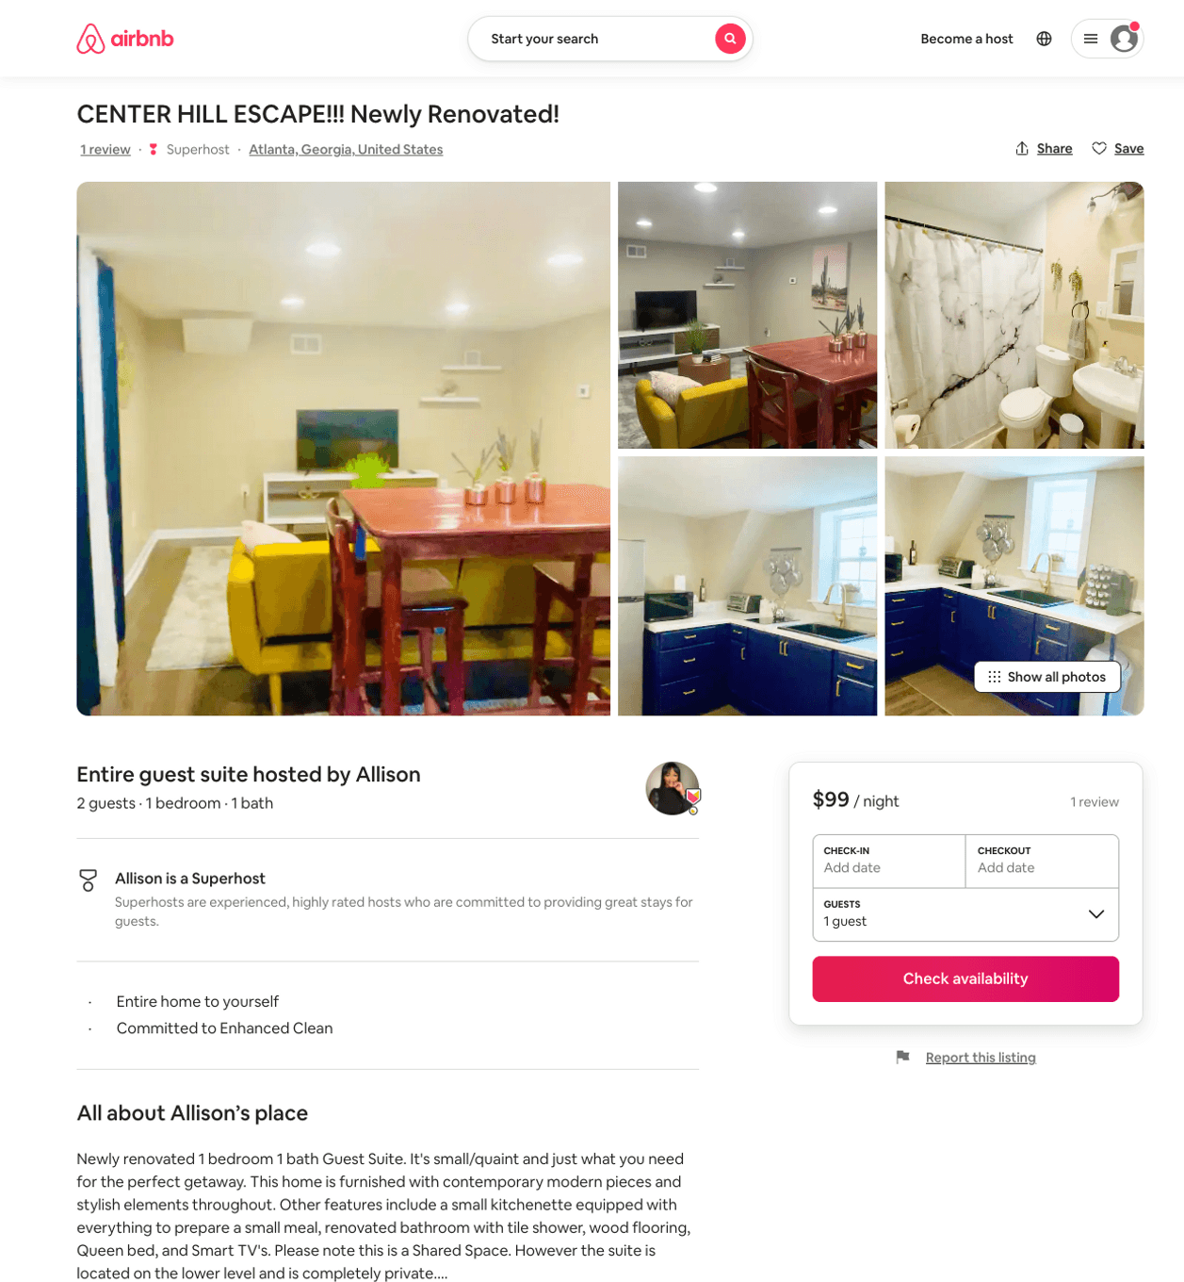
Listing 50466569
1
2
$89 - $99
4.50
2
Allison
204199885
7
https://www.airbnb.com/rooms/50466569
Aug 2022

Slide 11
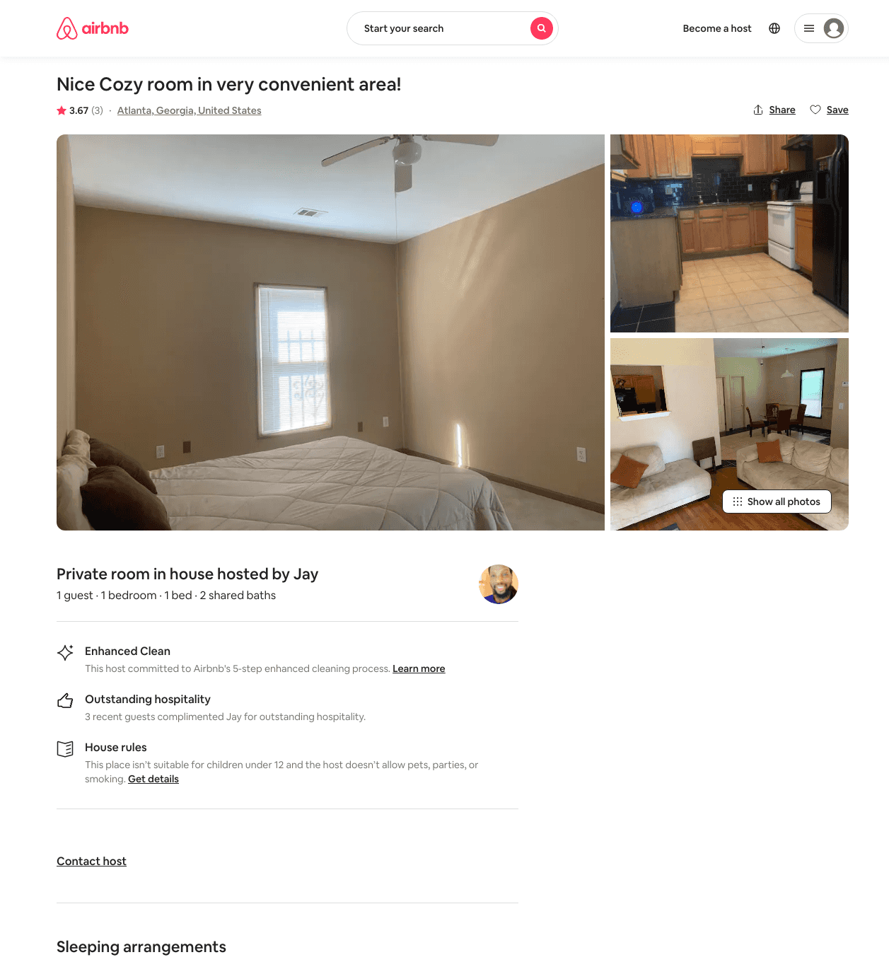
Listing 47197758
1
1
$35 - $45
4.50
30
Jay
318130008
3
https://www.airbnb.com/rooms/47197758
Aug 2022

Slide 12
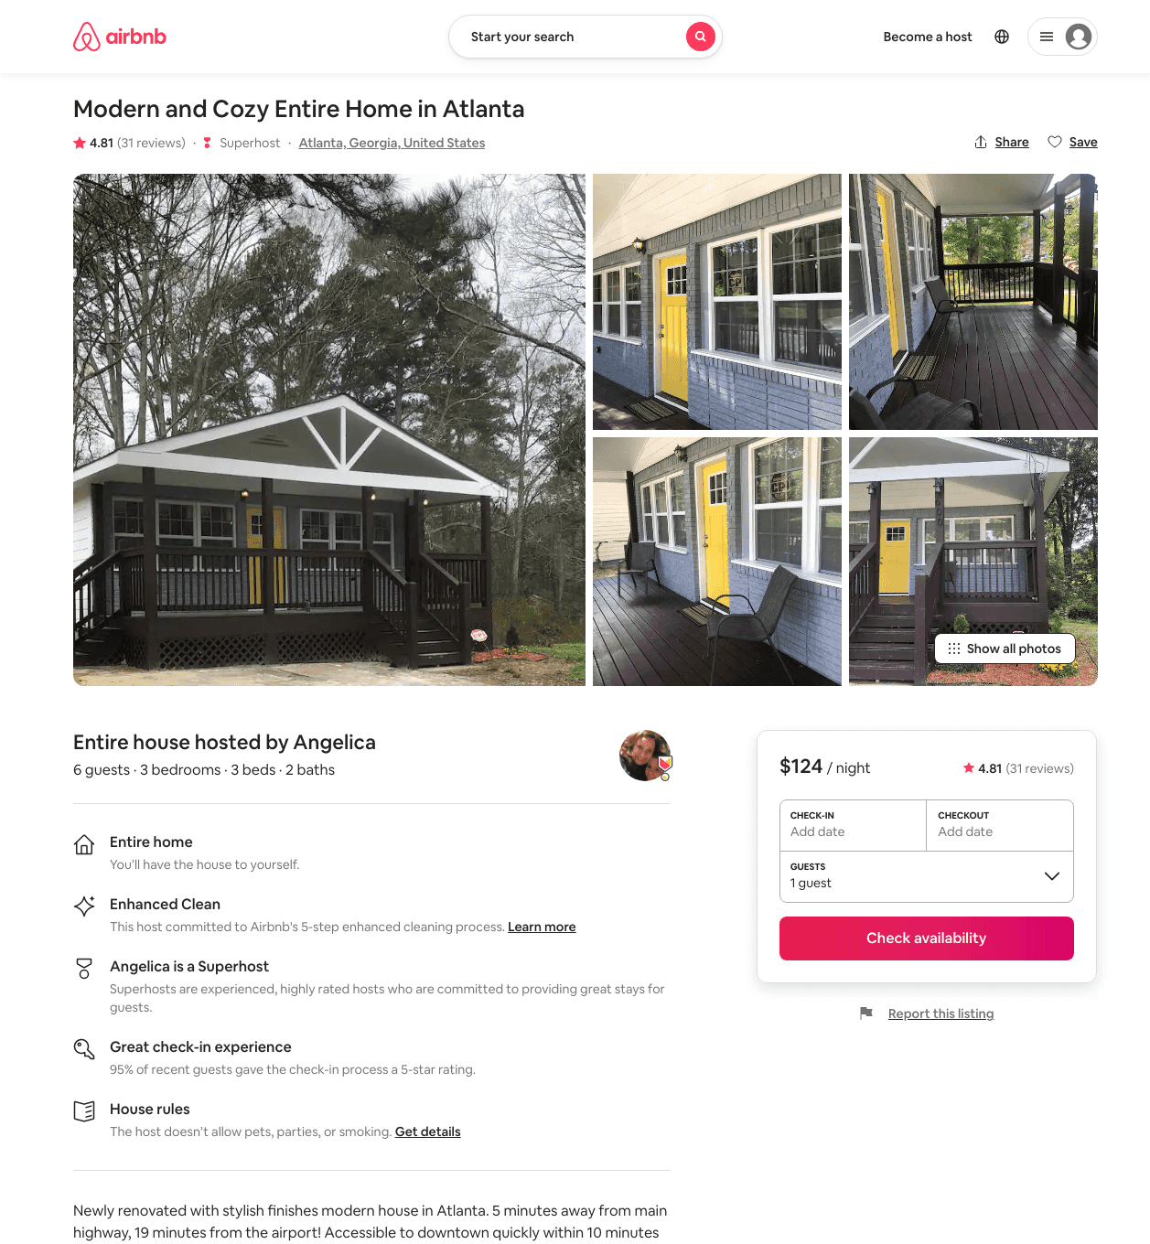
Listing 43024896
3
6
$121 - $160
4.75
3
Angelica
106948374
2
https://www.airbnb.com/rooms/43024896
Aug 2022

Slide 13
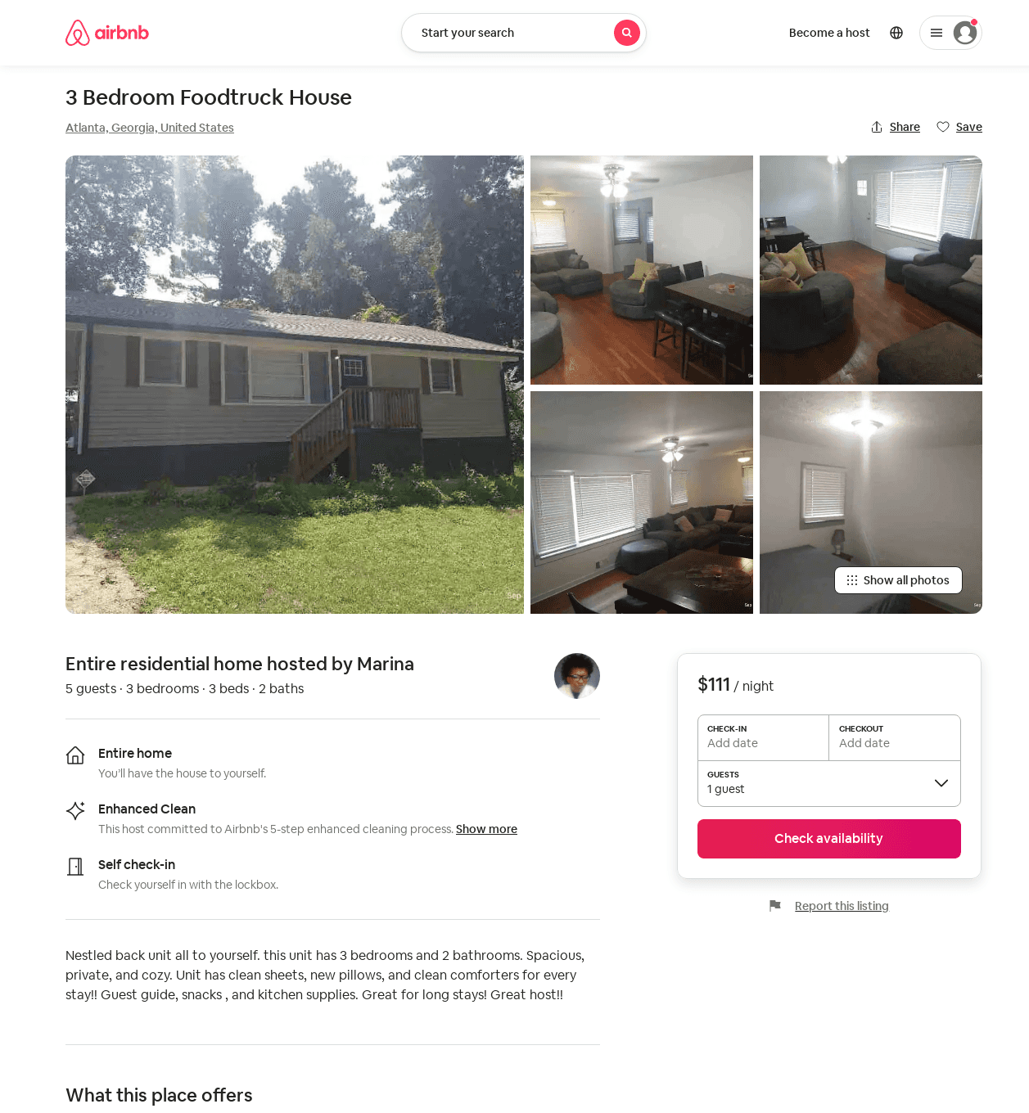
Listing 51909777
3
10
$59 - $111
4.76
1
Marina
62432824
3
https://www.airbnb.com/rooms/51909777
Aug 2022

Slide 14
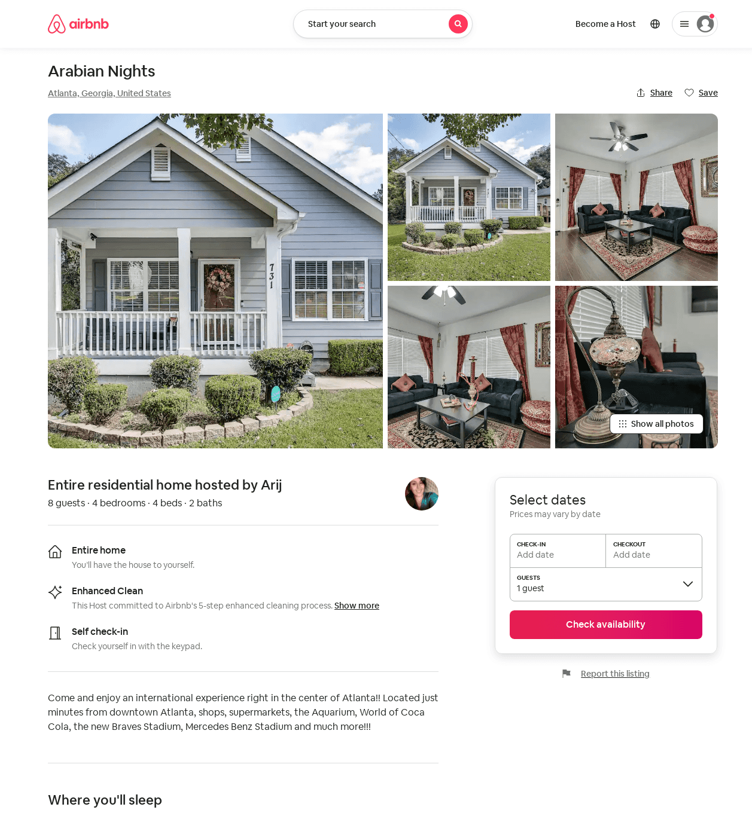
Listing 52535762
4
8
$175 - $189
4.91
2
Arij
425219508
1
https://www.airbnb.com/rooms/52535762
Jul 2022

Slide 15
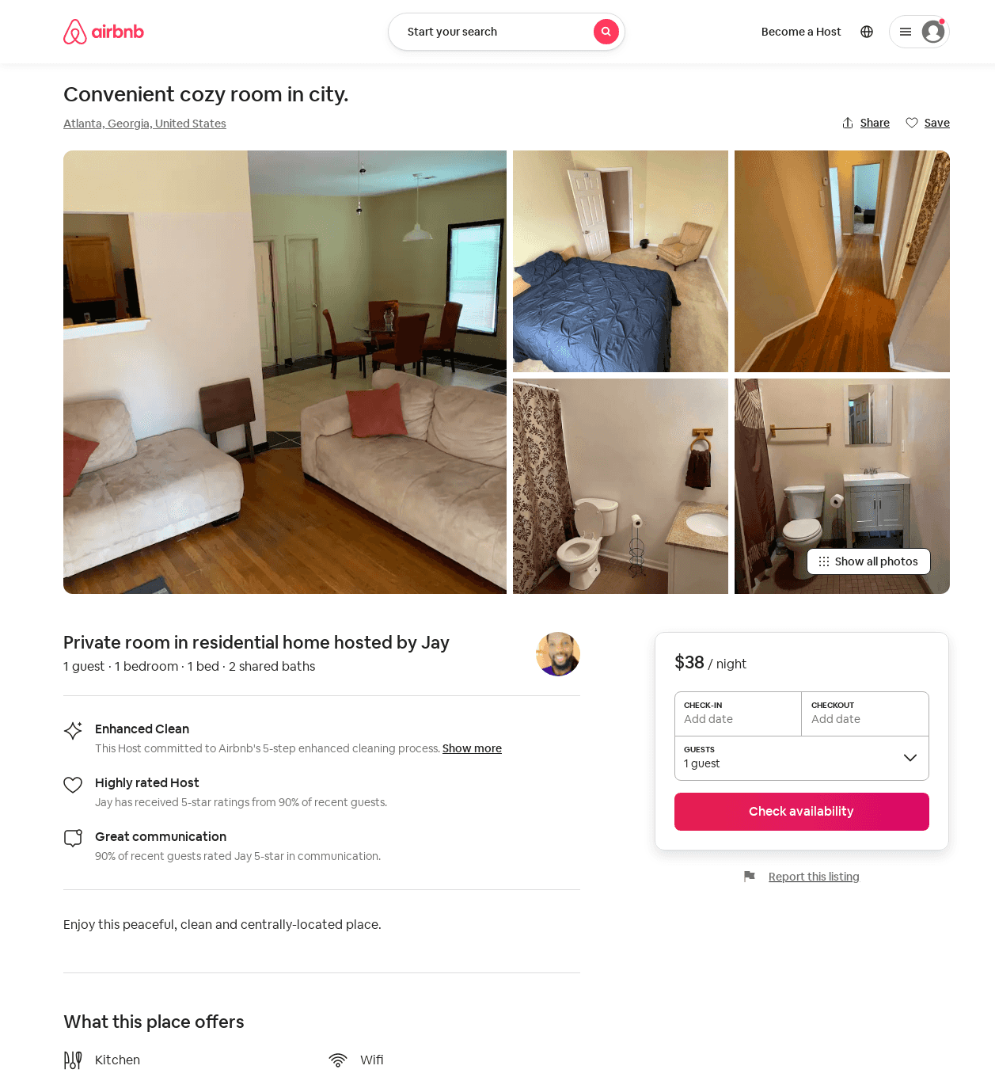
Listing 52827222
1
1
$38
4.40
30
Jay
318130008
3
https://www.airbnb.com/rooms/52827222
Aug 2022

Slide 16
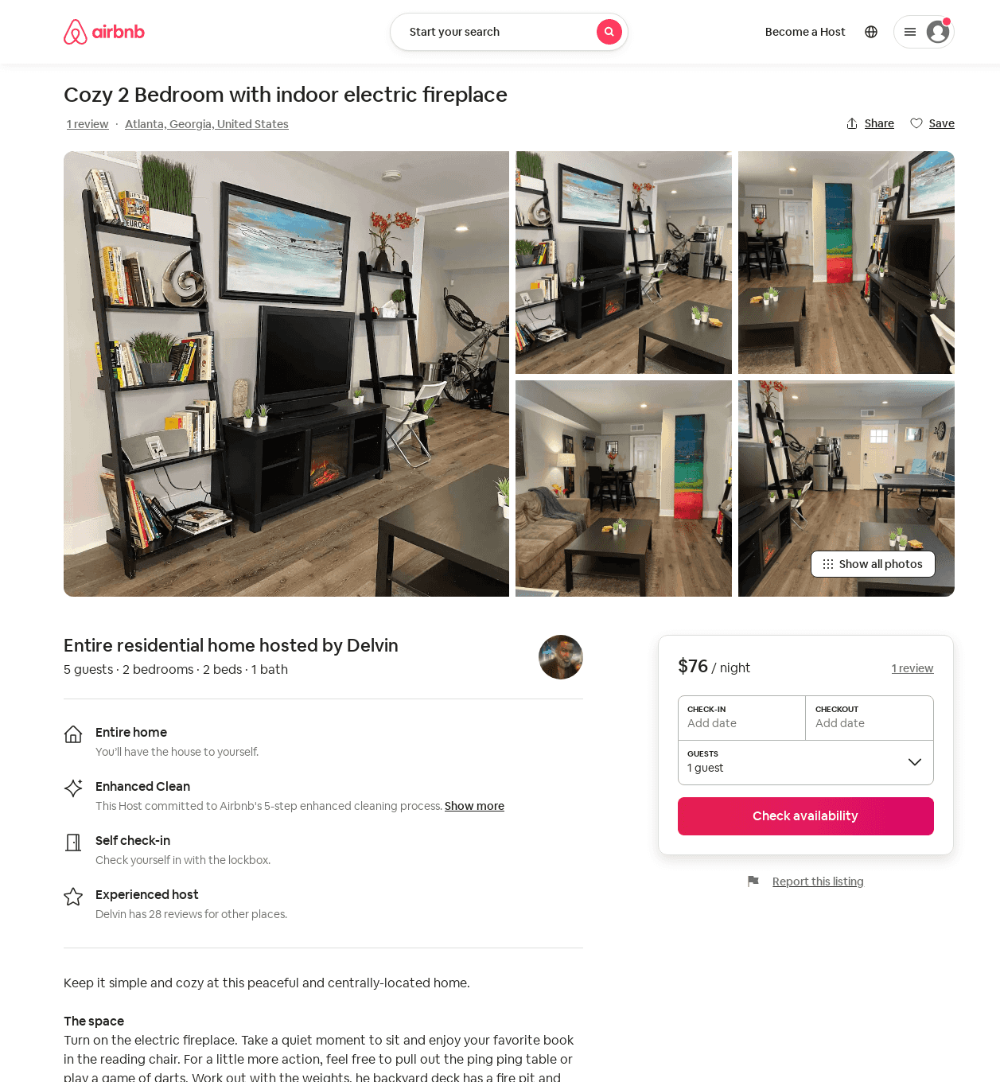
Listing 53412527
2
5
$76 - $156
4.79
1
Delvin
3480482
3
https://www.airbnb.com/rooms/53412527
Aug 2022

Slide 17
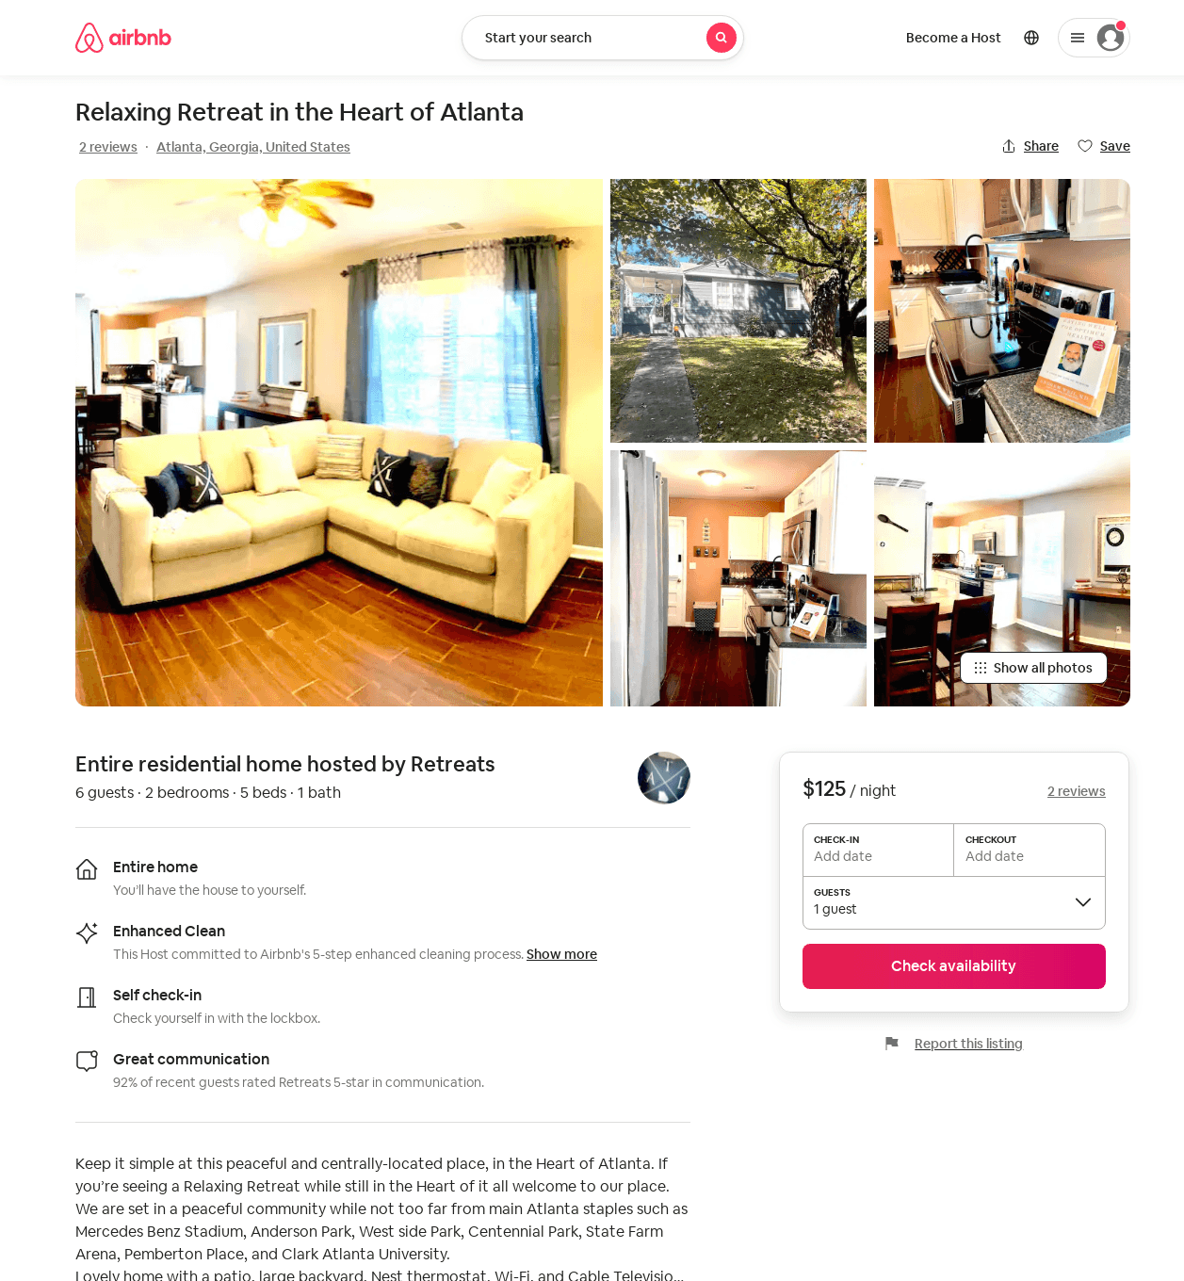
Listing 52960061
2
6
$125 - $154
4.77
3
Jennie
406879168
2
https://www.airbnb.com/rooms/52960061
Aug 2022

Slide 18
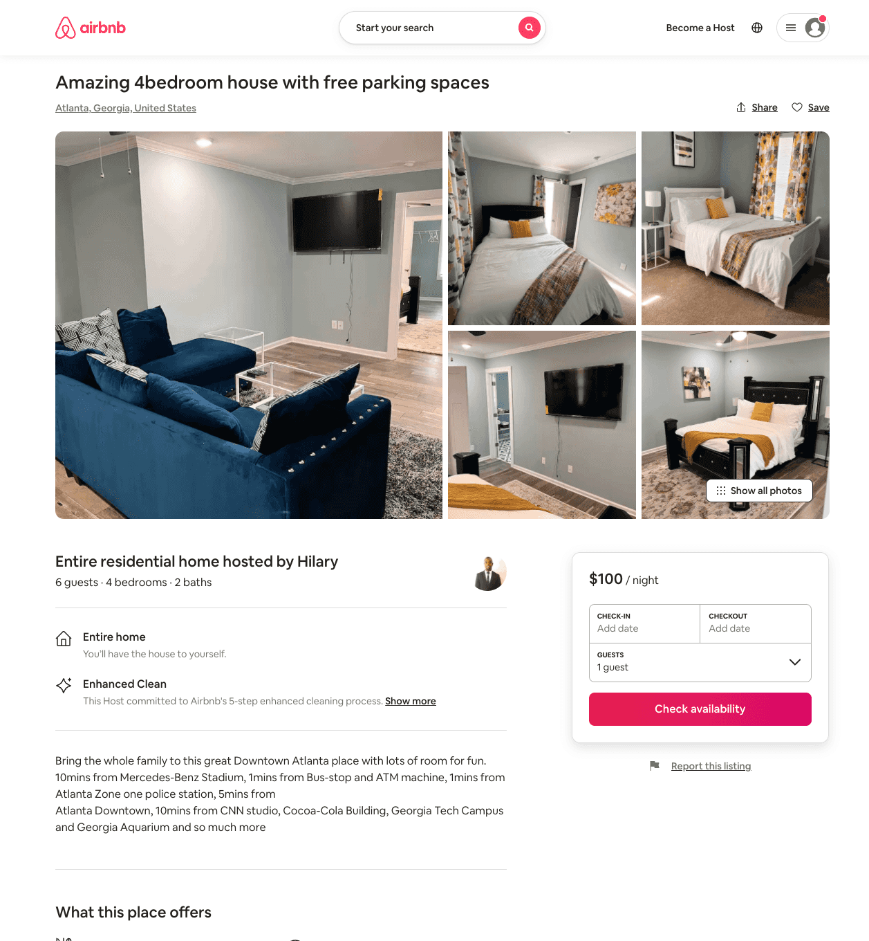
Listing 50355781
4
6
$100 - $148
4.84
3
Hilary
406652564
1
https://www.airbnb.com/rooms/50355781
Aug 2022

Slide 19
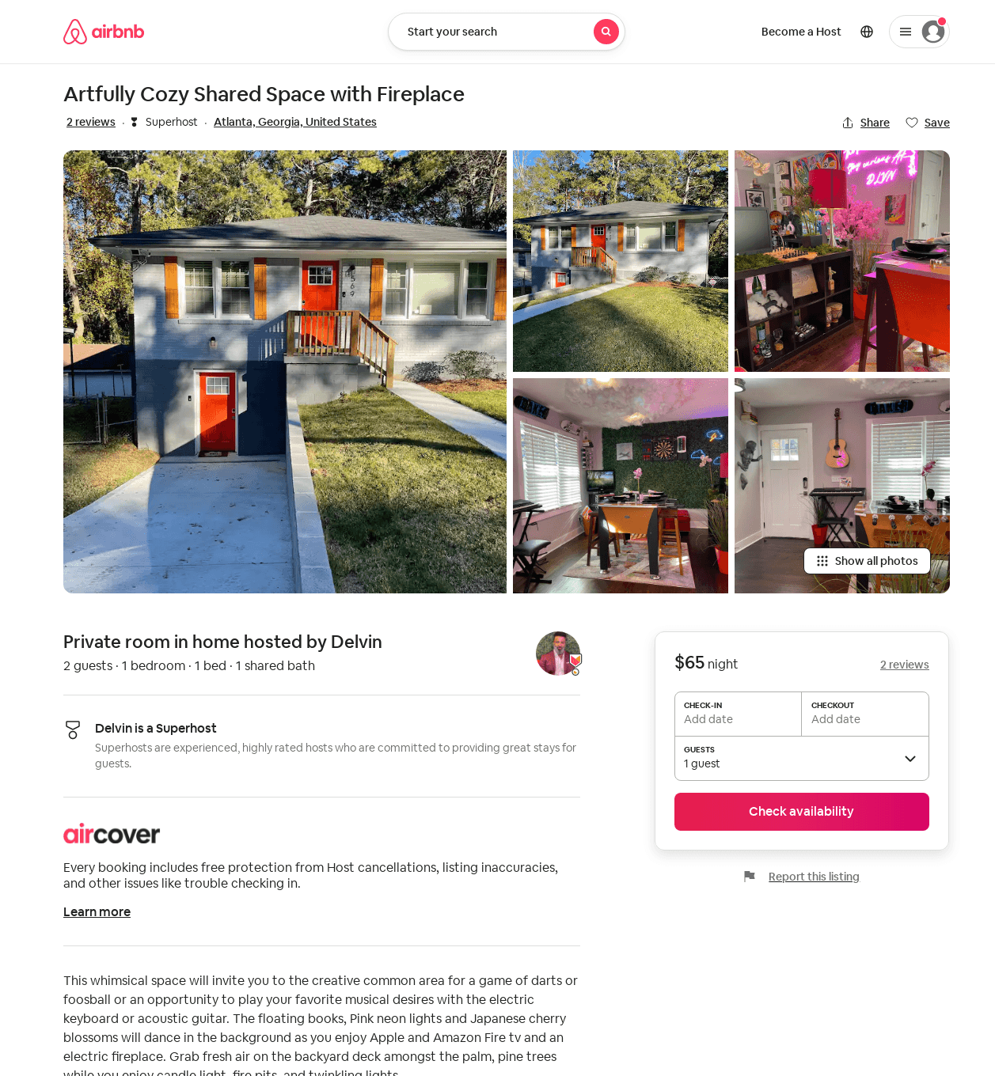
Listing 52381085
1
2
$65
4.90
1
Delvin
3480482
3
https://www.airbnb.com/rooms/52381085
Aug 2022

Slide 20
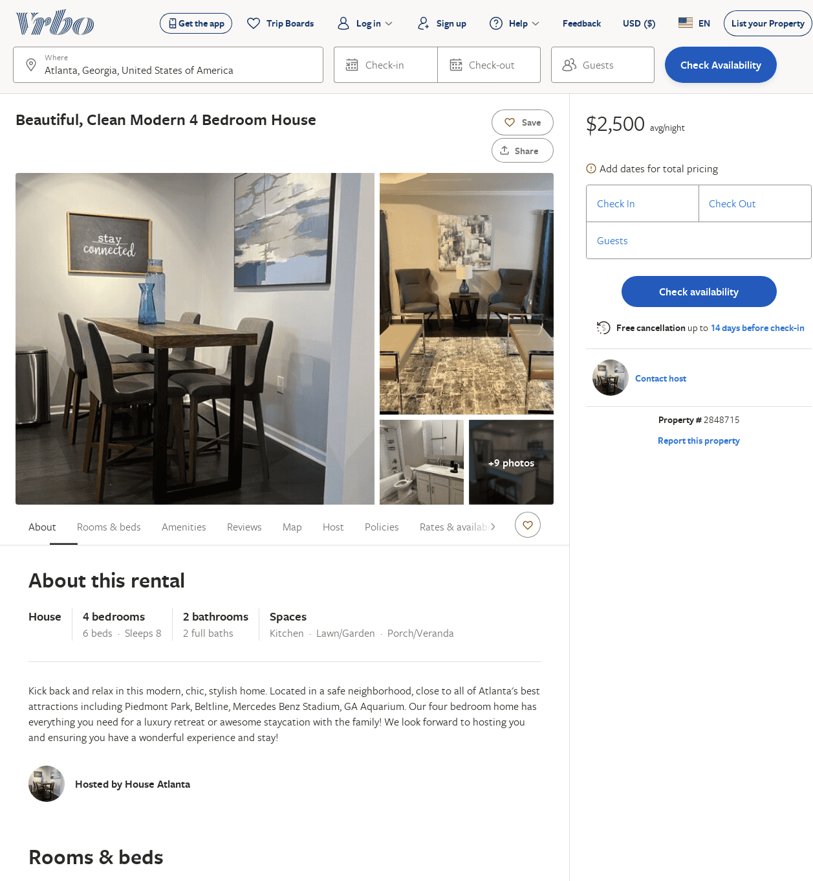
Listing 2848715
4
8
$2,500
2
https://www.vrbo.com/2848715
Aug 2022

Slide 21
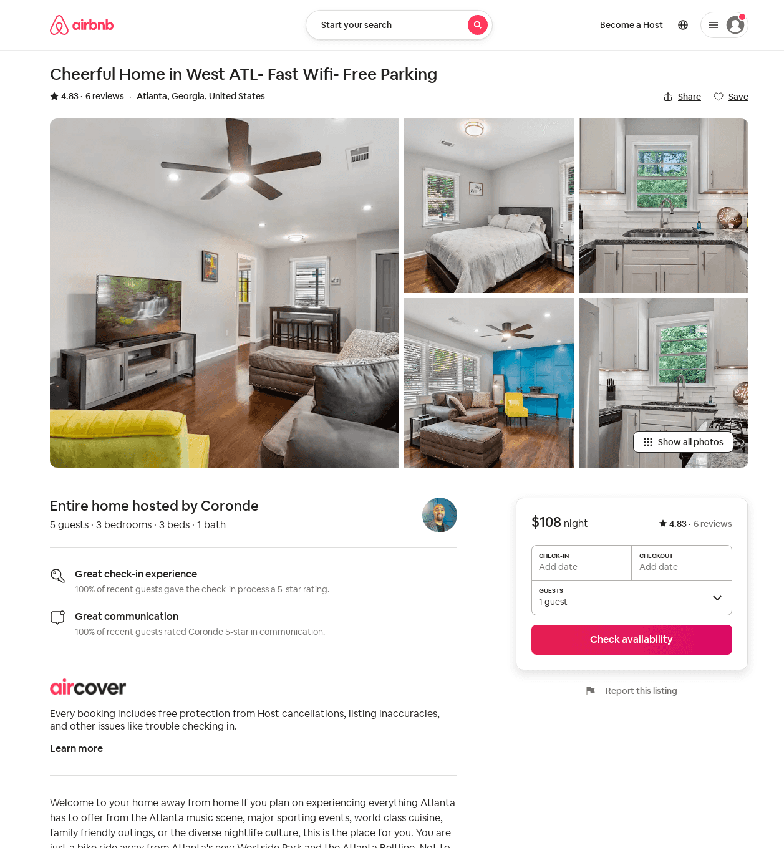
Listing 29800457
3
5
4.83
3
Coronde
74240416
1
https://www.airbnb.com/rooms/29800457
Aug 2022

Slide 22
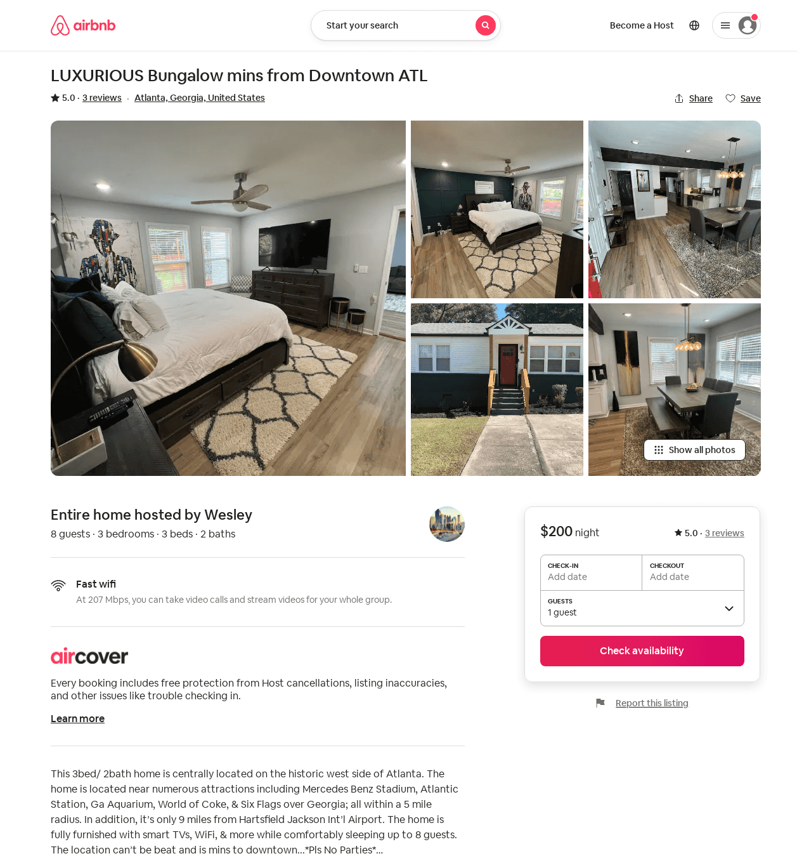
Listing 31689899
3
8
5.0
2
Wesley
24732462
1
https://www.airbnb.com/rooms/31689899
Aug 2022

