Slide 2
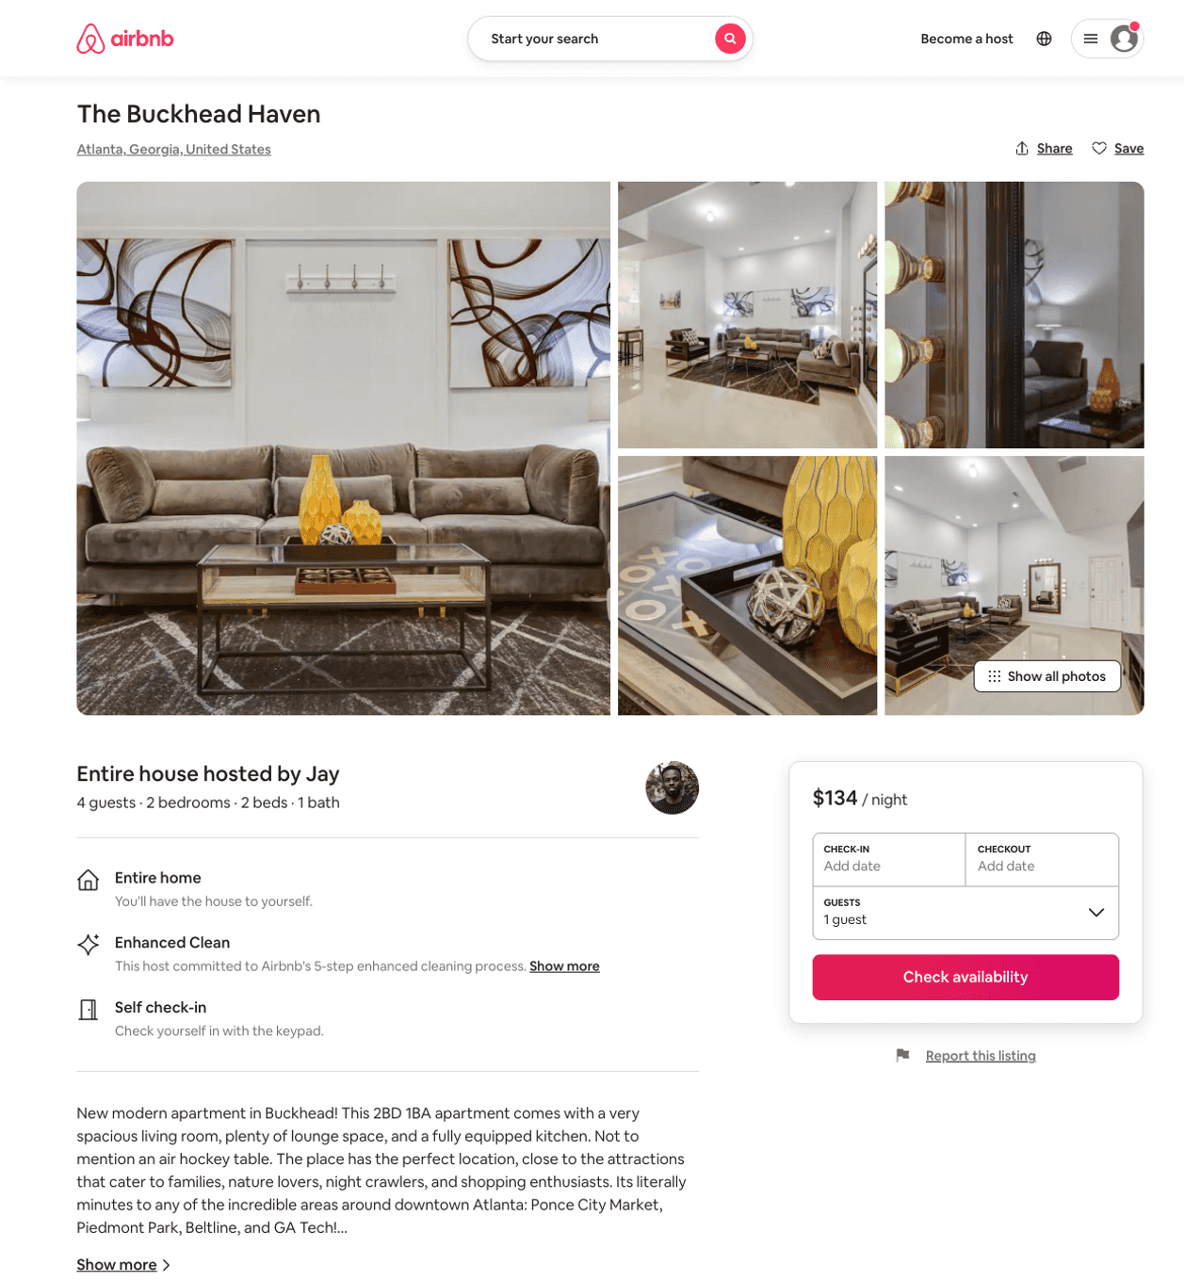
Listing 47965745
2
4
$134 - $352
4.88
2
Jay
59464335
3
https://www.airbnb.com/rooms/47965745
Aug 2022

Slide 3
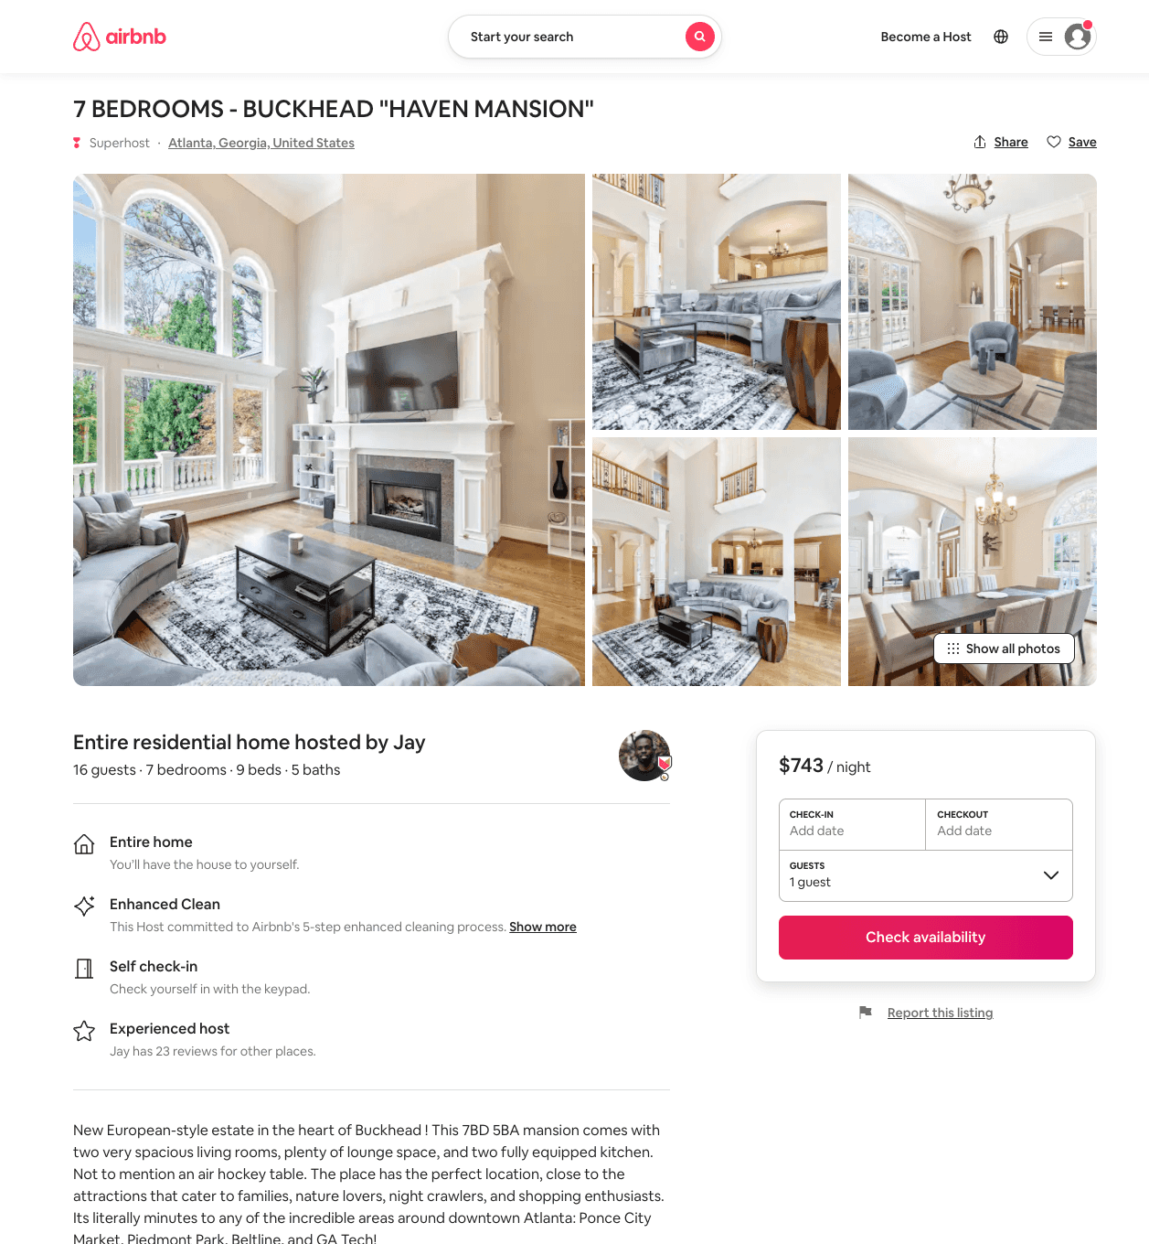
Listing 53406499
7
16
$731 - $929
4.68
2
Jay
59464335
3
https://www.airbnb.com/rooms/53406499
Aug 2022

