Slide 2
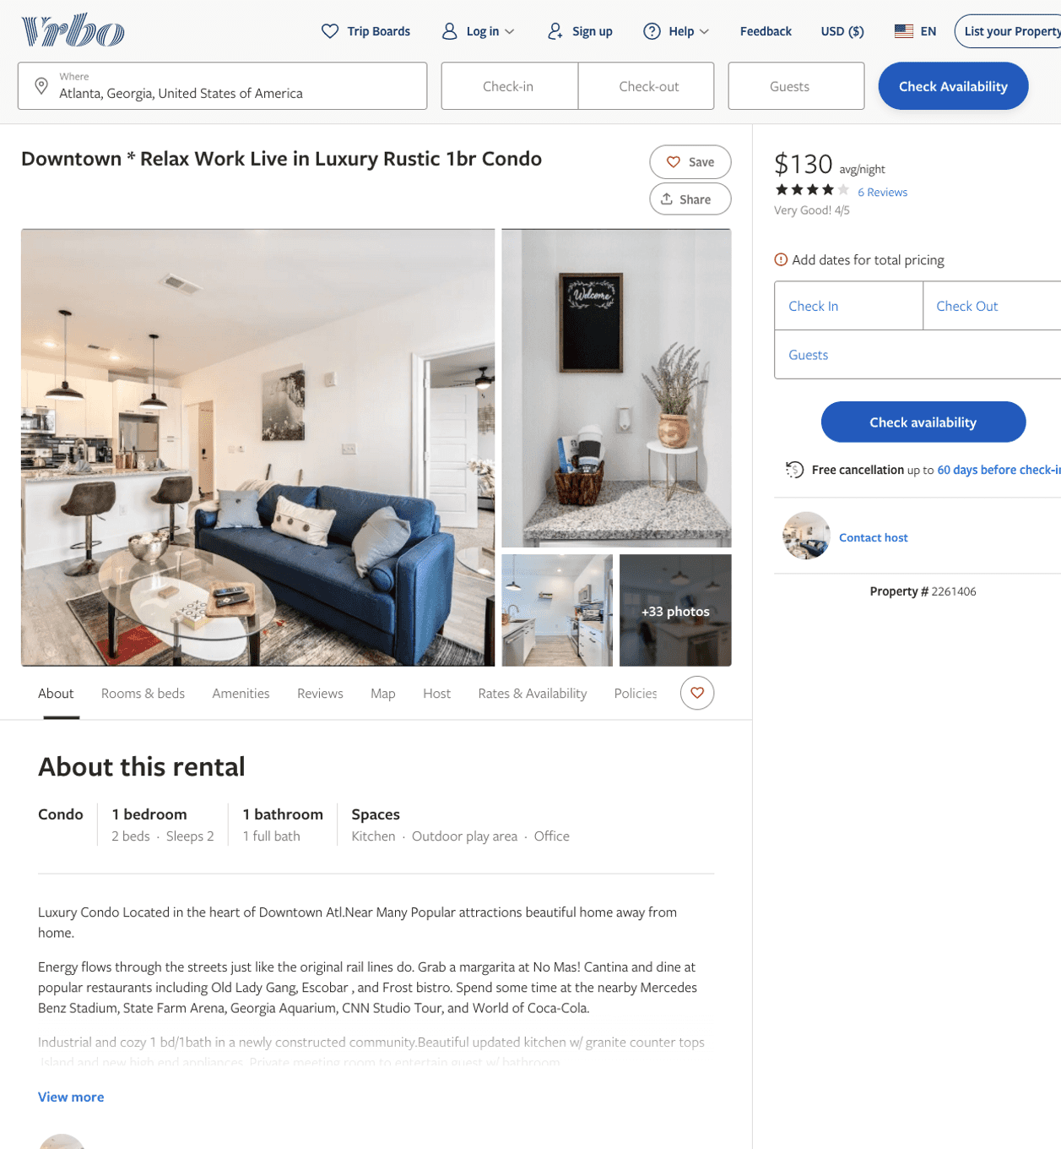
Listing 2261406
1
2
$109 - $93
4.0555553
2
https://www.vrbo.com/2261406
Aug 2022

Slide 3
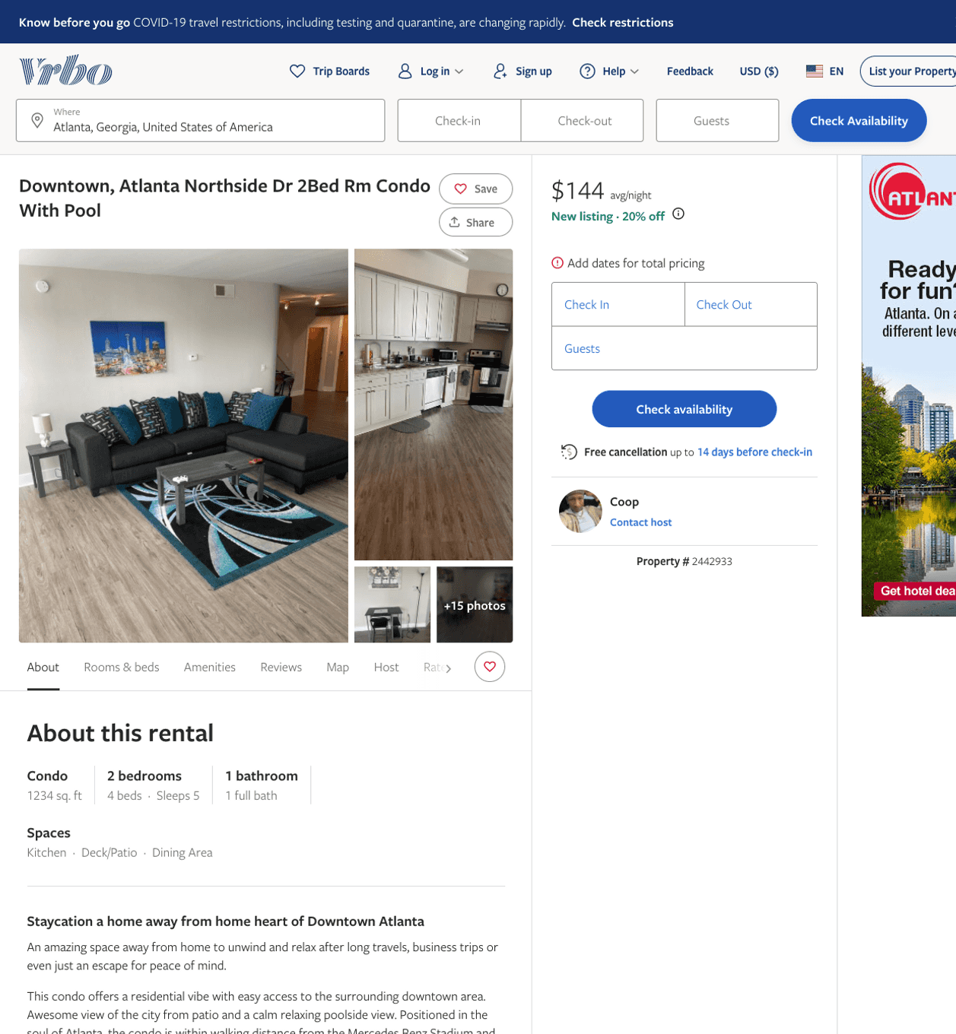
Listing 2442933
2
6
$127 - $157
4.888889
1
Coop
https://www.vrbo.com/2442933
Aug 2022

Slide 4
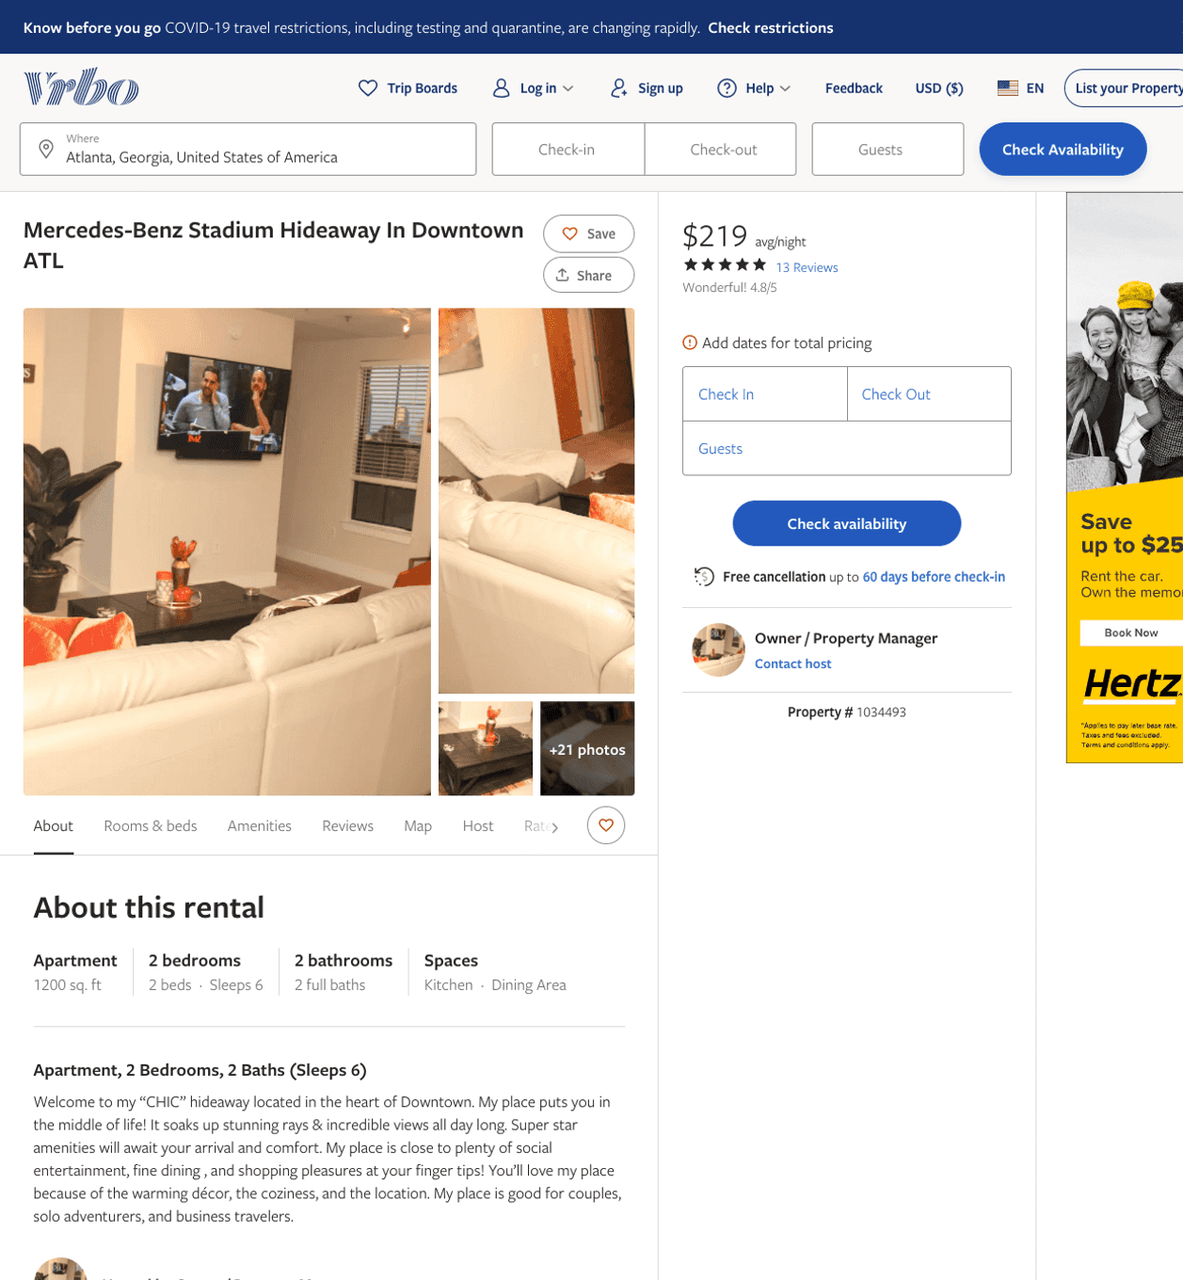
Listing 1034493
2
6
$219 - $222
4.625
3
Owner / Property Manager
https://www.vrbo.com/1034493
Aug 2022

Slide 5
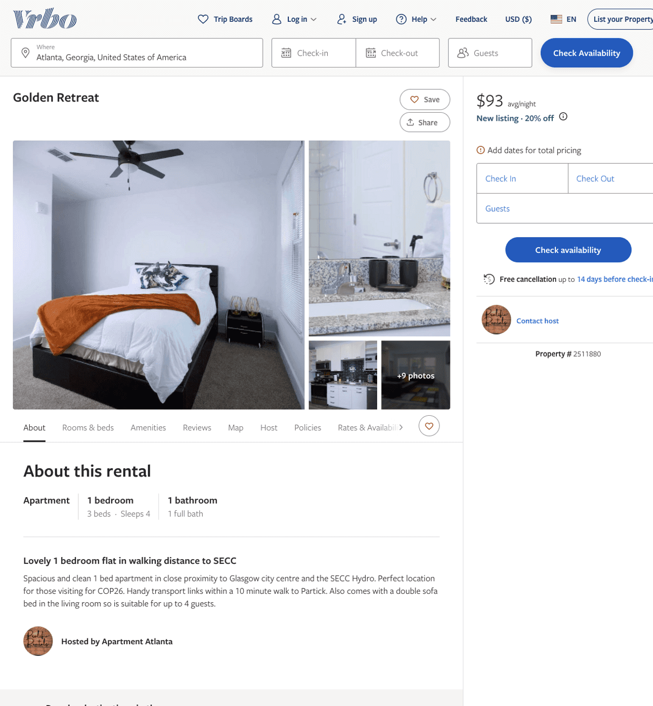
Listing 2511880
1
4
$105 - $98
4
1
Prolific Rentals
https://www.vrbo.com/2511880
Aug 2022

Slide 6
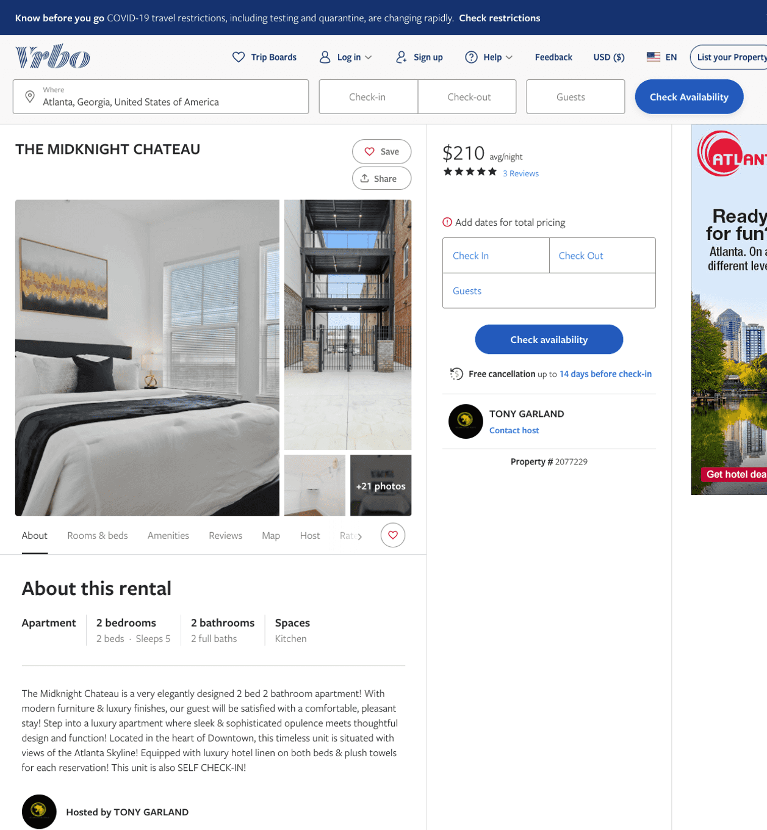
Listing 2077229
2
5
$210 - $215
4
2
TONY GARLAND
https://www.vrbo.com/2077229
Aug 2022

Slide 7
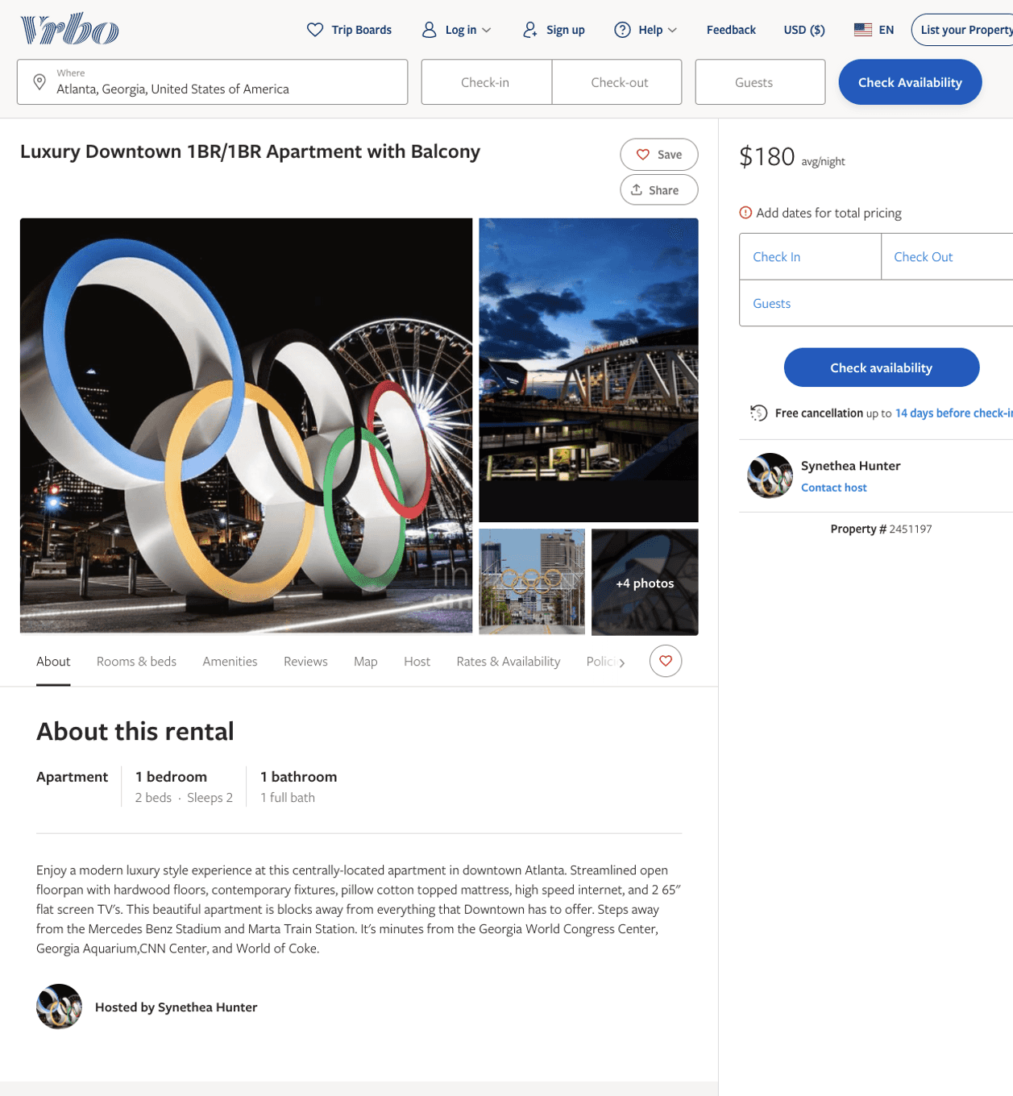
Listing 2451197
1
4
$144 - $180
5
2
Christine Properties
https://www.vrbo.com/2451197
Aug 2022

Slide 8
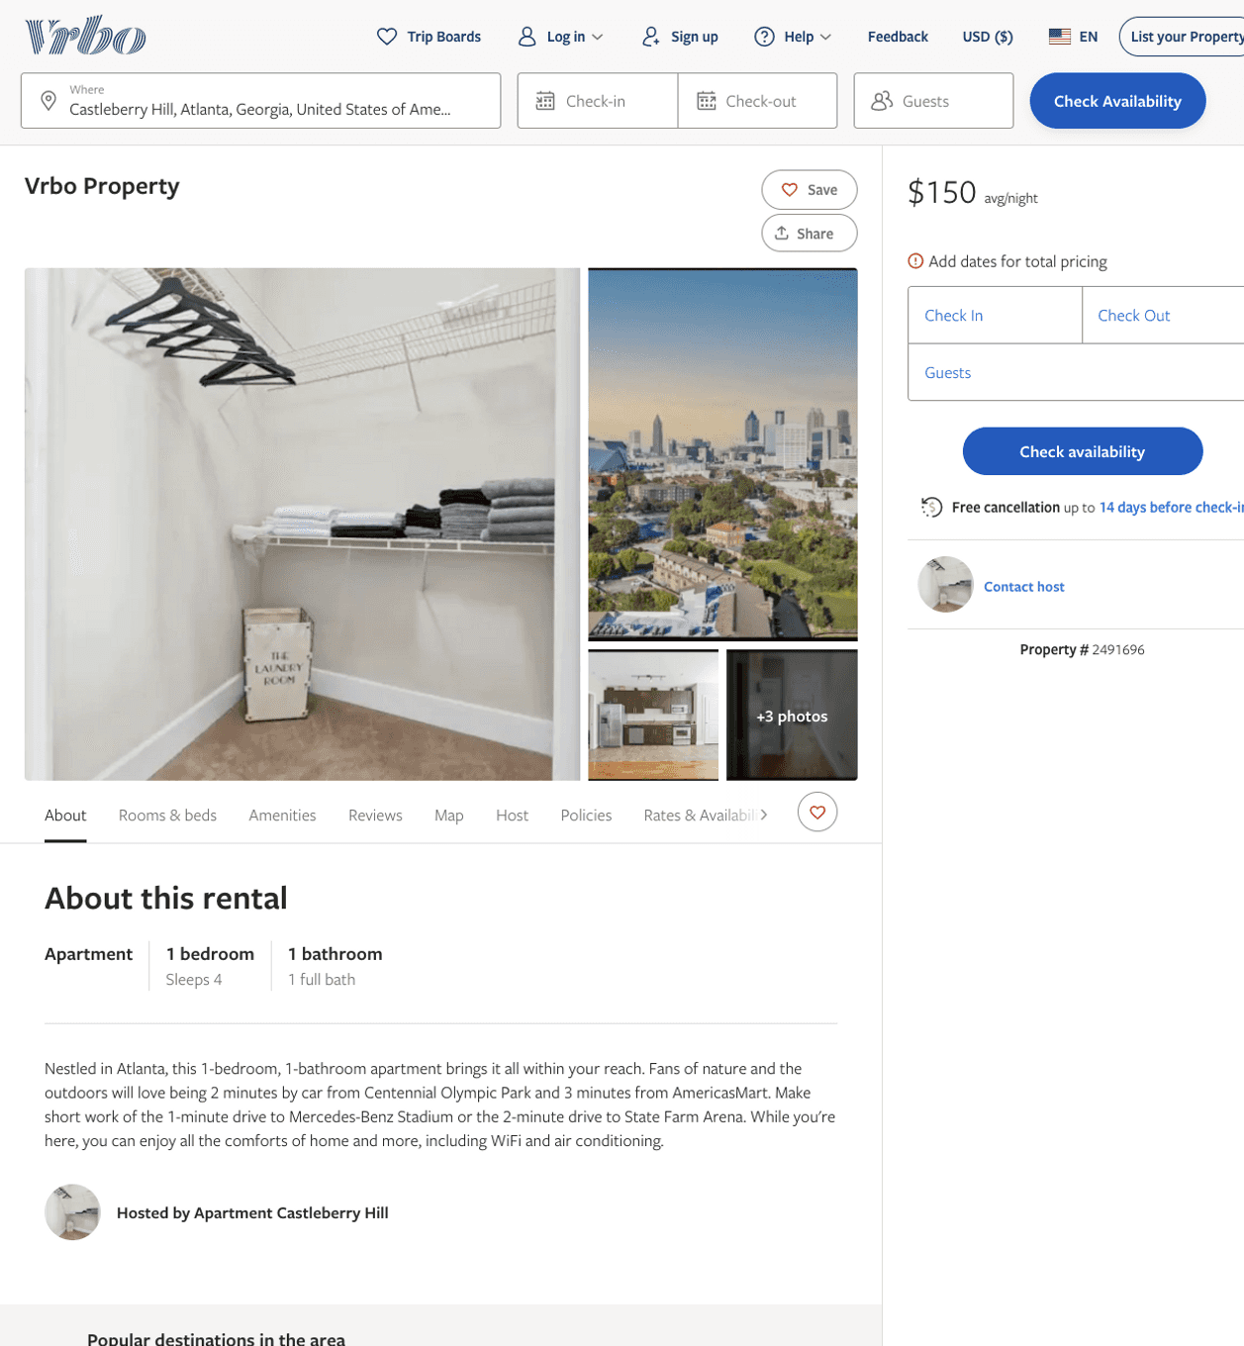
Listing 2491696
1
4
$150
1
2
https://www.vrbo.com/2491696
Aug 2022

Slide 9
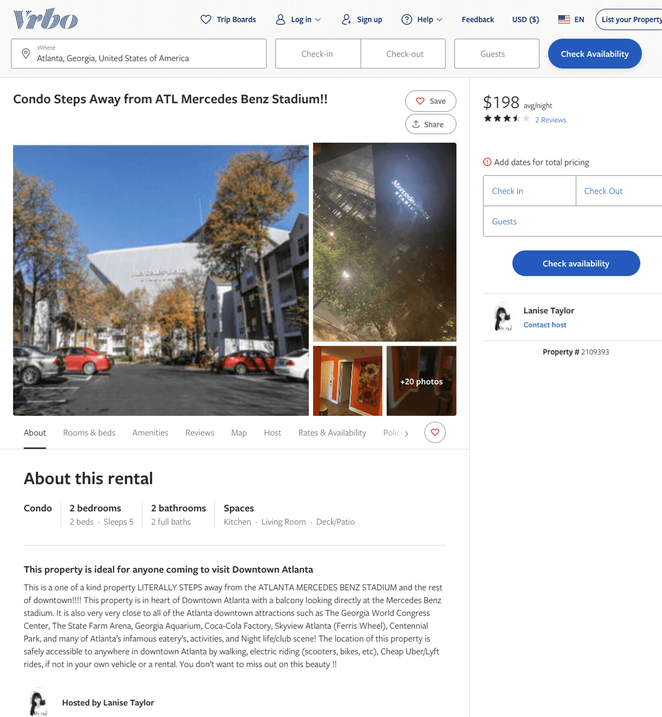
Listing 2109393
2
5
$190 - $256
4
1
Lanise Taylor
https://www.vrbo.com/2109393
Aug 2022

Slide 10
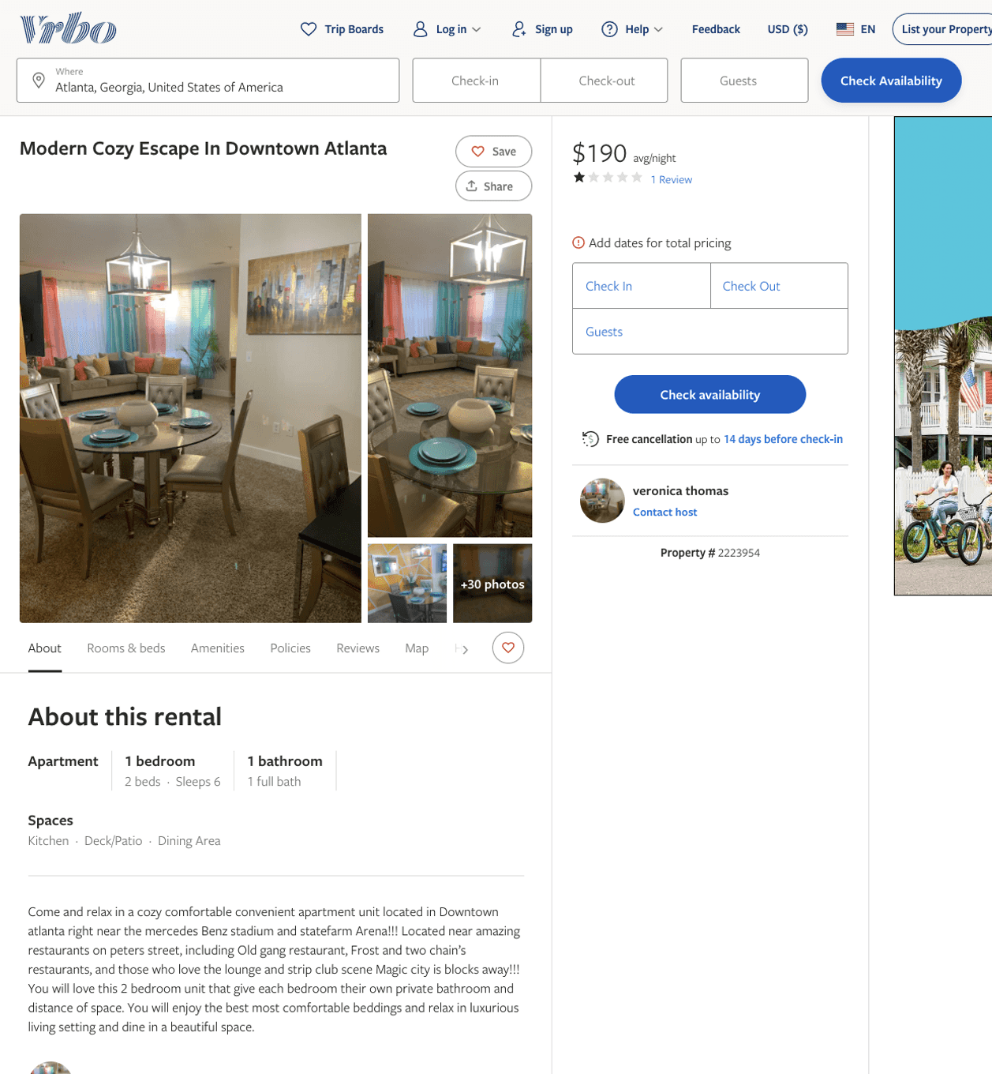
Listing 2223954
2
6
$190
3
2
veronica thomas
https://www.vrbo.com/2223954
Aug 2022

Slide 11
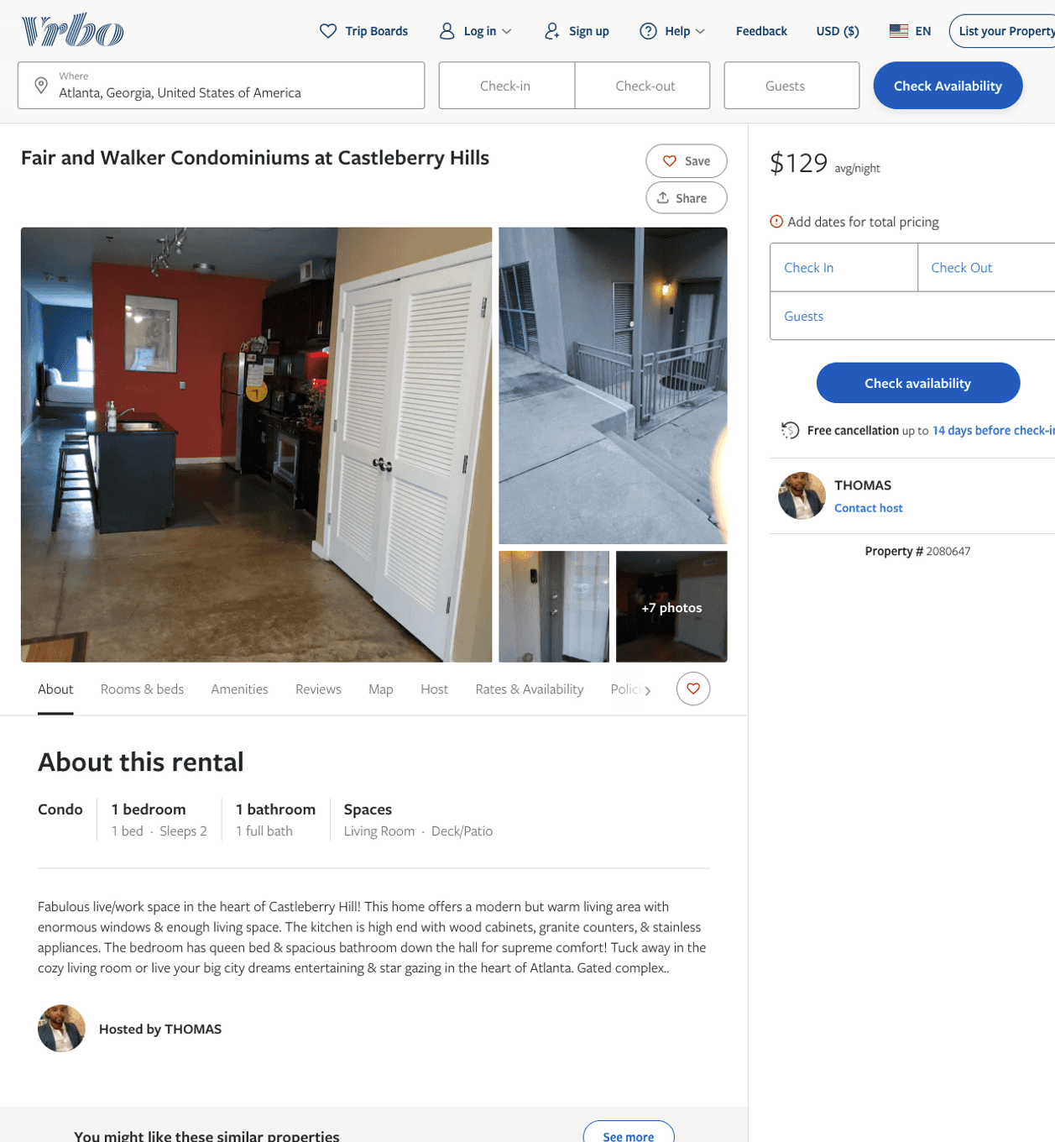
Listing 2080647
1
2
$110 - $129
1
THOMAS
https://www.vrbo.com/2080647
Aug 2022

Slide 12
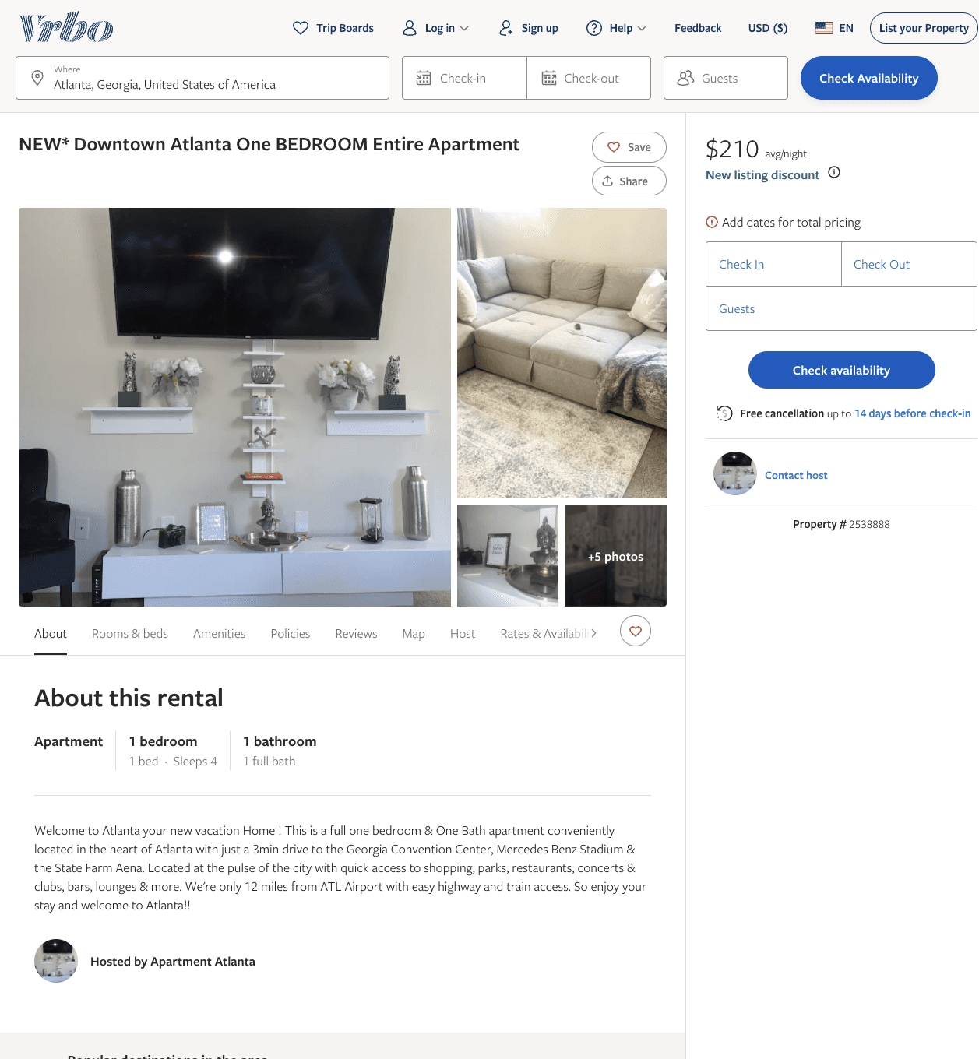
Listing 2538888
1
3
$150 - $210
1
https://www.vrbo.com/2538888
Aug 2022

Slide 13
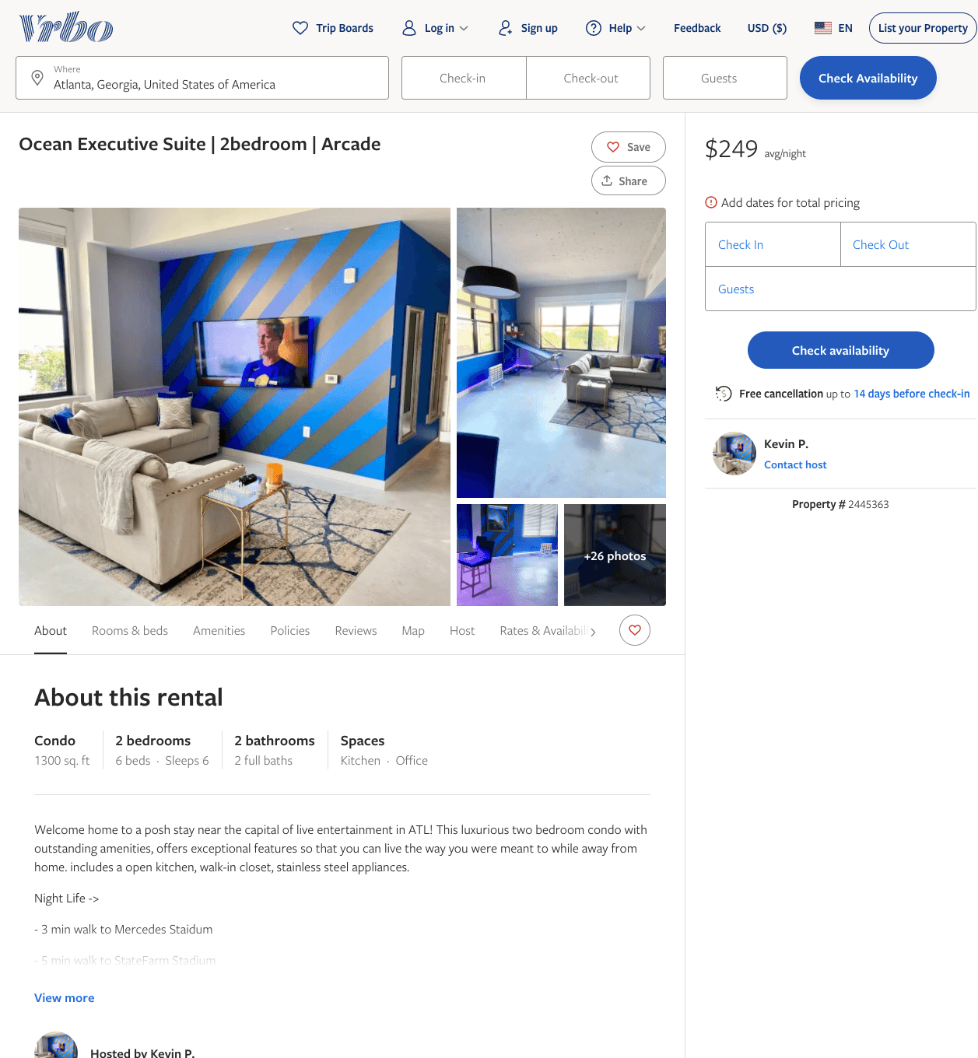
Listing 2445363
2
6
$170 - $267
2
Kevin P.
https://www.vrbo.com/2445363
Aug 2022

Slide 14
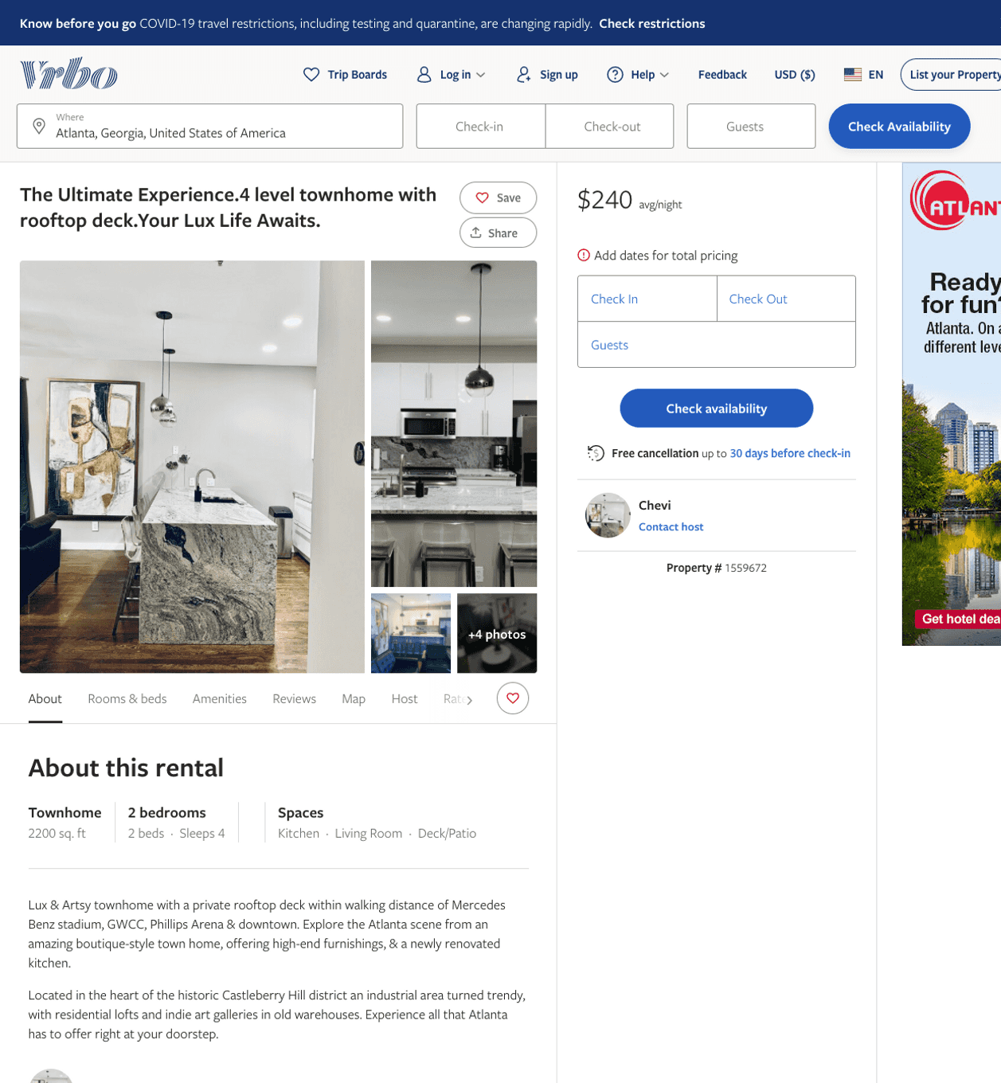
Listing 1559672
2
4
$240
2
Chevi
https://www.vrbo.com/1559672
Aug 2022

Slide 15
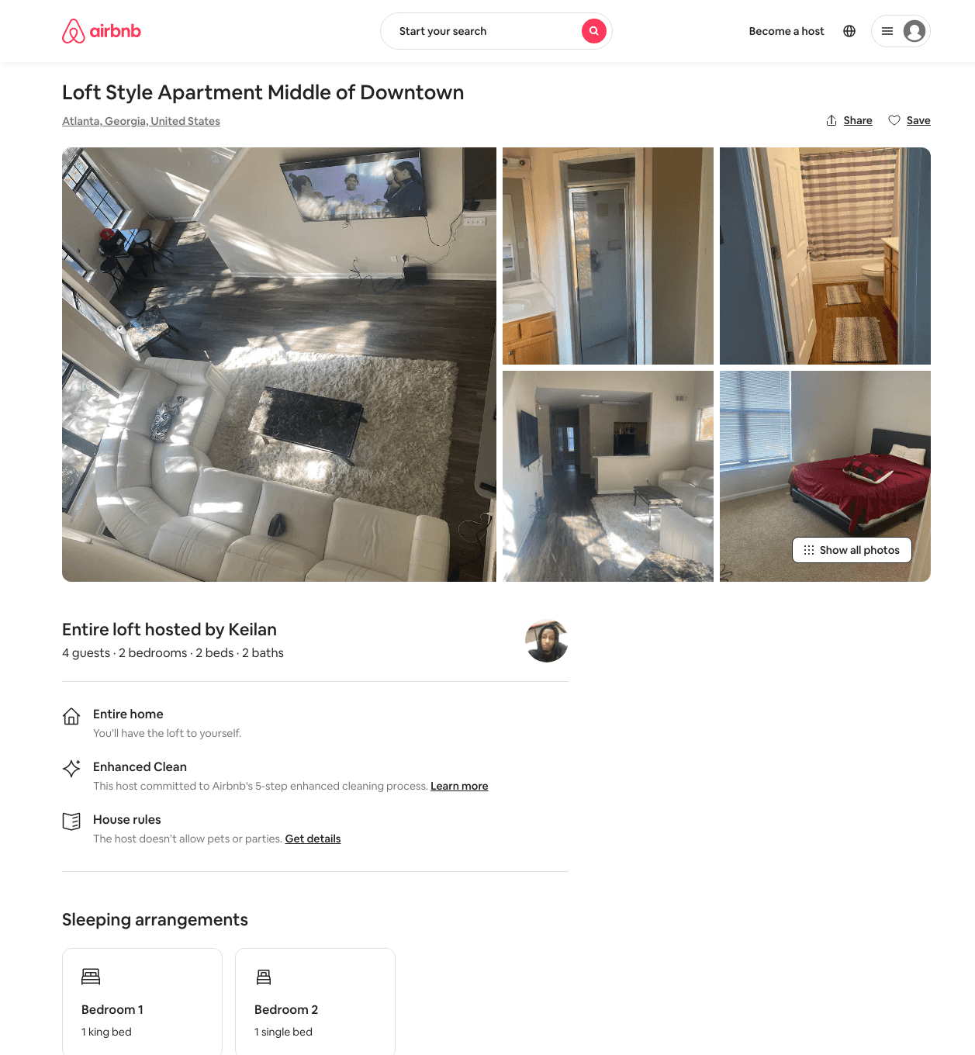
Listing 48488170
2
4
$500 - $800
2
Keilan
345817363
3
https://www.airbnb.com/rooms/48488170
Aug 2022

Slide 16
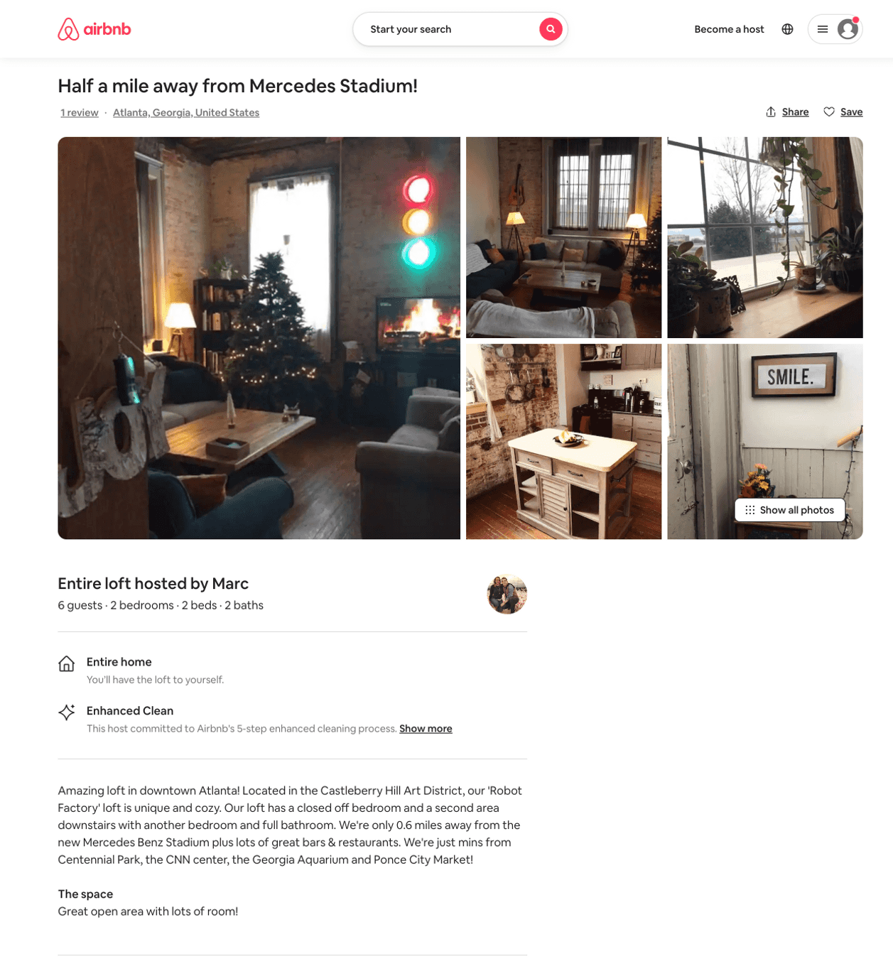
Listing 31067108
2
6
$650
3
Marc
43634894
3
https://www.airbnb.com/rooms/31067108
Aug 2022

Slide 17
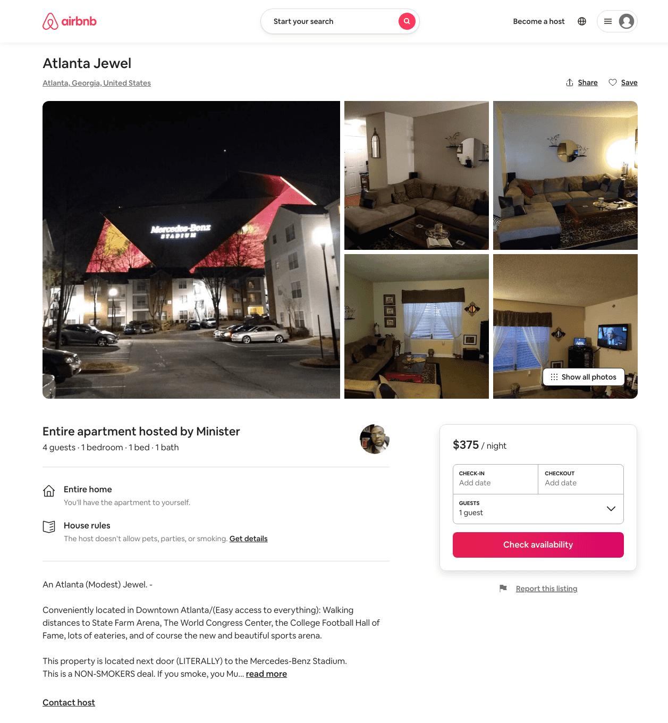
Listing 31034419
1
4
$375
1
Minister
174589692
1
https://www.airbnb.com/rooms/31034419
Aug 2022

Slide 18
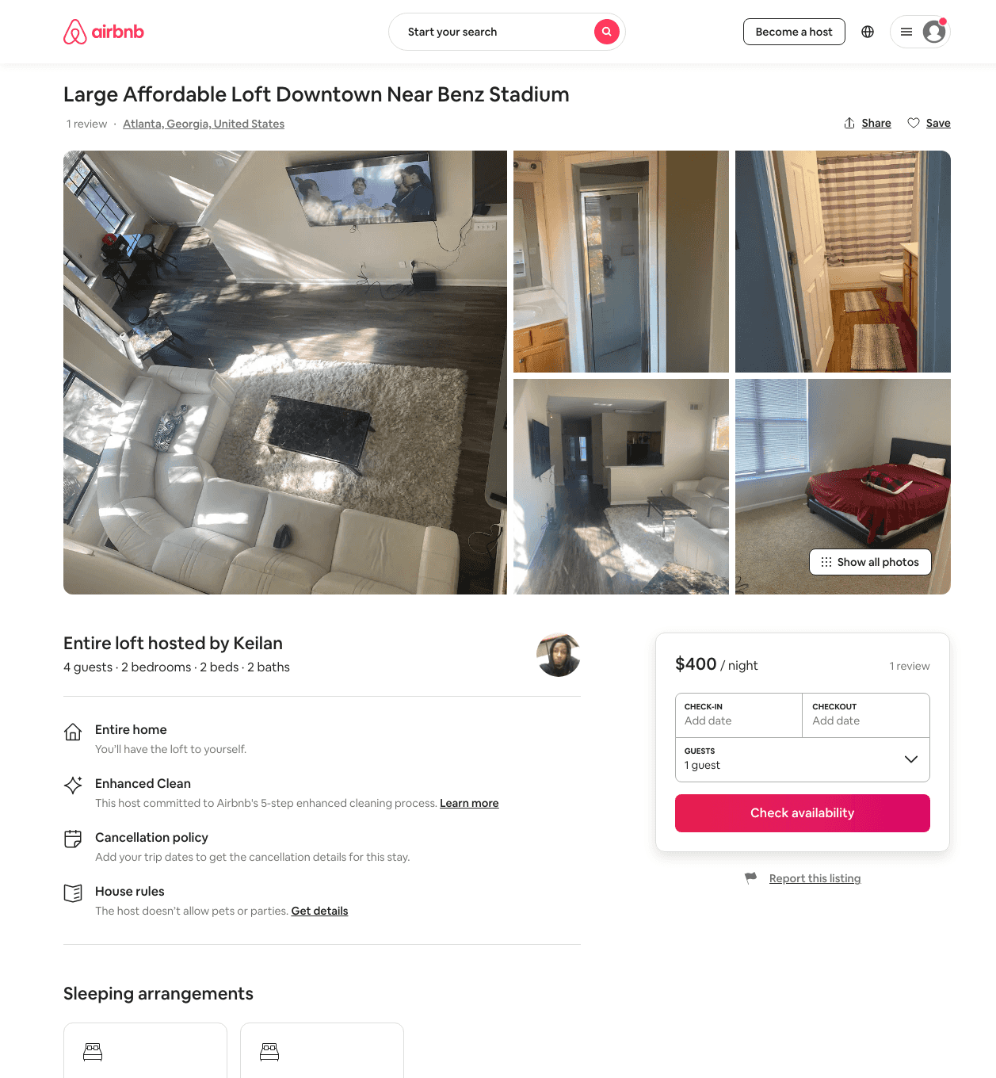
Listing 48314198
2
4
$400
2
Keilan
345817363
3
https://www.airbnb.com/rooms/48314198
Aug 2022

Slide 19
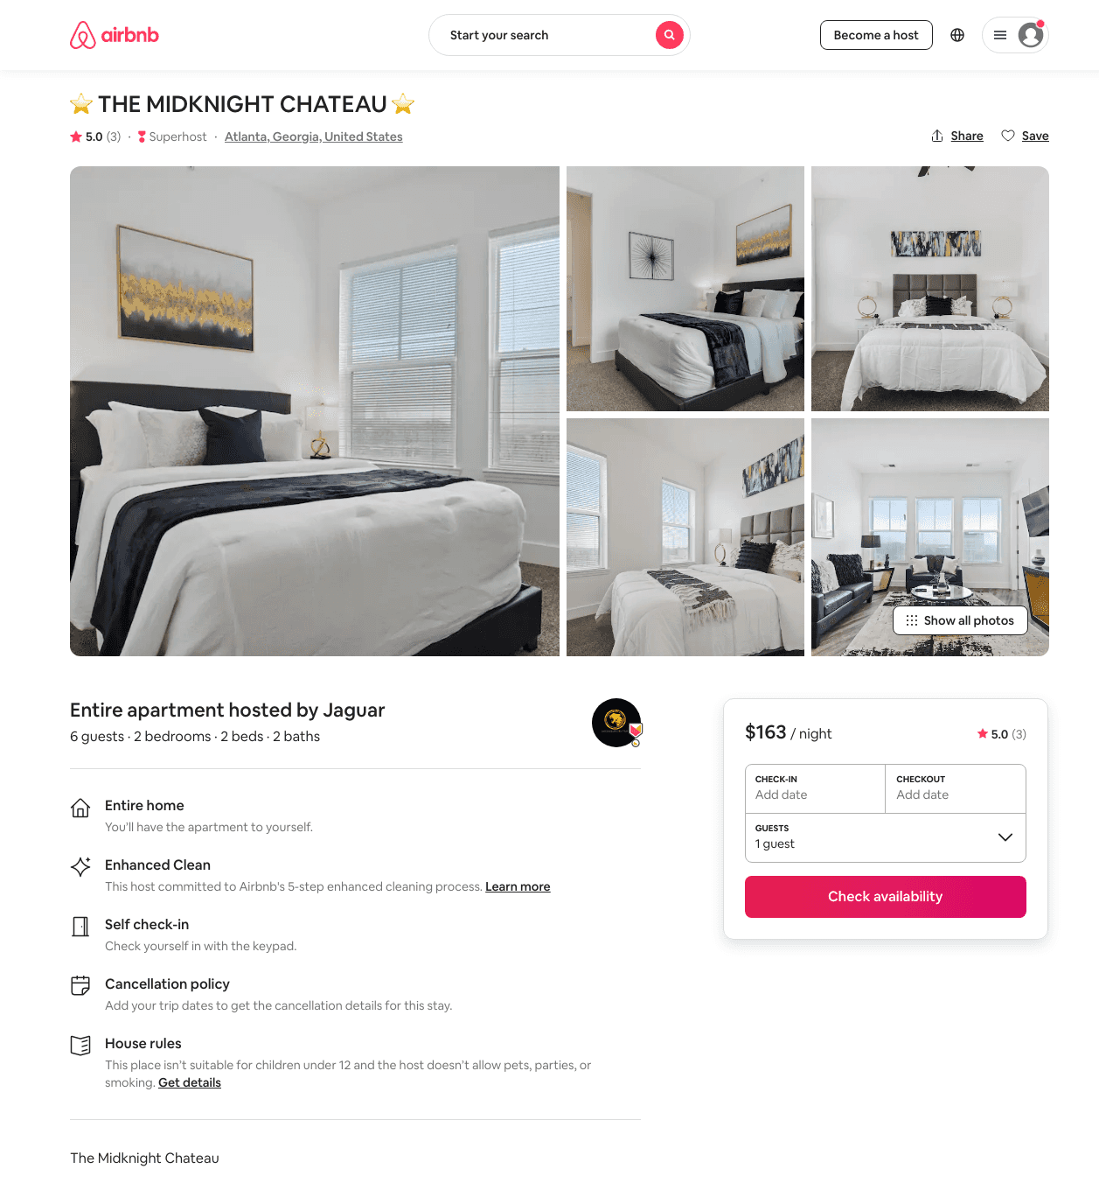
Listing 48385470
2
6
$146 - $385
4.80
1
Luxury Lyfe Suites
237419161
9
https://www.airbnb.com/rooms/48385470
Aug 2022

Slide 20
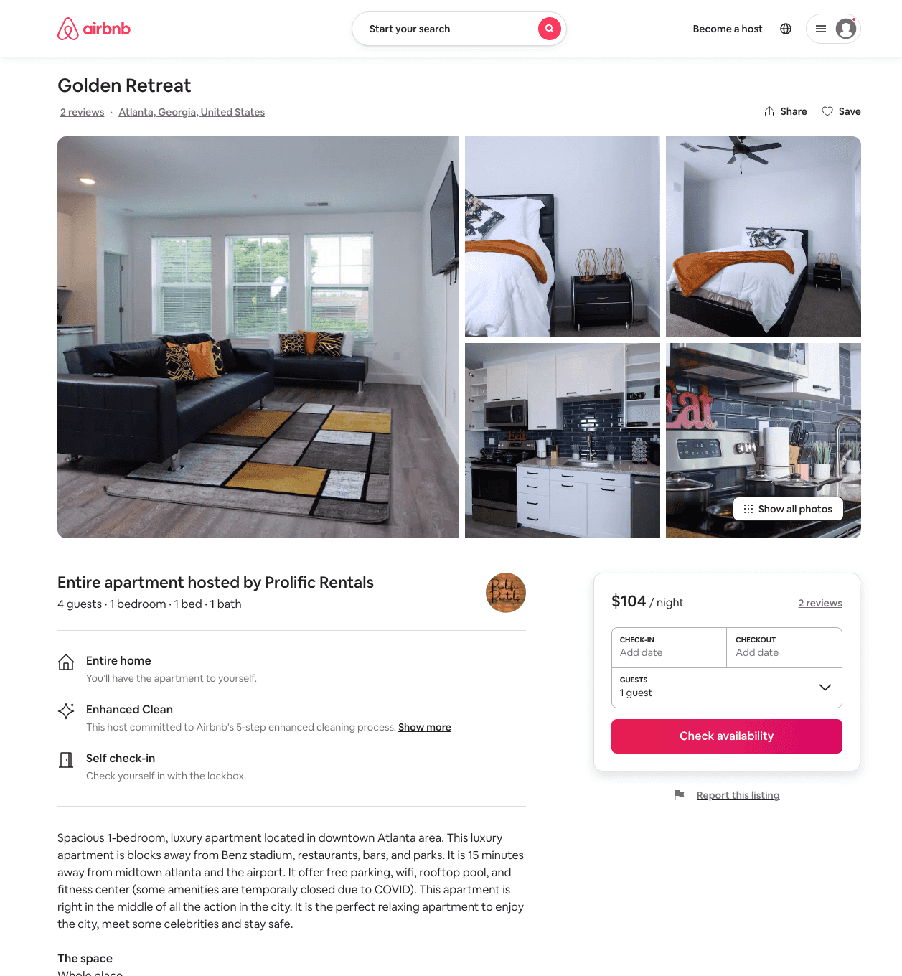
Listing 49815665
1
4
$79 - $111
4.68
1
Prolific Rentals
178072415
1
https://www.airbnb.com/rooms/49815665
Aug 2022

Slide 21
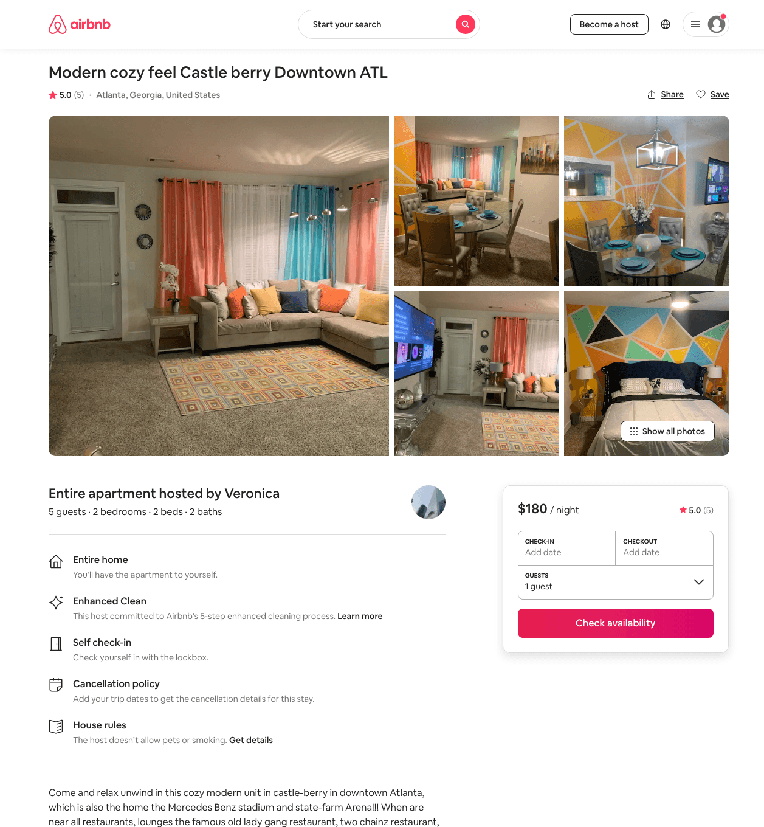
Listing 47881583
2
5
$131 - $185
4.67
1
Veronica
385965834
1
https://www.airbnb.com/rooms/47881583
Aug 2022

Slide 22
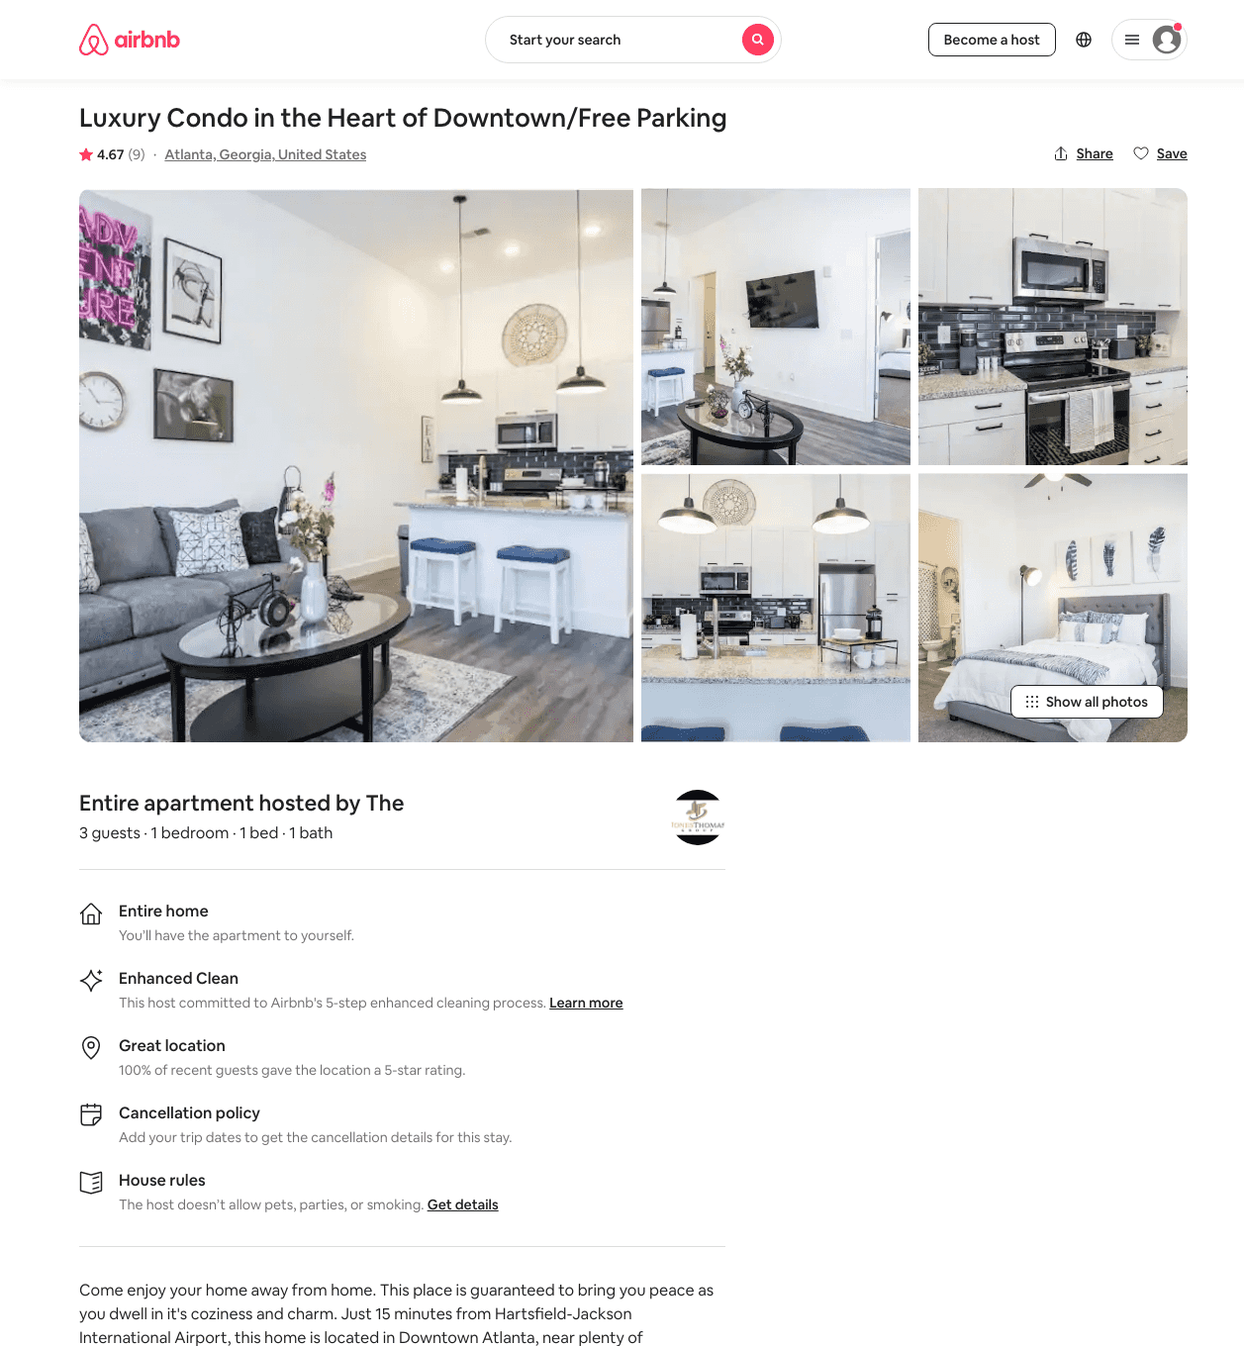
Listing 48262813
1
3
$84 - $158
4.77
1
The
87809431
7
https://www.airbnb.com/rooms/48262813
Aug 2022

Slide 23
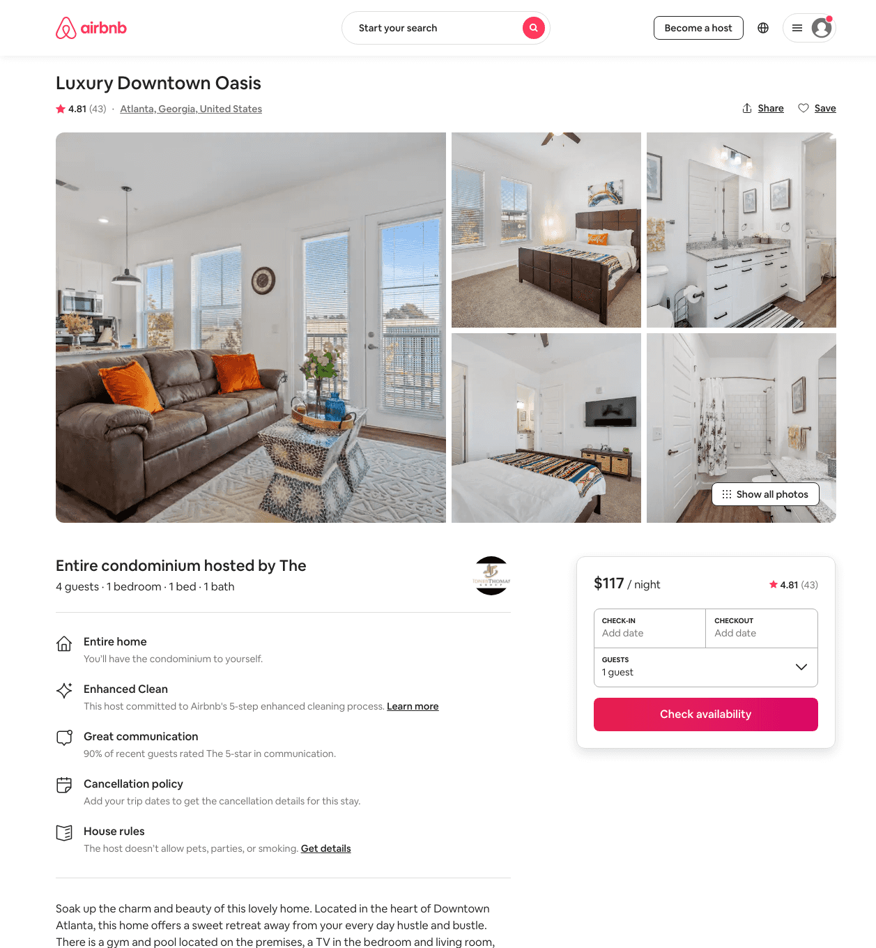
Listing 45547690
1
4
$81 - $158
4.58
1
The
87809431
7
https://www.airbnb.com/rooms/45547690
Jun 2022

Slide 24
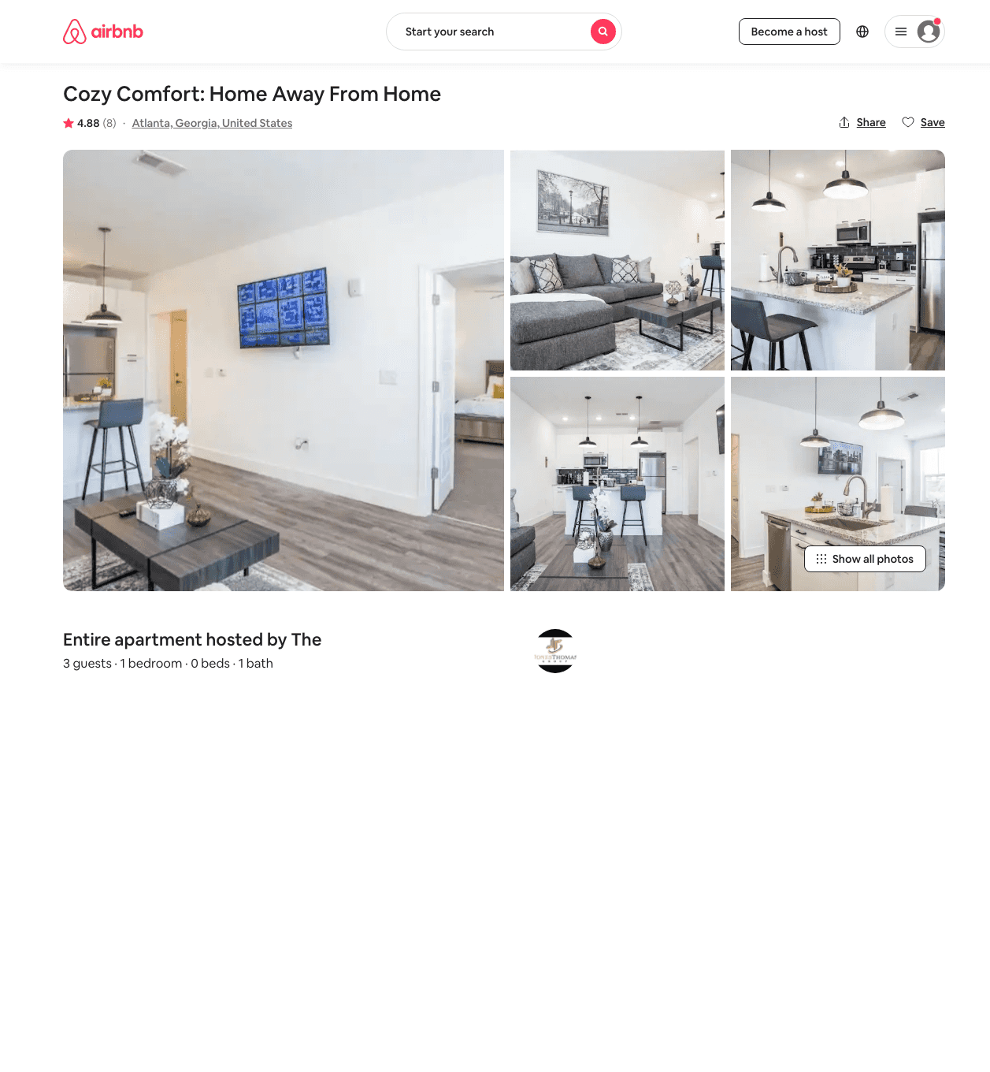
Listing 48258663
1
3
$81 - $150
4.73
1
The
87809431
7
https://www.airbnb.com/rooms/48258663
Aug 2022

Slide 25
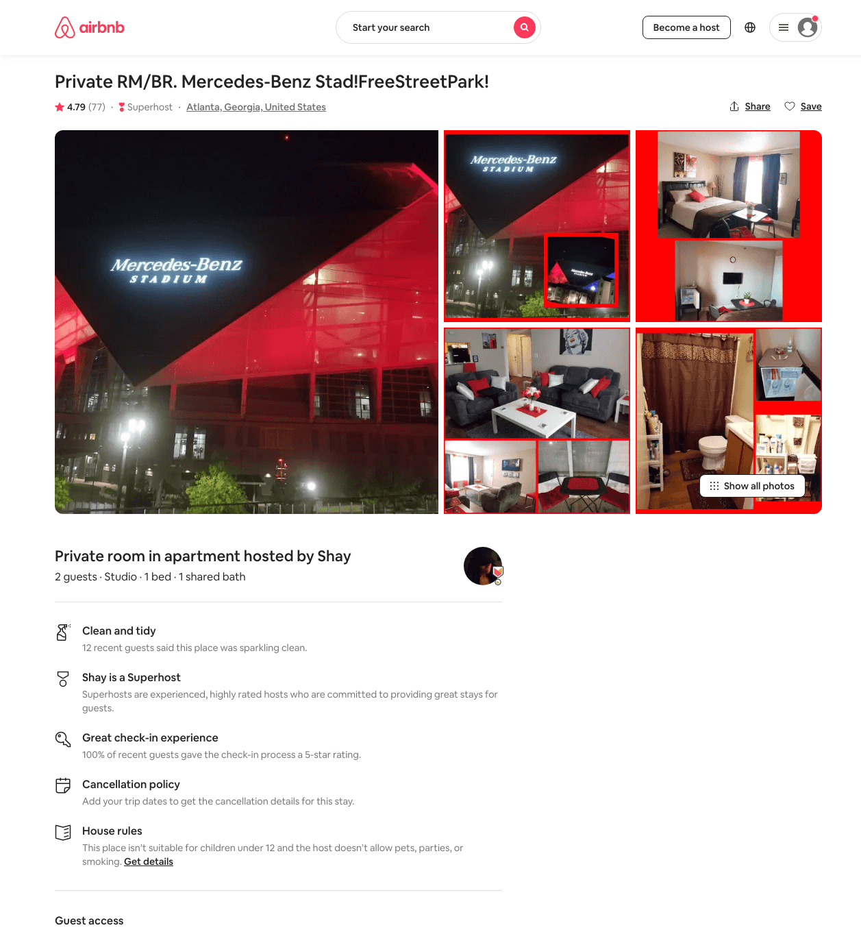
Listing 31671342
Studio
2
$44 - $101
4.78
2
Shay
191168290
2
https://www.airbnb.com/rooms/31671342
Aug 2022

Slide 26
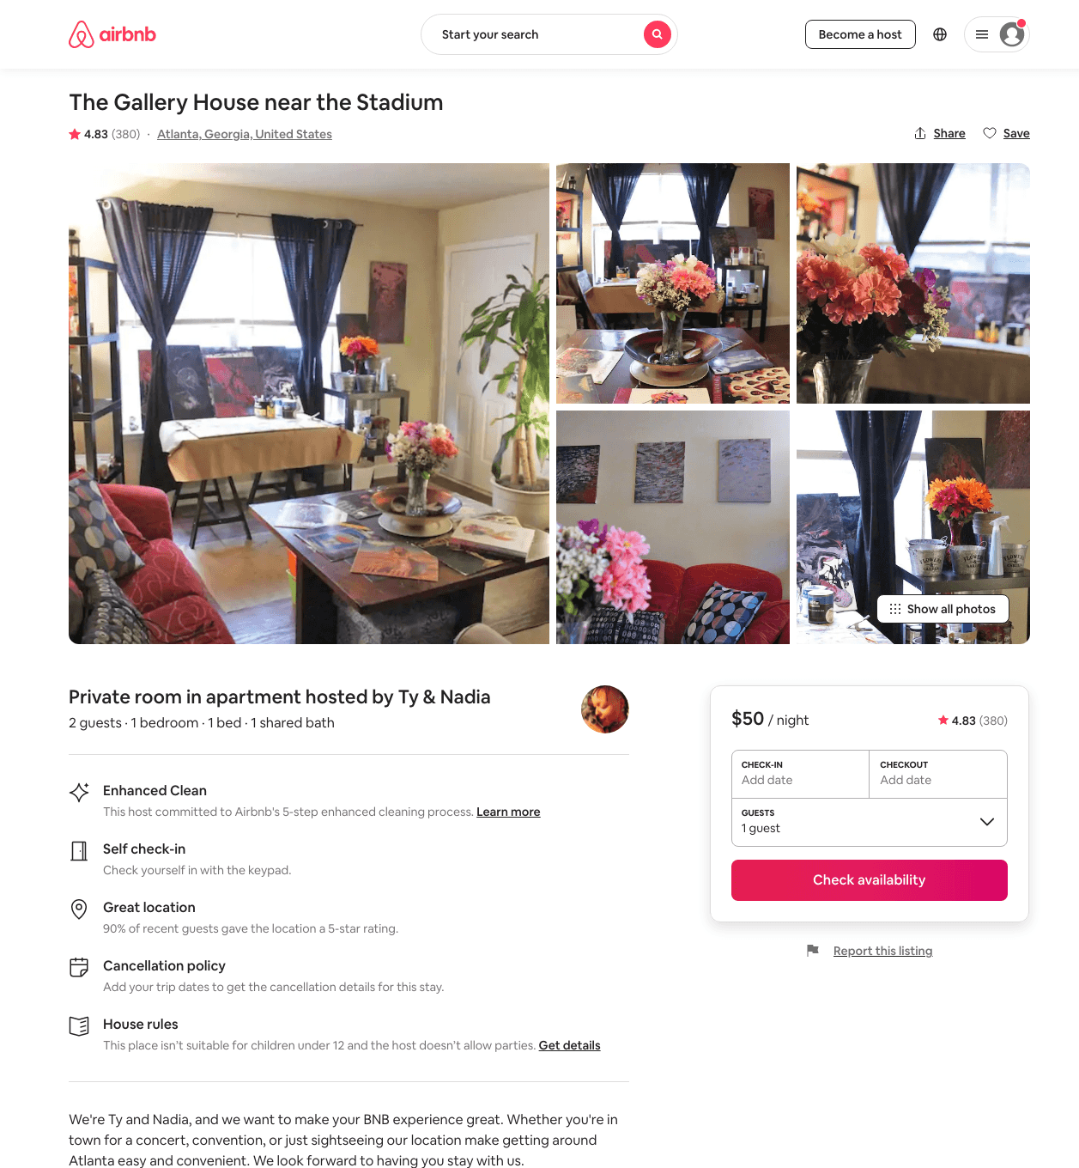
Listing 20598772
1
2
$49 - $127
4.85
1
Ty & Nadia
133714130
1
https://www.airbnb.com/rooms/20598772
Aug 2022

Slide 27
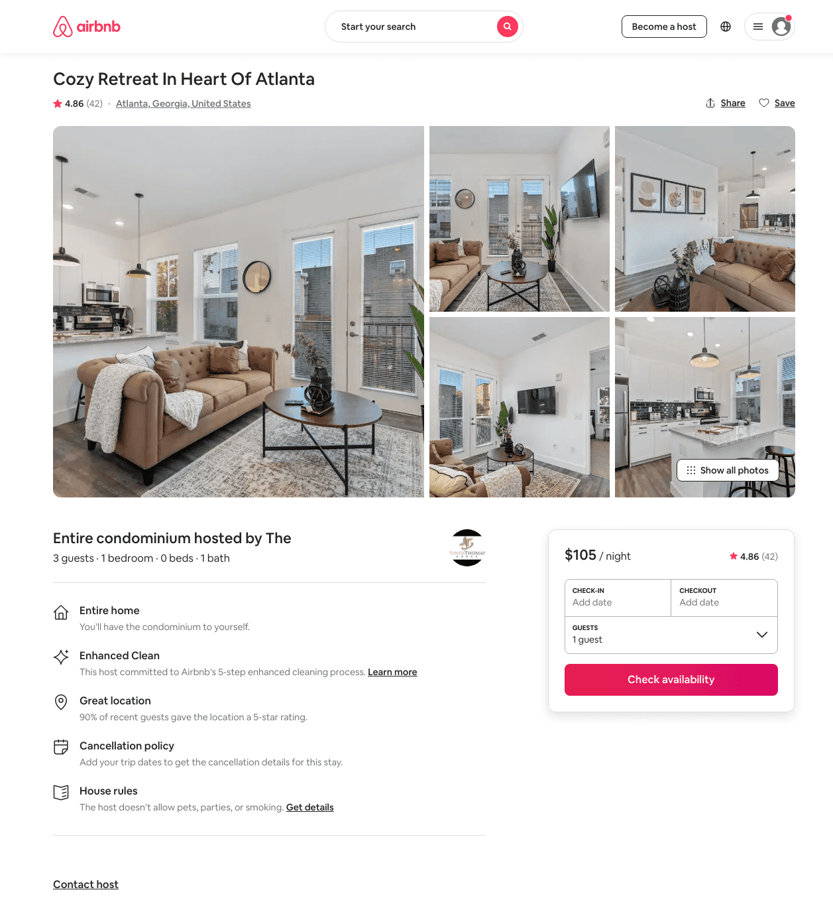
Listing 46505379
1
3
$82 - $240
4.71
1
The
87809431
7
https://www.airbnb.com/rooms/46505379
Aug 2022

Slide 28
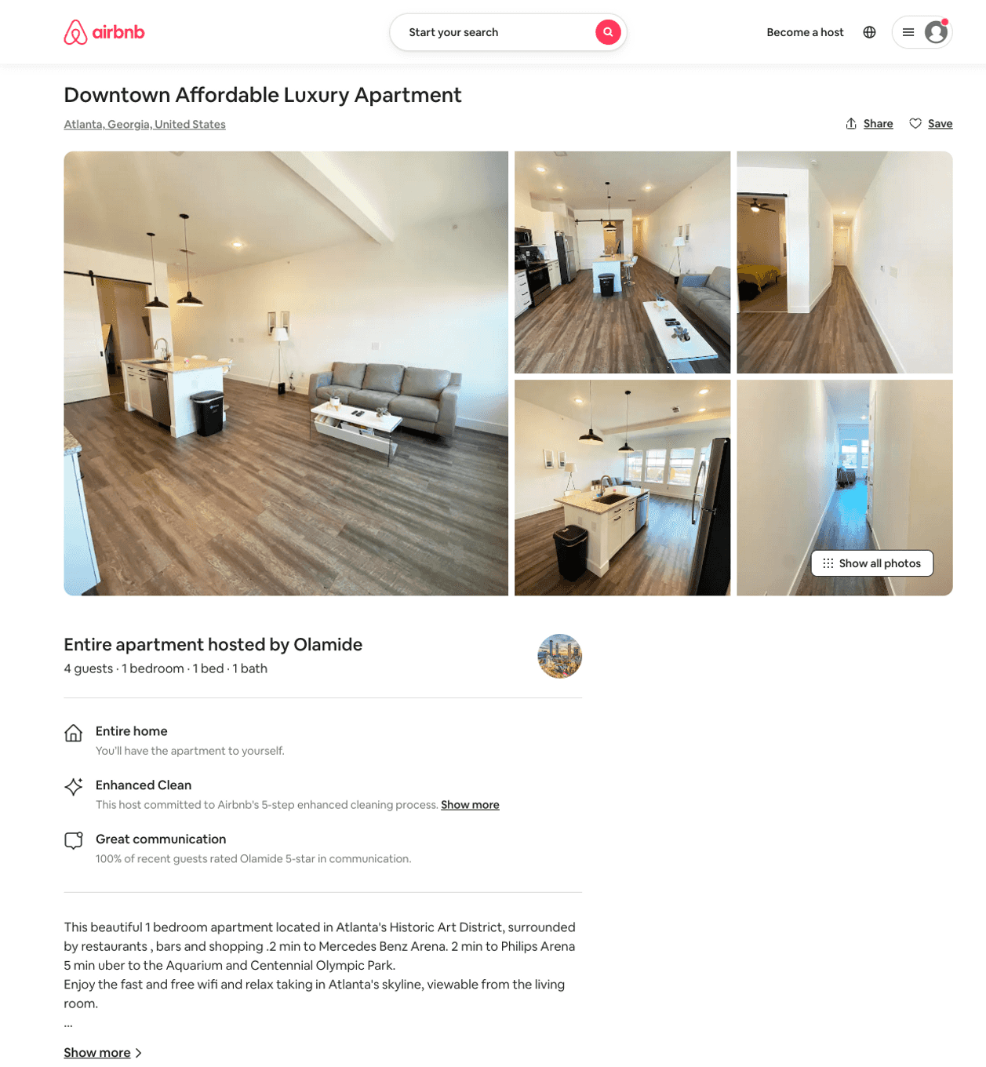
Listing 50418839
1
4
$130 - $136
2
Olamide
243298541
2
https://www.airbnb.com/rooms/50418839
Aug 2022

Slide 29
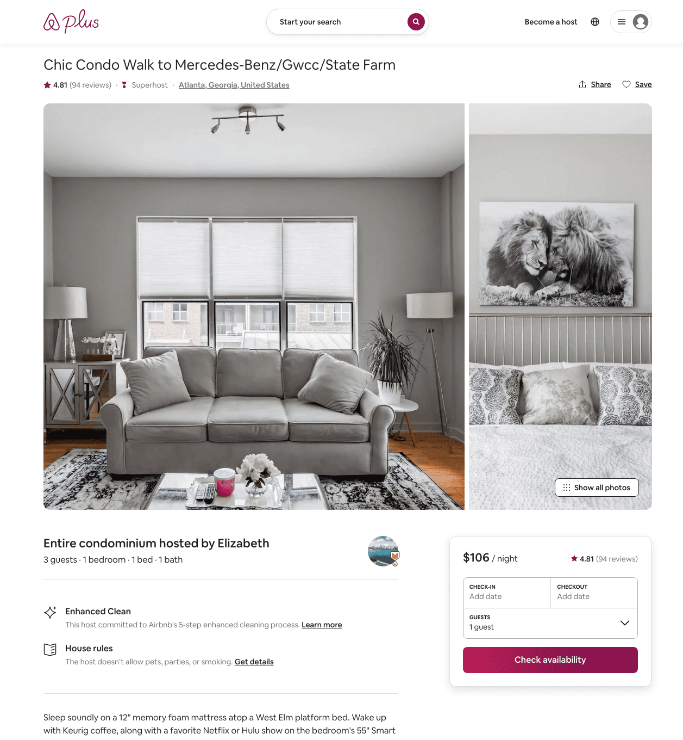
Listing 29534115
1
3
$79 - $118
4.78
1
Elizabeth
142442839
1
https://www.airbnb.com/rooms/29534115
Aug 2022

Slide 30
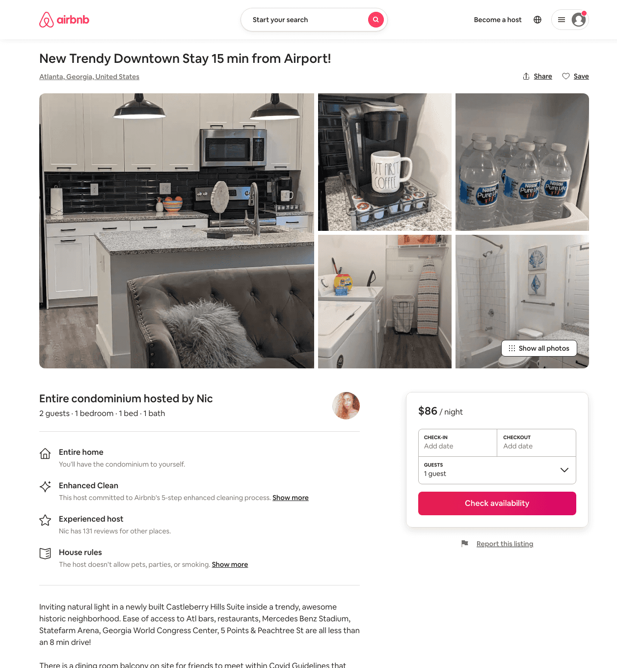
Listing 49595983
1
2
$79 - $116
4.53
1
Nic
155599941
1
https://www.airbnb.com/rooms/49595983
Aug 2022

Slide 31
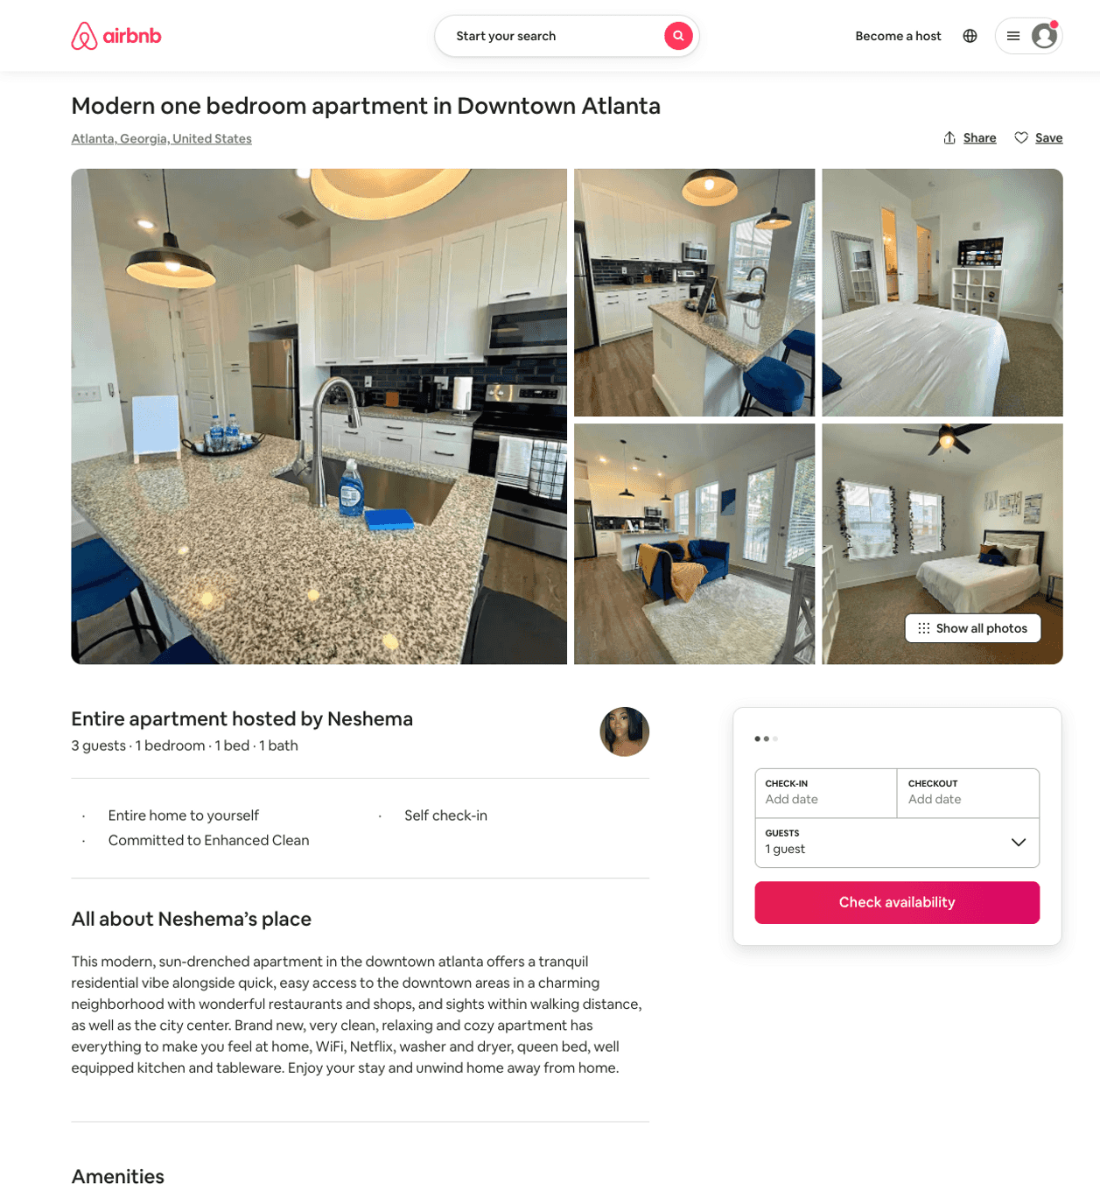
Listing 50522707
1
3
$68 - $109
4.62
1
Neshema
332751753
1
https://www.airbnb.com/rooms/50522707
Aug 2022

Slide 32
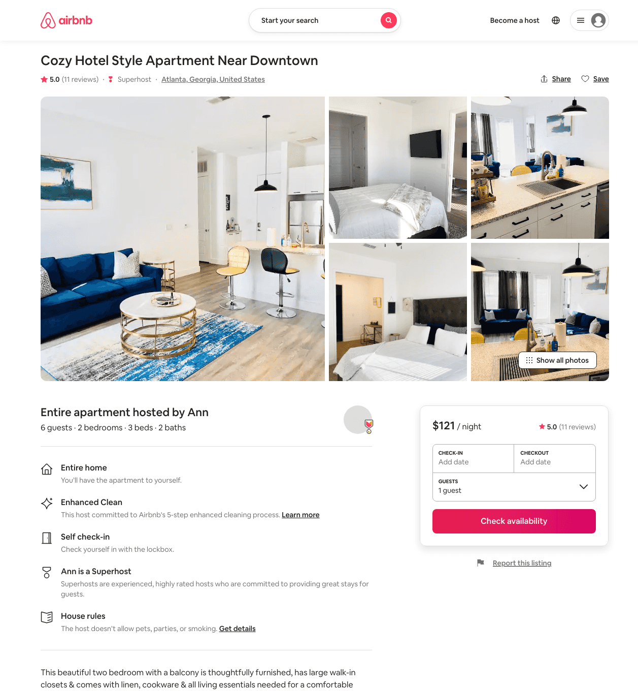
Listing 46691607
2
6
$121 - $149
4.81
2
Ann
70062712
1
https://www.airbnb.com/rooms/46691607
Aug 2022

Slide 33
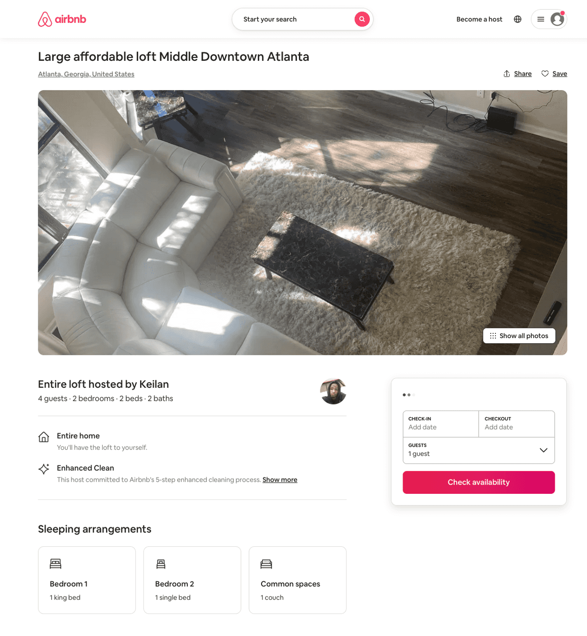
Listing 46892975
2
4
$225
3
Keilan
345817363
3
https://www.airbnb.com/rooms/46892975
Aug 2022

Slide 34
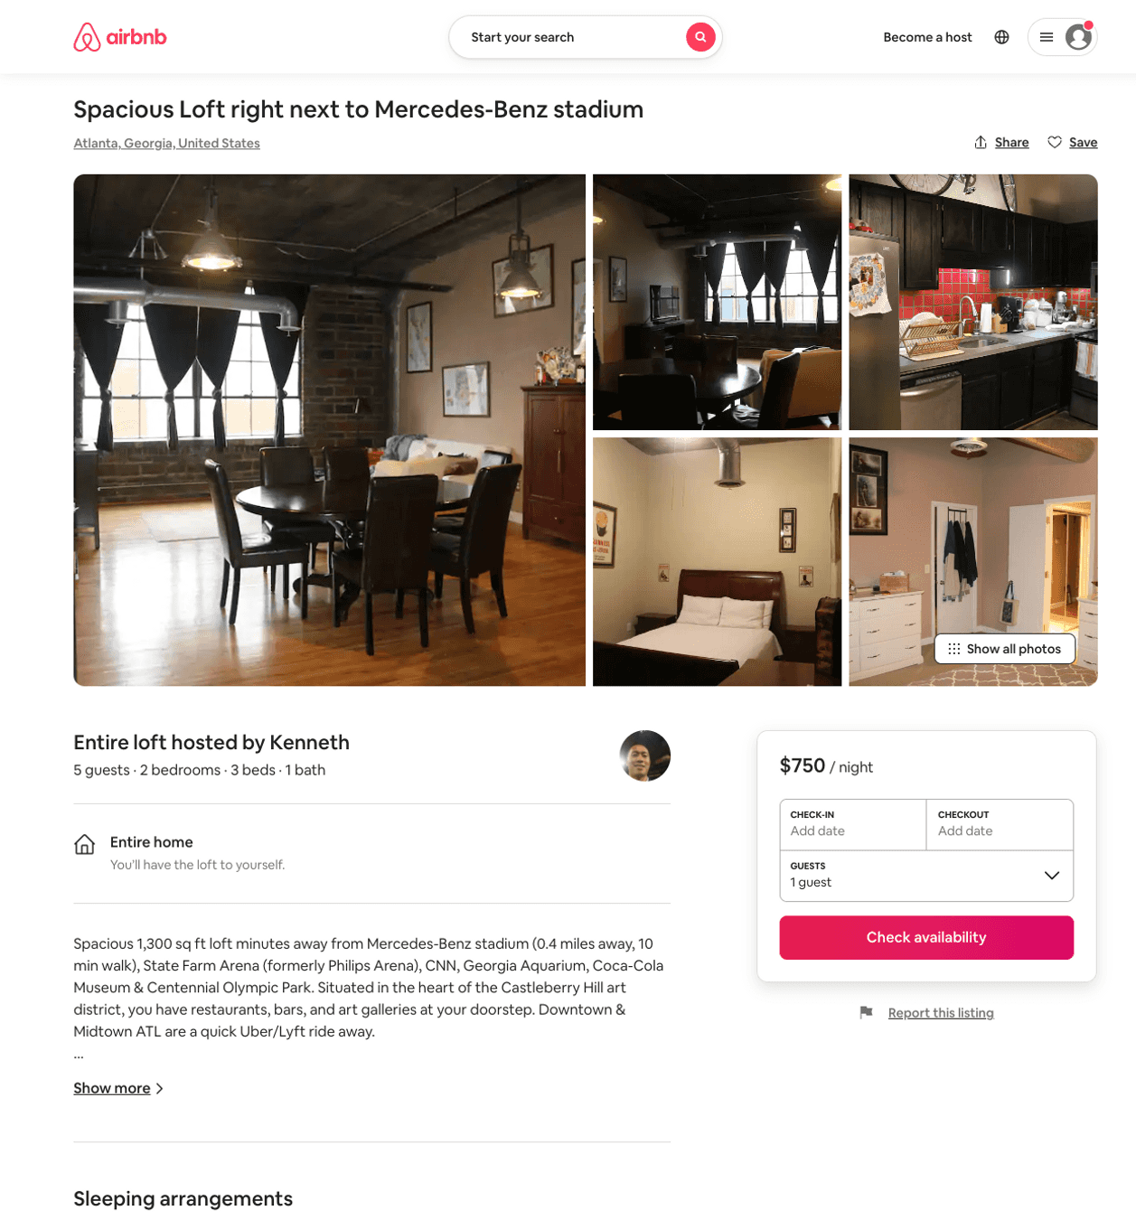
Listing 30499387
2
5
$750
3
Kenneth
106560132
1
https://www.airbnb.com/rooms/30499387
Aug 2022

Slide 35
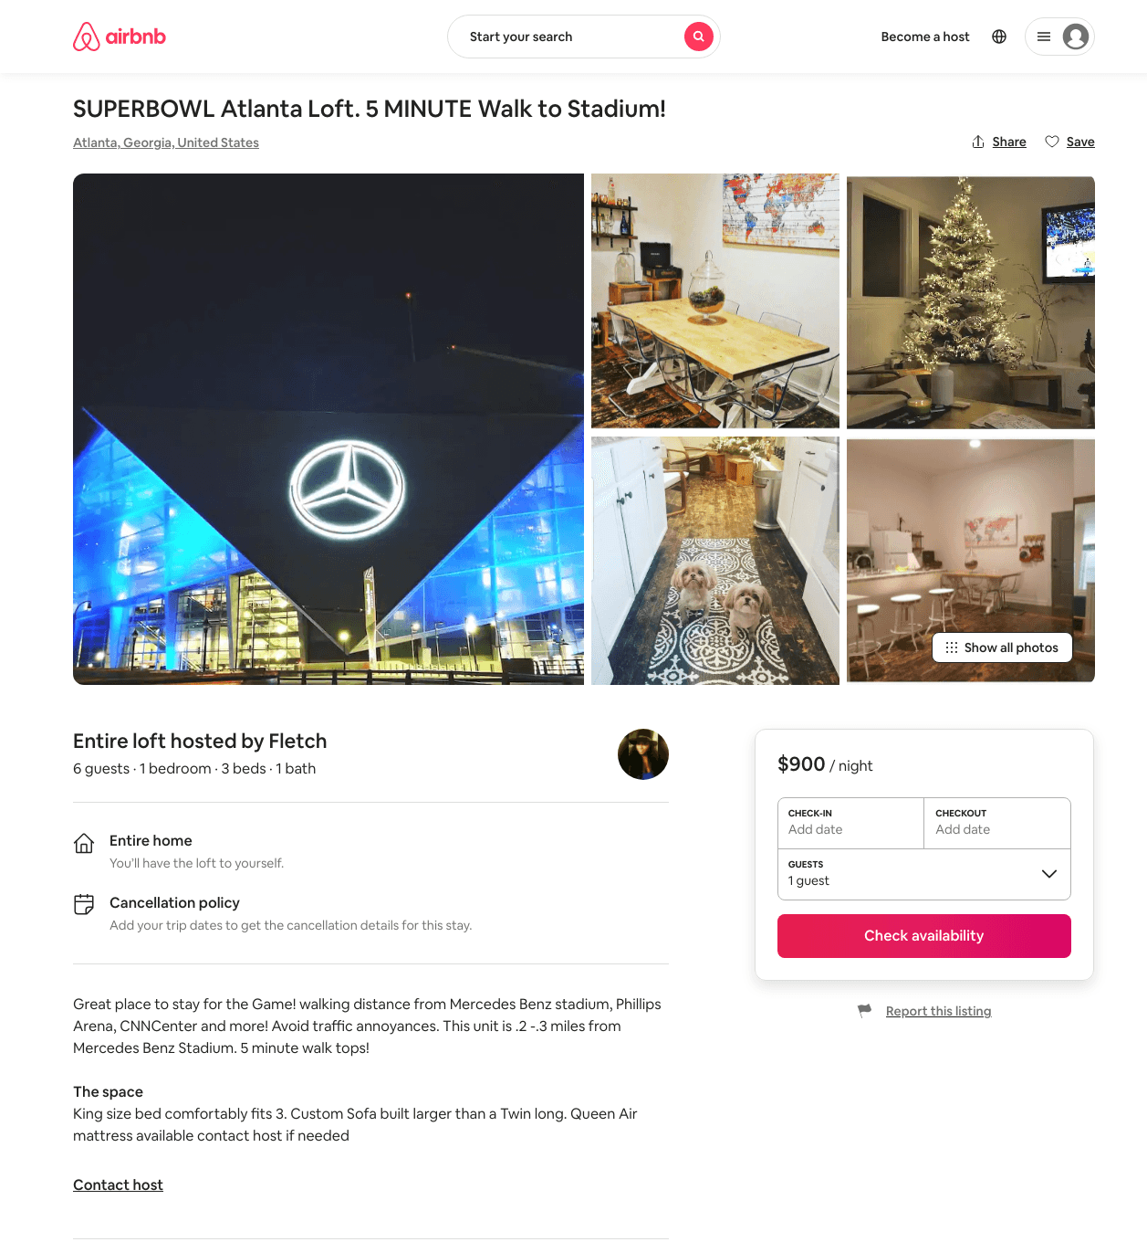
Listing 29985713
1
6
$900
1
Fletch
129330882
1
https://www.airbnb.com/rooms/29985713
Aug 2022

Slide 36
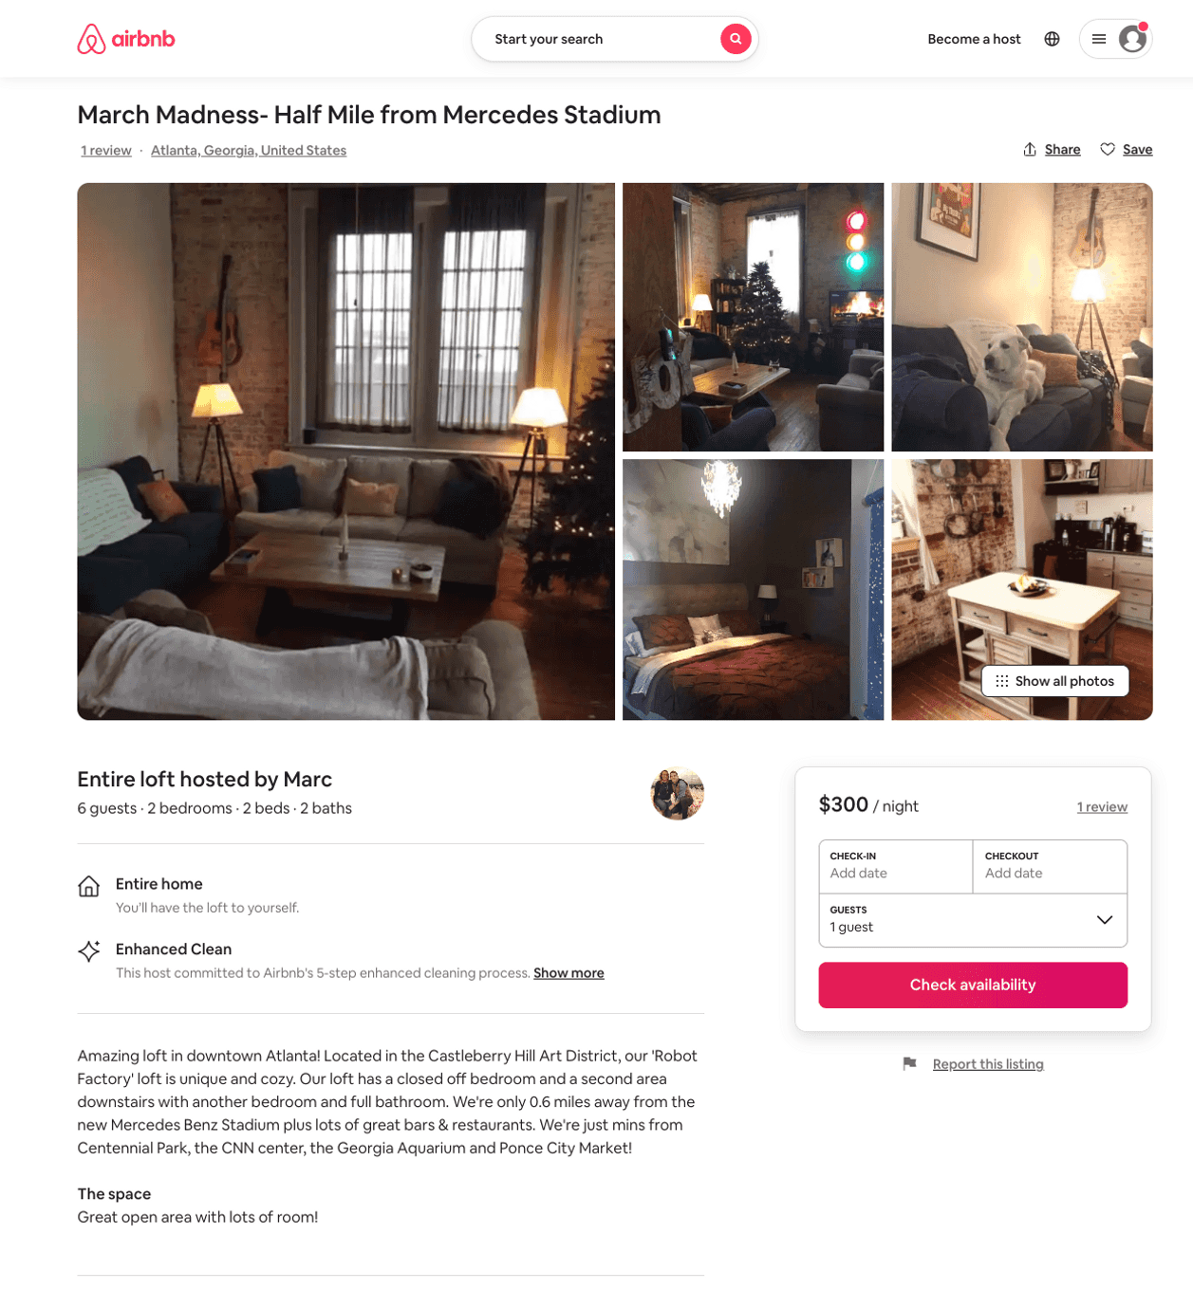
Listing 32817894
2
6
$300
2
Marc
43634894
3
https://www.airbnb.com/rooms/32817894
Jun 2022

Slide 37
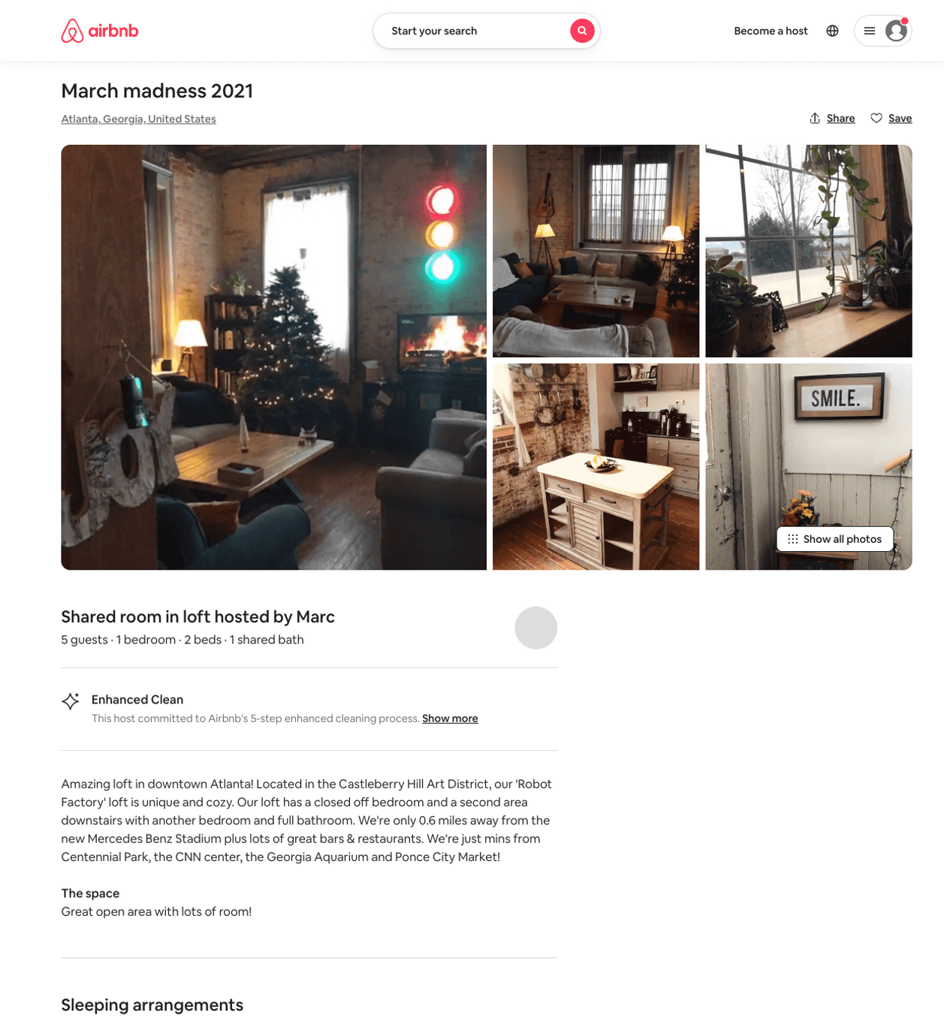
Listing 32817802
1
5
$300
3
Marc
43634894
3
https://www.airbnb.com/rooms/32817802
Aug 2022

Slide 38
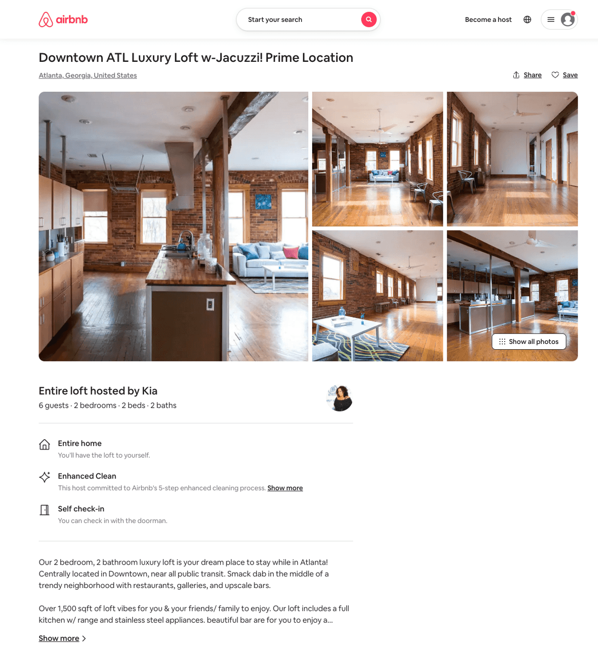
Listing 43621764
2
6
$300
2
Kia
217101277
1
https://www.airbnb.com/rooms/43621764
Aug 2022

Slide 39
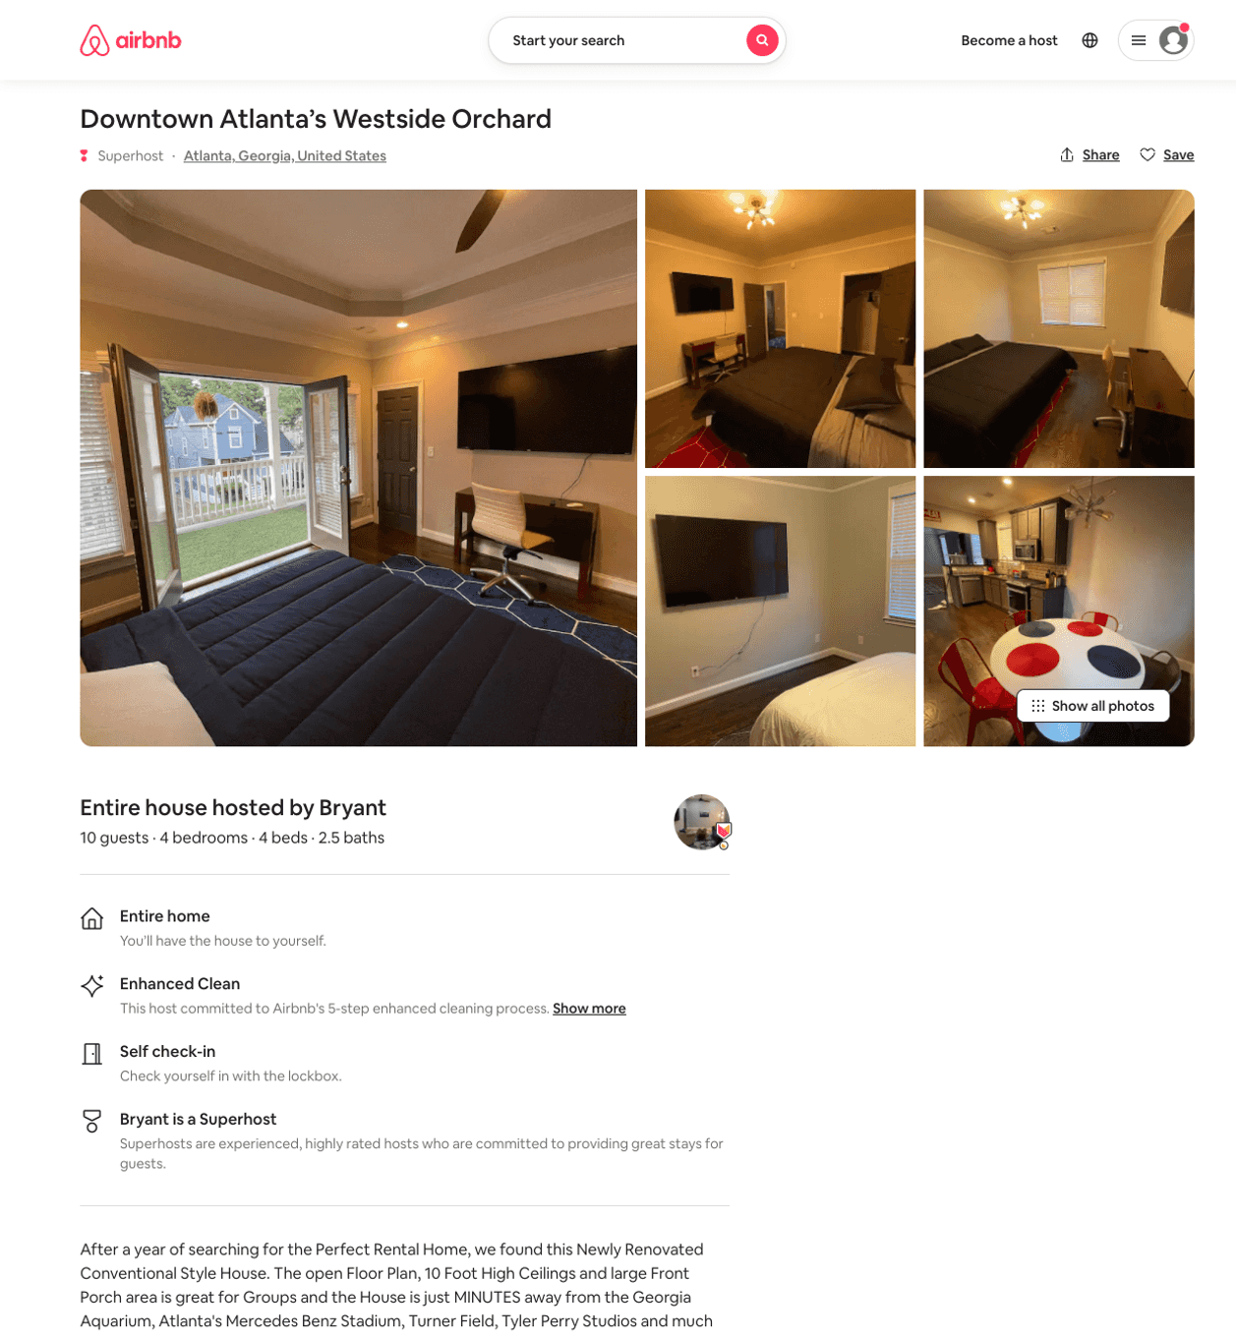
Listing 50941865
4
10
$141 - $396
4.82
1
Bryant
250716419
22
https://www.airbnb.com/rooms/50941865
Aug 2022

Slide 40
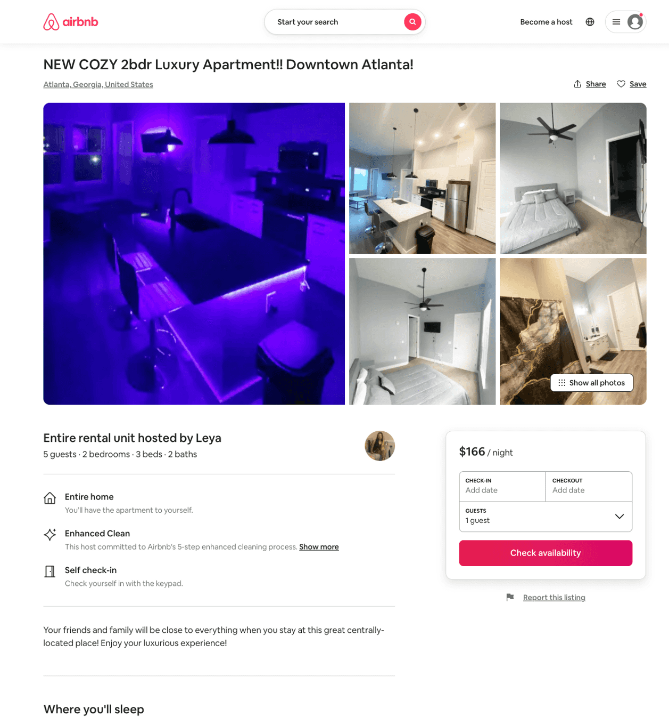
Listing 50566670
2
5
$154 - $178
5.0
2
Leya
242505100
2
https://www.airbnb.com/rooms/50566670
Aug 2022

Slide 41
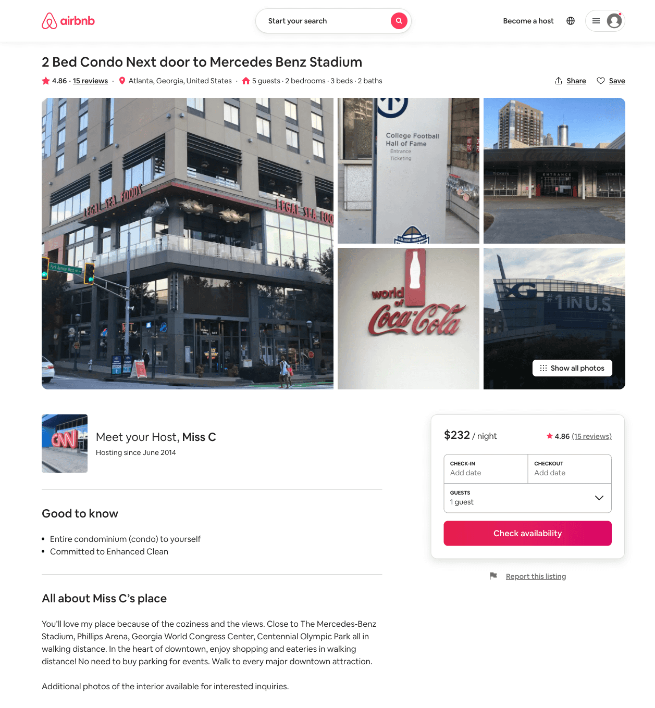
Listing 16038447
2
5
$232 - $329
4.87
2
Miss C
16591956
1
https://www.airbnb.com/rooms/16038447
Aug 2022

Slide 42
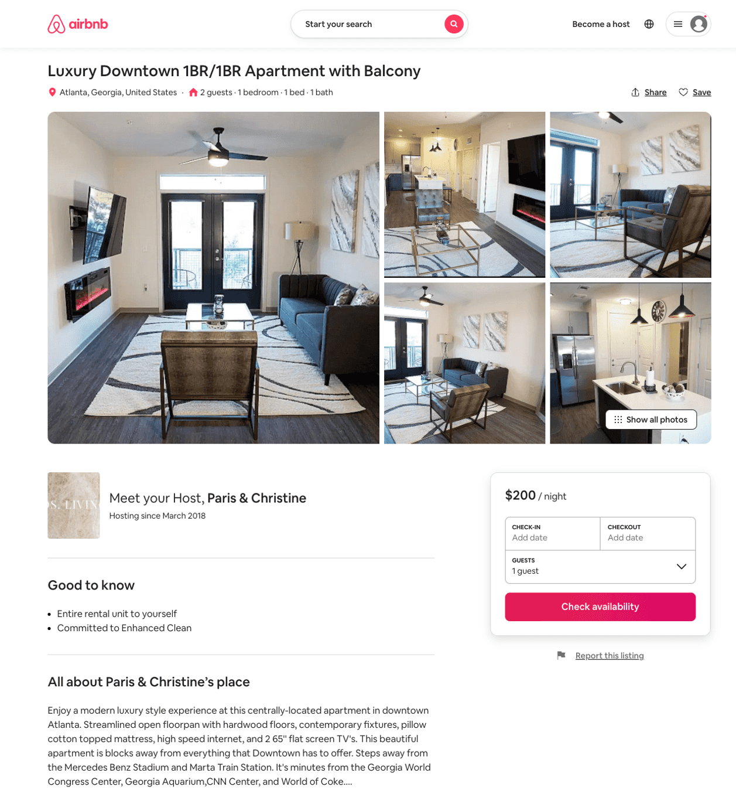
Listing 51679417
1
4
$104 - $200
4.74
2
Christine & Paris
178866278
1
https://www.airbnb.com/rooms/51679417
Aug 2022

Slide 43
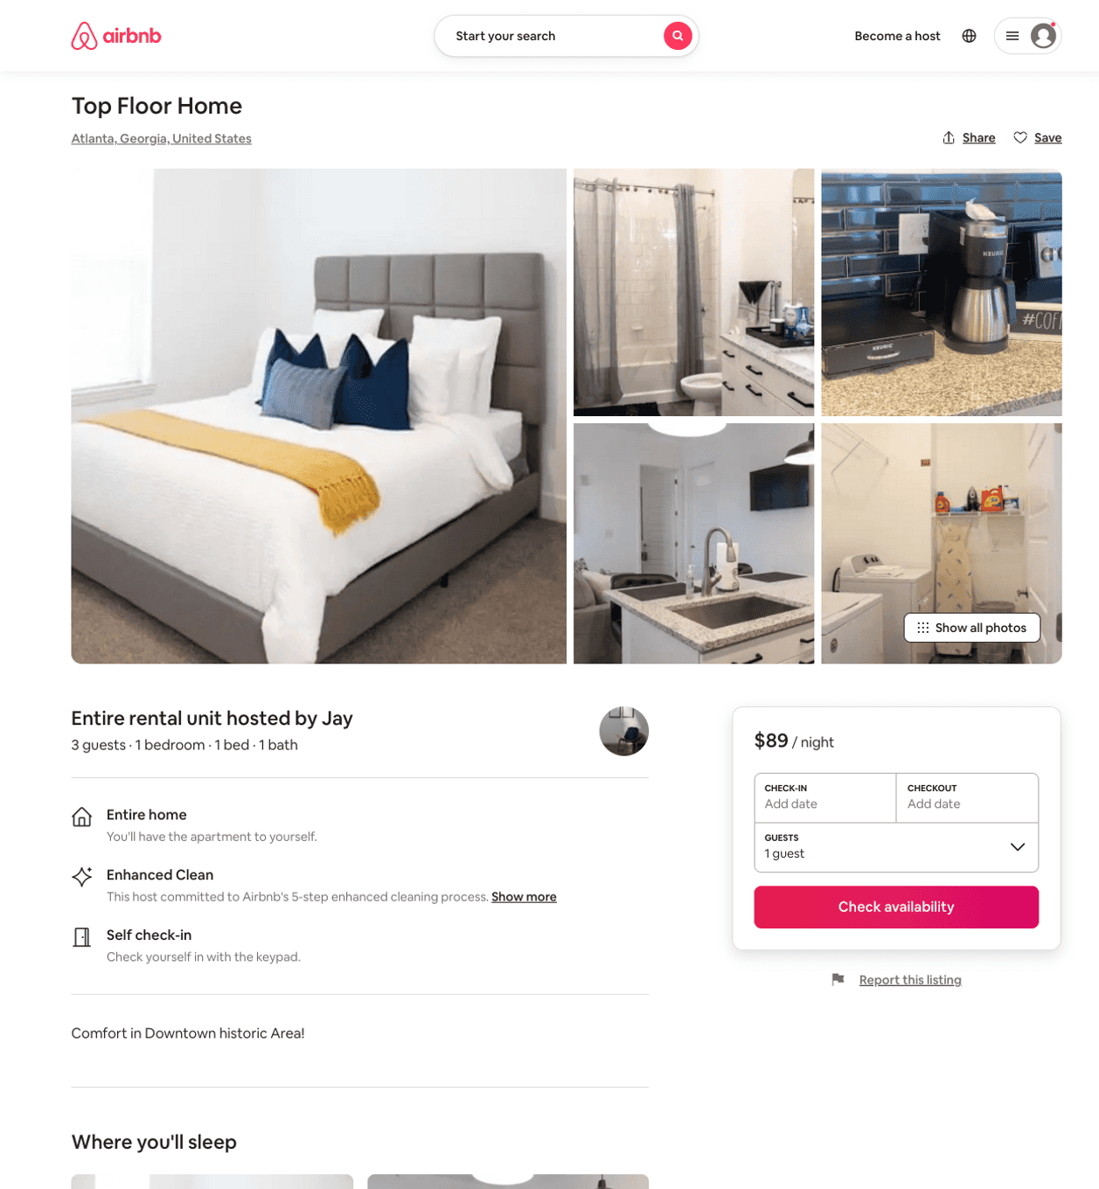
Listing 51771829
1
3
$70 - $121
4.70
1
Jay
419404405
1
https://www.airbnb.com/rooms/51771829
Aug 2022

Slide 44
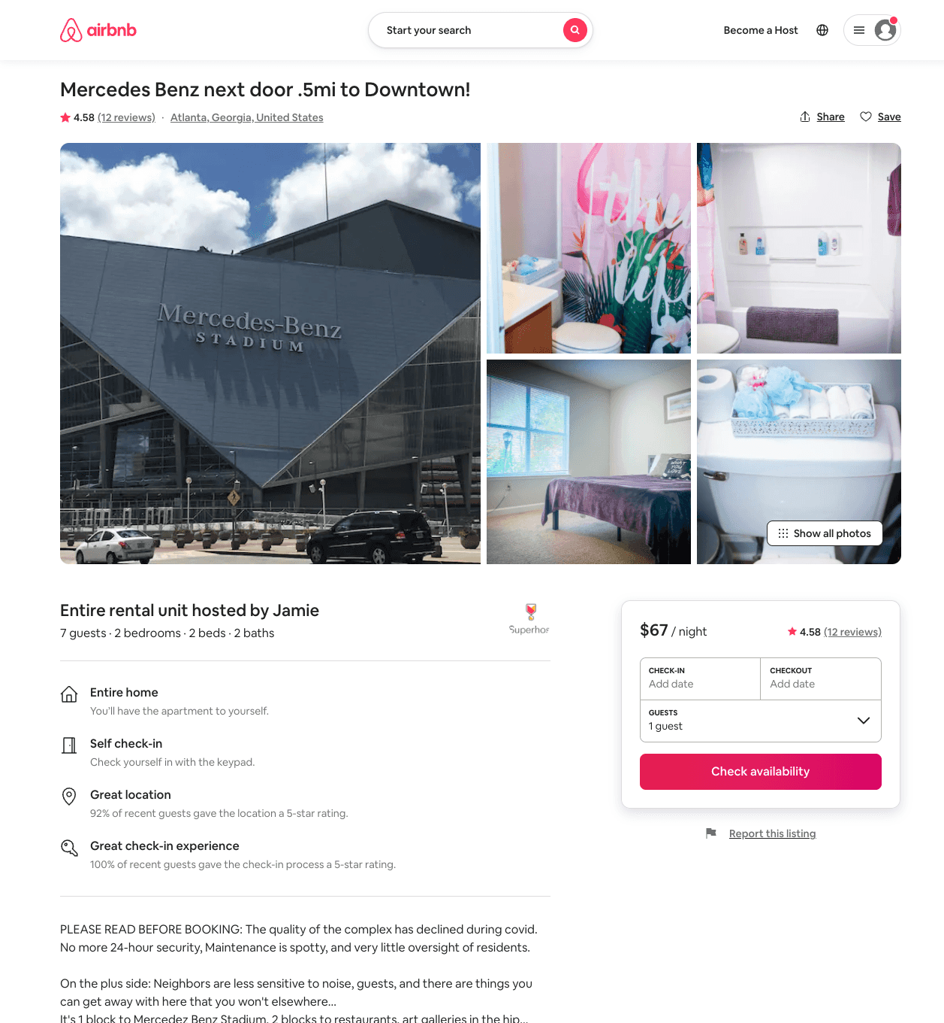
Listing 51963220
2
7
$63 - $101
4.52
2
Jamie
28685522
4
https://www.airbnb.com/rooms/51963220
Jul 2022

Slide 45
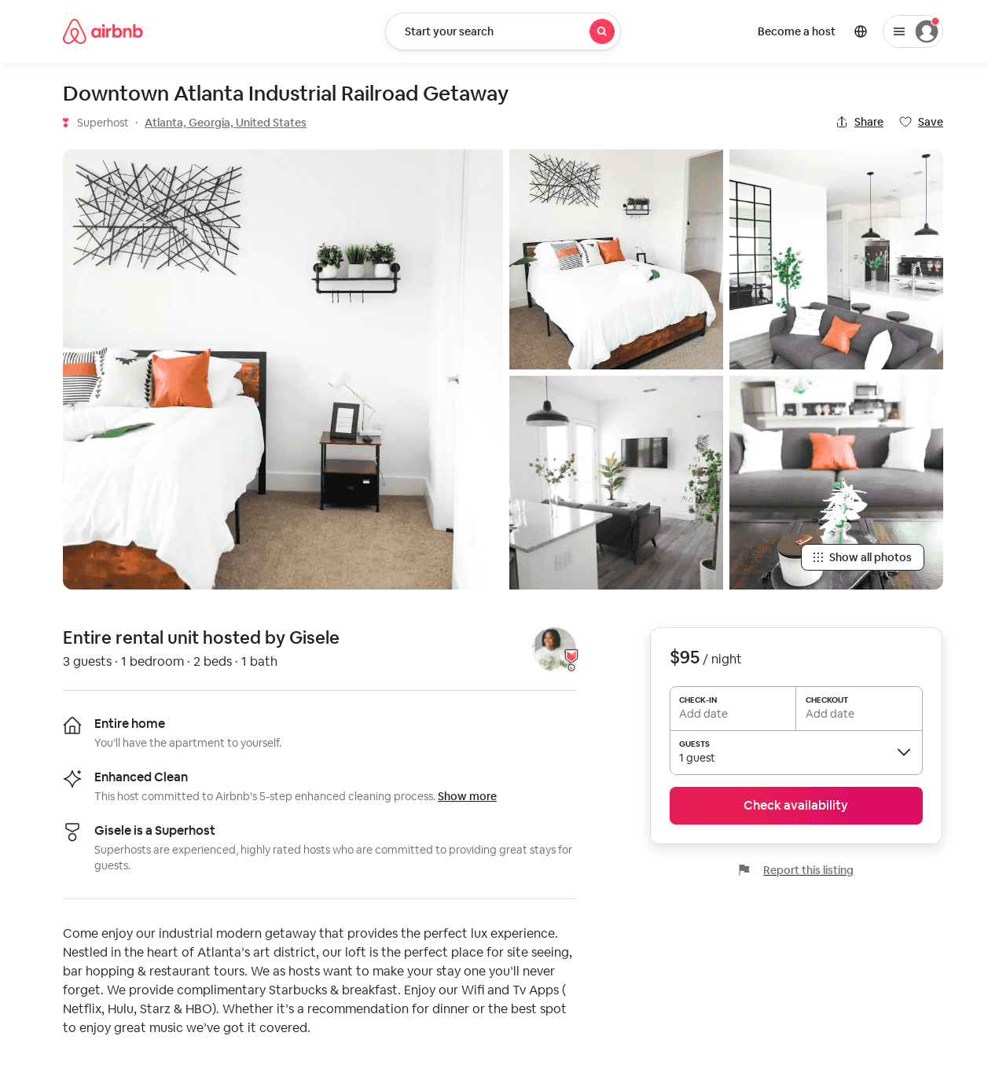
Listing 52040647
1
3
$85 - $130
4.89
2
Nathali
116705749
2
https://www.airbnb.com/rooms/52040647
Aug 2022

Slide 46
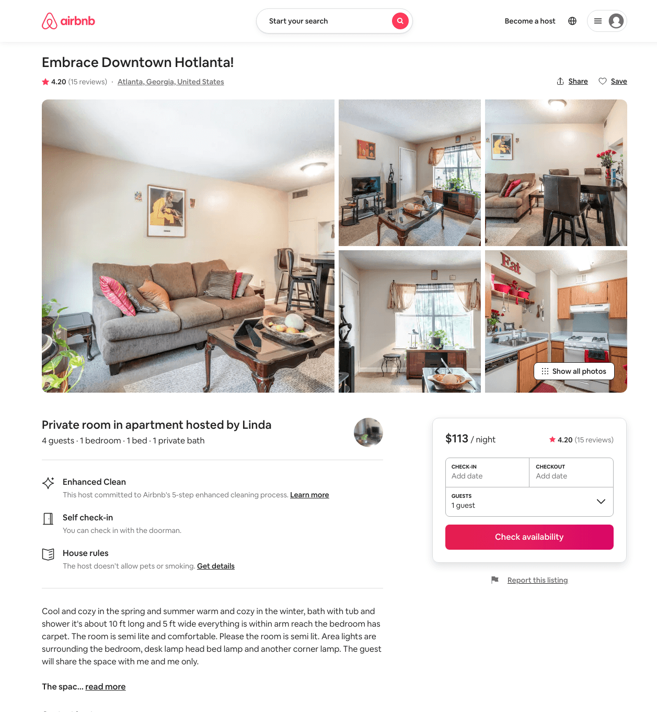
Listing 27319205
1
4
$113
4.20
1
Linda
205823991
1
https://www.airbnb.com/rooms/27319205
Jul 2022

Slide 47
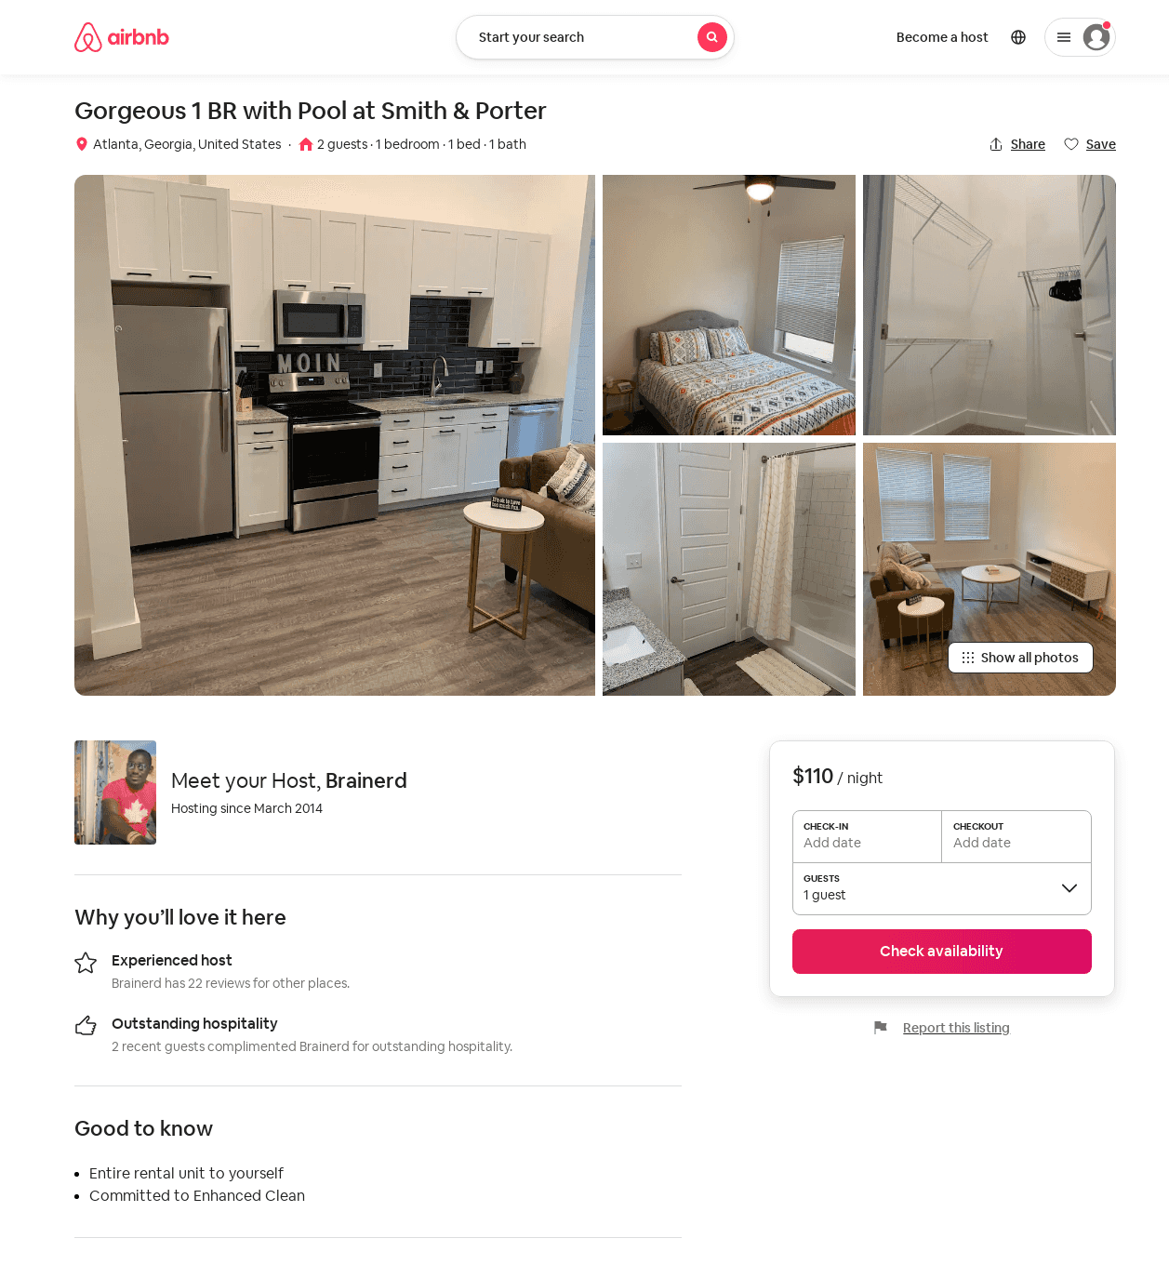
Listing 51603495
1
2
$91 - $110
3
Brainerd
13538169
3
https://www.airbnb.com/rooms/51603495
Jul 2022

Slide 48
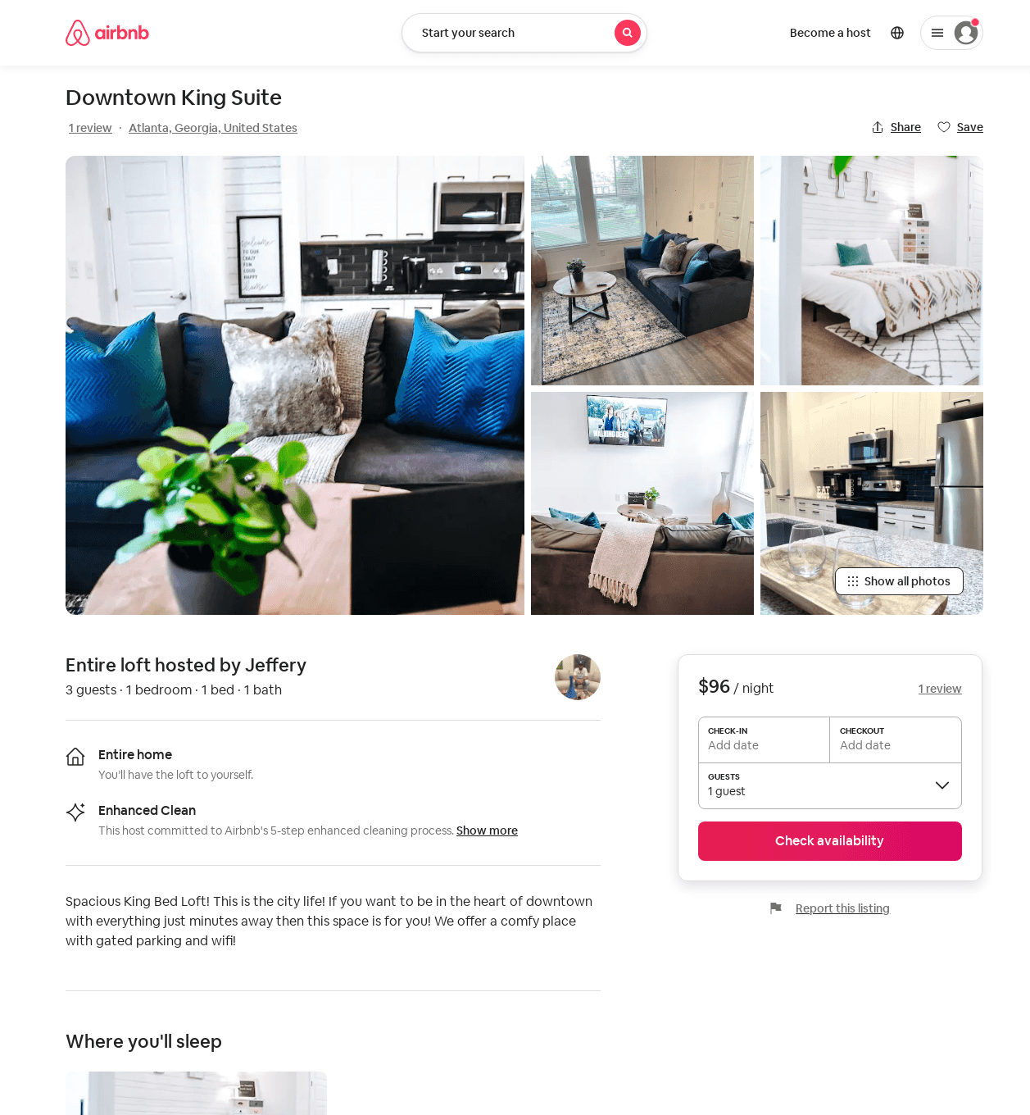
Listing 52369257
1
3
$69 - $133
4.81
1
Jeffery
420795607
1
https://www.airbnb.com/rooms/52369257
Aug 2022

Slide 49
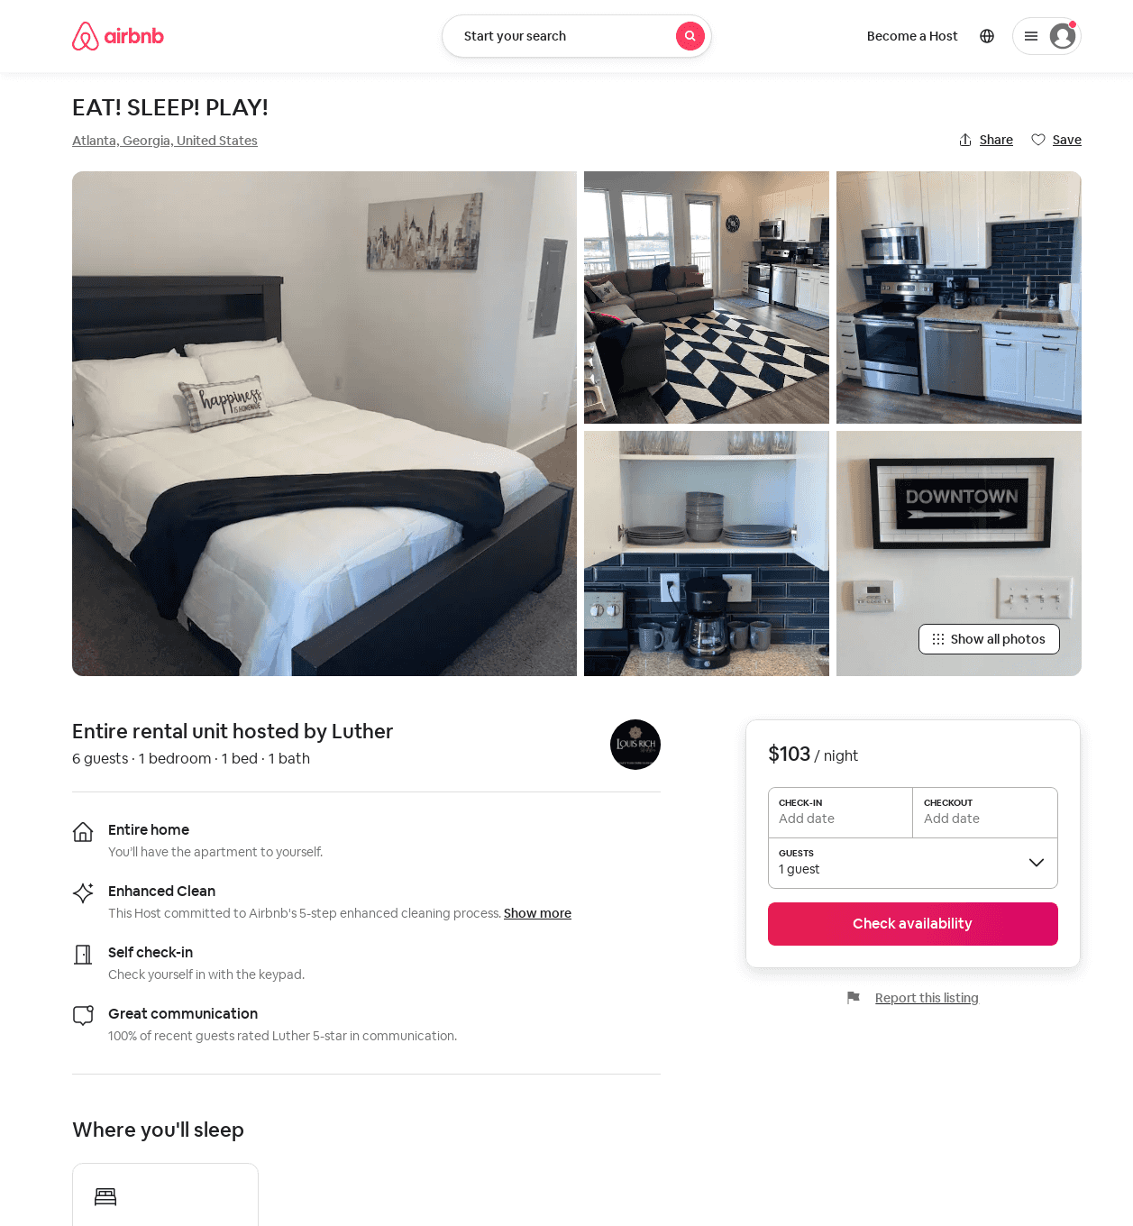
Listing 52721964
1
4
$103 - $1768
4.79
1
Luther
130780110
2
https://www.airbnb.com/rooms/52721964
Aug 2022

Slide 50
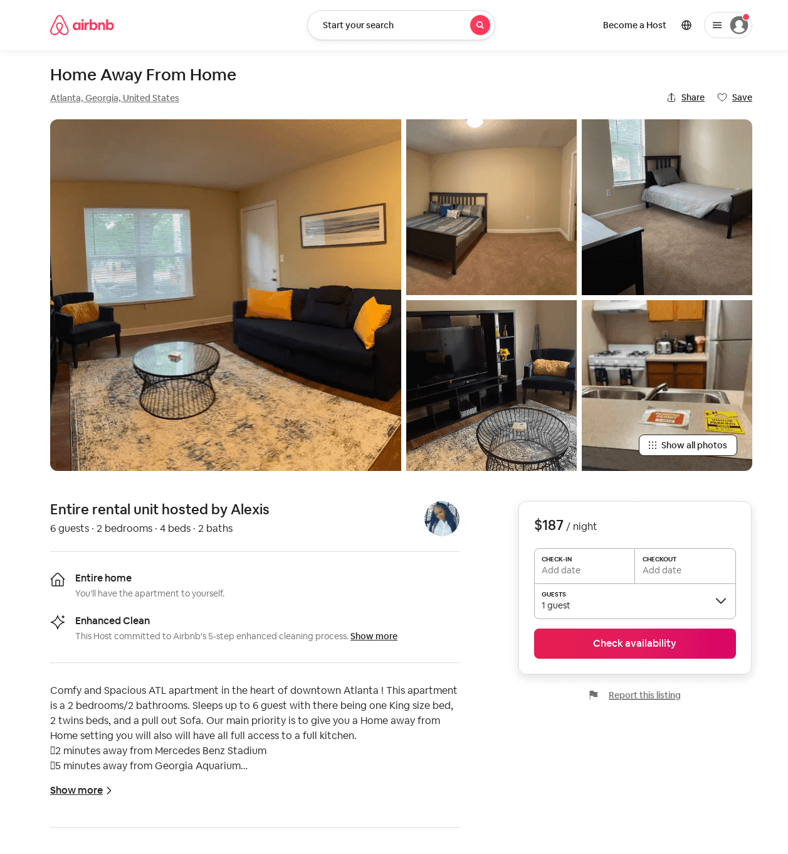
Listing 45378776
2
6
$99 - $220
4.39
2
Alexis
326129080
1
https://www.airbnb.com/rooms/45378776
Jun 2022

Slide 51
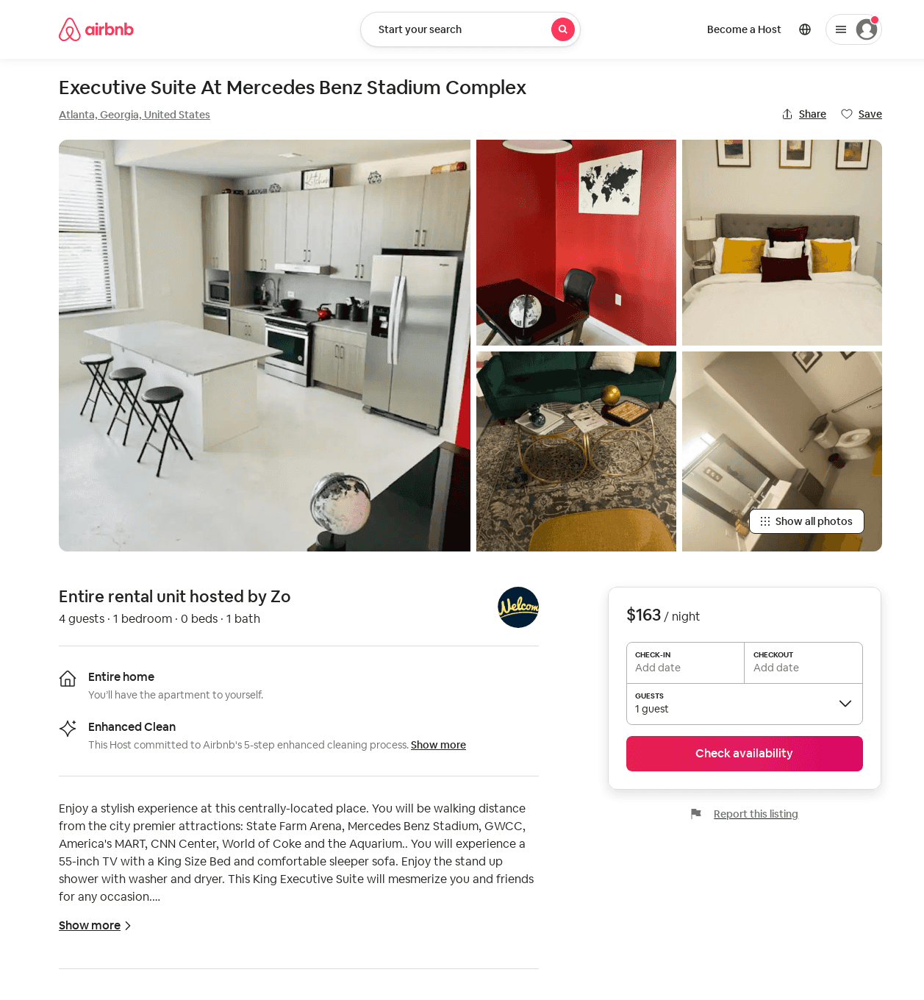
Listing 52428920
1
4
$75 - $188
4.90
1
Zoe
143193799
1
https://www.airbnb.com/rooms/52428920
Aug 2022

Slide 52
Listing 52619177
1
3
$123 - $199
4.91
2
Studio Noir
425951224
1
https://www.airbnb.com/rooms/52619177
Aug 2022

Slide 53
Listing 52853972
1
3
$84 - $105
4.61
2
Shamar
84915059
1
https://www.airbnb.com/rooms/52853972
Aug 2022

Slide 54
Listing 52974256
1
4
$91 - $127
4.68
1
Mia
90724108
2
https://www.airbnb.com/rooms/52974256
Aug 2022

Slide 55
Listing 53432375
1
3
$98 - $144
4.50
1
Out Of The Box
208955740
7
https://www.airbnb.com/rooms/53432375
Aug 2022

Slide 56
Listing 49631526
3
6
$207 - $339
4.99
2
Ian
23454048
1
https://www.airbnb.com/rooms/49631526
Aug 2022

Slide 57
Listing 53868786
3
6
$479 - $583
3
Evolve
121682456
51
https://www.airbnb.com/rooms/53868786
Aug 2022

Slide 58
Listing 53868235
3
6
$479 - $583
3
Evolve
121682456
51
https://www.airbnb.com/rooms/53868235
Aug 2022

Slide 59
Listing 30999639
2
5
$275 - $325
5.0
30
Rose
19417285
1
https://www.airbnb.com/rooms/30999639
Aug 2022

Slide 60
Listing 18273823
1
2
$81 - $93
4.76
2
Missy
2410068
3
https://www.airbnb.com/rooms/18273823
Aug 2022

Slide 61
Listing 9639974
3
6
$474 - $579
3
Evolve
https://www.vrbo.com/9639974ha
Aug 2022

Slide 62
Listing 52680865
3
11
$228 - $343
5.0
3
Mayu
216565735
11
https://www.airbnb.com/rooms/52680865
Jul 2022

Slide 63
Listing the-kingdom-atl-night-life-district
210 PETERS ST SW
undefined
1
8.3
https://www.booking.com/hotel/us/the-kingdom-atl-night-life-district.html
Sep 2022

Slide 64
Listing 9639975
3
6
$474 - $579
3
Evolve
https://www.vrbo.com/9639975ha
Aug 2022

Slide 65
Listing 2620947
2
7
$280
1
1
https://www.vrbo.com/2620947
Aug 2022

Slide 66
Listing 2637869
2
8
$103
5
2
Alexis S
https://www.vrbo.com/2637869
Aug 2022

Slide 67
Listing 54265754
1
4
$109 - $119
4.83
1
Troy
2447879
2
https://www.airbnb.com/rooms/54265754
Aug 2022

Slide 68
Listing 570843289125293600
1
3
$109 - $150
4.65
1
Najah
245762705
1
https://www.airbnb.com/rooms/570843289125293600
Aug 2022

Slide 69
Listing 2645548
1
2
$97
5
1
https://www.vrbo.com/2645548
Aug 2022

Slide 70
Listing 54280287
2
6
$154 - $166
4.33
1
Tiffany
324147987
3
https://www.airbnb.com/rooms/54280287
Aug 2022

Slide 71
Listing 36729916
Studio
4
$857
1
Tyon
219869829
1
https://www.airbnb.com/rooms/36729916
Aug 2022

Slide 72
Listing 28005353
1
2
$57 - $98
4.78
2
Shay
191168290
2
https://www.airbnb.com/rooms/28005353
Aug 2022

Slide 73
Listing 49112924
1
3
$140 - $199
4.33
2
Eazy
26239428
1
https://www.airbnb.com/rooms/49112924
Aug 2022

Slide 74
Listing 2783627
2
4
$300
2
https://www.vrbo.com/2783627
Aug 2022

Slide 75
Listing 2873082
2
6
$150
2
Dream Revolutions
https://www.vrbo.com/2873082
Aug 2022

Slide 76
Listing 32323247
2
2
14
Scott
37977552
1
https://www.airbnb.com/rooms/32323247
Aug 2022

Slide 77
Listing 2912753
1
3
$129
7
https://www.vrbo.com/2912753
Aug 2022

Slide 78
Listing 53004141
1
2
4.90
1
Tee
236204437
1
https://www.airbnb.com/rooms/53004141
Aug 2022

Slide 79
Listing 2936507
1
2
$145
1
https://www.vrbo.com/2936507
Aug 2022

