Slide 2
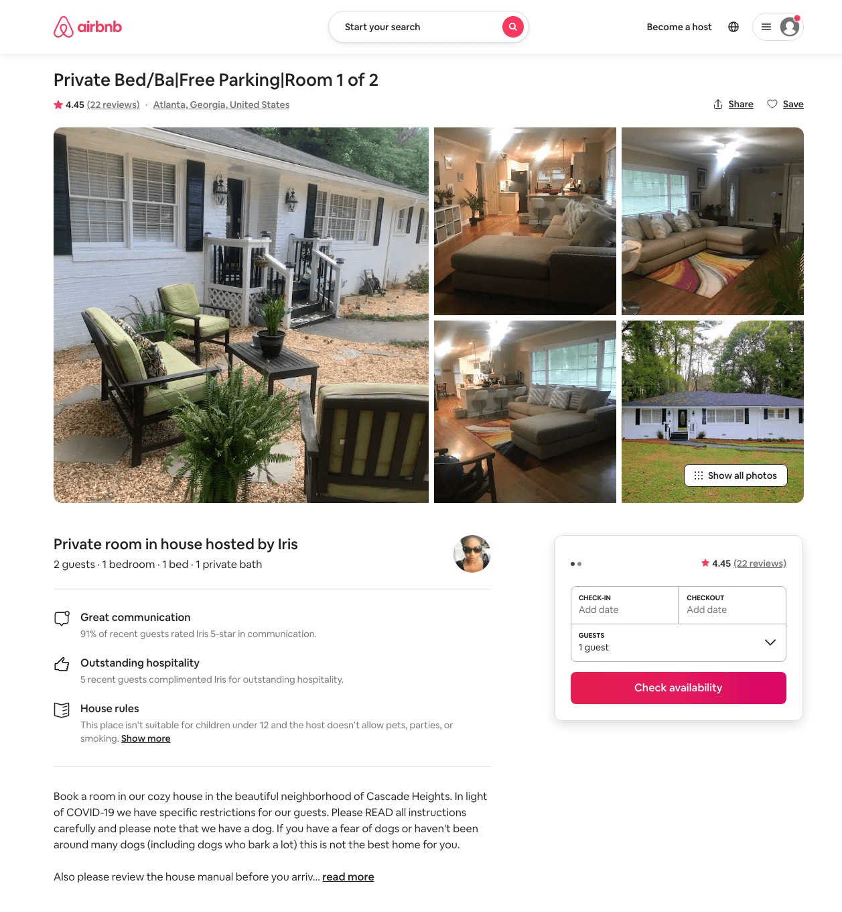
Listing 35873958
1
2
$25 - $26
4.42
5
Iris
57524811
2
https://www.airbnb.com/rooms/35873958
Aug 2022

Slide 3
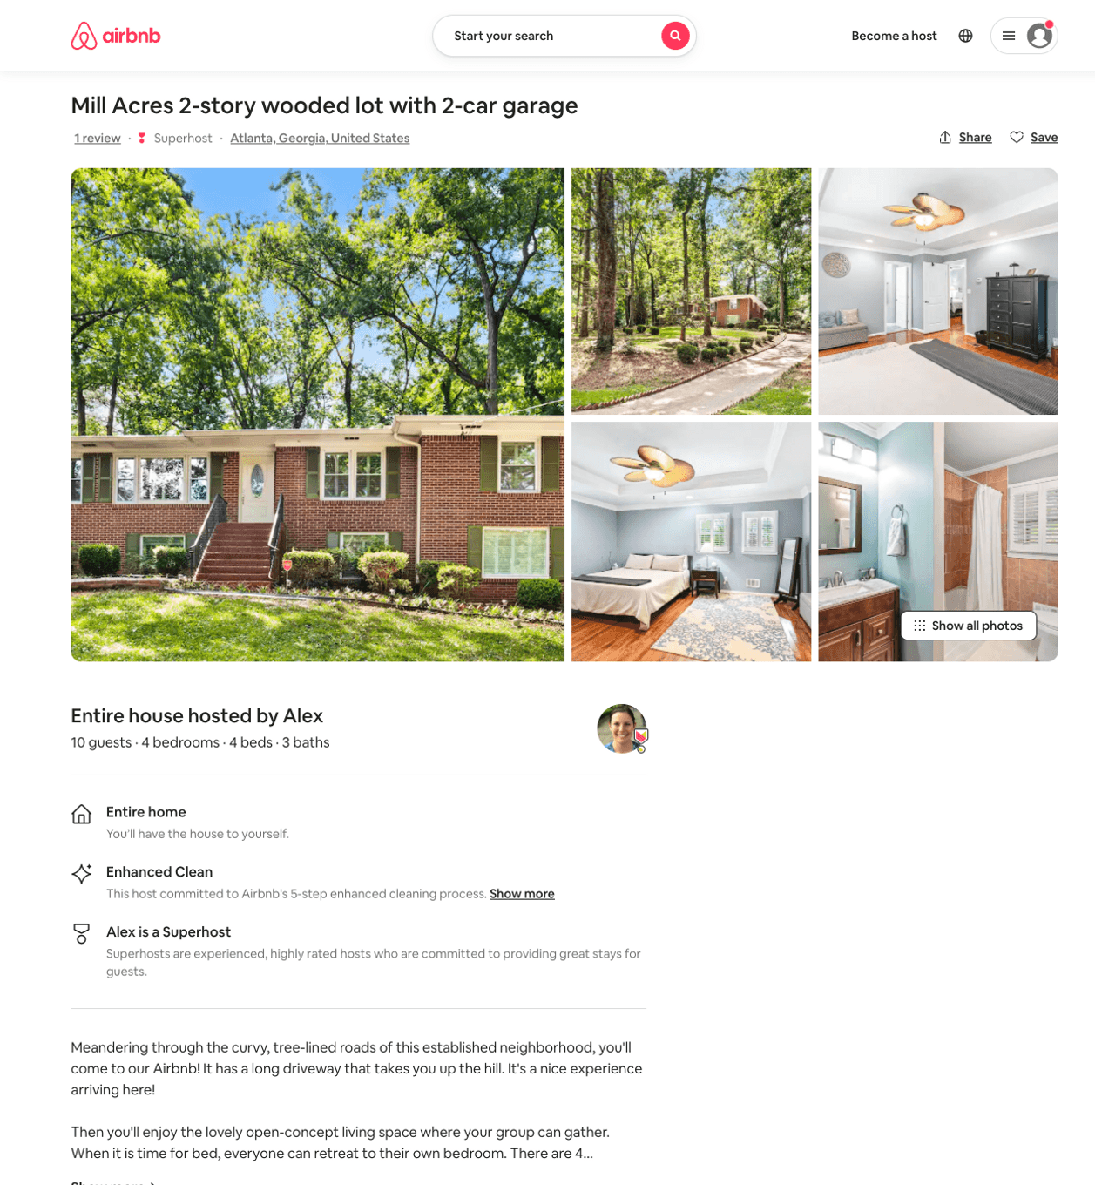
Listing 50505303
4
10
$175 - $336
4.91
2
Alex And Christina
20605441
40
https://www.airbnb.com/rooms/50505303
Aug 2022

Slide 4
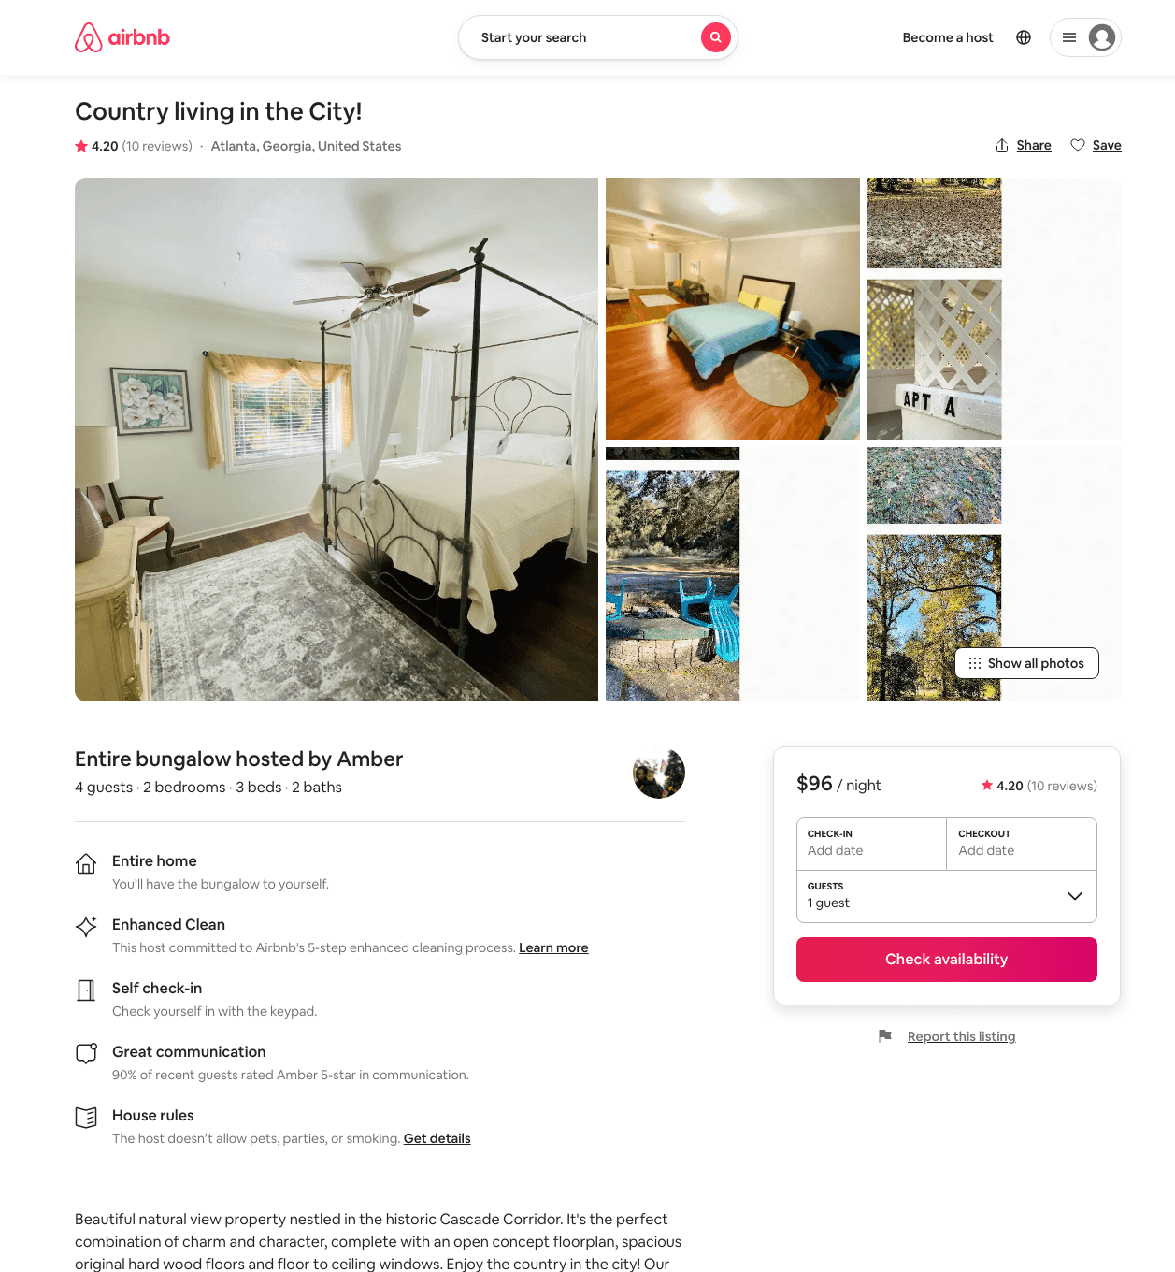
Listing 45633822
2
4
$95 - $112
4.30
2
Amber
235911319
1
https://www.airbnb.com/rooms/45633822
Aug 2022

Slide 5
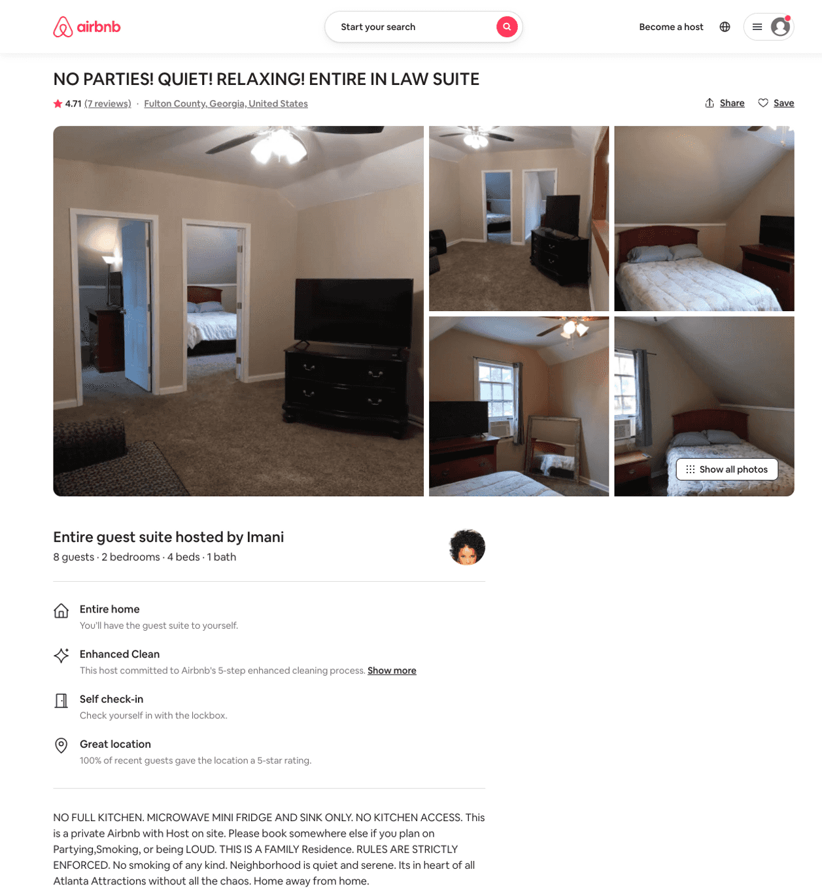
Listing 32337231
2
8
$89
4.33
4
Imani
165147235
1
https://www.airbnb.com/rooms/32337231
Aug 2022

