Slide 2
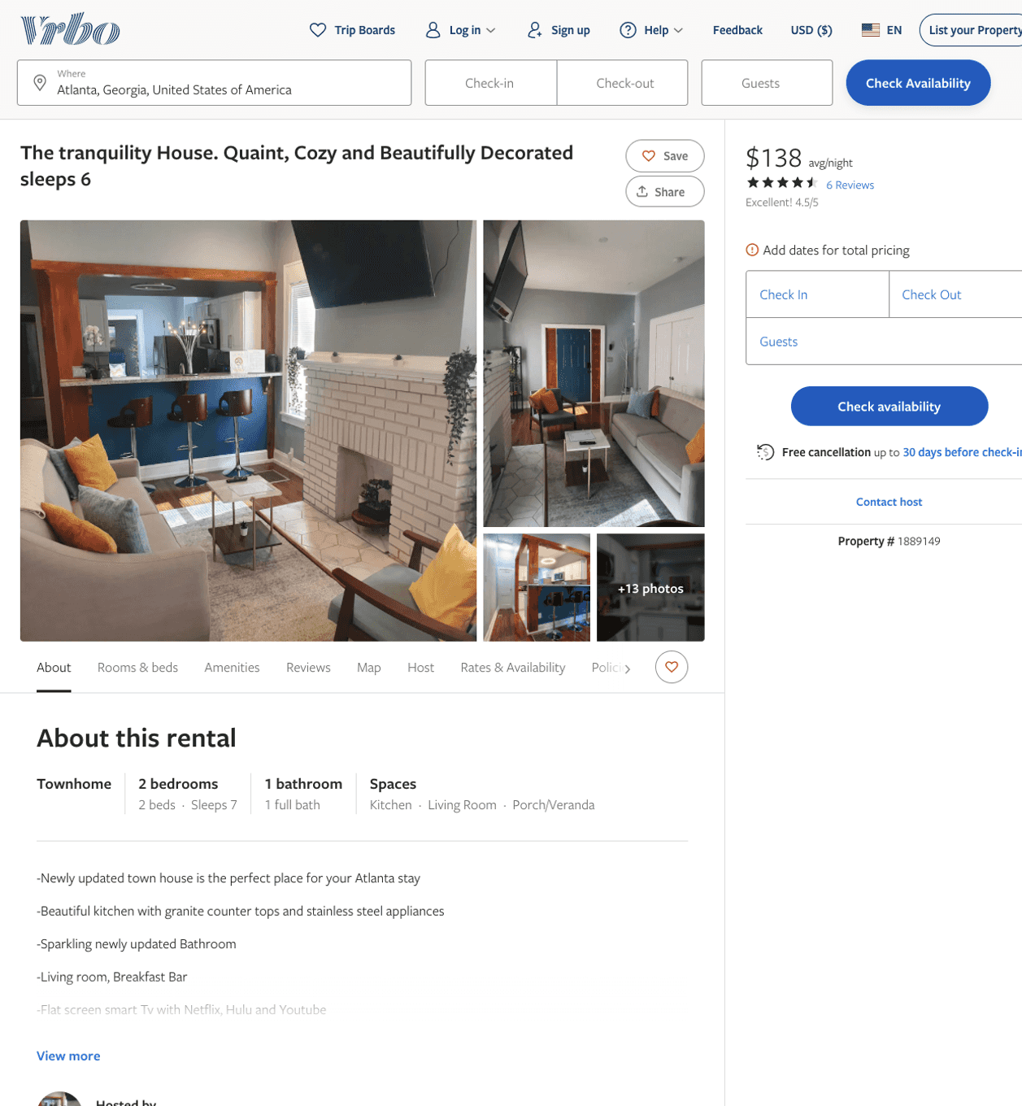
Listing 1889149
2
5
$124 - $95
4.5833335
2
Bethanie Nikoue
https://www.vrbo.com/1889149
Aug 2022

Slide 3
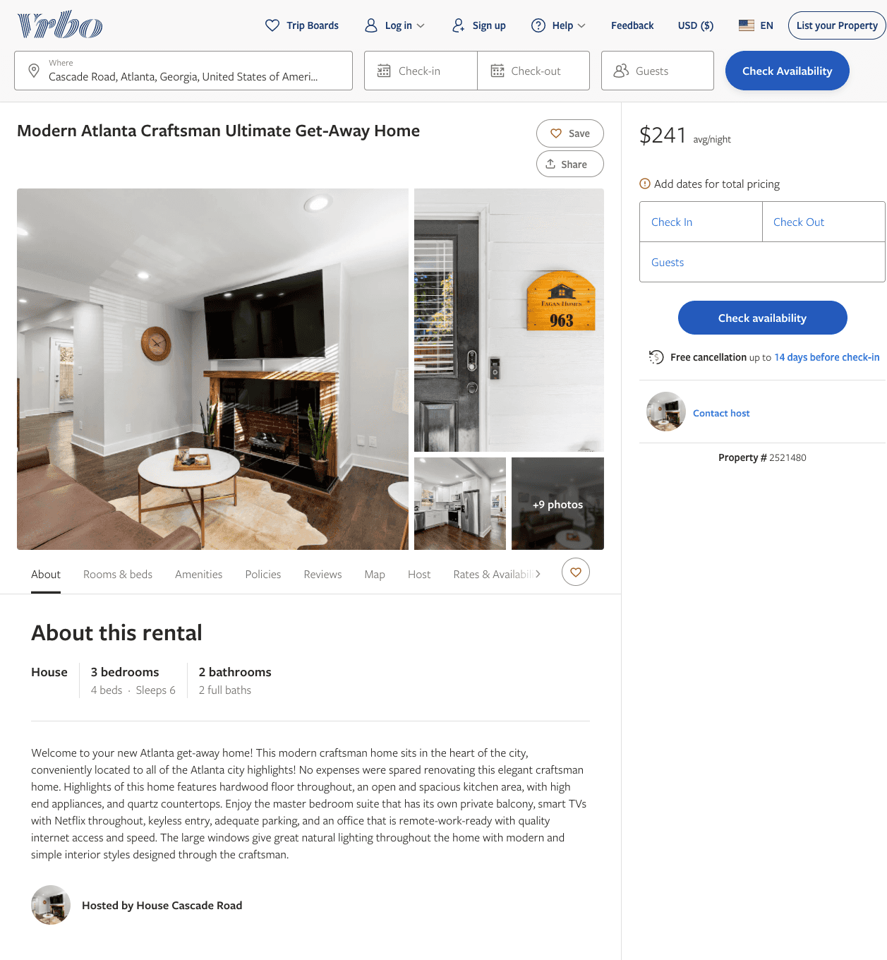
Listing 2521480
3
6
$200 - $242
4.8125
1
https://www.vrbo.com/2521480
Aug 2022

Slide 4
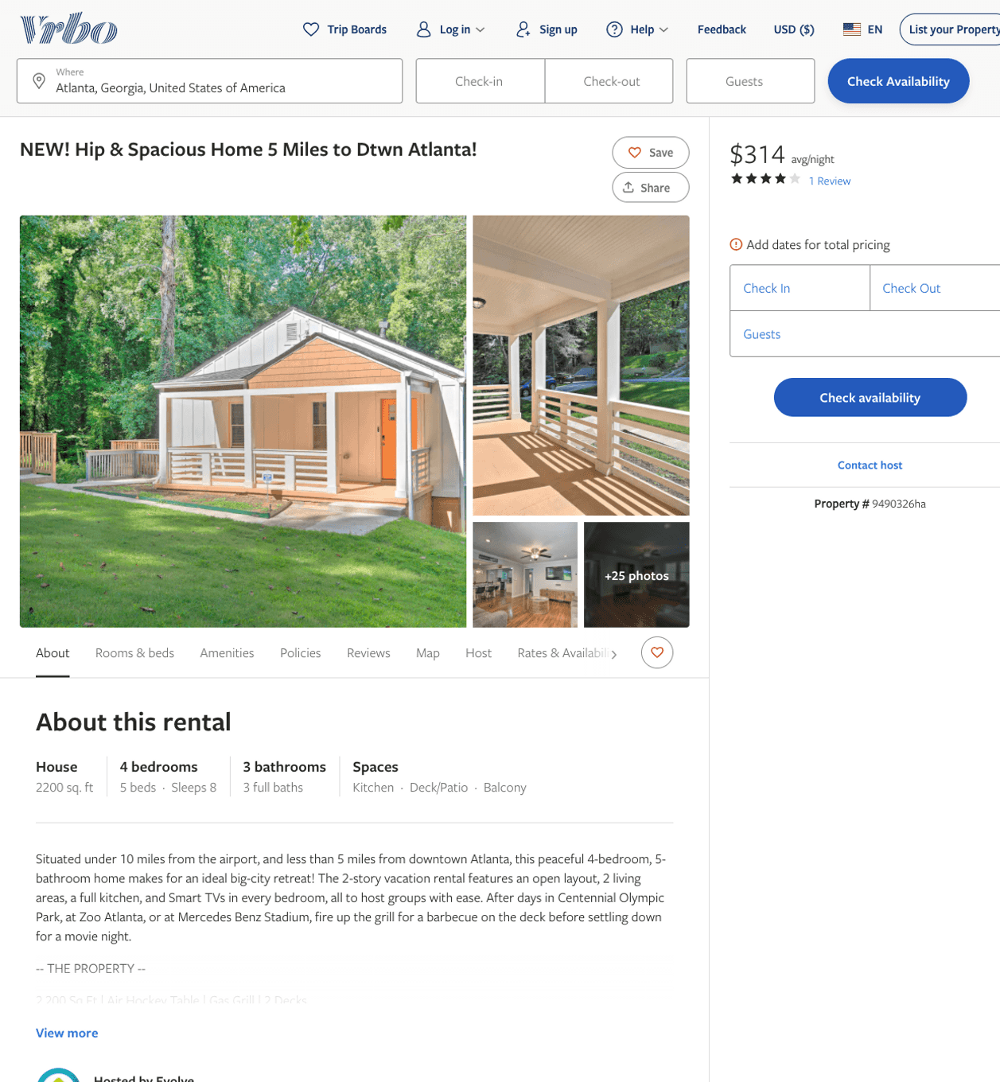
Listing 9490326
4
8
$164 - $316
4.25
2
Evolve
https://www.vrbo.com/9490326ha
Aug 2022

Slide 5
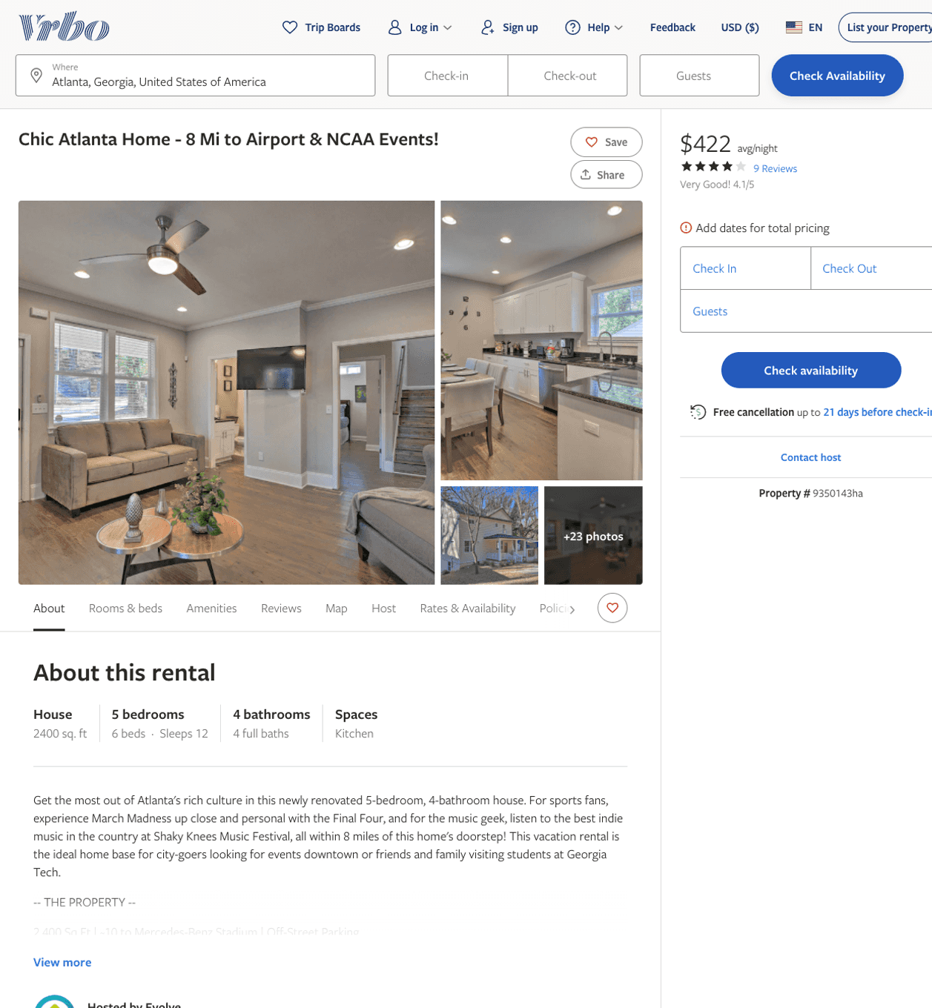
Listing 9350143
5
12
$257 - $422
4.25
2
Evolve
https://www.vrbo.com/9350143ha
Aug 2022

Slide 6
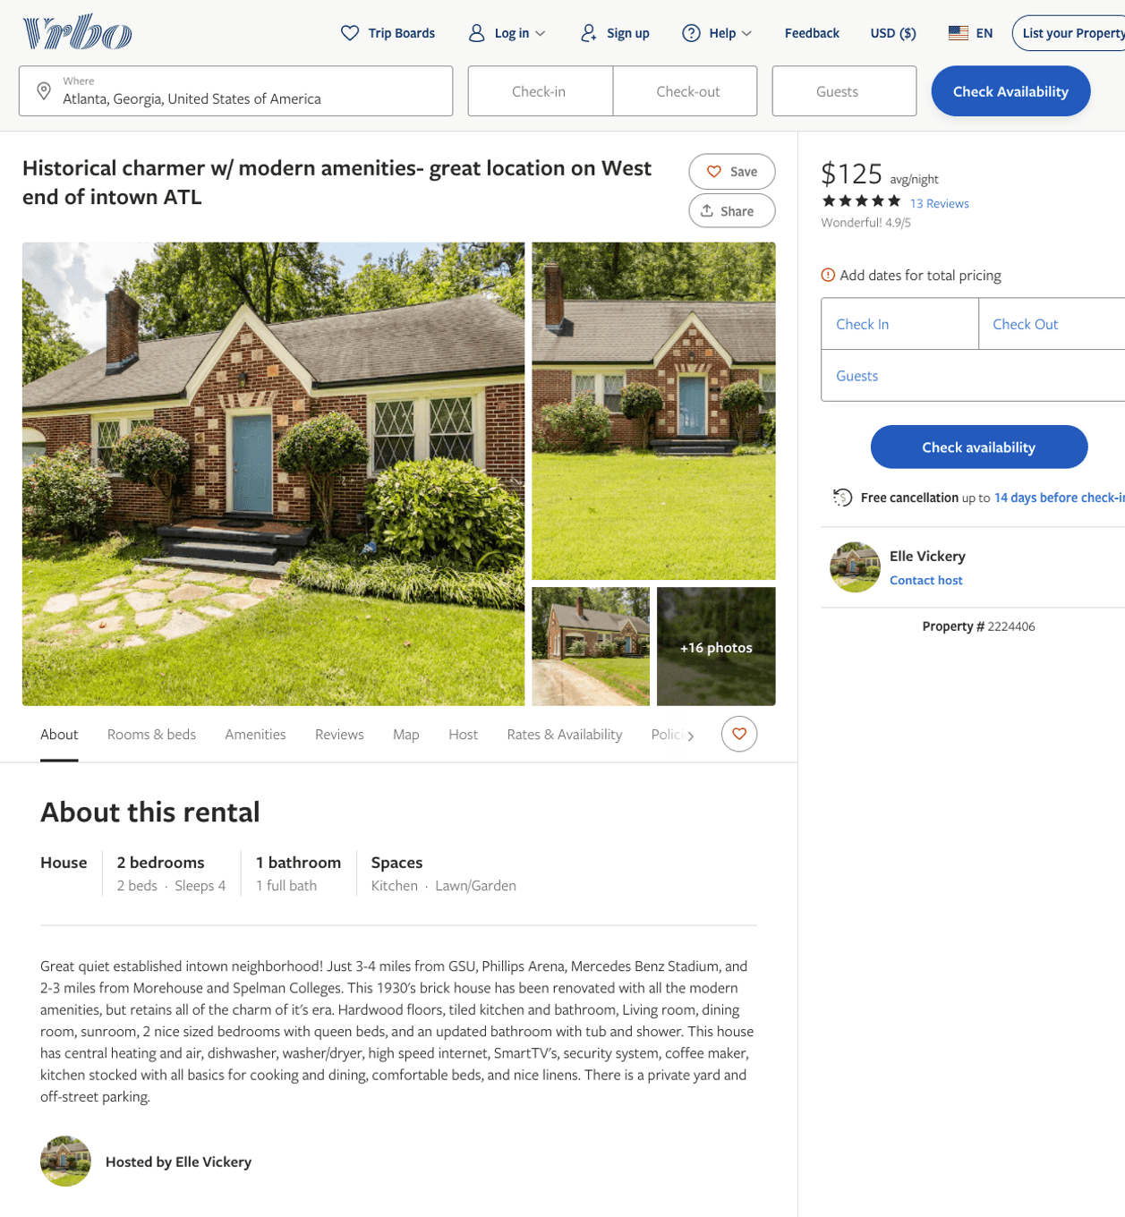
Listing 2224406
2
4
$125
4.4761906
2
Elle Vickery
https://www.vrbo.com/2224406
Aug 2022

Slide 7
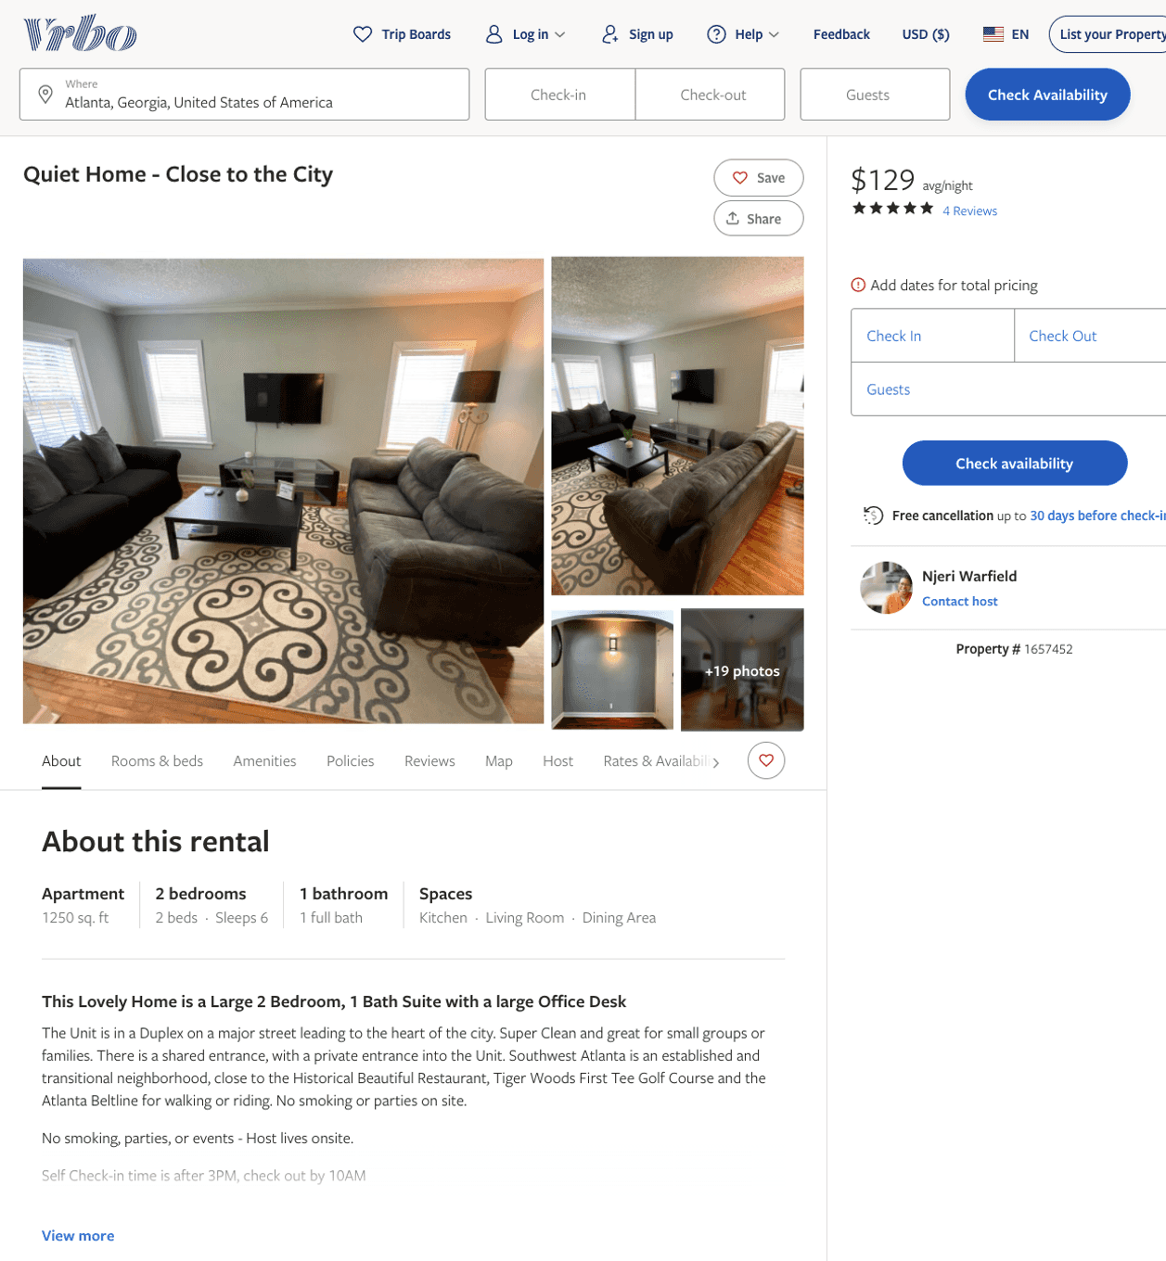
Listing 1657452
2
4
$119 - $151
4.8333335
2
Njeri Warfield
https://www.vrbo.com/1657452
Aug 2022

Slide 8
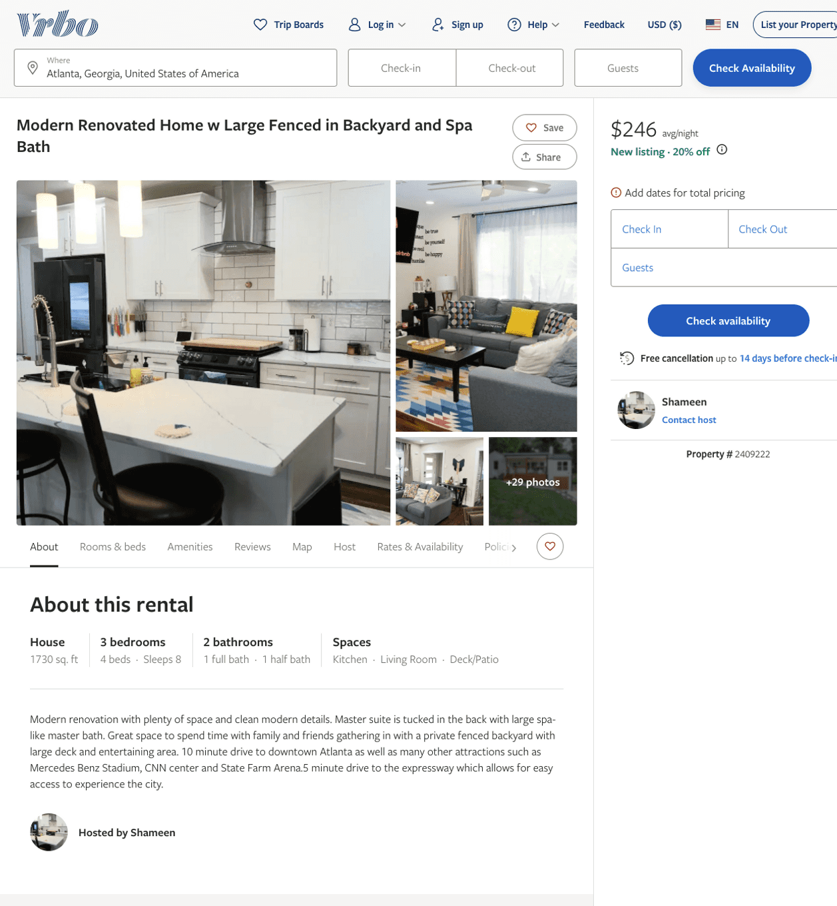
Listing 2409222
3
8
$160 - $287
4.6666665
1
Shameen
https://www.vrbo.com/2409222
Aug 2022

Slide 9
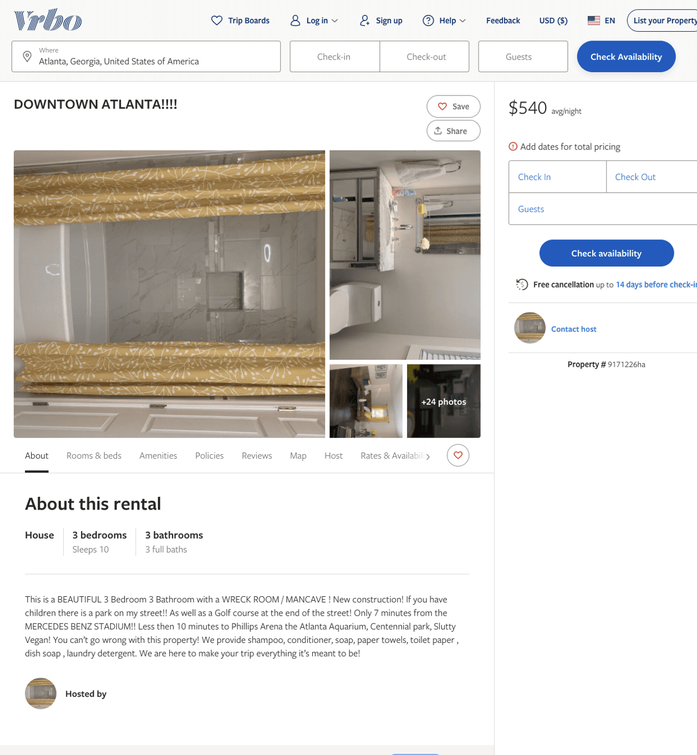
Listing 9171226
3
10
$540
3
https://www.vrbo.com/9171226ha
Aug 2022

Slide 10
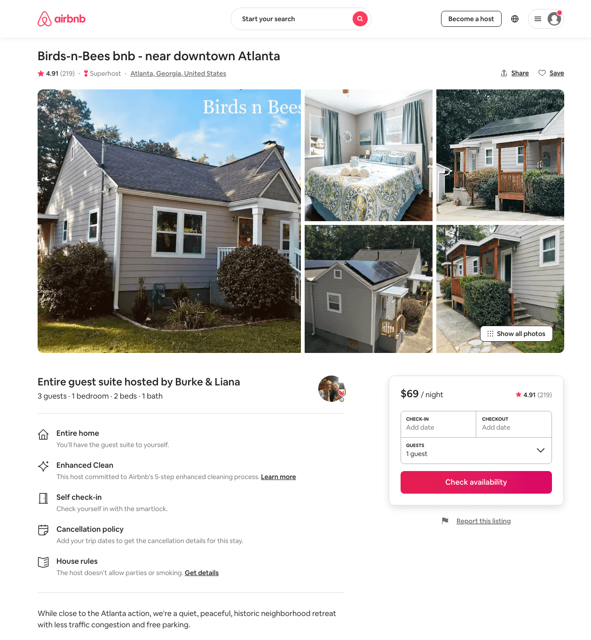
Listing 35279146
1
4
$58 - $80
4.94
1
Burke & Liana
22194389
1
https://www.airbnb.com/rooms/35279146
Aug 2022

Slide 11
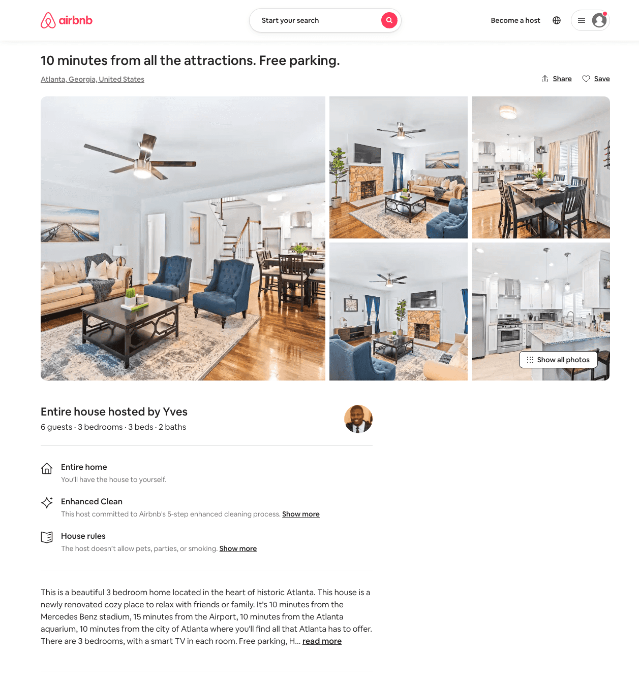
Listing 49632895
2
4
$155 - $225
4.60
2
Yves
257729709
1
https://www.airbnb.com/rooms/49632895
Aug 2022

Slide 12
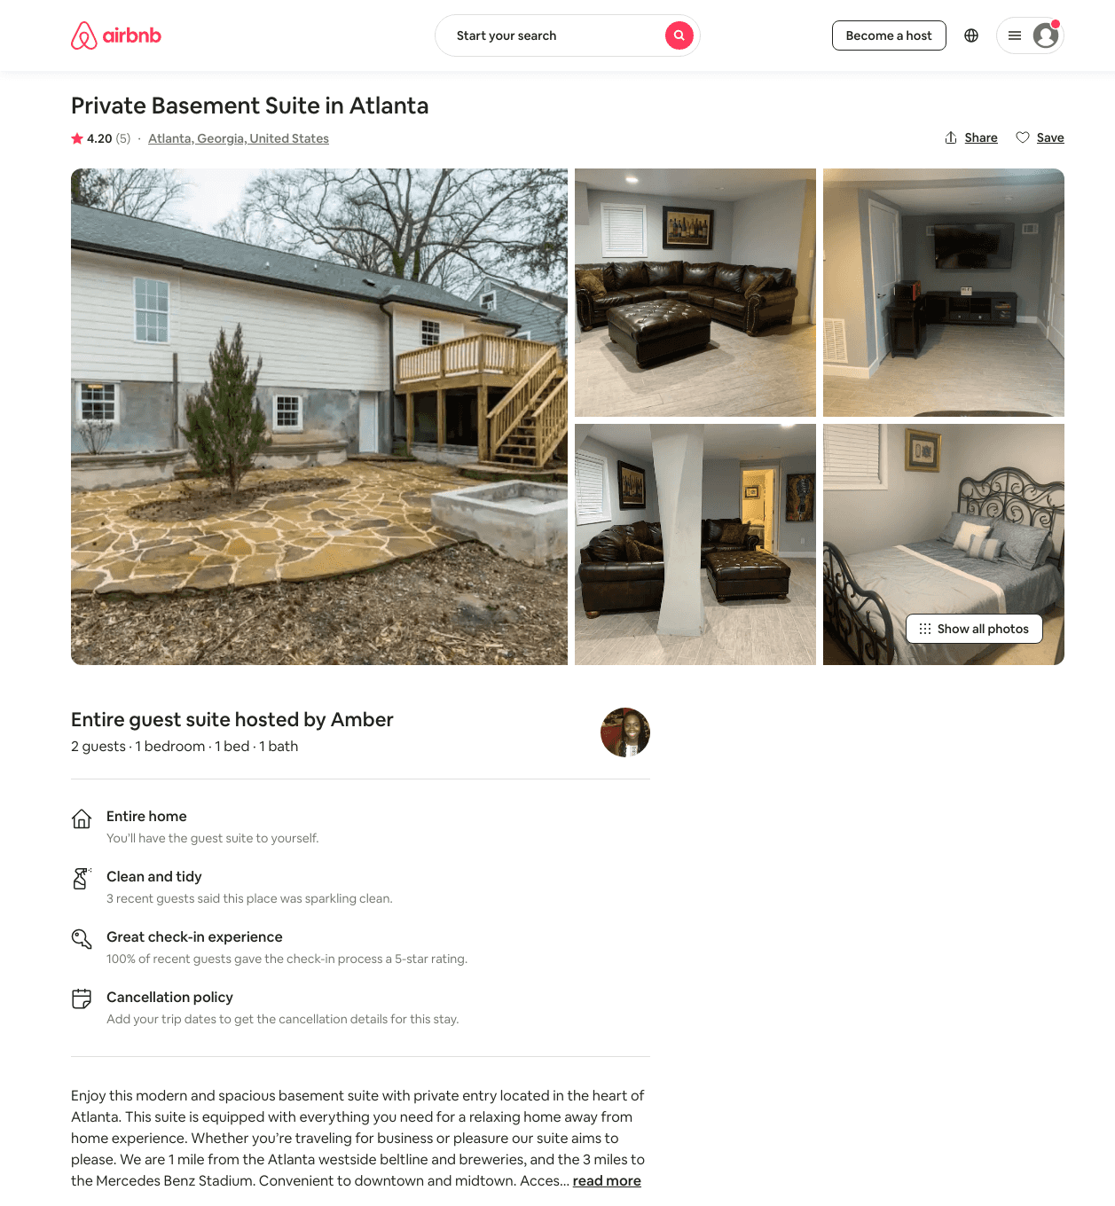
Listing 42873781
1
2
$60 - $76
4.50
2
Amber
93318162
1
https://www.airbnb.com/rooms/42873781
Aug 2022

Slide 13
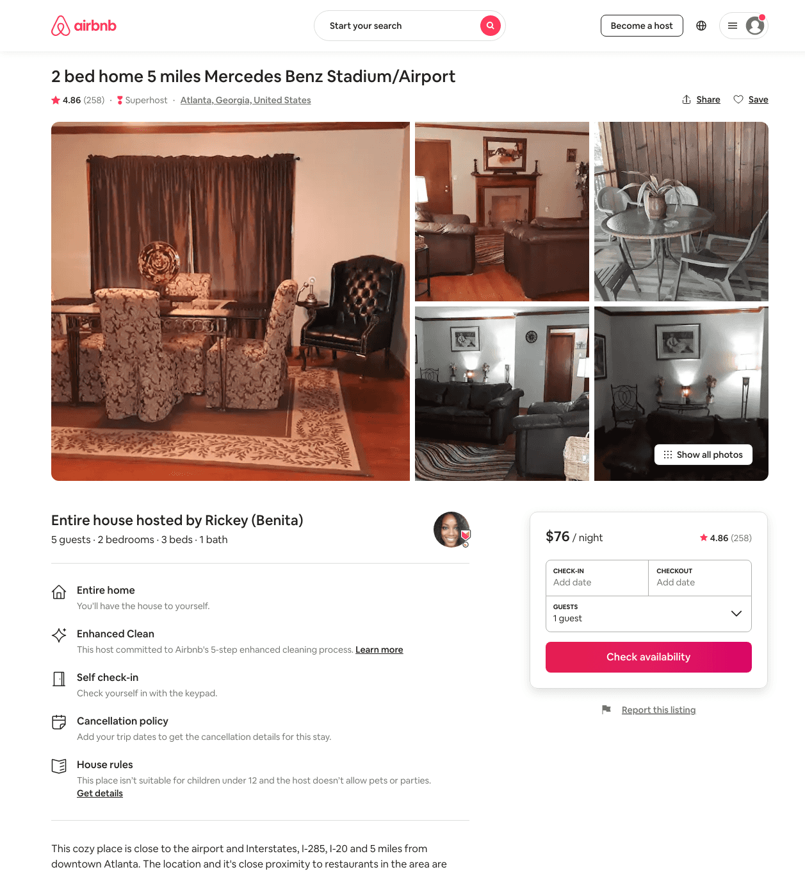
Listing 15974318
2
5
$76 - $88
4.83
1
Rickey (Benita)
20042030
1
https://www.airbnb.com/rooms/15974318
Jun 2022

Slide 14
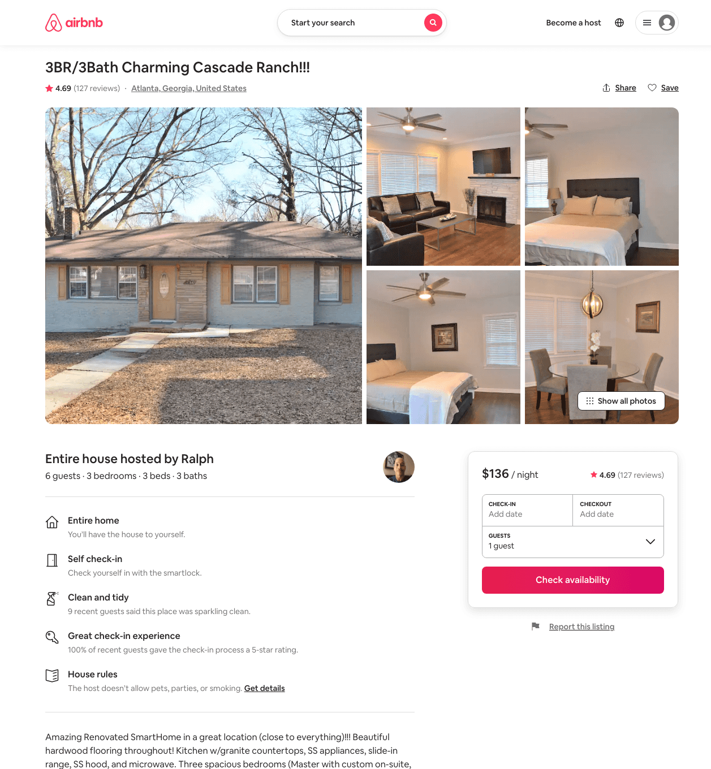
Listing 32065064
3
6
$136 - $239
4.68
2
Ralph
202311671
1
https://www.airbnb.com/rooms/32065064
Aug 2022

Slide 15
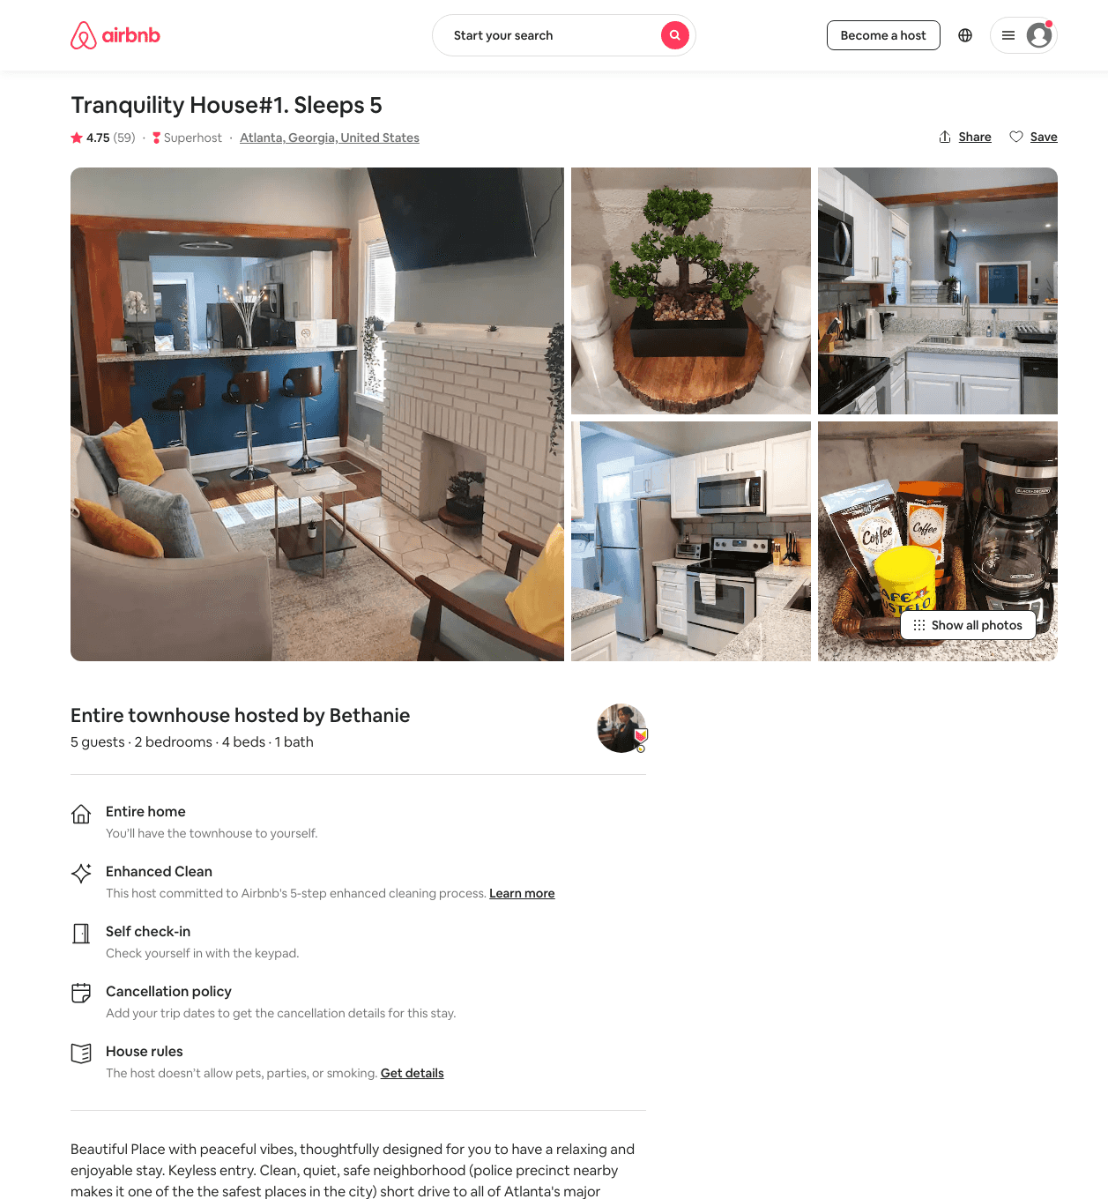
Listing 41463549
2
5
$86 - $173
4.79
2
Bethanie
87997117
6
https://www.airbnb.com/rooms/41463549
Aug 2022

Slide 16
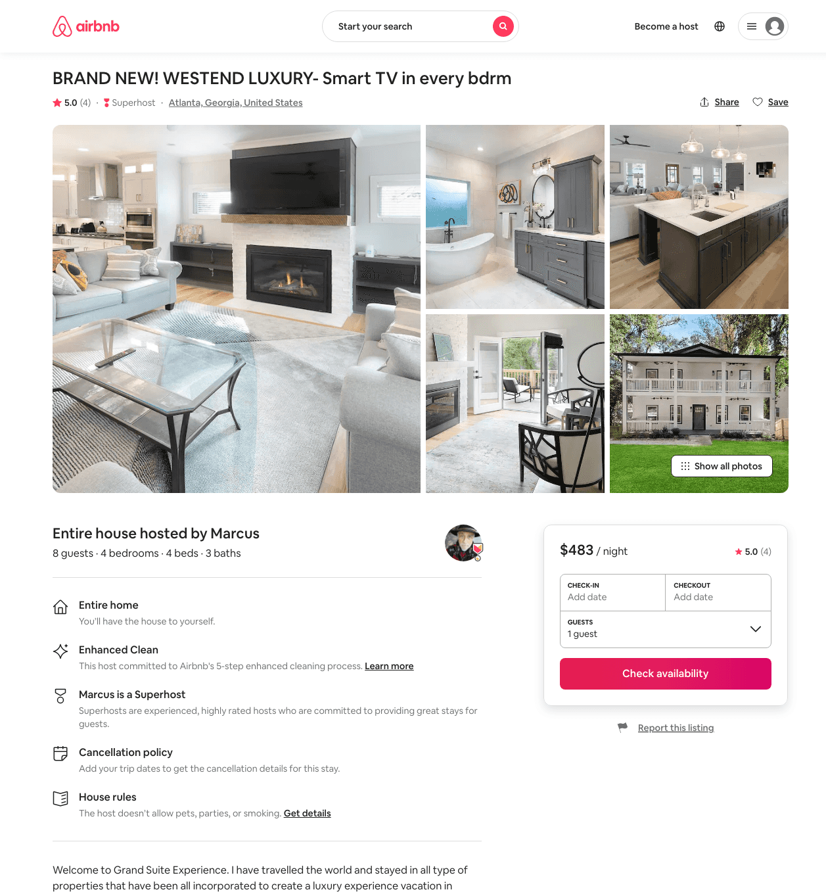
Listing 48120673
4
8
$318 - $530
4.92
2
Marcus
59148308
2
https://www.airbnb.com/rooms/48120673
Aug 2022

Slide 17
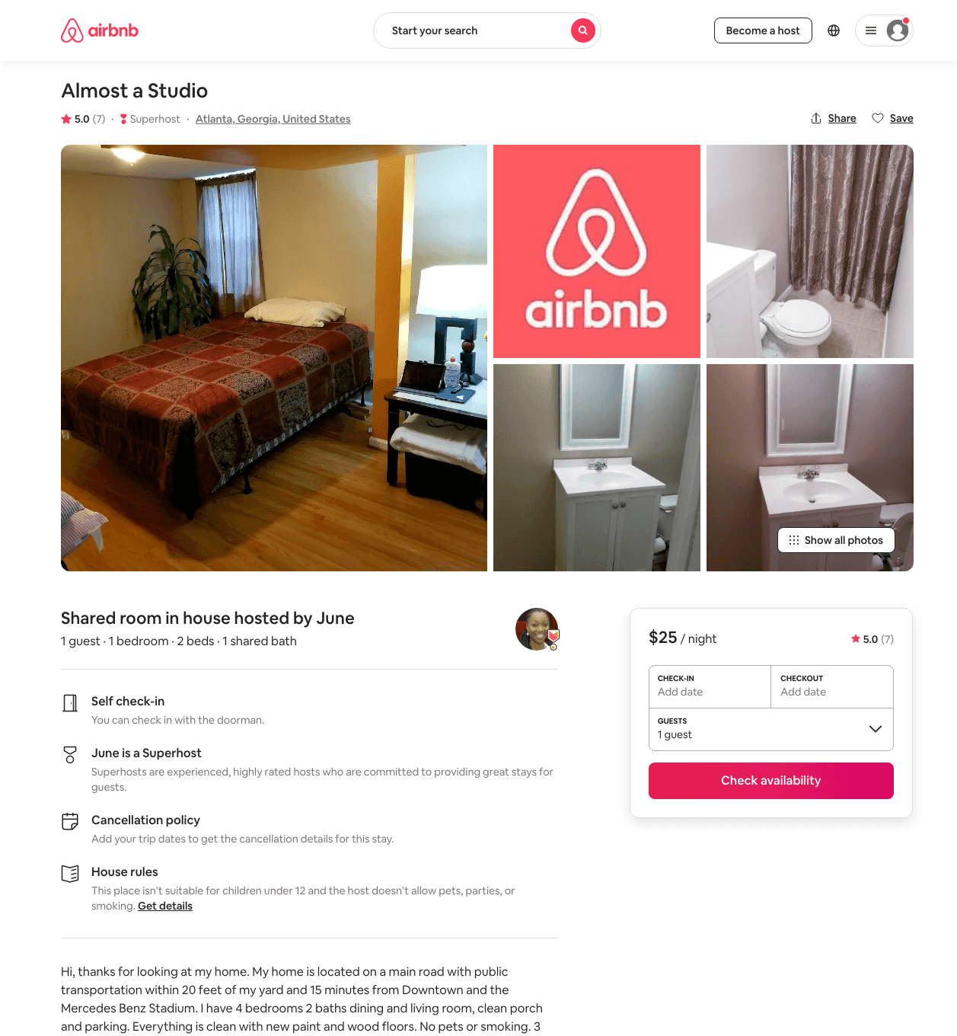
Listing 32065700
1
1
$25
5.0
1
June
240420023
1
https://www.airbnb.com/rooms/32065700
Jul 2022

Slide 18
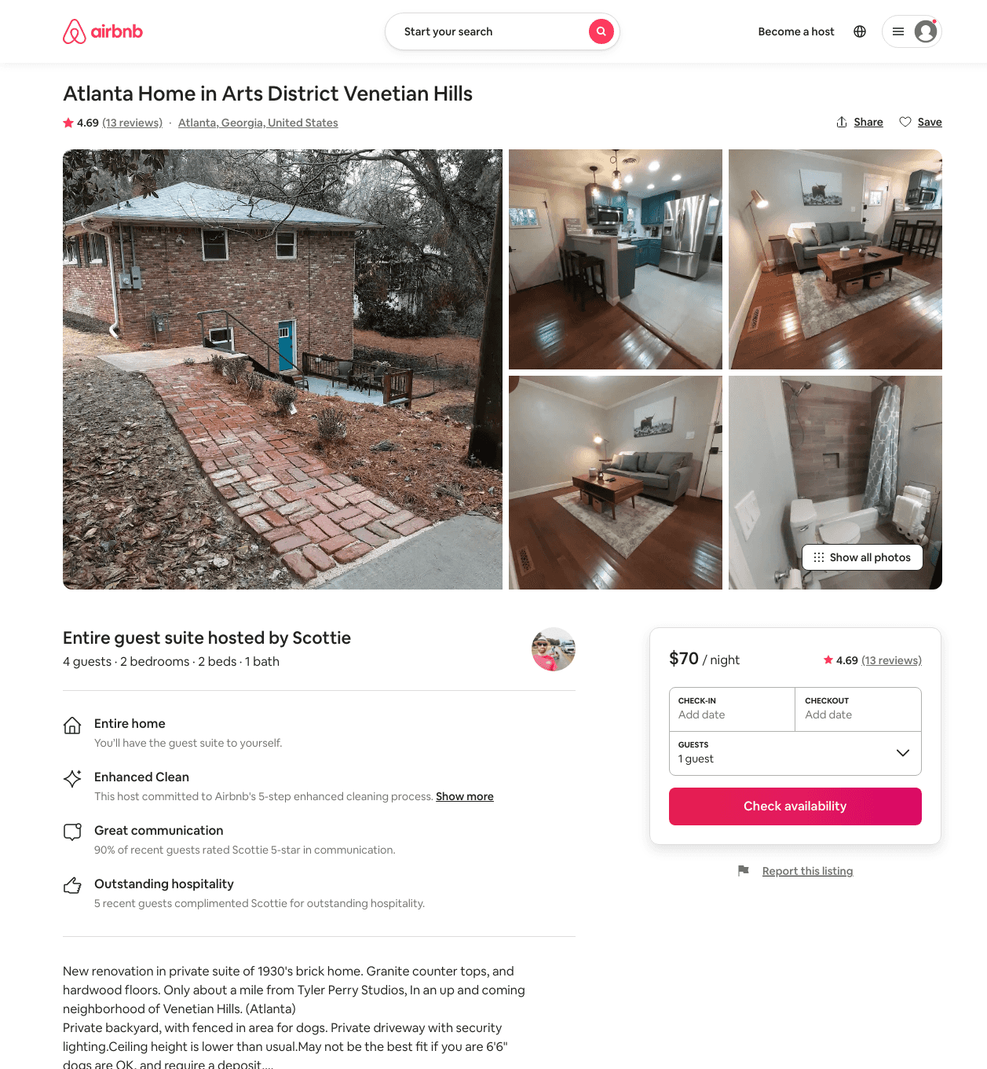
Listing 42488554
2
4
$69 - $99
4.78
2
Scottie
62335681
2
https://www.airbnb.com/rooms/42488554
Aug 2022

Slide 19
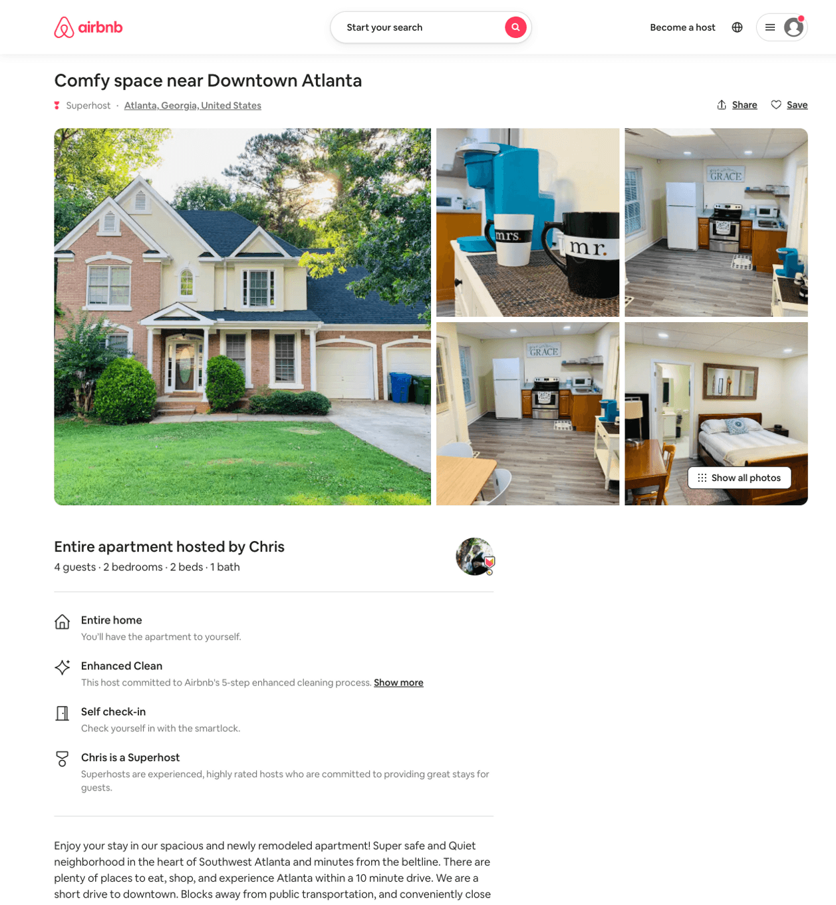
Listing 50269907
2
4
$96
5.0
2
Chris
162585227
3
https://www.airbnb.com/rooms/50269907
Aug 2022

Slide 20
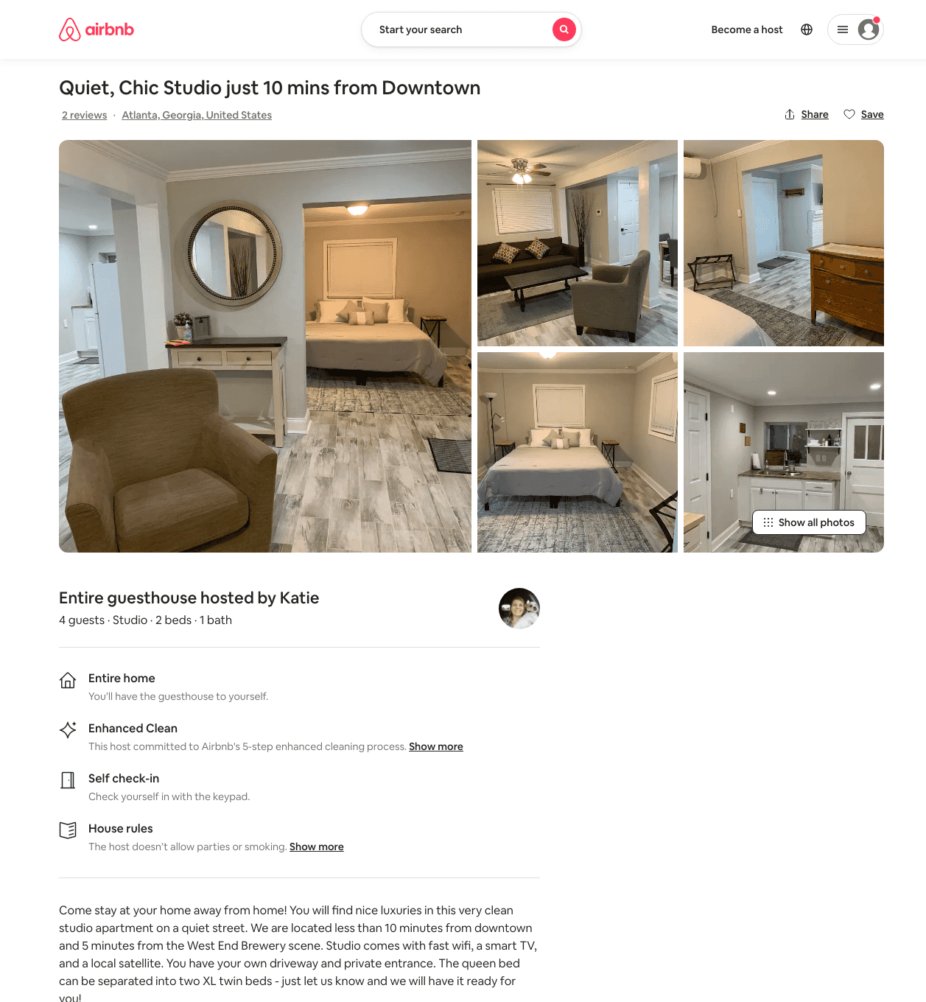
Listing 49692624
Studio
4
$79 - $110
4.88
1
Katie
52372271
1
https://www.airbnb.com/rooms/49692624
Aug 2022

Slide 21
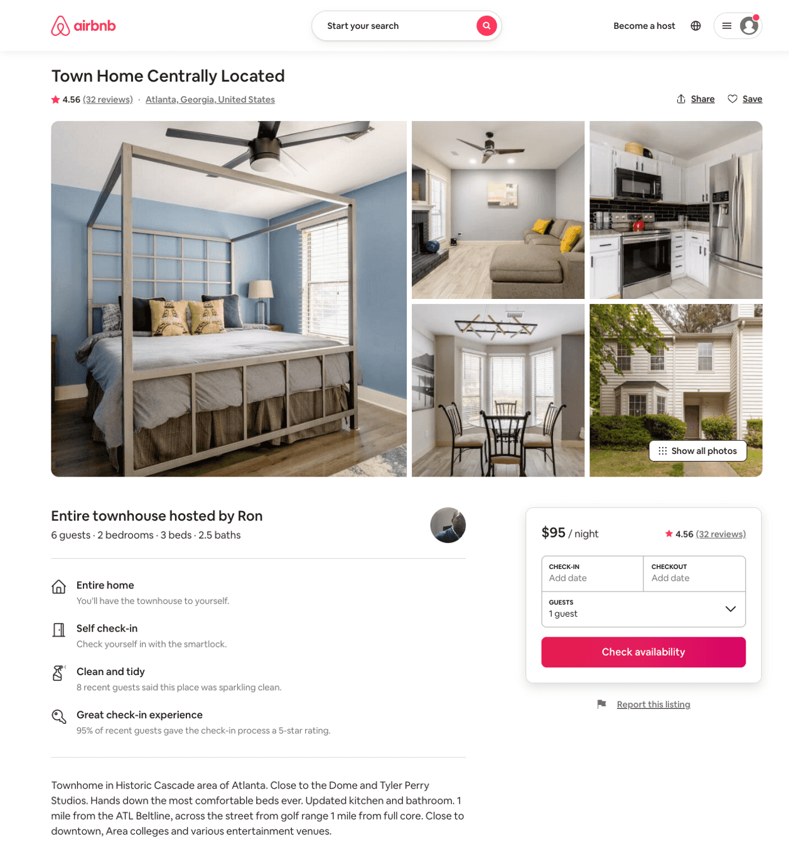
Listing 31764555
2
6
$88 - $141
4.54
7
Ron
42583896
2
https://www.airbnb.com/rooms/31764555
Aug 2022

Slide 22
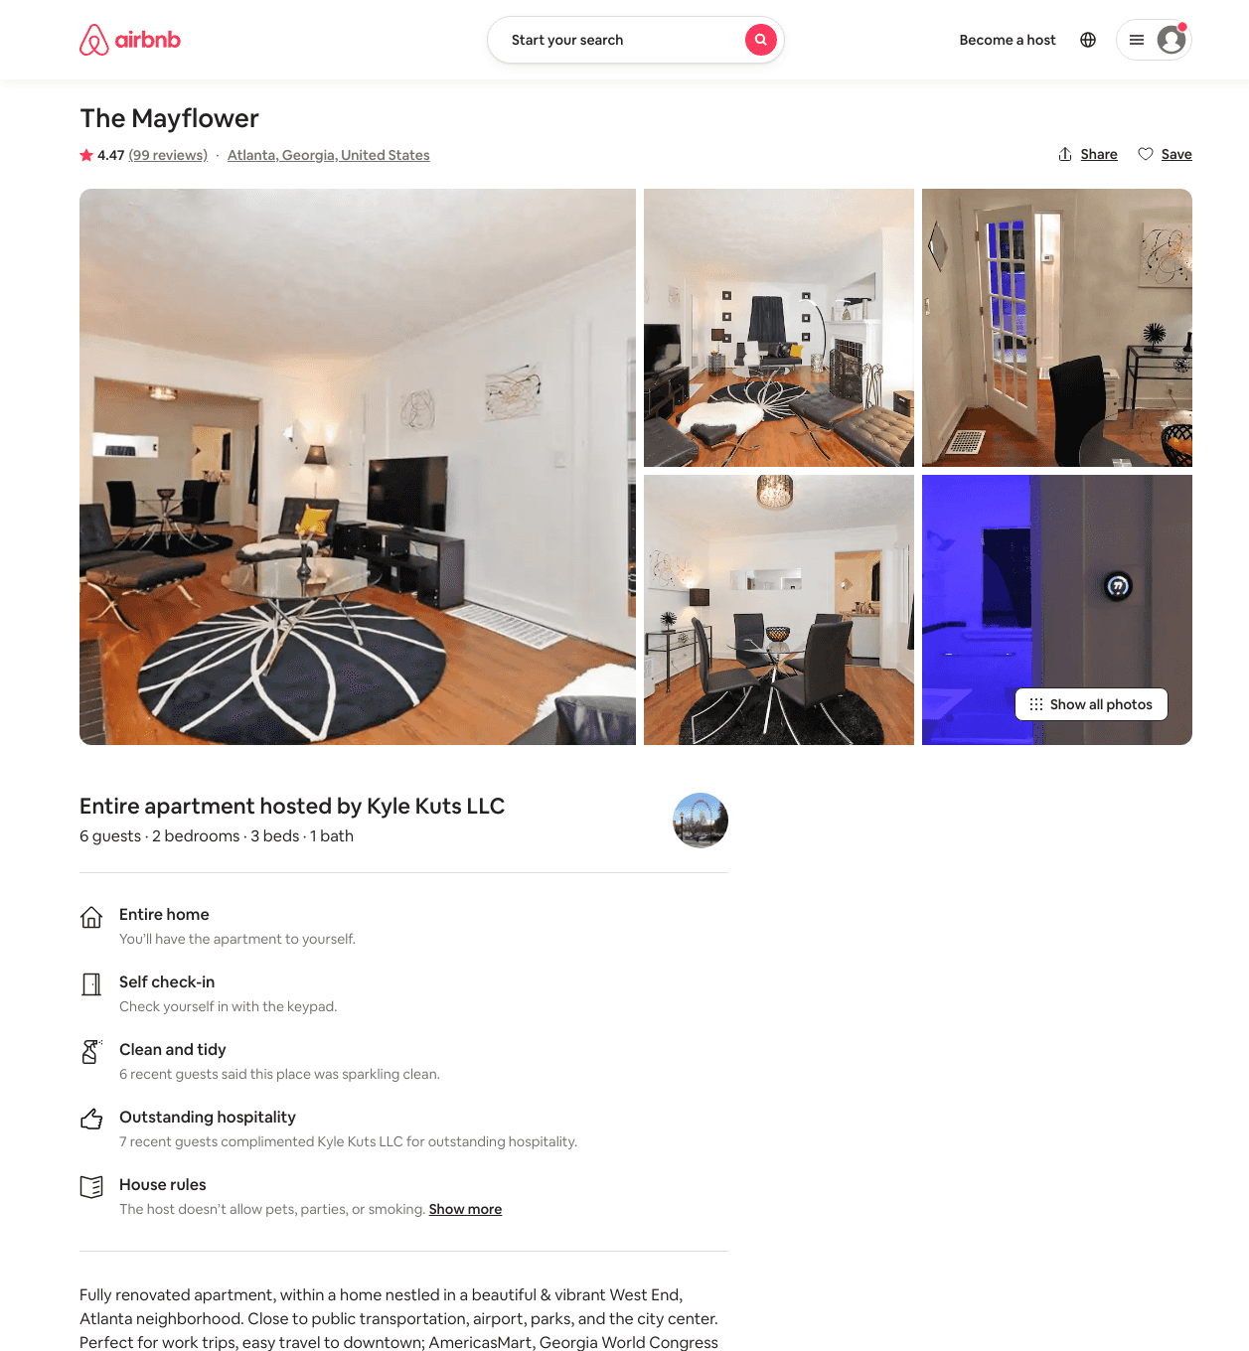
Listing 9730014
2
6
$213 - $2000
4.45
1
Kyle Kuts LLC
44838428
1
https://www.airbnb.com/rooms/9730014
Aug 2022

Slide 23
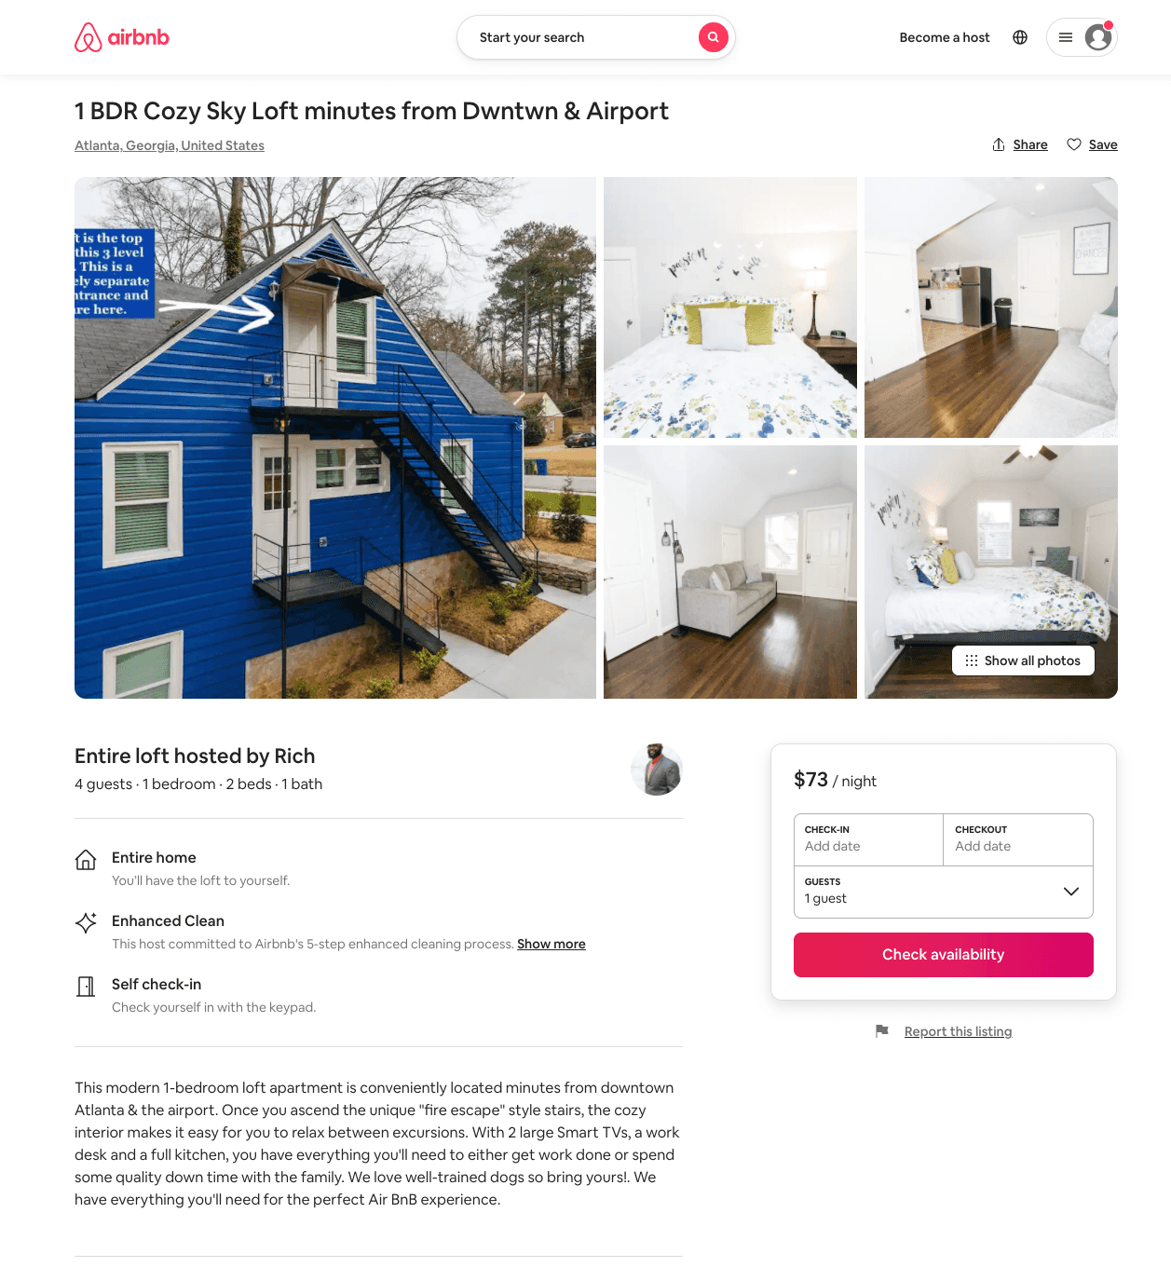
Listing 51153254
1
4
$59 - $98
4.90
4
Rich
14205050
2
https://www.airbnb.com/rooms/51153254
Aug 2022

Slide 24
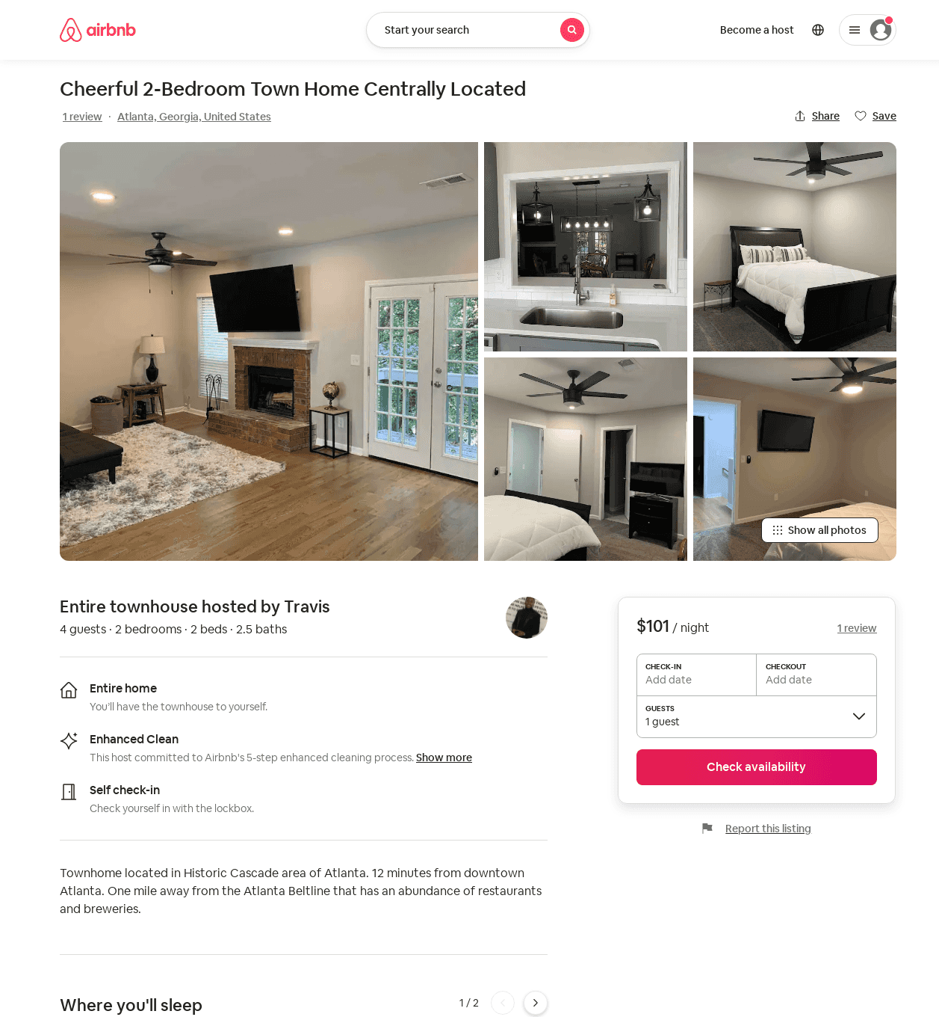
Listing 51980222
2
4
$85 - $132
4.88
3
Travis
4911337
1
https://www.airbnb.com/rooms/51980222
Jun 2022

Slide 25
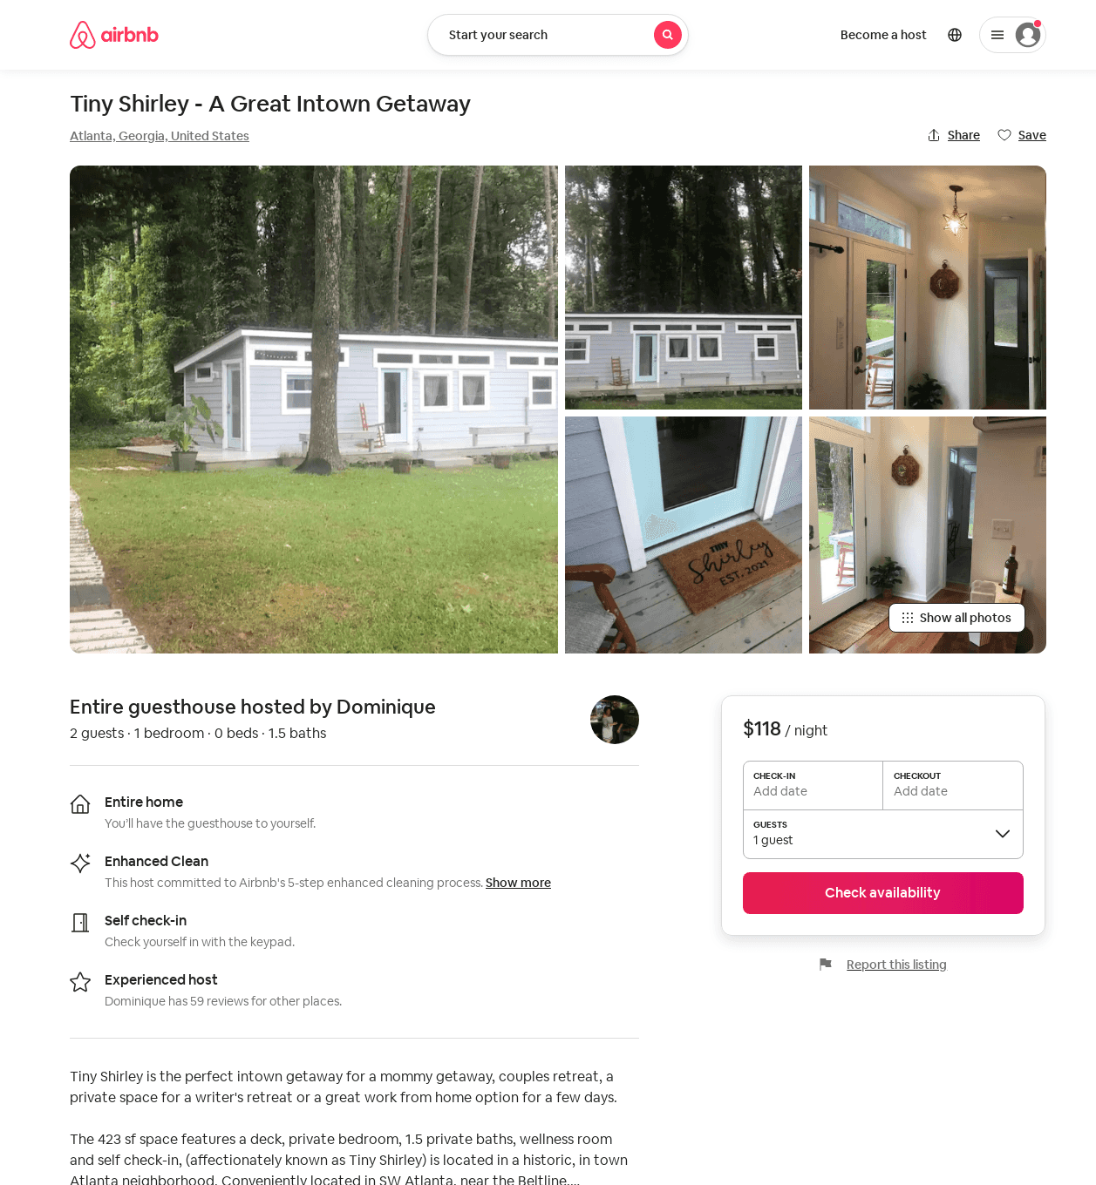
Listing 51838990
1
2
$118
5.0
1
Dominique
9328288
1
https://www.airbnb.com/rooms/51838990
Aug 2022

Slide 26
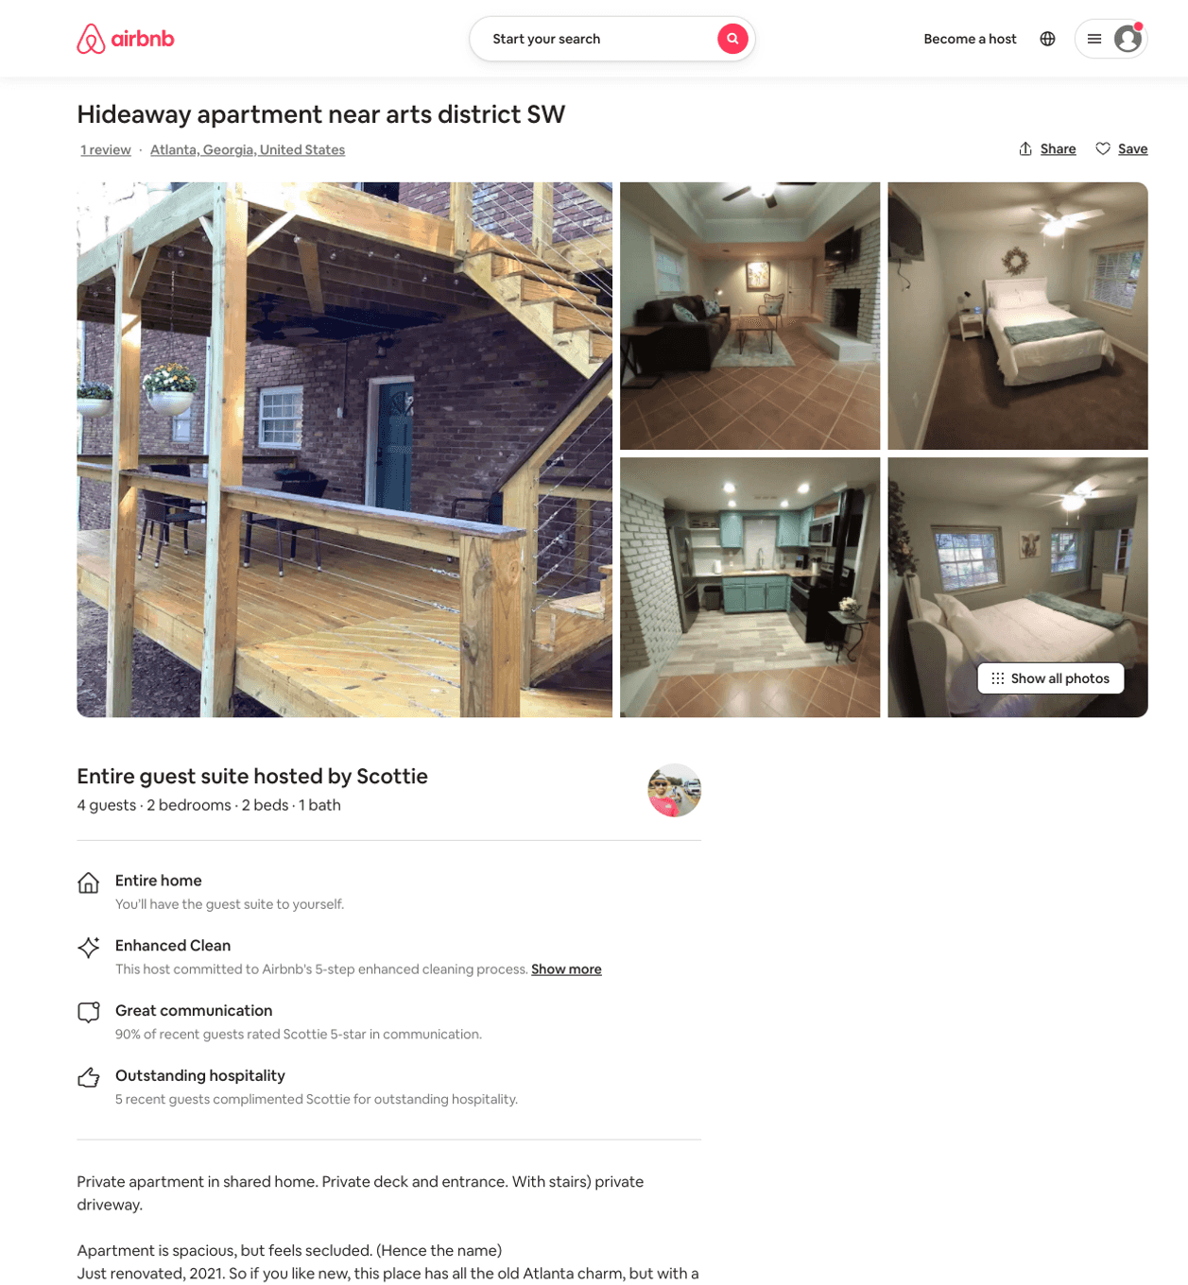
Listing 48529002
2
4
$79 - $91
4.79
2
Scottie
62335681
2
https://www.airbnb.com/rooms/48529002
Aug 2022

Slide 27
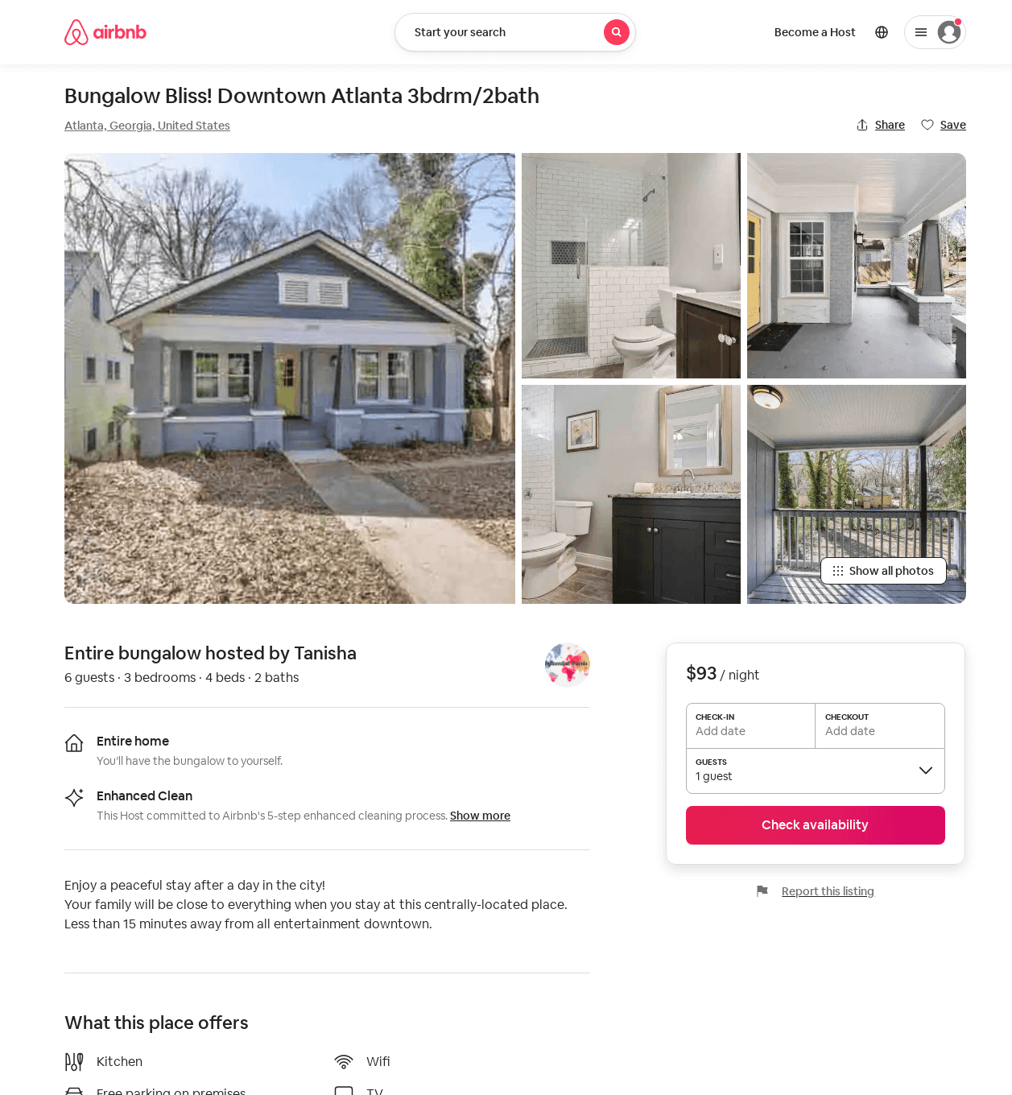
Listing 52829905
3
6
$93 - $170
4.78
2
Influential
393079813
1
https://www.airbnb.com/rooms/52829905
Jun 2022

Slide 28
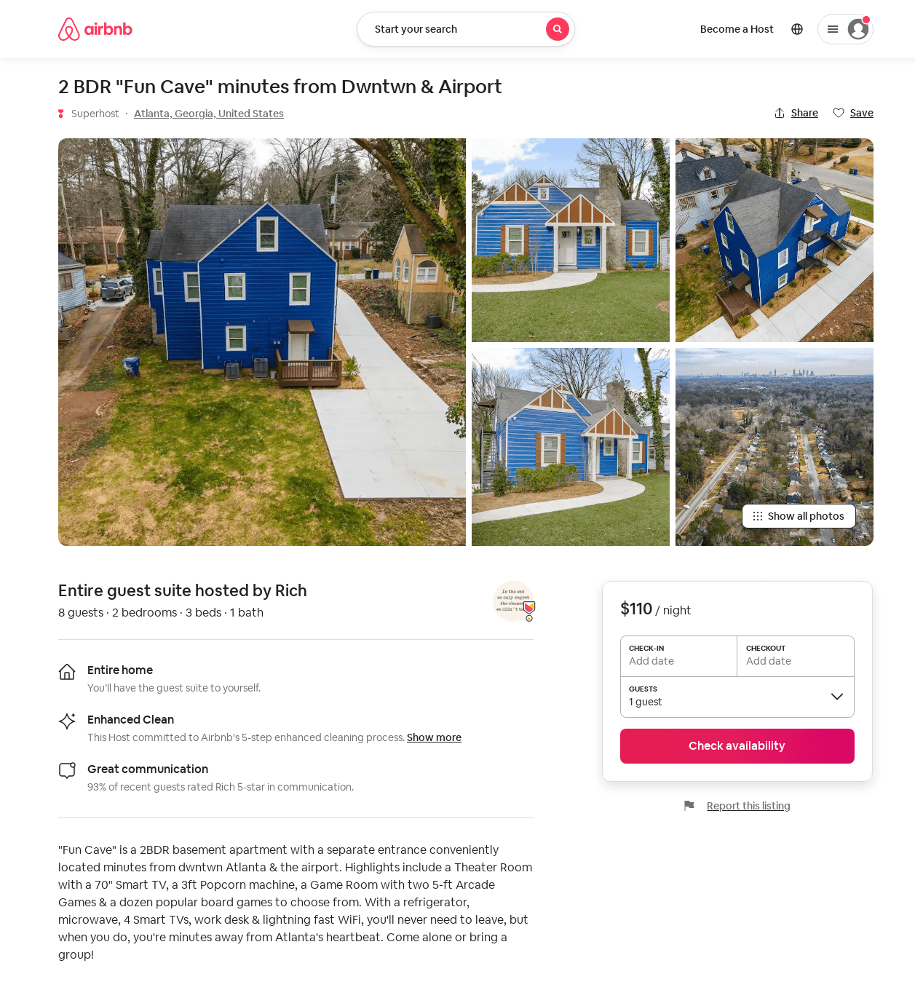
Listing 53074103
2
4
$59 - $110
4.88
4
Rich
14205050
2
https://www.airbnb.com/rooms/53074103
Aug 2022

Slide 29
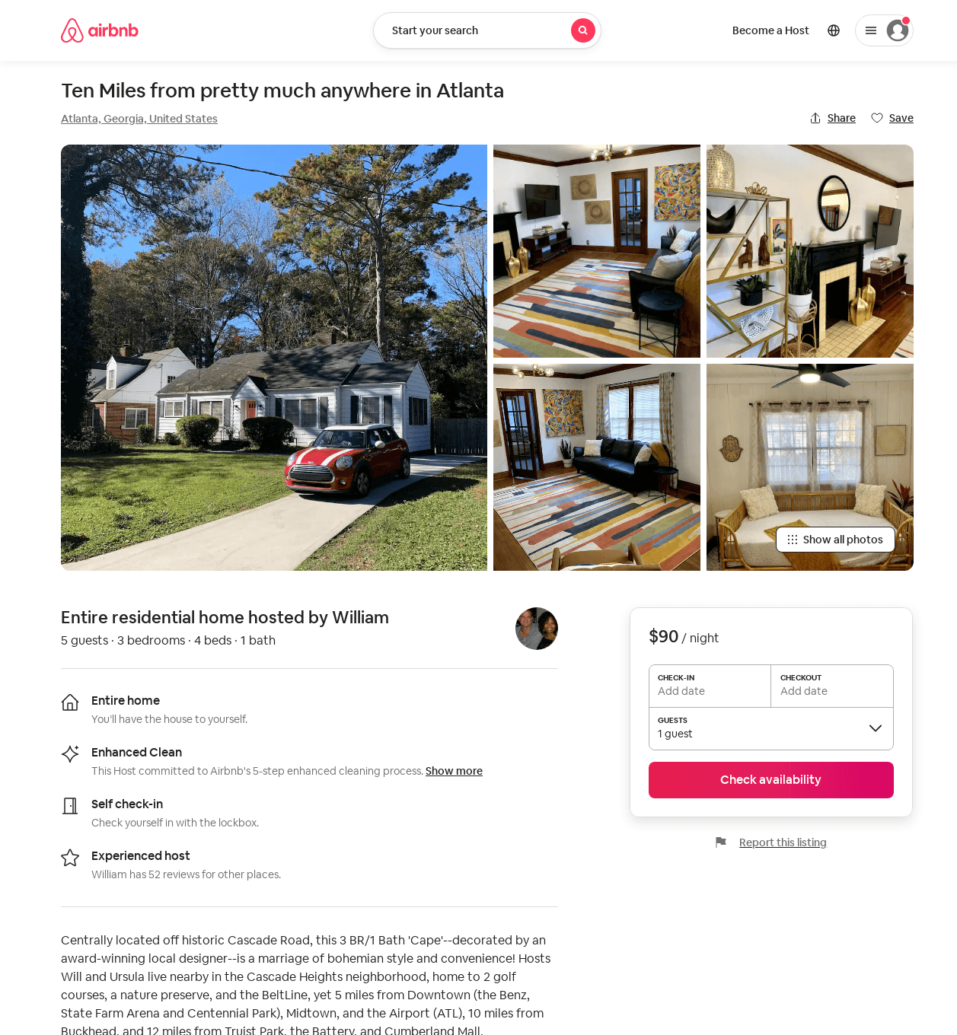
Listing 53435772
3
5
$90 - $105
4.89
1
William
20401585
1
https://www.airbnb.com/rooms/53435772
Aug 2022

Slide 30
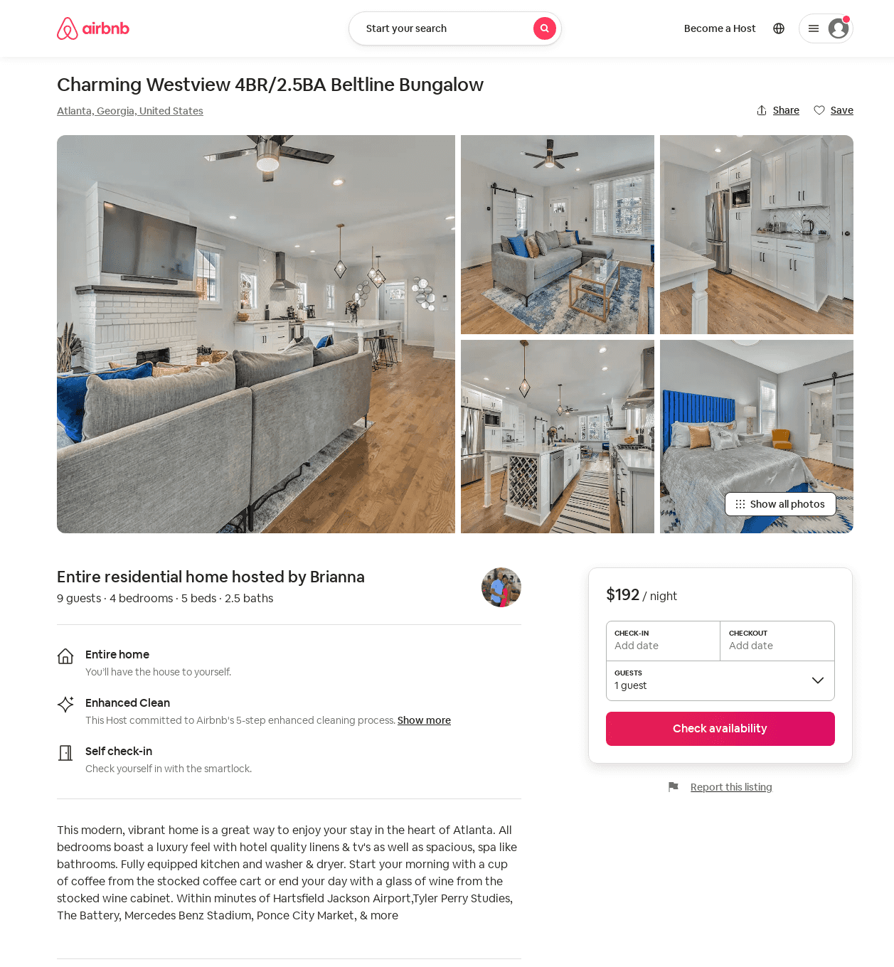
Listing 53891604
4
10
$124 - $325
4.91
3
Brianna
436539742
1
https://www.airbnb.com/rooms/53891604
Aug 2022

Slide 31
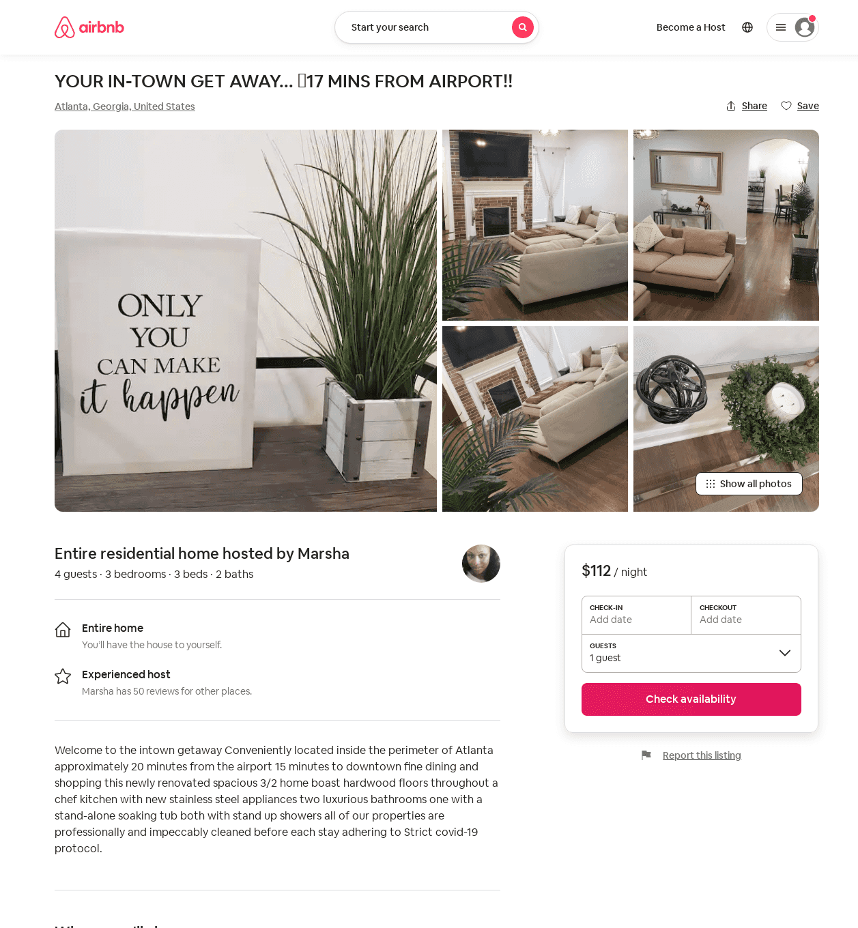
Listing 53924425
3
6
$107 - $140
4.81
3
Marsha
122195392
1
https://www.airbnb.com/rooms/53924425
Aug 2022

Slide 32
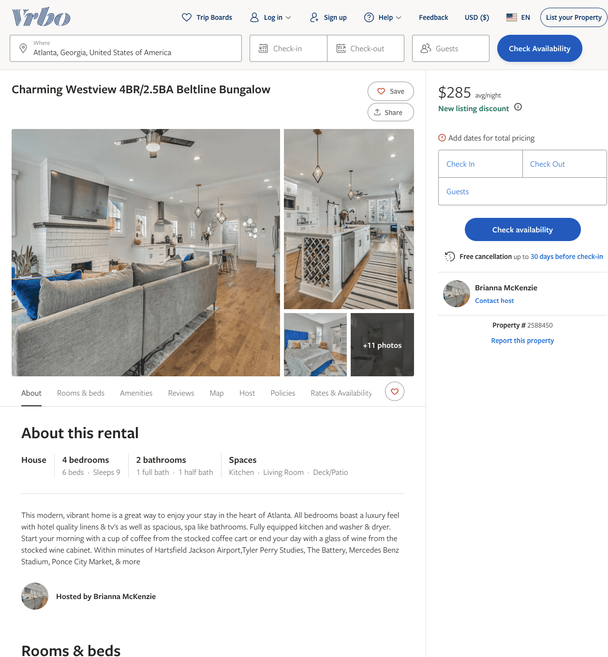
Listing 2588450
4
9
$235 - $285
5
3
Brianna McKenzie
https://www.vrbo.com/2588450
Aug 2022

Slide 33
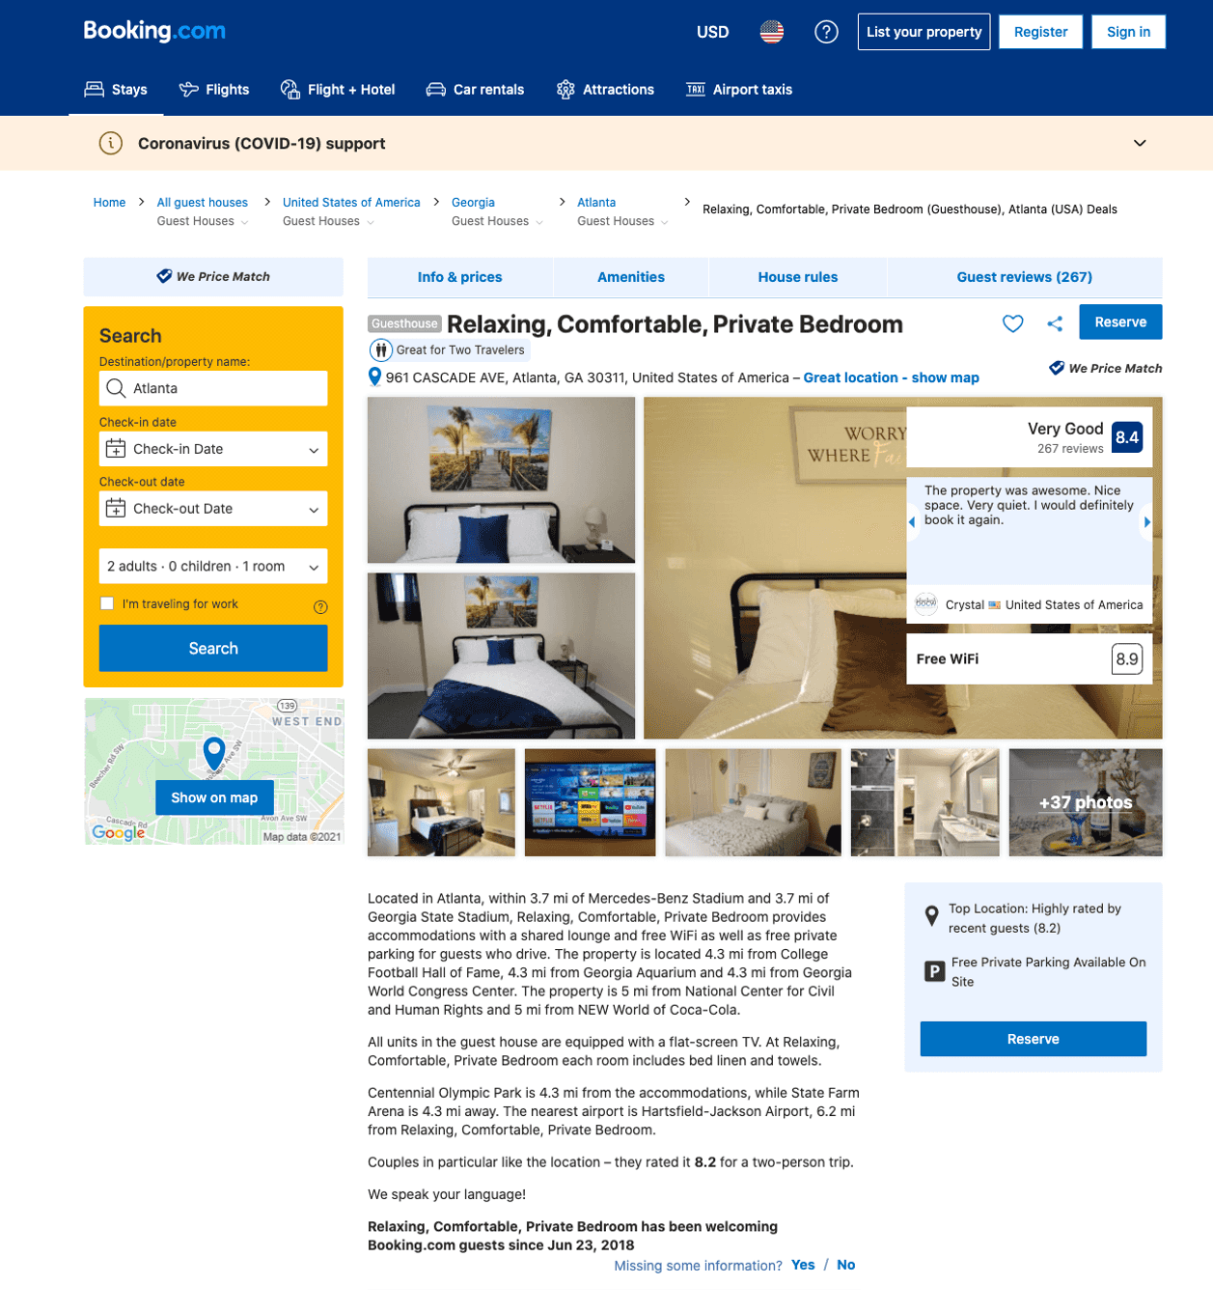
Listing relaxing-comfortable-private-bedroom
961 CASCADE AVE SW
undefined
1
8.5
https://www.booking.com/hotel/us/relaxing-comfortable-private-bedroom.html
Sep 2022

Slide 34
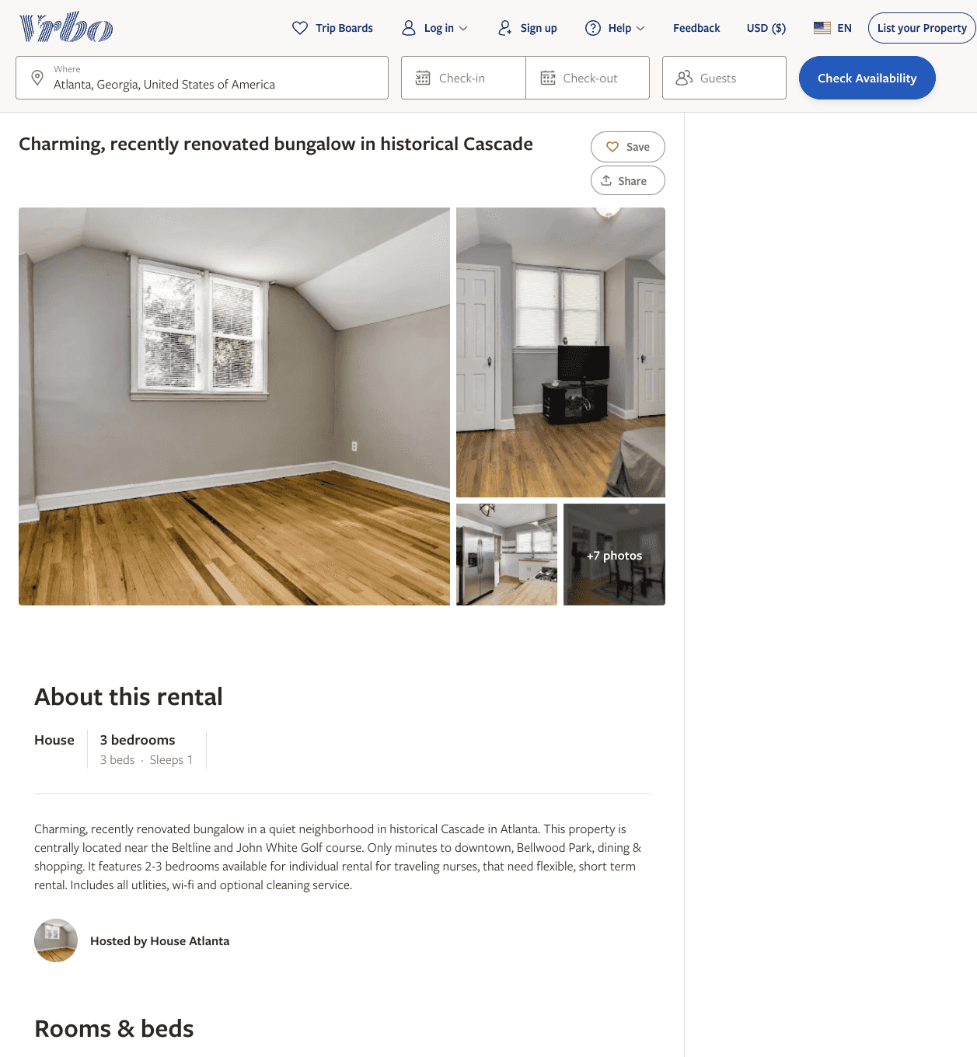
Listing 2599697
3
1
$45
30
Carmen Trimble
https://www.vrbo.com/2599697
Aug 2022

Slide 35
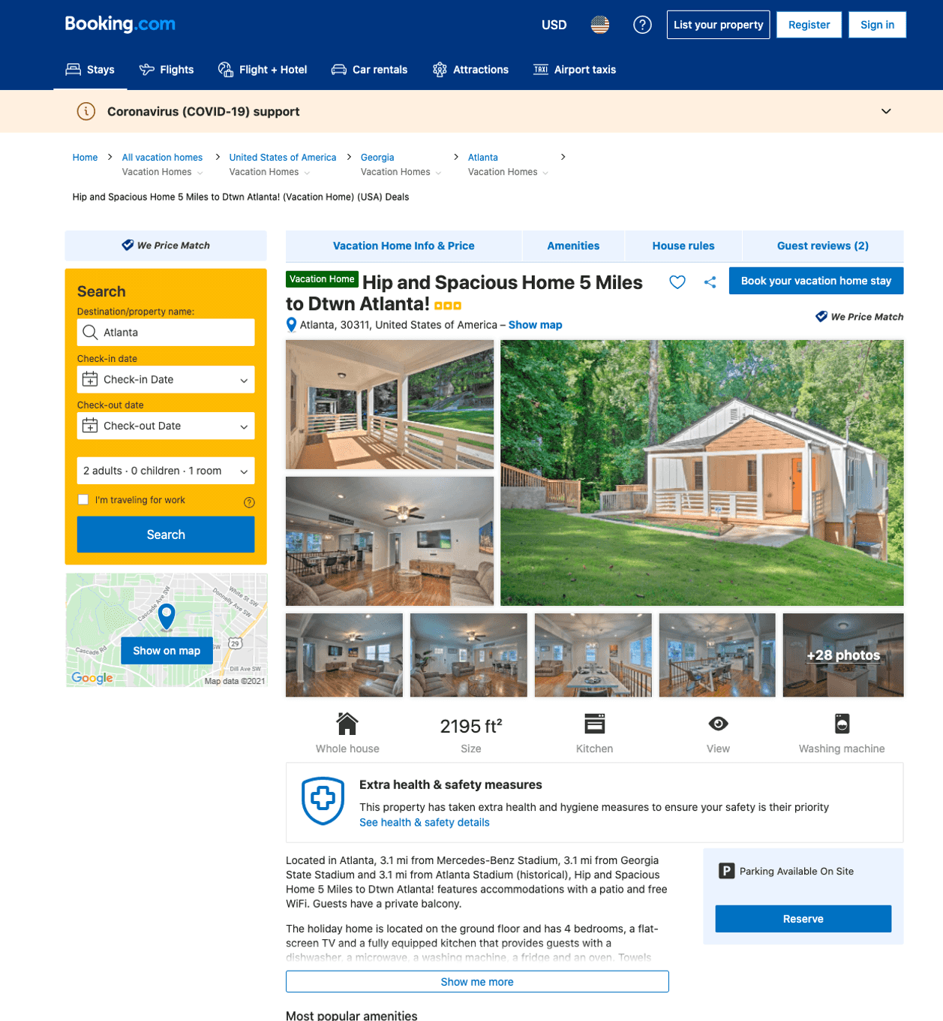
Listing hip-and-spacious-home-5-miles-to-dtwn-atlanta
undefined
8
9.7
https://www.booking.com/hotel/us/hip-and-spacious-home-5-miles-to-dtwn-atlanta.html
Sep 2022

Slide 36
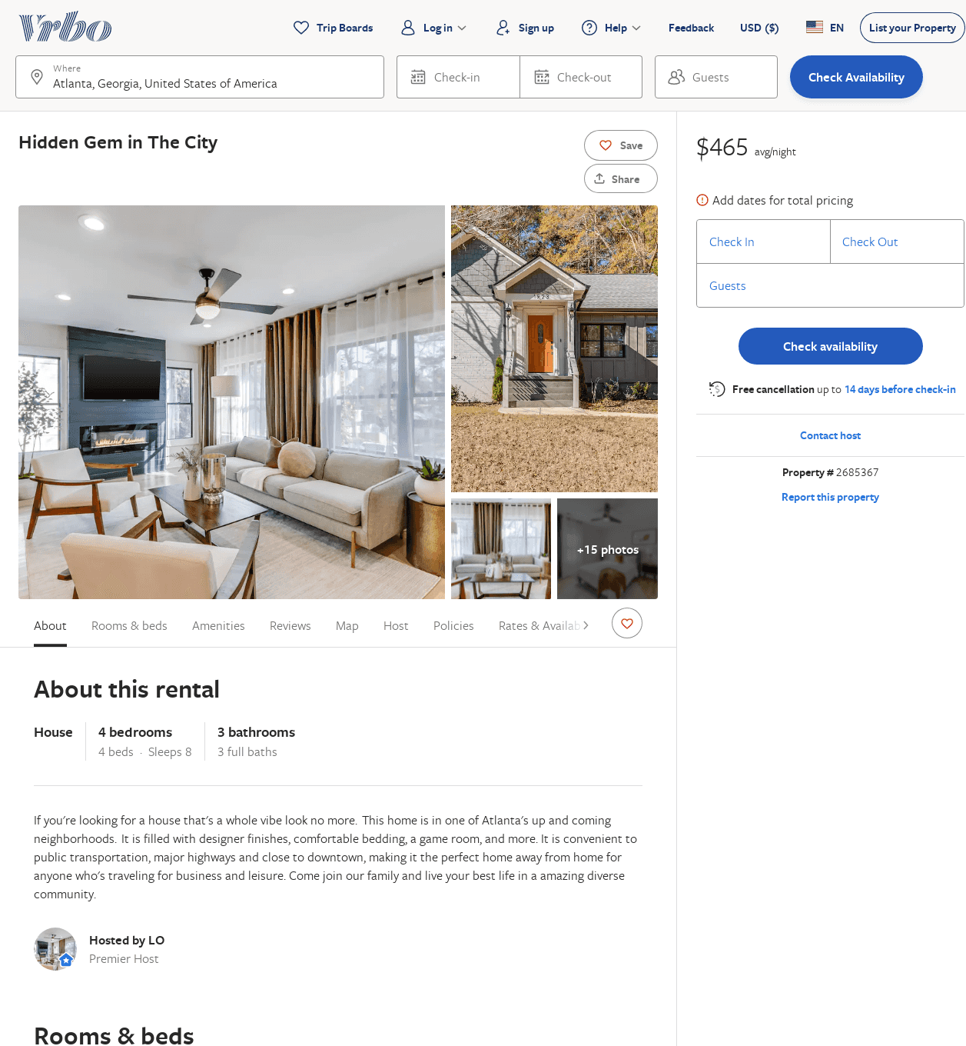
Listing 2685367
4
8
$386
5
2
LO
https://www.vrbo.com/2685367
Aug 2022

Slide 37
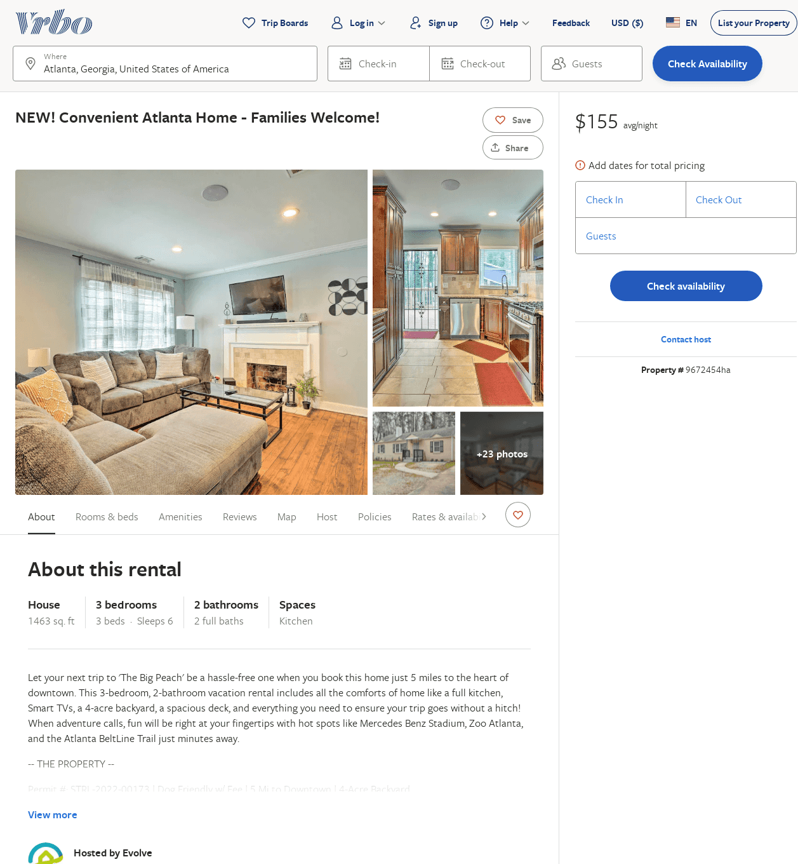
Listing 9672454
3
6
$112
4
2
Evolve
https://www.vrbo.com/9672454ha
Aug 2022

Slide 38
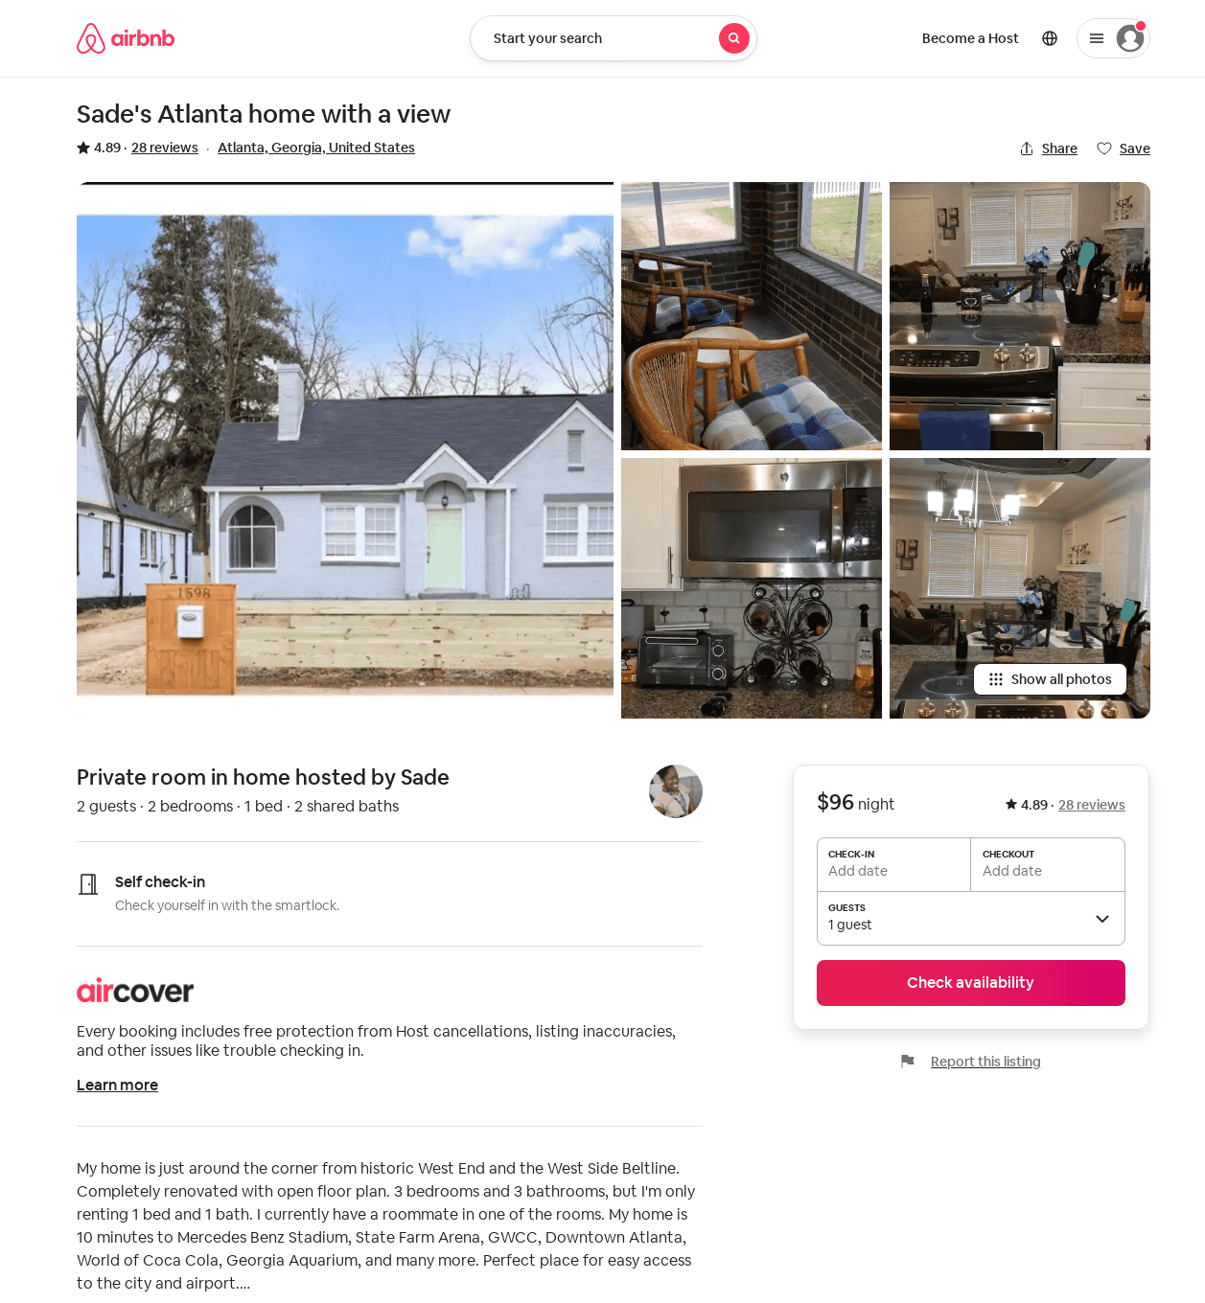
Listing 30442181
2
2
$96
4.89
1
Sade
82376233
1
https://www.airbnb.com/rooms/30442181
Jun 2022

