Slide 2
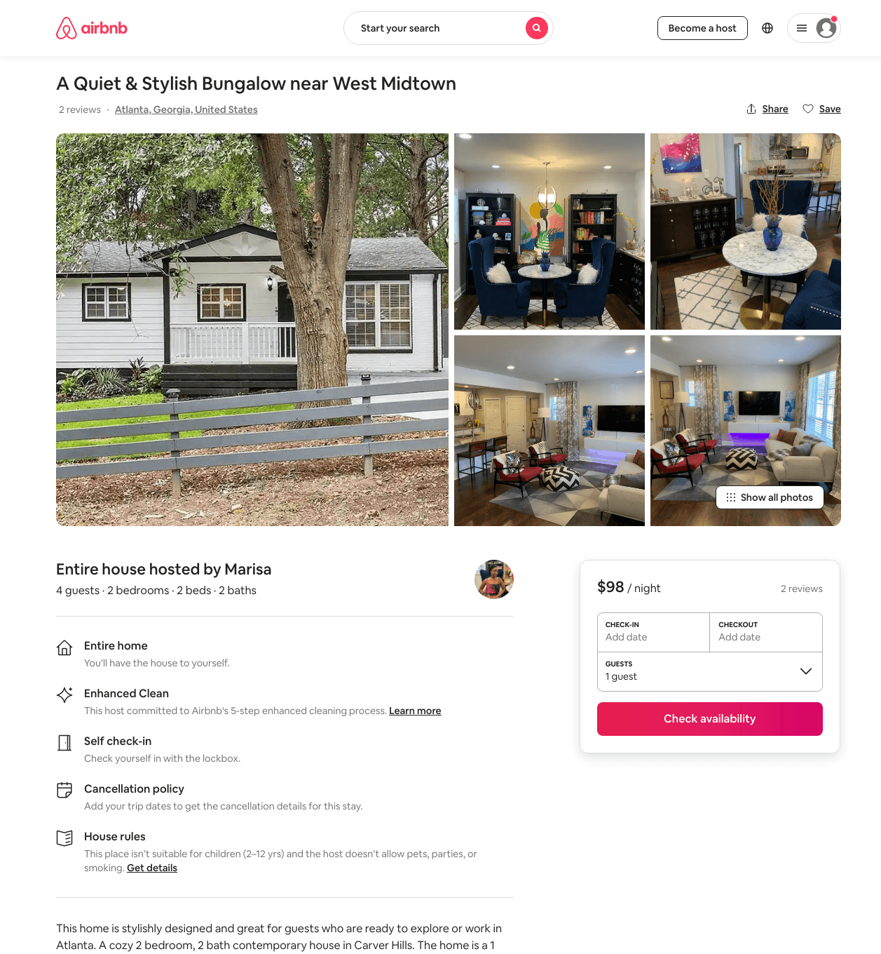
Listing 47748554
2
4
$76 - $98
4.72
2
Marisa
88027055
1
https://www.airbnb.com/rooms/47748554
Aug 2022

Slide 3
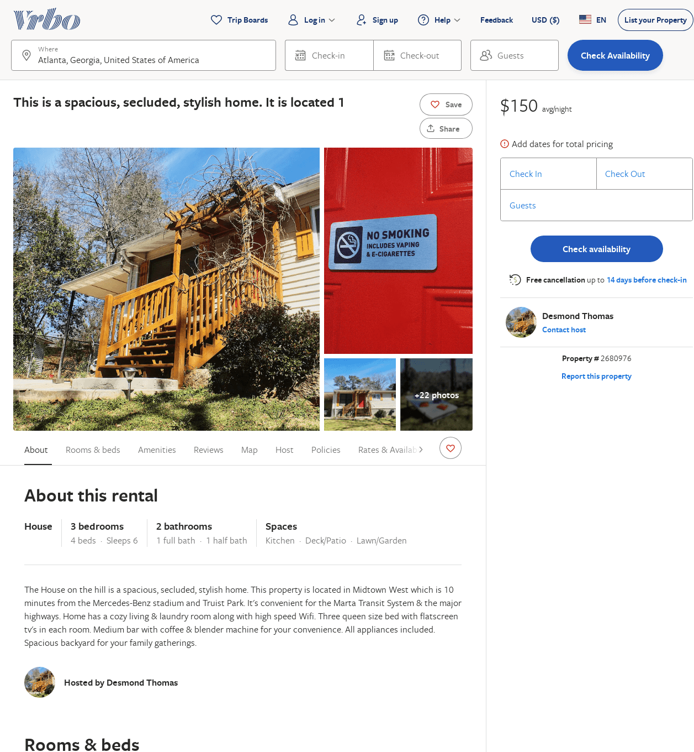
Listing 2680976
3
6
$136
2
Desmond Thomas
https://www.vrbo.com/2680976
Aug 2022

