Slide 2
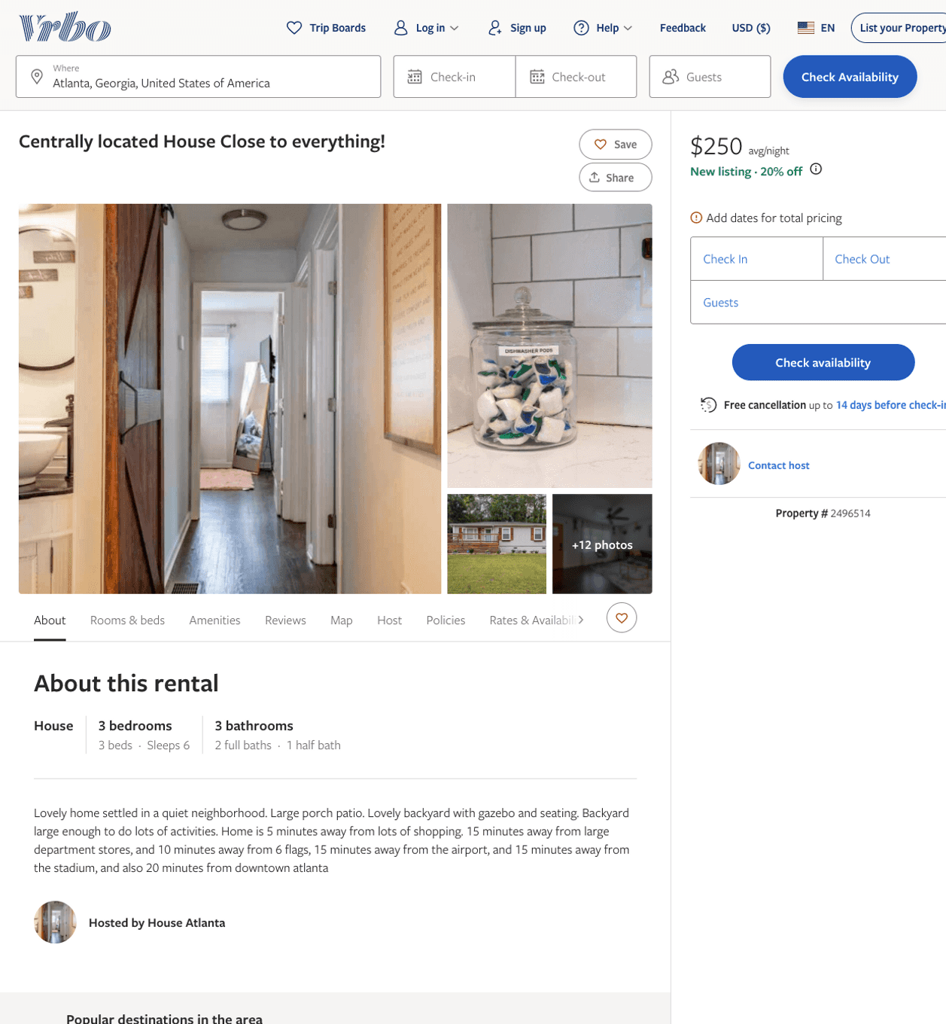
Listing 2496514
3
6
$191 - $250
5
2
Erica Sanford
https://www.vrbo.com/2496514
Aug 2022

Slide 3
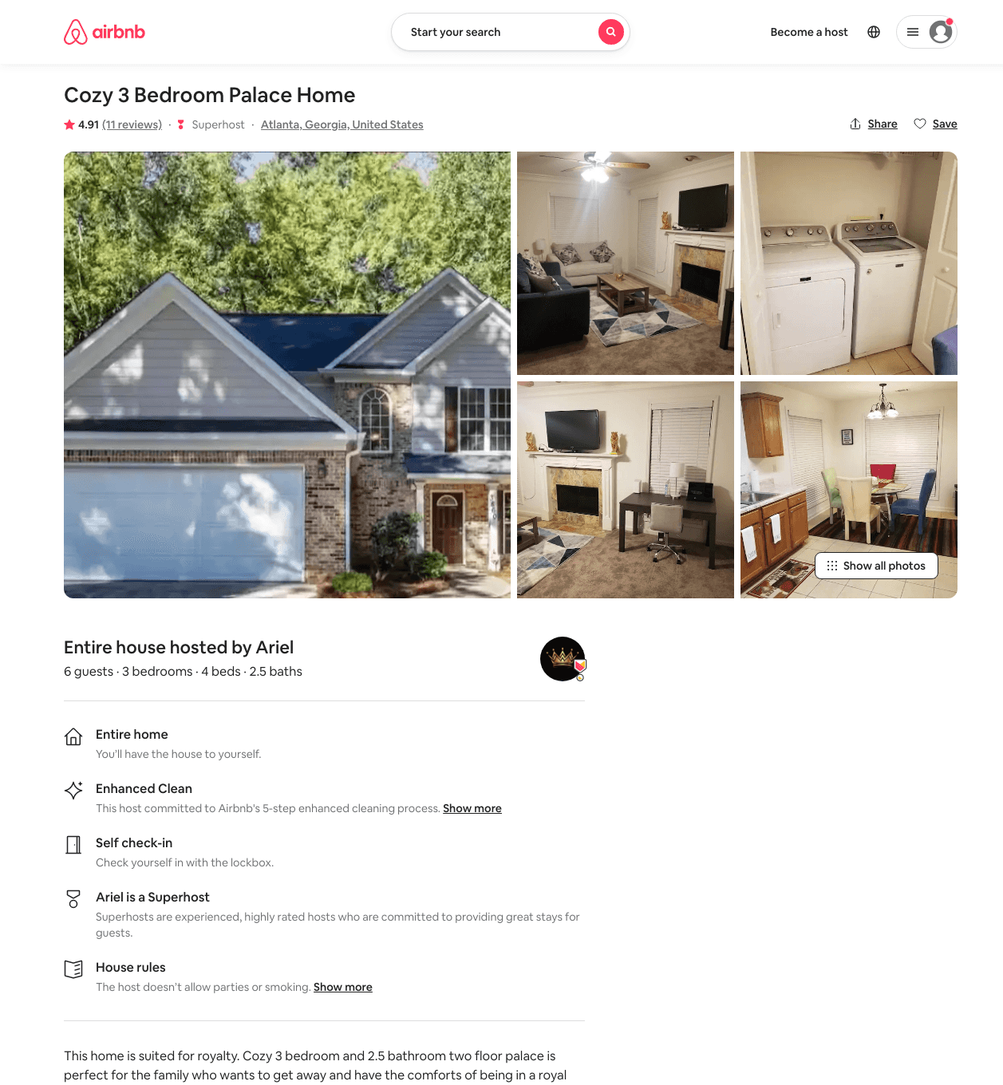
Listing 46755846
3
6
$165 - $175
4.79
2
Ariel
377860605
1
https://www.airbnb.com/rooms/46755846
Aug 2022

Slide 4
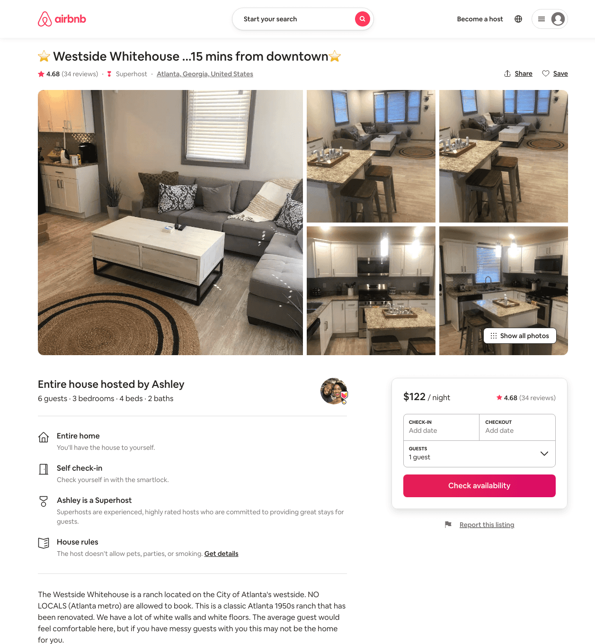
Listing 42217347
3
6
$91 - $196
4.76
2
Ashley
120155801
3
https://www.airbnb.com/rooms/42217347
Aug 2022

Slide 5
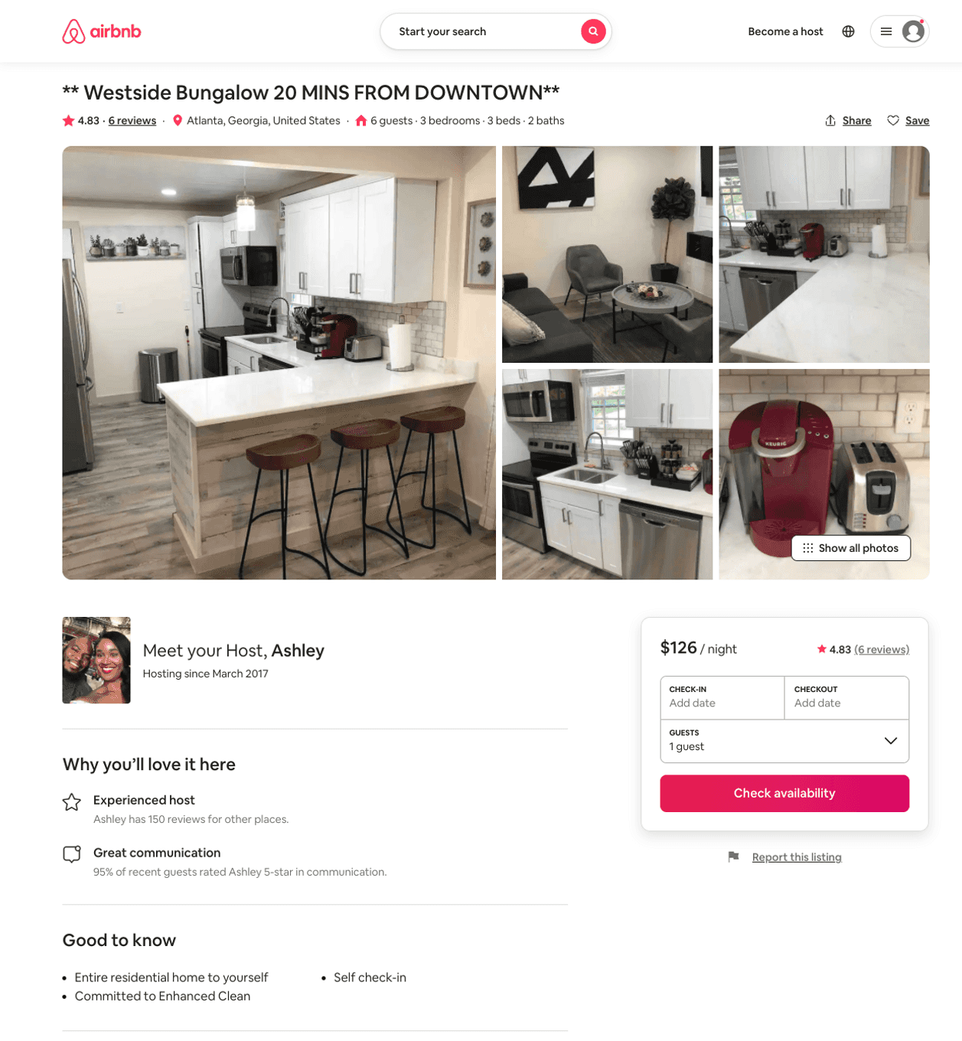
Listing 51122514
3
6
$100 - $190
4.86
2
Ashley
120155801
3
https://www.airbnb.com/rooms/51122514
Aug 2022

Slide 6
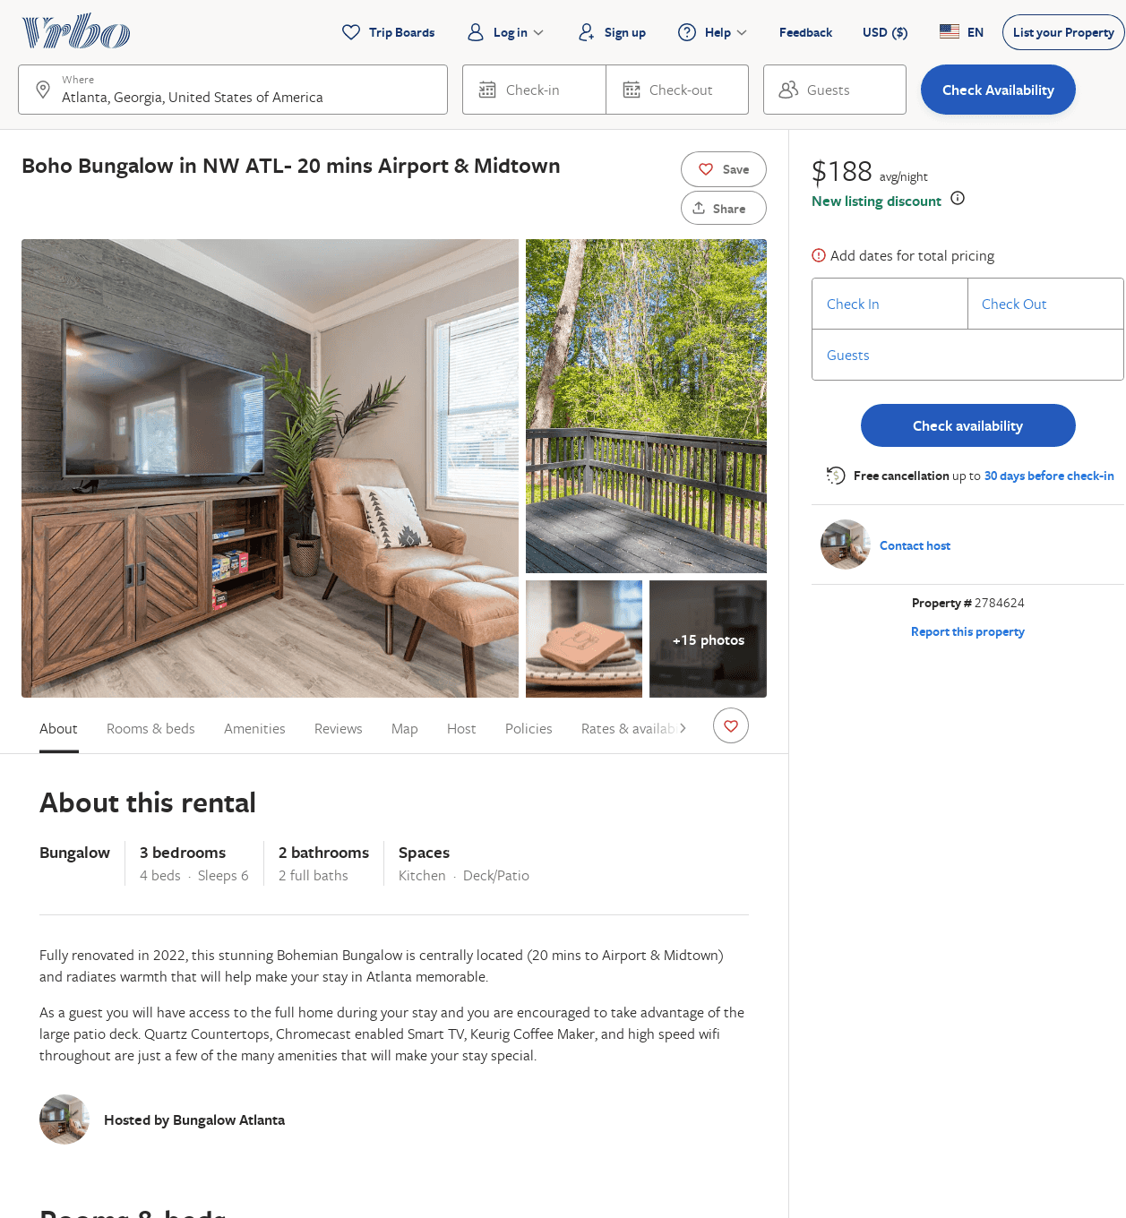
Listing 2784624
3
6
$122
5
1
Niyi
https://www.vrbo.com/2784624
Aug 2022

