Slide 2
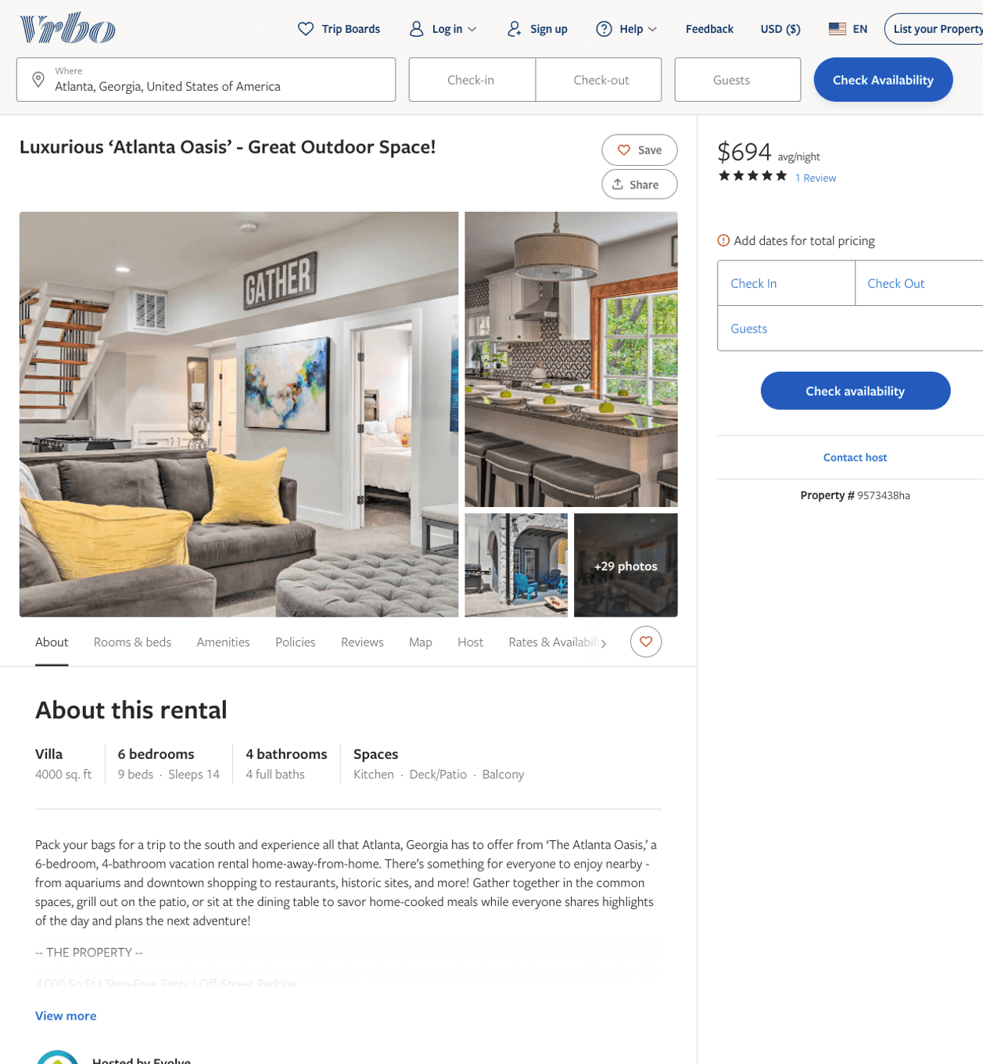
Listing 9573438
6
14
$384 - $840
4.5
3
Evolve
https://www.vrbo.com/9573438ha
Aug 2022

Slide 3
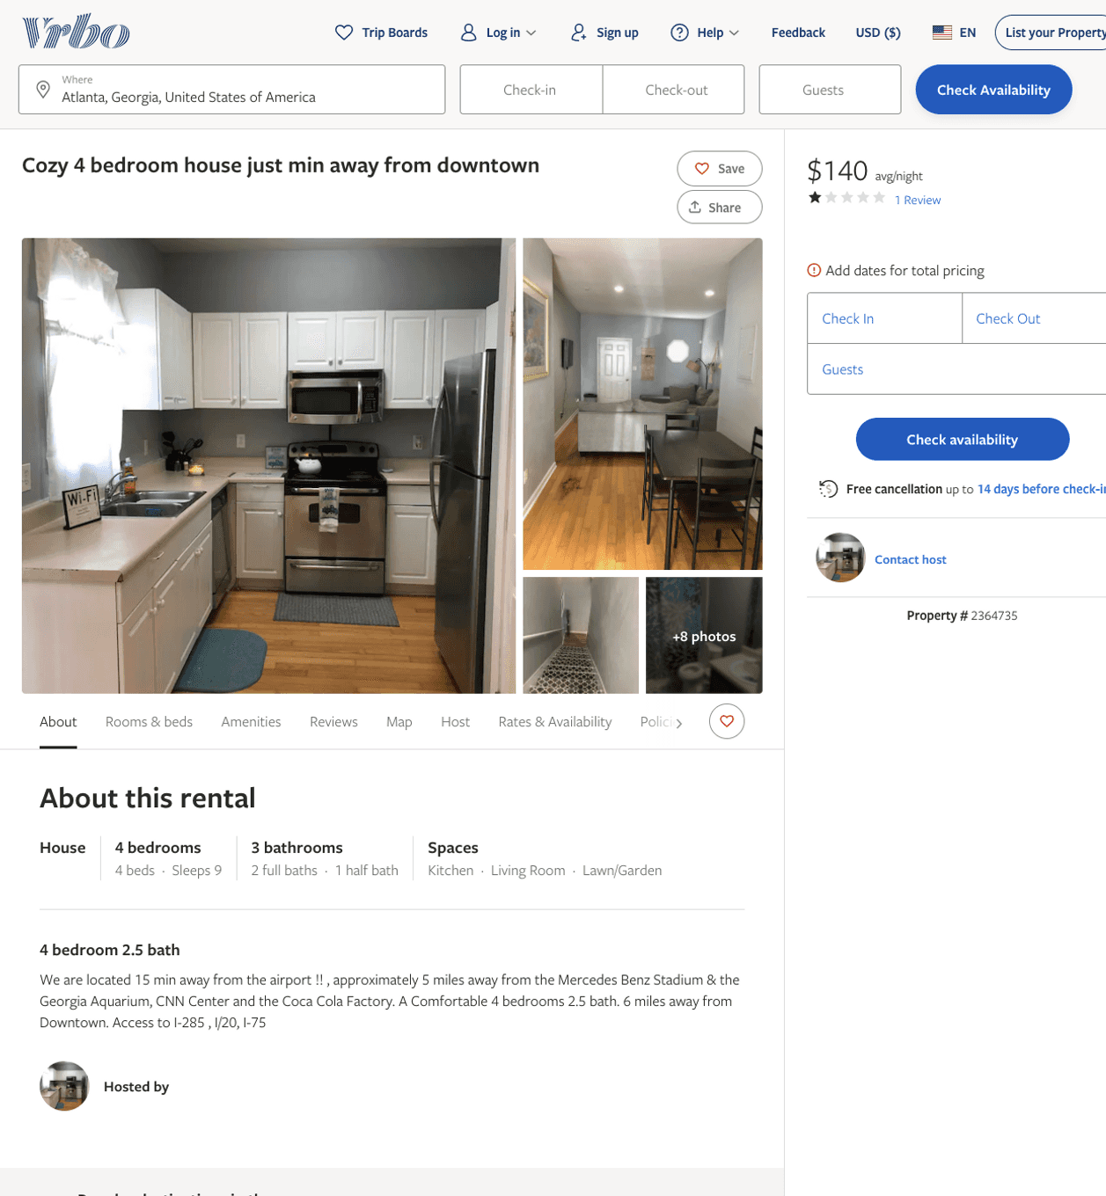
Listing 2364735
4
9
$140 - $250
1.5714285
1
https://www.vrbo.com/2364735
Aug 2022

Slide 4
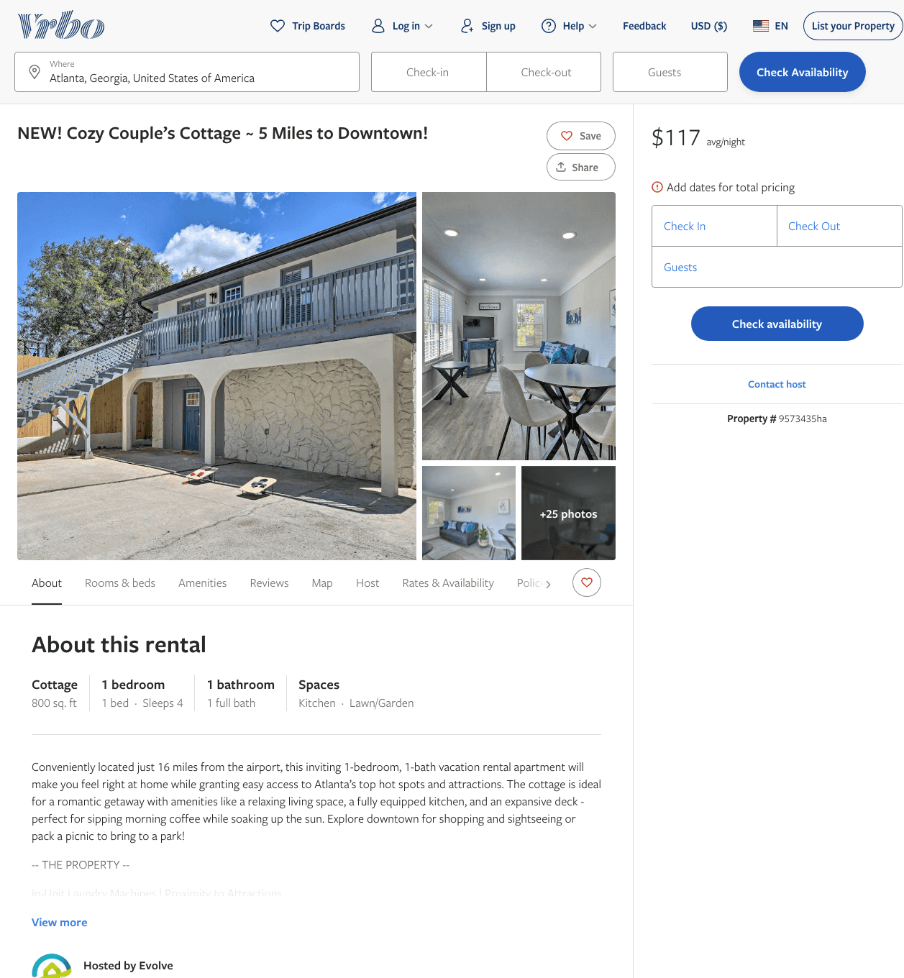
Listing 9573435
1
4
$109 - $95
2
Evolve
https://www.vrbo.com/9573435ha
Aug 2022

Slide 5
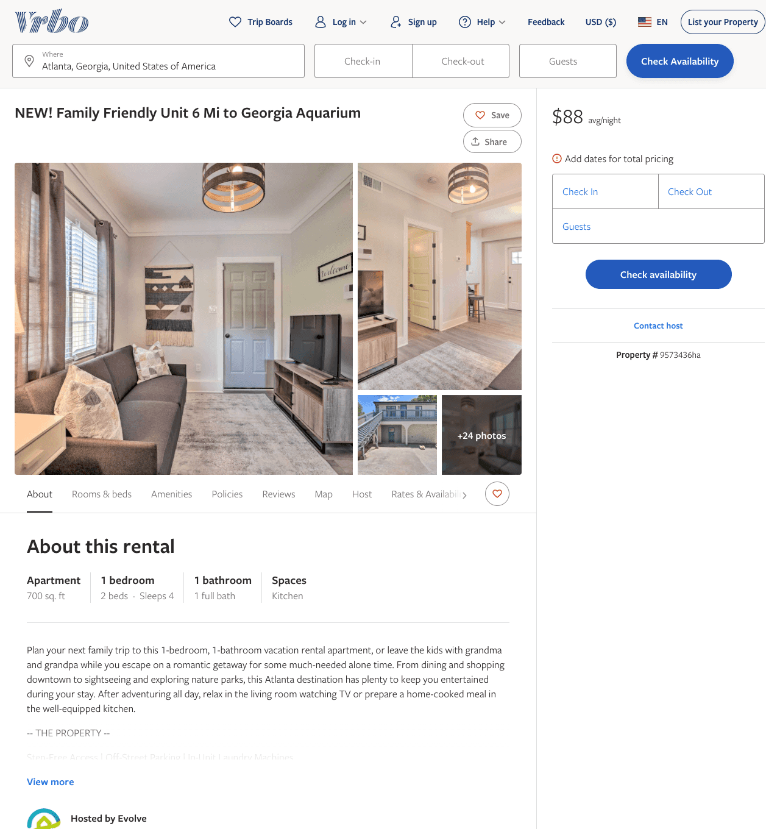
Listing 9573436
1
4
$103 - $92
3
2
Evolve
https://www.vrbo.com/9573436ha
Aug 2022

Slide 6
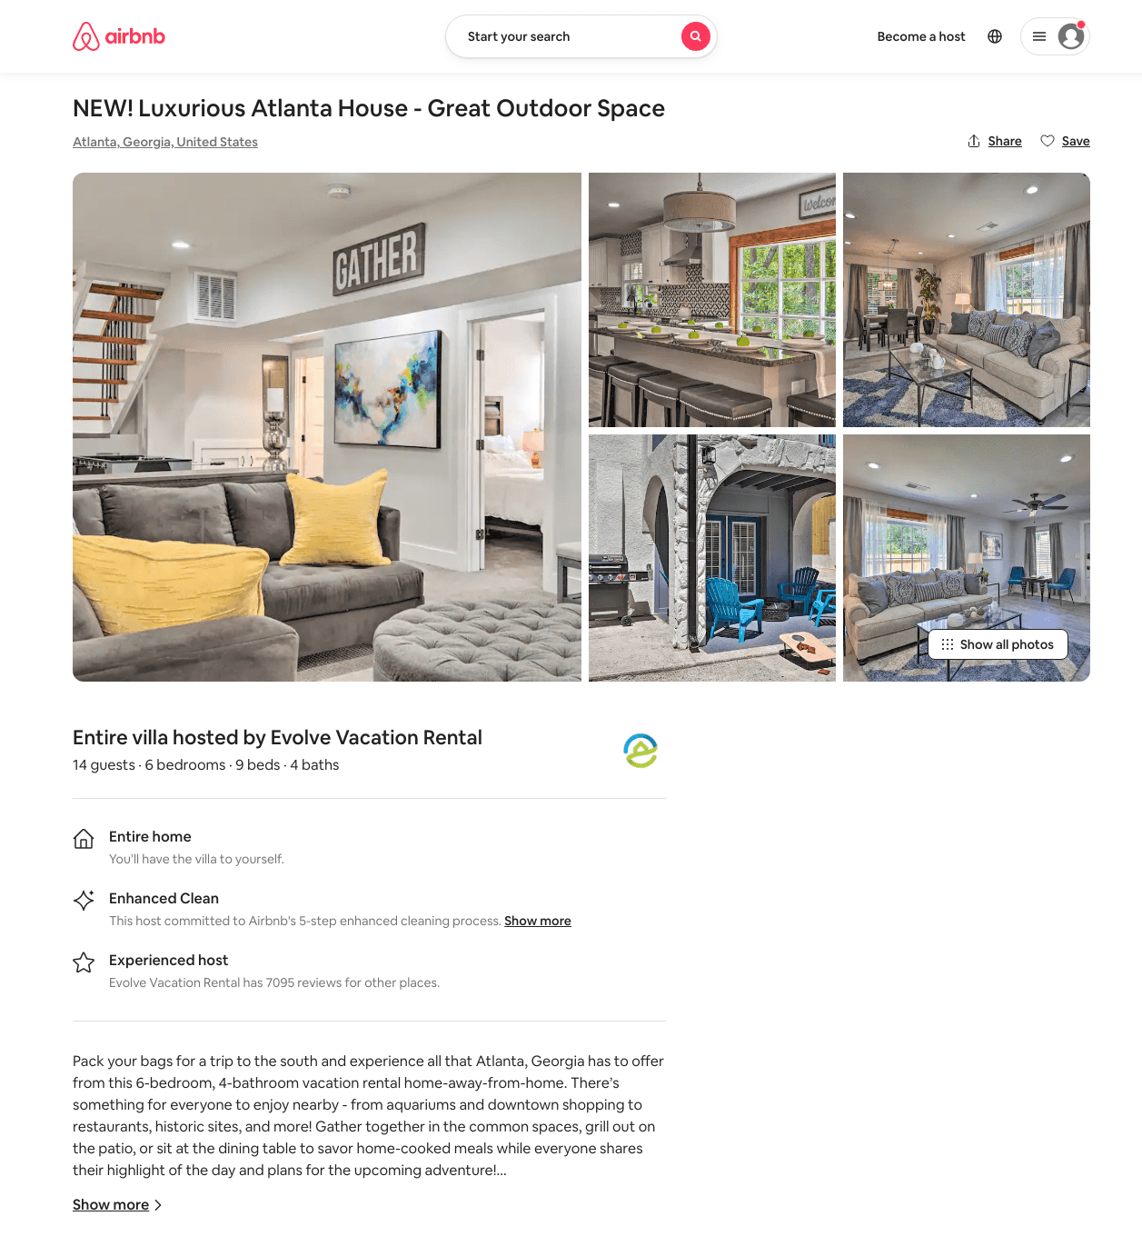
Listing 49943794
6
14
$354 - $796
4.29
3
Evolve
121682456
51
https://www.airbnb.com/rooms/49943794
Aug 2022

Slide 7
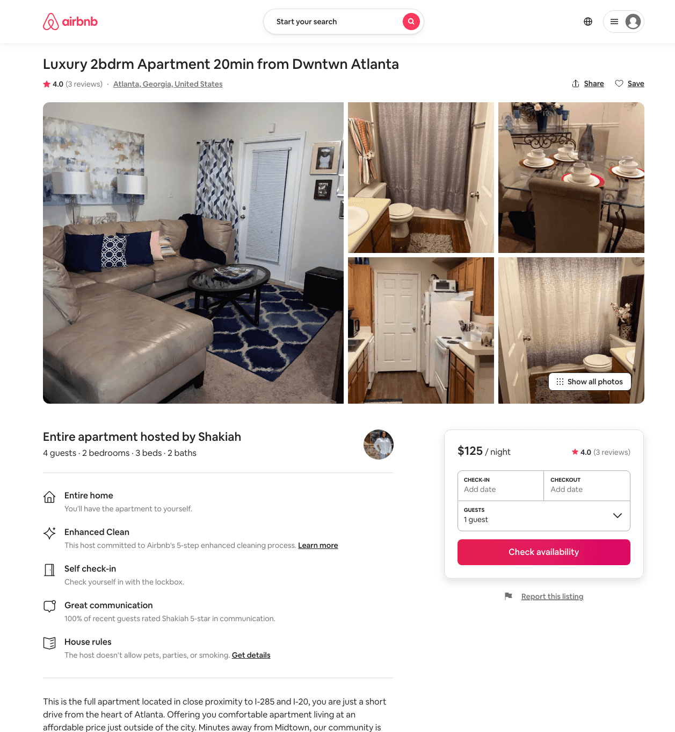
Listing 42805722
2
4
$110 - $125
4.0
3
Shakiah
45024435
1
https://www.airbnb.com/rooms/42805722
Aug 2022

Slide 8
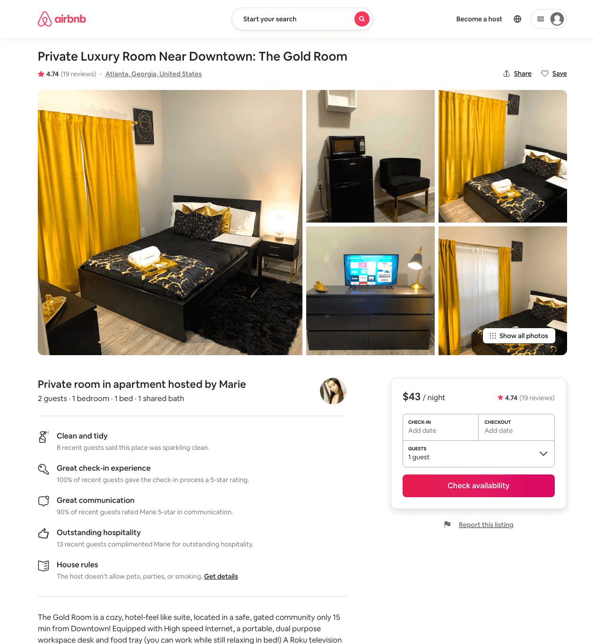
Listing 40493474
1
2
$42 - $46
4.72
1
Marie
191035127
2
https://www.airbnb.com/rooms/40493474
Aug 2022

Slide 9
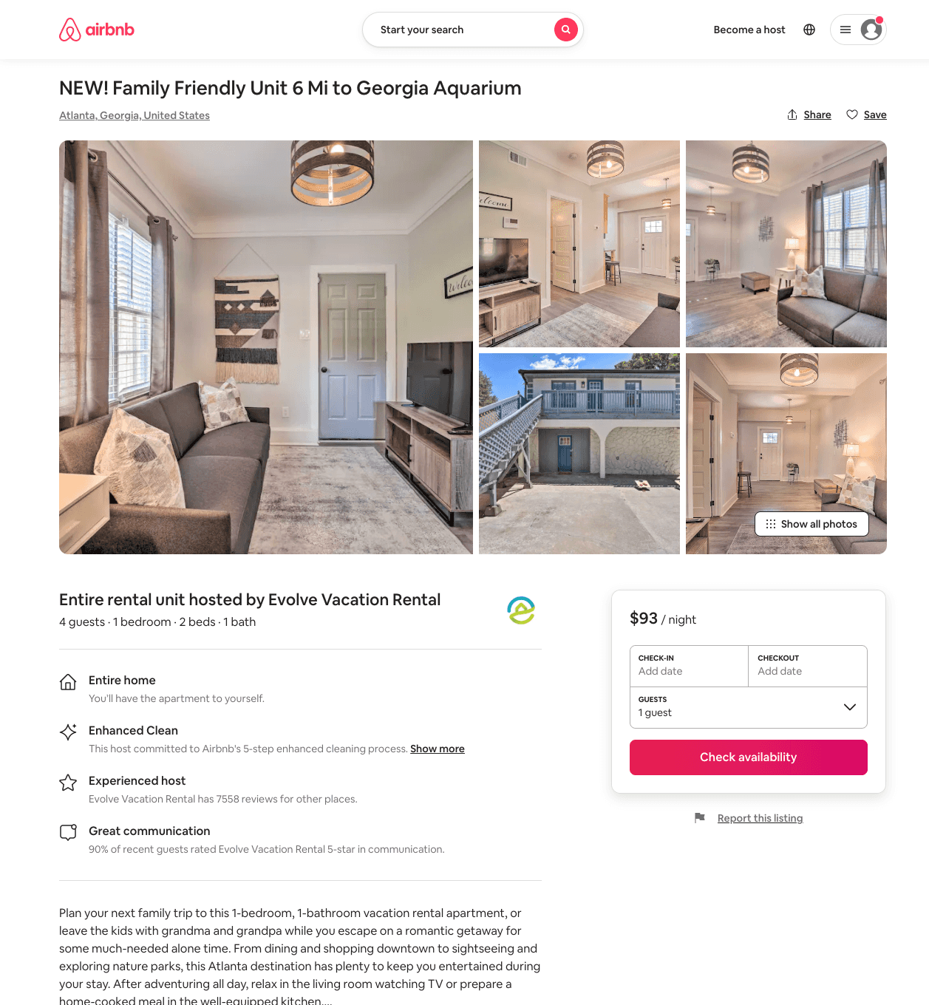
Listing 49943788
1
4
$91 - $112
4.13
2
Evolve
121682456
51
https://www.airbnb.com/rooms/49943788
Aug 2022

Slide 10
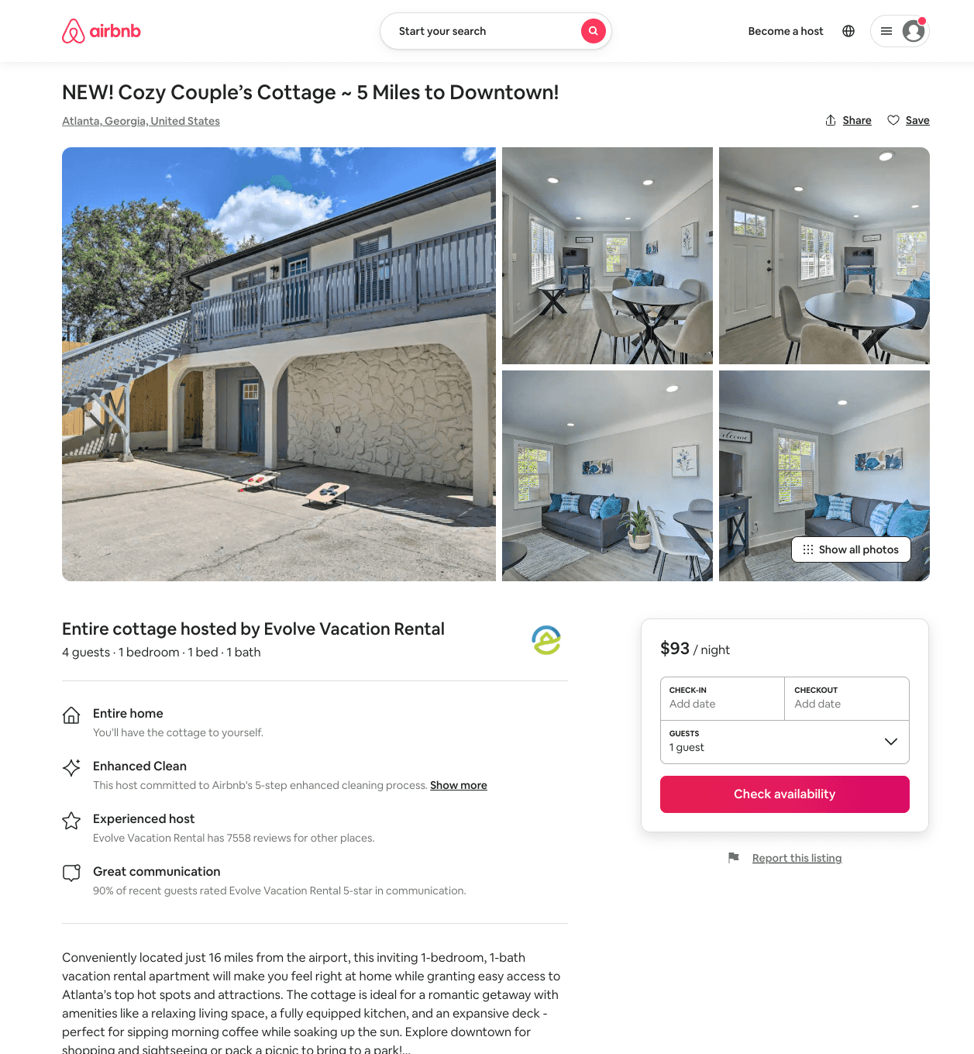
Listing 49945877
1
4
$91 - $112
2
Evolve
121682456
51
https://www.airbnb.com/rooms/49945877
Aug 2022

Slide 11
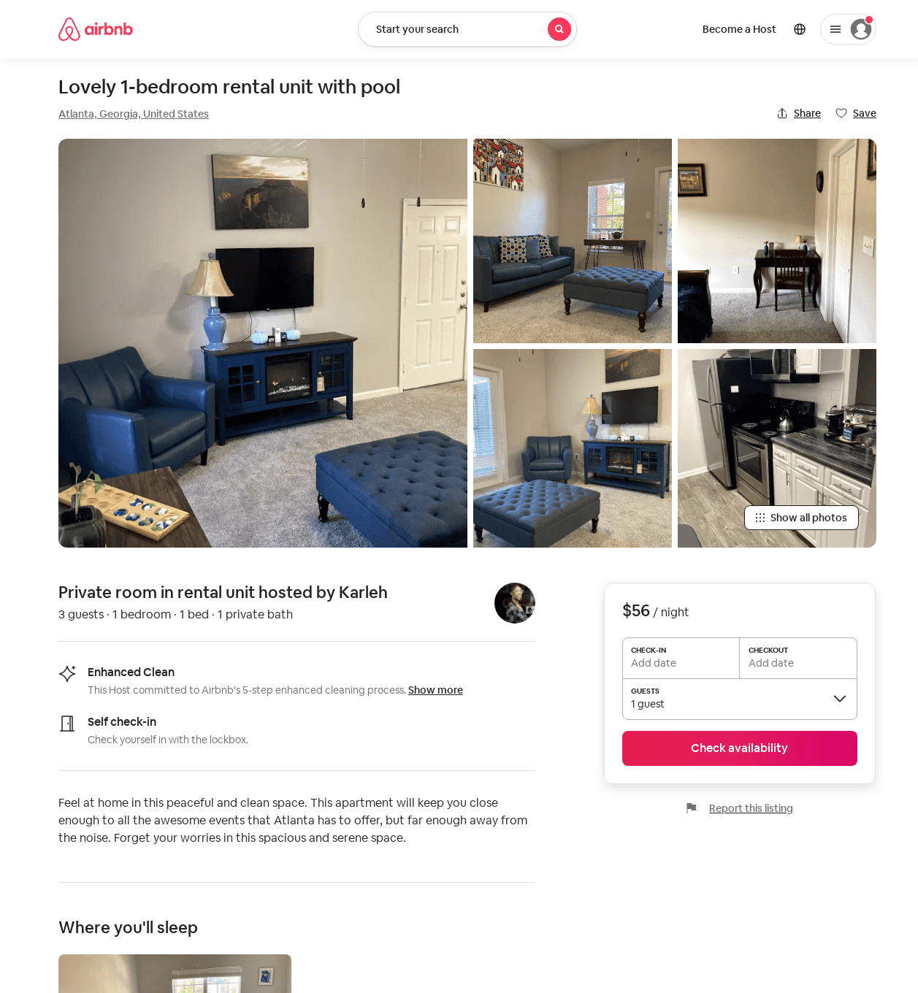
Listing 52842120
1
3
$56 - $70
1
Karleh
346111642
2
https://www.airbnb.com/rooms/52842120
Aug 2022

Slide 12
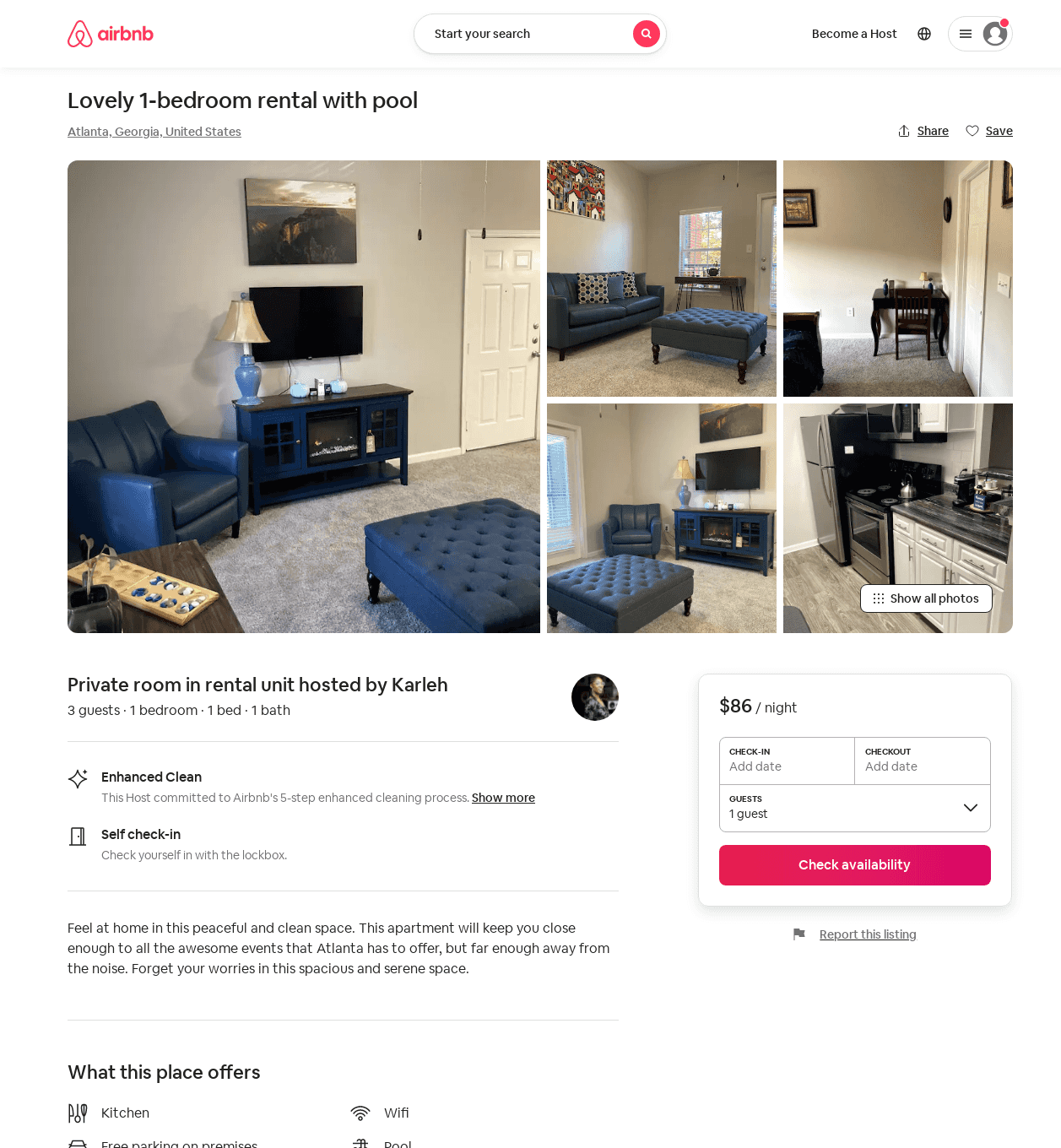
Listing 52865001
1
3
$86
1
Karleh
346111642
2
https://www.airbnb.com/rooms/52865001
Aug 2022

Slide 13
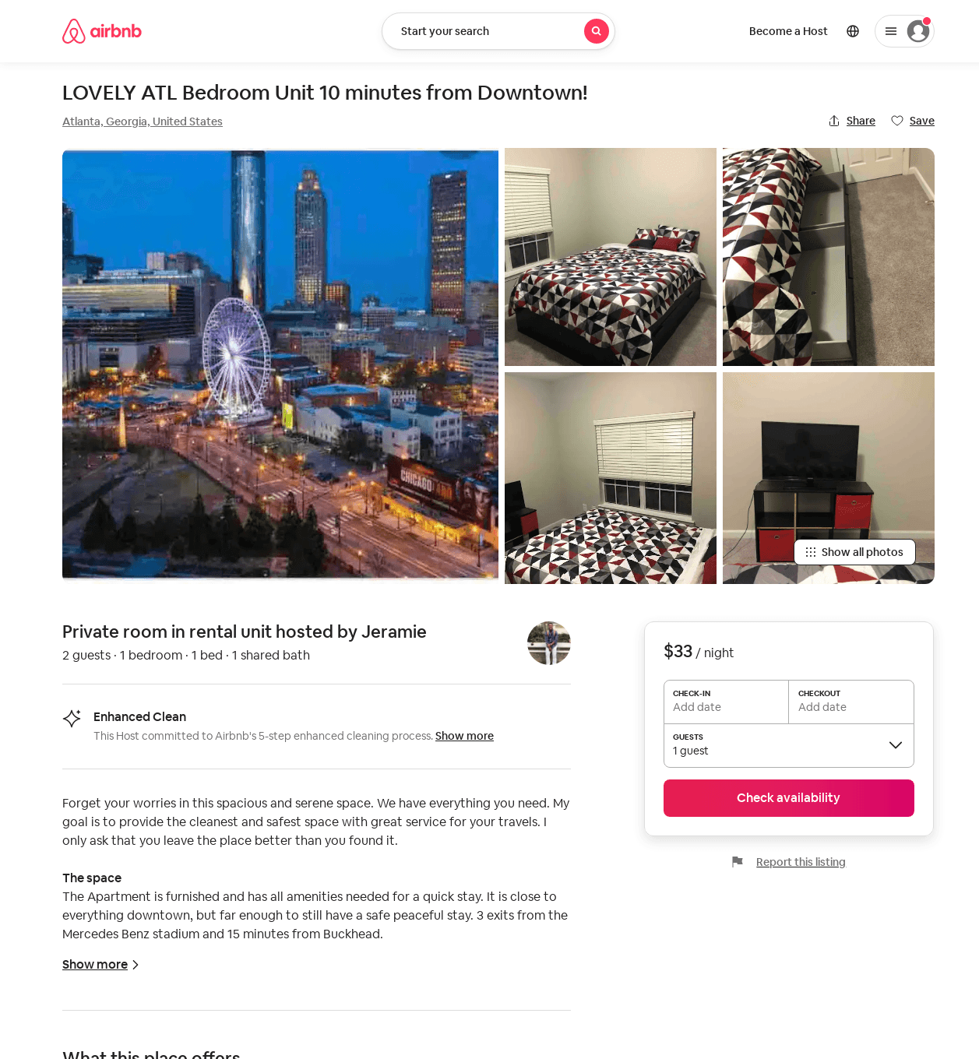
Listing 52602368
1
2
$26 - $33
4.25
1
Jeramie
264143338
2
https://www.airbnb.com/rooms/52602368
Jun 2022

Slide 14
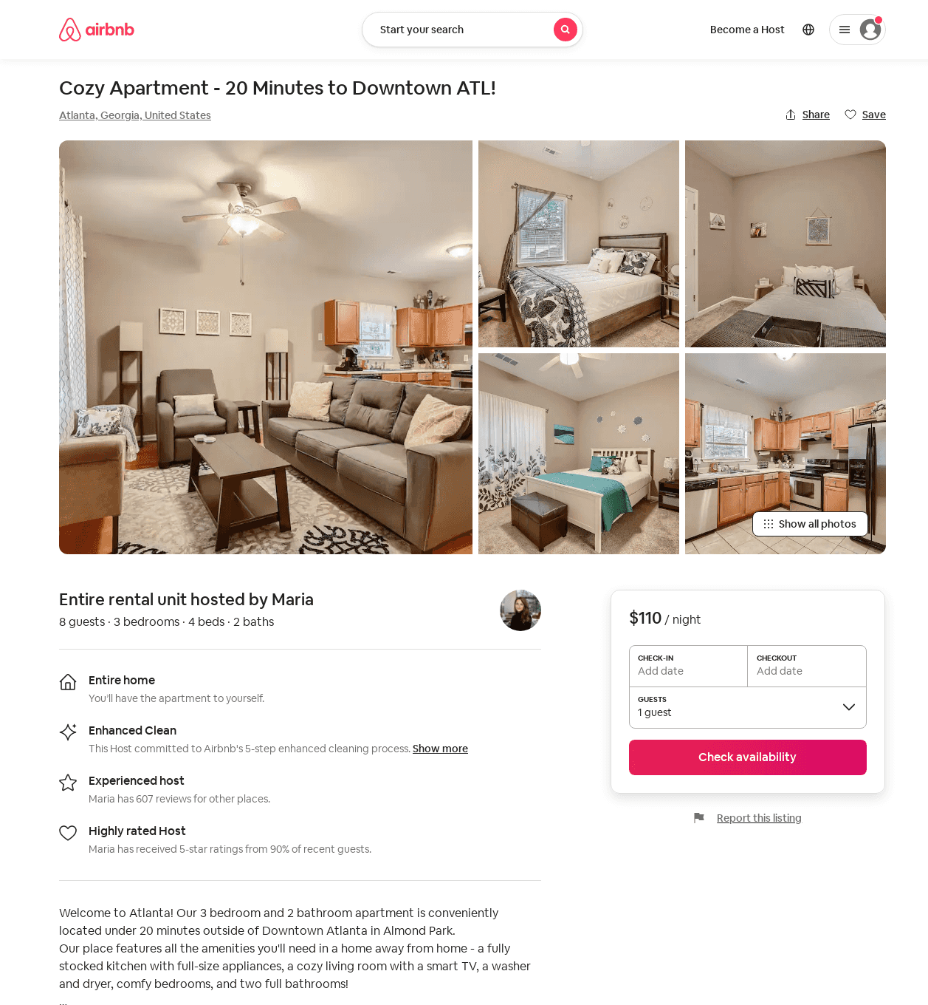
Listing 53722731
3
8
$110
4.17
1
Maria
230939573
13
https://www.airbnb.com/rooms/53722731
Jun 2022

Slide 15
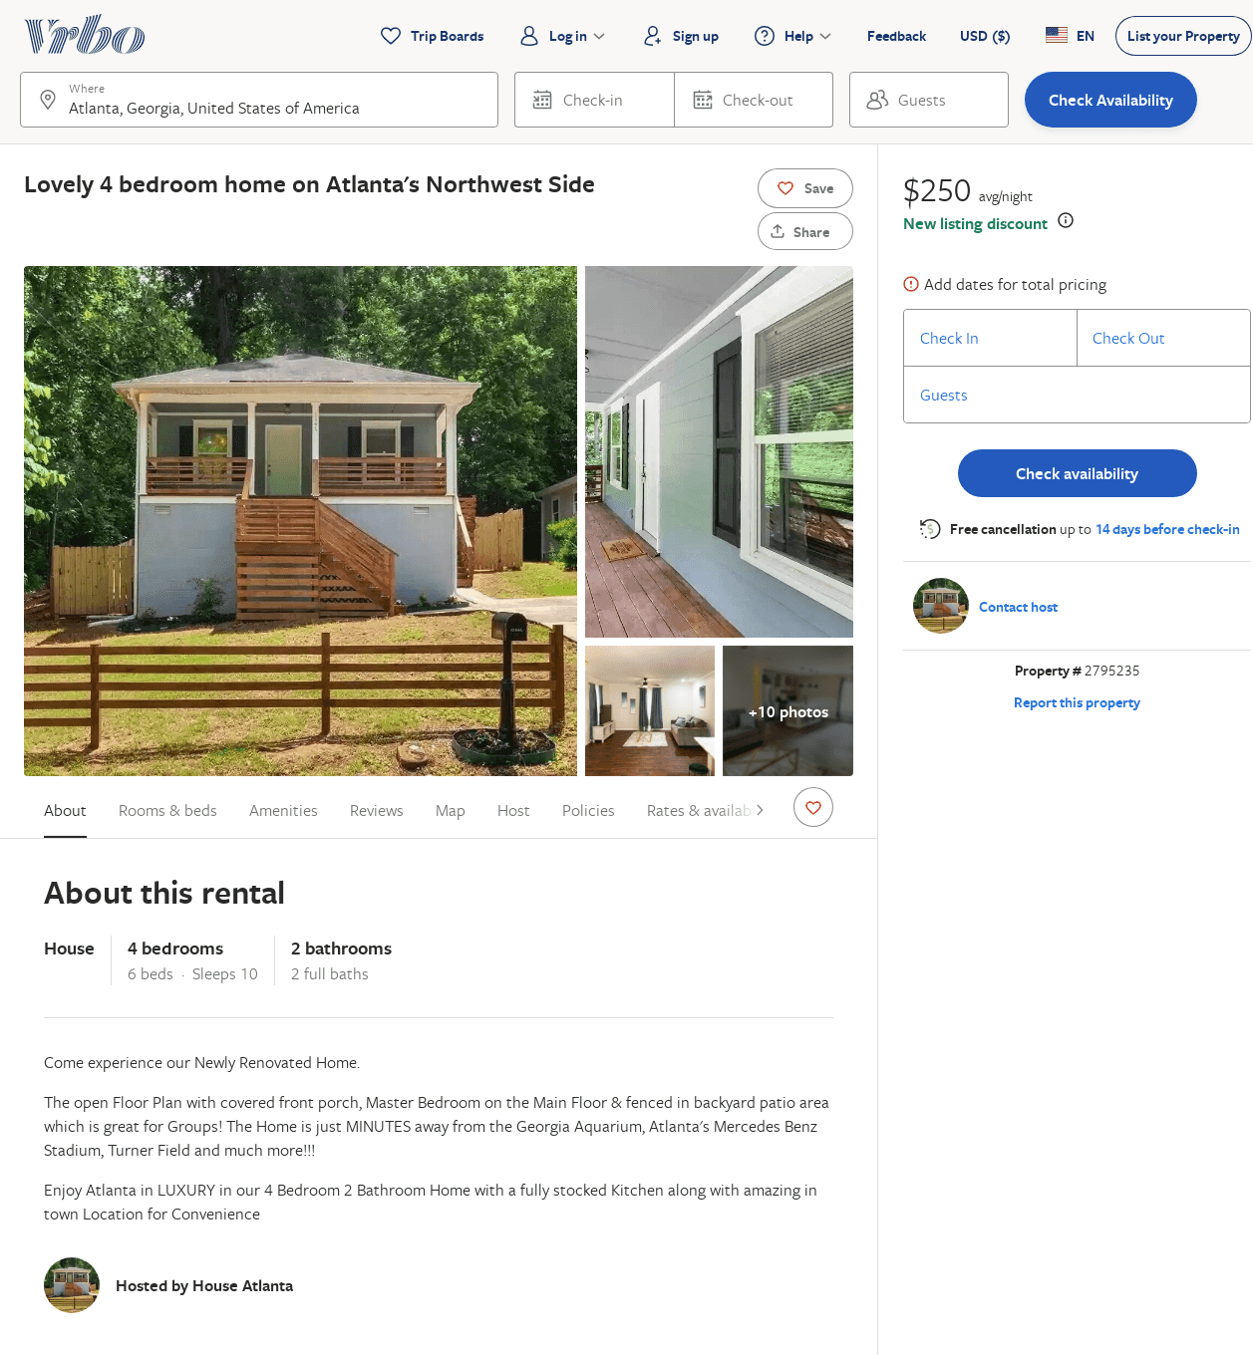
Listing 2795235
4
10
$250
45
https://www.vrbo.com/2795235
Aug 2022

