Slide 2
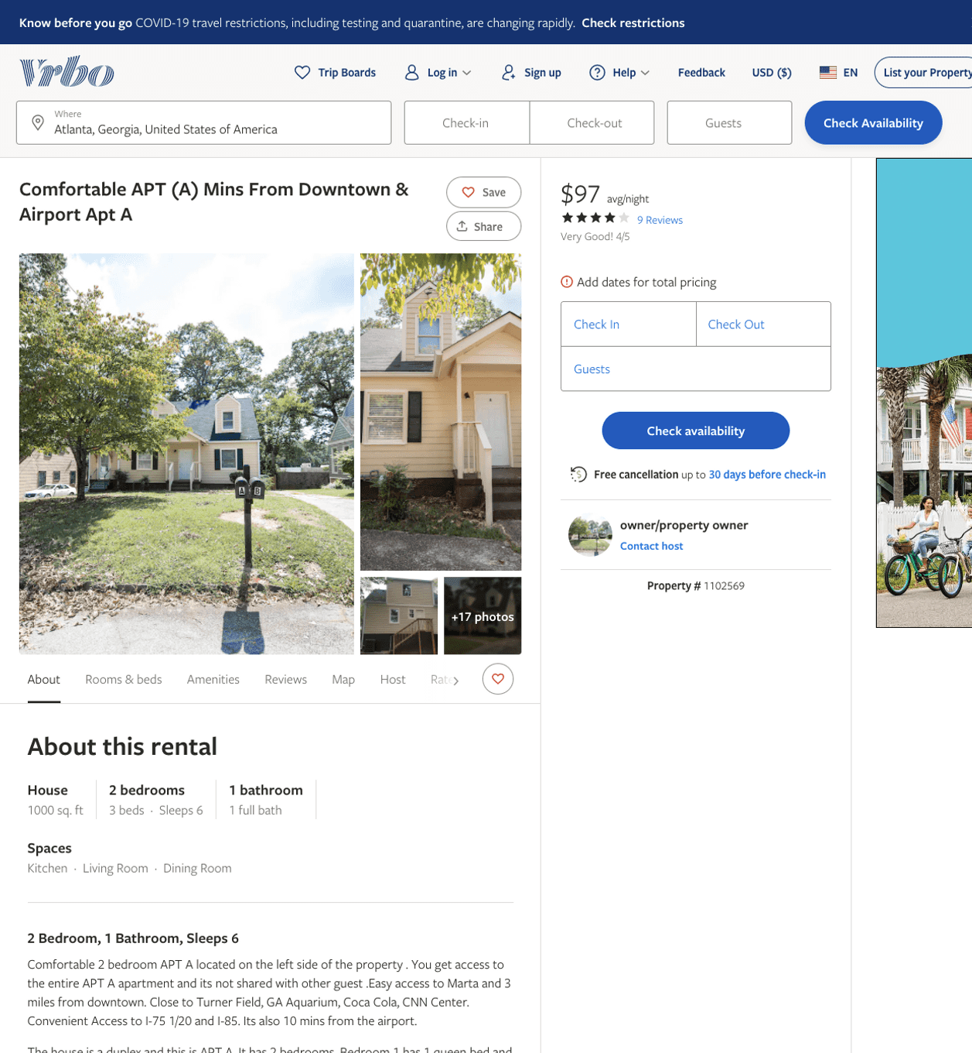
Listing 1102569
2
6
$96 - $99
4
3
owner/property owner
https://www.vrbo.com/1102569
Aug 2022

Slide 3
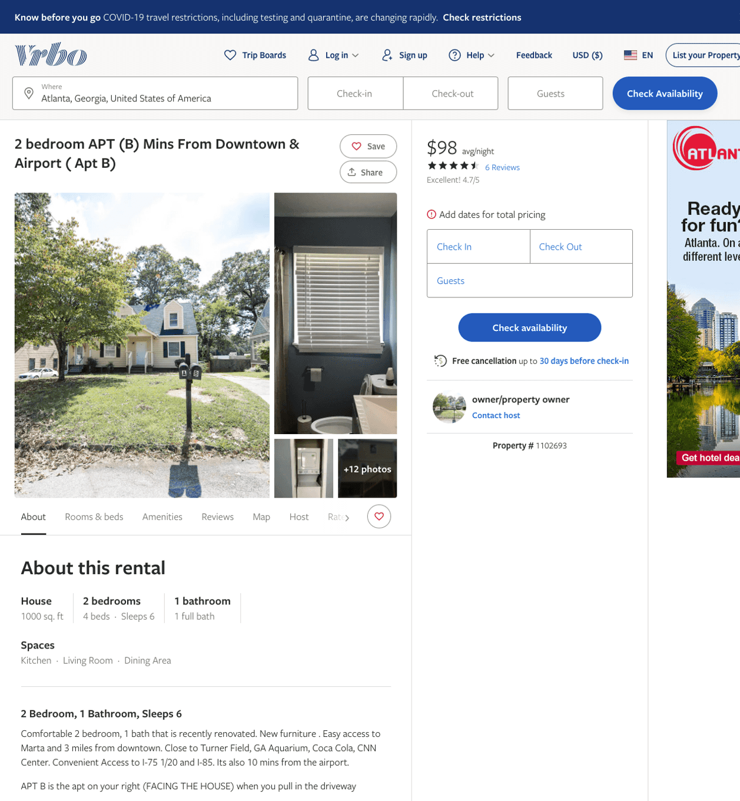
Listing 1102693
2
6
$79 - $98
4.6666665
2
owner/property owner
https://www.vrbo.com/1102693
Aug 2022

Slide 4
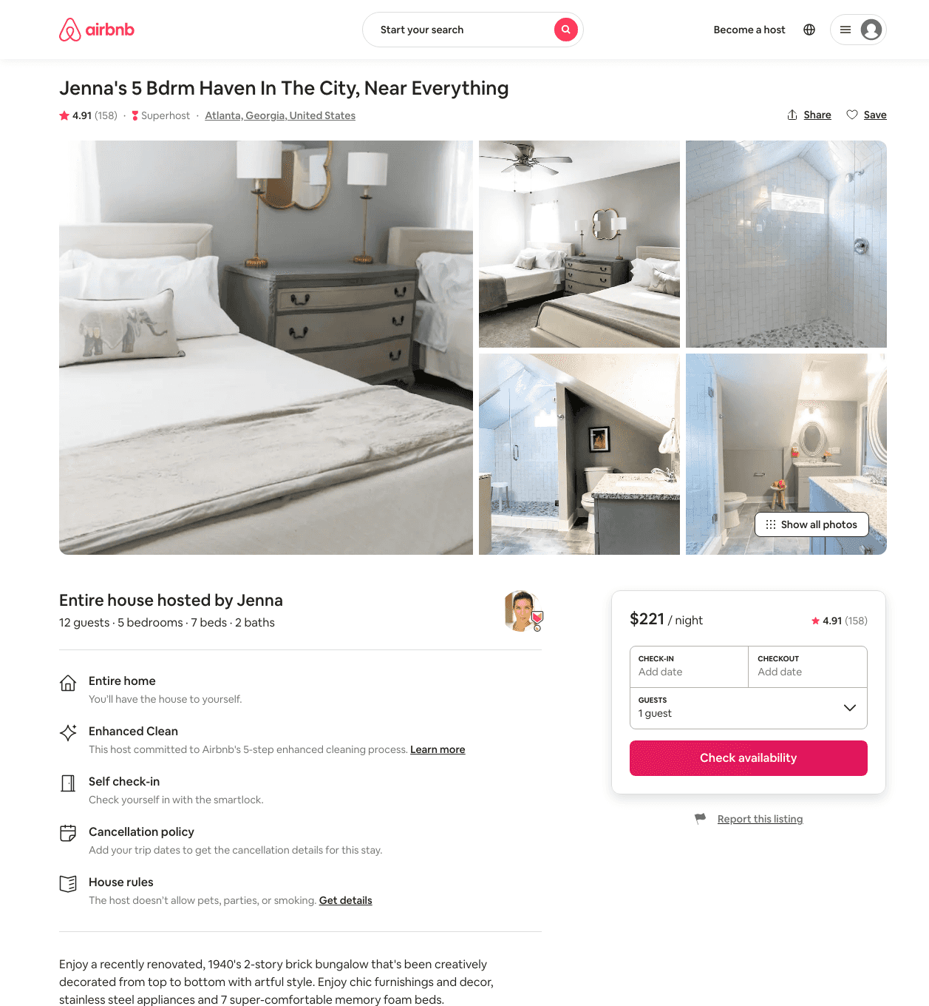
Listing 21134898
5
12
$201 - $282
4.89
1
Brendan
37742683
1
https://www.airbnb.com/rooms/21134898
Jul 2022

Slide 5
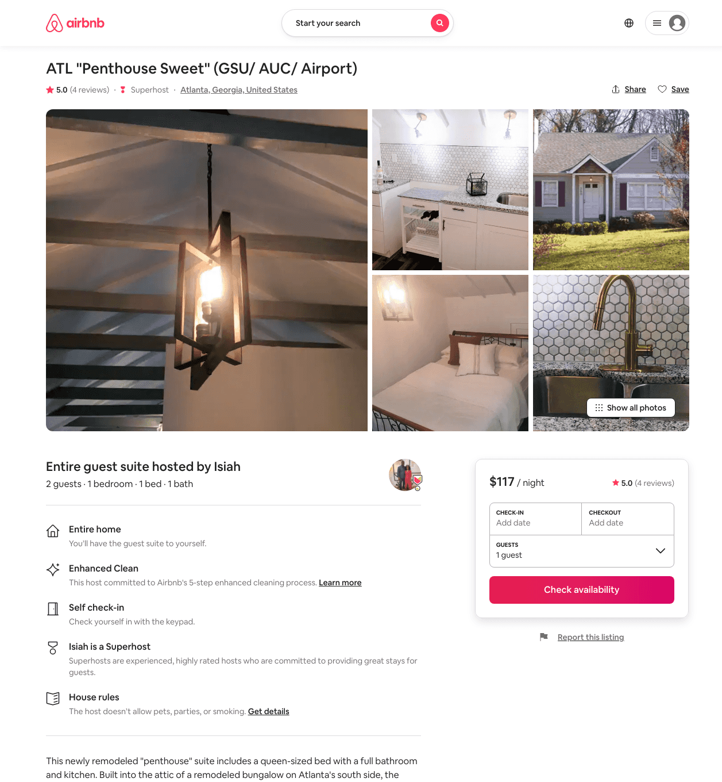
Listing 14117148
1
2
$95 - $141
5.0
2
Isiah
29416823
1
https://www.airbnb.com/rooms/14117148
Aug 2022

Slide 6
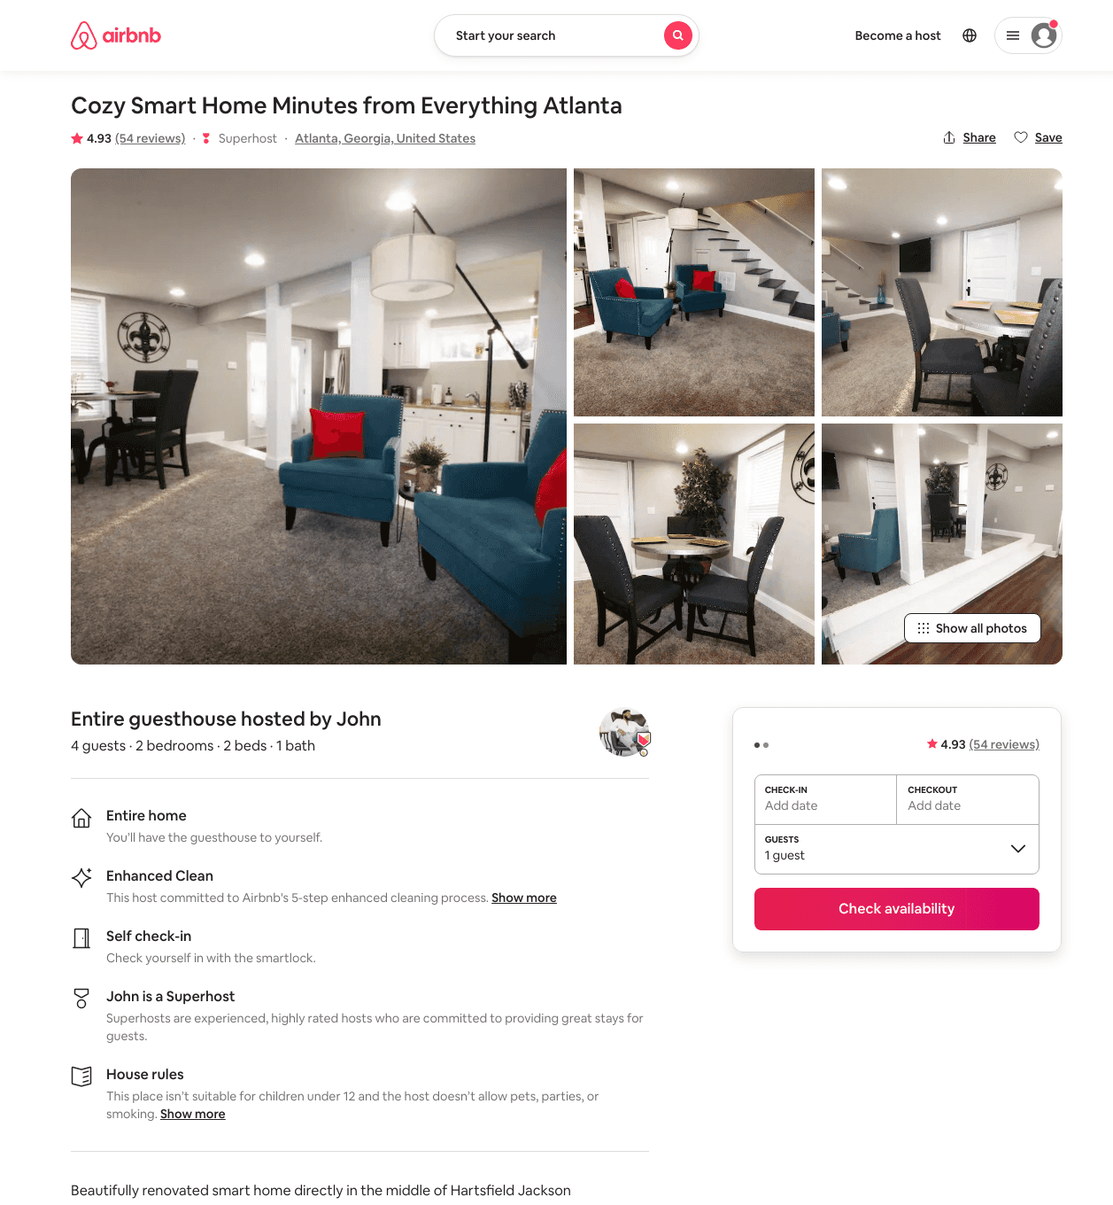
Listing 39311354
2
4
$83 - $134
4.87
2
John
116513052
1
https://www.airbnb.com/rooms/39311354
Aug 2022

Slide 7
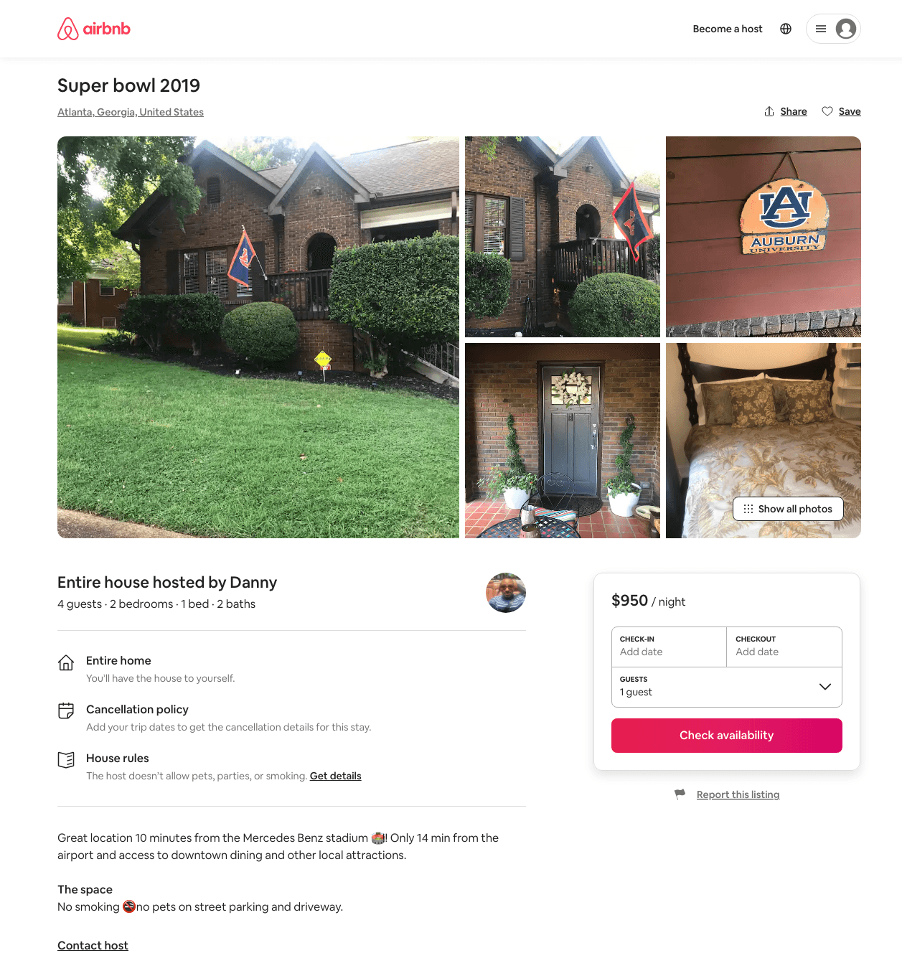
Listing 31965160
2
4
$950
6
Danny
75510647
2
https://www.airbnb.com/rooms/31965160
Aug 2022

Slide 8
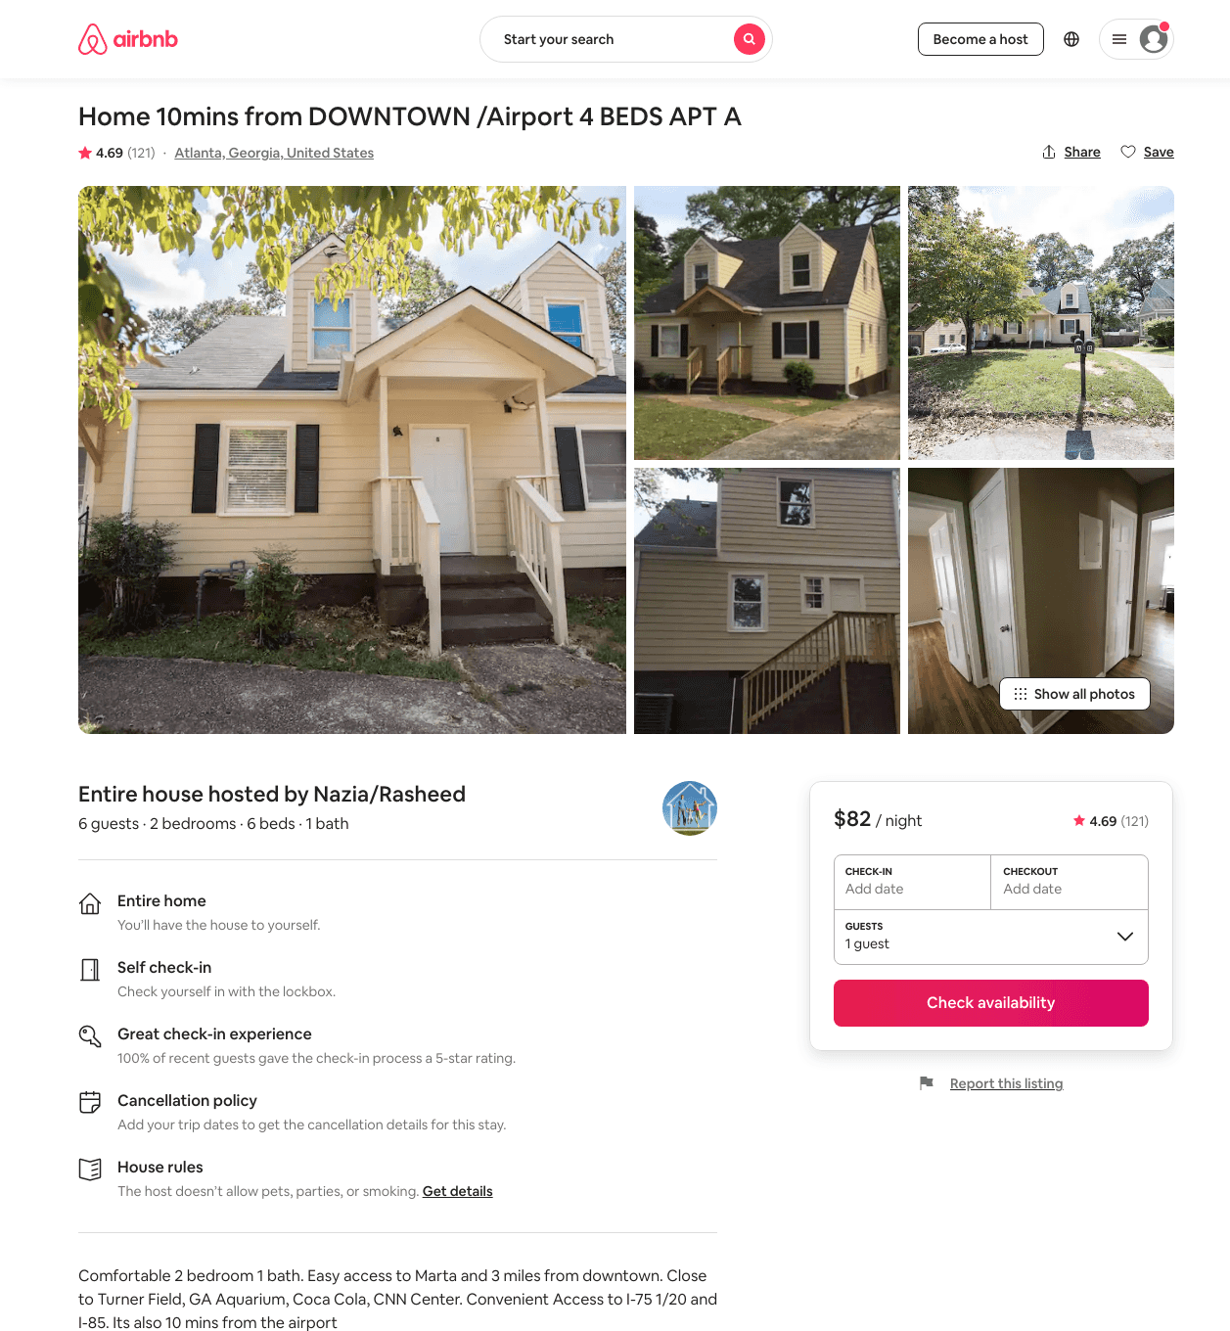
Listing 18895887
2
6
$62 - $191
4.59
3
Nazia/Rasheed
8544925
8
https://www.airbnb.com/rooms/18895887
Jun 2022

Slide 9
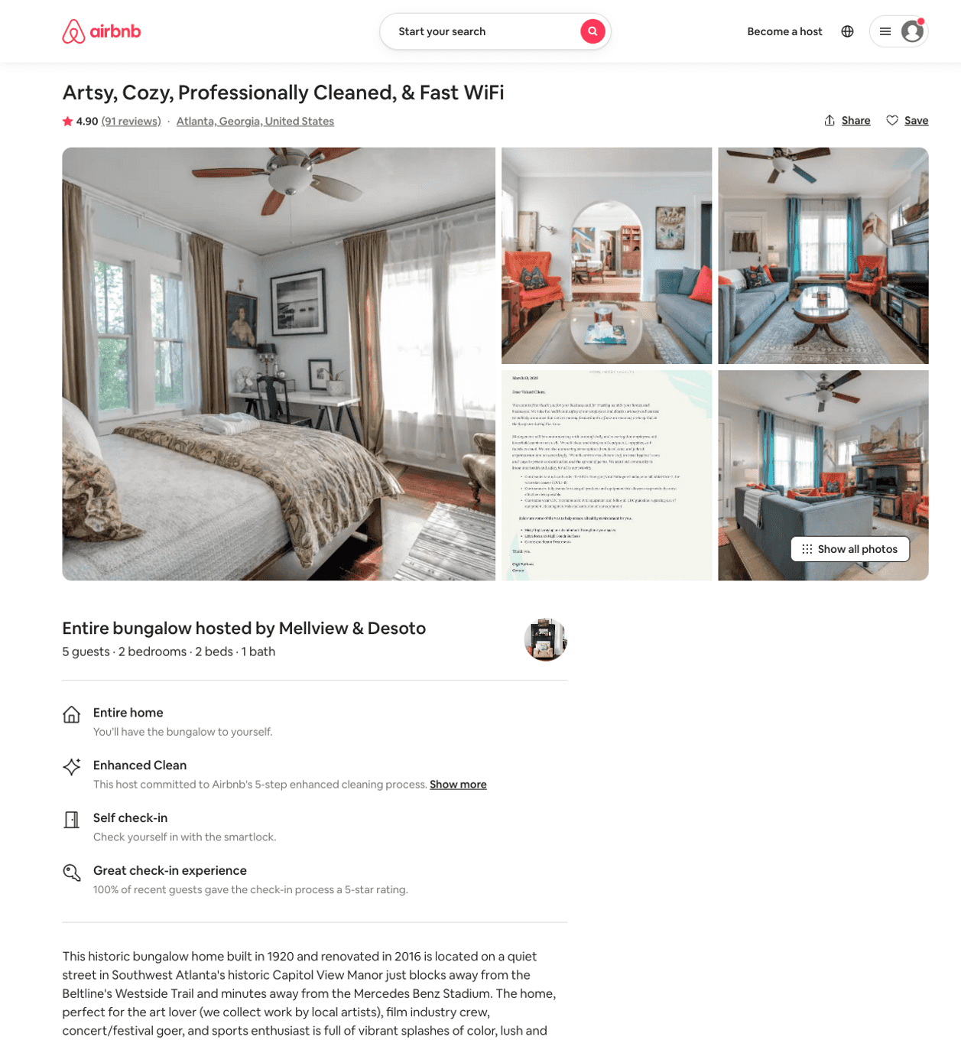
Listing 1943931
2
5
$74 - $111
4.88
3
Mellview And Desoto
5950866
2
https://www.airbnb.com/rooms/1943931
Aug 2022

Slide 10
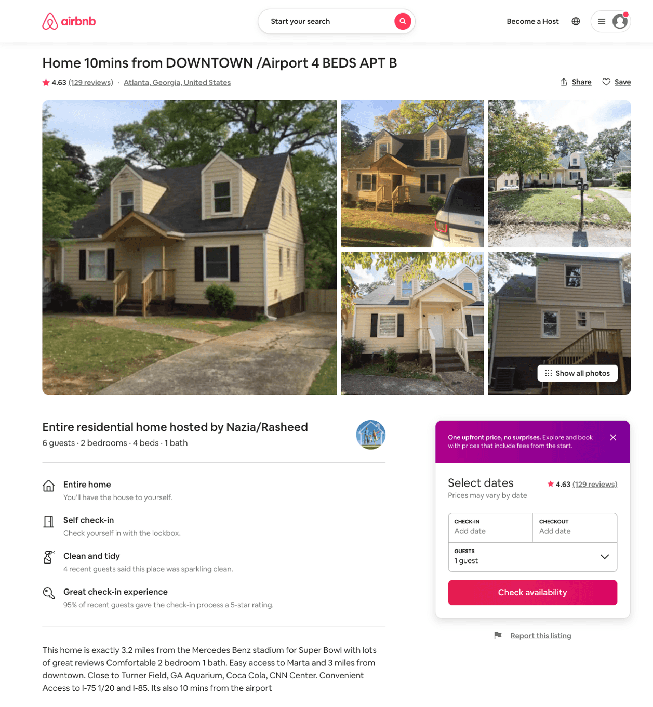
Listing 18810804
2
6
$73 - $85
4.58
3
Nazia/Rasheed
8544925
8
https://www.airbnb.com/rooms/18810804
Aug 2022

Slide 11
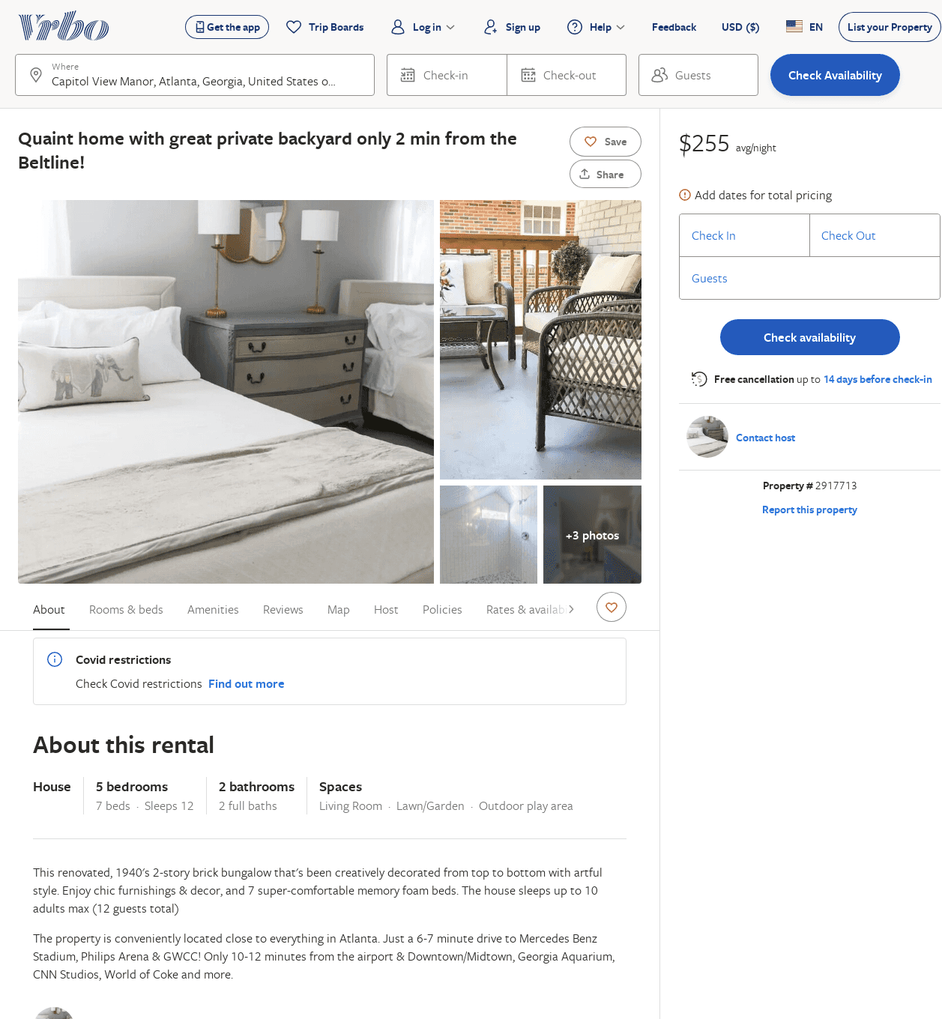
Listing 2917713
5
12
$255
3
https://www.vrbo.com/2917713
Aug 2022

