Slide 2
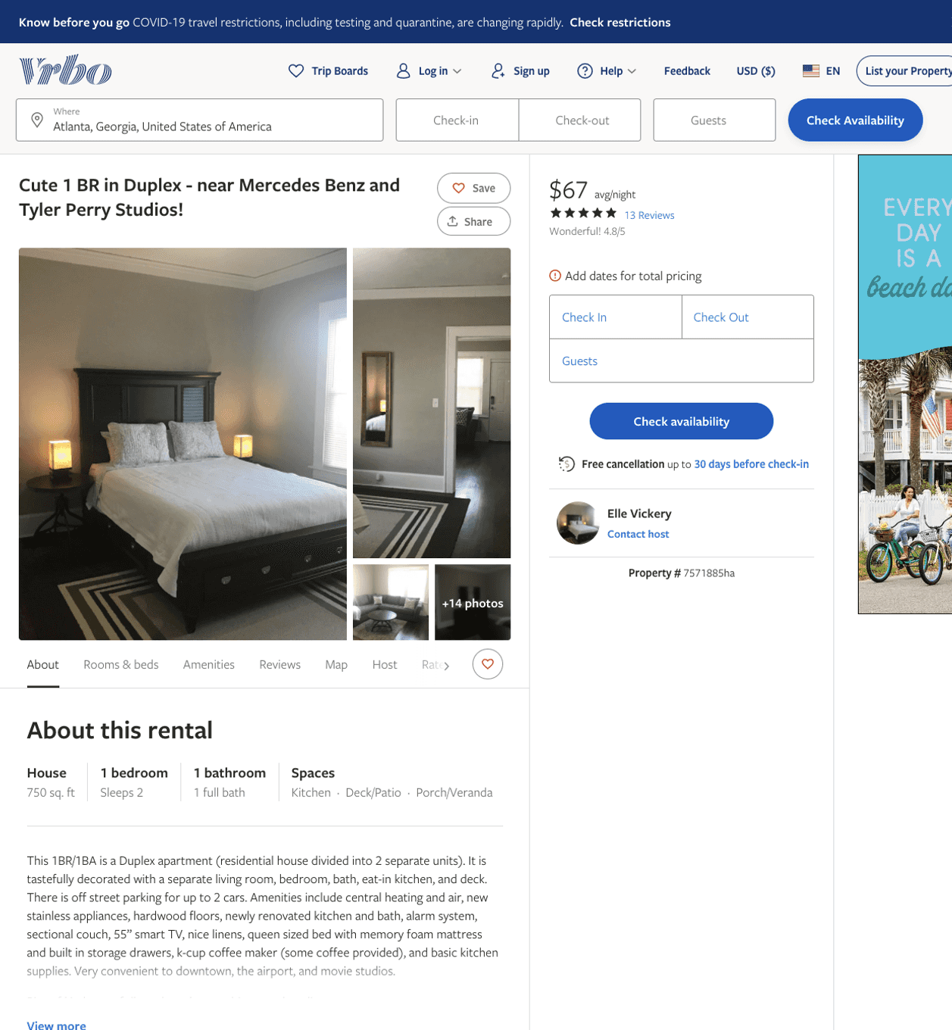
Listing 7571885
999 DILL AVE SW
1
2
$67
4.8125
4
Elle Vickery
https://www.vrbo.com/7571885ha
Aug 2022

Slide 3
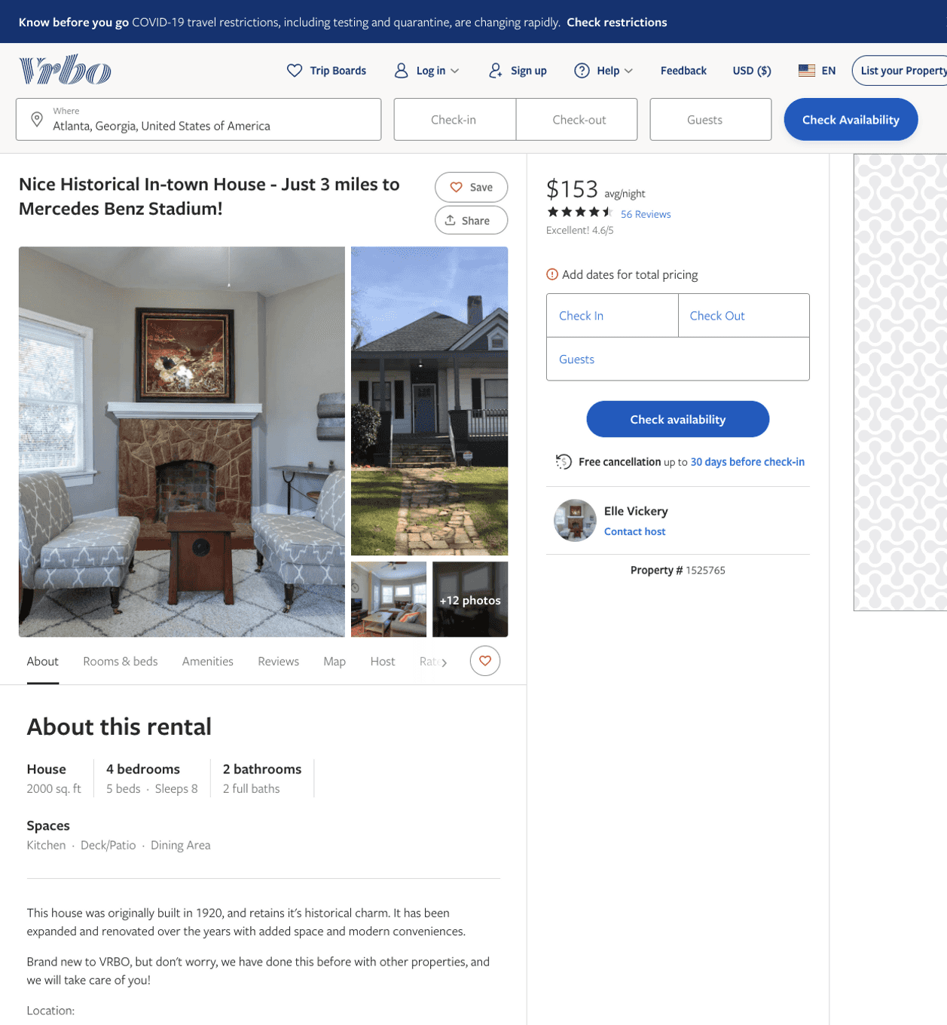
Listing 1525765
1464 ALLENE AVE SW
4
8
$133 - $153
4.5142856
3
Elle Vickery
https://www.vrbo.com/1525765
Aug 2022

Slide 4
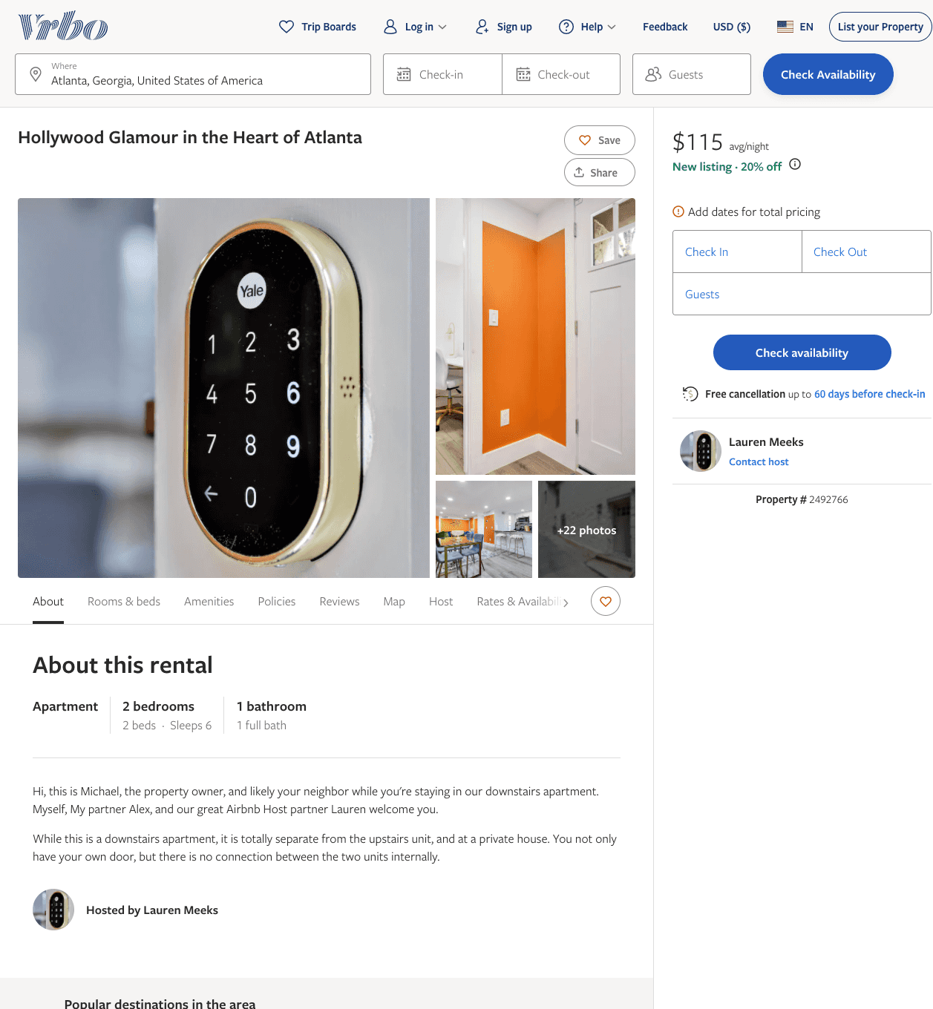
Listing 2492766
2
6
$108 - $90
5
2
Lauren Meeks
https://www.vrbo.com/2492766
Aug 2022

Slide 5
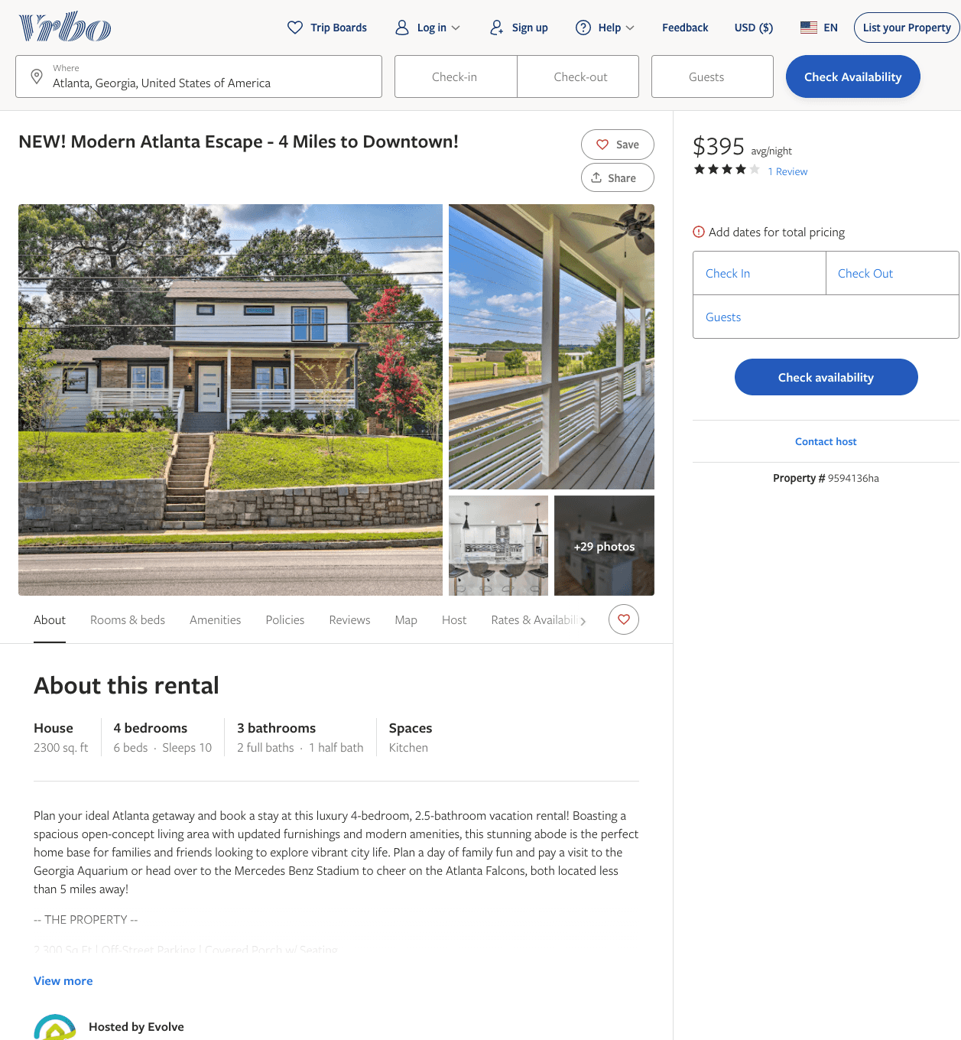
Listing 9594136
4
10
$268 - $466
4.6666665
3
Evolve
https://www.vrbo.com/9594136ha
Aug 2022

Slide 6
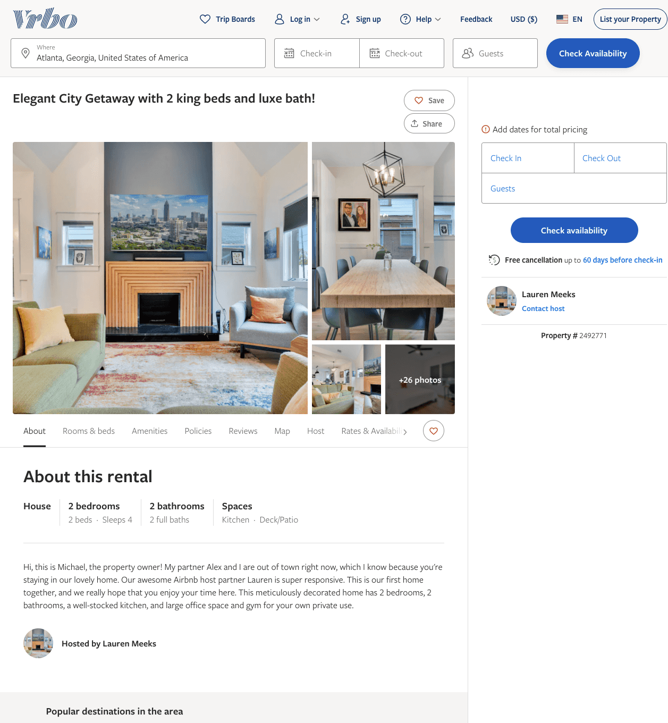
Listing 2492771
3
6
$155
2
Lauren Meeks
https://www.vrbo.com/2492771
Aug 2022

Slide 7
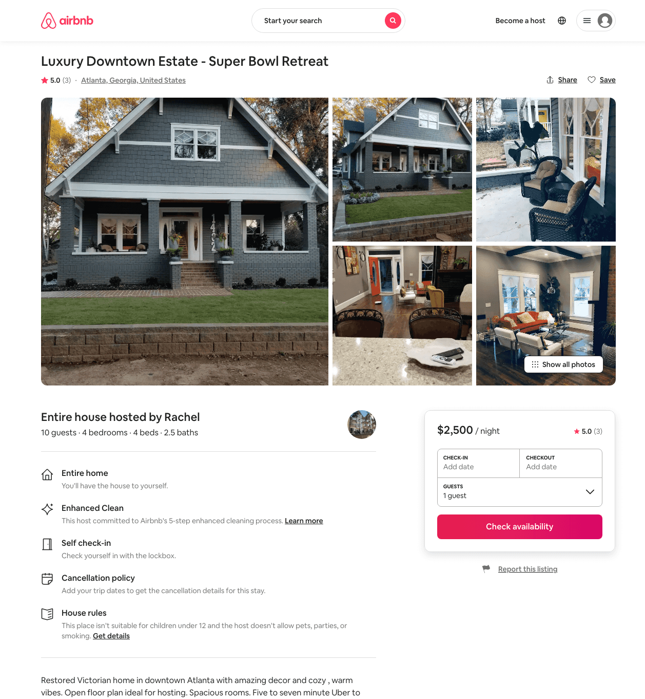
Listing 30270135
4
10
$2500
5.0
3
Rachel
80229979
2
https://www.airbnb.com/rooms/30270135
Aug 2022

Slide 8
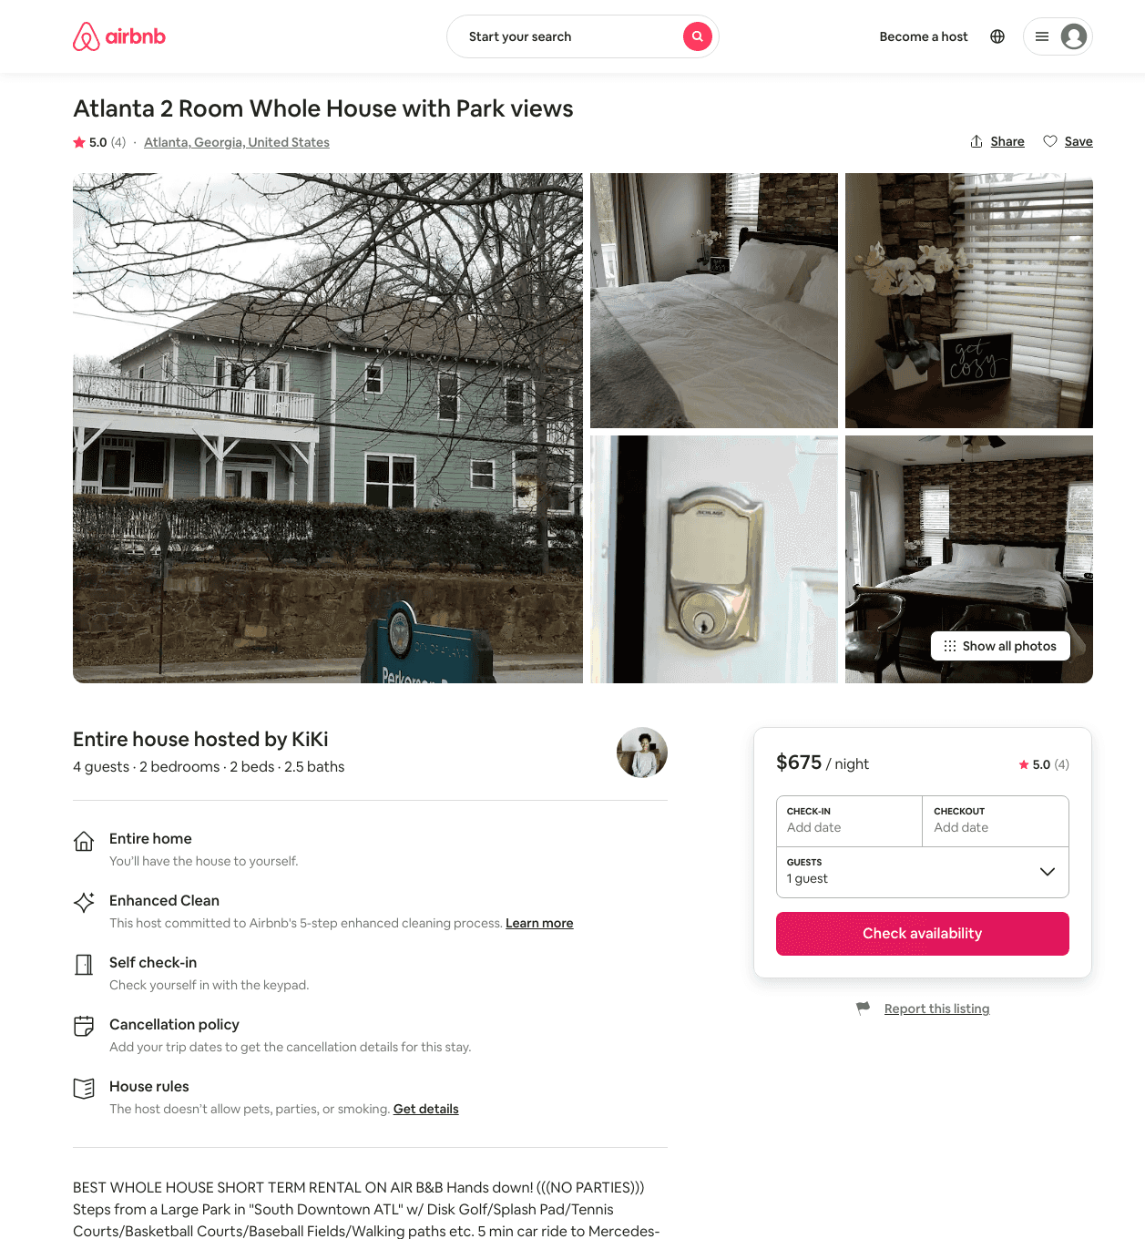
Listing 31263881
2
4
$675
5.0
1
KiKi
195492875
3
https://www.airbnb.com/rooms/31263881
Aug 2022

Slide 9
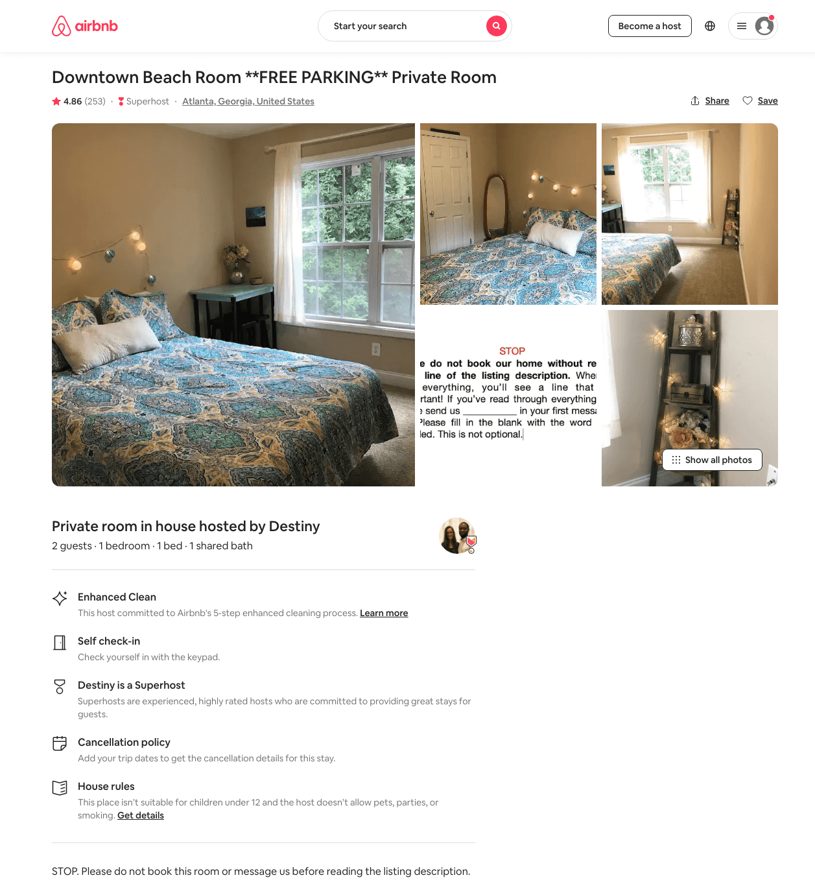
Listing 28314488
1
2
$25 - $60
4.84
1
Destiny
127211807
4
https://www.airbnb.com/rooms/28314488
Aug 2022

Slide 10
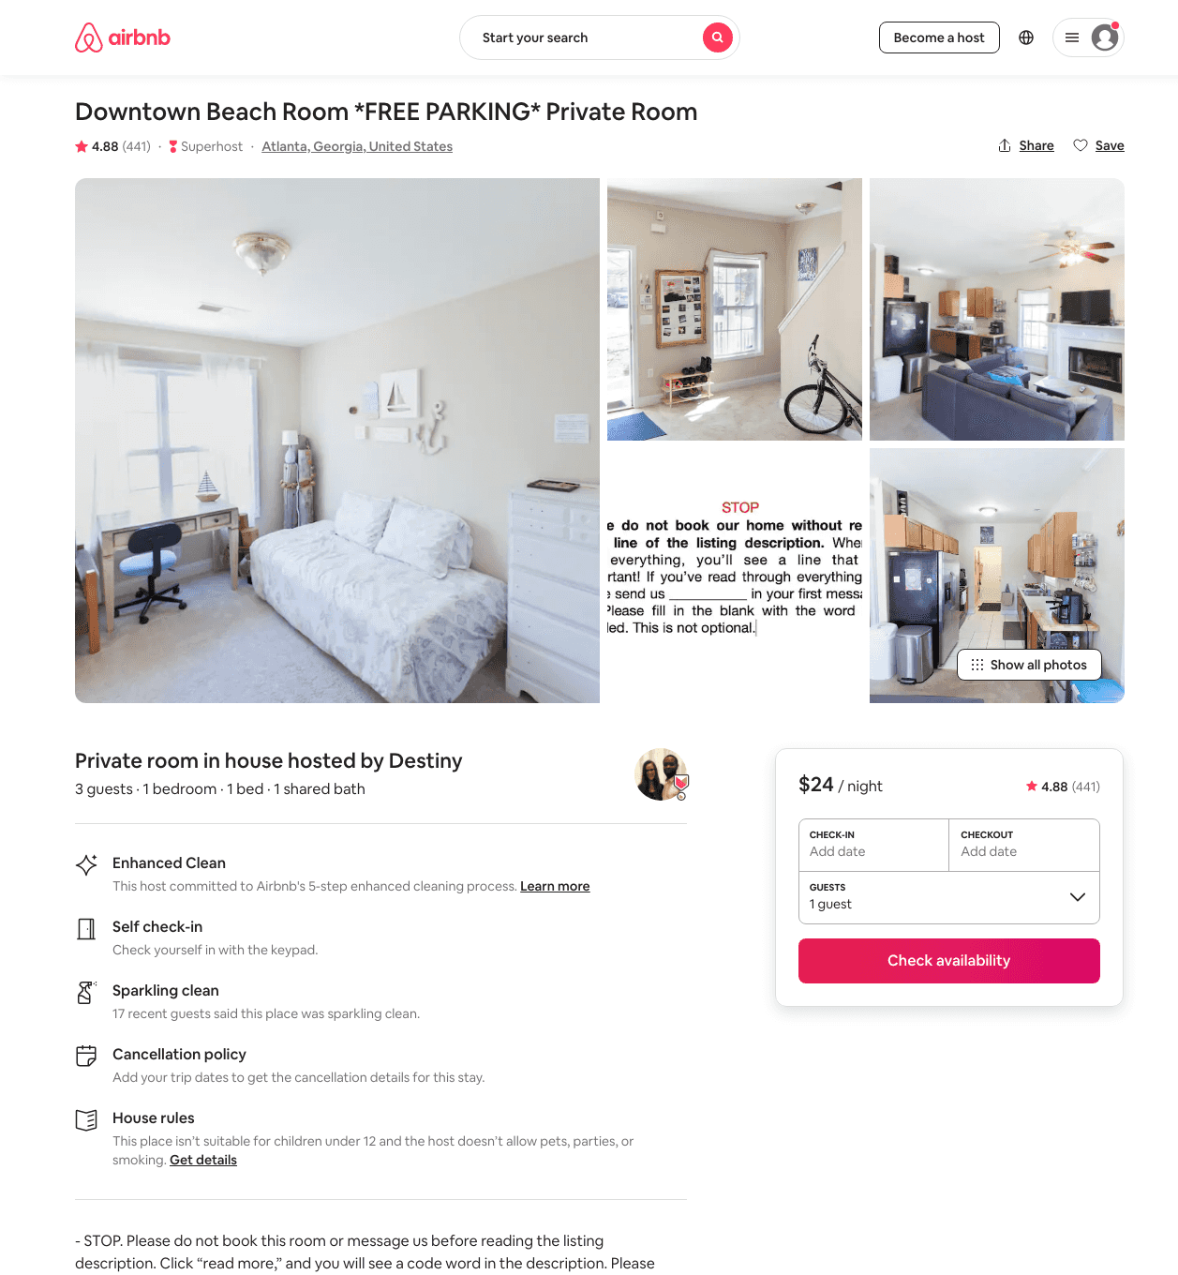
Listing 20756135
1
2
$24 - $40
4.85
1
Destiny
127211807
4
https://www.airbnb.com/rooms/20756135
Aug 2022

Slide 11
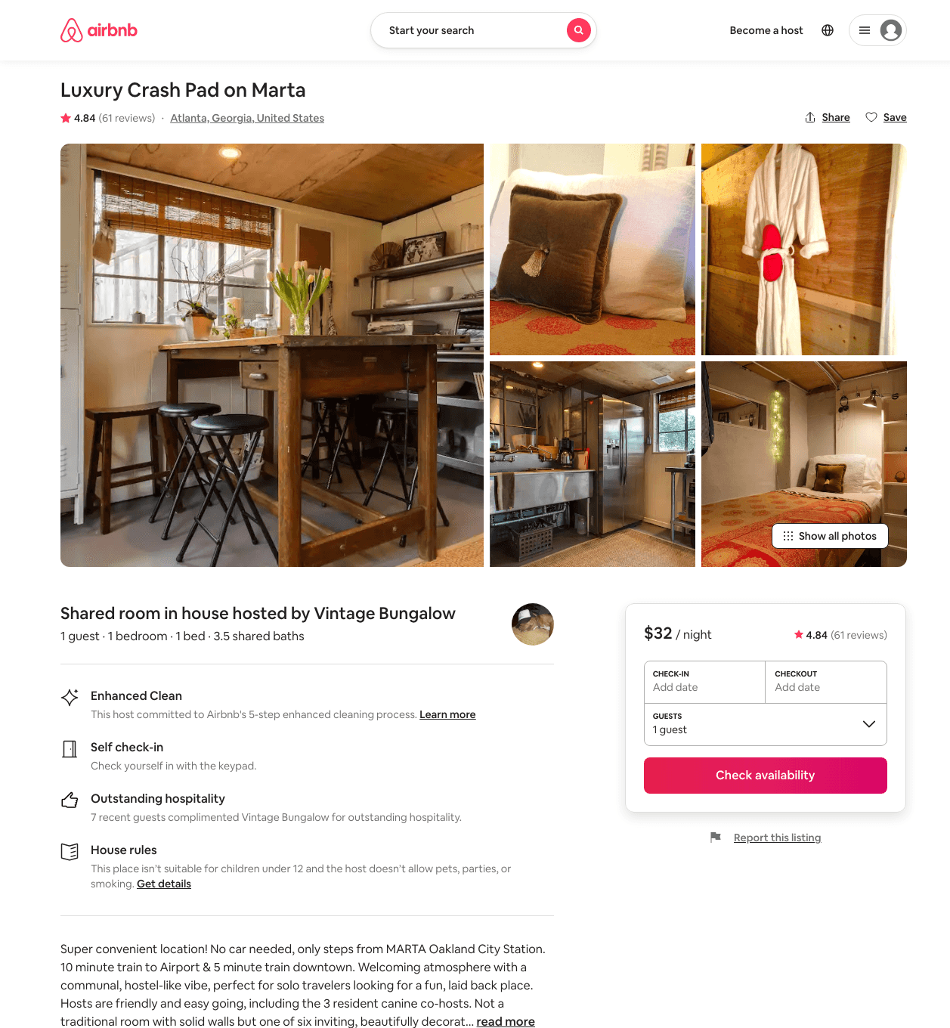
Listing 3480353
1
1
$32 - $36
4.82
3
Vintage Bungalow
2510032
14
https://www.airbnb.com/rooms/3480353
Aug 2022

Slide 12
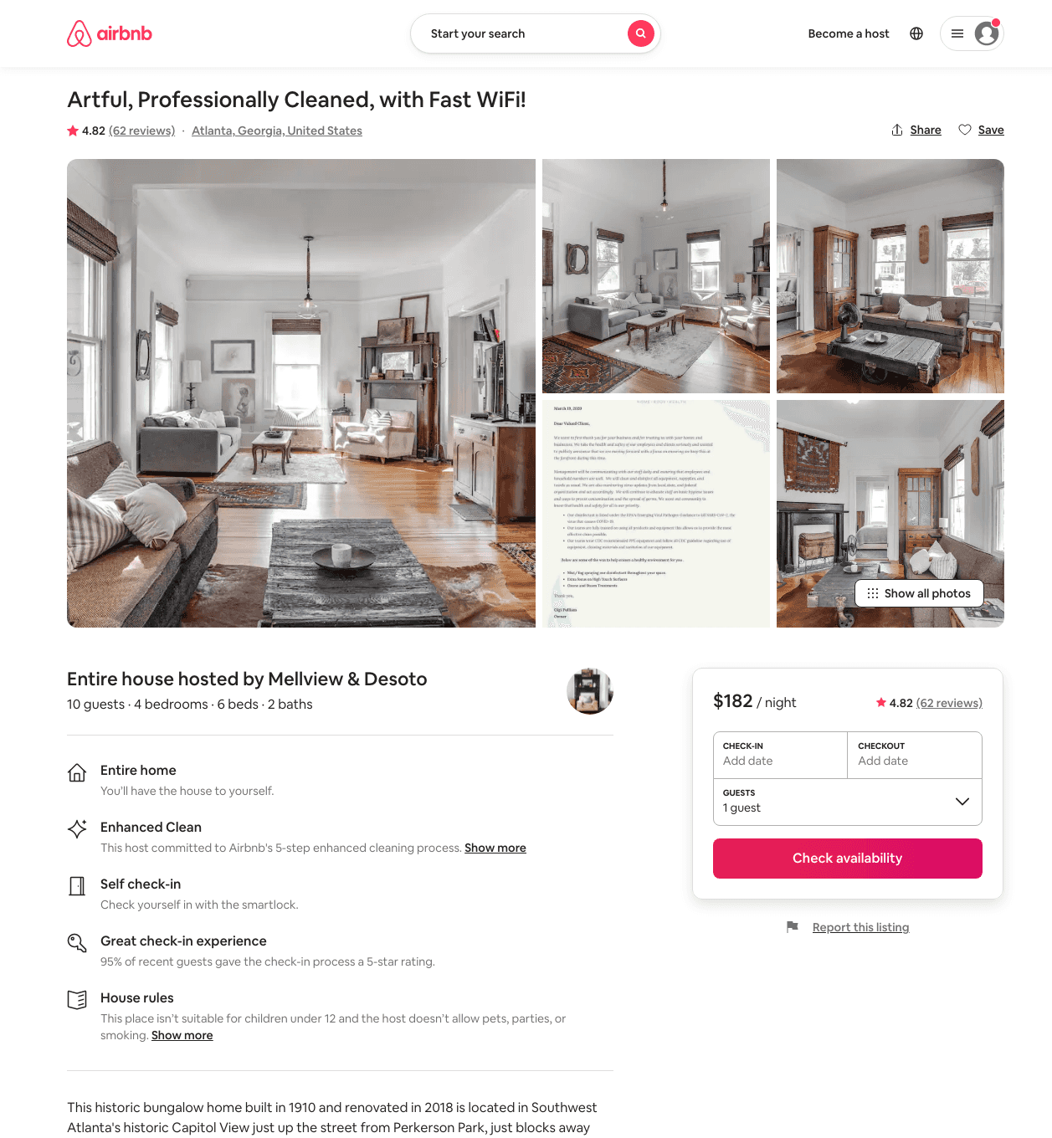
Listing 24066071
4
10
$131 - $187
4.83
3
Mellview And Desoto
5950866
2
https://www.airbnb.com/rooms/24066071
Aug 2022

Slide 13
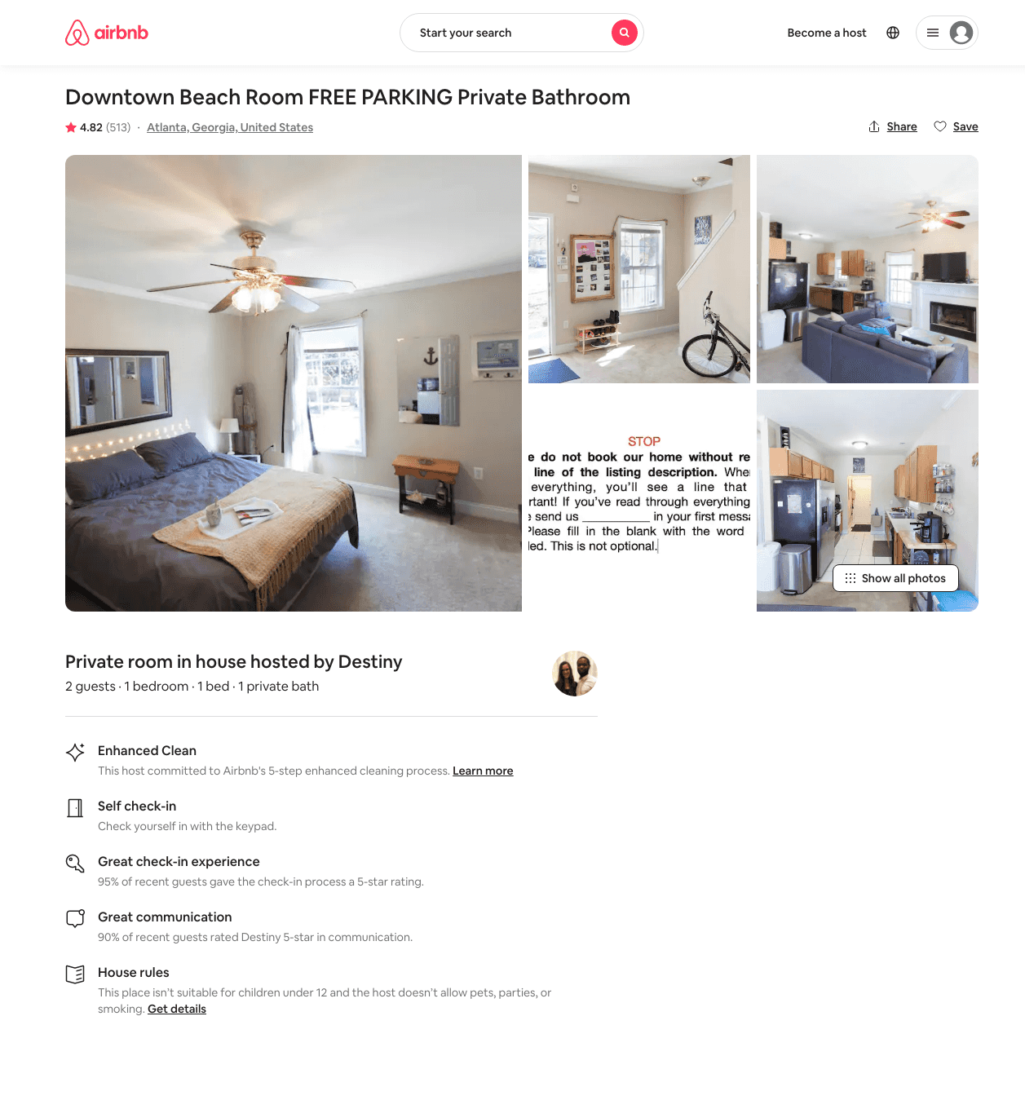
Listing 20755390
1
2
$31 - $70
4.82
1
Destiny
127211807
4
https://www.airbnb.com/rooms/20755390
Aug 2022

Slide 14
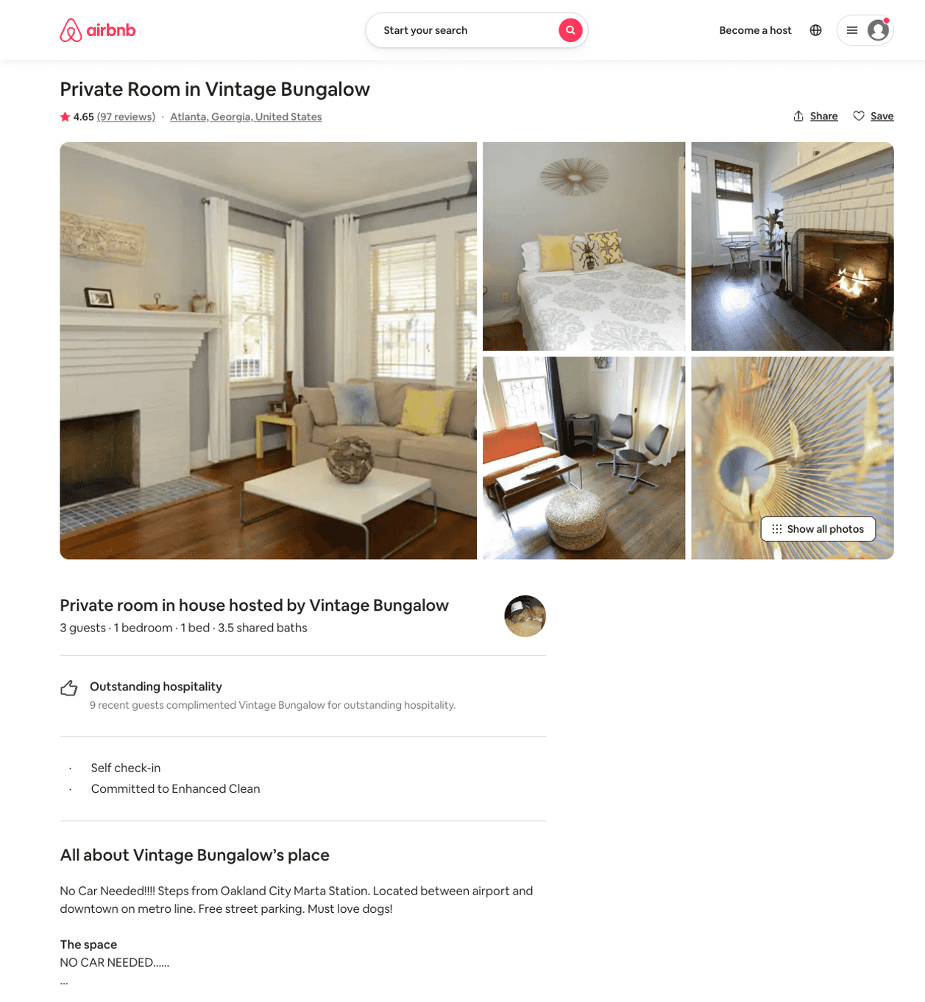
Listing 831505
1
3
$42
4.66
3
Vintage Bungalow
2510032
14
https://www.airbnb.com/rooms/831505
Jul 2022

Slide 15
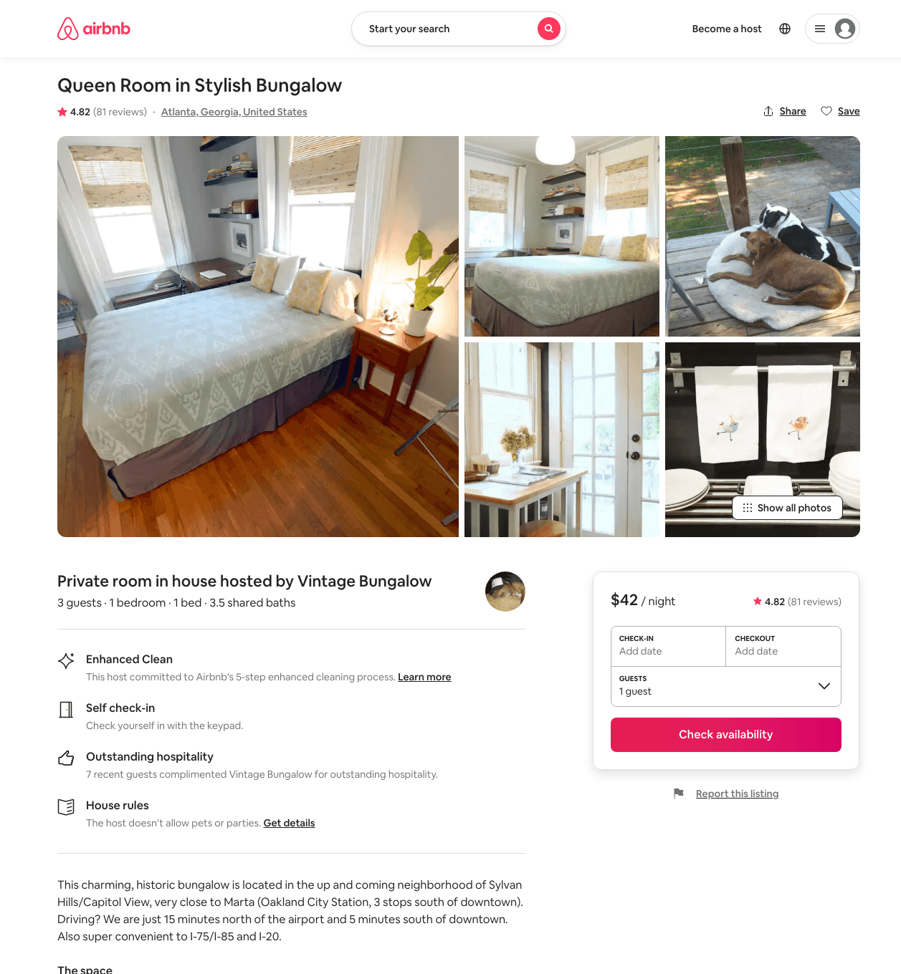
Listing 509476
1
3
$42 - $45
4.83
3
Vintage Bungalow
2510032
14
https://www.airbnb.com/rooms/509476
Jul 2022

Slide 16
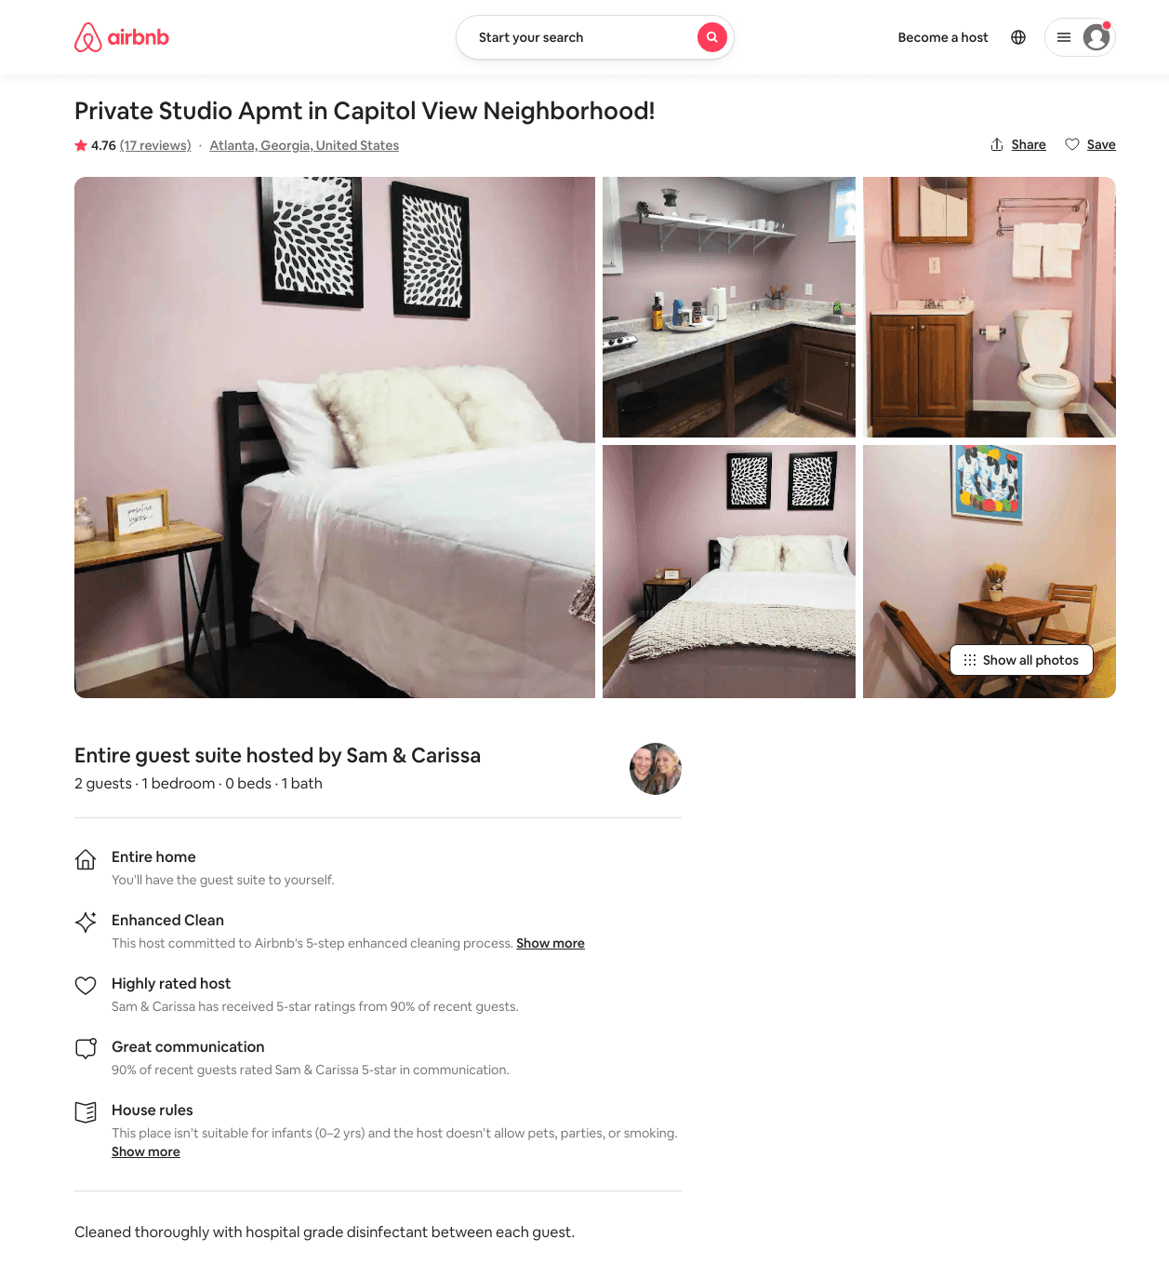
Listing 29981420
1
2
$33 - $233
4.71
28
Sam & Carissa
15489385
3
https://www.airbnb.com/rooms/29981420
Jun 2022

Slide 17
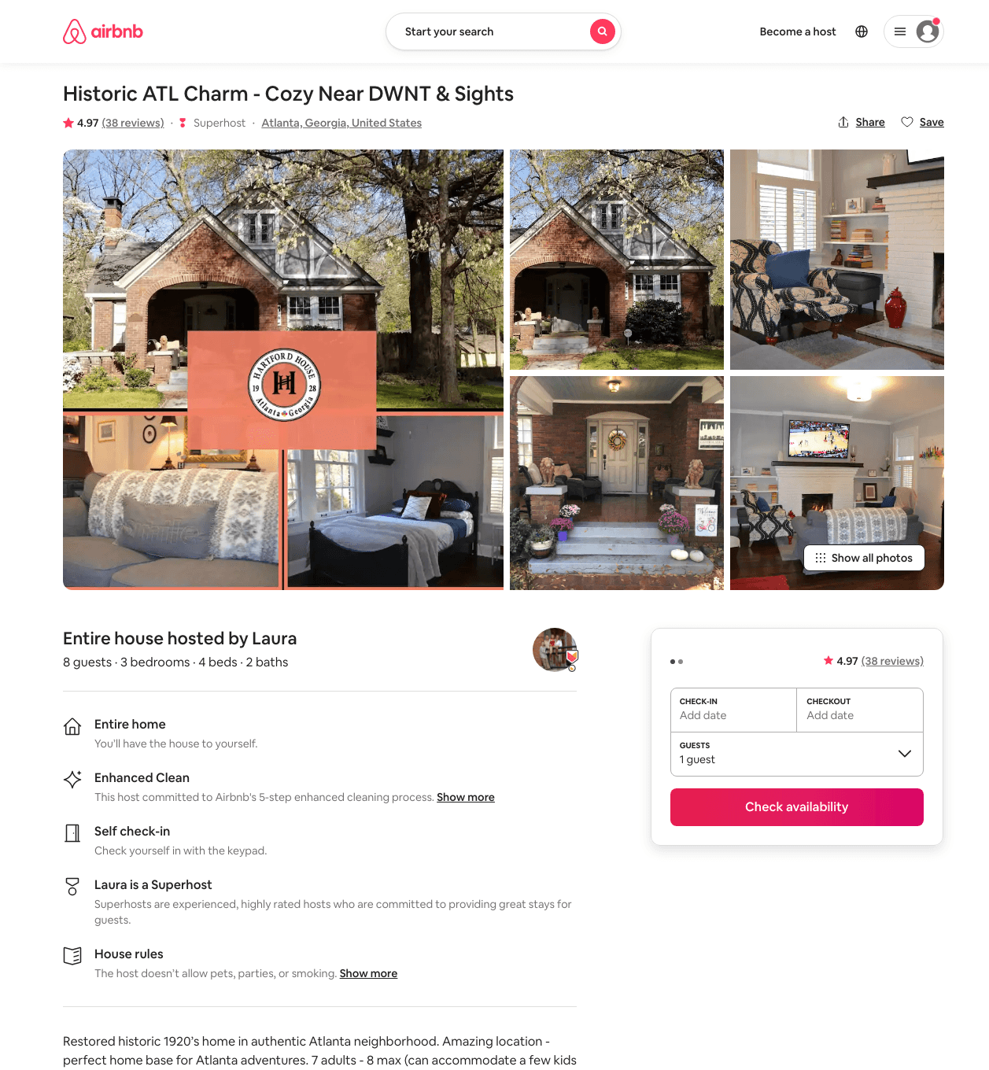
Listing 27954900
3
8
$186 - $243
4.98
2
Laura
187132756
3
https://www.airbnb.com/rooms/27954900
Jun 2022

Slide 18
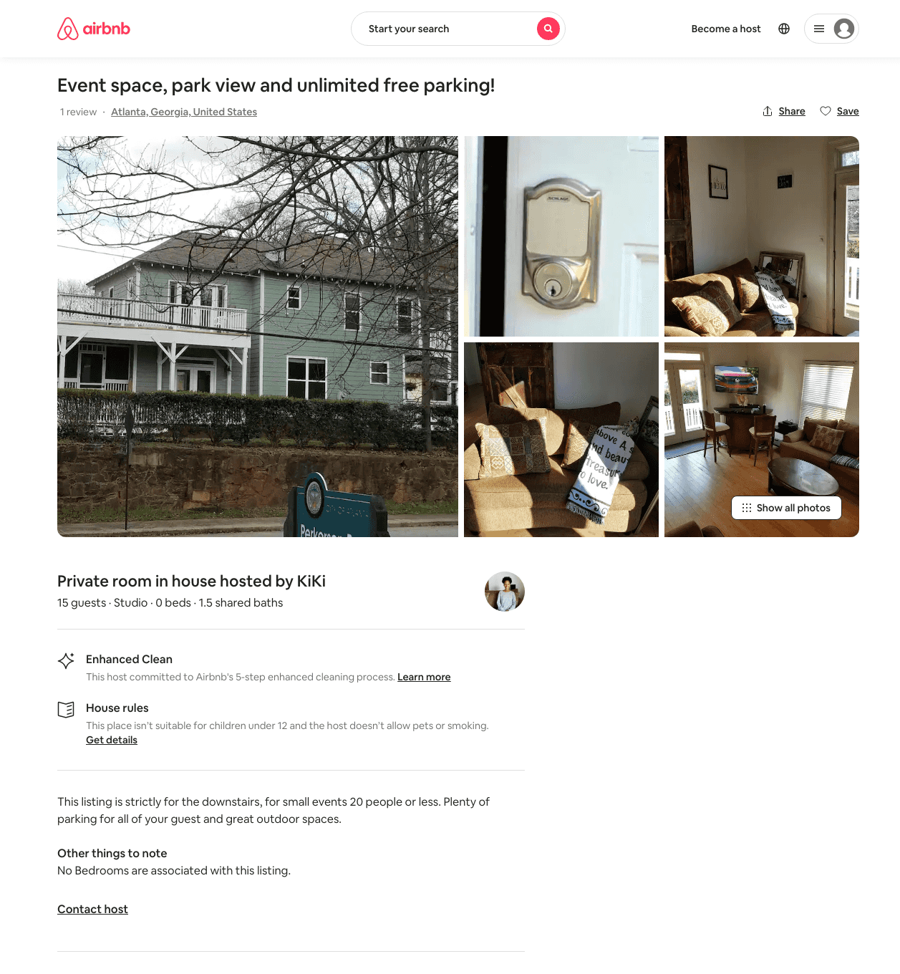
Listing 47713610
Studio
15
$500
1
KiKi
195492875
3
https://www.airbnb.com/rooms/47713610
Aug 2022

Slide 19
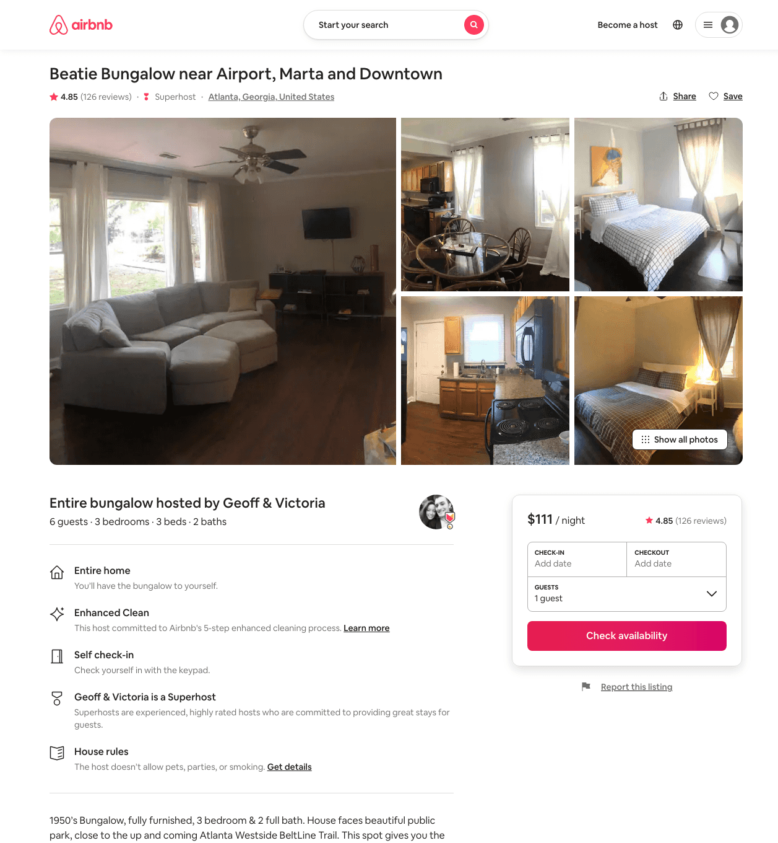
Listing 31147819
3
6
$104 - $150
4.84
3
Geoff & Victoria
41905899
1
https://www.airbnb.com/rooms/31147819
Aug 2022

Slide 20
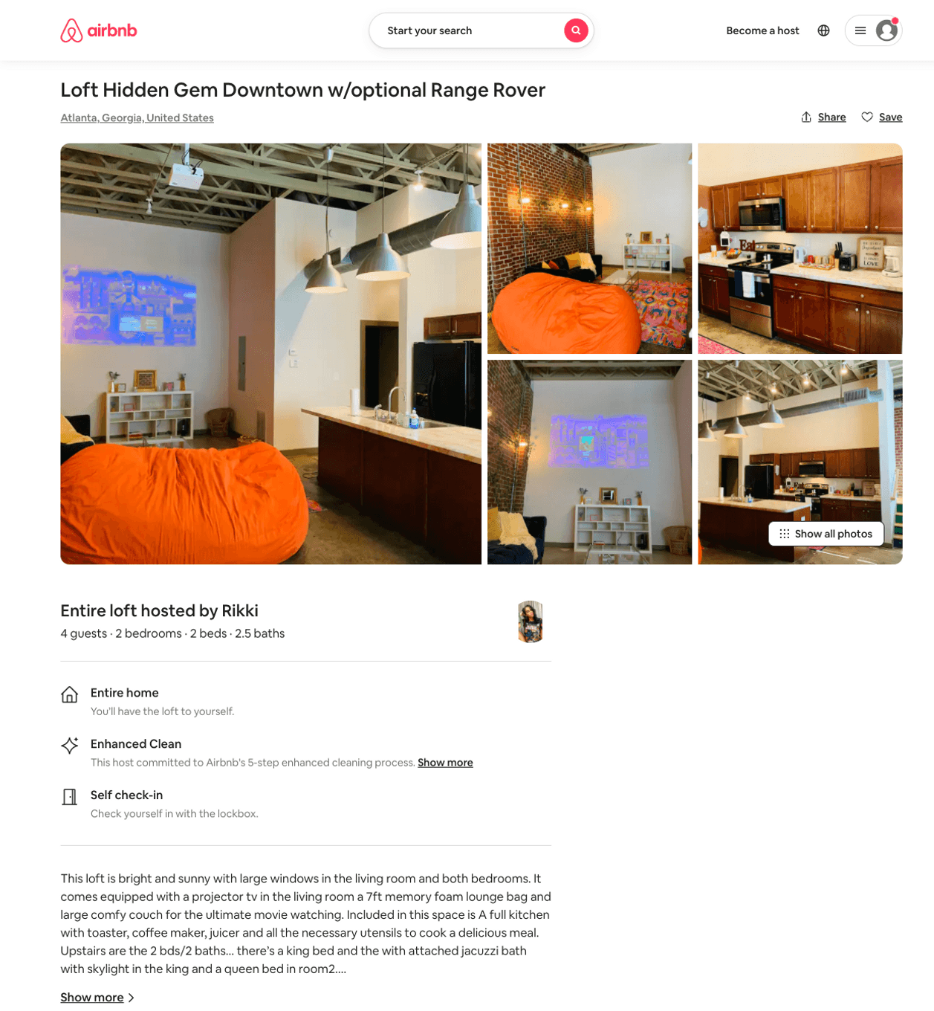
Listing 49636216
2
4
$108 - $240
4.76
28
Rikki
58477068
3
https://www.airbnb.com/rooms/49636216
Aug 2022

Slide 21
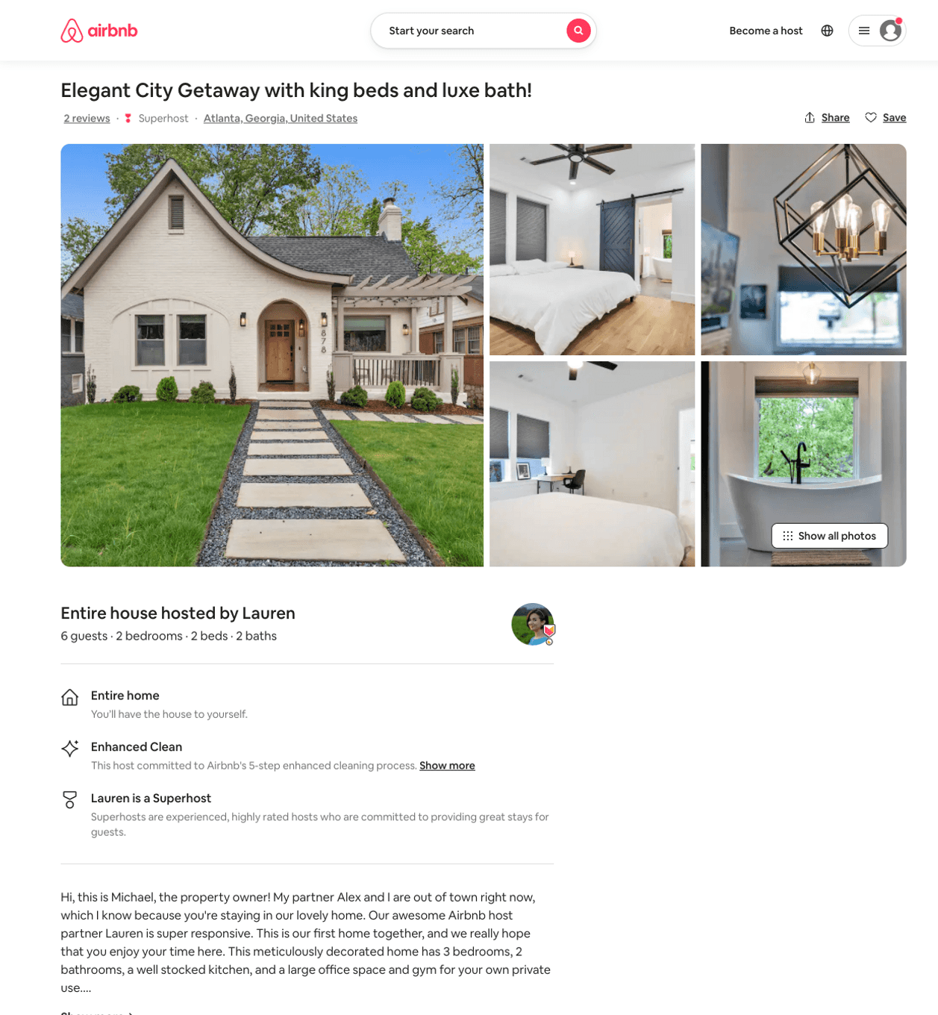
Listing 50753213
3
6
$121 - $250
4.65
2
Lauren
132056933
15
https://www.airbnb.com/rooms/50753213
Aug 2022

Slide 22
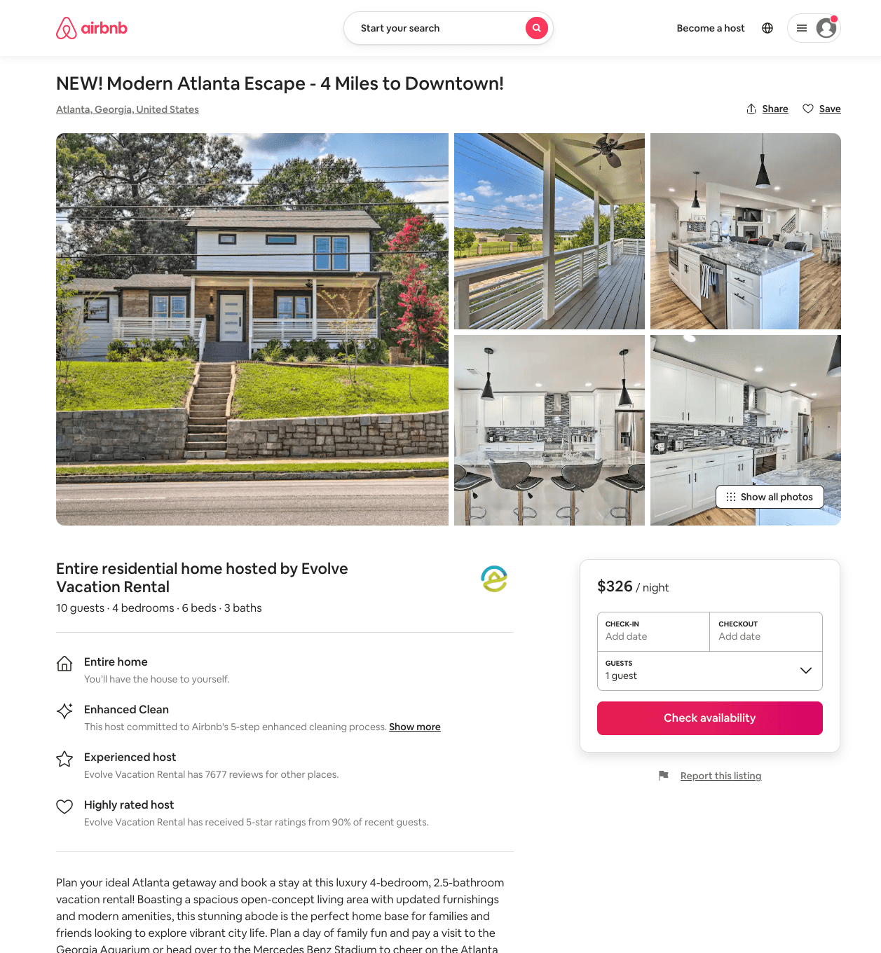
Listing 51284087
4
10
$235 - $436
4.48
3
Evolve
121682456
51
https://www.airbnb.com/rooms/51284087
Aug 2022

Slide 23
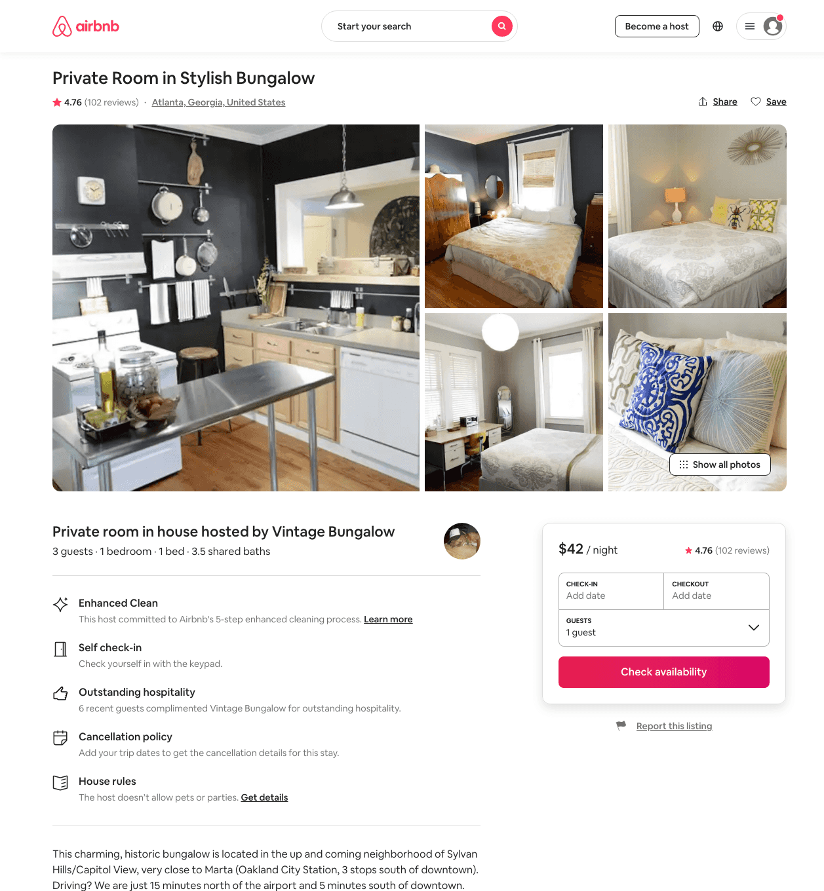
Listing 544018
1
3
$42 - $43
4.75
3
Vintage Bungalow
2510032
14
https://www.airbnb.com/rooms/544018
Aug 2022

Slide 24
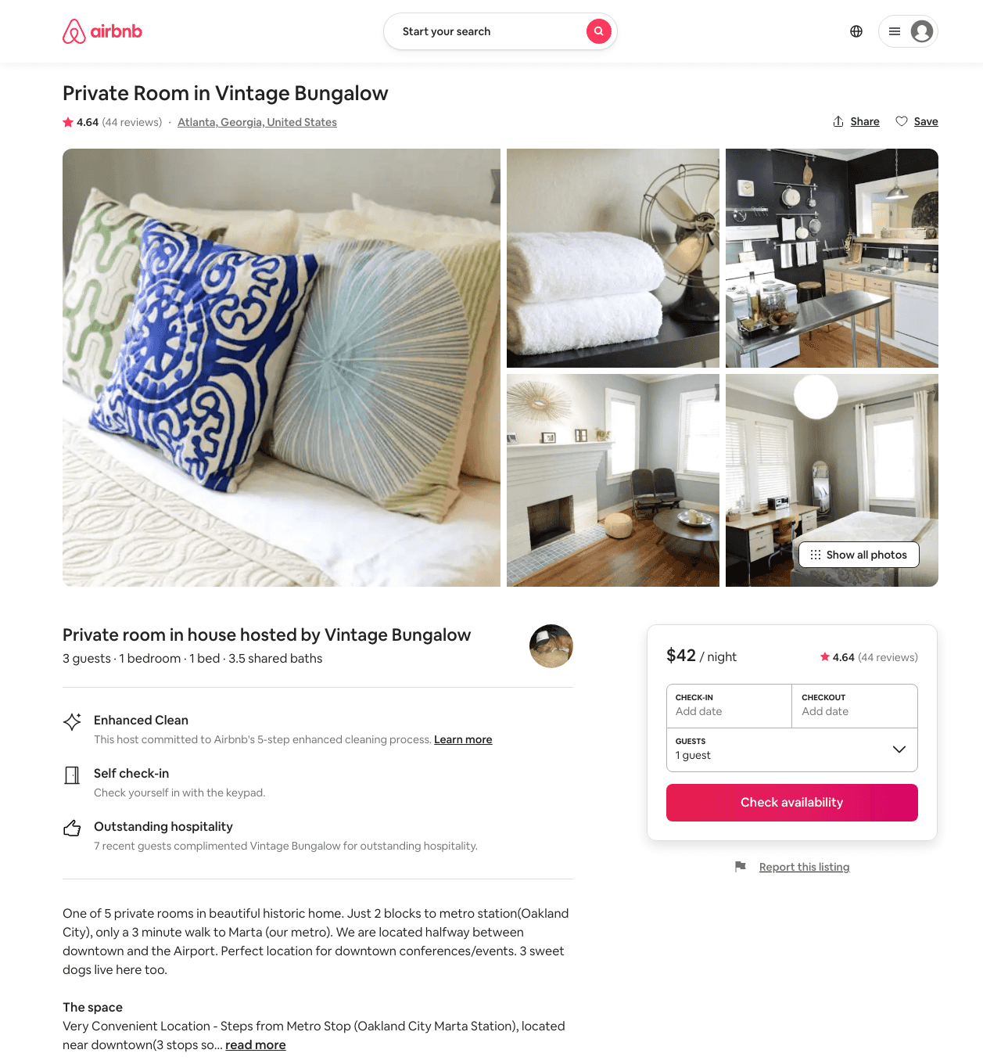
Listing 1322871
1
3
$42
4.67
3
Vintage Bungalow
2510032
14
https://www.airbnb.com/rooms/1322871
Aug 2022

Slide 25
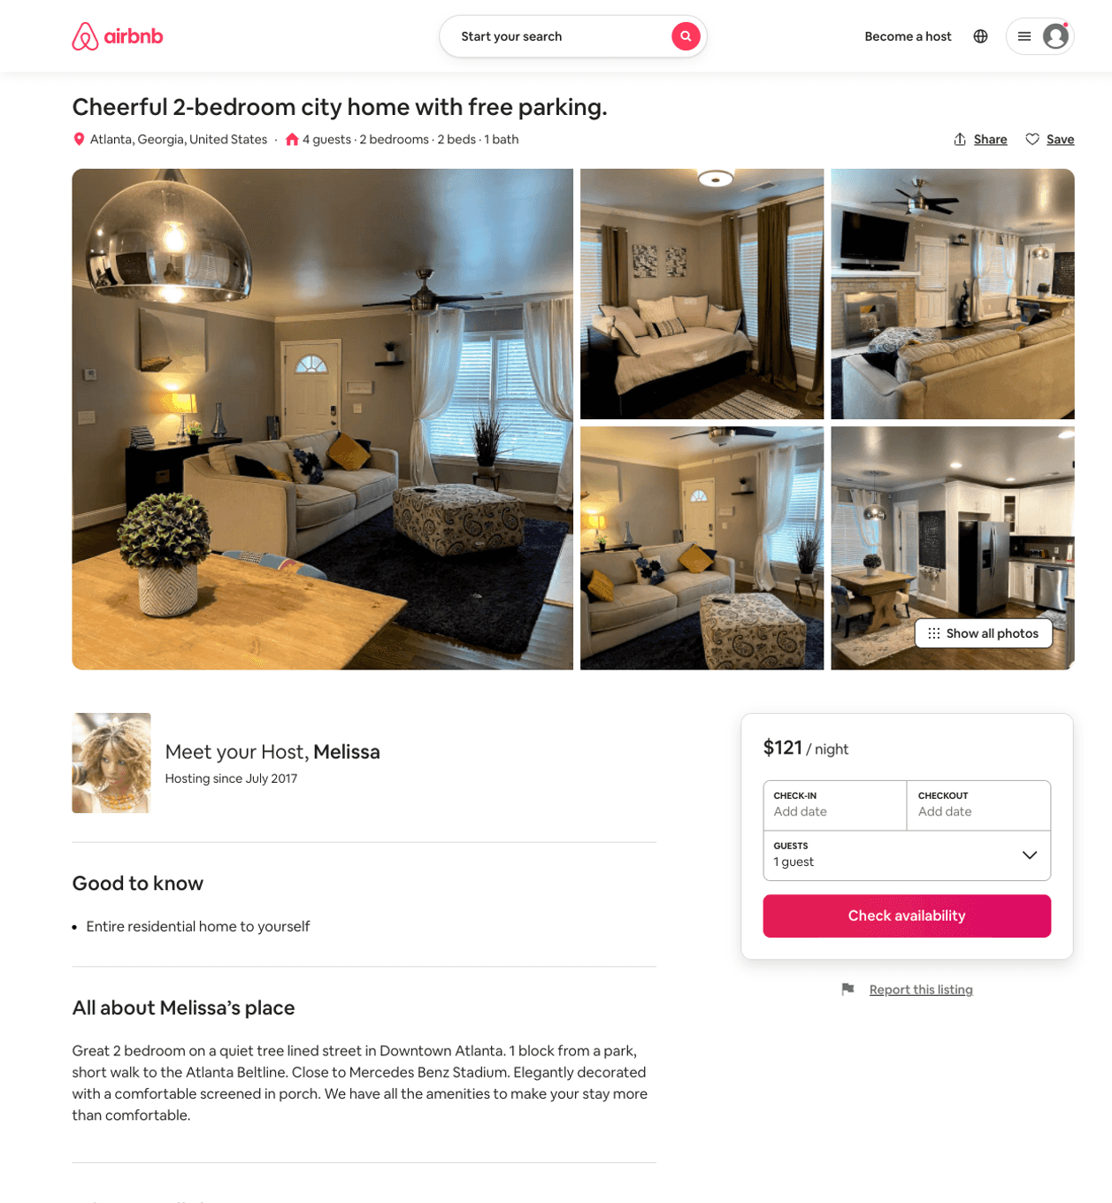
Listing 51903710
2
4
$75 - $132
4.89
3
Melissa
141541770
1
https://www.airbnb.com/rooms/51903710
Jun 2022

Slide 26
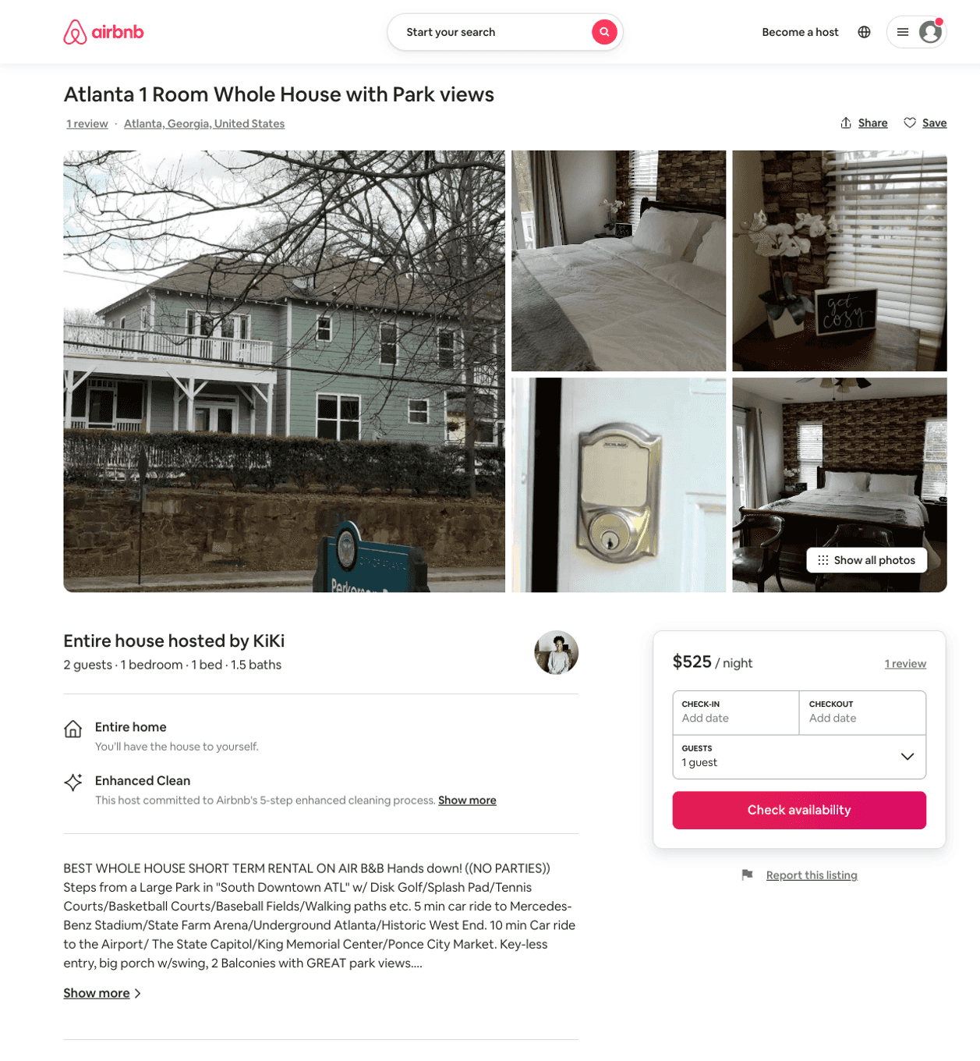
Listing 31262014
1
2
$525
2
KiKi
195492875
3
https://www.airbnb.com/rooms/31262014
Aug 2022

Slide 27
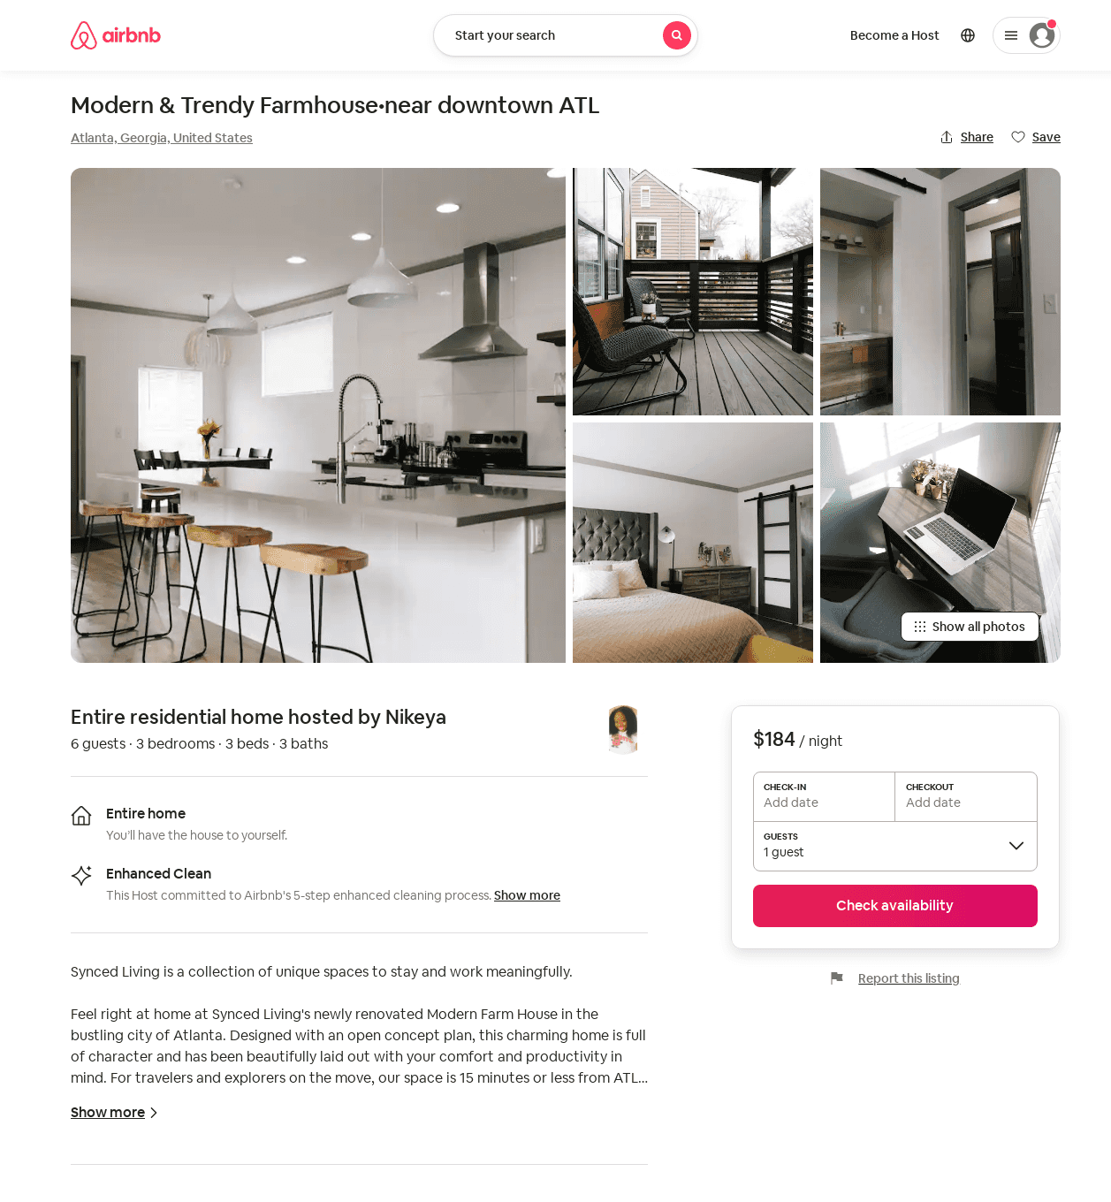
Listing 50549028
3
6
$126 - $327
4.90
2
Nikeya
33474008
1
https://www.airbnb.com/rooms/50549028
Aug 2022

Slide 28
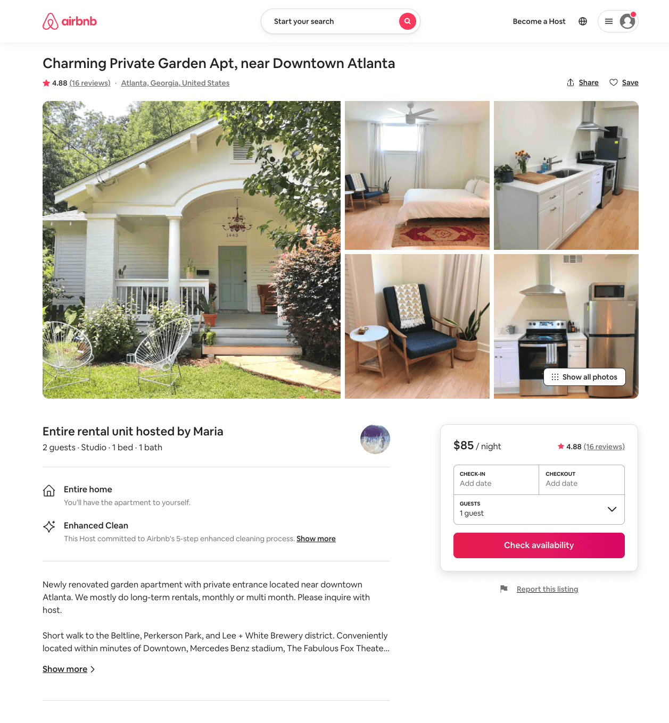
Listing 43799212
Studio
1
$85
4.88
2
Maria
27215775
2
https://www.airbnb.com/rooms/43799212
Aug 2022

Slide 29
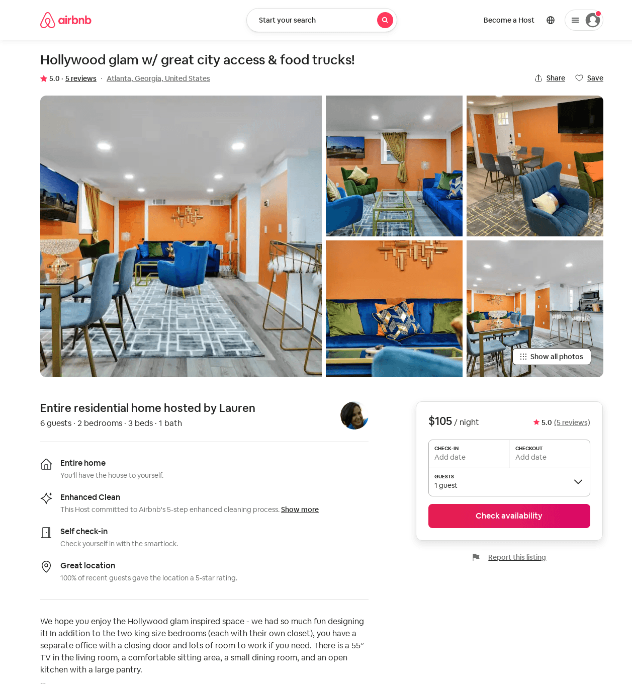
Listing 52388957
2
6
$81 - $126
4.50
2
Lauren
132056933
15
https://www.airbnb.com/rooms/52388957
Aug 2022

Slide 30
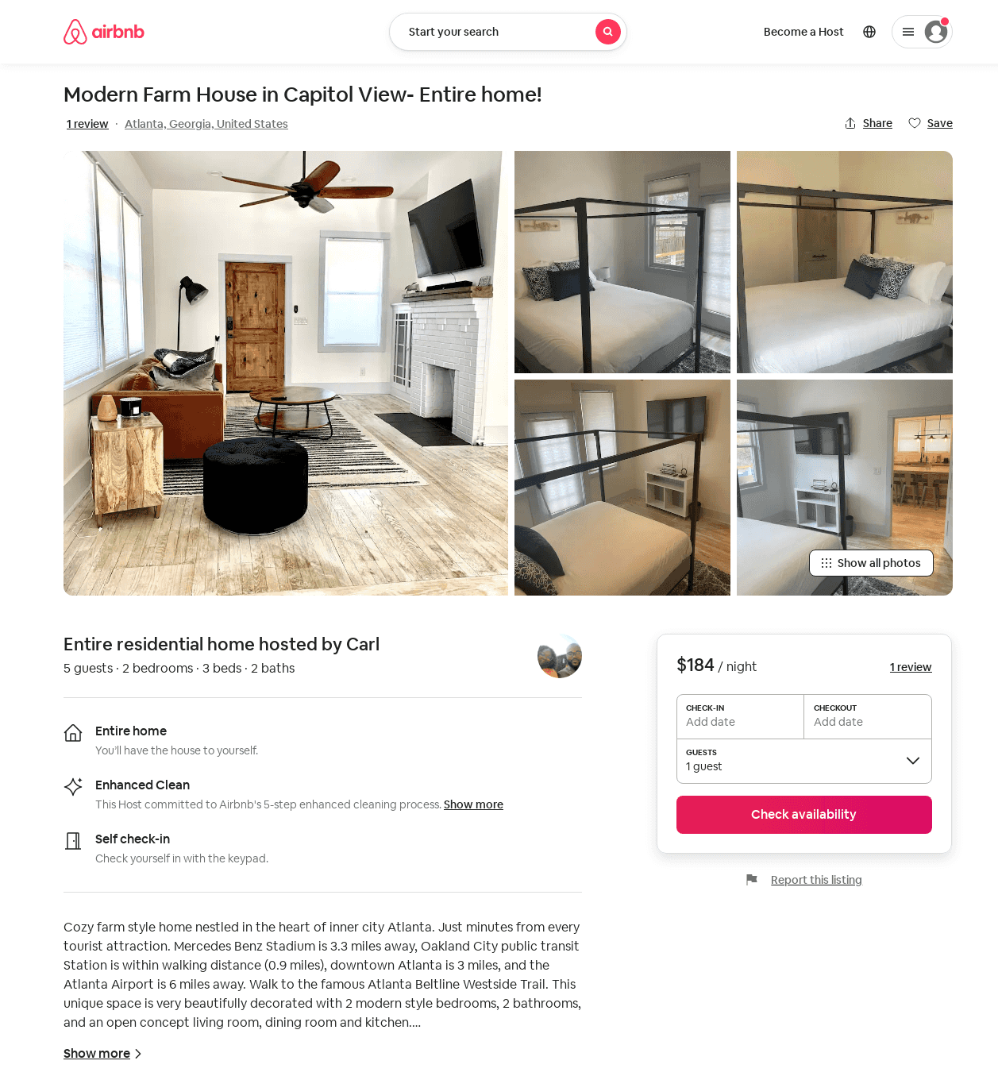
Listing 53826535
2
5
$106 - $184
4.54
2
Nicole
468527252
1
https://www.airbnb.com/rooms/53826535
Aug 2022

Slide 31
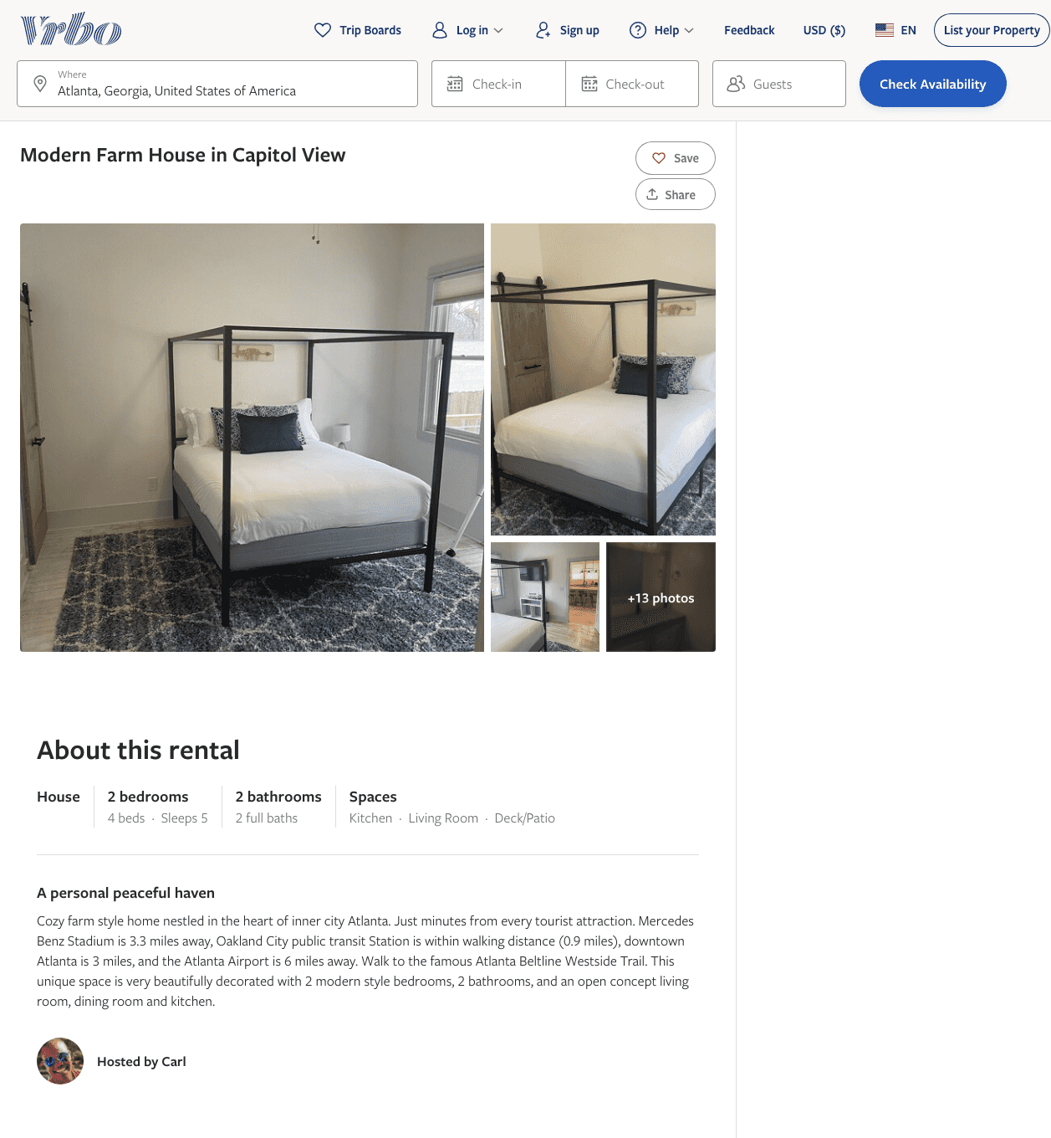
Listing 2600306
2
5
$144 - $205
3
Carl
https://www.vrbo.com/2600306
Aug 2022

Slide 32
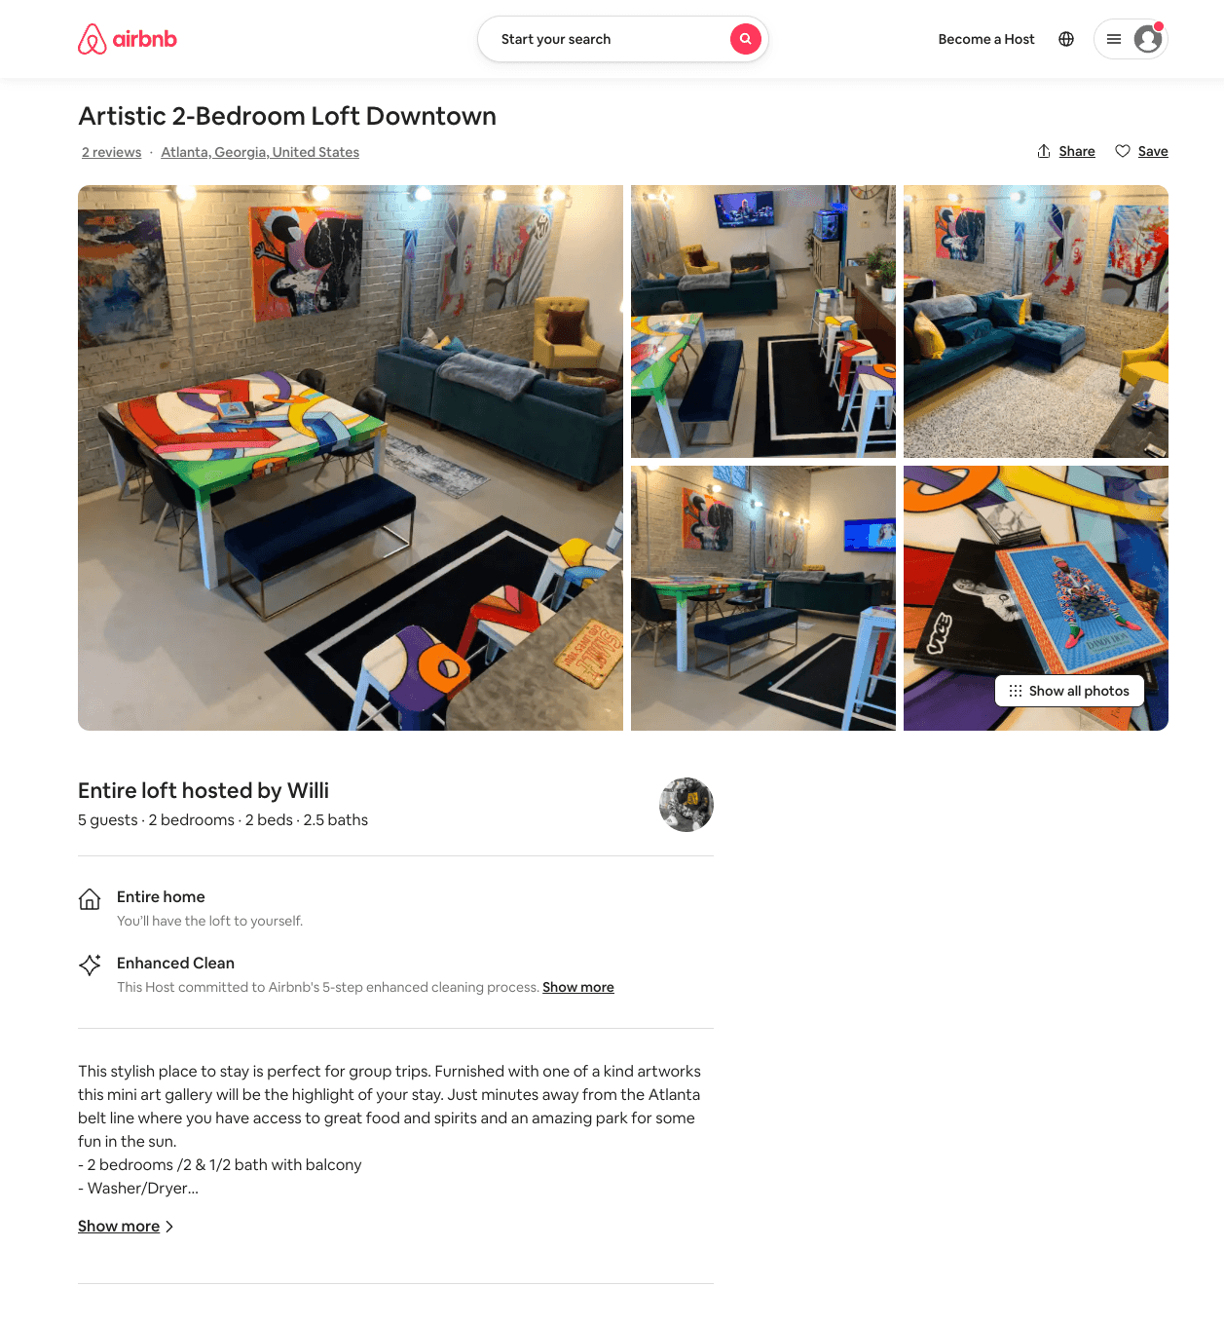
Listing 53717265
2
5
$207 - $225
5.0
1
Willi
232975431
1
https://www.airbnb.com/rooms/53717265
Aug 2022

Slide 33
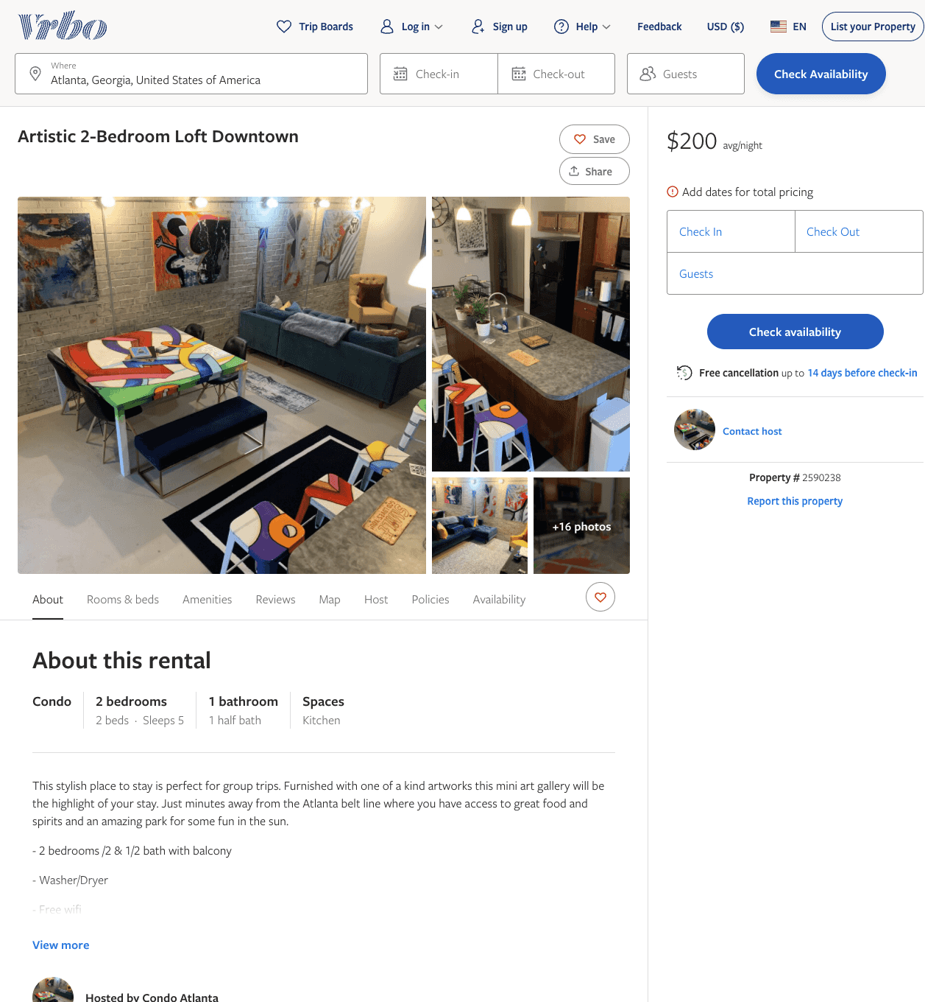
Listing 2590238
2
5
$200 - $225
5
1
Willi Millions
https://www.vrbo.com/2590238
Aug 2022

Slide 34
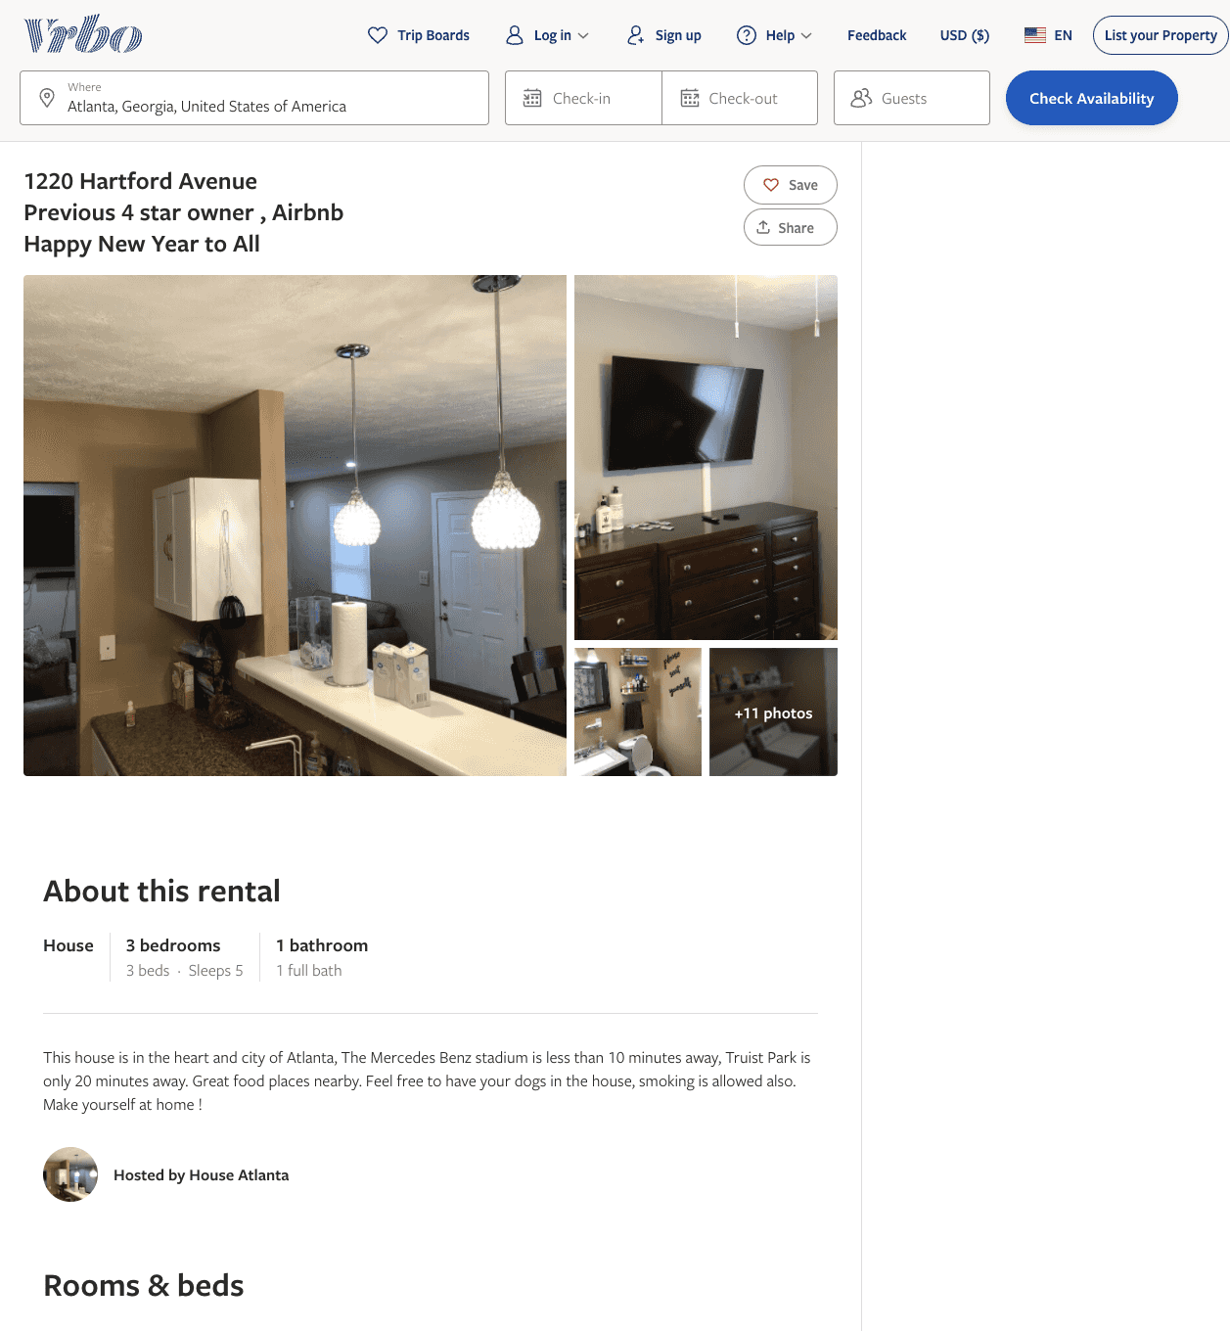
Listing 2604180
3
5
$80
80
https://www.vrbo.com/2604180
Aug 2022

Slide 35
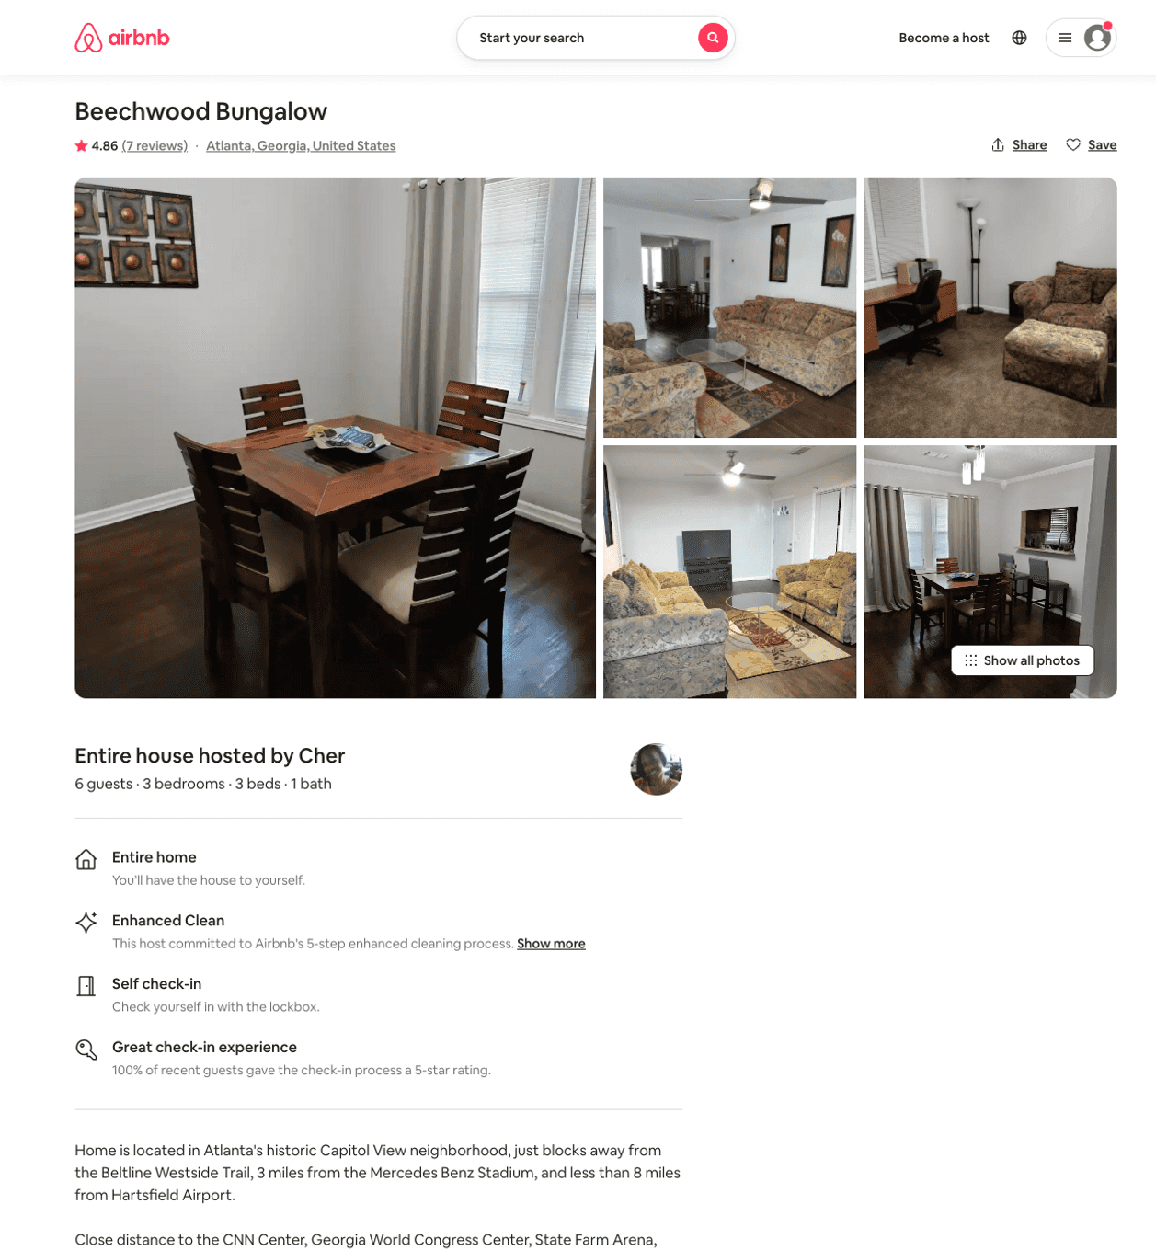
Listing 48509202
3
6
$80 - $94
4.83
2
Cher
5615664
1
https://www.airbnb.com/rooms/48509202
Aug 2022

Slide 36
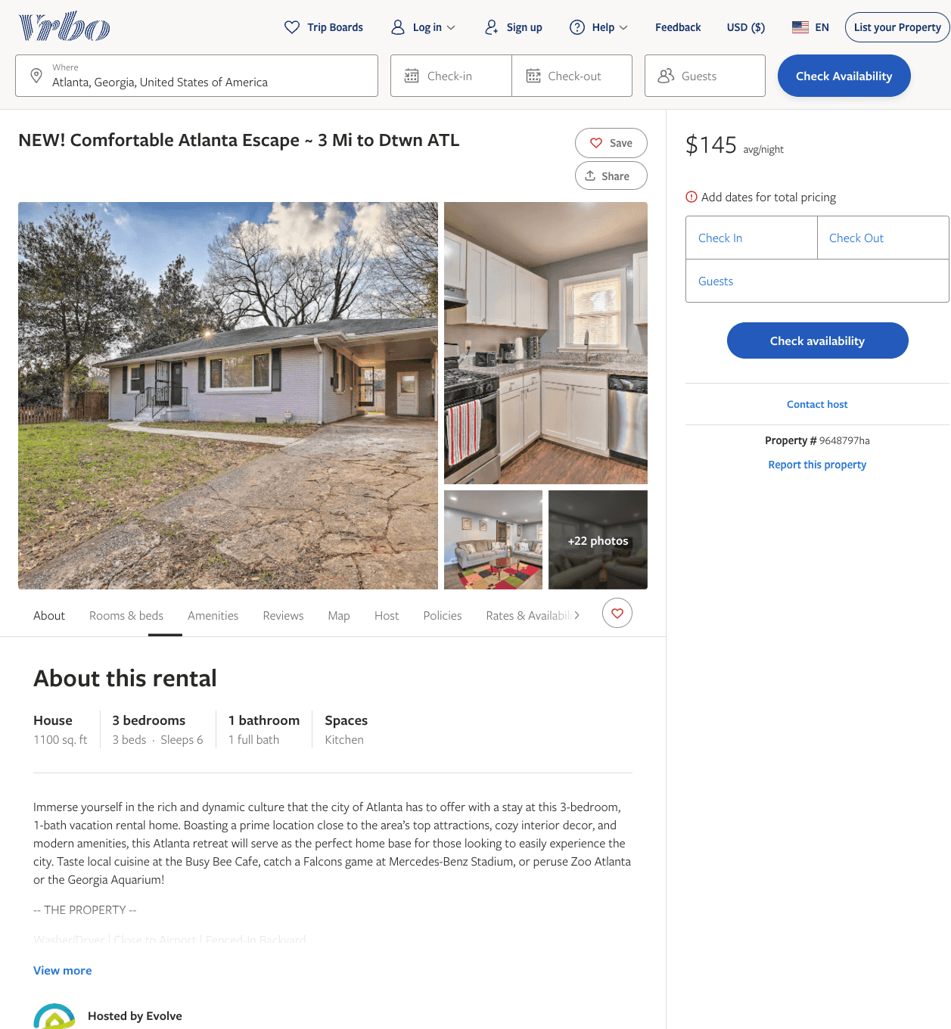
Listing 9648797
3
6
$99
1
2
Evolve
https://www.vrbo.com/9648797ha
Aug 2022

Slide 37
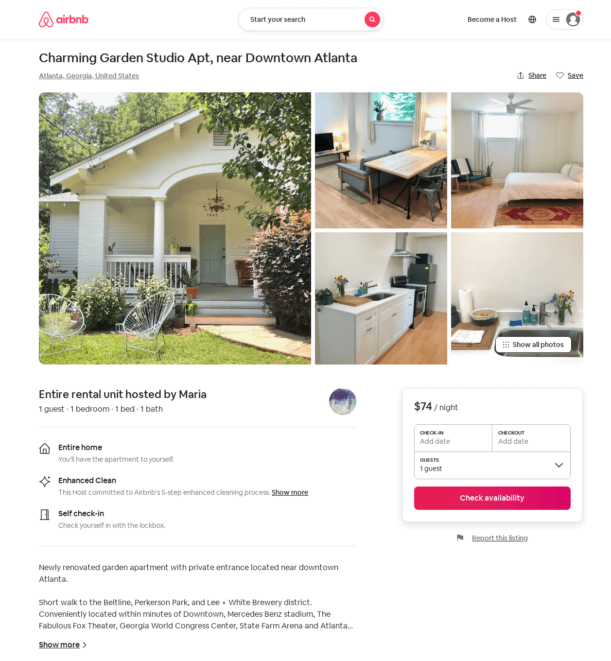
Listing 45637369
1
1
$74
30
Maria
27215775
2
https://www.airbnb.com/rooms/45637369
Jul 2022

Slide 38
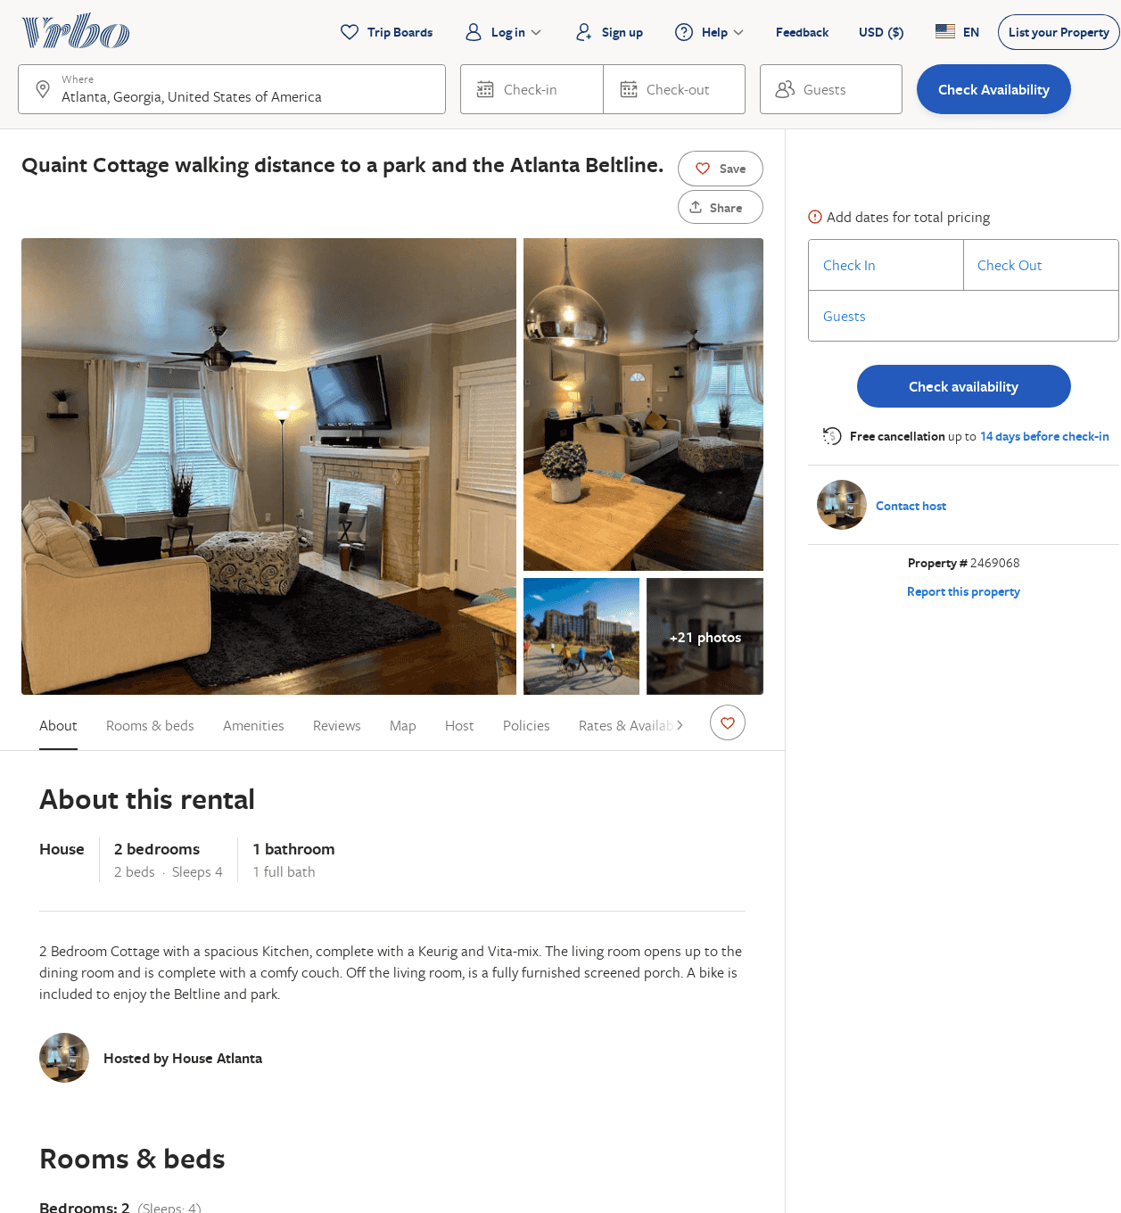
Listing 2469068
2
4
$102
3
Melissa
https://www.vrbo.com/2469068
Aug 2022

Slide 39
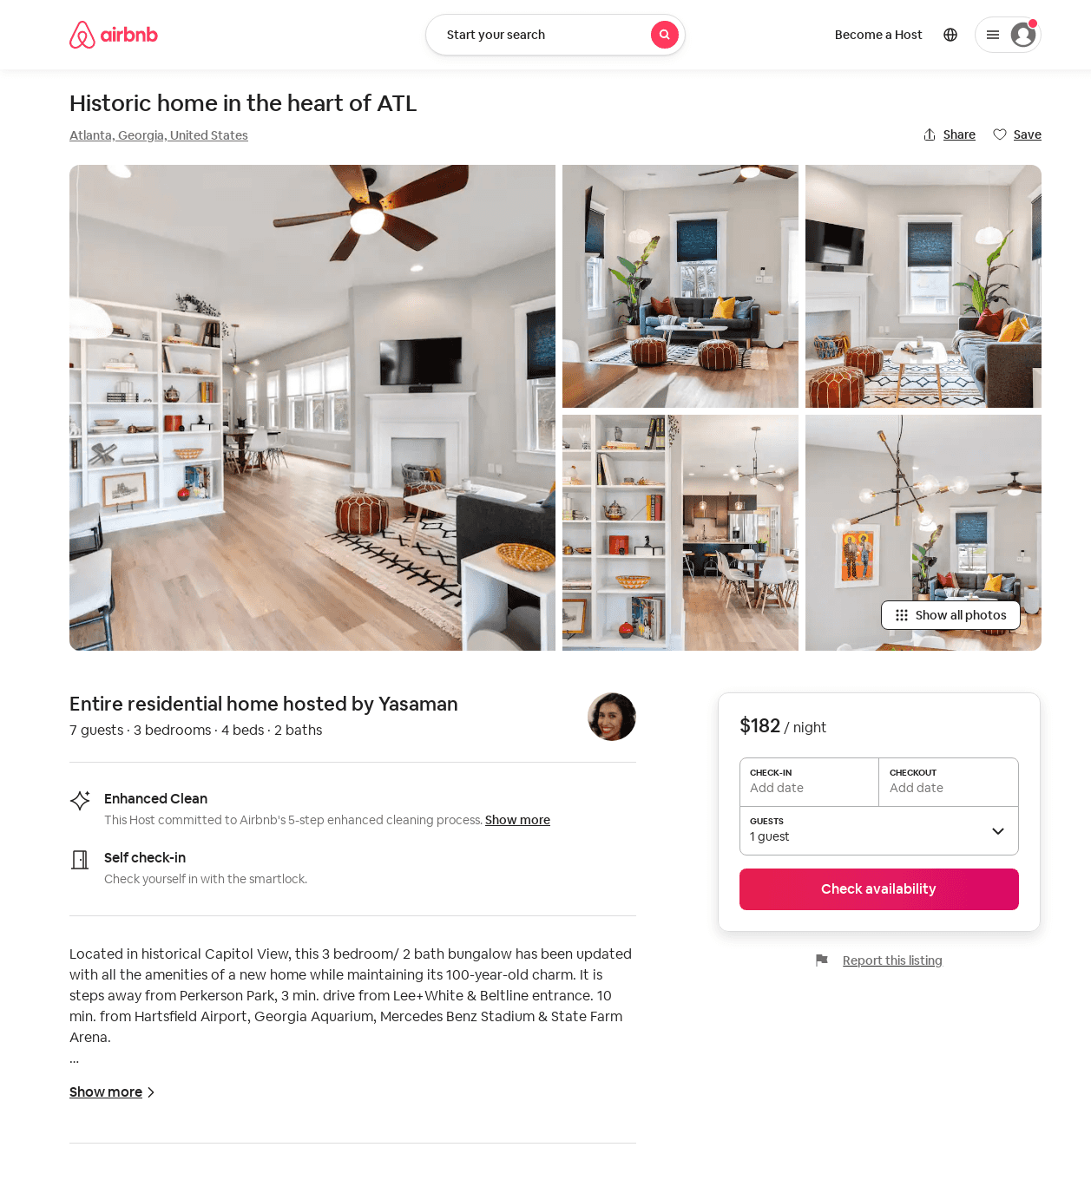
Listing 52924829
3
7
$145 - $185
4.94
3
Yasaman
1800427
1
https://www.airbnb.com/rooms/52924829
Aug 2022

Slide 40
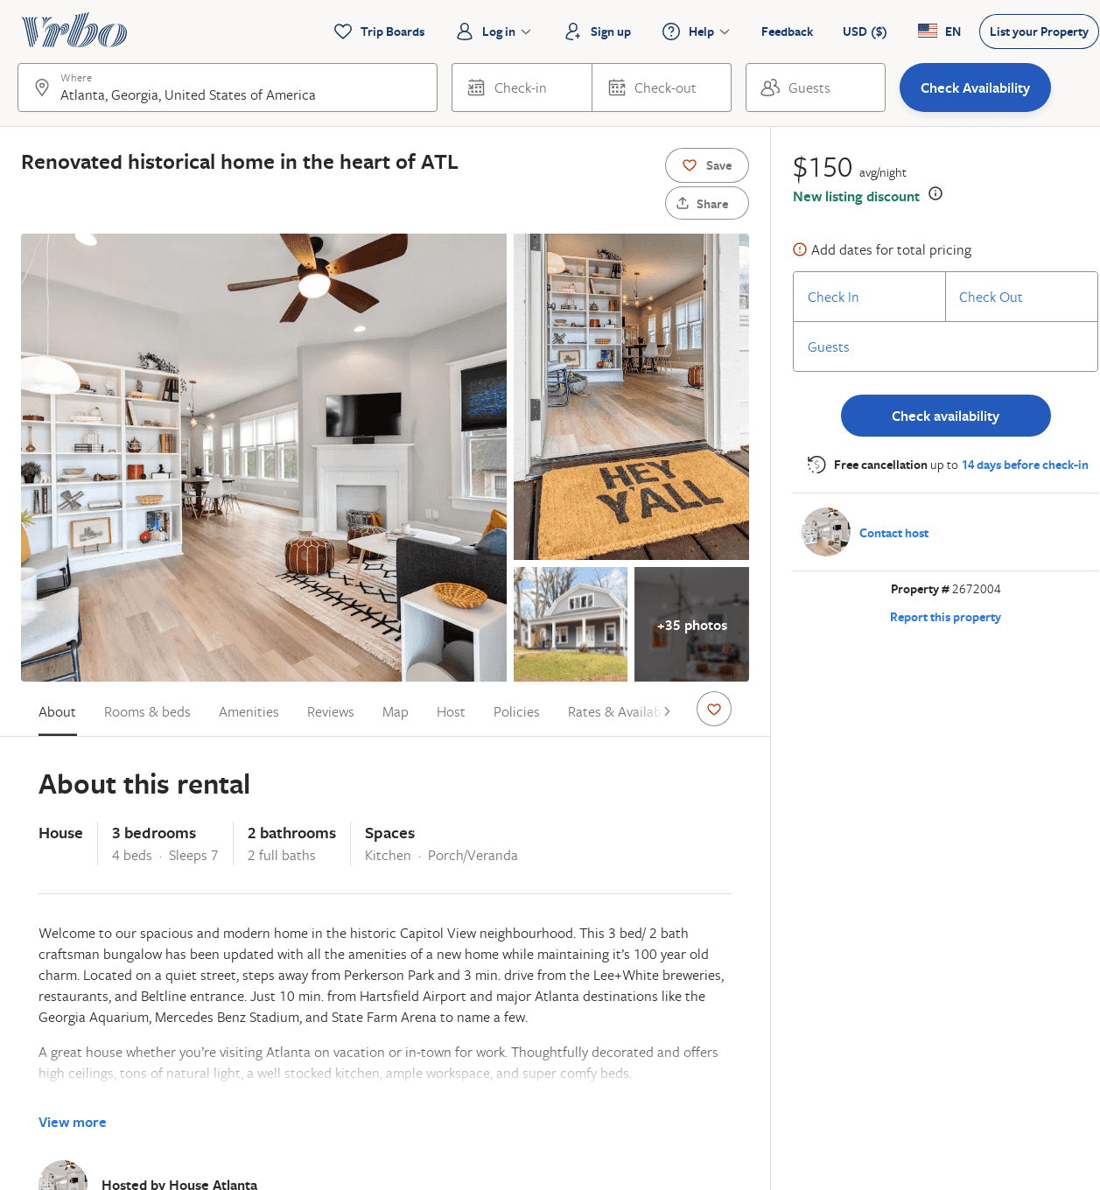
Listing 2672004
3
7
$201
3
Yasmine Molavi
https://www.vrbo.com/2672004
Aug 2022

Slide 41
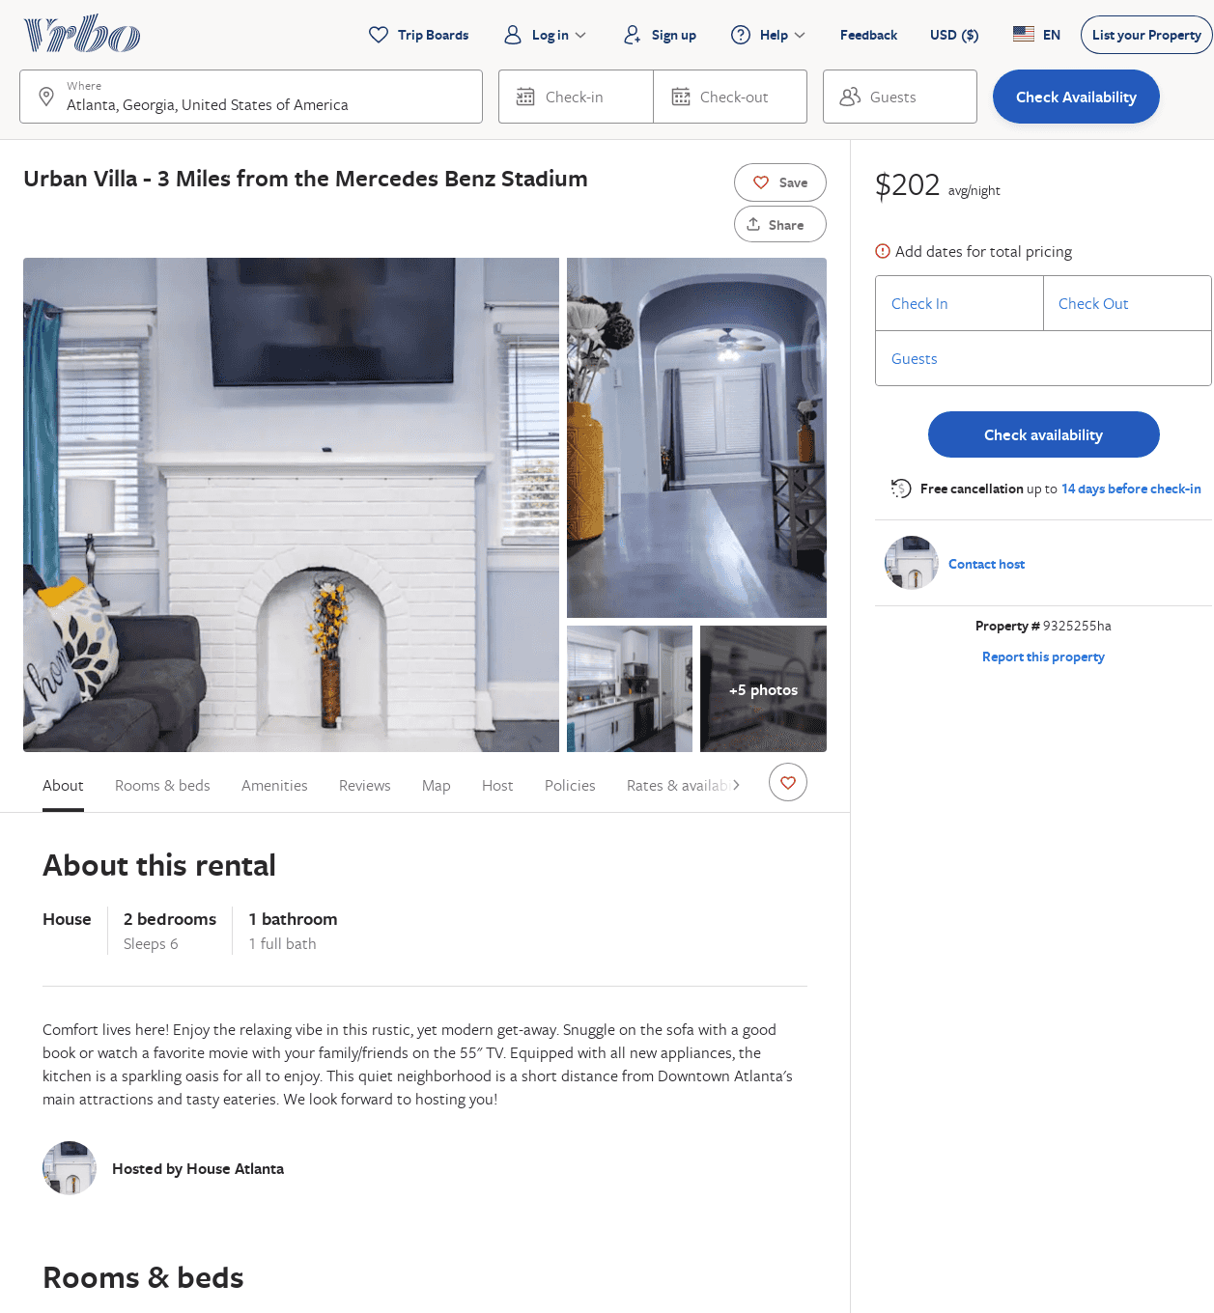
Listing 9325255
2
6
$145
1
https://www.vrbo.com/9325255ha
Aug 2022

Slide 42
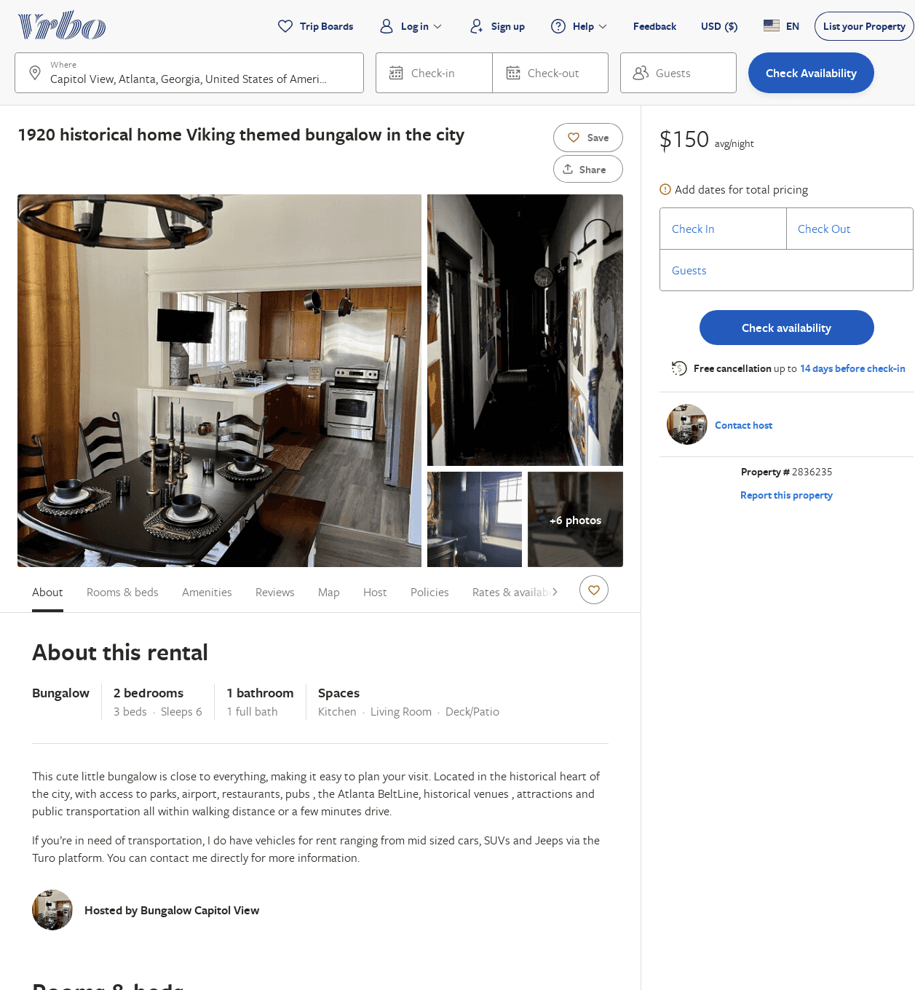
Listing 2836235
2
6
$150
2
https://www.vrbo.com/2836235
Aug 2022

Slide 43
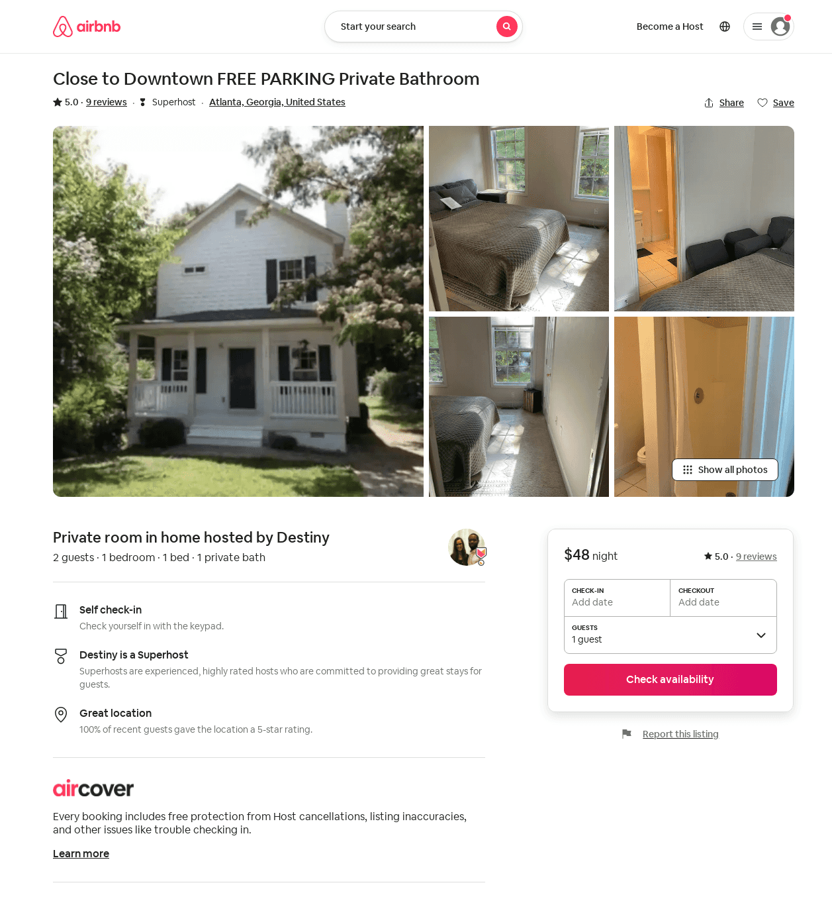
Listing 20830409
1
2
5.0
1
Destiny
127211807
4
https://www.airbnb.com/rooms/20830409
Aug 2022

Slide 44
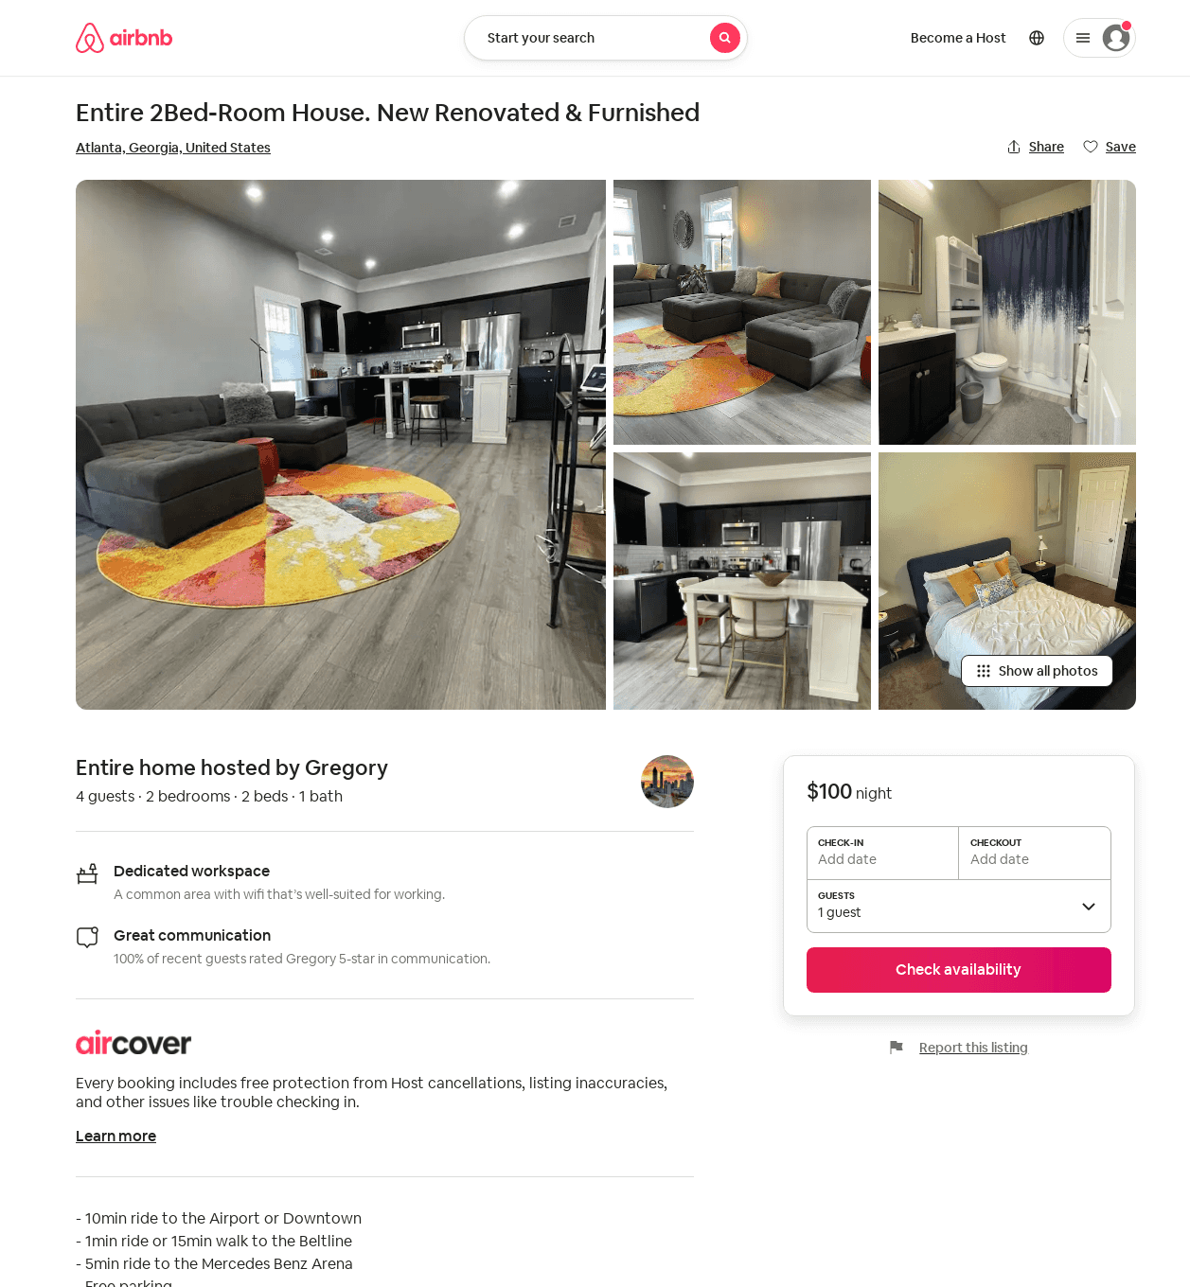
Listing 675502775572161500
2
4
3
Gregory
233693121
2
https://www.airbnb.com/rooms/675502775572161500
Aug 2022

Slide 45
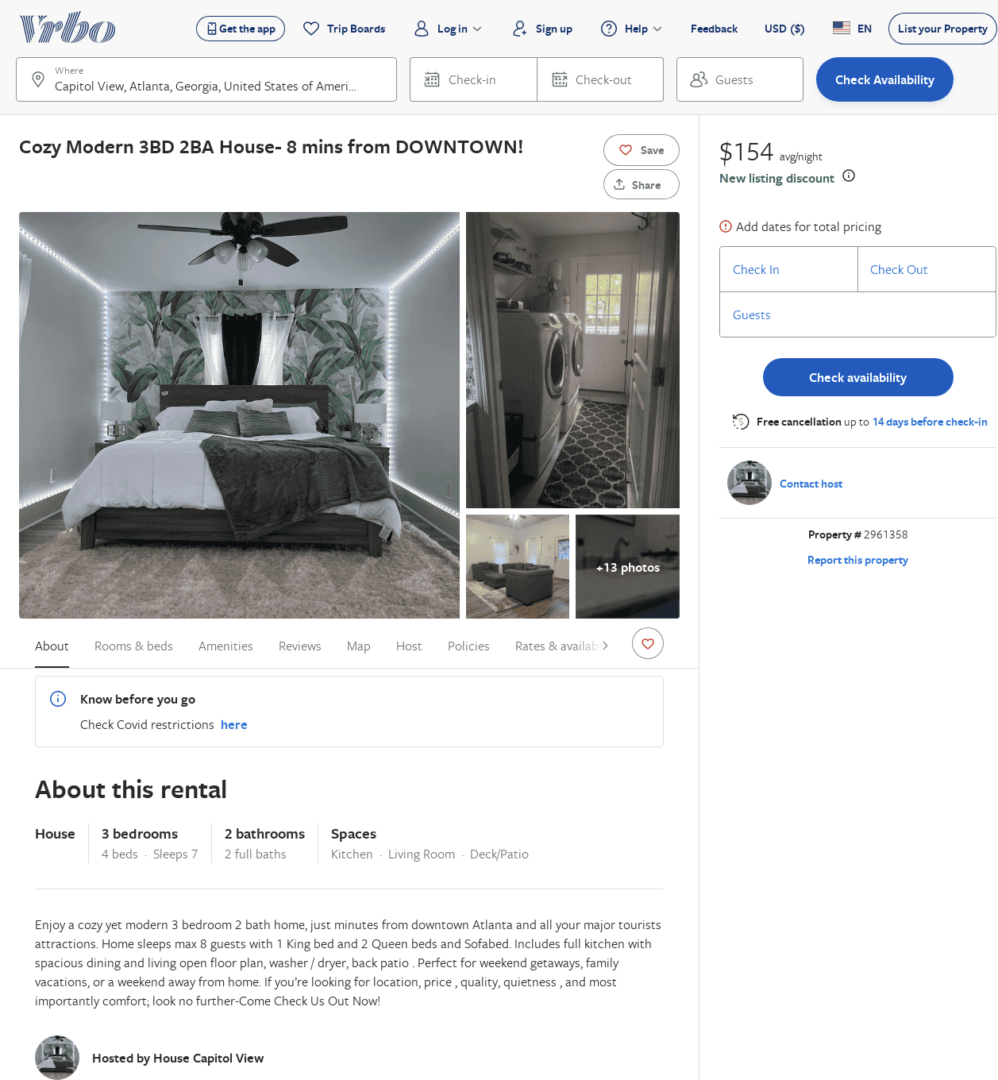
Listing 2961358
3
7
$154
1
https://www.vrbo.com/2961358
Aug 2022

Slide 46
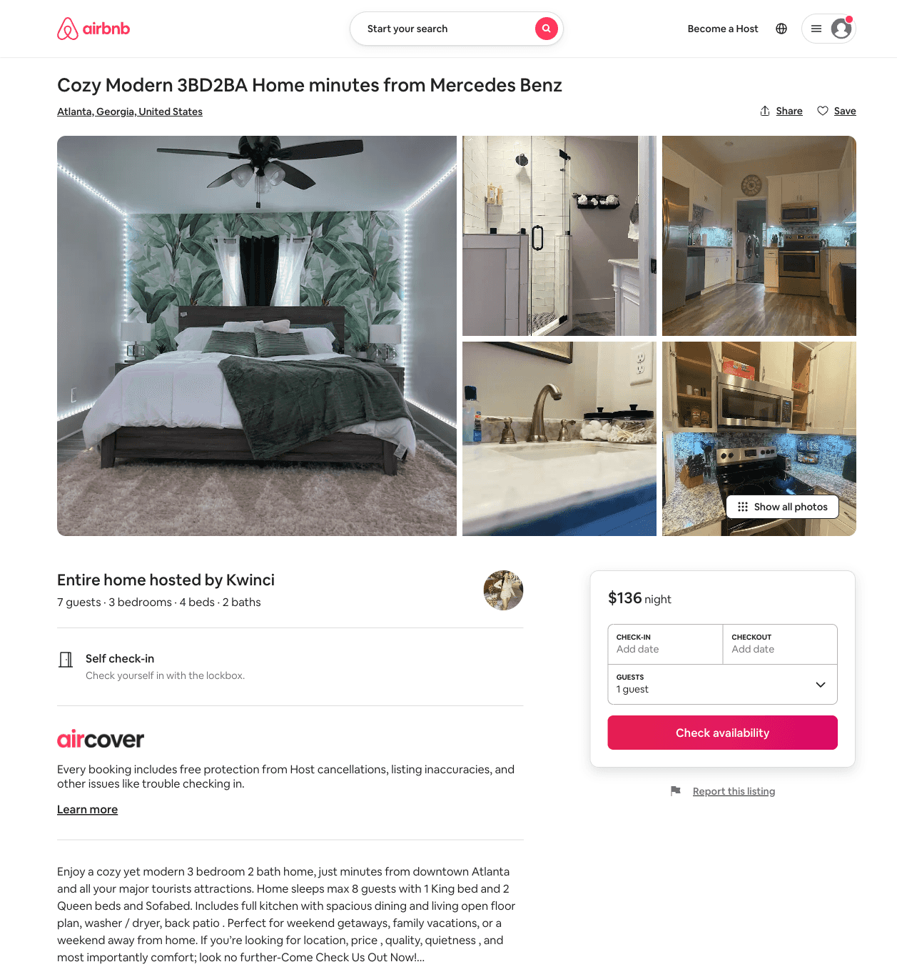
Listing 45413724
3
7
1
Kwinci
169156085
1
https://www.airbnb.com/rooms/45413724
Aug 2022

