Slide 2
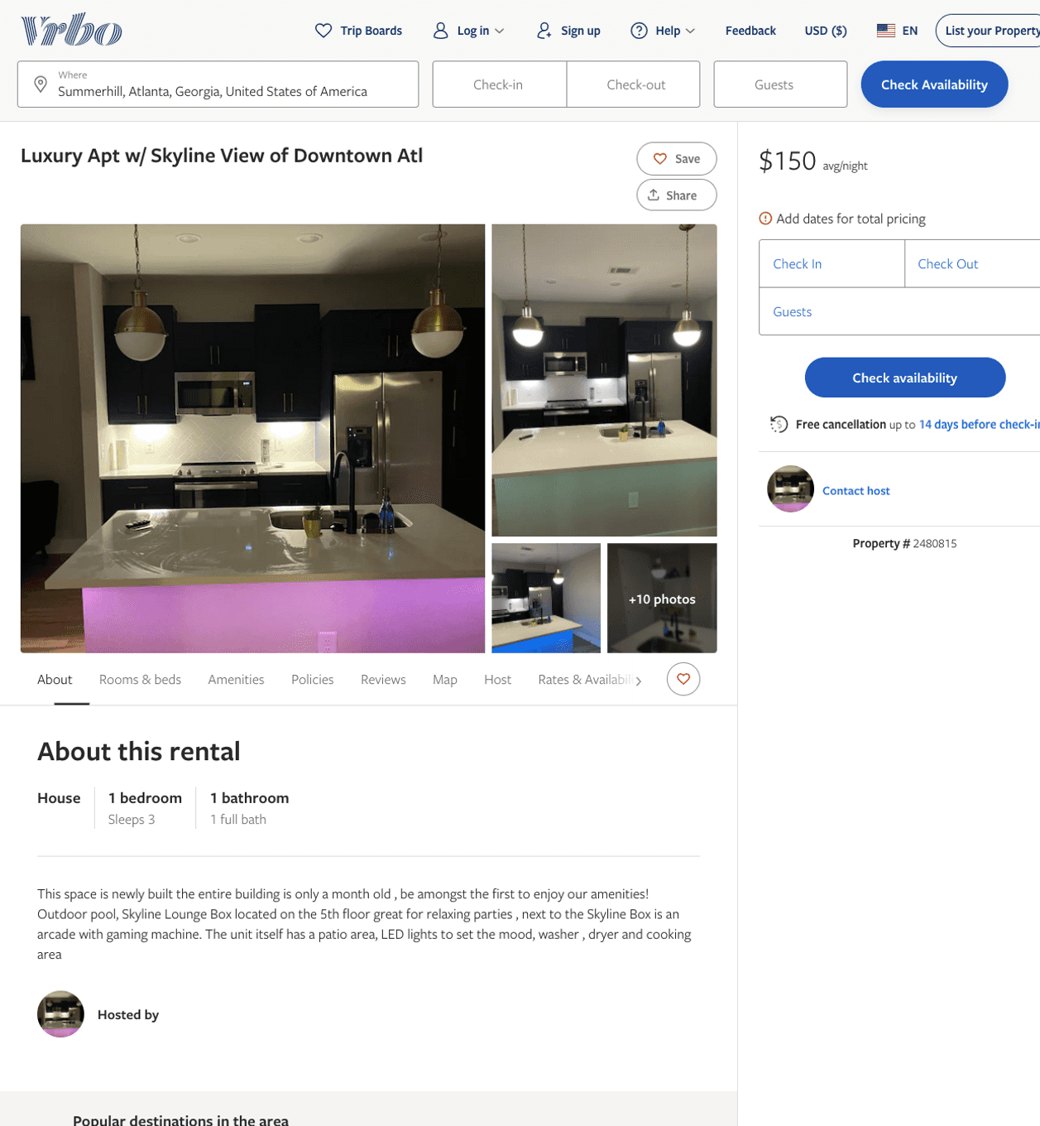
Listing 2480815
1
3
$150
5
2
https://www.vrbo.com/2480815
Aug 2022

Slide 3
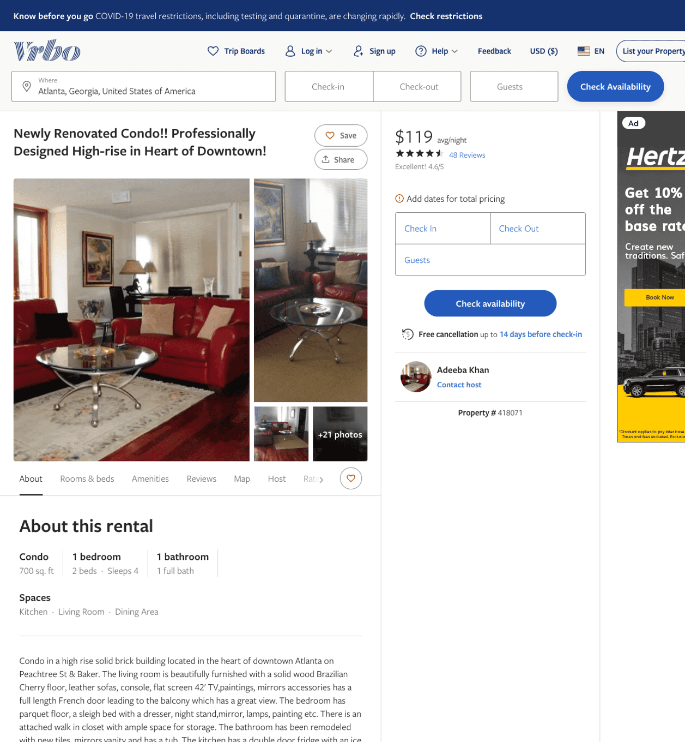
Listing 418071
1
4
$107 - $93
4.4126983
1
Adeeba Khan
https://www.vrbo.com/418071
Aug 2022

Slide 4
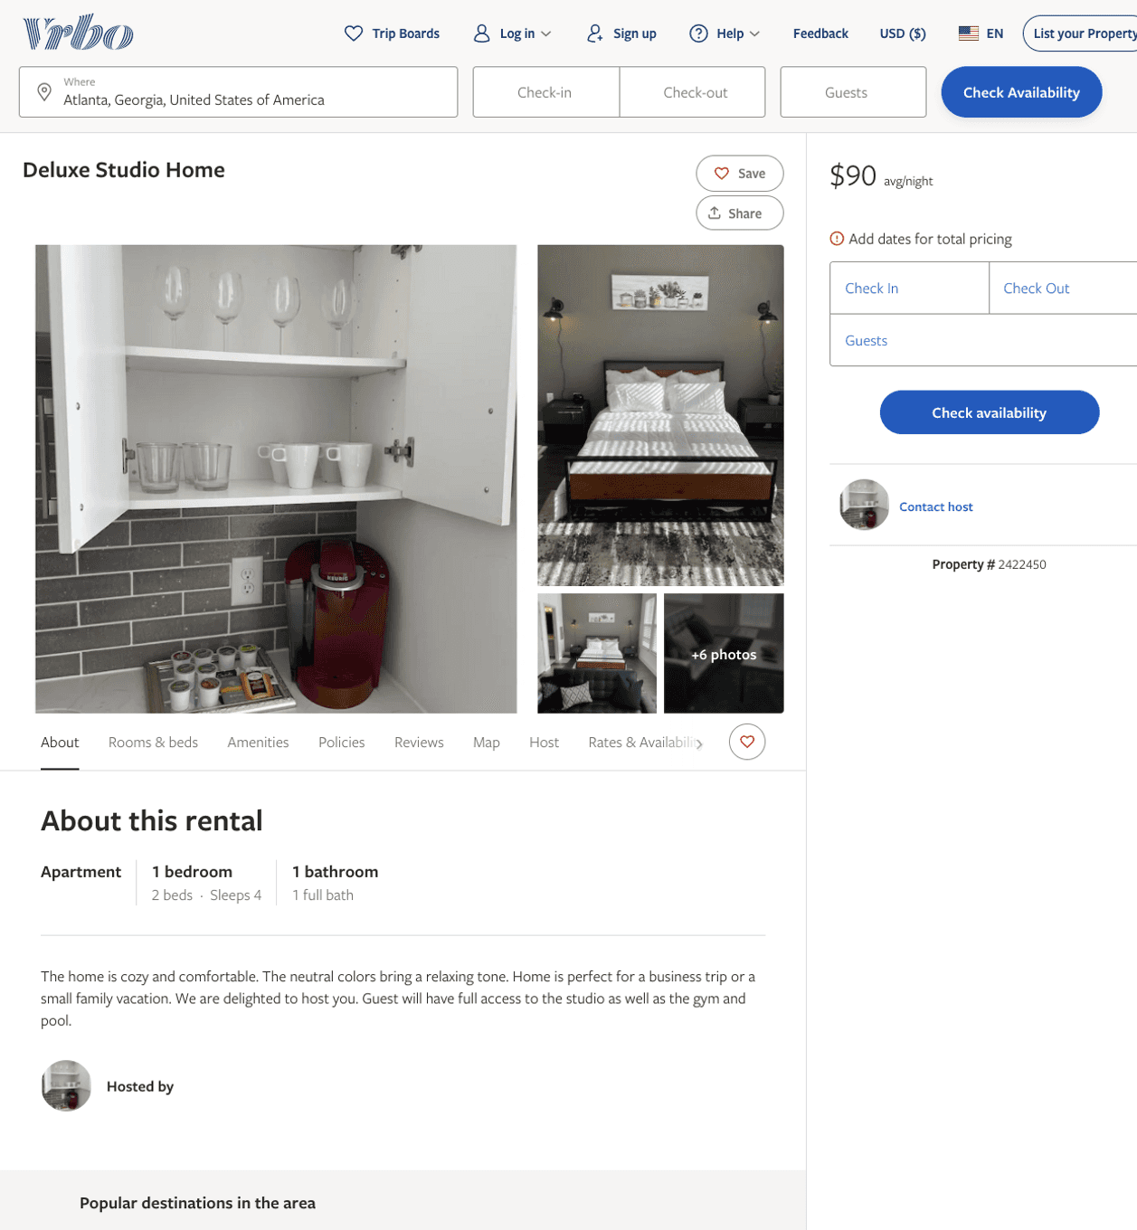
Listing 2422450
1
4
$90
1
1
https://www.vrbo.com/2422450
Aug 2022

Slide 5
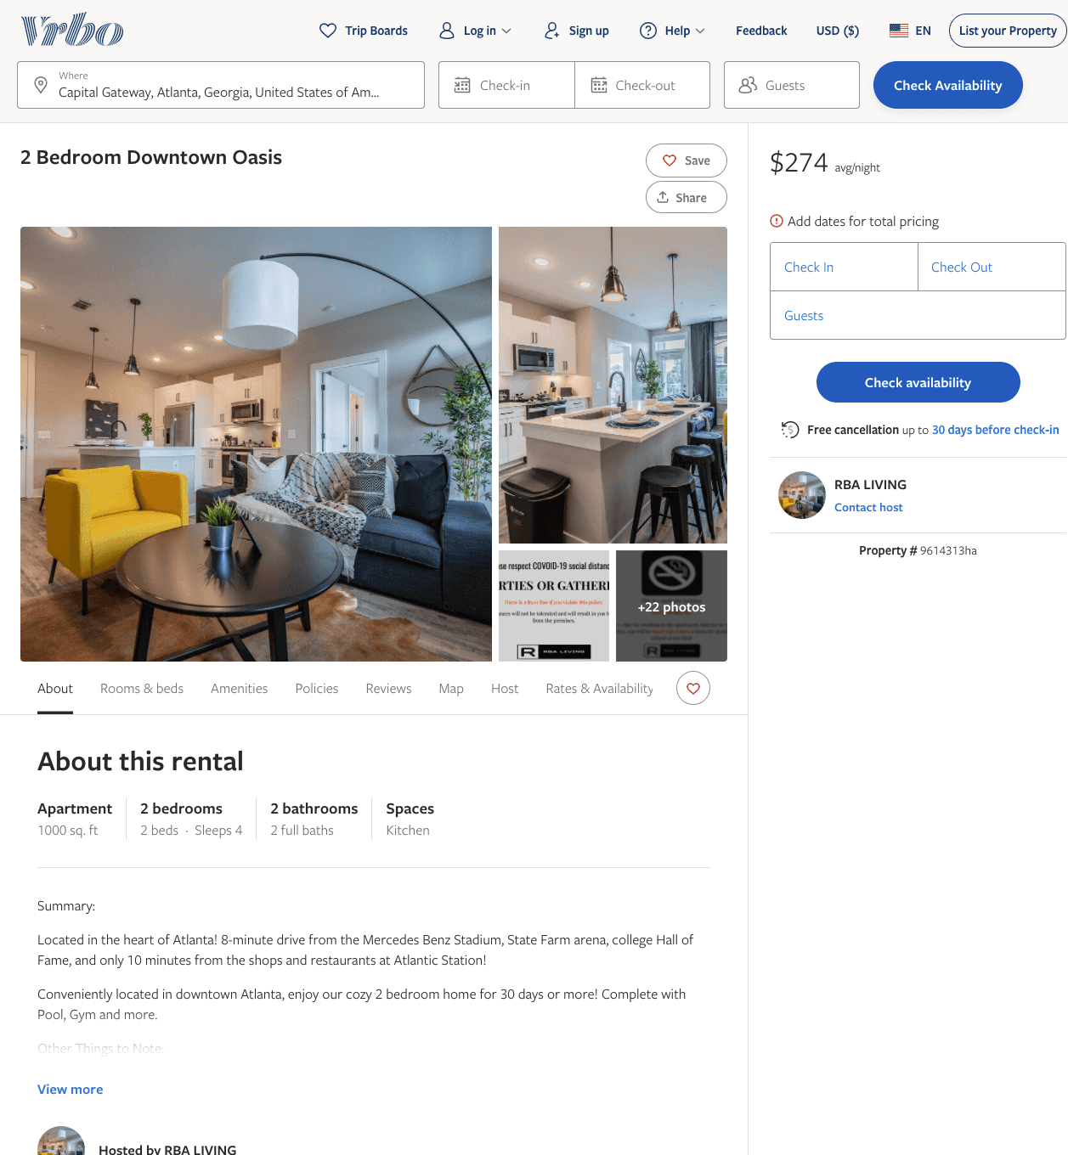
Listing 9614313
2
4
$219 - $274
4
2
RBA LIVING
https://www.vrbo.com/9614313ha
Aug 2022

Slide 6
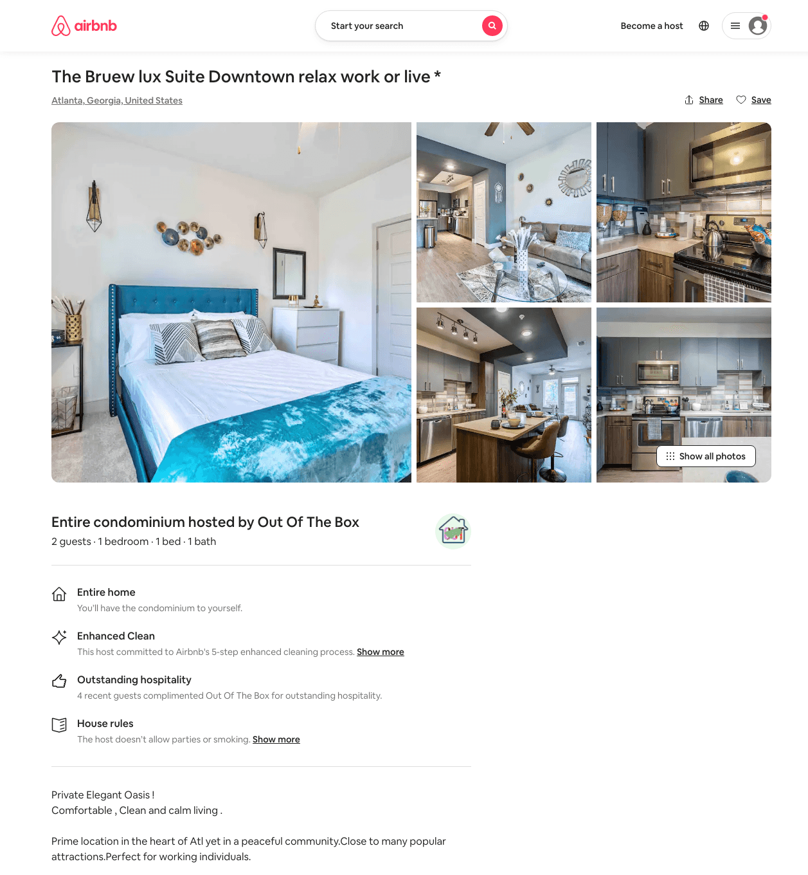
Listing 49698321
1
3
$67 - $250
4.88
1
Out Of The Box
208955740
7
https://www.airbnb.com/rooms/49698321
Aug 2022

Slide 7
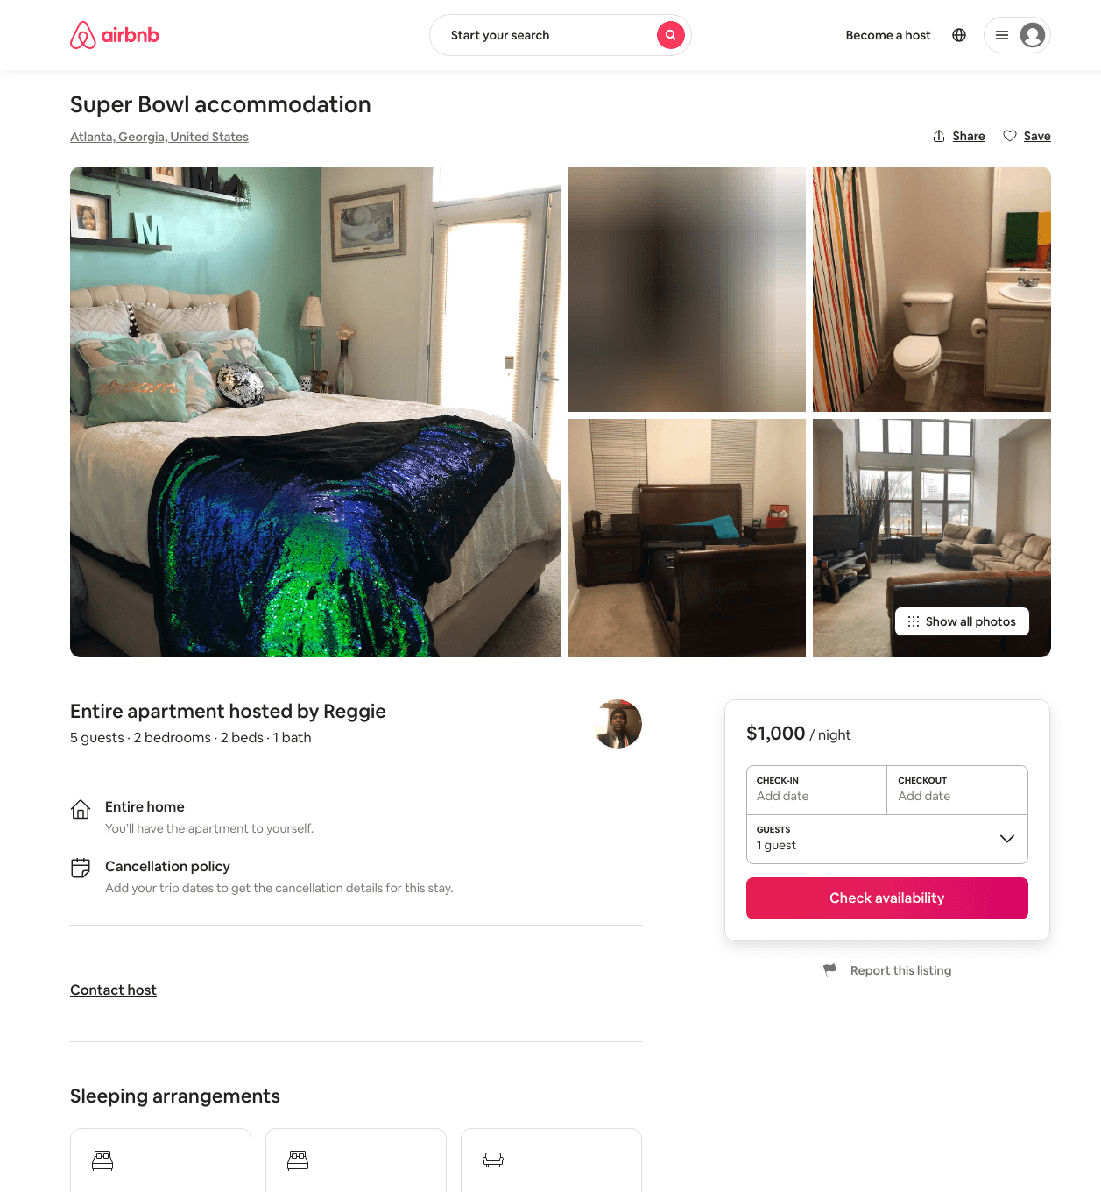
Listing 31742926
2
5
$1000
7
Meon
209158034
2
https://www.airbnb.com/rooms/31742926
Aug 2022

Slide 8
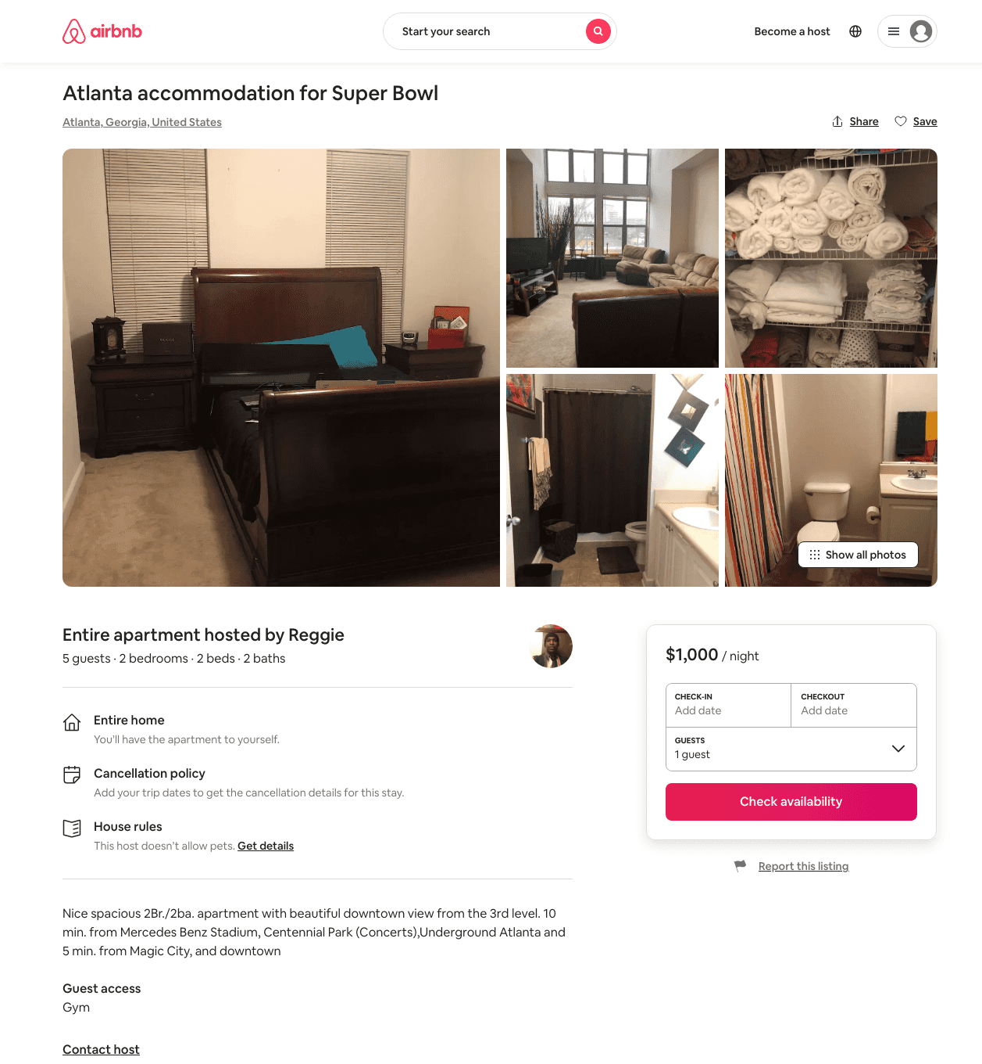
Listing 31626569
2
5
$1000
7
Meon
209158034
2
https://www.airbnb.com/rooms/31626569
Aug 2022

Slide 9
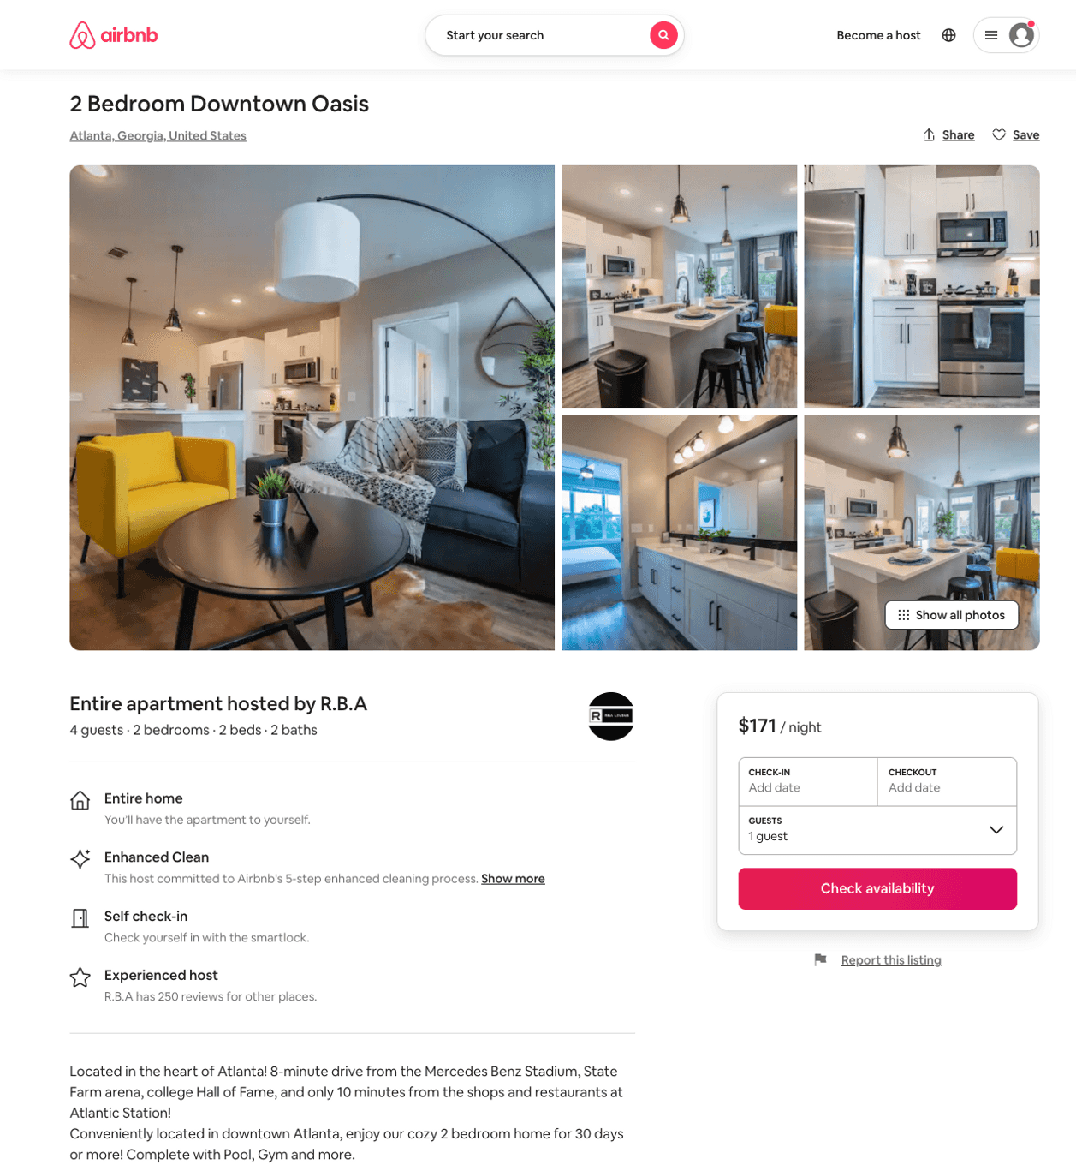
Listing 50743139
2
4
$133 - $590
4.74
2
R.B.A
26534449
17
https://www.airbnb.com/rooms/50743139
Aug 2022

Slide 10
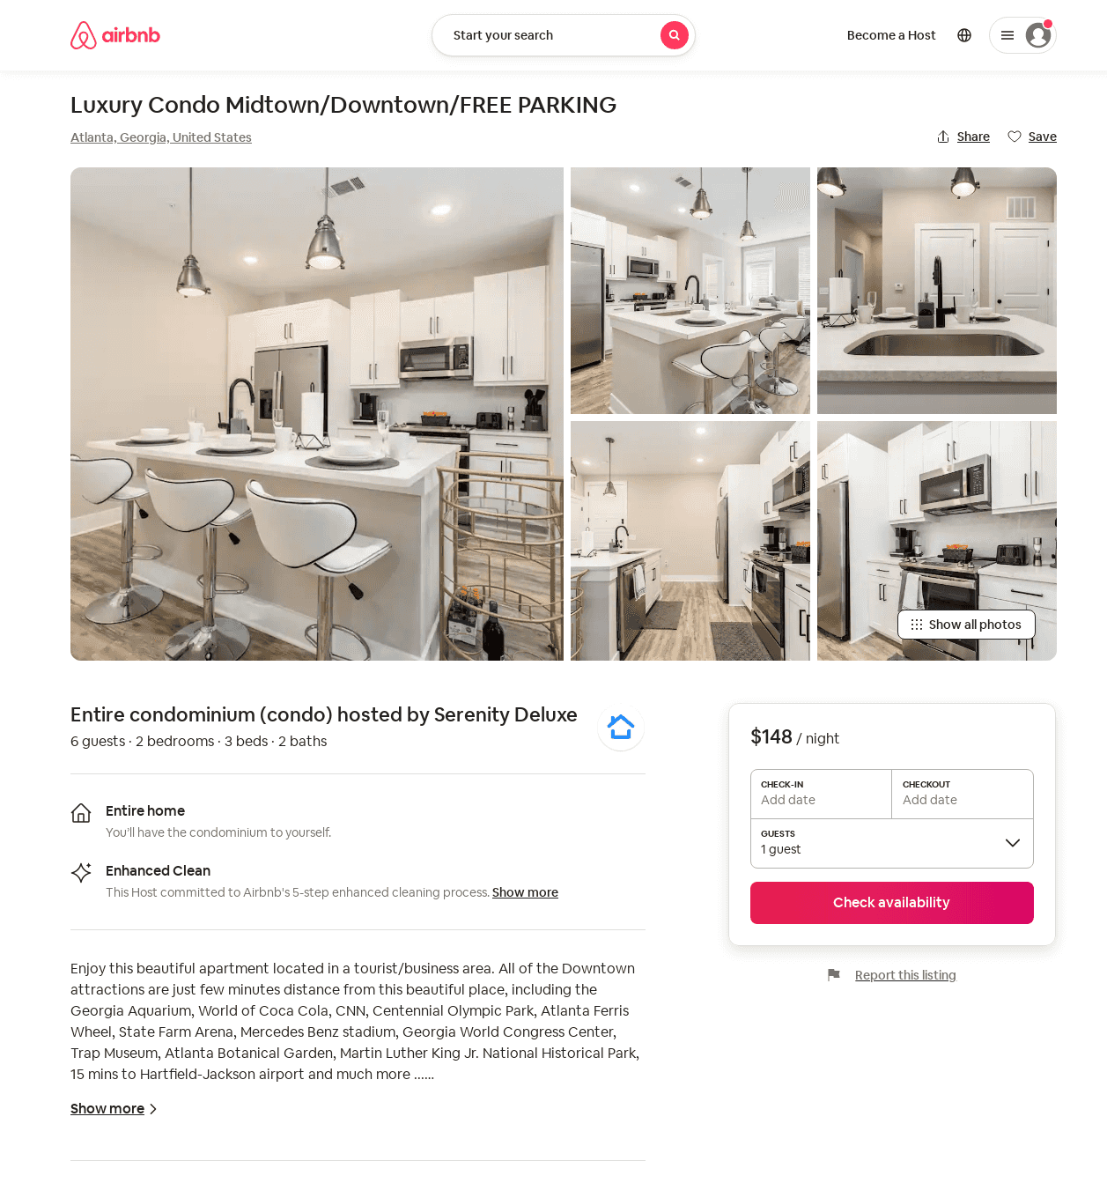
Listing 53434866
2
6
$148 - $194
4.55
2
Serenity Deluxe
432655733
1
https://www.airbnb.com/rooms/53434866
Aug 2022

Slide 11
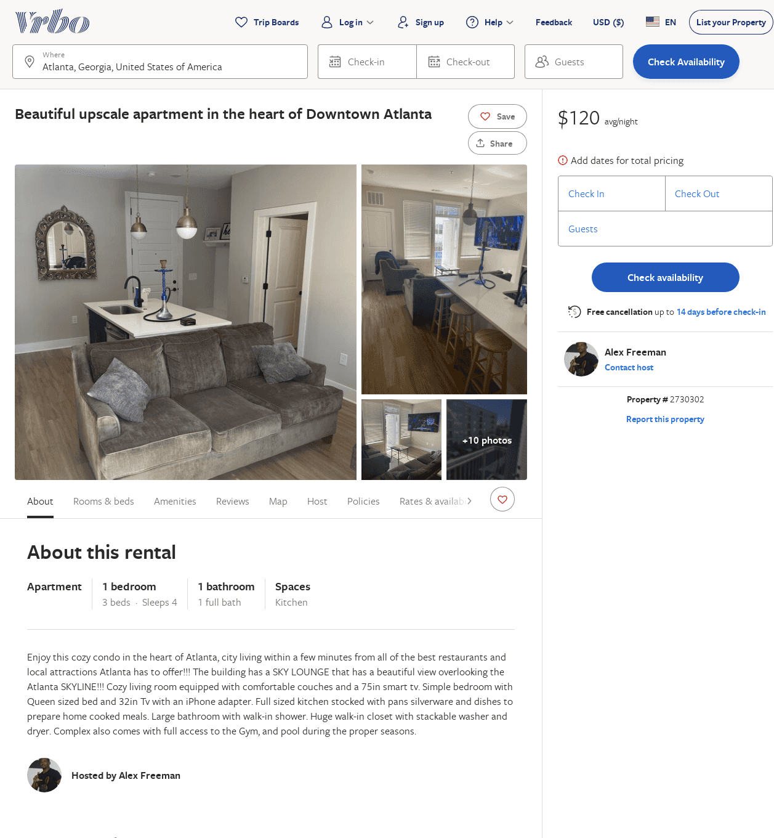
Listing 2730302
1
4
$135
3
Alex Freeman
https://www.vrbo.com/2730302
Aug 2022

Slide 12
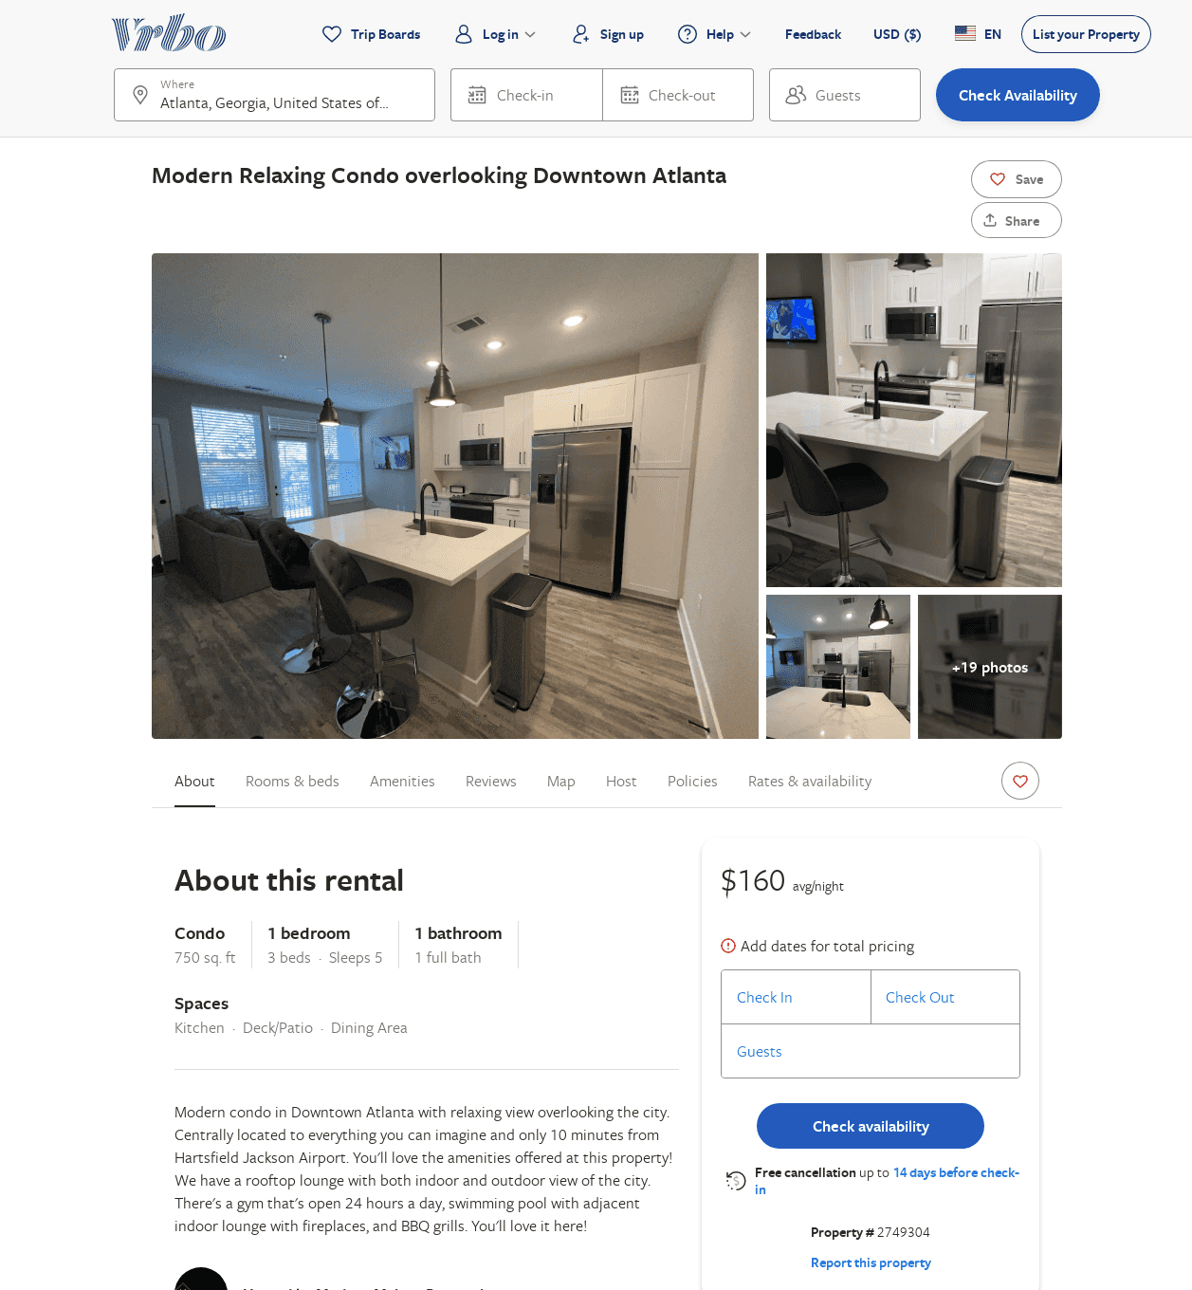
Listing 2749304
1
5
$150
1
Modern Maison Properties
https://www.vrbo.com/2749304
Aug 2022

Slide 13
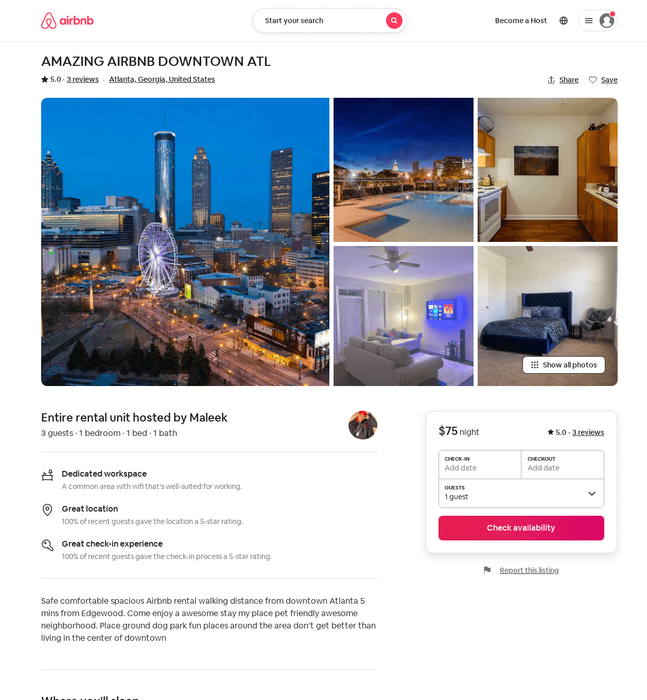
Listing 49179439
1
3
$75 - $107
4.44
1
Mal
345583476
1
https://www.airbnb.com/rooms/49179439
Jul 2022

Slide 14
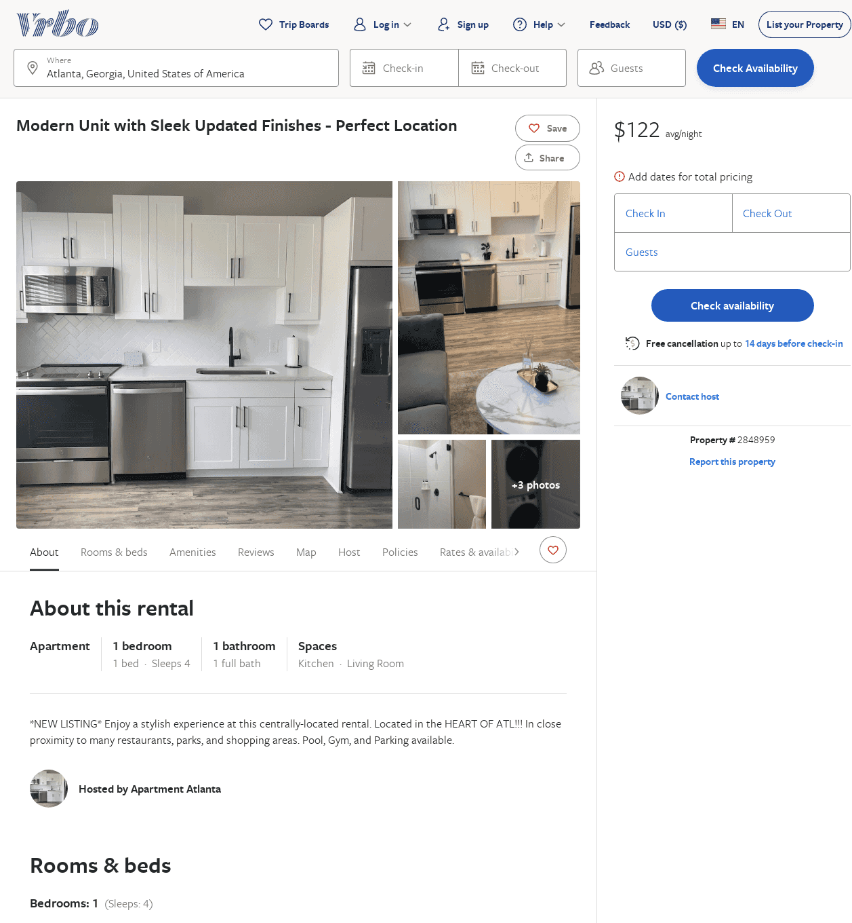
Listing 2848959
1
4
$159
2
https://www.vrbo.com/2848959
Aug 2022

Slide 15
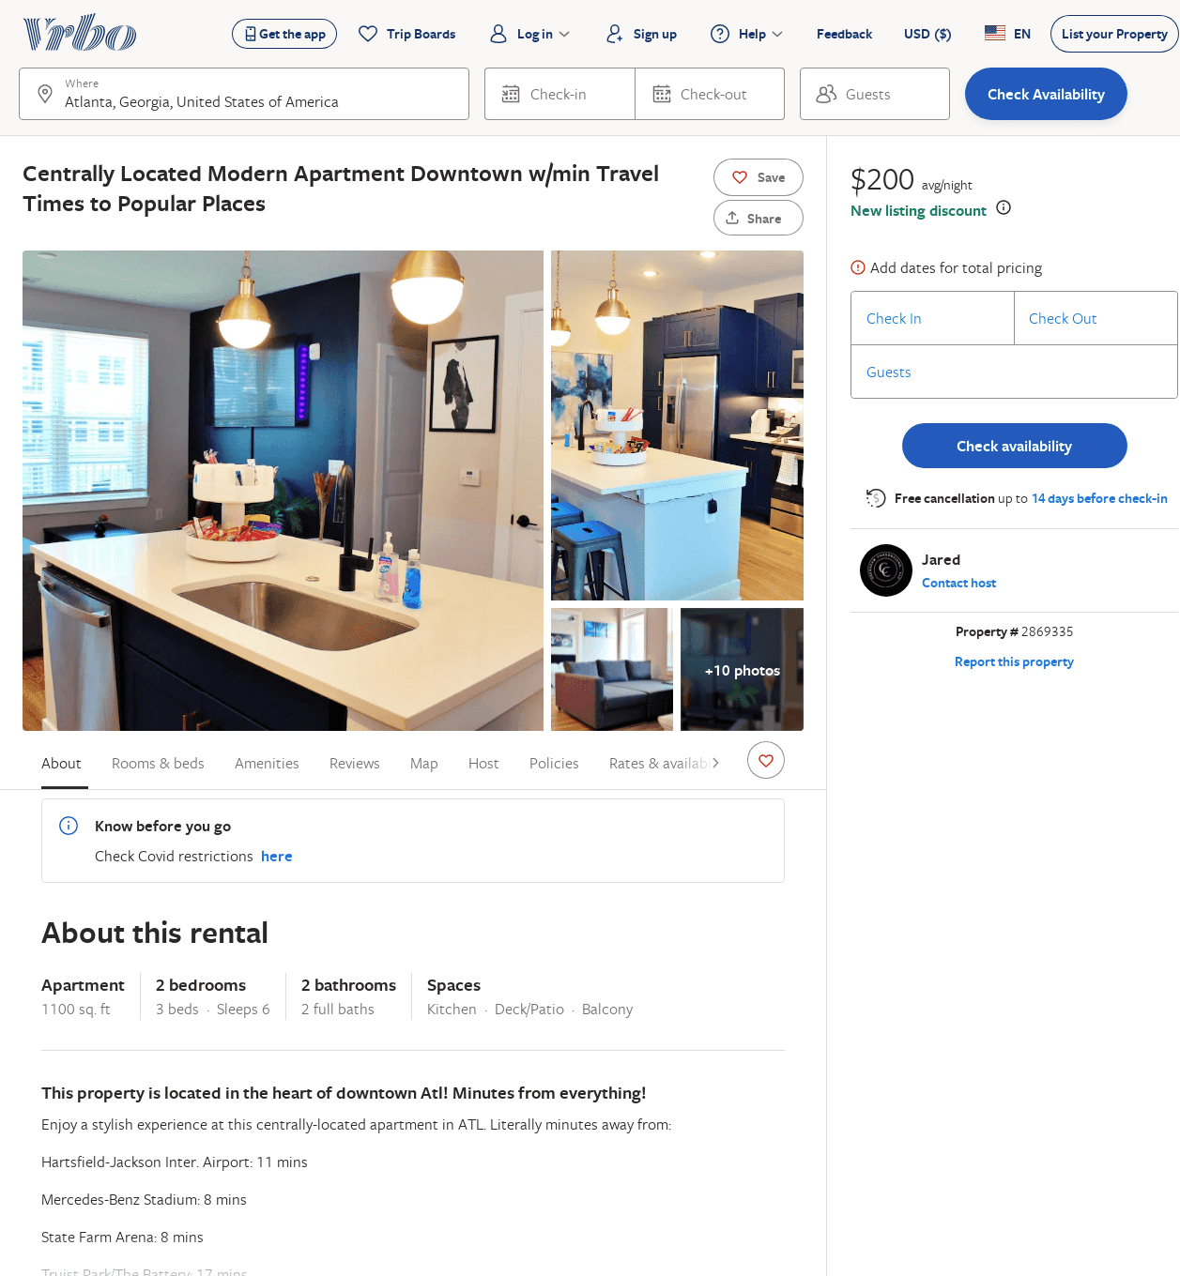
Listing 2869335
2
6
$202
2
Jared
https://www.vrbo.com/2869335
Aug 2022

