Slide 2
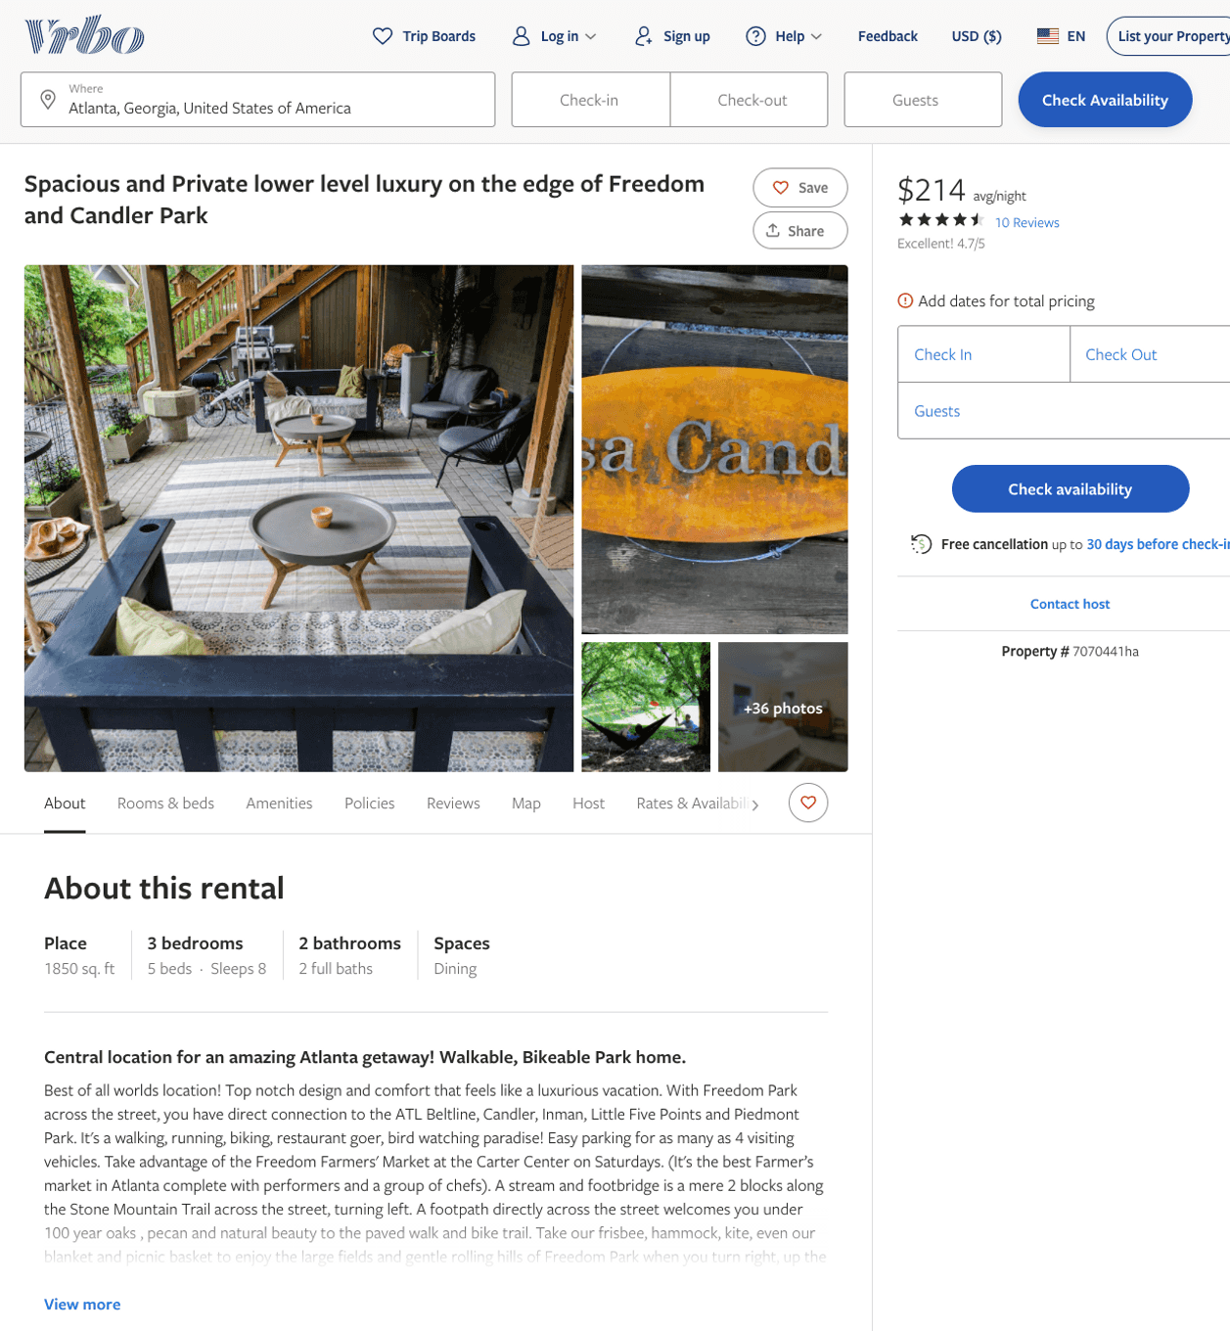
Listing 7070441
3
8
$205 - $225
4.7272725
3
Maria Crawford
https://www.vrbo.com/7070441ha
Aug 2022

Slide 3
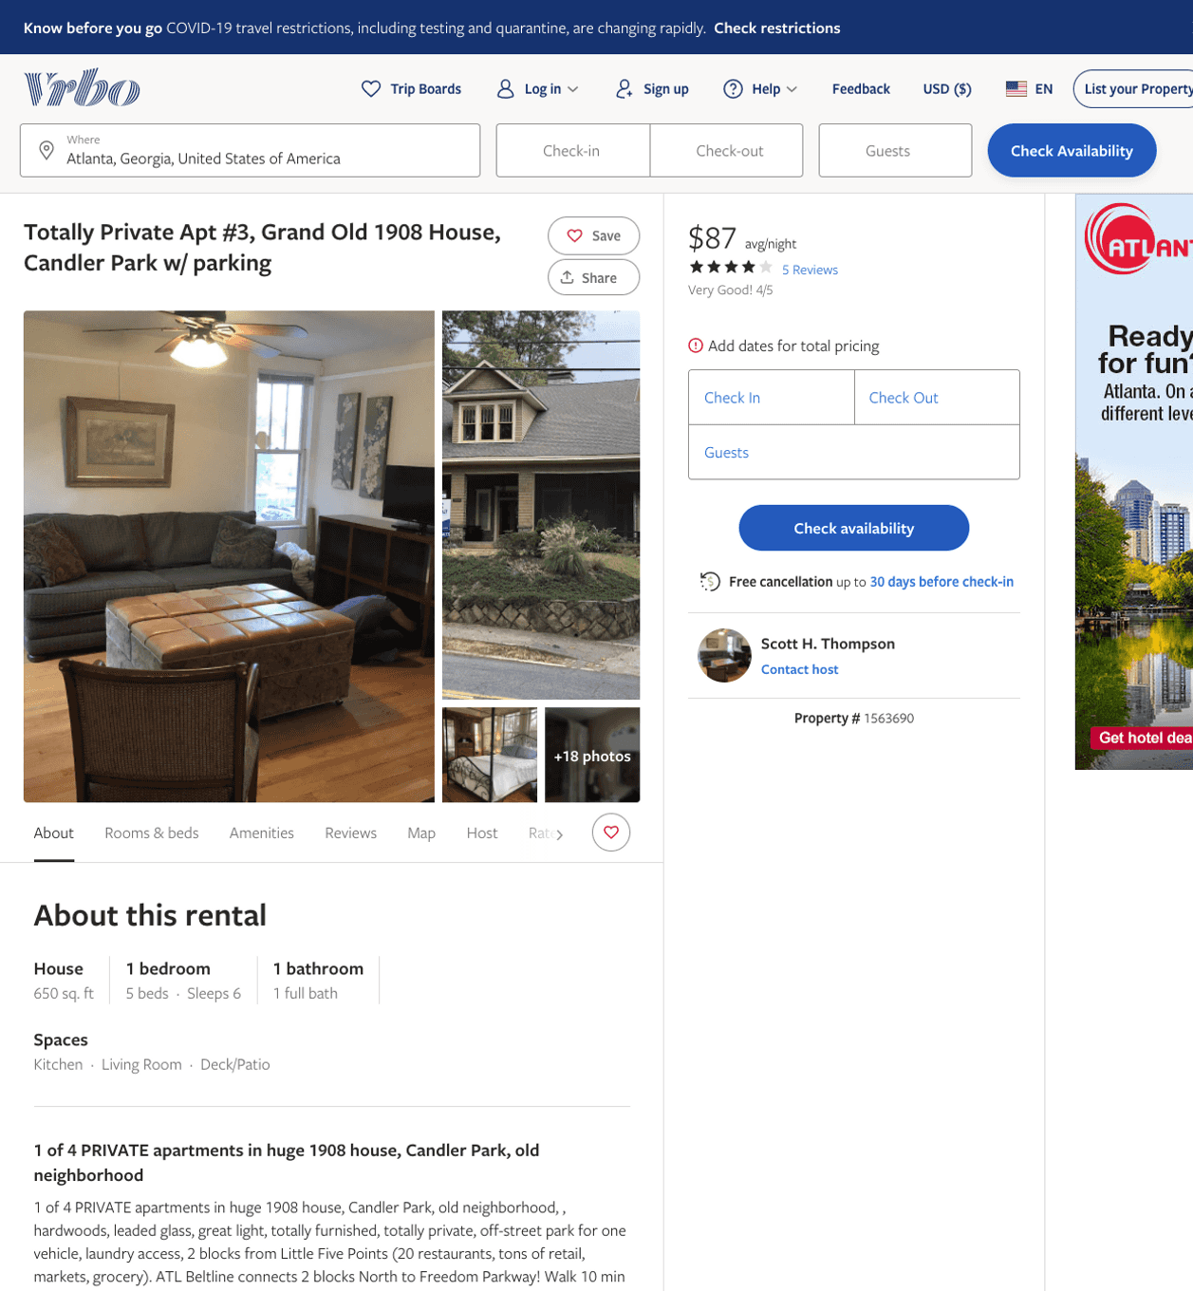
Listing 1563690
1
6
$85 - $90
4.1666665
1
Scott H. Thompson
https://www.vrbo.com/1563690
Aug 2022

Slide 4
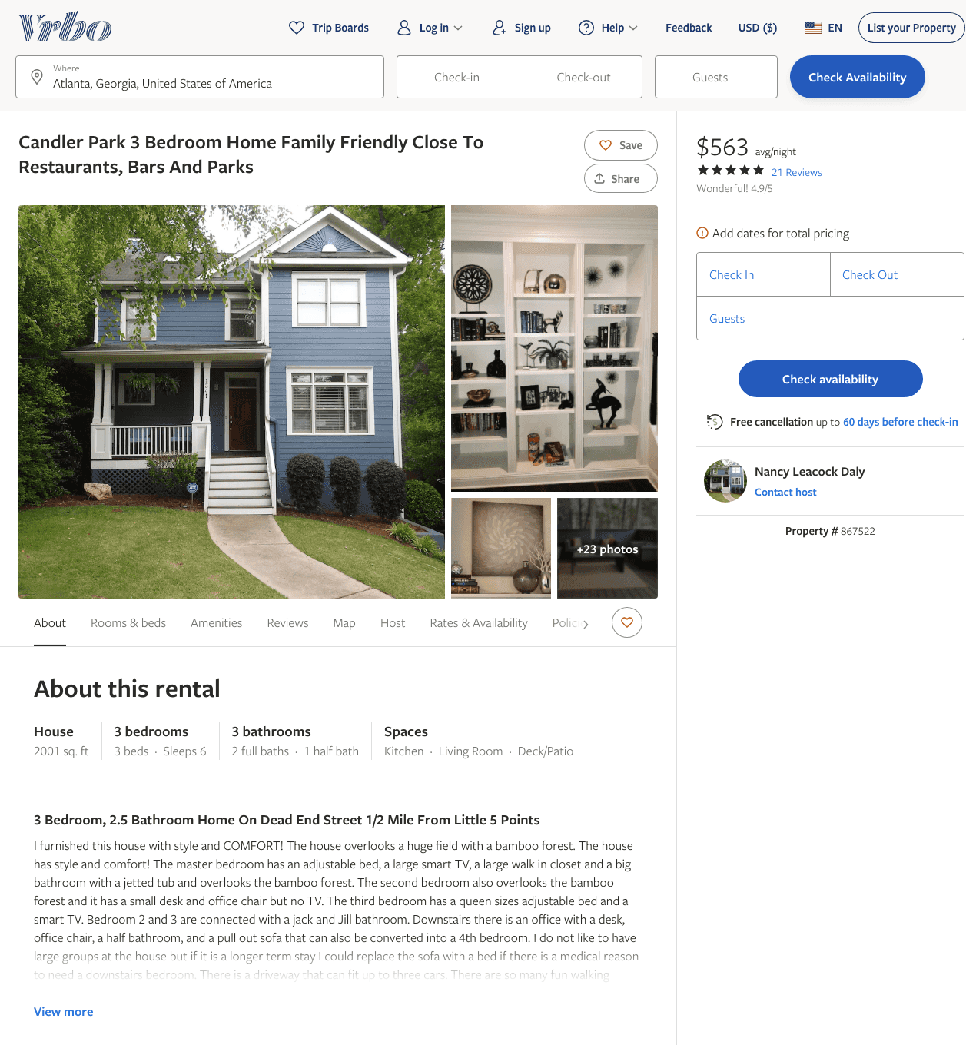
Listing 867522
3
6
$547 - $563
4.909091
3
Nancy Leacock Daly
https://www.vrbo.com/867522
Aug 2022

Slide 5
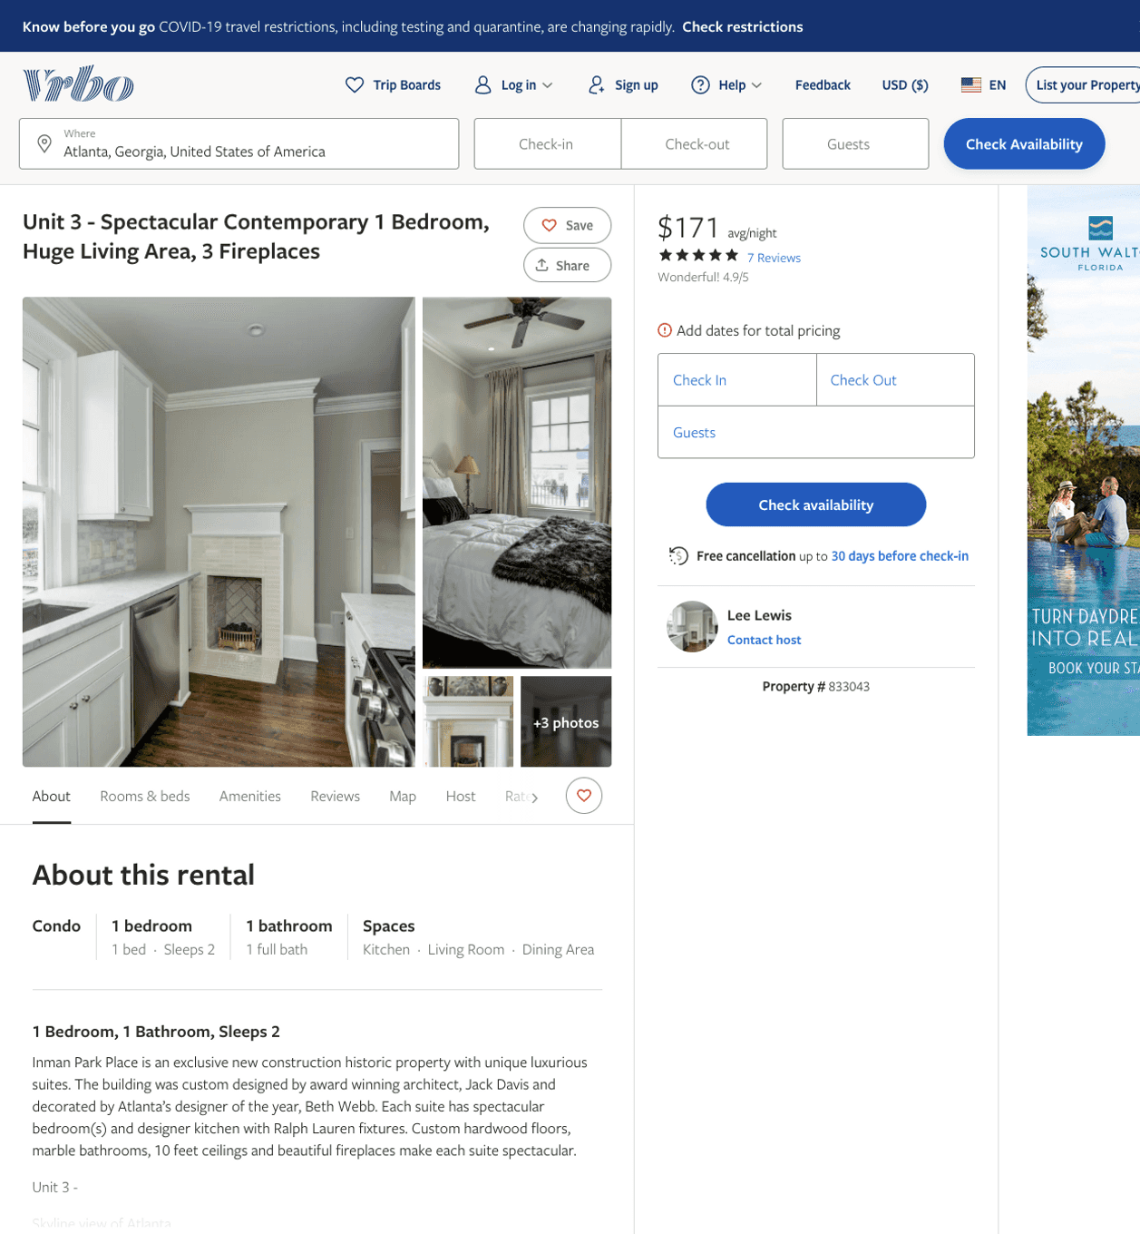
Listing 833043
1
2
$171 - $230
4.875
3
Lee Lewis
https://www.vrbo.com/833043
Aug 2022

Slide 6
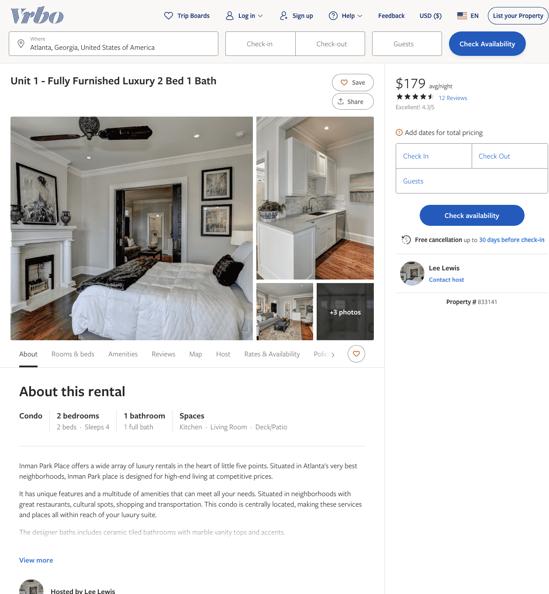
Listing 833141
2
4
$179 - $200
4.4
3
Lee Lewis
https://www.vrbo.com/833141
Aug 2022

Slide 7
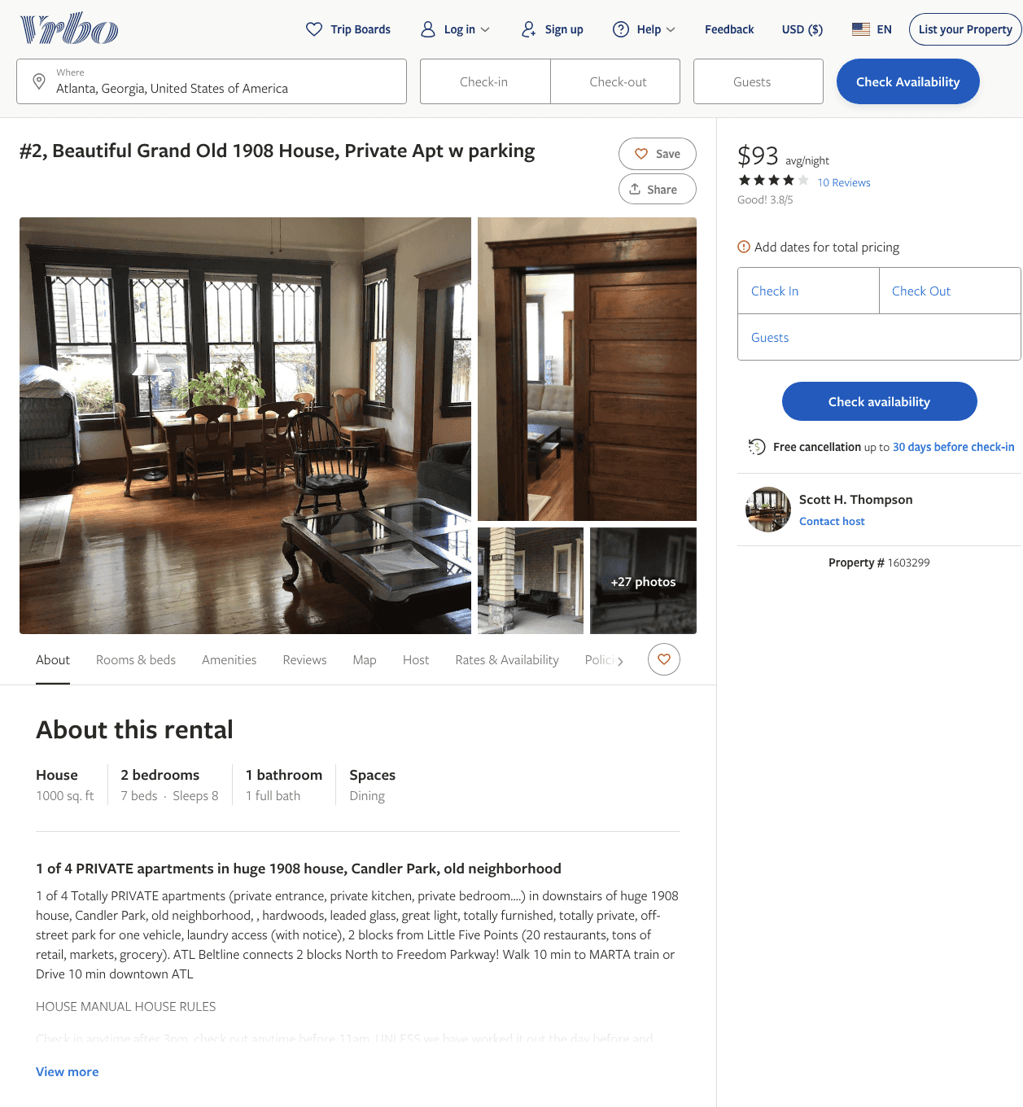
Listing 1603299
1
8
$85 - $93
3.8
1
Scott H. Thompson
https://www.vrbo.com/1603299
Aug 2022

Slide 8
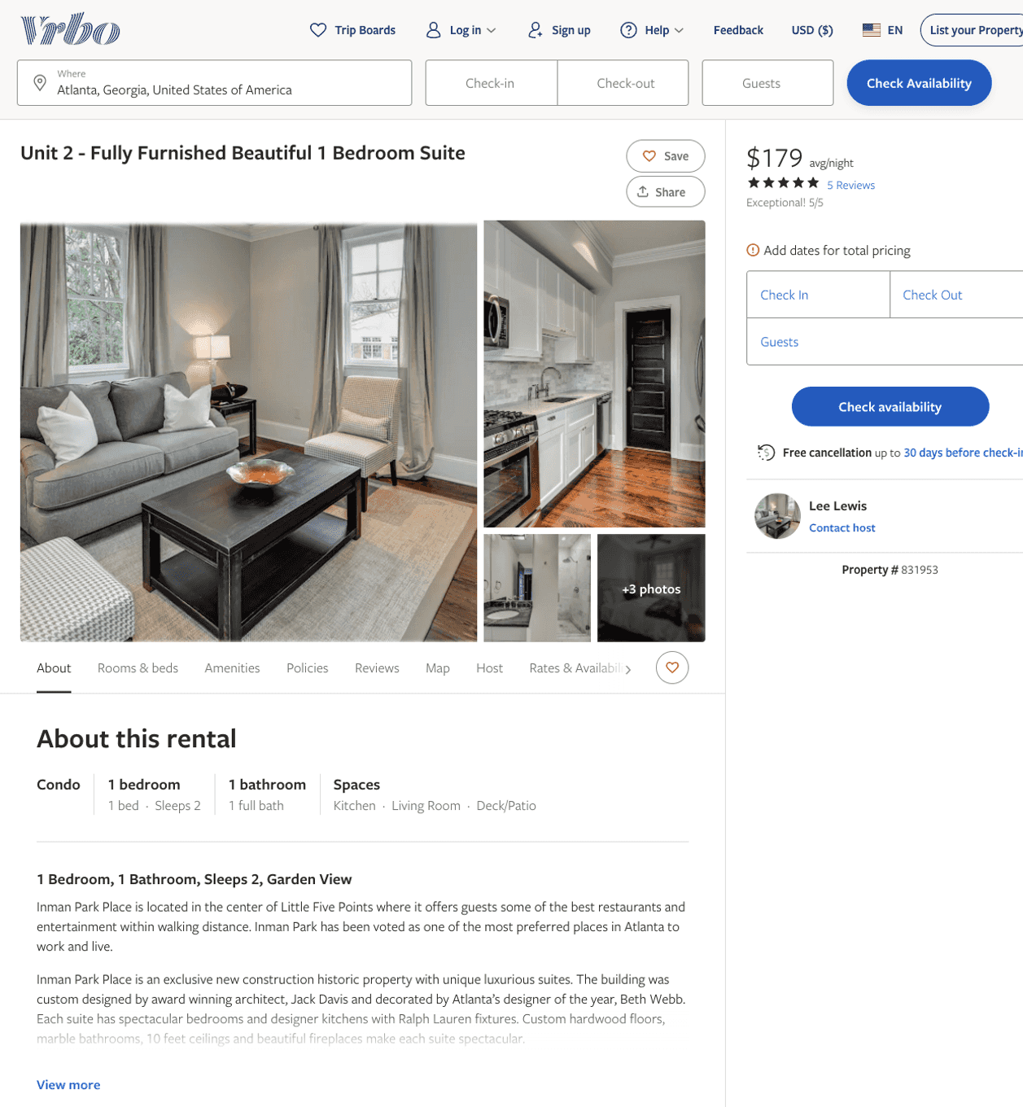
Listing 831953
1
2
$179 - $199
4.888889
3
Lee Lewis
https://www.vrbo.com/831953
Aug 2022

Slide 9
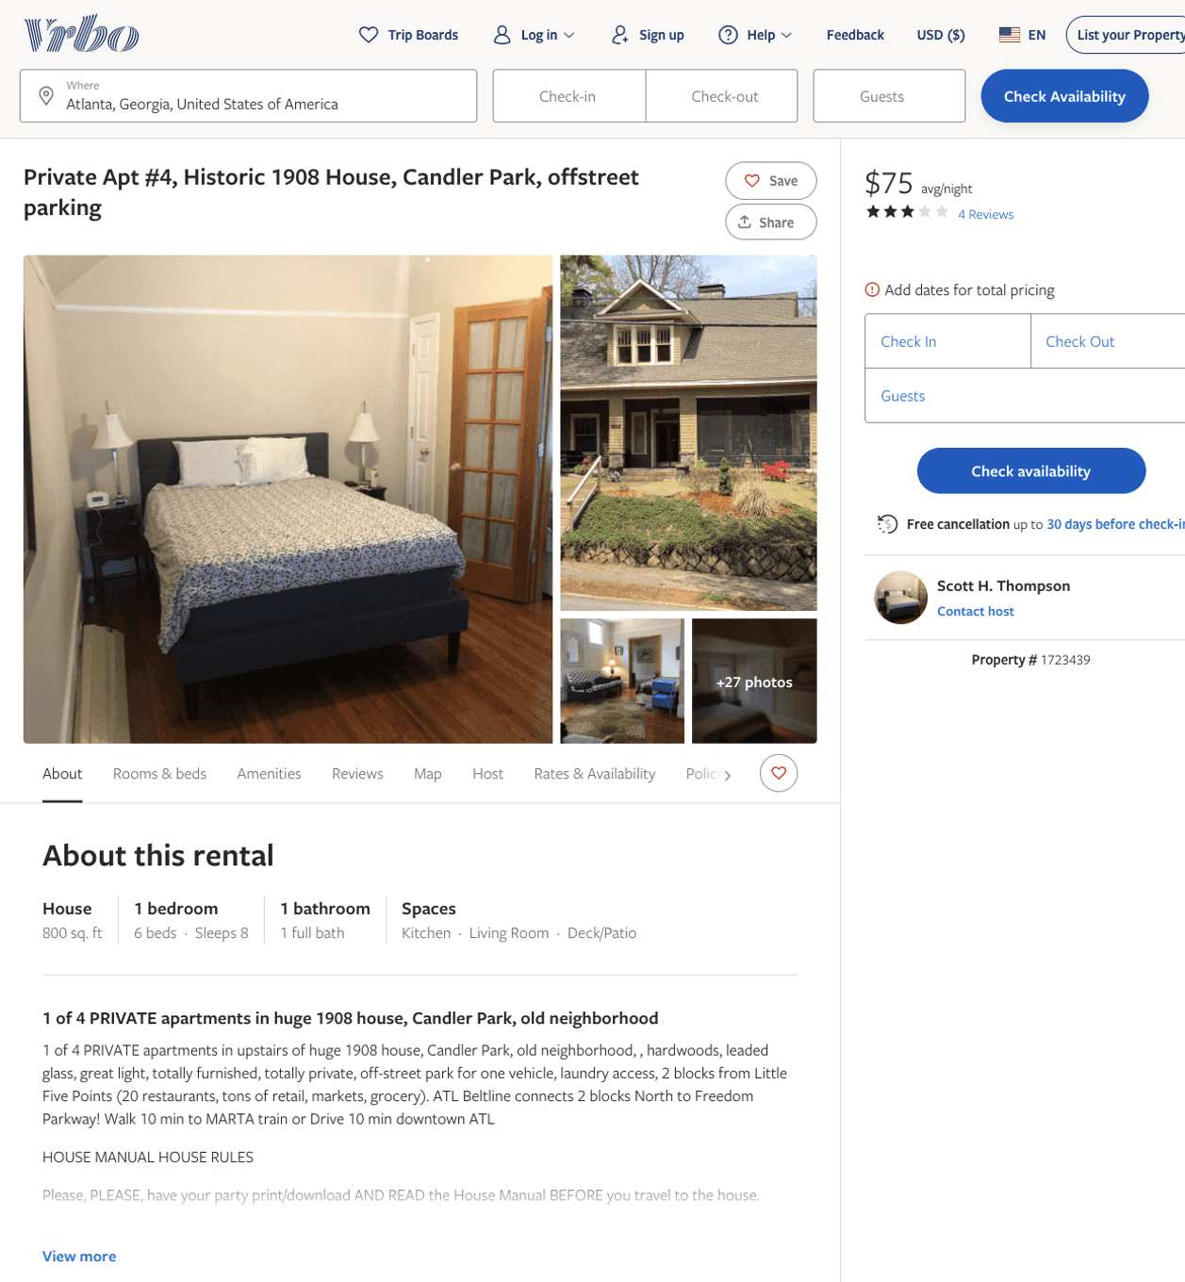
Listing 1723439
1
8
$75 - $80
3.4285715
1
Scott H. Thompson
https://www.vrbo.com/1723439
Aug 2022

Slide 10
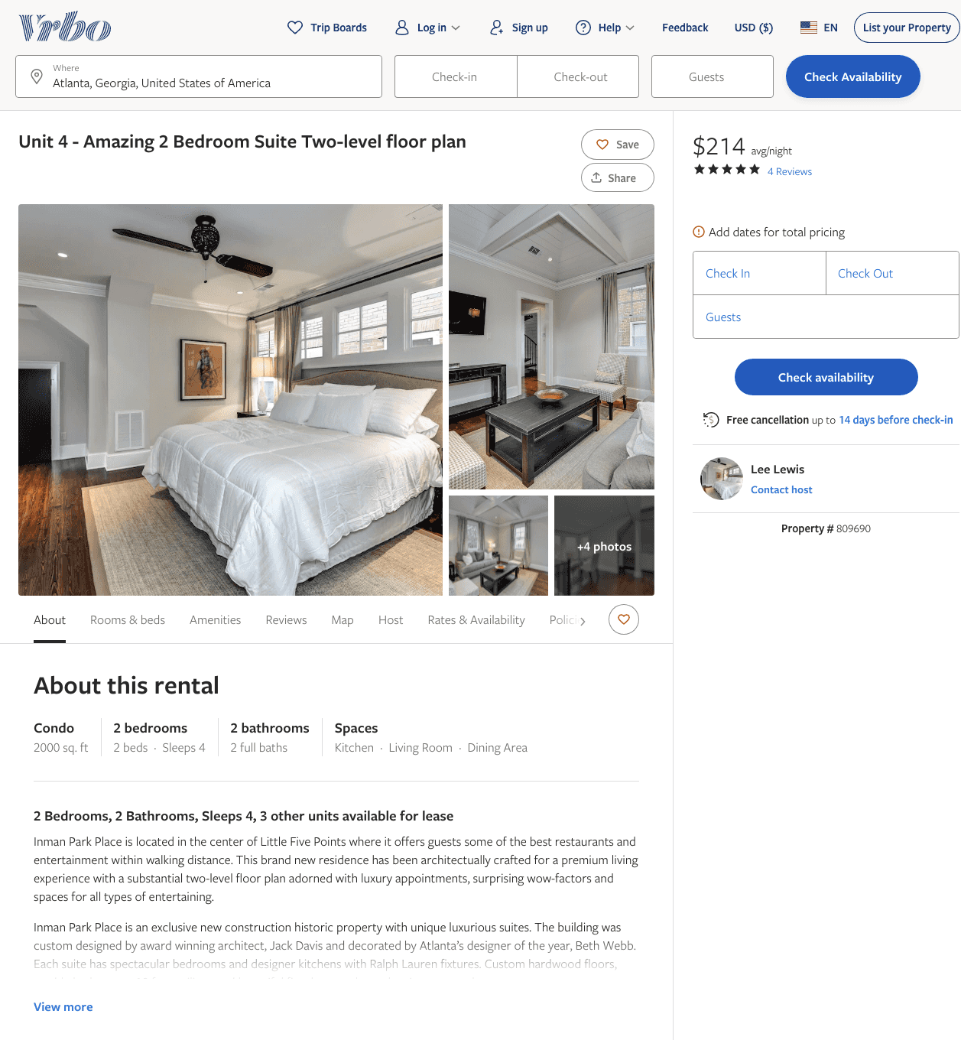
Listing 809690
2
4
$214 - $224
5
3
Lee Lewis
https://www.vrbo.com/809690
Aug 2022

Slide 11
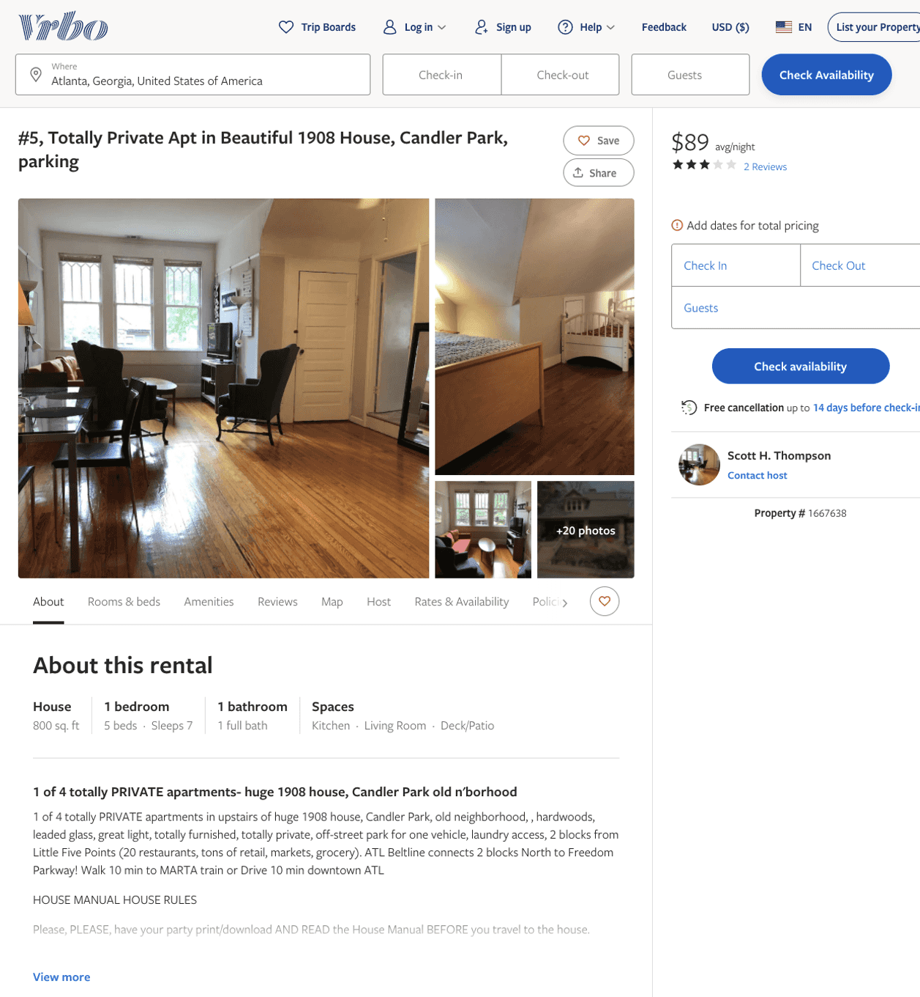
Listing 1667638
1
7
$85 - $89
3
1
Scott H. Thompson
https://www.vrbo.com/1667638
Aug 2022

Slide 12
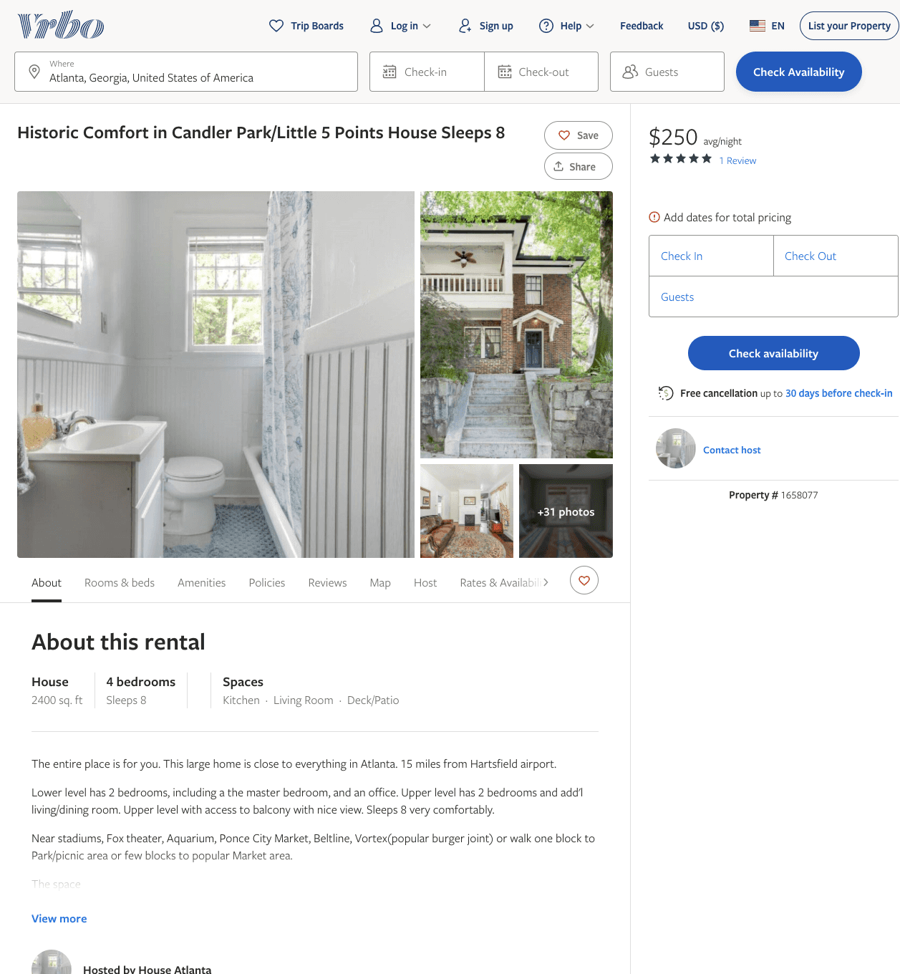
Listing 1658077
4
8
$250
5
3
https://www.vrbo.com/1658077
Aug 2022

Slide 13
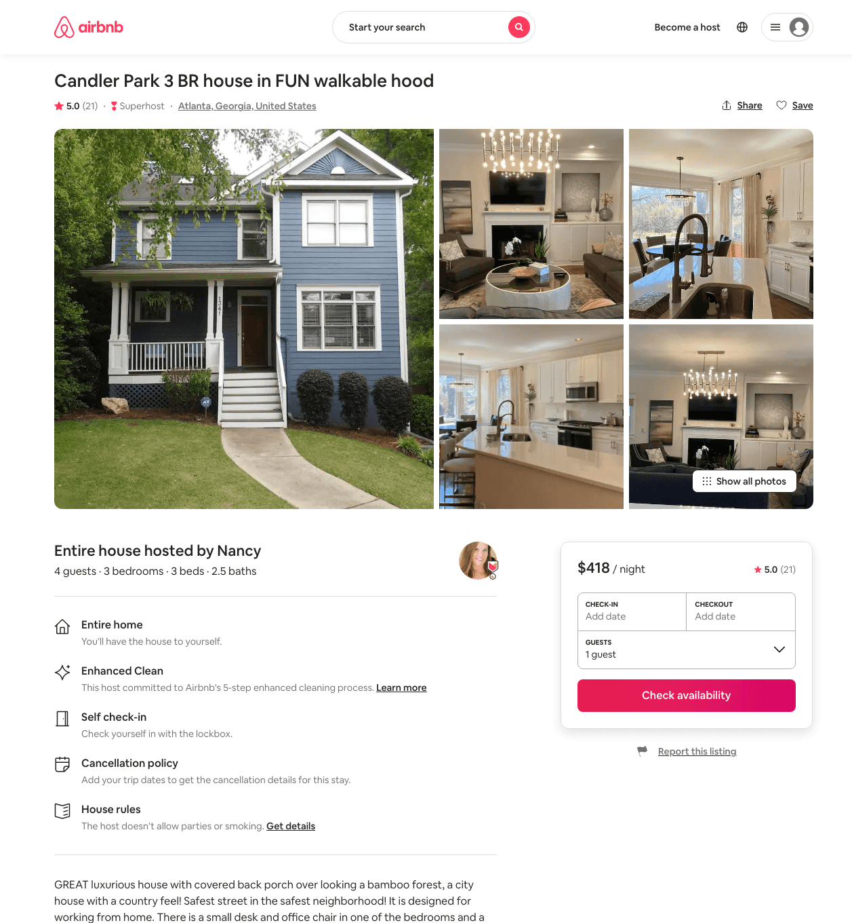
Listing 13004452
3
4
$311 - $600
5.0
3
Nancy
2773373
9
https://www.airbnb.com/rooms/13004452
Aug 2022

Slide 14
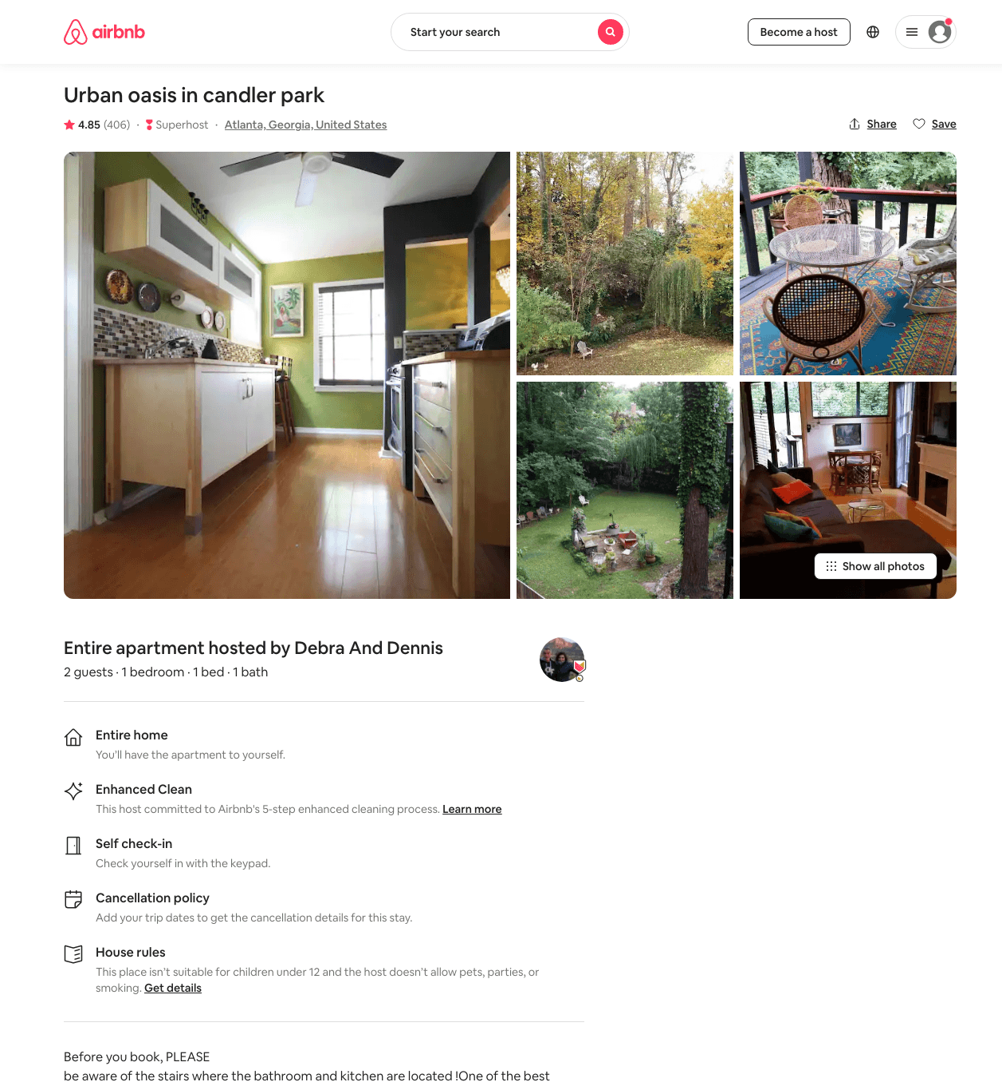
Listing 1126743
1
2
$72 - $89
4.86
5
Debra And Dennis
2916690
2
https://www.airbnb.com/rooms/1126743
Aug 2022

Slide 15
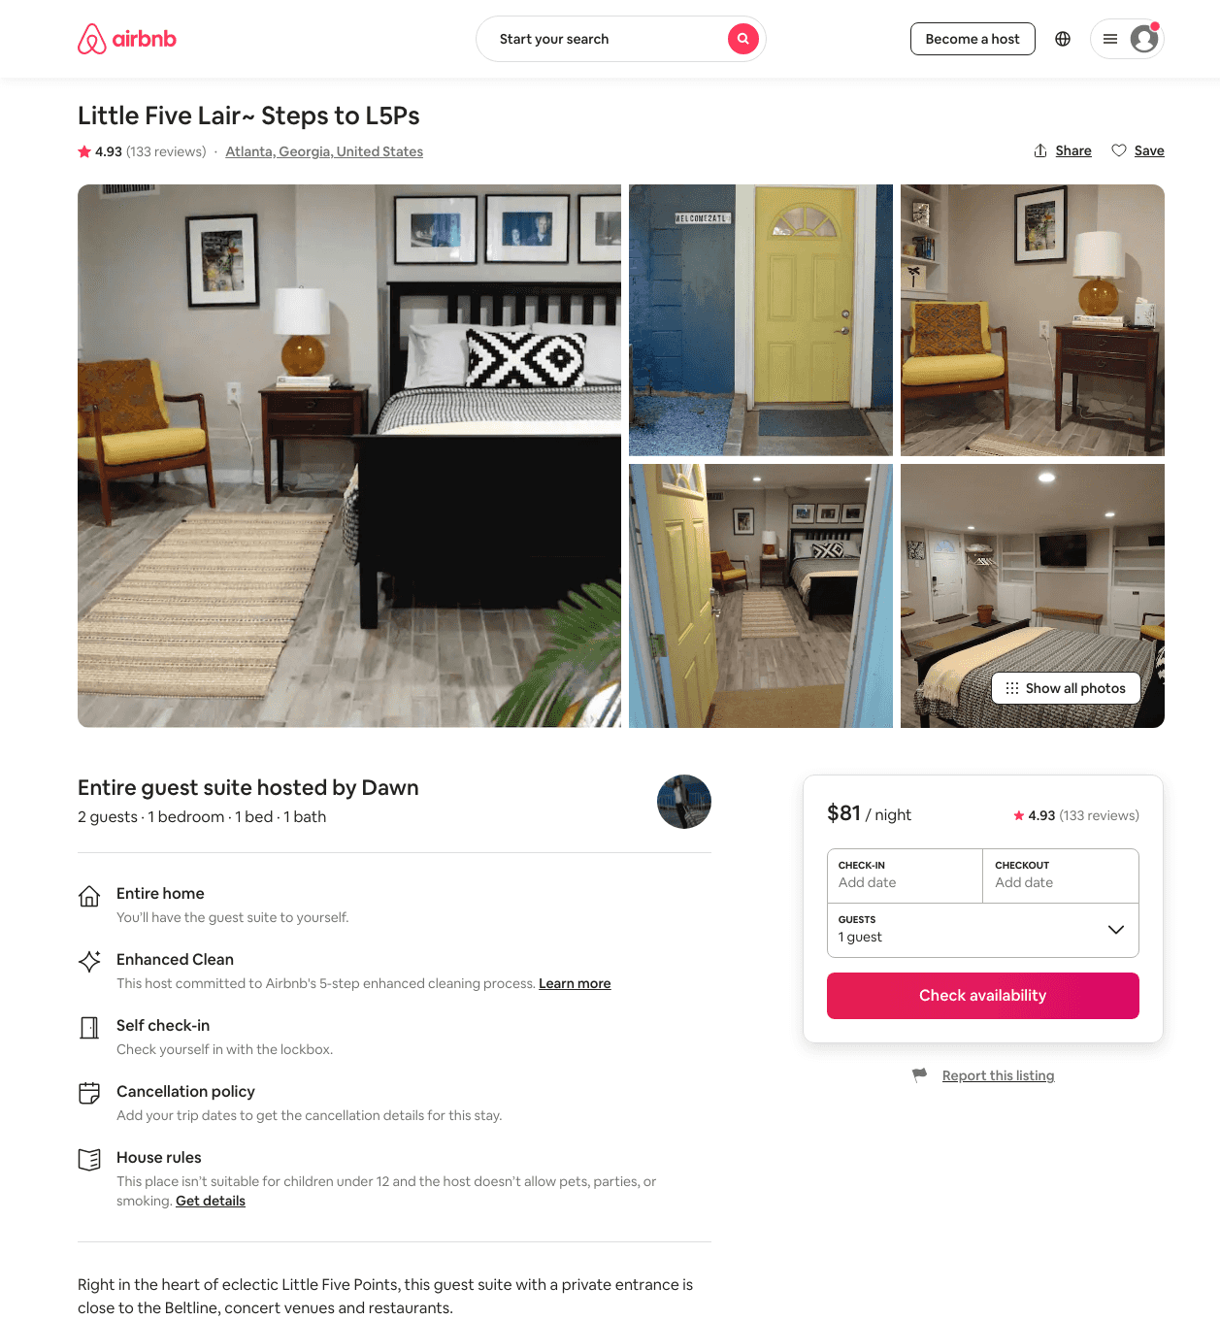
Listing 24654898
1
2
$80 - $101
4.94
15
Dawn
9310523
4
https://www.airbnb.com/rooms/24654898
Aug 2022

Slide 16
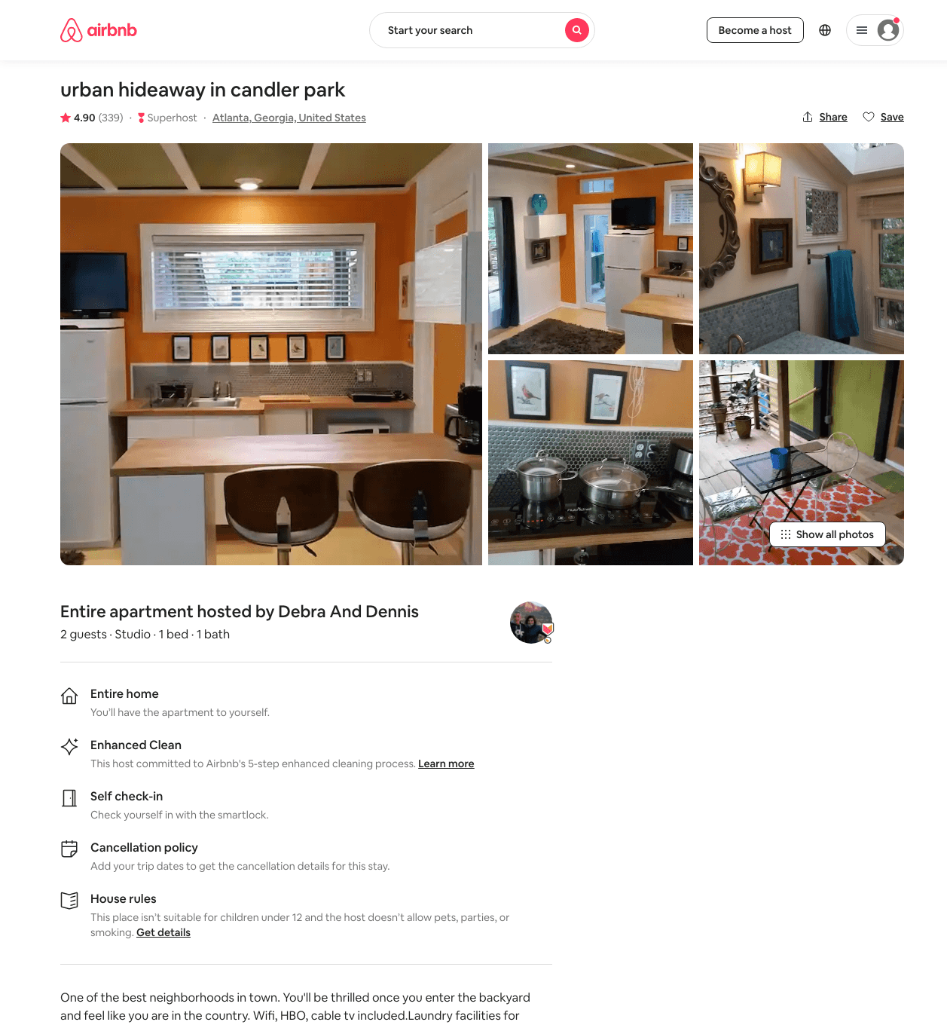
Listing 5642254
Studio
2
$72 - $86
4.90
5
Debra And Dennis
2916690
2
https://www.airbnb.com/rooms/5642254
Aug 2022

Slide 17
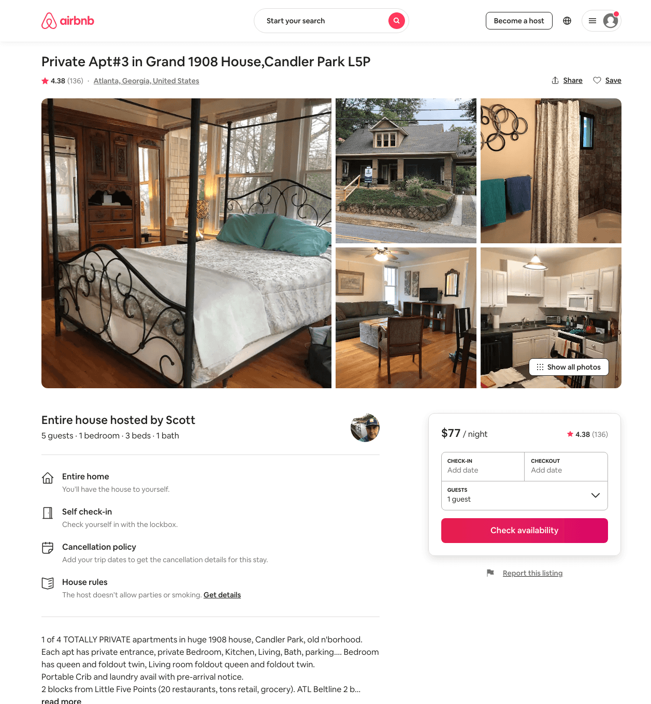
Listing 32214161
1
5
$77 - $90
4.38
1
Scott
6265647
8
https://www.airbnb.com/rooms/32214161
Aug 2022

Slide 18
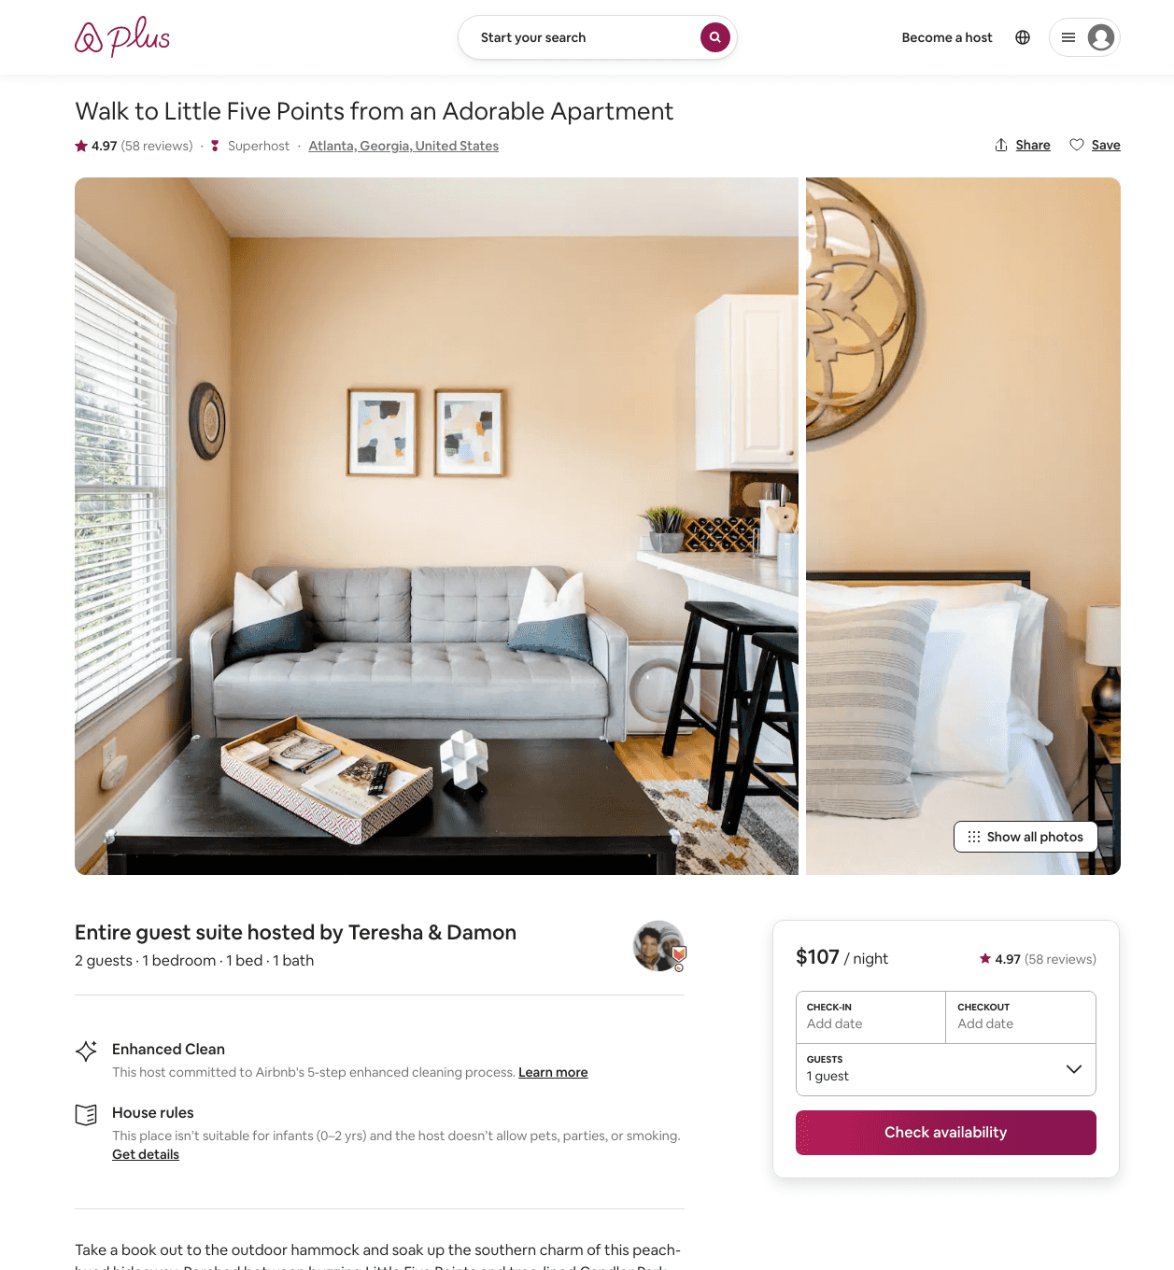
Listing 39612181
1
2
$107 - $136
4.96
1
Teresha & Damon
2791535
1
https://www.airbnb.com/rooms/39612181
Aug 2022

Slide 19
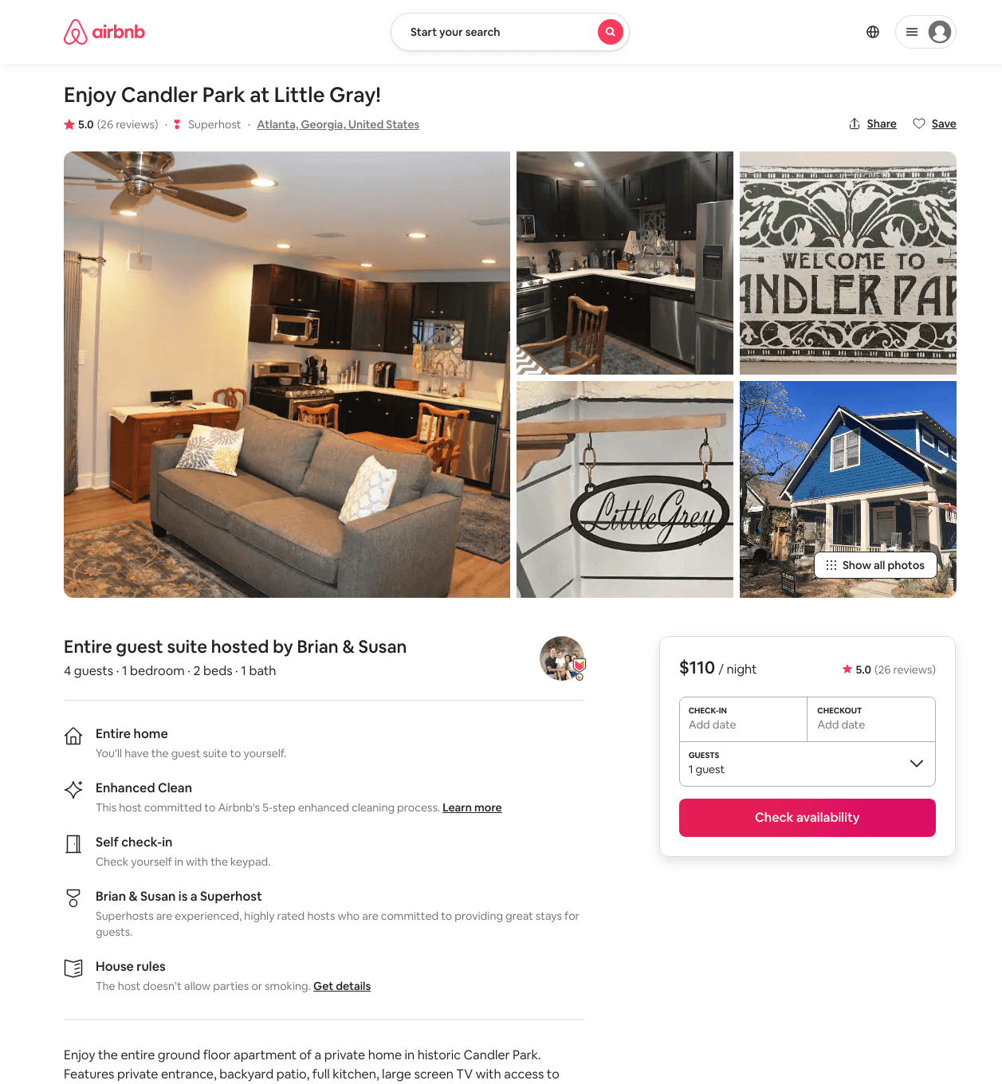
Listing 31509279
1
4
$110 - $122
5.0
2
Brian & Susan
80780620
1
https://www.airbnb.com/rooms/31509279
Aug 2022

Slide 20
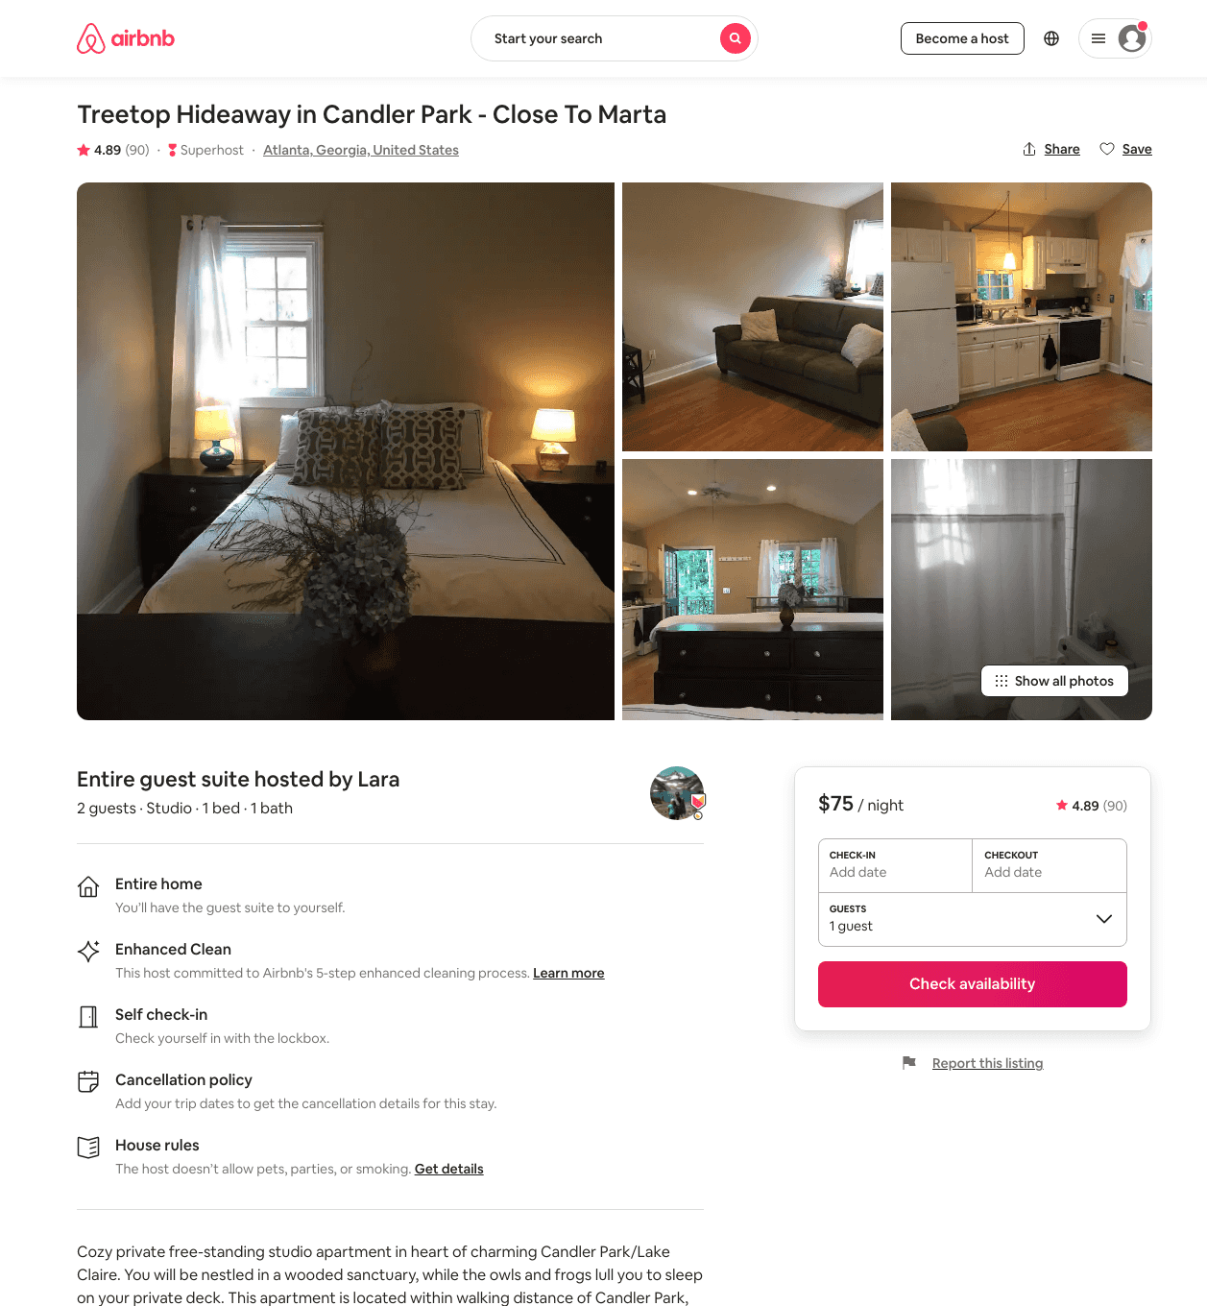
Listing 4428122
Studio
2
$75 - $85
4.89
2
Lara
22987905
1
https://www.airbnb.com/rooms/4428122
Aug 2022

Slide 21
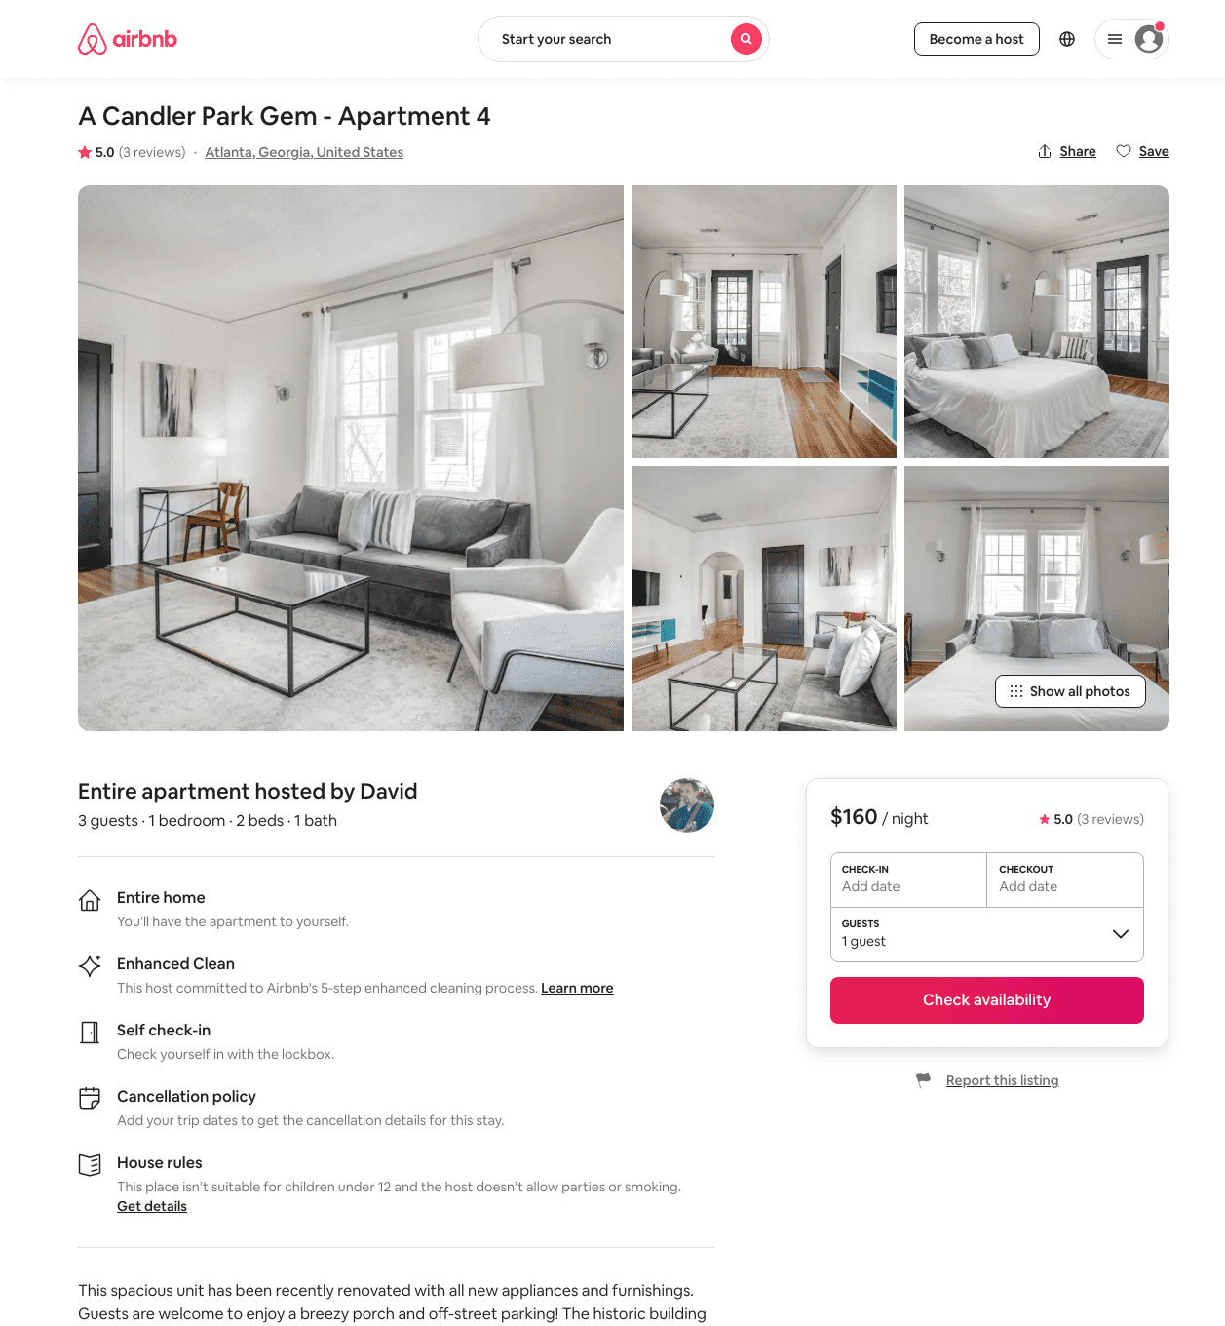
Listing 39437482
1
3
$160 - $162
5.0
30
David
294526897
6
https://www.airbnb.com/rooms/39437482
Aug 2022

Slide 22
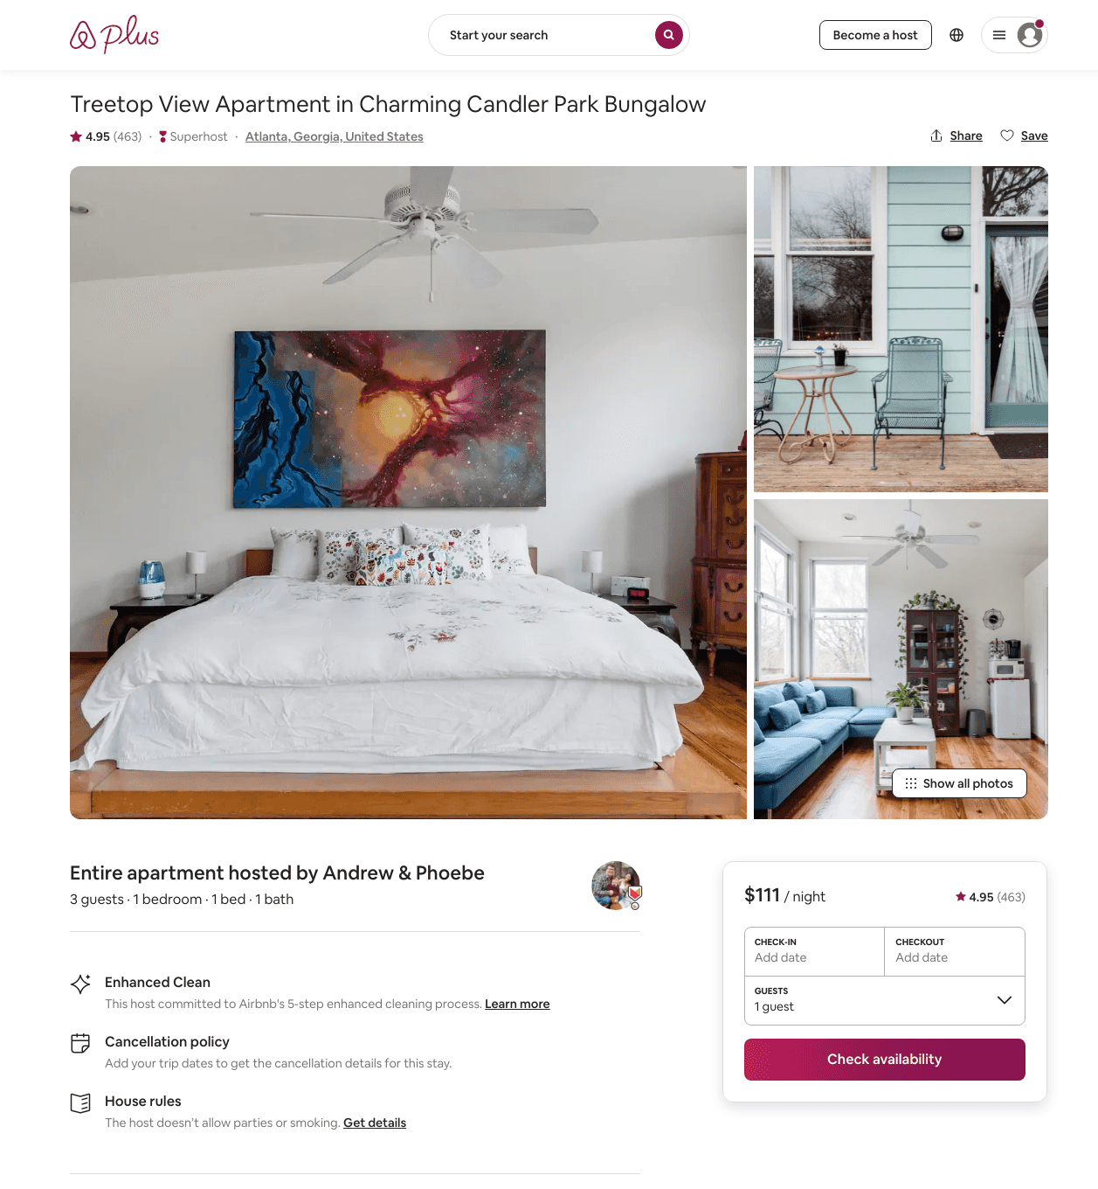
Listing 20863519
1
3
$101 - $127
4.95
1
Andrew & Phoebe
13816488
3
https://www.airbnb.com/rooms/20863519
Aug 2022

Slide 23
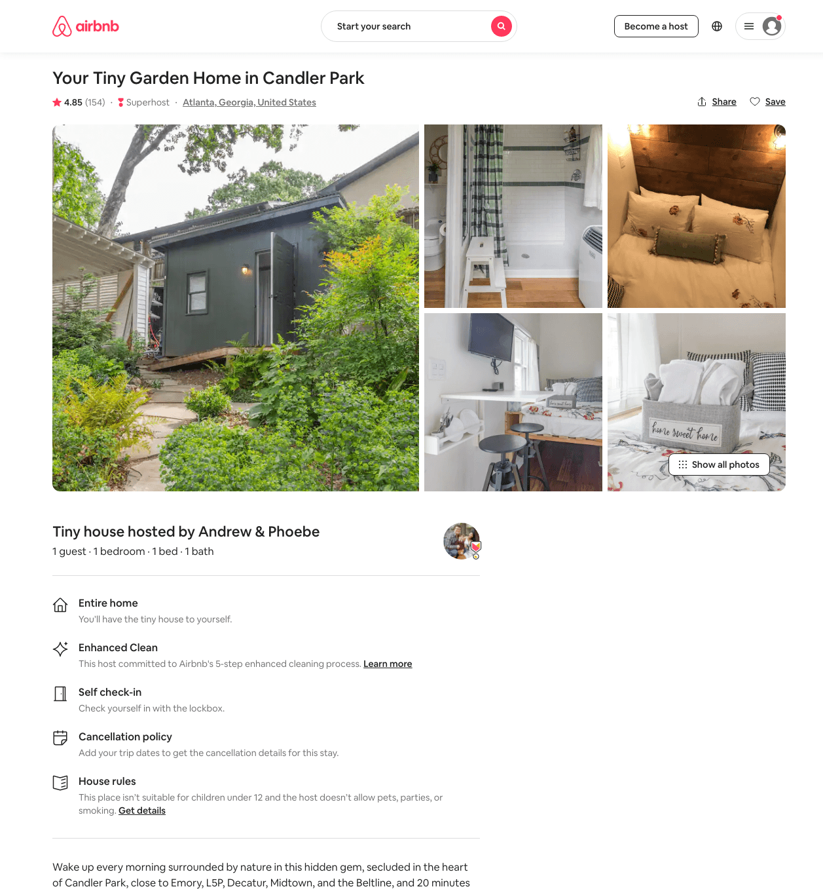
Listing 34480750
1
1
$48 - $63
4.85
1
Andrew & Phoebe
13816488
3
https://www.airbnb.com/rooms/34480750
Aug 2022

Slide 24
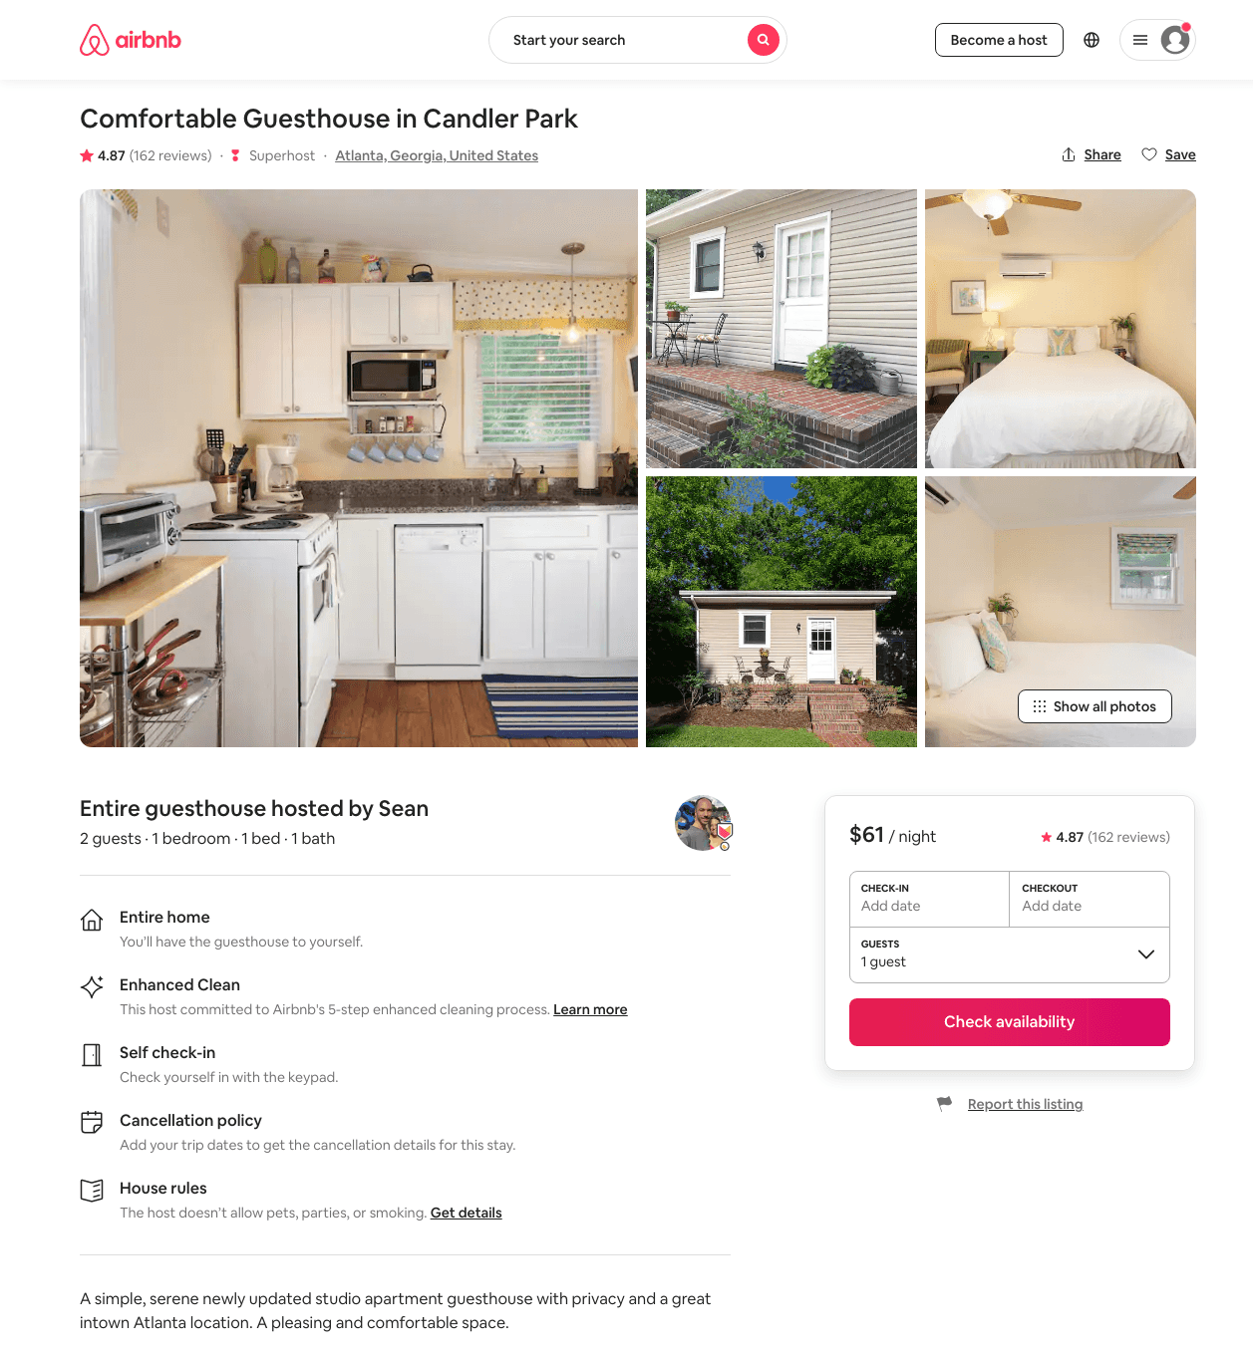
Listing 13244731
1
2
$61 - $65
4.87
3
Sean
4836791
1
https://www.airbnb.com/rooms/13244731
Aug 2022

Slide 25
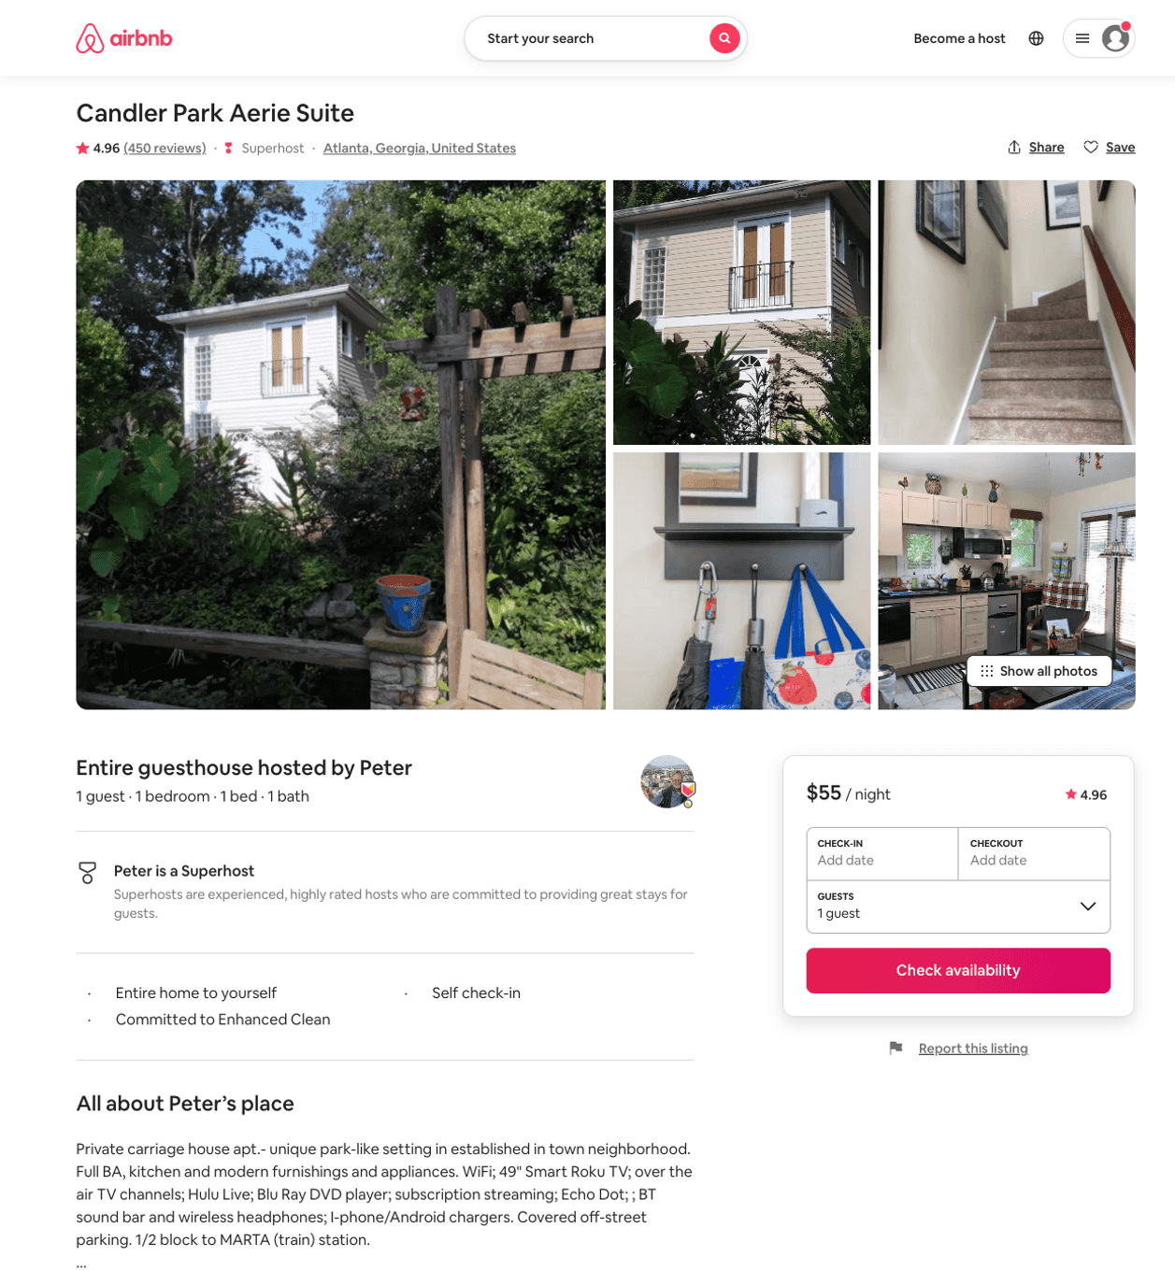
Listing 1582350
1
3
$55 - $108
4.96
2
Amy
8389337
2
https://www.airbnb.com/rooms/1582350
Aug 2022

Slide 26
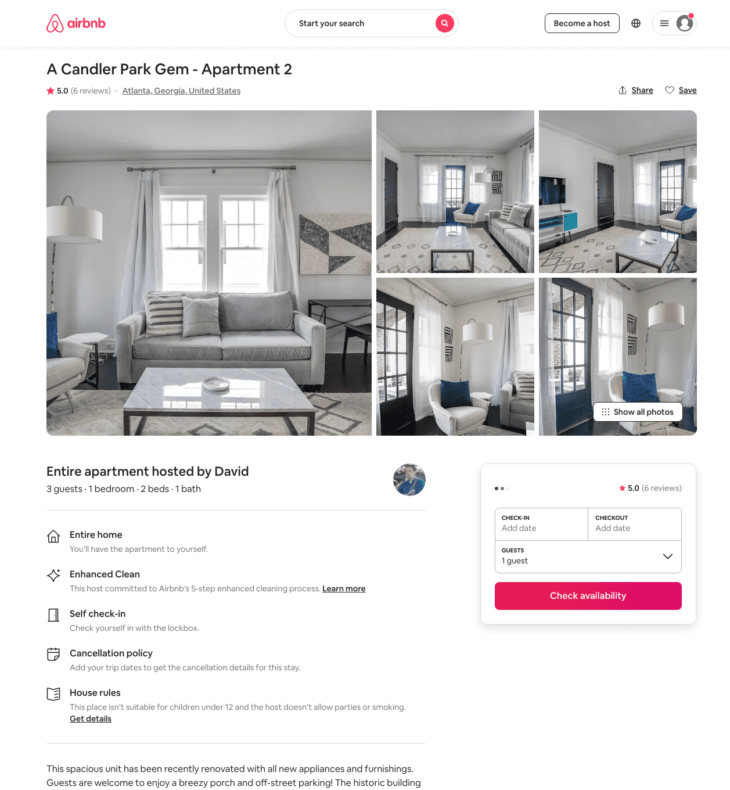
Listing 38600819
1
3
$160
5.0
30
David
294526897
6
https://www.airbnb.com/rooms/38600819
Aug 2022

Slide 27
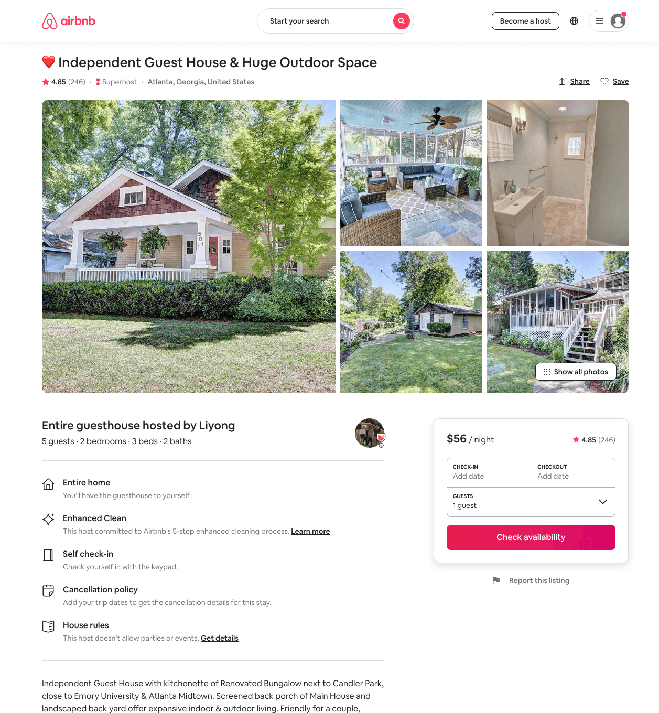
Listing 36207587
2
5
$54 - $79
4.86
1
Liyong
272314929
1
https://www.airbnb.com/rooms/36207587
Aug 2022

Slide 28
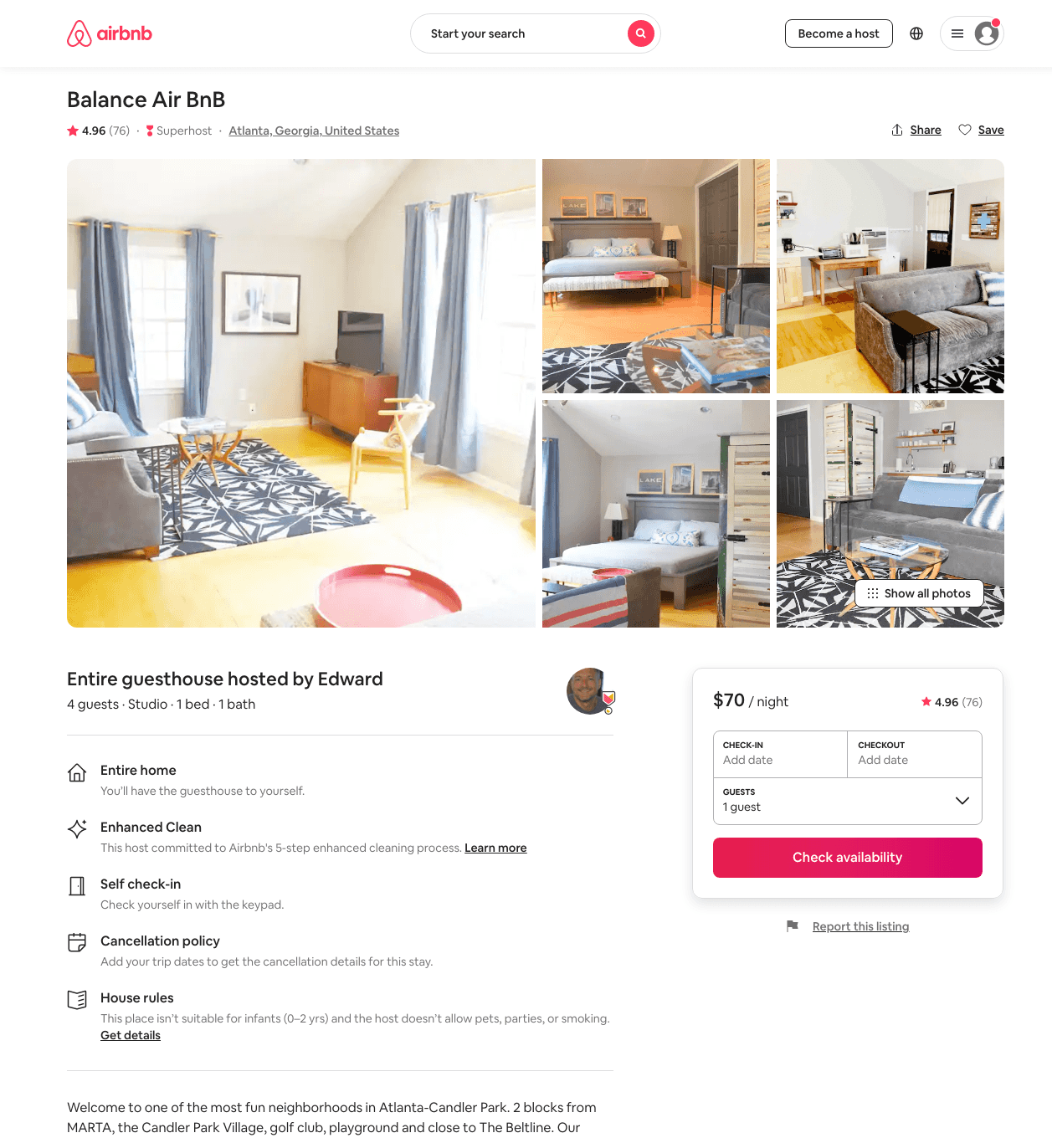
Listing 28241974
Studio
2
$70 - $112
4.96
2
Edward
10853942
1
https://www.airbnb.com/rooms/28241974
Aug 2022

Slide 29
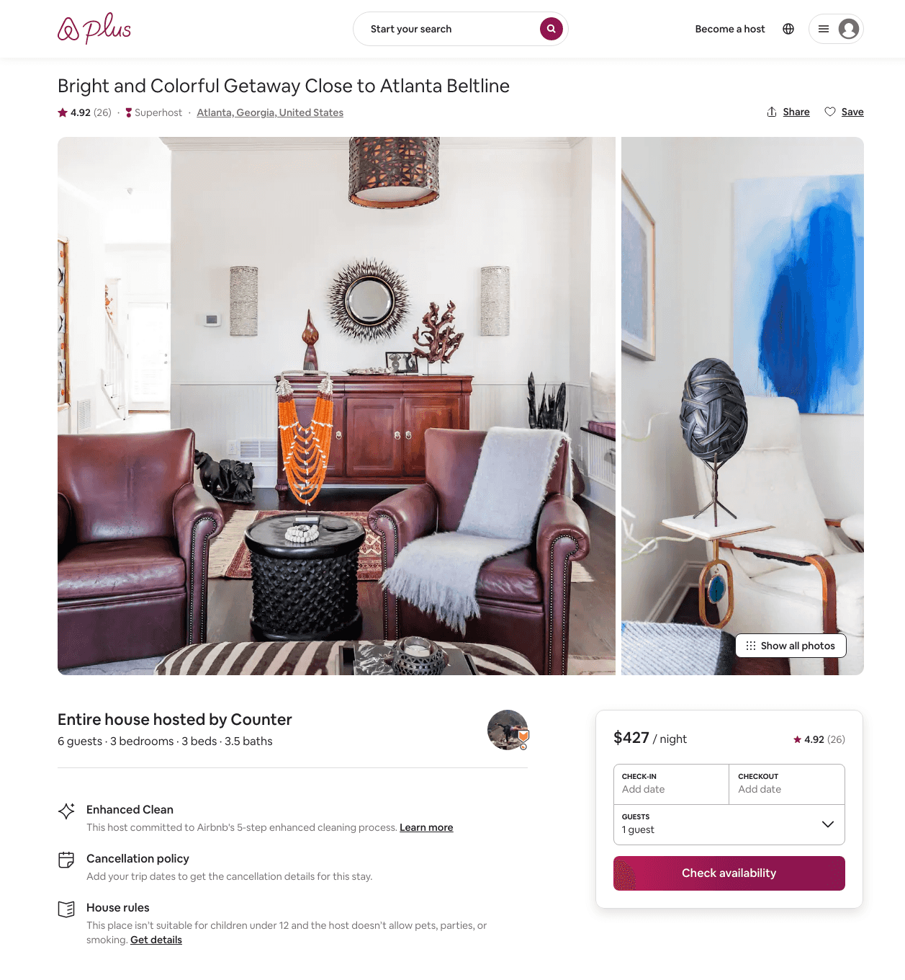
Listing 22417228
3
6
$461 - $493
4.96
2
Counter
51261141
3
https://www.airbnb.com/rooms/22417228
Aug 2022

Slide 30
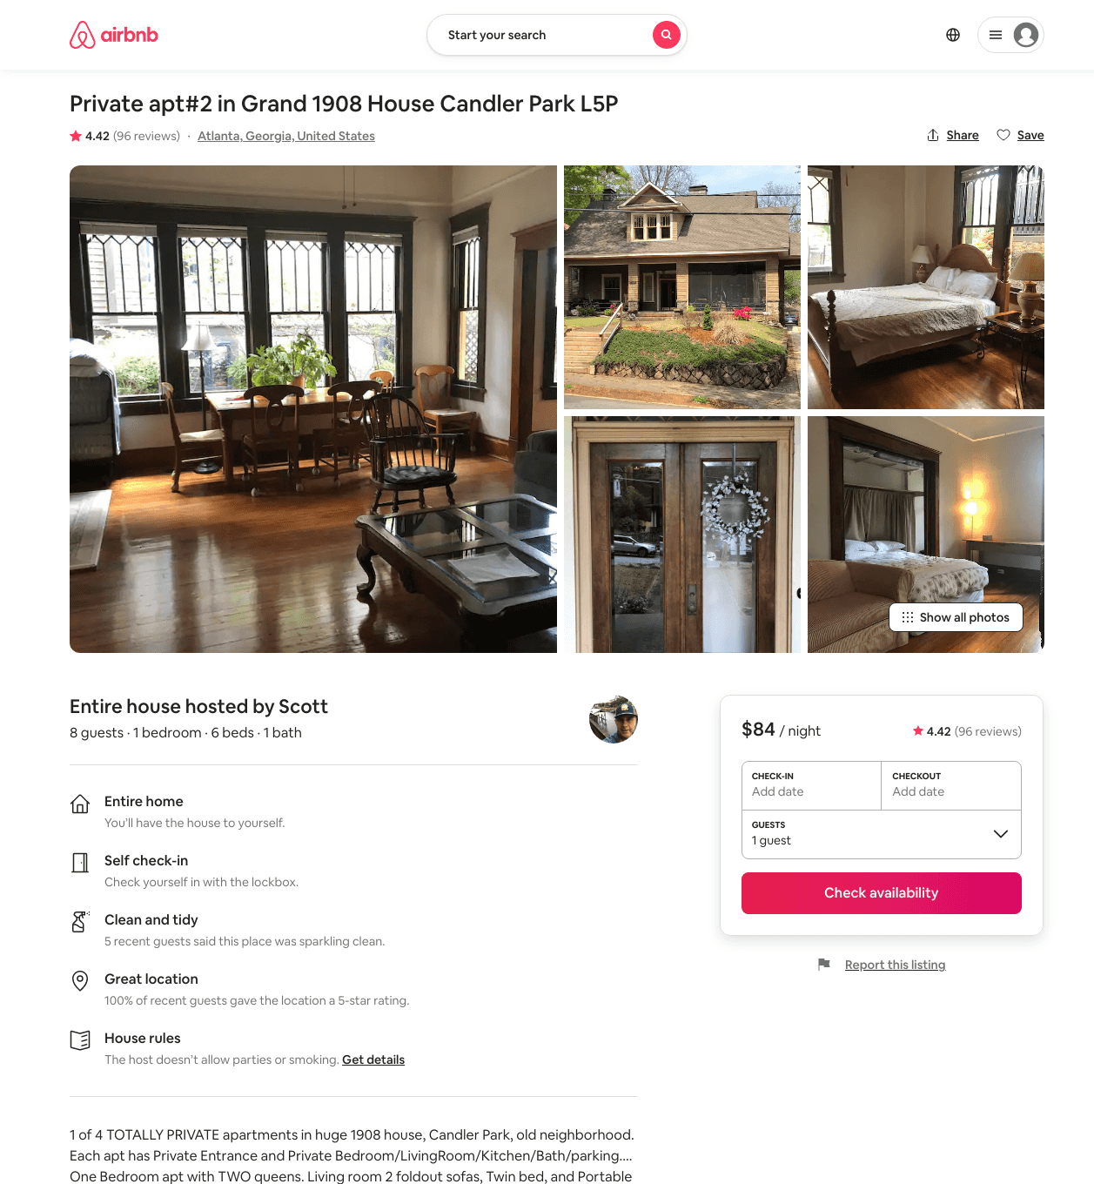
Listing 33044369
1
8
$79 - $93
4.44
1
Scott
6265647
8
https://www.airbnb.com/rooms/33044369
Aug 2022

Slide 31
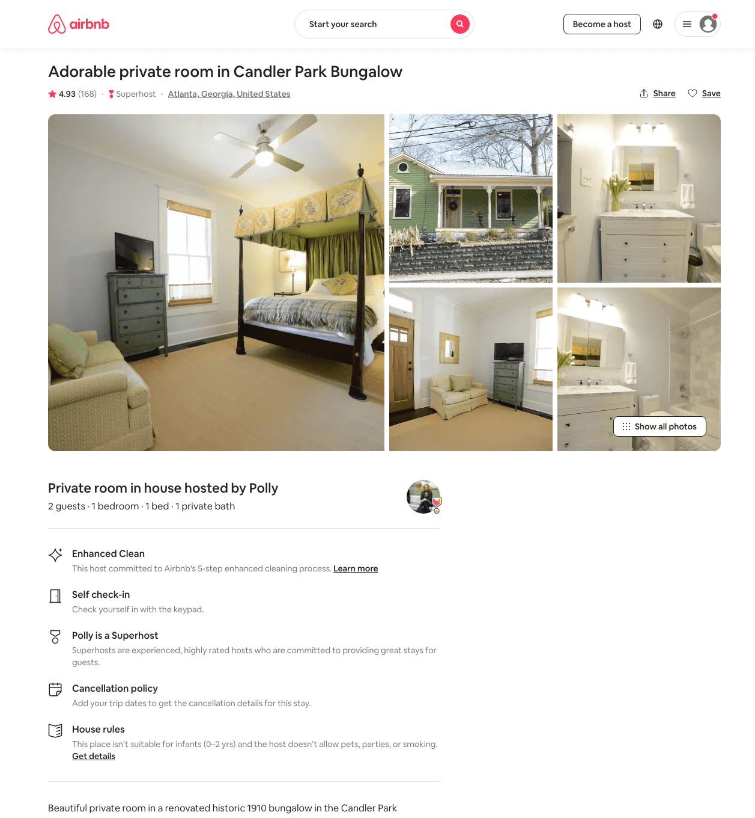
Listing 16973340
1
2
$60 - $66
4.93
2
Polly
3038830
1
https://www.airbnb.com/rooms/16973340
Aug 2022

Slide 32
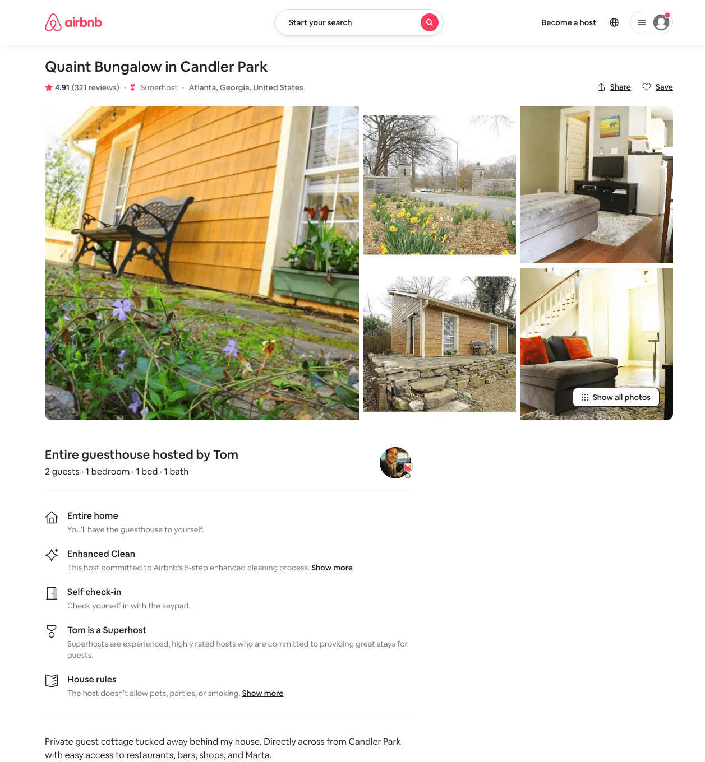
Listing 517617
1
2
$79 - $94
4.91
7
Tom
1571228
1
https://www.airbnb.com/rooms/517617
Aug 2022

Slide 33
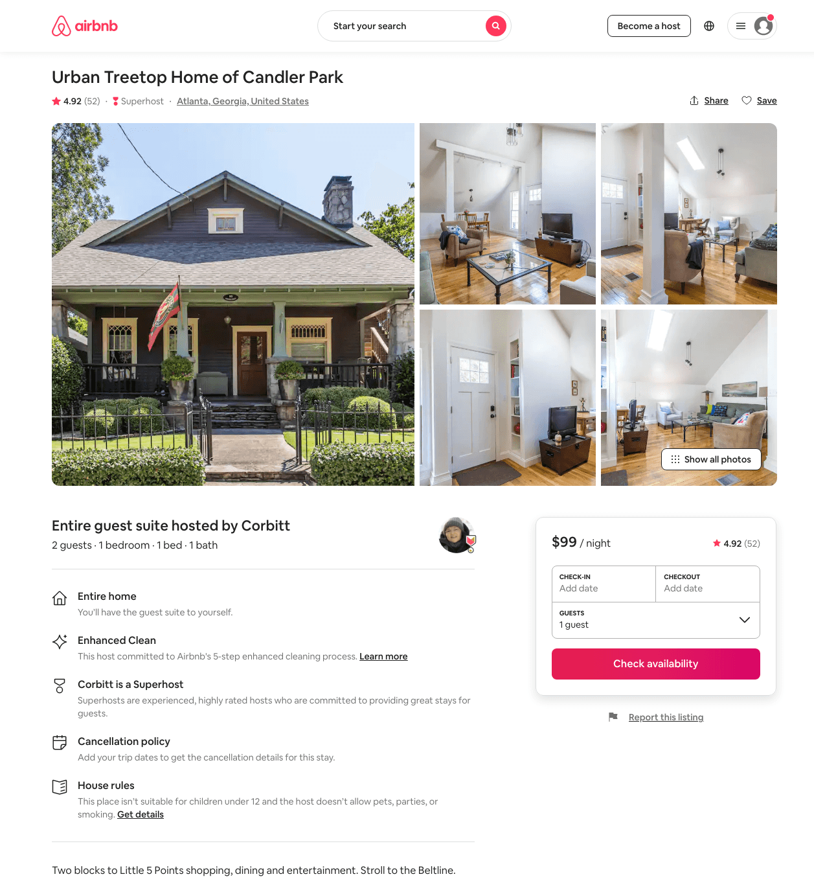
Listing 21830217
1
2
$99 - $106
4.92
30
Corbitt
159153937
1
https://www.airbnb.com/rooms/21830217
Jun 2022

Slide 34
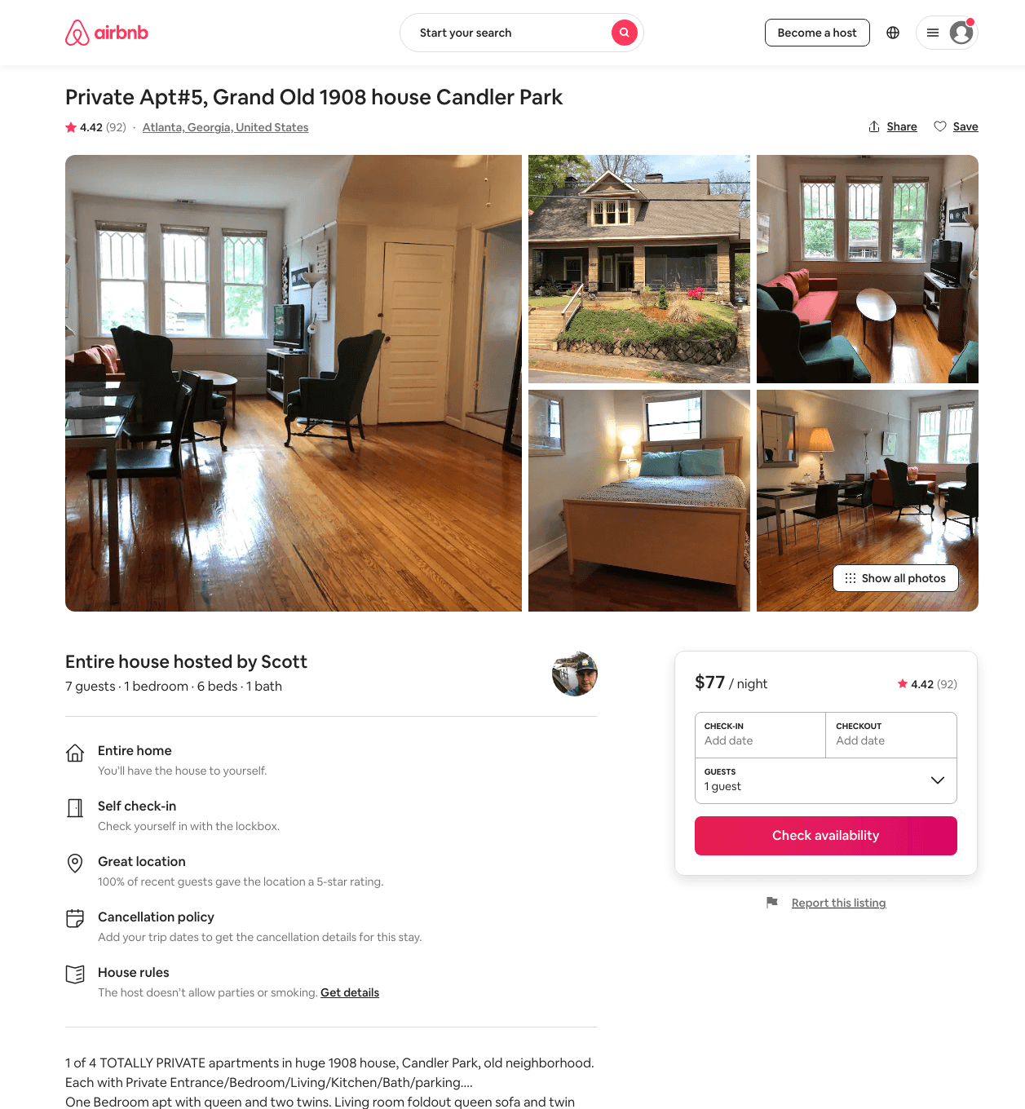
Listing 34011857
1
7
$77 - $94
4.47
1
Scott
6265647
8
https://www.airbnb.com/rooms/34011857
Aug 2022

Slide 35
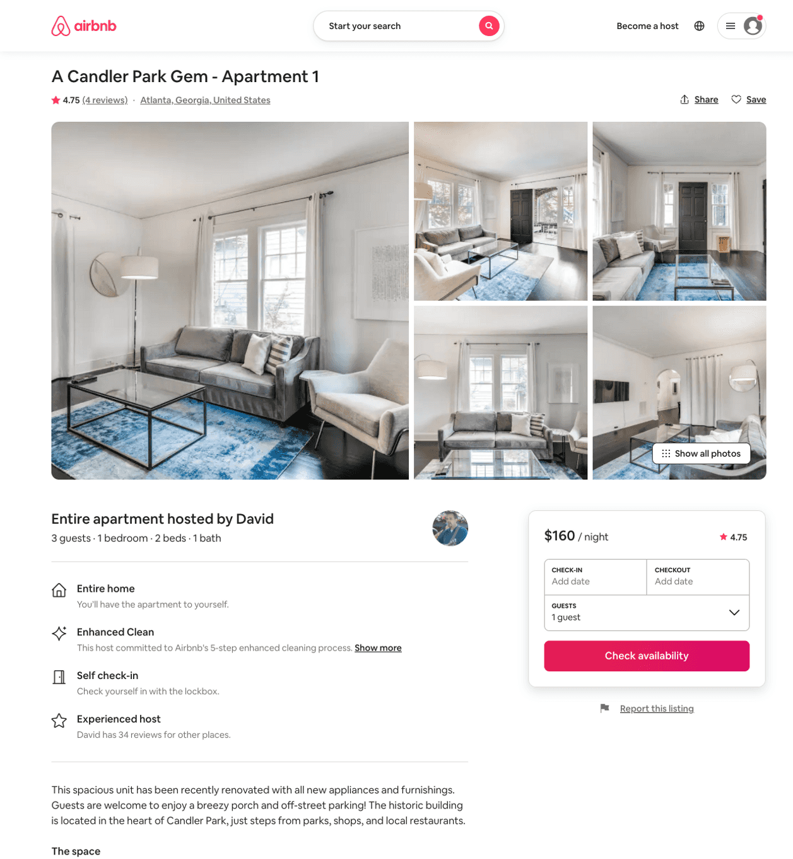
Listing 38597115
1
3
$160
4.83
28
David
294526897
6
https://www.airbnb.com/rooms/38597115
Aug 2022

Slide 36
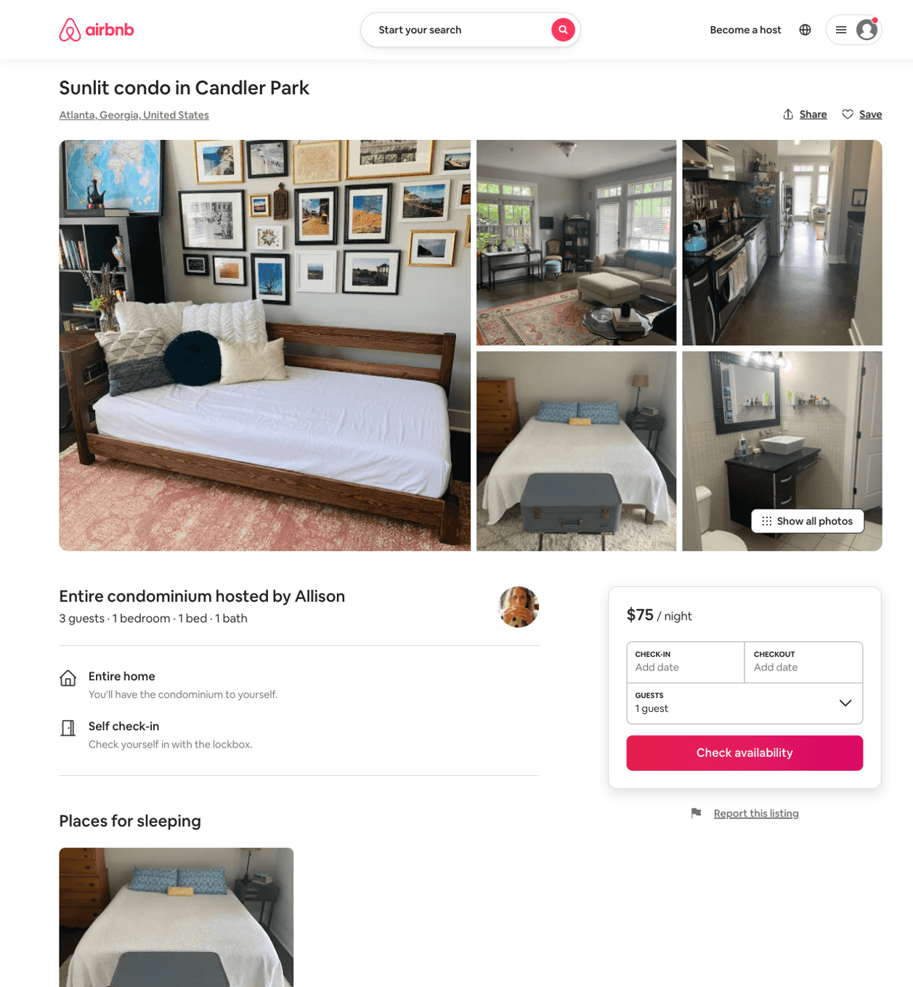
Listing 50855999
1
3
$75
28
Allison
5137479
1
https://www.airbnb.com/rooms/50855999
Aug 2022

Slide 37
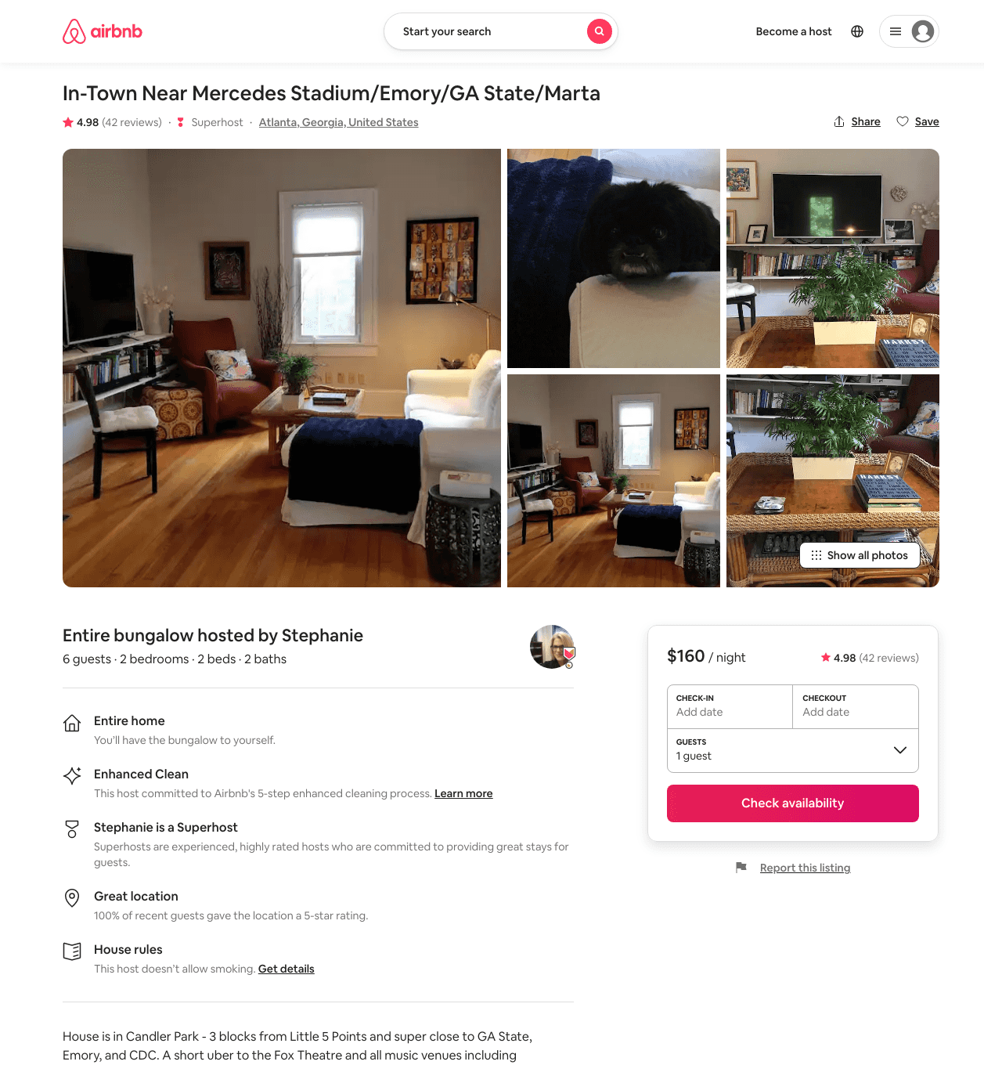
Listing 26892621
2
4
$114 - $161
4.97
2
Stephanie
26179453
1
https://www.airbnb.com/rooms/26892621
Aug 2022

Slide 38
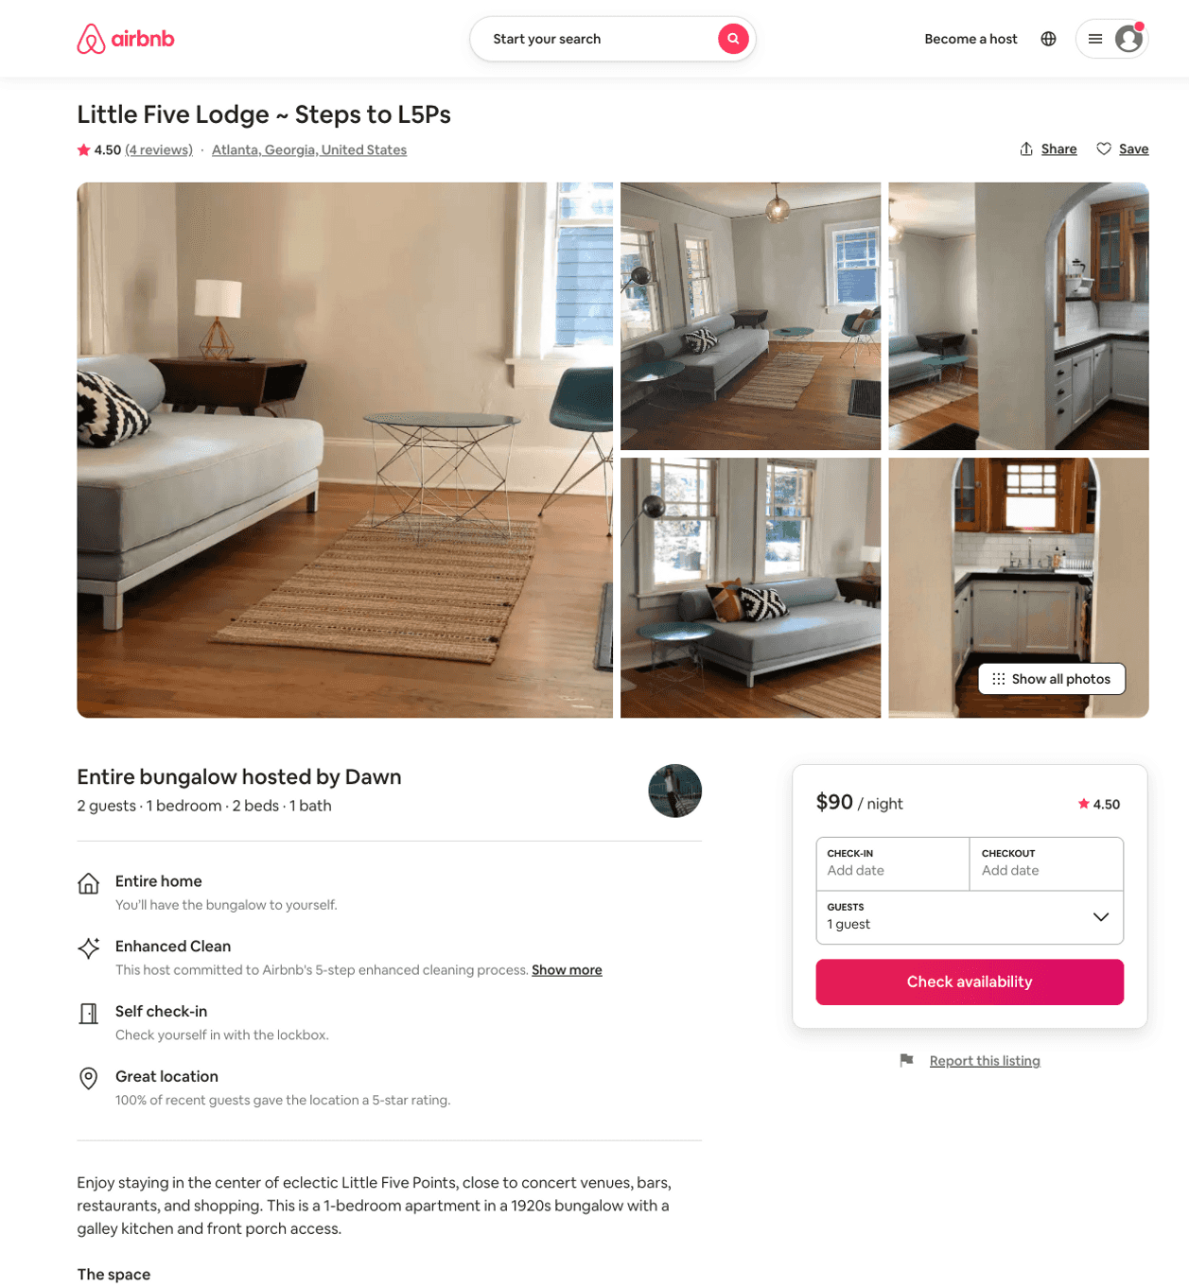
Listing 45543563
1
2
$90 - $97
4.75
7
Dawn
9310523
4
https://www.airbnb.com/rooms/45543563
Jul 2022

Slide 39
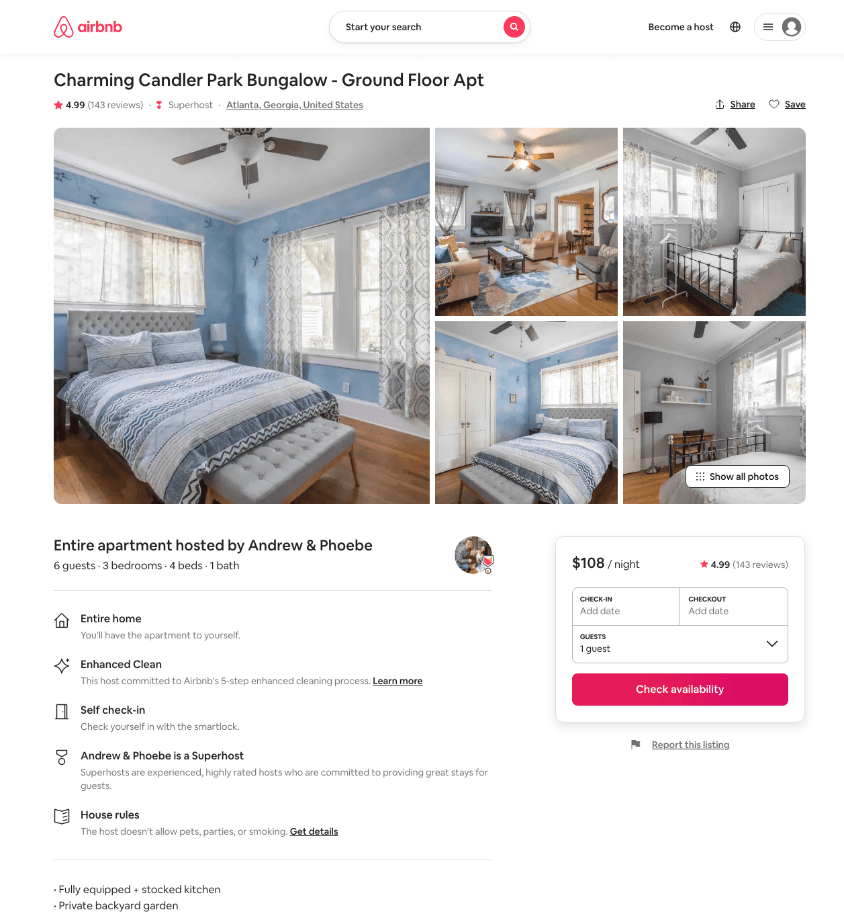
Listing 25403824
3
6
$108 - $141
4.98
2
Andrew & Phoebe
13816488
3
https://www.airbnb.com/rooms/25403824
Aug 2022

Slide 40
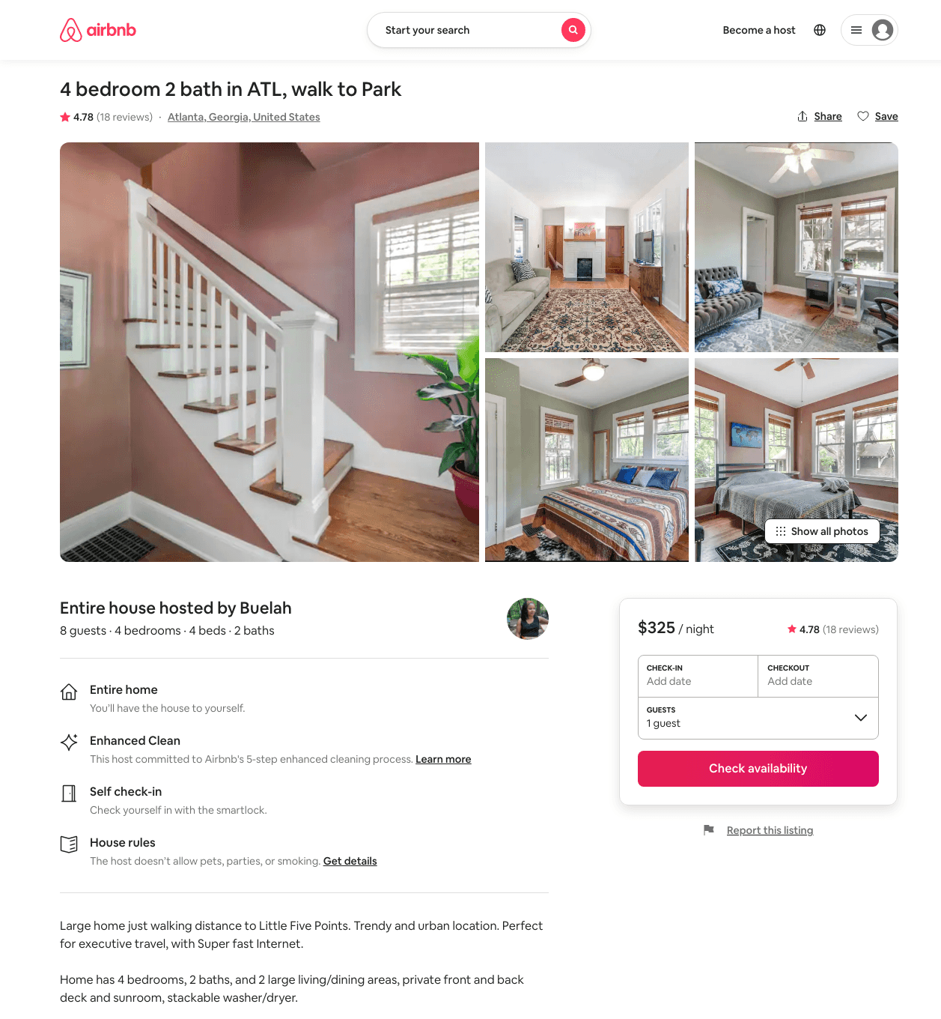
Listing 33115400
4
8
$221 - $399
4.80
3
Buelah
161822332
1
https://www.airbnb.com/rooms/33115400
Aug 2022

Slide 41
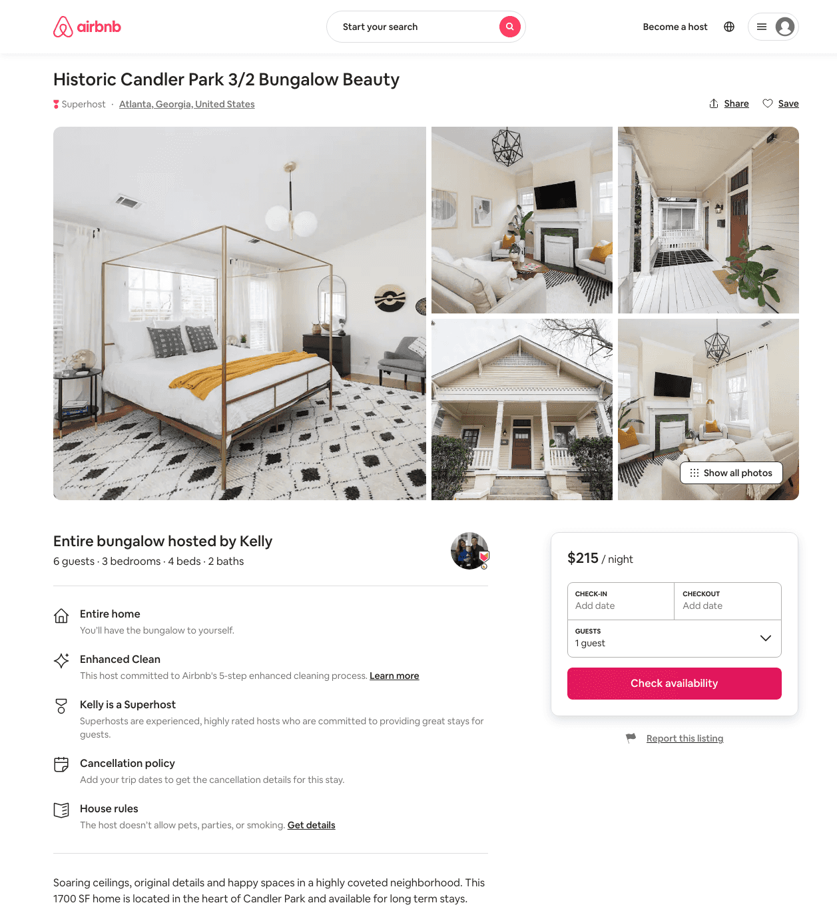
Listing 48621729
3
6
$200 - $223
5.0
20
Jane
392503678
1
https://www.airbnb.com/rooms/48621729
Aug 2022

Slide 42
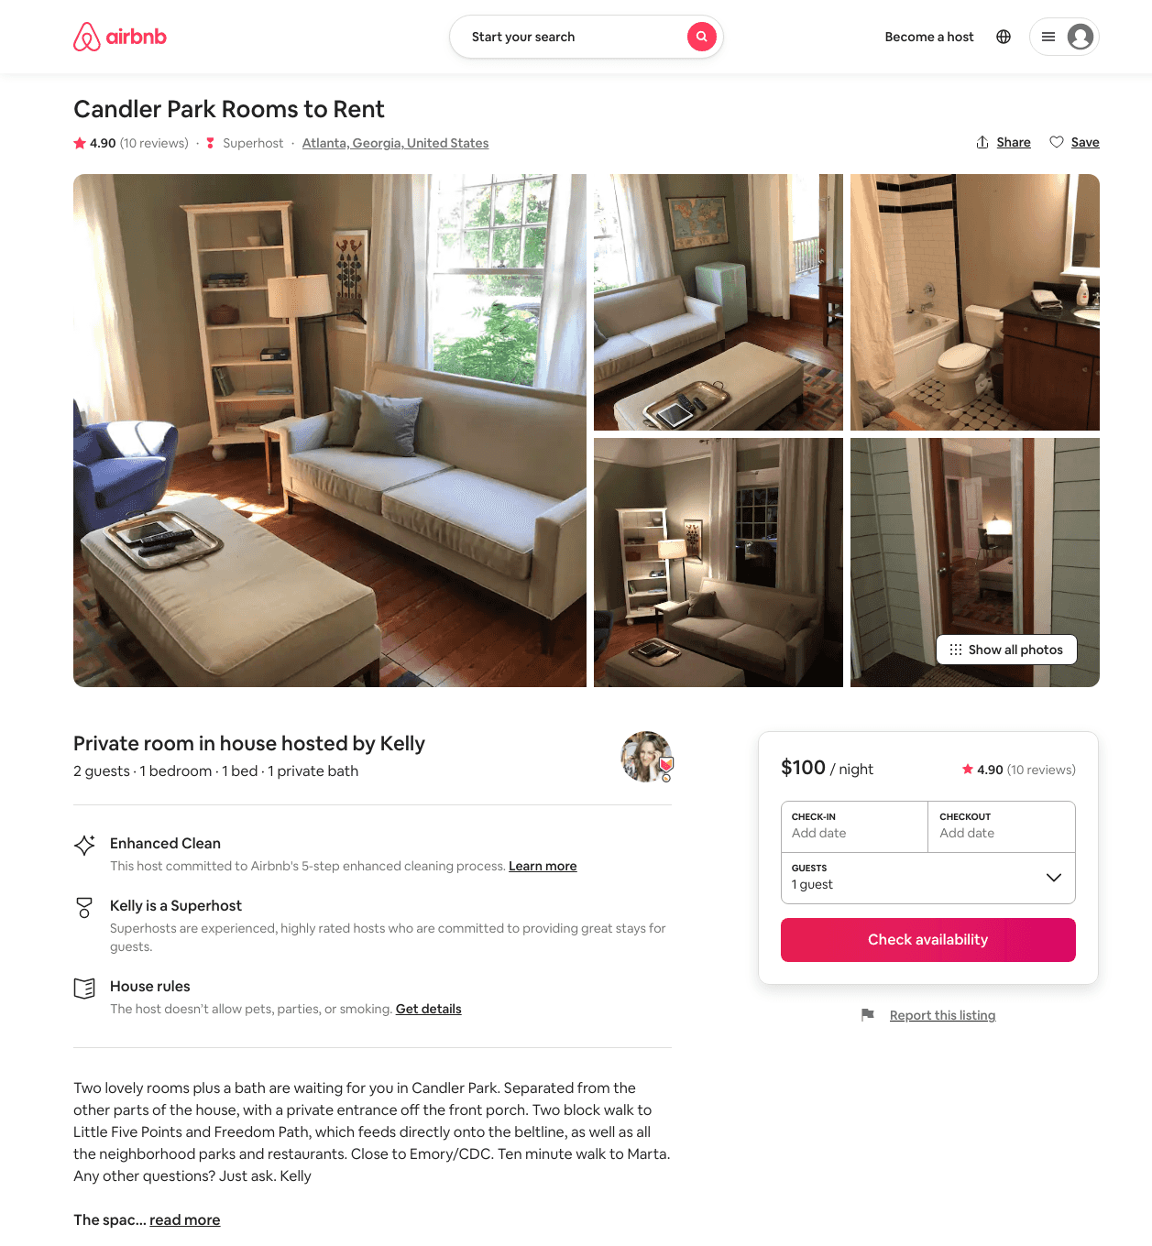
Listing 38348361
1
2
$100 - $125
4.91
1
Kelly
22695893
1
https://www.airbnb.com/rooms/38348361
Aug 2022

Slide 43
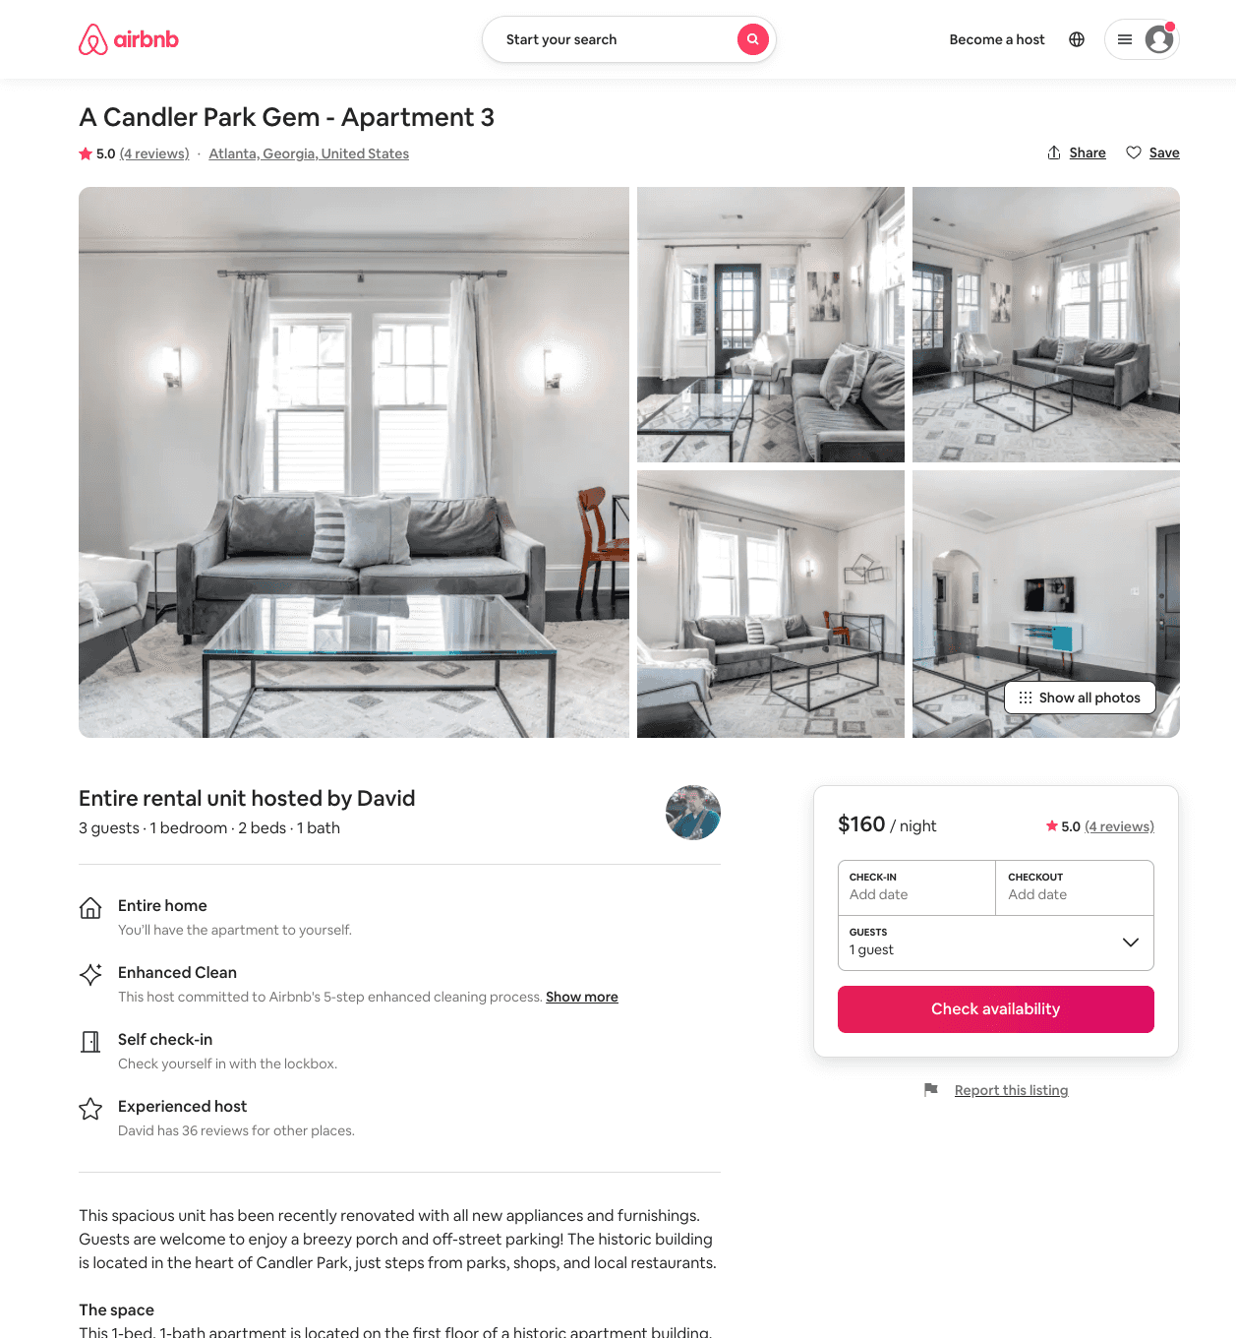
Listing 39416029
1
3
$160
5.0
30
David
294526897
6
https://www.airbnb.com/rooms/39416029
Aug 2022

Slide 44
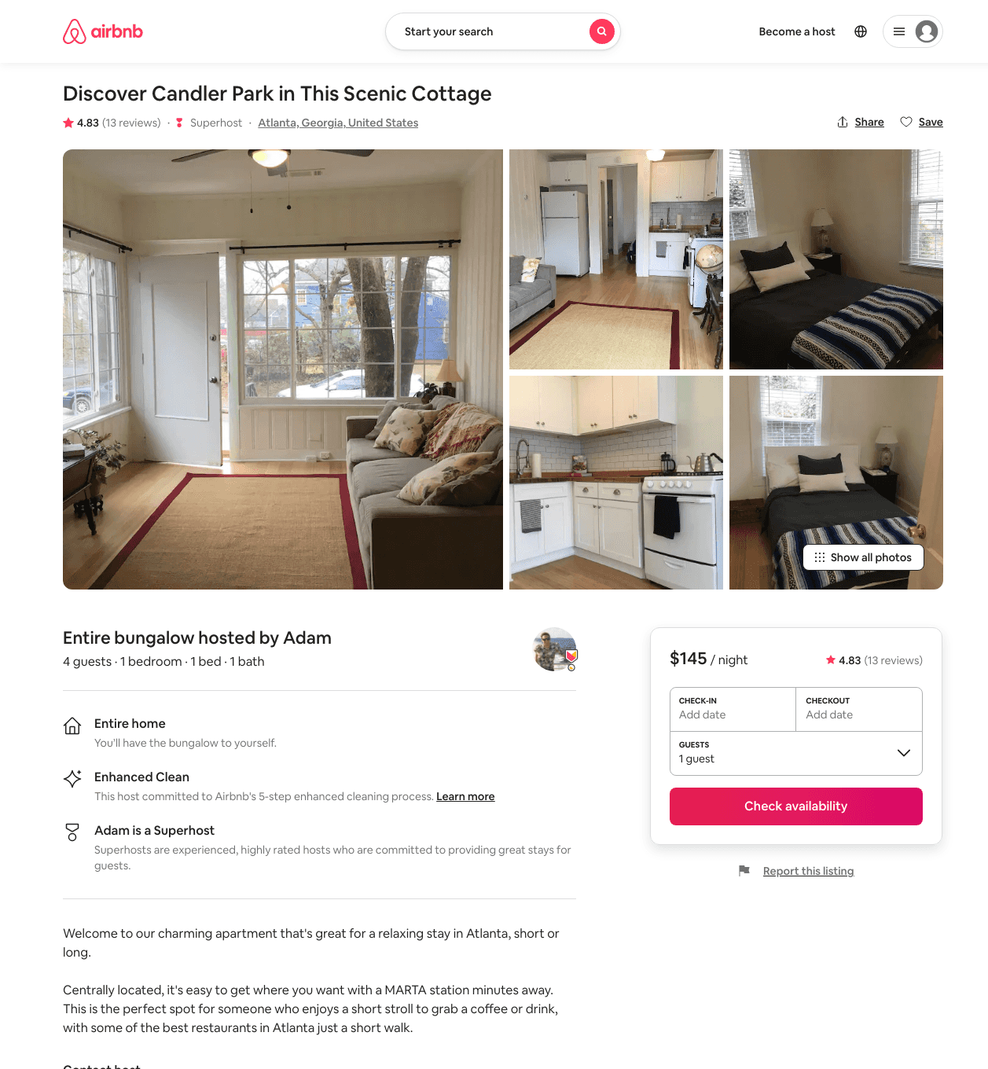
Listing 32591078
1
2
$140 - $145
4.60
6
Adam
9966440
2
https://www.airbnb.com/rooms/32591078
Aug 2022

Slide 45
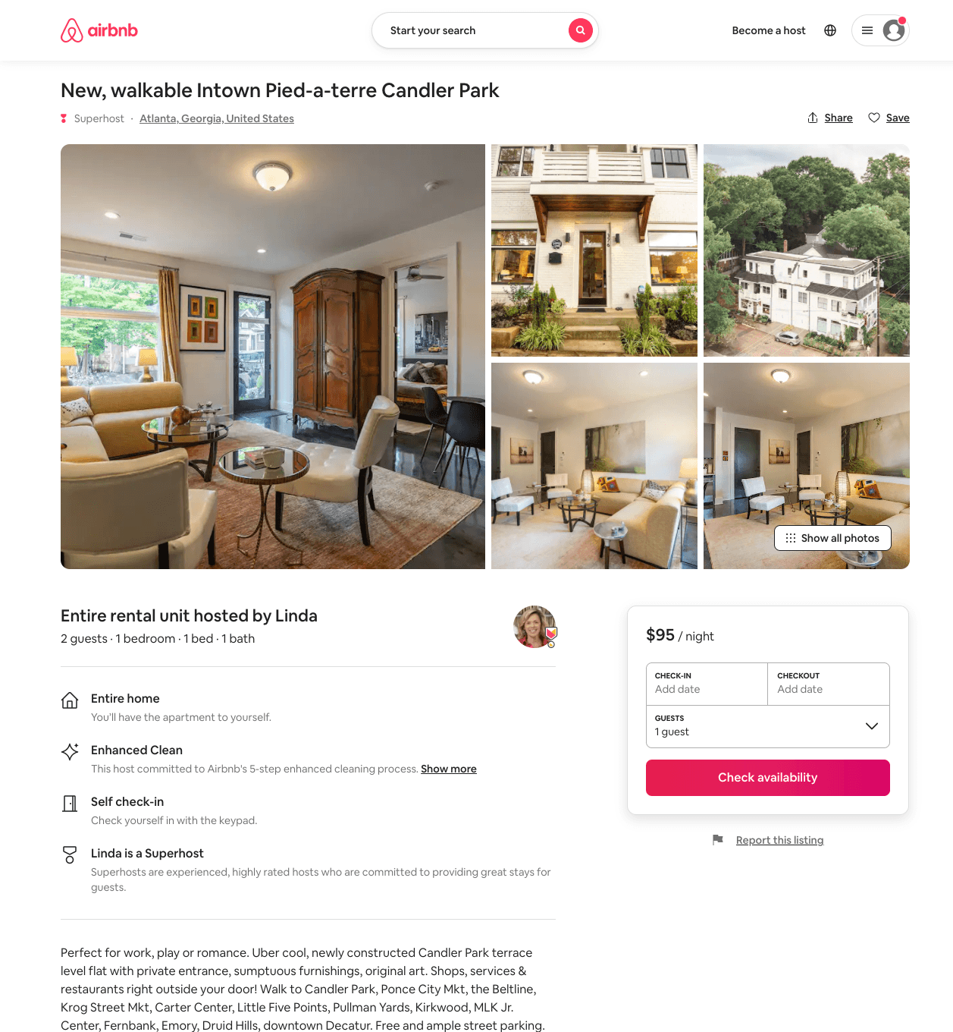
Listing 51168969
1
2
$69 - $137
4.97
1
Linda
37176590
1
https://www.airbnb.com/rooms/51168969
Aug 2022

Slide 46
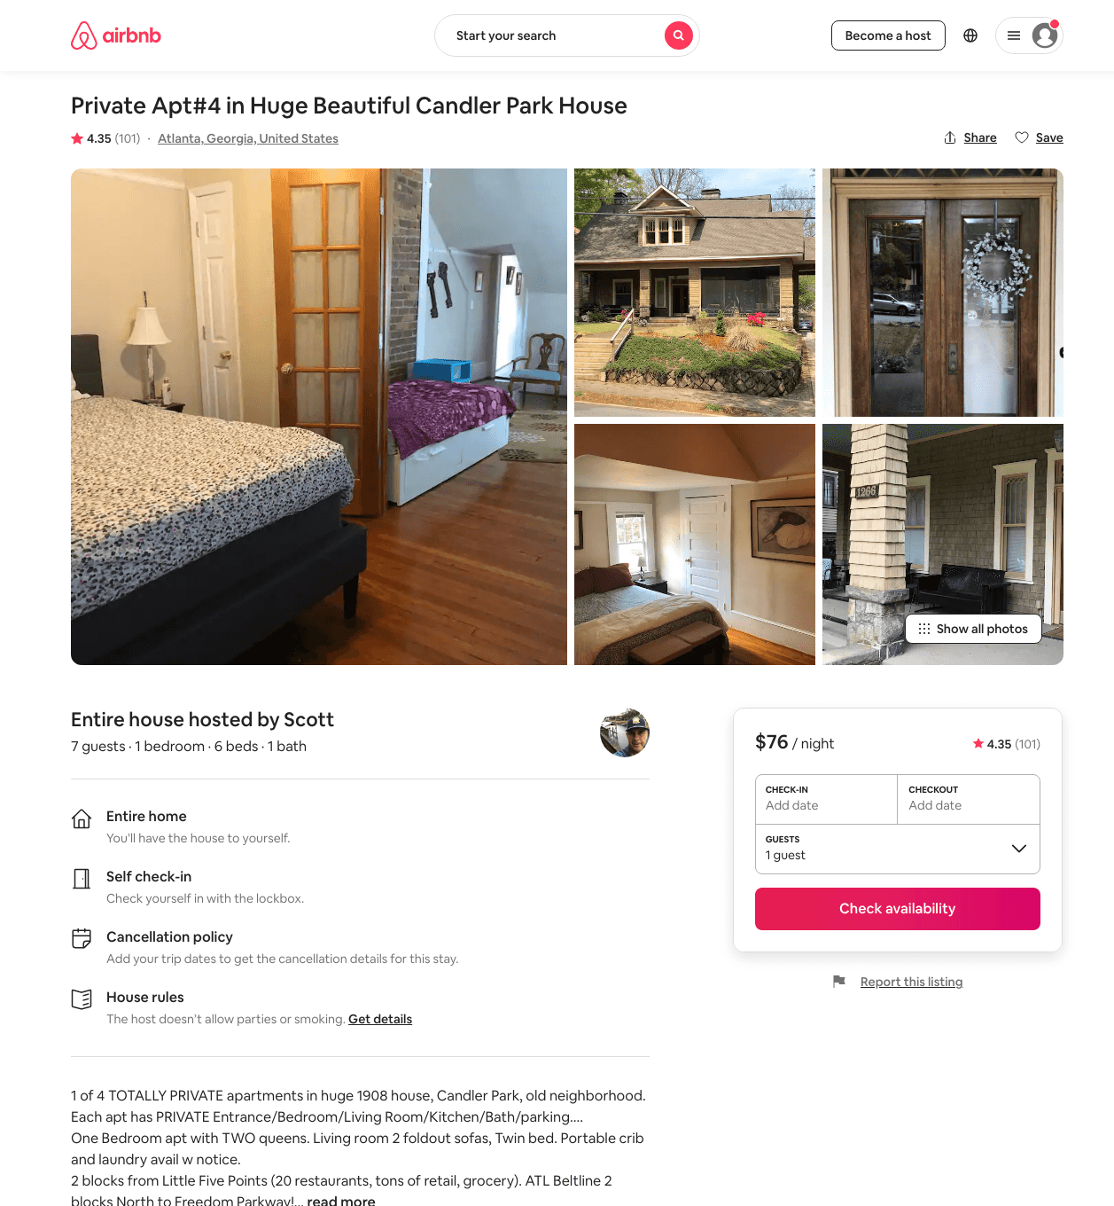
Listing 35372744
1
7
$77 - $94
4.53
1
Scott
6265647
8
https://www.airbnb.com/rooms/35372744
Aug 2022

Slide 47
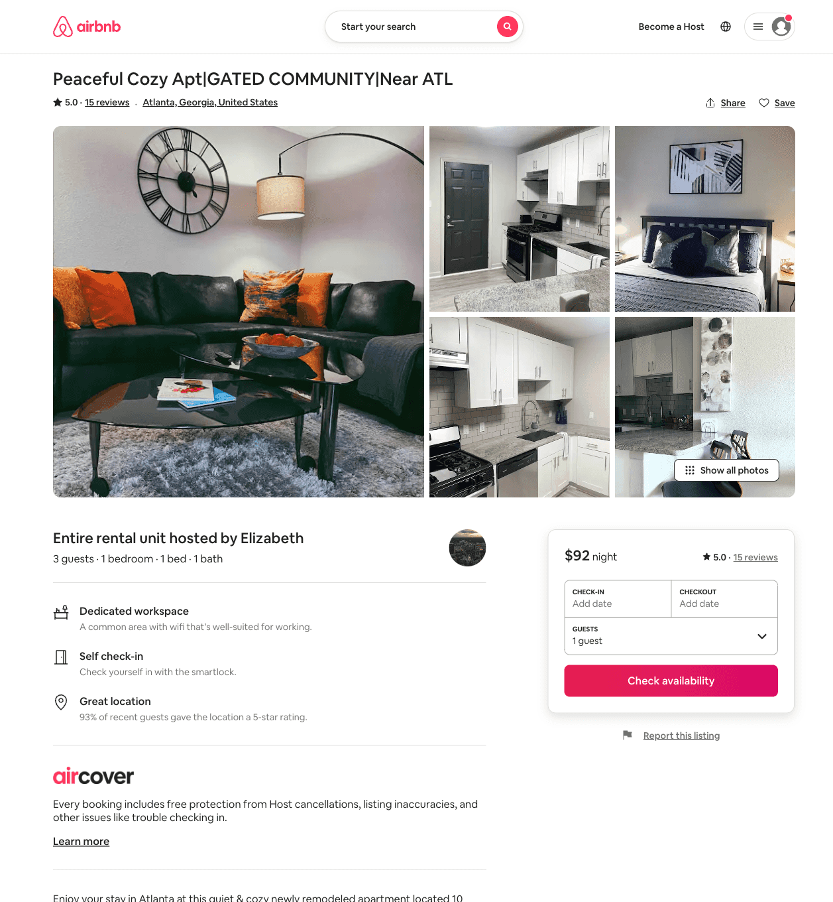
Listing 51577635
1
3
$73 - $135
1
Elizabeth
191458445
2
https://www.airbnb.com/rooms/51577635
Aug 2022

Slide 48
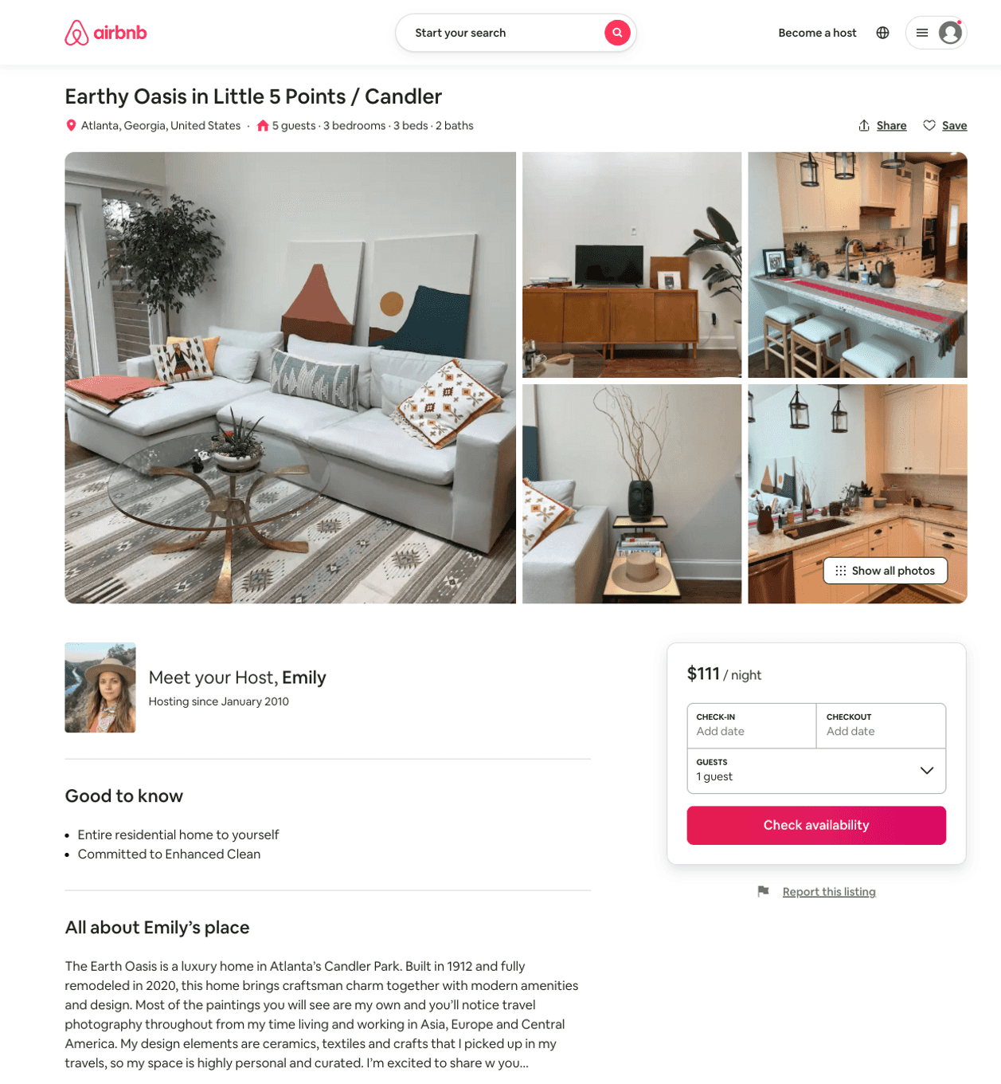
Listing 51784893
3
5
$111 - $305
5.0
28
Emily
73216
1
https://www.airbnb.com/rooms/51784893
Aug 2022

Slide 49
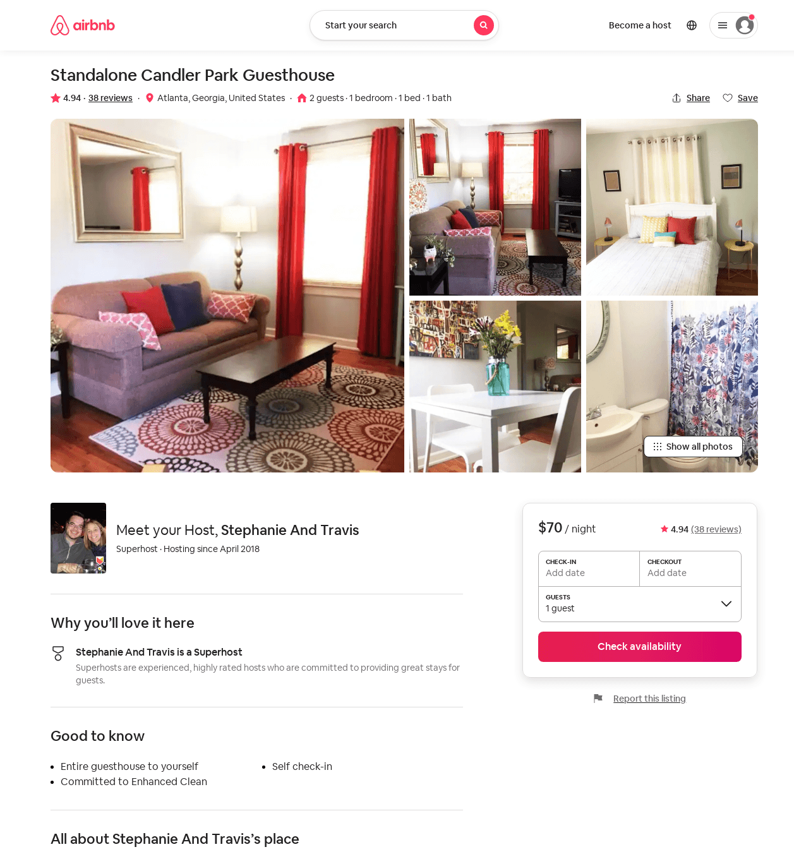
Listing 24678497
1
2
$70 - $98
4.93
2
Stephanie And Travis
186518801
1
https://www.airbnb.com/rooms/24678497
Aug 2022

Slide 50
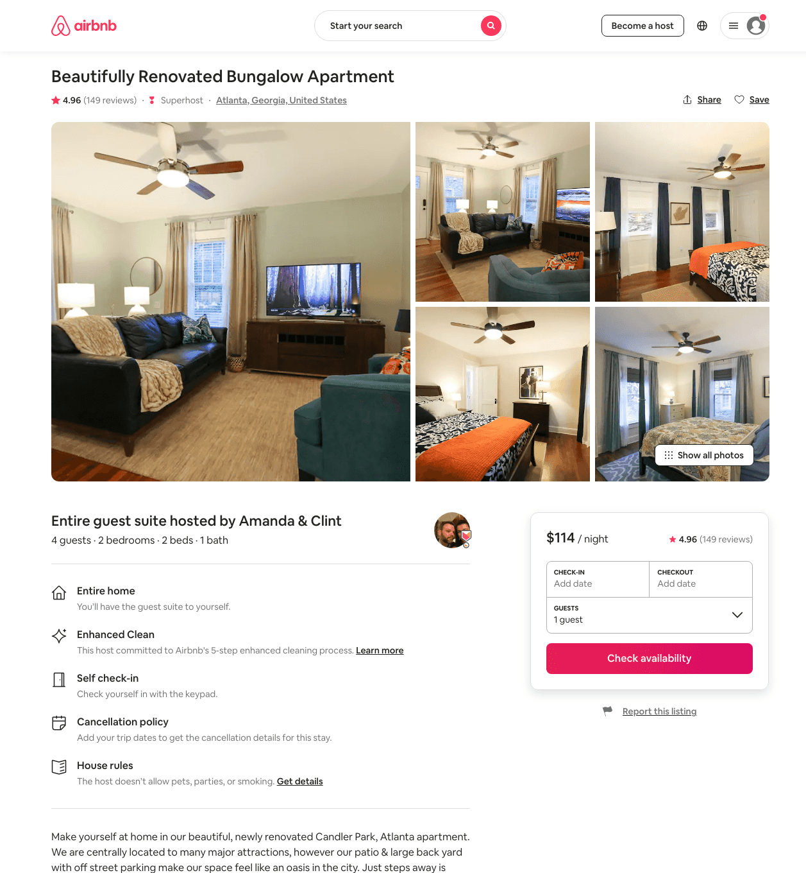
Listing 15659047
2
4
$114 - $151
4.96
2
Amanda & Clint
4943366
1
https://www.airbnb.com/rooms/15659047
Aug 2022

Slide 51
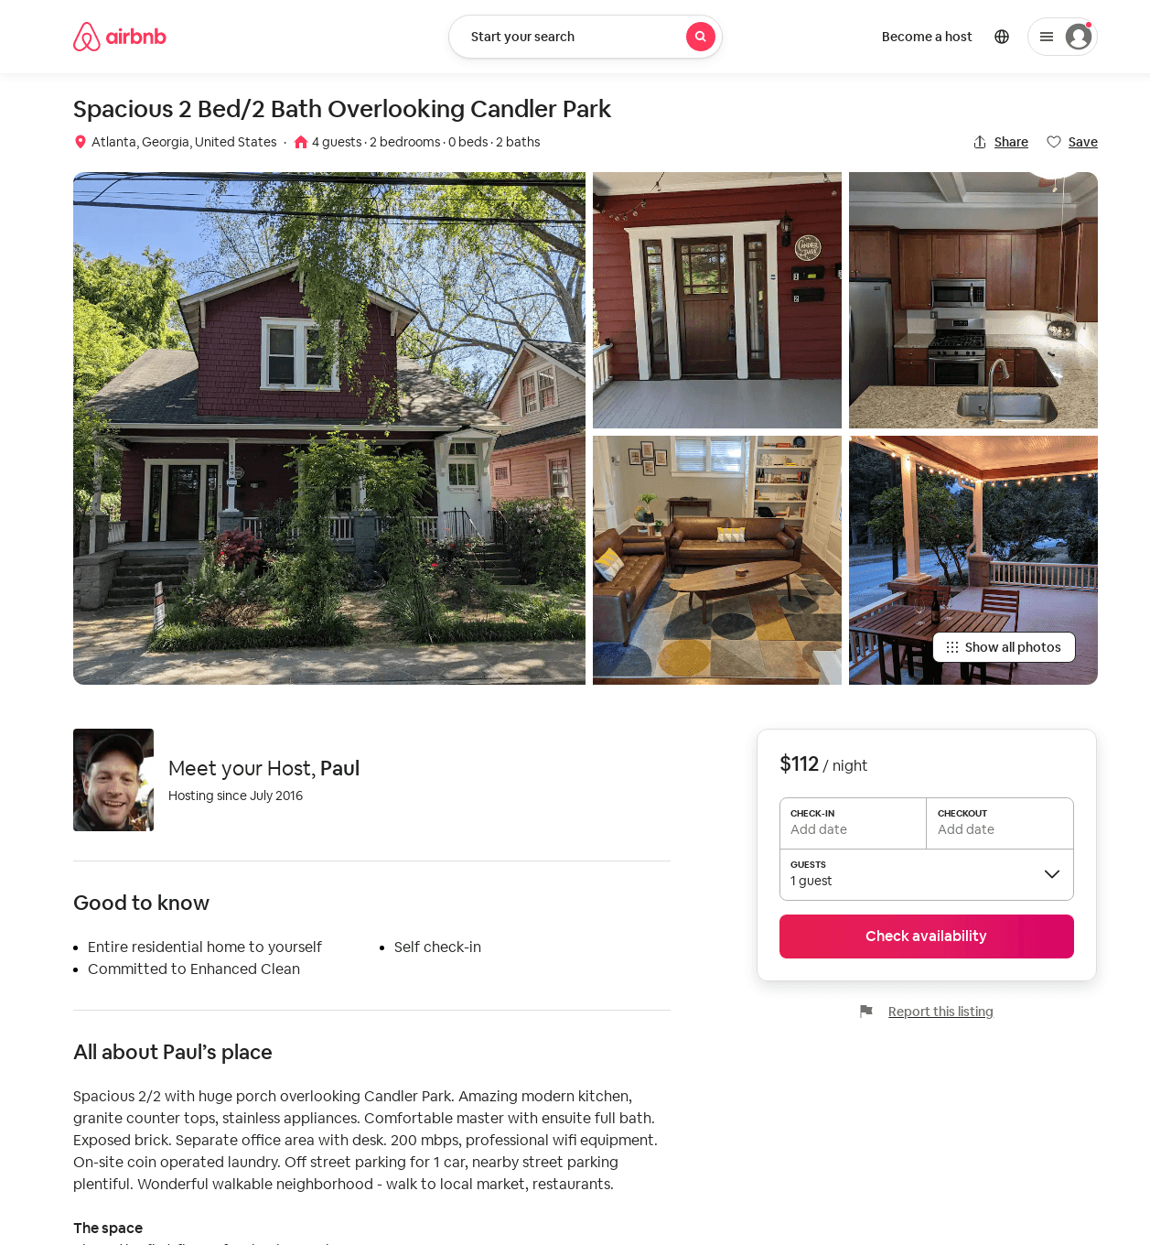
Listing 51702808
2
4
$105 - $147
4.94
7
Paul
81540380
1
https://www.airbnb.com/rooms/51702808
Aug 2022

Slide 52
Listing 52260805
2
3
$145 - $173
2
Minty
3976298
79
https://www.airbnb.com/rooms/52260805
Jun 2022

Slide 53
Listing 52260408
2
3
$121 - $183
5.0
2
Minty
3976298
79
https://www.airbnb.com/rooms/52260408
Aug 2022

Slide 54
Listing 43913332
1
2
$88 - $95
4.62
4
Dawn
9310523
4
https://www.airbnb.com/rooms/43913332
Aug 2022

Slide 55
Listing 15080033
1
3
$91
4.90
14
Doug And Nikolina
3377742
1
https://www.airbnb.com/rooms/15080033
Jun 2022

Slide 56
Listing 31901165
1
4
$174 - $196
5.0
30
Adam
9966440
2
https://www.airbnb.com/rooms/31901165
Jun 2022

Slide 57
Listing 52883969
5
12
$400 - $650
5.0
2
Amy
8389337
2
https://www.airbnb.com/rooms/52883969
Aug 2022

Slide 58
Listing 52985960
2
3
$146 - $180
2
Minty
3976298
79
https://www.airbnb.com/rooms/52985960
Jul 2022

Slide 59
Listing 53383961
1
2
$70 - $98
5.0
4
Jean
4556676
1
https://www.airbnb.com/rooms/53383961
Jun 2022

Slide 60
Listing 54090133
1
2
$280 - $350
5
Payal
432783592
1
https://www.airbnb.com/rooms/54090133
Jun 2022

Slide 61
Listing 31066500
4
6
$275 - $375
5.0
3
Dawn
9310523
4
https://www.airbnb.com/rooms/31066500
Aug 2022

Slide 62
Listing 2662290
1
4
$122
2
JQ
https://www.vrbo.com/2662290
Aug 2022

Slide 63
Listing 2253467
1
4
$140
15
Lucas D Ramirez
https://www.vrbo.com/2253467
Aug 2022

Slide 64
Listing 2716470
1
5
$100
5
1
Blex Rentals LLC
https://www.vrbo.com/2716470
Aug 2022

Slide 65
Listing 2660627
1
4
$175
2
Host
https://www.vrbo.com/2660627
Aug 2022

Slide 66
Listing 2745691
3
5
$200
3
https://www.vrbo.com/2745691
Aug 2022

Slide 67
Listing 2751486
2
5
$250
5
2
https://www.vrbo.com/2751486
Aug 2022

Slide 68
Listing 2792114
1
2
$175
2
https://www.vrbo.com/2792114
Aug 2022

Slide 69
Listing 2776046
1
2
$120
1
Maria McNiece
https://www.vrbo.com/2776046
Aug 2022

Slide 70
Listing 2863822
3
7
$200
30
https://www.vrbo.com/2863822
Aug 2022

Slide 71
Listing 31490700
3
7
$175 - $250
30
Honey Homes
235928659
3
https://www.airbnb.com/rooms/31490700
Aug 2022

Slide 72
Listing 2962117
2
3
$163
2
Minty Living
https://www.vrbo.com/2962117
Aug 2022

Slide 73
Listing 2962111
2
5
$186
2
Minty Living
https://www.vrbo.com/2962111
Aug 2022

Slide 74
Listing 2962079
2
3
$206
2
Minty Living
https://www.vrbo.com/2962079
Aug 2022

