Slide 2
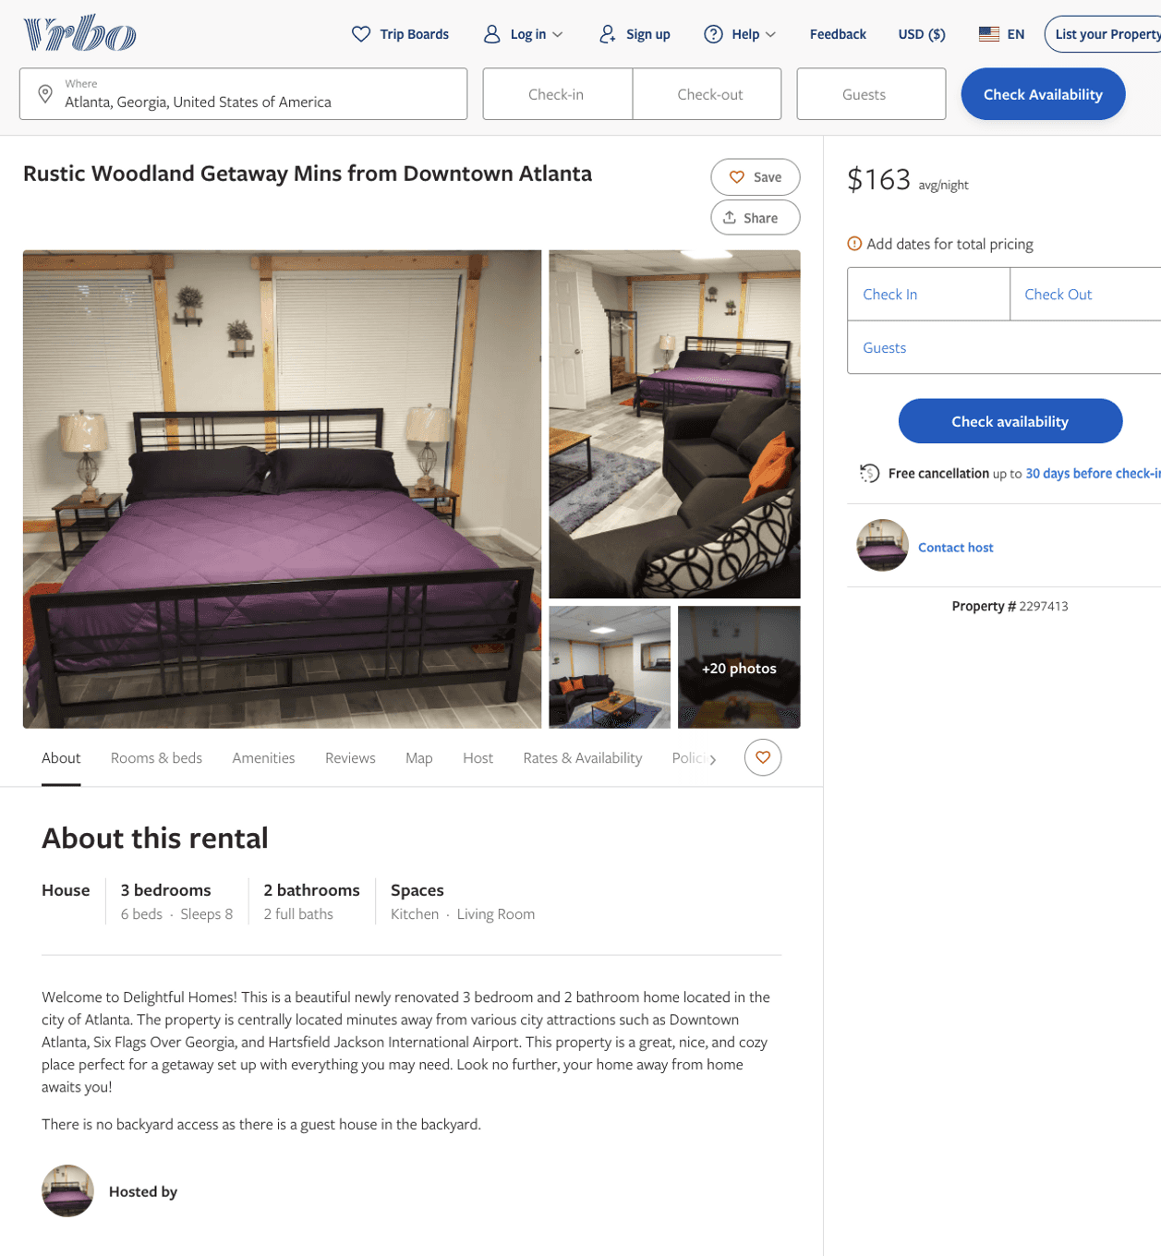
Listing 2297413
3
8
$150 - $176
5
2
https://www.vrbo.com/2297413
Aug 2022

Slide 3
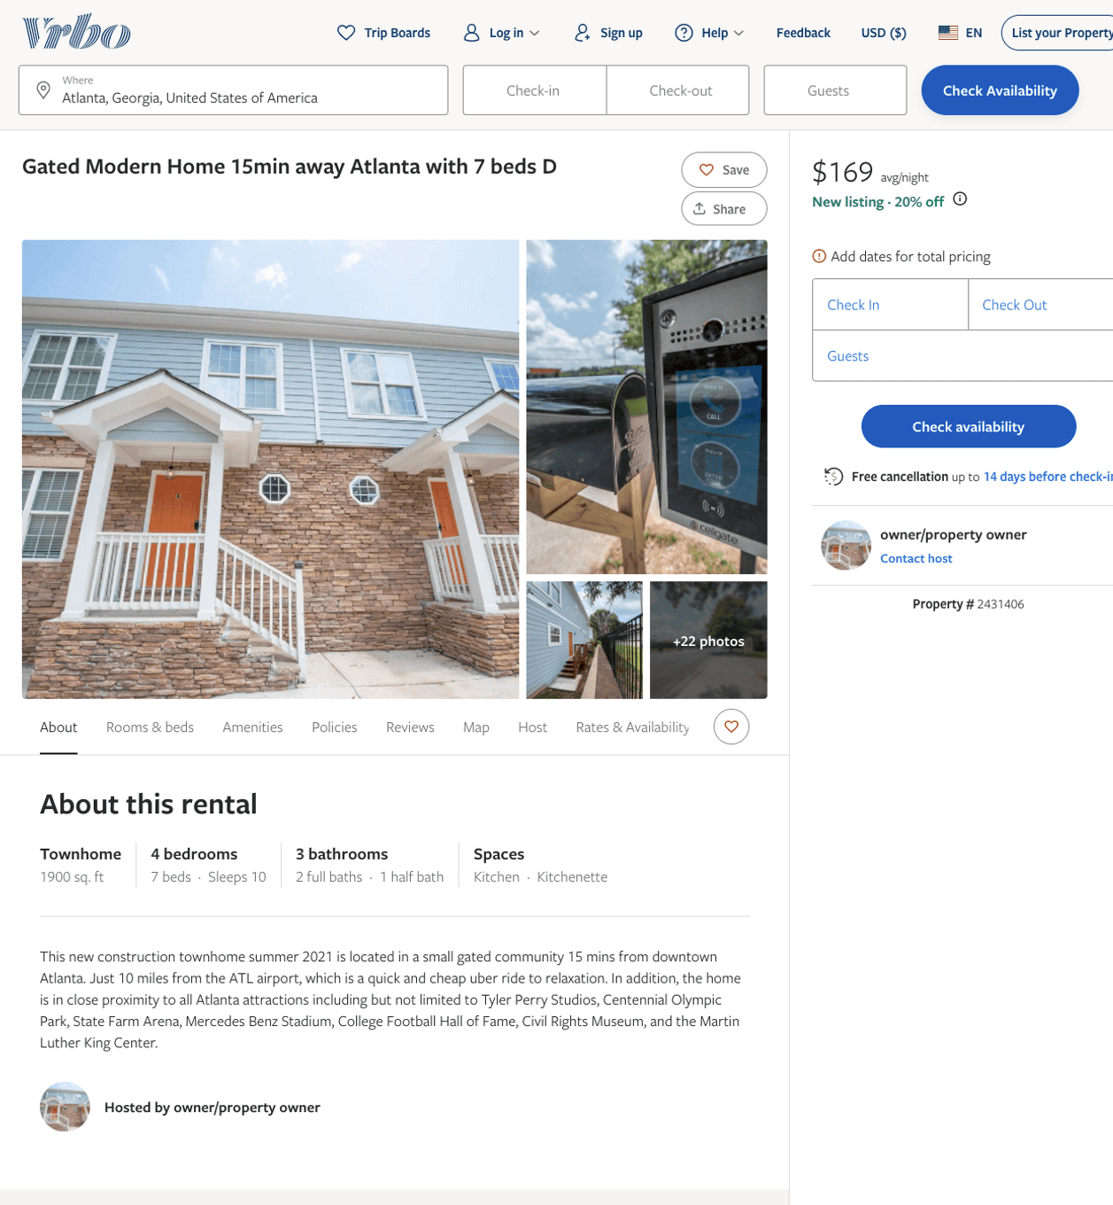
Listing 2431406
4
10
$114 - $169
5
2
owner/property owner
https://www.vrbo.com/2431406
Aug 2022

Slide 4
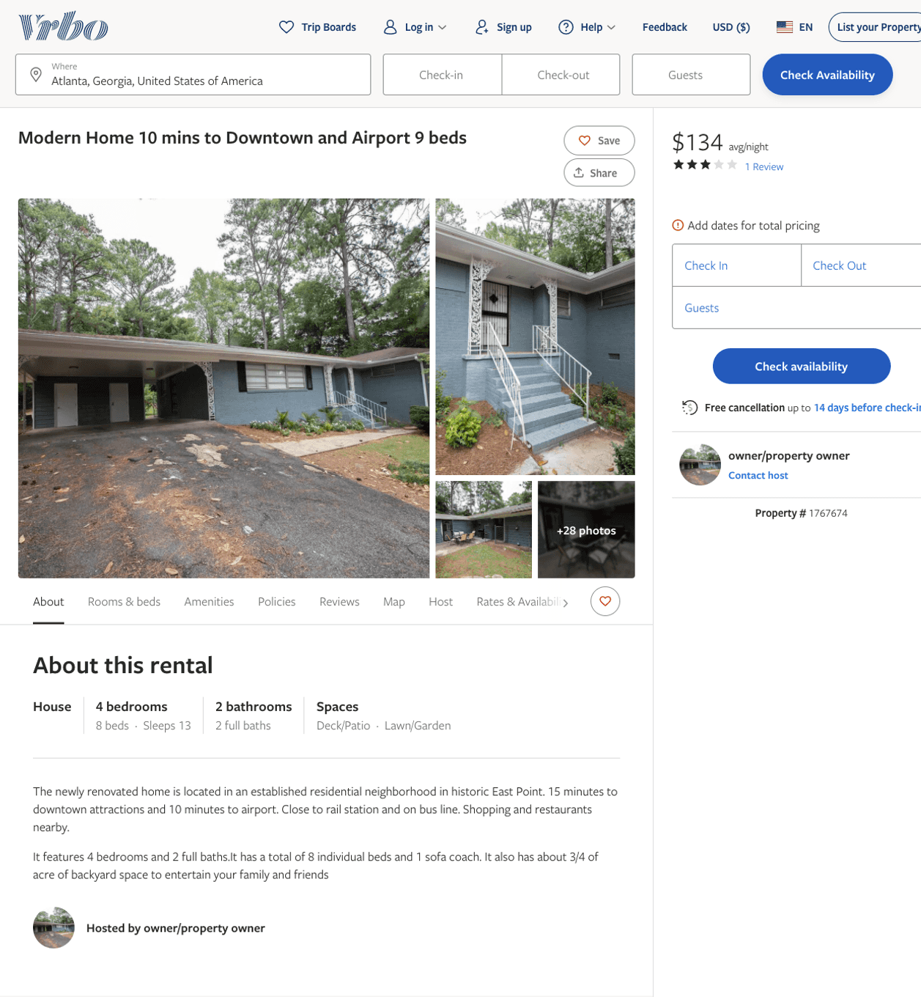
Listing 1767674
4
13
$134
4
3
owner/property owner
https://www.vrbo.com/1767674
Aug 2022

Slide 5
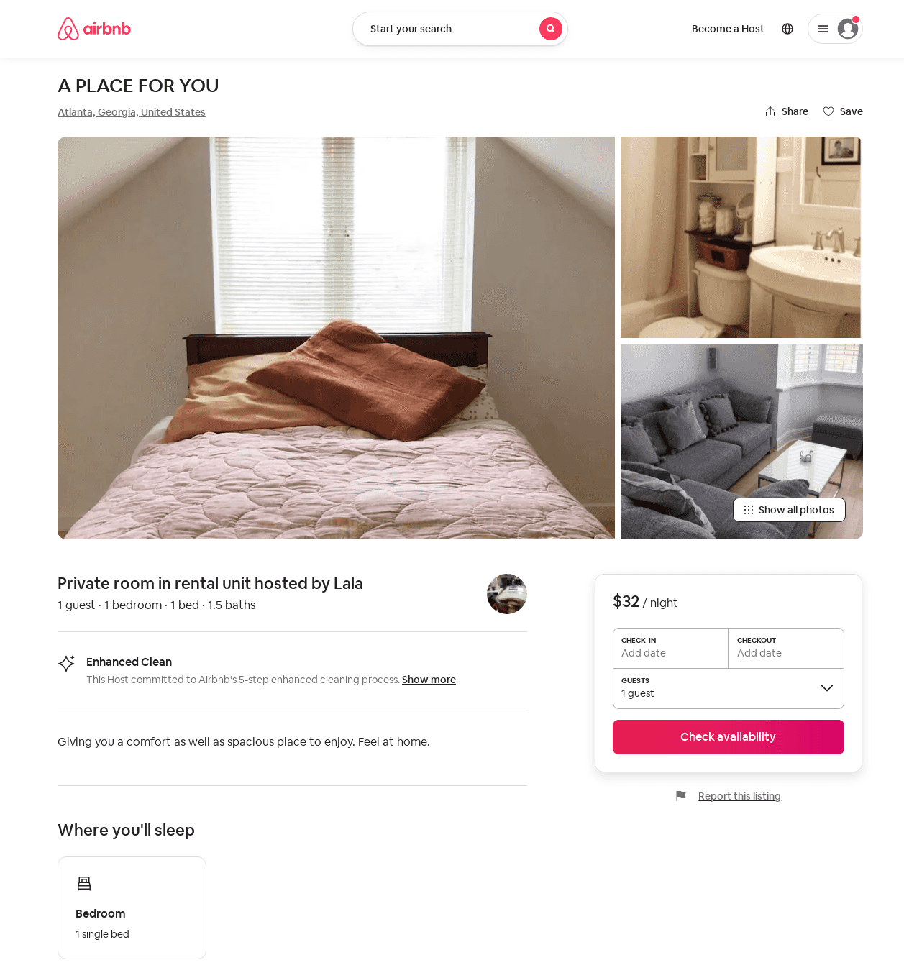
Listing 43266529
1
1
$32
7
Lala
196547660
1
https://www.airbnb.com/rooms/43266529
Jul 2022

Slide 6
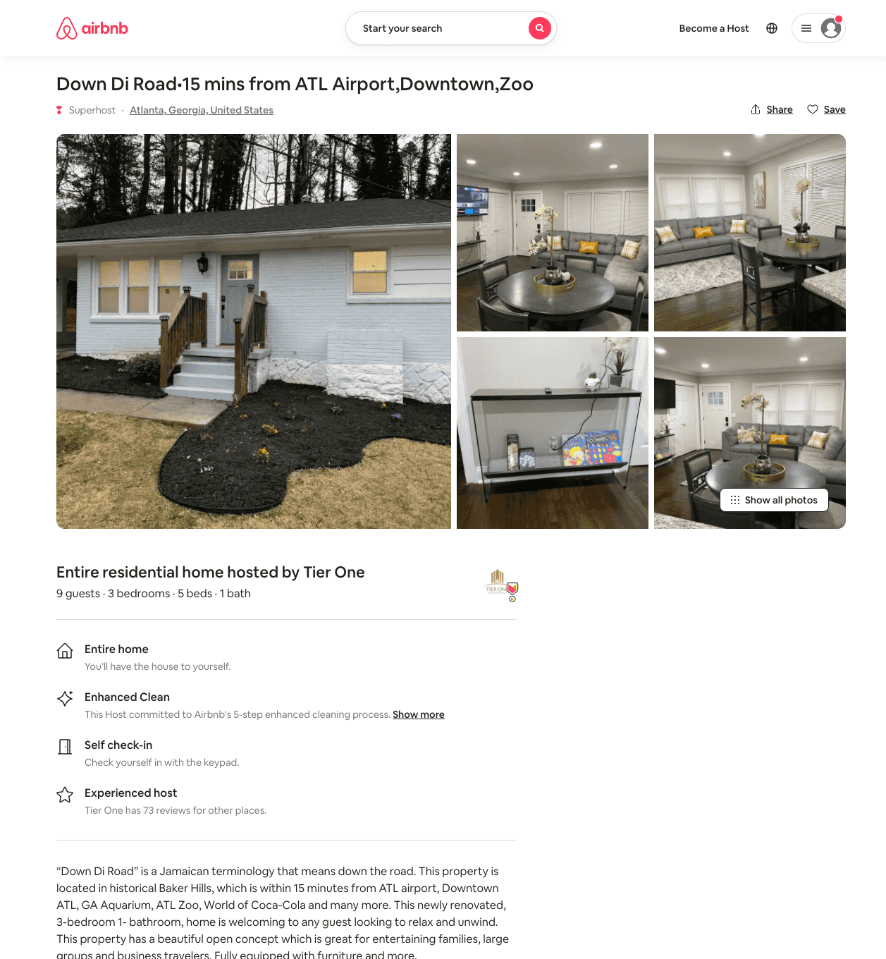
Listing 54040301
3
9
$106 - $140
4.79
1
Tier One
377628673
2
https://www.airbnb.com/rooms/54040301
Aug 2022

Slide 7
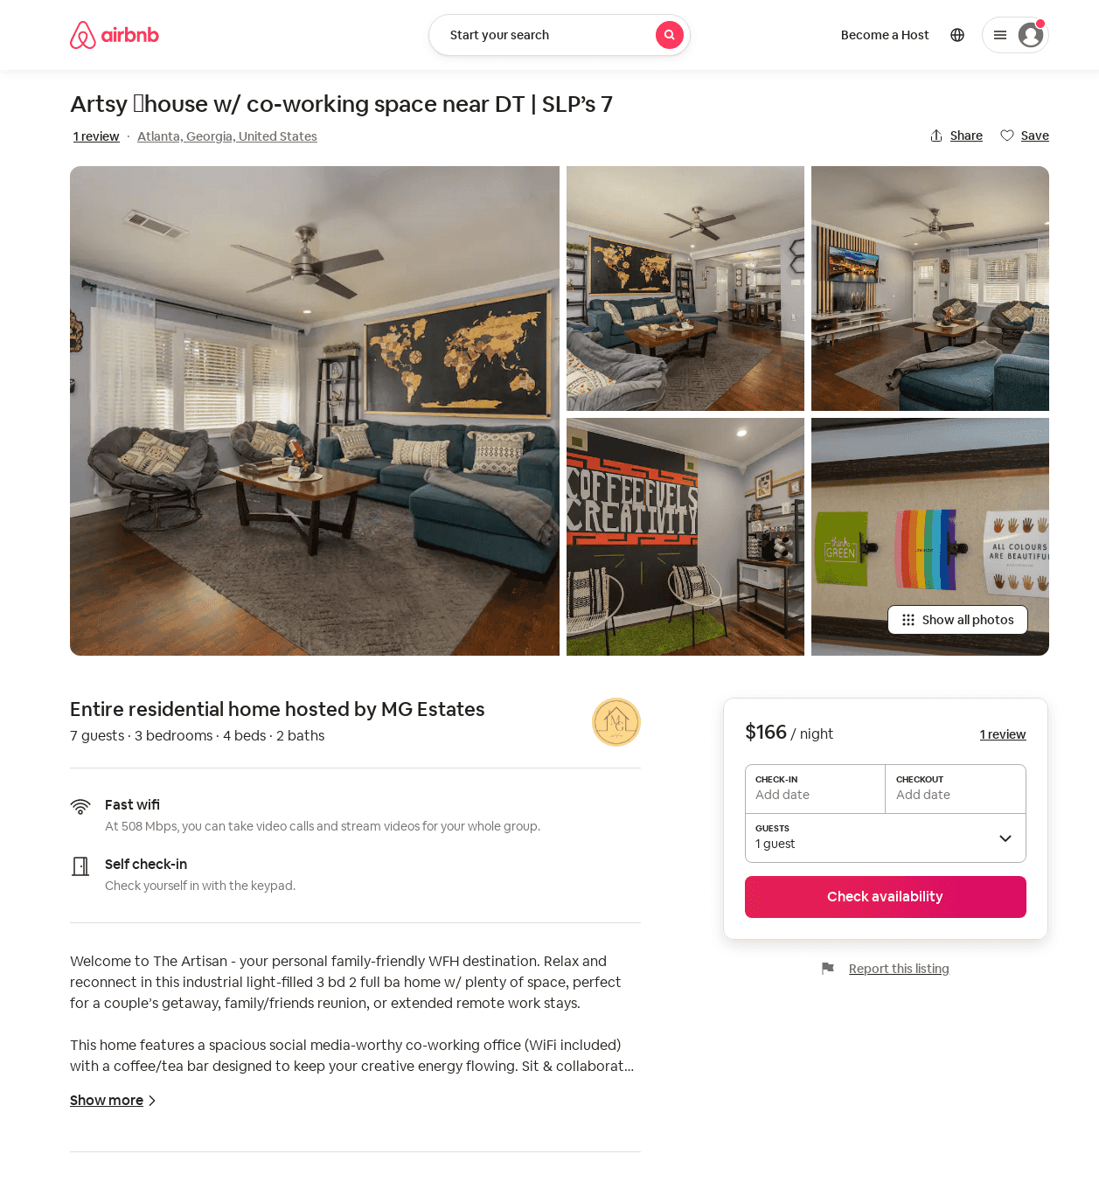
Listing 53443731
3
10
$166 - $176
4.92
2
MG Estates
421255405
1
https://www.airbnb.com/rooms/53443731
Jul 2022

Slide 8
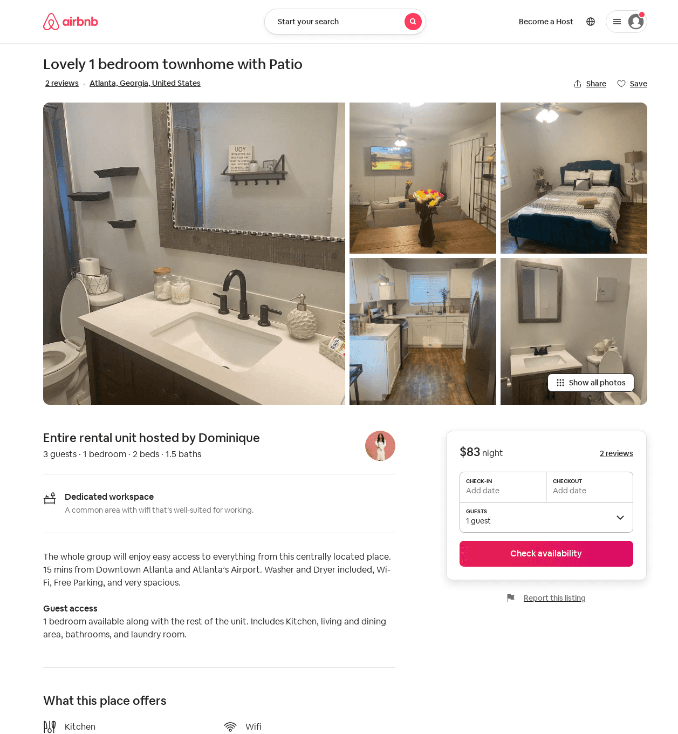
Listing 52193599
1
3
$83
3.50
1
Dominique
37685809
1
https://www.airbnb.com/rooms/52193599
Jul 2022

Slide 9
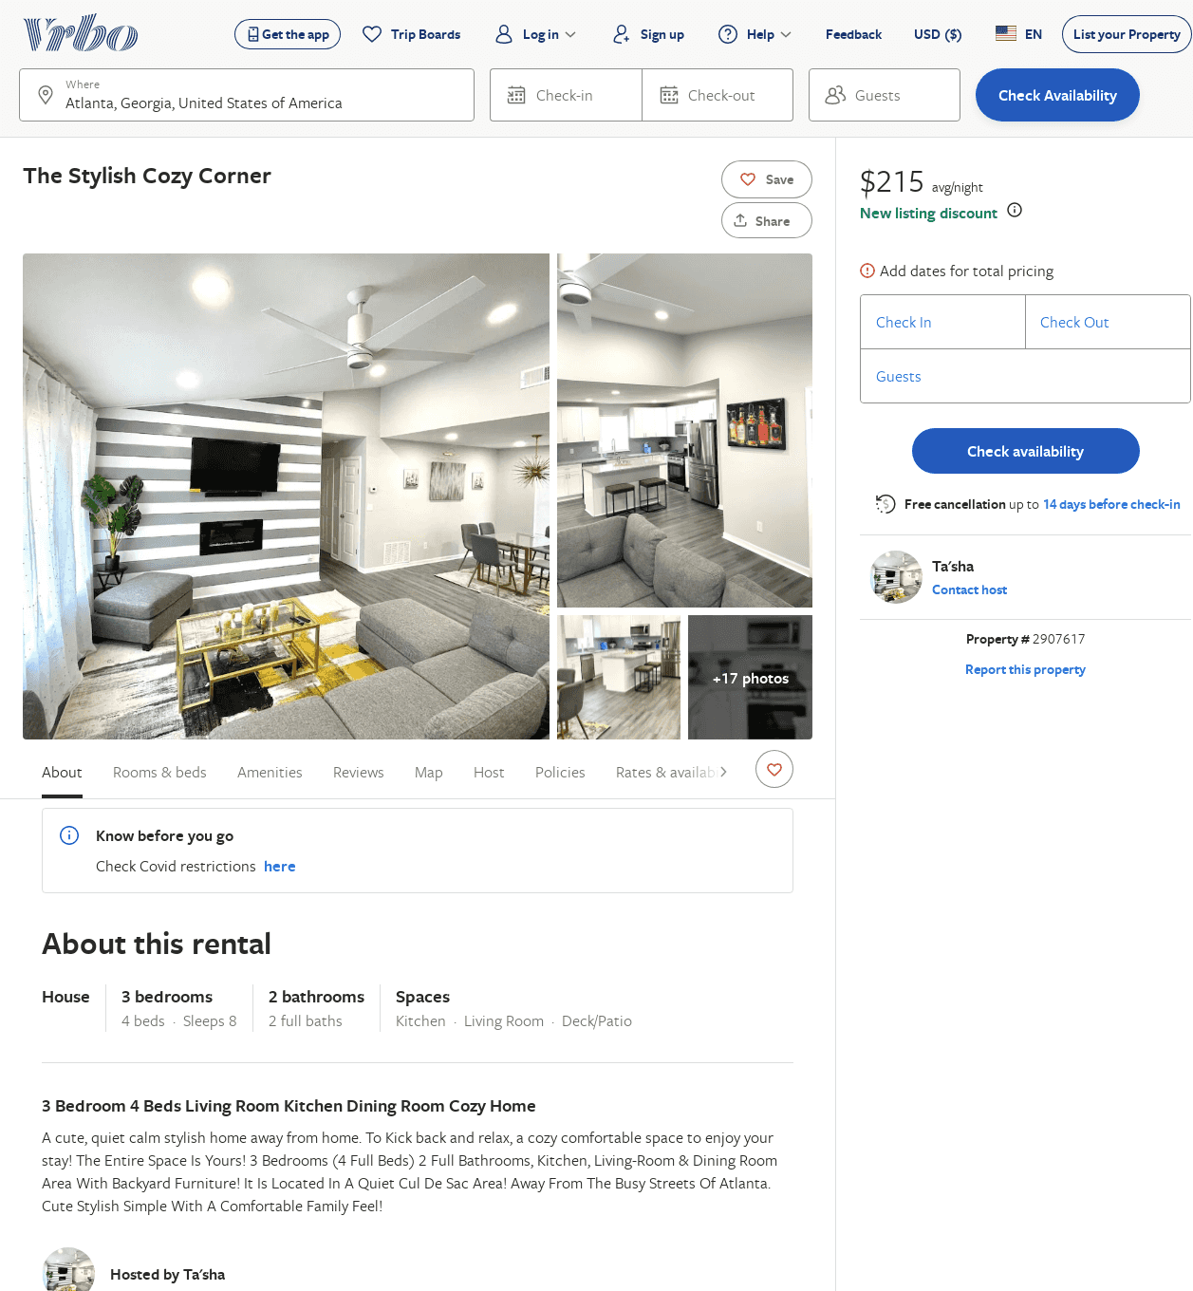
Listing 2907617
3
8
$215
2
Ta'sha
https://www.vrbo.com/2907617
Aug 2022

