Slide 2
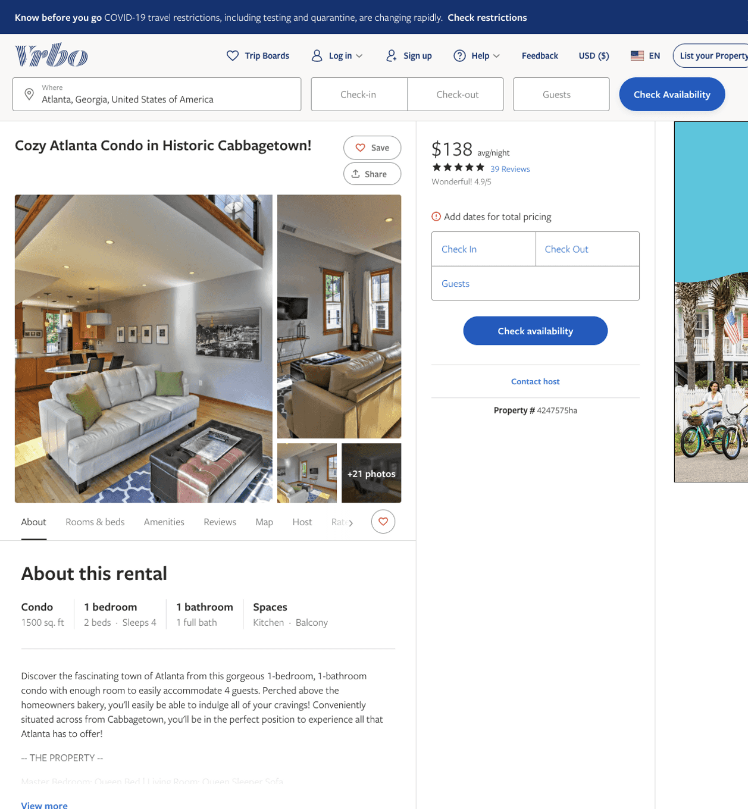
Listing 4247575
1
4
$129 - $158
4.931818
2
Evolve Vacation Rental Network
https://www.vrbo.com/4247575ha
Aug 2022

Slide 3
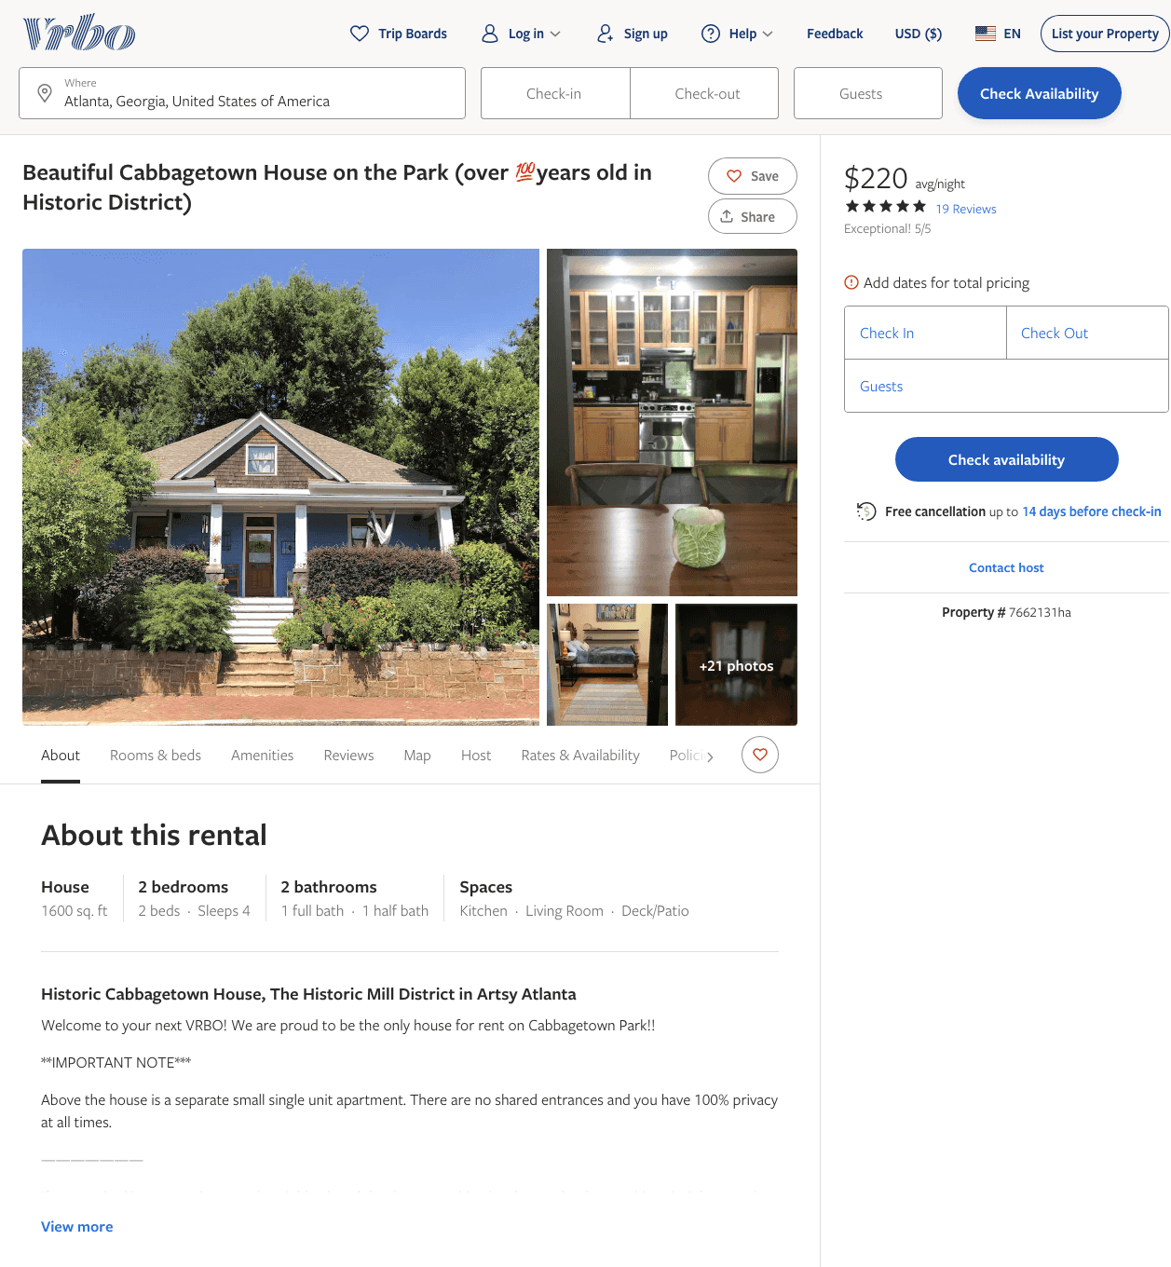
Listing 7662131
2
4
$215 - $287
5
2
David Lewis
https://www.vrbo.com/7662131ha
Aug 2022

Slide 4
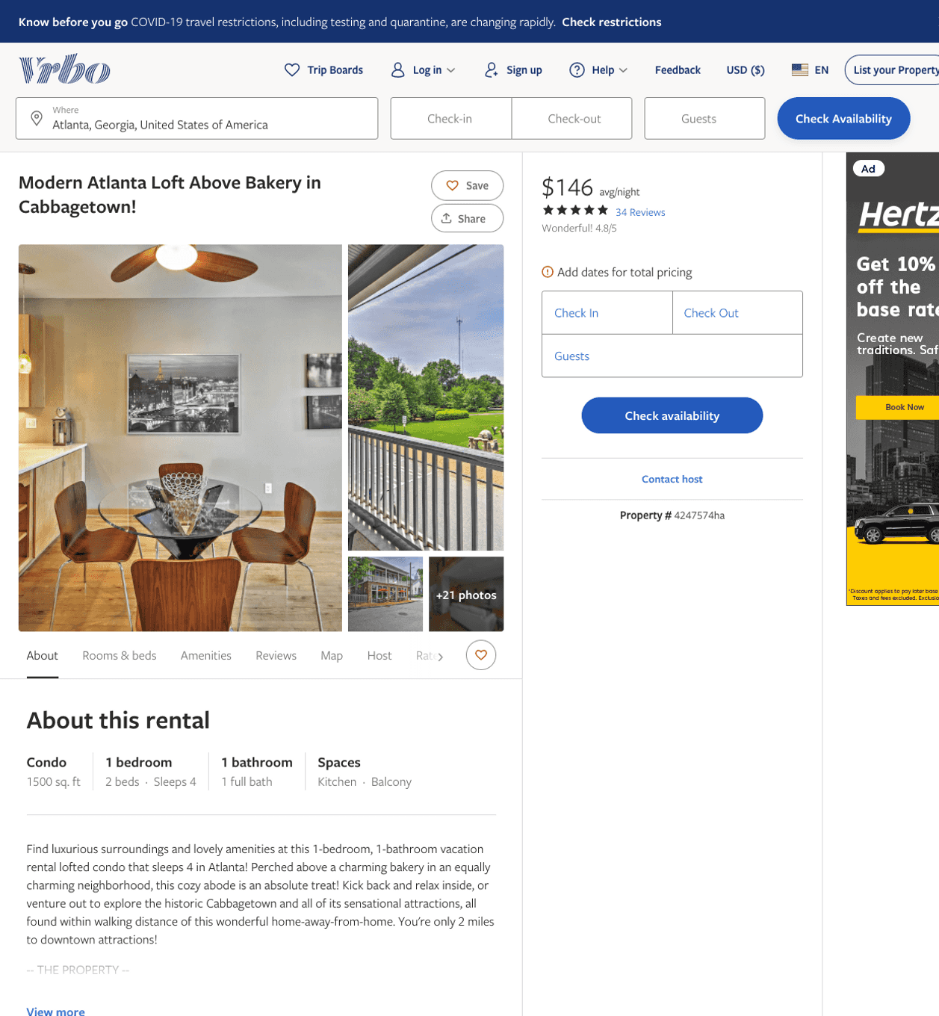
Listing 4247574
1
4
$126 - $146
4.847826
2
Evolve Vacation Rental Network
https://www.vrbo.com/4247574ha
Aug 2022

Slide 5
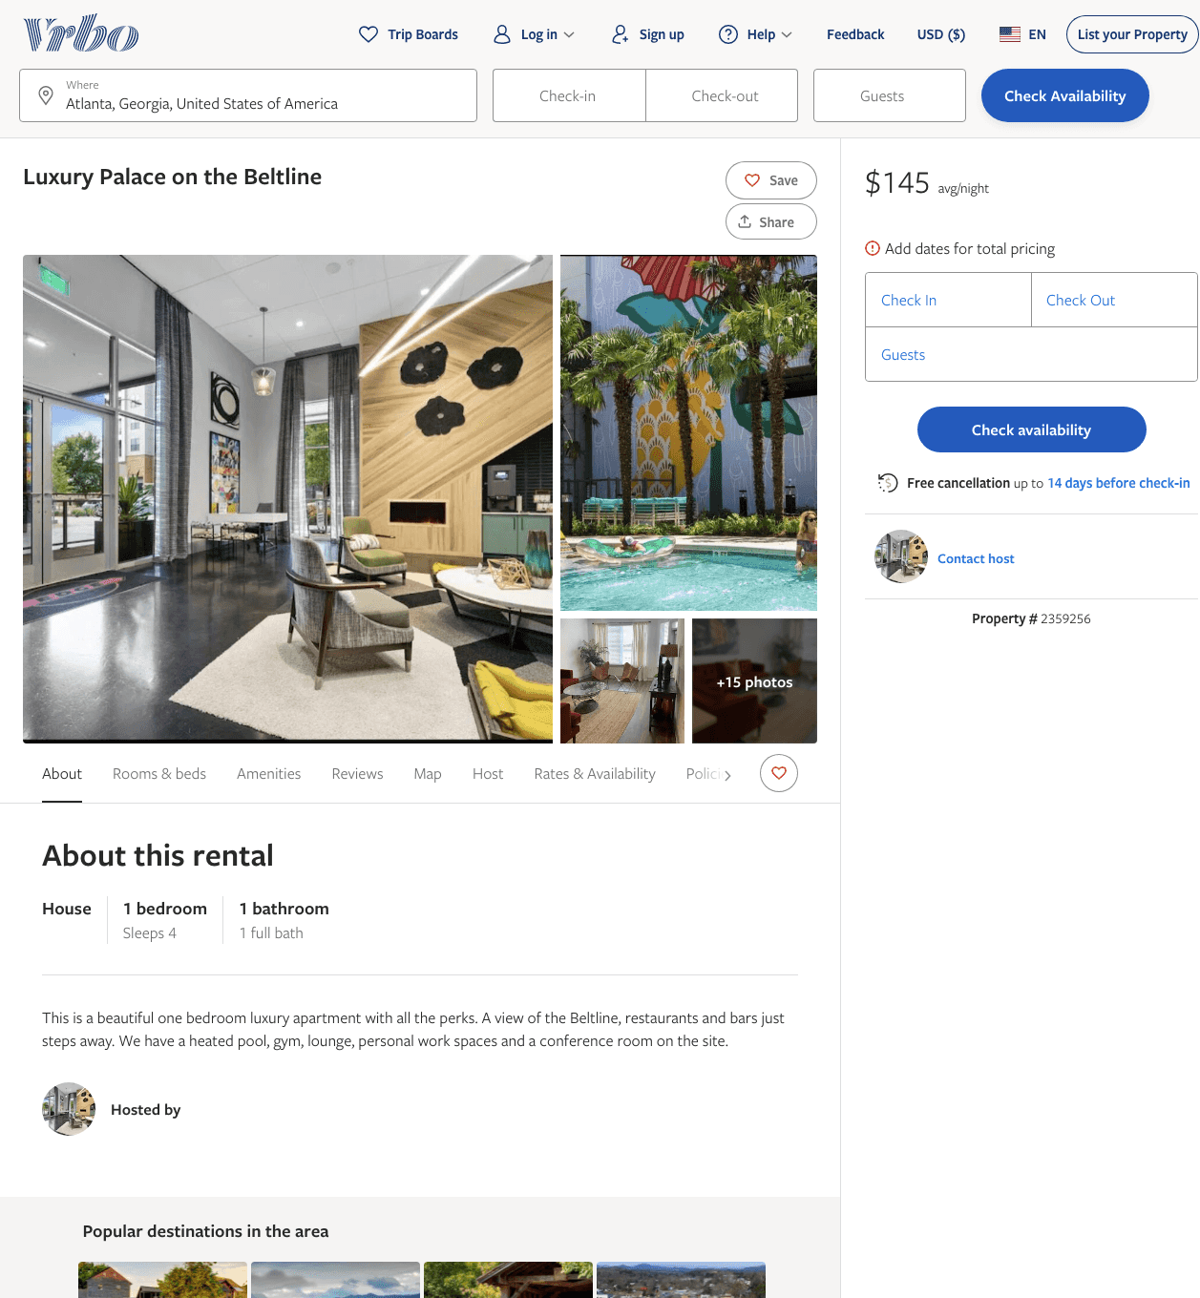
Listing 2359256
1
4
$145 - $169
2
https://www.vrbo.com/2359256
Aug 2022

Slide 6
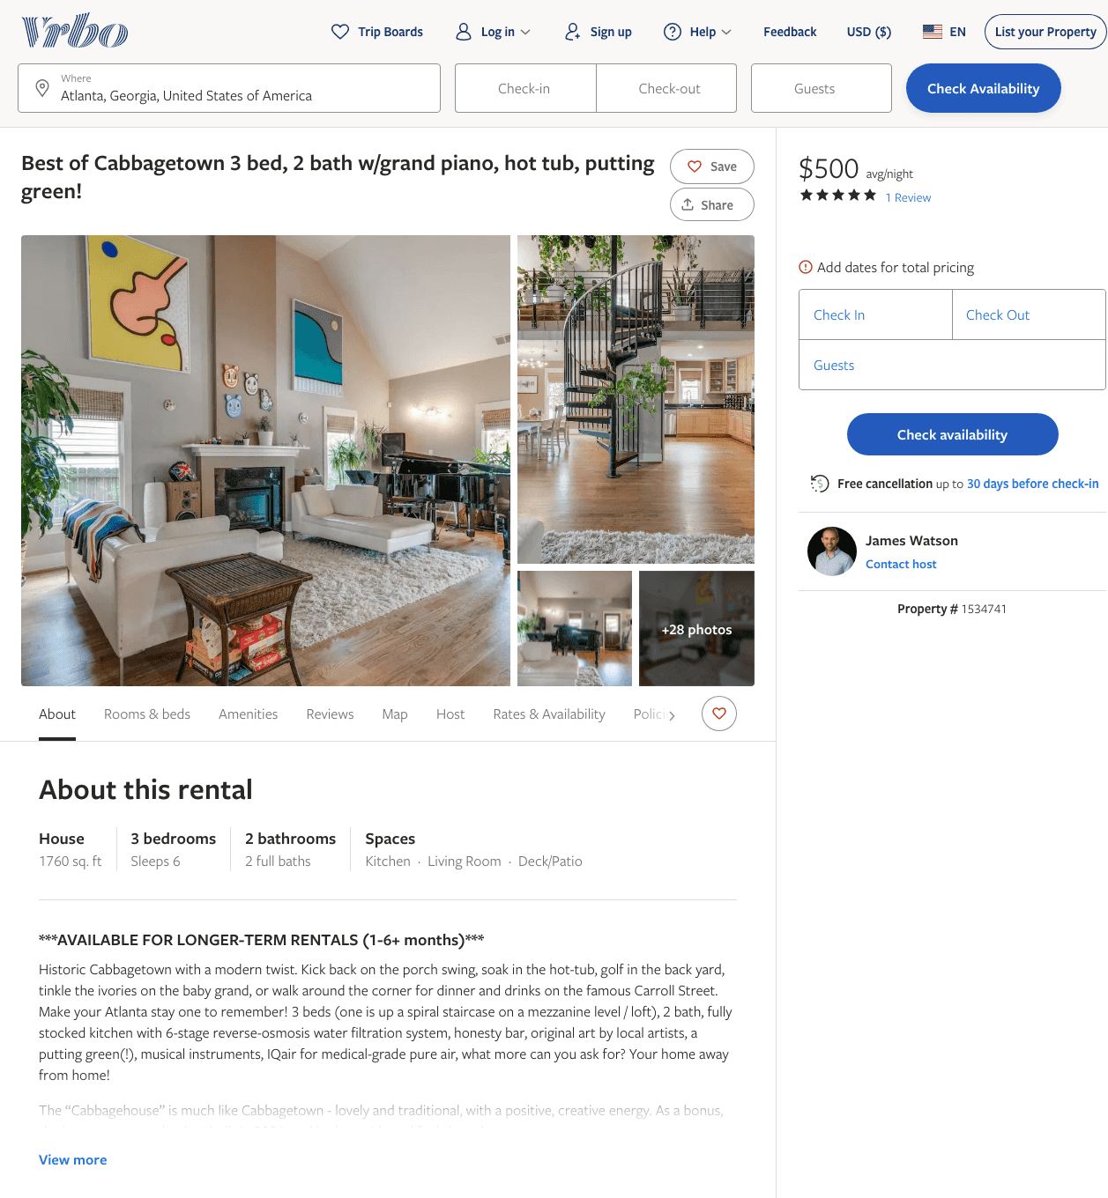
Listing 1534741
3
6
$280 - $500
5
30
James Watson
https://www.vrbo.com/1534741
Aug 2022

Slide 7
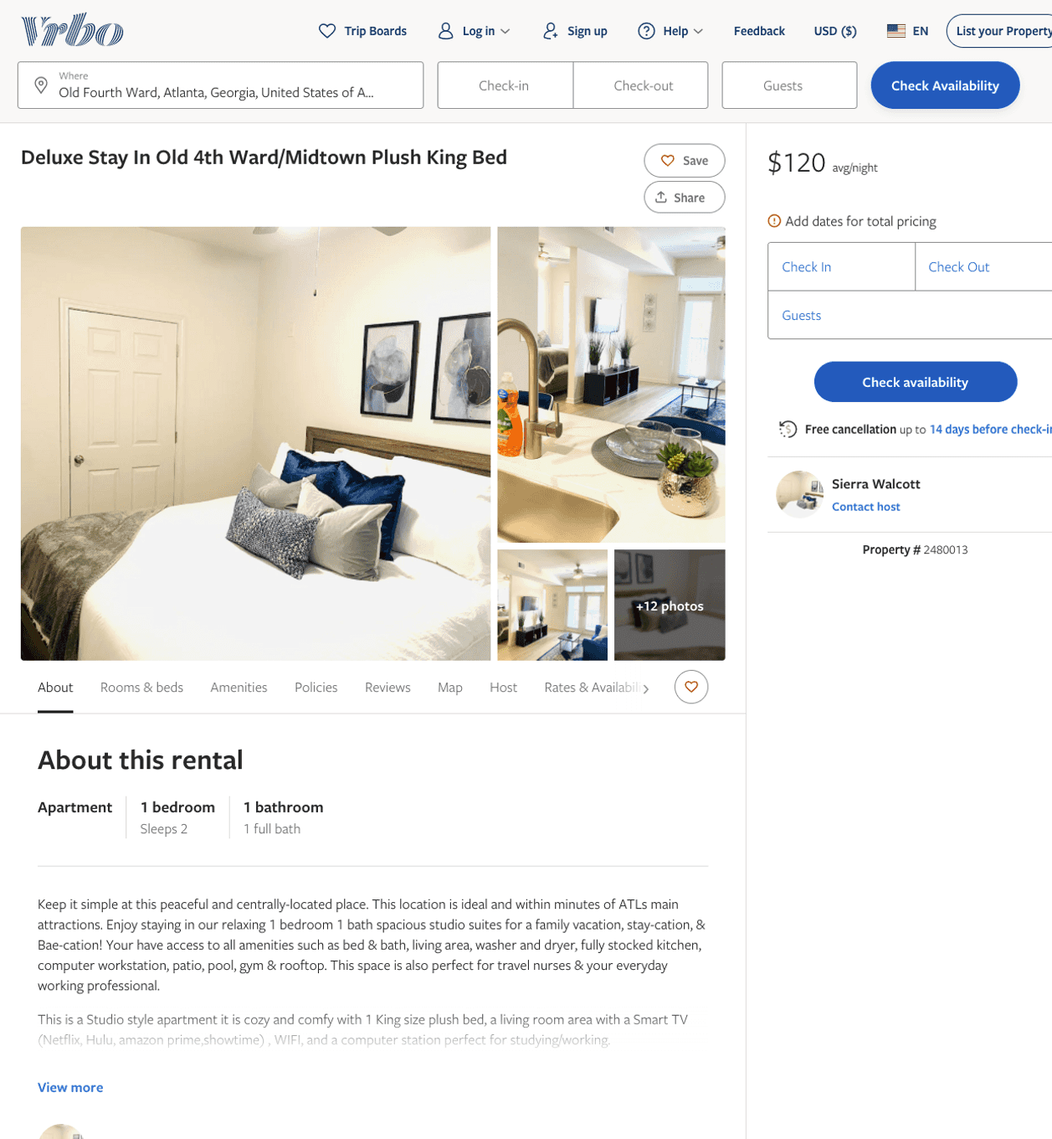
Listing 2480013
1
2
$116 - $95
2.6666667
1
Sierra Walcott
https://www.vrbo.com/2480013
Aug 2022

Slide 8
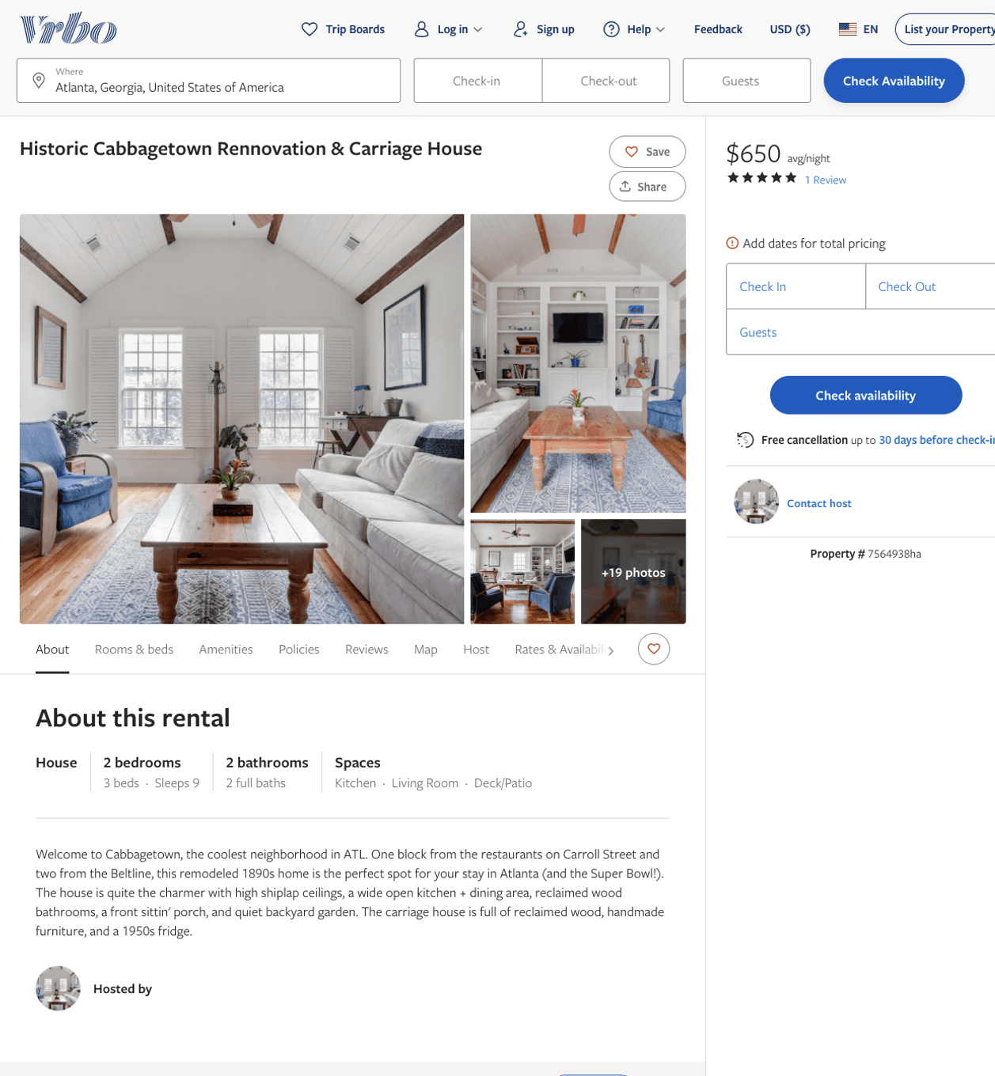
Listing 7564938
2
7
$650
5
2
https://www.vrbo.com/7564938ha
Aug 2022

Slide 9
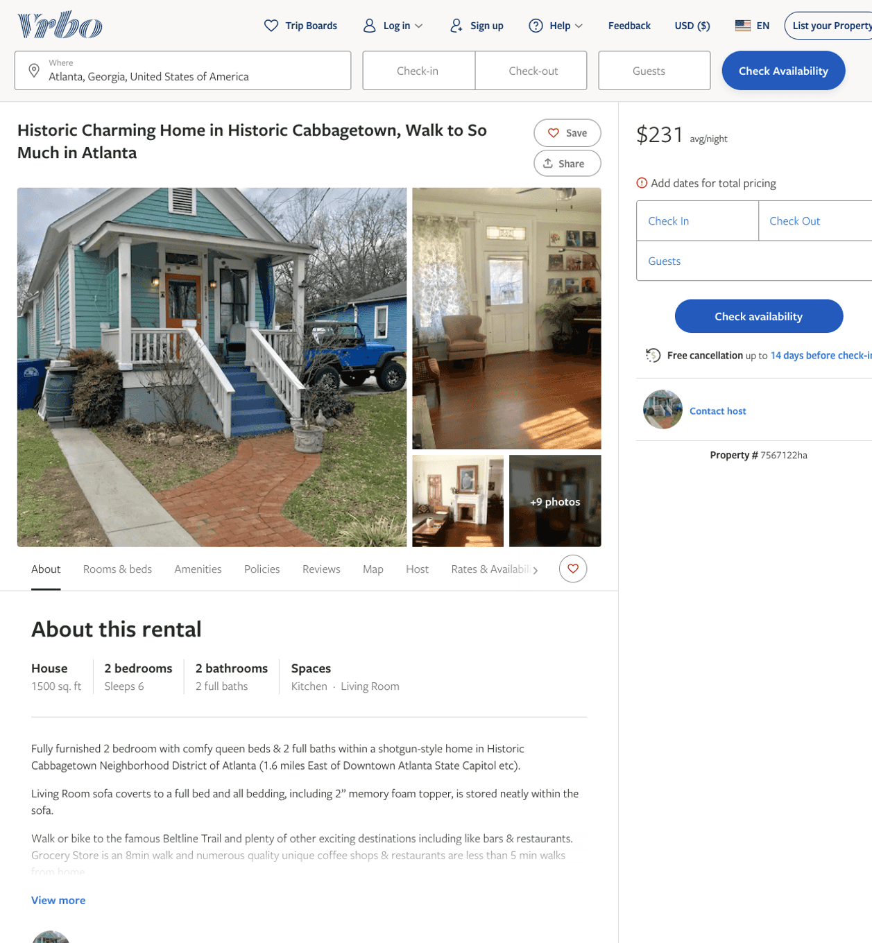
Listing 7567122
2
6
$231
3
https://www.vrbo.com/7567122ha
Aug 2022

Slide 10
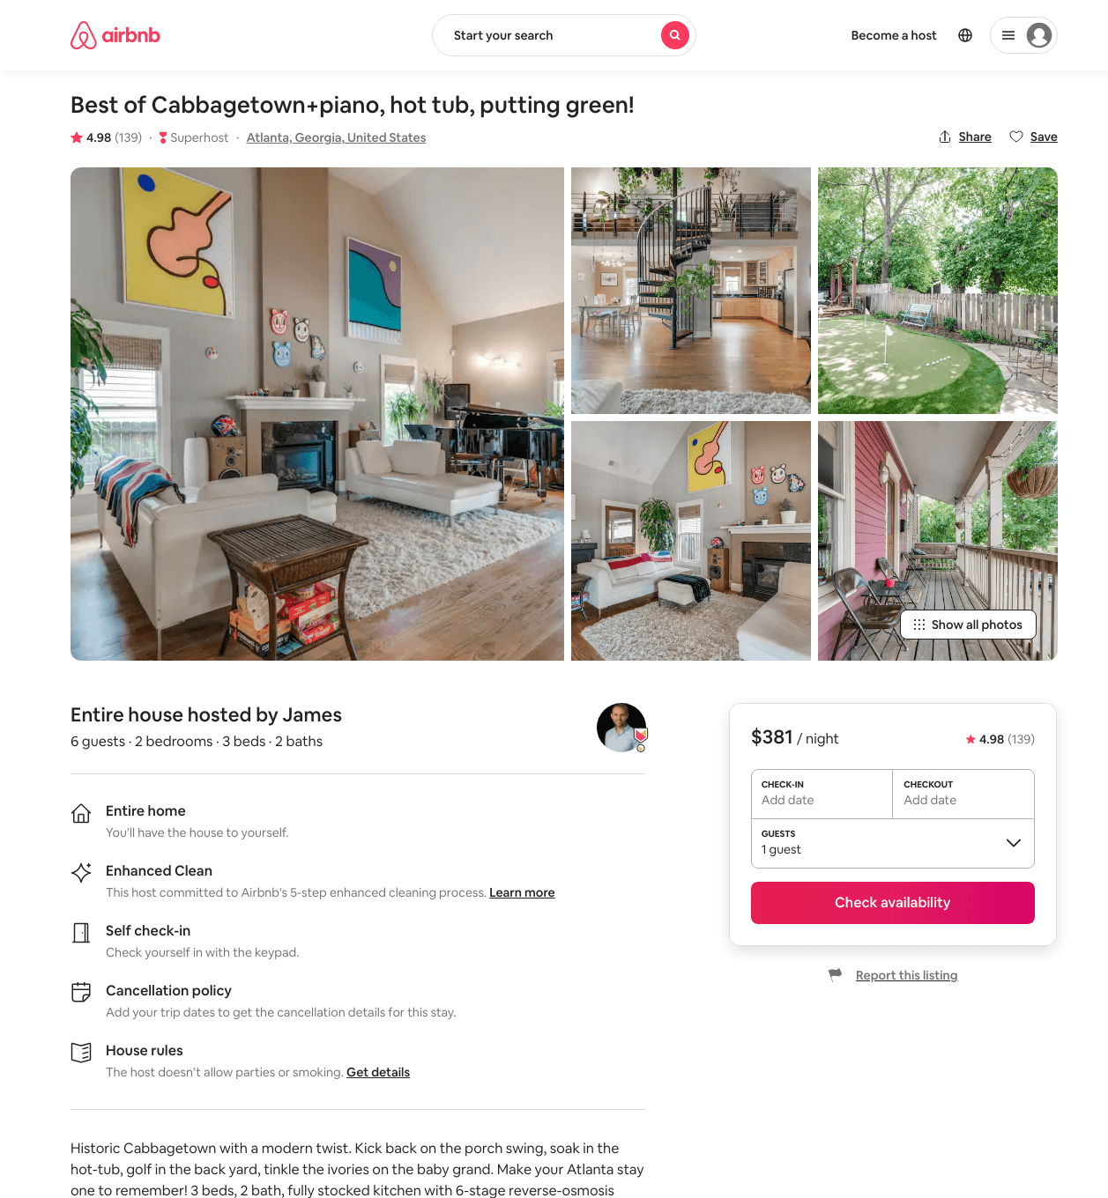
Listing 7069022
2
6
$277 - $646
4.97
31
James
6873807
1
https://www.airbnb.com/rooms/7069022
Aug 2022

Slide 11
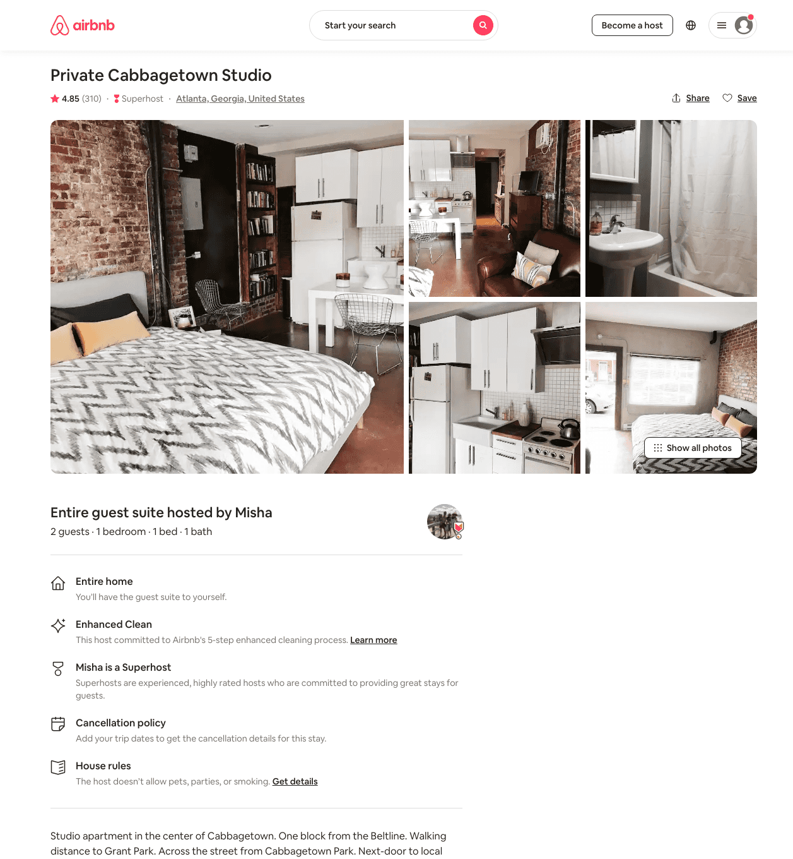
Listing 21449533
1
2
$64 - $130
4.86
1
Michael
53136151
1
https://www.airbnb.com/rooms/21449533
Aug 2022

Slide 12
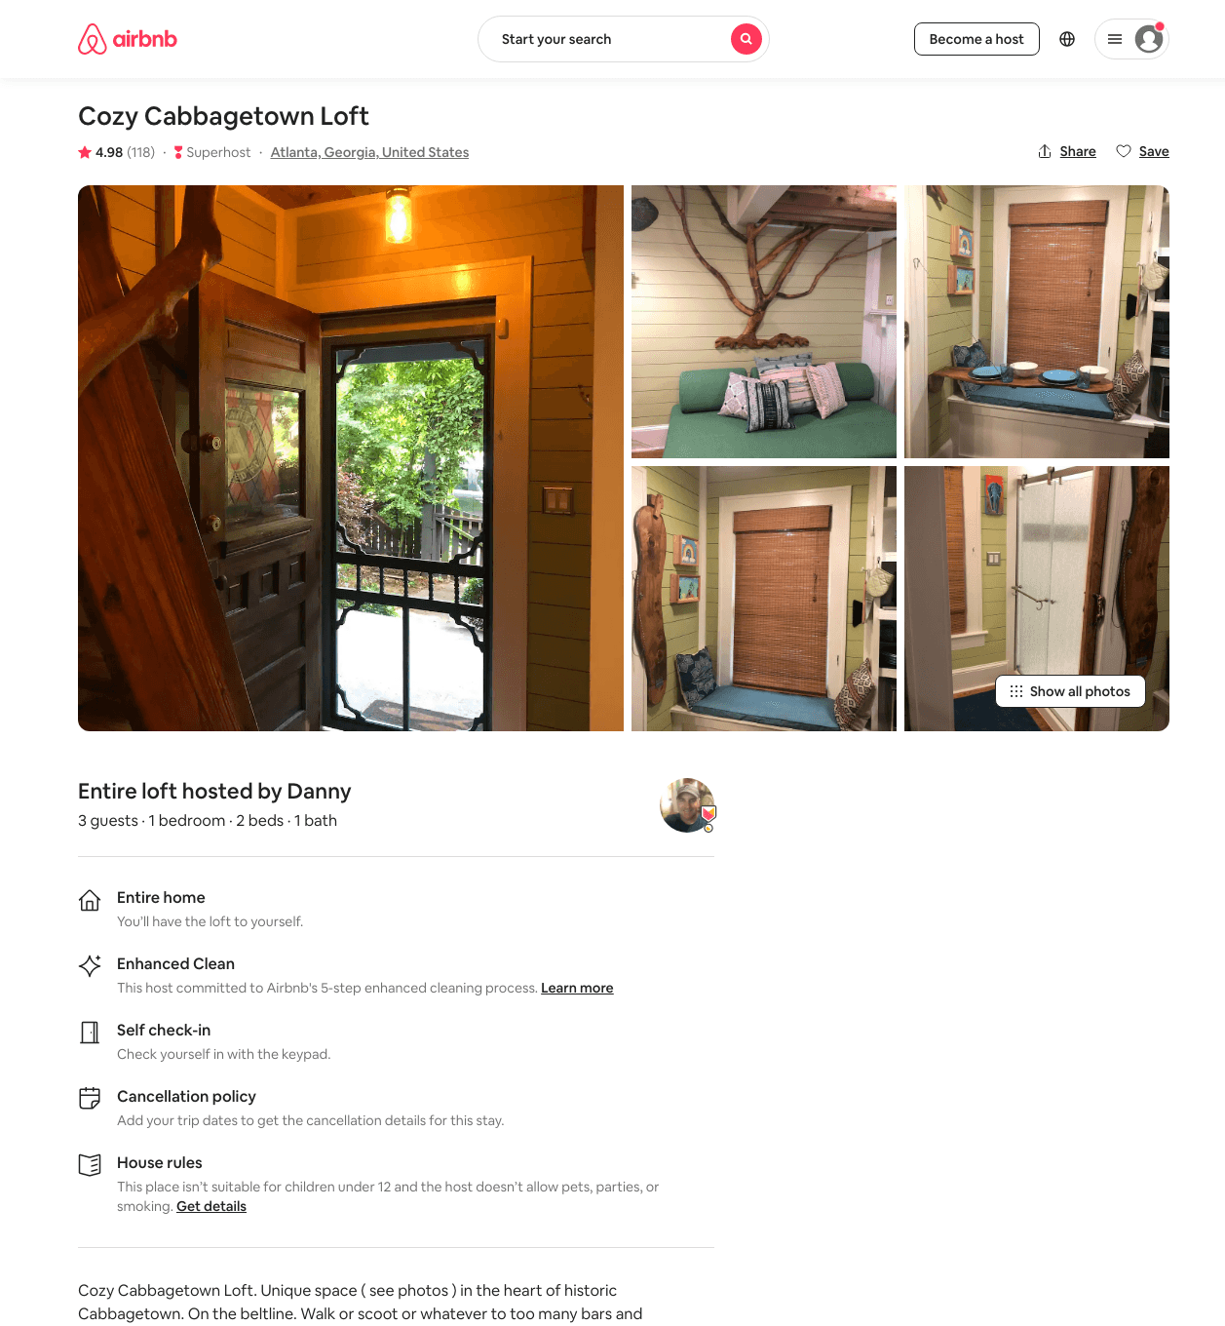
Listing 33914057
1
3
$90 - $106
4.98
2
Danny
256110355
1
https://www.airbnb.com/rooms/33914057
Aug 2022

Slide 13
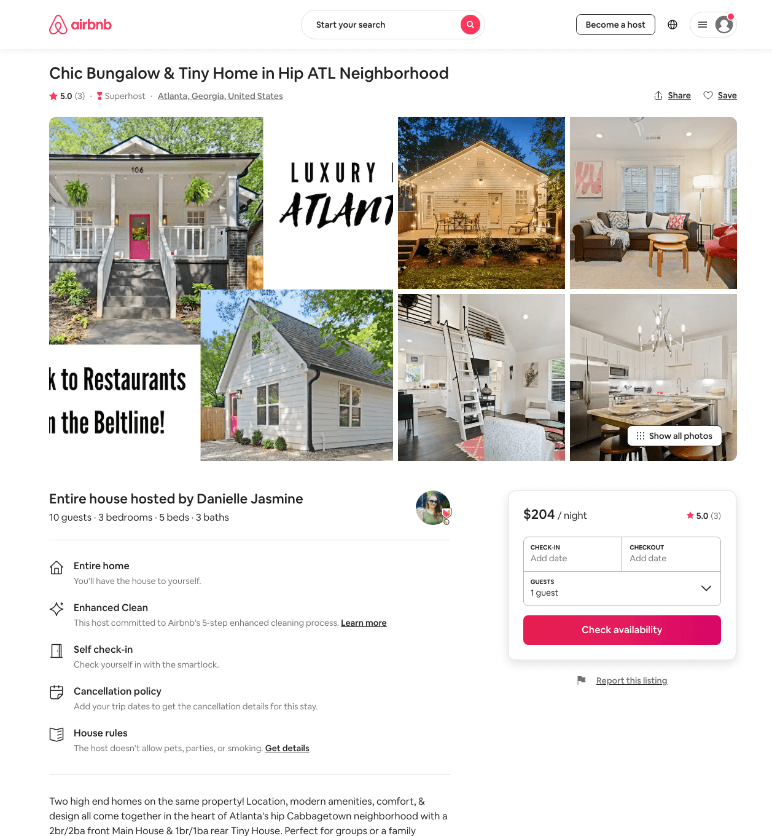
Listing 44464293
3
10
$182 - $414
5.0
2
Danielle
93004528
5
https://www.airbnb.com/rooms/44464293
Aug 2022

Slide 14
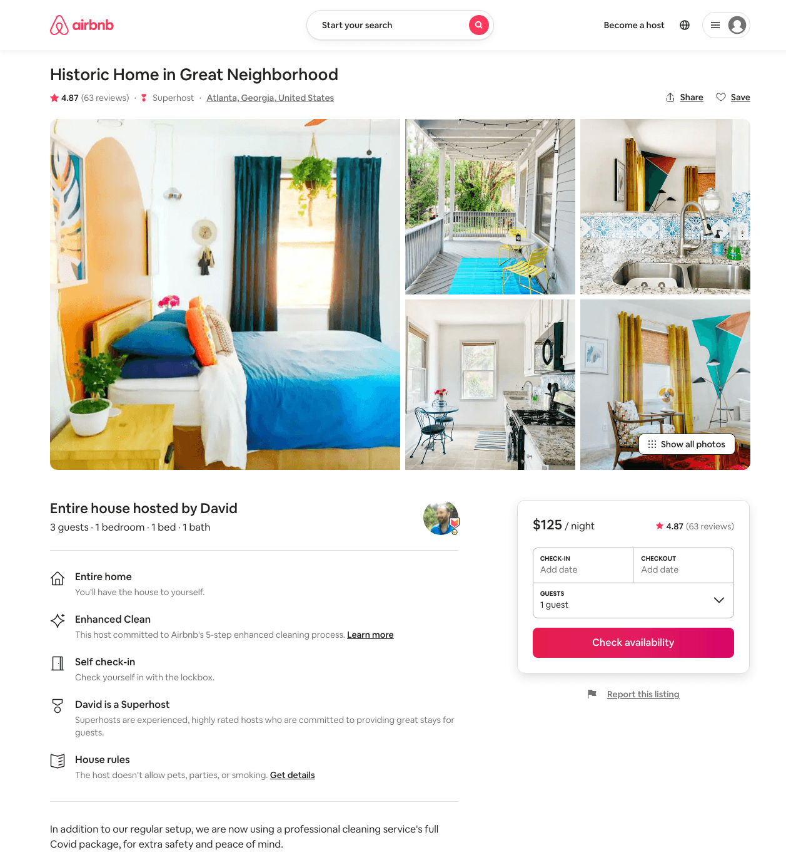
Listing 6834393
1
3
$96 - $145
4.85
1
David
10051267
4
https://www.airbnb.com/rooms/6834393
Jun 2022

Slide 15
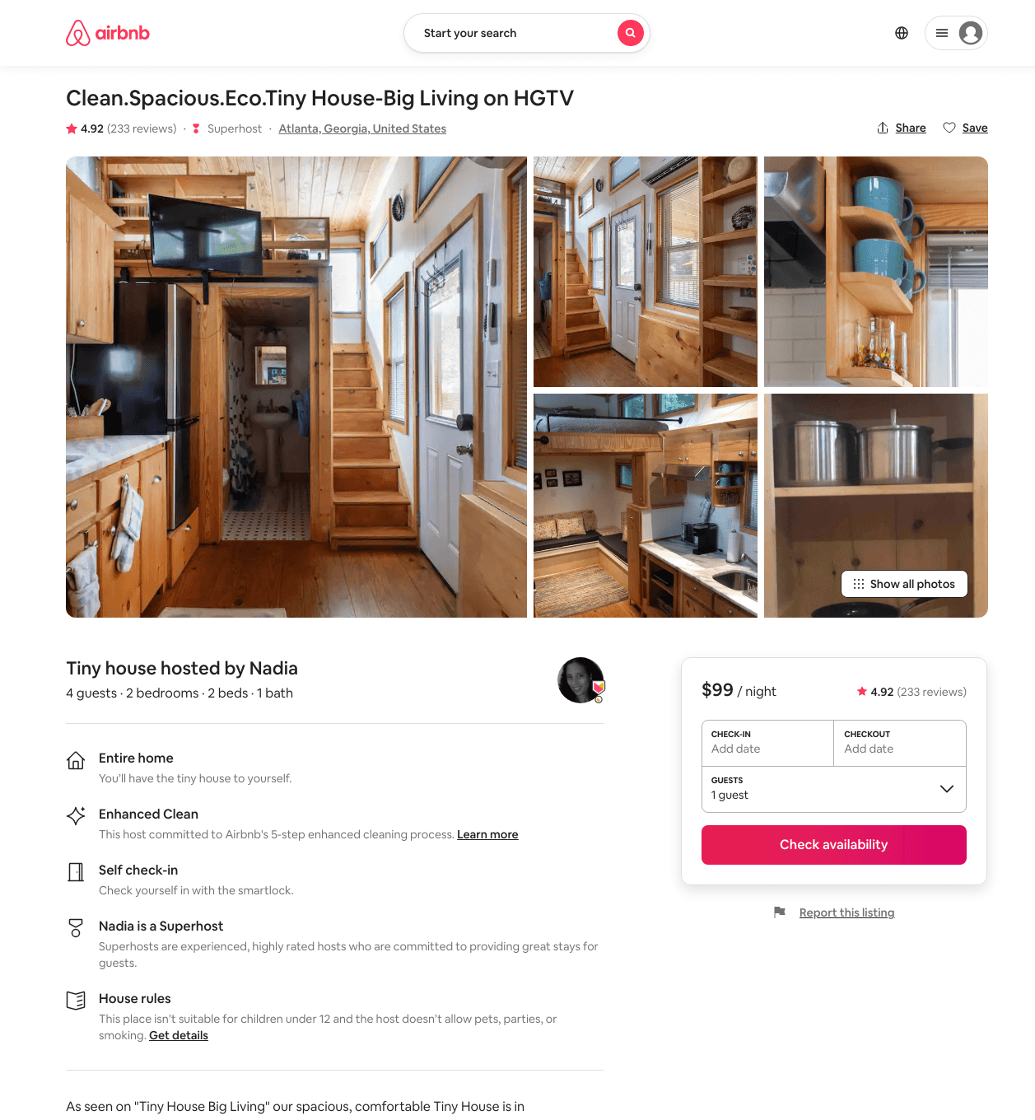
Listing 17436452
2
4
$99 - $142
4.93
1
Nadia
104371922
1
https://www.airbnb.com/rooms/17436452
Aug 2022

Slide 16
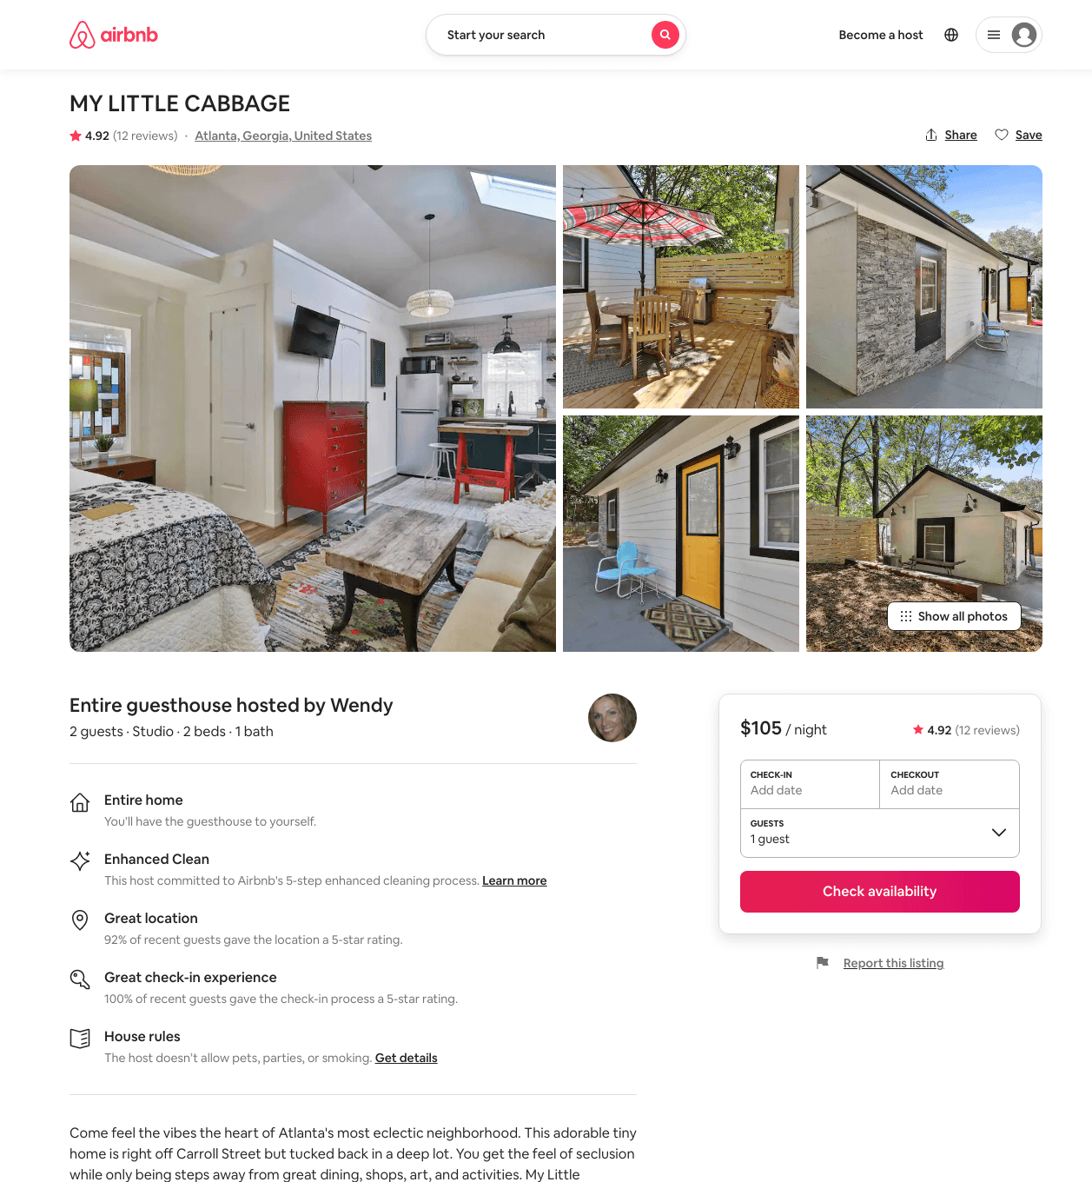
Listing 45938150
Studio
2
$105
4.89
2
Wendy
9150269
2
https://www.airbnb.com/rooms/45938150
Aug 2022

Slide 17
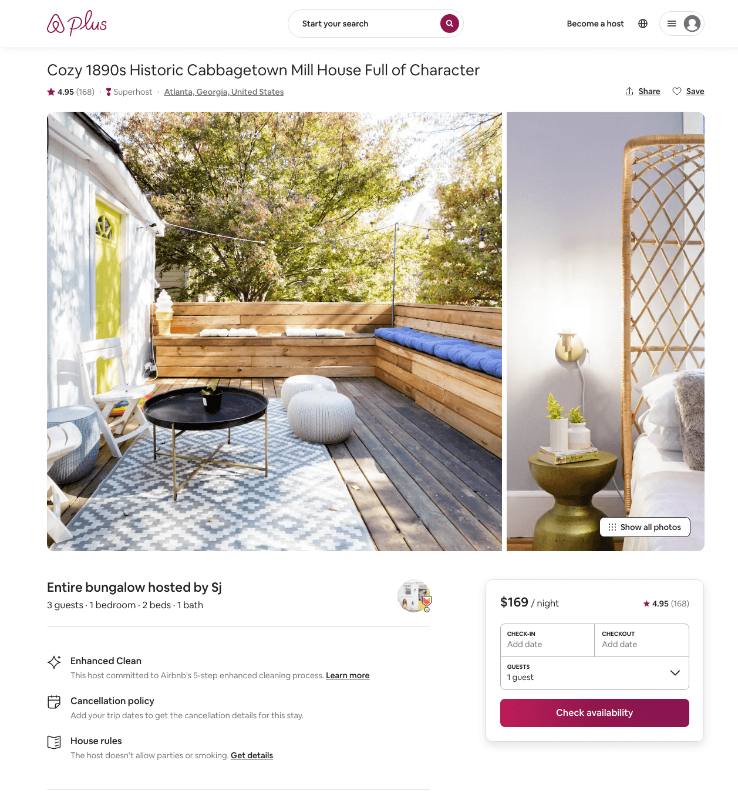
Listing 22435959
1
3
$113 - $319
4.94
3
Sj
37621286
1
https://www.airbnb.com/rooms/22435959
Aug 2022

Slide 18
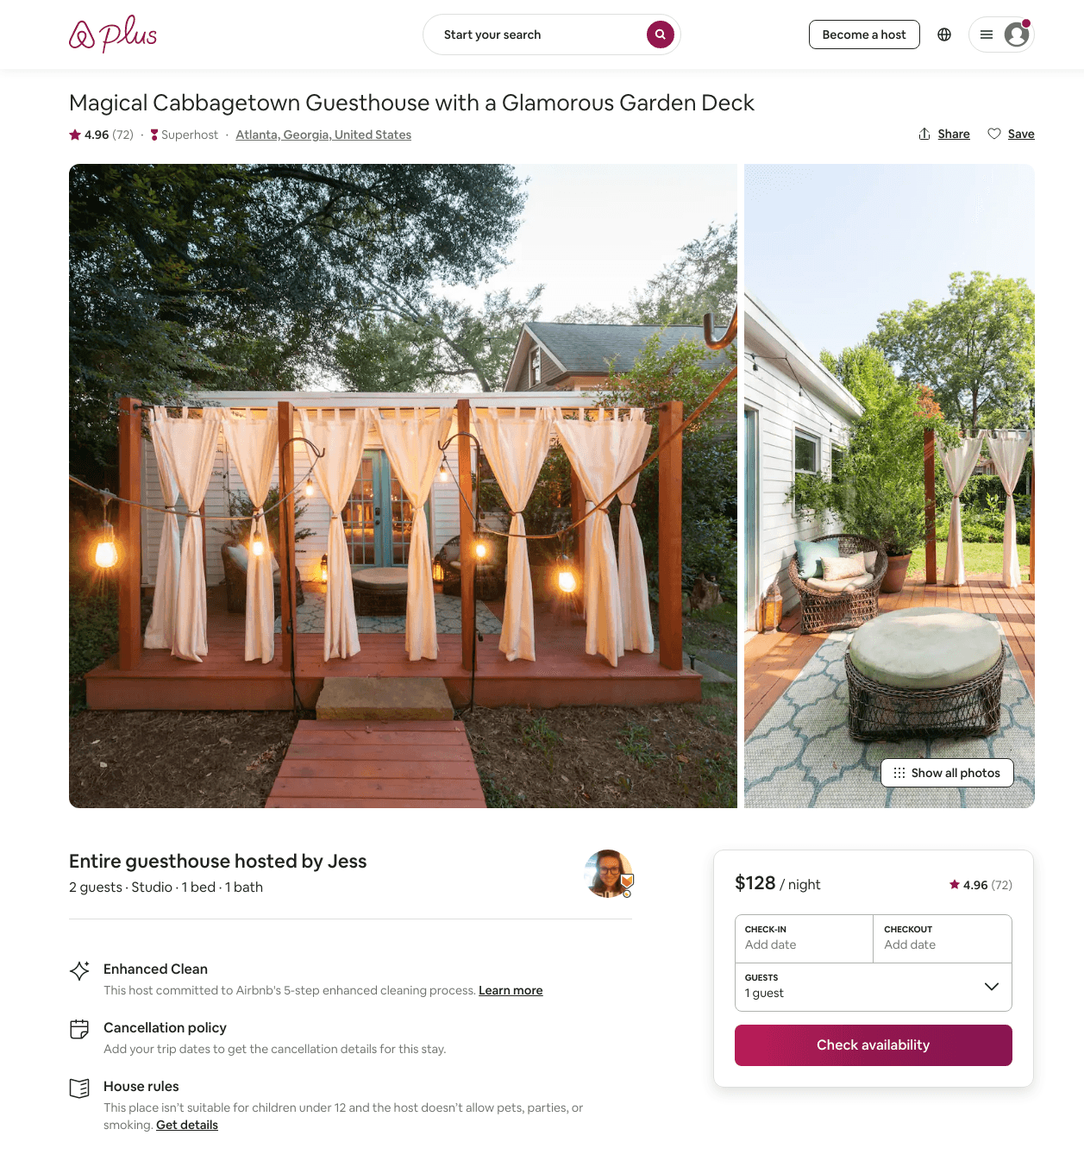
Listing 31194275
Studio
2
$104 - $190
4.92
2
Jess
4234195
1
https://www.airbnb.com/rooms/31194275
Aug 2022

Slide 19
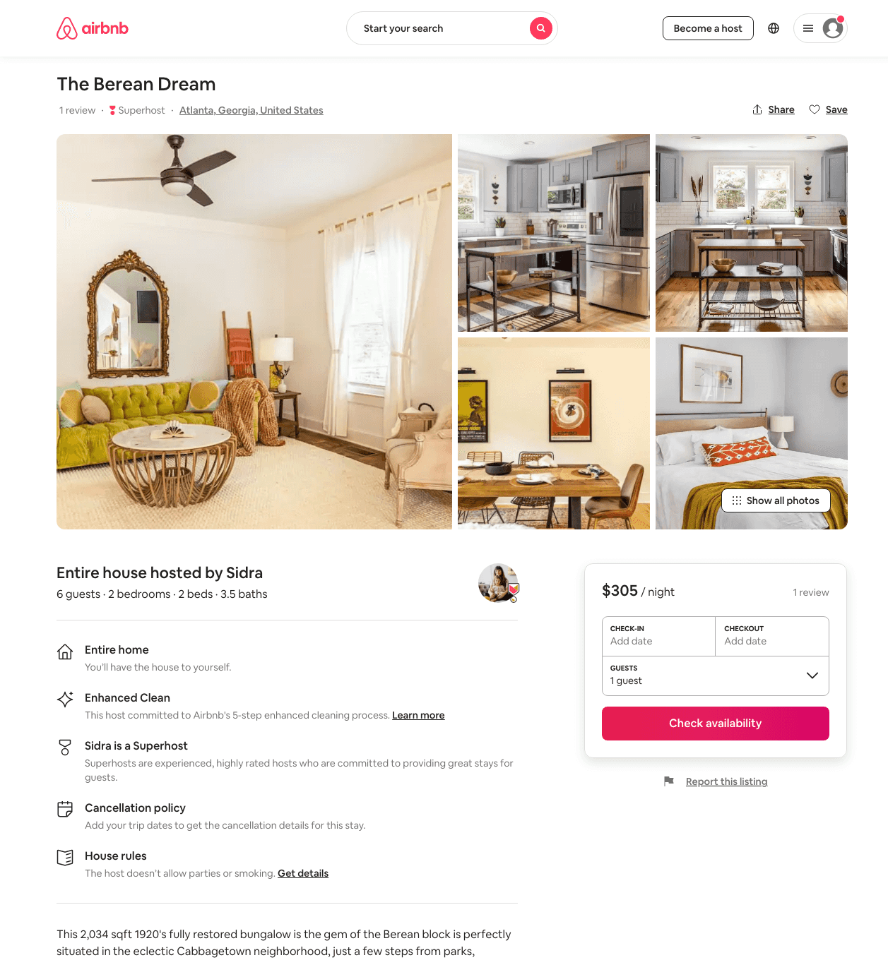
Listing 46371952
3
6
$214 - $358
4.40
2
Minty
3976298
79
https://www.airbnb.com/rooms/46371952
Aug 2022

Slide 20
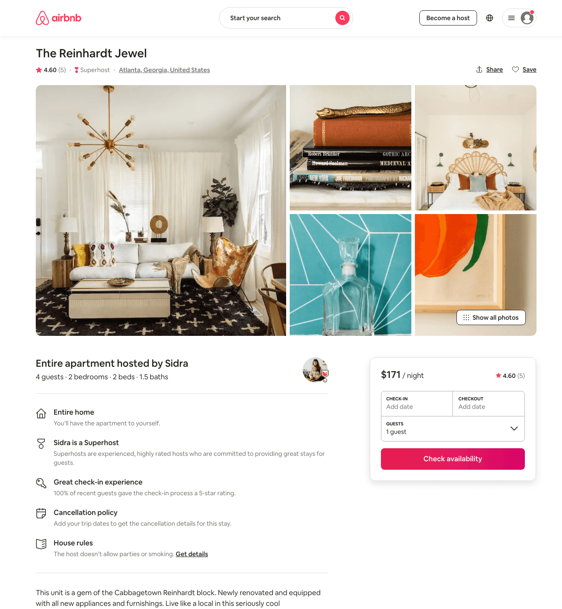
Listing 46068064
2
4
$155 - $225
4.86
2
Minty
3976298
79
https://www.airbnb.com/rooms/46068064
Aug 2022

Slide 21
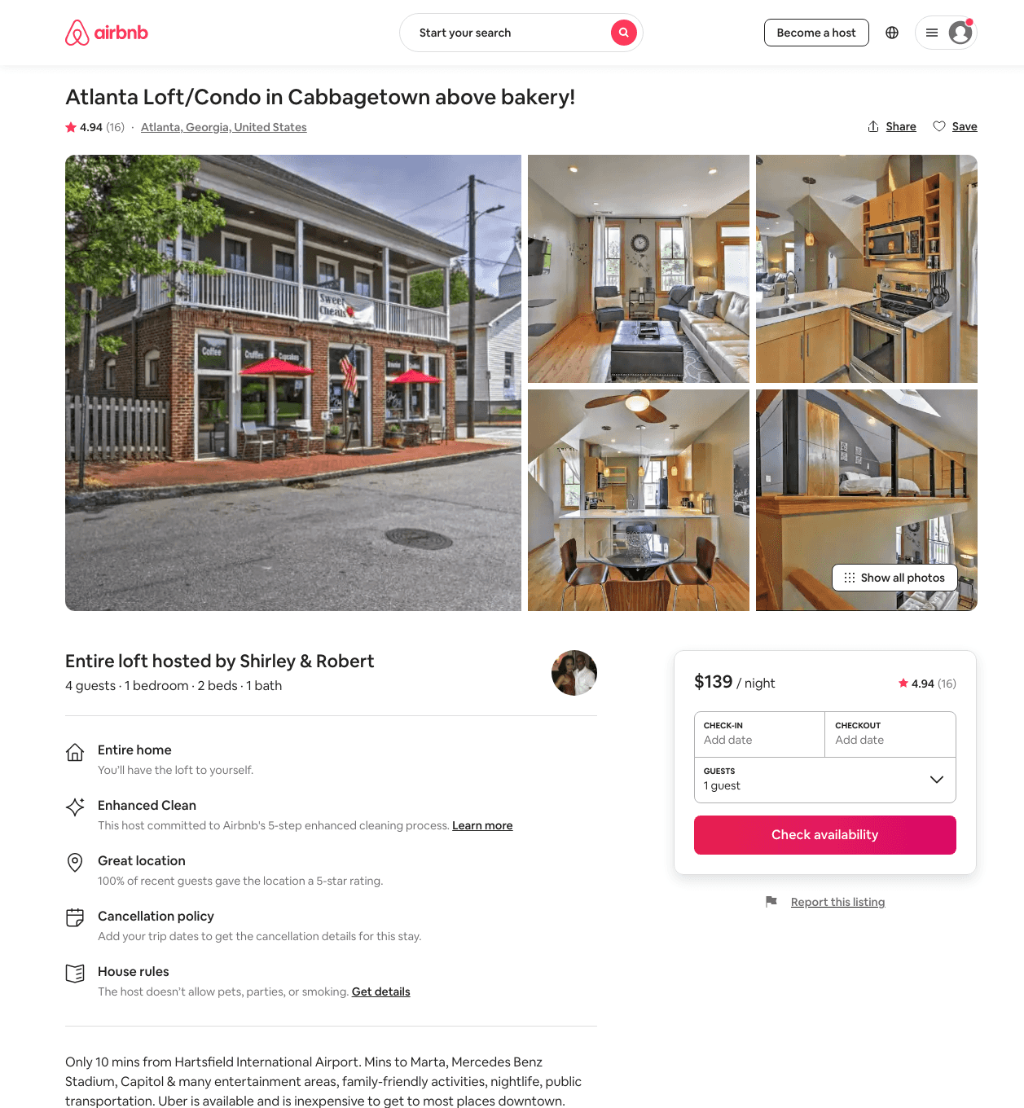
Listing 8803011
1
4
$130 - $202
4.91
2
Shirley & Robert
41742946
1
https://www.airbnb.com/rooms/8803011
Aug 2022

Slide 22
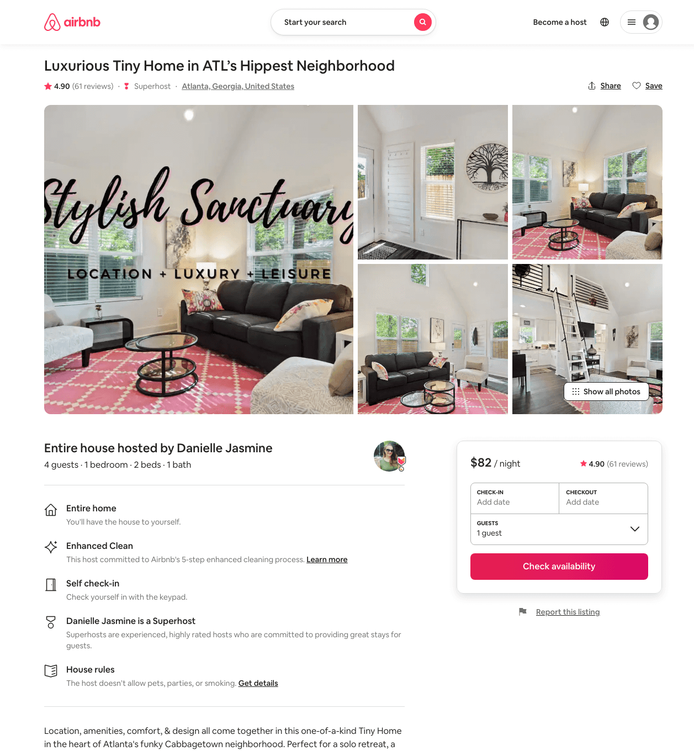
Listing 44448989
1
4
$71 - $133
4.95
2
Danielle
93004528
5
https://www.airbnb.com/rooms/44448989
Aug 2022

Slide 23
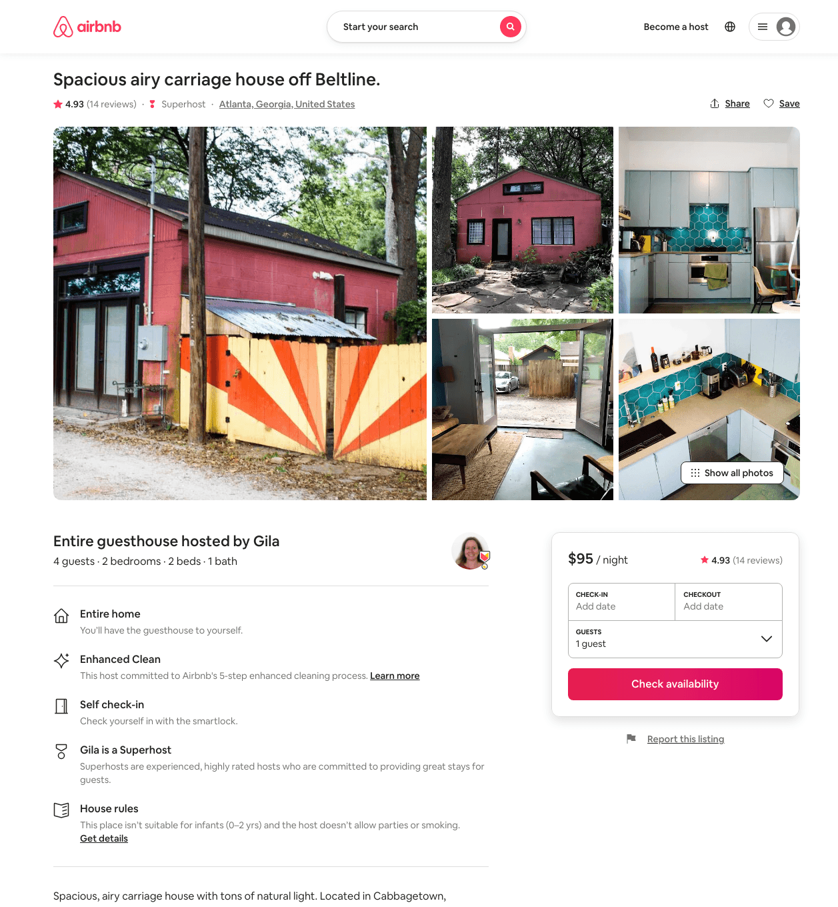
Listing 45141358
2
4
$95 - $132
4.98
2
Gila
16928696
1
https://www.airbnb.com/rooms/45141358
Aug 2022

Slide 24
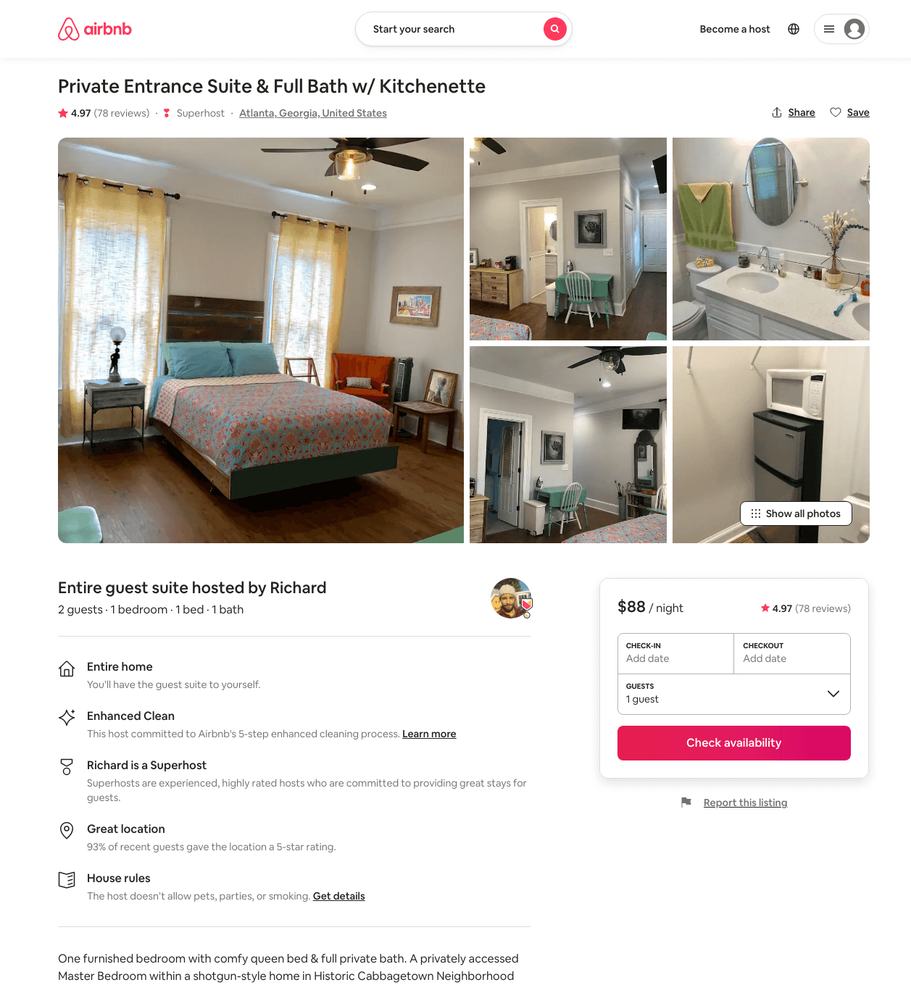
Listing 17813829
1
2
$82 - $146
4.97
3
Richard
52858735
2
https://www.airbnb.com/rooms/17813829
Aug 2022

Slide 25
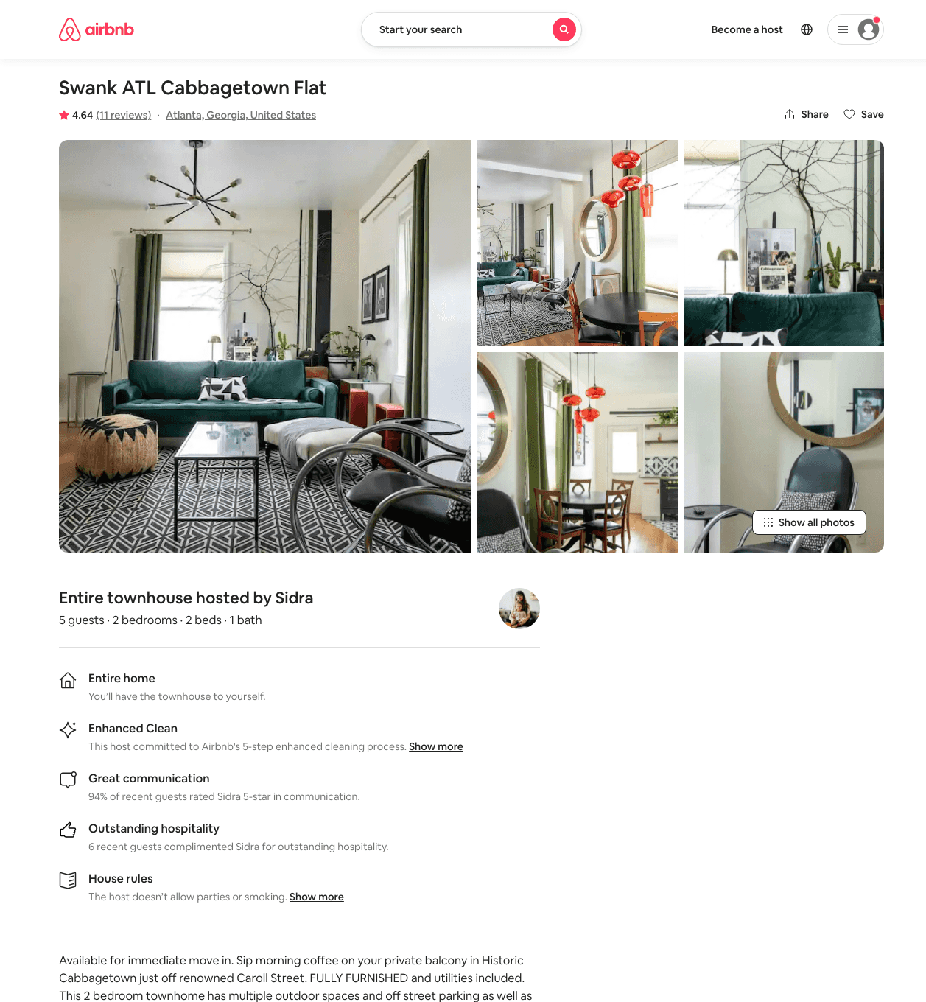
Listing 45236132
2
5
$154 - $193
4.71
2
Minty
3976298
79
https://www.airbnb.com/rooms/45236132
Aug 2022

Slide 26
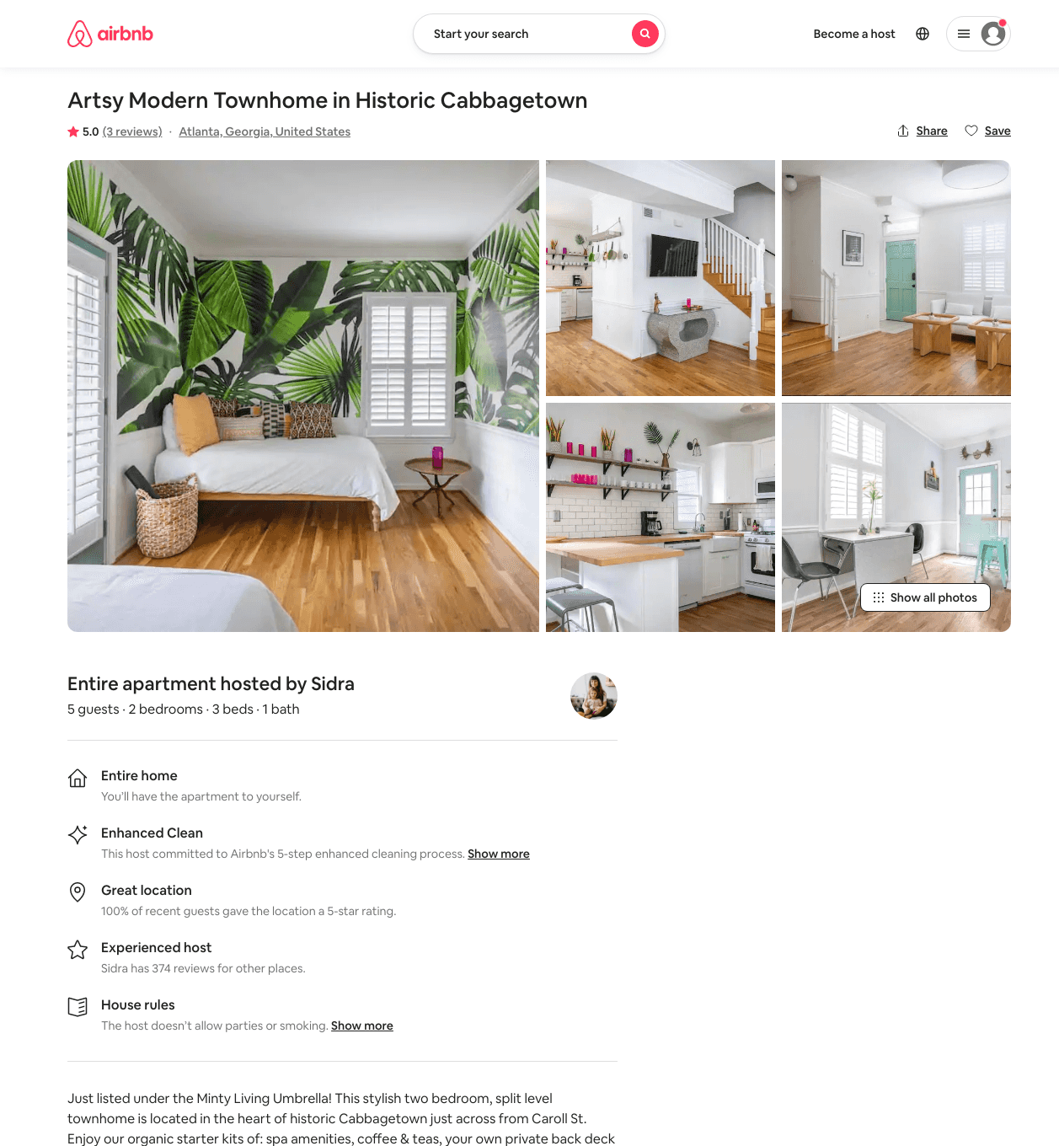
Listing 44168898
2
5
$141 - $254
5.0
2
Minty
3976298
79
https://www.airbnb.com/rooms/44168898
Aug 2022

Slide 27
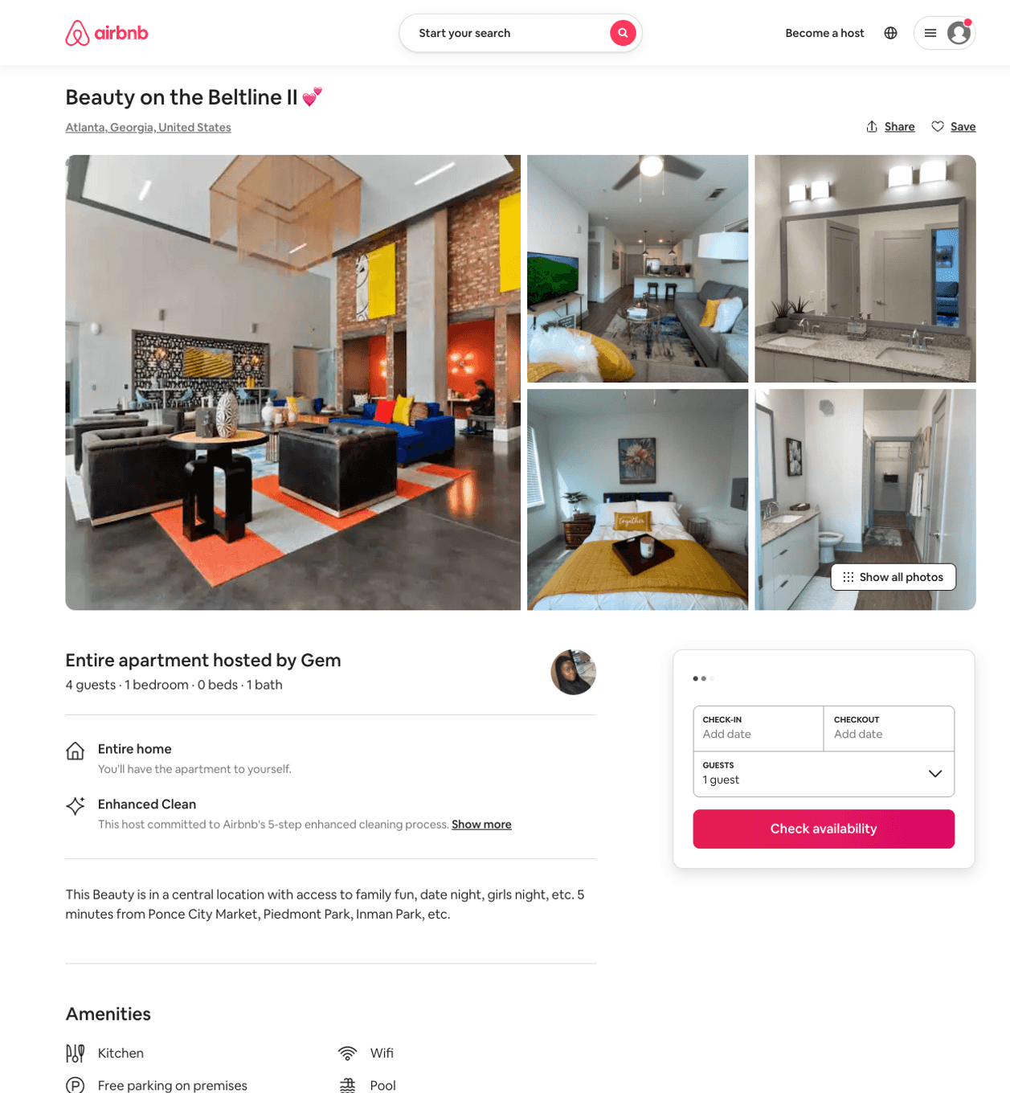
Listing 50126594
1
4
$126 - $185
4.15
2
Gem
98981036
1
https://www.airbnb.com/rooms/50126594
Aug 2022

Slide 28
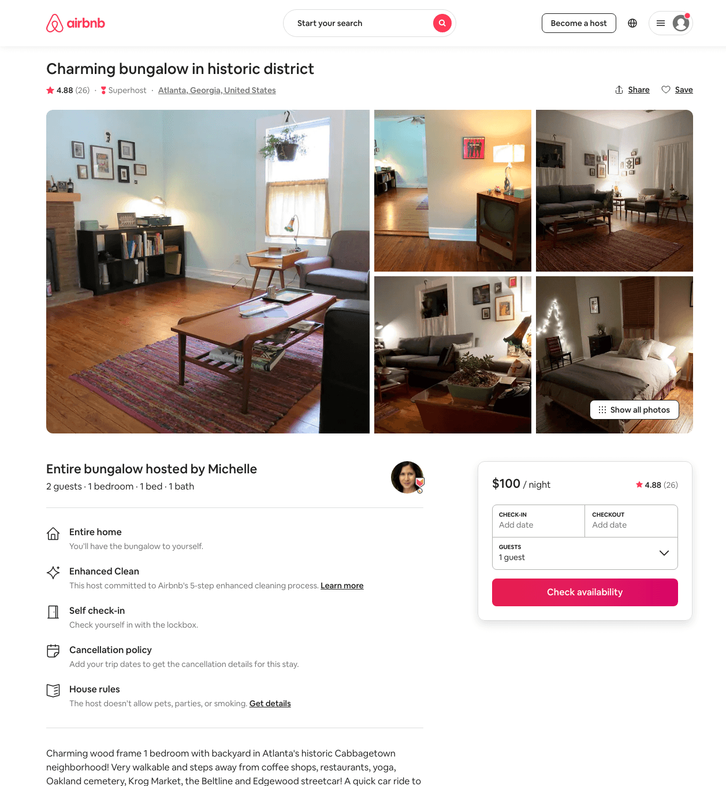
Listing 6213150
1
2
$100
4.88
31
Michelle
32217023
1
https://www.airbnb.com/rooms/6213150
Jun 2022

Slide 29
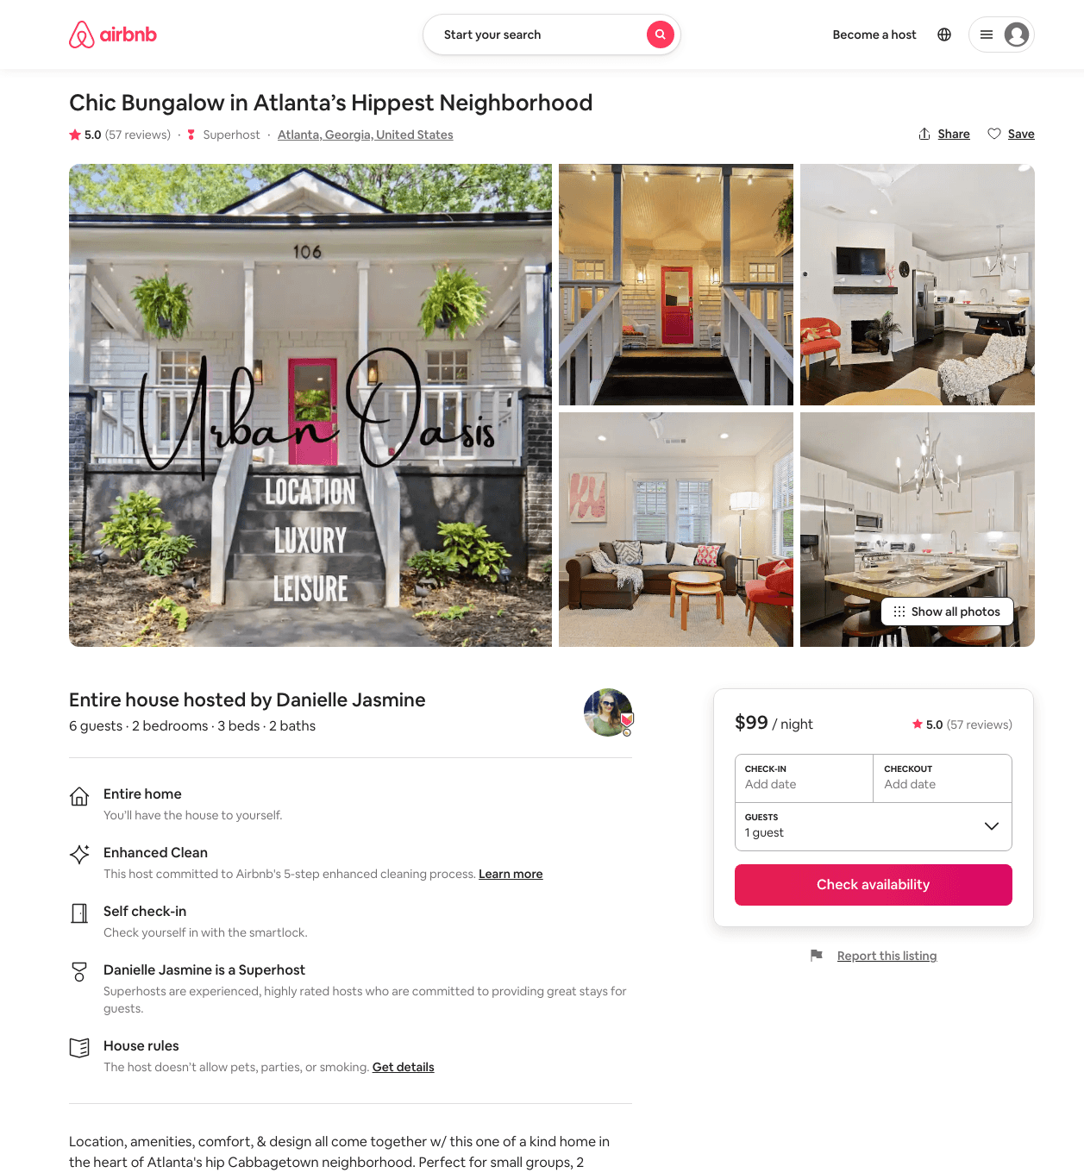
Listing 44334793
2
6
$90 - $191
4.95
2
Danielle
93004528
5
https://www.airbnb.com/rooms/44334793
Aug 2022

Slide 30
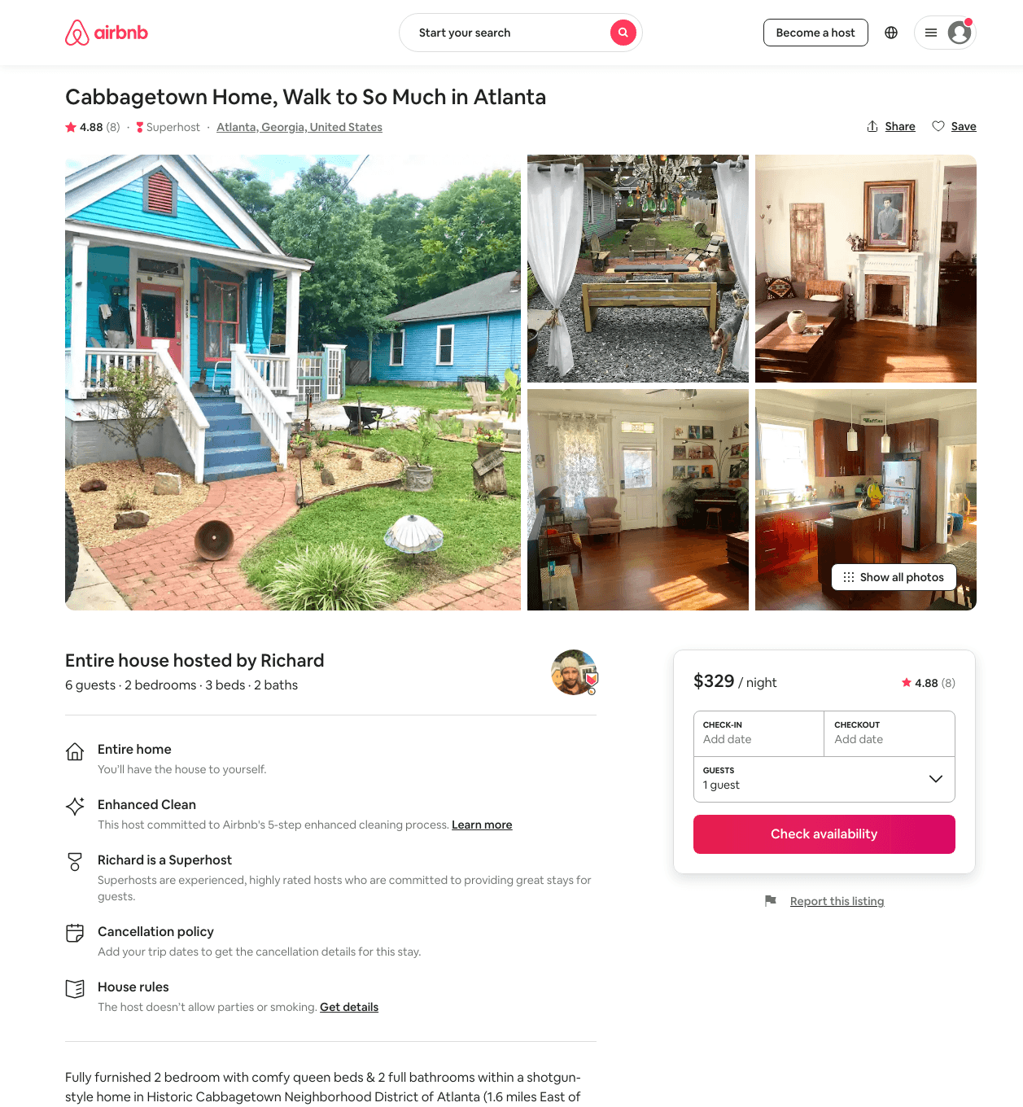
Listing 31317525
2
6
$255 - $341
4.94
2
Richard
52858735
2
https://www.airbnb.com/rooms/31317525
Jun 2022

Slide 31
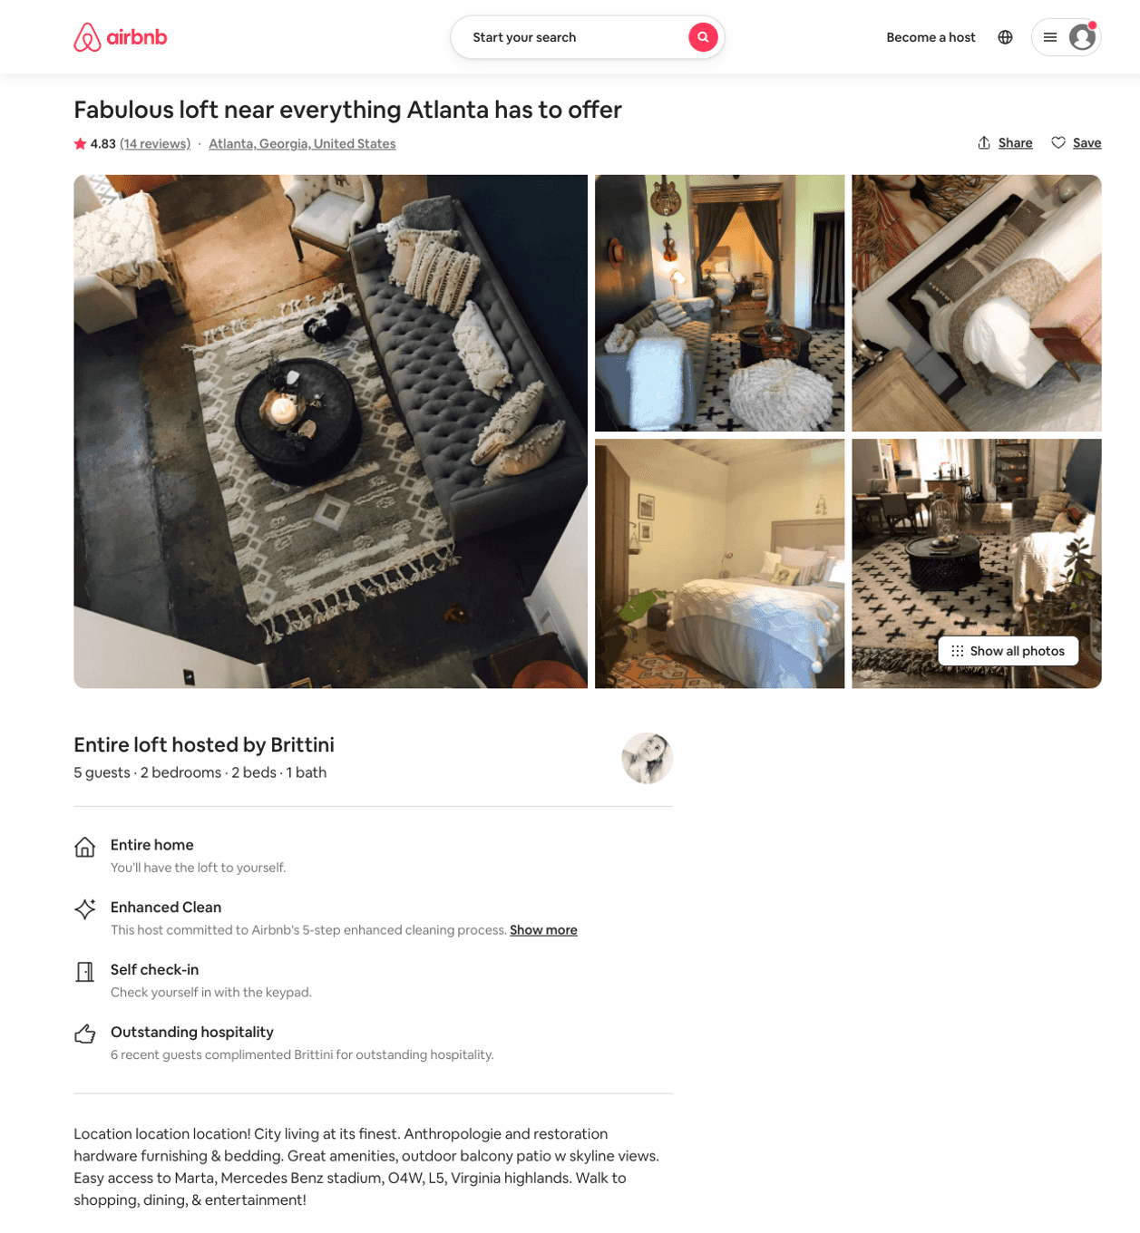
Listing 19831829
2
5
$298
4.83
1
Brittini
8385004
2
https://www.airbnb.com/rooms/19831829
Aug 2022

Slide 32
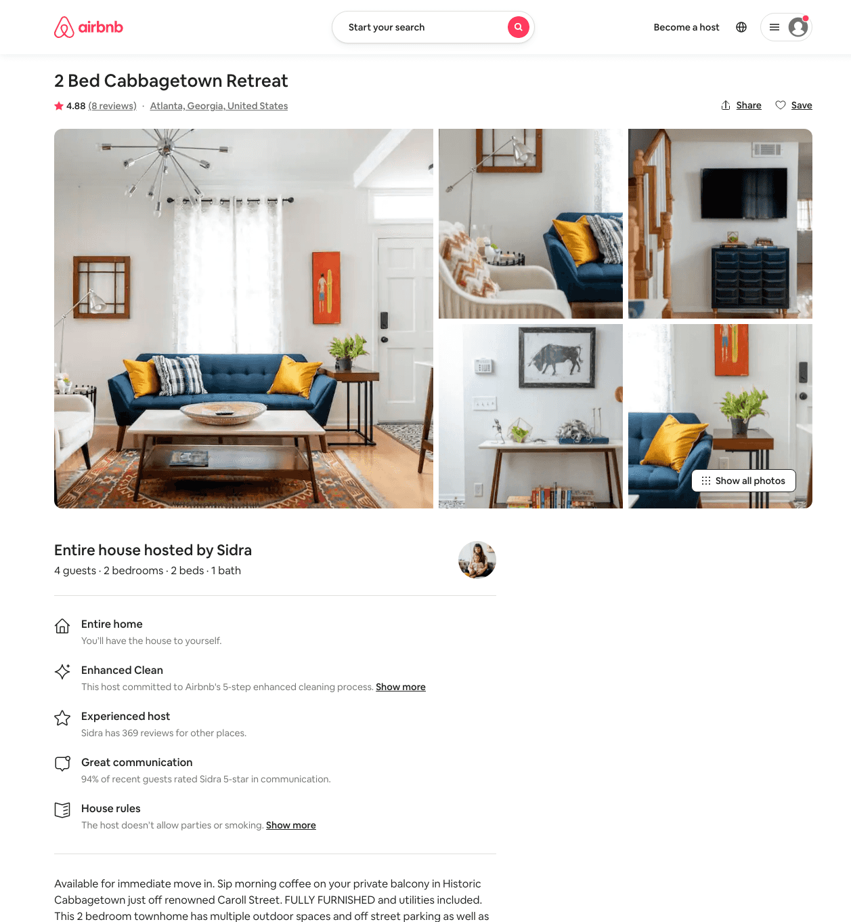
Listing 45235854
2
4
$153 - $203
4.92
2
Minty
3976298
79
https://www.airbnb.com/rooms/45235854
Jun 2022

Slide 33
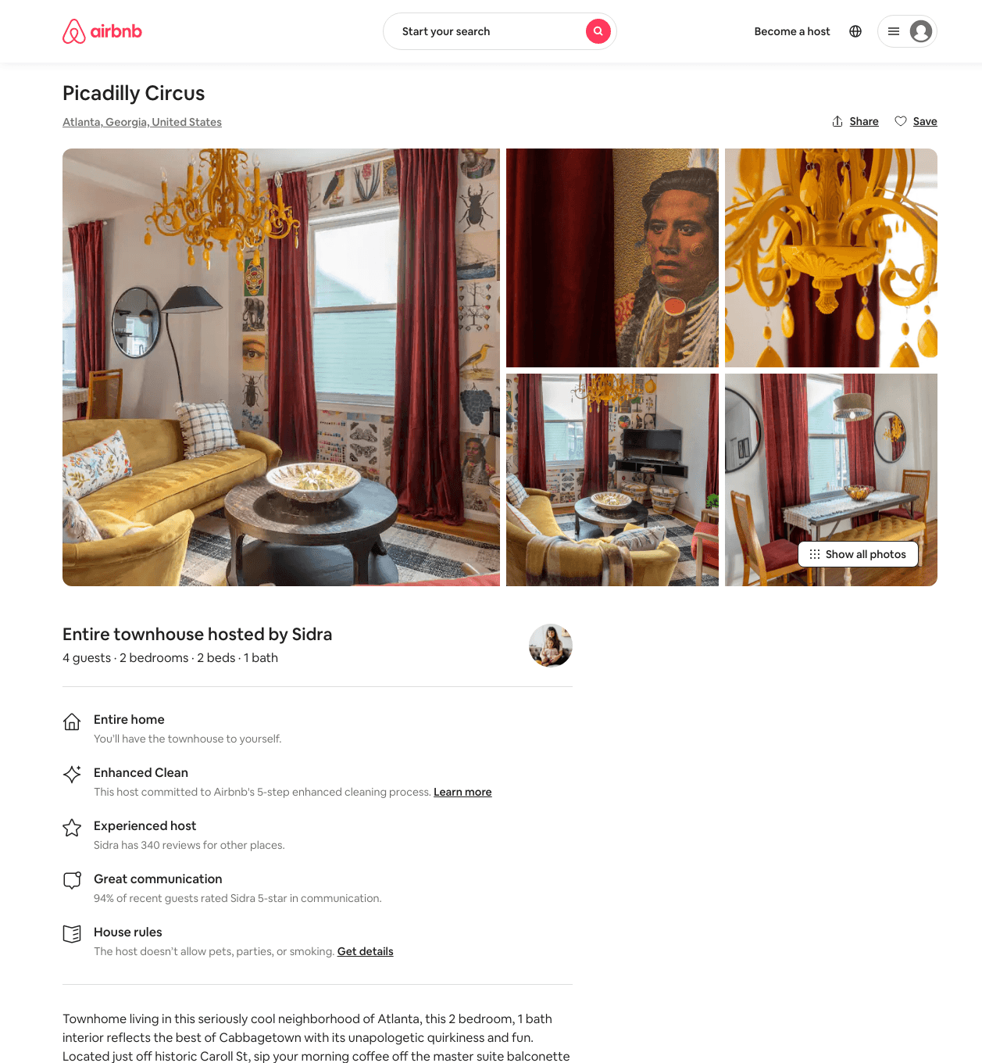
Listing 48754778
2
4
$176 - $236
5.0
2
Minty
3976298
79
https://www.airbnb.com/rooms/48754778
Aug 2022

Slide 34
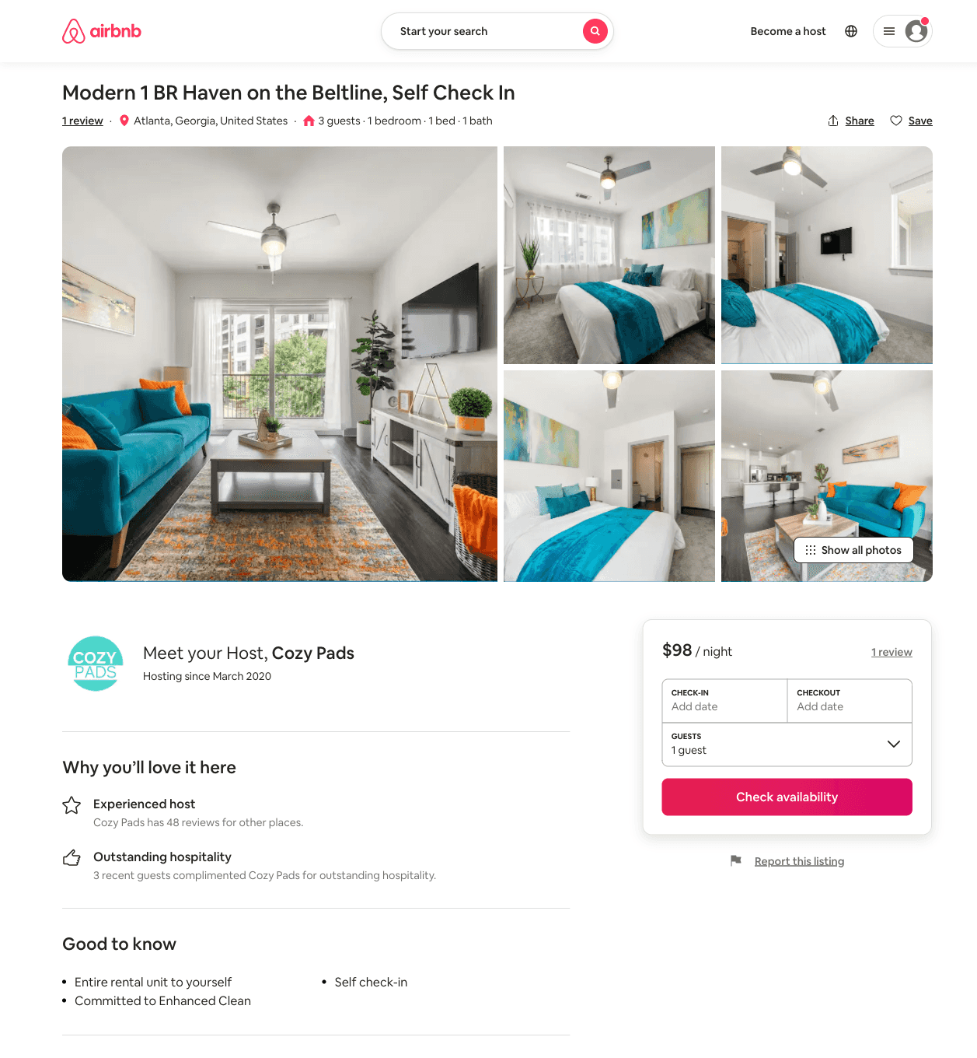
Listing 51469330
1
3
$71 - $171
4.41
2
Cozy Pads
342335761
9
https://www.airbnb.com/rooms/51469330
Jun 2022

Slide 35
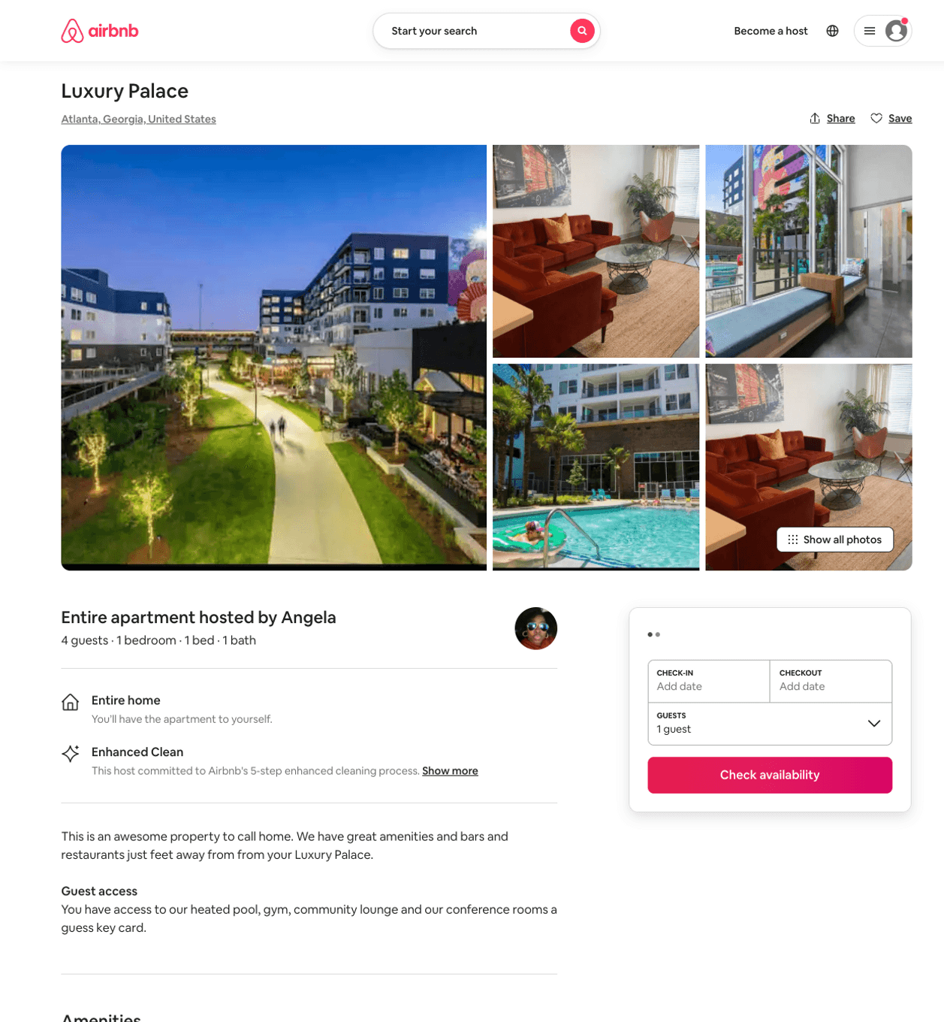
Listing 50311933
1
4
$155 - $182
5.0
2
April
247094576
3
https://www.airbnb.com/rooms/50311933
Jun 2022

Slide 36
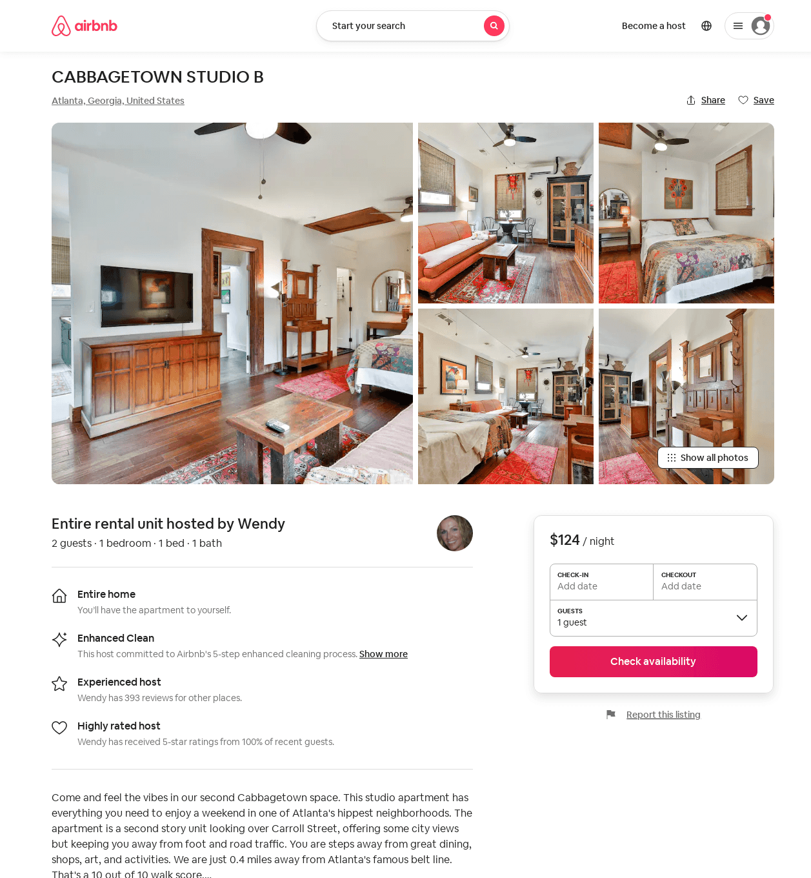
Listing 52217356
1
2
$124
4.87
2
Wendy
9150269
2
https://www.airbnb.com/rooms/52217356
Aug 2022

Slide 37
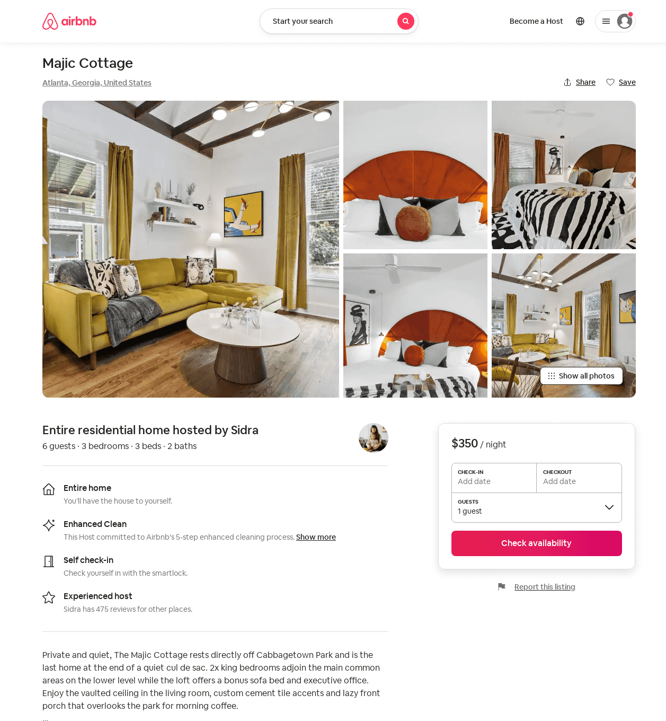
Listing 52749767
3
6
$274 - $356
2
Minty
3976298
79
https://www.airbnb.com/rooms/52749767
Aug 2022

Slide 38
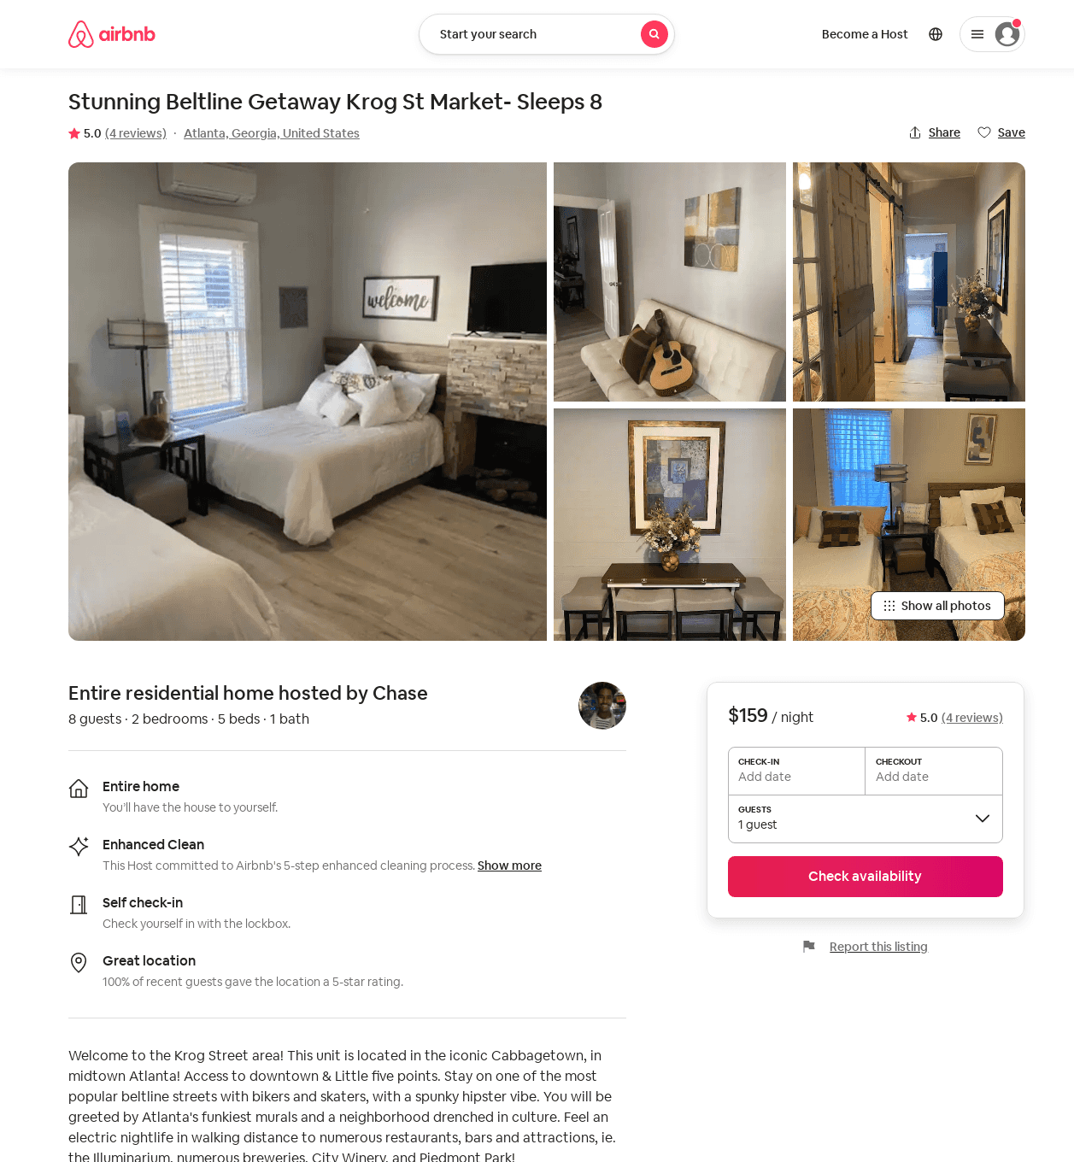
Listing 52423559
2
8
$95 - $173
4.87
1
Chase
424321561
1
https://www.airbnb.com/rooms/52423559
Jun 2022

Slide 39
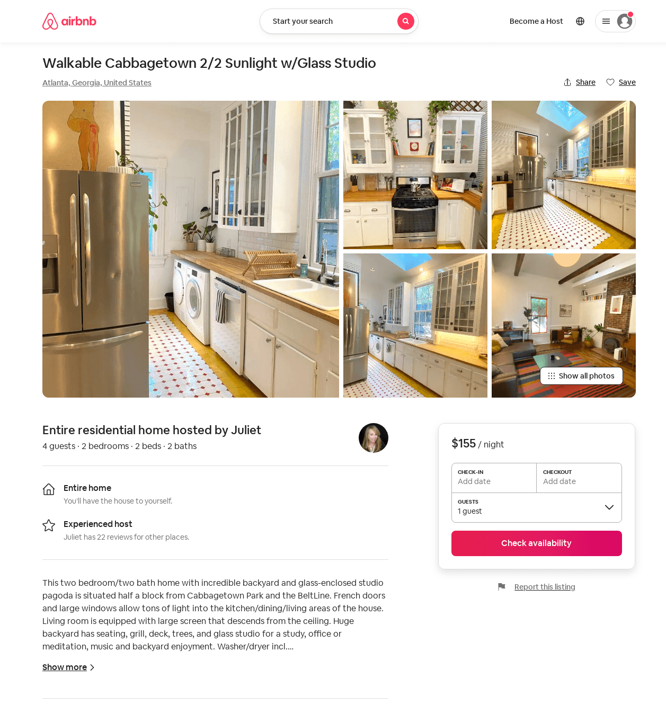
Listing 52994400
2
4
$148 - $200
12
Juliet
1188304
5
https://www.airbnb.com/rooms/52994400
Jul 2022

Slide 40
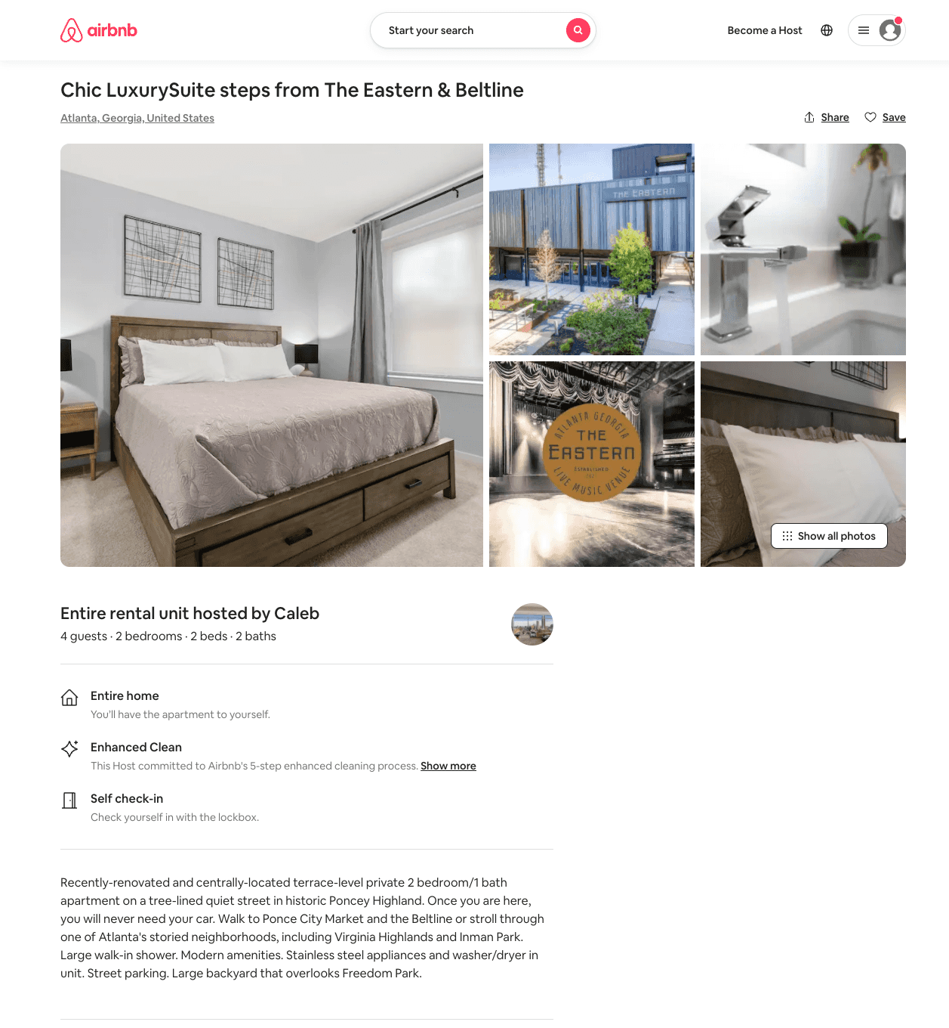
Listing 53765950
2
5
$50 - $249
5.0
1
Caleb
3068590
1
https://www.airbnb.com/rooms/53765950
Aug 2022

Slide 41
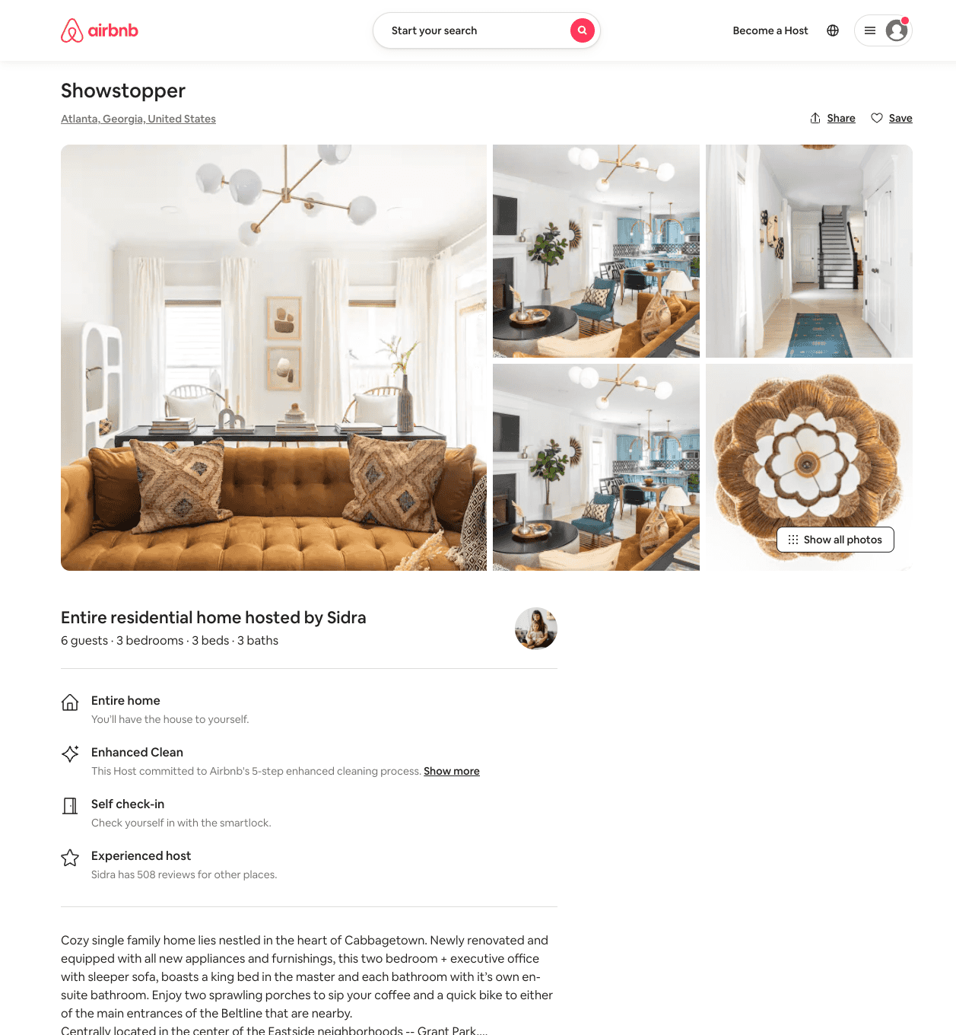
Listing 52262064
3
6
$199 - $247
5.0
2
Minty
3976298
79
https://www.airbnb.com/rooms/52262064
Aug 2022

Slide 42
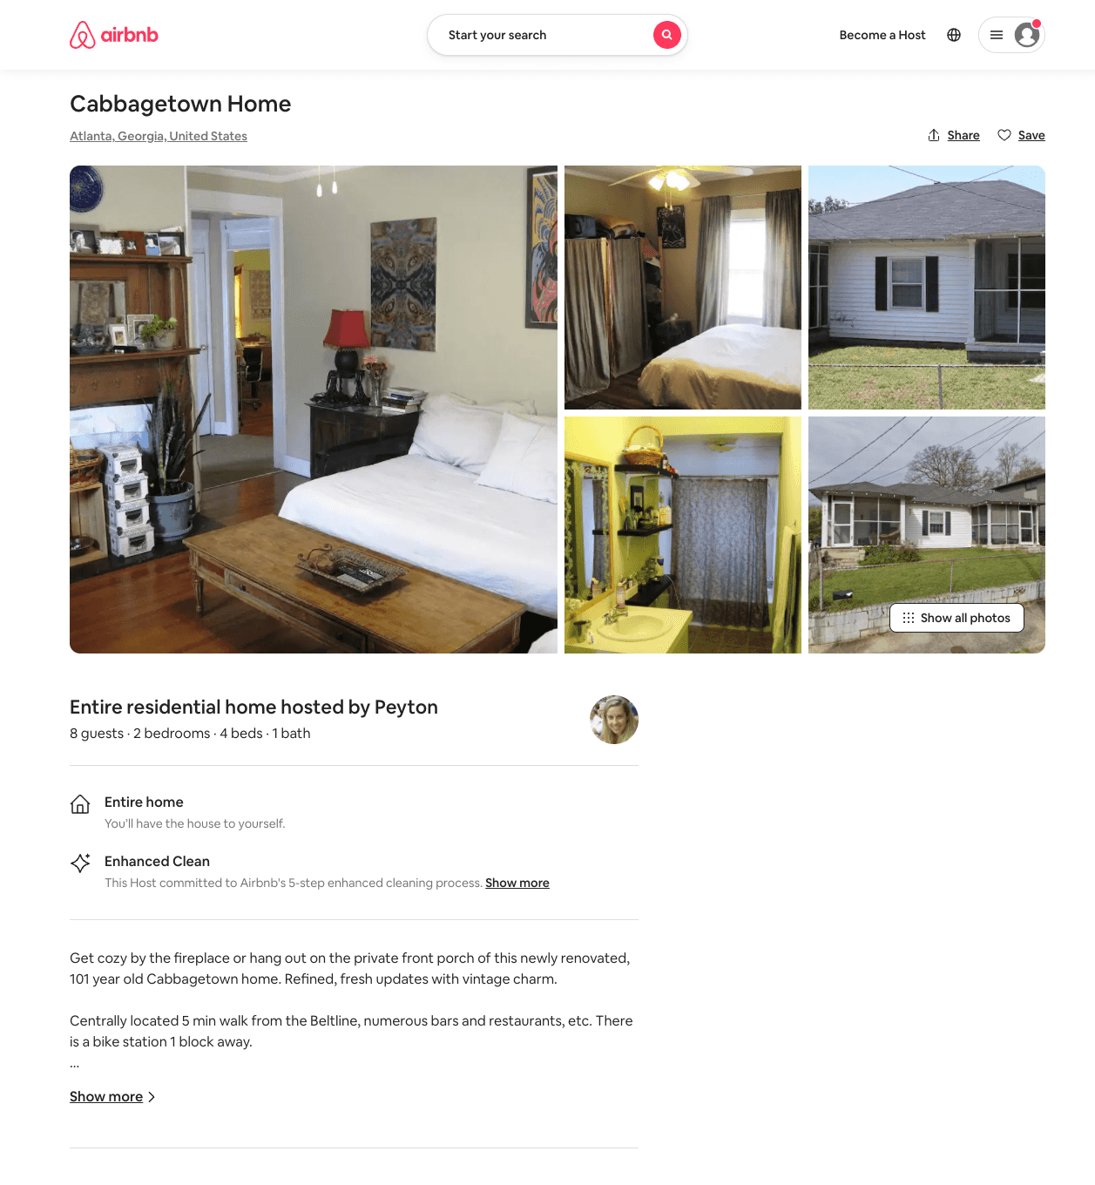
Listing 53308763
2
8
$205 - $5000
1
Peyton
44767
1
https://www.airbnb.com/rooms/53308763
Aug 2022

Slide 43
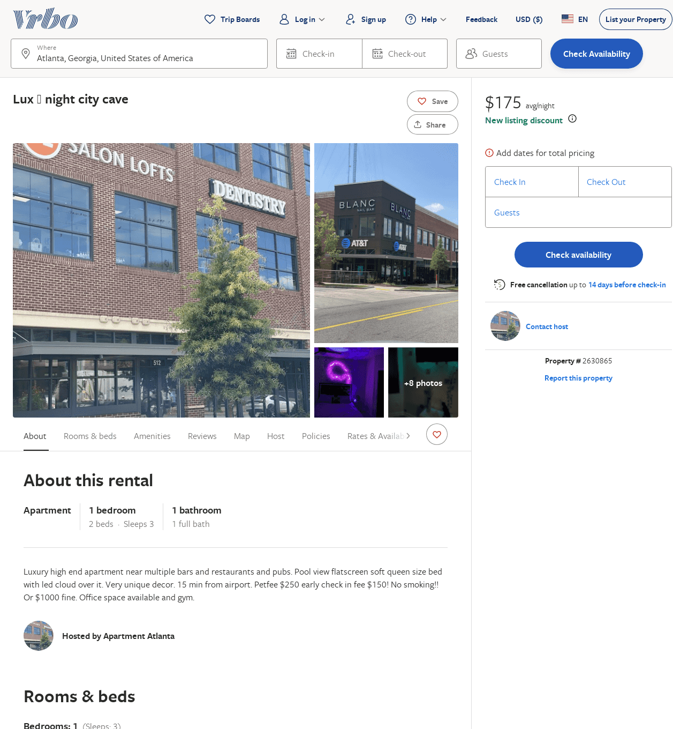
Listing 2630865
1
3
$175
1
https://www.vrbo.com/2630865
Aug 2022

Slide 44
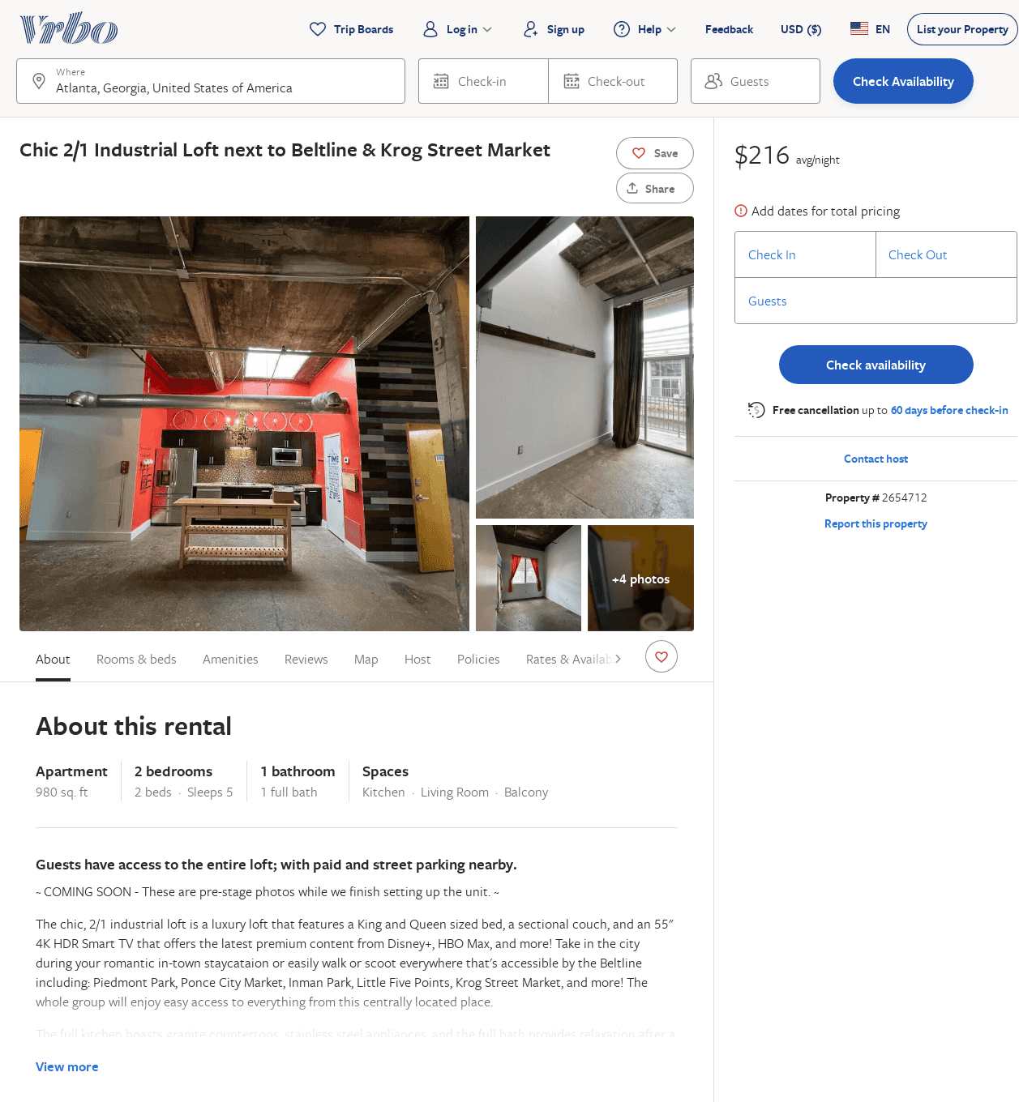
Listing 2654712
2
5
$155
1
1
Wei Yang
https://www.vrbo.com/2654712
Aug 2022

Slide 45
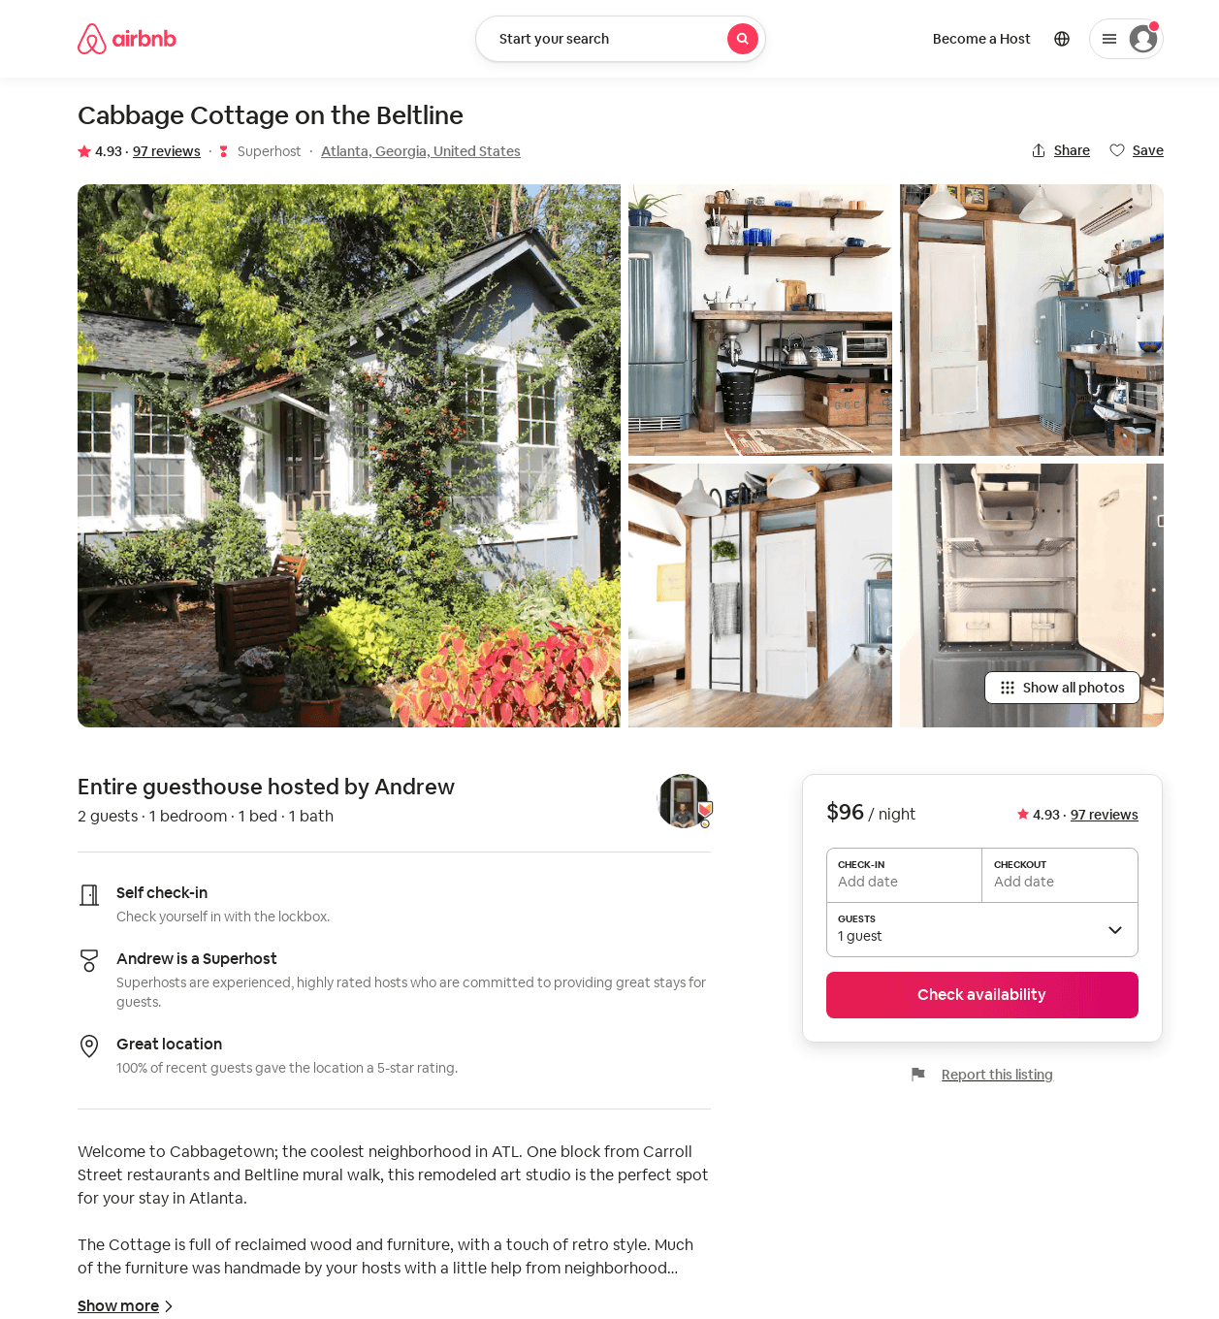
Listing 32165547
1
2
$96 - $109
4.92
3
Andrew
16196000
2
https://www.airbnb.com/rooms/32165547
Aug 2022

Slide 46
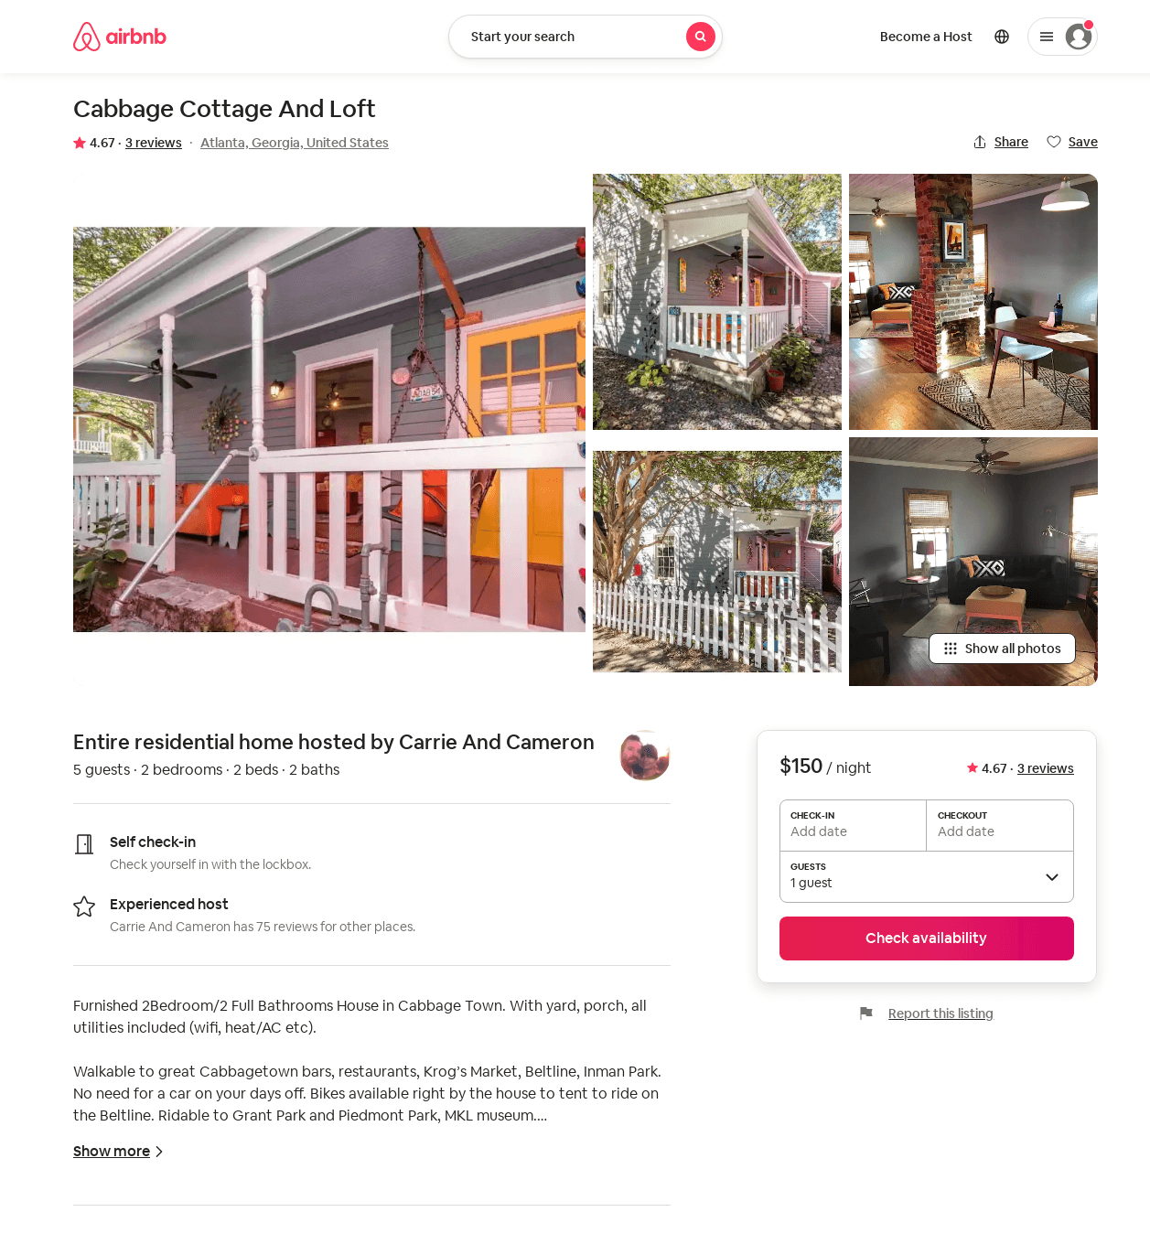
Listing 22360427
2
5
$150
4.60
31
Carrie And Cameron
1983929
1
https://www.airbnb.com/rooms/22360427
Aug 2022

Slide 47
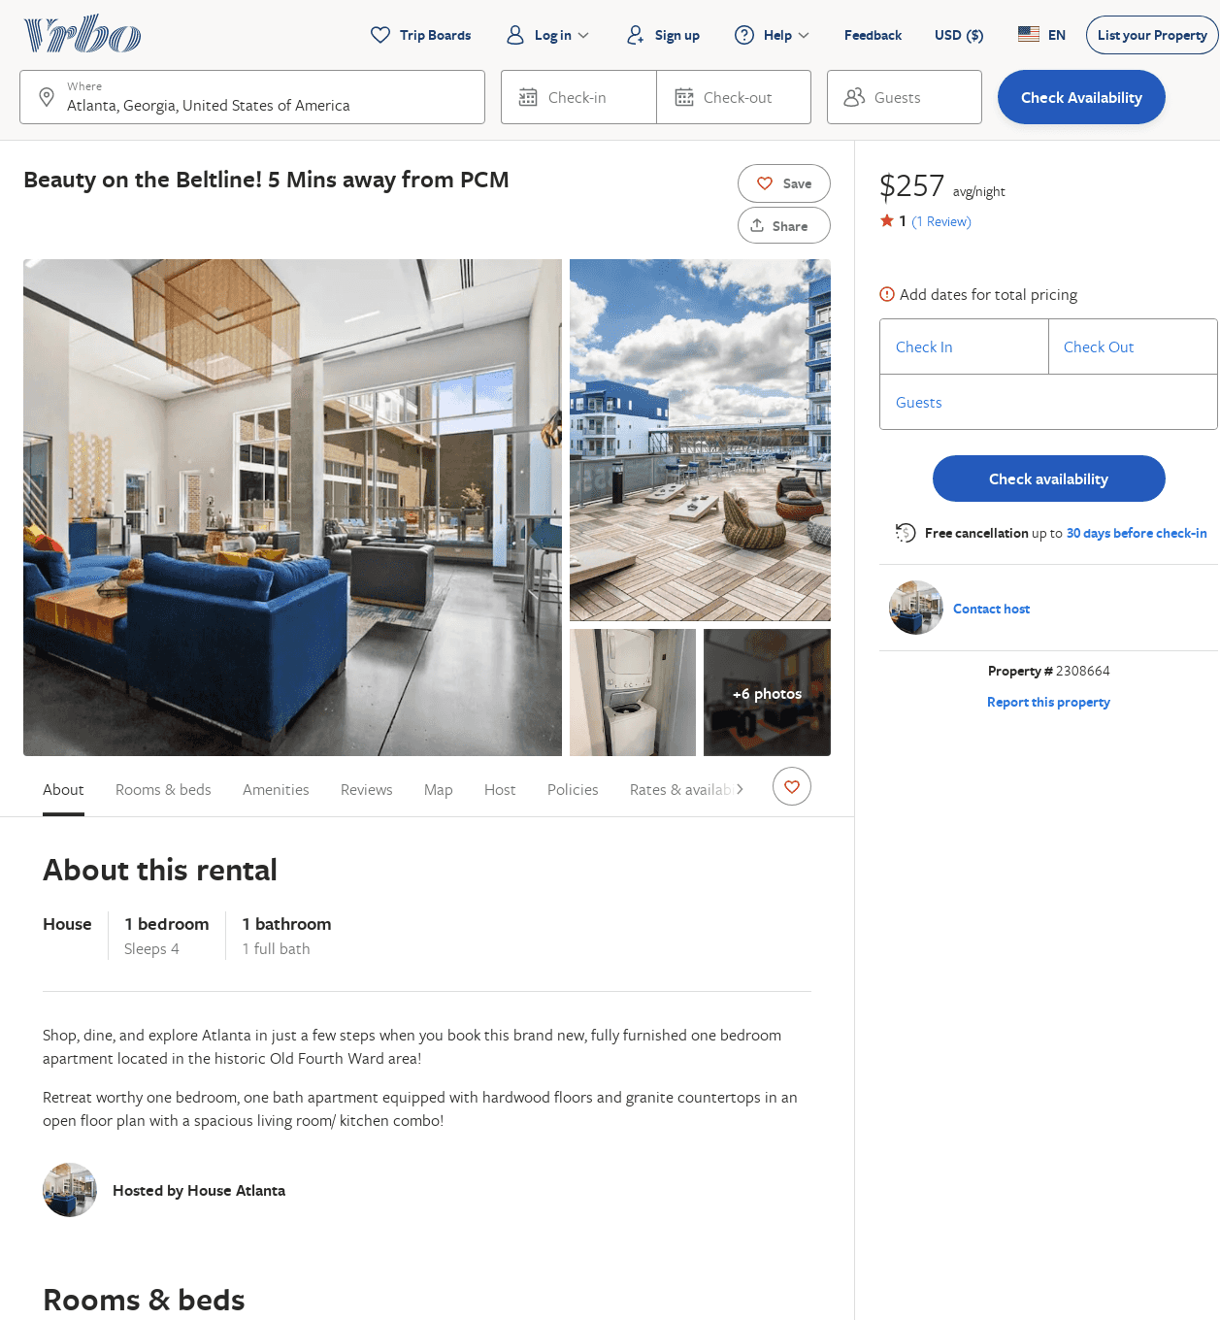
Listing 2308664
1
4
$225
1
2
https://www.vrbo.com/2308664
Aug 2022

Slide 48
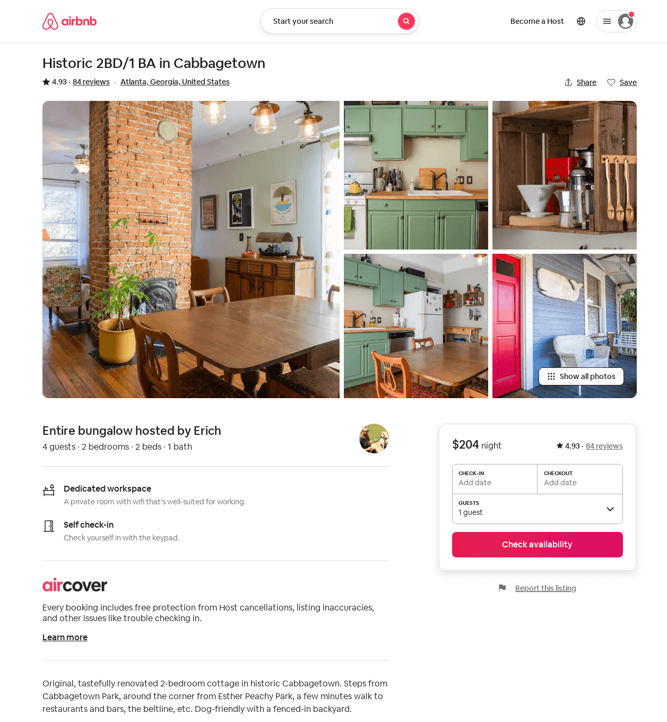
Listing 7144700
2
4
4.93
2
Erich
1657967
1
https://www.airbnb.com/rooms/7144700
Aug 2022

Slide 49
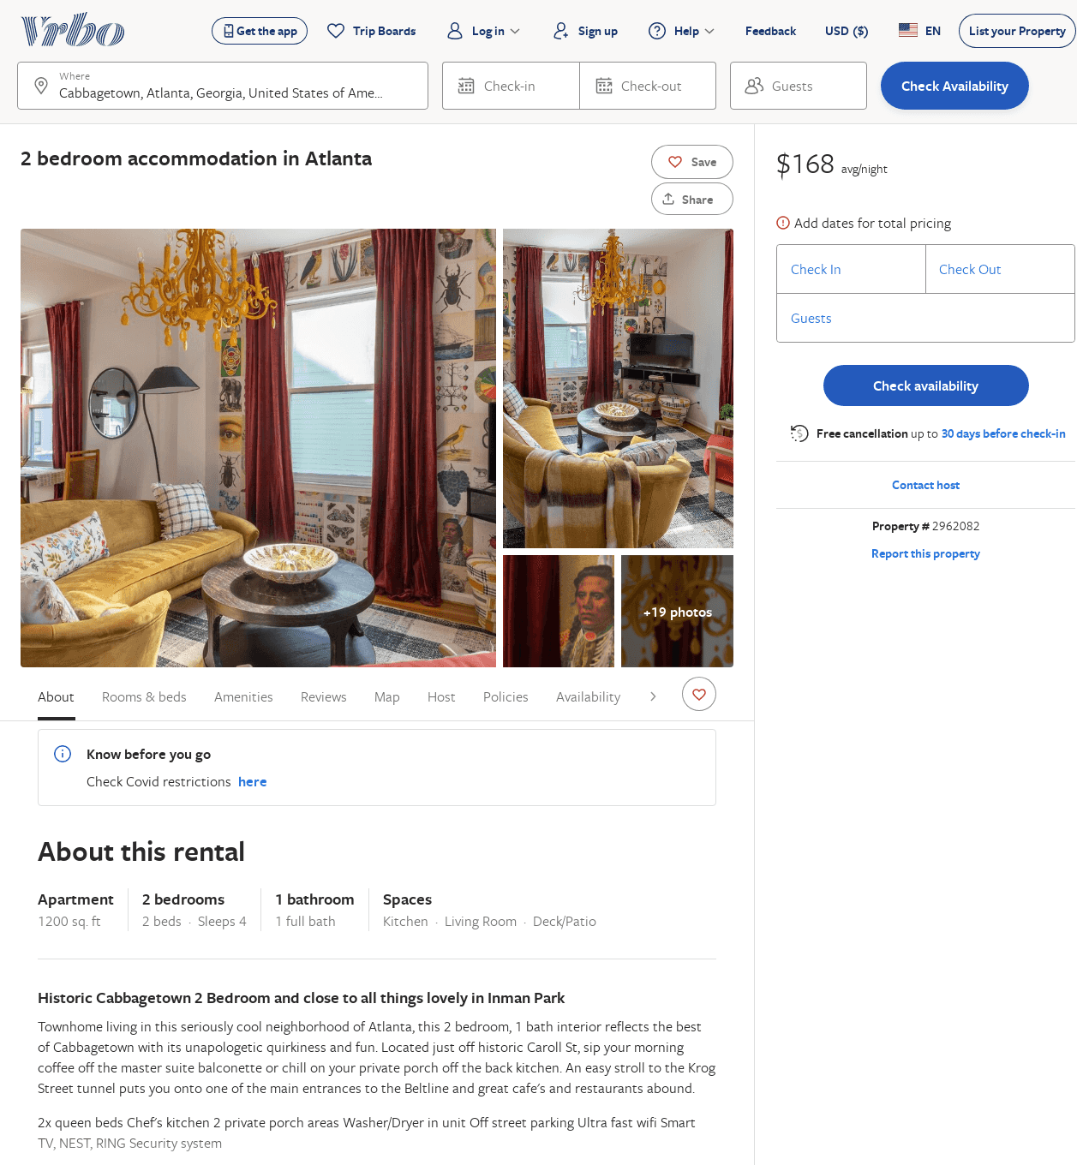
Listing 2962082
2
4
$168
2
Minty Living
https://www.vrbo.com/2962082
Aug 2022

Slide 50
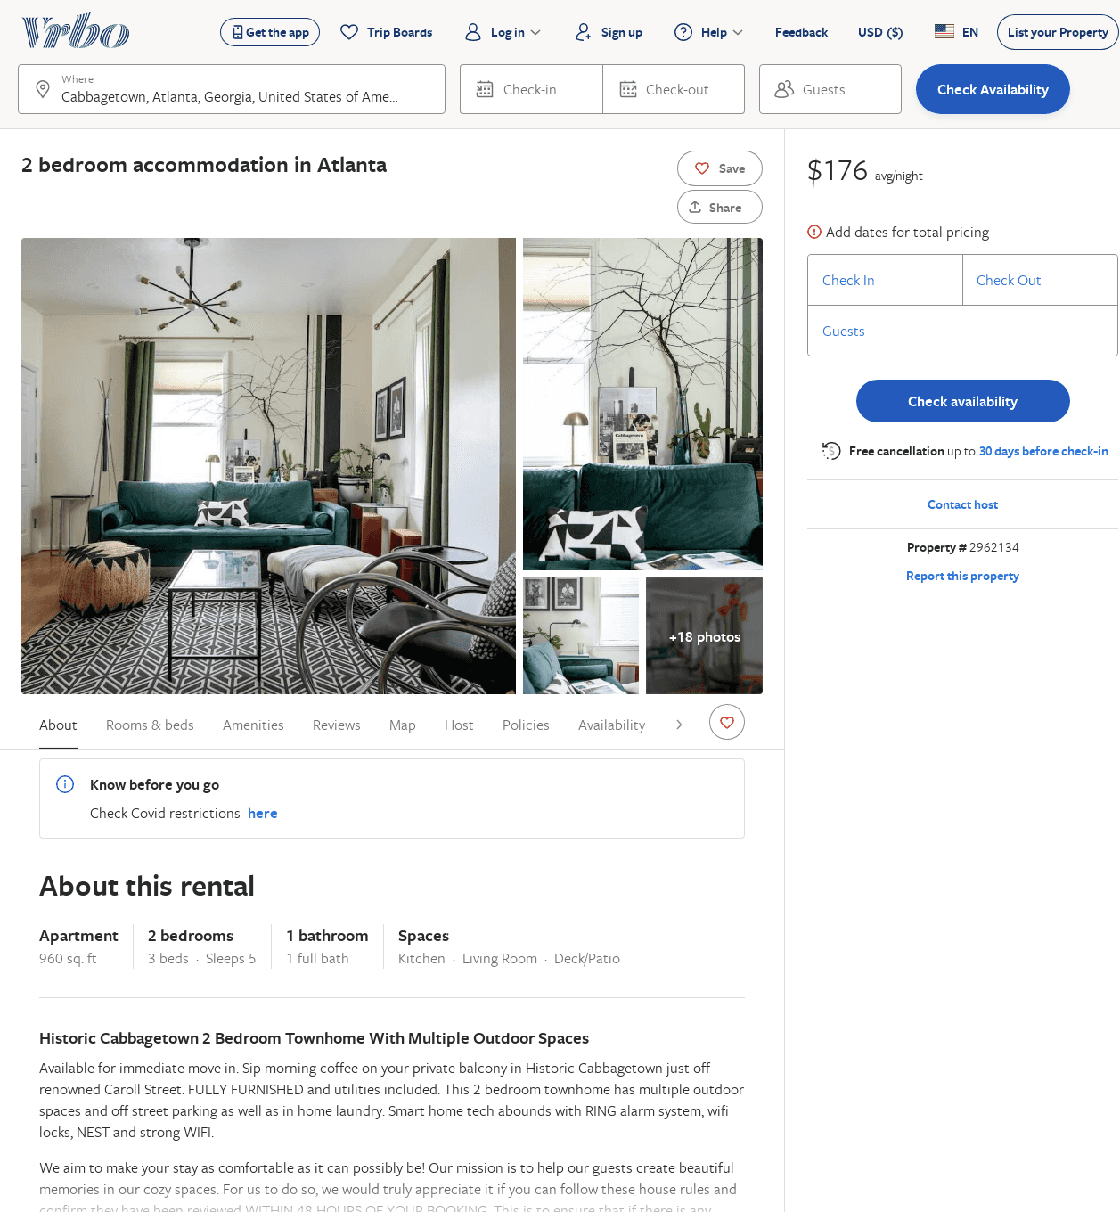
Listing 2962134
2
5
$176
2
Minty Living
https://www.vrbo.com/2962134
Aug 2022

Slide 51
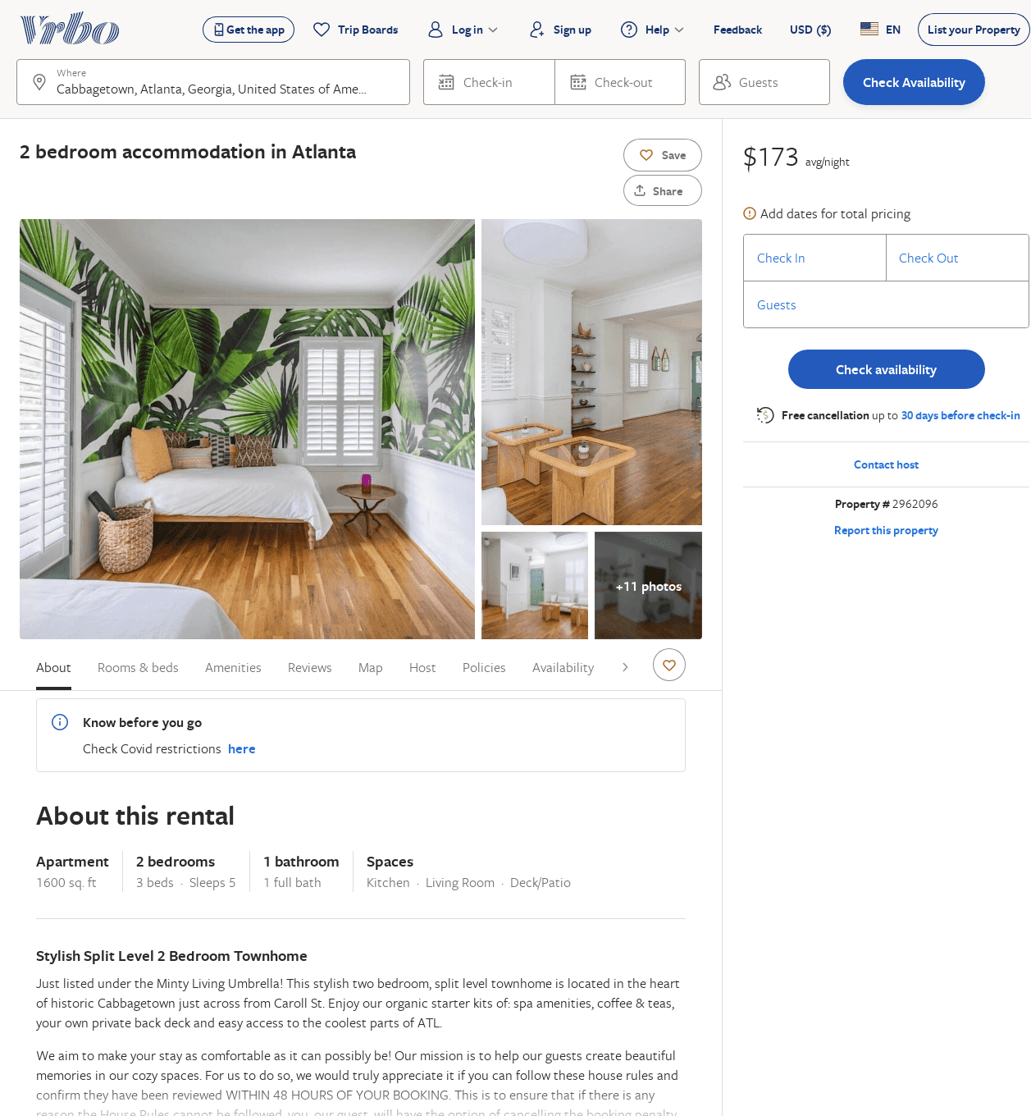
Listing 2962096
2
5
$173
2
Minty Living
https://www.vrbo.com/2962096
Aug 2022

Slide 52
Listing 2962131
1
2
$129
2
Minty Living
https://www.vrbo.com/2962131
Aug 2022

Slide 53
Listing 2962101
2
4
$159
2
Minty Living
https://www.vrbo.com/2962101
Aug 2022

Slide 54
Listing 2962100
2
4
$154
2
Minty Living
https://www.vrbo.com/2962100
Aug 2022

Slide 55
Listing 2967037
2
4
$189
2
Minty Living
https://www.vrbo.com/2967037
Aug 2022

Slide 56
Listing 2962126
2
4
$269
2
Minty Living
https://www.vrbo.com/2962126
Aug 2022

Slide 57
Listing 2962130
1
2
$218
2
Minty Living
https://www.vrbo.com/2962130
Aug 2022

Slide 58
Listing 2962084
3
6
$342
2
Minty Living
https://www.vrbo.com/2962084
Aug 2022

