Slide 2
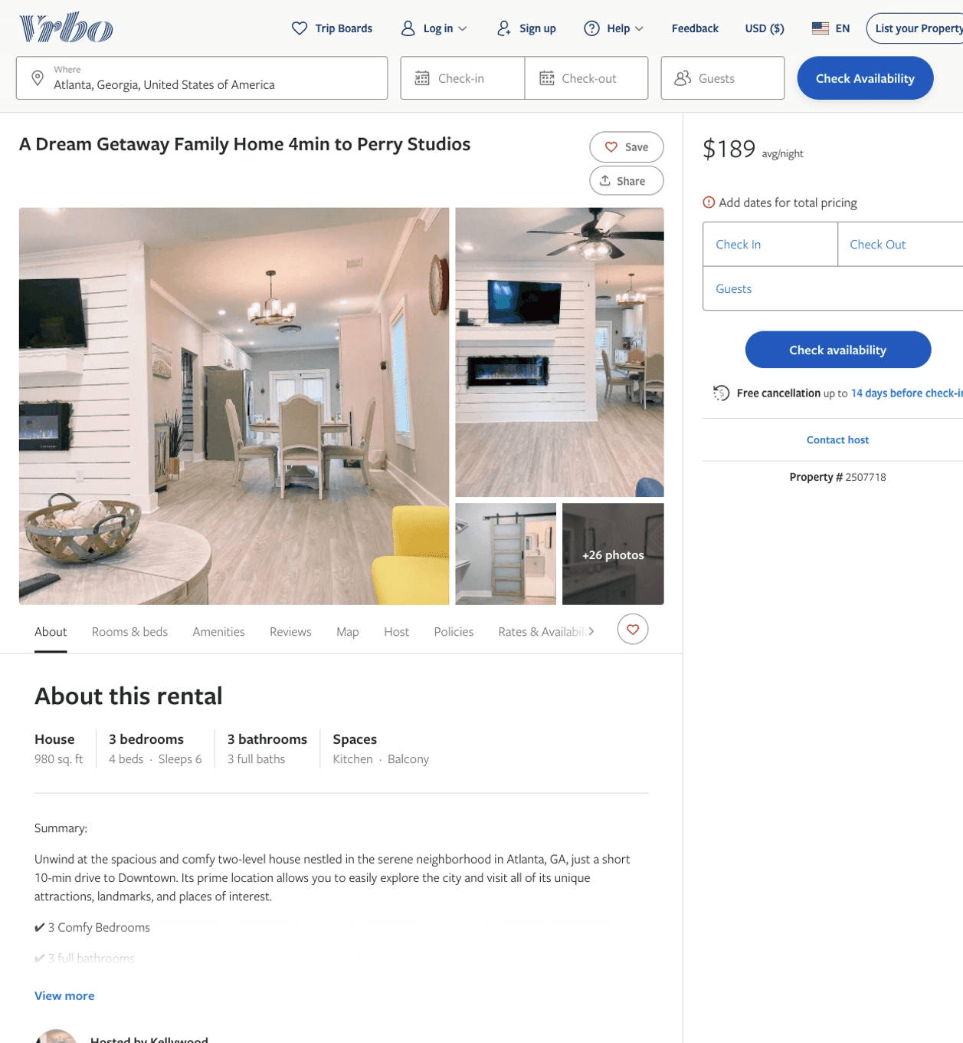
Listing 2507718
3
6
$130 - $189
4.5
2
Kellywood
https://www.vrbo.com/2507718
Aug 2022

Slide 3
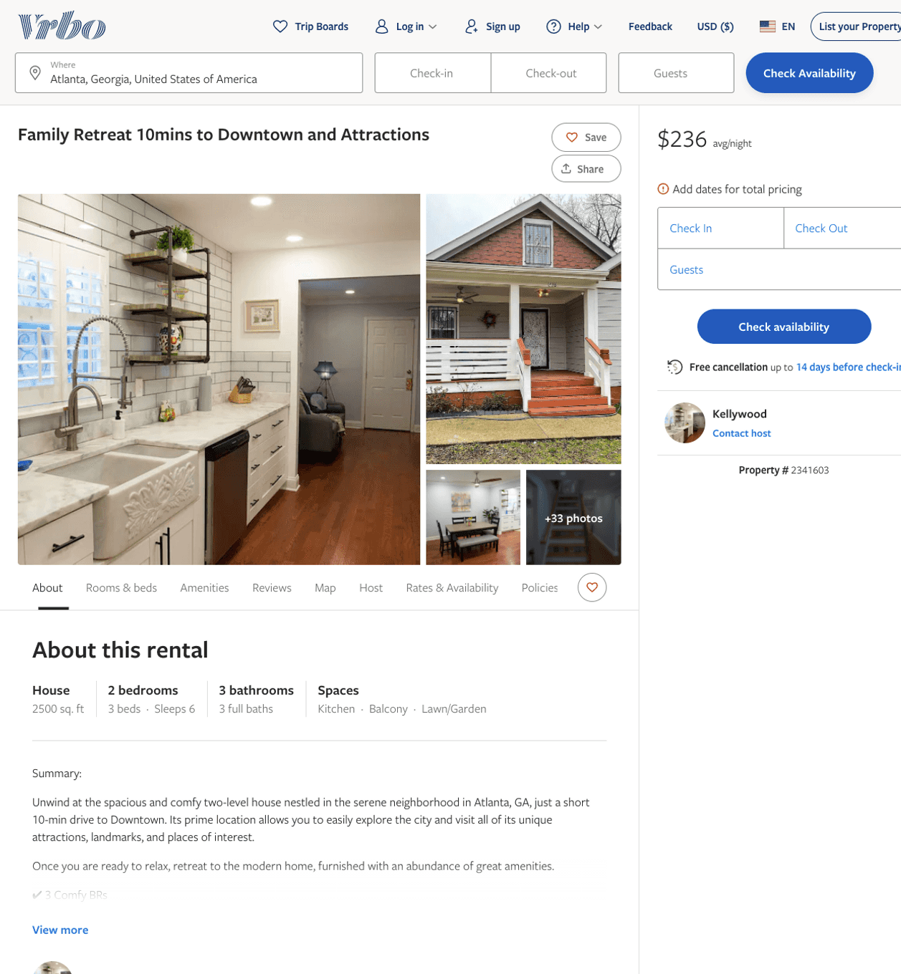
Listing 2341603
2
6
$127 - $240
4
2
Kellywood
https://www.vrbo.com/2341603
Aug 2022

Slide 4
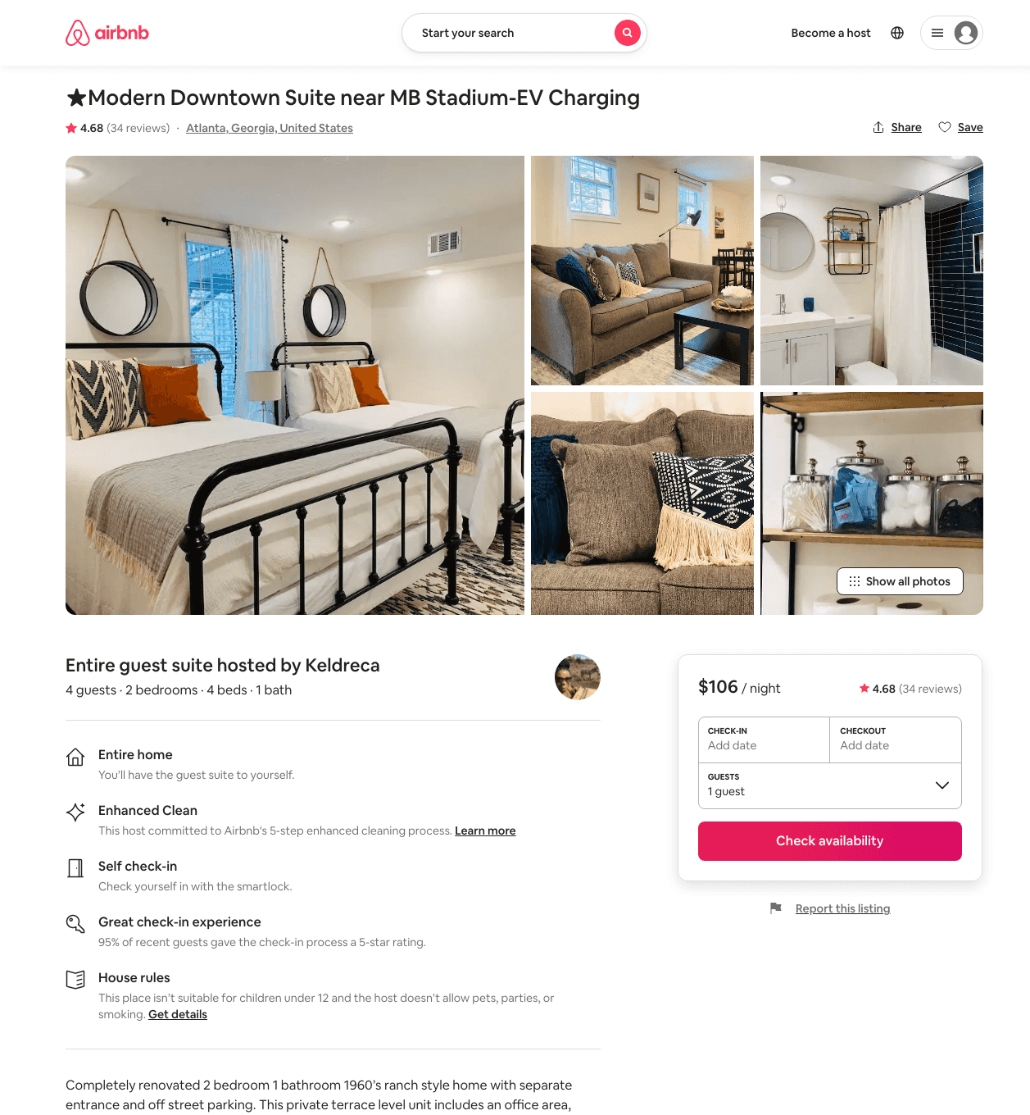
Listing 38583947
2
4
$103 - $160
4.56
2
Keldreca
54071913
3
https://www.airbnb.com/rooms/38583947
Aug 2022

Slide 5
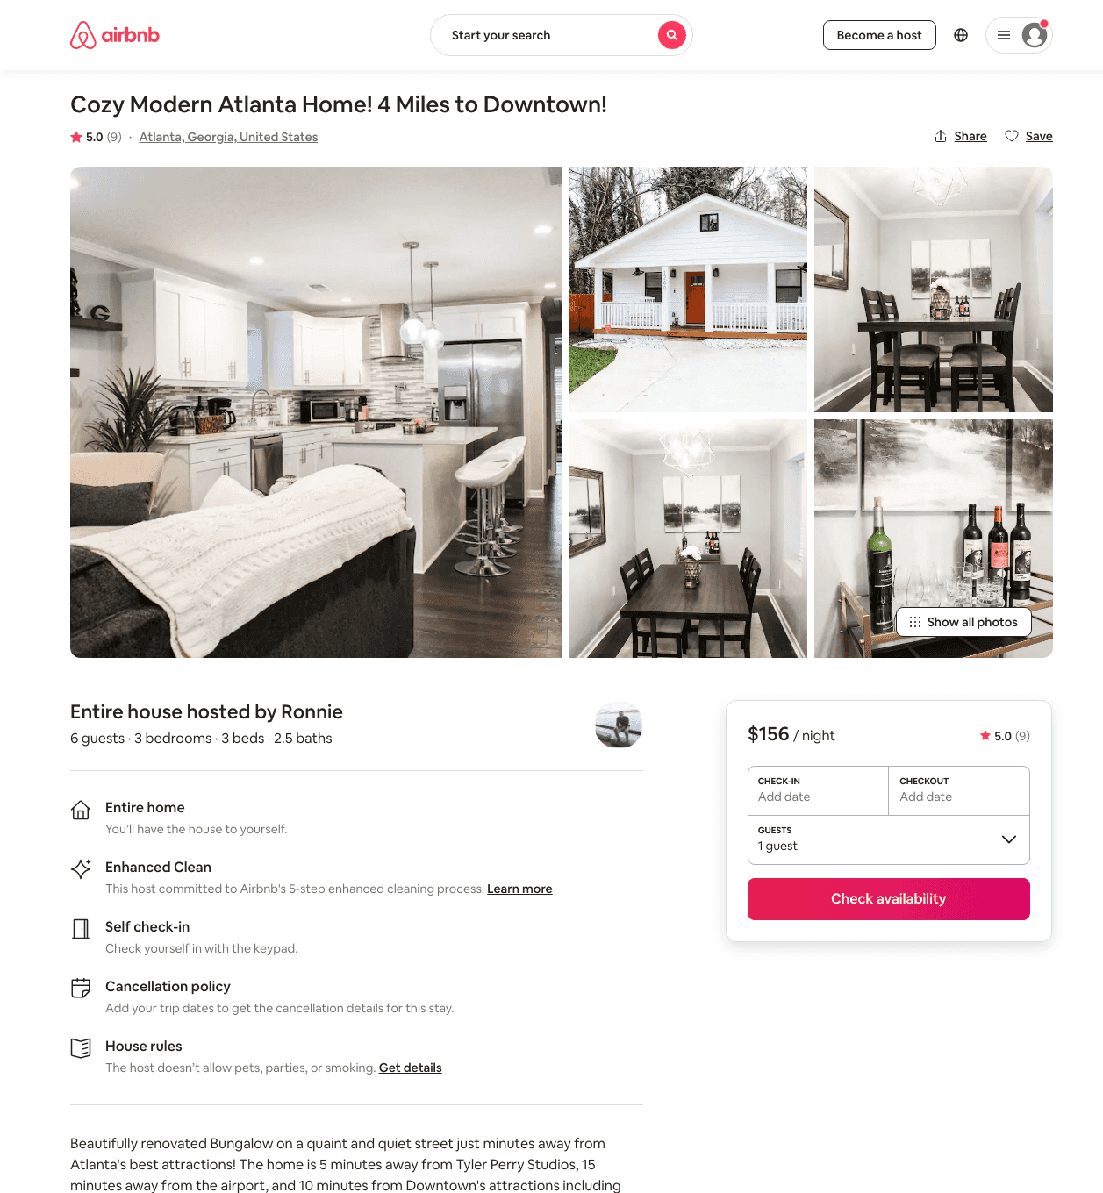
Listing 47772347
3
6
$117 - $193
4.99
3
Ronnie
164573412
1
https://www.airbnb.com/rooms/47772347
Aug 2022

Slide 6
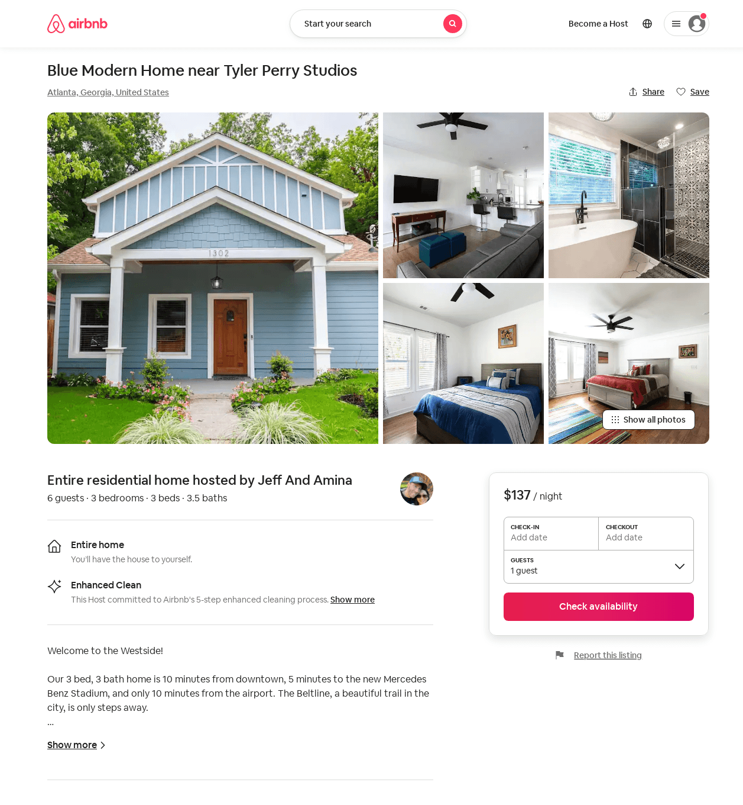
Listing 52988622
3
6
$123 - $191
4.86
2
Chris & Mallerie
13200756
10
https://www.airbnb.com/rooms/52988622
Aug 2022

Slide 7
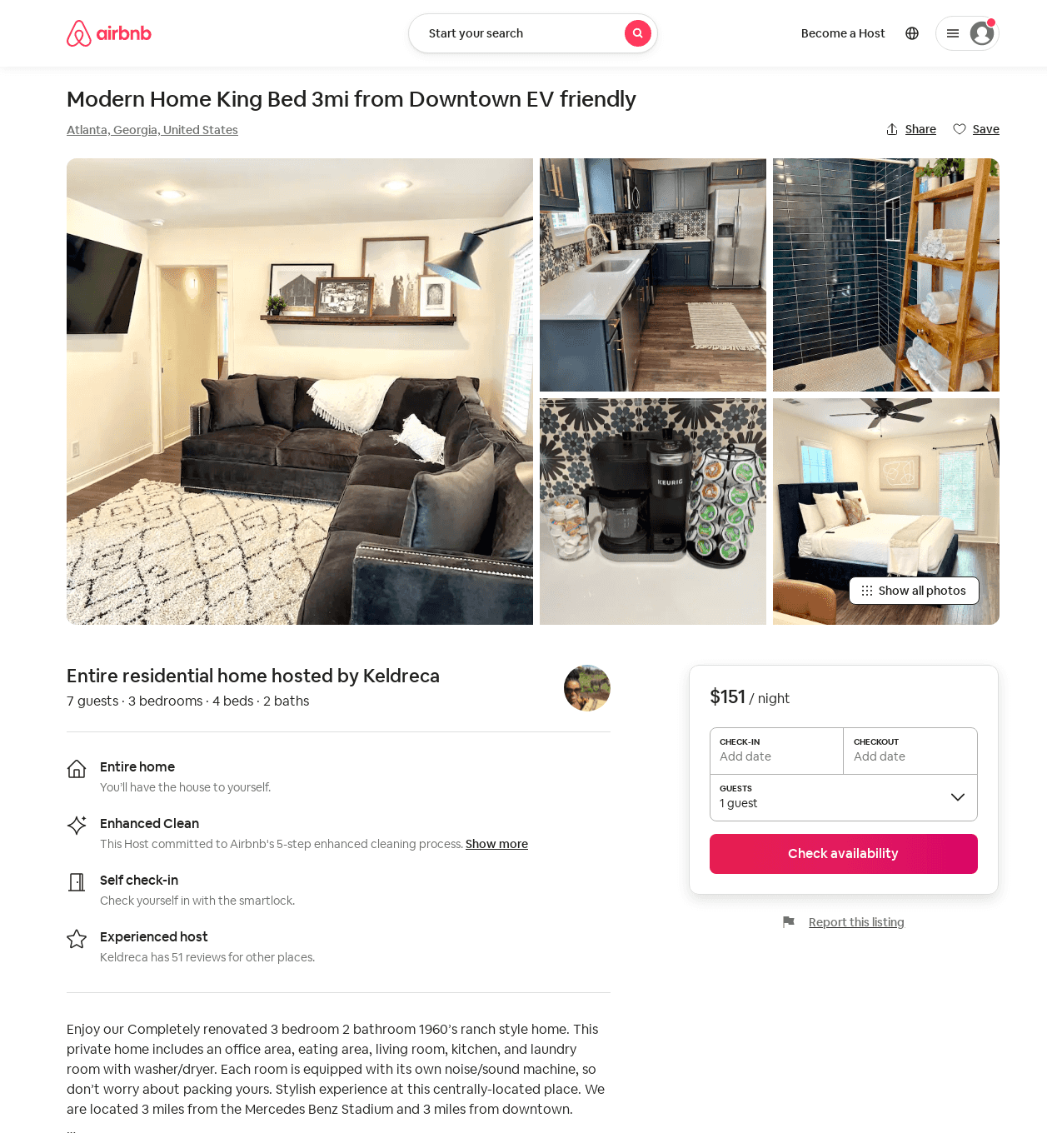
Listing 53398763
3
7
$137 - $207
4.79
2
Keldreca
54071913
3
https://www.airbnb.com/rooms/53398763
Aug 2022

Slide 8
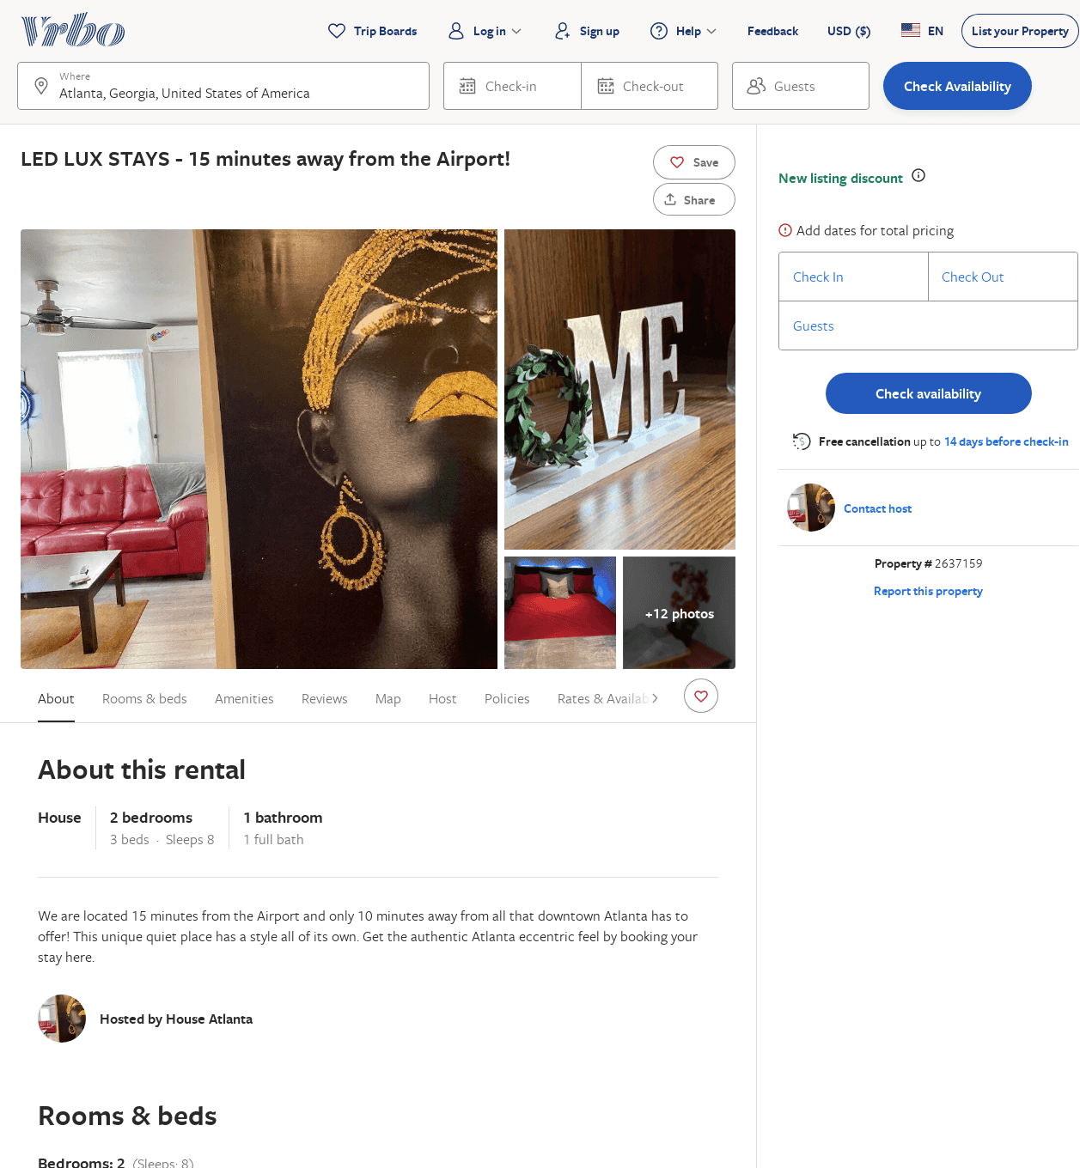
Listing 2637159
2
6
$120
4
2
Tamaris Massengale
https://www.vrbo.com/2637159
Aug 2022

Slide 9
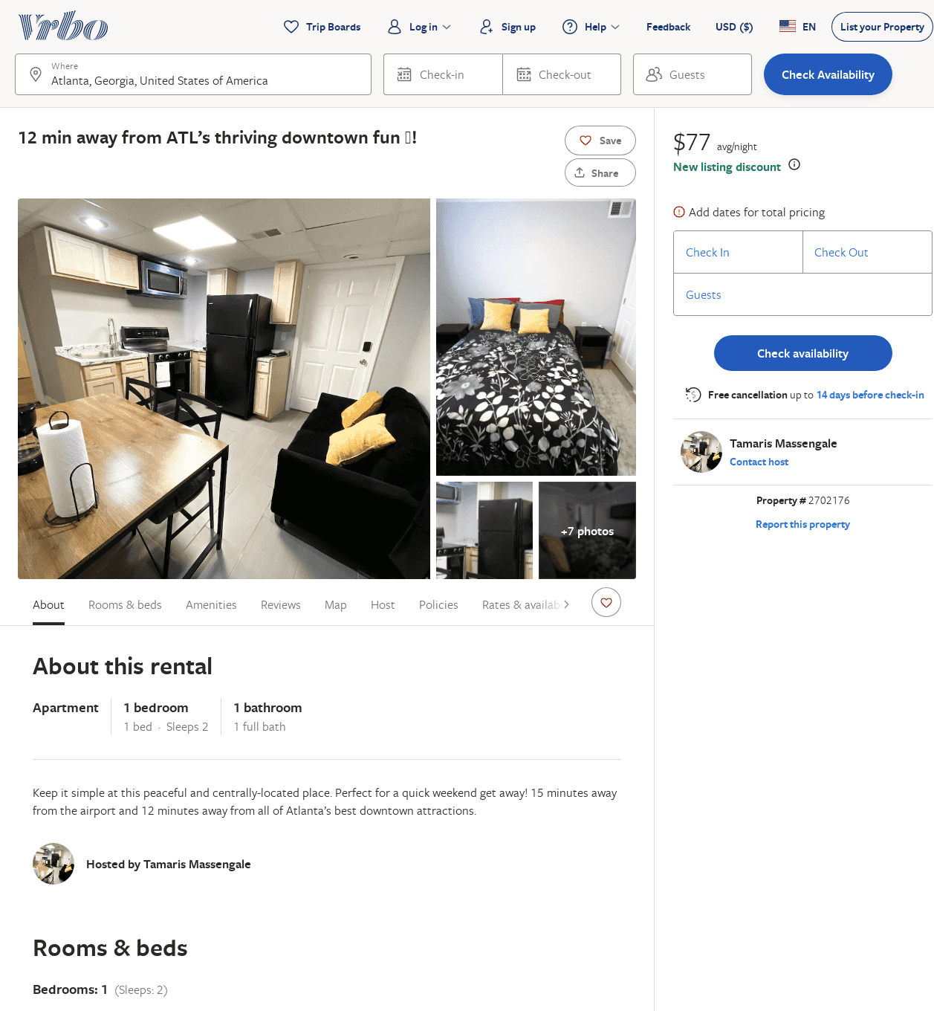
Listing 2702176
1
2
$99
2
Tamaris Massengale
https://www.vrbo.com/2702176
Aug 2022

Slide 10
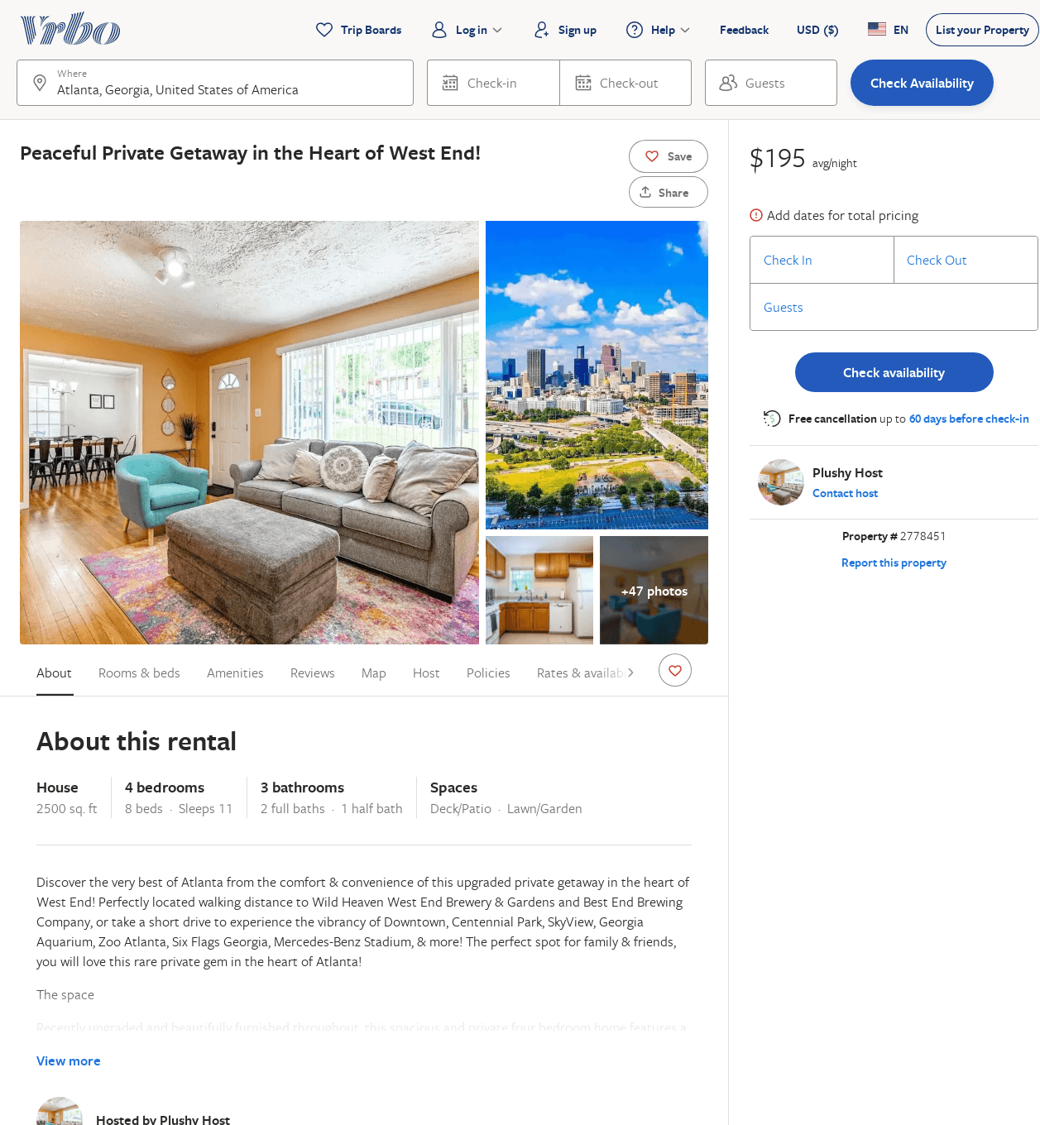
Listing 2778451
4
11
$128
4.5
2
Plushy Host
https://www.vrbo.com/2778451
Aug 2022

