Slide 2
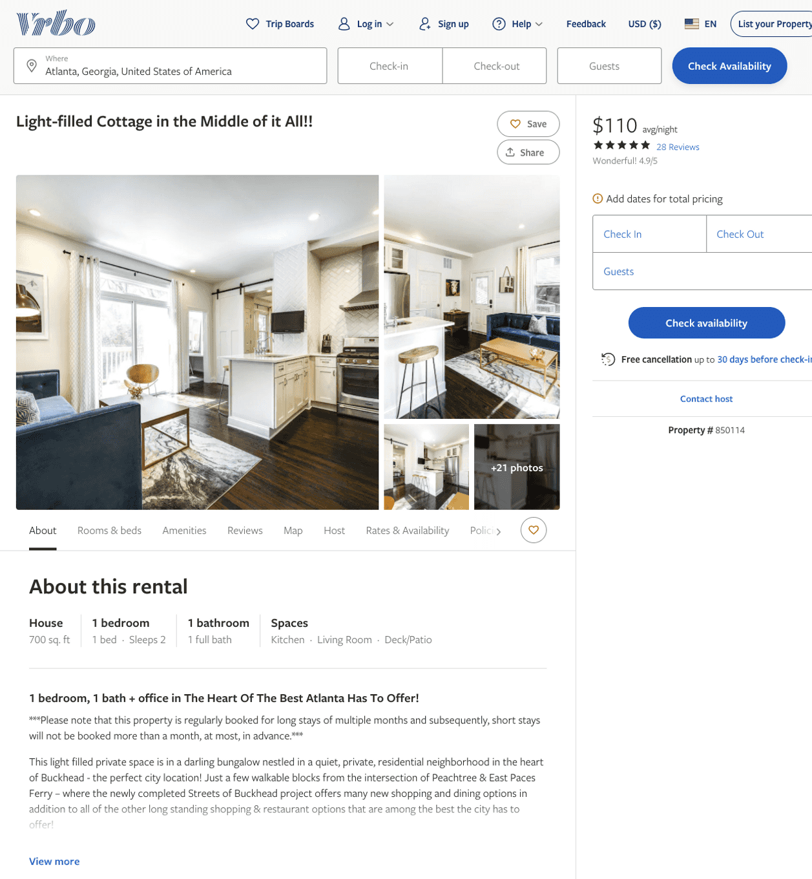
Listing 850114
1
2
$110 - $125
4.9428573
4
owner/property manager
https://www.vrbo.com/850114
Aug 2022

Slide 3
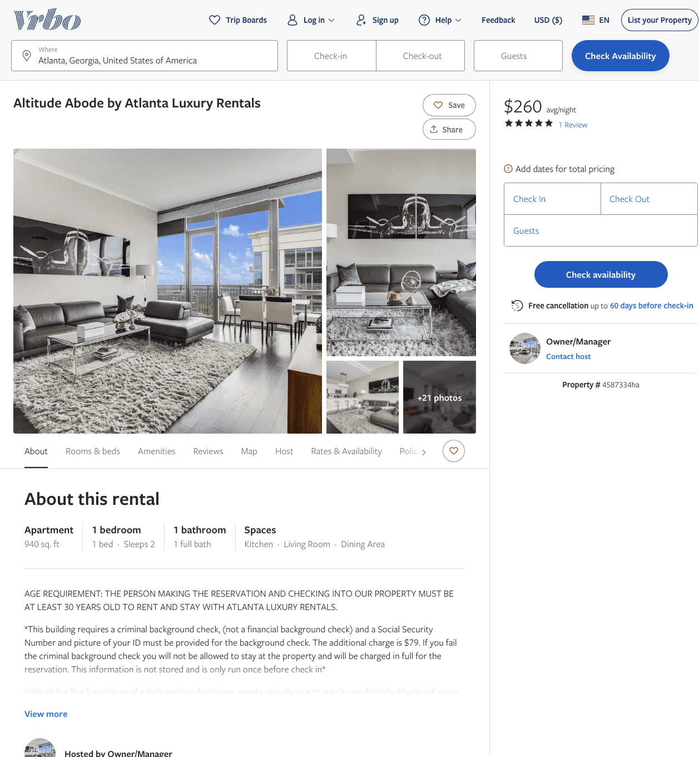
Listing 4587334
1
2
$184 - $265
5
30
Owner/Manager
https://www.vrbo.com/4587334ha
Aug 2022

Slide 4
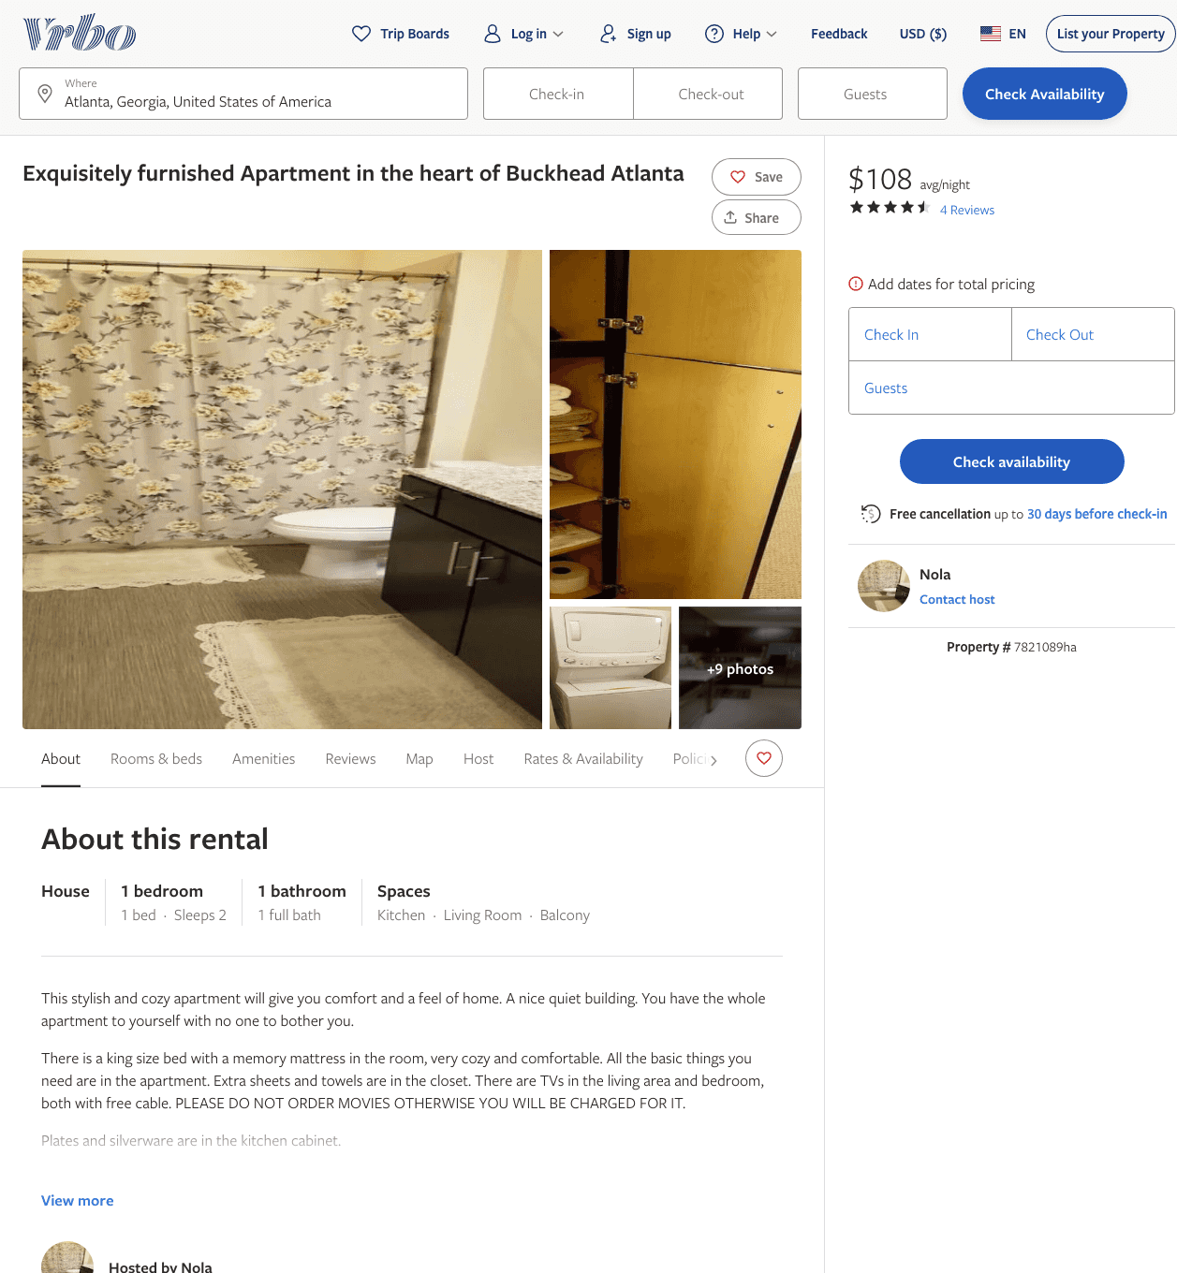
Listing 7821089
1
2
$100 - $111
4.6
1
Nola
https://www.vrbo.com/7821089ha
Aug 2022

Slide 5
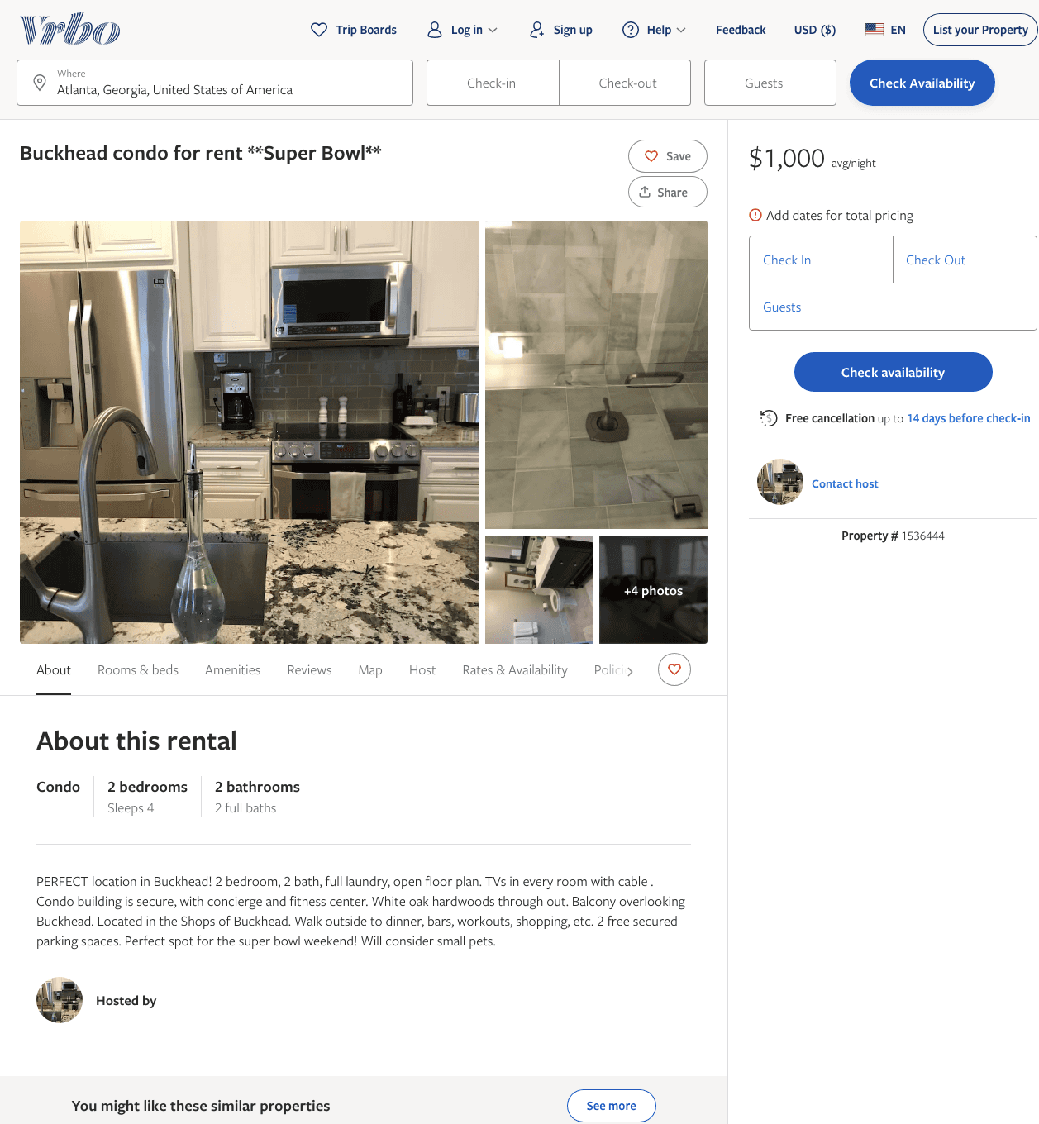
Listing 1536444
2
4
$1,000
1
https://www.vrbo.com/1536444
Aug 2022

Slide 6
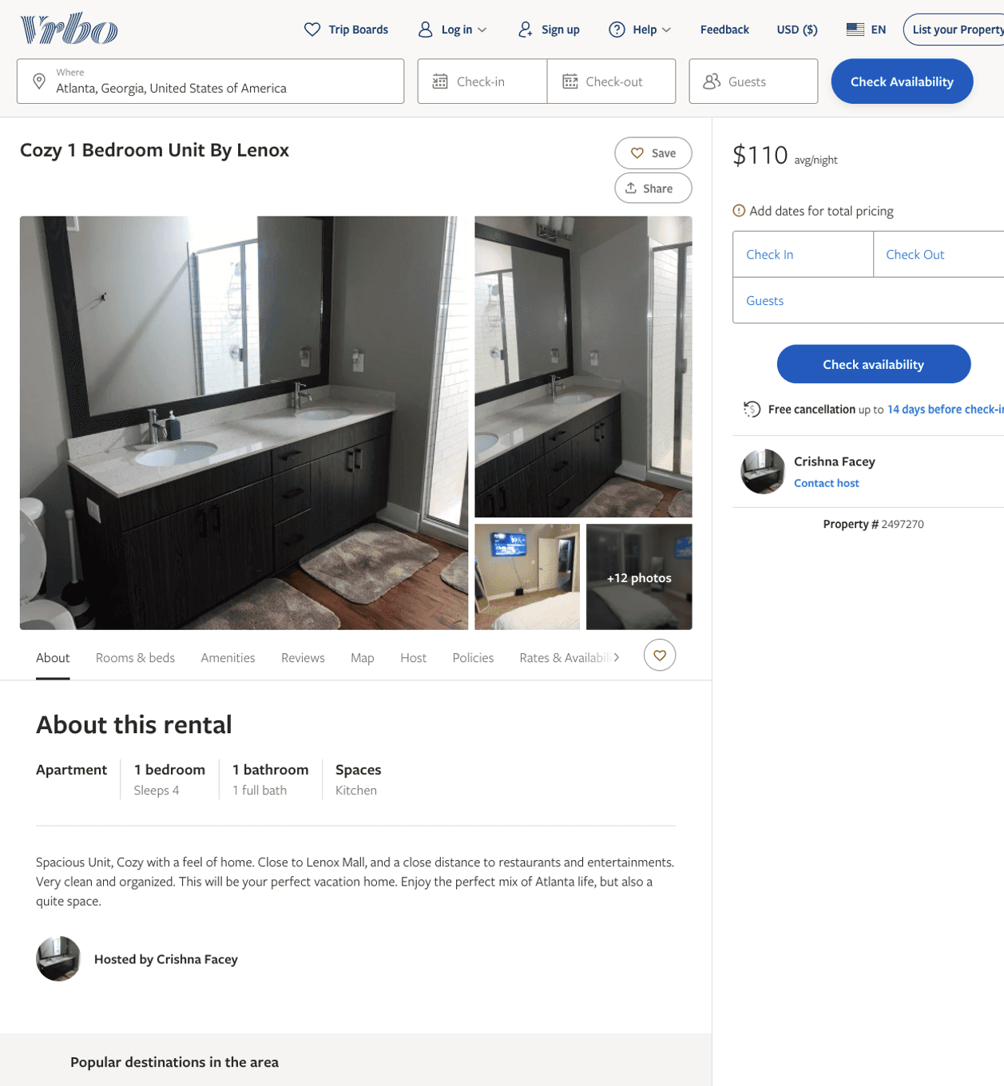
Listing 2497270
1
4
$110 - $130
4
1
Crishna Facey
https://www.vrbo.com/2497270
Aug 2022

Slide 7
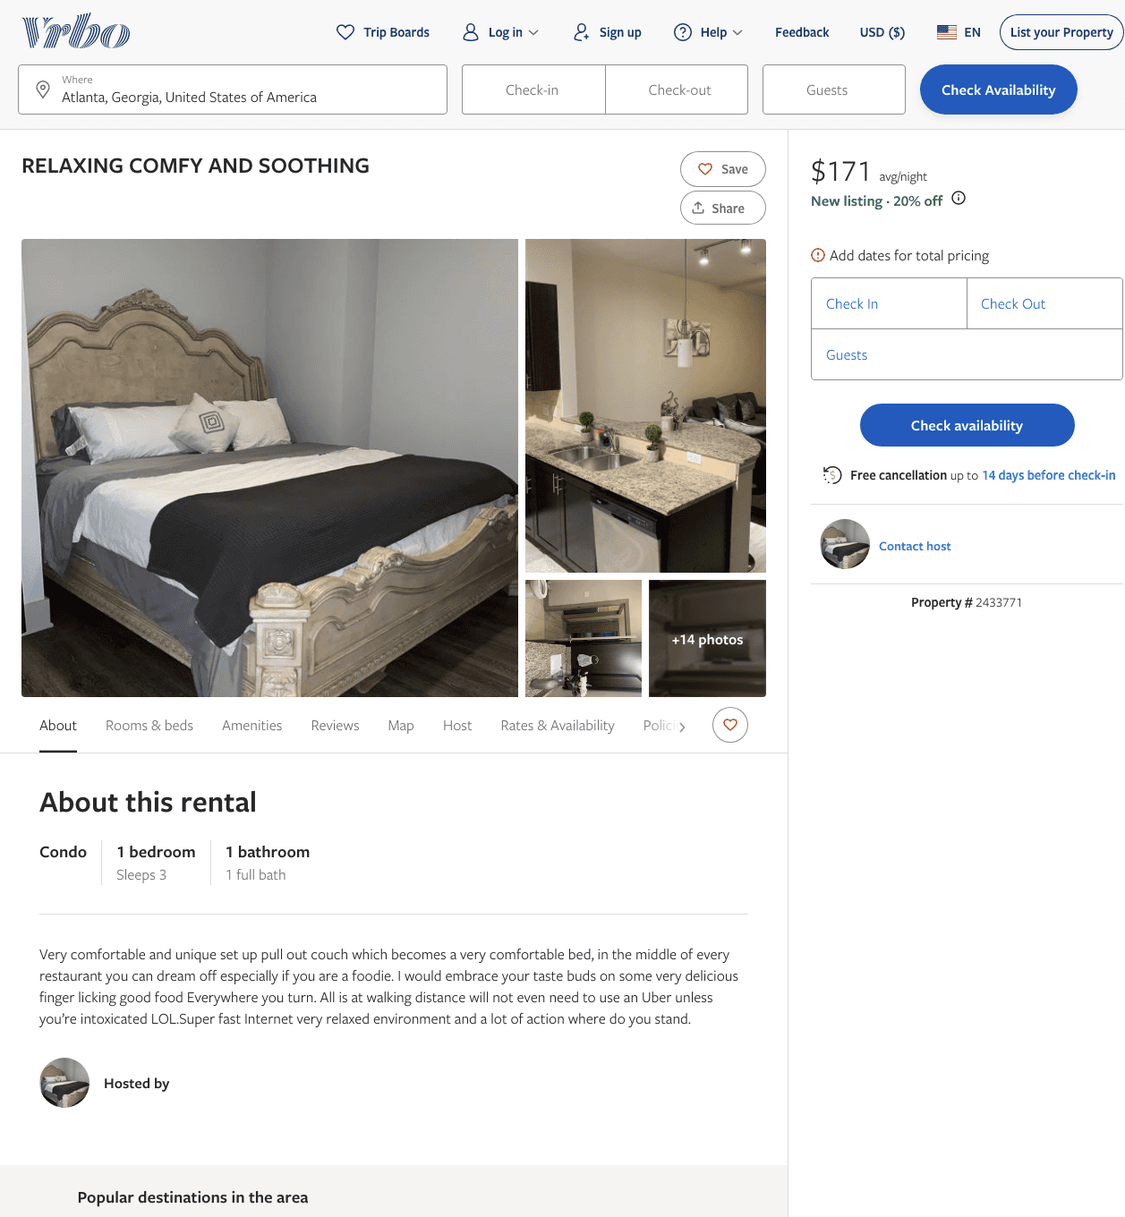
Listing 2433771
1
3
$150 - $171
2
Owner
https://www.vrbo.com/2433771
Aug 2022

Slide 8
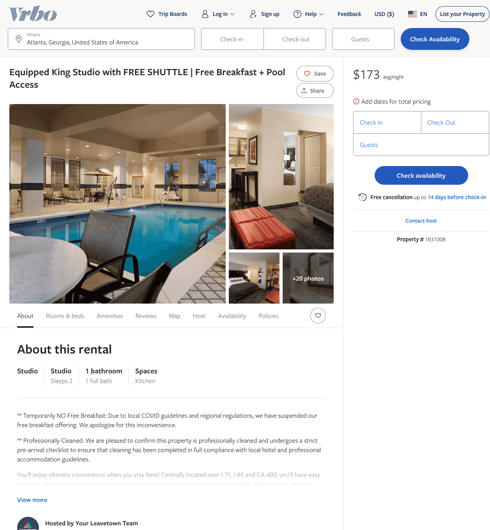
Listing 1831008
0
2
$150 - $172
1
Your Leavetown Team
https://www.vrbo.com/1831008
Aug 2022

Slide 9
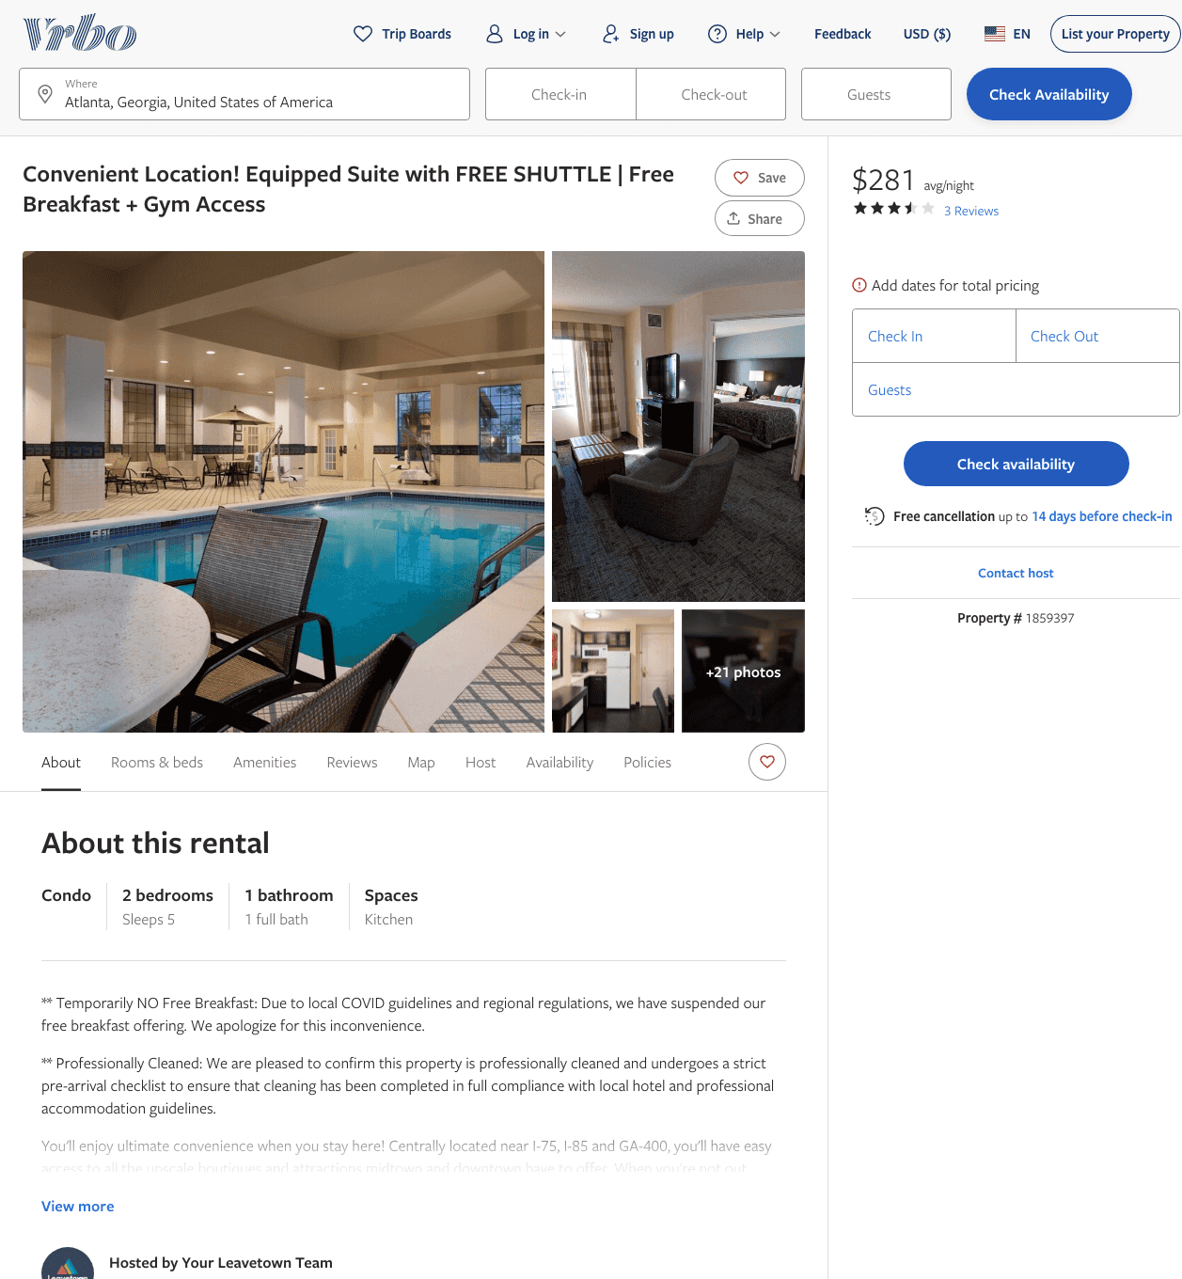
Listing 1859397
2
5
$265 - $279
3.3333333
1
Your Leavetown Team
https://www.vrbo.com/1859397
Aug 2022

Slide 10
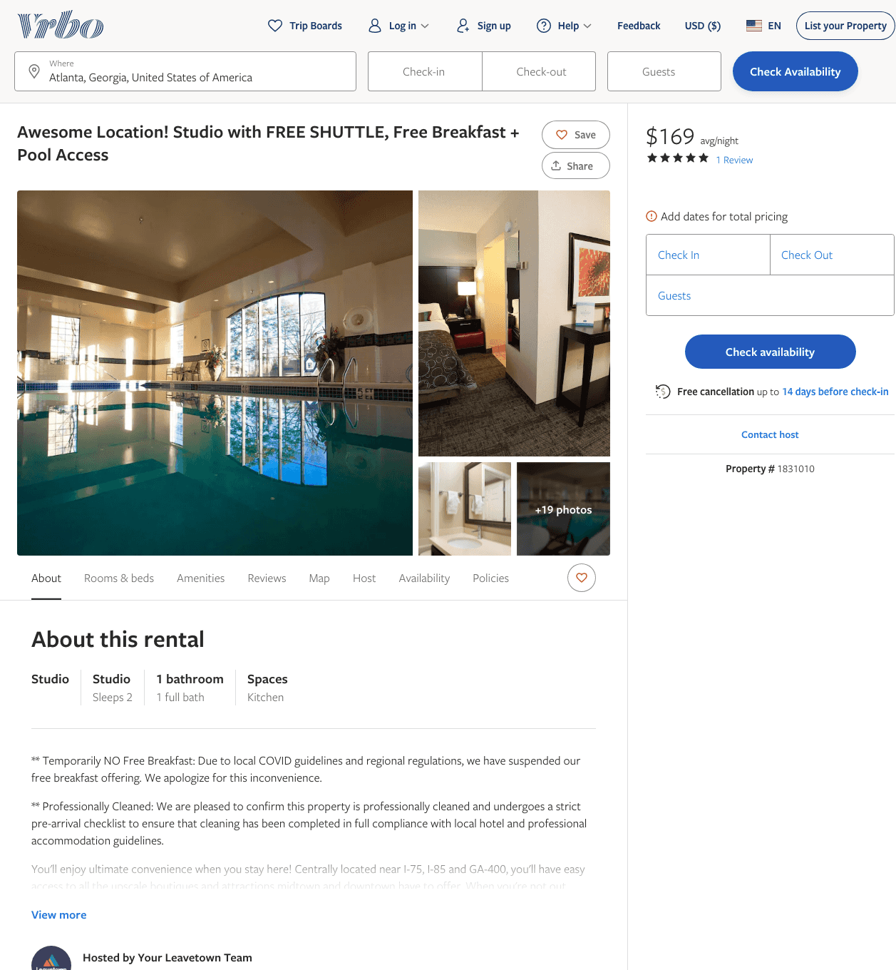
Listing 1831010
0
2
$150 - $173
5
1
Your Leavetown Team
https://www.vrbo.com/1831010
Aug 2022

Slide 11
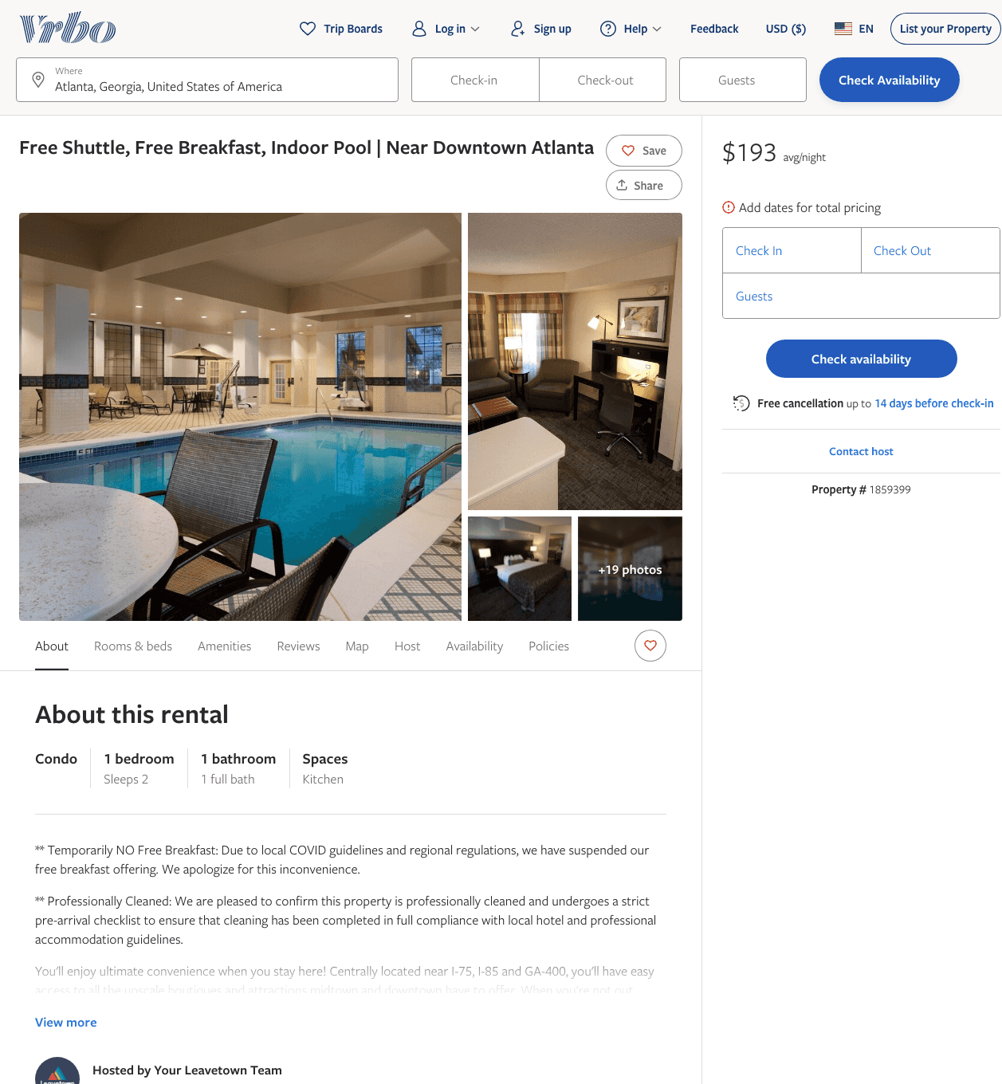
Listing 1859399
1
2
$170 - $200
2
Your Leavetown Team
https://www.vrbo.com/1859399
Aug 2022

Slide 12
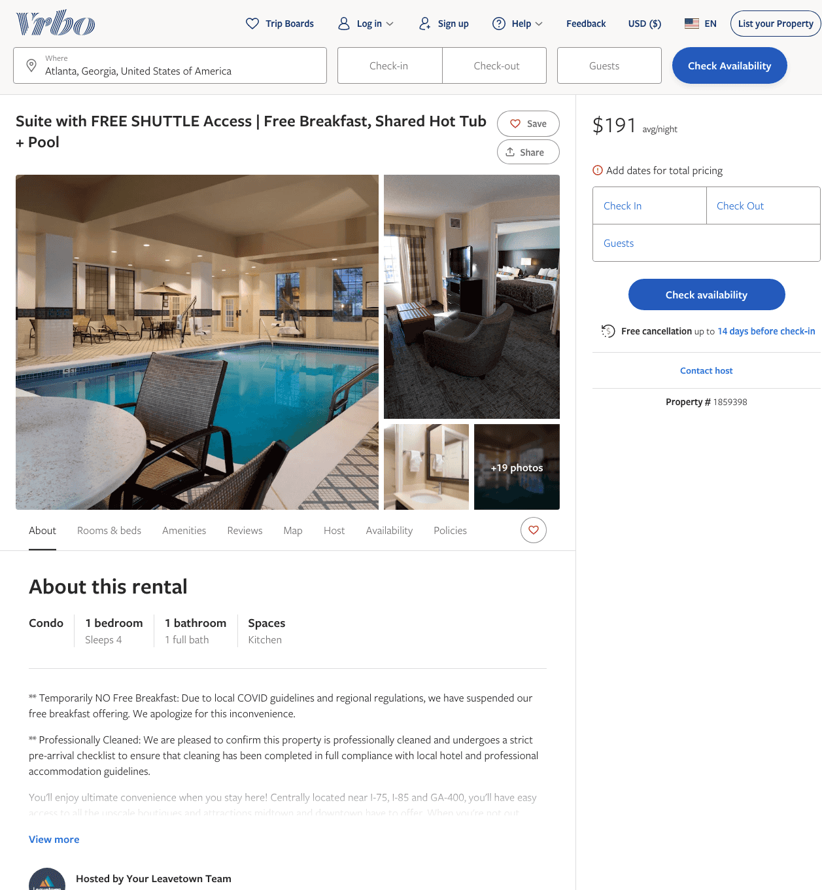
Listing 1859398
1
4
$174 - $195
1
Your Leavetown Team
https://www.vrbo.com/1859398
Aug 2022

Slide 13
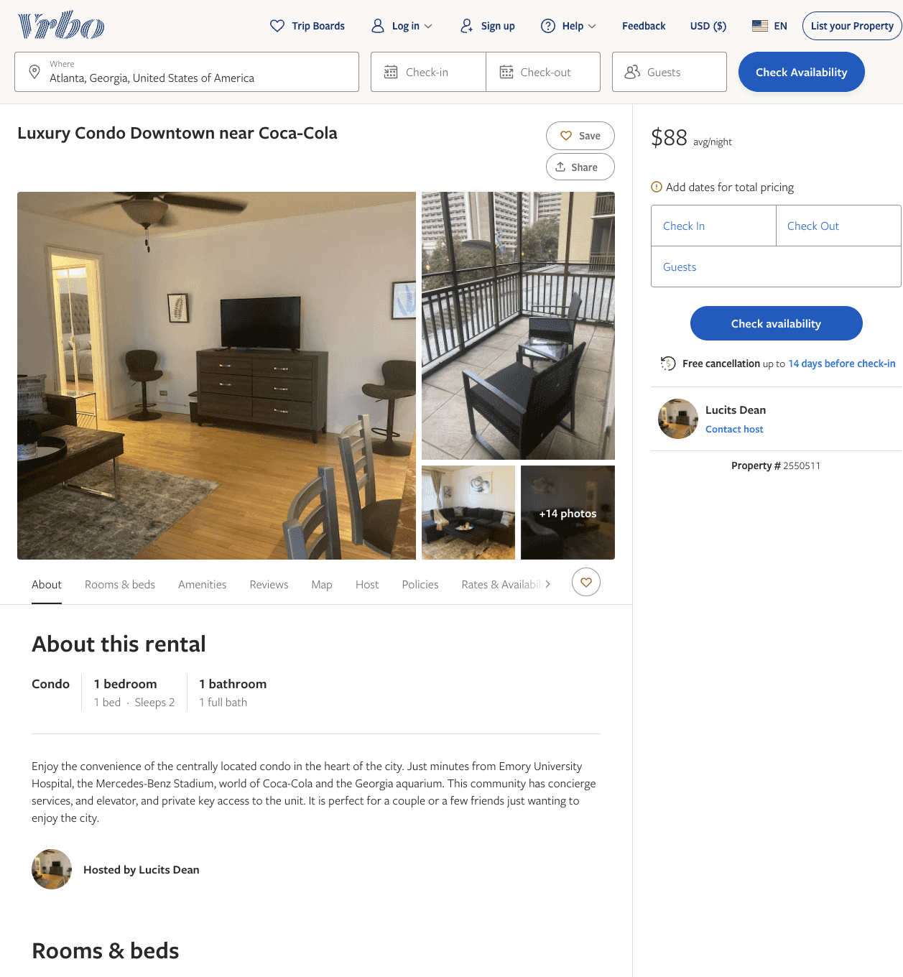
Listing 2550511
1
2
$80 - $93
2
Lucits Dean
https://www.vrbo.com/2550511
Aug 2022

Slide 14
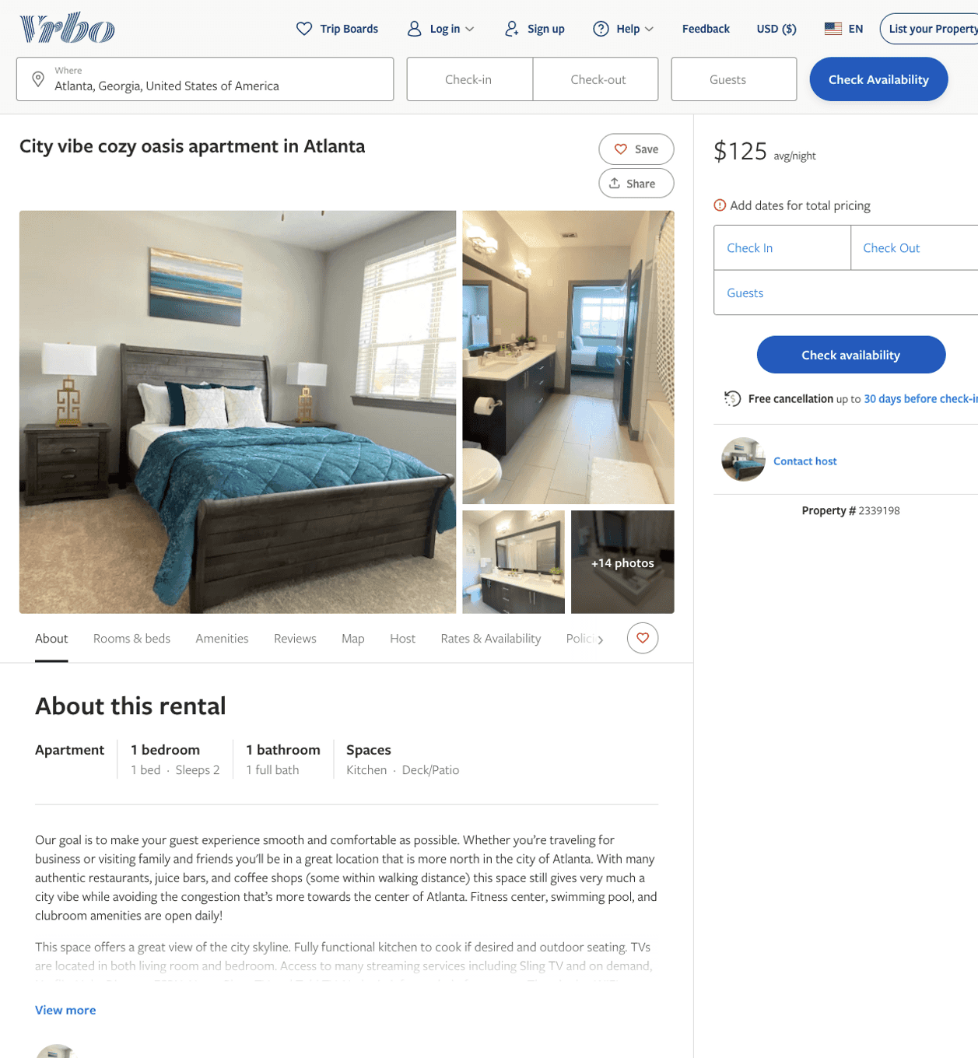
Listing 2339198
1
2
$125 - $138
2
https://www.vrbo.com/2339198
Aug 2022

Slide 15
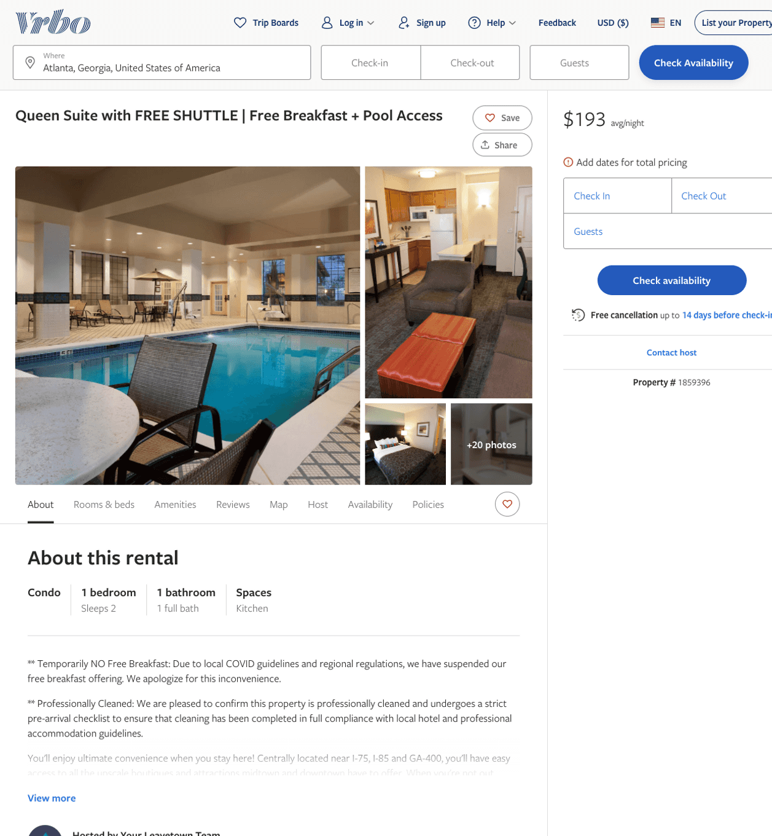
Listing 1859396
1
2
$170 - $192
1
Your Leavetown Team
https://www.vrbo.com/1859396
Aug 2022

Slide 16
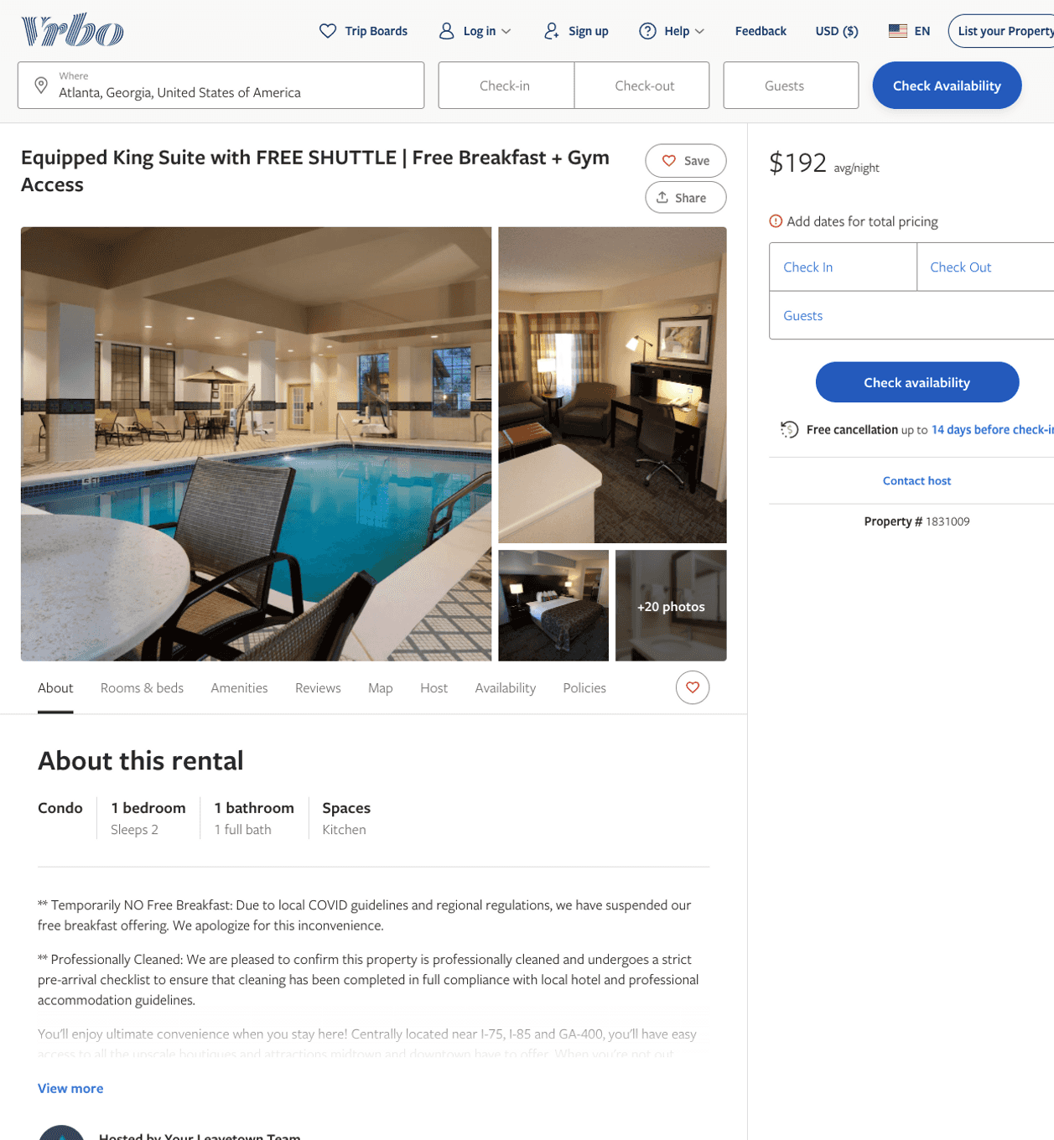
Listing 1831009
1
2
$170 - $193
1
Your Leavetown Team
https://www.vrbo.com/1831009
Aug 2022

Slide 17
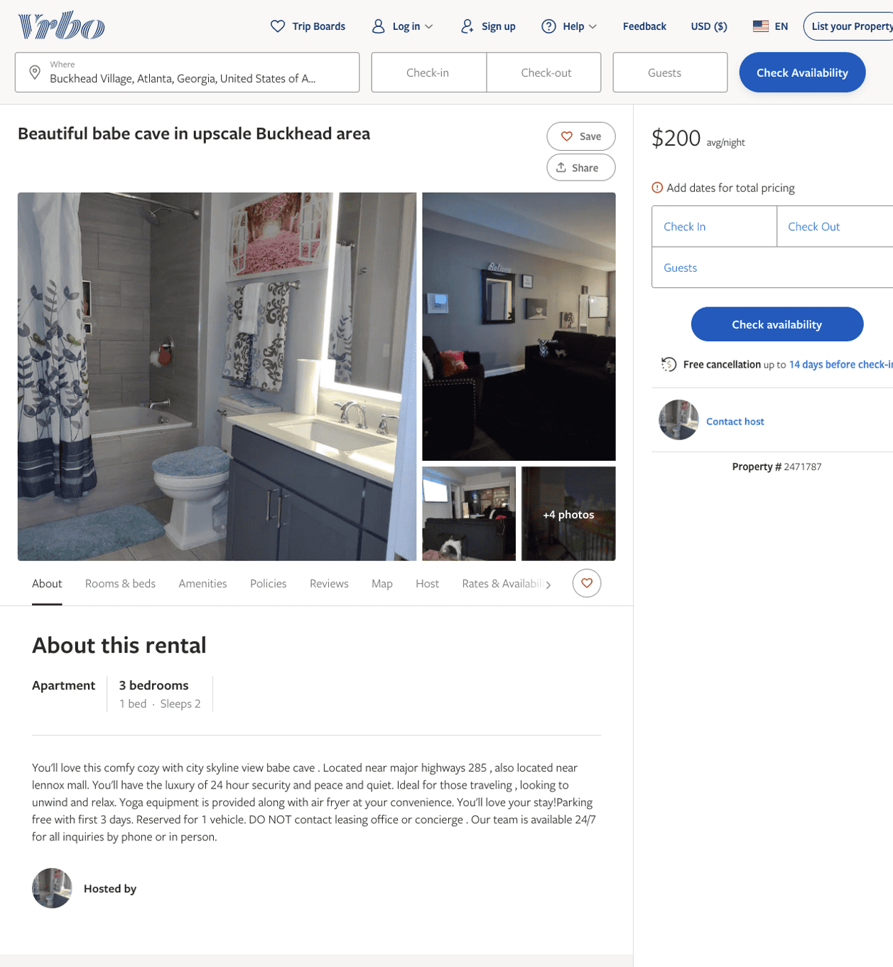
Listing 2471787
1
2
$200
3
https://www.vrbo.com/2471787
Aug 2022

Slide 18
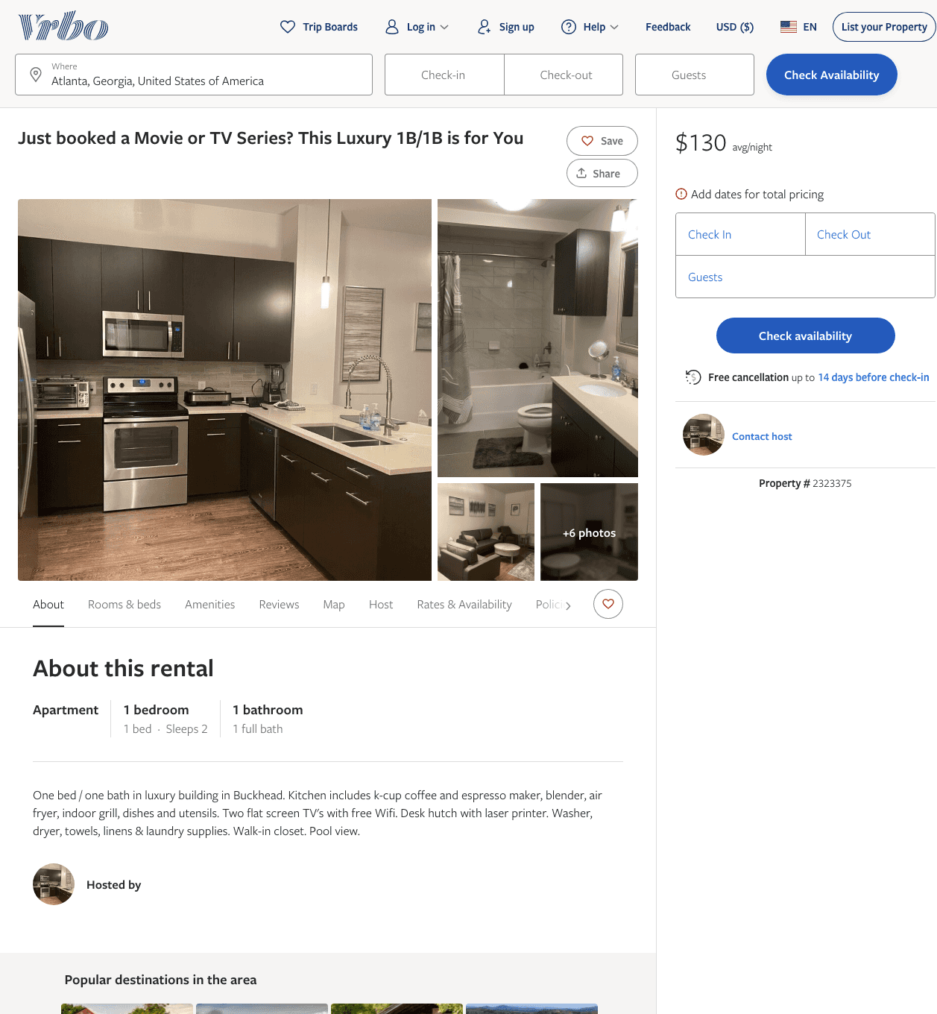
Listing 2323375
1
2
$130
30
https://www.vrbo.com/2323375
Aug 2022

Slide 19
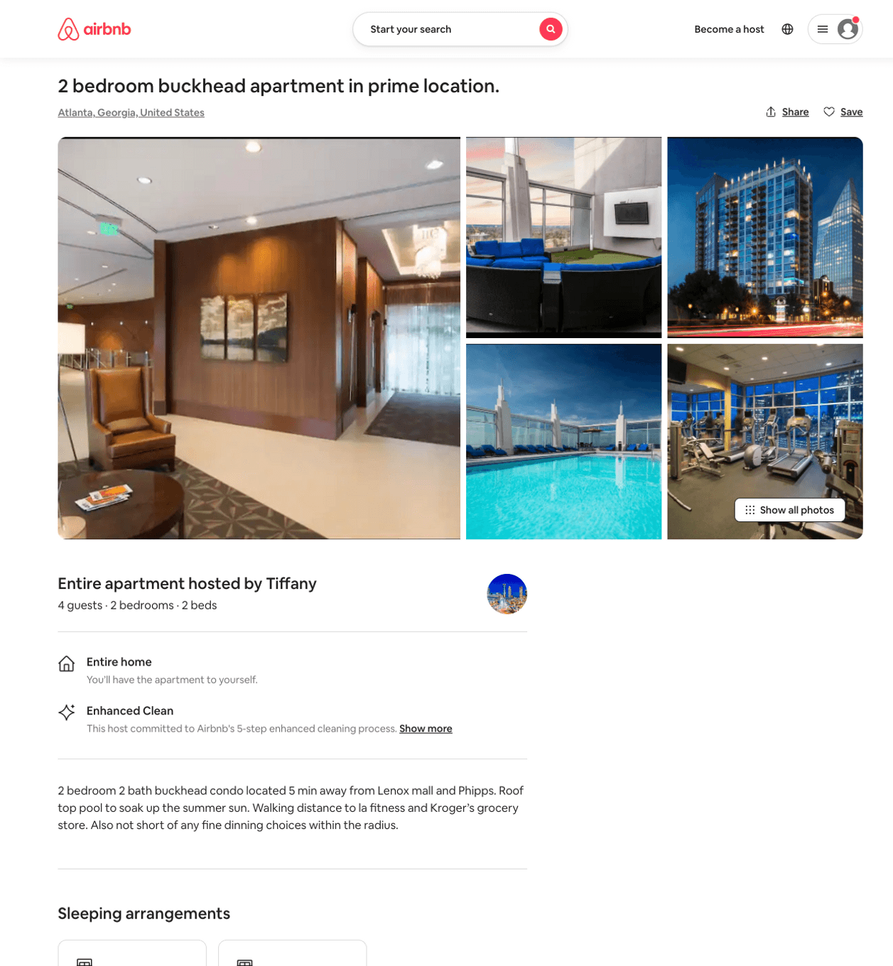
Listing 50343256
2
4
$300 - $650
4.80
3
Tiffany
404083517
1
https://www.airbnb.com/rooms/50343256
Aug 2022

Slide 20
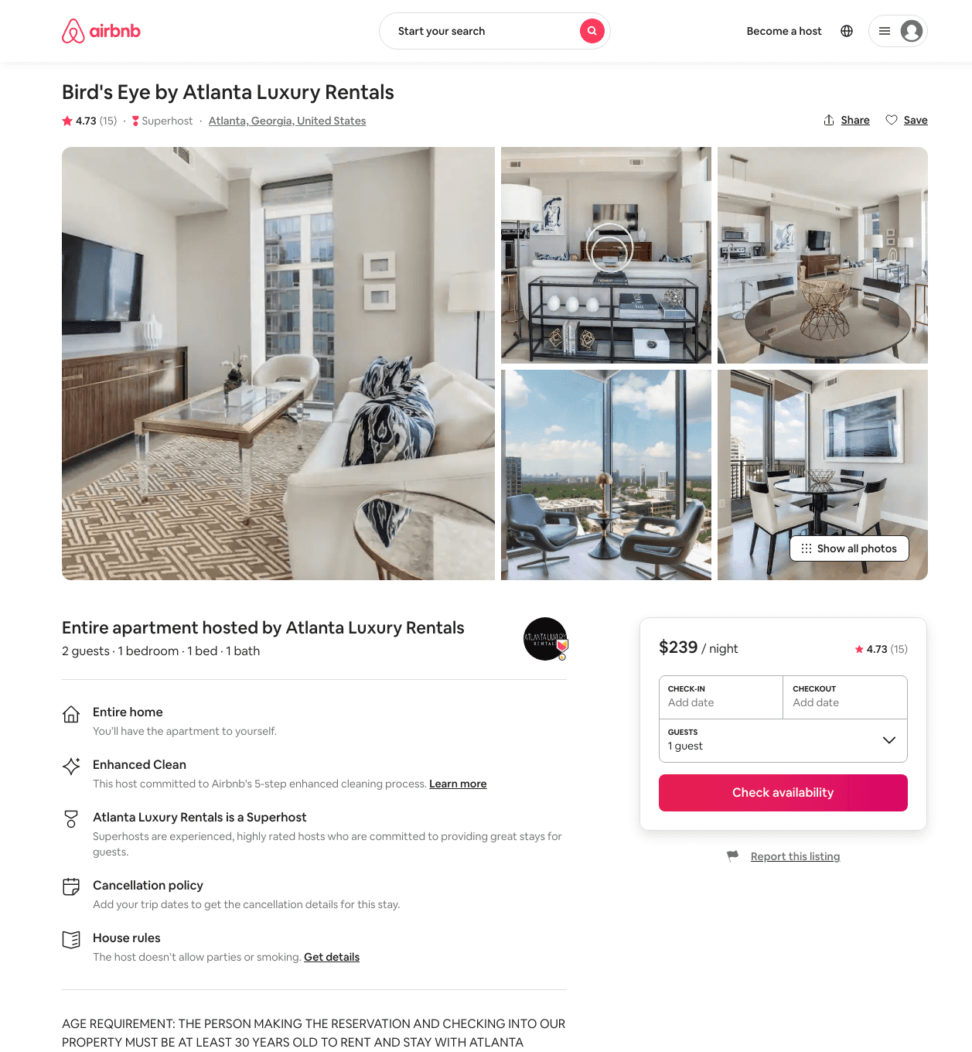
Listing 17378997
1
2
$194 - $297
4.73
4
Atlanta Luxury Rentals
115328988
54
https://www.airbnb.com/rooms/17378997
Aug 2022

Slide 21
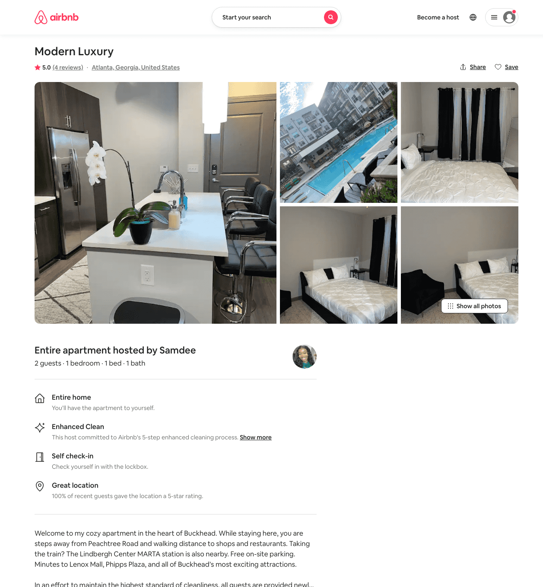
Listing 50105112
1
2
$98 - $160
4.65
2
Erika
75496660
1
https://www.airbnb.com/rooms/50105112
Aug 2022

Slide 22
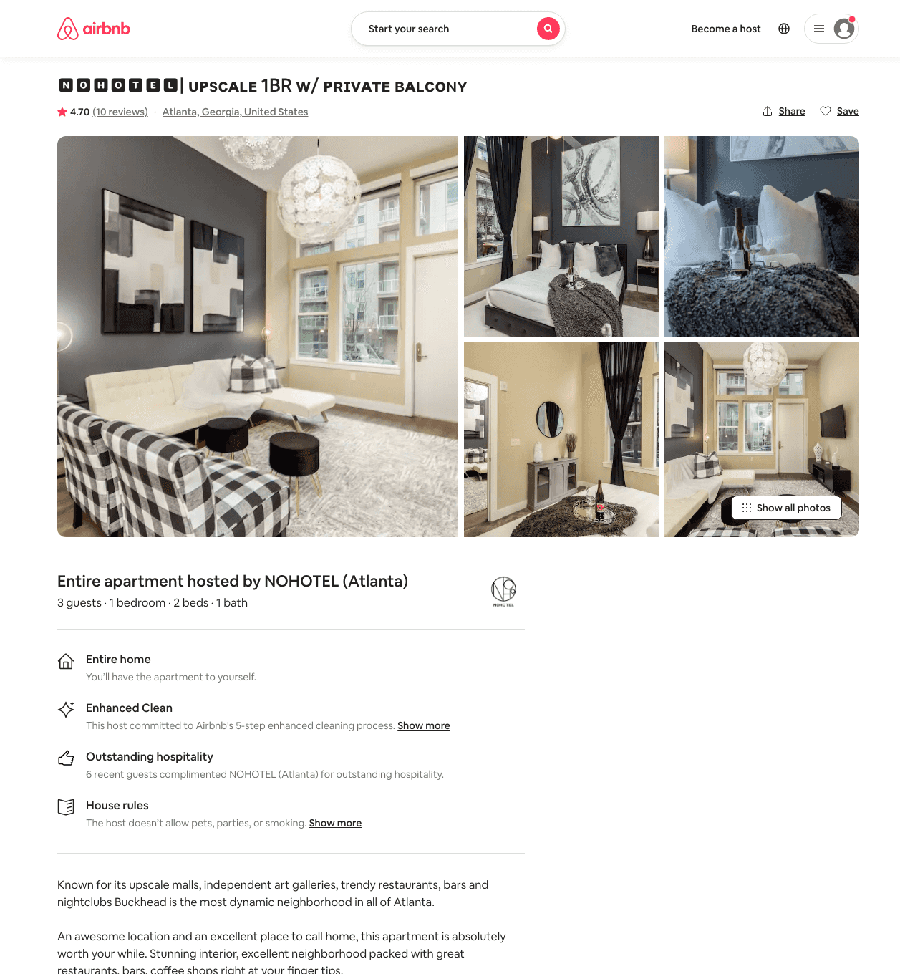
Listing 45723972
1
3
$86 - $140
4.80
2
NOHOTEL (Atlanta)
269120575
10
https://www.airbnb.com/rooms/45723972
Aug 2022

Slide 23
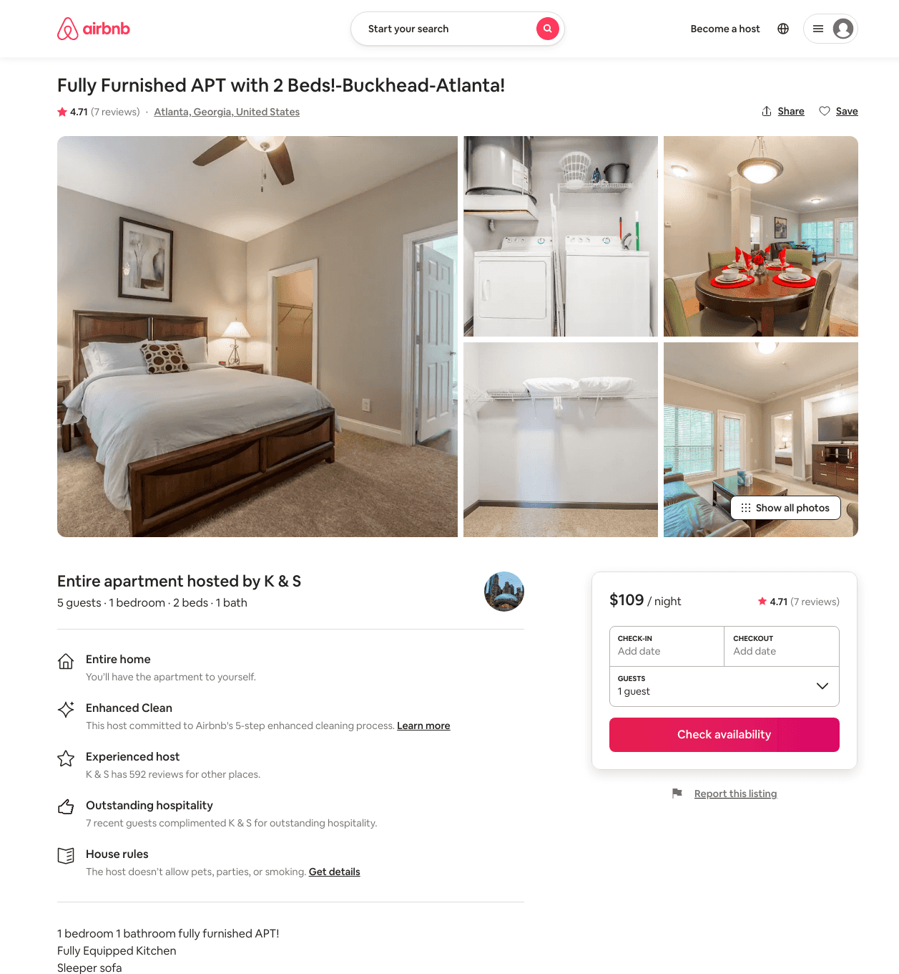
Listing 38359400
1
5
$90 - $114
4.50
8
K & S
89596337
7
https://www.airbnb.com/rooms/38359400
Aug 2022

Slide 24
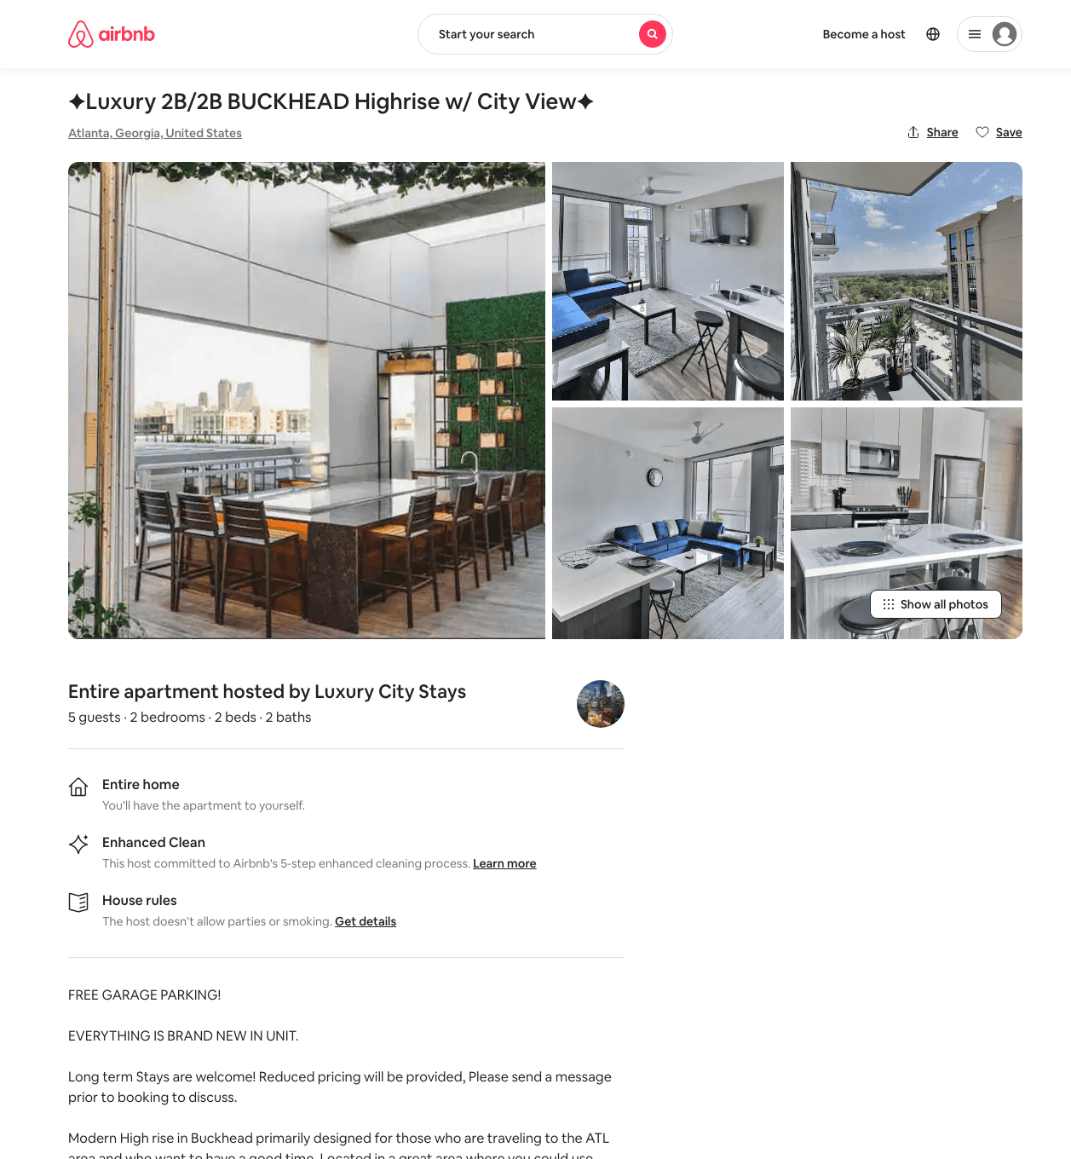
Listing 48963261
2
4
$145 - $211
4.91
3
Rob
394913304
3
https://www.airbnb.com/rooms/48963261
Aug 2022

Slide 25
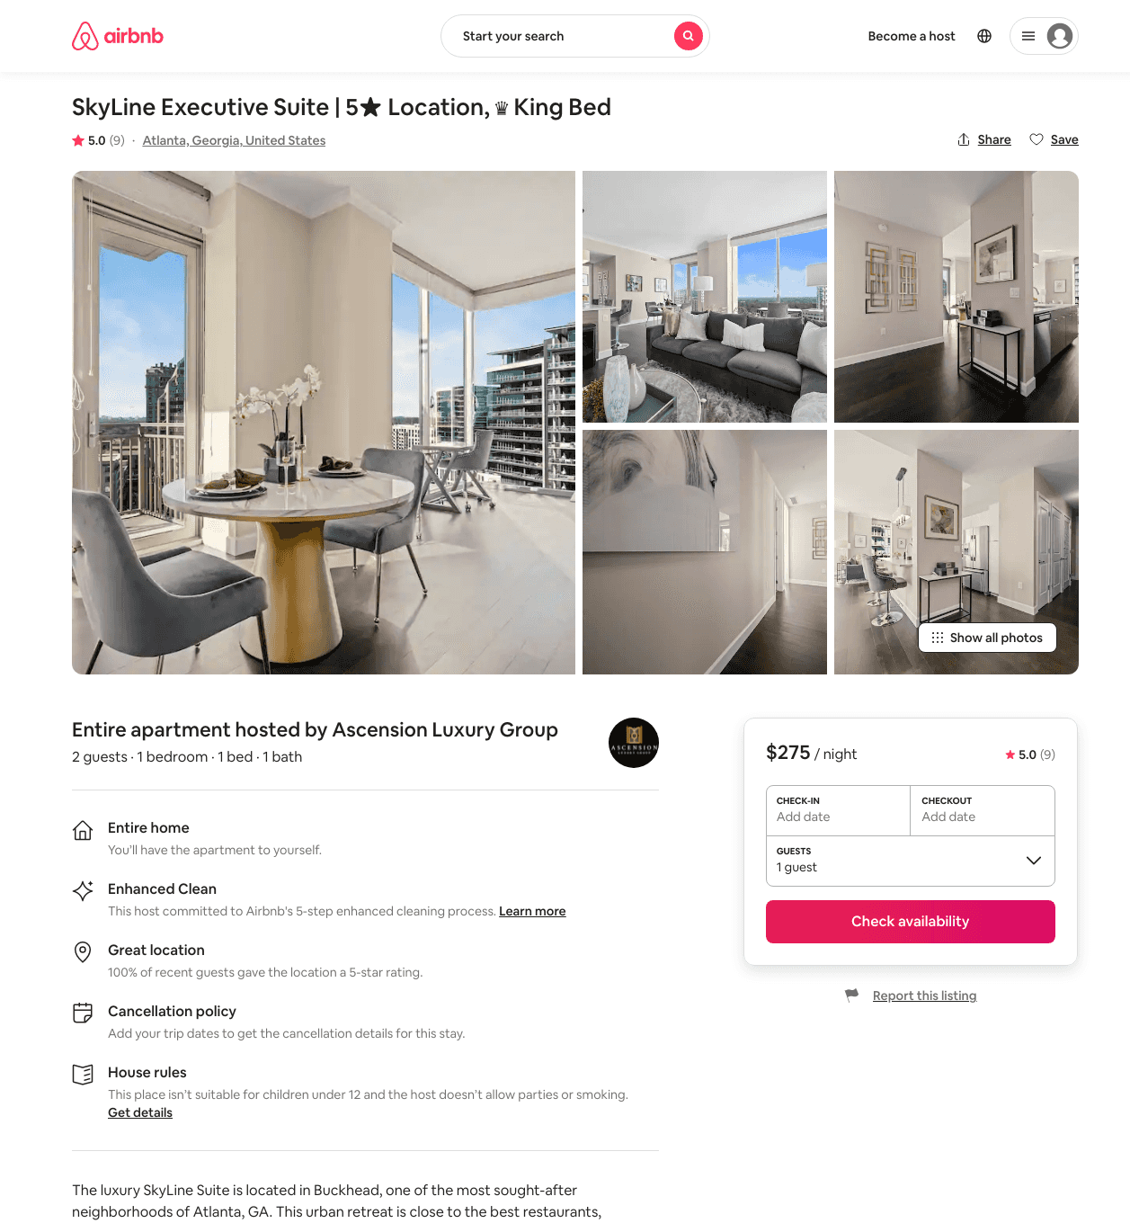
Listing 48078589
1
2
$225 - $456
5.0
2
Ascension Luxury Group
179447921
2
https://www.airbnb.com/rooms/48078589
Jul 2022

Slide 26
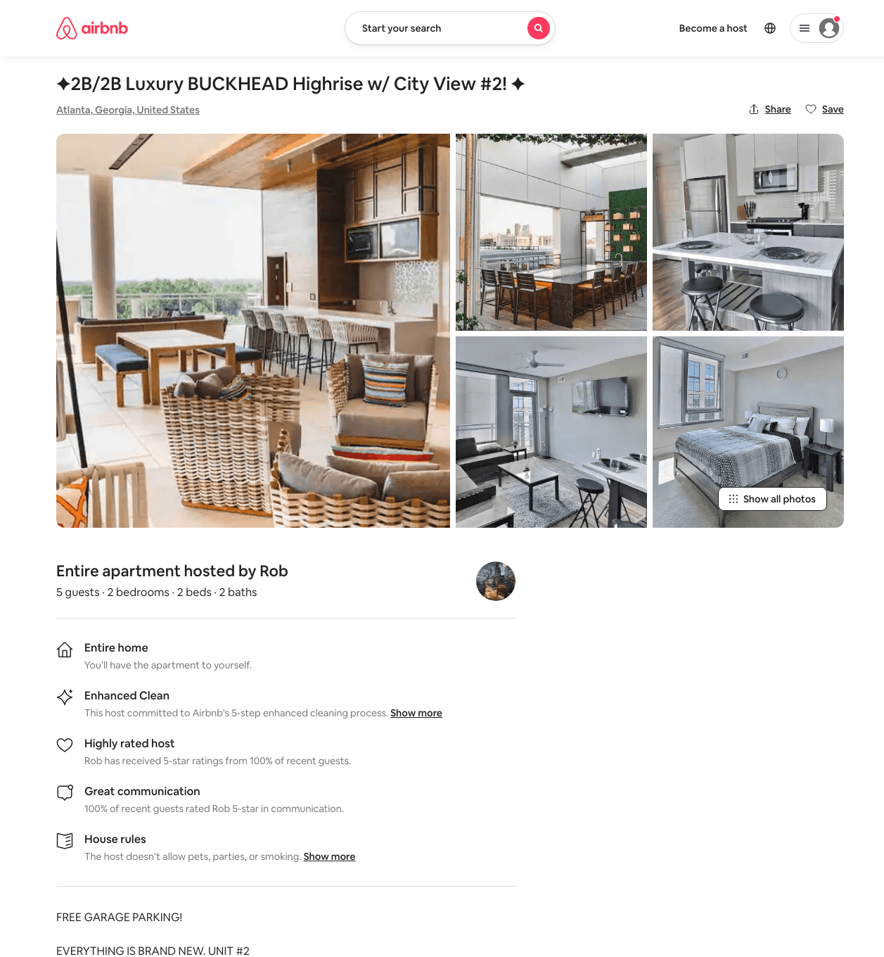
Listing 49738012
2
4
$162 - $222
4.88
3
Rob
394913304
3
https://www.airbnb.com/rooms/49738012
Aug 2022

Slide 27
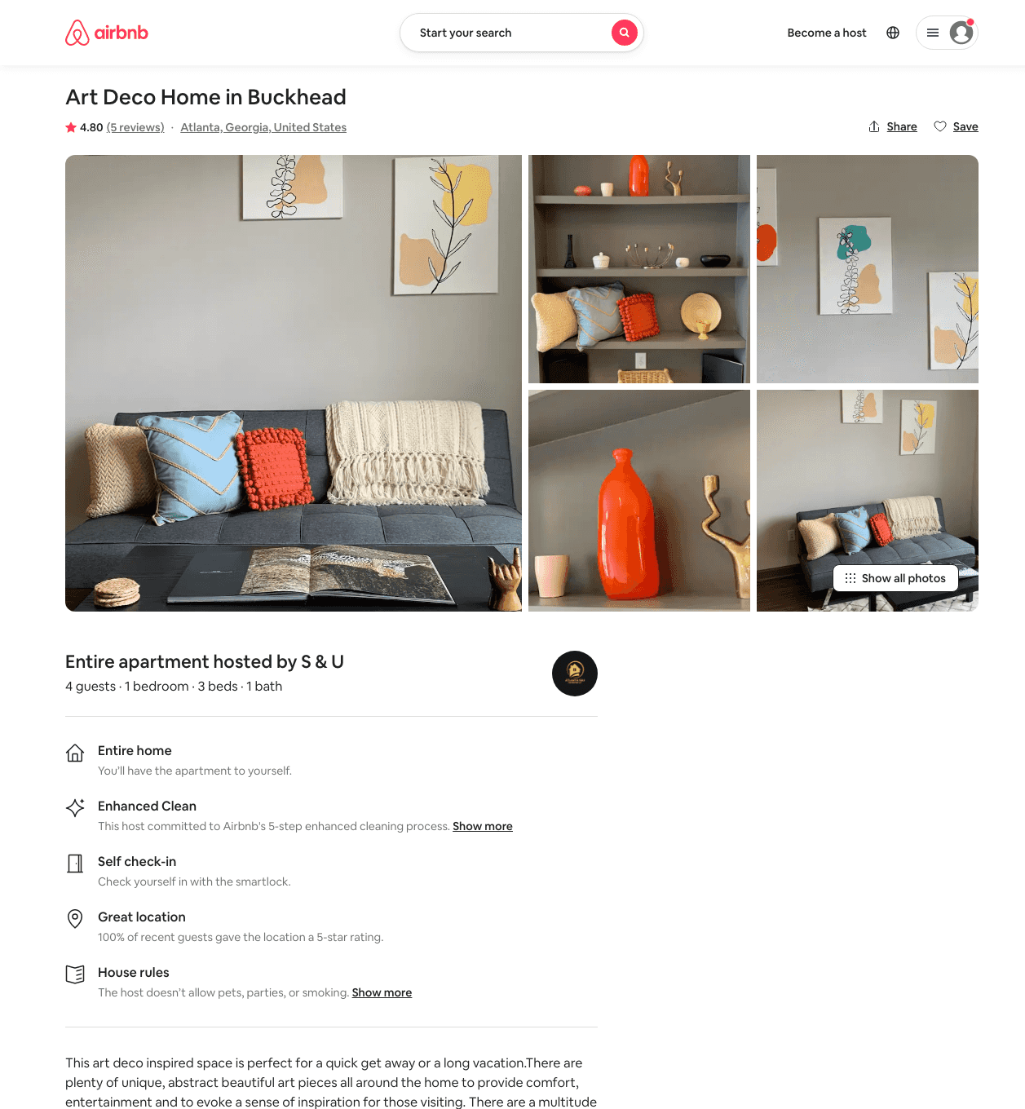
Listing 49468596
1
4
$76 - $156
4.79
2
Sandu
377269317
2
https://www.airbnb.com/rooms/49468596
Jun 2022

Slide 28
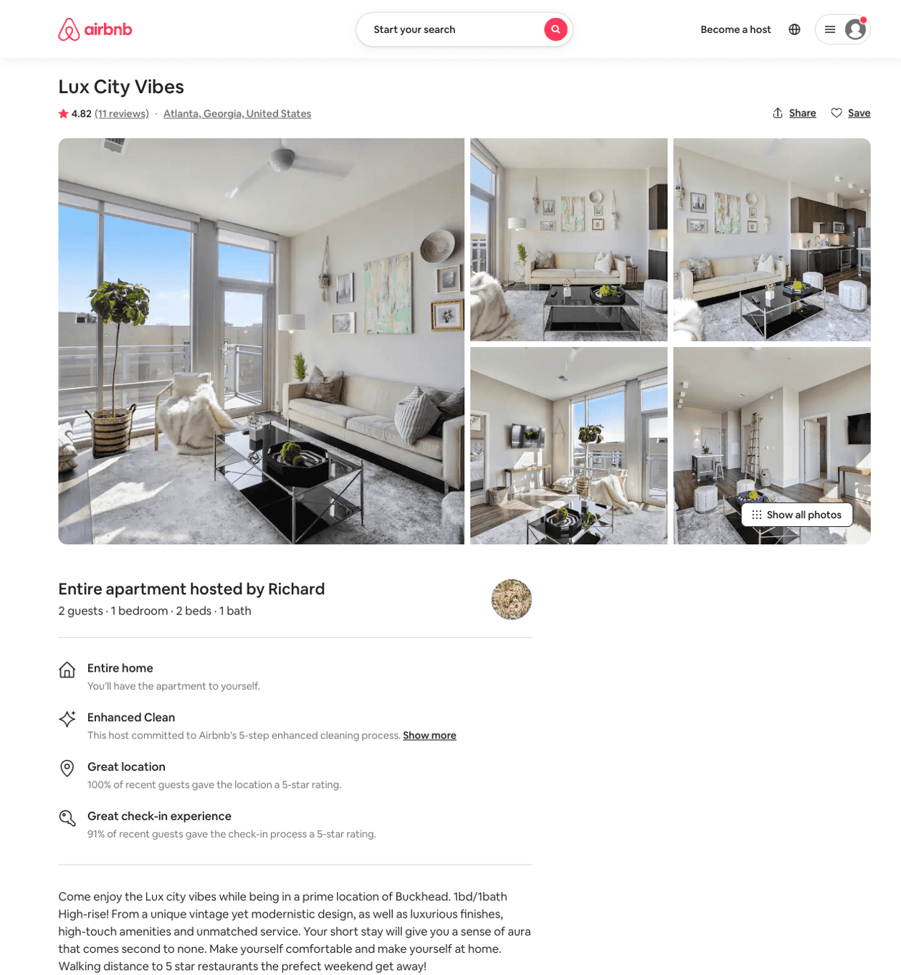
Listing 48702660
1
2
$95 - $150
4.49
1
Richard
309516005
5
https://www.airbnb.com/rooms/48702660
Aug 2022

Slide 29
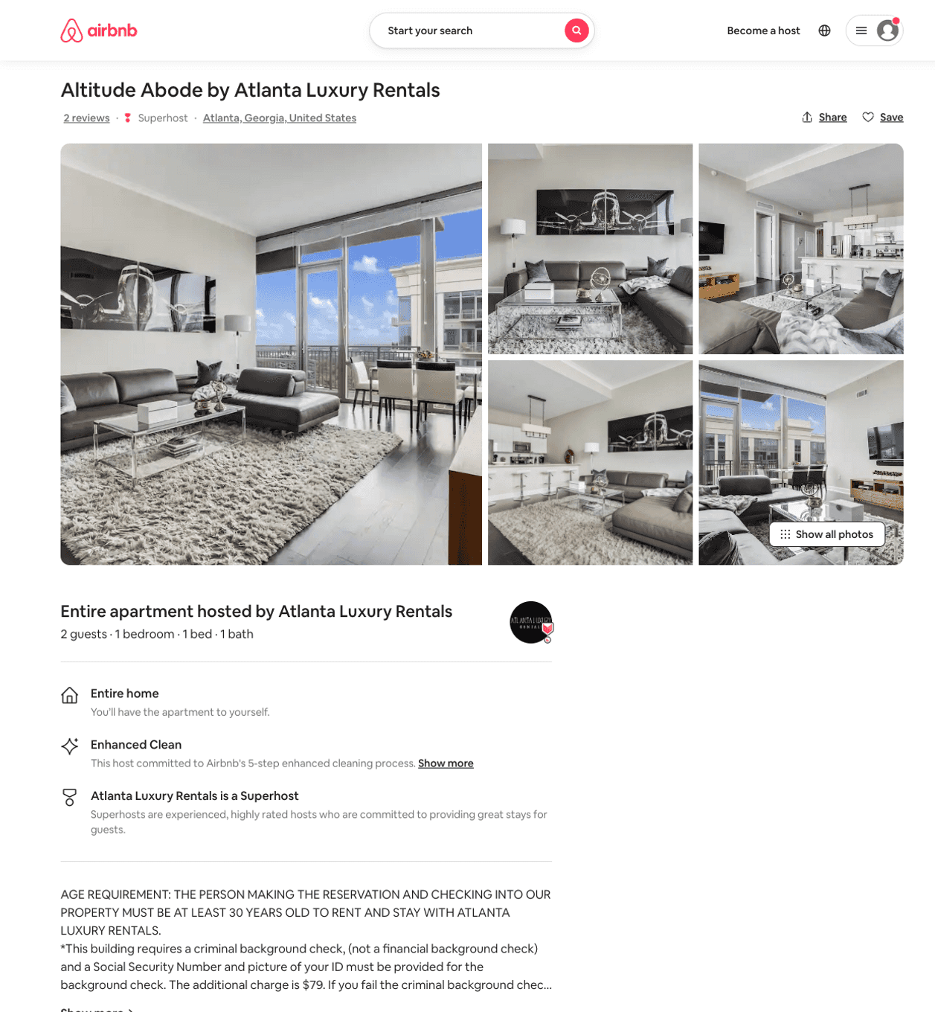
Listing 19048953
1
2
$185 - $277
4.83
3
Atlanta Luxury Rentals
115328988
54
https://www.airbnb.com/rooms/19048953
Aug 2022

Slide 30
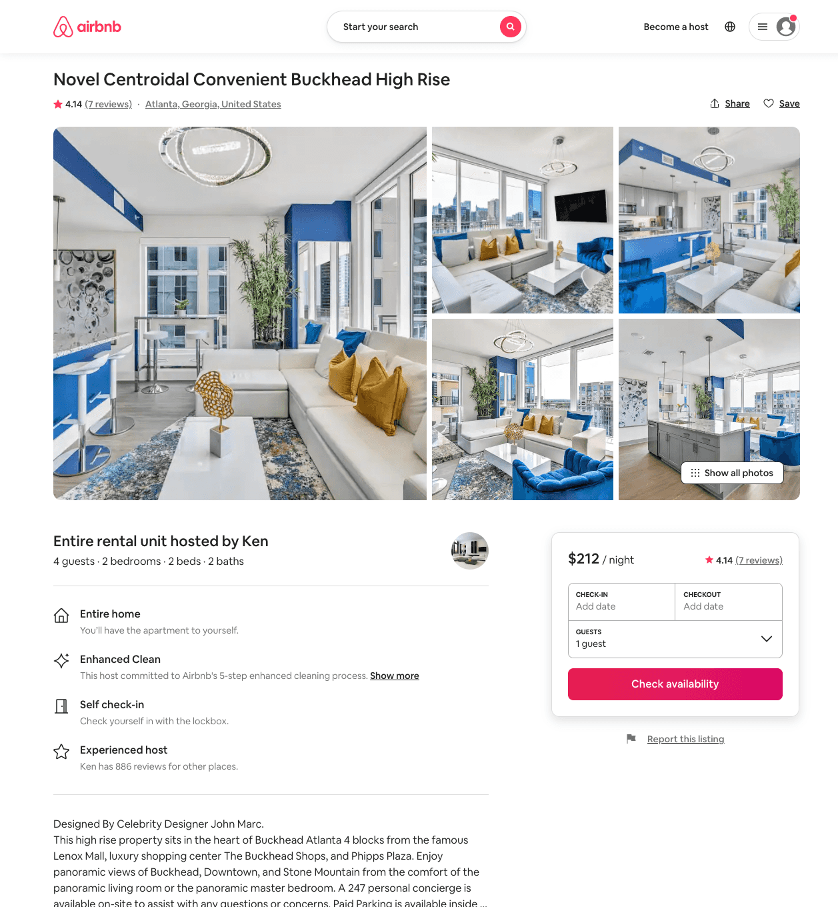
Listing 41690483
2
5
$177 - $335
4.23
2
Ken
152102544
8
https://www.airbnb.com/rooms/41690483
Aug 2022

Slide 31
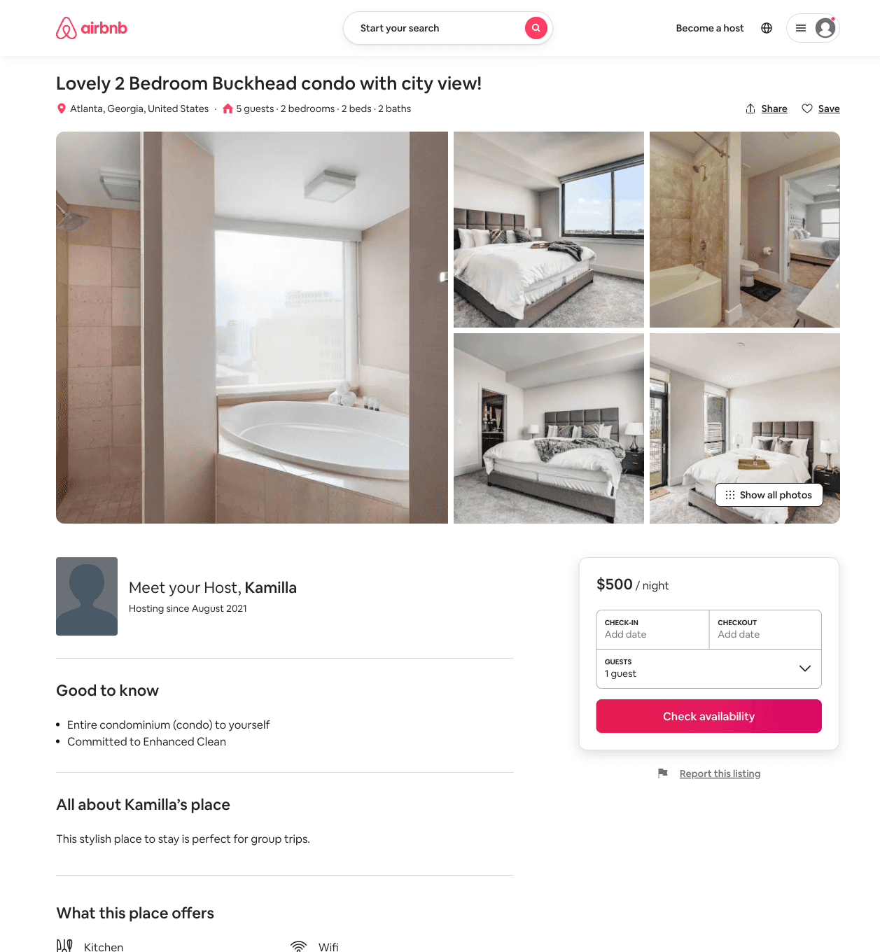
Listing 51451409
2
5
$500
1
Kamilla
416710472
2
https://www.airbnb.com/rooms/51451409
Aug 2022

Slide 32
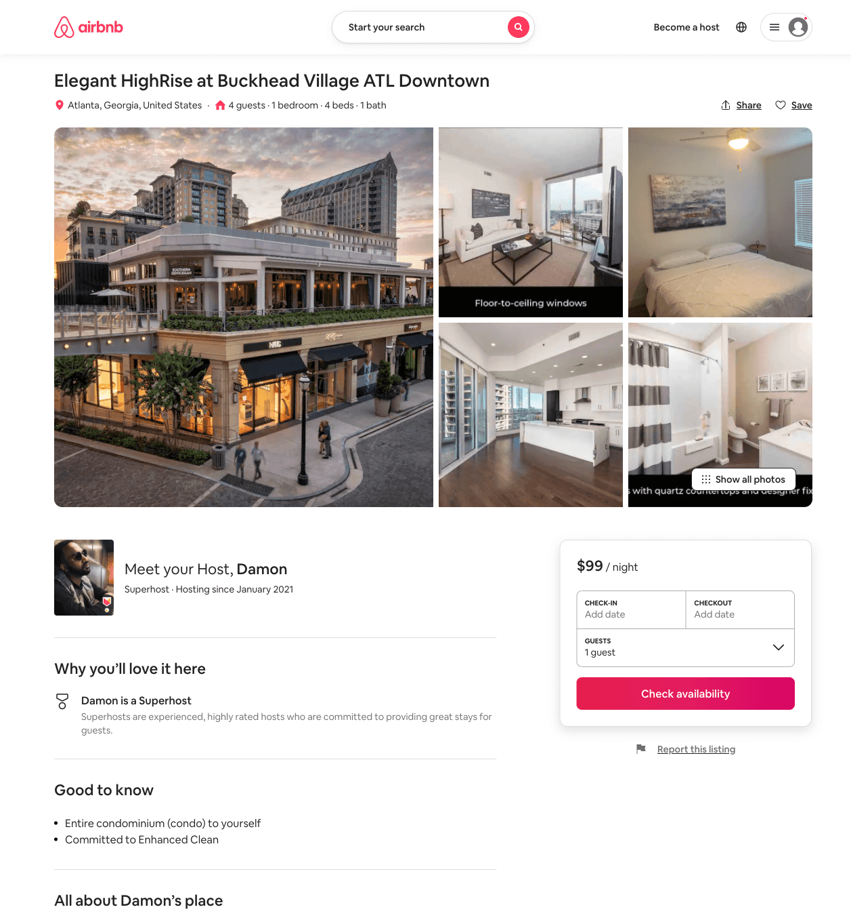
Listing 51651194
1
4
$99 - $248
1
Damon
386401880
8
https://www.airbnb.com/rooms/51651194
Aug 2022

Slide 33
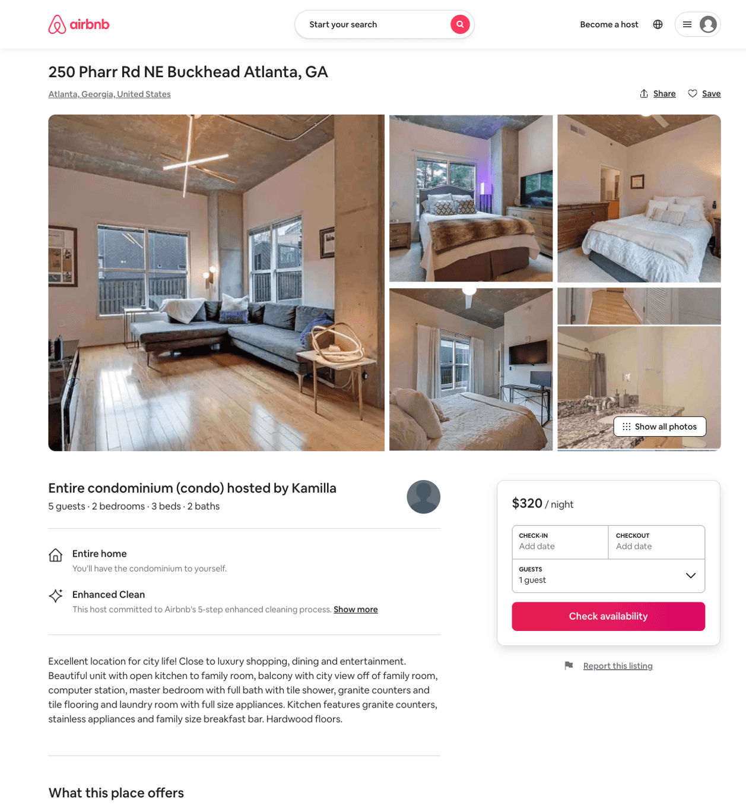
Listing 51671487
2
5
$320 - $400
1
Kamilla
416710472
2
https://www.airbnb.com/rooms/51671487
Aug 2022

Slide 34
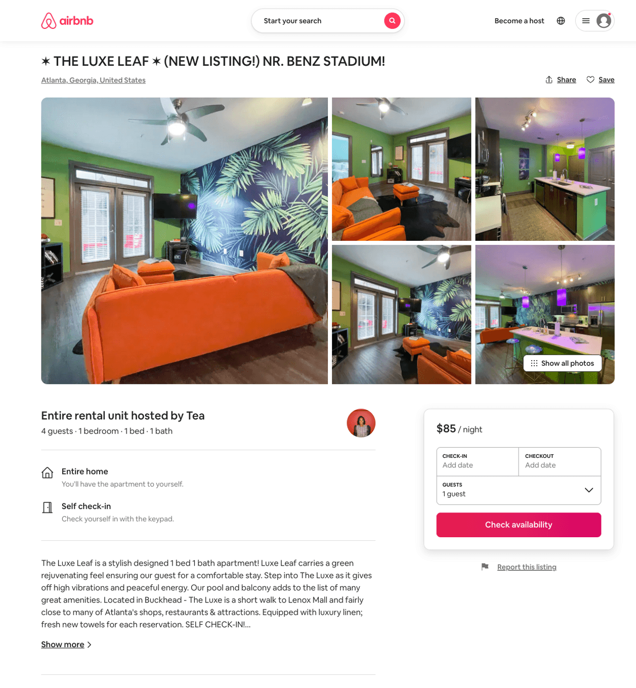
Listing 51803517
1
4
$85 - $103
5.0
1
Diane
225578017
1
https://www.airbnb.com/rooms/51803517
Aug 2022

Slide 35
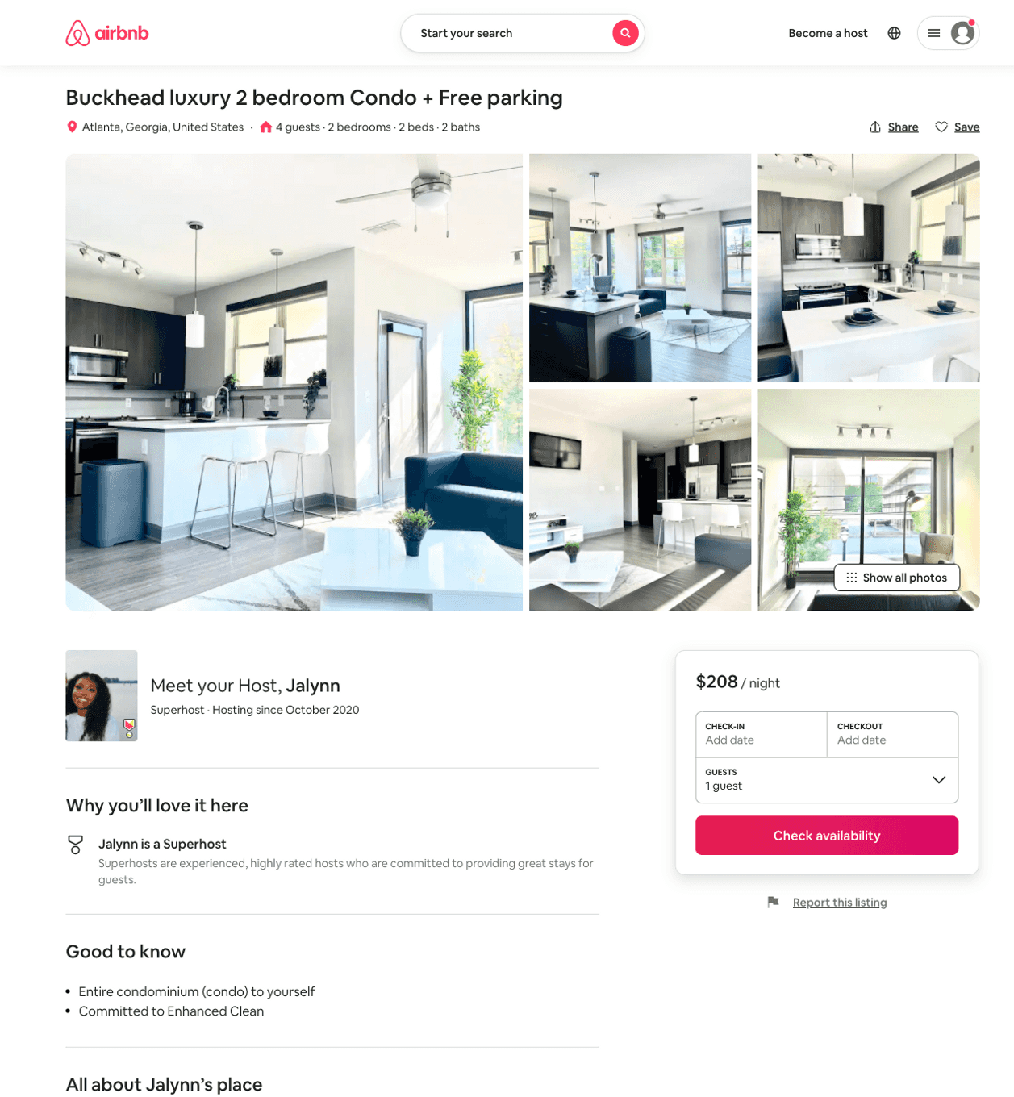
Listing 51722490
2
4
$142 - $239
5.0
2
Jalynn
373249883
2
https://www.airbnb.com/rooms/51722490
Aug 2022

Slide 36
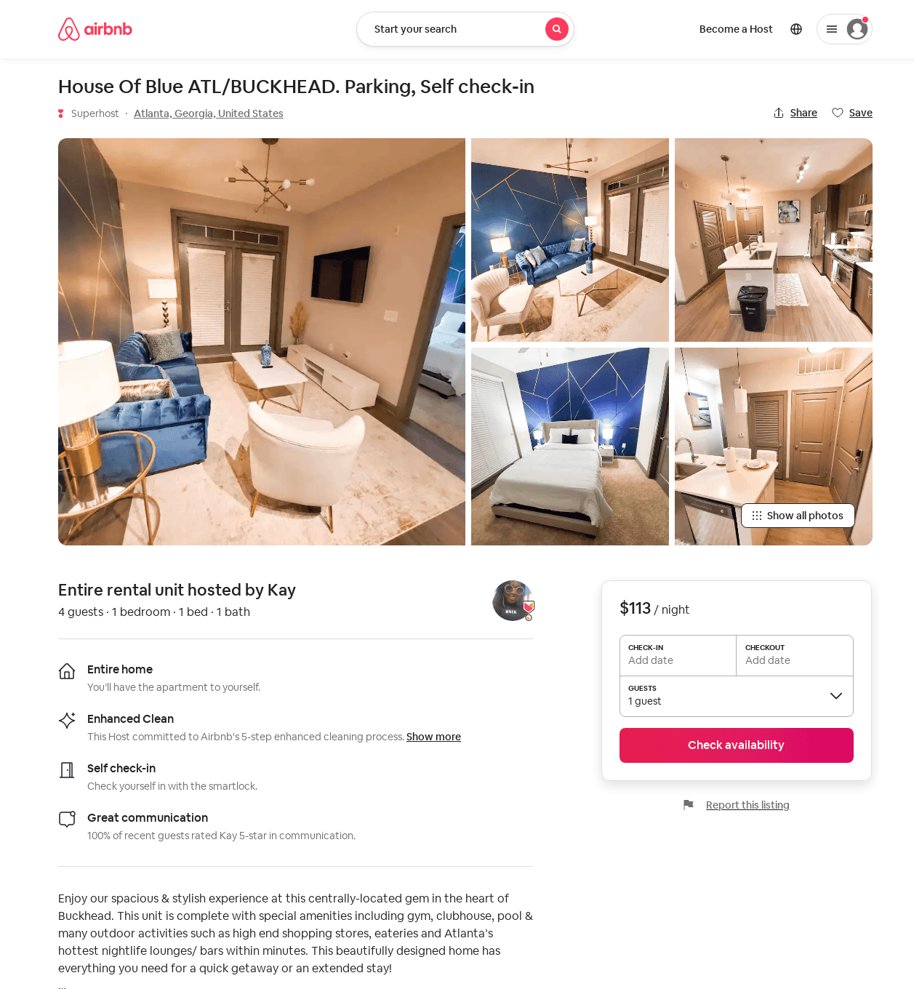
Listing 52693921
1
4
$110 - $144
4.92
1
Top Tier Management
57888219
2
https://www.airbnb.com/rooms/52693921
Aug 2022

Slide 37
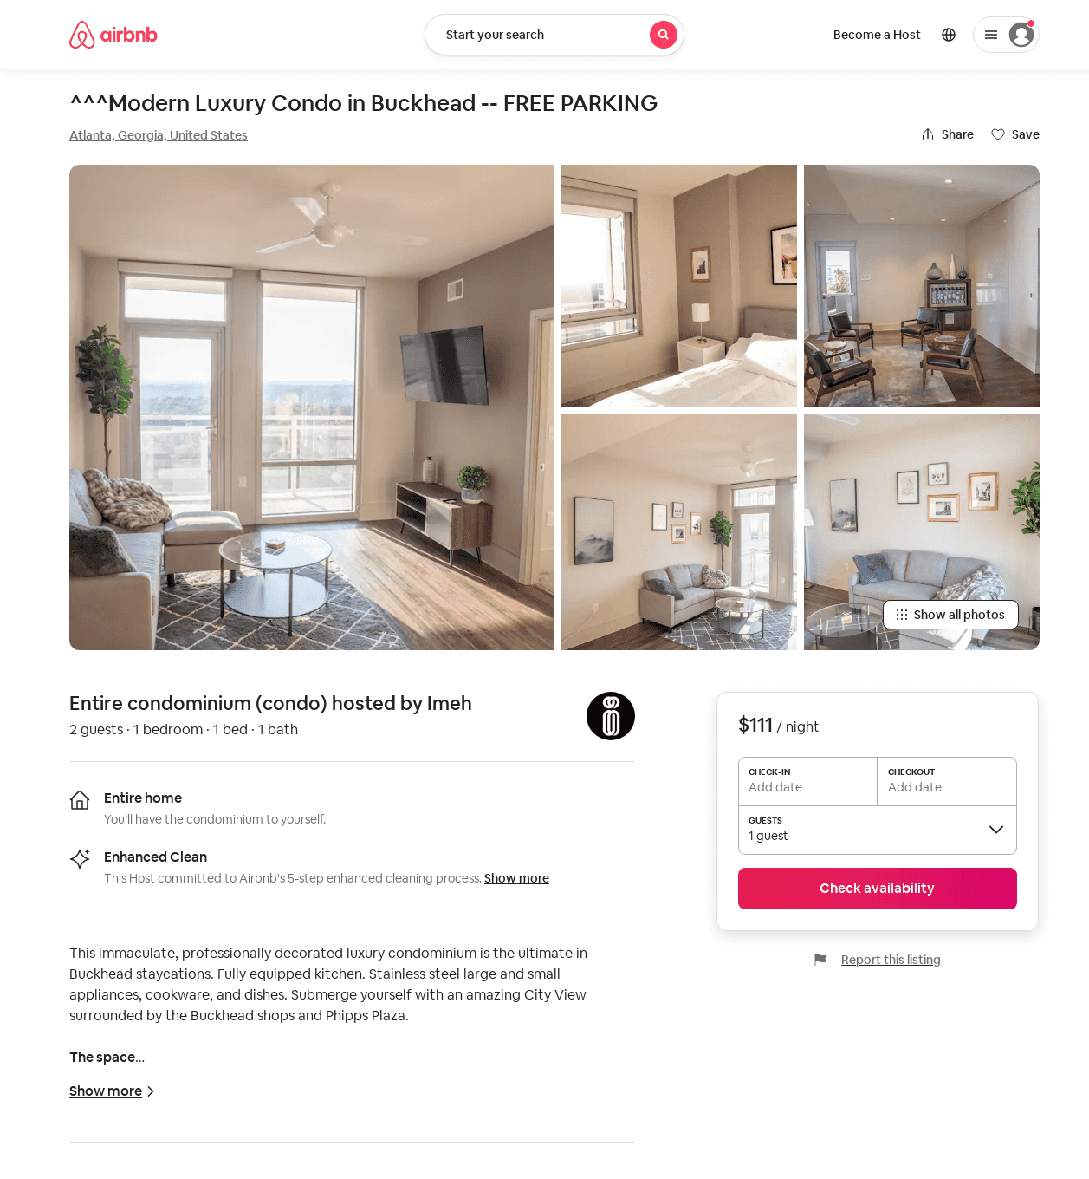
Listing 52741195
1
2
$83 - $141
4.69
1
Imeh
286057968
3
https://www.airbnb.com/rooms/52741195
Aug 2022

Slide 38
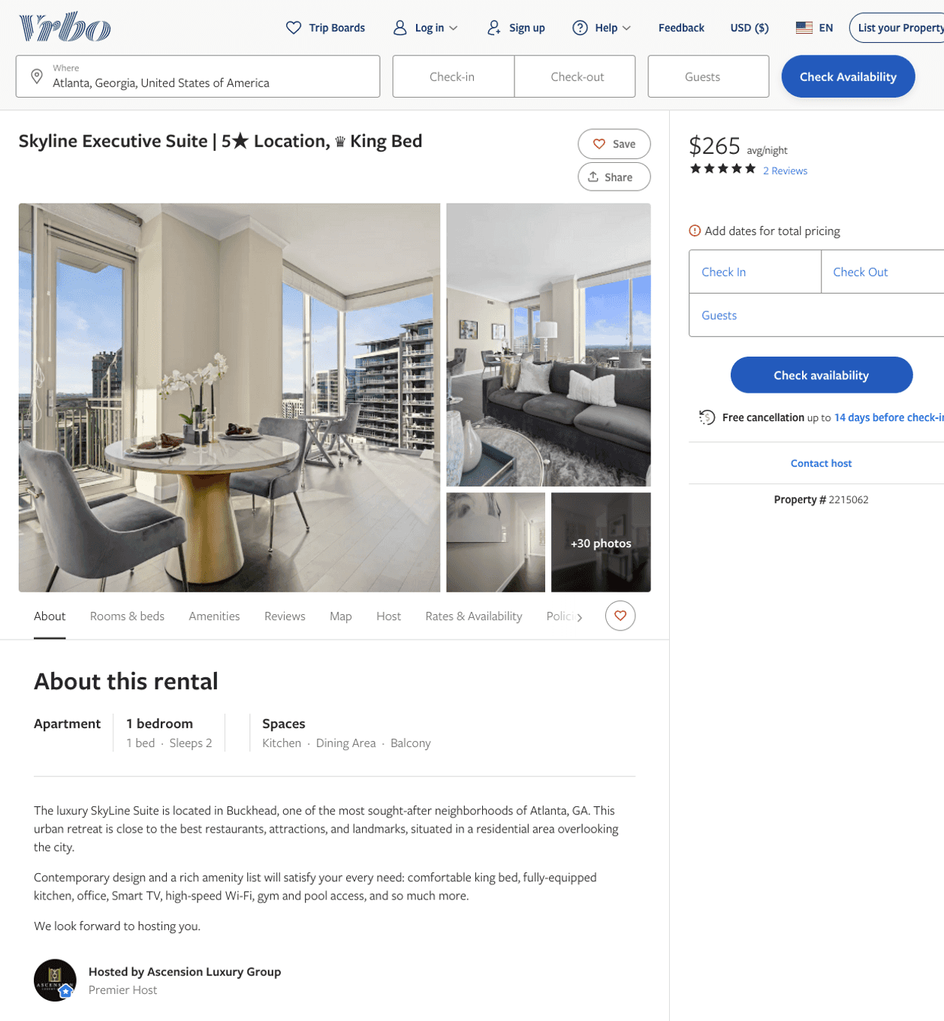
Listing 2215062
1
2
$214 - $252
5
14
Ascension Luxury Group
https://www.vrbo.com/2215062
Aug 2022

Slide 39
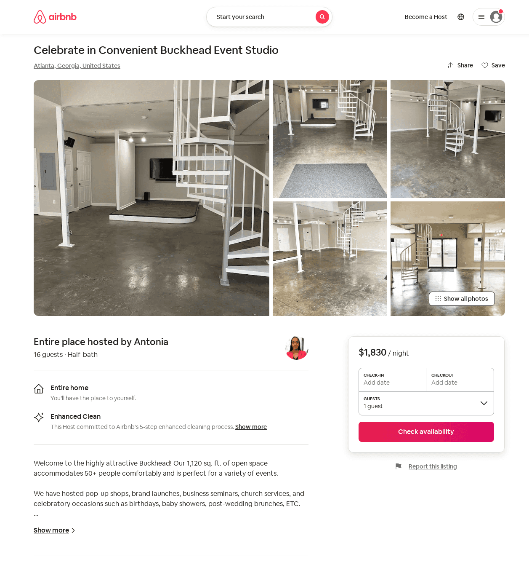
Listing 31714421
16
$1830
1
Antonia
236603525
1
https://www.airbnb.com/rooms/31714421
Aug 2022

Slide 40
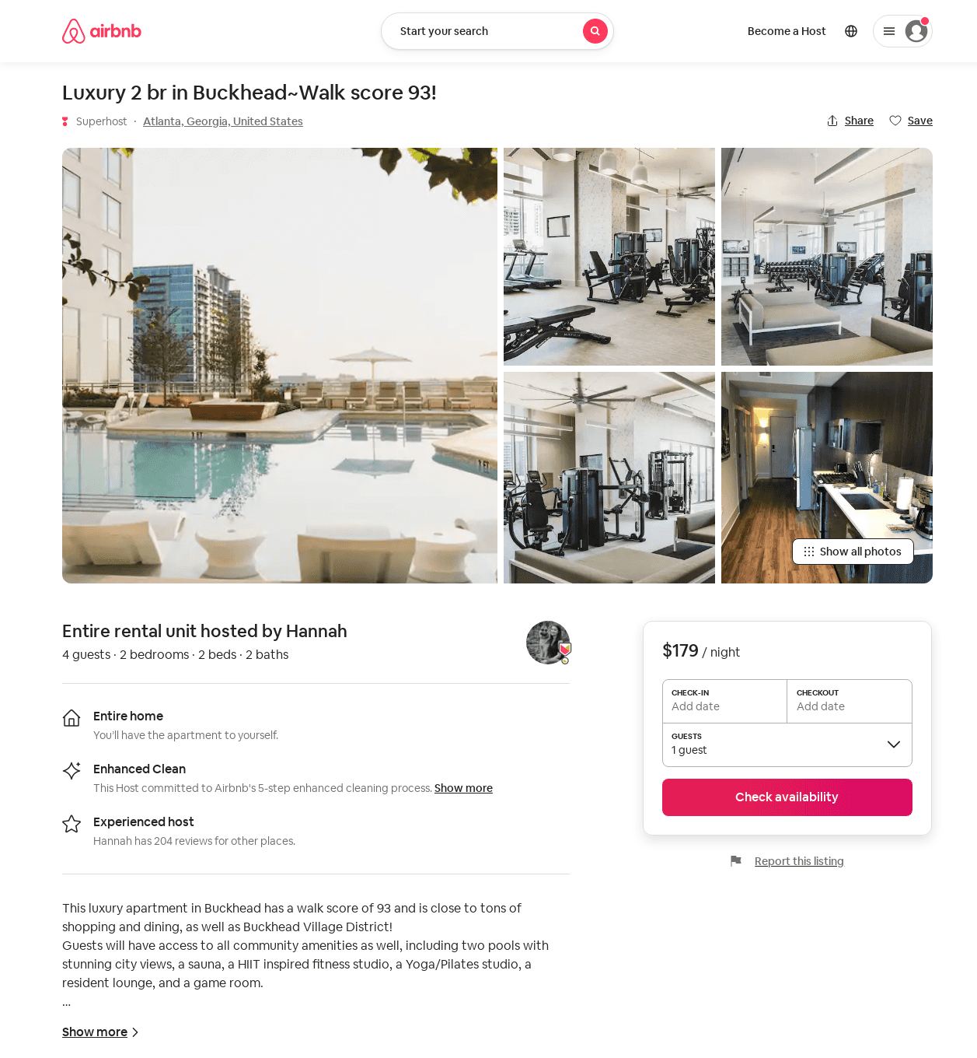
Listing 48958077
1
2
$179
4
Hannah
152046386
9
https://www.airbnb.com/rooms/48958077
Aug 2022

Slide 41
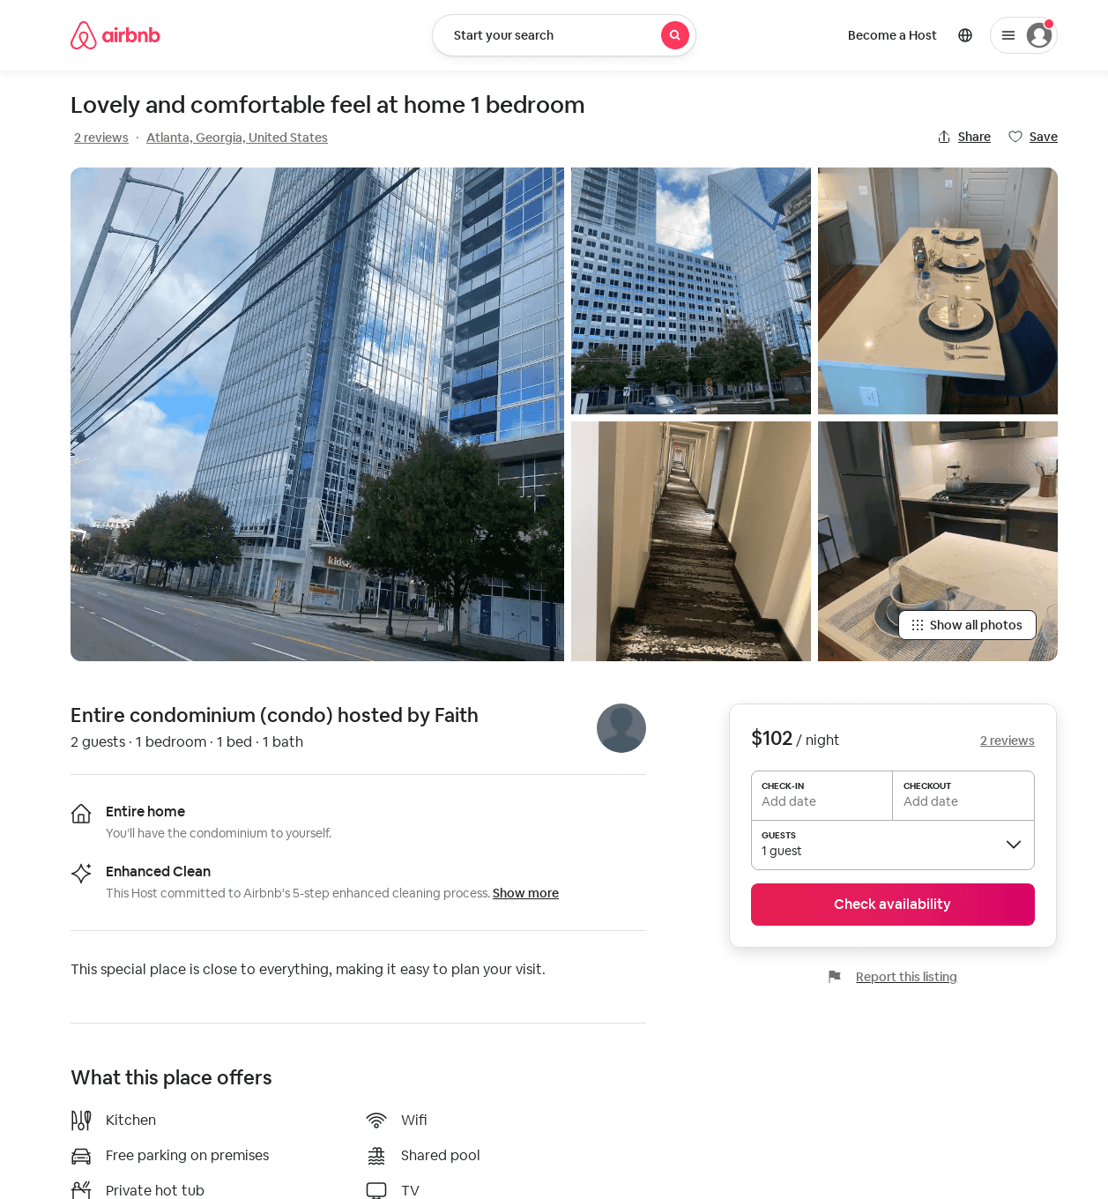
Listing 53190712
1
2
$102 - $117
4.75
1
Faith
430595461
1
https://www.airbnb.com/rooms/53190712
Aug 2022

Slide 42
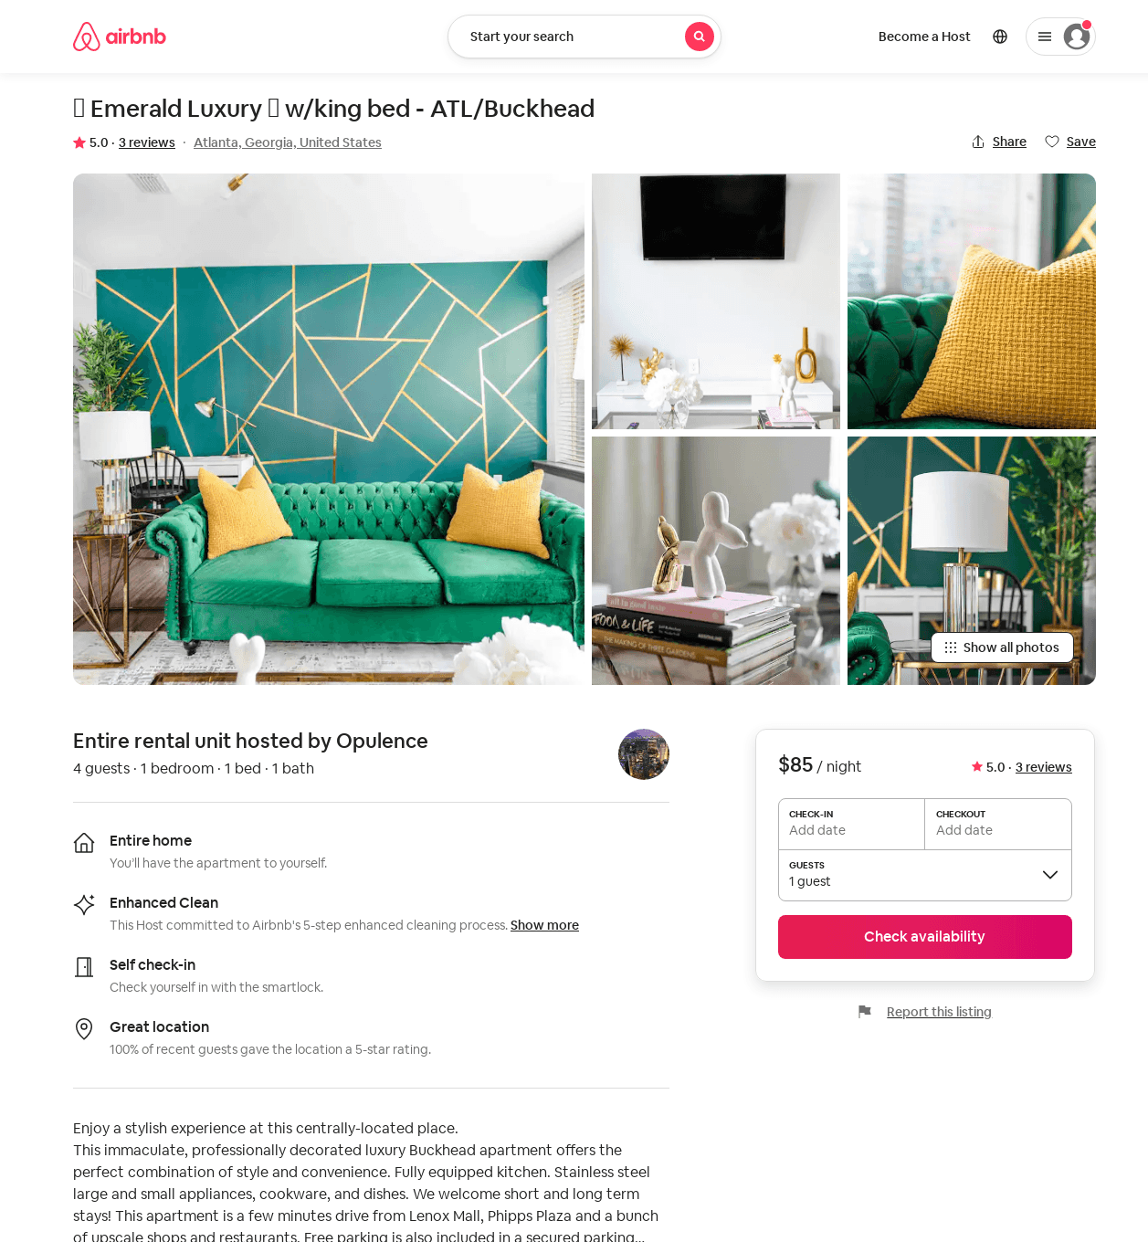
Listing 53743545
1
4
$82 - $102
4.98
2
Opulence
428174106
1
https://www.airbnb.com/rooms/53743545
Aug 2022

Slide 43
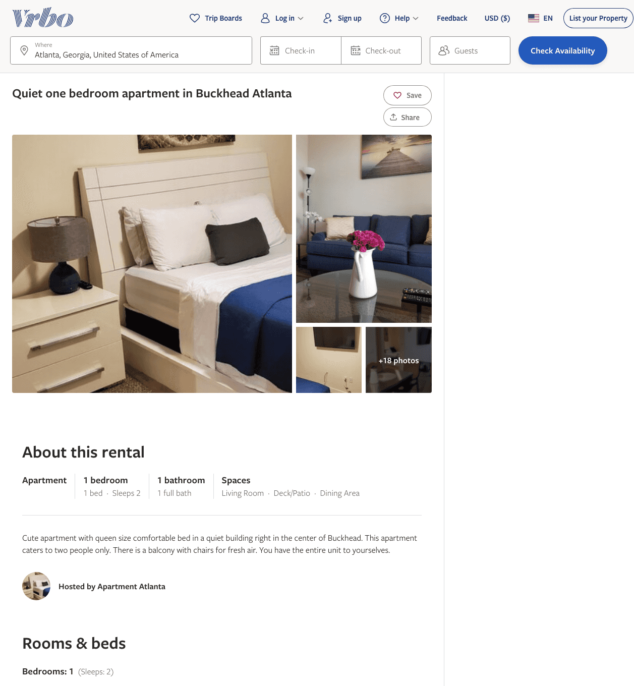
Listing 2326176
1
2
$106 - $110
5
1
https://www.vrbo.com/2326176
Aug 2022

Slide 44
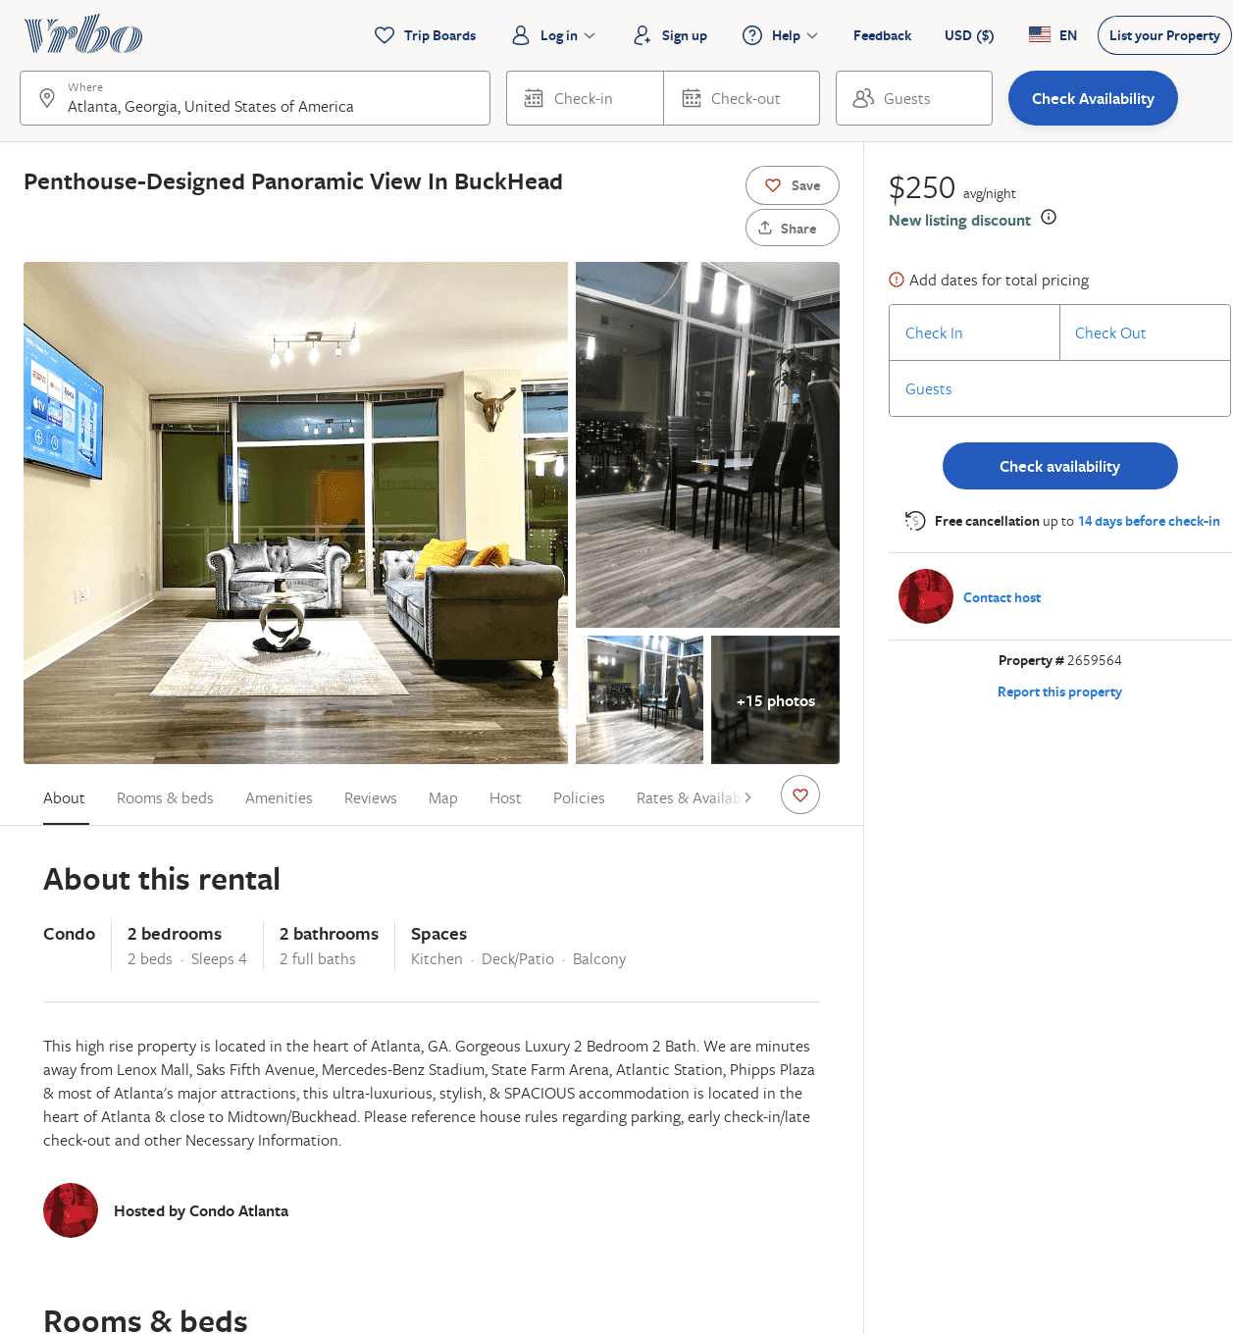
Listing 2659564
2
4
$499
10
Ashley Edmond
https://www.vrbo.com/2659564
Aug 2022

Slide 45
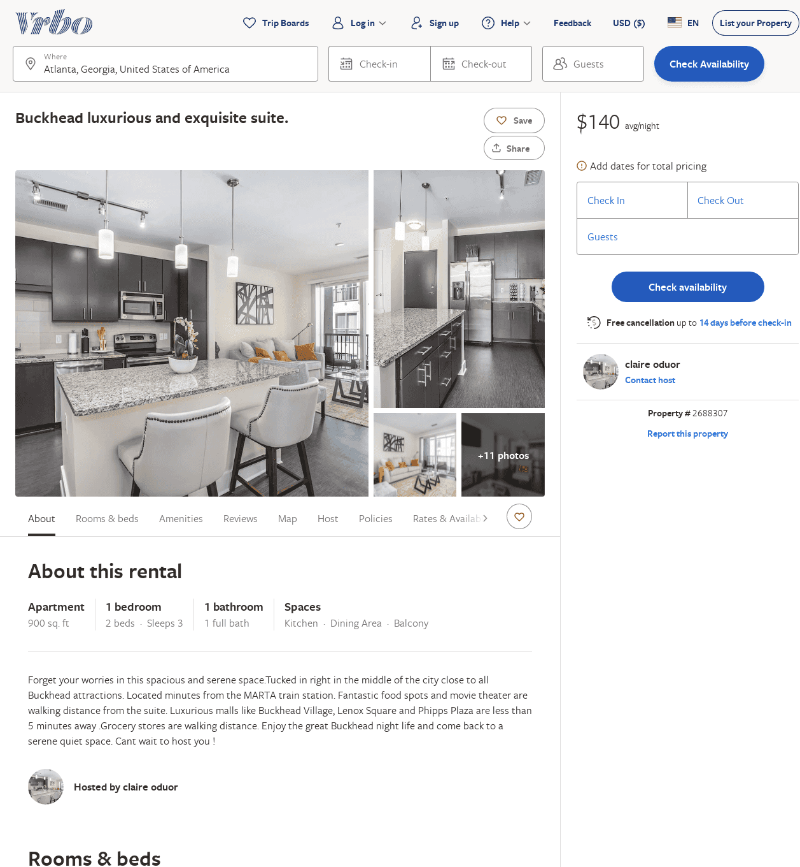
Listing 2688307
1
3
$140
2
claire oduor
https://www.vrbo.com/2688307
Aug 2022

Slide 46
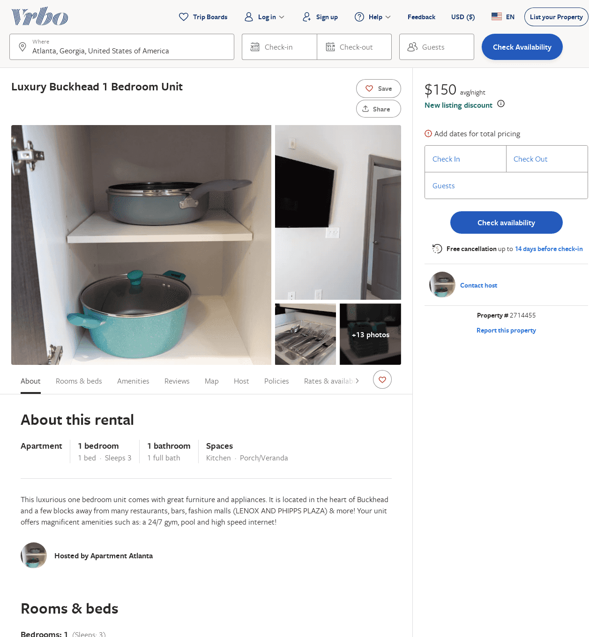
Listing 2714455
1
3
$190
2
Terence
https://www.vrbo.com/2714455
Aug 2022

Slide 47
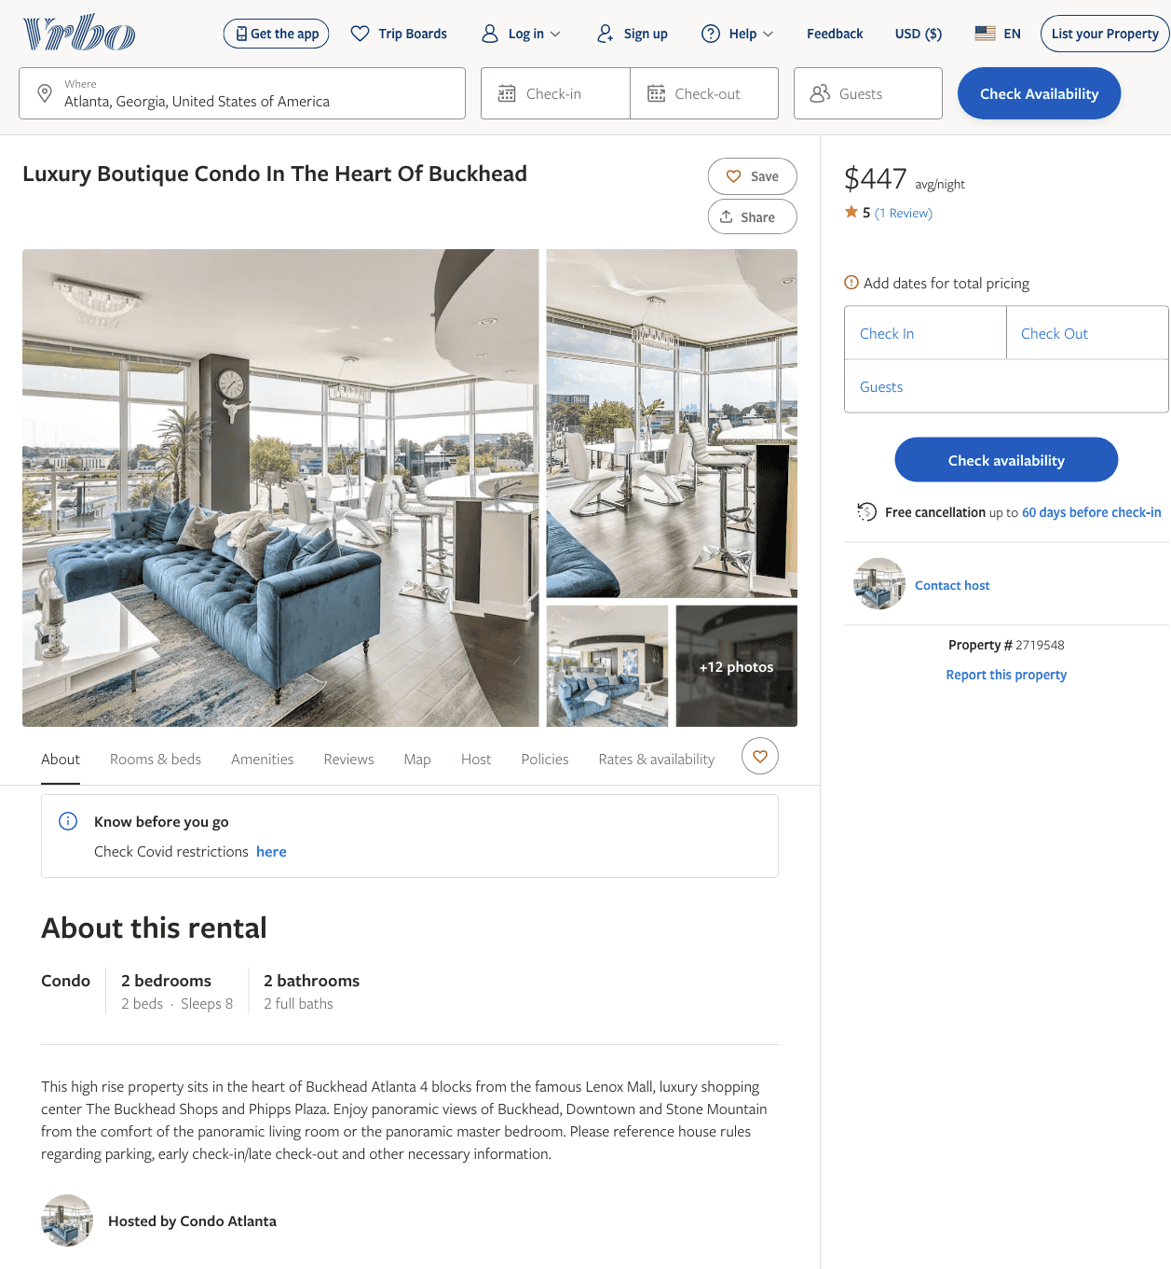
Listing 2719548
2
8
$447
5
3
https://www.vrbo.com/2719548
Aug 2022

Slide 48
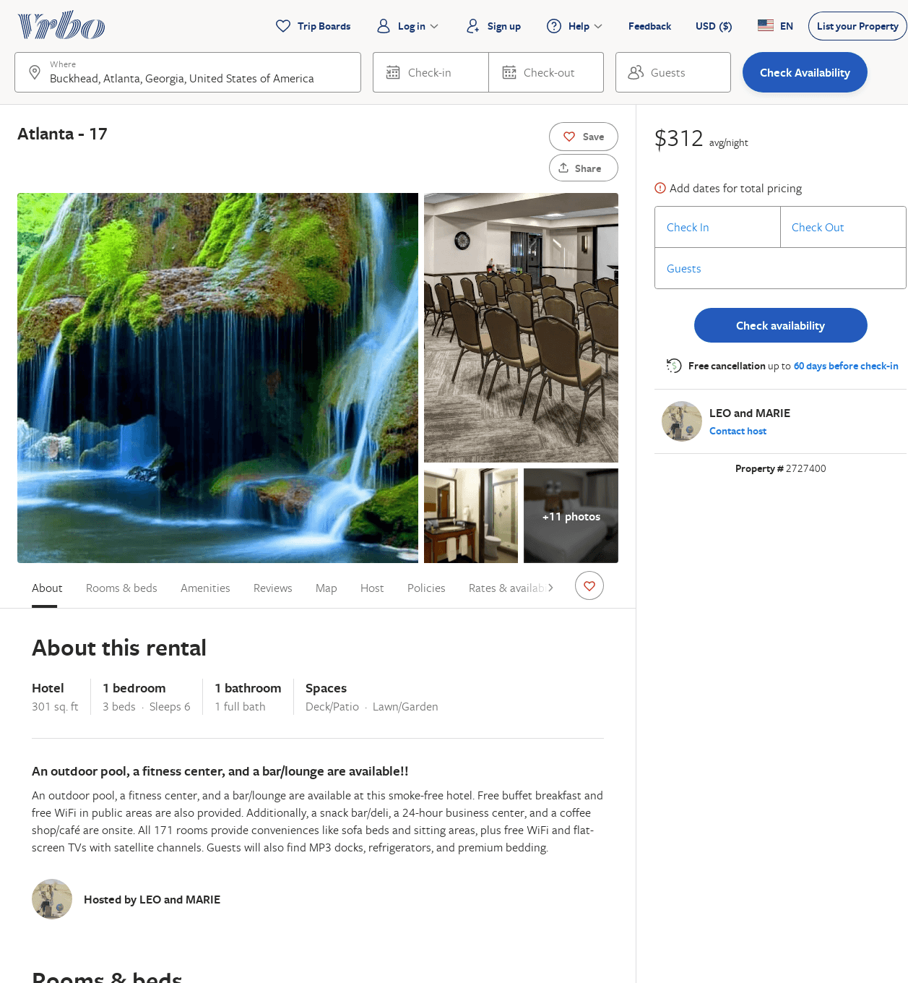
Listing 2727400
1
6
$312
2
LEO and MARIE
https://www.vrbo.com/2727400
Aug 2022

Slide 49
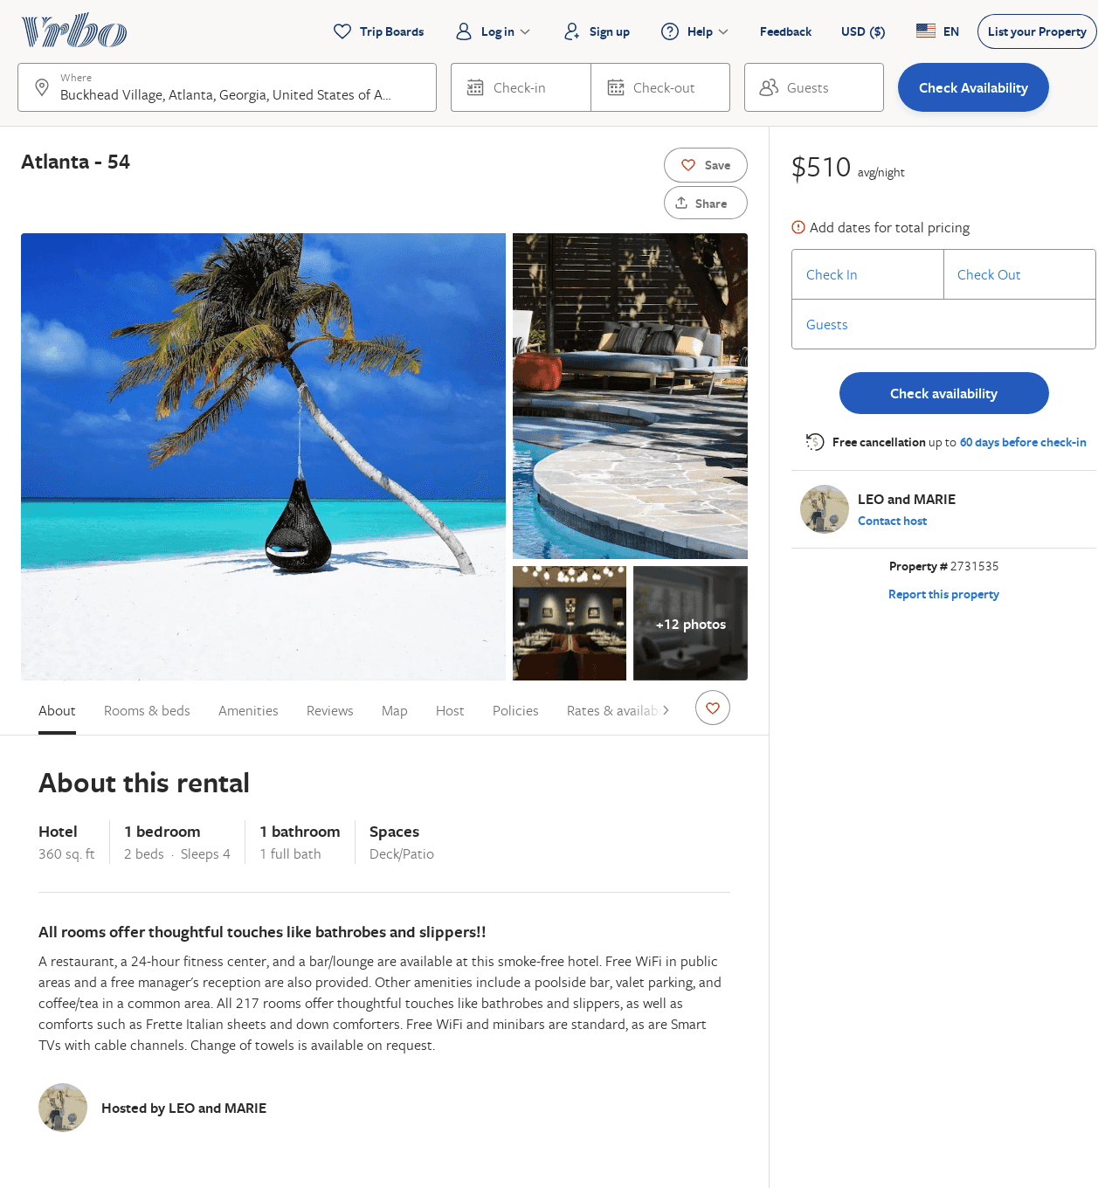
Listing 2731535
1
4
$510
2
LEO and MARIE
https://www.vrbo.com/2731535
Aug 2022

Slide 50
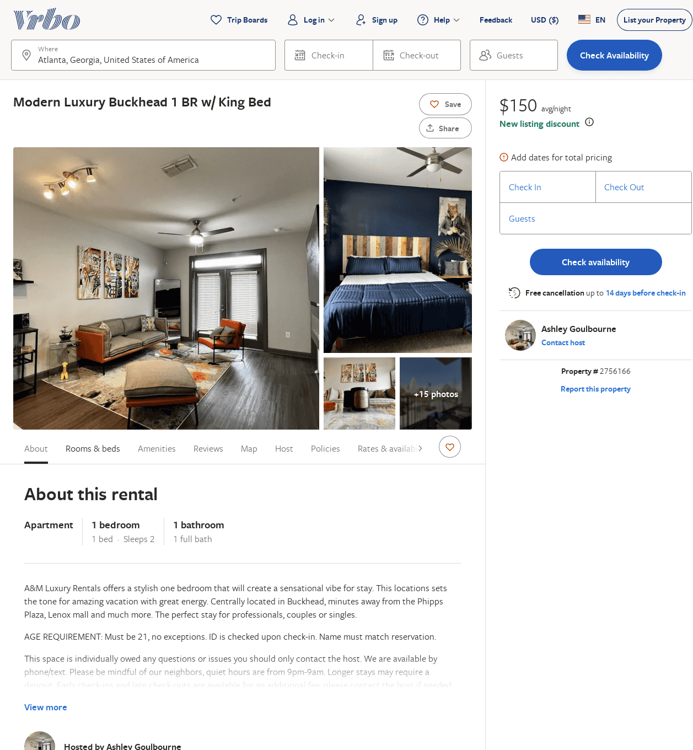
Listing 2756166
1
2
$161
2
Ashley Goulbourne
https://www.vrbo.com/2756166
Aug 2022

Slide 51
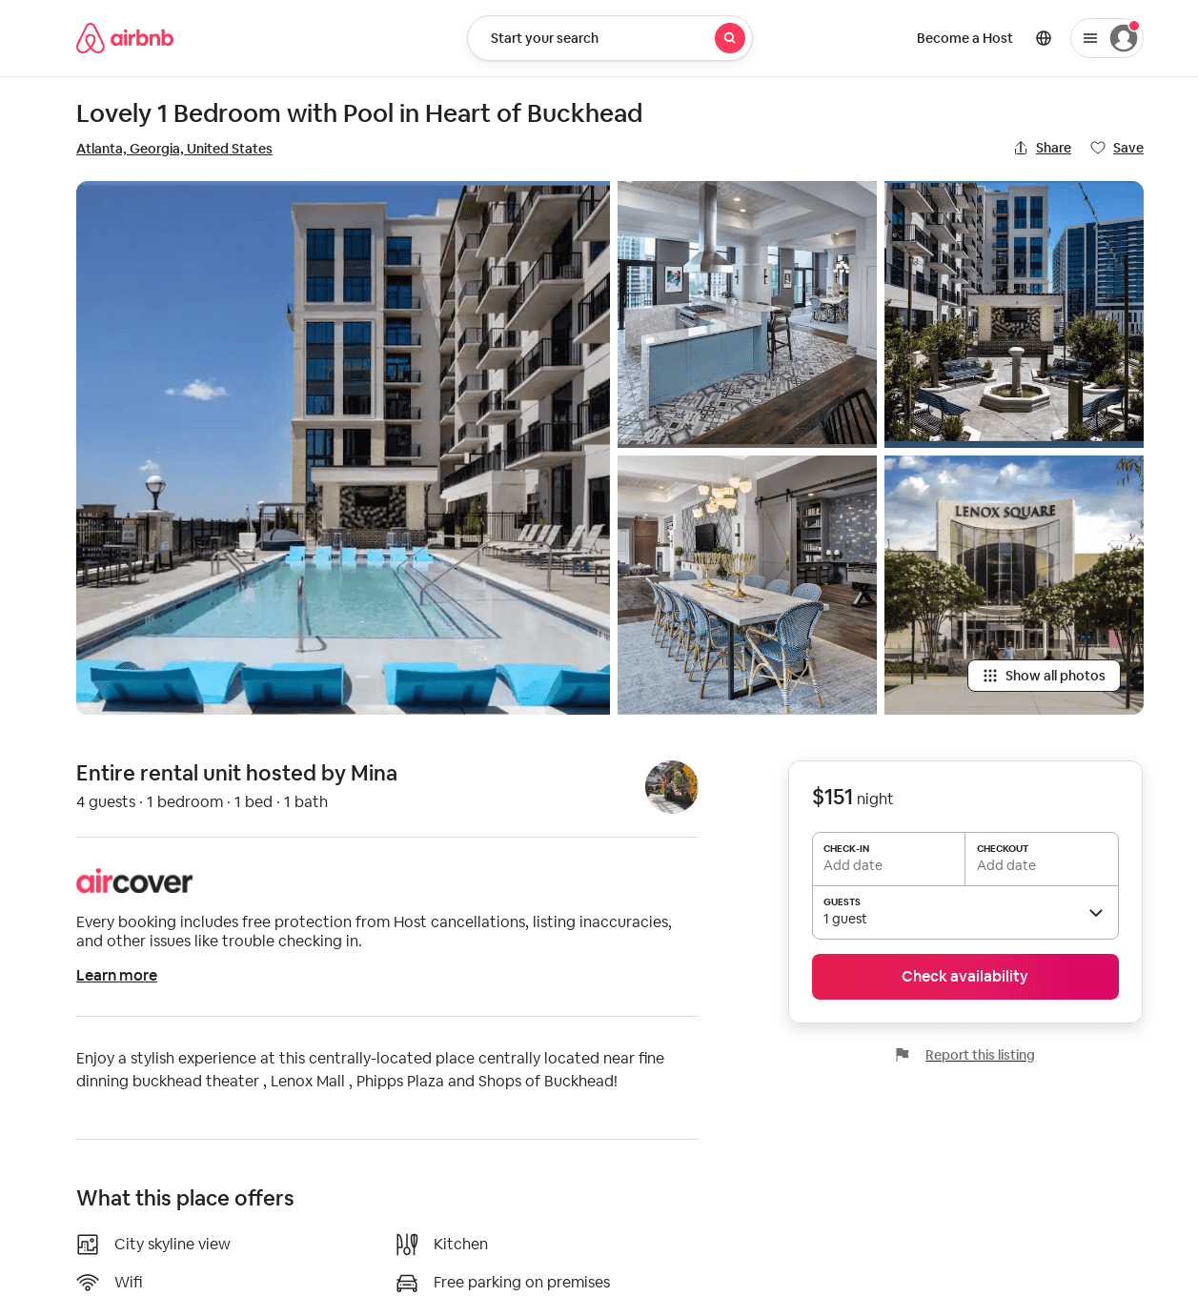
Listing 50641467
1
4
$151
2
Mina
306592415
1
https://www.airbnb.com/rooms/50641467
Aug 2022

Slide 52
Listing 51375013
1
2
5
Angel
126288364
1
https://www.airbnb.com/rooms/51375013
Aug 2022

Slide 53
Listing 2905685
2
4
$253
1
Your Leavetown Team
https://www.vrbo.com/2905685
Aug 2022

Slide 54
Listing 2940413
1
3
$162
2
https://www.vrbo.com/2940413
Aug 2022

